Slide 1


Precision measurements with polarized beams
Sabine Riemann, DESY
JINR Dubna, 23 July 2018 (Bardin’s Day)

Slide 2
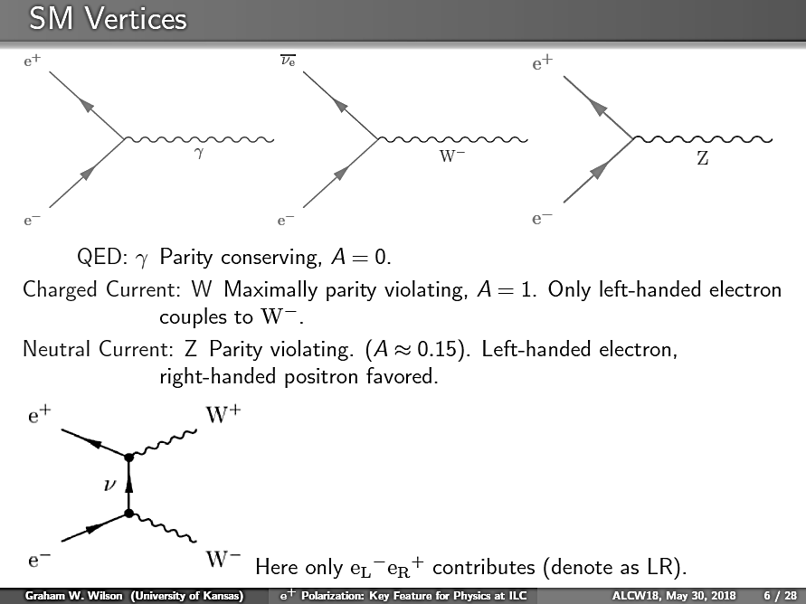
outline
It is long recognized that beam polarization is an essential feature for probing electroweak interactions
In this talk:
Introduction
Collider projects and beam polarization
Beam polarization at future e+e- colliders
  Advantages and challenges
Summary
QED: γ Parity conserving
Charged Current: W Maximally parity violating
Neutral Current: Z Parity violating

Slide 3
A Choice of Dima Bardin’s papers devoted explicitly to polarized scattering
(without LEP/SLD)
One-loop electroweak radiative corrections to polarized Bhabha scattering
  D. Bardin, Ya Dydyshka, L. Kalinovskaya, L. Rumyantsev , A. Arbuzov, R. Sadykov, S. Bondarenko ; Phys.Rev. D98 (2018) no.1, 013001
QED corrections for polarized elastic muon e scattering
  Dmitri Yu. Bardin, Lida Kalinovskaya; DESY-97-230, e-Print: hep-ph/9712310
O(alpha) QED corrections to polarized elastic muon e and deep inelastic l N scattering
  Dmitri Yu. Bardin, Johannes Blumlein, Penka Christova , Lida Kalinovskaya; Published in *Hamburg 1997, Physics with polarized protons at HERA* 44-53; e-Print: hep-ph/9711228
The Spin dependent structure function g1(x) of the deuteron from polarized deep inelastic muon scattering
  Spin Muon (SMC) Collaboration (D. Adams et al.); Phys.Lett. B396 (1997) 338-348
O (alpha) QED corrections to neutral current polarized deep inelastic lepton - nucleon scattering
  Dmitri Yu. Bardin Johannes Blumlein, Pena Christova Lida Kalinovskaya; Nucl.Phys. B506 (1997) 295-328
Radiative Corrections to P Odd Asymmetries in Deep Inelastic Scattering of Polarized Muons on Nucleons at TeV Energies
  D.Yu. Bardin, O.M. Fedorenko, N.M. Shumeiko; J.Phys. G7 (1981) 1331; JINR-E2-80-503
Radiative Corrections To P Odd Asymmetries In Deep Inelastic Scattering Of Polarized Leptons And Anti-leptons On Nucleons
  D.Yu. Bardin, O.M. Fedorenko, N.M. Shumeiko; JINR-E2-12761
On the Radiative Corrections to P Odd Asymmetry in Deep Inelastic Scattering of Polarized Leptons on Nucleons
  D.Yu. Bardin, O.M. Fedorenko, N.M. Shumeiko (Dubna, JINR), Sov.J.Nucl.Phys. 32 (1980) 403, Yad.Fiz. 32 (1980) 782-795; JINR-E2-12564

Slide 4
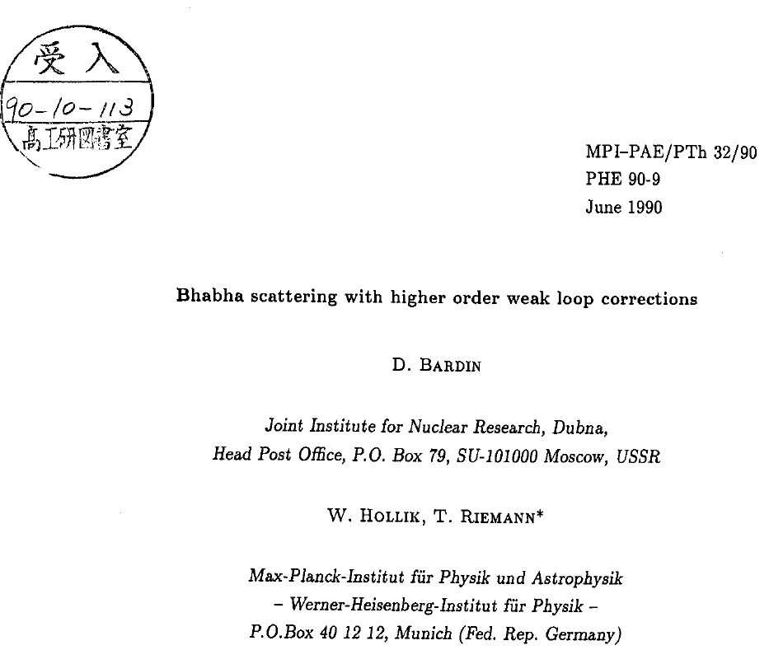

Slide 5
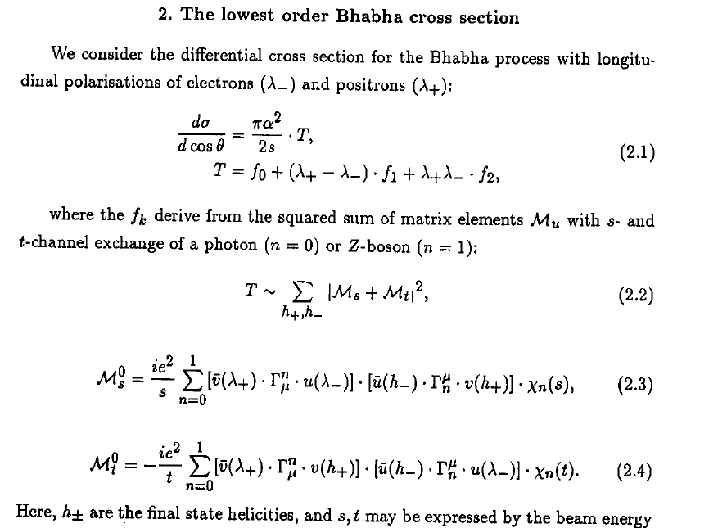

Slide 6
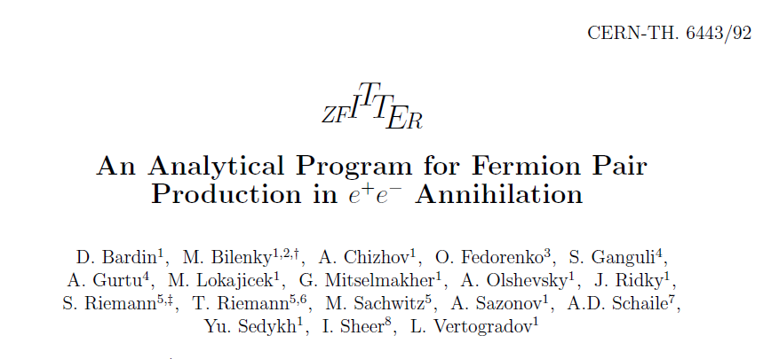
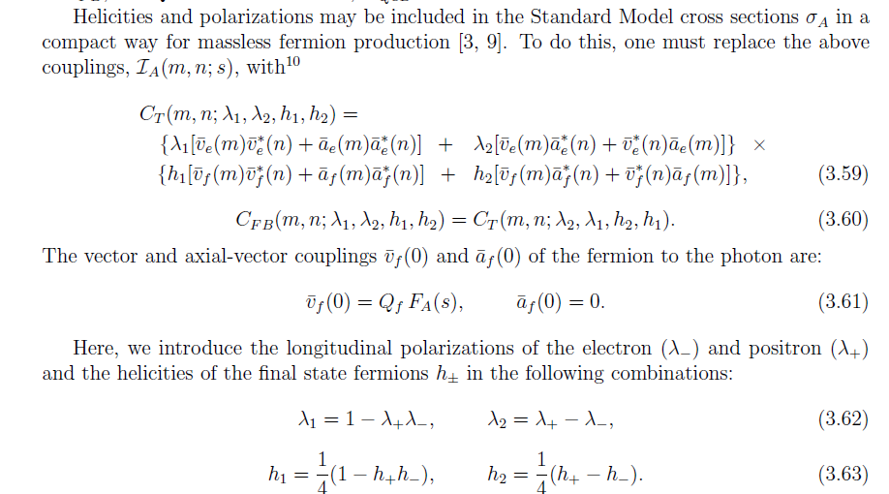

Slide 7
Focus on lepton collider projects
Linear collider (e+e-)
ILC; technology at hand, realization in Japan??
CLIC
E_{cm}
250GeV – 1TeV (ILC)
350GeV – 3TeV (CLIC)
L ≈ 2×10³⁴cm⁻²s⁻¹ (~500fb⁻¹/year)
Stat. uncertainty ~ 10⁻³…10⁻²
Beam polarization
  e- beam P = 80-90%
  e+ beam
    ILC: P = 30% baseline;
    60% upgrade
    CLIC: P ≥ 60% upgrade
Circular collider
FCC-ee
CEPC
μ Collider
E_{cm} (e+e-)
91 GeV, 160GeV, 240GeV, 350GeV
L ≈ 2×10³⁶cm⁻²s⁻¹ (4 experiments)
Stat. uncertainty <10⁻³
Beam polarization
Desired ??

Slide 8
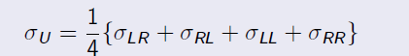
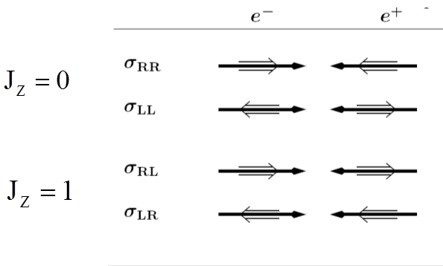
Measurement in unpolarized colliders
Circular e+e- colliders (PETRA, TRISTAN, LEP, FCC-ee, CEPC)
  Measurement with unpolarized beams averages over all spin states:
  The 4 individual contributions cannot be studied
Only the J_{z}=1 configuration applies to s-channel γ and Z exchange
  in case of unpolarized beams only 50% of the collisions are useful

Slide 9
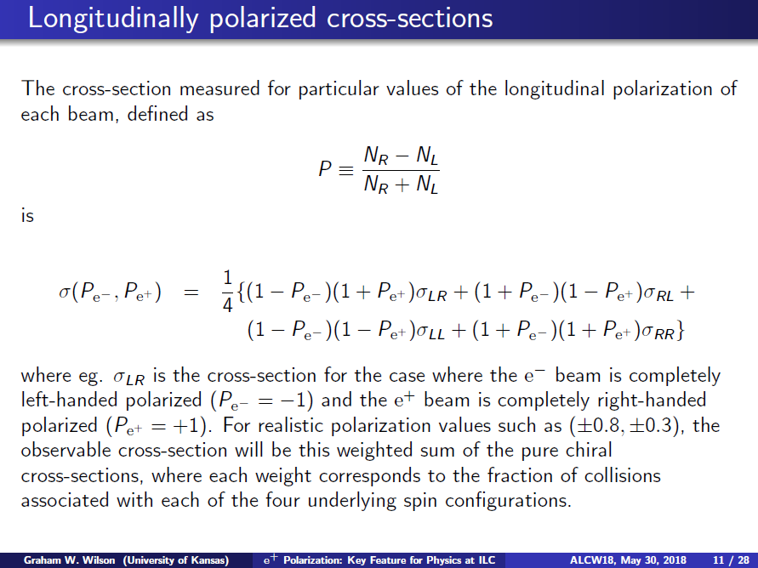
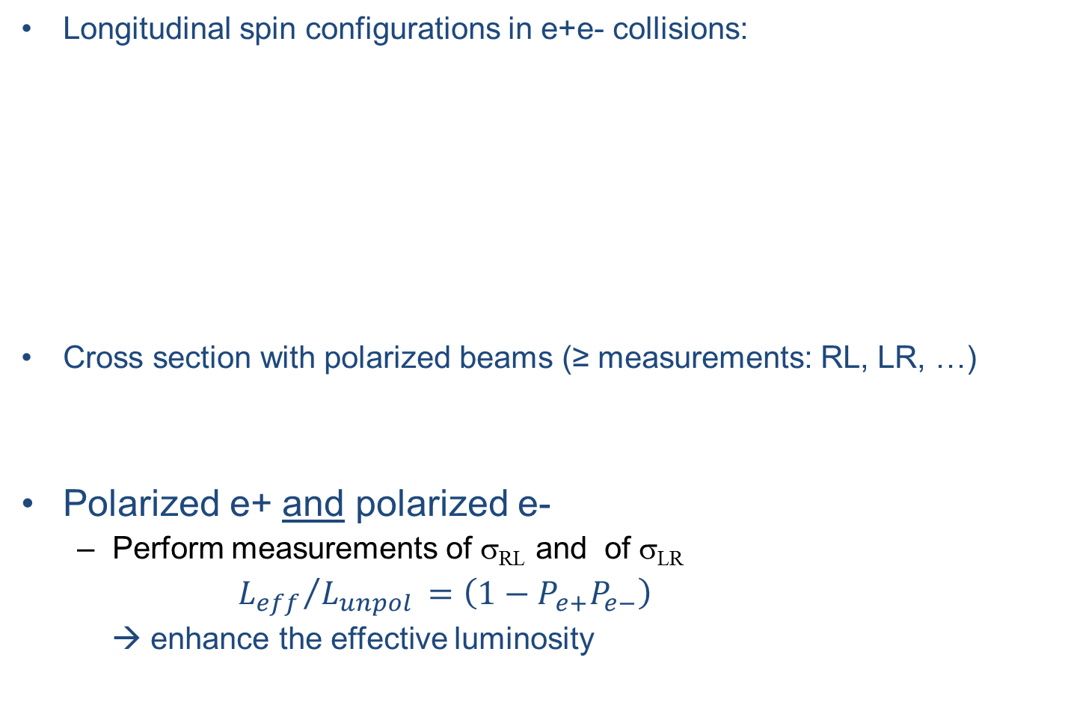
Beam polarization at e+e- colliders (1)
Longitudinal spin configurations in e+e- collisions:
Cross section with polarized beams (≥ measurements: RL, LR, …)
Polarized e+ and polarized e-
  Perform measurements of σ_{RL} and of σ_{LR}
${L_{eff}}/{L_{unpol }=\left(1−P_{e+}P_{e−}\right)}$
  → enhance the effective luminosity
P_{e-} = -1:
100% Ieft-polarized e-
P_{e+} = -1:
100% right-polarized e+

Slide 10
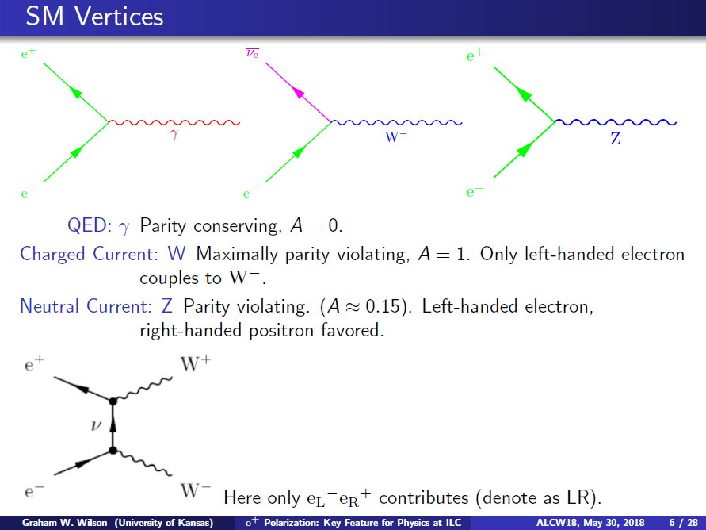
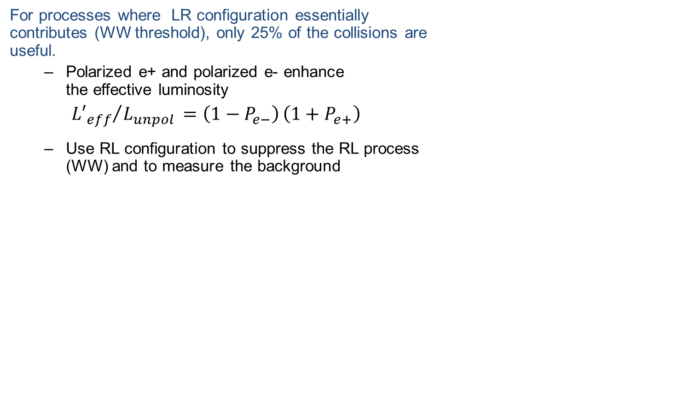
Beam polarization at e+e- colliders (2)
For processes where LR configuration essentially contributes (WW threshold), only 25% of the collisions are useful.
  Polarized e+ and polarized e- enhance the effective luminosity
  ${{L′}_{eff}}/{L_{unpol }=\left(1−P_{e−}\right)}\left(1+P_{e+}\right)$
  Use RL configuration to suppress the RL process (WW) and to measure the background
With a clever choice of beam polarization and running scenarios the statistics of the desired processes can be substantially increased
  → reduce the running time (cost saving)
  Decrease the statistical uncertainty
  Reduce systematic uncertainty by controlling the background
  Construct asymmetry variables sensitive SM parameters and/or to physics scenarios beyond SM

Slide 11
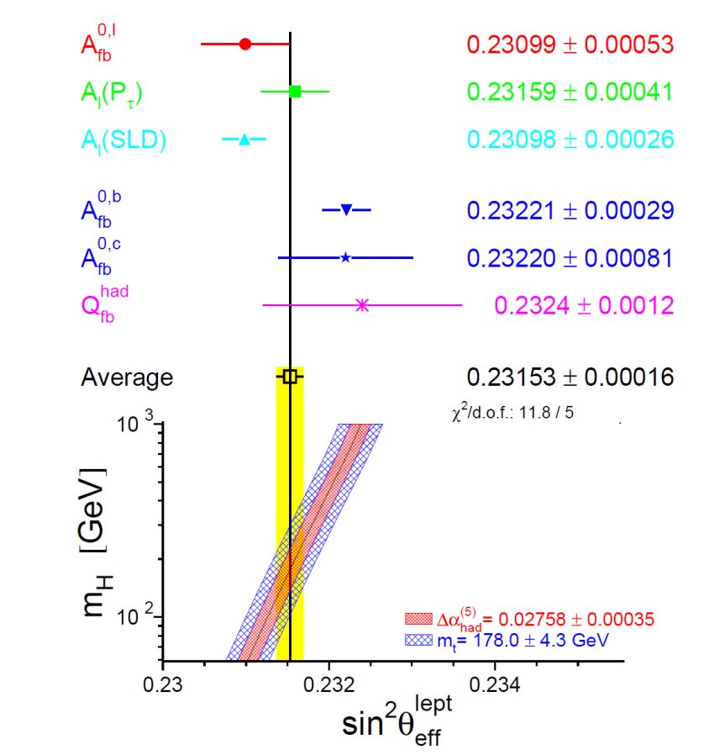
Lesson from LEP/SLD: Measurement of sin²θ_{eff}
Phys.Rep. 427(2006)257
[hep-ex/0509008]
LEP (circular collider)
Unpolarized e+, e- beams,
17x10⁶ Z events
SLD (linear collider)
Polarized electron beam,
5x10⁵ Z events
Improved precision with beam polarization
However, precision of beam polarization measurement
could limit this advantage: SLD polarimeter: δP = 0.5%,
ILC polarimeter: δP ~ 0.25% expected
A_{l}(SLD)
0.23098 ± 0.00028

Slide 12
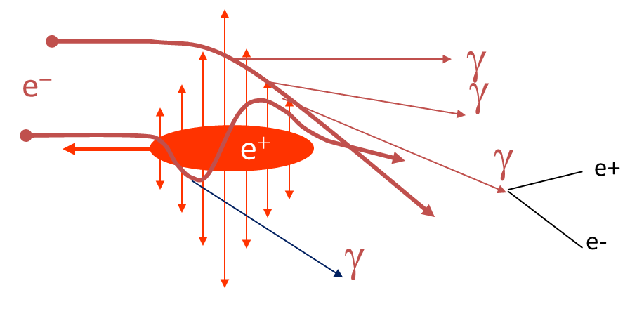
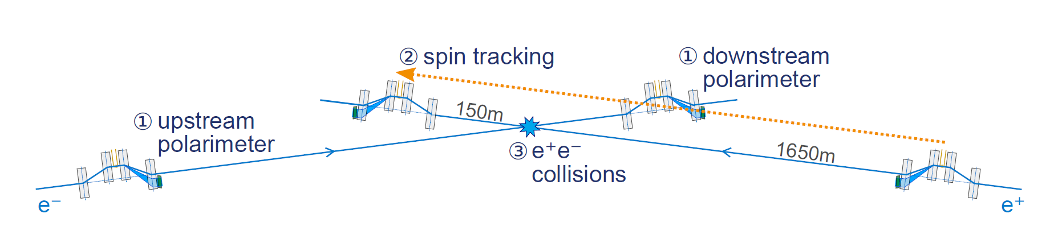
Polarimetry at future linear e+e- colliders
Small beam sizes at interaction point:
  flat beams, at ILC:
  σ_{x} ~500 nm, σ_{y} ~ 6nm
  Beamstrahlung → Some depolarization
  Beams are disrupted after collision
Compton polarimeters to measure e+ and e- polarization upstream and downstream the interaction point (IP)
At ILC, (similar at CLIC):
    → spin tracking to relate the measurements in the polarimeters to the polarization at the IP
For physics analyses the luminosity weighted polarization is required
J. List

Slide 13


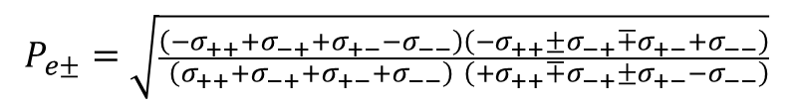
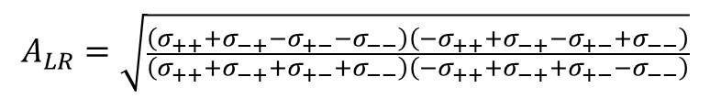
Precision polarization measurement
Use polarized e- and polarized e+ beam ,
Perform 4 independent measurements with different helicity combinations; use also some luminosity for the “inefficient” helicity configurations σ±±:
determine simultaneously P_{e+} and P_{e-}, and A_{LR} directly measured from collision data
the polarimeters are used to monitor the polarization
Precision of δP~10⁻³ (and even below) is possible at high energies at ILC or CLIC
  Further studies are necessary to include the realistic beam properties and systematic effects (energy spread, uncertainty at helicity reversal, beam disruption,…)
$$σ_{±±}=\frac{1}{4}σ_{0}\left[1+P_{e+}P_{e−}+A_{LR}\left(±P_{e+}±P_{e−}\right)\right]$$
$$σ_{∓±}=\frac{1}{4}σ_{0}\left[1−P_{e+}P_{e−}+A_{LR}\left(∓P_{e+}±P_{e−}\right)\right]$$
$$A_{LR}=\sqrt{\frac{\left(σ_{++}+σ_{−+}{−σ}_{+−}{−σ}_{−−}\right)}{\left(σ_{++}{+σ}_{−+}+σ_{+−}+σ_{−−}\right)}\frac{\left({−σ}_{++}+σ_{−+}{−σ}_{+−}{+σ}_{−−}\right)}{\left({−σ}_{++}{+σ}_{−+}+σ_{+−}−σ_{−−}\right)}}$$
$$P_{e±}=\sqrt{\frac{\left({−σ}_{++}+σ_{−+}{+σ}_{+−}{−σ}_{−−}\right)}{\left(σ_{++}{+σ}_{−+}+σ_{+−}+σ_{−−}\right)}\frac{\left({−σ}_{++}±σ_{−+}{∓σ}_{+−}{+σ}_{−−}\right)}{\left({+σ}_{++}{∓σ}_{−+}±σ_{+−}−σ_{−−}\right)}}$$

Slide 14
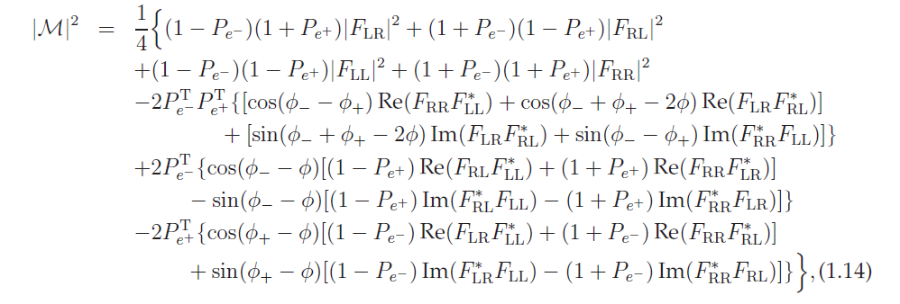
Linear collider: Transverse polarization
Matrix element for e+e- interaction with arbitrarily oriented polarization vector:
    where the F_{ik} denote the helicity amplitudes, P_{T} gives the magnitude of transverse polarization and φ₊ and φ₋ are the azimuthal orientations of the respective transverse polarizations, φ is the azimuthal angle of the reference momentum
In a linear collider, φ₊ and φ₋ are given by the experimental setup and can be changed independently
Transverse polarization gives only measurable effects if both beams, e+ and e-, are polarized.
New physics phenomena could show up as φ dependent modulation in the differential cross section remaining the φ averaged cross section unchanged

Slide 15
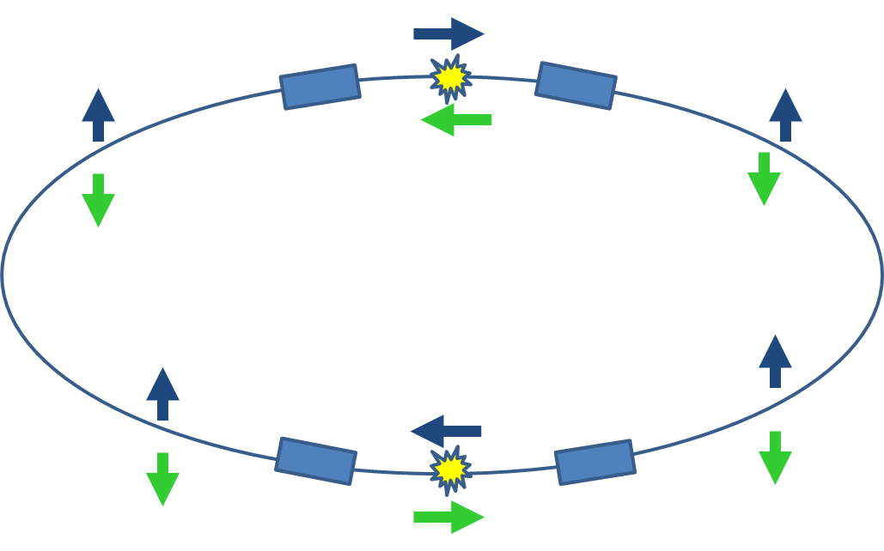
Beam polarization @ FCC-ee ?
FCC-ee, Z pole measurements: 5×10¹² Z bosons ⬄ statistical uncertainty is improved by 3 orders of magnitude compared to LEP;
Coupling and widths measurements can be done with best precision ever
Beam polarization ?
  e+, e- circulate with spins aligned (anti-aligned) to the dipole field of the collider
  To collide longitudinally polarized beams, spin rotation is necessary before and after beam crossing
  Depolarization effects along the ring
  → beam polarization requires large effort
  Knowledge of polarization could be much less
  precise than the statistical error of measurements

Slide 16
Summary (experimentalist’s view)
Future linear e+e- colliders will achieve a statistical precision of ~10⁻³
Physics analyses benefit from polarized beam(s)
  spin related observables – sensitive to SM and models beyond
Single beam polarization is an established aspect of linear colliders
Polarization of both beams has distinct advantages and is desired for precision measurements at future linear e+e- colliders
  Substantial enhancement of luminosity
  Better control of systematic effects
  More precise determination of polarization; in particular, with collision data an ‘in situ’ polarization measurement at the IP is possible
It is crucial for the precision measurements at future linear colliders that MC generators and analysis tools include beam polarization
SANC is now implementing polarization effects
  arXiv:1801.00125; “One-loop electroweak radiative corrections to polarized Bhabha scattering”; D. Bardin, A. Arbuzov, S. Bondarenko, Ya. Dydyshka, L. Kalinovskaya, L. Rumyantsev, R. Sadykov
Project Advanced Research of Interactions in e+e- coLlisions

Slide 17
Many thanks to the organizers of Bardin’s Day and CALC2018, in particular Lida Kalinovskaya, Andriy Arbuzov and Alexander Bednyakov for the invitation and kind hospitality.

