Slide 1
Fusion reactions of astrophysical interest
V. Sargsyan

Slide 2
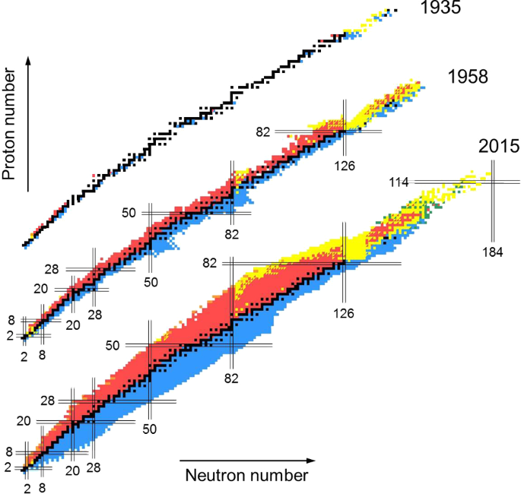
The chart of nuclides
In 1935 - 327 isotopes of 92 elements were recorded.
In 1958 - about 1500 nuclides of 102 elements.
In 2015 - 4000 different isotopes of 118 elements.

Slide 3
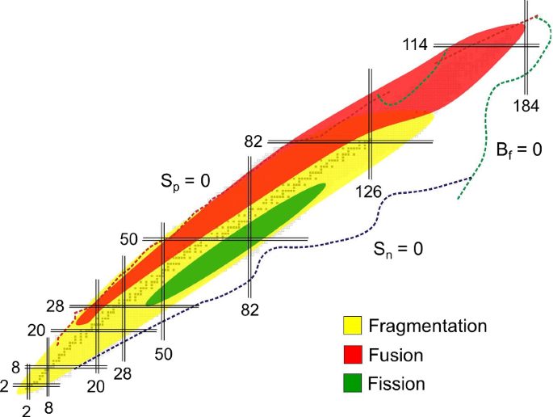
The chart of nuclides

Slide 4
Fusion reactions

Slide 5
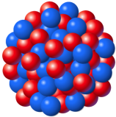
Collision of two nuclei
Target
Projectile
Different channels of reaction:
Elastic scattering
Inelastic scattering
Deep-inelastic scattering
Transfer reactions
Direct reactions
…..
Fusion reaction (formation of compound nuclei)
Fusion is in general a process, in which two or more nuclei join to form a new, heavier nucleus. However, we identify fusion with formation of a compound nucleus!

Slide 6
The compound nucleus
Projectile
Target
Compound nucleus
When projectile and target come into close contact during a nuclear reaction they form a combined system in which the nucleons interact strongly with each other.
The energy is carried in from entrance channel is not invested in one or a few degrees of freedom, but is shared among many complicated configurations.
It takes a long time on a nuclear scale until the energy is concentrated again in some configurations of nucleons from which a transition to an open final channel can take place.
The lifetime of a compound nucleus lies between 10⁻¹⁹s and 10⁻¹⁶s; it is appreciably longer than “flying by time” of the projectile (10⁻²¹s), but still short on a macroscopic scale.
Niels Bohr (1936) introduce the concept of a compound nucleus.

Slide 7
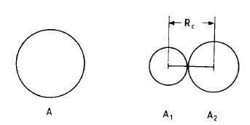
Stability in the mass
The most important quantity determining the stability of a nucleus is its energy as compared to the energies of any two component nuclei into which it may be subdivided.
The difference between the energy of separated fragments and the energy of the compound nucleus:

Slide 8
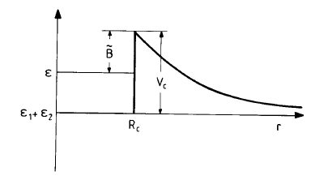
Stability in the mass

Slide 9
Decay of the compound nucleus
The compound nucleus is highly excited and has a temperature; it is “hot”.
It also carries an angular momentum equal to the sum of angular momentum of the relative motion in the entrance channel and the spins of initial collision partners.
Evaporation: emission of light particles like neutrons, protons, a- particles and so on. There remains a bound residual nucleus called evaporation residue of a slightly lower mass than the compound nucleus. The particle evaporation process generally accompanied by the g-emission.
Fission: the compound nucleus splits up to into two halves of more or less equal size. This process is accompanied by evaporation of light particles out of the fissioning nucleus, and similarly the fission fragments will generally decay further by evaporation. The emitted particles are called pre-scission and post-scission particles, respectively.

Slide 10
Forces acting between the nuclei in the process of the fusion
Conservative forces:
Coulomb, nuclear and centrifugal forces create an entrance potential barrier. the projectile ion must have sufficient kinetic energy to overcome the barrier.
Dissipative forces:
Induce an irreversible transition of the kinetic energy of a collision into internal excitations of the nuclear.

Slide 11
Double folding potential

Slide 12
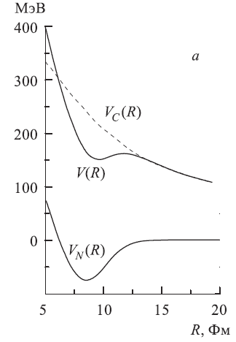
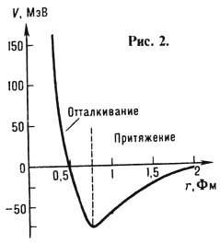
Nucleus-nucleus potential
Coulomb energy:

Slide 13
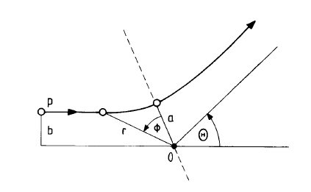
Impact parameter and angular momentum
For each impact parameter b corresponds to certain angular momentum l
Rotational energy:

Slide 14
Nucleus-nucleus potential

Slide 15
Fusion above the barrier

Slide 16
Classical fusion
For the first estimate of the fusion cross section we assume that projectile and target can interact in only two ways: the projectile either scatters elastically off the target or fuses with it into a compound nucleus, i.e. is absorbed.
--- the probability of projectile to fuse.

Slide 17
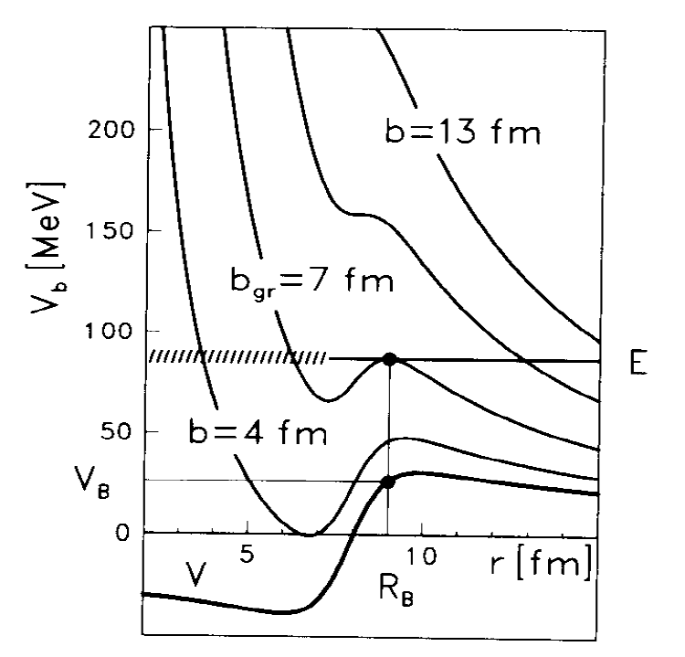
The classical fusion cross section
For the given impact parameter b the radial motion is governed by the effective potential
If the projectile has an impact parameter b>b_{gr}, it will be reflected by the barrier.
If b<b_{gr}, surmounts the barrier and proceeds towards the interior, where it is absorbed by the action of the nuclear forces; it fuses with the target.

Slide 18
The classical fusion cross section
At energies above the barrier for the fusion cross section one can obtain:
or
The classical picture of fusion has its quantal counterpart in the sharp-cut-off approximation:

Slide 19
Sub-barrier fusion

Slide 20
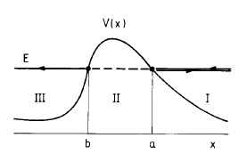
Tunneling through the potential barrier
At low energies quantum effects come into play and influence the behaviour of the fusion cross section. In particular, quantal tunneling allows for partial transmission.
The incoming plane wave on the right (region I) is partially reflected at the turning point a;
the remainder penetrates into the barrier region (II);
which it leaves again at the turning point b to become the transmitted wave in region (III).
The complete WKB solution is constructed by connecting the solutions in the three regions.
In general case, these solutions could be found only numerically.

Slide 21
Tunneling through a parabolic barrier
Potential barrier of the form of inverted oscillator:
Schrödinger equation for parabolic barrier
In case of the potential of inverted oscillator we can find an analytic solution!

Slide 22
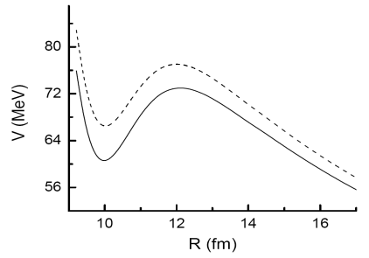
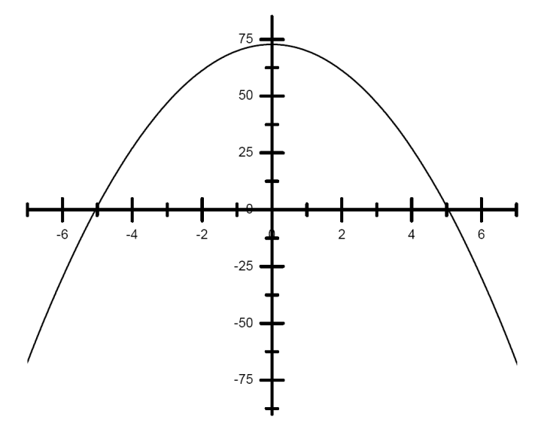
Tunneling through a parabolic barrier
Near the barrier top any physical reasonable potential can be approximated by a parabola.
--- the height of the barrier
The potential barrier frequency

Slide 23
The Will-Wheeler formula
Replacing the height and frequency for the potential, we obtain the Hill-Wheeler formula for penetrability:
Penetrability for the l wave:

Slide 24
The Wong formula
For the above and sub- barrier energies one can use the following expressions for the fusion cross section

Slide 25
Approximation: realistic nucleus-nucleus potential → inverted oscillator
The real interaction between nuclei can be approximated by the inverted oscillator.
The frequency of oscillator is found from the condition of equality of classical action

Slide 26
Fusion reactions in astrophysics

Slide 27
Key fusion reactions
In a hydrogen-rich environment the light elements such as Li, Be, and B have all positive (p, α) Q values. These nuclei are easily destroyed, before fusion reactions start to play a role.
The stable carbon isotopes ^{12,13}C are the first nuclei with sufficiently negative (p, α) Q values. This makes ¹²C + ¹²C the first fusion reaction that needs to be considered in nuclear astrophysics.
In non-explosive scenarios carbon fusion takes place in the center of massive stars toward the end of their lifetime during the carbon-burning phase at temperatures of about 0.6–1 GK.
In stellar explosions carbon fusion plays a role during the ignition phase of supernovae (1–10 GK).
Fusion reactions involving ¹⁶O, plays a role only at higher temperatures.
In explosive environments.

Slide 28
Key fusion reactions
The study of fusion of light heavy nuclei (C, O, Si…) at extreme sub- barrier energies (e.g. Gamow energies for C+C reaction is 1-3 MeV) is a key to understand and predict different scenarios of evolution of the stars.
Main problem:
Gamow energies are in a range where no reliable cross-section measurements can be made with present technologies.
Possible solution:
Extrapolation of the existing experimental data to lower energies starting with data at higher energies.
Theoretical calculations.

Slide 29
Thermonuclear reactions rates
Non resonant nuclear reactions rates are the number of reactions taking place between elements “i” and “k” in per unit of volume at per unit of time
Maxwell distribution
E₀ - Gamow maximum
The particles with energy E₀ mostly contribute to reaction rate
For typical stellar environment
T << E₀
Typical values of quantities:
E₀ ~ 1-2 MeV
E_{b} ~ 6-8 MeV
kT ~ 0.1 ~ 0.6 MeV

Slide 30
Astrophysical S- factor
Fusion in pure Coulomb potential
(Gamow theory)
The interaction potential is Coulomb potential
Considered only central collision
The structure of the nuclei is ignored
The coupling between the relative motion and the internal excitation is not considered
-- Gamow factor
Hence, it is assumed, that at extreme low energies, the astrophysical S - factor
should be constant or at least have very weak energy dependence

Slide 31
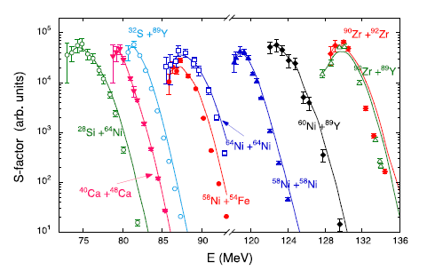
The experimental S- factor
For the medium heavy systems, a clear maximum and strong energy dependence of S -factor was observed experimentally at deep sub-barrier energies.
Due to strong resonances in fusion of light heavy systems, the existence of the S- factor maximum is not obvious. However, it seems that the general trend is similar to the heavy systems.
¹⁶O+¹⁶O
¹²C+¹²C

Slide 32
Fusion in the presence of nuclear excitation

Slide 33
Quantum-diffusion approach
The quantum diffusion approach based on the following assumptions:
The capture (fusion) can be treated on the one collective variable: the relative distance between the colliding nuclear.
The real interaction between nuclear can be approximated by the inverted oscillator.
The internal excitations (for example, coupling of the relative motion with low-lying collective modes such as dynamical quadropole and octupole excitations of the target and projectile, one particle excitations etc. ) can be presented as an environment which is coupled with the collective variable.
This approach takes into account the fluctuation and dissipation effects in the collisions of heavy ions which model the coupling with various channels

Slide 34
The formalism of quantum-diffusion approach
The starting point is the full Hamiltonian of the system:
The Hamiltonian of the
collective subsystem
The Hamiltonian of the
internal subsystem
The Hamiltonian of the
coupling between the
collective and internal subsystems

Slide 35
The capture probability in quantum diffusion approach
Capture probability depends on the ratio of mean value and the variance of the collective coordinate:
The coupling to internal excitations leads to fluctuation of collective coordinate.
Equations for the mean value and variance contain friction and diffusion.
The friction and diffusion are obtained in a self-consistent way.
Our approach takes into account the fluctuation and dissipation effects in the collisions of heavy ions which model the coupling with various channels.

Slide 36
The analytical expressions for the first and second moments
Functions determine the dynamic of the first and second moments
--- are the roots of the following
equation

Slide 37
The capture probability
Constant friction coefficient (linear coupling).
The frequency of the approximated oscillator.
The internal excitation width --- is responsible for non-Markovian effects.
The QD approach was successfully applied to describe the heavy ion fusion reactions at near- and below the Coulomb barrier energies.

Slide 38
Nucleus-nucleus interaction potential:
The calculated potentials respect to their barriers for the indicated reactions
The large Coulomb repulsion in case of the ¹⁶O+²⁰⁸Pb reaction leads to steep fall off of the potential, compared to those in case of ¹⁶O+¹⁶O reaction.
The same energy below the Coulomb barrier, two colliding nuclei approach to closer distance in case of the heavier system.

Slide 39
To consider reactions at extremely low energies one need to extend the model!!
The friction is proportional to the square of the nuclear force:
This form of friction takes into account the comparatively larger overlap of the nuclear surfaces is case of two heavier nuclei.
Determination of the excitation width:
Phenomenological coefficient!!

Slide 40
Results of calculations
The main trend of new experimental data is reproduced.
We clearly identify a maximum in S- factor.

Slide 41
Results of calculations
The calculation is in good agreement with the experimental data
The lowest data are very close to the position of the maximum of S factor

Slide 42
Probability at extreme sub-barrier energies
At low energies (weak friction limit) one obtains simple expression for the capture probability !
For very light nuclei the formulas are applicable already at energies 1-2 MeV below the barrier.
The formulas could be used to obtain analytical expression for the S- factor position and reaction rates.

Slide 43
Schematic representation of the Gamow’s bell
E₀ - Gamow maximum
The particles with energy E₀ mostly contribute to reaction rate
For typical stellar environment
T << E₀
-- fusion probability in Coulomb potential (constant S- factor)
-- complicated energy dependence (our approach, strong energy dependence of S- factor)

Slide 44
Gamow maximum in case of ¹²C + ¹²C reaction
-- Gamow maximum with constant S- factor
-- Gamow maximum
in our approach
Different T dependences!
in the center of massive stars toward the end of their lifetime
ignition phase of supernovae
The calculated Gamow maximum with analytical expression is practically identical with the numerical calculation!
In all considered temperatures, the difference between the position of the Gamow maximum with constant S- factor and with our approach is less then 40% !

Slide 45
Reaction rate
Reaction rate with constant S- factor
Unknown S₀, S₀=S(E₀) ??
Reaction rate in our approach

Slide 46
Temperature dependence of reaction rates
The temperature dependence of ¹²C + ¹²C fusion rate.
The temperature part of reaction rates, calculated with our approach and with Coulomb potential.
Our approach predicts lower reactions rates for heavy elements fusions during evolution of stars (carbon, oxigen, silicon burning).
As a consequence, the formation of heavy elements via fusion reactions mainly occurs in explosion phase.

Slide 47
Thank you!

Slide 48
Summary
The structure of astrophysical S-factor for various reactions is analyzed within the extended quantum diffusion approach .
We compared the calculated fusion cross sections with the available experimental data. In all cases we obtained a good description of the experiments .
For the considered reactions, the S-factor shows a clear maximum in the sub-barrier energy range E_{s}∼(0.60 − 0.86)V_{b} .
We propose an analytical expression, predicting very reliably, the dependence of the S-factor maximum on the ion mass and charge numbers, which may be used not only in stellar burning studies but also as a guidance for future experiments .
The S-factor has strong energy dependence below the maximum
We obtained a new analytical formula for the Gamow maximum and fusion reactions rates
It is shown, that the formation of heavy elements via fusion reaction mainly occurs in explosion stage

Slide 49
Fusion of heavy nuclei Dinuclear system concept

Slide 50
Dinuclear system concept
At the capture stage, after complete dissipation of the kinetic energy of the collision, a dinuclear system is formed.
The process of complete fusion is realized as a result of the evolution of the DNS in the direction of increasing its charge and mass asymmetries: the nucleons of the lighter nucleus are transferred to the heavier nucleus.
In reactions between massive nuclei, evolution in the opposite direction is energetically favorable: nucleons from a heavier nucleus are transferred to a lighter nucleus, which leads to symmetrization of the system.

Slide 51
Dinuclear system concept
In symmetric DNS, the Coulomb repulsion between the nuclei reaches the maximum value, and the system splits into two fragments that are close in mass — a quasifission occurs.
Due to the statistical nature of evolution in massive DNS, competition arises between channels of complete fusion and quasifission, which leads to a decrease in the cross section for the formation of a compound nucleus compared to the capture cross section.

Slide 52
The mechanism of the reaction
Colliding nuclei
Formation of DNS
Compound system
Quasifission products
Evaporation residue

Slide 53
Collective coordinates

Slide 54
Schematic picture of the reaction mechanism
Fusion: formation of compound nucleus
Entrance channel
Transfer of nucleons
quasifission
Touching configuration

Slide 55
1. First stage: Capture
Passage through the Coulomb barrier and the formation of a DNS

Slide 56
2. Second stage: Transfer of nucleons
The energy of the system
The energy of the system

Slide 57
Fusion in mass asymmetry coordinate
The DNS evolves along the mass asymmetry coordinate towards fusion and along the relative distance along the quasi-fission direction.
Entrance channel

Slide 58
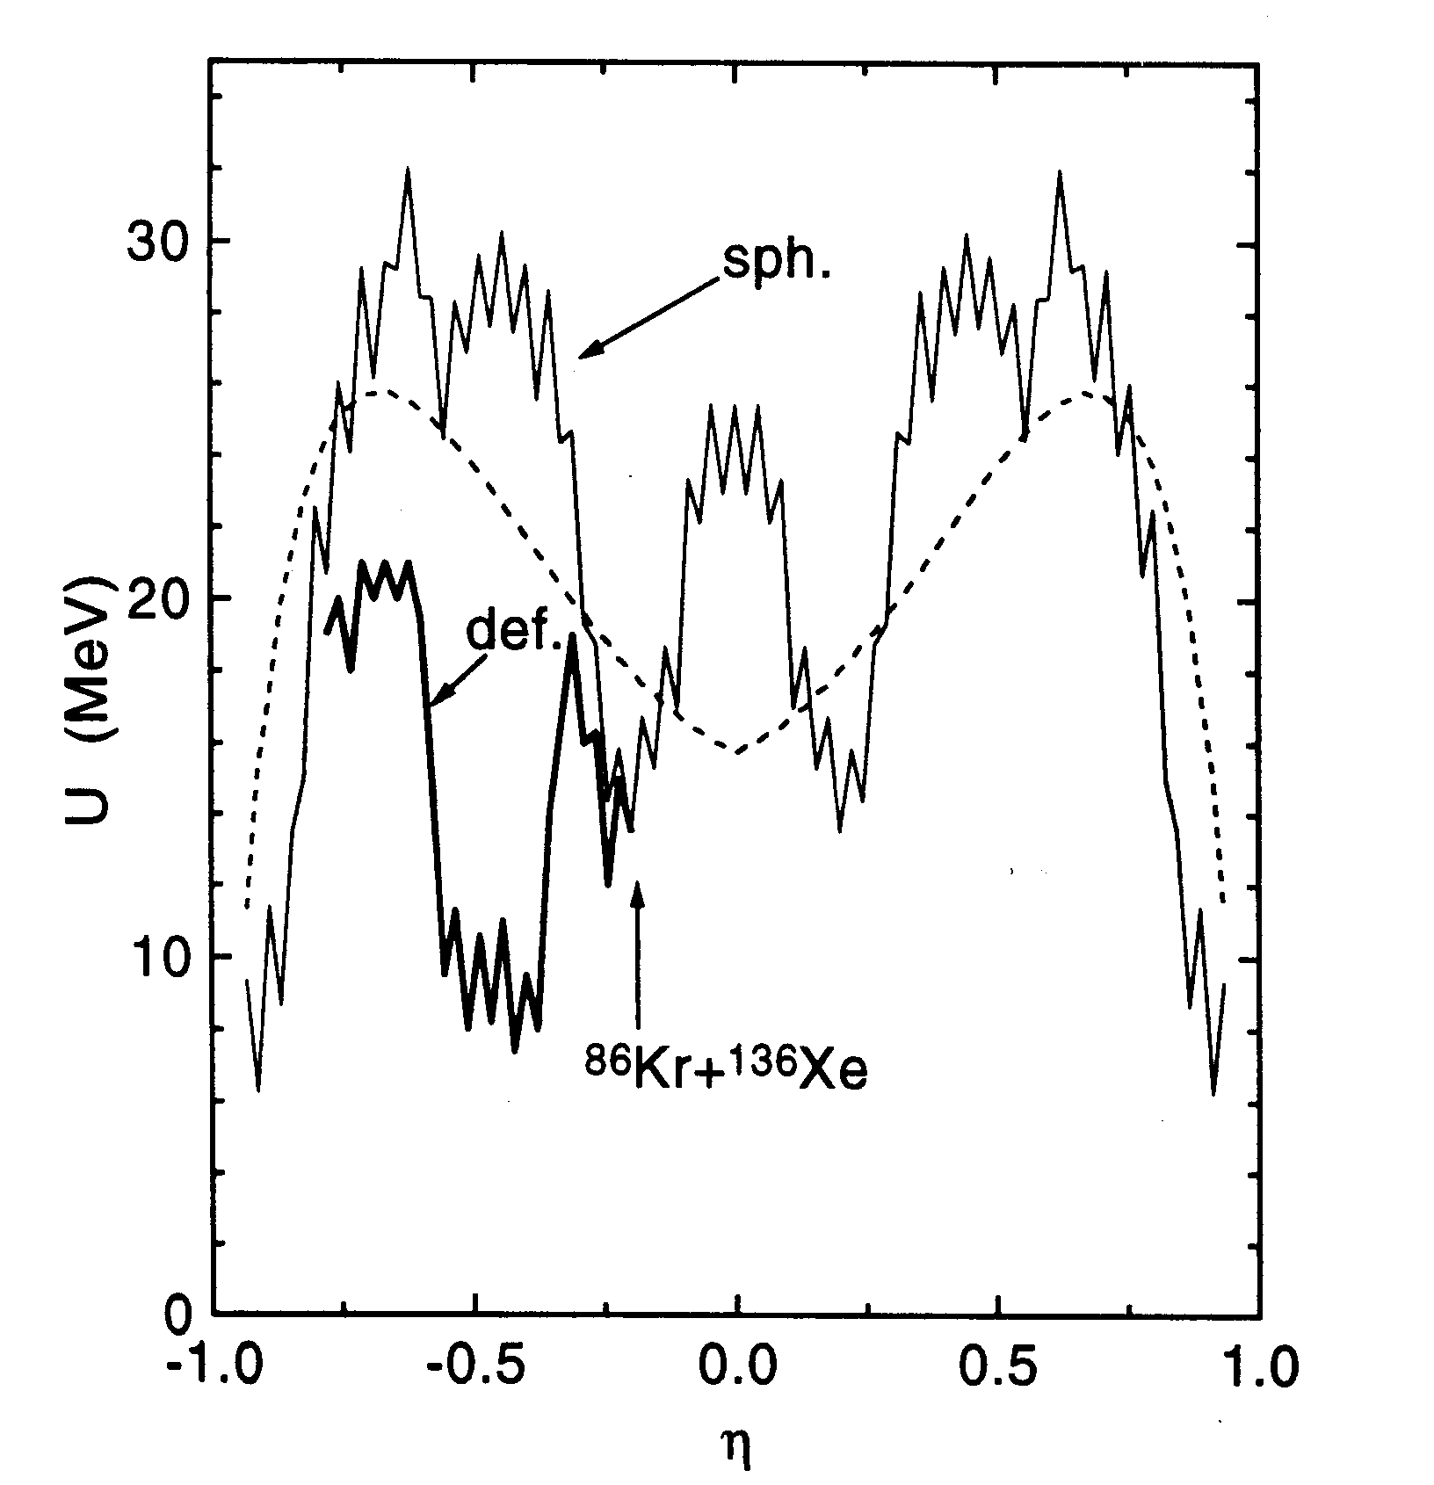

Slide 59
Fusion probability P_{CN}
The probability of complete fusion
Two-dimensional Kramers-type expressions could be used for the calculations of the rates

Slide 60
Survival of the compound nucleus
De-excitation of the compound nucleus (transition of the excited nucleus to the ground state) occurs by emission of neutrons, protons, alpha particles and gamma.
P_{s} -- the probability of the realization of the s- channel.

Slide 61
Application of DNC concept
Nuclear structure: super- and hyperdeformed nuclei
Fusion reactions: superheavy elements
Quasifision reactions
Transfer reactions
Emission of clusters from hot and cold nuclei
Fission

