Slide 1
Giant resonances:
basics and perspectives
V.O. Nesterenko
Bogoliubov Laboratory of Theoretical Physics,
Joint Institute for Nuclear Research, Dubna, Moscow region, Russia
in collaboration with:
J. Kvasil - Charles Univ, Praha, Czech Republic
P. von Neumann Cosel, - TU, Darmstadt, Germany
P.-G. Reinhard ⁻ Inst. of Theor. Physics II, University of Erlangen, Erlangen, Germany
A. Repko - Inst. of Physics, Slovak Academy of Sciences, Bratislava, Slovakia
P. Vishnevskiy, - BLTP JINR, Dubna; Inst. Nucl. Phys., Almaty, Kazakhstan
Lecture at International School
“Nuclear Theory and Astrophysical Applications”,
Dubna, JINR, February 13
1

Slide 2
Content of the talk:
Variety of giant resonances (GR) in nuclei:
- basic properties, present main research directions, open problems
- electric GR: E1(T=1), E0(T=0), E2(T=0)
- exotic E1(T=0) GR: toroidal and compression
- magnetic M1 (orbital scissors and spin-flip) GR
Theory vs experiment
Basics: deformations splitting, resonance widths, Landau damping,
Hill’ vortex ring, Skyrme functional, sum rules, wavelet, etc

Slide 3
Giant resonances: definition
z
Photoabsorption
Giant dipole resonance (GDR)
p
n
E1 GDR (IV)
More accurate definition of GR:
GR is a collective excitation exhausting an essential part of the proper sum rule.
response to external field F
Sum rules look complicated but in many cases they are reduced to
very simple expressions.
GDR :
- model independent!
Soviet physicist Migdal has predicted GDR using the sum rule estimation.

Slide 4
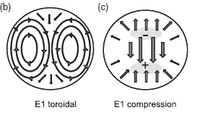
Variety of GR
p
n
p
n
E0(T=0,1)
GMR
E1(T=1)
GDR
E2(T=0,1)
GQR
M1(T=1)
scissors
M2(T=0,1)
twist
E1(T=0,1)
toroidal
vortical
E1(T=0,1)
compression
isoscalar (IS,T=0): protons and neutrons oscillate in phase
isovector (IV,T=1): protons and neutrons oscillate in opposite phase
For each GR there is the optimal reaction where it can be well observed
and discriminated.
Each GR describe some particular nuclear properties
spin-flip M1 GR(T=1), …..
charge-exchange GR: Gamow-Teller GR, …
omitted in the present talk

Slide 5
As a rule, the origin and main properties of GR are already well known.
Why then the study of GR is still actual?

Slide 6
GR are the robust test for modern self-consistent mean field approaches
(Skyrme, Gogni, relativistic, …) based on
density functional theory (DFT)
These approaches:
- are main theoretical tools (work horses) to describe GR
and other nuclear excitations
- are self-consistent: both mean field and residual interaction are obtained
from the same initial functional (no additional free parameters), high predictive
power.
pretend to be universal: description of astrophysical problems,
nuclear matter (symmetric, neutron), and finite nuclei of a different shape
(spherical, deformed) through the full periodic table,
pretend to describe both static nuclear properties and nuclear dynamics
- parameters of the initial functional are fitted to describe both finite nuclei
(statics, dynamics) and nuclear matter
GR provide the robust check of the accuracy of the self-consistent models.

Slide 7
Skyrme functional with spin-isospin channel
spin-independent
IS-IV channel
(gs properties, EL excitations)
spin-orbit
IS-IV channel
(gs properties,
EL-ML excitations)
spin-dependent
IS-IV channel
(ML excitations)
tensor contribution
Spin-independent and spin-orbit channels can be fitted by gs properties
of even-even nuclei. So these channels are rather well fitted.
Instead, spin-dependent channels cannot be fitted by gs properties of
even-even nuclei. So this channel is still rather vague.
The impact of tensor contribution is also not yet well understood.

Slide 8
Функционал Скирма для атомных ядер
Y.M. Engel et al, NPA 249, 215 (1975).
J. Dobaczewski and J. Dudek,
PRC, 52 1827 (1995).
q=p,n
(+) плотность нуклонов.
(+) плот. кин. энергии
(+) спин-орбит. плот.
Т-четные:
Contribute both to the ground state and excitations.
(-) плот. тока
Time-odd:
(-) спиновая плот.
Contribute only to
excitations.
(-) плот. спин. кинет. энергии

Slide 9
E. Lipparini and S. Stringari,
NPA, 371, 430 (1981).
TD-DFT
Time-dependent formulation:
T-even and T-odd
densities
Linear regime: small time-dependent
perturbation
Mean field hamiltonian:
static g.s. + time-dependent response
The only unknowns
Now we have to specify the perturbed many-body wave function

Slide 10
Besides GR provide a useful information on particular features
of finite nuclei and nuclear matter
p
n
p
n
E0(T=0,1)
GMR
E1(T=1)
GDR
E2(T=0,1)
GQR
M1(T=1)
scissors
M2(T=0,1)
twist
E1(T=0,1)
toroidal
E1(T=0,1)
compression
nuclear
incomp.
orbital
magnetism
orbital
magnetism
electric
vortical
motion
nuclear
incomp.

Slide 11
Mean-field origin of GR

Slide 12
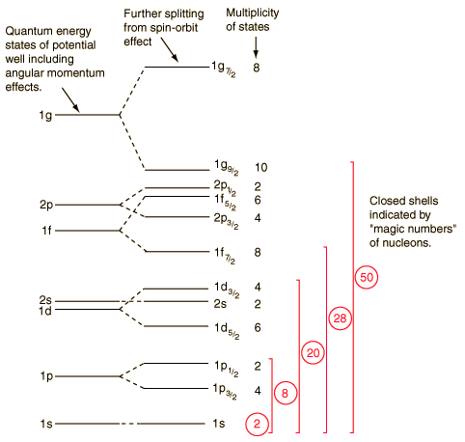
Классификация частично-дырочных (1ph)
и коллективных возбуждений
nlj – квантовые числа
состояния,
n – число узлов,
l – орбит. момент,
N – главное оболочечное
квантовое число
- простр. четность
s, p, d, f, g, ...
l = 0, 1, 2, 3, 4, …
1ph возбуждение
N=3,π = --
(4)
E1
F
Много одновременных
1ph возбуждений одинаковой
мультипольности под действием
внешнего поля образуют
коллективную моду
(гигантский резонанс)
N=2, π = +
(6)
N=1,π = --
N=0, π = +
Notes:
Внешнее поле и остаточное взаимодействие

Slide 13
Гигантские резонансы и квантовые оболочки
Четность перехода:
Связь ГР и оболочек в среднем поле
- natural parity
- unnatural parity
E1
E2,M1
E
N+3 -
N+2 +
N+1 -
N +
F
N-1 -
N-2 +
E1-GR
E2-GR
( ~ 7 MeV for )
Гигантские резонансы можно объяснить
как коллективные переходы между
квантовыми оболочками.

Slide 14
Giant dipole resonance
p
n
E1 GDR (IV)

Slide 15
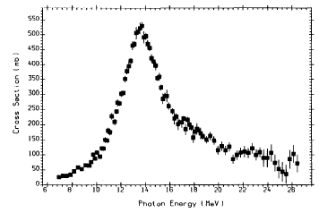
E1(T=1) - GDR
A. V. Varlamov, V. V. Varlamov, D. S. Rudenko, and M. E. Stepanov, Atlas of Giant Dipole Resonances, INDC(NDS)-394,1999
Experimental photoabsorption cross-section
Goldhaber-Teller model,
(1948)
p
n
It is convenient to describe GDR
by the energy-weighted strength function
with the Lorentz averaging weight
Empirical estimation for GDR energy:
Transition operator
We should keep the translation invariance = conservation of the total nuclear moment P:
includes effective charges to remove spurious admixtures (motion of the whole nucleus) in the transition rates.
The violation happens if Hamiltonian depends o the center-of mass coordinate R

Slide 16
Extraction of spurious admixture is a general problem of the theory
E1 states: violation of translation invariance =
conservation of the total nuclear moment)
E2(K=0) states: pairing-induced violation of the conservation of the
particle number
E2(K=1) states: violation of rotational invariance =
conservation of the total angular momentum
There were derived general methods for extraction of various spurious admixtures from nuclear excitations.
These methods reproduce the familiar effective charges etc.
1) J. Kvasil, A. Repko, and V.O.N. Eur. Phys. J. A 55, 213 ( (2019);
2) A. Repko, J. Kvasil, and V.O.N., Phys. Rev. C 99, 044307 (2019).

Slide 17
Fine structure of GDR: effect of deformation splitting
Nuclei with fully occupied valence shell are spherical (magic and semi-magic nuclei).
Nuclei with partly occupied valence shell can be deformed.
The nuclear shape with a minimum of the system energy is actually realized.
axial
prolate
axial
oblate
spherical
z
z
z
- oscillator
length
y
y
y
x
x
x
GDR
B(E1)
z
y
y
y
x
z
x
x
z
n
p
K=0
K=1
K=1
K=0
Axial quadrupole deformation causes splitting of GDR into K=0 and K=1 branches
K=1 peak should be twice higher than K=0 one. Is this indeed the case?

Slide 18
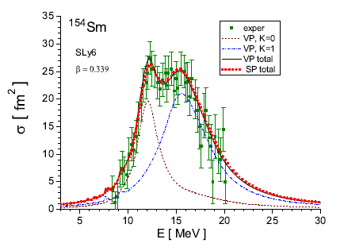
Fine structure of GDR: examples of deformation-induced GDR splitting
Exp: G.M. Gurevich et al,
Nucl. Phys. A351, 257 (1981).
K=0 K=1
Repko, J. Kvasil, V.O.N. and P.-G. Reinhard,
Eur. Phys. J. A, 53, 221 (2017).
W. Kleinig, V.O.N., J. Kvasil, P.-G. Reinhard, P. Vesely, PRC, 78, 044313 (2008)
Prolate nuclei exhibit different relative altitudes of K=0 and K=1 branches.
The GDR fine structure depends on the Landau damping of the branches.
K=1 branch lies at a higher energy and so is more damped.
In deformed nuclei, GDR width is almost fully provided by Landau damping.
In spherical nuclei, the coupling with complex configurations is also important.

Slide 19
Resonance width
- Landau damping
- decay of the collective resonance into elementary states
- the main mechanism of GR decay, width and gross-structure
often calculated in Random
Phase Approximation (RPA)
- coupling with complex configuration
- can affect resonance width, position and gross-structure
- most important in spherical nuclei
- very complicated calculations (Pauli principle)
- realized in Quasiparticle-Phonon model (Dubna), methods of Colo, Lyutorovich, etc
- can be simplified by random-matrix treatment
N. N. Arsenyev, A. P. Severyukhin,
R.G.Nazmitdinov,JETF Letters, 1 (2023)
- escape width caused by escape of particles from the nucleus
- important for GR width
- needs taking into account continuous spectrum (usually
approximated by spectrum discretization)

Slide 20
Время жизни резонанса определяется
фрагментацией (диссипацией) Ландау
резонанс взаимодействует
c 1ph и распадается. У него
появляется ширина распада G.
Чем быстрее распад (меньше
время жизни t ), тем больше G.
резонанс не взаимодействует
c 1ph и не распадается
Ширина плазмона мала.
s
s
коллективное
возбуждение
G
коллективное
возбуждение
E
E
элементарные электрон-дырочные 1ph возбуждения
элементарные электрон-дырочные 1eh возбуждения
Если коллективное возбуждение взаимодействует (V) с соседними 1eh
элементарными возбуждениями, то оно распадается по этим элементарным возбуждениям.
У коллективного уровня появляется ширина , обратно
пропорциональная его времени жизни.
Этот эффект называется фрагментацией Ландау для дискретного спектра и
диссипацией Ландау для непрерывного спектра.
Это общий эффект для самых разных квантовых систем.

Slide 21
Wavelet can be associated with the
local Fourier transform.
- The extracted scales are attributed to
different physical damping mechanisms.
- Very new and interesting area in
investigation of nuclear structure.
However wavelet analysis in nuclei still has open questions:
physical interpretation of characteristic scales, e.g. widths vs energy intervals,
is still unclear.
SLy6

Slide 22
Wavelet analysis

Slide 23
Wavelet (WL) analysis
Extension of the Fourier transformation relating total
time and frequency domains
Instead WL provides a local transformation for a given frequency interval.
It is widely used in
- geophysics, ocean waves, coherence in turbulent flows,
- electrical engineering (signal processing, data compression)
- mathematical analysis, physics (fractals, ..) ….
In nuclear physics, WL is used to build the width - excit. energy map
One can analyze:
- the width content
- fine structures
recently applied to analysis of fine structure of GQR in spherical atomic nuclei
deformation effects cause fine structures of GR (splitting, …) and
thus can be a subject of WL analysis
A.Shevchenko et al,
PRL, 93, 122501 (2004),
PRC, 79,044305 (2009).
locally, in any energy interval

Slide 24
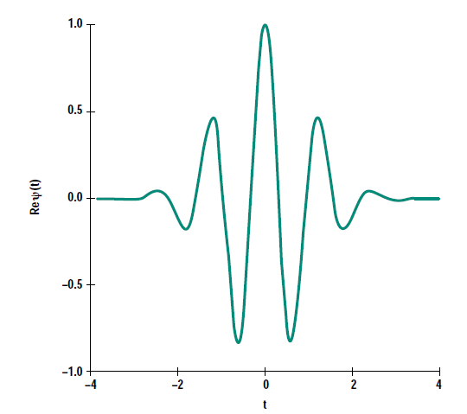
WL transform:
- input spectrum to be analyzed
- argument of wavelet function
- Morlet wavelet
- Gaussian modulated by cosine
- in this study only real part is used
energy location (energy grid)
- energy scale (width of the Gauss function)
In the present
calculations:
n=16, k=5
k - regulates the ratio between scale and energy resolutions

Slide 25
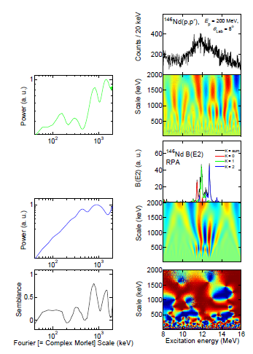
Wavelet analysis of E2(T=0) GR : 146Nd
L.M. Donaldson et al,
PRC 102, 064327 (2020)
Large positive
Large negative
small
power
Experiment
Power:
E [keV]
power
Theory
Semblance:
semblance
- very nice semblance
- there are large widths from
deformation K-splitting
(scale, width)

Slide 26
GDR
- is the main resonance to check IV channel in Skyrme functional
- has counterparts in other quantum systems, e.g. plasmons in atomic clusters and quantum dots
Which reaction to use for observation GDR?
- photoabsorption
- Nuclear Resonance Fluorecence (NRF)
- (e,e’)
- (p,p’)
- (a,a’), (d,d’)
Yes since these reactions are sensitive tom IV modes
No, since these
reactions are IS

Slide 27
Still open problems:
1) GDR for different cases of photoabsorption
All the decay channels must be
measured to get the complete
photoabsorption. This is often
not the case.
σ = (γ, n) + (γ,p) + (γ, np) + (γ, 2n) + (γ, d)
+ · · ·+(γ, f ),
2) The method of production of initial photons (bremsstrahlung vs
positron annihilation) affects the result:
positron annihilation
bremsstrahlung
See review: V.V. Varlamov and B.S. Ishkhanov, Part. Nucl.35(4) 858 (2004)

Slide 28
3) Photoabsorption vs (p,p’)
Inelastic scattering of protons to very small angles is now very popular
in exploration of GDR, see e.g.
L.M. Donaldson et al, PRC 102, 064327 (2020)
Deformed 152Sm and 150Nd:
- two-hump GDR structure in old photoabsorption data (green) and Skyrme QRPA calculations (blue)
- one-hump structure in new (p,p’) experiment of Donaldson (red)
- initial (p,p’) cross-section deviates from the photoabsorption extracted by using Bertulani’s procedure
Problems with Bertulani’s
procedure?
Still open question.

Slide 29
Other GR in more detail:
- E2(T=0),
- E0(T=0),
- spin-flip M1,
- scissors M1
- exotic toroidal and compression E1(T=0)

Slide 30
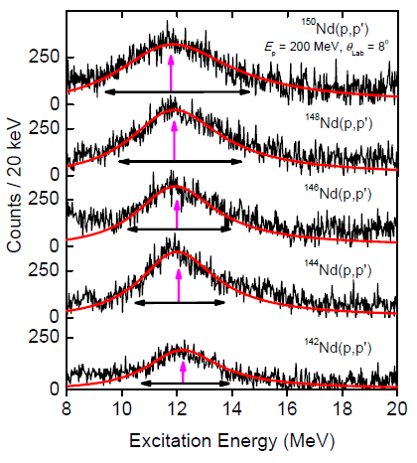
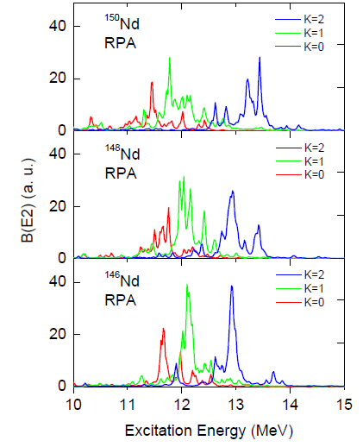
Wavelet for E2(T=0) - GQR
C.O. Kureba et al,
PLB, 779, 269 (2018).
experiment
Theory SVmas10
IS-GQR:
- the deformation splitting is hidden out.
- the wavelet analysis could be useful
. very important to check IS spin-independent channel of DFT

Slide 31
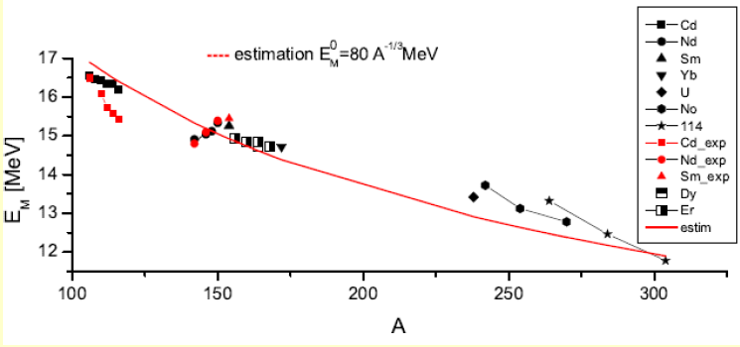
Giant monopole resonance E0(T=0) - GMR
GMR is the main source of information on nuclear incompressibility and
GMR energy of atomic nuclei
incompressibility of nuclear matter
Each Skyrme force
have fixed
and
- empirical relation
GMR
Skyrme QRPA calculations (black) vs exper. data (red) and empir. estimation
See systematics in
J. Kvasil , V. O. N., A. Repko, W. Kleinig, and P.-G. Reinhard, PRC,94, 064302 (2016)

Slide 32
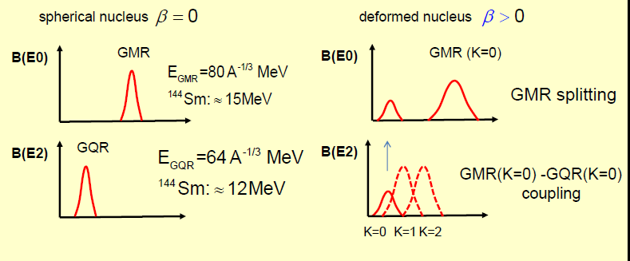
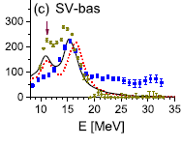
Deformation effect in GMR
J. Kvasil , V. O. N., A. Repko, W. Kleinig,
and P.-G. Reinhard, PRC,94, 064302 (2016)
Till now mainly GMR in spherical nuclei was used to get
But most of nuclei are deformed! Is it possible to use deformed nuclei?
GMR and QMR are independent in spherical nuclei but coupled in axial deformed nuclei. This leads to double-peak structure of GMR. This is maybe the strongest deformation-induced coupling of different multipole modes!
Systematic study: J. Kvasil et al, PRC,94, 064302 (2016)
Open problem: essential discrepancy in TAMU and RCNP experimental data.
So GMR strength in deformed nuclei has two humps!

Slide 33
Recent RCNP data
- Even in slightly deformed
Mo isotopes there is a
noticeable deformation-induced
E0/E2 peak
The best agreement with the
experiment is obtained for Skyrme
force SkP with very low
Incompressibility and IS
effective mass m* are coupled!
IS GMR and GQR must be described simultaneously!!! In both deformed and spherical nuclei!
In nuclear matter:

Slide 34
Deformation-induced E0/E2 in light nuclei
prolate 24Mg and oblate 28Si
iThemba (a,a’) data vs Skyrme QRPA theory
IS0/IS2 coupling results in 14_MeV peak
which is more suitable for testing Skyrme forces
than IS-GMR itself!
Skyrme force with and m*/m=0.9 is
needed but such force is yet absent.
Good example of how GR and its satelites help to improve parameters of modern self-consistent DFT.
IS2

Slide 35
Exotic dipole resonances:
- pygmy
- toroidal
- compression

Slide 36
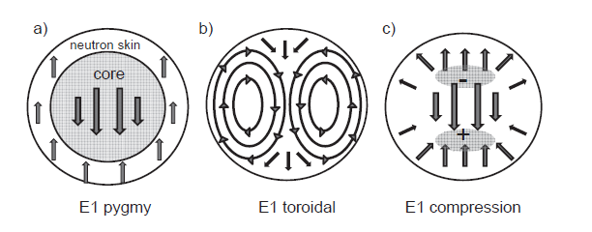
In addition to GDR, there are
exotic dipole resonances
R. Mohan et al (1971),
V.M. Dubovik (1975)
S.F. Semenko (1981)
M.N. Harakeh (1977)
S. Stringari (1982)
Alternative source
of information on
nuclear
incompressibility
Dominate in E1(T=0) excitation channel
(due to suppression of dominant E1(T=1) motion)
irrotational
vortical
irrotational
Reviews:
N. Paar et al, Rep. Prog. Phys. 70 691 (2007);
D. Savran et al, Prog. Part. Nucl. Phys. 70, 210 (2013)
V.O. Nesterenko, Phys. Atom. Nucl. 79, 842 (2016).
Different kinds of dipole oscillations with
fixed c.m.
TR: elastic, at fixed boundaries
TR: the only known electric vortical mode

Slide 37
Pygmy E1 resonance

Slide 38
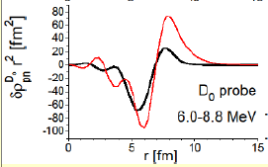
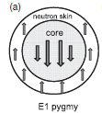
Skyrme QRPA (SLy6) calculations
A. Repko, P.G. Reinhard, VON, J. Kvasil,
PRC, 87, 024305 (2013)
Strength functions
Typical PDR transition density:
GDR
- n
- p
E [MeV]
PDR:
- is not formally GR since it carries a small
E1 strength
- however, is extremely important for
astrophysical applications since it lies near
particle thresholds and so its E1 strength
affects astrophysics-relevant nuclear reactions.
See for recent review:
A. Bracco, E.G. Lanza, A. Tamii,
Prog. Part. Nucl. Phys. 106, 360 (2019)

Slide 39
Toroidal E1 resonance
as a Hill’s vortex ring

Slide 40
Nuclear toroidal flow as a vortical ring (VR)
Toroidal dipole resonance (TDR) in nuclei:
- confined vortical flow
- spinning-like oscillations on
the torus surface
- vortex ring at each oscillation step
- unique example of intrinsic E1
vortical excitation
S.F. Semenko, Sov.J. Nucl. Phys. 34 356 (1981)
………..
VON, J. Kvasil, A. Repko,W. Kleinig, and P.-G. Reinhard, Phys. Atom. Nucl. 79, 842 (2016).
Central heavy ion collisions:
- collision energies 4-30 GeV
- two vortex rings
- spinning of nucleons
Yu.B. Ivanov, V.D. Toneev and A.A. Soldatov,
Phys. At. Nucl. 83, 179 (2020)
Both vortical flows are Hill’s vortex rings

Slide 41

Hill’s vortex ring (HIR)
was suggested by Hill in 1894 as one of the exact solutions of Euler equations
is one of the most simple cases of a vortical flow caused by nuclear turbulence
this is a vortex ring
very stable, may not consume the external energy
is very common in liquids and gases but rarely noticed unless the motion of the fluid is revealed by suspended particles (smoke rings)
colored by tobacco particles
and so are visible
Each listener of my talk permanently produces (invisible) Hill’s vortex rings in the surrounding air when breathing out!

Slide 42
Hill’s vortex is very general phenomenon. It must exist in nuclei as TDR but still was not safely observed. TDR is a general phenomenon in atomic nuclei, independently on nuclear size, Z/A ratio and nuclear shape.
Unlike a conventional hydrodynamics, nuclear TDR is caused not by turbulence but by mean-field vortical flow of nucleons.
Being vortical, TDR does not contribute to the continuity equation (CE)
So TDR is a remarkable example of nuclear dynamics beyond CE.
This is still a challenge to observe vortical excitations in general and TDR in particular in nuclei So the experimental search of TDR is a useful first step in solution of this general experimental problem.
TDR should exist in PDR energy region near nuclear thresholds. It can affect E1 strength in this energy range. So it can be important for nucleosynthesis and astrophysical problems.
Interesting crossover with other areas of physics (neutron stars, heavy-ion collisions, metamaterials, …).
Individual toroidal states can affect manifestations of clustering in light nuclei.

Slide 43
Toroidal vortical mode appears in:
nuclear current density
Following theorems of Helmholtz and Chandrasekhar/Moffat,
the current distribution can be decomposed as
V.M. Dubovik and A.A. Cheshkov,
Sov. J. Part. Nucl. v.5, 318 (1975).
electric
moments
magnetic
moments
electric toroidal
moments
E1 GDR, compression
transversal
Multipole electric operator (probe external field) :
So, the toroidal operator is the
second order term in long-wave
expansion of the electric operator
standard electric operator
In long wave approximation

Slide 44
J. Kvasil, VON, W. Kleinig, P.-G. Reinhard,
P. Vesely, PRC, 84, 034303 (2011)
Toroidal E1 operator:
mainly vortical flow
Compression E1 operator:
cmc
irrotational flow
Toroidal and compression operators are coupled:

Slide 45
A. Repko, VON, J. Kvasil and P.-G. Reinhard,
EPJA, 55, 242 (2019)
Origin of E1 vortial toroidal strength
.
E1 toroidal strength must exist in all nuclei at the energy ~ E( ).
E1 strength
1ph E1 strength from
dipole transitions
Strength is mainly irrotational
Vortical fraction is small
~ 7 MeV
E1 strength
IV residual interaction upshifts
the irrotational E1 strength
to form GDR but leaves at 7 MeV
the vortical (toroidal) strength.
remaining
vortical strength
IV-GDR
~ 7 MeV
~ 14 MeV
So TDR is indeed a general feature of atomic nuclei

Slide 46
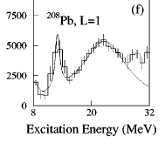
TDR and CDR constitute low- and high-energy ISGDR branches (?)
Familiar treatment
LE
HE
Experiment:
(toroidal)
(compression)
D.Y. Youngblood et al, 1977
H.P. Morsch et al, 1980
G.S. Adams et al, 1986
B.A. Devis et al, 1997
H.L. Clark et al, 2001
D.Y. Youngblood et al, 2004
M.Uchida et al, PRC 69, 051301(R) (2004)
There are also exp ISGDR data in
Theory:
TDR
CDR
G. Colo et al, PLB 485, 362 (2000)
D. Vretenar et al, PRC, 65, 021301(R) (2002)
N. Paar et al, Rep. Prog. Phys. 70 691 (2007);
A.Repko, P.-G. Reinhard, V.O.N. and J. Kvasil,
PRC 87, 024305 (2013).
Perhaps Uchida observed at 10-17 MeV not TDR but CDR fraction coupled to TDR. Main TDR peak should lie lower at ~ 7-9 MeV.
The direct observation of TDR in can be disputed in general since is mainly determined by transition density while toroid mainly depends on the vortical transition current.
NEED IN NEW EXPERIMENTS!

Slide 47
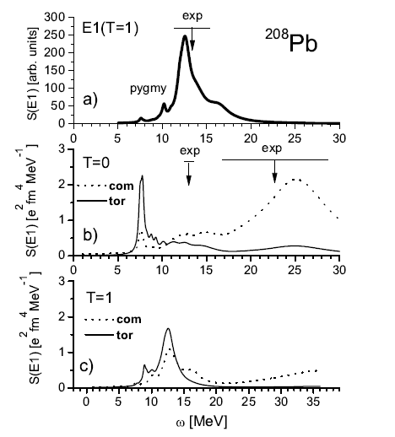
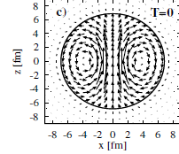
Skyrme QRPA calculations
A. Repko, P.G. Reinhard, VON, J. Kvasil,
PRC, 87, 024305 (2013)
Strength functions
SLy6
PDR region hosts TDR and CR!
GDR
Typical PDR transition density:
- n
- p
Nucleon current in the PDR
region is mainly toroidal!

Slide 48
Toroidal flow in PDR energy region is obtained in various nuclei and within different models
Skyrme RPA: 208Pb
Repko, P.-G. Reinhard, VON, J. Kvasil,
PRC, 87, 024305 (2013).
QPM: 208Pb
N.Ryezayeva et al,
PRL 89, 272502 (2002).
Relativistic RPA: 116Sn
D. Vretenar et al,
PRC 65, 021301R (2002).
P. Papakonstantinou et al,
EPJA 47, 14 (2011).
Similar results in Ca, Ni,
Zr, Sn, Sm, Yb, U, ..
Nuclear vorticity was also earlier discussed in:
F.E. Serr, T.S. Dumitrescu, T. Suzuki, C.H. Dasso, NPA 404, 359 (1983),
D.G. Raventhall and J. Wambach, NPA 475, 468 (1987).

Slide 49
120Sn
SLy6
A. Repko, VON, J. Kvasil and P.-G. Reinhard,
EPJA, 55, 242 (2019)
Strengths: TDR shares the same energy region with PDR and 2qp dipole strength
RPA transition densities: typical for PDR
RPA currents: clear IS toroidal flow with dominant neutron contribution
Is there one-to-one correspondence between transition densities and currents?
This can be checked through the continuity equation (CE):
Only irrotational part of the current with non-zero divergence contributes to CE.
15

Slide 50
A. Repko, VON, J. Kvasil and P.-G. Reinhard,
EPJA, 55, 242 (2019)
40Ca, SLy6
- no PDR but clear TDR
- residual interaction
enforces toroidal flow
- protons and neutrons
equally contribute
- squeezed toroidal flow
48Ca, SLy6
Basically the same results
as for 120Sn, SLy6.
Toroidal mode persists
In nuclei independently
on the neutron excess
16

Slide 51
A. Repko, VON, J. Kvasil and P.-G. Reinhard,
EPJA, 55, 242 (2019)
58Ni, SLy6
- small neutron excess,
almost no PDR
but strong TDR
72Ni, SLy6
- large neutron excess
- dominant neutron,
contribution to toroidal
current,
- RPA enforces the flow
- basically the same results
as for 120Sn, SLy6.
17

Slide 52
A. Repko, VON, J. Kvasil and P.-G. Reinhard,
EPJA, 55, 242 (2019)
90Zr, SLy6
100Zr, SLy6
Basically the same results
as for 120Sn, SLy6.
18

Slide 53
Altogether,
- TDR as a Hill’s vortex is a general feature of atomic nuclei
- PDR scheme is a rough oversimplification of the actual toroidal nuclear flow. Consequences for astrophysical applications?
- unlike GDR, TDR can be both IS and IV
- IS TDR is more suitable for the analysis
- one can look for not TDR but individual low-energy toroidal state
Modern experiment can discriminate irrotational E1 states (GDR, PDR,CDR).
However, we still do not know how to discriminate in experiment vortical E1 states.
This is a challenge for the modern theory and experiment.
The search of TDR can help in solution of the fundamental problem

Slide 54
Recent results: Toroidal E1 states in spherical 58Ni
(e,e’) experiments: W. Mettner, A. Richter et al, Nucl. Phys. A473, 160 (1987), Reitz
P. von Neumann Cosel (TU, Darmstadt) :
- large transversal form factors for some low-energy E1 states.
- exp. data from (g,g’), (p,p’),
- to check if these states are toroidal?
exp
exp
exp
exp
large E1 toroidal strength
typical toroidal proton and neutron currents
25

Slide 55
Mettner
Reitz
The calculations well describe Mettner’s
and Reitz’s (e,e’) data
Just toroidal states (not GDR or compression)
describe the slope in Mettner’s data
This is the first (e,e’)-based indication of E1 toroidal states in nuclei.
Combined (e,e’), (p,p’), (γ,γ’) analysis: P. von Neumann-Cosel, V.O. Nesterenko, I. Brandherm,
P.I. Vishnevskiy, P.-G. Reinhard, J. Kvasil, H. Matsubara, A. Repko, A. Richter, M. Scheck and A. Tamii, submitted to Nature Communications.
26

Slide 56
M1 giant resonances
- M1 orbital scissors (exists only in deformed nuclei)
- M1 spin-flip (exists only in both spherical and
deformed nuclei)
Operator of M1 transition has two terms:
- orbital with gyromagnetic factors
- spin with gyromagnetic factors

Slide 57
Ножничный резонанс
общее свойство деформированных двух-компонентных ферми-и бозе-систем
- уже обнаружен (предсказан) в различных системах
низкая энергия и сильные M1( ΔK=1) - переходы
на основное состояние
существует только в
деформированных системах
a
b
Атомные ядра
N. Lo Iudice and F. Palumbo, PRL, 41, 1532 (1978)
E. Lipparini and S. Stringari, PL, 130B, 139 (1983)
Атомные кластеры
E. Lipparini and S. Stringari, PRL, 63, 570 (1989)
V.O. Nesterenko, W. Kleinig, F.F. de Souza Cruz and N. Lo Iudice, PRL, 83, 57 (1999)
Конденсат Бозе-Эйнштейна
D. Gueri and S. Stringari, PRL, 83, 4452 (1999)
один из индикаторов КБЭ !
Квантовые точки
Ll. Serra, A. Puente, and E. Lipparini, PRB, 20, R13966 (1999)

Slide 58
Origin of orbital (scissors) and spin-flip excitations
VON, P.I. Vishnevskiy, P.G. Reinhard,
A. Repko, J. Kvasil,PRC, 103, 064313 (2021)
Both M1 modes are valuable tests for:
- orbital magnetism in nuclei,
- spin-dependent channel in Skyrme functional
- impact of tensor non-central nuclear forces

Slide 59
Production of Spin-Flip Giant Resonance (SFGR)
**In medium/heavy nuclei, N>Z and so we should have two well separated
peaks (proton and neutron) arising from spin-orbit splitting
**The proton peak should lie at a lower energy than neutron one
**However, the strong residual interaction can mix these
two peak and thus provide one-hump SFGR structure.
**Different Skyrme parameterizations have different relations
and so provide a different gross-structure of SFGR
The final SFGR gross-structure is
determined by competition between
spin-orbit splitting and value of
residual interaction
So SFGR is the robust test
ror spin-isospin channel in
DFT Skyrme functional
P. Vesely et al, PRC, 80, 031302(R) (2009)

Slide 60
Particular example why we should know SFGR
NRF experiment: M. Tamkas et al, Nucl. Phys.A 987, 79 (2019)
Calculations: VO. Nesterenko, P.I. Vishnevskiy, A. Repko, P.-G. Reinhard and J. Kvasil, EPJA 60, 28 (2024)
(p,p’)
NRF
New NRF data for 2-6 MeV energy range in 156Gd do not give any M1 strength at 4-6 MeV despite this range must host the proton branch of SFGR !!??
Questionable experimental result ….

Slide 61
There are still absent universal Skyrme parametrizations
suitable for description of all GR in all finite nuclei
IV-GDR prefers Skyrme forces (SLy4, …) with a low IS effective mass
m*/m=0.7-0.9
IS-GQR prefers Skyrme forces (SkT6, …) with a high IS effective mass
m*/m=0.9-1.0
Nuclear masses and low-energy states are well described with m*/m=1
IS-GMR gives different values of nuclear incompressibility in doubly
magic and open-shell nuclei: Pb-Sn problem, Mo isotopes
Depending on the Skyrme force, we get one- or two-hump structure of
spin-flip M1 GR.
So, for the quantitative description of the particular GR, we should chose the proper Skyrme parametrization.
Unfortunately, this is still a common practice.

Slide 62
Conclusions
Features of different GR have been studied for many years
and now, as a rule, are basically known.
However investigation of GR remains to be very important because:
- GR are used for fitting modern self-consistent models to nuclear dynamics
- provide valuable information on nuclear matter characteristics
- have many open problems
- fine structure of GDR and GQR, wavelet analysis,
- double hump structure of GMR in deformed nuclei, different
- toroidal E1(T=0): still should be found experimentally
- impact of tensor forces
- …….
Still very hot topic!

Slide 63
Thank you for your attention!

Slide 65
Besides GR provide a useful information on particular features
of finite nuclei and nuclear matter
p
n
p
n
E0(T=0,1)
GMR
E1(T=1)
GDR
E2(T=0,1)
GQR
M1(T=1)
scissors
M2(T=0,1)
twist
E1(T=0,1)
toroidal
E1(T=0,1)
compression
nuclear
incomp.
orbital
magnetism
orbital
magnetism
electric
vortical
motion
nuclear
incomp.
GR still have many open problems themselves:
- troubles to describe simultaneously:
- GDR(T=1) and GQR(T=0),
- one-hump and two-hump structures in spin-flip M1 GR
- different from ISGMR in Pb and Sn isotopes
- exotic vortical GR (toroidal) : how to measure and identify vortical states?
GR are still very hot topic!

Slide 66
GR are the robust test for modern self-consistent mean field approaches
(Skyrme, Gogni, relativistic, …) based on
density functional theory (DFT)
These approaches:
- are main theoretical tools (work horses) to describe GR
and other nuclear excitations
- are self-consistent: both mean field and residual interaction are obtained
from the same initial functional (no additional free parameters), high predictive
power.
pretend to be universal: description of astrophysical problems,
nuclear matter (symmetric, neutron), and finite nuclei of a different shape
(spherical, deformed) through the full periodic table,
pretend to describe both static nuclear properties and nuclear dynamics
- parameters of the initial functional are fitted to describe both finite nuclei
(statics, dynamics) and nuclear matter
GR provide the robust check of the accuracy of the self-consistent models.

Slide 67
Силы Скирма в ядерной физике
- центральный член
- нелокальный член
- член, зависящий от плотности
- спин-орбитальный член

Slide 68
Функционал Скирма для атомных ядер
Y.M. Engel et al, NPA 249, 215 (1975).
J. Dobaczewski and J. Dudek,
PRC, 52 1827 (1995).
q=p,n
(+) плотность нуклонов.
(+) плот. кин. энергии
(+) спин-орбит. плот.
Т-четные:
Contribute both to the ground state and excitations.
(-) плот. тока
Time-odd:
(-) спиновая плот.
Contribute only to
excitations.
(-) плот. спин. кинет. энергии

Slide 69
Sum rules:
If V and F depend only on coordinates, then
[ F,H ] = [ F,T ] + [ F,V ] = [ F,T ]
model independent !
= 1 для l =1

Slide 70
Which densities do we need?
Formal arguments:
Single-particle density matrix:
Other densities are first and second derivatives of basic densities :
basic densities
their momenta
(first derivatives)
their kin. energies
(second derivatives)
Functional involves all possible bilinear combinations of the basic
densities and their first and second derivatives.
Some kind of gradient expansion (important for non-uniform systems)
- Combinations of densities in the functional must:
a) be time-even,
b) fulfill local gauge (Galilean) invariance

Slide 71
Сравнение ядерного (Скирм) и электронного (Кон-Шам) функционалов
Можно ли доказать теорему ХК и получить аналог УКШ для ядер?
Да, но надо решить проблему выделения движения центра масс.
Функционал Скирма строился следуя логике Кш.
Почему тогда он так сильно внешне отличается от КШ?
Skyrme functional:
- система ц.м.
- нет xc-члена,
- точная форма основного
взаимодействия неизвестна
Kohn-Sham functional:
- лабор. система координат
- имеется xc-член,
Основное взаимодействие
(кулоновское) известно

Slide 72
Правила отбора для электромагнитных переходов в сферических атомных ядрах и наносистемах
Волновая функция одночастичного состояния
в сферически симметричном потенциале среднего поля
Пространственная четность:
Правила отбора для мультипольных электрических
(нормальной четности)
и магнитных
(аномальной четности)
переходов между одночастичными состояниями:
n – число узлов
l - орбит. момент
- полный спин
Правила отбора позволяют определить, какие матричные
элементы перехода отличны от нуля.

Slide 73
Правила отбора для электромагнитных переходов в атомном ядре и наносистемах
Волновая функция одночастичного состояния
в сферически симметричном потенциале среднего поля
Пространственная четность:
Правила отбора для мультипольных электрических
(нормальной четности)
и магнитных
(аномальной четности)
переходов между одночастичными состояниями:
n – число узлов
l - орбит. момент
- полный спин
E2,M1
E1,E2,M1
E1,E3

Slide 74
Very recent example of the wavelet analysis

Slide 75
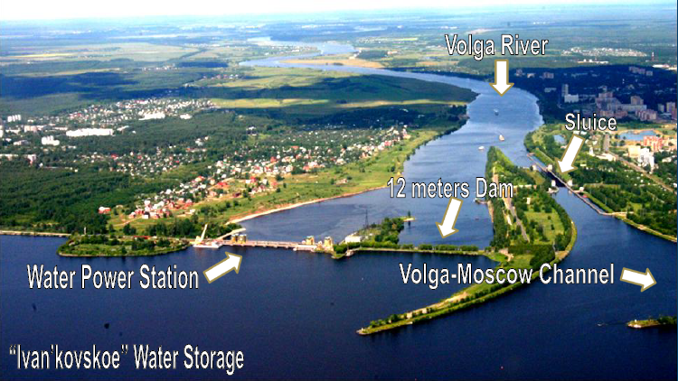
JINR is located at Dubna city 120 km north from Moscow
Dubna :
- scientific/education/innovation town, population: ~75 000
- JINR, Dubna university, special innovation economic zone

Slide 76

At present JINR has 18 members:
- Egypt, Germany, Italy, Hungary, Serbia, South Africa
– associated members
International (not Russian) organization supported by JINR members
- Budget ~ 200 M $ (2021), ~ 4500 staff members, ~ 1500 publ /year

Slide 77
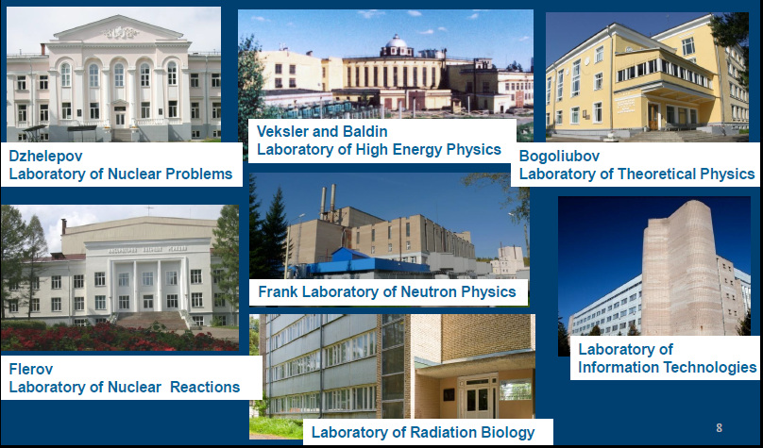
7 JINR laboratories:
Perhaps largest in the world
theoretical lab ~ 250 stuff
members
Collaboration with CERN
NICA facility
Discovery of superheavy
elements!
The most new lab
Various neutron physics,
unique pulse reactor
Network,
computing

Slide 78
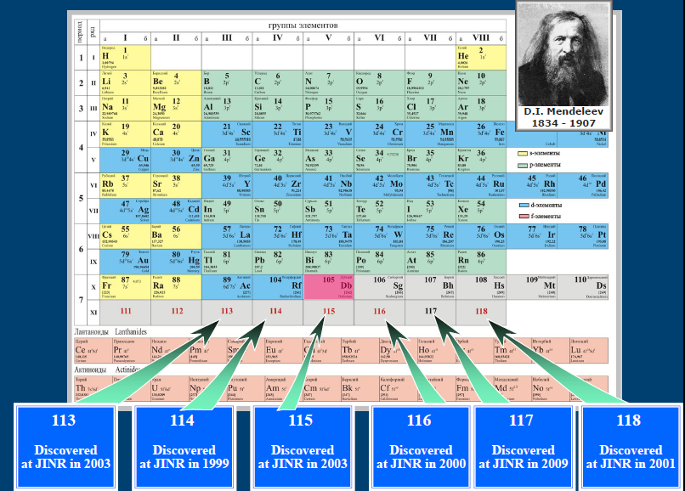
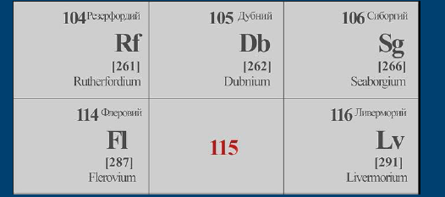
!
Several chemical elements have titles related to Dubna: Db, Fl,
Og (Z=118)

Slide 79
Long-time collaboration between iThemba/Wits Univ.
I. Usman, J. Carter, L.M. Donaldson, P. Adsley, A. Bahini, R. Neveling, …
and our group
Dubna- Darmstadt –Erlangen-Prague –Bratislava
- V.O. Nesterenko - JINR, Dubna, Moscow Region, Russia
- P. von Neuman Cosel – TU Darmstadt, Germany
- P.-G. Reinhard – Erlangen University, Germany
- J. Kvasil – Charles University, Prague, Czech Republic
- A. Repko - Institute of Physics, Bratislava, Slovakia

Slide 80
Phys. Lett. B 776, 133 (2018)
Phys. Lett. B 779, 269 (2018)
Phys. Rev. C102, 064327 (2020)

Slide 81
Phys. Rev. C, 103, 044315 (2021)
Phys. Rev. C105, 024311 (2022)
- iThembda: (p,p’) and ( a,a’) data for IV-E1, IS-E2, IS-E0 giant resonances
- Dubna: theoretical analysis within fully self-consistent Skyrme QRPA for
spherical and deformed nuclei
BLTP/JINR – SA grant, mutual research visits,
visit of A. Bahini to Dubna in October 2022.

Slide 82
Modern self-consistent mean field methods:
- relativistic
- Skyrme contact interaction
- Gogny finite-range forces
These approaches
- are main theoretical tools to describe GR and other excitations,
- are self-consistent: both mean field and residual interaction are obtained
from the same energy functional (no additional free parameters)
- parameters of the initial functional are fitted to describe both finite
nuclei (almost all the periodic table), nuclear matter (symmetric, neutron, …)
and astrophysical constraints
- many various parameterizations, a universal parameterization is absent
mean field
residual interaction
See e.g. reviews:
M. Bender, P.-H. Heenen, and P.-G. Reinhard, Rev. Mod. Phys. 75, 121 (2003)
D. Vretenar, A. V. Afanasjev, G. A. Lalazissis, and P. Ring, Phys. Rep. 409, 101 (2005).
J. R. Stone and P.-G. Reinhard, Prog. Part. Nucl. Phys. 58, 587 (2007)..

Slide 83
Modern studies of GDR:
wavelet analysis of GDR fine structure
L.M. Donaldson, et al, PRC 102, 064327 (2020)
spectrum
mother function
The method may be viewed as
a local (by excitation energy)
Fourier analysis.
The main aim is to determine the
contribution (local or integral)
of various spectral widths.
As a rule, both experimental and
theoretical wavelet results are
compared.
-wavelet
transform
Morlet mother func.
(with Gaussian)
in nuclear physics
power (integral
contribution
of the width )
power

Slide 84
The model:
fully self-consistent Skyrme QRPA
A. Repko, J. Kvasil, VON., and P.-G. Reinhard,
arXiv:1510.01248[nucl-th]
A. Repko , J. Kvasil, VON, W. Kleinig, P.-G. Reinhard EPJA, 53, 221 (2017)
1d, 2d QRPA (codes of A. Repko):
- fully self-consistent matrix RPA,
- ph- and pp-channels,
- cmc
A. Repko, J. Kvasil, VON, PRC, 99, 044307 (2019)
J. Kvasil, A. Repko, VON, EPJA, 55, 213 (2019)
Mean field (SKYAX)
- 2D mesh in cylindrical coordinates
- calculation box: 3R, mesh step 0.4 fm
- sp levels up to +55 MeV
Matrix and separable QRPA:
Numerous calculations for:
GDR, PDR, GQR, GMR,
orbital and spin-flip M1,
low-energy states( , …)
Nuclei:
spherical and axial deformed,
from light to superheavy.
2qp basis (SLy6):
- 2qp states until ~ 100 MeV
- EWSR(E1,T=1), EWSR(E1,T=0): 97-100%
Pairing:
- volume monopole pairing
- BCS

Slide 85
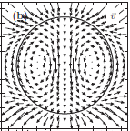
Three conceptions of nuclear vorticity: HD, RW, torooidal
1. Hydrodynamical vorticity:
2. RW vorticity
D.G.Raventhall, J.Wambach,
NPA 475, 468 (1987).
continuity equation
current transition
density
independent part of charge-current distribution,
decoupled from CE in the integral sense
- may be a measure of vorticity
However sometimes
3. Toroidal strength as a measure of vorticity
P.-G. Reinhard et al, PRC 89, 024321 (2014)

Slide 86
Toroidal vortical mode appears in:
nuclear current density
Following theorems of Helmholtz and Chandrasekhar/Moffat,
the current distribution can be decomposed as
V.M. Dubovik and A.A. Cheshkov,
Sov. J. Part. Nucl. v.5, 318 (1975).
electric
moments
magnetic
moments
electric toroidal
moments
transversal
Multipole electric operator (external field) :
So, the toroidal operator is the
second order term in long-wave
expansion of the electric operator
standard electric operator
In long wave approximation

Slide 87
J. Kvasil, VON, W. Kleinig, P.-G. Reinhard,
P. Vesely, PRC, 84, 034303 (2011)
Toroidal E1 operator:
mainly vortical flow
Compression E1 operator:
irrotational flow
Toroidal and compression operators are coupled:

Slide 88
A. Repko, VON, J. Kvasil and P.-G. Reinhard,
arXiv:1903.013482 [nucl-th], subm. to EPJA
120Sn, SVbas
- no first hump
- squeezed toroidal flow
120Sn, SkM*
Basically the same results
as for 120Sn, SLy6.
Stability of the conclusions
for different Skyrme forces.

Slide 89
A. Repko, VON, J. Kvasil and P.-G. Reinhard,
arXiv:1903.013482 [nucl-th], subm. to EPJA
40Ca, SLy6
- no PDR but clear TDR
- residual interaction
enforces toroidal flow
- protons and neutrons
equally contribute
- squeezed toroidal flow
48Ca, SLy6
Basically the same results
as for 120Sn, SLy6.
Toroidal mode persists
In nuclei independently
on the neutron excess

Slide 90
A. Repko, VON, J. Kvasil and P.-G. Reinhard,
arXiv:1903.013482 [nucl-th], subm. to EPJA
58Ni, SLy6
- small neutron excess,
almost no PDR
but strong TDR
72Ni, SLy6
- large neutron excess
- dominant neutron,
contribution to toroidal
current,
- RPA enforces the flow
- basically the same results
as for 120Sn, SLy6.

Slide 91
A. Repko, VON, J. Kvasil and P.-G. Reinhard,
arXiv:1903.013482 [nucl-th], subm. to EPJA
90Zr, SLy6
100Zr, SLy6
Basically the same results
as for 120Sn, SLy6.

Slide 92
A. Repko, VON, J. Kvasil and P.-G. Reinhard,
arXiv:1903.013482 [nucl-th], subm. to EPJA
100Sn, SLy6
132Sn, SLy6
Basically the same results
as for 120Sn, SLy6.

Slide 93
Wavelet analysis
L.M. Donaldson, et al,
"Fine Structure of the Isovector Giant Dipole Resonance in 14-150Nd and 152Sm",
arXiv:2010.01210 [nucl-ex], to be published in Phys. Rev. C.
spectrum
mother function
The method may be viewed as
a local (by excitation energy)
Fourier analysis.
The main aim is to determine the
contribution (local or integral)
of various spectral widths.
As a rule, both experimental and
theoretical wavelet results are
compared.
-wavelet
transform
Morlet mother func.
(with Gaussian)
in nuclear physics
power (integral
contribution
of the width )
power

Slide 94
Skyrme interaction: the simplest contact interaction
- central term
- non-local term
- density-dependent term
- spin-orbit term

Slide 95
Skyrme energy density:
V.O.Nesterenko, et al, PRC 66, 044307 (2002)
P. Vesely et al, PRC, 80, 031302(R) (2009).
conventional terms
for electric modes
spin-isospin terms
(+) nucleon
(+) kin. en.
(+) spin-orb.
(-) current
(-) spin
(-) spin-kin. en.

Slide 96
Justification of Skyrme densities
Formal arguments:
Single-particle density matrix:
Other densities are first and second derivatives of basic densities :
basic densities
their momenta
(first derivatives)
their kin. energies
(second derivatives)
Functional involves all possible bilinear combinations of the basic
densities and their first and second derivatives.
Some kind of gradient expansion (important for non-uniform systems)
- Combinations of densities in the functional must:
a) be time-even,
b) fulfill local gauge (Galilean) invariance

Slide 97
E. Lipparini and S. Stringari,
NPA, 371, 430 (1981).
TD-DFT
Time-dependent formulation:
T-even and T-odd
densities
Linear regime: small time-dependent
perturbation
Mean field hamiltonian:
static g.s. + time-dependent response
The only unknowns
Now we have to specify the perturbed many-body wave function

Slide 98
Sum rules

Slide 99
Sum rules (1):
If V and F depend only on coordinates, then
[ F,H ] = [ F,T ] + [ F,V ] = [ F,T ]
model independent !
= 1 для l =1

Slide 100
Sum rules (2):
Sum rules are related to basic quantum chacteristics:
Sum rules are moments
p = … -1, 0,1, 2, 3,…
of the strength function
Sum rule determine limits of the polarizability:

Slide 101
Sum rules (3):
SR allow to estimate the GR energy and width
SR with p=1 and 3 are most used
They appear in oscillator Hamiltonian
as
- spring parameter (restoring force)
- inertia or mass parameter

Slide 102
Sum rules (4):
SR are generally expressed through commutators and anticommutators:
only commutators
only commutators
SR with odd p=2n+1 expressed via commutators and most useful.
Thouless:
Insensitivity of commutators to g.s.
correlations !
The same for .
Can be used as a test for completeness of the
single-particle basis.

Slide 103
TM can be excited in various reactions through its irrotational fraction
as the doorway:
Isoscalar reactions , ,
2) (e,e’)
Most simple reaction to start
the theoretical analysis
3) Reactions of inelastic scattering with - decay
scattering angle of the photon can depend
on the nuclear flow.
In analogy with relativistic heavy ion collisions (HIC), a vortical flow
can lead to polarization of the outcoming .
General problem:
- modern theory and experiment are not yet able to propose ways for
identification of intrinsic vortical modes. This fundamental problem
is still unresolved
Reviews of experimental methods:
D. Savran, T. Aumann, and A. Zilges, Prog. Part. Nucl. Phys., 70, 210 (2013)
A. Bracco, E.G. Lanza, and A. Tamii, Prog. Part. Nucl. Phys., 106, 360 (2019)

Slide 104
(e,e’): PWBA cross section
H. Theissen, Springer Tacts in Mord. Phy., 65 , 1 (1972)
J. Heisenberg and H.P. Blok, Ann. Rev. Nucl. Part. Sci, 33, 569 (1983),
For states, but contributes to
A. Richter, NPA, 731, 59 (2004).
Toroidal mode contributes to E1 transversal form-factor and can in principle be discriminated in (e,e’) to back angles.

Slide 105
What about (e,e’)?
V.O. Nesterenko et al, PRC 100, 064302 (2019).
Here we meet the problem: impact of the magnetization current
Nuclear current
toroidal flow
PWBA for 24Mg
Impact of current is significant at
Makes toroidal effect unresolved?
It will be shown that can even
help in search of E1 TM!

Slide 106
QRPA: basic equations
- formulation
- formulation in terms of time-even coord. and time-odd momentum
QRPA holds the TI
condition at
QRPA has a principle ability
to separate spurious and
physical states.
However this ability is not
fully realized even in modern
self-consistent models!
spurious state
physical states
We still need the refinement of QRPA states!

Slide 107
A.Repko. J. Kvasil, V.O. Nesterenko, PRC 99, 044307 (2019)
Motivated by: G. Colo et al, PLB 485, 362 (2000), J. Li et al, PRC, 78, 064304 (2008).
SEARPA – Spuriosity Elimination After solution of RPA equations
almost pure spurious state
with tiny but positive
1)
- polluted physical states
The refined physical states are formed requiring their
orthogonality to the spurious state:
2)
We can also directly refined matrix elements:
- for time-even
- for time-odd

Slide 108
Further, one can directly refine the transition densities and currents:
3)
Finally, one may be even enough to do the refinement merely through
modification of the transition operators:
So SEARPA allows to do the refinement at different stages of calculations:
1) for QRPA states
2) directly for matrix elements and transition densities and currents
3) directly for transition operators (e.g. in calculation of responses)
A.Repko. J. Kvasil, V.O. Nesterenko, PRC 99, 044307 (2019)

Slide 109
Particular examples:
Translational invariance and E1 transitions
Spurious state is characterized by well known cm momentum and coordinate:
Simplest case of refinement of the transition operators:
So SEARPA reproduces the familiar:
effective charges in
CoM correction in T=0 compression operator
N.Van Giai and H. Sagawa,
NPA, 371, 1 (1981)
- deformation-induced correction
A.Repko. J. Kvasil, V.O. Nesterenko, PRC 99, 044307 (2019)

Slide 110
Restoration of translational invariance in toroidal E1 transitions
Initial transition toroidal E1 operator:
Refined transition toroidal E1 operator:
CoM corrections
J. Kvasil, VON, W. Kleinig, P.-G. Reinhard
and P. Vesely, PRC, 84, 034303 (2011).
So SEARPA reproduces all the CoM corrections obtained earlier
by different methods.
Now this is done on the same theoretical footing!
A.Repko. J. Kvasil, V.O. Nesterenko, PRC 99, 044307 (2019)

Slide 111
Introduction
Cross section for excitations of a given multipolarity
giant resonance (GR)
Low-energy
states
GR is an excitation of a given multipolarity with a significant (dominant)
contribution to the cross section of the relevant reaction.
GR:
- are explored already for 70
- now we know a variety of electric and magnetic GR and
understand well basic GR properties
M. N. Harakeh and A. van der Woude, “Giant Resonances”
(Clarendon Press, Oxford, 2001).

