Slide 1






Распределённая обработка и генерация данных экспериментов MPD и BM@N
Игорь Пелеванюк
Научный сотрудник
Рабочее совещание МИФИ-ОИЯИ Компьютинг для мегапроекта NICA

Slide 2
BM@N:
Konstantin Gertsenberger
MPD:
Victor Riabov, Arkadiy Taranenko
Andrey Moshkin, Oleg Rogachevskiy
DIRAC:
Igor Pelevanyk, Andrey Tsaregorodtzev
Responsibles for resources:
Tier-1,Tier-2, EOS: Valery Mitsyn
Govorun: Dmitry Podgainy
LHEP cluster: Ivan Slepov
List of participants

Slide 3




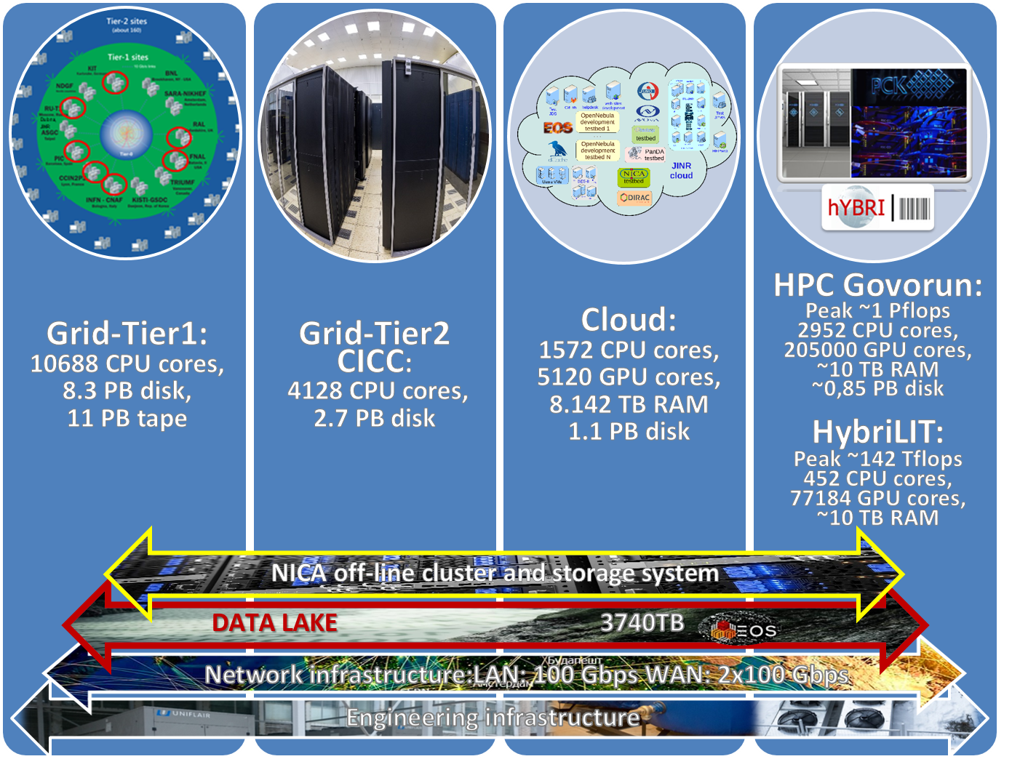
MICC Resources
EOS
dCache
Storage
Disk, Tape
Protocol
local, root
GridFTP, root
local
local
Auth Storage
Kerb. , x509
x509
ceph key
HybriLIT
Auth Jobs
x509
x509
SSO
HybriLIT
Job Submit.
Grid
Grid
OpenNebula
Slurm
Component
Tier-2/CICC
Tier-1
Cloud
Govorun/HybriLIT
* This is a simplified schema to demonstrate complexity and variability of protocols and accesses approaches

Slide 4







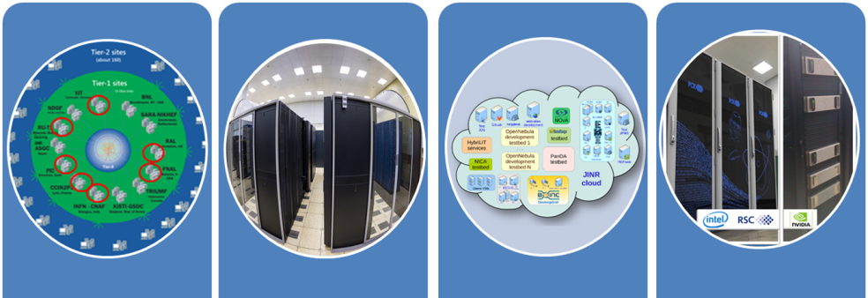

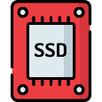


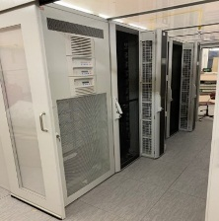

NICA DIRAC Infrastructure
MEPHI
MICC basic facility
UNAM
MLIT EOS
Clouds
Tier-1
Tier-2
Govorun
Lustre
Ultra-fast storage
MPD
Collaboration
Polytech
MSC
NICA cluster
Thanks to:
Artem Anikeev
Serge Smirnov
JINR
LHEP

Slide 5
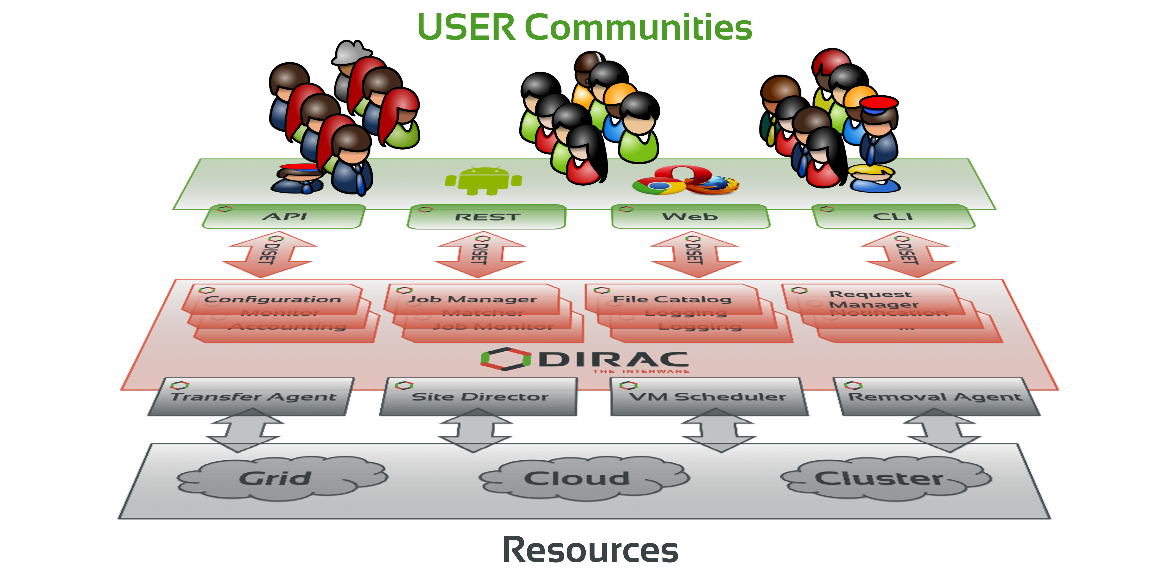
What is DIRAC?
DIRAC provides all the necessary components to build ad-hoc grid infrastructures interconnecting computing resources of different types, allowing interoperability and simplifying interfaces. This allows to speak about the DIRAC interware.
Web
CLI
API
REST

Slide 6
Ratio: between experiments

Slide 7
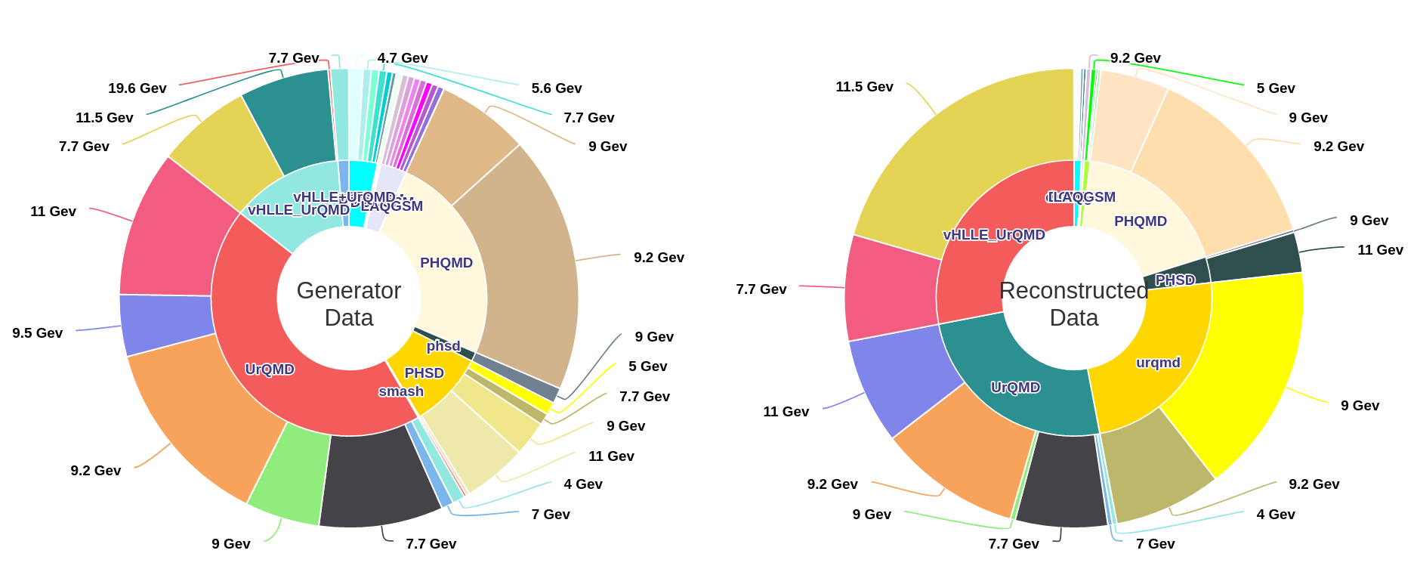
MPD MC generation
The MPD(Multi Purpose Detector) apparatus has been designed as a 4π spectrometer capable of detecting of charged hadrons, electrons and photons in heavy-ion collisions at high luminosity in the energy range of the NICA collider. To reach this goal, the detector will comprise a precise 3-D tracking system and a high-performance particle identification (PID) system based on the time-of-flight measurements and calorimetry.
http://db-nica.jinr.ru/mpdmc/stat.php

Slide 8
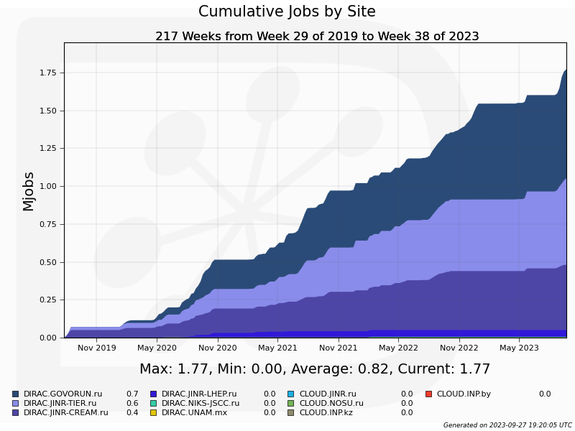
MPD Jobs Total
1,75 million jobs
Govorun
LHEP
Tier1
Tier2

Slide 9
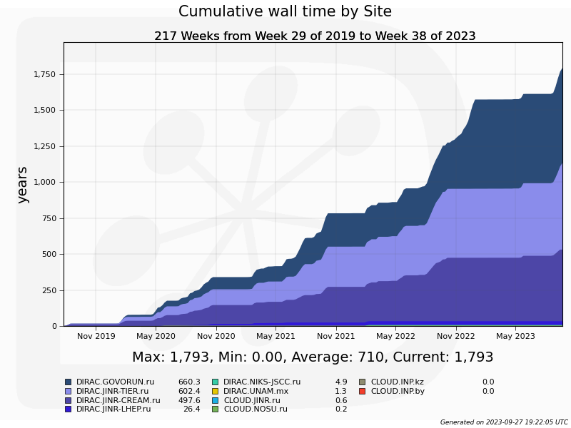
MPD Wall time
1.750 M jobs
Each lasts ~9 hours
Govorun
LHEP cluster
Tier1
Tier2

Slide 10
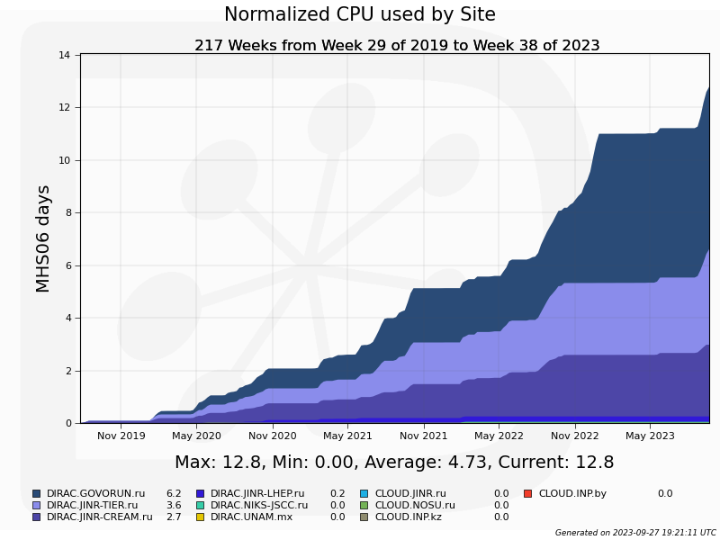
MPD Normalized time
Govorun
LHEP cluster
Tier1
Tier2

Slide 11
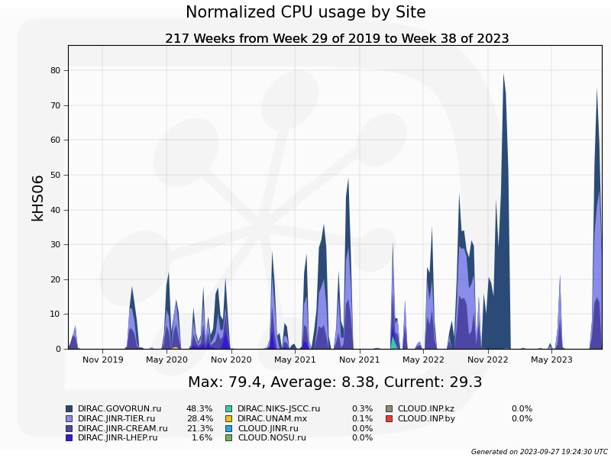
Computing power in DIRAC
Govorun may calculate jobs with extremely high RAM and disk space requirements.
At that time all jobs were “hard”.

Slide 12
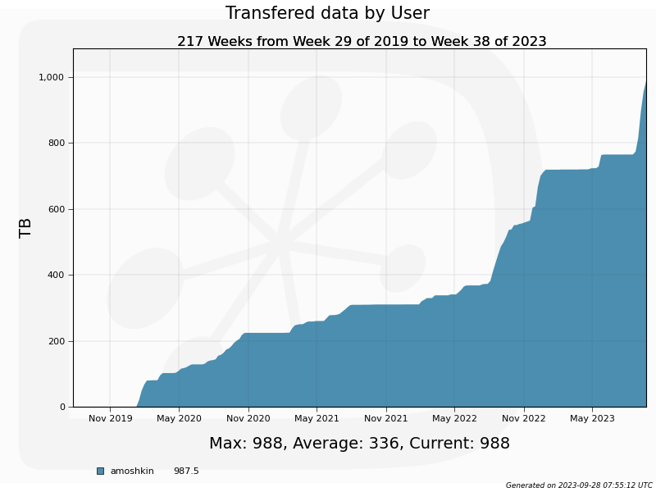
Computing power in DIRAC
Almost 1 PB of data successfully generated and stored for MPD

Slide 13
Automatization
and
Tools

Slide 14
Questions that we always ask
How 100k jobs executes on heterogeneous distributed computing infrastructure?
Are we efficient?
If not, is network is responsible for inefficiency?
If it is not the network, what is the profile of the user job?
Having the information about jobs’ profile, network throughput and characteristics of the resources, can we guess how the workload will be executed?

Slide 15
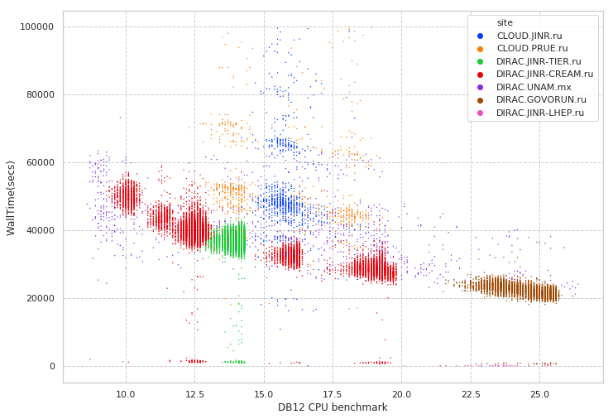
Performance evaluation in distributed infrastructures
Folding@Home
Job execution time
MPD MC
Errors during execution
Immediate errors or short jobs
DB12 Benchmark of a core on which jobs was executed

Slide 16
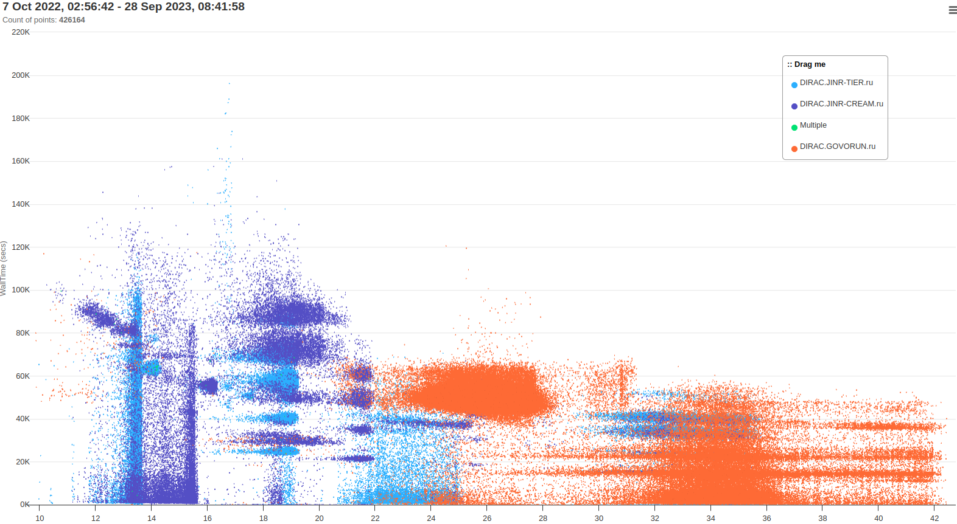
MPD real job distribution for last year

Slide 17


Workflow of BM@N production
Digitization step
Reconstruction step
RawToDigi
DigiToDst
DIGI
DST

Slide 18
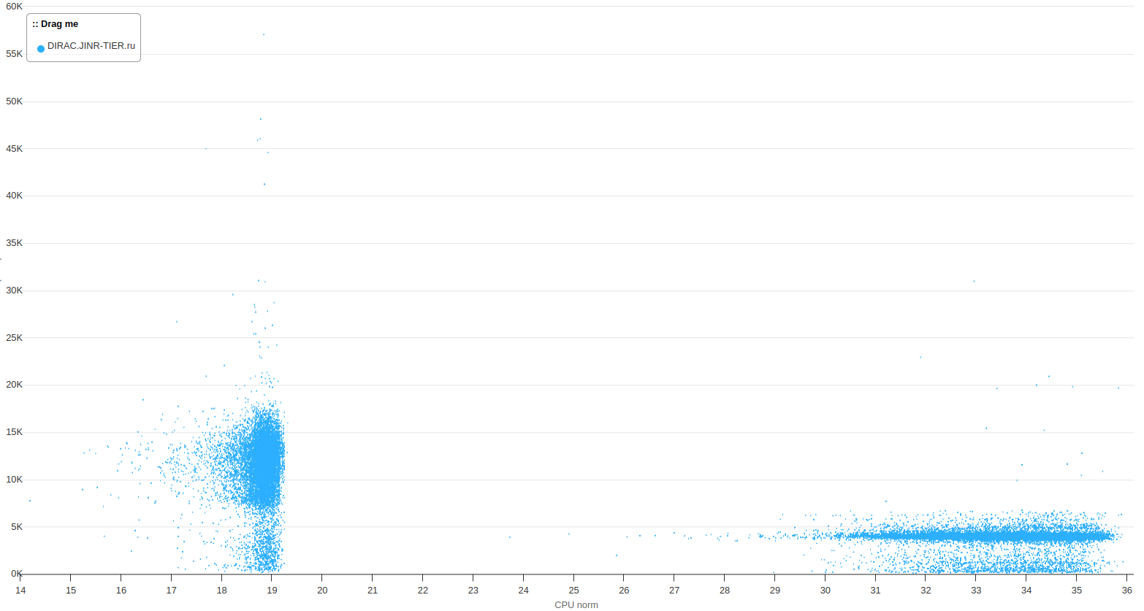
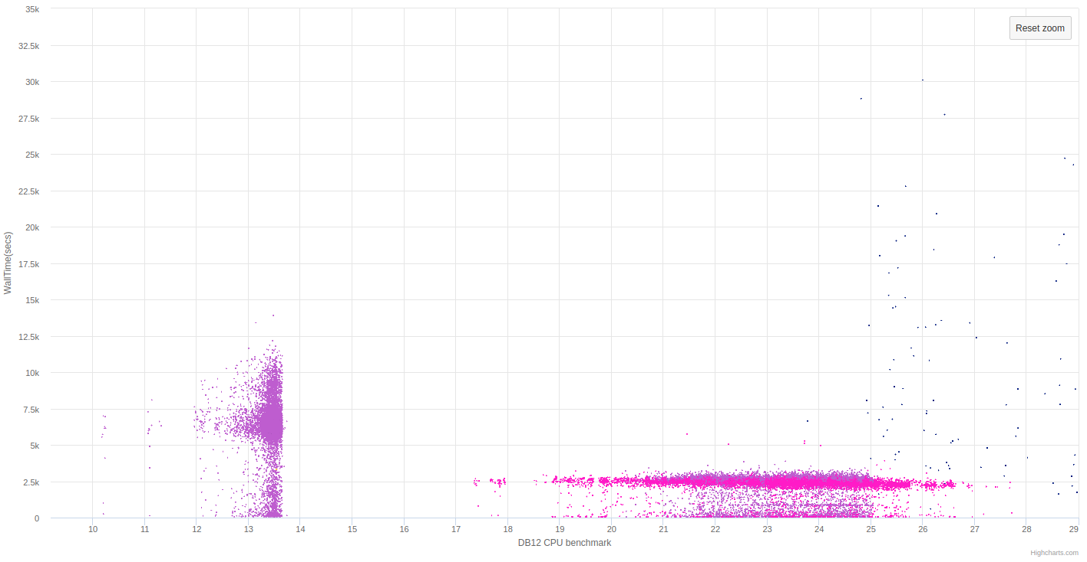
BM@N Raw to DIGI jobs
Average Raw2Digi calculation time increased by 60%
(2500 -> 4000 seconds)

Slide 19
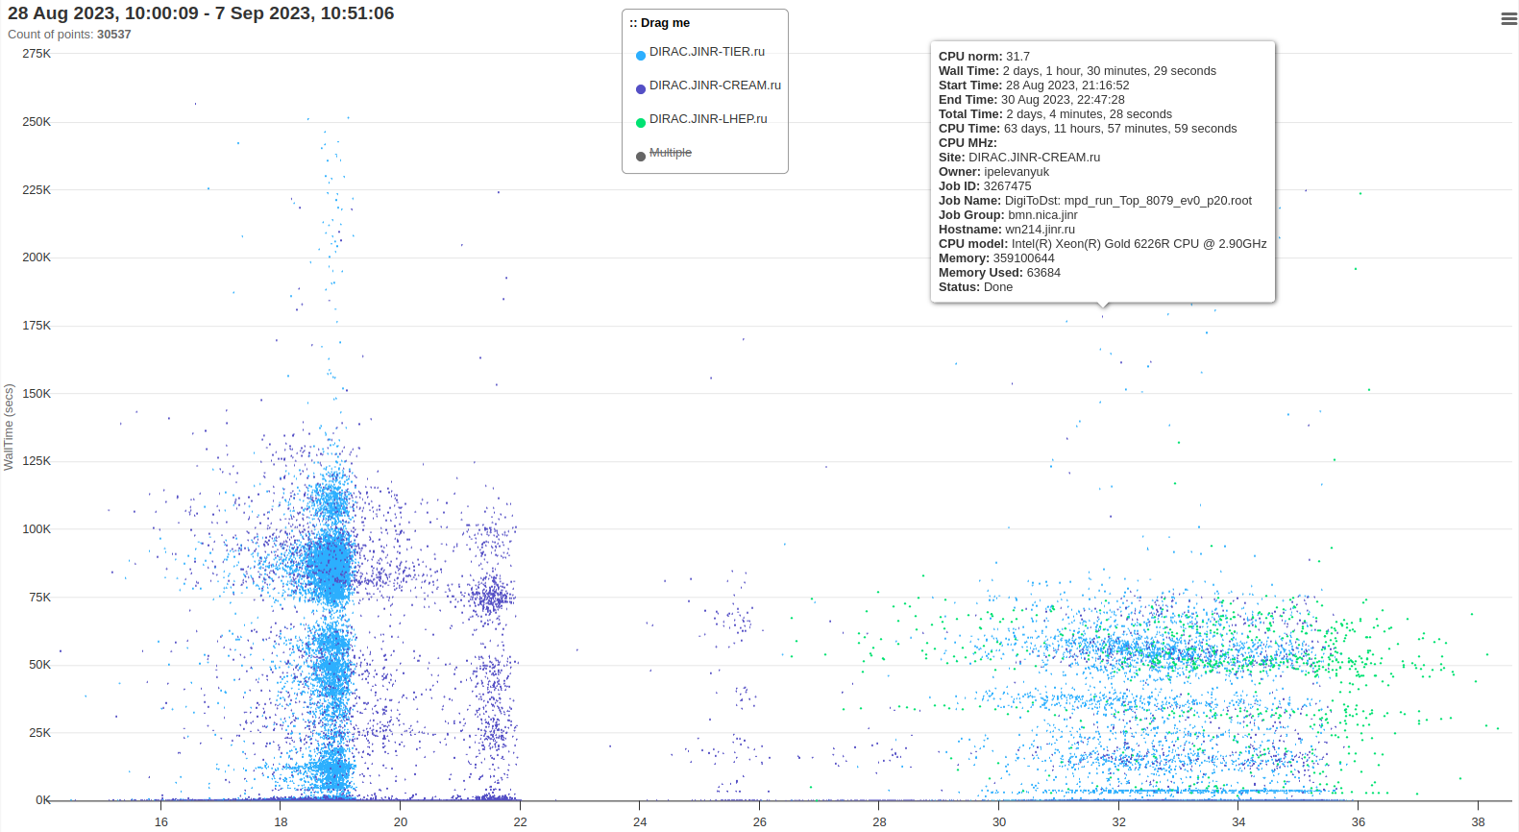
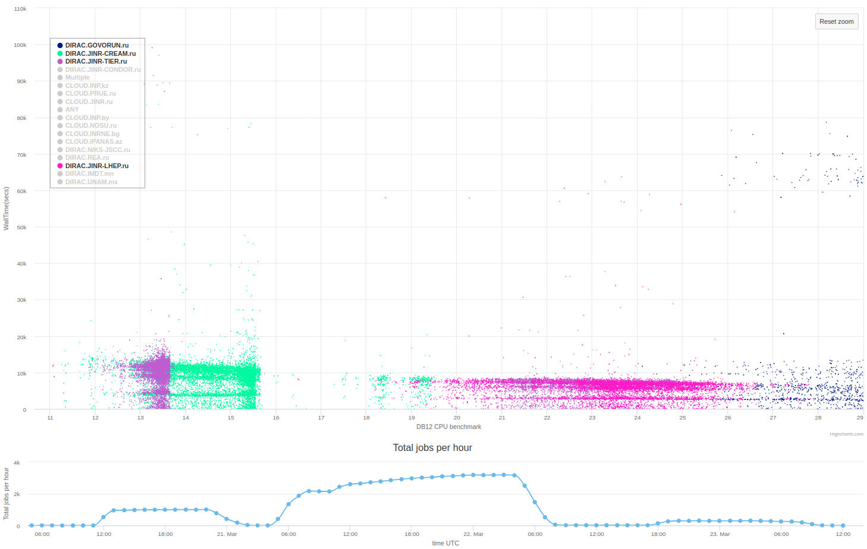
BM@N DIGI to DST jobs

Slide 20
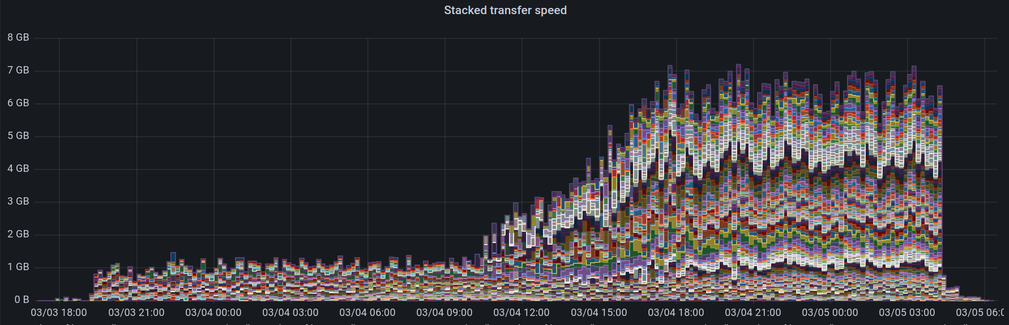
Data transfers monitoring
Monitoring Database
jinr-get-file
jinr-add-file
dirac-dms-get-file
dirac-dms-add-file
Storage

Slide 21
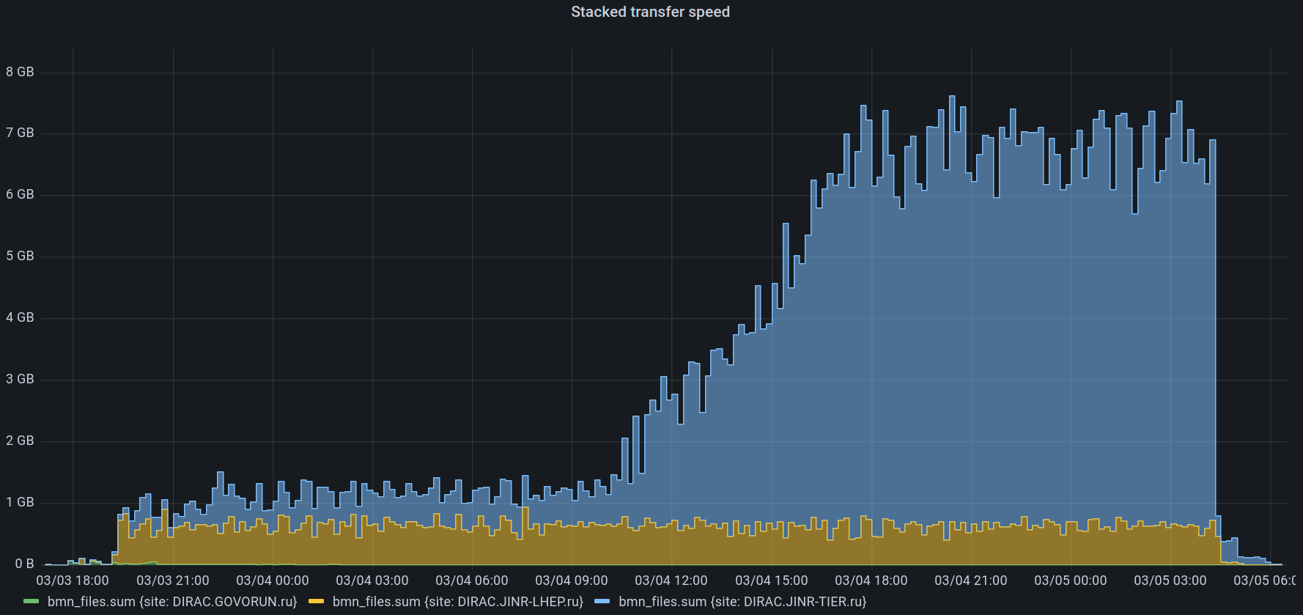
Data transfers monitoring
300 jobs running
4 MB/s per job
NICA Cluster
Tier1
1580 jobs running
4.1 MB/s per job
Maximal transfer speed (Read+Write) with EOS in MLIT – 7.5 GB/s

Slide 22
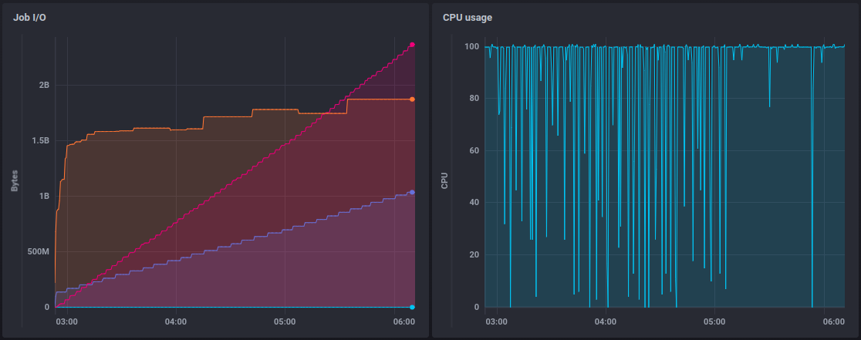
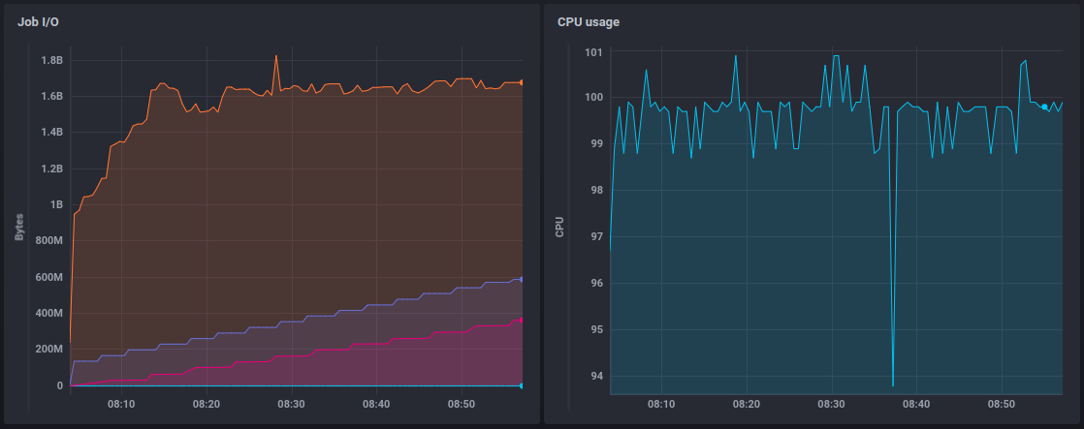
Job monitoring
Write
RAM usage
Read
Write
RAM usage
Read

Slide 23
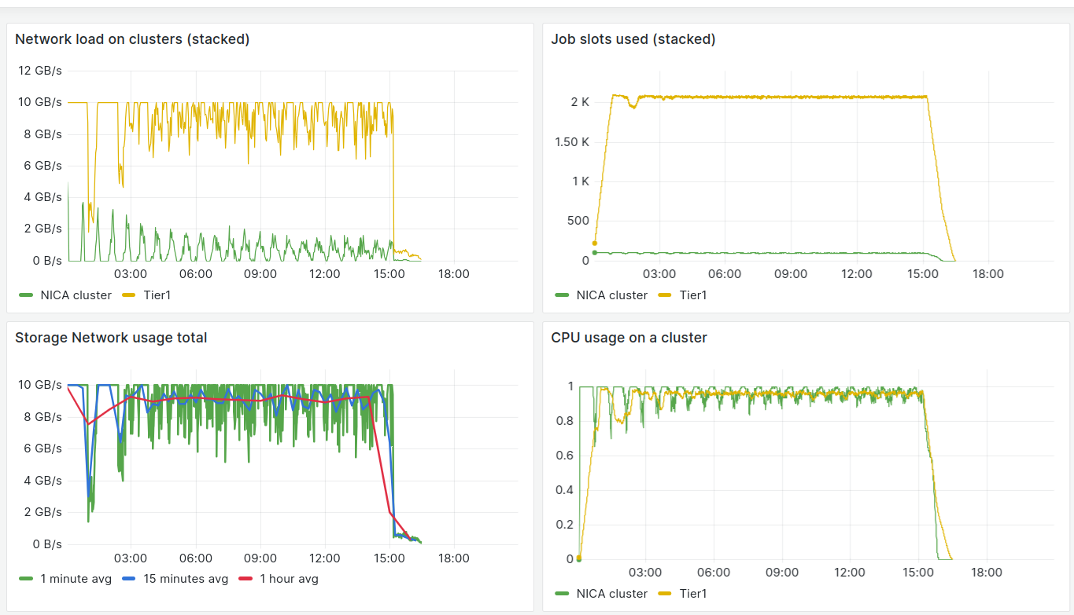
Simulation of job execution

Slide 24
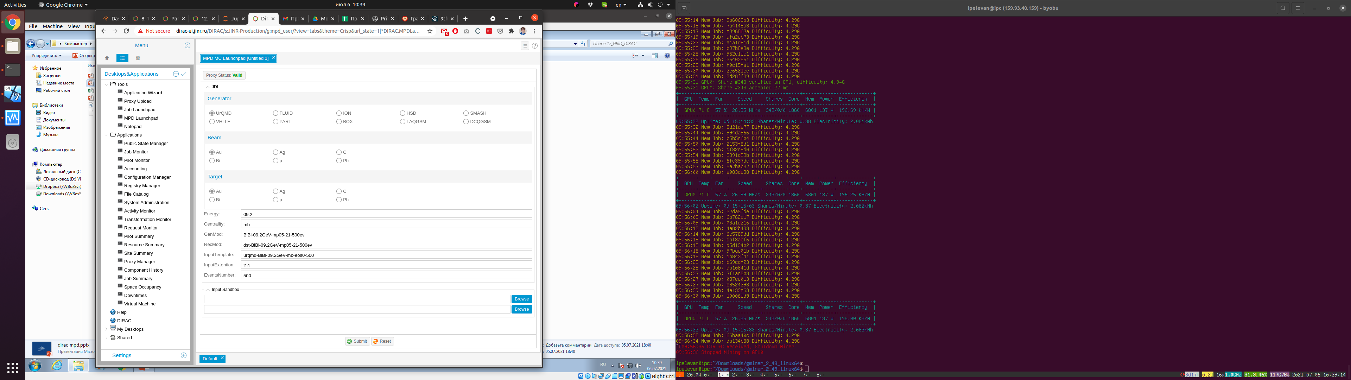
MPD Monte-Carlo launchpad
Main issue is that in many cases it is necessary to have possibility to provide root commands which should be executed.
Especially for trains.
And it is still necessary to obtain user’s certificate in order to use that application
So, the whole concept was rethought.

Slide 25
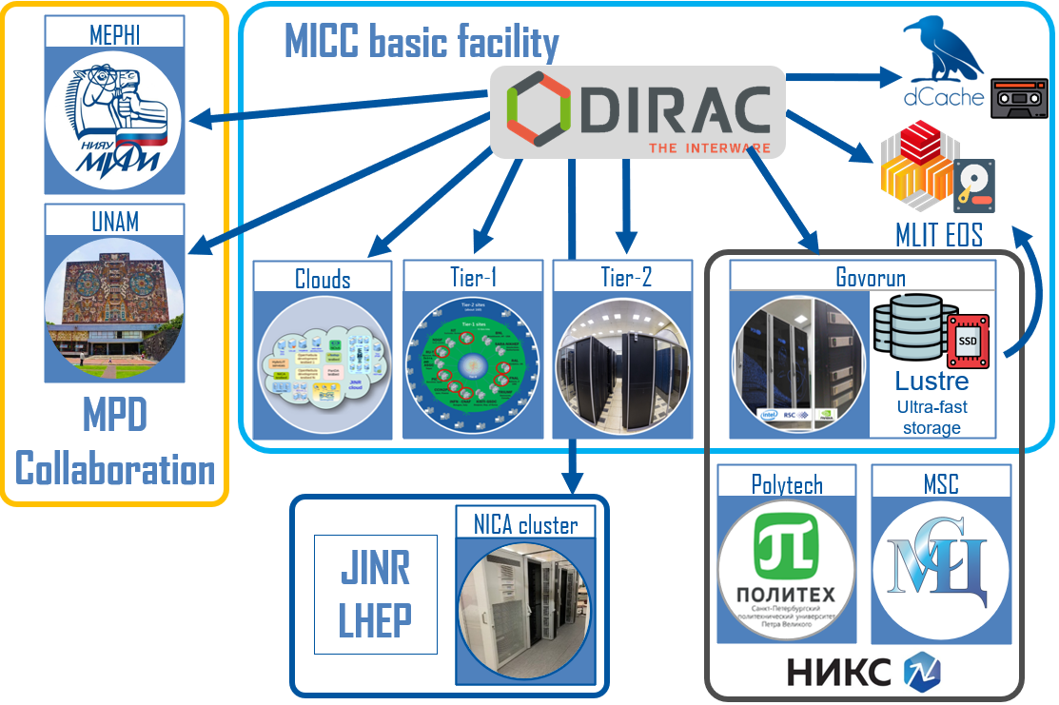

MPD mass production launcher
Production launcher
Access Control List
Parameters
MPD Collaboration Web site *
General Production Certificate
Parameters
Token
Jobs
JINR SSO*
Login
User
parameters
Results(DST files)
EOS
* Needs to be deployed

Slide 26
Conclusion on MPD+DIRAC
It was 4 years of fruitful cooperation between MPD physicists, engineers, developers and administrators:
1.75M jobs successfully completed, 1PB generated
If we compare speed of job execution on a standard NICA cluster quota(200 cores), the use of distributed infrastructure speeds up the workload execution .
But still, some jobs can be completed only on Govorun!
Additional services greatly improve our understanding of computing load, requirements and efficiency.
MPD trains is the next big challenge for us. We are working on providing simple and transparent tool to execute them on a distributed infrastructure.

Slide 27
Conclusion on BM@N+DIRAC
First BM@N tests of Monte-Carlo on DIRAC infrastructure were performed in 2018
Active productions started since 8th BM@N run. Before that DIRAC infrastructure was used only for Monte-Carlo.
430 TB of raw data were converted to 26 TB of Digi files. Digi files were converted in 53 TB of DST file which are suitable for analysis.
7 minor productions and 5 major productions were performed since the last BM@N Collaboration meeting(14-17 May 2023)
BM@N Monte-Carlo looks like relatively simple workload for the DIRAC infrastructure (at least now).

Slide 28
General conclusion
Major Resources | Amount
NICA cluster | 200 cores
Govorun | up to 3260 cores
Tier1 | 1500 cores
Tier2 | 1000 cores
EOS | 2 PB (~1.2 PB used) (total 5 PB)
All experiments benefit from all developed tools and systems.
Experiments usually submit workloads independently, so the resources are utilized in the most efficient way. But, before the collaboration meetings we have long job queues.
Use if distributed infrastructure speeds up workload execution in 20 times comparing the execution on the standard NICA cluster quota.

Slide 30

Why DIRAC?
1. Single system for all aspects of computing
User Interface
API
Central configuration
Workload management
Data management
Integration tools
File Catalog
Workflow management
Metadata management
Accounting
Management

Slide 31
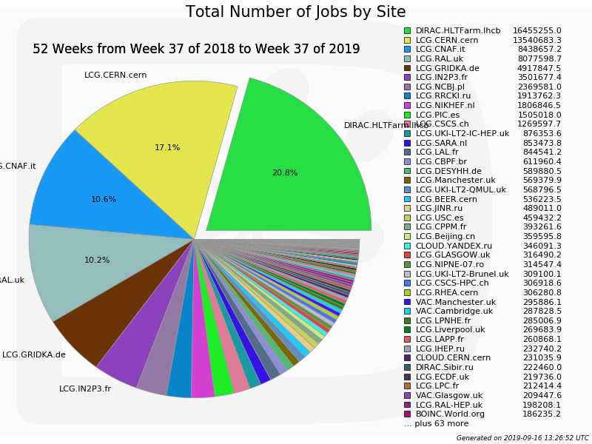
Why DIRAC?
2. Good performance

Slide 32
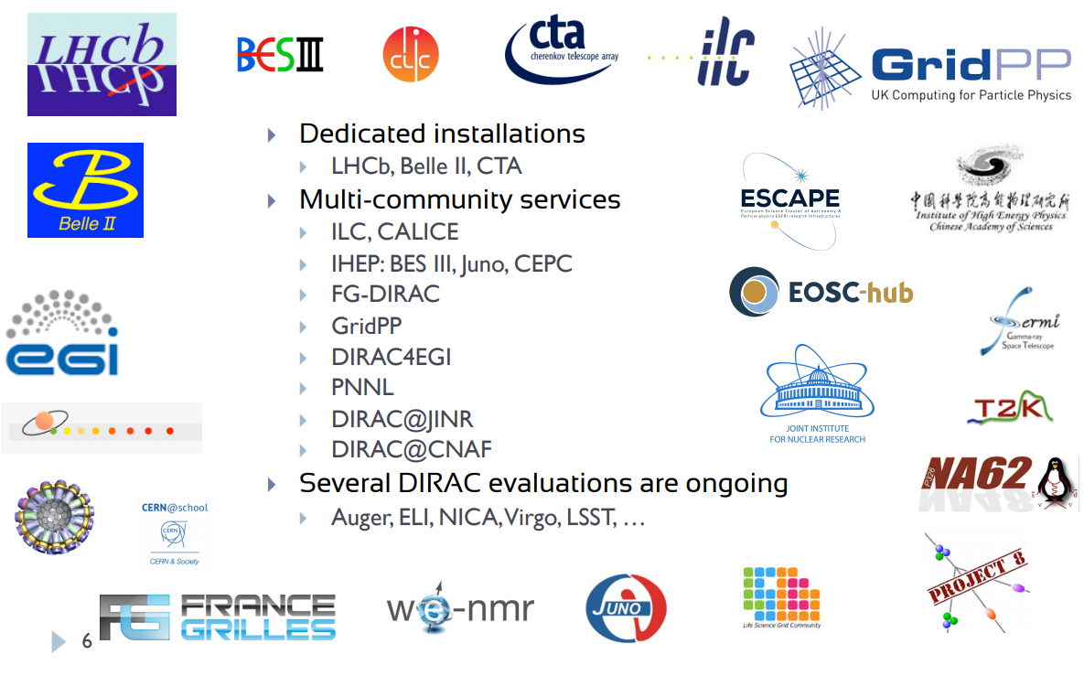
Why DIRAC?
3. Active users and developers community

Slide 33

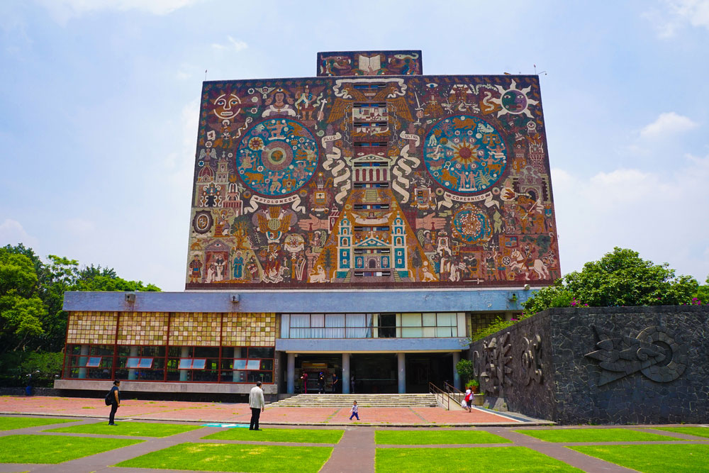

Workload management
Submit thousand of jobs to DIRAC Job Queue
Tier-1
CICC/Tier-2
Clouds
Govorun
NICA Cluster
UNAM

Slide 34
Workload management
Submit thousand of jobs to DIRAC Job Queue
User Job
User Job
User Job
User Job
User Job
User Job
User Job
User Job
User Job
Tier-1
CICC/Tier-2
Clouds
Govorun
NICA Cluster
UNAM

Slide 35
Workload management
Submit thousand of jobs to DIRAC Job Queue
User Job
User Job
User Job
User Job
User Job
User Job
User Job
User Job
User Job
Pilot job
Pilot job
Pilot job
Pilot job
Pilot job
Pilot job
Tier-1
CICC/Tier-2
Clouds
Govorun
NICA Cluster
UNAM

Slide 36
Workload management
Submit thousand of jobs to DIRAC Job Queue
User Job
User Job
User Job
User Job
User Job
User Job
Pilot job
Pilot job
Pilot job
Pilot job
Pilot job
Pilot job
User Job
User Job
User Job
User Job
User Job
User Job
Tier-1
CICC/Tier-2
Clouds
Govorun
NICA Cluster
UNAM

Slide 37
Workload management
Submit thousand of jobs to DIRAC Job Queue
User Job
User Job
User Job
User Job
User Job
User Job
Pilot job
Pilot job
Pilot job
Pilot job
Pilot job
Pilot job
User Job
User Job
User Job
User Job
User Job
User Job
Tier-1
CICC/Tier-2
Clouds
Govorun
NICA Cluster
UNAM

Slide 38
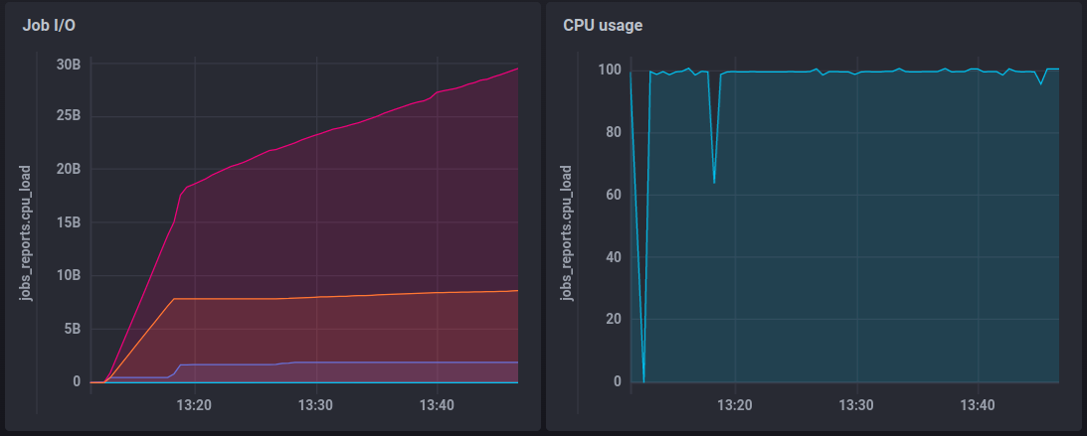
Система мониторинга потреблённых задачами ресурсов
Bites read from disk
Read raw file and temporary file
Bites written to disk
Write resulting Digi file
RAM usage
Disk usage
Temporary file: +8 GB
Result file: 800MB
Total disk usage per 15 GB job: 25 GB
Initial read of 15GB raw file and creation of temporary 8 GB file
RAM usage : ~2GB
Notes:
38

Slide 39
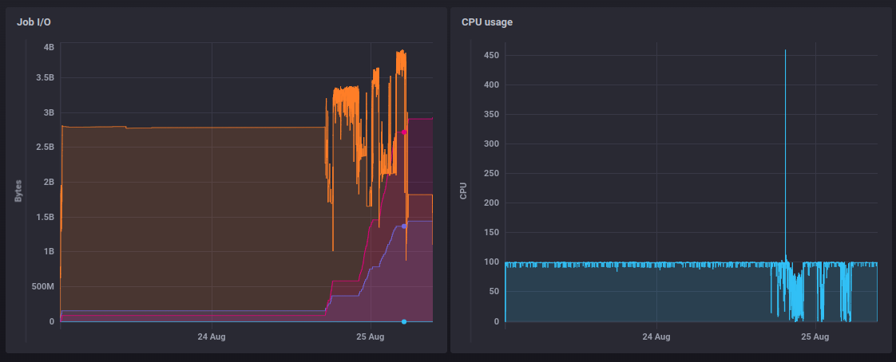
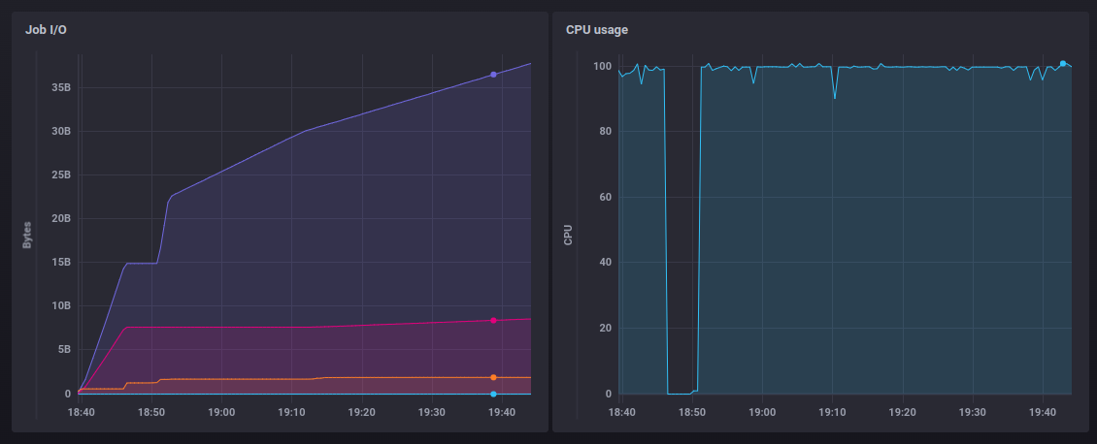
Система мониторинга потреблённых задачами ресурсов
Notes:
39

Slide 40
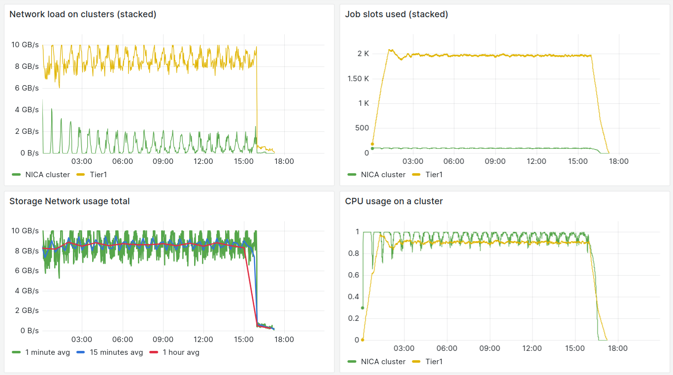
Система симуляции нагрузки
30000 задачи Raw->Digi, Tier1 - 2000 slots, NICA cluster – 100 slots
Скорость отправки пилотов - 30 пилотов на ресурс в минуту
Notes:
40

Slide 41
Система симуляции нагрузки
30000 задачи Raw->Digi, Tier1 - 2000 slots, NICA cluster – 100 slots
Скорость отправки пилотов - 40 пилотов на ресурс в минуту
Notes:
41

Slide 42
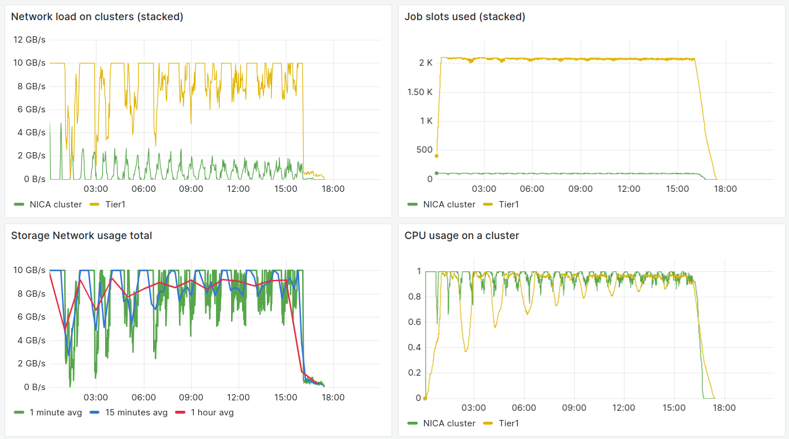
Система симуляции нагрузки
30000 задачи Raw->Digi, Tier1 - 2000 slots, NICA cluster – 100 slots
Скорость отправки пилотов - 100 пилотов на ресурс в минуту
Notes:
42

