Slide 1



The stabilization of octupole deformation in heavy and superheavy atomic nuclei
E. V. Mardyban
E. A. Kolganova, T. M. Shneidman, R. V. Jolos

Slide 2
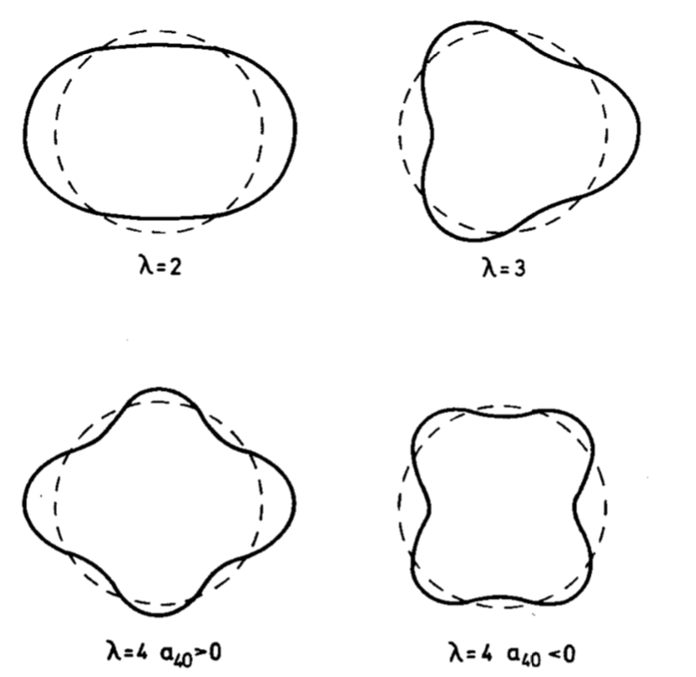
Introduction
The collective variables describing the deformation are introduced as coefficients of the expansion of the nucleus radius in terms of spherical harmonics:
The surface shapes for different types of deformations

Slide 3

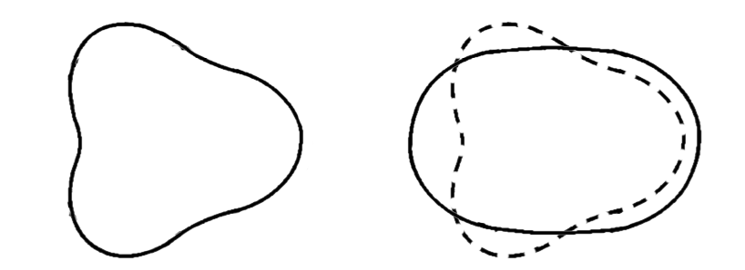
Introduction
Spectrum of the nucleus with stable octupole deformation
Spectrum for ²²⁶Ra
The transition to stable octupole deformation
I. Ahmad and P. A. Butler, Annu. Rev. Nucl. Part. Sci 43, 71 (1993).
P. A. Butler, W. Nazarewicz Rev. Mod. Phys., Vol. 68, No. 2 (1996)
R. V. Jolos, P. von Brentano and J. Jolie, Phys. Rev. C 86: 024319 (2012).

Slide 4
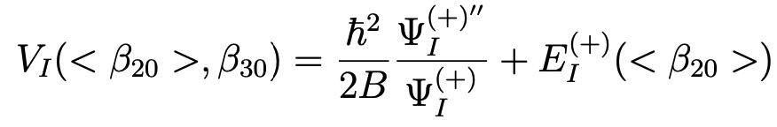
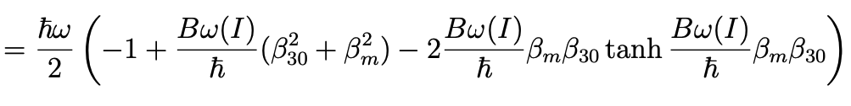
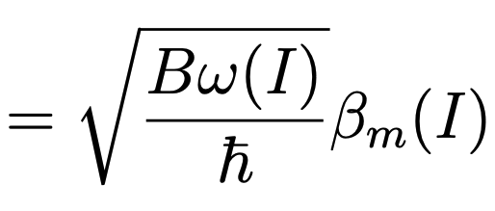

Model
To calculate the parity splitting, denoting the corresponding dynamical variable as β₃₀ , the Hamiltonian describing the collective motion at β₃₀ for a given angular momentum I, can be written as
For the ground state of positive parity, one can find the potential describing the dynamics of the nucleus with respect to the octupole deformation
The wave function and the potential depend on only one parameter, which is a function of the angular momentum
E. V. Mardyban, E.A. Kolganova, T.M. Shneidman, R.V. Jolos, Physics of Atomic Nuclei, Vol. 83, p. 53 (2020).
E. V. Mardyban, T. M. Shneidman, E.A. Kolganova, R.V. Jolos, and S.-G. Zhou, Chin. Phys. C 42, 124104 (2018).

Slide 5
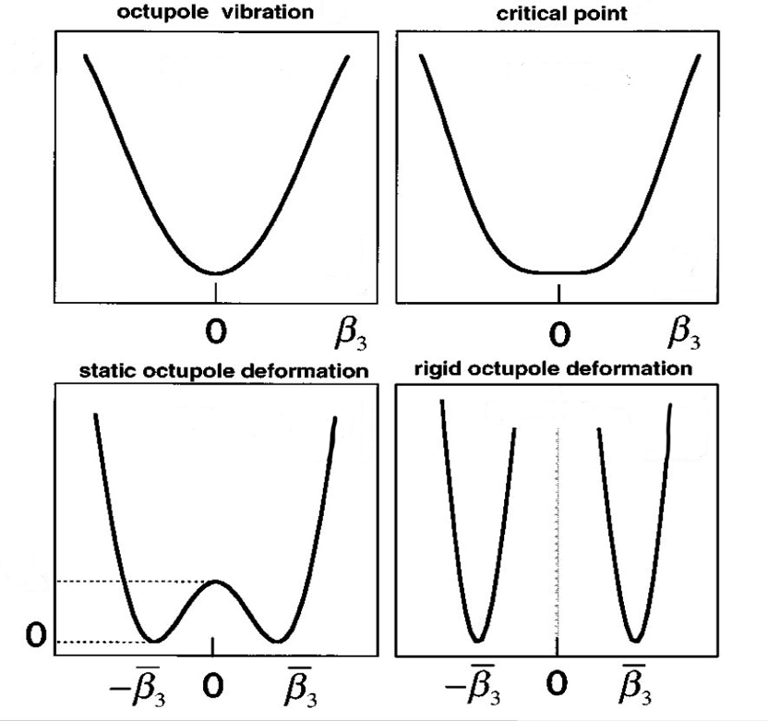
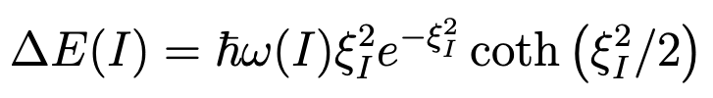
Model
Considering the limits of large and small angular momenta, one can obtain analytical solutions that are well reproduced by one general expression:
Зависимость потенциальной энергии от углового момента

Slide 6
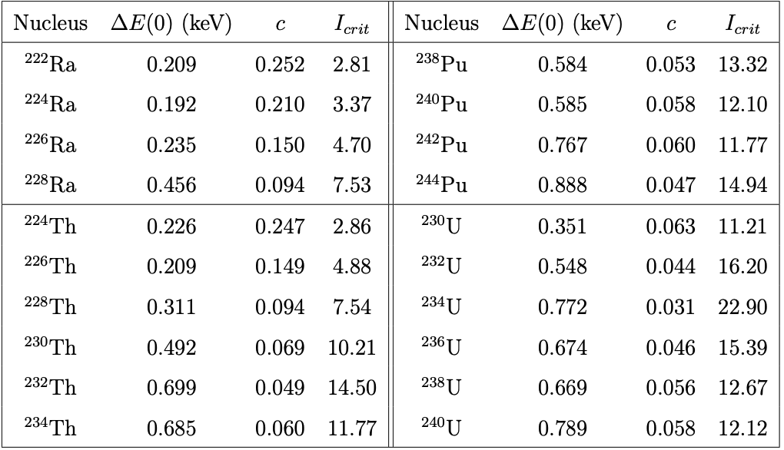
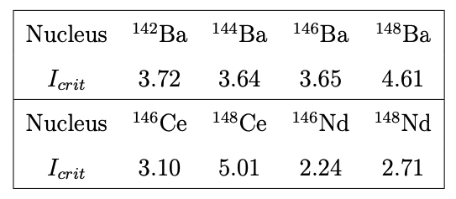
Results
The calculated values of critical angular moments for the nuclei of the actinide and rare earth regions
E. V. Mardyban, E.A. Kolganova, T.M. Shneidman, R.V. Jolos, Physics of Atomic Nuclei, Vol. 83, p. 53 (2020).
E. V. Mardyban, T. M. Shneidman, E.A. Kolganova, R.V. Jolos, and S.-G. Zhou, Chin. Phys. C 42, 124104 (2018).

Slide 7
Results
The parity splitting in dependency on angular momentum for various Th and Pu isotopes
E. V. Mardyban, E.A. Kolganova, T.M. Shneidman, R.V. Jolos, Physics of Atomic Nuclei, Vol. 83, p. 53 (2020).
E. V. Mardyban, T. M. Shneidman, E.A. Kolganova, R.V. Jolos, and S.-G. Zhou, Chin. Phys. C 42, 124104 (2018).

Slide 8
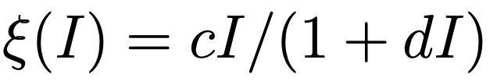
Results
The parity splitting in dependency on angular momentum for various U and Ra isotopes
There are discrepancies that can be partially taken into account using parameterization:
E. V. Mardyban, E.A. Kolganova, T.M. Shneidman, R.V. Jolos, Physics of Atomic Nuclei, Vol. 83, p. 53 (2020).
E. V. Mardyban, T. M. Shneidman, E.A. Kolganova, R.V. Jolos, and S.-G. Zhou, Chin. Phys. C 42, 124104 (2018).

Slide 9
Results
The parity splitting in dependency on angular momentum for various Ba, Ce and Nd isotopes
E. V. Mardyban, E.A. Kolganova, T.M. Shneidman, R.V. Jolos, Physics of Atomic Nuclei, Vol. 83, p. 53 (2020).
E. V. Mardyban, T. M. Shneidman, E.A. Kolganova, R.V. Jolos, and S.-G. Zhou, Chin. Phys. C 42, 124104 (2018).

Slide 10
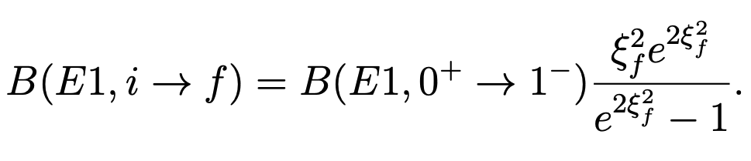
Results
²⁴⁰Pu
²²⁶Ra
¹⁴⁸Nd
The calculated and experimental values of the dipole moment for ²²⁶Ra, ¹⁴⁸Nd and ²⁴⁰Pu depending on the angular momentum.
The dependence of the dipole transition probability on the angular momentum will have the form:
E. V. Mardyban, E.A. Kolganova, T.M. Shneidman, R.V. Jolos, Physics of Atomic Nuclei, Vol. 83, p. 53 (2020).
E. V. Mardyban, T. M. Shneidman, E.A. Kolganova, R.V. Jolos, and S.-G. Zhou, Chin. Phys. C 42, 124104 (2018).

Slide 11
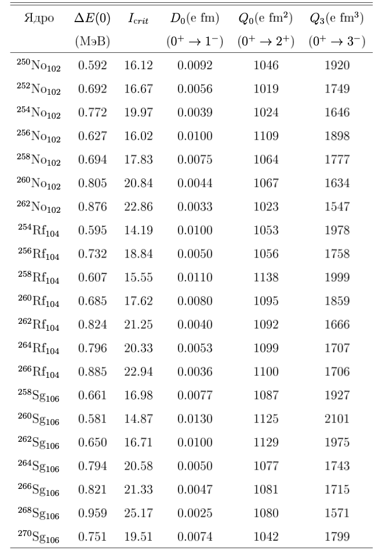
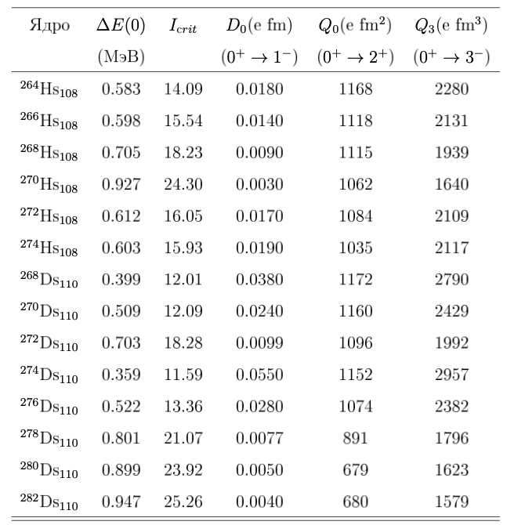
Results
The calculated initial values of parity splitting and critical moments. The calculated values of transition dipole, quadrupole and octupole moments for the transition from the ground state to the state of the main band of alternating parity.

Slide 12
Conclusion
The analytical expressions are obtained for the parity splitting and electric transitional dipole moment in alternating parity bands in dependences on the angular momentum of the nucleus.
The spectra of alternating parity bands and the probabilities of E1 transitions for the nuclei of the actinide and rare earth regions are described.
The characteristics of the variable parity bands of superheavy nuclei within the framework of the cluster model of a double nuclear system are calculated.
The rigidity of superheavy nuclei with respect to reflection-asymmetric deformation has been studied.
Thank you for your attention!
Publications on the topic of the report:
E. V. Mardyban, E.A. Kolganova, T. M. Shneidman, R.V. Jolos, and S.-G. Zhou, Chin. Phys. C 42, 124104 (2018)
E. V. Mardyban, E.A. Kolganova, T.M. Shneidman, R.V. Jolos, Physics of Atomic Nuclei, Vol. 83, p. 53 (2020)
R. V. Jolos, E. A. Kolganova, L. A. Malov, E. V. Mardyban, D. A. Sazonov and T. M. Shneidman, Physics of Atomic Nuclei Vol. 83, p. 550 (2020)
E. V. Mardyban, E.A. Kolganova, T. M. Shneidman, R.V. Jolos, Physics of Particles and Nuclei Letters, Vol. 19, No. 6, 646-651 (2022)
R. V. Jolos, E. A. Kolganova, E. V. Mardyban and T. M. Shneidman, Int. J. Mod. Phys. E, 2340002 (2023).

