Slide 1
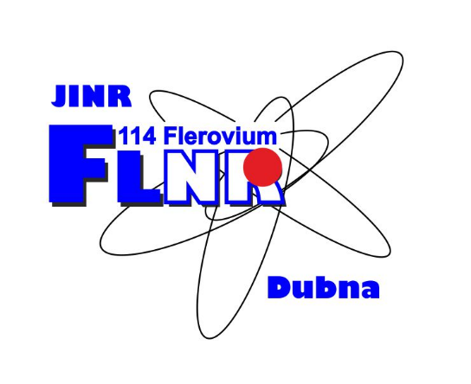
Production of heavy neutron-rich nuclei with the magic number N=126 in the multinucleon transfer reactions induced by radioactive ion beams
The XXVII International Scientific Conference of
Young Scientists and Specialists
AYSS-2023
30.10 – 03.11
Vyacheslav Saiko and Alexander Karpov

Slide 2
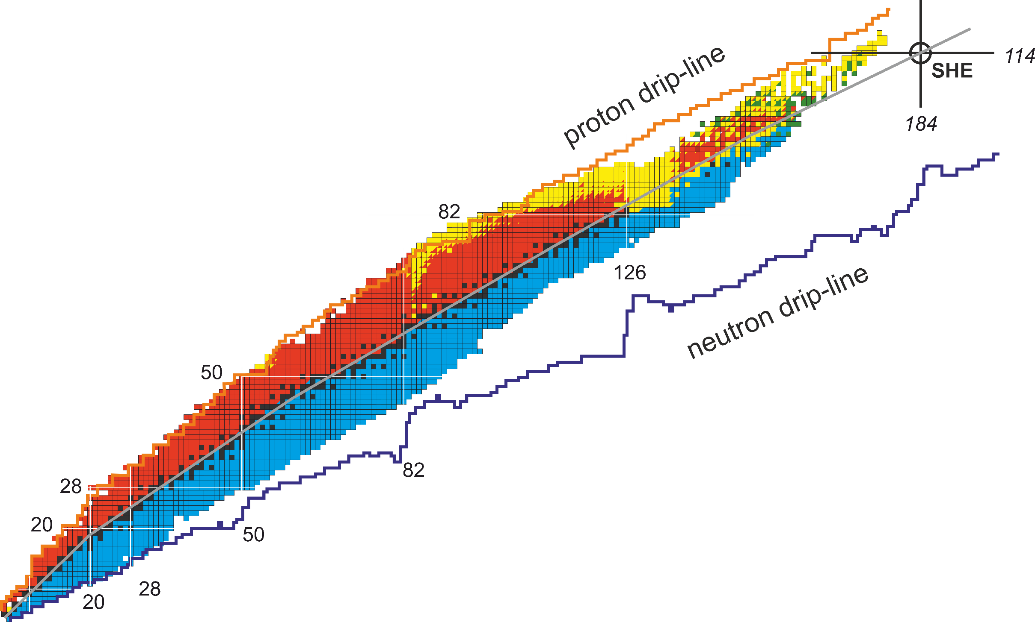
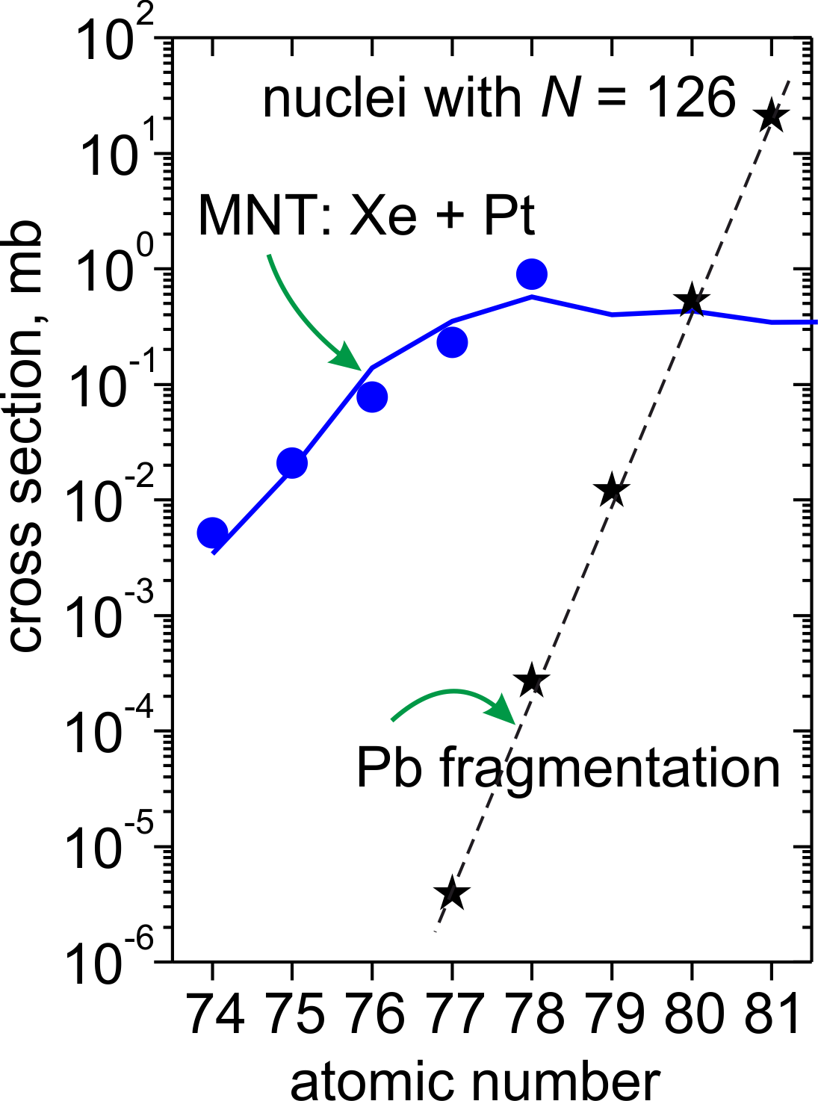
Methods of production of new nuclei
Multinucleon transfer reactions (MNT)
is a promising method of production of
new nuclei
Fusion
MNT?
Fragmentation
Fission

Slide 3
Multinucleon transfer reactions
¹³⁶Xe + ²⁰⁸Pb
interaction time
exp.: E.M. Kozulin, et. al,
Phys. Rev. C 86, 044611 (2012)
Main features:
Transfer of a large number of nucleons
Dissipation of initial kinetic energy

Slide 4
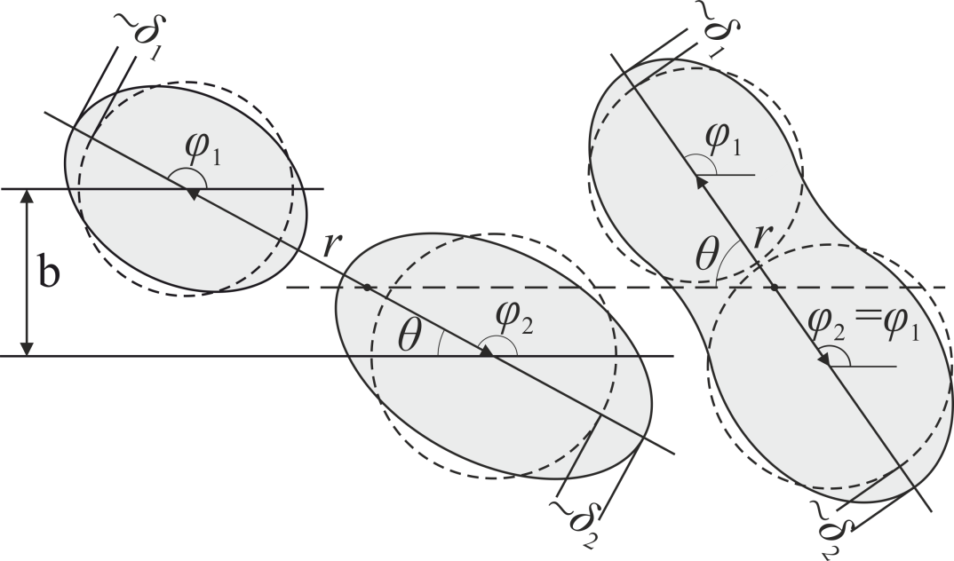
Model
A.V. Karpov and V.V. Saiko,
Phys. Rev. C 96, 024618 (2017)
Phys. Rev. C 99, 014613 (2019)
system of
Langevin equations
driving, friction and random forces
r – distance between centers of nuclei
δ_{1,2} – ellipsoidal deformations
η_{A} – mass asymmetry
η_{Z} – charge asymmetry
θ – angle between symmetry axis and beam direction
φ_{1,2} – angles of rotation of nuclei in the reaction plane
– mass tensor
– dissipation tensor
– amplitude of random force
– random value

Slide 5
Model
a collision of ¹³⁶Xe + ²⁰⁸Pb
A.V. Karpov and V.V. Saiko,
Phys. Rev. C 96, 024618 (2017)
Phys. Rev. C 99, 014613 (2019)
r
each trajectory of a collision provides:
Z and A of fragments,
scattering angle,
kinetic energy,
excitation energy,
reaction time,
…
δ
Final fragments are simulated by means of
statistical model of decay of heavy excited nuclei,
GEF code http://nrv.jinr.ru
http://www.khschmidts-nuclear-web.eu/GEF.html
mass
E_{rel}, MeV
differential reaction cross section:
interaction time, 10⁻²² s

Slide 6
MNT in the ¹³⁶Xe + ¹⁹⁸Pt reaction
E_{lab} = 1221 MeV
24º ≤ θ_{lab} ≤ 34º
exp.: Y.X. Watanabe, et. al,
Phys. Rev. Lett. 115, 172503 (2015)

Slide 7
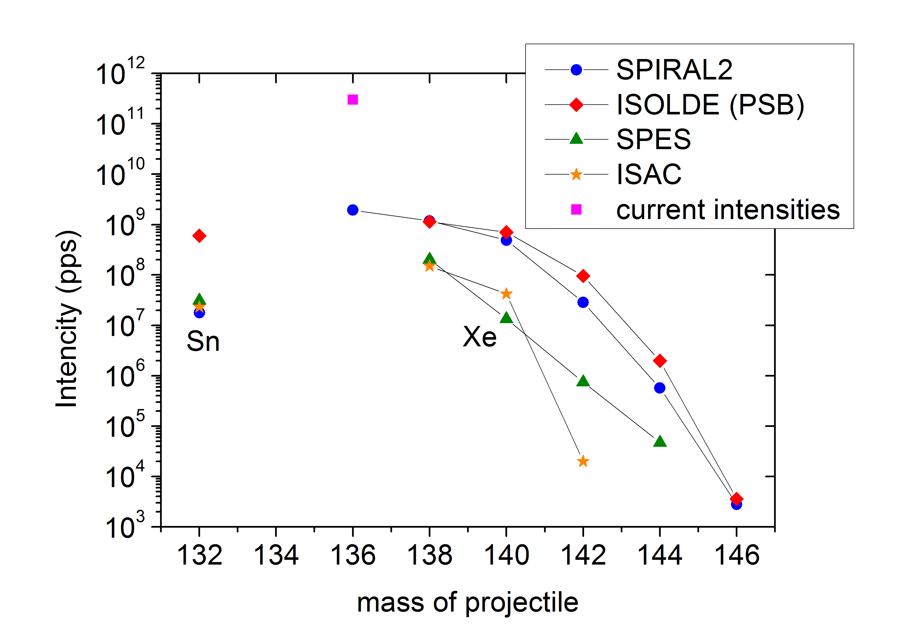
Extension of the approach
Radioactive Ions Beams (RIBs)
SPES
ISAC

Slide 8
Production cross sections
E_{cm} = 1.2V_{B}

Slide 9
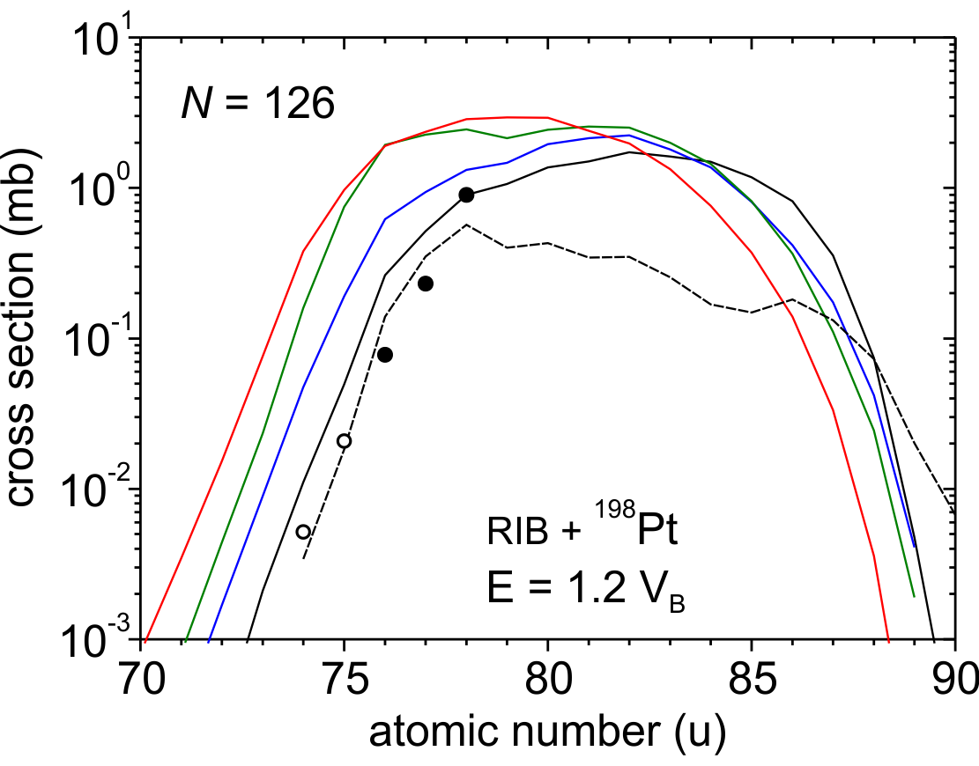
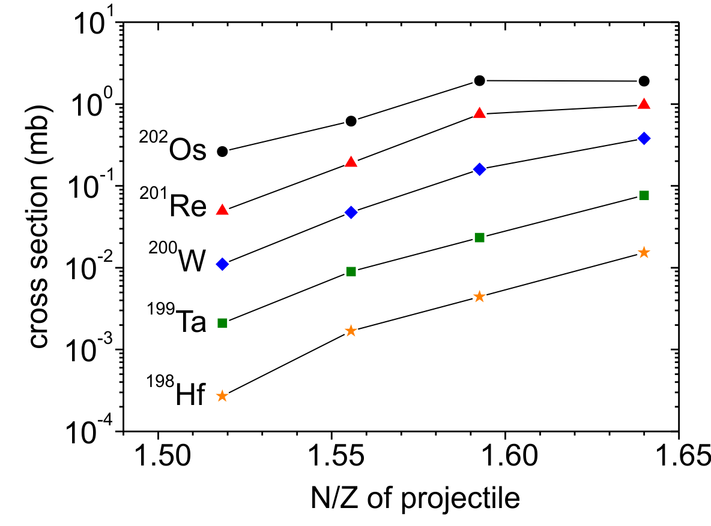
Production cross sections
¹³⁶Xe
643 MeV
¹³⁸Xe
¹⁴⁰Xe
¹³²Sn
exp.: ¹³⁶Xe + ¹⁹⁸Pt @ 643 MeV
Y.X. Watanabe, et. al,
Phys. Rev. Lett. 115, 172503 (2015)
Production cross section depend on isospin of projectile

Slide 10
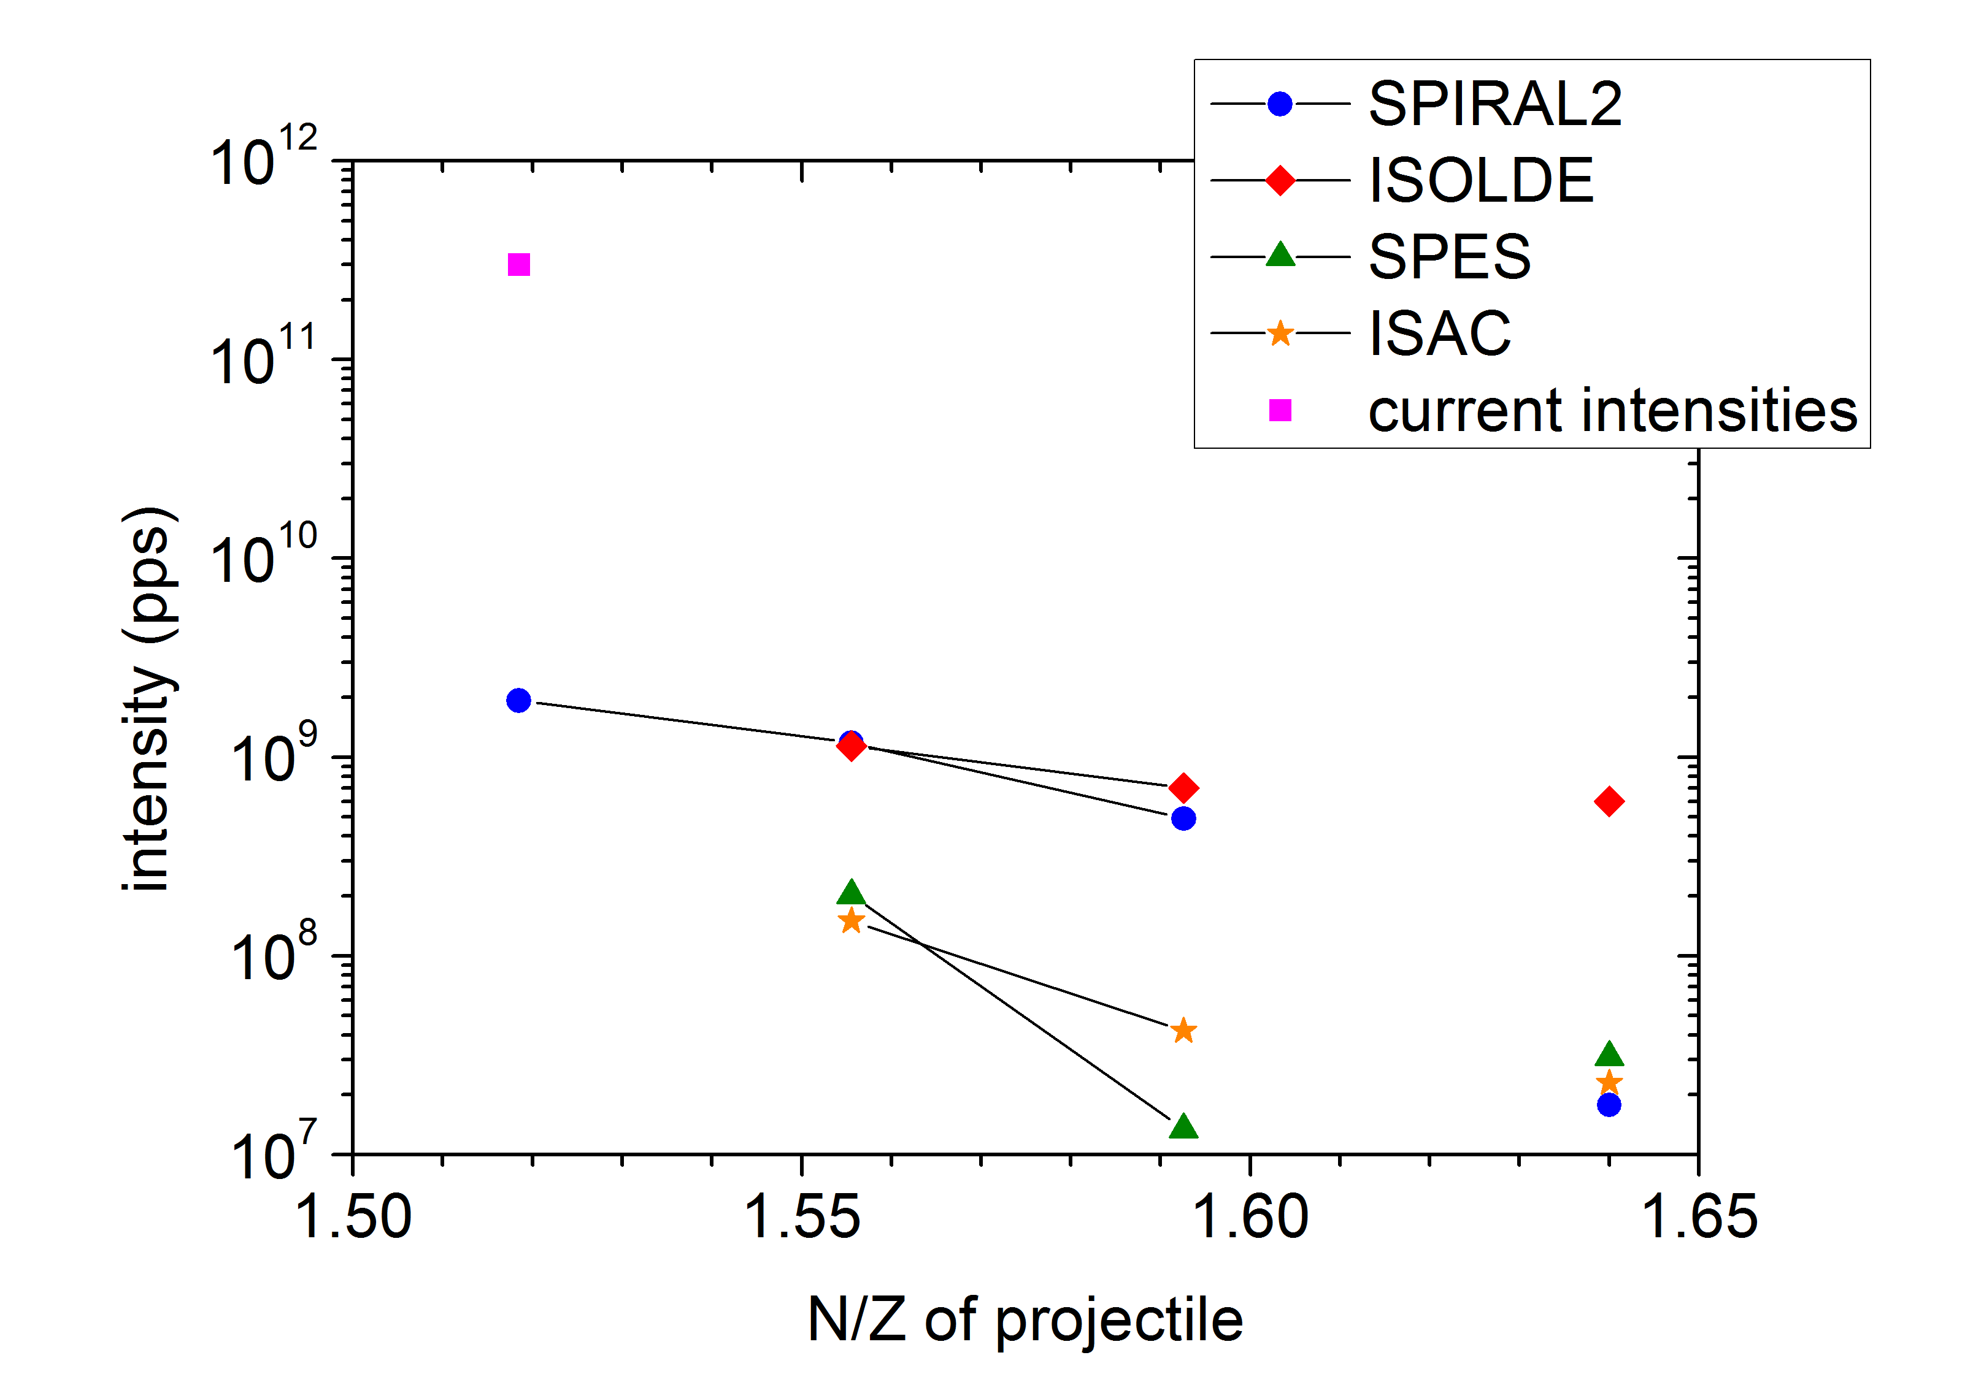
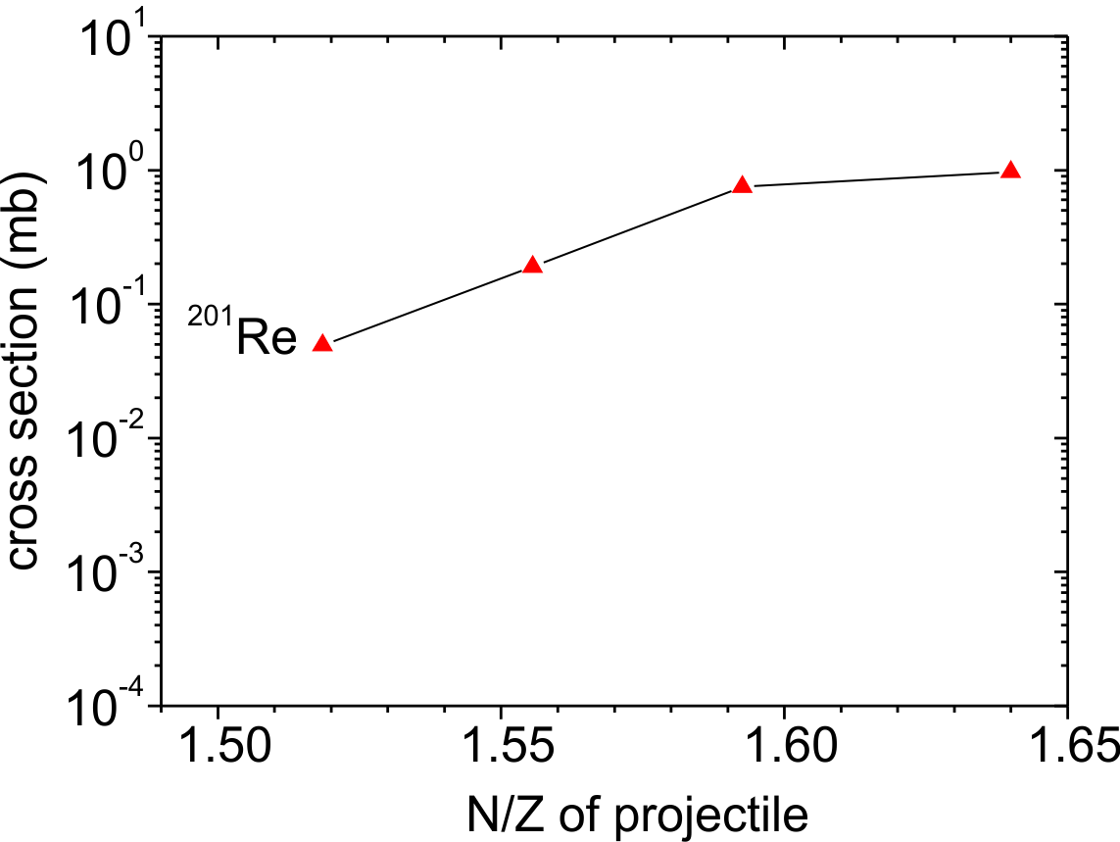
Predicted yields of yet-unknown ²⁰¹Re
¹³⁶Xe
¹³⁸Xe
¹⁴⁰Xe
¹³²Sn
¹³⁶Xe
¹³⁸Xe
¹⁴⁰Xe
¹³²Sn
Yield ~ intensity x cross section

Slide 11
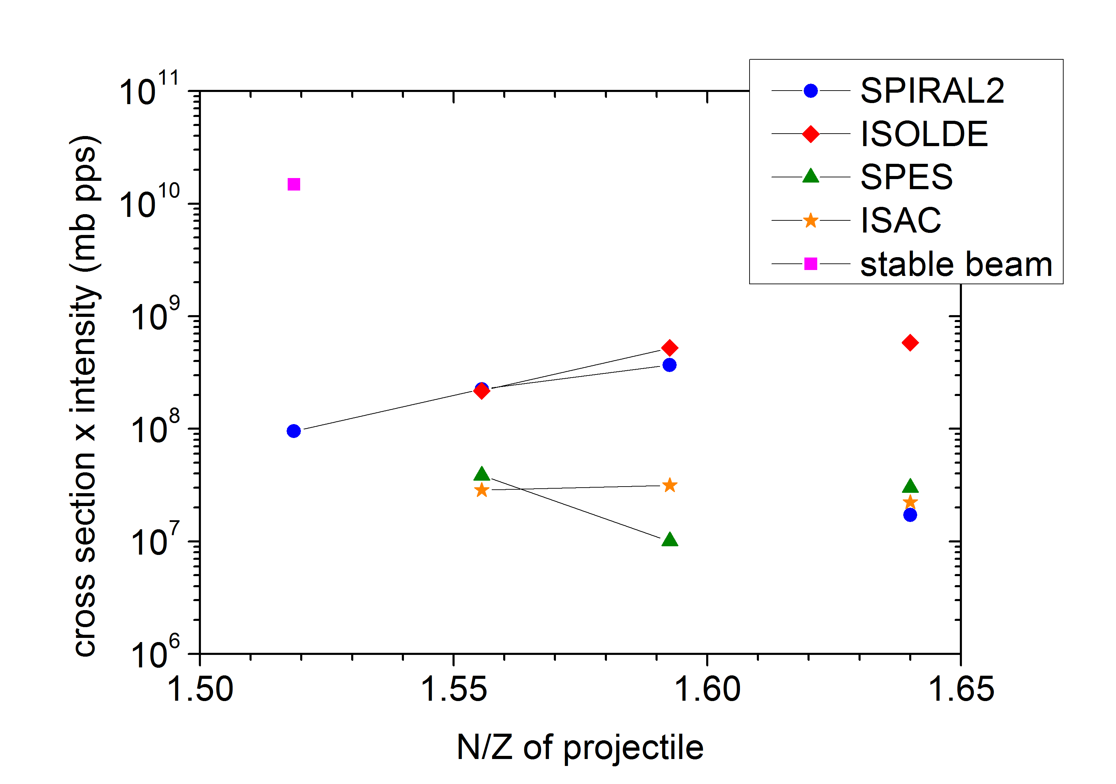
Predicted yields of yet-unknown isotope ²⁰¹Re
²⁰¹Re
¹³⁶Xe
¹³⁸Xe
¹⁴⁰Xe
¹³²Sn

Slide 12
Conclusions
Multinucleon transfer reactions with radioactive ion beams and ¹⁹⁸Pt target were
studied at comparable energies within the multidimensional dynamic model of
nucleus-nucleus collisions based on Langevin equations.
2. The more neutron-rich projectile the higher production cross sections of neutron-
enriched isotopes of elements lighter than the target in the multinucleon transfer
reactions.
3. Cross sections of yet-unknown neutron-enriched nuclide ²⁰¹Re with the magic
number N = 126 reach the level of ~1 mb in the reactions ¹⁴⁰Xe, ¹³²Sn + ¹⁹⁸Pt.
3. Nowadays, the available intensities of radioactive ion beams are quite low to
provide yields of neutron-enriched heavy products in the MNT reactions higher than
in the MNT reactions with stable beams.

Slide 13
Thank you for attention!

Slide 14
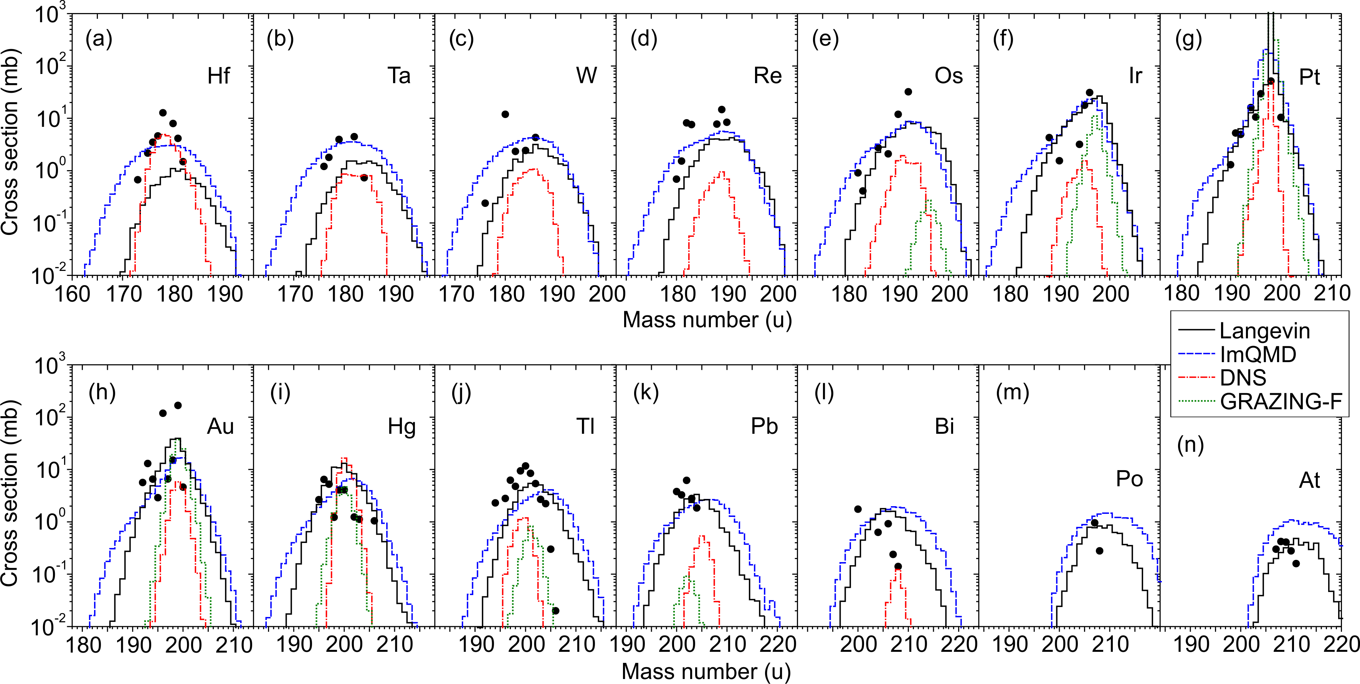
Heavy products of the ¹³⁶Xe + ¹⁹⁸Pt reaction
Gammasphere, ANL E_{lab} = 760 MeV
exp.: V.V. Desai, W. Loveland et. al,
Eur. Phys. J. A 56, 150 (2020)

Slide 15
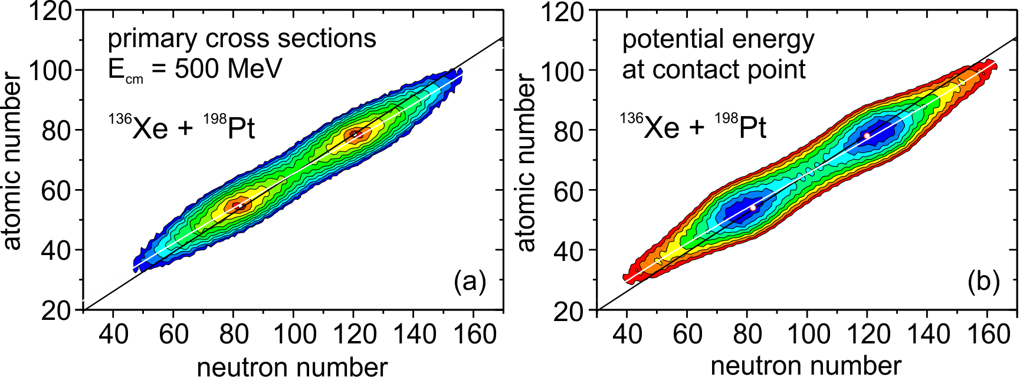
Potential energy and cross sections
Z_{tot}/N_{tot}
Z_{tot}/N_{tot}
logarithmic scale

Slide 16
Potential energy and cross sections

