Slide 1


JINR Young Scientists and Specialists 2023
Light Induced Release of Neutrophil Extracellular Traps(NETs)
Raman Spectroscopy Department, FLNP, JINR
Yersultan Arynbek, Kahramon Mamatkulov,
Nina Vorobyeva, Grigory Arzumanyan

Slide 2
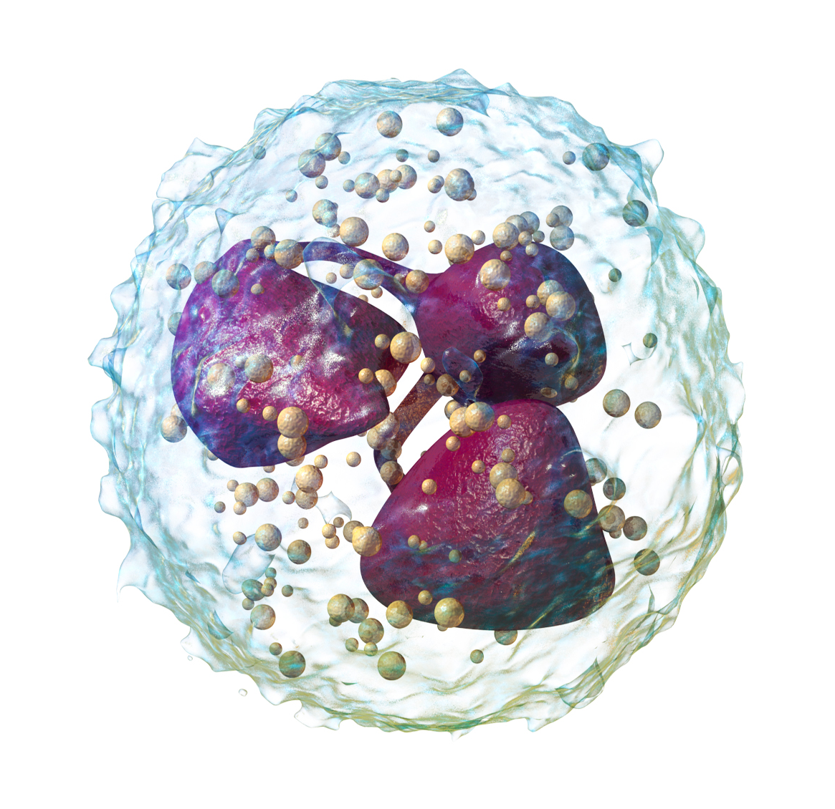
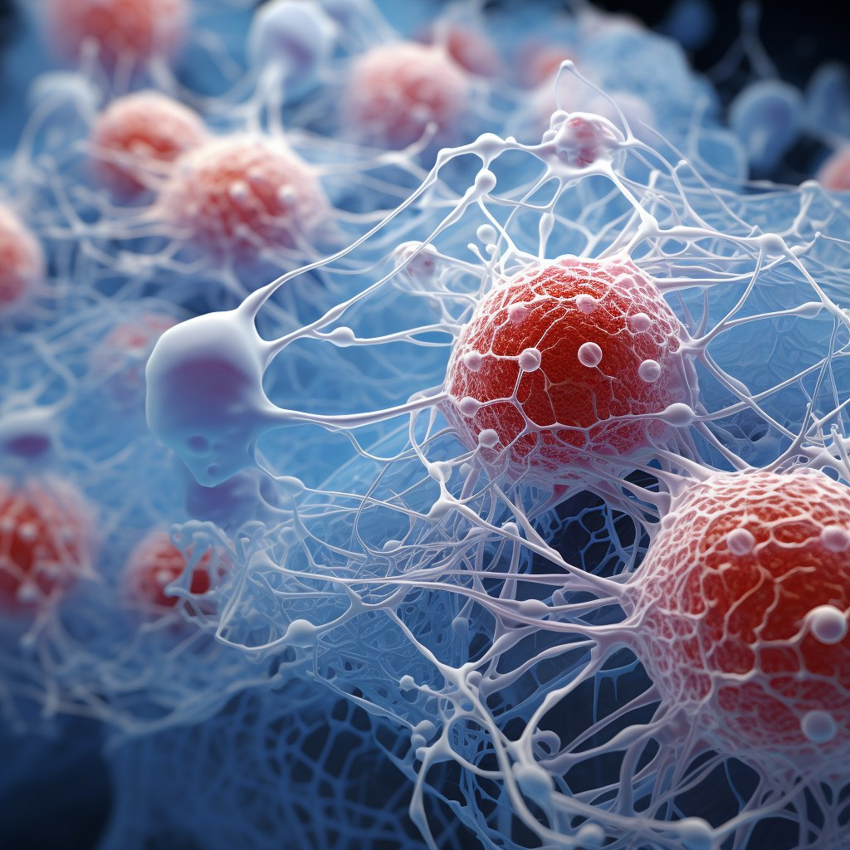
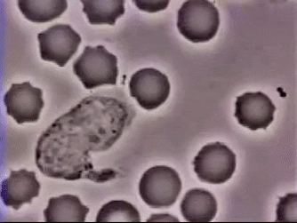
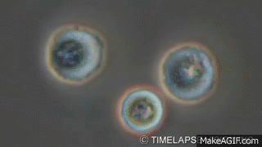
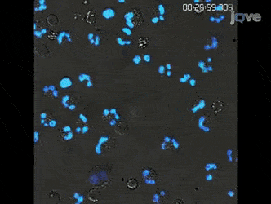
NETosis
Neutrophil Extracellular Traps (NETs) are web-like structures composed of chromatin and antimicrobial proteins released by neutrophils, a type of white blood cell. They are the immune system's first line of defense and serve as a mechanism to capture and neutralize pathogens, particularly bacteria, fungi and viruses.
Protective capabilities of neutrophils
Phagocytosis
Chromatin decondensation
Formation of NETs
In the cytoplasm of neutrophil cells
there are granules with antimicrobial agents
NET has an electrostatic charge which holds pathogens
Notes:
p

Slide 3
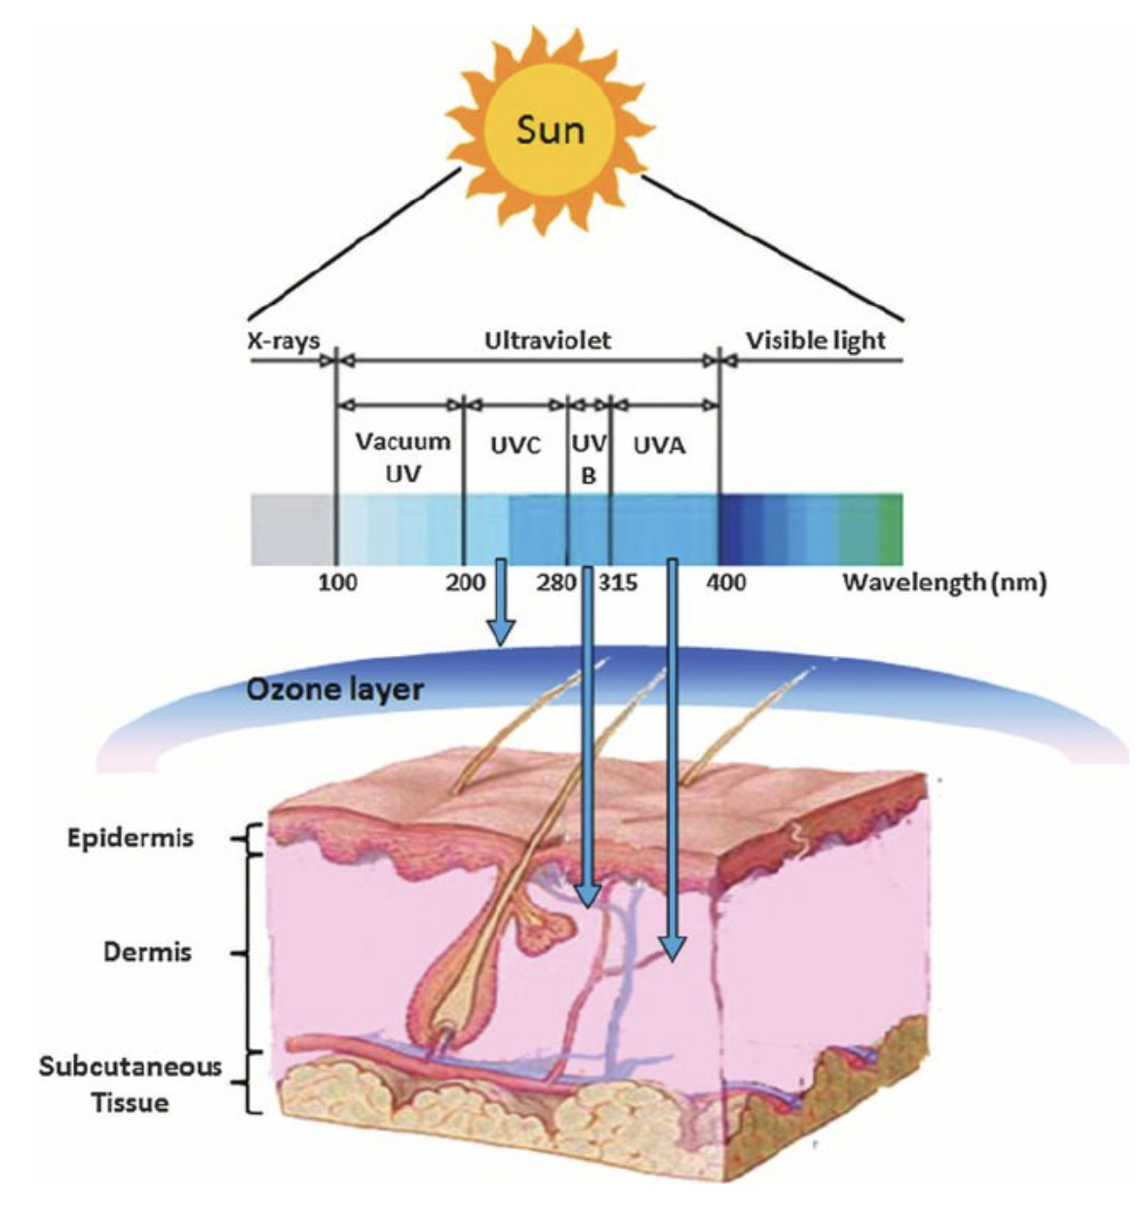
Light-INDUCED NETosis
Prolonged exposure of the skin to ultraviolet radiation (UV) leads to its damage and loss of protective properties.
This condition called photoaging of the skin is caused by a number of destructive factors, such as reactive oxygen species (ROS) and proteolytic enzymes that cause damage to the extracellular matrix, e.g. collagen fibers.
Many cells of the immune system, including neutrophils, are involved in the photoaging process. The presence of neutrophils in the skin exposed to UV irradiation is known; however, the mechanism of neutrophil activity at these conditions remains unclear.
Notes:
p

Slide 4
Example of photoaging
William McElligott
69-year-old truck driver with sun damage on left side of face
His image was published in the New England Journal of Medicine
28 years of sun exposure
Notes:
p

Slide 5
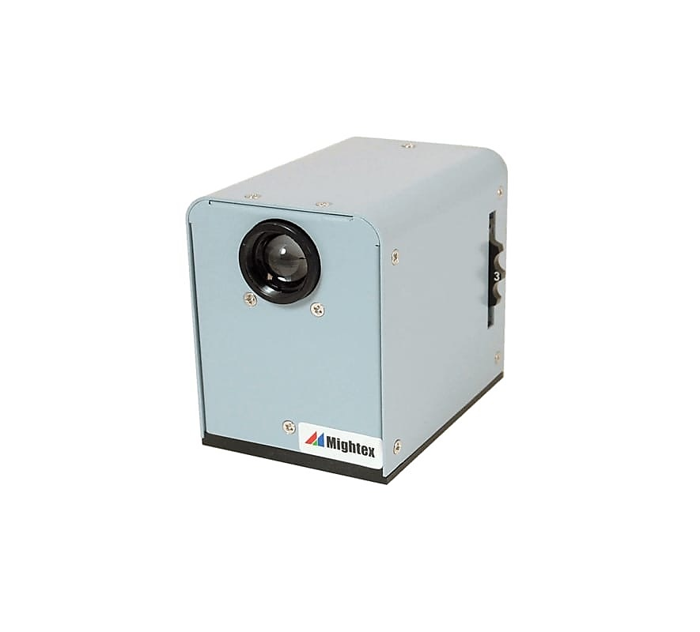
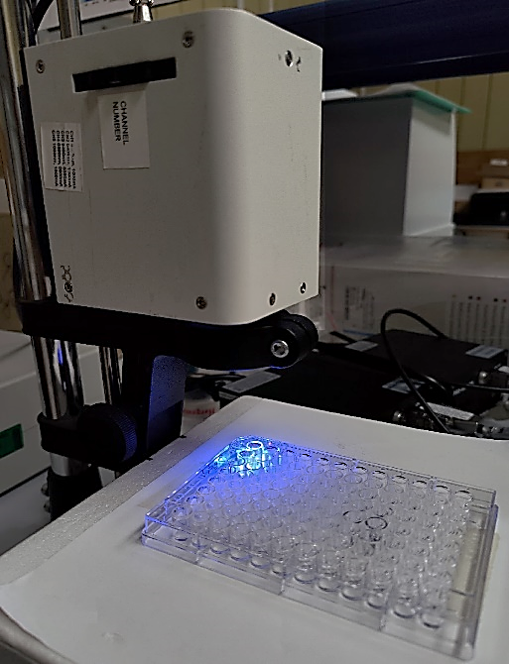
Experiment
Applied light wavelengths:
365 nm (UV, WLSLED-0365-04)
405 nm (blue light, WLS-LED-0405-03)
530 nm (green light, WLS-LED-0530-03)
625 nm (orange light, WLS-LED-0625-03)
656 nm (red light, WLS-LED-0656-03)
CONTROL:
Negative – non irradiated cells
Positive – PMA (50nM)
INHIBITORS:
of NADPH oxidase: apocynin (400µM)
of PAD4: GSK 484 (10µM)
of Mitochondria: Mito-Tempo
WheeLED wavelength-switchable LED source (Mightex, Canada)
Cells were irradiated in a selected dose-dependent manner at the:
4, 16, and 32 J/cm²
Notes:
p

Slide 6
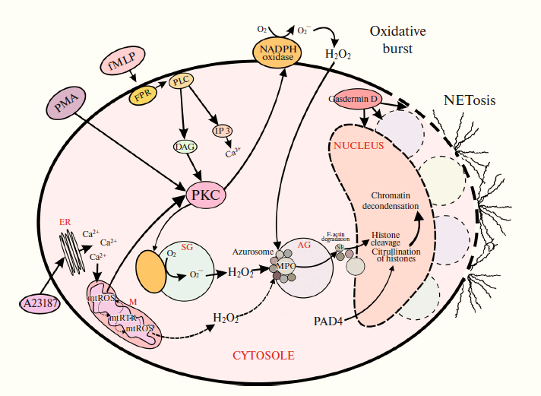
Signalling pathways and mechanisms of NETosis
Schematic representation of classic NETosis
NADPH oxidase – Nicotinamide Adenine Dinucleotide Phosphate Oxidase) – membrane-bound enzyme complex, one of the major sources of cellular ROS
PKC – protein kinase C
NE - neutrophil elastase
MPO – myeloperoxidase
PAD4 – peptidyl arginine deaminase 4
АG – azurophilic granules
SG – specific granules
ER – endoplasmic reticulum
М – mitochondrial matrix
The figure is presented with the kind permission
of the author – Dr Nina Vorobyeva, MSU
Notes:
p

Slide 7
OXIDATIVE STRESS in ACTIVATED NEUTROPHILLS
Stimulation of neutrophils leads to the activation of respiratory burst, which is accompanied by an increase in oxygen consumption and the subsequent production of ROS by the enzyme NADPH oxidase and electron transport chain of mitochondria.
NADPH oxidase assembles in the plasma and granule membranes and transfers electrons from NADPH to molecular oxygen, forming superoxide (O₂⁻).
The enzyme superoxide dismutase then converts O₂⁻ into hydrogen peroxide (H₂O₂), which serves as a precursor to several toxic substances. Of these, HOCl is obtained from the reaction between H₂O₂ and chloride anion (Cl⁻), mediated by the heme enzyme known as myeloperoxidase (MPO).
Schematic of HOCl production
in neutrophils.
H₂O₂ + Cl⁻ + H⁺ → HOCl + H₂O
Notes:
p

Slide 8
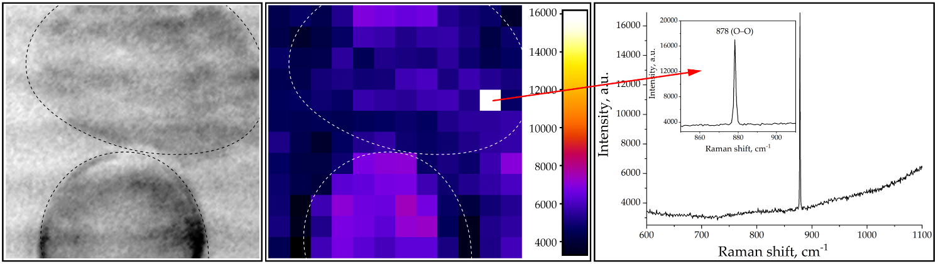
Raman markers of photo-induced NETosis:
various ROS (H₂O₂, HCLO), and citrulline.
Micrograph (left), Raman map (center) and spectrum (right) of neutrophils exposed to radiation with a wavelength of 625 nm and a dose of 32 J/cm².
Characteristic sharp line of hydrogen peroxide (H₂O₂) can be seen on the spectrum (right). Scan area 24 х 24 μm
Notes:
p

Slide 9
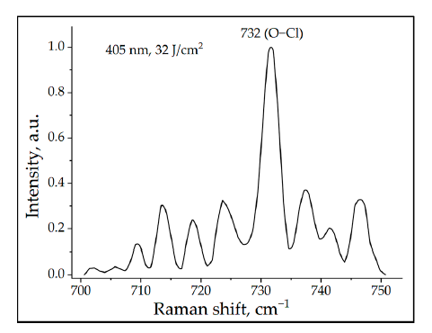
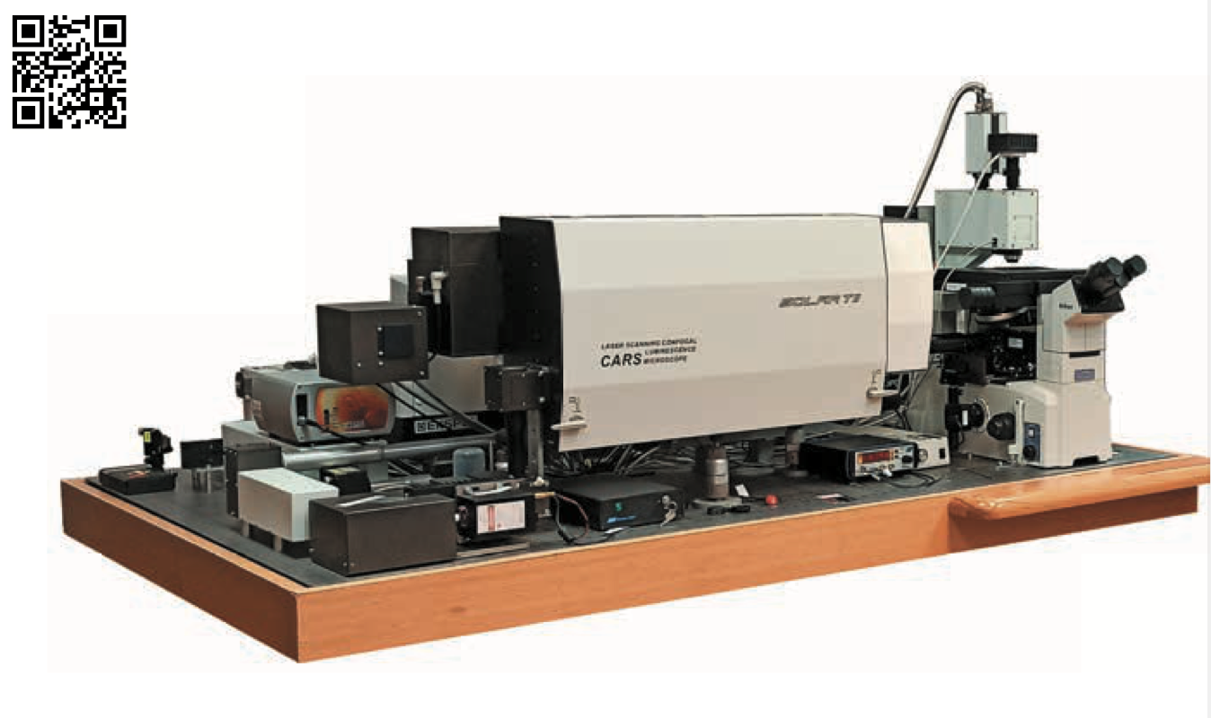
Raman markers of photo-induced NETosis:
various ROS (H₂O₂, HCLO), and citrulline.
Multimodal optical platform: F-CARS, E-CARS, P-CARS, SERS, SECARS
Лаборатория нейтронной физики им. И. М. Франка
flnph.jinr.ru
Raman spectrum of neutrophils exposed to radiation with a
wavelength of 405 nm and a dose of 32 J/cm².
Сharacteristic Raman frequency of 732 cm⁻¹ (O–Cl) for hypochlorous acid (HClO) was recorded.
Notes:
p

Slide 10
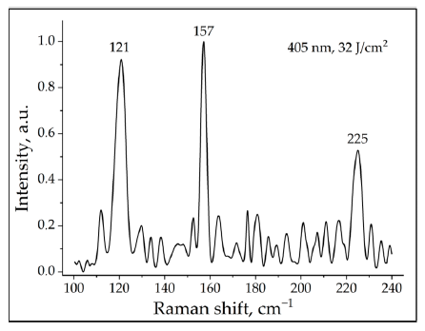
Raman markers of photo-induced NETosis:
PAD4 signaling pathway – citrullinization of histones.
Early study
Raman spectrum of neutrophils exposed to radiation with a wavelength of 405 nm and a dose of 32 J/cm².
Сharacteristic lattice vibrational modes of citrulline can be seen.
Notes:
p

Slide 11
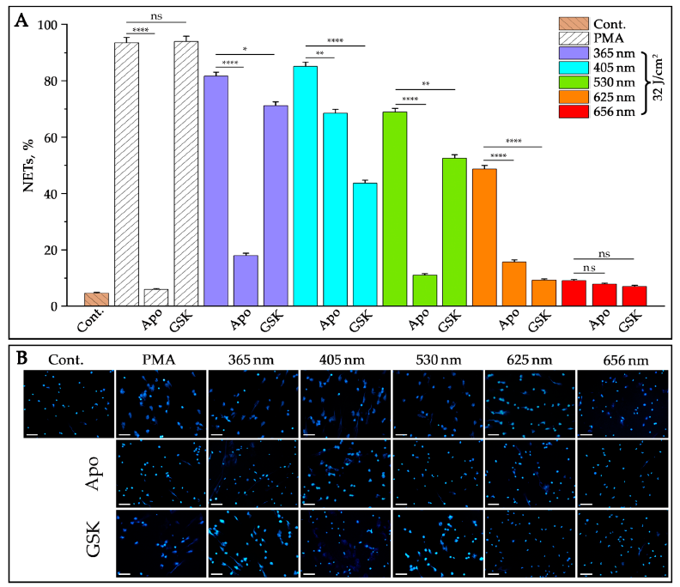
Key Results on Photo-induced NETosis
Inhibitors:
(i) NADPH oxidase – apocynin, 400 μM;
(ii) PAD4 – GSK484, 10 µM
Control:
negative – non-irradiated cells,
positive – PMA, 50nM
Notes:
p

Slide 12
Key Findings on Light-induced NETosis
For the first time, NETosis was detected not only under the action of UV, but also under the visible light radiation at 4 wavelengths from blue to red.
Spectral ROS biomarkers of photoinduced NETosis in its initial stage of oxidative stress have been registered for the first time by Raman spectroscopy.
A hypothesis was put forward and proved about the primary photoacceptors of photoinduced NETosis.
Understanding the molecular mechanisms of various forms of NETosis is important for regulating unwanted NET formation.
The work was carried out over a period of about 3 years 2021-2023 and partially published in:
Arzumanyan G.M., Mamatkulov K.Z., Arynbek Y. et al., Int. J. Mol. Sci., Vol. 24, 6, 2023
Special Issue "Raman Spectroscopy for Chemical and Structural Character. in Biology 2.0”
Notes:
p

Slide 13
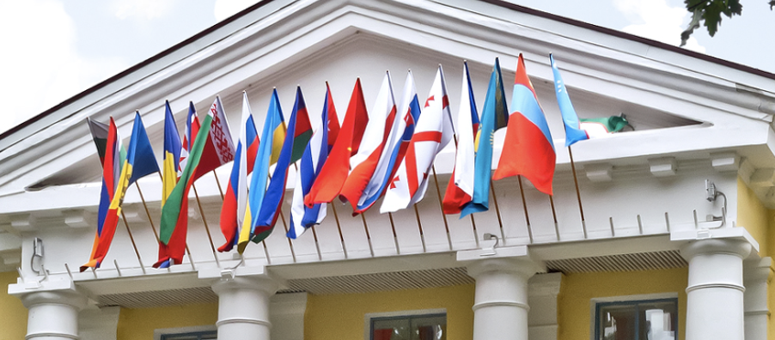
Thank you for your attention!

