Slide 1



Investigation of the crystal structure properties of Bi-activated strontium aluminates
O.N. Lis, S.E. Kichanov, N.M. Belozerova, Yu. V. Bokshyts, G.P. Shevchenko, D.P. Kozlenko

Slide 2
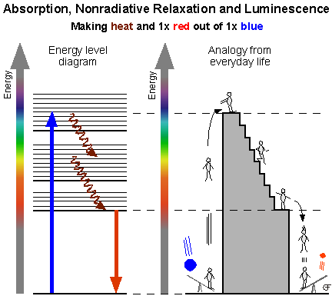
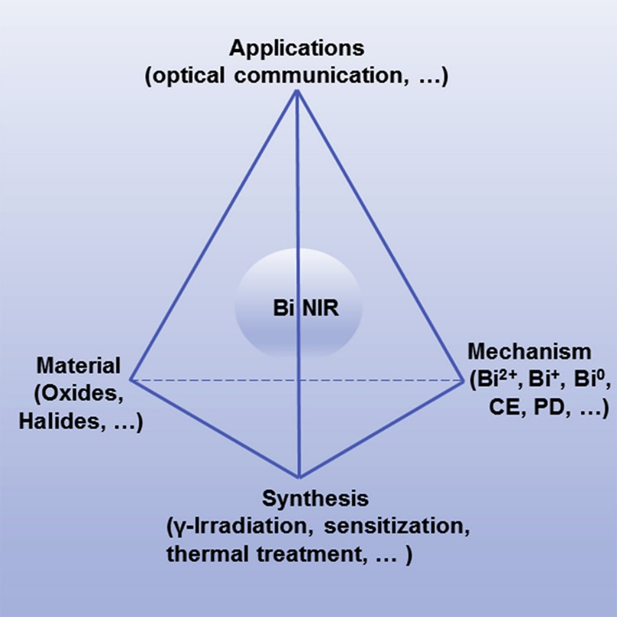
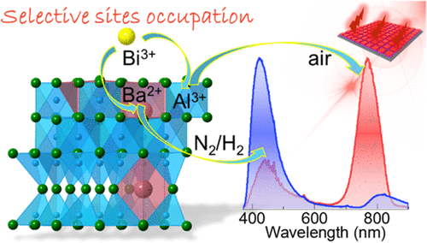

Bi-activated strontium aluminates
Bismuth is a non-toxic metal with a large number of possible valence states which, together with its tendency to form clusters, make it a versatile but complex dopant for possible luminescence applications.
The properties of phosphors depend on the composition of the matrix, the type of activator, its concentration, and, consequently, on the type of crystal structure, replacement positions and environment.

Slide 3
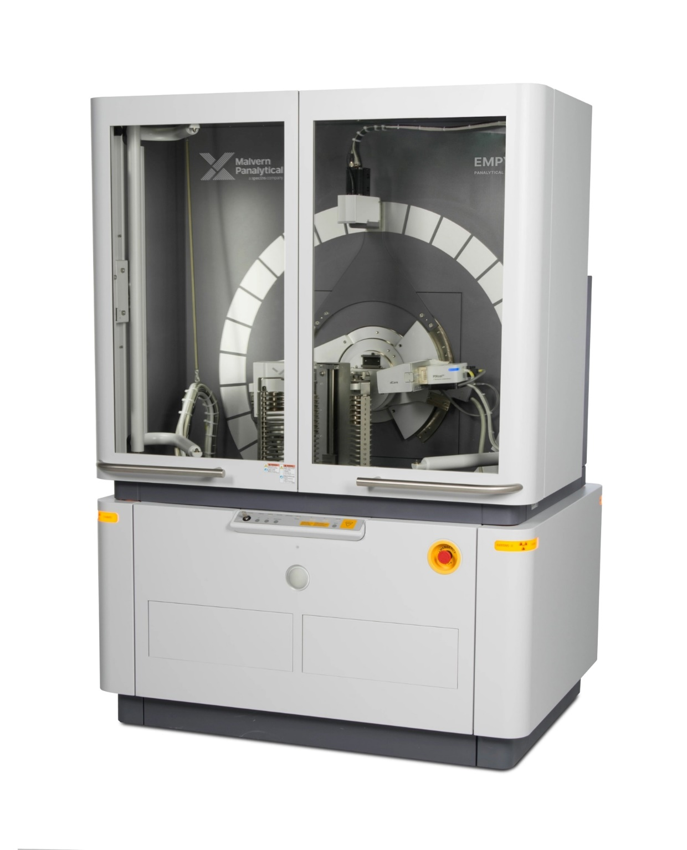

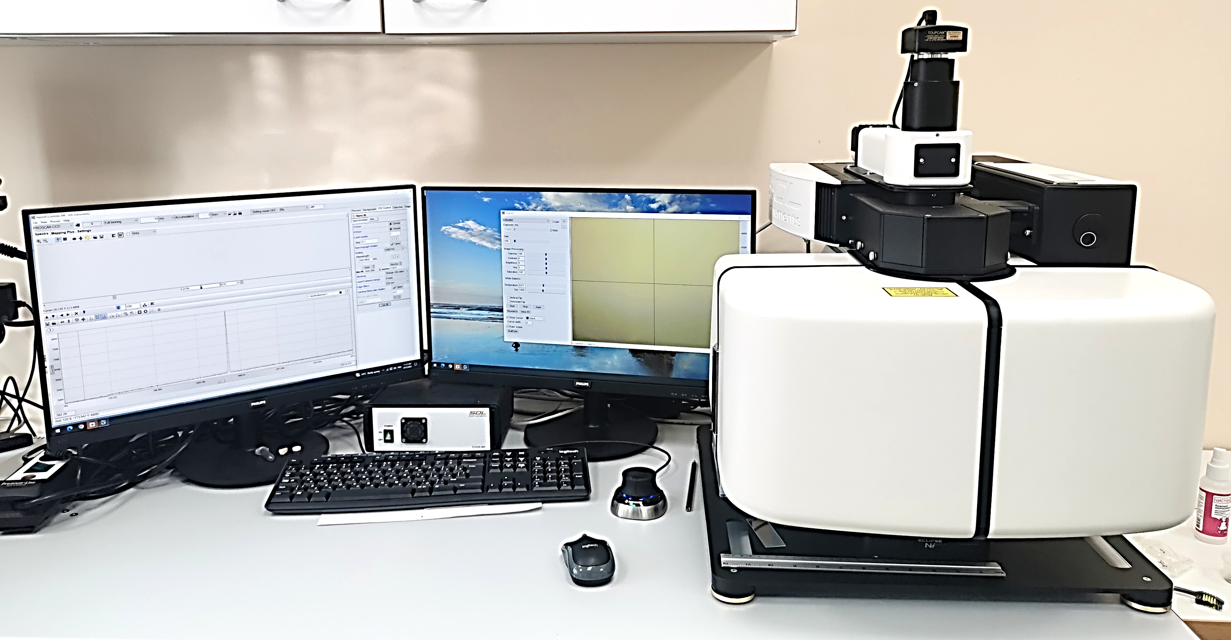
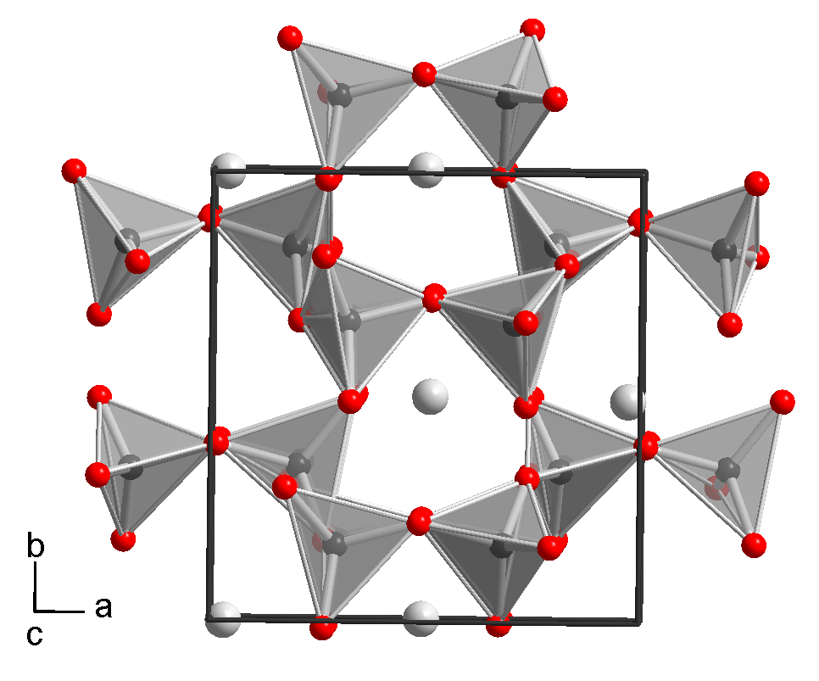
Experimental methods
X-ray diffraction
PANalytical Empyrean Advance X-ray diffractometer
Structure of synthesized compounds
Raman spectroscopy SOL instruments
λ =532 nm, 633 nm

Slide 4
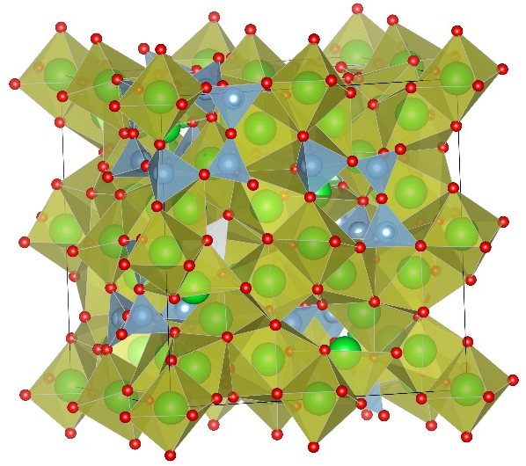
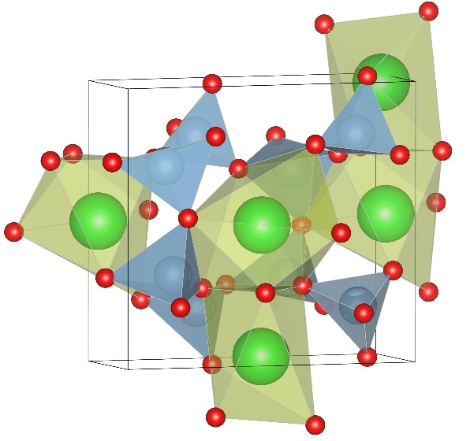
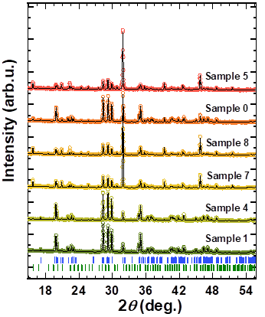
Sr₃Al₂O₆
Structural studies of crystal phosphors
s.g. P2₁
s.g. Pa$\overline{3}$
SrAl₂O₄
SrAl₂O₄/Sr₃Al₂O₆:Bi₂O₃/Bi₂O₄
Synthesis conditions
№ of sample | Activator oxide | Molar ratio of initial reagents
Sample 0 | No | Sr(NO₃)₂:Al₂O₃ = 1:1
Sample 1 | Bi₂O₃ 1.5%
Sample 2 | Bi₂O₃ 3%
Sample 3 | Bi₂O₄ 1.5%
Sample 4 | Bi₂O₄ 3%
Sample 5 | No | Sr(NO₃)₂:Al₂O₃ = 5:3
Sample 6 | Bi₂O₃ 1.5%
Sample 7 | Bi₂O₃ 3%
Sample 8 | Bi₂O₄ 1.5%
Sample 9 | Bi₂O₄ 3%
Sample 9
X-ray diffraction patterns of strontium aluminate compounds Color labeling of the corresponding diffraction peaks of the monoclinic (M) and cubic (C) phases.

Slide 5
Sr₃Al₂O₆
Structural studies of crystal phosphors
SrAl₂O₄
The relative decrease in the unit cell volumes of the monoclinic (orange triangles) and cubic phases (violet points) of studied strontium aluminates.
The average lengths of the Sr-O bonds of the strontium aluminate compounds. b) The average Al-O bond lengths of the tetragonal oxygen coordination for monoclinic and cubic phases of the strontium aluminates compounds.

Slide 6
Structural studies of crystal phosphors
The position of characteristic Raman lines for the monoclinic (a) and cubic (b) phase of the strontium aluminate compounds.

Slide 7
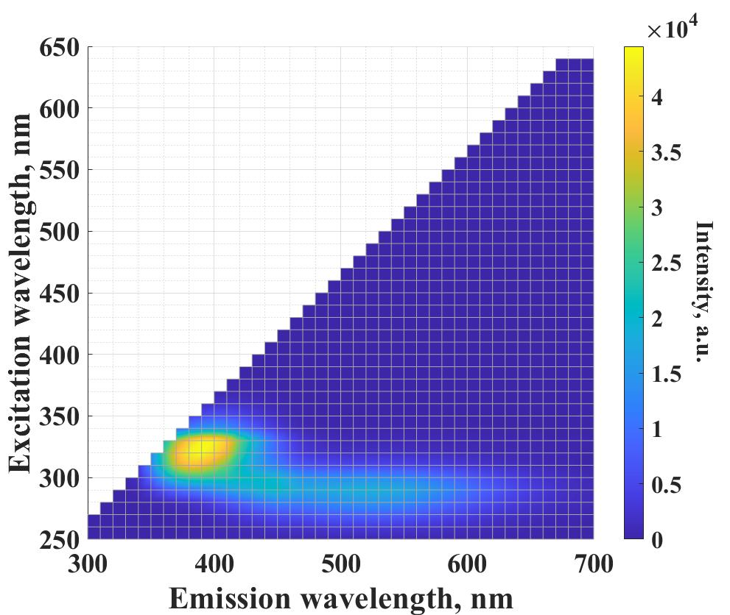
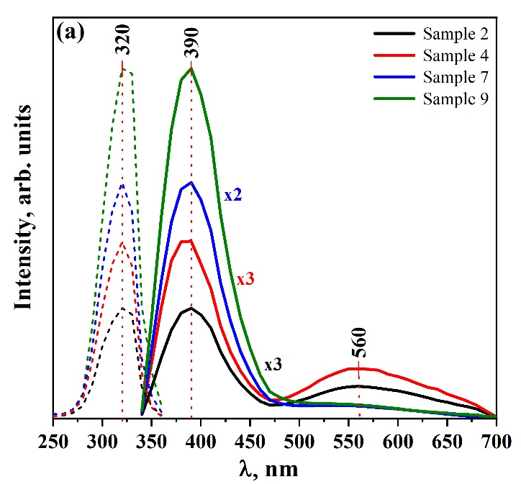
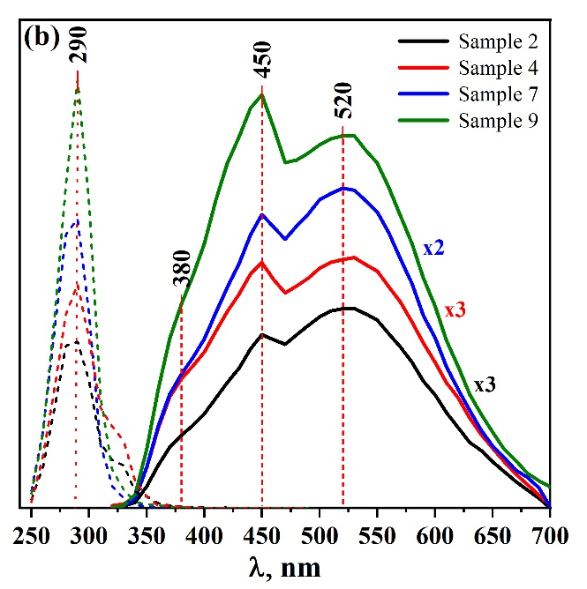
Optical properties of phosphors
Measured fluorescence data for selected strontium aluminate compounds (Samples 2,4,7,9): (a) excitation (λ_{em}=390 nm, dashed lines) and emission (λ_{ex}=320 nm, solid lines) spectra revealing a sharp emission peak at 390 nm; (b) excitation (λ_{em}=520 nm, dashed lines) and emission (λ_{ex}=290 nm, solid lines) spectra revealing a broadband emission centered at ~520 nm; The peak positions corresponding to different radiative transitions are labeled with corresponding wavelength values.
2D excitation – emission map for Sample 9. Such fluorescence signal distribution is typical for a whole set of studied bismuth-activated strontium aluminates.

Slide 8
Conclusions
The results clearly indicate the formation of monoclinic SrAl₂O₄ and cubic Sr₃Al₂O₆ phases of strontium aluminates during synthesis, and the relative content of these phases can be controlled through the ratio of the initial components in the chemical synthesis. Changes in the crystal structural parameters, bond lengths, and frequencies of characteristic vibration modes indicate the incorporation of bismuth ions into the crystal lattice of both phases.
Based on structural and spectral data, we can declare that the fluorescent properties of the studied strontium aluminates can be controlled through the formation of a two-component system in which the bismuth ion activators can be located in various crystallographic coordination.
The increase in luminescence intensity can be explained by the redistribution of the activator ion Bi³⁺ both between the monoclinic and cubic phases as well as between different strontium positions in the crystal structure.

Slide 9
Thank you for attention!

