Slide 1


Joint Institute for Nuclear Research
Frank Laboratory of Neutron Physics
Polyacrylamide brushes synthesized with “grafting through” approach: characterization and scaling analysis
Avdeev M.M.^{1,2}, Shibaev A.V.², Maslakov K.I.³, Dvoryak S.V.³, Lokshin B.V.⁴, Gorshkova Yu.E^{1,5}, Tropin T.V.¹, Philippova O.E.²
¹ Frank Laboratory of Neutron Physics, Joint Institute for Nuclear Research, Dubna, Russia
² Faculty of Physics, M.V. Lomonosov Moscow State University, Moscow, Russia
³ Chemistry Department, M.V. Lomonosov Moscow State University, Moscow, Russia
⁴ Nesmeyanov Institute of Organoelement Compounds, Russian Academy of Sciences, Moscow, Russia
⁵Institute of Physics, Kazan Federal University, Kazan, Russia
Dubna 2023

Slide 2
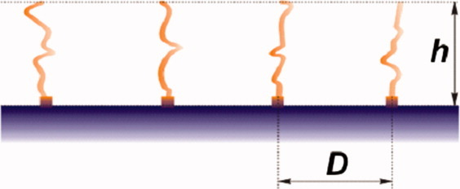
What are polymer brushes and what are they used for?
2a
Fig. 1.1. Scheme of the structure of an ordinary polymer brush

Slide 3
What are polymer brushes and what are they used for?
2a
Fig. 1.1. Scheme of the structure of an ordinary polymer brush
Fig. 1.2. Stimuli-responsive coatings
Zhe Chen, et. al.. Langmuir 2012 28 (37), 13452-13458

Slide 4
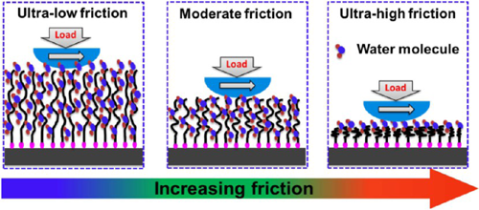
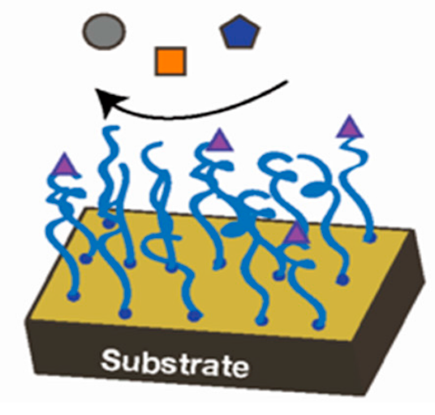
What are polymer brushes and what are they used for?
2a
Fig. 1.1. Scheme of the structure of an ordinary polymer brush
Fig. 1.2. Stimuli-responsive coatings
Zhe Chen, et. al.. Langmuir 2012 28 (37), 13452-13458
Fig. 1.3. Lubricants and protective coatings
Qiangbing Wei, et. al.; Macromolecules 2013 46 (23), 9368-9379

Slide 5
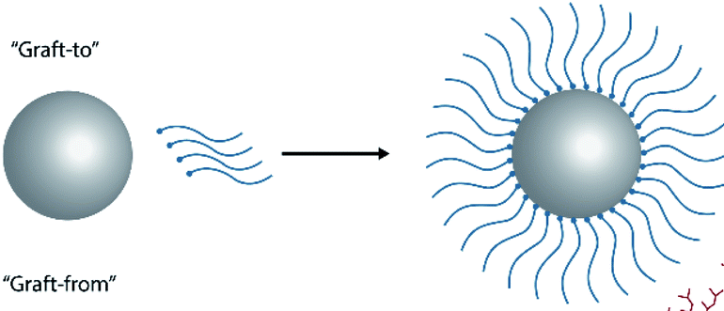
What are polymer brushes and what are they used for?
2a
Fig. 1.1. Scheme of the structure of an ordinary polymer brush
Fig. 1.2. Stimuli-responsive coatings
Zhe Chen, et. al.. Langmuir 2012 28 (37), 13452-13458
Fig. 1.3. Lubricants and protective coatings
Fig. 1.4. Stabilization and integration of nanoparticles in nanocomposites
Qiangbing Wei, et. al.; Macromolecules 2013 46 (23), 9368-9379

Slide 6
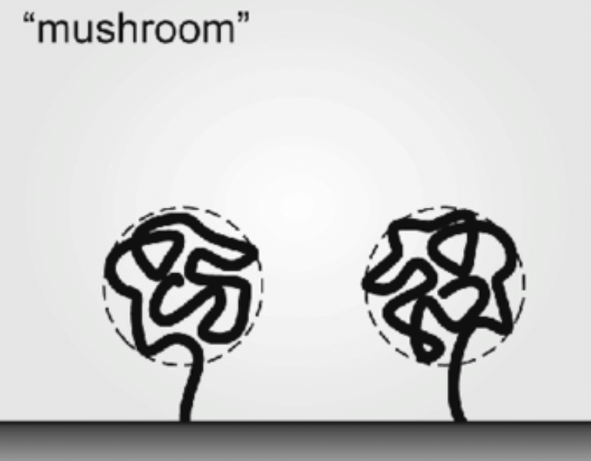
Polymer brush synthesis: “grafting through” approach
“grafting-to”
“grafting-from”
“grafting-through”
Mushroom-like brush

Slide 7
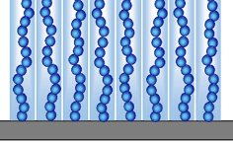
Polymer brush synthesis: “grafting through” approach
“grafting-to”
“grafting-from”
“grafting-through”
Mushroom-like brush
Dense brush

Slide 8
Polymer brush synthesis: “grafting through” approach
“grafting-to”
“grafting-from”
“grafting-through”
Mushroom-like brush
Dense brush
???

Slide 9
GOALS & OBJECTIVES
Goals
Investigate the features of “grafting-through” approach
Objectives
Scaling analysis of the polymer brush thickness
Tuning the polymer brush thickness by changing the external conditions

Slide 10
Sample preparation: Step 1 – surface activation
in H₂O
Andrew S. D’Souza, et. al. Journal of the American Ceramic Society, Vol. 82, 5, 1998, 1289-1293
piranha – H₂SO₄ + H₂O₂ (3:1)
Silicon substrate
After piranha etching

Slide 11
Sample preparation: Step 2 – monomer grafting
TMSPMA(MPS)

Slide 12
Sample preparation: Step 3 – polymerization process

Slide 13
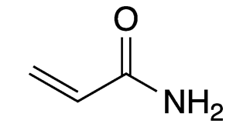
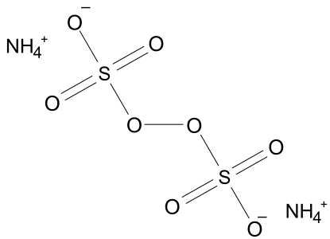
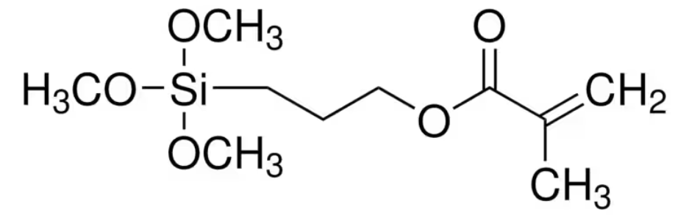
Sample preparation: Step 3 – polymerization process
Reaction vessel
Substances
acrylamide (monomer)
Ammonium persulfate (initiator)
Free-radical polymerization
Thermal catalysis at T = 30-60°C
Preparation time: 12 hrs
Reaction mixture
  Monomer – 10 wt%
  Initiator – 0.16 wt%
TMSPMA (anchor)

Slide 14
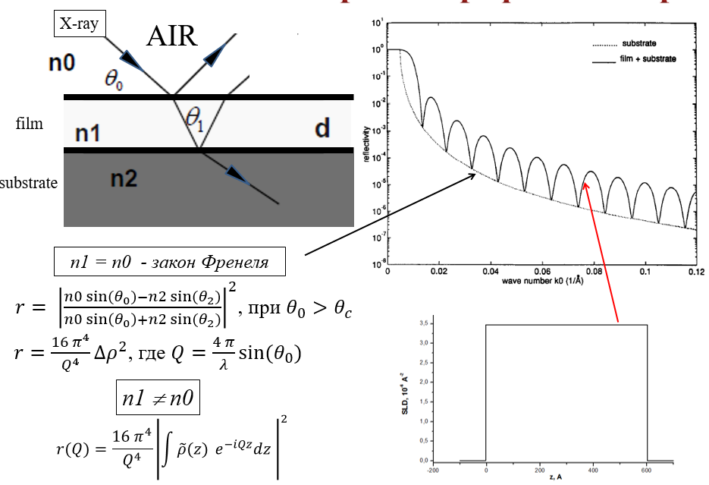
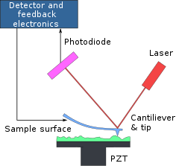

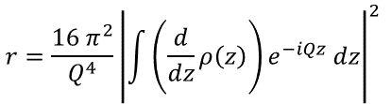
Investigation methods
X-Ray Reflectometry (XRR)
Atomic-Force Microscopy (AFM)
Fresnel law
$$≈$$
$$r=\frac{16 π^{2}}{Q^{4}}{\left|\int{\left(\frac{d}{dz}ρ\left(z\right)\right)e^{−iQz} dz}\right|}^{2}$$
Thickness and SLD profiles analysis
Surface morphology analysis
device: EMPYRIAN (Malvern Pananalytical)
Tubes: Cu (λ = 1.54), Co (λ = 1.79A)
Measurements were carried out at FLNP JINR
device: NTEGRA (NT MDT Spectrum Instruments)
Probe: NSG01(monocrystal. Si, R = 10 nm, k=5.1 N/m)
Measurements were carried out at FLNP JINR

Slide 15
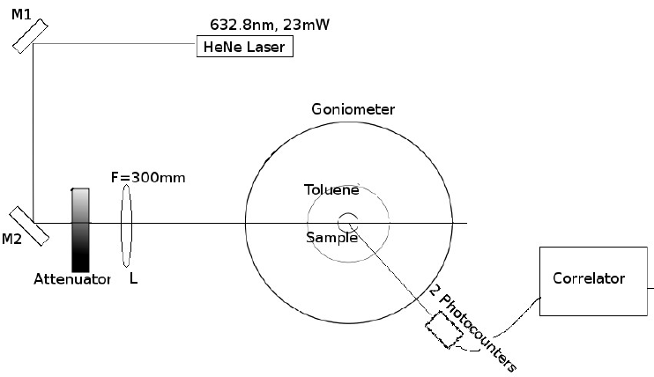
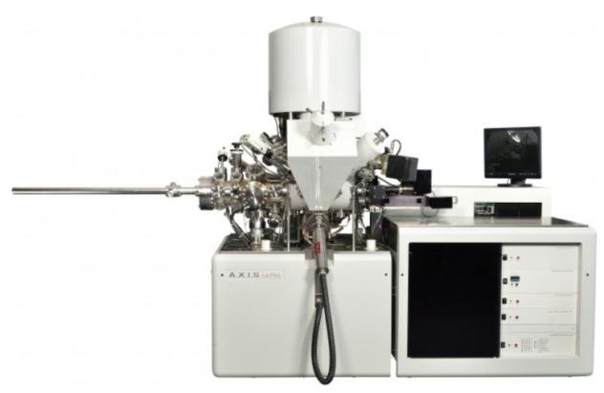
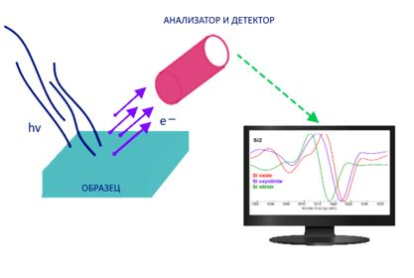
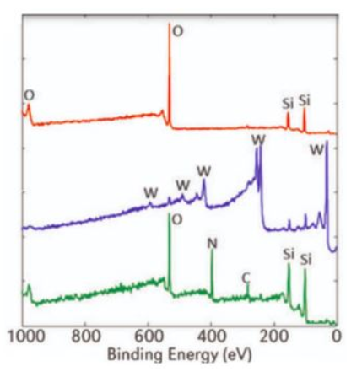
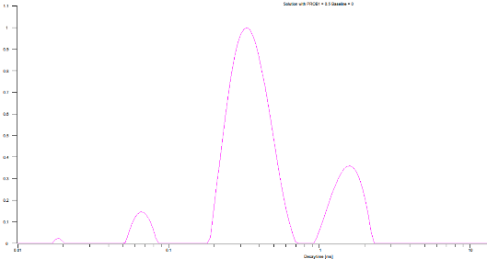
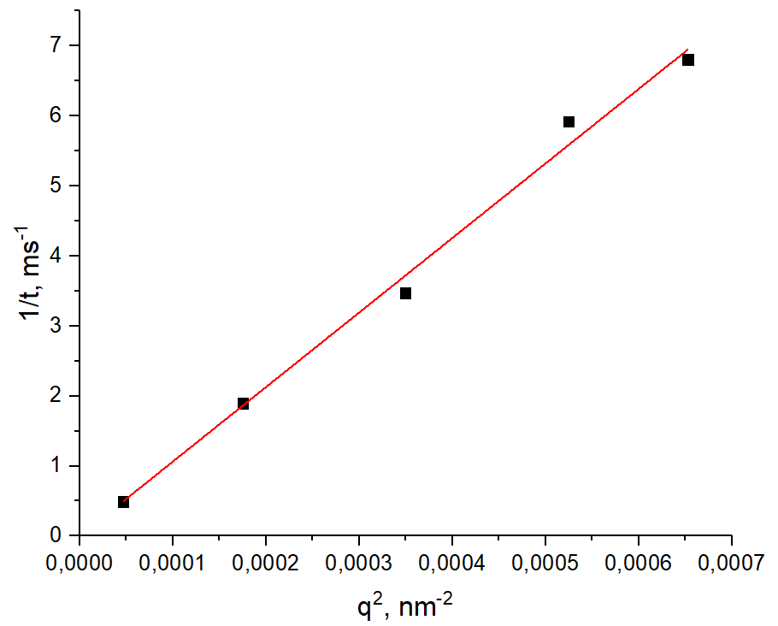
Investigation methods
Dynamic light scattering (DLS)
X-Ray Photoelectron Spectroscopy (XPS)
Diffusion analysis of free-polymer coils
Chemical composition analysis
device: ALV 5000 MULTIPLE TAU DIGITAL CORRELATOR with goniometer
λ =632.8нм
Measurements were carried out at Faculty of physics of Lomonosov MSU
device: Kratos Axis Ultra DLD
Съемка – AlKa mono c нейтрализатором
XPS measurements were made at XPS facility of Lomonosov MSU

Slide 16
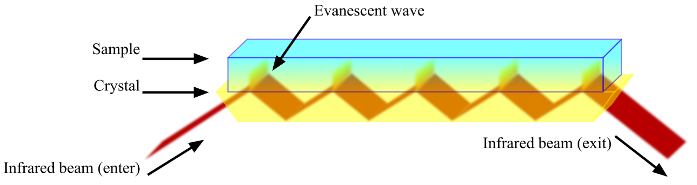
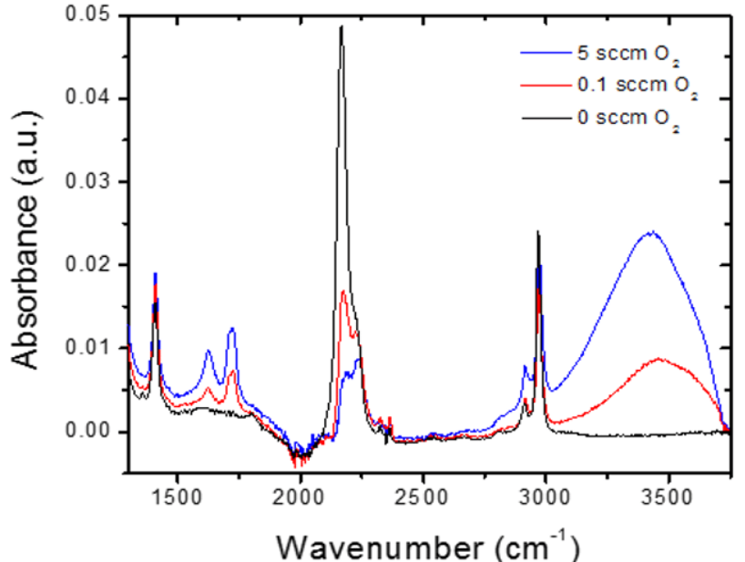
Investigation methods
Fourier-transform infrared spectroscopy (FTIR - ATR)
Chemical composition analysis
device: VERTEX 70v
Diamond crystal
FTIR measurements were made at INEOS RAS

Slide 17
Polymer brush formation
XPS
FTIR ATR
C1s
O1s
Si peaks
polymer
С=O val.
C-H def.
anchor
Si
С-H val.
N-H val.
Si2p
N1s
Figure 2.1. High-resolution C1s, O1s, Si2p and N1s XPS spectra of substrates at different stages of preparation
Figure 2.2 FTIR-ATR spectra at each stage of preparation

Slide 18
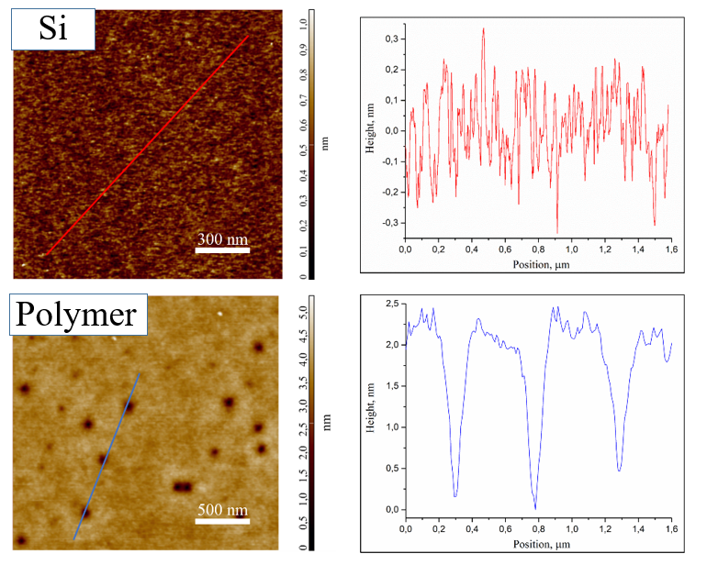
Polymer brush formation
Fig. 2.3. XRR curves: dependences of the reflectivity (R) on the scattering vector (q) for the dried samples at different preparation stages.
Fig. 2.4. AFM images of pristine(a) and polymer covered(b) Si substrates.

Slide 19
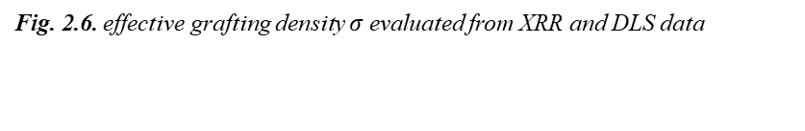
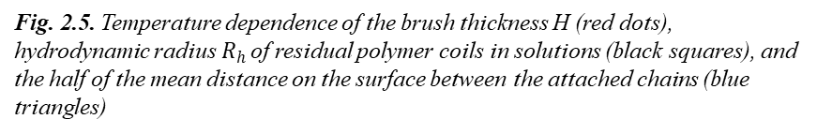
Grafting and polymerization at low temperatures
Fig. 2.5. Temperature dependence of the brush thickness H (red dots), hydrodynamic radius $R_{h}$ of residual polymer coils in solutions (black squares), and the half of the mean distance on the surface between the attached chains (blue triangles)
Fig. 2.6. effective grafting density $σ$ evaluated from XRR and DLS data

Slide 20

Grafting and polymerization at low temperatures
$$v2=0.5$$
Fig. 2.6. Log-log plot of the polymer chains hydrodynamic radii (R_{h}) vs. brush thickness (H) for the scaling analysis of the polymer chains in the bulk and on the surface
Fig. 2.7. Dependence of brush thickness on the washing time

Slide 21

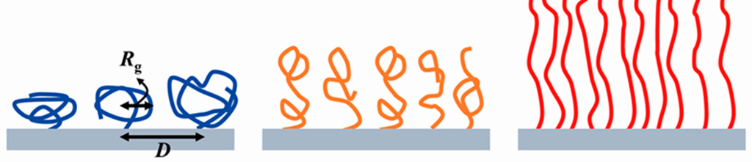
Grafting and polymerization at low temperatures
Grafting to
Grafting through
Grafting from

Slide 22
Conclusions
the polyacrylamide brushes with different thickness were synthesized and chemically attached to flat silica surface using the “grafting through” technique.
pros and cons of the grafting-through approach:
  “+” “-”
  cheap chaotic structure
  simple hard to control
  high grafting density residual product
  “clean” synthesis
new features of “grafting-through” approach:
  the intermediate stretch of attached polymer chains
  possibility of the thickness control by temperature variation
The work is financially supported by the Russian Science Foundation (project № 21-73-10197)
Colloids and Surfaces A: Physicochemical and Engineering Aspects. Submitted
Avdeev, Mikhail M. et.al. “Brushes Synthesized by “Grafting Through” Approach: Characterization and Scaling Analysis”

Slide 23
Thank you for your attention!

Slide 24
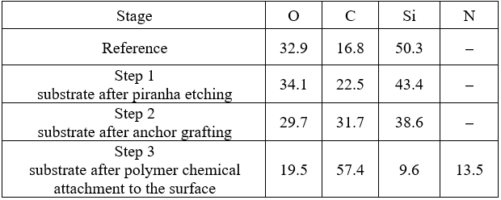
Polymer brush formation
Elemental composition calculated from high-resolution XPS spectra, at.%.
Figure 2.1. Survey XPS spectra of substrates at different stages of preparation
6

Slide 25
Polymer brush formation
Table 2. Binding energies of components in high-resolution XPS spectra of polymer brush on silicon wafer surface at different stages of preparation, their attribution to different species and the content of these species.
Spectrum | Binding energy, eV | Content, at. % |  |  |  | Species
 |  | Reference | Step 1 | Step2 | Step 3
O1s | 531.4 | – | – | – | 13.5 | O=C
 | 532.4–532.5 | 32.9 | 34.1 | 29.7 | 5.0 | SiO2, HO−C
 | 533.6 | – | – | – | 1.0 | C−O−C, O=C−O
C1s | 285.0 | 12.9 | 18.5 | 27.1 | 39.0 | C−C,H (sp3)
 | 286.3–286.6 | 2.8 | 2.8 | 2.9 | 3.3 | С−O
 | 287.9–288.1 | 0.5 | 0.6 | 0.6 | 14.4 | O−C−O, C=O, O=C−N
 | 289.2–289.3 | 0.6 | 0.6 | 1.1 | 0.7 | O=C−O
N1s | 399.8 | – | – | – | 13.5 | −NH2
Si2p3/2 | 98.8–99.0 | 41.4 | 34.6 | 30.5 | 7.4 | Si0
 | 102.6–103.0 | 8.9 | 8.8 | 8.1 | 2.2 | SiO2
6

