Slide 1

K. Berestov, D. Pugachev
Jinr, Dubna, Moscow Region, Russia
Simulation of the Permanent Magnet System for Compact 14 GHz ECR Ion Source

Slide 2
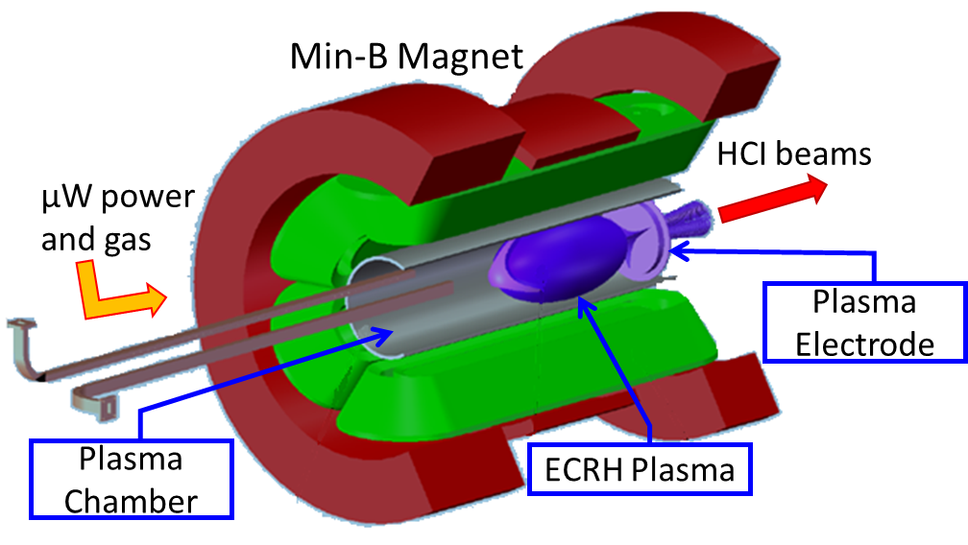
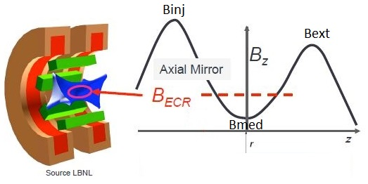

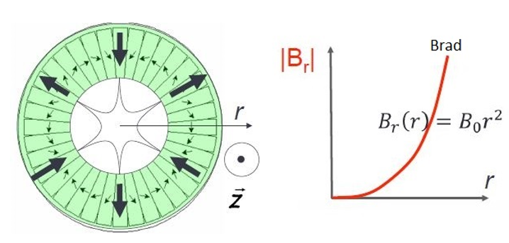
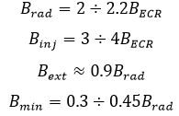
Basics of the ECR Ion Sources
Magnets for axial field
ECR Ion Source
f[GHz] | B[T] | n_{ec} [cm⁻³]
2.45 | 0.0875 | 7.44x10¹⁰
6.4 | 0.23 | 5.08x10¹¹
10 | 0.36 | 1.24x10¹²
14 | 0.5 | 2.43x10¹²
16 | 0.57 | 3.2x10¹²
18 | 0.64 | 4x10¹²
28 | 1 | 10¹³
Permanent magnet hexapole

Slide 3
The purpose of the work
Production and use of heavy-ion beams with high energy for basic, applied, and cross-disciplinary research
at the 5.5 MV single ended Van de Graaff Accelerator.
Scientific motivations:
Material Sciences.
Characterization of materials through the use of Analytical Techniques of Nuclear Origin:
ERDA, RBS, NRA, PIXE
Implantation, crystalline structure modification….
Low energy nuclear physics.
Beam energy:
E = V_{T} × Z
V_{T} - terminal voltage
Multicharged ions
Z – charge state of accelerated ion
Electron Cyclotron Resonance (ECR) ion source

Slide 4
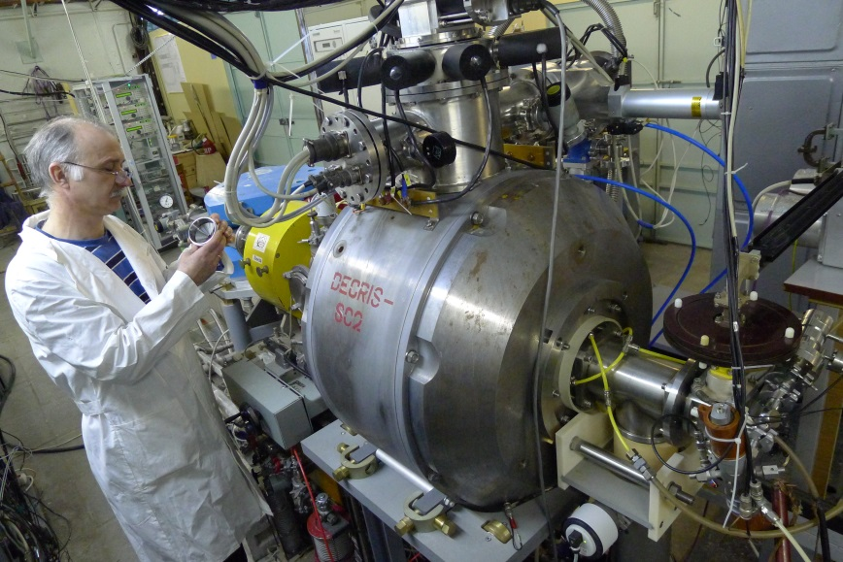
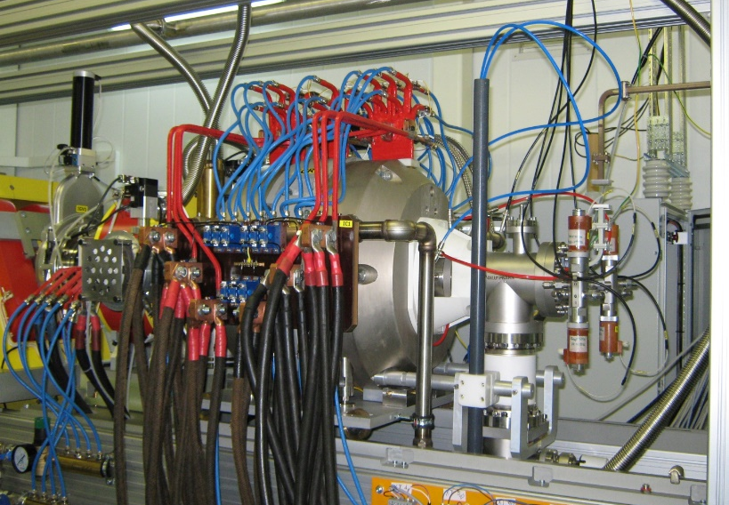
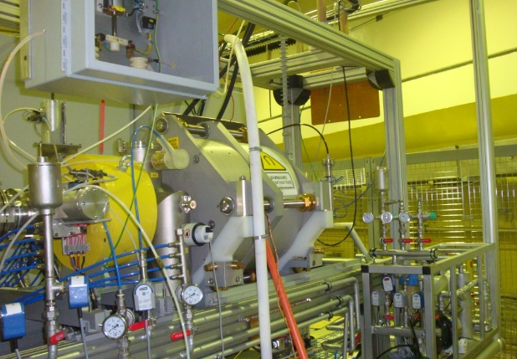
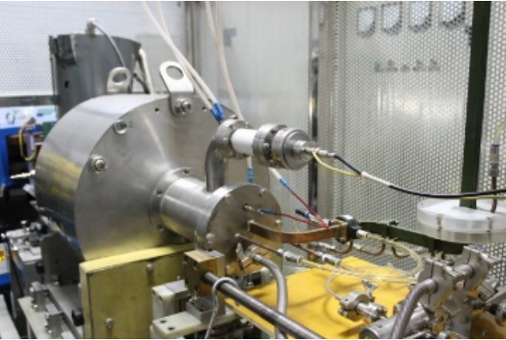
ECR ion source options
Superconducting type
Hybrid type
Room temperature type
˃ 1m
~ 0.5 m
~ 0.5 m
DECRIS-SC2
DECRIS-5
SECRAL-II@28 GHz
Permanent magnet type
~ 0.5 m
DECRIS-PM
LAPECR2
SUPERNANOGAN

Slide 5
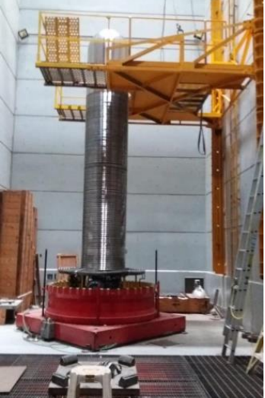
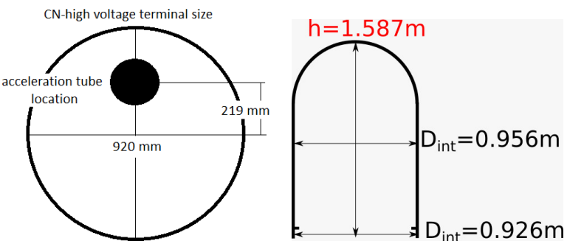
Requirements to the ECR ion source located at HV terminal
Low power consumption: up to 1 kW is available
Low maintenance: This ECRIS should be able to run without any maintenance for no less than 2000 hours.
Compact size
High Voltage Terminal
The space available for the ion source

Slide 6

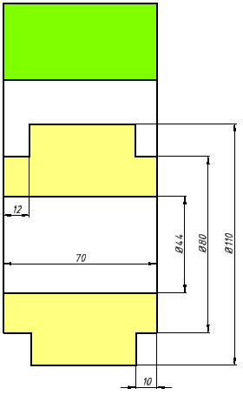
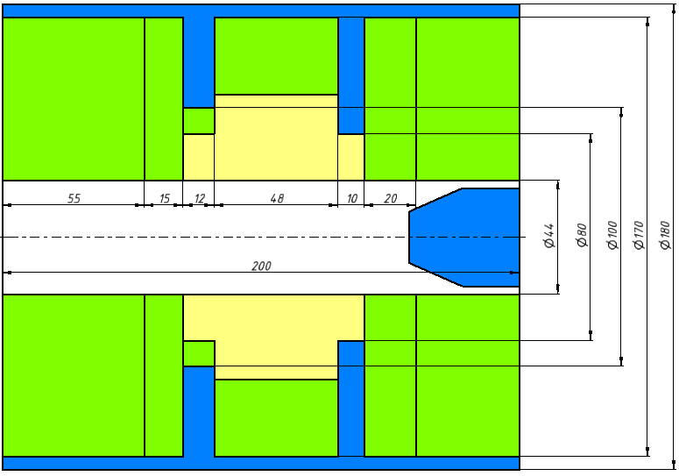

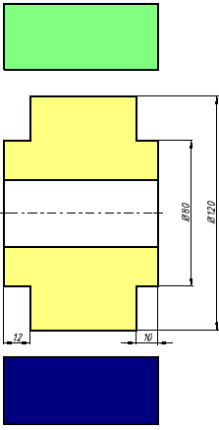

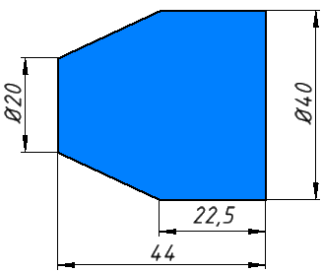
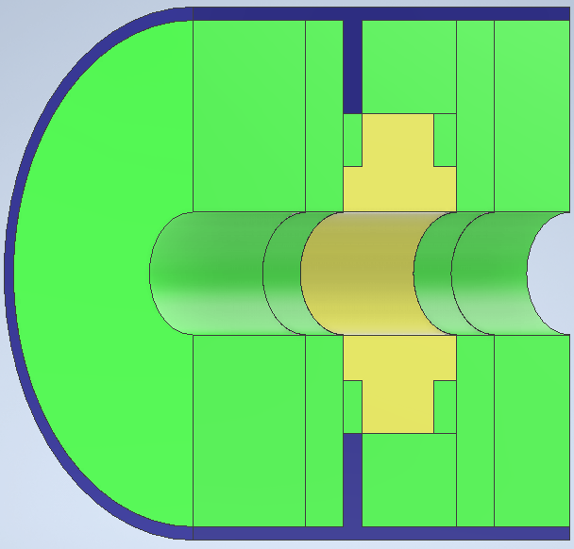
PM Magnet System for Compact 14 GHz ECR Ion Source №1
PM Magnet
Hexapole
Magnet
Iron Plug
Magnetic system for 14 GHz ECR Ion Source №1

Slide 7
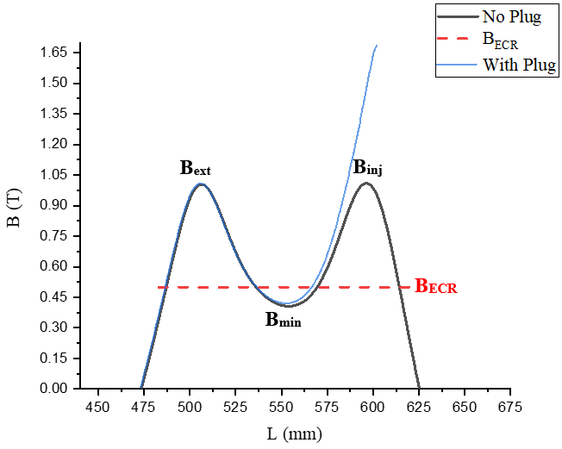
Axial magnetic system configuration
Configuration №1 | No Plug | With Plug
Magnet Ø, mm | 170 | 170
Chamber Ø, mm | 44 | 44
L, mm | 200 | 200
B_{ext}, T | 1.0 | 1.0
B_{min}, T | 0.40 | 0.41
B_{inj}, T | 1 | 1.68
B_{rad}, T | 1.15 | 1.15
W (no hexapole and iron), kg | 26.45 | 26.45
Material | NdFeB (N48SH) | NdFeB (N48SH)
Axial magnetic field distribution

Slide 8
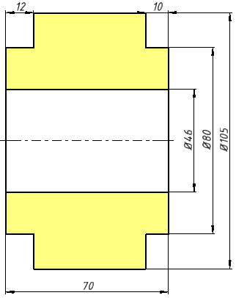
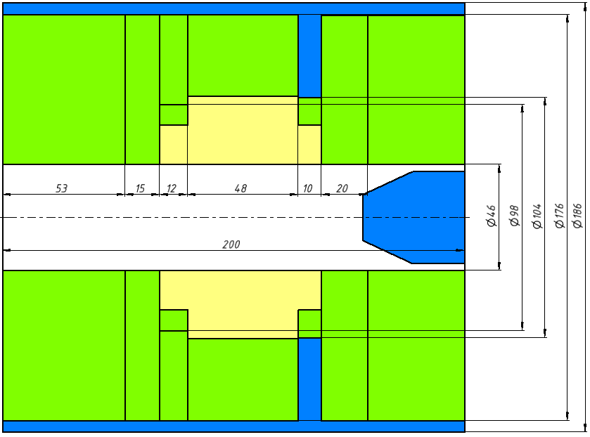
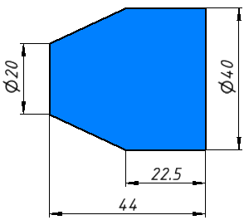
PM Magnet System for Compact 14 GHz ECR Ion Source №2
Hexapole
Magnet
Iron Plug
Magnetic system for 14 GHz ECR Ion Source №2

Slide 9
Axial magnetic system configuration
Configuration №1 | No Plug | With Plug
Magnet Ø, mm | 176 | 176
Chamber Ø, mm | 46 | 46
L, mm | 200 | 200
B_{ext}, T | 1.01 | 1.01
B_{min}, T | 0.40 | 0.41
B_{inj}, T | 1.04 | 1.74
B_{rad}, T | 1.13 | 1.13
W (no hexapole and iron), kg | 29.12 | 29.12
Material | NdFeB (N48SH) | NdFeB (N48SH)
B_{ext}
B_{inj}
B_{ECR}
B_{min}
Axial magnetic field distribution

Slide 10
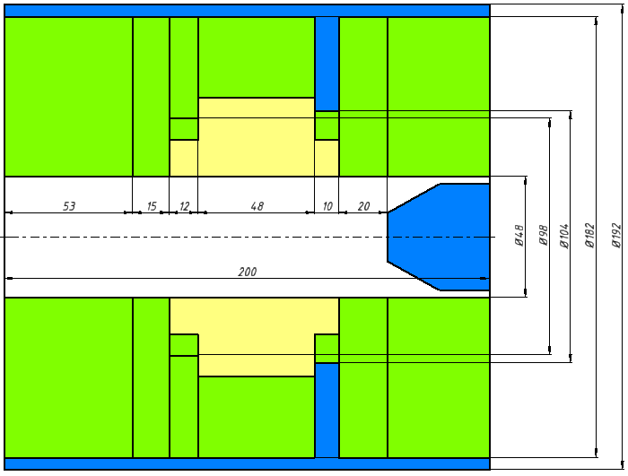
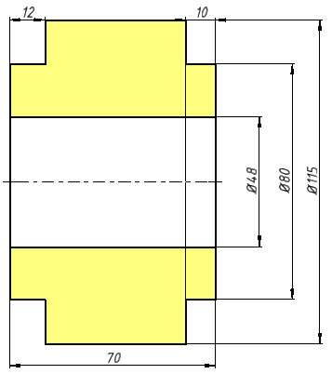
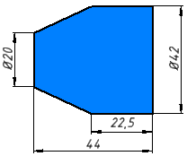
PM Magnet System for Compact 14 GHz ECR Ion Source №3
Hexapole
Magnet
Iron Plug
Magnetic system for 14 GHz ECR Ion Source №3

Slide 11
Axial magnetic system configuration
Configuration №1 | No Plug | With Plug
Magnet Ø, mm | 182 | 182
Chamber Ø, mm | 48 | 48
L, mm | 200 | 200
B_{ext}, T | 1 | 1
B_{min}, T | 0.4 | 0.41
B_{inj}, T | 1.01 | 1.61
B_{rad}, T | 1.17 | 1.17
W (no hexapole and iron), kg | 30.67 | 30.67
Material | NdFeB (N48SH) | NdFeB (N48SH)
B_{ext}
B_{inj}
B_{ECR}
B_{min}
Axial magnetic field distribution

Slide 12
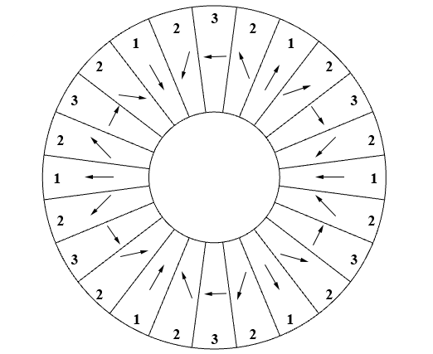
Hexapole configuration
105 mm
Magnetization configuration (24 sectors): 1 – poles (0^{о}), 2 – middle sectors (45^{о}), 3 – inter-pole sectors (90 ^{о})
Radial magnetic field distribution
Hexapole Ø, mm | 105 | 110 | 115
B_{rad}, T | 1.13 | 1.15 | 1.17

Slide 13
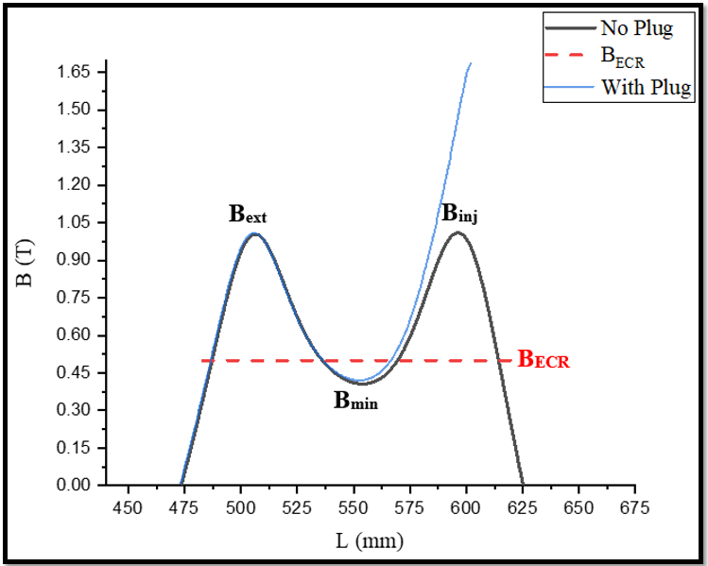
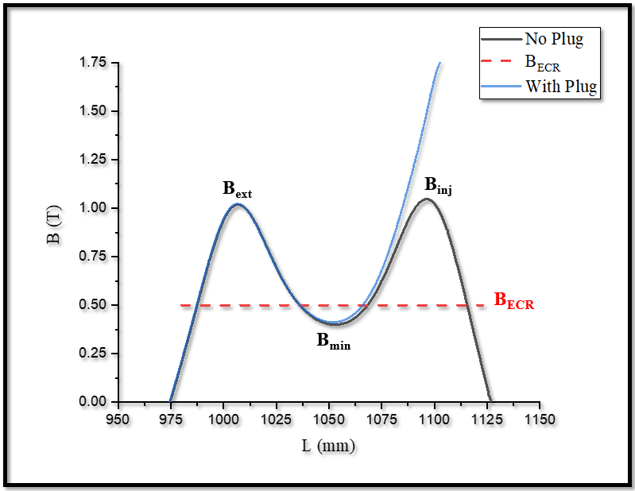
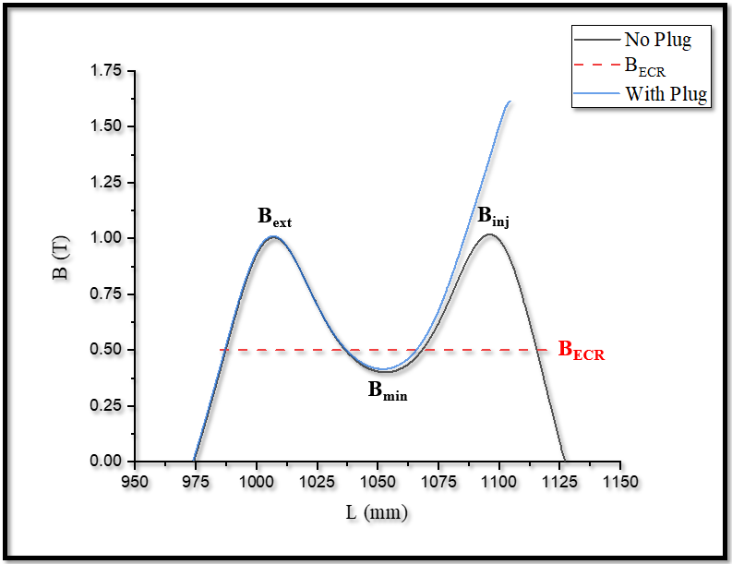
Results
Axial field distribution Configuration 1
Axial field distribution
Configuration 2
Axial field distribution
Configuration 3
Configuration № | Сhamber Ø, mm | L, mm | No plug/With Plug |  |  | B_{rad}, T | W, kg
 |  |  | B_{ext}, T | B_{min}, T | B_{inj}, T
1 | 44 | 200 | 1/1 | 0.4/0.41 | 1/1.68 | 1.15 | 37.35
2 | 46 | 200 | 1/1 | 0.4/0.41 | 1.04/1.74 | 1.13 | 38.47
3 | 48 | 200 | 1/1 | 0.4/0.41 | 1.01/1.61 | 1.17 | 40.89

Slide 14
Conclusion
Compact magnetic plasma-confinement system for 14 GHz ECR Ion Source was simulated;
The weight of the permanent magnets for axial magnetic field is about 37, 38, 40 kg;
Simulated permanent magnetic system for 14 GHz ECR Ion Source satisfies the specified requirements.

Slide 15
Thanks for your attention!

Slide 16
Magnetic System Parameters
Magnetic Plasma-Confinement System Parameters B_{inj}, B_{ext} and B_{min} as a function of parameters (a) L₃ and (b) L₄

