Slide 1
Superintegrability, W-operators and matrix integrals – three sides of a coin through the deformations
A.A. Oreshina
ITEP, MIPT
Problems of the Modern Mathematical Physics
February, 2024

Slide 2
Plan
Short review on matrix models
Simple example: Hermitian Gaussian model
Deformations and generalizations
Central object of report: β-WLZZ
Helpful functions: Izikson-Zuber integral and Dunkle operator
The main result: β-WLZZ integral representation

Slide 3
Matrix models
Matrix models – special kind of matrix integrals
$$Z=\int{dX e^{Tr V(X)}}$$
Historically, they arose in the statistical physics and have found further application in string theory, combinatory, topological gravity.
Three types of representation:
Integral
W-representation
Polynomial representation (superintegrability)

Slide 4
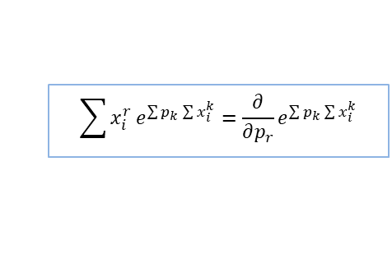
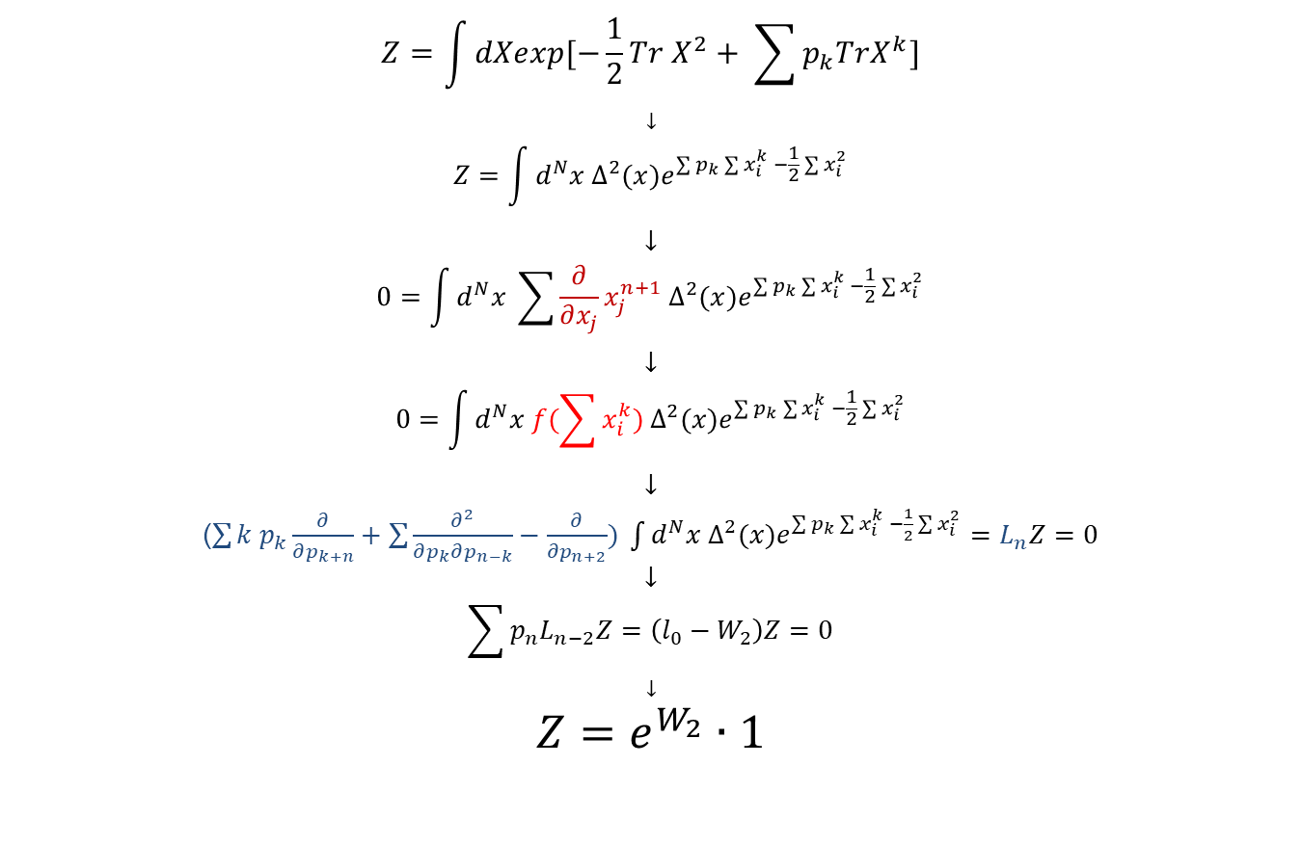
Simple example: Hermitian Gaussian model
$$Z=\int{dXexp[−\frac{1}{2}Tr X^{2}+ \sum{p_{k}TrX^{k}}]}$$
$$↓$$
$$Z=\int{d^{N}x{ ∆^{2}(x)e}^{\sum{p_{k}\sum{x_{i}^{k}}} −\frac{1}{2}\sum{x_{i}^{2}}}}$$
$$↓$$
$$0=\int{d^{N}x \sum{\frac{∂}{∂x_{j}}x_{j}^{n+1}}{ ∆^{2}(x)e}^{\sum{p_{k}\sum{x_{i}^{k}}} −\frac{1}{2}\sum{x_{i}^{2}}}}$$
$$↓$$
$$0=\int{d^{N}x f(\sum{x_{i}^{k}}){ ∆^{2}(x)e}^{\sum{p_{k}\sum{x_{i}^{k}}} −\frac{1}{2}\sum{x_{i}^{2}}}}$$
$$↓$$
($\sum{k p_{k}\frac{∂}{∂p_{k+n}}+\sum{\frac{∂^{2}}{∂p_{k}∂p_{n−k}}−\frac{∂}{∂p_{n+2}}) \int{d^{N}x{ ∆^{2}(x)e}^{\sum{p_{k}\sum{x_{i}^{k}}} −\frac{1}{2}\sum{x_{i}^{2}}}}}}=L_{n}Z=0$
$$↓$$
$$\sum{p_{n}L_{n−2}Z=\left(l_{0}−W_{2}\right)Z=0}$$
$$↓$$
$$Z=e^{W_{2}}∙1$$
Integral representation
$$\sum{x_{i}^{r}}e^{\sum{p_{k}\sum{x_{i}^{k}}}}=\frac{∂}{∂p_{r}}e^{\sum{p_{k}\sum{x_{i}^{k}}}}$$
W-representation

Slide 5
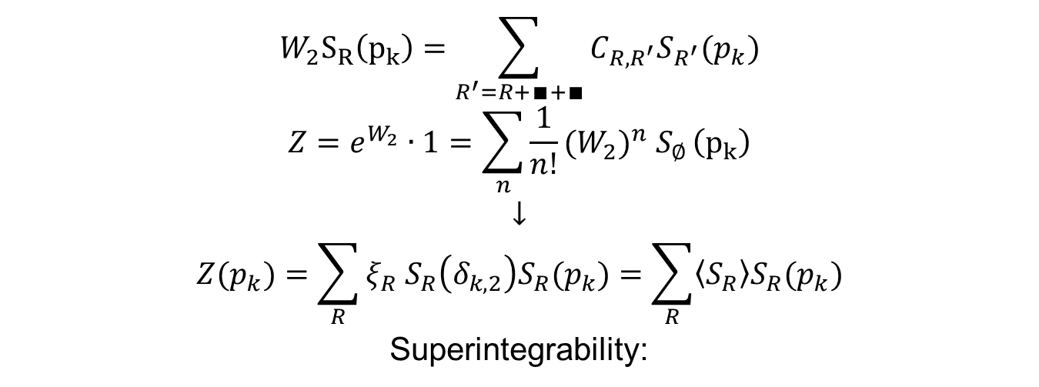
Hermitian Gaussian model
$$W_{2}S_{R}\left(p_{k}\right)=\sum_{R^{′}=R+∎+∎}{C_{R,R^{′}}S_{R^{′}}(p_{k})}$$
$$Z=e^{W_{2}}∙1=\sum_{n}{\frac{1}{n!}{{(W}_{2})}^{n} S_{∅}}\left(p_{k}\right)$$
$$↓$$
$$Z(p_{k})=\sum_{R}{{ξ_{R} S}_{R}\left(δ_{k,2}\right)S_{R}(p_{k})}=\sum_{R}{\left\langle S_{R}\right\rangle S_{R}(p_{k})}$$
Superintegrability:
$$\frac{S_{R}\left(N\right)}{S_{R}\left(δ_{k,1}\right)}S_{R}\left(δ_{k,2}\right)=\left\langle S_{R}\right\rangle$$
$$ξ_{R}=\frac{S_{R}\left(N\right)}{S_{R}\left(δ_{k,1}\right)}=\prod_{(i,j)∈R}{(N−i+j)}$$

Slide 6
Deformations and generalizations
1) Deformation of integration space:
β-deformation: $Z=\int{d^{N}x{ ∆^{2β}(x)e}^{\sum{p_{k}\sum{x_{i}^{k}}} −\frac{1}{2}\sum{x_{i}^{2}}}}$
(β=1, ½, 2 for hermitian, orthogonal and simplectic models)
q,t-deformation
2) Combining different W-operators (and respective models) to a class of models (WLZZ class)
Object of our interest – β-WLZZ class

Slide 7
β-WLZZ
$$\left\{\begin{aligned}Z_{m}=e^{{−W}_{m}/m}⋅1, m<0 \\ Z_{0}=e^{W_{0}}⋅e^{βp_{1}} \\ { Z}_{m}=e^{W_{m}/m} e^{\sum{g_{k}p_{k}}}, m>0\end{aligned}\right.$$
Partition function of positive, negative and zero branches:
Negative branch
$$E_{2}=[W_{0},[W_{0},p_{1}]]$$
$$W_{−m−1}=\frac{1}{m!}[E_{2},W_{−m}], m≥2$$
Zero branch
$$W_{0}=β\sum{ {(a+b)p}_{a}p_{b}\frac{∂}{∂p_{a+b}}+\sum{{a b p}_{a+b}\frac{∂^{2}}{∂p_{a}∂p_{b}}+\frac{(1−β)}{2}\sum{k\left(k−1\right)p_{k}}\frac{∂}{∂p_{k}} }}$$
$$F_{2}=[W_{0},[W_{0},\frac{∂}{∂p_{1}}]]$$
$$W_{m+1}=−\frac{1}{m!}[F_{2},W_{m}], m≥2$$
Positive branch

Slide 8
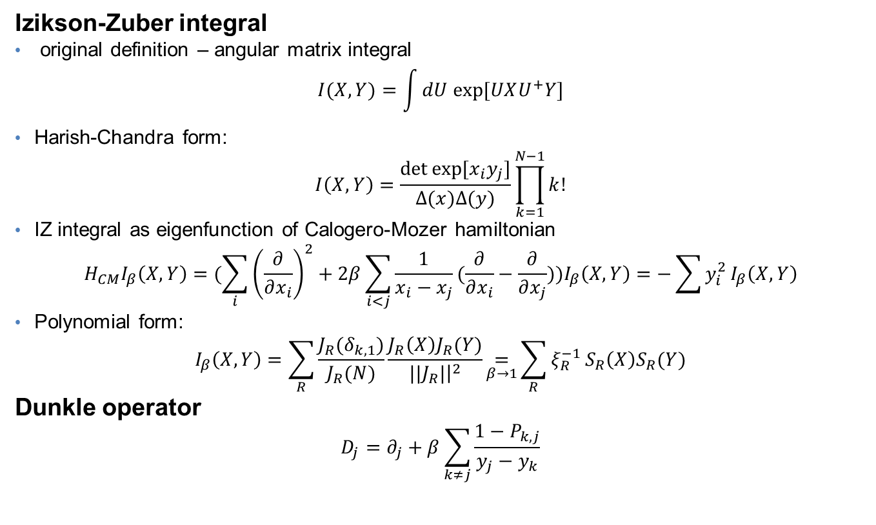
Auxillary objects
Izikson-Zuber integral
original definition – angular matrix integral
$$I(X,Y)=\int{dU exp⁡[UXU^{+}Y]}$$
Harish-Chandra form:
$$I\left(X,Y\right)=\frac{\det{exp⁡[x_{i}y_{j}]}}{∆(x)∆(y)}\prod_{k=1}^{N−1}{k!}$$
IZ integral as eigenfunction of Calogero-Mozer hamiltonian
$$H_{CM}I_{β}\left(X,Y\right)=(\sum_{i}{{\left(\frac{∂}{∂x_{i}}\right)}^{2}+2β}\sum_{i<j}{\frac{1}{x_{i}−x_{j}}(\frac{∂}{∂x_{i}}−\frac{∂}{∂x_{j}})})I_{β}\left(X,Y\right)=−\sum{y_{i}^{2}}I_{β}\left(X,Y\right)$$
Polynomial form:
$$I_{β}\left(X,Y\right)=\sum_{R}{\frac{J_{R}(δ_{k,1})}{J_{R}(N)}}\frac{J_{R}\left(X\right)J_{R}(Y)}{||J_{R}|{\left.​\right|}^{2}}\underset{β→1}{=}{\sum_{R}{ξ_{R}^{−1}}}S_{R}\left(X\right)S_{R}(Y)$$
Dunkle operator
$$D_{j}=∂_{j}+β\sum_{k≠j}{\frac{1−P_{k,j}}{y_{j}−y_{k}}}$$

Slide 9
β-WLZZ integral representation
Motivation:
Ambiguity in the defining W-representation
Integral representation lets study dividing into phases, that appears in the Kontsevich model and Brezin-Gross-Witten model
Convenient for making further generalizations and deformations, that could bound the model with other knowing models. For this purpose in the integral representation one could add a potential or change the integrating space
Virasoro constraints can not be restored from the W-representation, but there are some methods that produced it from the integral representation
Some symmetries could be found only in the integral representation

Slide 10
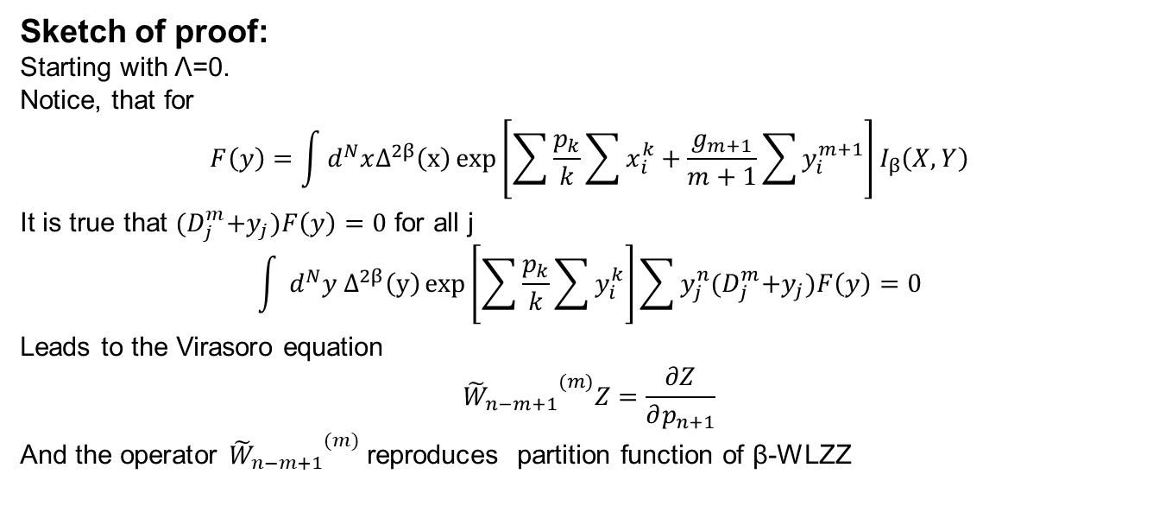
β-WLZZ integral representation
$$Z_{β}\left(g_{k},p_{k},Λ\right)=\int{d^{N}x d^{N}yΔ^{2β}\left(x\right)Δ^{2β}\left(y\right)\exp\left[\sum{\frac{p_{k}}{k}\sum{x_{i}^{k}+\sum{\frac{g_{k}}{k}\sum{y_{i}^{k}}}}}\right]}I_{β}\left(X,Y\right)I_{β}(X,Λ)$$
Sketch of proof:
Starting with Λ=0.
Notice, that for
$$F\left(y\right)=\int{d^{N}xΔ^{2β}\left(x\right)\exp\left[\sum{\frac{p_{k}}{k}\sum{x_{i}^{k}+\frac{g_{m+1}}{m+1}\sum{y_{i}^{m+1}}}}\right]}I_{β}\left(X,Y\right)$$
It is true that ${(D}_{j}^{m}+y_{j})F\left(y\right)=\text{0}$ for all j
$$\int{ d^{N}y{ Δ}^{2β}\left(y\right)\exp\left[\sum{\frac{p_{k}}{k}\sum{y_{i}^{k}}}\right]\sum{y_{j}^{n}{(D}_{j}^{m}+y_{j})F\left(y\right)=\text{0}}}$$
Leads to the Virasoro equation
$${{\tilde{W}}_{n−m+1}}^{(m)}Z=\frac{∂Z}{∂p_{n+1}}$$
And the operator ${{\tilde{W}}_{n−m+1}}^{(m)}$ reproduces partition function of β-WLZZ

Slide 11
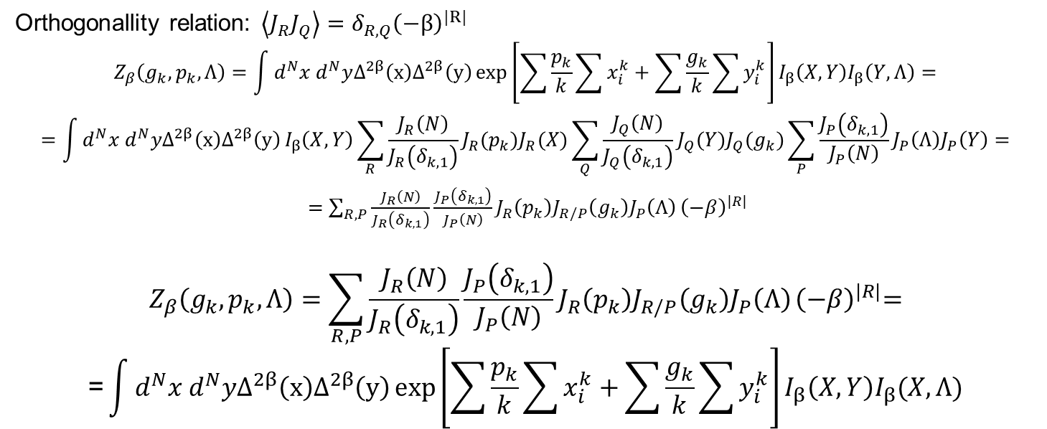
β-WLZZ integral representation
Use polynomial representation of the partition function
$$Z=\int{d^{N}x d^{N}yΔ^{2β}\left(x\right)Δ^{2β}\left(y\right)\exp\left[\sum{\frac{p_{k}}{k}\sum{x_{i}^{k}+\sum{\frac{g_{k}}{k}\sum{y_{i}^{k}}}}}\right]}I_{β}\left(X,Y\right)=\sum_{R}{\frac{J_{R}\left(N\right)}{J_{R}\left(δ_{k,1}\right)}J_{R}(p_{k})J_{R}(g_{k})}$$
Orthogonallity relation: $\left\langle J_{R}J_{Q}\right\rangle =δ_{R,Q}{\left(−β\right)}^{|R|}$
$$Z_{β}\left(g_{k},p_{k},Λ\right)=\int{d^{N}x d^{N}yΔ^{2β}\left(x\right)Δ^{2β}\left(y\right)\exp\left[\sum{\frac{p_{k}}{k}\sum{x_{i}^{k}+\sum{\frac{g_{k}}{k}\sum{y_{i}^{k}}}}}\right]}I_{β}\left(X,Y\right)I_{β}\left(Y,Λ\right)=$$
$$=\int{d^{N}x d^{N}yΔ^{2β}\left(x\right)Δ^{2β}\left(y\right)}I_{β}\left(X,Y\right)\sum_{R}{\frac{J_{R}\left(N\right)}{J_{R}\left(δ_{k,1}\right)}J_{R}(p_{k})J_{R}(X)}\sum_{Q}{\frac{J_{Q}\left(N\right)}{J_{Q}\left(δ_{k,1}\right)}J_{Q}(Y)J_{Q}(g_{k})}\sum_{P}{\frac{J_{P}\left(δ_{k,1}\right)}{J_{P}\left(N\right)}J_{P}\left(Λ\right)J_{P}\left(Y\right)=}$$
$=\sum_{R,P}{\frac{J_{R}\left(N\right)}{J_{R}\left(δ_{k,1}\right)}{\frac{J_{P}\left(δ_{k,1}\right)}{J_{P}\left(N\right)}J}_{R}\left(p_{k}\right)J_{R/P}\left(g_{k}\right)J_{P}\left(Λ\right)}{\left(−β\right)}^{|R|}$
$$Z_{β}\left(g_{k},p_{k},Λ\right)=\sum_{R,P}{\frac{J_{R}\left(N\right)}{J_{R}\left(δ_{k,1}\right)}{\frac{J_{P}\left(δ_{k,1}\right)}{J_{P}\left(N\right)}J}_{R}\left(p_{k}\right)J_{R/P}\left(g_{k}\right)J_{P}\left(Λ\right)}{\left(−β\right)}^{|R|}\text{=}$$
$$\text{=}\int{d^{N}x d^{N}yΔ^{2β}\left(x\right)Δ^{2β}\left(y\right)\exp\left[\sum{\frac{p_{k}}{k}\sum{x_{i}^{k}+\sum{\frac{g_{k}}{k}\sum{y_{i}^{k}}}}}\right]}I_{β}\left(X,Y\right)I_{β}(X,Λ)$$

