Slide 1
NDL SiPm Series EQR15 11-6060D-S
1) Test results with 480 nm LED
2) Cosmic test www.ndl-sipm.net/PDF/Datasheet-EQR15.pdf
NDL (Novel Device Laboratory, Beijing) http://www.ndl-sipm.net/indexeng.html
12/19/2023
Oleg Gavrishuk, JINR, Dubna , Russia
1

Slide 2
NDL SiPm Series EQR15 11-6060D-S www.ndl-sipm.net/PDF/Datasheet-EQR15.pdf
For a conventional SiPM, the quenching resistors are usually fabricated on the surface, and used to connect all APD cells to trace metal lines. In contrast, NDL SiPM employs intrinsic epitaxial layer as the quenching resistors (EQR), and uses a continuous silicon cap layer as an anode to connect all the APD cells. As a result, the device has more compact structure and simpler fabrication technology, allows larger micro cell density (larger dynamic range) while retaining high photon detection efficiency (PDE).
Для обычного SiPM гасящие резисторы обычно изготавливаются на поверхности и используются для соединения всех ячеек APD с металлическими линиями. Напротив, NDL SiPM использует собственный эпитаксиальный слой в качестве гасящих резисторов (EQR) и использует непрерывный слой кремния в качестве анода для соединения всех ячеек APD. В результате устройство имеет более компактную структуру и более простую технологию изготовления, позволяет увеличить плотность микроячеек (больший динамический диапазон) при сохранении высокой эффективности детектирования фотонов (PDE).
NDL (Novel Device Laboratory, Beijing) http://www.ndl-sipm.net/indexeng.html
12/19/2023
Oleg Gavrishuk, JINR, Dubna , Russia
2

Slide 3
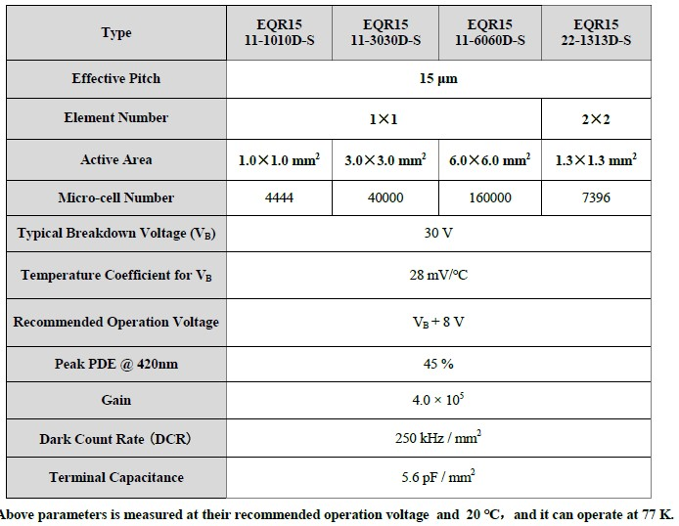
12/19/2023
Oleg Gavrishuk, JINR, Dubna , Russia
3

Slide 4
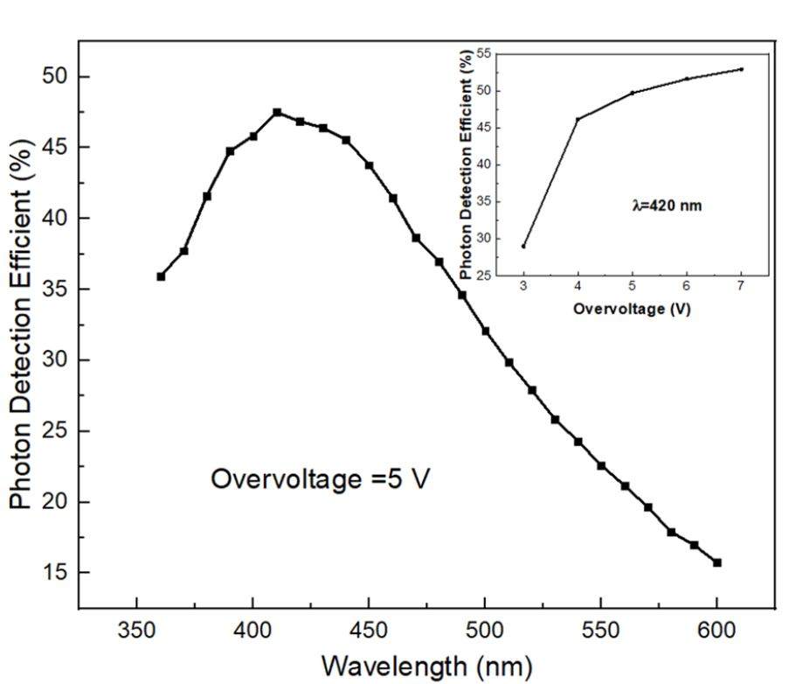
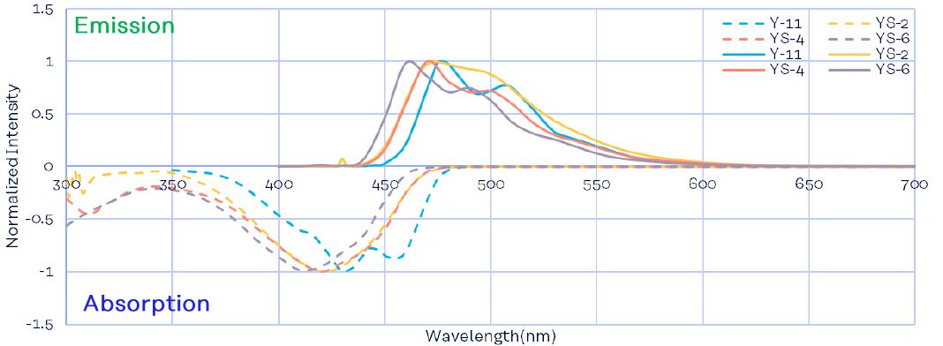
Photon Detection Efficient (PDE) correspond to WLS Emission spectra of Y11.
PDE close to flat maximum about 45% at 6-7 Overvoltage.
Notes:
4

Slide 5
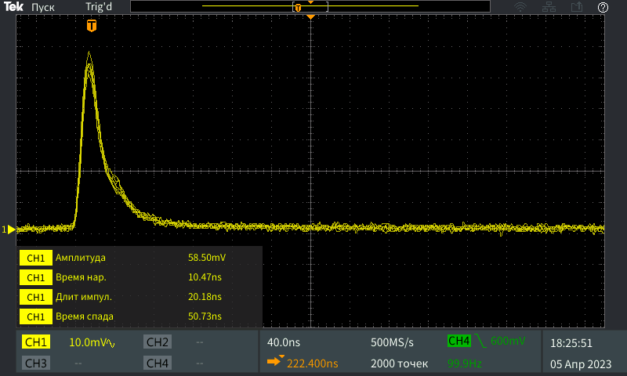
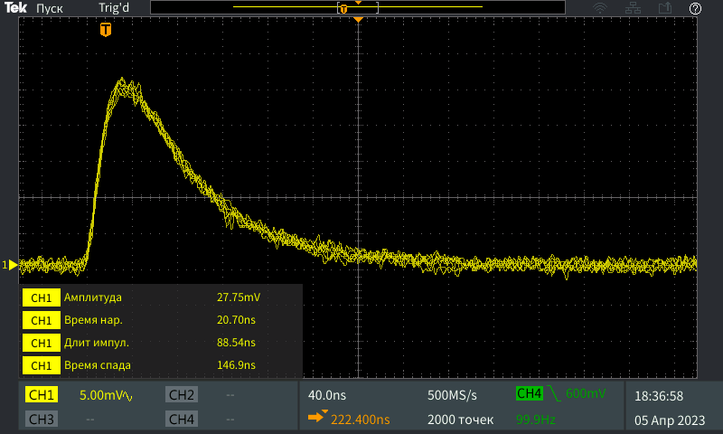
Pulse shape of SiPm with 15 µ pitch and 6x6 mm² size – frm 10 ns LED
EQR11-15-6060-S
Front – 10 ns
Length – 20 ns
HAMAMATSU S14160-50
Front – 21 ns
Length – 89 ns
12/19/2023
Oleg Gavrishuk, JINR, Dubna , Russia
5

Slide 6
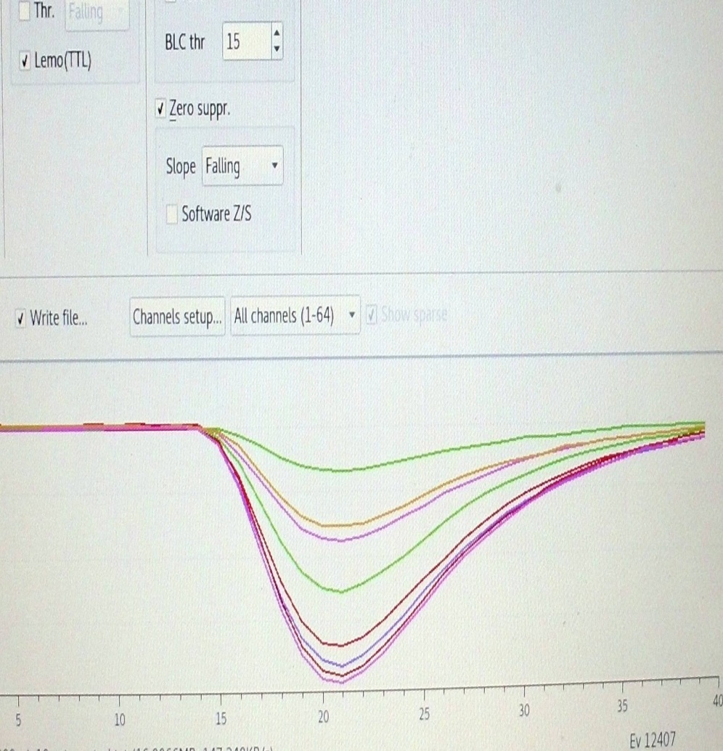
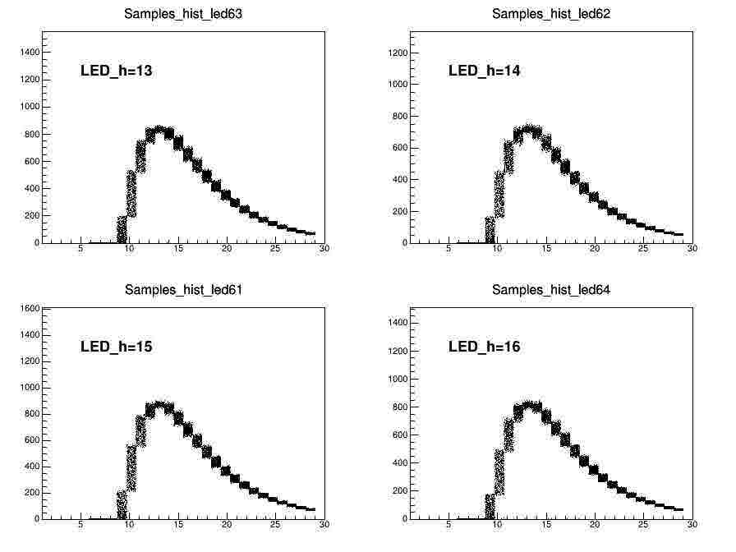
Wave form and digitizing

Slide 7
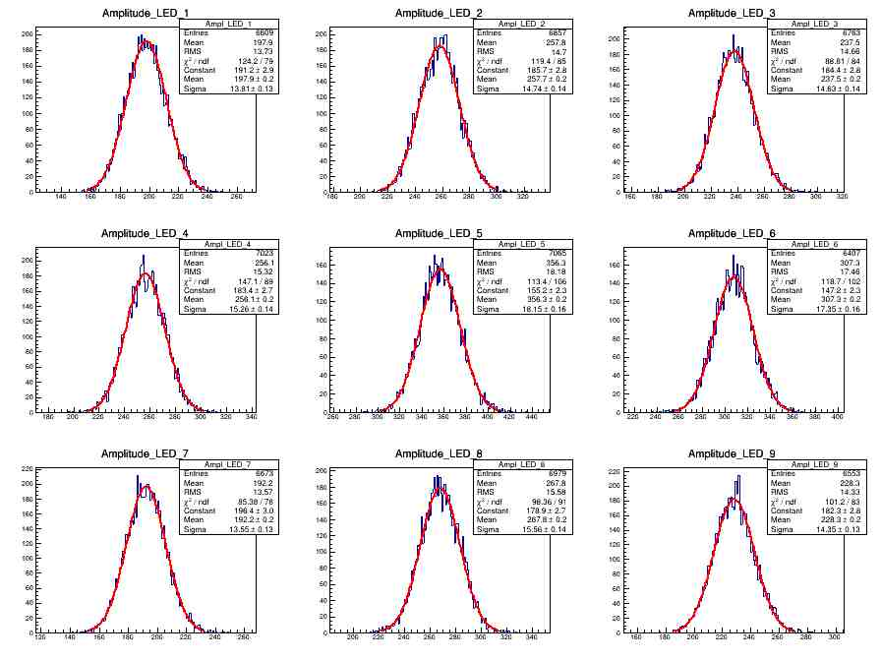
LED amplitudes to caclucte Number Pixel Fired = {Amean/sigma}**2

Slide 8
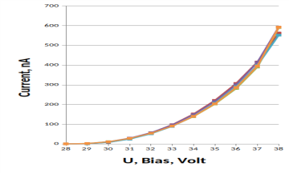
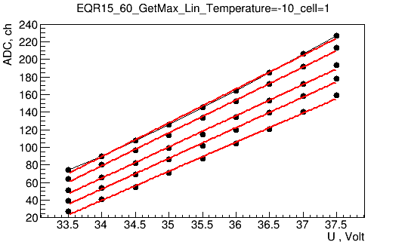
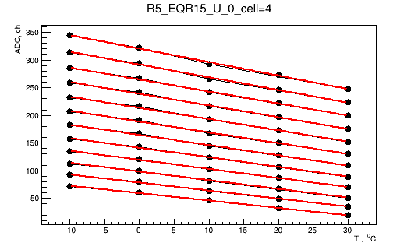
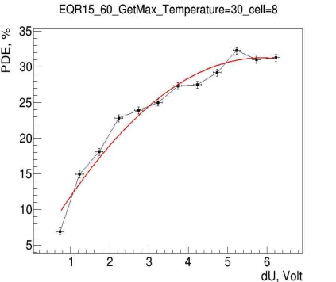
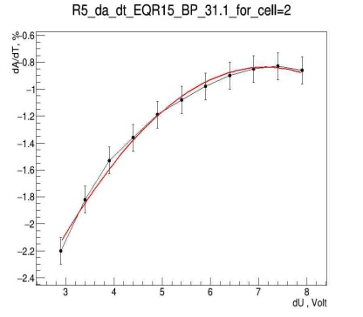
SiPm test Results
Dark Current measurements
Gain vs Overvoltage: dA/dU
Gain vs Temperature: dA/dt
PDE vs Overvoltage
Operation Volt. how to select it ?
Temperature stability studies
12/19/2023
Oleg Gavrishuk, JINR, Dubna , Russia
8

Slide 9
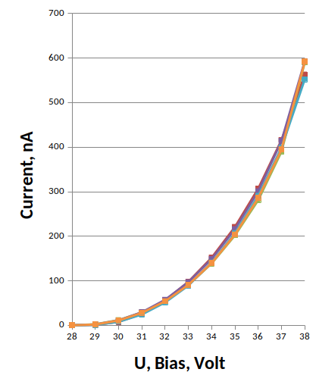
EQR15-60 Dark Current vs Bias voltage and its temperature dependences around operate Voltage
Dark Current vs Operation Bias (36-37 V) at room temperature (20 ⁰C)
is equal to 300-400 nA. Its are corresponded to the factory data and is similar HAMAMATSU too.
12/19/2023
Oleg Gavrishuk, JINR, Dubna , Russia
9

Slide 10
Gain vs Overvoltage allow obtain: slope=dA/dU vs U
Gain vs Temperature allow obtain:
slope=dA/dT vs T
U=38V
T=-10 ⁰C
dA/dT
dA/dU
T=+30 ⁰C
U=32V
K_{t}=dU/dT=dA/dT/dA/dU
The thermal stabilization coefficient (K_{t}) was defined as the ratio of the slope dA/dT to the slope dA/dU depending on the applied bias.
12/19/2023
Oleg Gavrishuk, JINR, Dubna , Russia
10

Slide 11
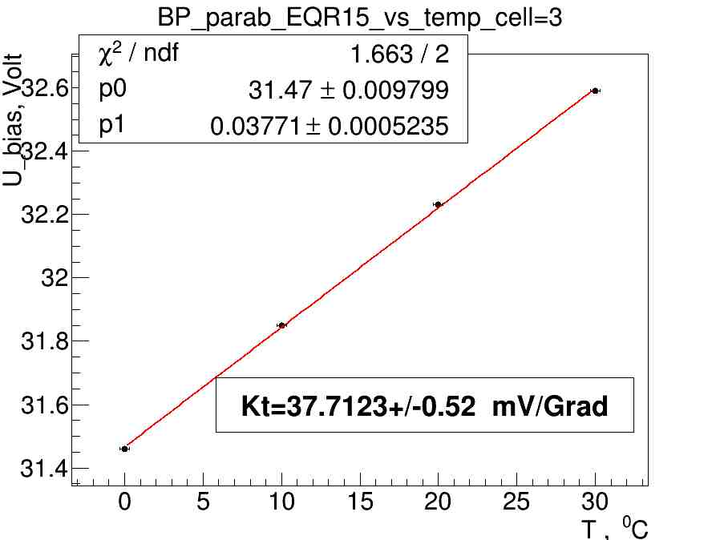
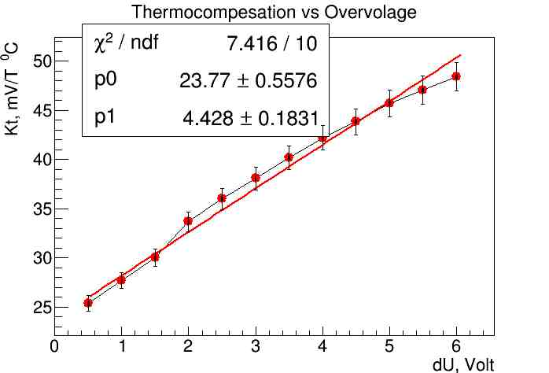
Break Point (Bp) was defined as extrapolation point of dA/dU to zero. Take assumption his linear behavior from Temperature we find that Bp=32 V at 20 ⁰C.
Kt=dU/dT=dA/dt/dA/dU fom previous slides we find that dependence from Overvoltage has linear behavior and equal to ~50 mv/⁰C at Operation point 5.5 V.
Operate point
12/19/2023
Oleg Gavrishuk, JINR, Dubna , Russia
11

Slide 12
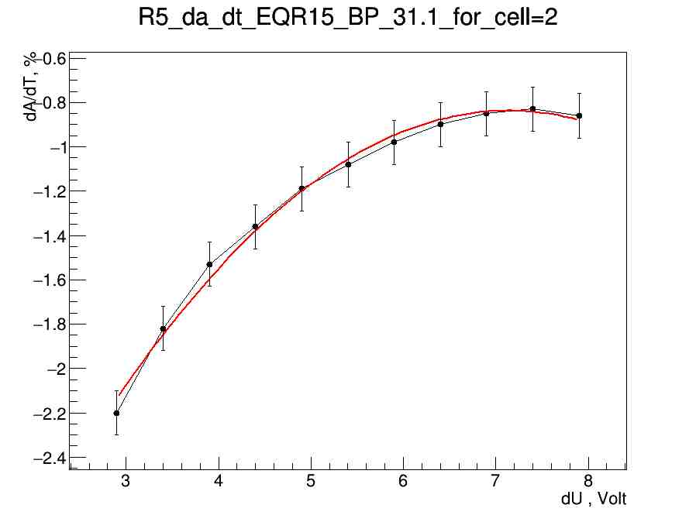
Temperature sensitivity vs dU
Photon Detection Efficient vs dU
dA/dT vs dU
PDE vs dU
Operation point
Operation point
Operation point was found at dU=6.5 V take in account that:
dA/dT and PDE – has Plato in dU.
dA/dT has minimal value ~ 1%/⁰C , PDE close to maximal value ~ 32%.
12/19/2023
Oleg Gavrishuk, JINR, Dubna , Russia
12

Slide 13
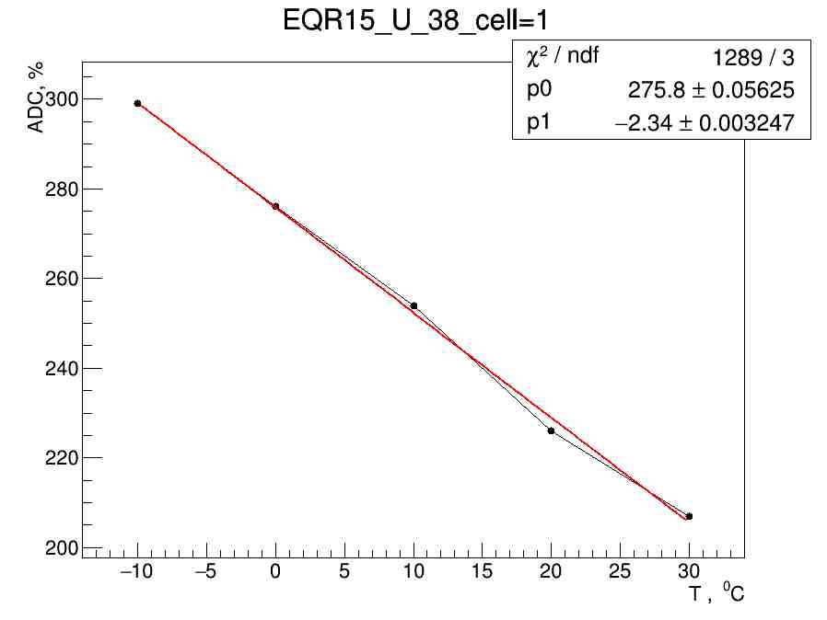
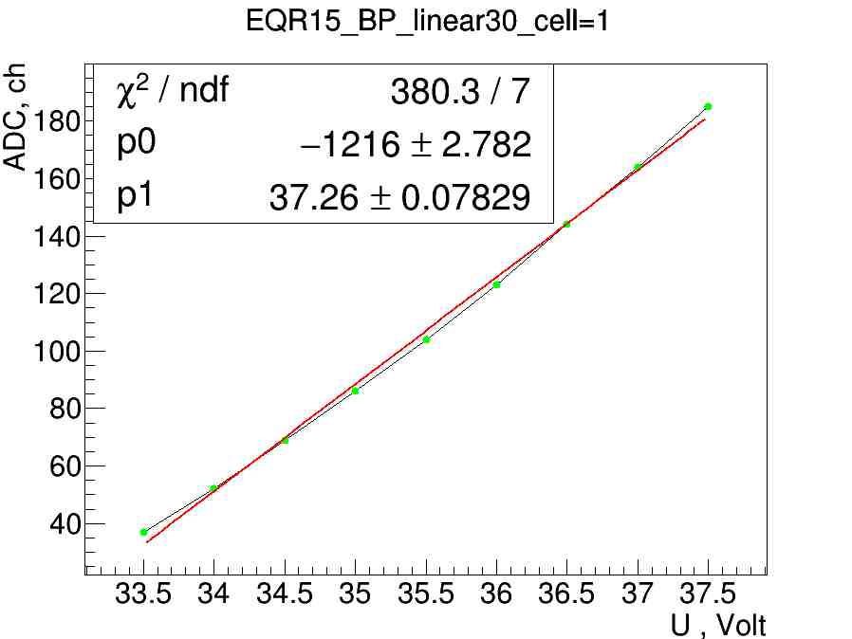
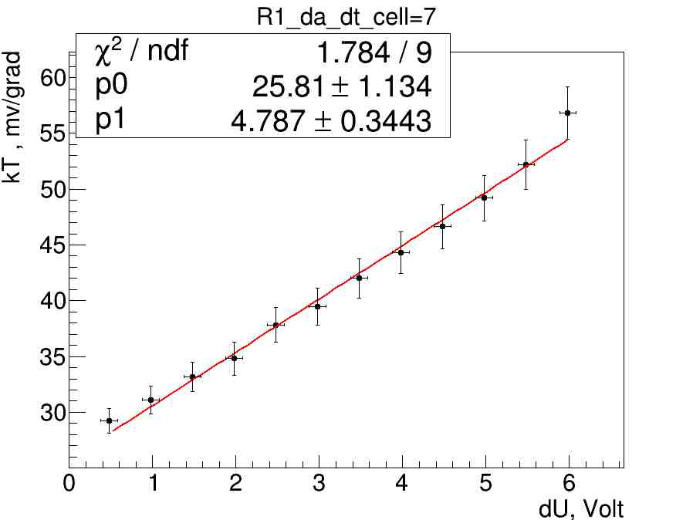
Kt=dA/dT / dA/dU

Slide 14
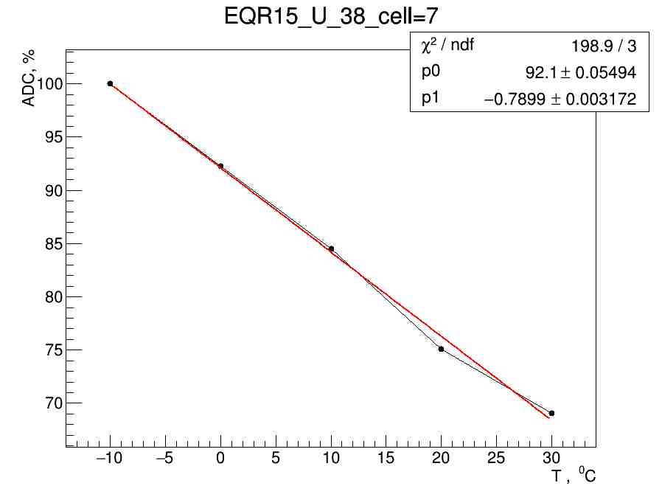
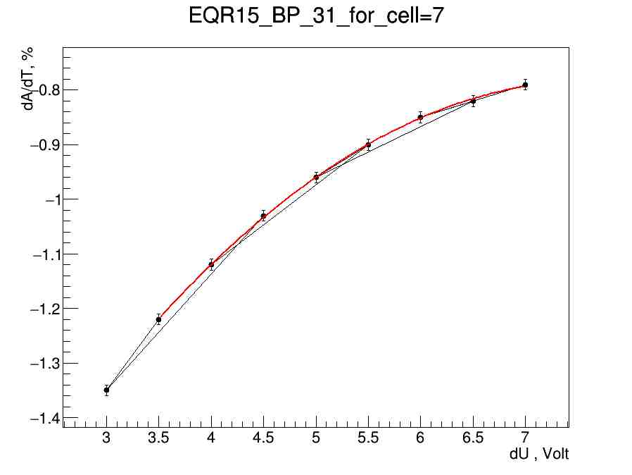
dA/dT % vs Overvotage

Slide 15
Test results with cosmic particles
4 Module 3x3 cell wit sixes 40x40 mm – MPD option 2012
Cosmic beam
Event selection = only One cell – one hit events
LED monitoring – 1 Hz permanently
Kt = 20,30,40,50 mv/Grag for different modules
Mip resolutin = 9.7 %
Long time stabilyti at Kt=50 mv/Grad

Slide 16
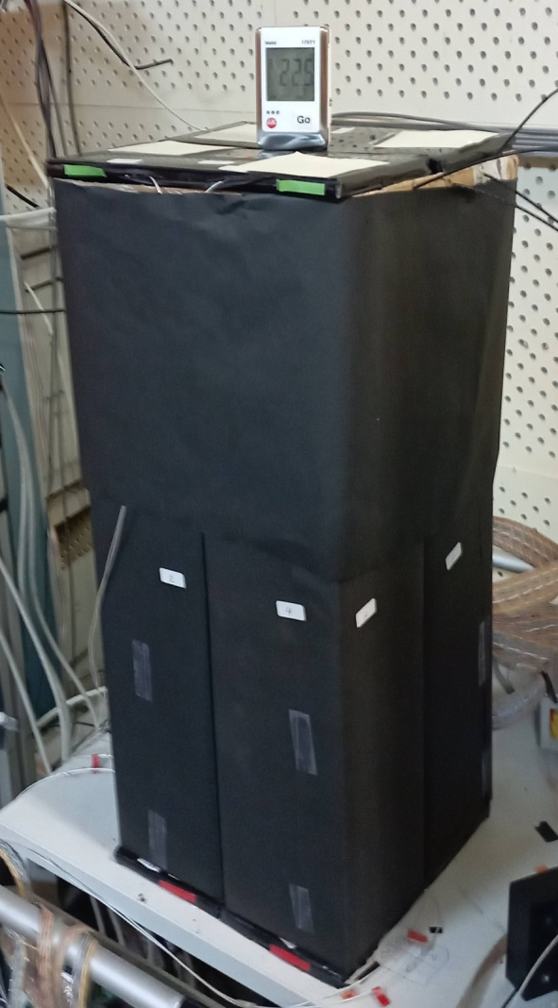
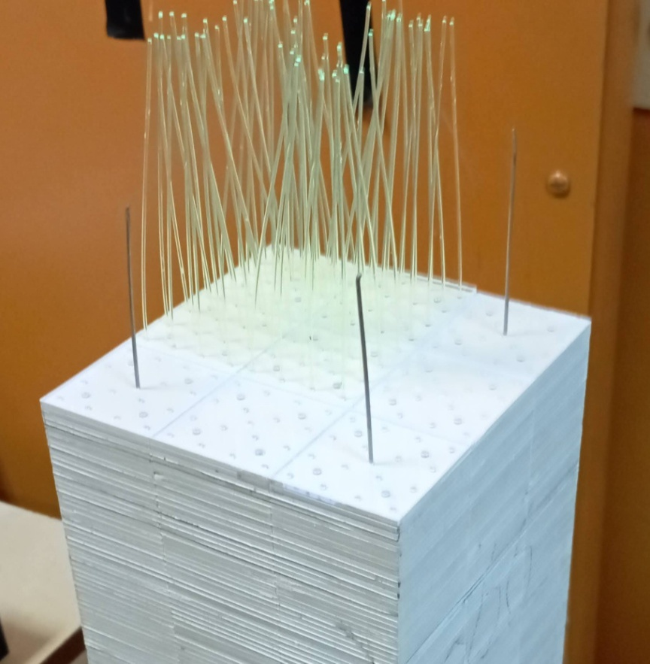
Test results with cosmic particles
Cosmic Rays
Setup of 4 modules. Each module consist from 9 cells of 4x4 cm². Totally tested 36 cells.
Sampling:
1.5 mm Scintillator
0.3 mm Lead
200 layers
Scintillator composition:
Polysterene
1.5% Paterphenyle
0.04% POPOP
Single Ecal module shown in assembling stage.
It is visible 9 cells as 3x3 matrix with WLS fibers (16 per cell). Y11(200) diameter 1.0 mm was used.
12/19/2023
Oleg Gavrishuk, JINR, Dubna , Russia
16

Slide 17
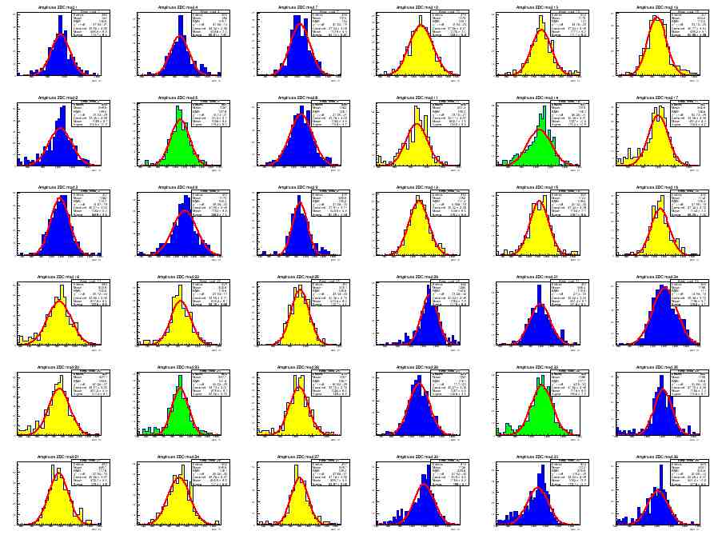
MIP spectra from 36 Cells. Top view shown on picture Above. One hit/event – applied selection criteria during analysis.
Calibration coefficients were found and normalized to 240 MeV.
12/19/2023
Oleg Gavrishuk, JINR, Dubna , Russia
17

Slide 18
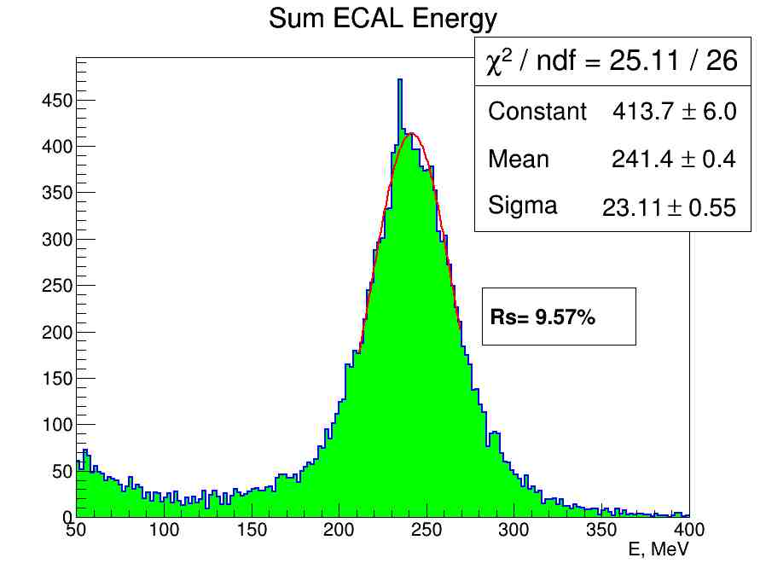
MIP spectra from 36 Cells as Total Sum take in account the Calibration coefficients normalized to 240 MeV. These Energy resolution corresponded to MC
12/19/2023
Oleg Gavrishuk, JINR, Dubna , Russia
18

Slide 19
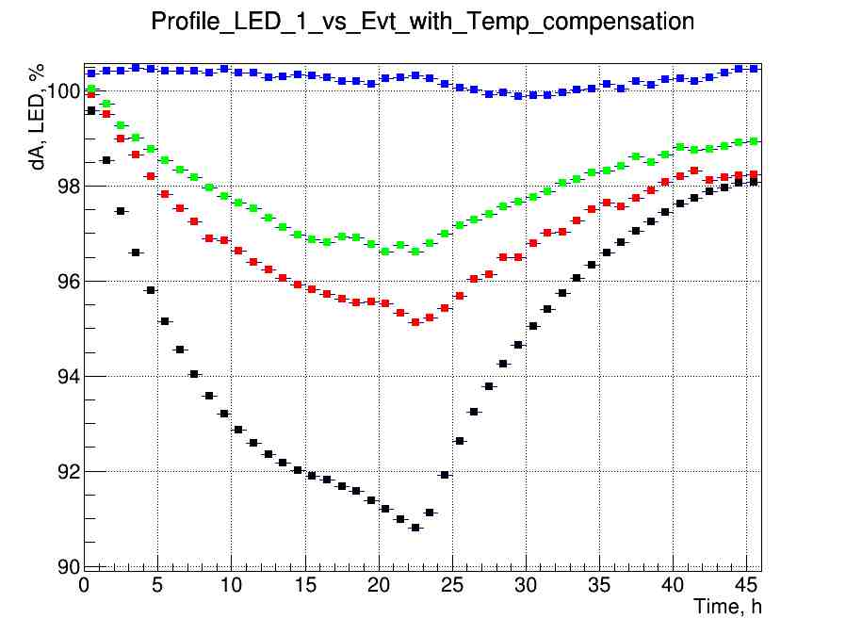
Kt=50 mV/⁰C
Kt=40 mV/⁰C
Kt=30 mV/⁰C
Kt=20 mV/⁰C
Test of long time Stability was done with different Kt for individual module.
The temperature variation from 20 to 30 ⁰C per day was applied.
12/19/2023
Oleg Gavrishuk, JINR, Dubna , Russia
19

Slide 20
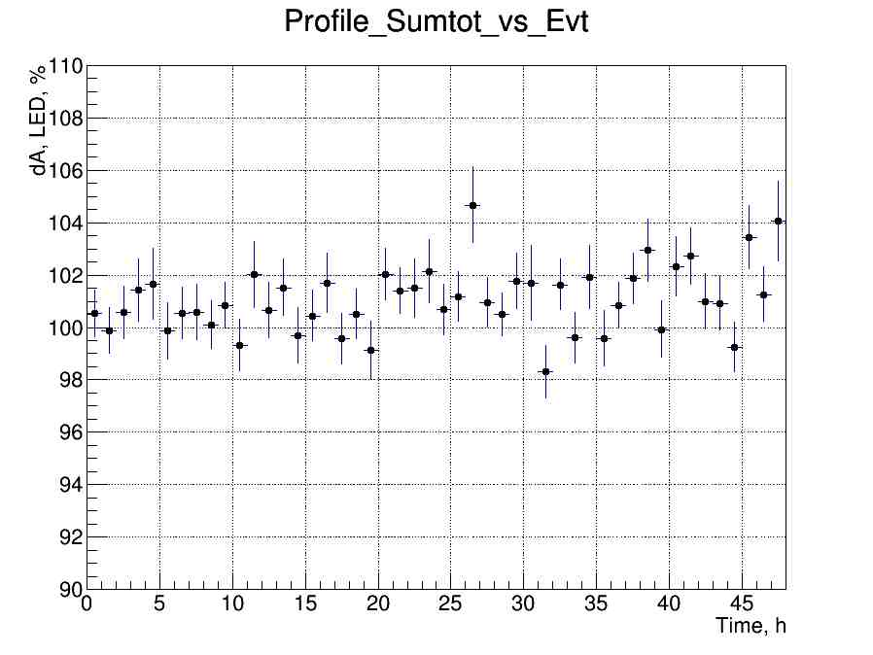
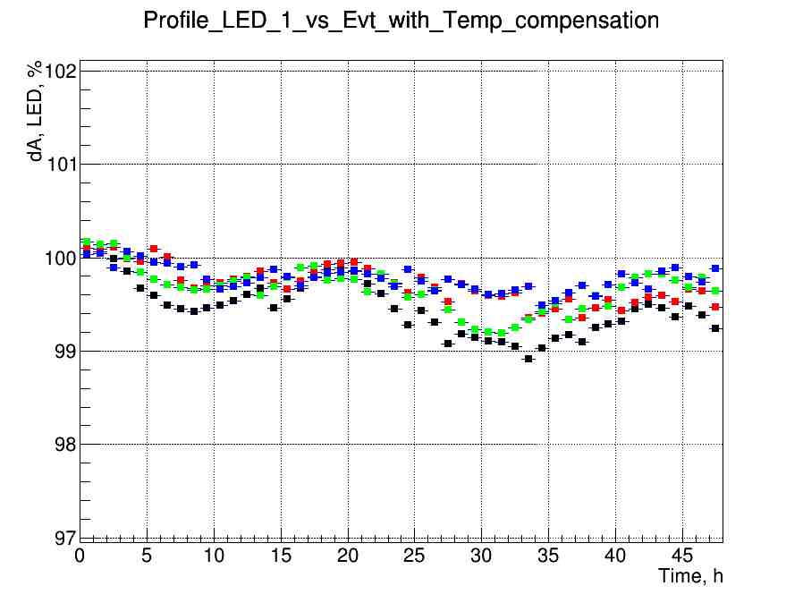
Kt=50 mV/⁰C
Long time stability for 4 modules shown +/-0.5% LED signal variation during 45 hours at Kt=50 mv/⁰C.
Profile Sum total of MIP signal shown ~1% variation during 45 hours.
This variation is not sensitive for MIP spectra with 9% resolution.
12/19/2023
Oleg Gavrishuk, JINR, Dubna , Russia
20

Slide 21
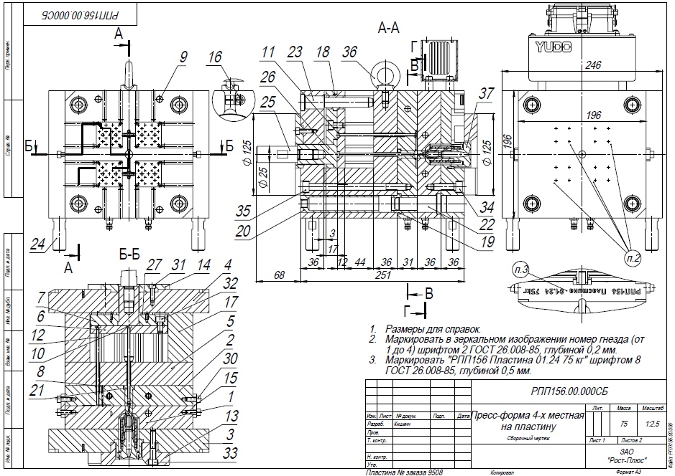
Matrix form for new scintillator production (40x40x1.5 mm³) should be ready in end of 2023
Matrix firm is special setup for molding by pressure technology
It allow produce scintillator from granulated polystyrene with doppands
4 set form produce 4 scintillator plate per 1 minute

Slide 22
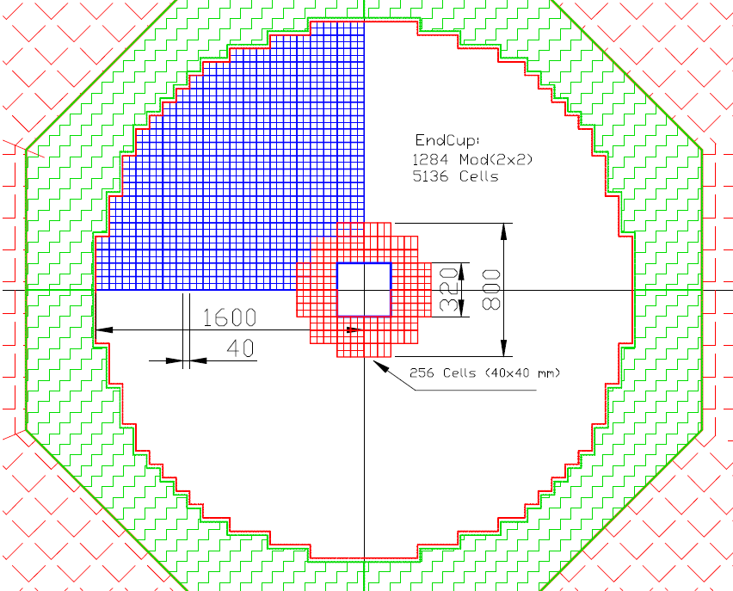
Plan for 2024: End Cup for SPD with new scintillator to be produced in February-March of2024 256 cells of 40x40 mm² = 64 modules of 4 cells=2x2
This Figure shows in red 64 modules, consisting of 4 cells each. The weight of this assembly is 597 kg. This will require 130 kg of polystyrene, 465 kg of lead, as well as additives: 1.95 kg of P-terphenyl and 65 g. POPOP, and 2000 meters WLS fiber type Y-11.
It is 1/20 part of End Cup and
taken time of 36 Days to prepared 51200 Stint. plates.
To read this setup, we need four ADC64 - 64-channel amplitude encoders, as well as 16 boards of 16-channel amplifiers and bias voltage regulators.

