Slide 1
59th PAC on Particle Physics
JINR, January 22, 2024
Implementation of recommendations
Itzhak Tserruya

Slide 2
Outline
134th Scientific Council meeting (September 21-22, 2023)
Agenda

Slide 3
Scientific Council (I)
Excerpts from the Resolutions of the 134th session of the SC held on September 21-22, 2023:
General considerations related to the PAC-PP:
The SC notes with satisfaction the progress in implementing the current plan of research and development of the scientific infrastructure at JINR and JINR’s achievements in the international collaboration projects:
– for the first time at JINR, the entire computing infrastructure integrated by DIRAC was successfully used for the complete reconstruction of the raw experimental data recorded during the long-term stable operation of the accelerator complex of the BM@N experiment in full configuration, when more than 550 million events with the Xe beam were registered; the DIRAC distributed platform is used to support the collaborations of the NICA experiments: MPD, BM@N, SPD, as well as the Baikal-GVD neutrino telescope;
– the successful work of the MPD collaboration and the VBLHEP team on the construction of all the components of the MPD detector, including the cryogenics, control and power supply systems, detector subsystems, and other equipment;
– the dynamic development of the ARIADNA collaboration, whose applied research programme was launched at the NICA complex in the beginning of 2023, and based on the results of the experiments, a series of publications is being prepared;

Slide 4
Scientific Council (II)
Draft Seven-Year Plan for the Development of JINR for 2024–2030
The Scientific Council notes with satisfaction the report on the main achievements
of JINR in 2017–2023 and prefinal revision of the Draft Seven-Year Plan for the Development of JINR for 2024–2030 presented by JINR Director G. Trubnikov.
The Scientific Council emphasizes that despite the difficult working conditions
associated with Covid and the dramatic deterioration of the geopolitical situation, in 2017–2023 JINR achieved impressive results both in the development of the Institute’s large research infrastructure and scientific research based on this infrastructure. The JINR’s significant contribution to international collaborations, especially at CERN, should be also mentioned... The Council considers it important to prepare and publish an information booklet dedicated to the achievements of JINR in 2017–2023.
The Scientific Council supports the submission of the current version of the Plan,
possibly with minor editorial corrections, to the CP session in November 2023 for final approval for implementation in 2024–2030.

Slide 5
Scientific Council (III)
Recommendations in connection with the PAC-PP:
The Scientific Council congratulates the accelerator team of the Nuclotron-NICA
complex for the very successful 4th technical run.
The Scientific Council takes note of the development of the VBLHEP infrastructure. It also
notes the various delays due to the current geopolitical situation, among them the delays in the completion of infrastructure work at the collider building and in the construction of transfer lines from the Nuclotron to the NICA collider. The Scientific Council acknowledges the efforts of the JINR and NICA managements to mitigate these delays and takes note of the resulting revised schedule, according to which the first beams at the NICA collider are now expected by 2025.
The Scientific Council notes that the production of the MPD detector is progressing
and the work is ongoing towards the commissioning of the large superconducting solenoid of MPD. Although the schedule is delayed due to problems with supplies of many components from European companies, all components of the MPD first-stage detector remain on track to be installed in 2024.
The SC congratulates the BM@N Collaboration for the first and successful physics run of the
BM@N detector in its full configuration with Xe beams and seconds the PAC in encouraging the BM@N team to concentrate its efforts on getting first physics results from the Xe run data.
The SC seconds the PAC in reiterating its recommendation to the JINR management on the
need to resume the activities of the international SPD Detector Advisory Committee, which will allow the SPD team to proceed further with the preparation of the TDR.

Slide 6
Scientific Council (IV)
The SC acknowledges the contribution of the JINR teams participating in the LHC experiments in obtaining physical results and upgrading the detectors.
The SC supports the PAC decisions and endorses its recommendations on the
extension of the following projects:
NA64, BES-III, TAIGA, JUNO, NOVA/DUNE, and MICC with ranking A
The SC supports the decision of the PAC to postpone the approval of the SCAN-3
project and to request the JINR team to present at the next session of the PAC a clear proposal outlining the original goals of the project, the achievements over the past four years, and its plans for the requested extension period.
The SC endorses the PAC’s recommendation to open the new projects:
- “Mathematical methods, algorithms and software for modelling physical
processes and experimental facilities, processing and analysing experimental
data” with ranking A.
- Participation in the AMBER fixed target experiment at the CERN SPS, with
ranking A.

Slide 7
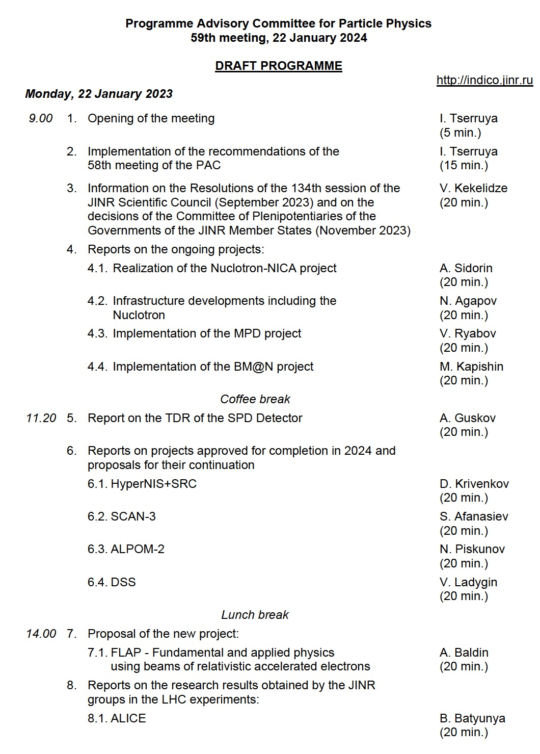
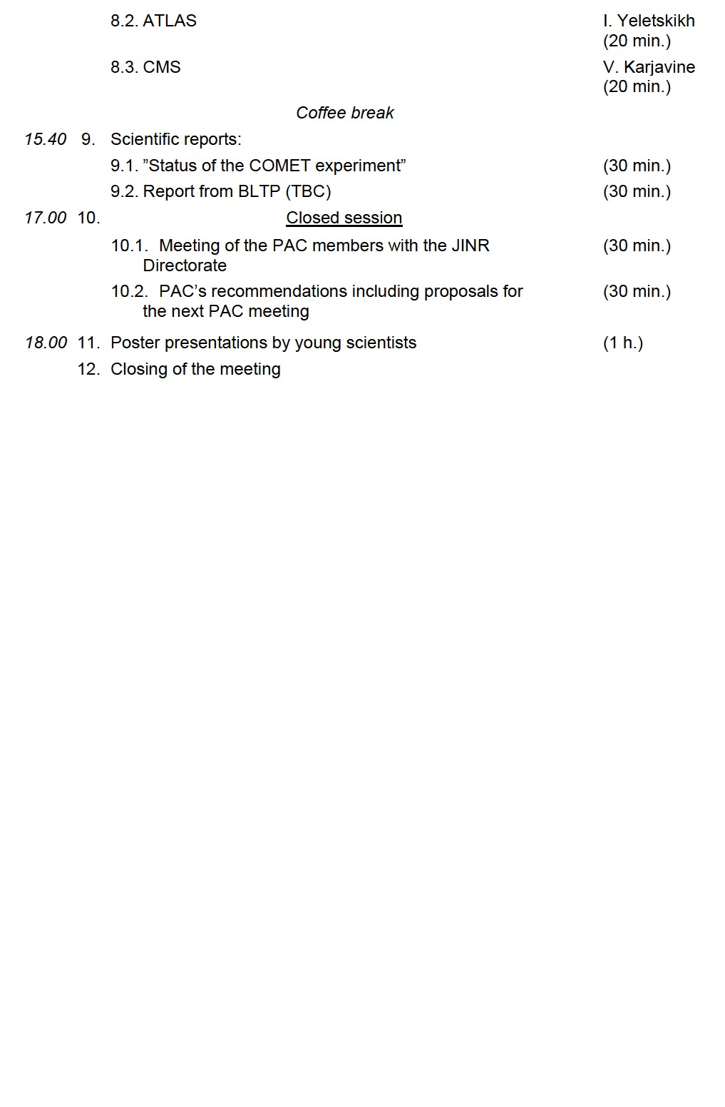
59th PAC-PP agenda January 22, 2024
Highlights of today's meeting:
JINR News
Update reports on NICA, MPD, BM@N and SPD
Extension of projects: HyperNIS+SRC, SCAN-3, ALPOM-2, DSS
New project: FLAP
Reports from the LHC experiments

Slide 8
Thank you!

