Slide 1
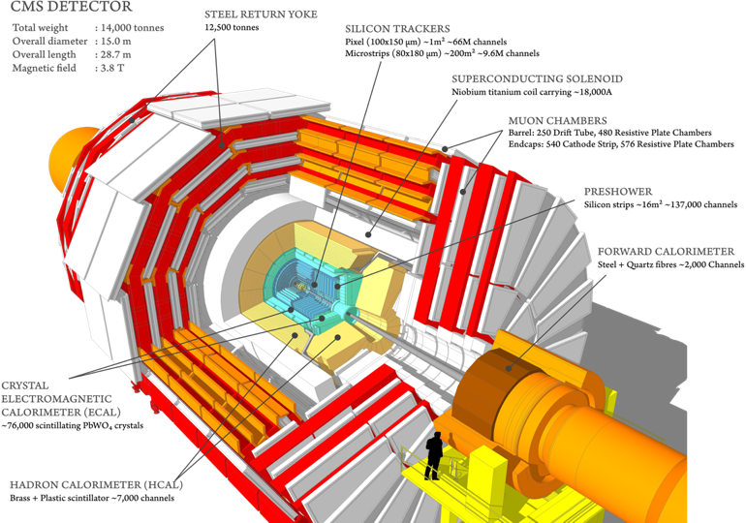
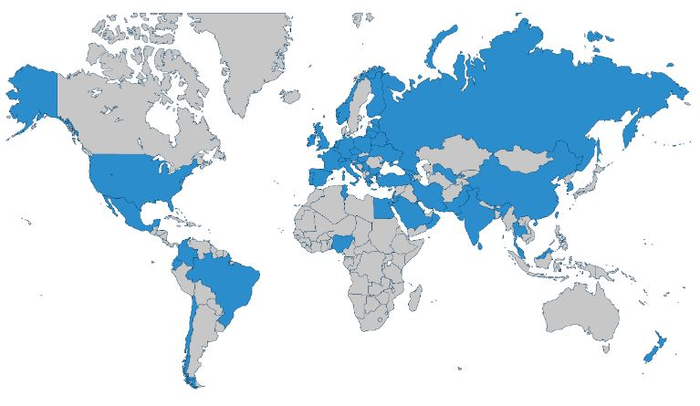
Report on the scientific results obtained
by the JINR group in the CMS experiment
JINR Topic 02-1-1083-2009
CMS Collaboration
https://cms.cern/
Vladimir Karjavine
for JINR CMS group
59th Meeting of the Programme Advisory Committee. 22.01.2024.

Slide 2
JINR Group Activities in 2023
In accordance with the M&O category B the JINR team is responsible for:
- CMS Detector commissioning after 2022 YETS.
- Maintenance and operation of detector systems in Run 3 data taking.
- Provide robust work of the JINR Tier-1 and Tier-2 centers for CMS computing.
Under the MoUs of JINR participation in CMS Phase-2 upgrade JINR contributes to:
- Construction of the High Granularity Calorimeter (HGCal).
- Endcap Muon system upgrade.
JINR physicists participate in data analysis and software development.
- 8 physics analysis based on RUN2 data and RUN3 data within CMS physics working groups:
- Exotica, Higgs, and Standard Model.
- Muon and Jet/MET physics Object.
- Muon and HCAL Detector Performance.
2

Slide 3
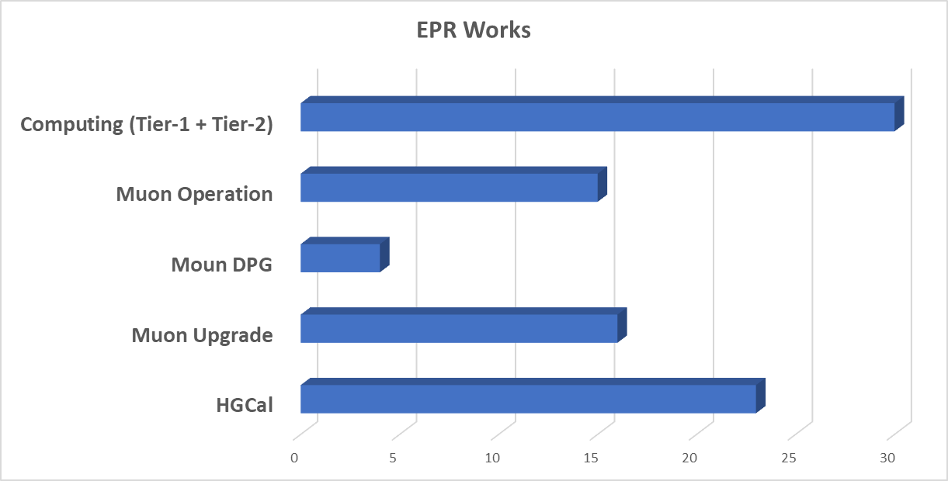
JINR group Responsibilities in CMS
Total number of CMS participants from JINR: 70
JINR authors in CMS: 21 (17 paid and 4 unpaid PhD St.)
11 young researchers: 1 MS from JINR, 5 PhD Students from JINR, 5 PhD Students from DMS
JINR team full time equivalent (FTE): 105.32 FTE-months*
62 central shifts were served by JINR group in 2023
CMS duties executed by JINR physicists:
HCAL Technical Coordination
Muon DQM Coordination
CMS data managers of Tier-1 and Tier-2 sites
Participation in Analysis Review Committee (ARC) and Institutional publication review (IR)
*) According to Experimental Physics Responsibilities (EPR) each author (paid and unpaid) is required to work on operational, maintenance, upgrade duties, including participation in shifts, at least 4 months
JINR EPR information over 5 years
JINR group pledges per year | JINR members in EPR months
I | 2019 | 2020 | 2021 | 2022 | 2023
Work Due | 87.38 | 88.61 | 95.85 | 81.32 | 84.00
Work done | 95.50 | 98.95 | 105.00 | 87.09 | 88.00
Shift done | 2.12 | 1.78 | 0.23 | 2.86 | 3.37
Work + Shifts done | 97.62 | 100.73 | 105.23 | 89.95 | 91.37
Ratio done/Expected | 1.12 | 1.14 | 1.15 | 1.11 | 1.09
green: more than 100% of expected work done per year
3

Slide 4
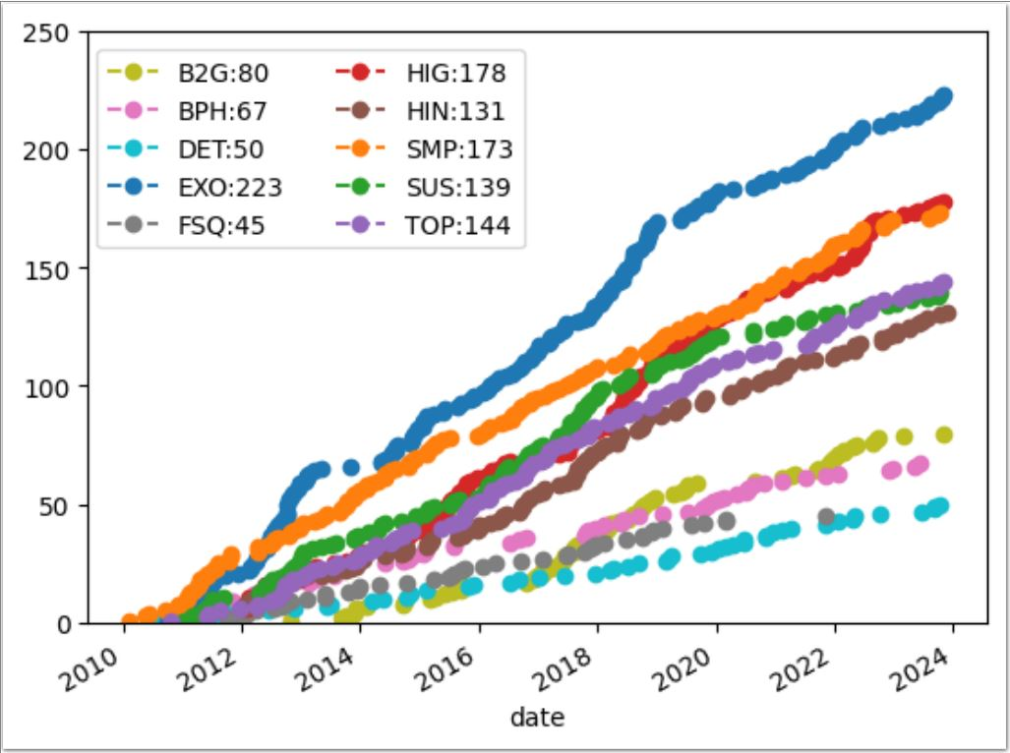
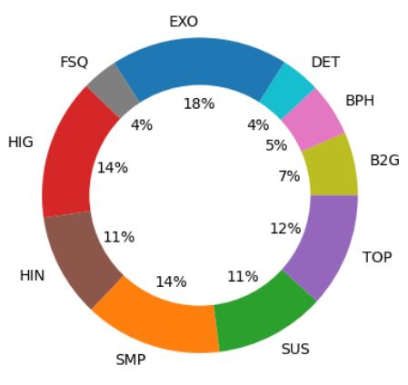
Publications in 2023
JINR Group publications
JINR physicists made a significant contribution to the preparation - 24 scientific papers.
The full list of the CMS publications with JINR authors - 58 scientific papers
The results of the scientific research were presented in 28 reports at various conferences.
CMS publication status
By research areas
1230 CMS papers based on collision data submitted
1193 paper published
4

Slide 5
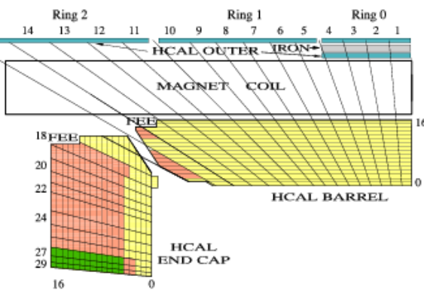
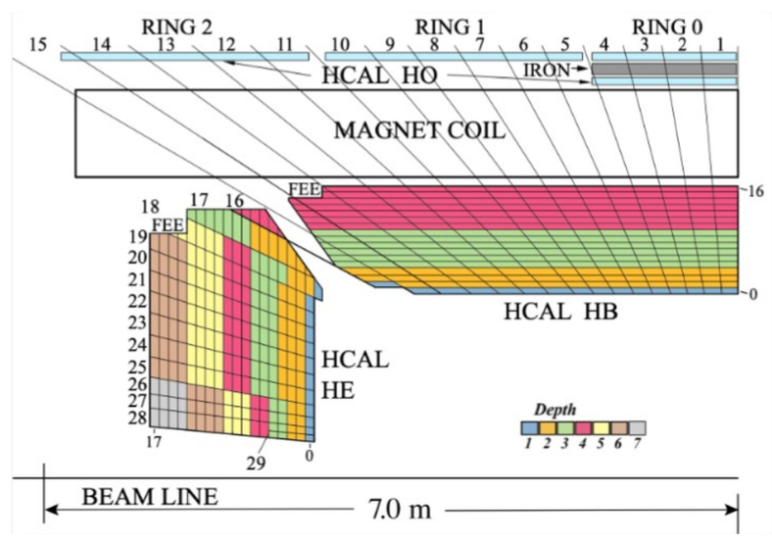
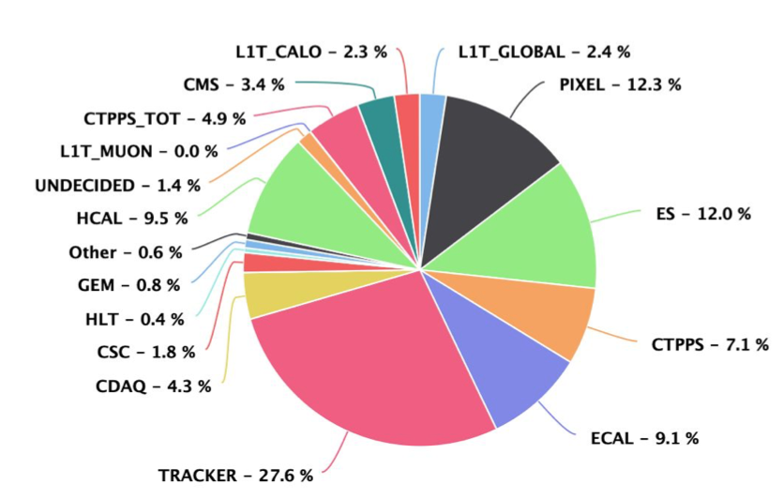
HCAL improvements and operation in Run 3.
Motivation:
Mitigate radiation damage to the HB scintillator.
Eliminate a source of high-amplitude noise.
Maintain physics performance for jets and MET.
Endcap upgrade before 2018
HCAL improvements.
Hybrid photodetectors(HPD) replaced with new silicon multipliers (SiPM).
3 times higher photon detection efficiency, 200 times higher gain.
Finer depth segmentation 4 in barrel, up to 7 in endcap ==> depth dependent calibration.
350% increase in the number of readout channels.
Added timing information (0.5ns resolution).
Enable new triggers (e. g. long lived particles).
Barrel upgraded for RUN-3
Data collection/certification results:
HCAL losses are ~9.5% as equivalent to ~250 pb-1 out of 29 fb-1.
No losses in HI run.
Great improvement with respect to 2022!
5

Slide 6
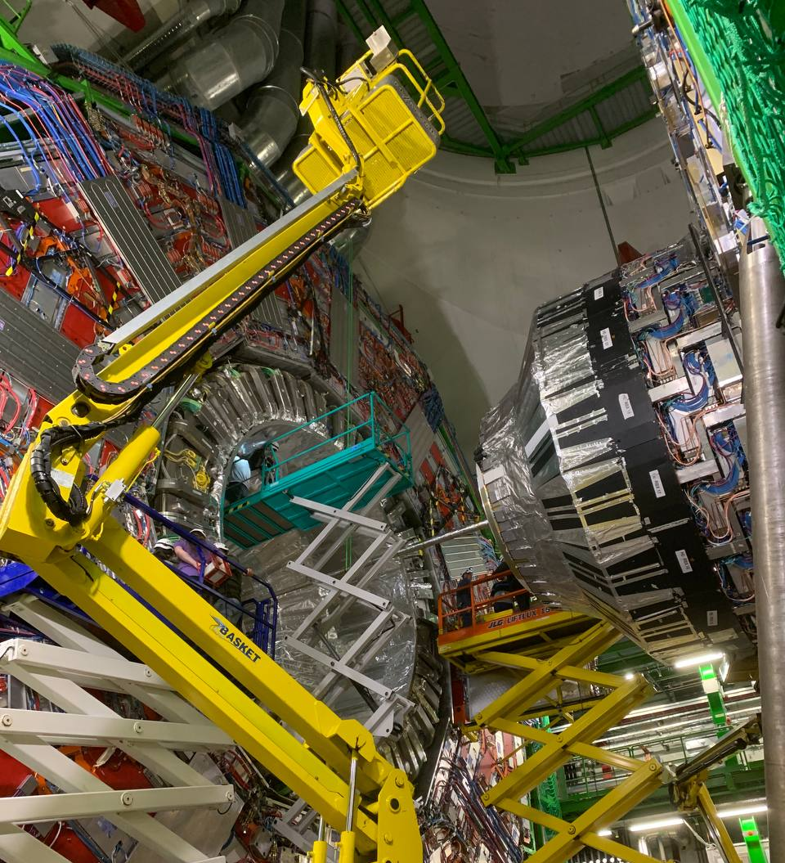
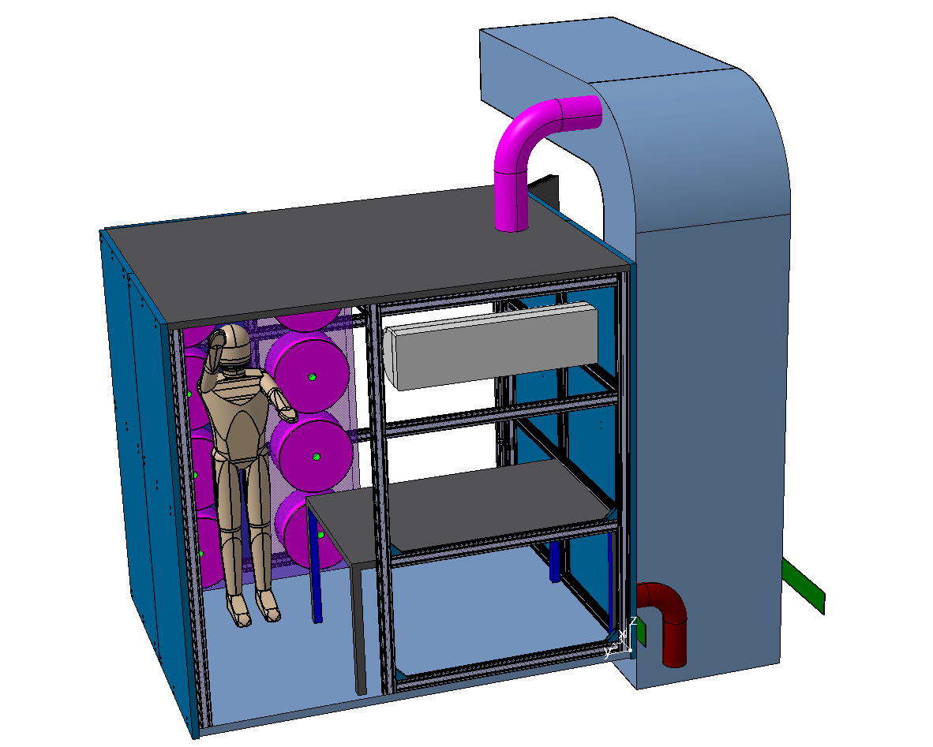
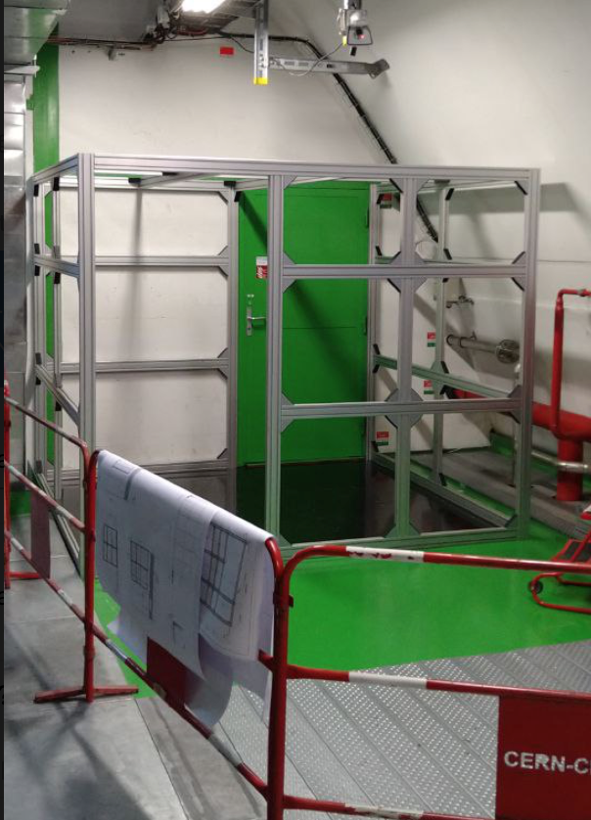
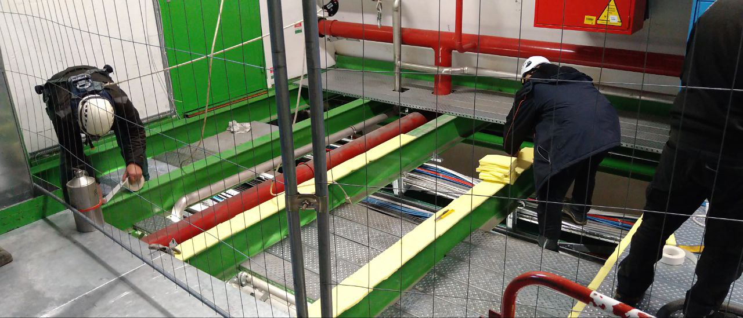
HCAL maintenance in 2023 YETS
Replacement the failed HCAL electronics components:
- 5 clock and control modules (ngCCM).
- 1 readout module (RM)
Done in December’23.
Relocation of the Hadron Calorimeter laser calibration system and related components:
- building the new laser room is being performed by JINR technician team.
- Commissioning is planned on February’24.
Jan 2024
Nov 2023
6

Slide 7
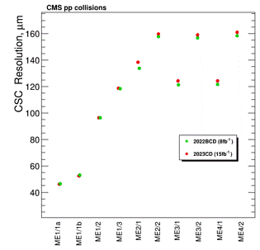
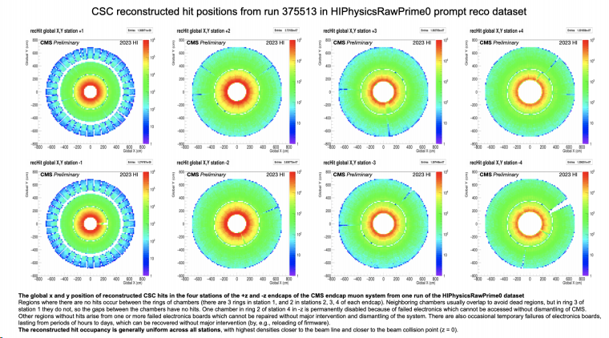
Maintenance and operation the Endcap Muon system
CSC electronics was replaced on detectors of the inner rings Endcap stations (LS2 period).
JINR group developed and constructed 120 Low Voltage Distribution boards (LVDB7).
180 chambers were upgraded with the new electronics to sustain HL-LHC conditions.
72 ME1/1 CSCs were equipped with the new on-chamber cooling systems.
Major part of CSC Phase-2 upgrade was done in LS2.
CSC operation in Run 3
The CSC spatial resolution values ​​with RUN3 2023 data are in good agreement with 2022 indicate the stability of the CSC operation .
Smooth CSC operation during heavy ion data-taking in October 2023 (except few LV issues).
7

Slide 8
RUN3 2023 CMS operation schedule
First beam on March 28.
First Stable beams @900 GeV on April 6.
First stable beams @ 13.6 TeV on April 19-22.
Start of high luminosity pp physics run on May 15th.
End of high luminosity pp running July 17 (vacuum leak in the Inner Triplet at Point 8).
- 48 days instead of the 97 of proton-proton physics were possible.
- 32 fb⁻¹ of pp luminosity were delivered (~40 fb⁻¹ less than planned).
The heavy-ion programme start on September 11.
First stable beams with ions start September 26.
CMS ran well during the HI period.
- Recorded up to 34 kHz of hadronic pb pb collisions to disk, compared to 8 kHz in 2018.
End of 2023 RUN3 – October 30.
Start of 2024 LHC beam commissioning scheduled for March 11.
8

Slide 9
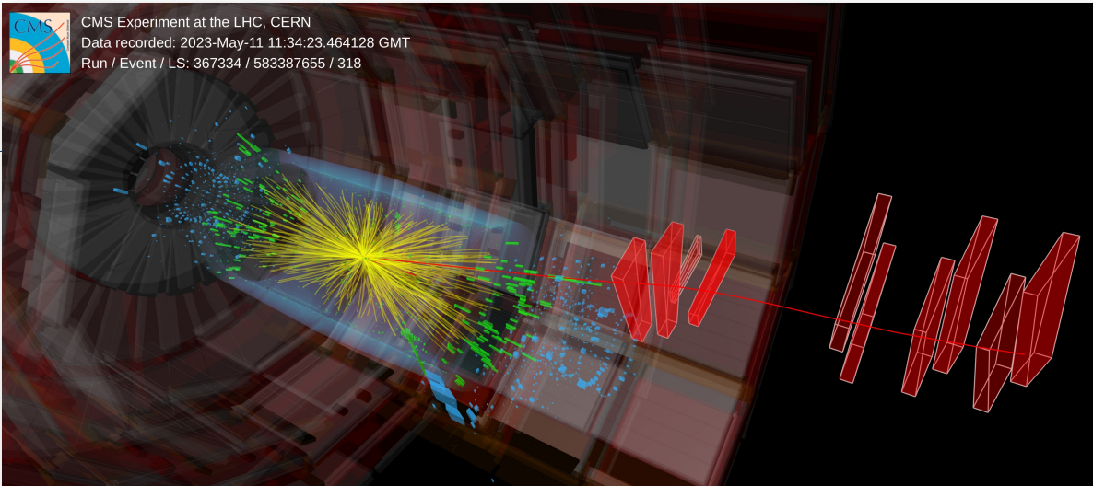
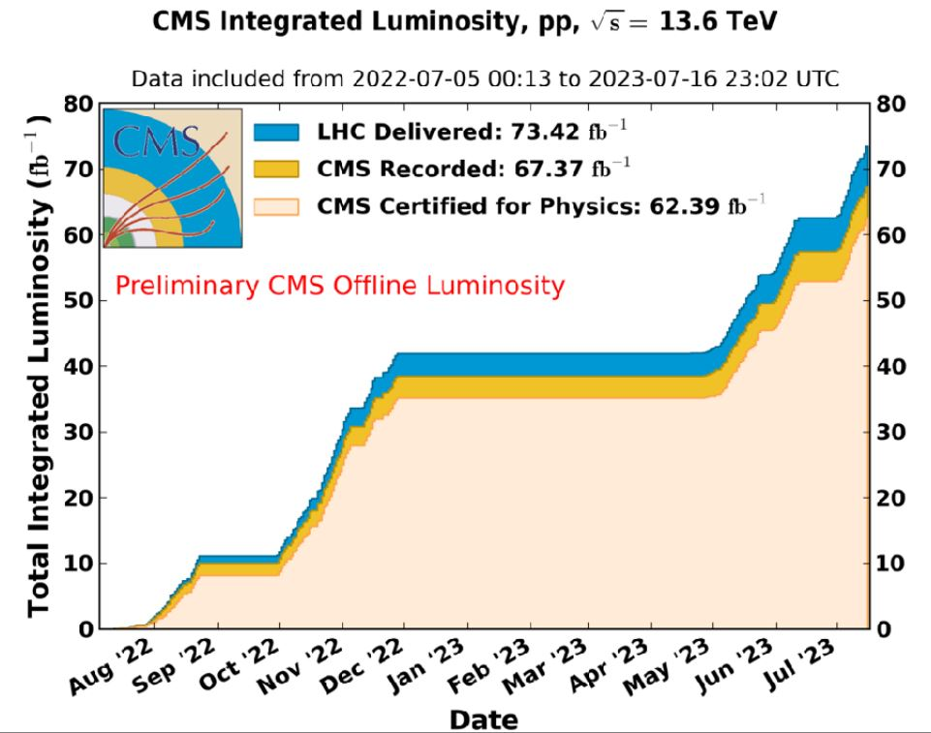
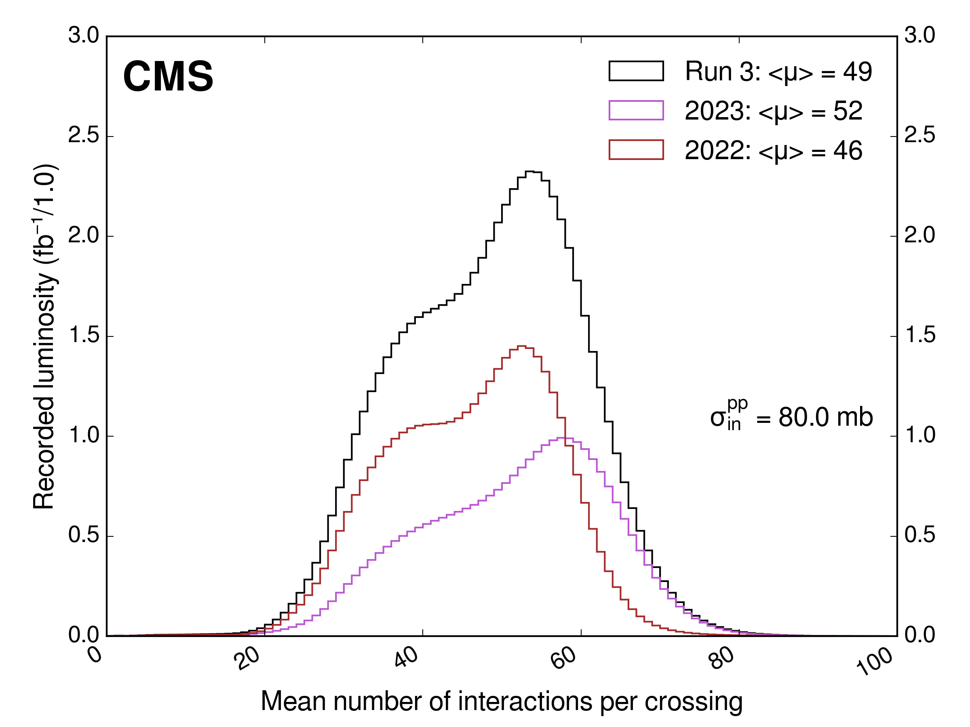
CMS in 2023 RUN 3
13.6 TeV pp collisions ~ 73 fb⁻¹ delivered in Run 3 (2022/23).
CMS data taking efficiency in 2023 (pp): ~ 92%.
Run 3 pp data certification efficiency 93%.
Prospective pp dataset in 2024 run > 80 fb⁻¹.
Pileup in 2022-2023
Downtimes of subsystems
9

Slide 10
JINR activity in the CMS physics analysis and SW
List of Physics and SW Tasks.
Physics beyond the Standard Model and Higgs Physics.
Search for physics beyond the standard model in dilepton mass spectra in pp collision search for new gauge bosons, extra dimensions, new higgs states, dark matter candidates.
Searches for signals of dark matter and new scalar bosons beyond SM (extra Higgs bosons) produced pairs of leptons/b-quarks and missing ET.
Search for a mu+mu-+b-jet event excess at the dimuon mass of 28 GeV in pp collisions at 13 TeV.
Search for physics beyond the standard model in processes with fermion flavor violation (microscopic black holes, dark matter candidates, new higgs states).
Studies of Higgs bosons with bbar-decays in Vector-Boson-Fusion Higgs production process.
Standard Model
Measurement of the differential Drell-Yan cross section in p-p collisions. Drell-Yan Radiative Corrections.
Angular coefficients of Z bosons produced in pp collisions as a function of transverse momentum and rapidity.
Measurements of the multiplicity in quark and gluon jets and fractions of gluon jets.
Algorithms and Software
Development of algorithms for high-momentum muons reconstruction. Muon hit reconstruction and segment builder.
Data Certification (DC) software development with machine learning (ML) algorithms.
10

Slide 11
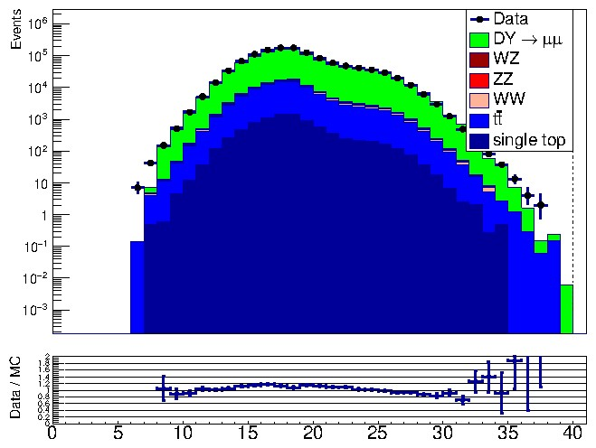
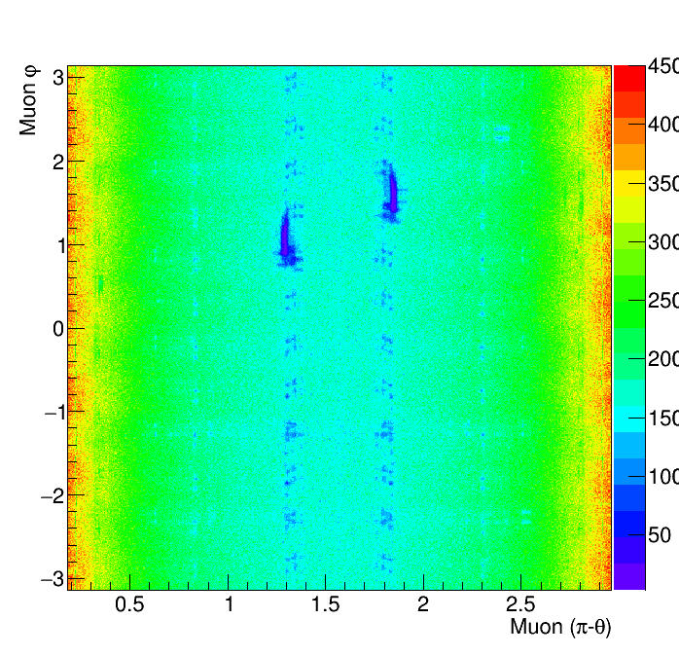
Scrutiny of the muon reconstruction and comparison
to the Monte Carlo simulation with Run3 data
Analysis focused on search for new physics beyond the SM
(new gauge bosons, graviton exited states, dark matter mediators).
preliminary
Distributions of the reconstructed muons
used in physics analyses checked:
Distributions of muon angles from dimuons.
Other kinematical quantities.
Similar structures were also seen in previous
runs due to the muon detector geometry.
Data/MC plots of various kinematical quantities were studied.
MC samples simulated with √s = 13 TeV were used
(13.6 TeV MC samples are in production).
Scrutiny of events with heavy dimuons is done.
Distribution of No. of tracker hits per muon
Detector redundancy makes the muon reconstruction not concerned by rare problems in some individual chambers.
Nice agreement with the expected behavior.
11

Slide 12
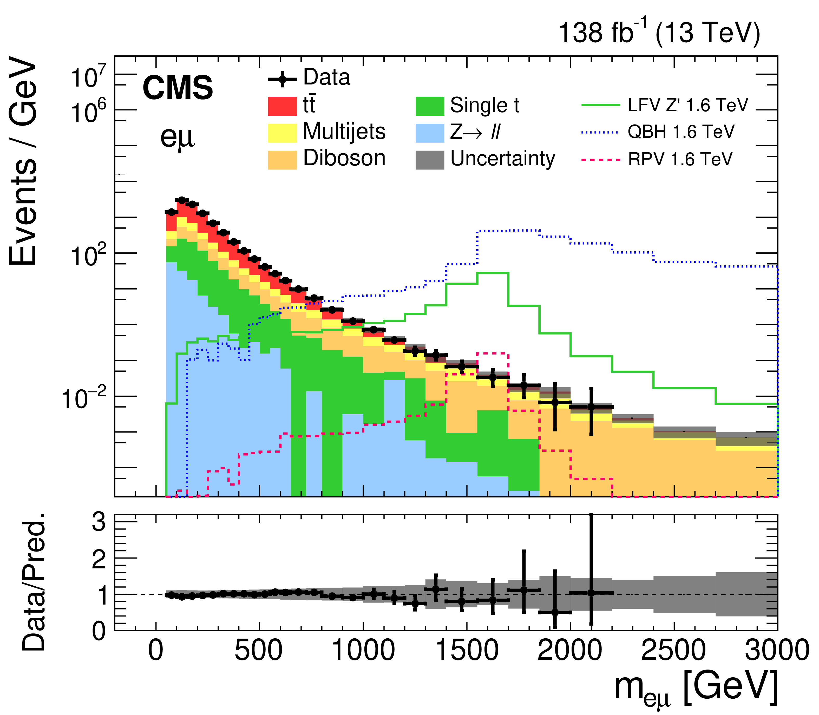
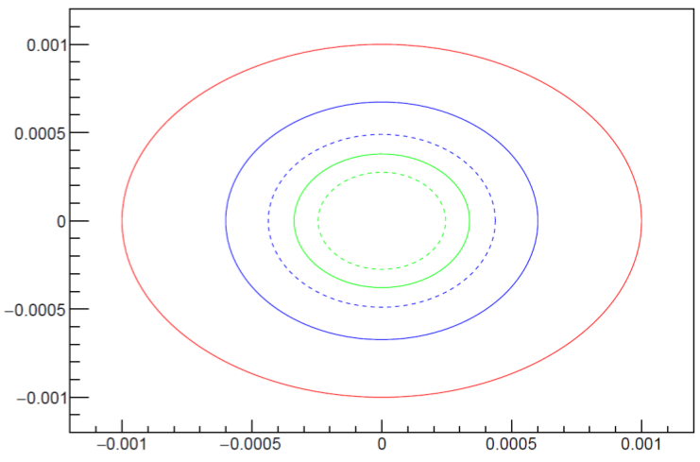
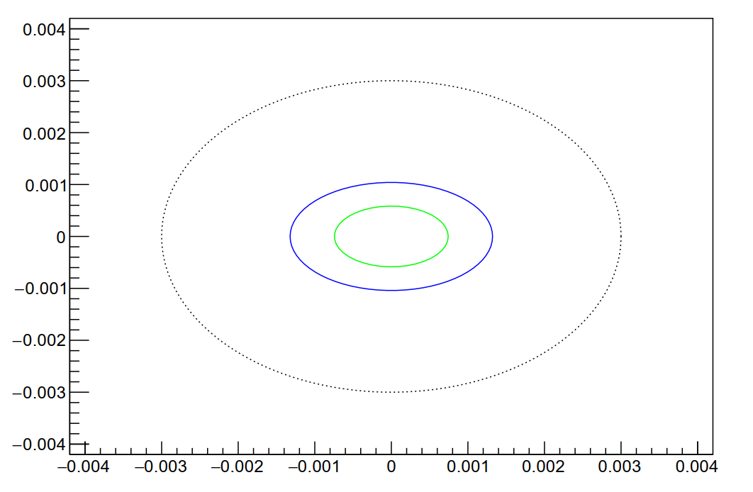
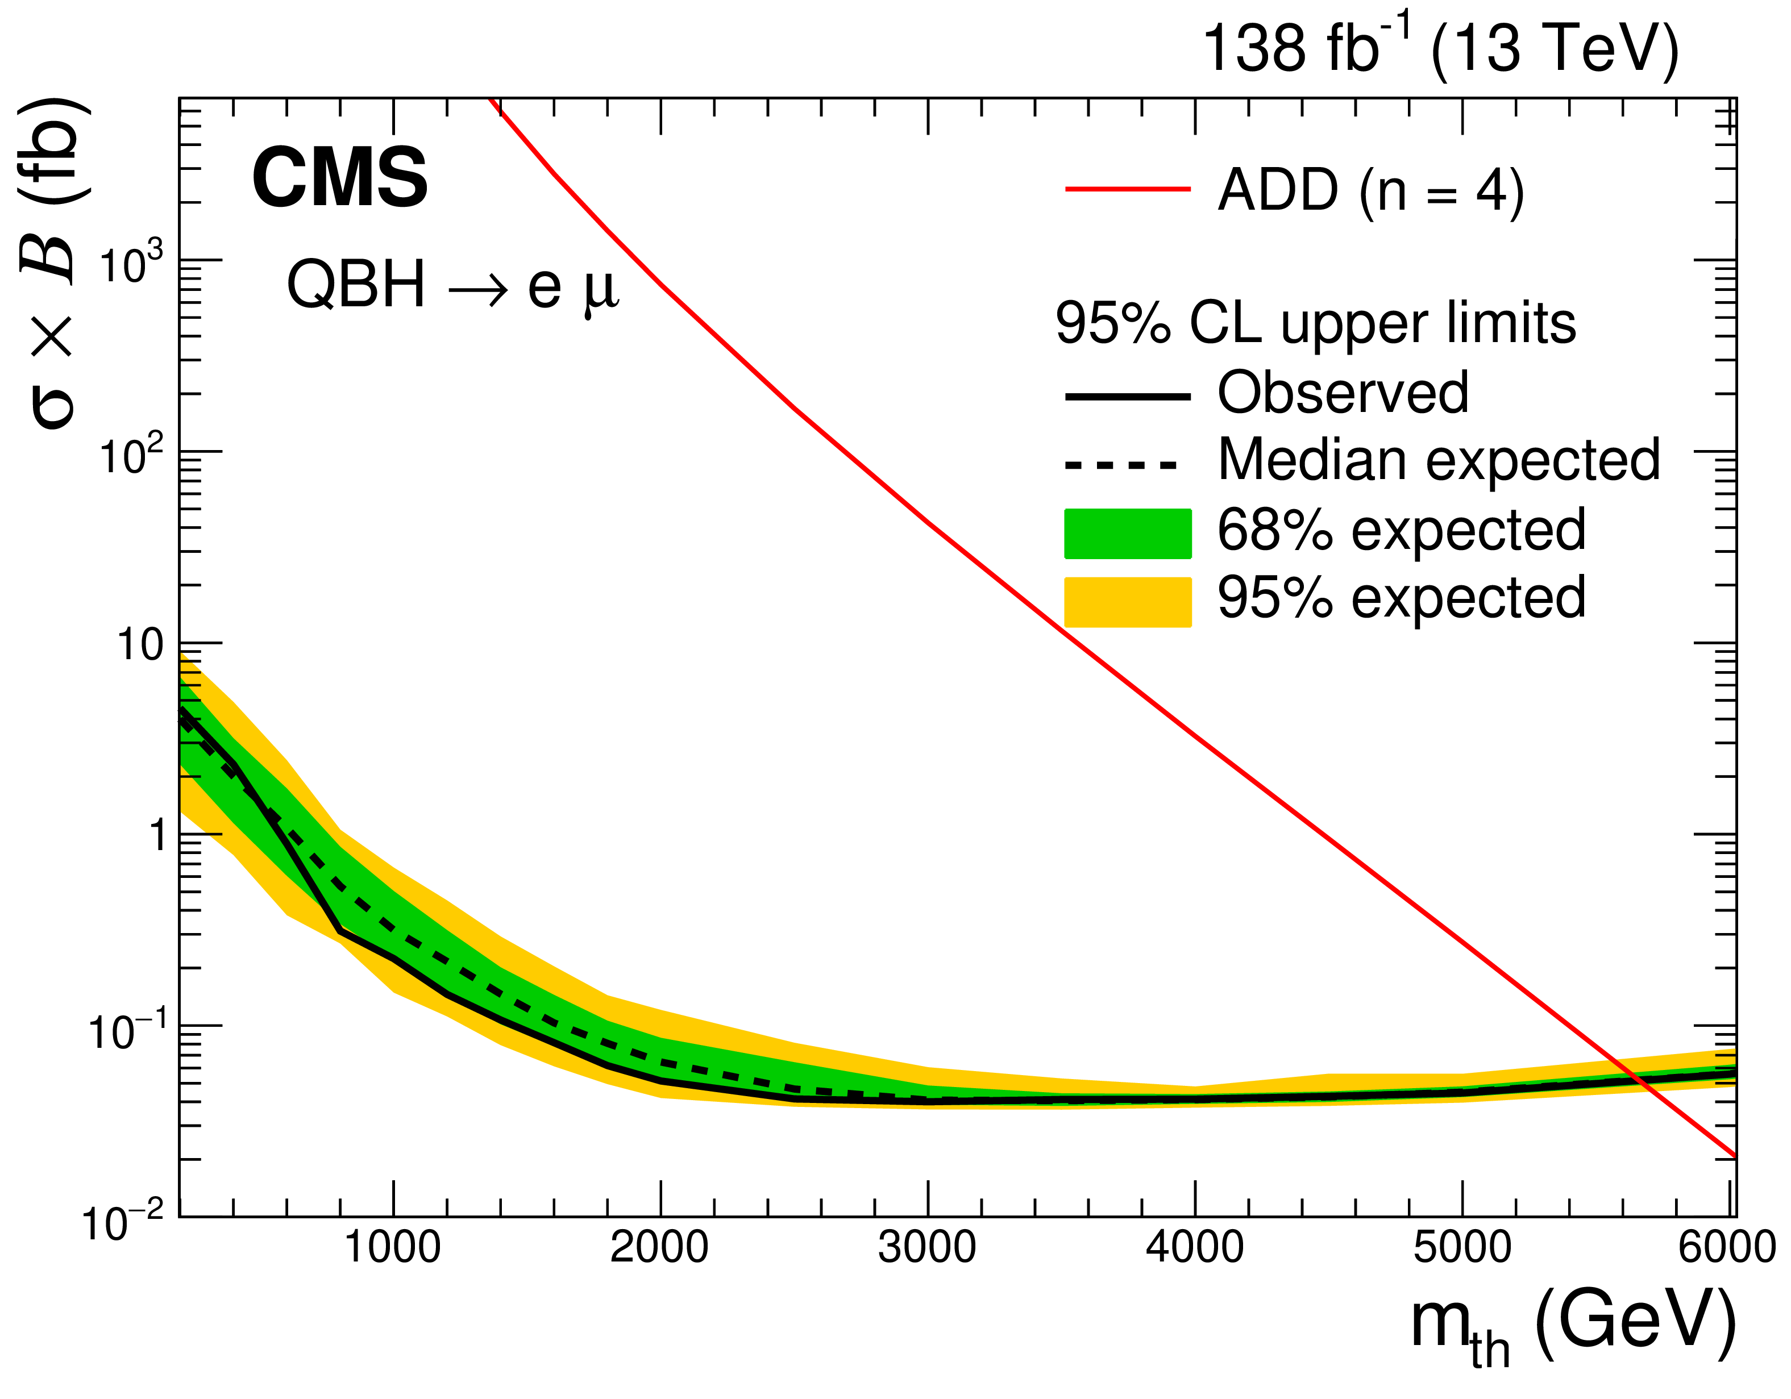
Lepton Flavour Universality with Dileptons
Continued studies with ee, μμ, eμ, eτ, and μτ pair invariant mass spectra.
To test lepton-flavour universality of SM at the TeV scale.
To search for heavy resonances and quantum black holes
(three benchmark signals are studied):
- R parity violating supersymmetric models.
- Heavy Z' gauge bosons with lepton flavor violating decays.
- Quantum black hole production in models with extra spatial dimensions.
To explore LFV effects with the effective field theory (EFT) approach.
RUN2 (13 TeV, 138 fb⁻¹)
JHEP 05 (2023) 227
(a)
(b)
Upper limits are set at 95% CL on the product of the cross section and branching fraction for lepton flavor violating signals.
The expected limits for the scalar vs. vector LFV constants for eµ (a) and µτ (b) production processes at 300 fb⁻¹ (blue) and 3000 fb⁻¹ (green).
12

Slide 13
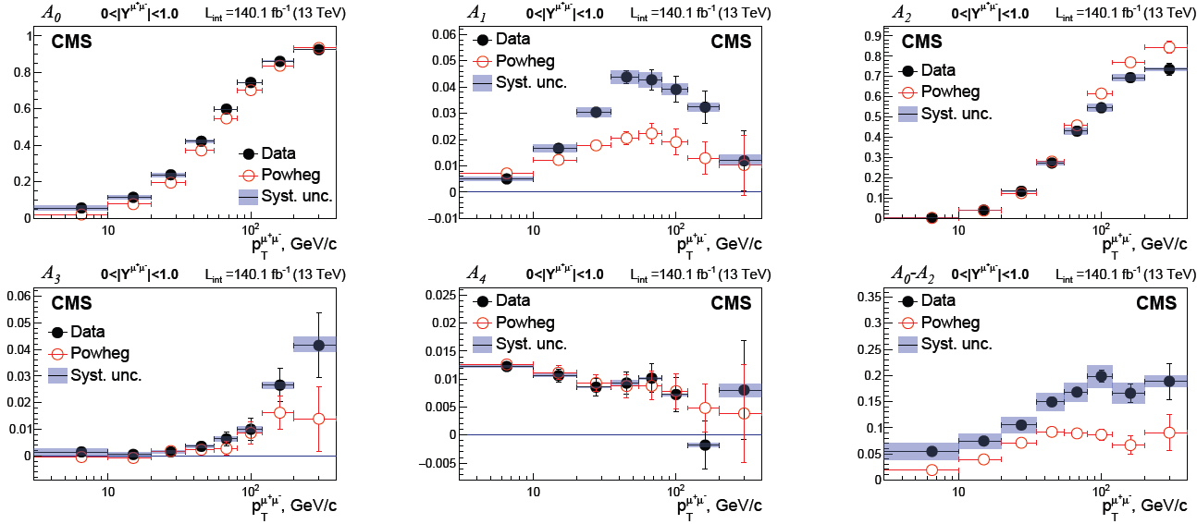
Measurement of Drell-Yan Angular Polarization Coefficients at 13 TeV
In 2023 systematic uncertainty from nine main sources was estimated.
The full set of angular polarization coefficients and $A_{0}{−A}_{7}$was measured at the first time in the CMS experiment.
Non-conservation of the Lam-Tung relation $A_{0}−A_{2}=0$ was also observed in pp-collisions at $\sqrt{s}=13$ TeV.
CMS Note was created with a full description of the analysis methodology (Analysis Note 20-220v6).
The analysis has been assigned a CADI number: SMP-23-007.
A prototype of an article in Physical Letters B was created and sent to the CMS collaboration to review.
13

Slide 14
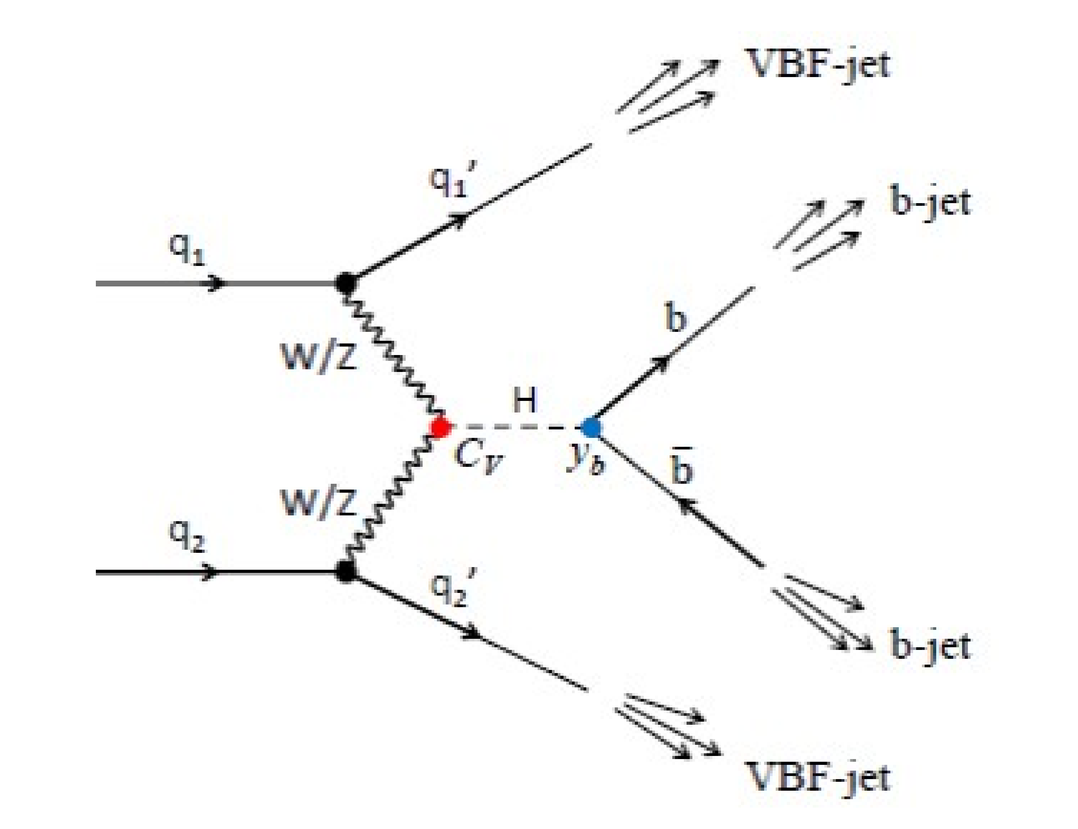
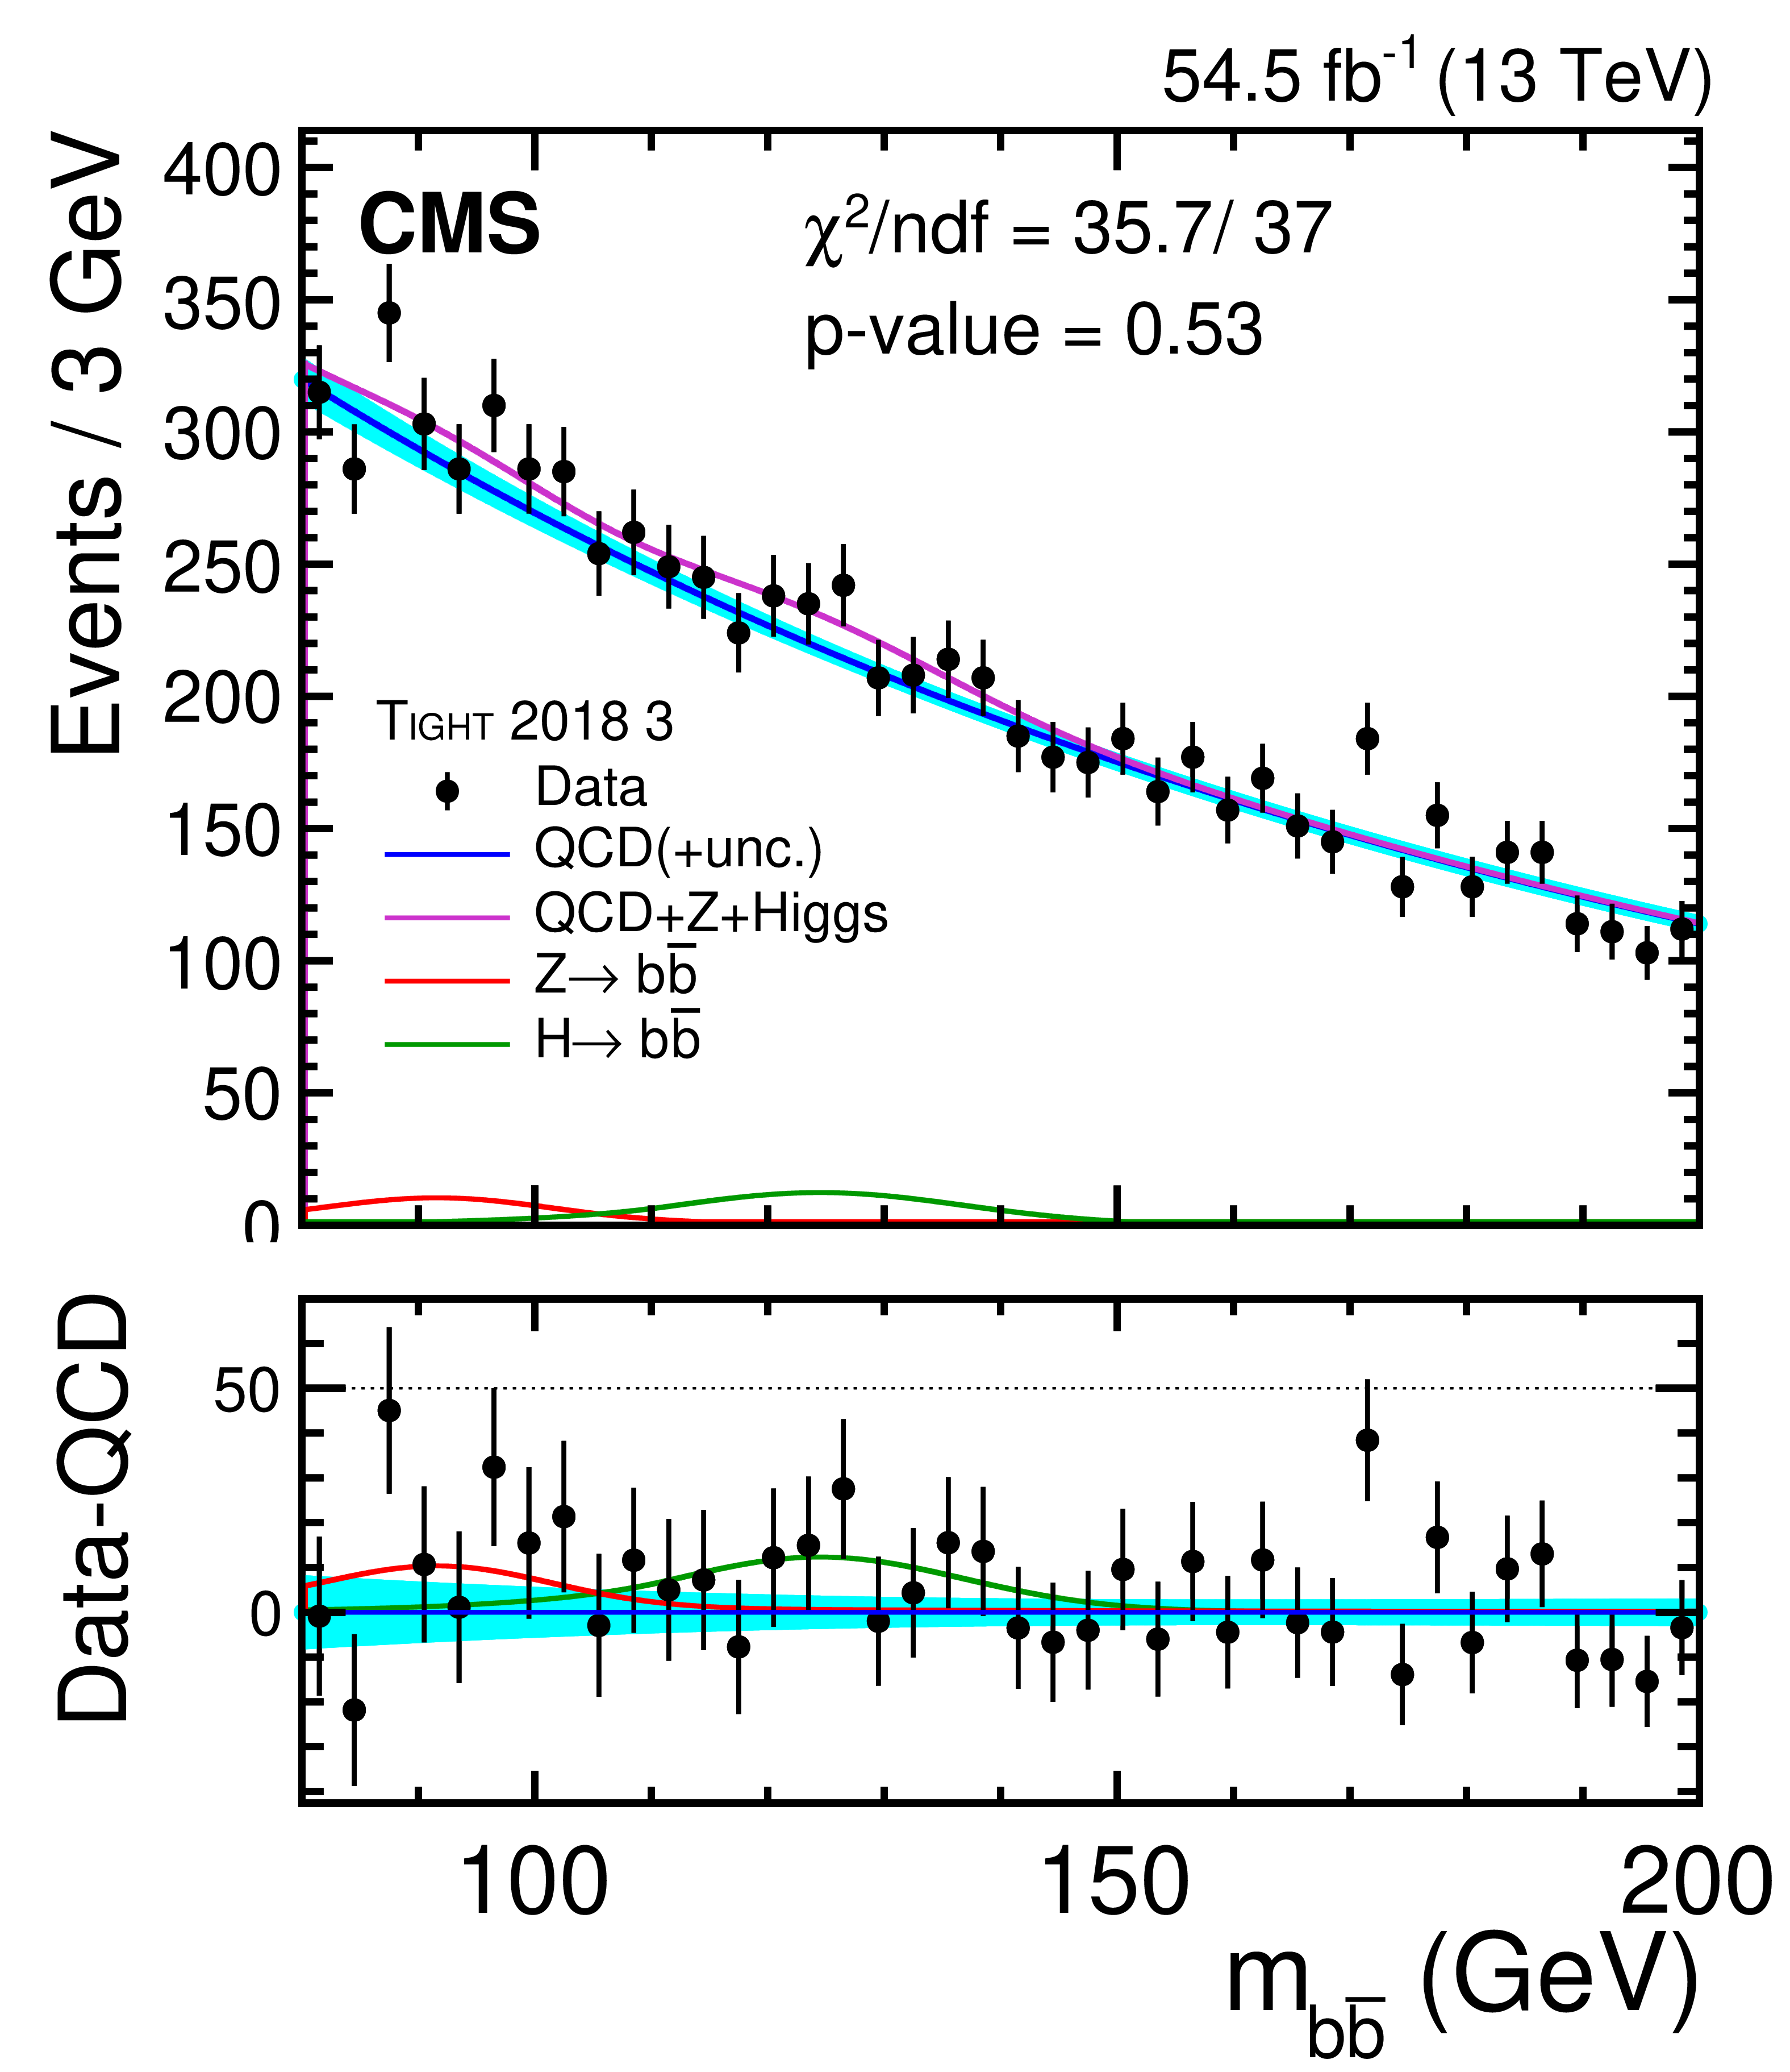
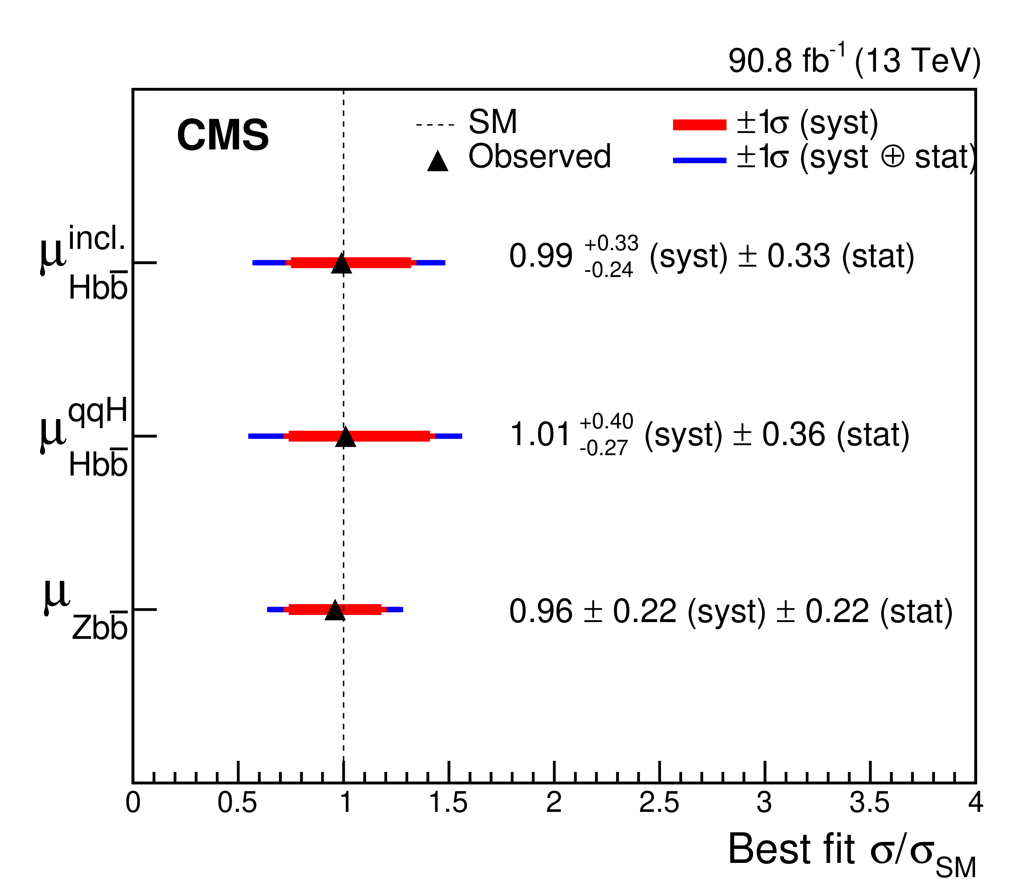
Search for $\text{VBF} H→b\overline{b}$
CMS 2016, 2018 data of pp-collisions at 13 TeV corresponding to ~91 fb⁻¹.
arXiv:2308.01253
ANALYSIS STRATEGY
Inclusive $H→b\overline{b}$(VBF+ggF):
Significance (observed/expected) = 2.6/2.9.
μ_{Hbb} = 0.99±0.33 (stat.)+0.33 (syst.)–0.24 (syst.).
Pure VBF (ggF is constrained within SM-expectation):
Significance (observed/expected) = 2.4/2.7.
μ_{Hbb} = 1.01 ±6 (stat.) +0.40 (syst.) – 0.27 (syst.).
Dedicated online triggers (L1 – HLT).
BDT Signal-Background discrimination.
Separate Zbb analysis category for validation and Zbb constrain.
MC signal and resonant background models.
Data-derived QCD model.
DNN regression to b-jets energy.
Signal extraction using m_{bb} distribution.
14

Slide 15
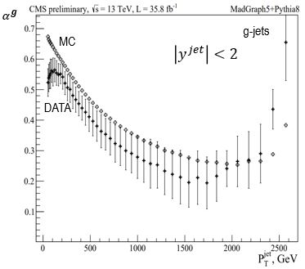
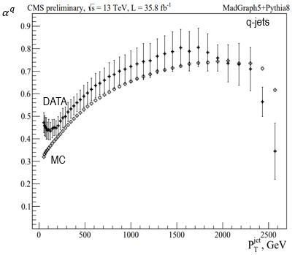
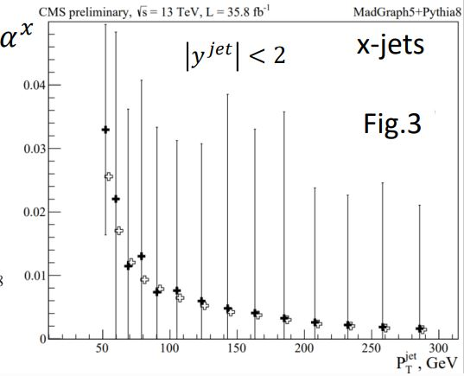
Measurement of q/g-jet fractions with CMS
preliminary
New method of measurement of q/g jets fractions which includes model uncertainty (MU) has been proposed and implemented.
In the measurement of q/g-jet fractions the effects of pileup (PU) were considered.
q/g-jet fractions with new QGL in data analysis and MC simulation are in a good agreement within uncertainties except jet P_{T} < 90 GeV.
The estimation of fraction of jets with unidentified flavour have been done.
CMS Analysis Note on q/g jets fractions in preparation
15

Slide 16
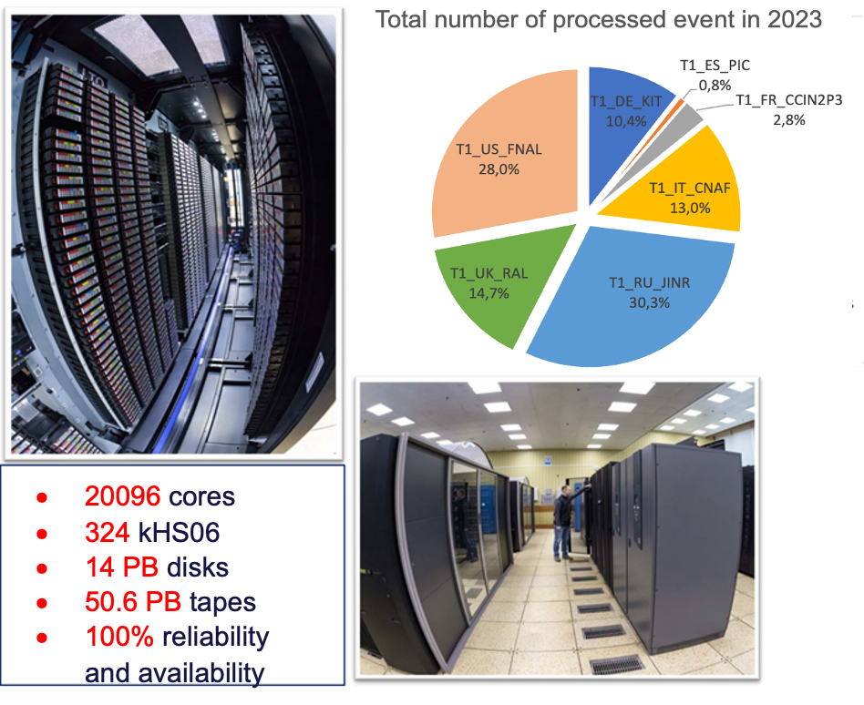
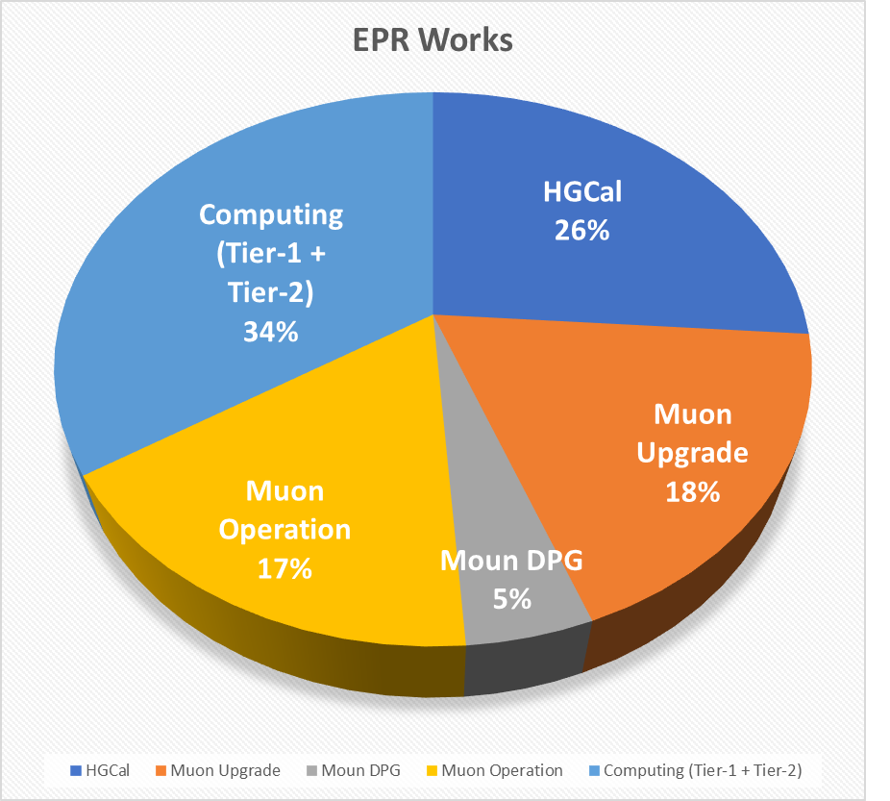
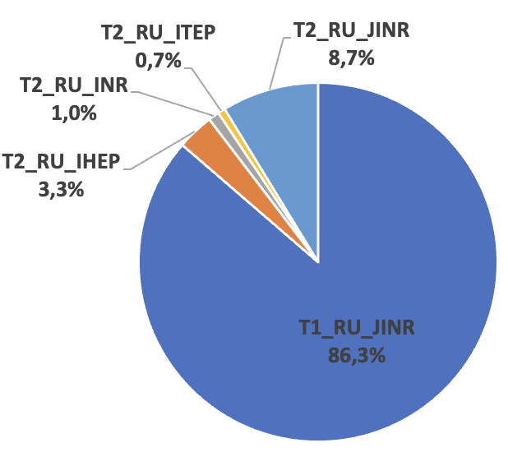
JINR contribution in CMS Computing
In 2023 JINR grid Tier-1 and Tier-2 centers extensively used for processing and storing CMS data,
ensuring 100% availability and reliability of services.
More than 3.7 billion events were successfully processed by JINR Tier-1 in 2023.
The JINR Tier-1 is ranked the first place among all CMS Tier-1 centers.
JINR Contribution in RDMS
Computing is crucial.
Total number of completed jobs by Russian sites in 2023
JINR Tier2 is the most productive in
the Russian Data Intensive Grid (RDIG).
16

Slide 17
JINR contribution to CMS Phase 2 Upgrade
Participation in High Granularity Calorimeter (HGCal) project.
Cooling plate of HGCal cassettes design.
Design and construction of the HGCAL silicon and scintillator cassettes test facility.
Participation in the Endcap Muon system upgrade.
Cathode Strip Chambers maintenance during LS3 long shutdown period.
CSC longevity study and searches for eco friendly gas mixtures R&D.
Upgrade of the ME1/1 CSCs cables and services layout for the new CMS Endcap detectors configuration.
Design and construction of the new ME1/1 Patch Panel.
Design and construction of new tooling for ME1/1 CSC assembly and installation.
17

Slide 18
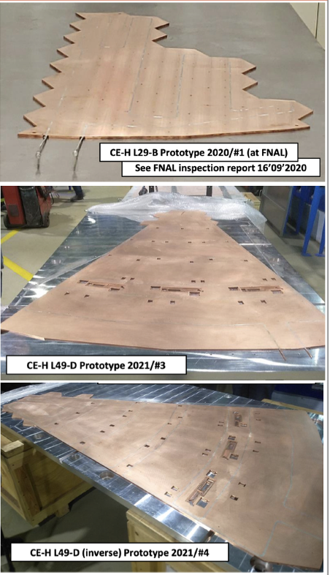
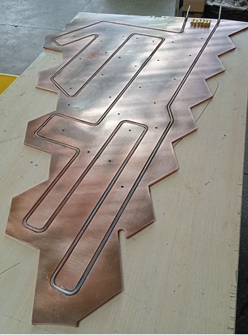
CE-H Cassette Cooling Panels Prototypes
The panels are designed for precision placement of silicon and scintillation detectors and to provide detector electronics cooling.
4 prototypes of cooling plates with different sizes were produced in Minsk.
The goal: development and test of production technologies and tooling.
Automatic soldering using a heating table.
Copper sheet straightening before and after machining.
Raw vs. annealed steel tube bending.
Heat dissipation with press-fitted tube.
Copper spray coating technique.
Press fit + glue tube binding technique.
Soldering the spray-coated tube.
Press-fit + glue
Comprehensive test of prototypes done in Nov 2023. Results were reported on HGCal meeting.
18

Slide 19
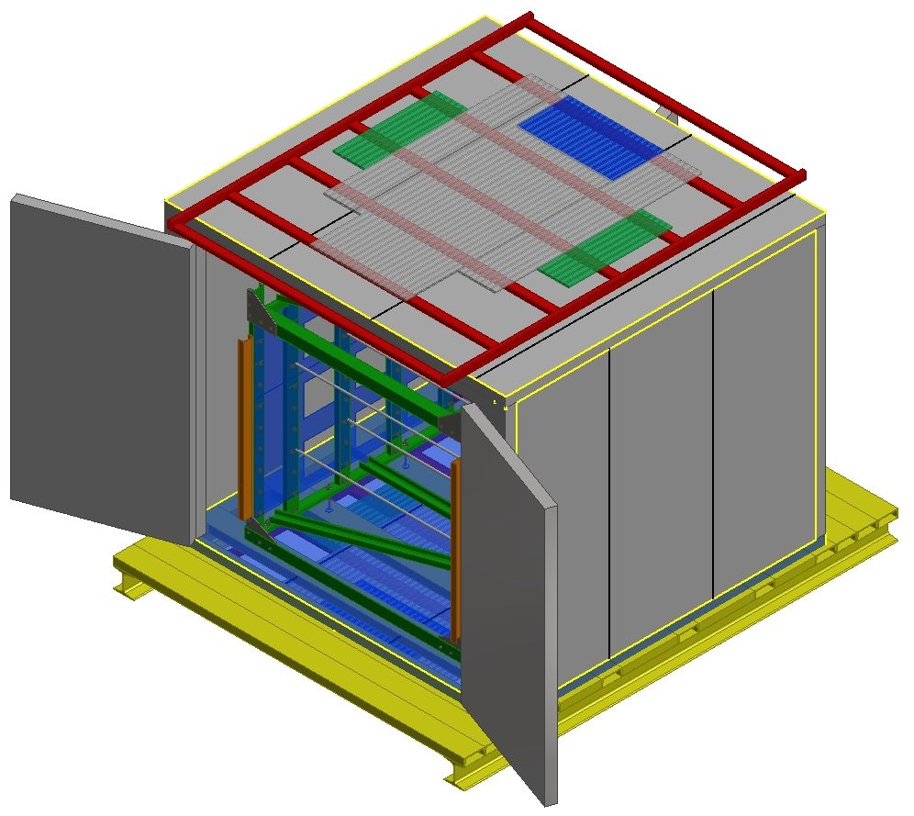
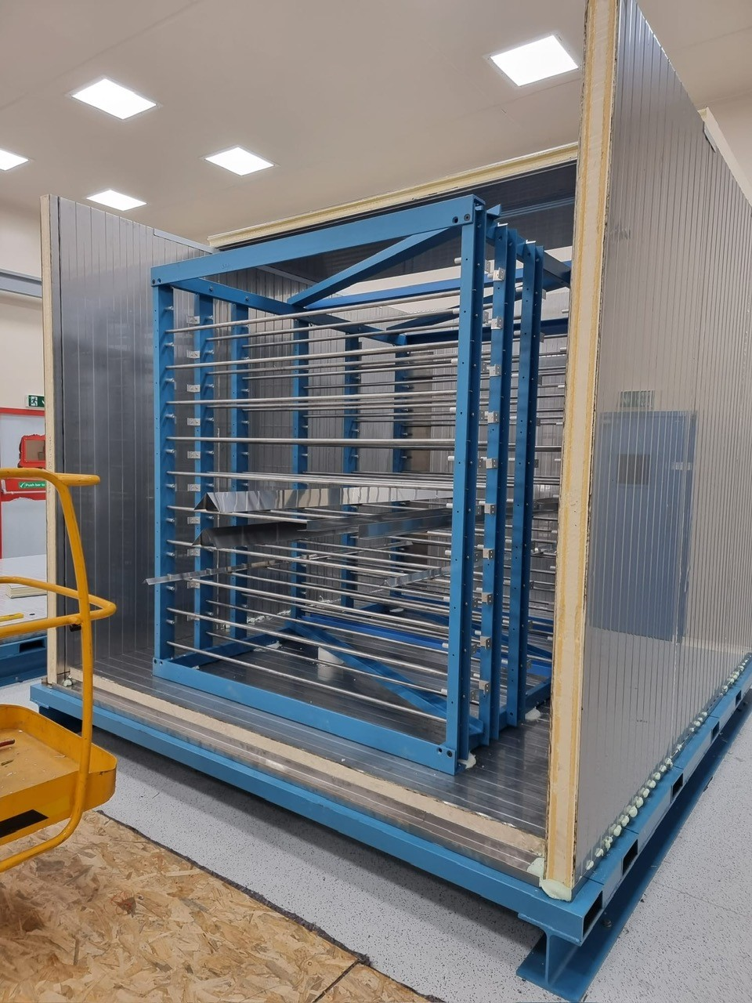
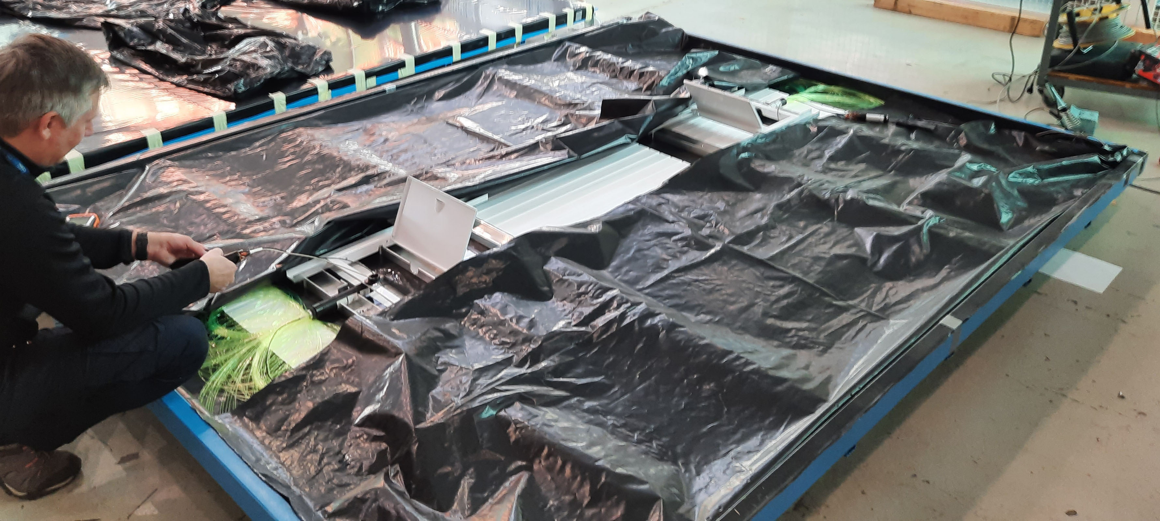
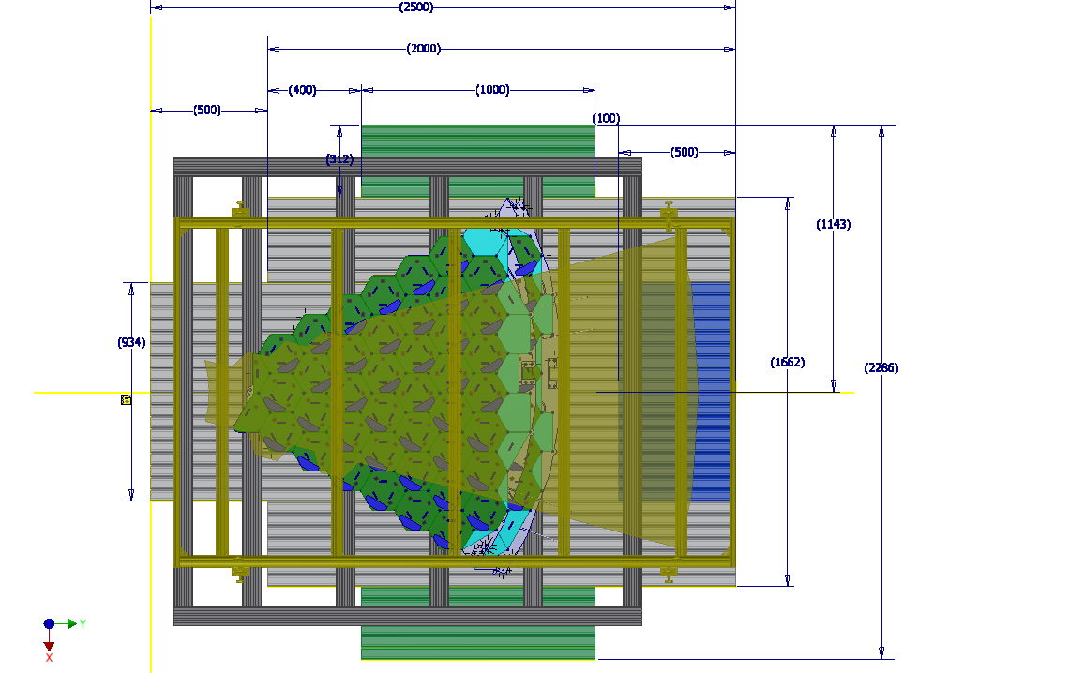
Test Setup for HGCal Cassettes
2 Cold rooms delivered to CERN in 2023.
HGCal test setup assembly in progress including:
Racks for cassettes.
Supporting frames for cassettes.
Trigger scintillator planes located on top and bottom of cold room.
Cold room
3.1x2.9x2.5 m.
Trigger scintillator plates top and bottom.
Trigger simulation have been done.
- Optimization of the trigger plates dimensions.
- Detectors performance estimation.
- Test of Evaluation algorithms.
Trigger scintillator plane construction.
Cold room with cassettes rack inside.
Goal is to complete test setup construction by May 2024.
19

Slide 20
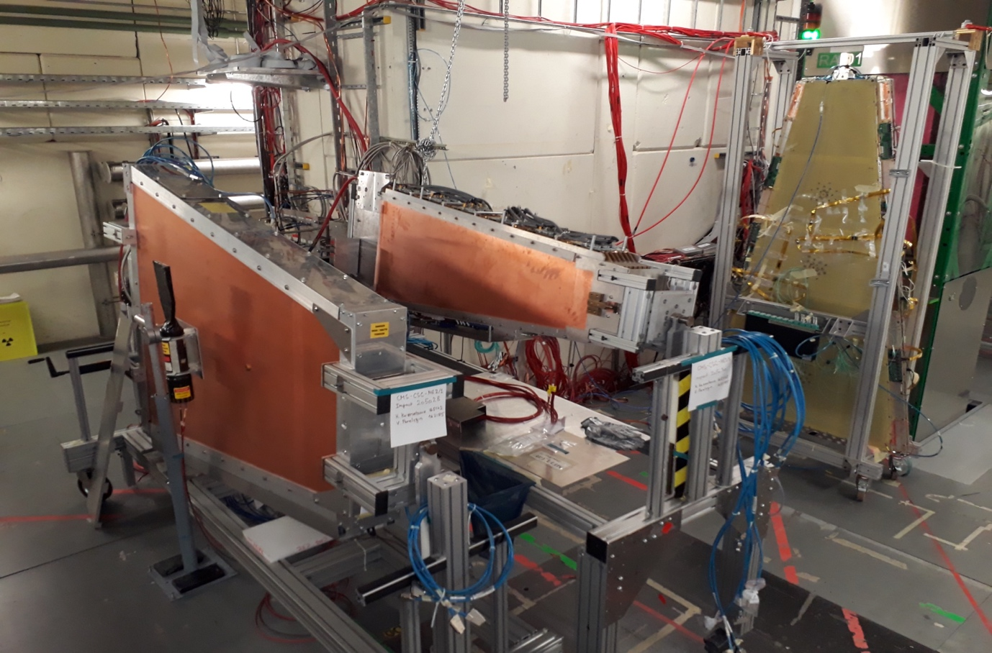
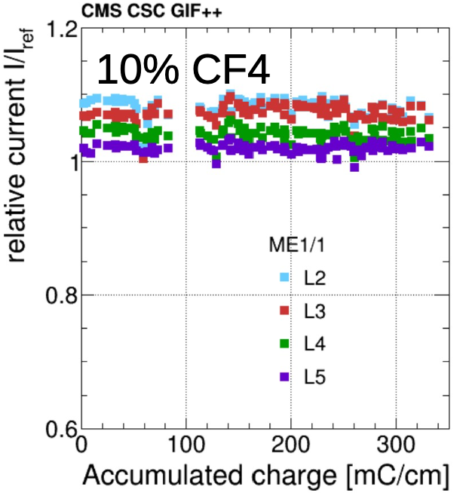
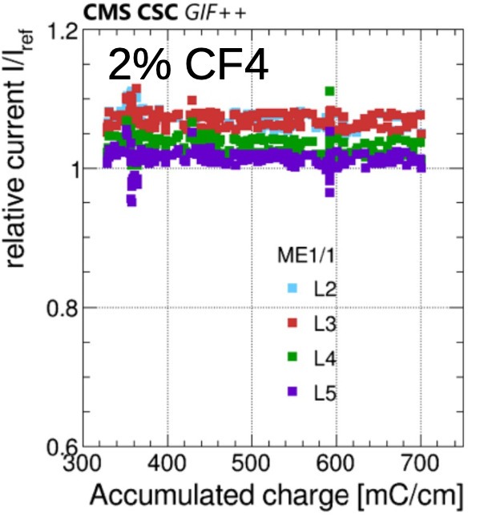
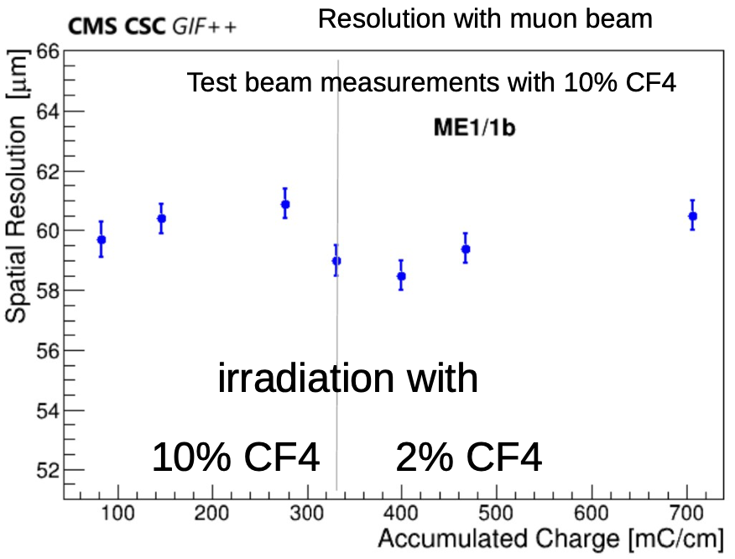
Cathode Strip Chamber Longevity Study
Irradiation setup: ME1/1 and ME2/1 CSCs exposed with the 12 TBq Cs-137 gamma source
at the GIF++ Facility (HV-ON on 4 layers and HV-OFF on 2 layers kept as reference).
Amount of integrated charge expected at 1 HL-LHC estimated using the Run2. currents scaled with the Fluka simulation (HL-LHC/Run2 ratio):
- ME1/1: 200 mC/cm => accumulated 700 - safety factor 3.5.
- ME2/1: 130 mC/cm => 390 - safety factor 3.0.
Studies with nominal gas mixture and with reduced CF4% ongoing from 2016:
- ME1/1 and ME2/1 received 330 mC/cm using 40% Ar, 50% CO2,10% CF4.
- ME1/1 received further 370 mC/cm using 2% of CF4 (test continuing with 5% CF4 ).
- No significant performance degradation observed so far.
ME1/1
ME2/1
2023 Test Beam at GIF++
20

Slide 21
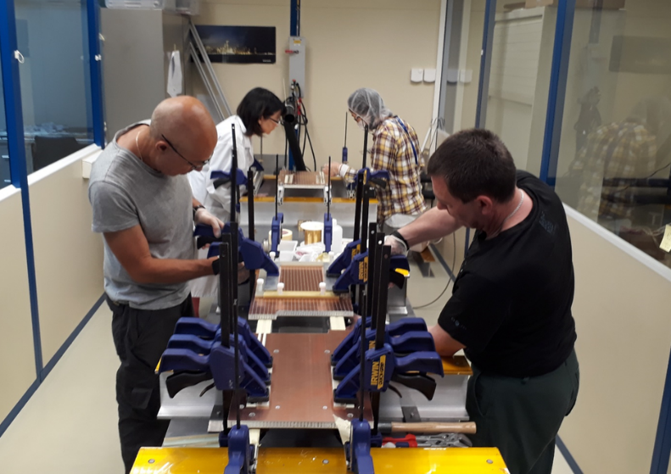
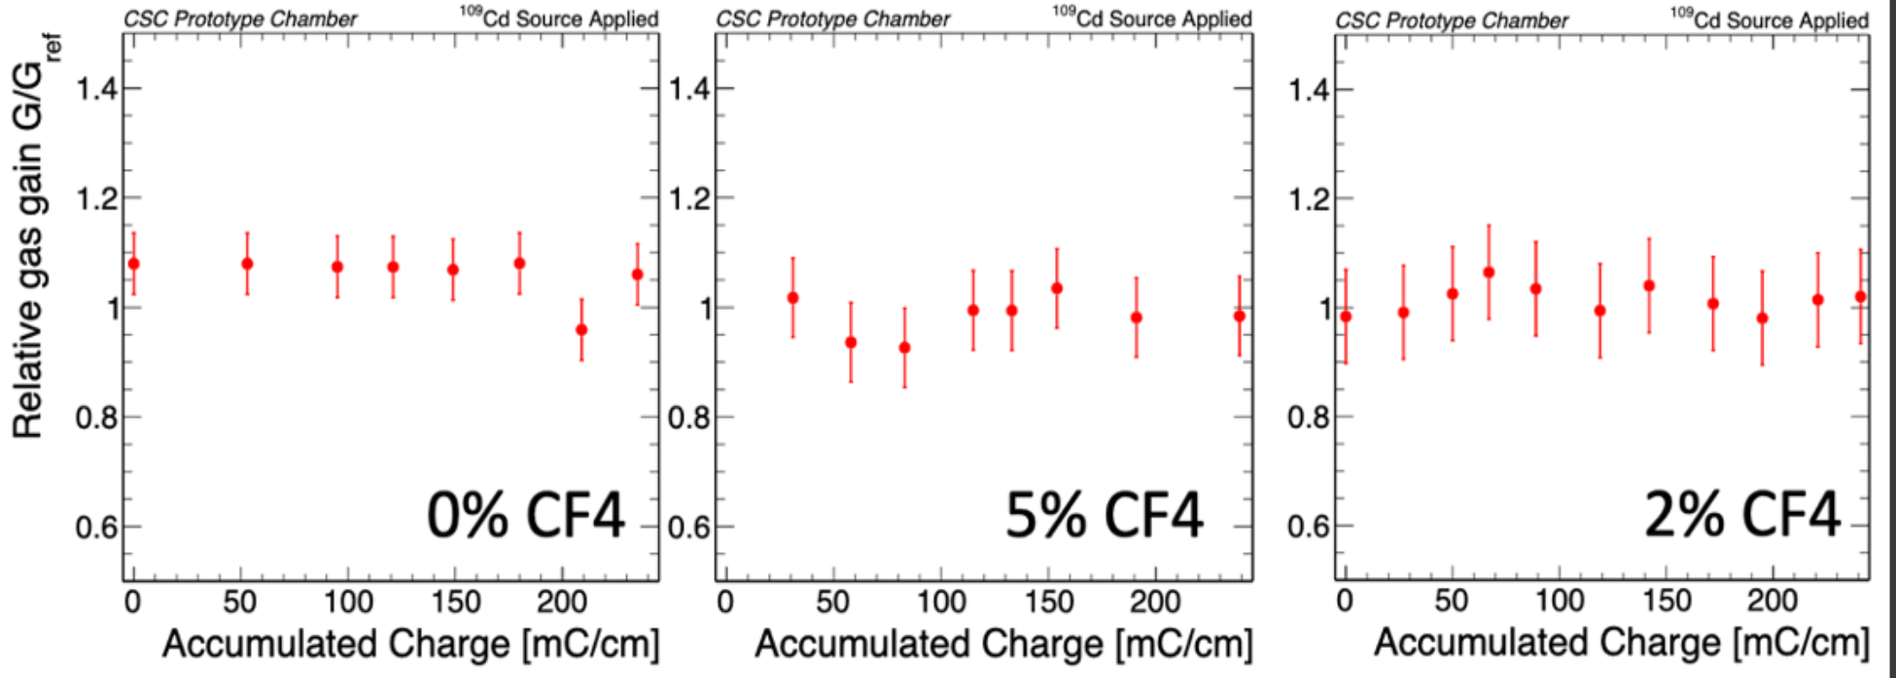
Searches for Eco-friendly Gas Mixtures
Motivation: CSC use CF4 to protect anode wire from Si deposits and carbon polymers.
But Global Warning Potential (GWP) is too high 7000 x CO₂.
Six 2-layer mini-CSCs with sensitive area (30 x 30 cm²) were constructed to study the CSC operation with the new gas mixtures.
Lab tests shows that reduction of CF4 doesn’t affect the CSC longevity however an increased pollution is visible on the wire (validated up to 2 HL-LHC).
Deposits on the anode wires show that operating with 2% CF4 might be a risky choice, while running with 5% CF4 looks more sustainable (irradiation ongoing).
CSCs prototypes irradiated with and different percentages of CF4 (10%, 5%, 2%, 0%).
Studies with HFO1234ze and other potential CF4 alternatives are ongoing.
21

Slide 22
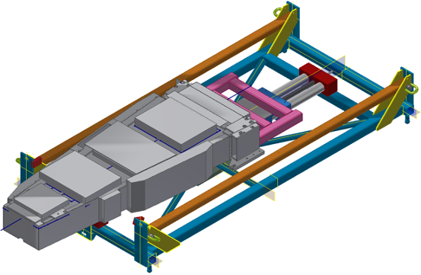
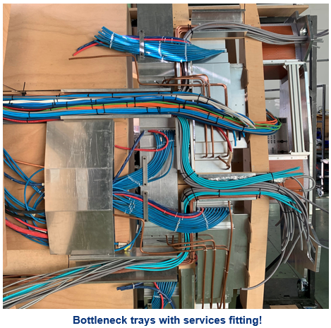
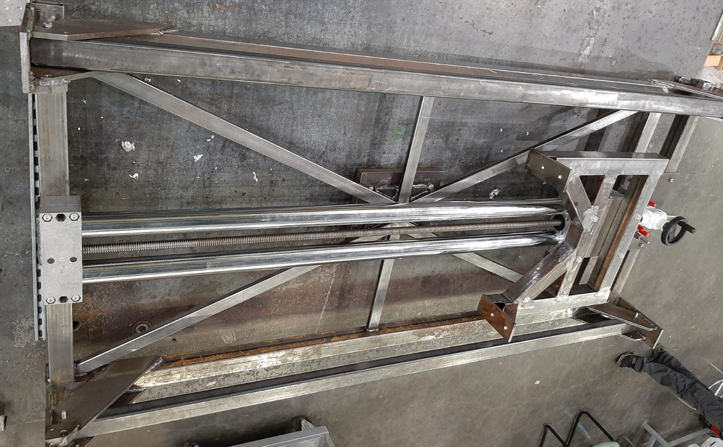
ME1/1 CSC Integration and Tooling Modification
Preparation to the Phase-2 upgrade during L3.
Work in progress.
ME1/1 zone is redesigned to avoid bottlenecks
for services routing of the HGCal.
ME1/1 Insertion tooling is modified
(extraction/installation ME1/1 CSC detectors).
ME1/1 Patch Panel redesign
(became thinner and wider).
The mockup of ME1/1 zone was built to validate layout of services and cables.
Frame
DLRE Table
ME1/1 chamber
ME1/1 PP
36 new ME1/1 PP should be constructed before LS3.
22

Slide 23
Summary
In 2023, the JINR group concentrate on RUN2 and RUN3 data analysis.
Dimuons, dimuons + MET, Z + MET, bbar + MET to search for new physics and to test the SM.
In 2023 JINR grid Tier-1 and Tier-2 centers insured 100% availability and reliability for CMS data processing services.
CMS had successful LS2 upgrade (Phase-1 completion) and commissioning period following YETS 2022.
The considerable contribution to the CMS Phase-1 upgrade was done by JINR group.
CMS Endcap Muon System and Hadron Calorimeter shows a good performance in RUN3.
CMS Phase-2 HL-LHC upgrade are making good progress. JINR group is actively involved in:
High-Granularity Calorimeter (HGCal) project.
Studies for the technology of cooling panels production for the HGCal CE-H cassettes.
Construction of the HGCAL silicon and scintillator cassettes test facility in progress.
CMS Muon Endcap system upgrade (major part of CSC Phase-2 upgrade successfully completed in LS2).
CSC patch panel was redesigned, preparation to production in progress.
ME1/1 loading machine constructed.
CSC longevity and performance study in progress.
Continuation study of the CSC operation with the new gas mixtures.
23

Slide 24
Plans for 2024
Continue RUN2 and RUN3 data analysis.
Dimuons, dimuons + MET, Z + MET, bbar + MET to search for
new physics and to test the SM.
Participation in RUN3 within JINR responsibilities.
- Participation in shifts.
- Detector systems operation and maintenance.
- Detector performance study.
Participation in Phase-2 HGCAL project.
- Test and calibration of trigger system of the HGCAL test setup– April 2024.
- Complete construction and launching of the HGCAL cassettes test facility ~ May 2024.
Participation in Phase-2 upgrade of Muon Endcap System.
Preparation to the ME1/1 CSC upgrade during LS3.
Studying the ageing effects of the CMS muon endcap detectors (CSC) at GIF ++ facility.
Participation in the new gas mixture studies.
Development and test of algorithms for reconstruction of muon track segments.
24

Slide 25
Backup slides
25

Slide 26
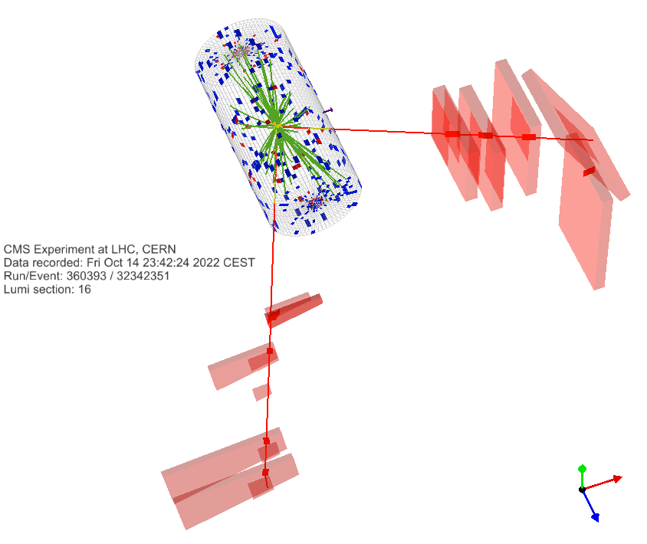
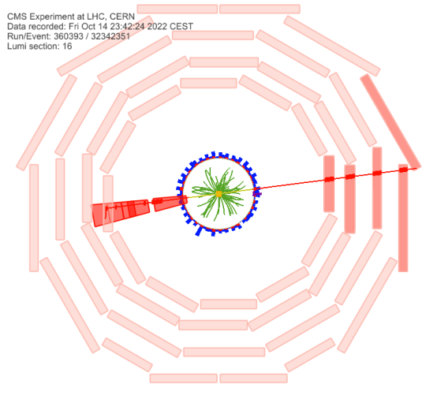
The First Look on RUN3 Data (Dimuons)
Data-to-data comparison of dimuon events between 2018 and RUN3.
Event 360393:16:32342351 taken on 14-Oct-2022.
RUN3 data: 27.3 fb⁻¹ (normalized to 2018 integrated luminosity for the comparison).
Two muons passing high-p_{T} ID and loose tracker isolation with opposite charge (same as Run 2 analysis).
To search for:
New resonances (dark matter, extra gauge bosons, graviton states, etc).
Non-resonant signals (extra dimensions, compositeness, etc.).
Lepton-flavor violated processes.
Good event, passes all the cuts, the run was certified by the data quality as good. M = 2407 GeV.
Muon1: p_{T} = 1161 GeV eta = 1.589 phi = -3.014 (hits CSC including ME1/1).
Muon2: p_{T} = 935 GeV eta = 0.538 phi = 0.131 (hits DT chambers).
26

Slide 27
Search for New Physics: Dark Matter Candidates with RUN2/3 Data
95% confidence level (CL) observed and expected exclusions have been set for combined di-jet and di-lepton searches in the simplified dark matter (DM) scenario. The mass limits are presented in the plane of the Dirac DM particle m_{DM} and mediator m_{med}.
The exclusions are computed for:
Leptophilic scenarios with the axial-vector mediator (a universal
quark coupling of g_{q} = 0.1, lepton coupling g_{l} = 0.1, and for a DM
coupling of g_{DM} = 1.0).
And for leptophobic scenarios with the vector mediator
(a universal quark coupling of g_{q} = 0.1, lepton coupling g_{l} = 0.01, and for a DM coupling of g_{DM} = 1.0).
The analysis of the RUN3 data within the framework of the extended two-Higgs-doublet models (2HDM+a/2HDM+S).
The cross sections are calculated for the processes of production of dark matter particles associated with Higgs or Z boson at an energy of 13.8 TeV.
The analysis parameters were tuned, and the simulation of the CMS setup response was started.
RUN3 area
RUN2 exclusions
27

Slide 28
Higgs Physics and Standard Model
Analysis of VBF Higgs boson in bb decay is pre-approved
Drell-Yan angular polarization coefficients
The vector boson fusion (VBF) signal is measured with
a significance of 2.5 (2.9 expected).
Deep neutral network (DNN) is used for VBF selection.
Coefficients $A_{5}, A_{6}$, $A_{7}$ were measured for the first time at the CMS experiment. Full Run 2 statistic at $\sqrt{s}=13$ TeV was used. $A_{5}, A_{6}$,$A_{7}$ are small as expected in the standard model.
The measured inclusive signal strength
Drell-Yan Radiative Corrections
Search for additional Higgs bosons μ+μ− + b–jet events
Detailed numerical analysis of electromagnetic radiative effects is performed for differential cross sections in wide kinematical region including the CMS experiment in Run3 HL-LHC operation mode corresponding ultra-high energies and dilepton invariant masses.
The blind analysis @ 13 TeV is continued with the full Run2 dataset. CMS AN-21-089, the last release 2023/01/07.
The SINP MSU, Moscow and JINR, Dubna groups have performed the synchronization running independent codes and using AOD.
28

