Slide 1
57
th
Meeting of the
Programme Advisory Committee for Nuclear Physics
29-30 June 2023
Valery Nesvizhevsky

Slide 2
Programme Advisory Committee for Nuclear Physics, 57th. meeting, 29-30 June 2023
1. Opening of the meeting V. Nesvizhevsky
2. Implementation of the recommendations of the 56th PAC meeting V. Nesvizhevsky
3. Information on the Resolution of the 133rd session of the JINR Scientific Council (February 2023) and S. Dmitriev
on the decisions of the JINR Committee of Plenipotentiaries (March 2023)
4. Proposals for opening new projects within the theme "Theory of Nuclear Systems":
4.1 Project "Low-energy nuclear dynamics and properties of nuclear systems" N. Antonenko
4.2 Project "Microscopic models for exotic nuclei and nuclear astrophysics" A. Dzhioev
4.3 Project "Quantum few-body systems" A. Motovilov
4.4 Project "Relativistic nuclear dynamics and nonlinear quantum processes“ S. Bondarenko
5. Proposal for extending the theme "Synthesis and Properties of Superheavy Elements, the Structure of Nuclei S. Sidorchuk
at the Limits of Nucleon Stability":
5.1 Proposals for opening new projects within the theme "Synthesis and Properties of Superheavy Elements,
the Structure of Nuclei at the Limits of Nucleon Stability“
5.1.1. Project "Investigation of heavy and superheavy elements“ A. Karpov
5.1.2. Project "Light exotic nuclei at the borders of nuclear stability“ G. Kaminski
6. Report on the theme "Development of the FLNR Accelerator Complex and Experimental Setups (DRIBs-III)". I. Kalagin
Proposals for its reformation into a large research infrastructure project (LRIP)
6.1. Proposals for opening new projects within the LRIP "Development of the FLNR accelerator complex and
experimental setups (DRIBs-III)“
6.1.1. Project "The U-400R accelerator complex“
6.1.2. Project "Development of experimental setups to study the chemical and physical properties of A. Eremin
superheavy elements"

Slide 3
Programme Advisory Committee for Nuclear Physics, 57th. meeting, 29-30 June 2023
7. Report on the theme "Investigations of Neutron Nuclear Interactions and Properties of the Neutron“ Yu. Kopatch
and on the projects "TANGRA", "ENGRIN" and "Modernization of EG-5".
Proposals for extending the projects "TANGRA" and "Modernization of EG-5"
8. Proposals for opening a new theme "Nuclear Physics with Neutrons" and a new project "Investigations of neutron V. Shvetsov
nuclear interactions and properties of the neutron“
9. Proposal for extending the project "BECQUEREL 2023“ P. Zarubin
10. Proposal for extending the project "E&T&RM" with the new title "ADSR“ M. Paraipan
11. Proposal for extending the project "Study of the nucleon spin structure in strong and electromagnetic Yu. Plis
interactions (GDH&SPASCHARM&NN)"
12. Proposal for opening a new project "Radiochemistry and spectroscopy for astrophysics and nuclear medicine“ A. Baimukhanova
13. Proposal for opening a new project "Short baseline reactor neutrino studies" I. Zhitnikov
14. Proposal for opening a new project "Nuclear spectrometry for the search and investigation of rare phenomena“ E. Yakushev
15. Report on the project "BAIKAL-GVD" and proposal for its extension I. Belolaptikov
Closed session:
16. Meeting of the PAC members with the JINR Directorate
17. Drafting the PAC recommendation
18. Proposals for the agenda of the next PAC meeting
19. Presentation of the PAC recommendations to the directorates of JINR and the laboratories
20. Closing of the meeting

Slide 4
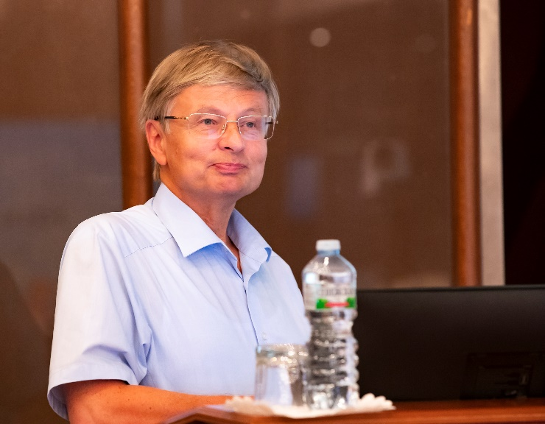
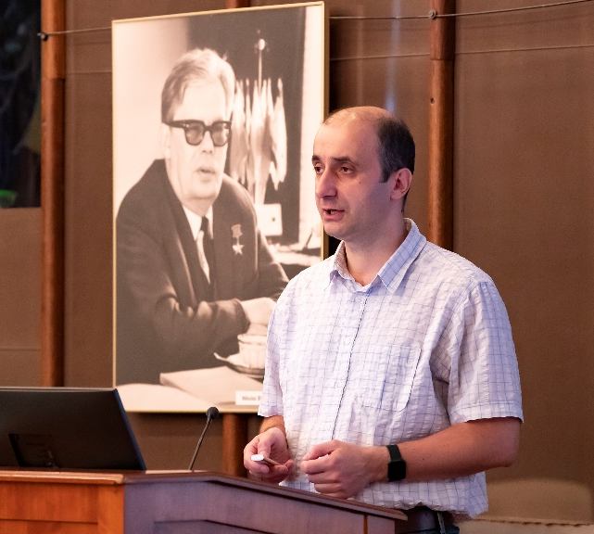
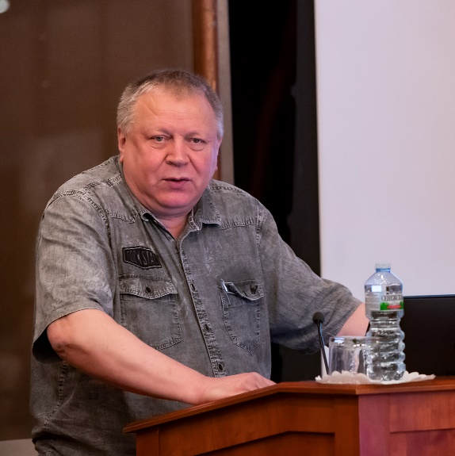
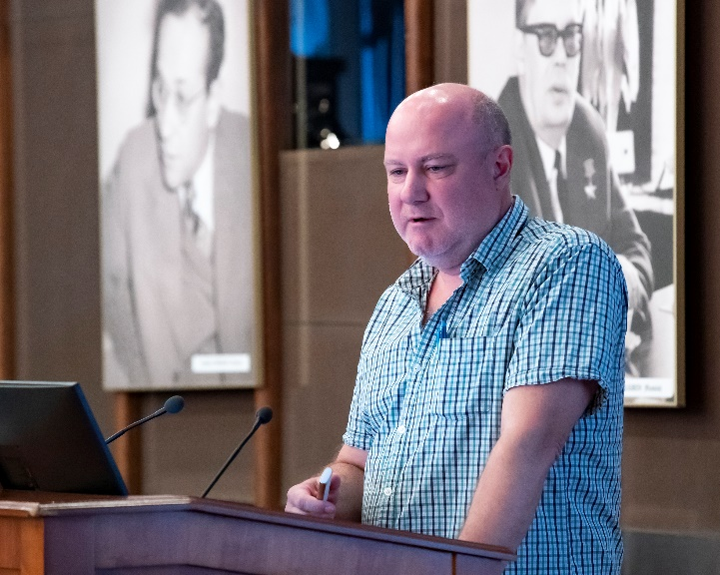
BLTP: Proposals for opening new projects within the theme "Theory of Nuclear Systems"
Nikolay
Antonenko
Alan Dzhioev
Alexander Motovilov
Sergey Bondarenko
“Low-energy nuclear dynamics and properties of nuclear systems”
“Microscopic models for exotic nuclei and nuclear astrophysics”
“Quantum few-body systems”
“Relativistic nuclear dynamics and nonlinear quantum processes”
To study in detail the effects of environment on the rate of astrophysical reactions. Thus, further development of the theory of open quantum systems. Thus, considering the low-energy dipole excitations that play presumably a noticeable role in the stellar nucleosynthesis.
The project plays an important role in the development of theoretical methods for the self-consistent description of nuclear structure and its application to the study of exotic and superheavy nuclei, predicting their decay properties for the experiments planning and the astrophysical applications.
The project plays an important role in the development of methods and approaches of the theory of few-body systems. One of the interesting directions of research is the study of universal features in the behavior of few-body systems at ultra-low energies.
The goal of the project is to study the properties of heated and compressed nuclear matter in the collision of heavy ions. Of particular interest is the study of possible phase transitions that occur during the cooling of the system, as well as the problem of CP invariance violation in strong interaction.

Slide 5
PAC recommendation:
The PAC recommends opening four new projects: “Low-energy nuclear dynamics and properties of nuclear systems”, “Microscopic models for exotic nuclei and nuclear astrophysics”, “Quantum few-body systems”, and “Relativistic nuclear dynamics and nonlinear quantum processes” until the end of 2028.
The PAC supports the proposed structure of the extended theme “Theory of Nuclear Systems”.
SC recommendation:
The SC supports the extension of the theme “Theory of Nuclear Systems”, which includes four new projects: “Low-energy nuclear dynamics and properties of nuclear systems”, “Microscopic models for exotic nuclei and nuclear astrophysics”, “Quantum few-body systems”, and “Relativistic nuclear dynamics and nonlinear quantum processes”.
The SC highly appreciates the current state of research within the framework of the theme and the scientific programmes of the projects proposed for implementation in 2024–2028, namely: structural features of nuclei far from the line of stability, structure of superheavy nuclei, interaction of nuclei at low energies, dynamics of fusion and fission, astrophysical reactions, systems of low-energy particles, nuclear dynamics at relativistic energies, properties of hot and dense nuclear matter, nonlinear quantum processes in strong polarized electromagnetic fields.

Slide 6
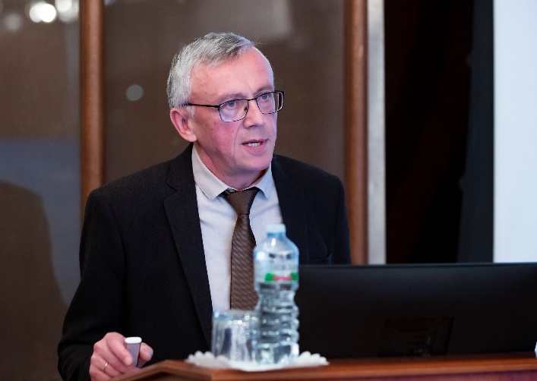
Proposal for extending the theme "Synthesis and Properties of Superheavy Elements, the Structure of Nuclei at the Limits of Nucleon Stability"
Flerov Laboratory: Scientific Themes
for 2024 - 2030
2024
Synthesis and Properties of SHE, Structure of Nuclei at the Limits of Nucleon Stability
Development of the FLNR Accelerator Complex and Experimental Setups (DRIBS-III)
Scientific leader: Yu.Ts. Oganessian
Leader: S.I. Sidorchuk
Scientific leader: Yu.Ts. Oganessian
Leaders: I.V. Kalagin, S.I. Sidorchuk
Sergey
Sidorchuk
Structure of the
lightest nuclei
at the borders of
nucleon stability
2024 - 2028
Leaders:
G. Kaminski,
S.I. Sidorchuk
Development of the setups for the study of properties of superheavy nuclei
2024 – 2028
Leader:
A.V. Yeremin,
Investigation of
H&SH nuclei
2024 - 2028
Leaders:
M.G. Itkis,
A.V. Karpov
U400R accelerator complex
2024 - 2028
Leaders:
I.V. Kalagin,
A.G. Popeko
2028
New projects:
Mass measurements of SH nuclei;
Chemistry of short-lived SHE;
Mechanisms of MNT reactions;
Reaction mechanisms competing with fusion;
Production of new neutron-rich isotopes in MNT reactions and study of their properties;
…
2030
T

Slide 7
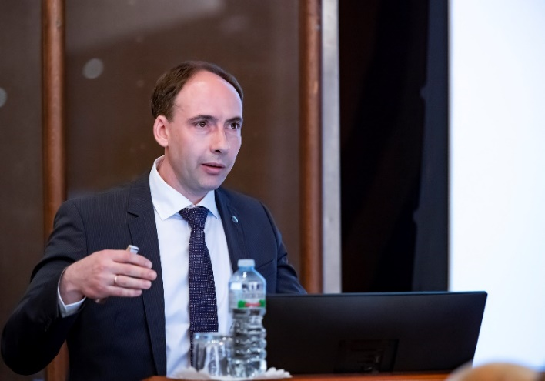
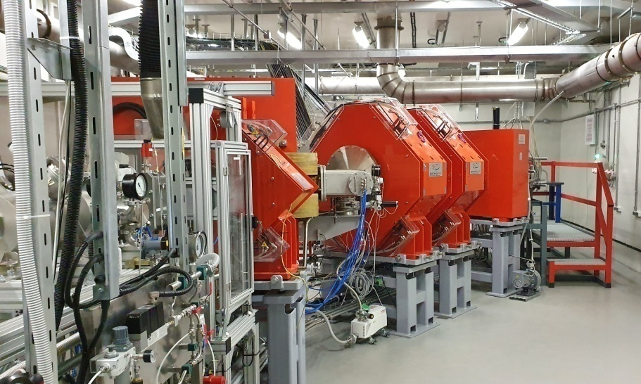
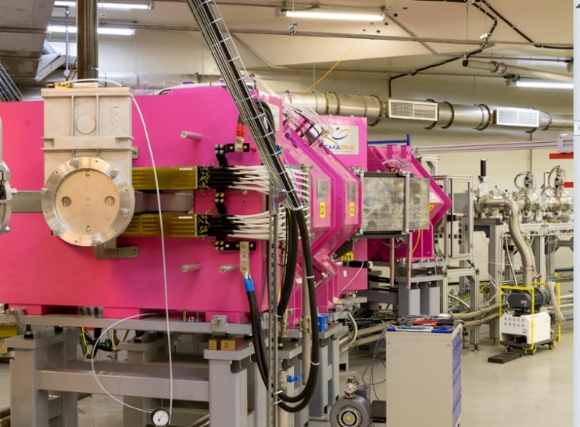
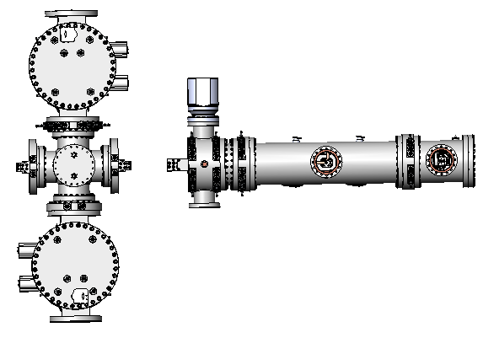
Project “Investigation of heavy and superheavy elements”
Main directions of research:
Synthesis of new elements
SHE Factory – DGFRS II
119 and 120 is a task of the highest importance. ²⁴⁹Bk+⁵⁰Ti→²⁹⁹119*,
²⁴⁹⁻²⁵¹Cf+⁵⁰Ti→²⁹⁹⁻³⁰¹120* ²⁴⁸Cm+⁵⁴Cr→³⁰²120*
Synthesis of new SHE isotopes
SHE Factory – DGFRS II
2n channels of fusion reactions;
p1n- p3n channels, EC;
MNT reactions U+U, U+Cm;
More neutron-rich targets.
Chemistry of SHE
SHE Factory – GRAND, GASSOL
Chemical properties of SHE with Z = 112 – 114 (T_{1/2}>0.5 sec) at the GRAND separator. New experimental setups for the study of heavier elements
Alexander
Karpov
Nuclear SHE spectroscopy
SHE Factory – GRAND
U400R – SHELS
Radioactive decay and the structure of isotopes of heavy and superheavy elements. The first experiments on the study of Fl and Mc isotopes in the ⁴⁸Ca+²⁴²Pu,²⁴³Am reactions.
MR-TOF
Mass-Analyzer
DGFRS-2:
launched in 2020
Measurement of masses of SH isotopes
SHE Factory – MR TOF
Mass measurement of any of the nuclei in the α-decay chain with a precision of ~30 keV would provide the masses of all the nuclei in the chain
GRAND:
launched in 2022

Slide 8
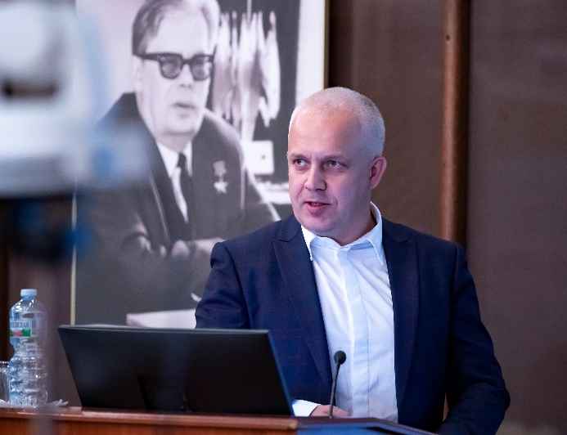
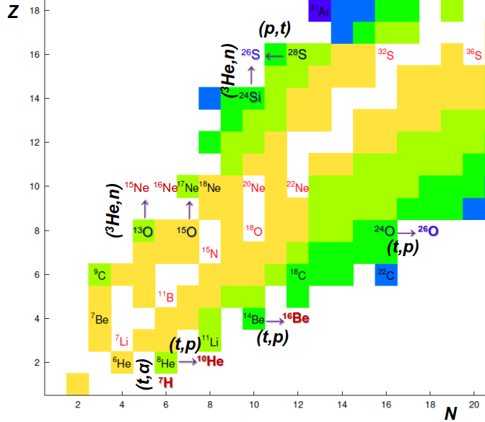
Project “Light exotic nuclei at the borders of nuclear stability”
Planned research areas: 2024 - 2028
Structure of neutron-rich isotopes in (d,p), (d,t), (d,³He) reactions
Impact of the reaction mechanisms on the population of low energy spectra of exotic nuclear systems
Exotic radioactivity - formation of 2p radioactive nuclei in the (³He,n) and (p,d) reactions
Study of production cross sections of exotic nuclei
Beyond the nucleon stability line with 2n-transfer ¹⁰He,¹³Li,¹⁶Be using tritium-target. Lighter neutron-rich isotopes like ^{6,8}Не, ¹¹Li, ¹¹⁻¹⁴Be are also in the zone of interest
Study the energy dependence of total reaction cross section in the reactions ¹⁰⁻¹⁴Be+²⁸Si, ¹²⁻¹⁵B+²⁸Si, etc.
Grzegorz
Kaminski
Transfer reactions via ²H target
⁶He(d,³He)⁵H
⁶He(d,t)⁵He
⁶He(d,p)⁷He
Transfer reactions on ³He target
¹³O(³He,n)¹⁵Ne
²⁴Si(³He,n)²⁶S
Transfer reactions on H target
⁷Be(p,d)⁶Be
⁸B(p,d)⁷B
⁹C(p,d)⁸C
Transfer reactions on ³H target
⁸He(t,p)¹⁰He
¹⁴Be(t,p)¹⁶Be
⁸He(t,α)⁷H
σ_{R}(E) and σ_{Σ}(E)
¹⁰⁻¹⁴Be+²⁸Si
¹²⁻¹⁵B+²⁸Si
Charge-exchange reactions
(p,n),(³He, ³H),(³He, ³H)

Slide 9
PAC recommendation:
The PAC highly appreciates the proposals of FLNR for the development of research in the field of heavy-ion physics and recommends opening two new projects “Investigation of heavy and superheavy elements” and “Light exotic nuclei at the borders of nuclear stability” until the end of 2028.
In order to be able to open and implement two new projects, as well as to conduct other experiments in the field of heavy-ion physics, the PAC recommends extending the theme “Synthesis and Properties of Superheavy Elements, the Structure of Nuclei at the Limits of Nucleon Stability” for a period of 7 years until the end of 2030.
The target preparation and the recycling of the target material are urgent issues.
SC recommendation:
The SC supports the extension of this theme for the next seven years
Within the framework of this theme, the SC supports the opening of two new projects until the end of 2028: “Investigation of heavy and superheavy elements” and “Light exotic nuclei at the borders of nuclear stability”, the main tasks of which are the synthesis and study of the nuclear and atomic (chemical) properties of the heaviest elements, as well as the study of mechanisms of nuclear reactions leading to the formation of such elements and to the study of the structure and properties of the decay of isotopes of light elements located near the boundaries of nuclear stability.

Slide 10
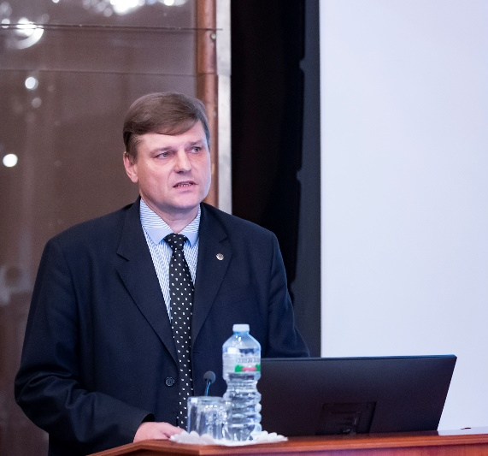
Large JINR Research Infrastructure “Development of the FLNR Accelerator Complex and Experimental Setups (DRIBs-III)” and proposals for opening new projects in this LRIP
Within the framework of this Large JINR Research Infrastructure, it is planned to open two projects:
“Construction of the U-400R accelerator complex”;
“Development of the experimental setups to study the chemical and physical properties of superheavy elements”.
In addition, within this project, it is planned:
To complete the construction, to commission and develop the DC-140 accelerator complex for applied research.
The project also includes support for experiments performed at the FLNR accelerator complex, in particular ensuring the required operating parameters for existing accelerators, improving the reliability of accelerators, and developing experimental facilities.
Igor Kalagin

Slide 11
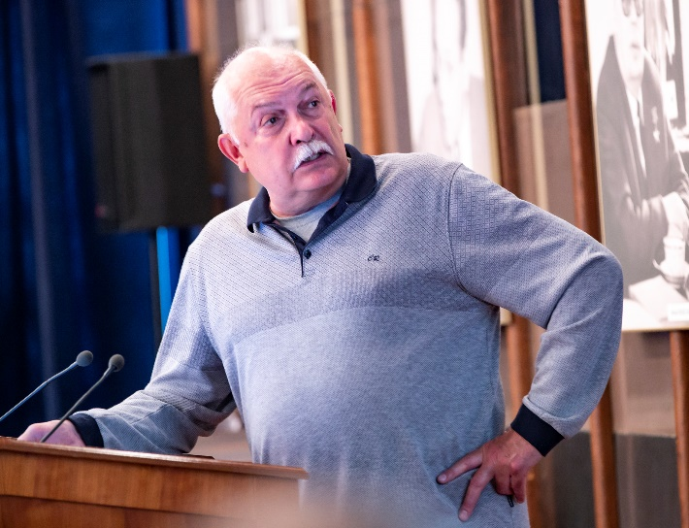
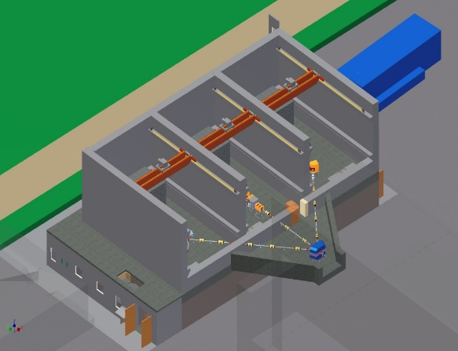
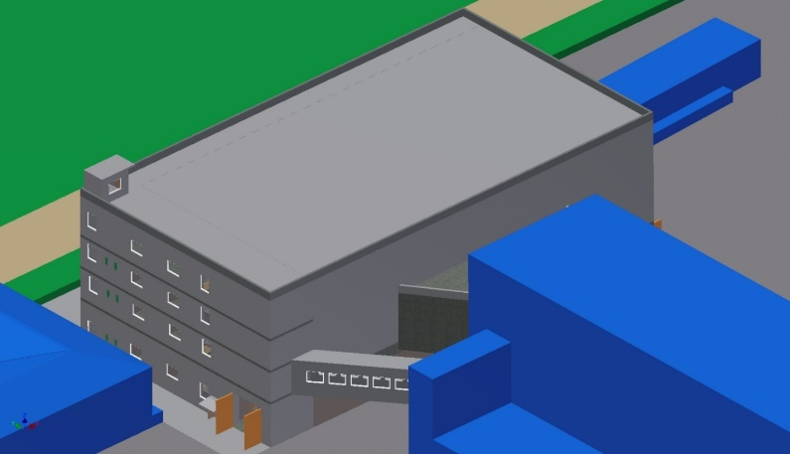
New projects: “Construction of the U-400R accelerator complex” and
“Development of the experimental setups to study the chemical and physical properties of superheavy elements”
Project “Construction of the U-400R accelerator complex”
Upgrade of the U400 cyclotron: main purposes of upgrade
Improvement of the quality and intensity of stable and radioactive beams (48Ca – 2÷2.5 pμA );
Upgrade of the beam extraction system (electrostatic deflector in addition to the recharging foils )
Providing a smooth variation of the ion energy in the range of 0.8 – 27 MeV/A;
Decreasing the total cyclotron power consumption from 1 to 0.4 MW.
Upgrade: 2024 – 2026
Extension of the experimental areas through the construction of a new building
Currently the total experimental area of the U400 cyclotron is about 200 m² (building 131). The physical facilities located on two levels of the building occupy almost the entire available area. New facilities of the U400R complex require additional space.
Main purposes:
Extension of the experimental areas by constructing an experimental building with a total area of about 1200 m² for placing new experimental facilities there
Alexander Eremin

Slide 12
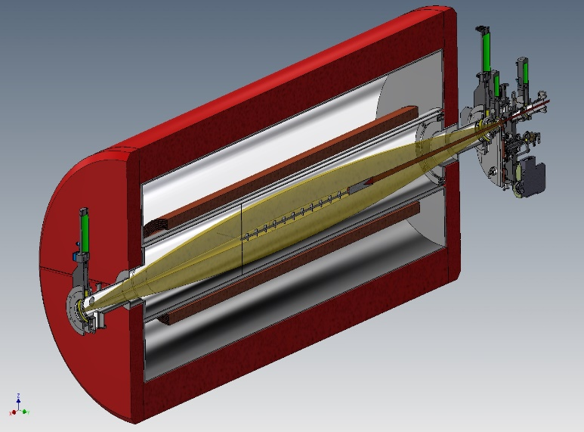
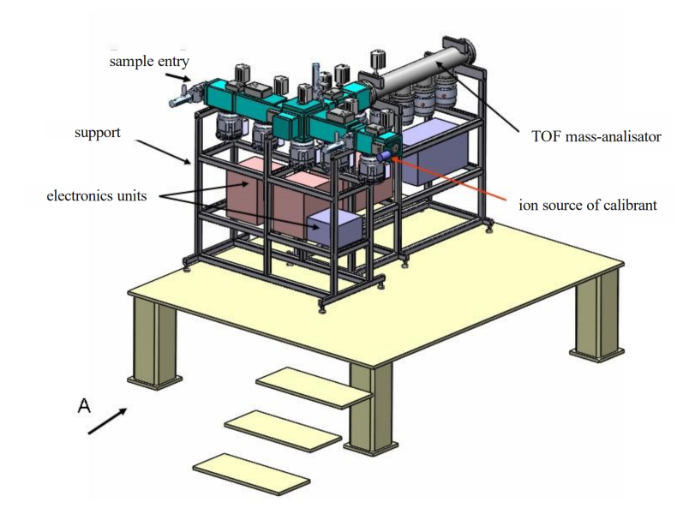
New projects: “Construction of the U-400R accelerator complex”
“Development of the experimental setups to study the chemical and physical properties of superheavy elements”
Project “Development of the experimental setups to study the chemical and physical properties of superheavy elements”
New experimental setups at the operating DC280 cyclotron (SHE factory: DGFRS2 and GRAND
Pre-Separator for studies of the chemical properties of short-lived SH nuclides based on a superconducting solenoid (GASSOL)
The task is:
To provide the delivery of synthesized SH isotopes within a time comparable with their lifetimes;
To provide a high level of separation.
Multi-Reflection Time-Of-Flight (MR-TOF) spectrometer for the precise measurements of masses of heavy and superheavy nuclides
Measuring masses of SH isotopes with an accuracy of 10⁻⁷ (30 кeV)
Theory predictions ~ 300 keV
Requirements for a facility:
High rate of analysis;
Low losses;
High degree of purification;
Accuracy of 10⁻⁷ (30 кeV);
Mass range 266 – 300.
GASSOL
rotating
target
beam
axial screens
radial
screens
EVRs
beam
axial screens
SC-coils
to He-stop
chamber
beam stopper
3 kW

Slide 13
PAC recommendation:
The PAC recommends that the theme “Development of the FLNR Accelerator Complex and Experimental Facility (DRIBs-III)” be reformed into a large research infrastructure project with the same title for the period 2024–2030.
The PAC recommends opening two new projects “Construction of the U-400R accelerator complex” and “Development of the experimental setups to study the chemical and physical properties of superheavy elements” until the end of 2028.
SC recommendation:
The SC endorses the proposal of the JINR Directorate to reform the themes and projects into large research infrastructure (LRI), in particular: LRI “Development of the FLNR Accelerator Complex and Experimental Facility (DRIBs-III)”, which includes the projects “Construction of the U-400R accelerator complex” and “Development of the experimental setups to study the chemical and physical properties of superheavy elements”.

Slide 14
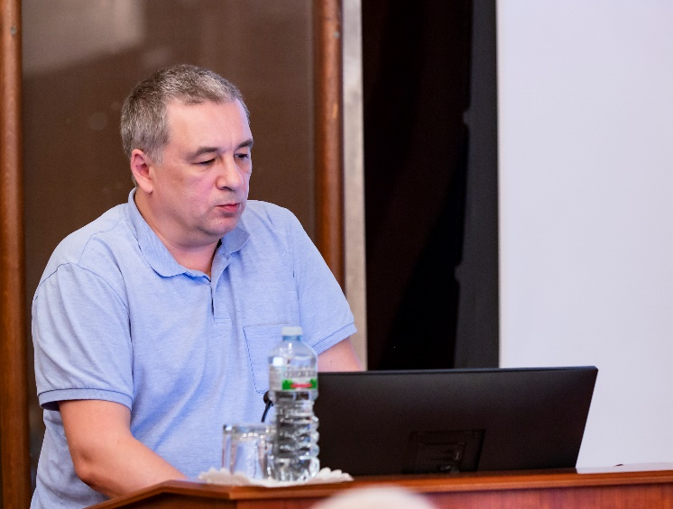
Theme “Investigations of Neutron Nuclear Interactions and Properties of the Neutron”
Proposals for extending the projects “TANGRA” and “Modernization of EG-5”
Projects in 2023: 1. TANGRA. Leader Kopatch Y.N. (2014-2023) 2. ENGRIN. Leader Zeinalov Sh. S. (2022-2023)
3. Modernization of EG-5. Leader Doroshkevich A.S. (2022-2023)
The theme “Investigations of Neutron Nuclear Interactions and Properties of the Neutron” was started in 2017 and was extended in 2022 for one year.
The project “TANGRA” was started in 2014 and was extended in 2022 for one year.
The projects “ENGRIN” and “Modernization of EG-5” were started in 2022, also for one year.
Yury Kopatch
Scientific research was focused in three areas:
the study of violations of fundamental symmetries in the interactions of neutrons with nuclei and collection of nuclear data;
the study of the fundamental properties of the neutron, physics of ultracold and very cold neutrons;
applied and methodological research.

Slide 15
PAC recommendation:
The PAC notes the high quality of the results obtained and the prospects of the proposed scientific programme and takes note of the report on the completion of work under the ENGRIN project and the theme “Investigations of Neutron Nuclear Interactions and Properties of the Neutron”.
The PAC recommends the completion of the project “ENGRIN” and closing the theme “Investigations of Neutron Nuclear Interactions and Properties of the Neutron”.

Slide 16
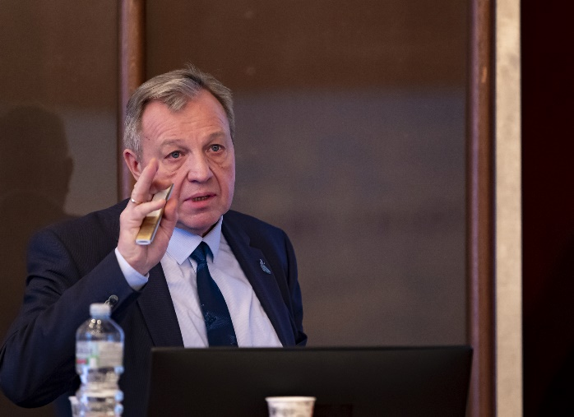
Proposals for opening a new project “Investigations of neutron nuclear interactions and properties of the neutron” and a new theme “Nuclear Physics with Neutrons”
Directions in research and activities:
Investigations of neutron nuclear interactions and properties of the neutron.
P, T – parity conservation in nuclear reactions
Fission physics (ROT & TRI effects, rare modes)
Nuclear reactions for nuclear data & nuclear theory
Cold, very cold & ultracold neutrons, neutron optics
Applied research (NAA, PGNAA, RBS, neutron mutagenesis, etc.)
Development of the tagged neutron method (TNM) for determining the elemental structure of matter and studying nuclear reactions (TANGRA project).
TNM for nuclear reaction research & nuclear data
Fast elemental analysis (method & compact facilities)
Modernization of the EG-5 accelerator and its experimental infrastructure.
To realize nuclear reactions research program
For applied research.
Valery Shvetsov

Slide 17
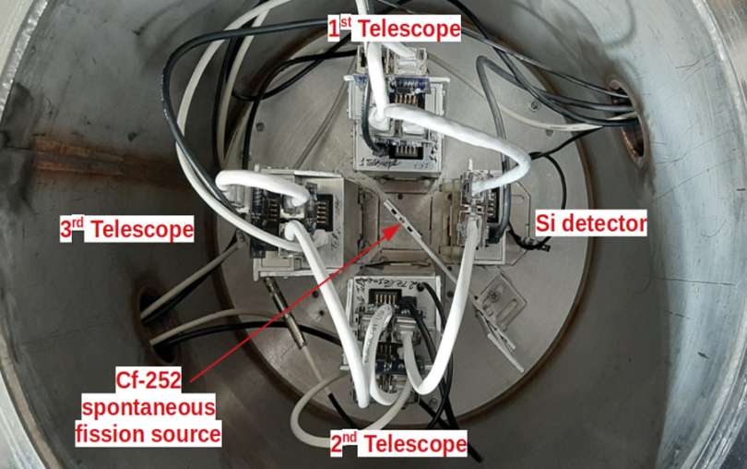
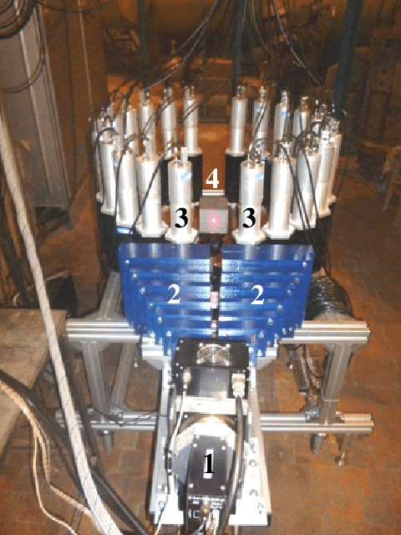
NEUTRON NUCLEAR PHYSICS AT NEUTRON GENERATOR, IBR-2 AND OTHER NEUTRON SOURSES
Nuclear fission process:
measurement of mass-energy and angular distributions of fragments;
prompt and delayed neutrons and γ-quanta;
search for rare and exotic fission modes – quaternary and quinary fission, etc;
measurements of T-odd effects in fission.
RESEARCH WITH ULTRACOLD NEUTRONS
Application of the tagged neutron method for measurements of angular and energy distributions of emitted γ-rays and neutrons in the (n,n’) reactions with neutrons at the energy of 14 MeV.
Scientific program for UCN source in Dubna:
Plan for the next seven years is to build a prototype UCN source at IBR-2 reactor with world-class parameters based on the time-focusing principle;
Measurement of the neutron lifetime (better than 1 sec).
Investigation of anomalous UCN losses
Non-stationary quantum effects and neutron optics
TANGRA Project
Tasks for the next 7 years:
Development of an original method for measuring the neutron lifetime in a beam of a pulsed neutron source.
Development and application of neutron and nuclear methods: instrumental activation analysis; prompt-γ neutron activation; elemental analysis of surface layers of solids.
Development of experimental infrastructure (design of neutron polarizers, new detector systems etc)
Nuclear data

Slide 18
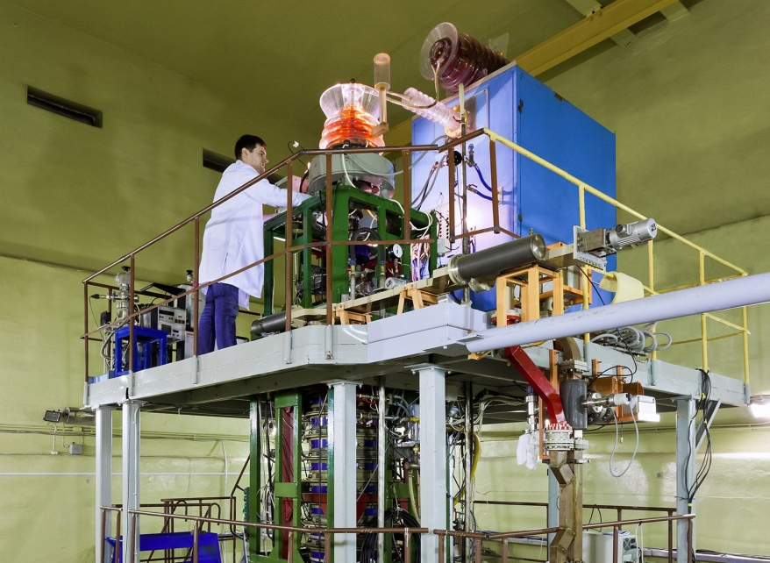
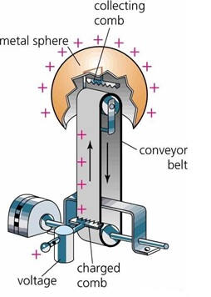
Plans for 2024-2030
IREN neutron source. It allows realizing a research program on fundamental nuclear physics with neutrons and nuclear data measurements analogous to the programs at other neutron sources like GELINA (IRMM, Geel).
Scientific program for IREN
Nuclear fission in resonances.
Search and study of P- and T- violating effects.
Nuclear data for nuclear engineering and astrophysics.
Neutron activation analysis and prompt-γ analysis.
Experimental study of the isotopes production in photonuclear reactions
Tasks:
Increase neutron yield up to 3⋅10¹² n/sec
Electron energy up to 150 MeV;
Peak current 2.5 A;
Pulse length 150-200 ns
modernization of the experimental halls
Increase the operation time up to 3000 hours/year
EG-5 electrostatic generator as neutron source and source for ion beam analysis
Scientific program for the EG-5 in nuclear physics
Collecting data for nuclear engineering and astrophysics: integral and differential neutron cross sections, angular correlations in the relevant energy range.
Tasks:
increase current up to 50 $μ$A;
increase energy up to 4.1 MeV;
modernization of the experimental infrastructure;
design of ion microbeams.

Slide 19
PAC recommendation:
The PAC recommends opening the new project “Investigations of neutron nuclear interactions and properties of the neutron” for a period of 5 years until the end of 2028.
The PAC also recommends extending the project “TANGRA” for a period of 5 years until the end of 2028 and the project “Modernization of the accelerator EG-5 and its experimental infrastructure” for a period of 3 years until the end of 2026.
In relation to the proposals to open the new project, extend two other projects, as well as to open the new activity, the PAC recommends opening the new theme “Nuclear Physics with Neutrons” for a period of 7 years until the end of 2030.
SC recommendation:
The SC notes the high quality of the obtained scientific results in: 1) the study of violations of fundamental symmetries in the interactions of neutrons with nuclei, obtaining nuclear data; 2) studies of the fundamental properties of the neutron, the physics of ultracold and very cold neutrons; 3) applied and methodical work.
The SC supports the opening of a new theme “Nuclear Physics with Neutrons” and a new project “Investigations of neutron nuclear interactions and properties of the neutron” until the end of 2028 as well as extending the project “TANGRA” until the end of 2028 and the project “Modernization of the accelerator EG-5 and its experimental infrastructure” until the end of 2026.

Slide 20
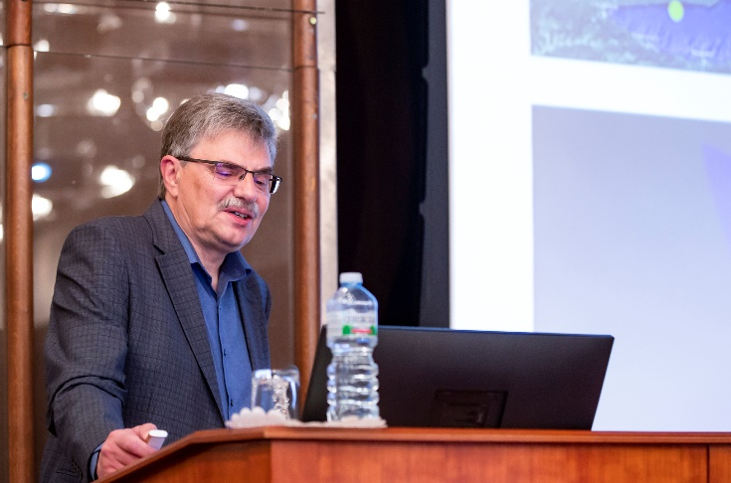
Large research infrastructure project “BAIKAL-GVD”
The Baikal-GVD project is one of the leading projects at JINR and the largest detector of astrophysical high energy neutrino in the North hemisphere. The project is highlighted as a Large Infrastructure Project since 2024. Currently the activity is related to the theme 03-2-1100-2010/2024 (Non-accelerated neutrino physics and astrophysics).
Baikal Collaboration:
Joint Institute for Nuclear Research (Dubna, Russia)
Institute for Nuclear Research, Russian Academy of Sciences (Moscow, Russia)
Irkutsk State University (Irkutsk, Russia)
Skobeltsyn Institute of Nuclear Physics, MSU (Moscow, Russia)
Comenius University (Bratislava, Slovakia)
Czech Technical University in Prague (Prague, Czech Republic)
Institute of Nuclear Physics ME RK (Almaty, Kazakhstan)
Nizhni Novgorod State Technical University (Nizhni Novgorod, Russia)
St. Petersburg State Marine Technical University (St. Petersburg, Russia)
Igor Belolaptikov
Objectives:
flexible structure allowing an upgrade and/or a rearrangement of the main building blocks (clusters)
km³-scale 3D-array of photo sensors
high sensitivity and resolution of neutrino energy, direction and flavor content
Main Physics Goals:
Diffuse neutrino flux – energy spectrum, local and global anisotropy, flavor content
Investigate Galactic and extragalactic neutrino “point sources” in energy range > TeV
Transient sources (GRB, …)
Dark matter – indirect search
Exotic particles – monopoles, Q-balls, nuclearites, …

Slide 21
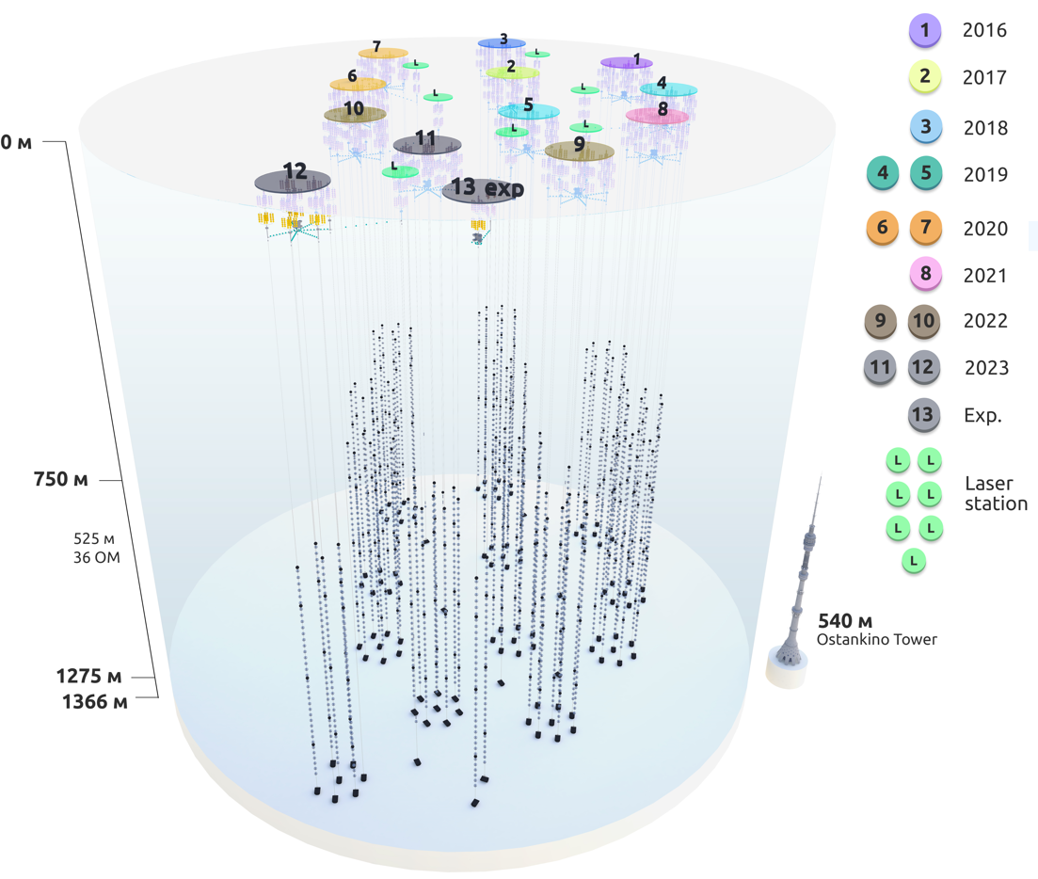
Current status of Baikal-GVD
Currently, the deployment of the Baikal-GVD neutrino telescope is successfully underway. - 12 clusters with 3456 OMs.
- About 10 astrophysical neutrinos per year.
The production and technical base of the Baikal project provides the deployment of two clusters annually.
GVD has developed shore infrastructure: control center, laboratories, workshops, deployment tools, living quarters.
GVD is testing ground for the development the systems for next-generation telescope:
- 2 strings with fiber-optic DAQ;
- 3 inter-cluster strings.
FO string
Inter-cluster string
Notes:
Currently, the deployment of the Baikal-GVD neutrino telescope is successfully underway in Lake Baikal.
The view of the telescope in configuration 2023 is shown in the figure.
Telescope now comprises 12 clusters with about 3.5 thousand optical modules.
The year of installation of each cluster is shown in the right part of the figure.
At present Baikal-GVD is the largest neutrino telescope in the Northern Hemisphere, allows to register ~10 neutrinos of astrophysical nature per year.
The production and technical base of the Baikal project ensures the deployment of two clusters each year.
GVD has developed shore infrastructure: control center, laboratories, workshops, comfortable living quarters for about 50 peoples with independent power supply
GVD is testing ground for the development the systems for next-generation installation:
Currently, the telescope includes two strings with fiber-optic DAQ and three inter-cluster strings.

Slide 22
PAC recommendation:
The PAC appreciates the high scientific importance of the project “BAIKAL-GVD” and JINR’s leading role in its implementation.
The PAC strongly recommends extending the project “BAIKAL-GVD” as a large research infrastructure project until the end of 2028.
SC recommendation:
The SC endorses the proposal of the JINR Directorate to reform the themes and projects into large research infrastructure (LRI) “Baikal-GVD”, which represents the Baikal-GVD gigaton neutrino detector, the largest operating neutrino telescope in the Northern Hemisphere, and includes infrastructure aimed at studying astrophysical neutrino fluxes.

Slide 23
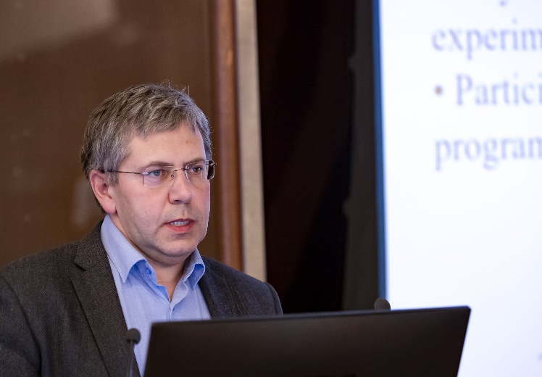
Project “Nuclear spectrometry for the search and investigation of rare phenomena”
The project combines research on the fundamental properties of neutrinos and the search for dark matter particles in the experiments with JINR’s participation:
LEGEND (Large Enriched Germanium Experiment for Neutrinoless double β-Decay);
TGV (Telescope Germanium Vertical);
SuperNEMO (Neutrino Ettore Majorana Observatory);
MONUMENT (Muon Ordinary capture for the NUclear Matrix elemENTs);
EDELWEISS (Expérience pour DétEcter Les WIMP En Site Souterrain).
The above experiments are aimed at solving the following main scientific problems:
the search and study of neutrinoless double β-decay using detectors enriched with ⁷⁶Ge (LEGEND), low-background germanium detectors (TGV spectrometer) as well as the application of a unique potentially zero-background tracking-calorimetric technique (SuperNEMO);
measurements of muon capture on several daughter nuclei, candidates for 0ν2β-decay (MONUMENT);
the direct search for dark matter using the array of single-crystal germanium bolometers (EDELWEISS).
Evgeny Yakushev

Slide 24
PAC recommendation:
The PAC notes the significant contribution of JINR scientific groups to the above experiments and recommends opening the new project “Nuclear spectrometry for the search and investigation of rare phenomena” until the end of 2028.
SC recommendation:
The SC recommends opening new project “Nuclear spectrometry for the search and investigation of rare phenomena” until the end of 2028.

Slide 25
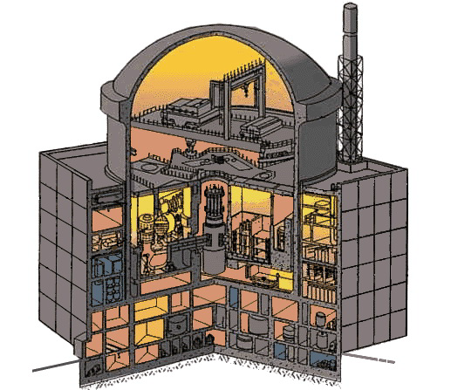
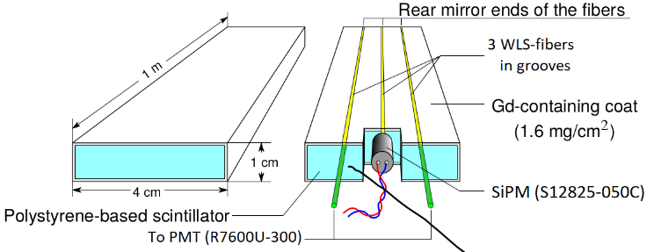
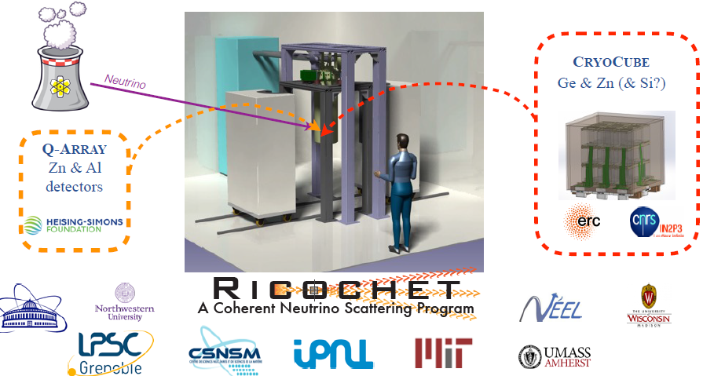
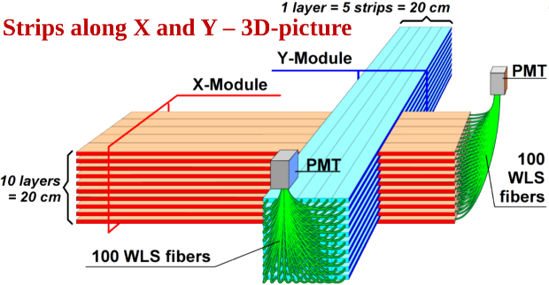
Project “Investigations of reactor neutrinos on a short baseline”
The PAC heard a proposal to open a new project “Investigations of reactor neutrinos on a short baseline” presented by Igor Zhitnikov.
The project combines research on the fundamental properties of neutrinos in the DANSS, νGeN, and Ricochet experiments with JINR’s participation.
Scientific program:
the search for and investigations of Coherent Elastic neutrino Nuclear Scattering (CEνNS) with low-threshold germanium detectors (νGeN) and low-threshold cryogenic detectors (Ricochet)
the search for the neutrino magnetic moment (νGeN and Ricochet)
the search for short-baseline reactor antineutrino active-sterile oscillations with a highly-segmented plastic scintillator detector (DANSS, DANSS-2)
remote monitoring of nuclear reactor core operation measuring the antineutrino flux (DANSS, DANSS-2)
DANSS Detector design

Slide 26
PAC recommendation:
The PAC recommends opening the new project “Investigations of reactor neutrinos on a short baseline” until the end of 2028.
SC recommendation:
The SC recommends opening new project “Investigations of reactor neutrinos on a short baseline” until the end of 2028.

Slide 27
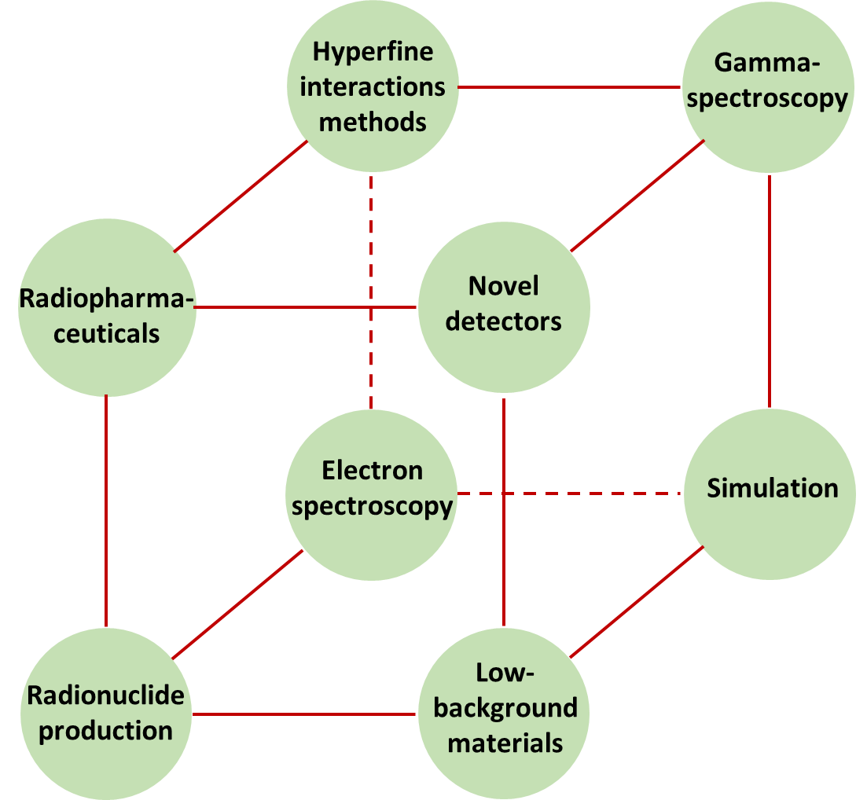
Project “Radiochemistry and spectroscopy for astrophysics and nuclear medicine”
The PAC heard a proposal to open a new project “Radiochemistry and spectroscopy for astrophysics and nuclear medicine” presented by Ayagoz Baimukhanova.
Scientific research in the project is devoted to the development of nuclear spectroscopy and radiochemistry methods to study rare phenomena associated with the weak interaction and a number of problems in astrophysics, as well as the development of radiopharmaceuticals and their application in nuclear medicine.
The project focuses on the following areas of work:
designing novel detectors;
high-resolution “post-decay” spectroscopy of electrons and other emissions with an emphasis on extremely low energies;
γ-spectroscopy based on semiconductor detectors;
development of methods for the production and purification of radionuclide preparations for the synthesis of radiopharmaceuticals;
development and application of methods and techniques for the production and analysis of low-background materials with a uniquely low content of radioactive impurities.

Slide 28
PAC recommendation:
The PAC recommends opening the new project “Radiochemistry and spectroscopy for astrophysics and nuclear medicine” until the end of 2028.
SC recommendation:
The SC recommends opening new project “Radiochemistry and spectroscopy for astrophysics and nuclear medicine” until the end of 2028.

Slide 29
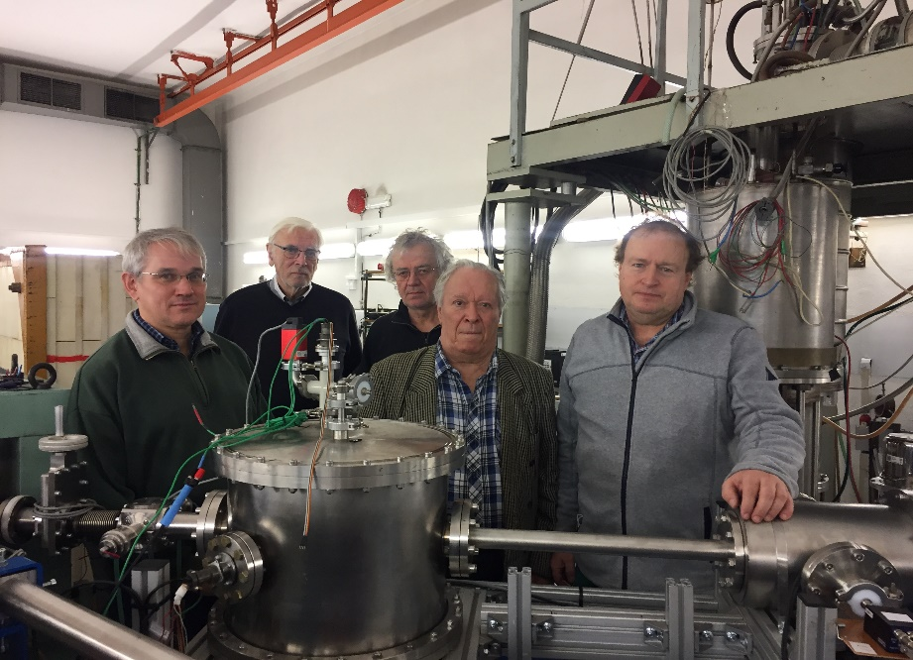
Project “Study of the nucleon spin structure in strong and electromagnetic interactions (GDH&SPASCHARM&NN)”
The PAC heard a detailed report on the project “Study of the nucleon spin structure in strong and electromagnetic interactions (GDH&SPASCHARM&NN)” and a proposal for its extension presented by Yuri Plis.
This project includes three independent experiments related to the study of the spin structure of the nucleon in strong and electromagnetic interactions:
GDH
A2 Collaboration at MAMI, Mainz (Participation from 2008. 21 papers have been published. A lot of talks at different International Conferences and A2 Collaboration Meetings were presented).
CBELSA/TAPS Collaboration, Bonn (Participation from 2018. Preliminary results have been presented).
P2 Collaboration at MESA, Mainz (Participation from 2019. Research and development stage).
2. SPASCHARM (Participation from 1978).
3. NN (Participation from 1984).

Slide 30
PAC recommendation:
The PAC recommends extending the project “Study of the nucleon spin structure in strong and electromagnetic interactions (GDH&SPASCHARM&NN)” until the end of 2028.
SC recommendation:
The SC recommends extending the project “Study of the nucleon spin structure in strong and electromagnetic interactions (GDH&SPASCHARM&NN)” until the end of 2028

Slide 31
Proposal for extending the project “E&T&RM” with the new title “ADSR”
(Accelerator Driven Subcritical Reactor)
Main objectives of the project
Experimental study on the effect of the material used for the converter by measuring the neutron yield for various beam-converter combinations.
Design of an extended graphite target for the experimental verification of the efficiency of proton and ion beams with different converters.
Mihaela Paraipan
Factors which affect the efficiency of ADSR
Systematic study of the conditions which maximize the energy gain, provide high fuel burnup and long period between refueling:
- factors related to the core structure and composition
- particle beam and energy
- accelerator type
The PAC notes that, in spite of the almost general opinion that the optimal beam for ADS is a proton beam with an energy of about 1–1.5 GeV, it was shown that heavier ion beams have a superior energy efficiency than protons. Research within the framework of the project will be aimed at studying the conditions, which maximize the energy efficiency of ADS systems and ensure a high burnup.

Slide 32
PAC recommendation:
The PAC appreciates the work done during the previous period of the project implementation and supports its extension for the period 2024–2027 with updated content and the title “Accelerator driven subcritical reactor (ADSR)”.
SC recommendation:
The SC recommends extending the projects “Accelerator driven subcritical reactor (ADSR)” until the end of 2027

Slide 33
THANK YOU FOR YOUR ATTENTION!

Slide 34
The Concept of the Theme «Theory of Nuclear Systems» Development of theoretical Applications for experimental methods Multidisciplinar nature Attraction of young researchers to nuclear theory
The future theoretical studies will be closely associated with the programs of operating and commissioning the facilities at JINR (SHE-factory, ACCULINA-2) and over the world (FAIR, ISOL, HIE-ISOLDE, SPES, SPIRAL2, FRIB, RAON, HIAF). The studies of heavy-ion collisions at high energies will be associated with the NICA project at JINR.

Slide 35
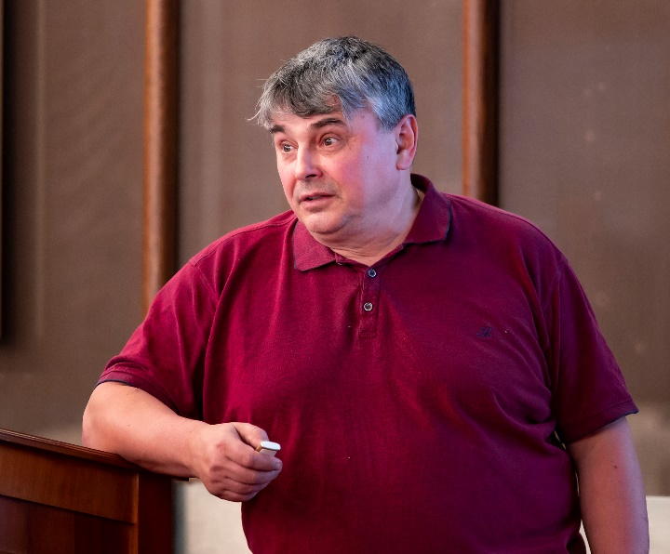
Project “BECQUEREL2023”
The PAC heard a report on extending the project “BECQUEREL2023” at the Nuclotron-NICA accelerator complex to study peripheral interactions of relativistic nuclei presented by P. Zarubin.
The project is focused on the search for α-particle Bose-Einstein condensate (αBEC). Identification of decays ⁸Be → 2α, ⁹Be → 2α, and ¹²C(0⁺₂) → ⁸Beα (the Hoyle state) by the invariant mass was tested for light nuclei, including radioactive ones.
Pavel Zarubin
Recommendation:
The PAC recommends extending work on the project “BECQUEREL2023” in the status of activity.

