Slide 1
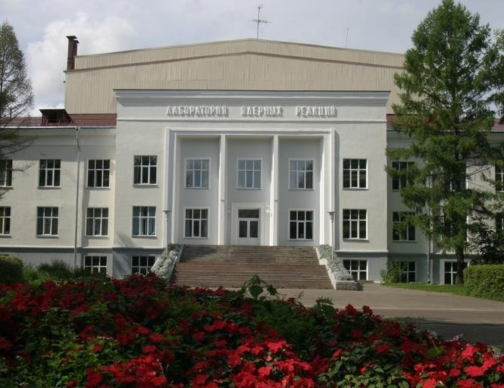


Development of the
FLNR Accelerator Complex and Experimental Setups (DRIBs-III)
and projects within the framework of this LRI for 2024
(03-5-1129-2024/2028)
Head of FLNR Accelerator department
Vasiliy Semin
seminva@jinr.ru

Slide 2

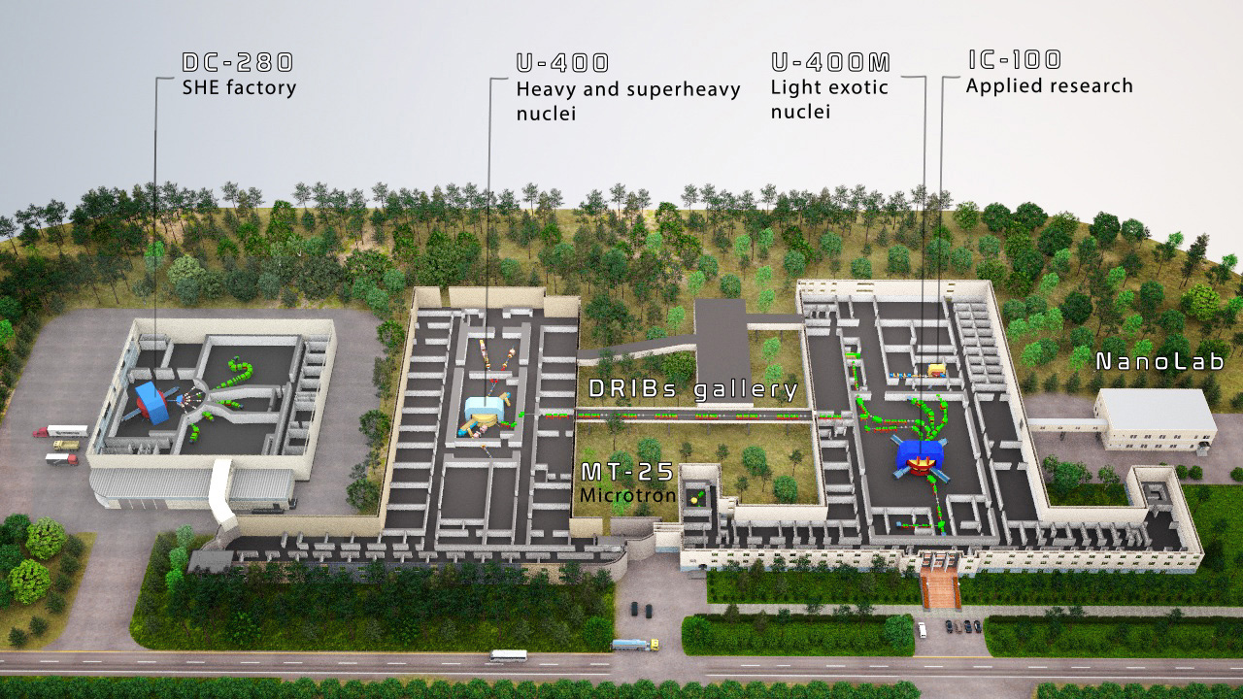
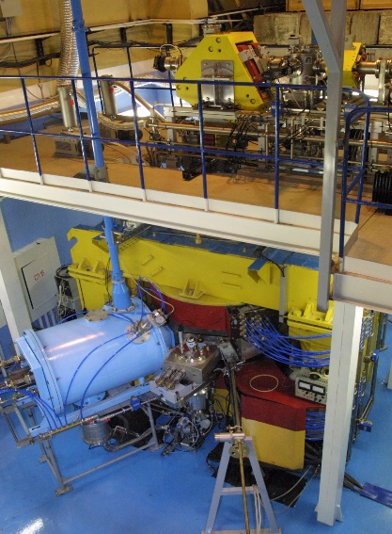
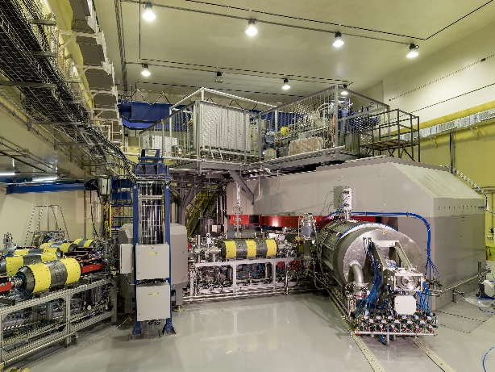

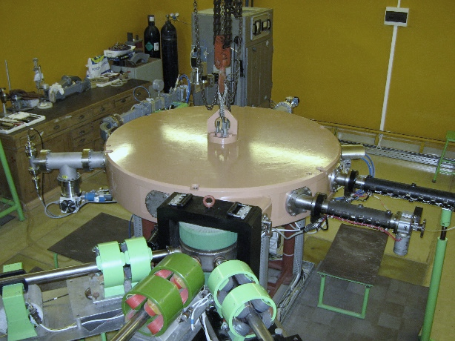
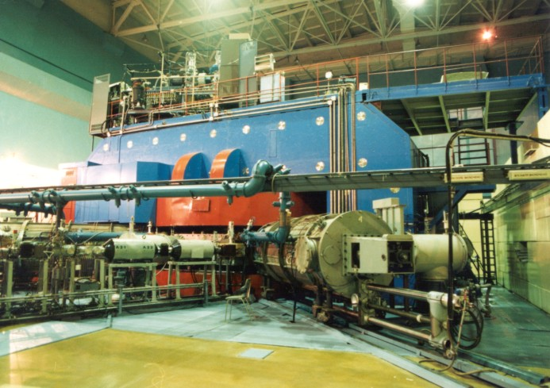
Accelerated complex FLNR
work in 2023
Sum time of work of accelerator facilities (hours) | 2018 | 2019 | 2020 | 2021 | 2022 | 2023
 | 16904 | 20110 | 15124 | 15065 | 16834 | 16583
IC-100
New experimental hall U-400R
stopped 11.11.23
DC-280
U-400
Mt-25
U-400M
2
Notes:
New experimental hall is in the stage of building completion

Slide 3
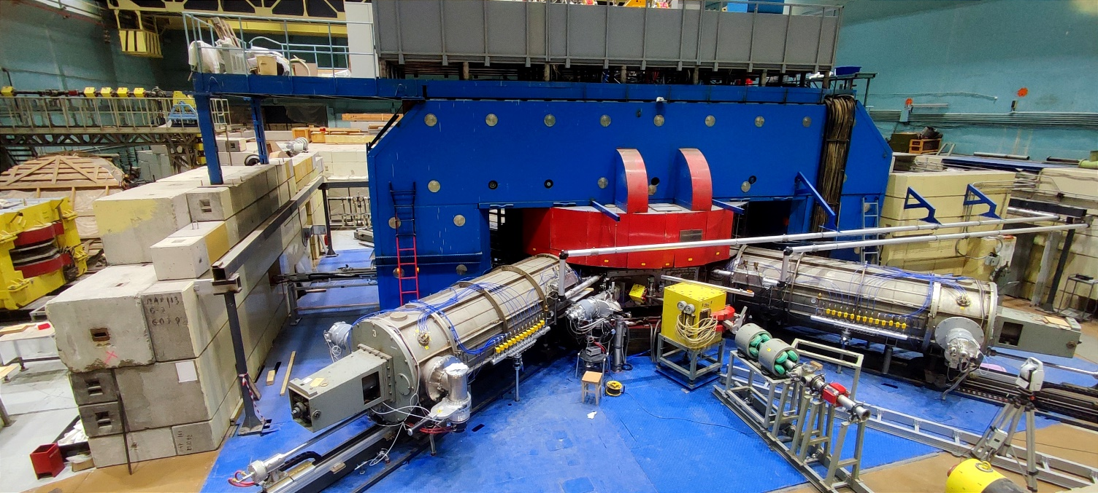

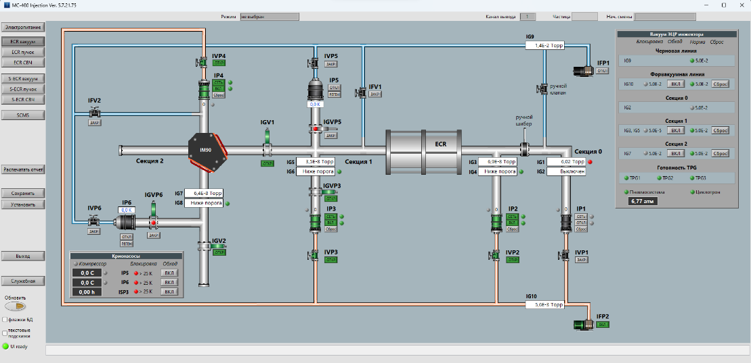
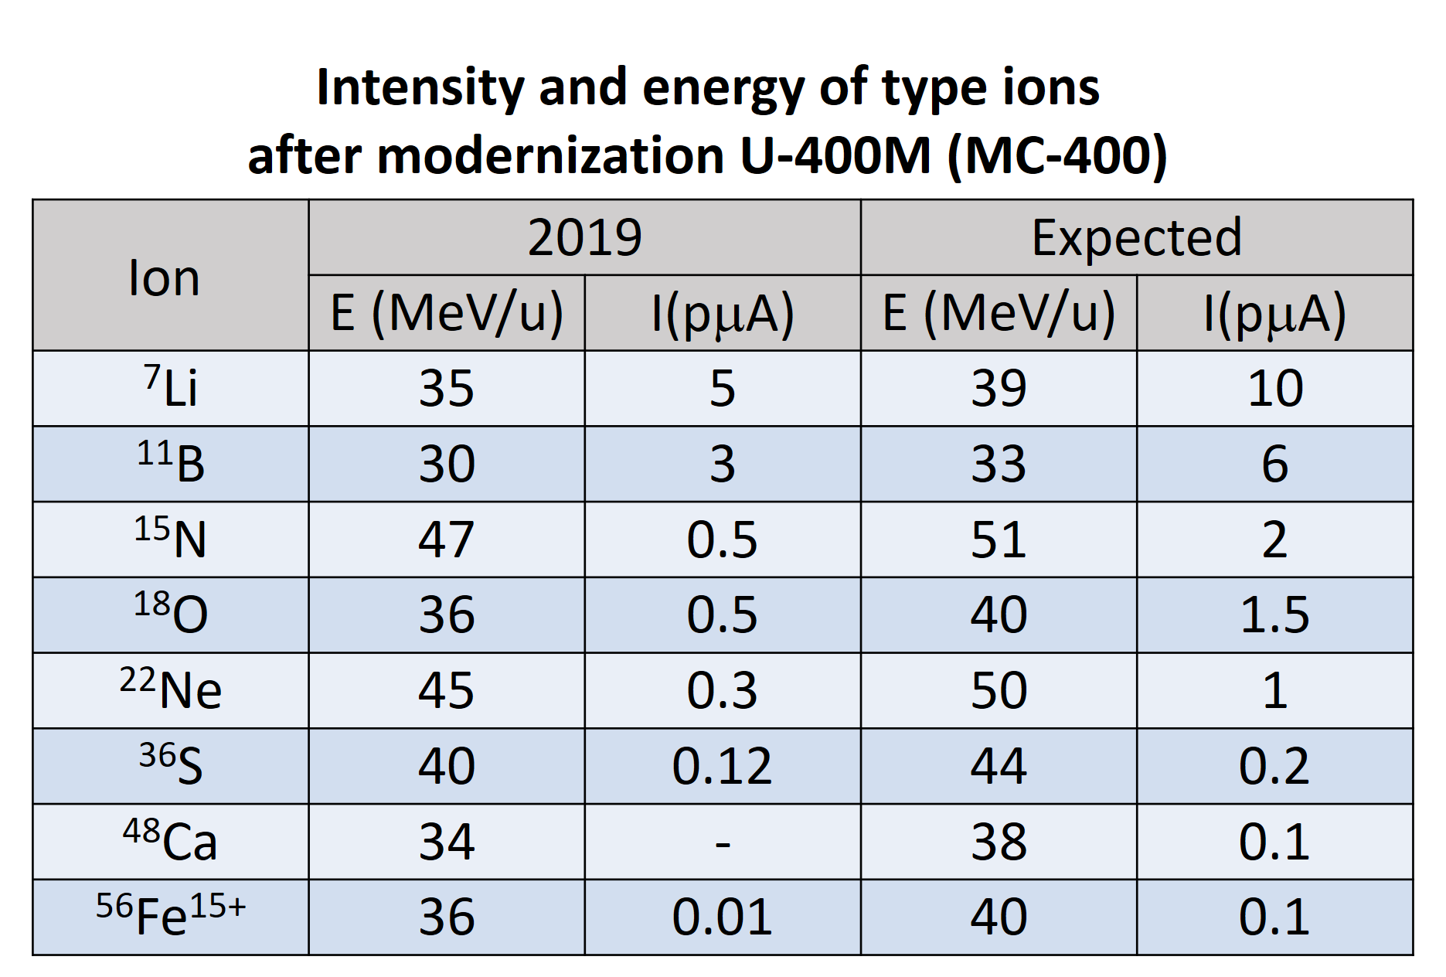
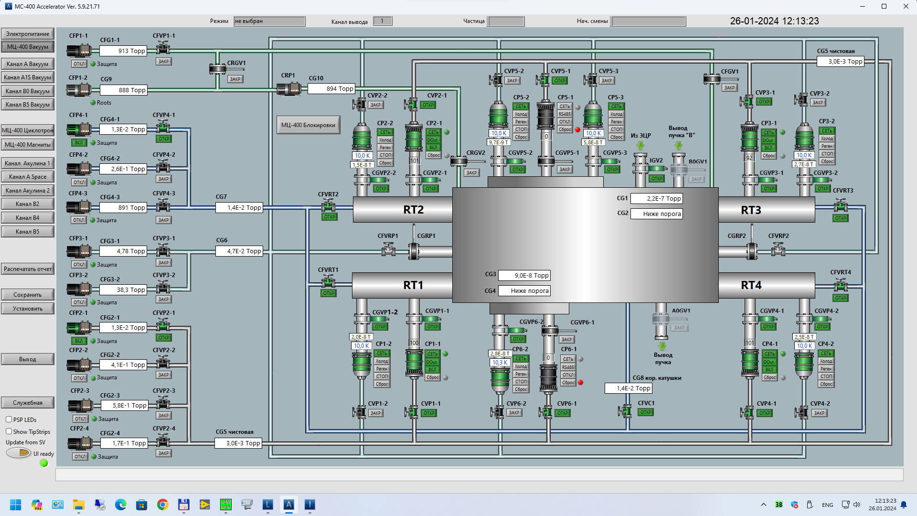
Modernization of U-400M (MC-400)
15.01.24
30.01.23
03-5-1129-1-2024/2028

Slide 4
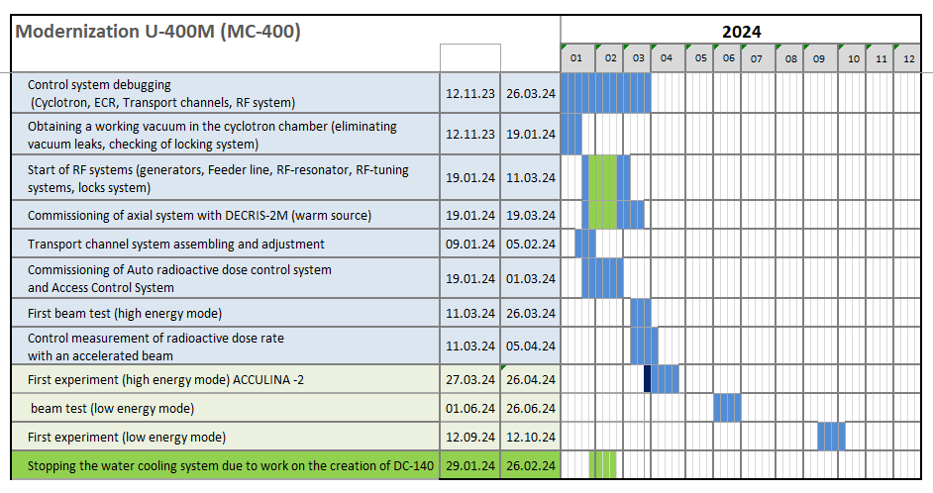
Modernization of U-400M (MC-400)
03-5-1129-1-2024/2028

Slide 5
U-400 → U-400R
Increasing of intensity of beam for ion with
A ≈ 50 from 1.2 pμA to 2.5 pμA;
Smooth variation of energy up to 5 time ;
Decrease of magnetic field from 1.9 ÷ 2.1 Т to 0.8 ÷ 1.8 T.
Main cyclotron parameters
Parametersс | U400 | U400R
A/z range | 5÷12 | 4÷12
Magnetic field | 1.93÷2.1 T | 0.8÷1.8 T
K factor | 530÷625 | 100÷500
RF modes | 2 | 2, 3, 4, 5, 6
Injection potential | 10÷20 kV | 10÷50 kV
Ion energy range | 3÷20 MeV/n | 0.8÷27 MeV/n
Number of sectors | 4 | 4
Number of dees | 2 | 2
Beam extraction | stripping | Stripping, deflector
Power consuption | ~1 MW | ~0.4 MW
03-5-1129-1-2024/2028

Slide 6
Layout of U400R extraction system :
U-400 → U-400R
electrostatic deflector (ESD, MC1, MC2, MC3)
recharging method
(foil probes FP1 and FP2)
Increasing of intensity of beam for ion with
A ≈ 50 from 1.2 pμA to 2.5 pμA;
Smooth variation of energy up to 5 time ;
Decrease of magnetic field from 1.9 ÷ 2.1 Т to 0.8 ÷ 1.8 T.
Start of modernization 2nd half of 2024
03-5-1129-1-2024/2028

Slide 7
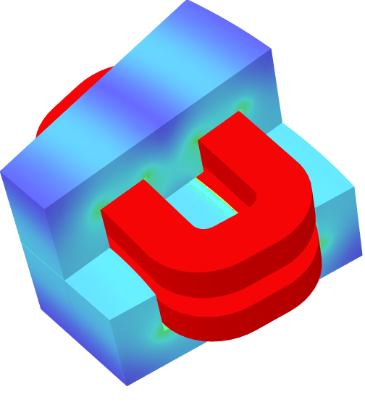
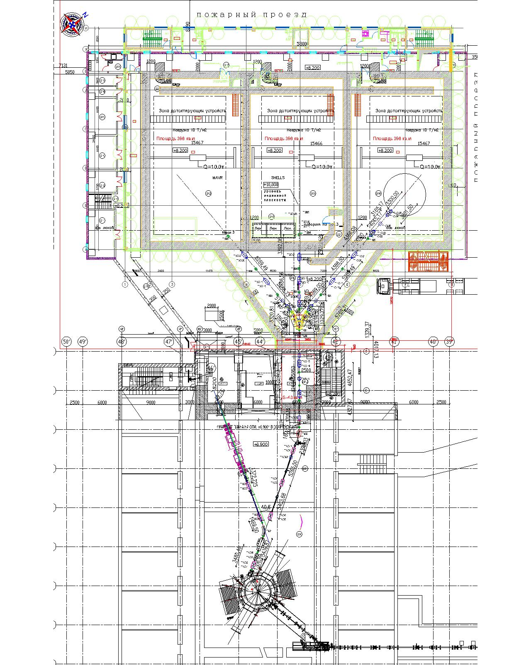
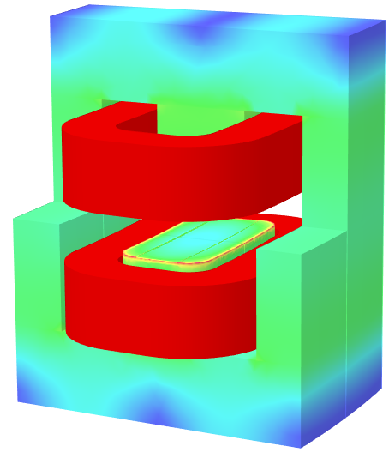
U-400 → U-400R
ТМ2 (19⁰, R=2.2m)
ТМ3/ТМ4
(8⁰, R=3.1 m)
Start of modernization 2nd half of 2024

Slide 8
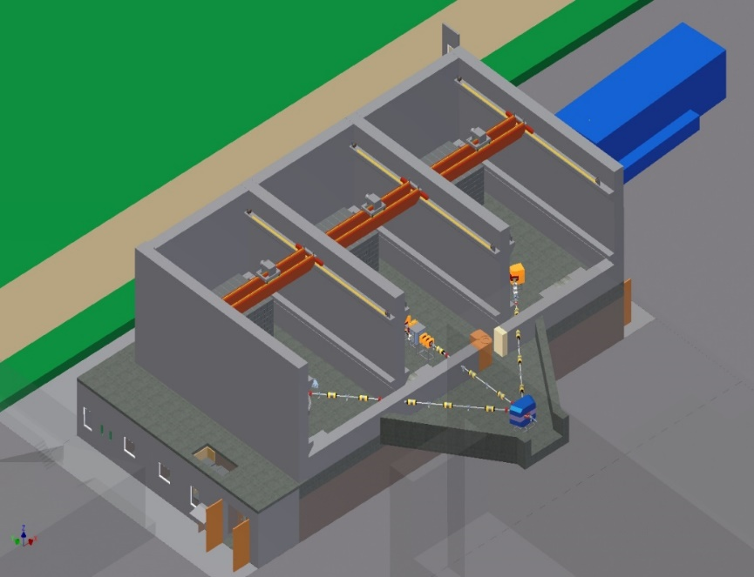
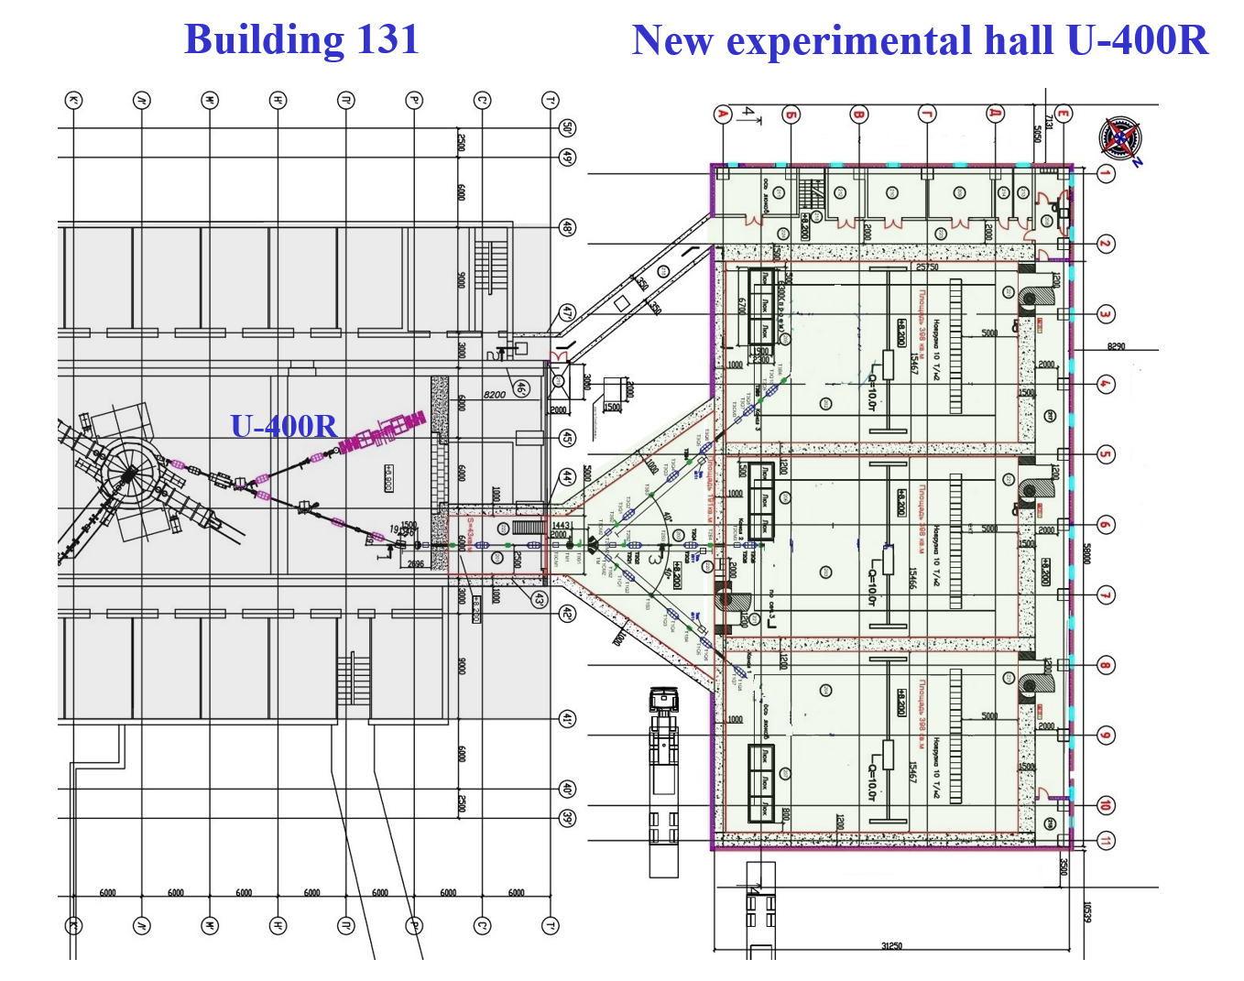
New experimental hall for U-400R
The building computer model
Area for New building: 2073 m² ;
Total area of New building: 4565,7 m² ;
The building will have 4 floors:
1st floor: placement of technological systems;
2nd floor: experimental halls, transport gallery and sanitary lock;
3rd floor: measuring and server rooms;
4th floor: power supplies for physical installations.
03-5-1129-1-2024/2028

Slide 9

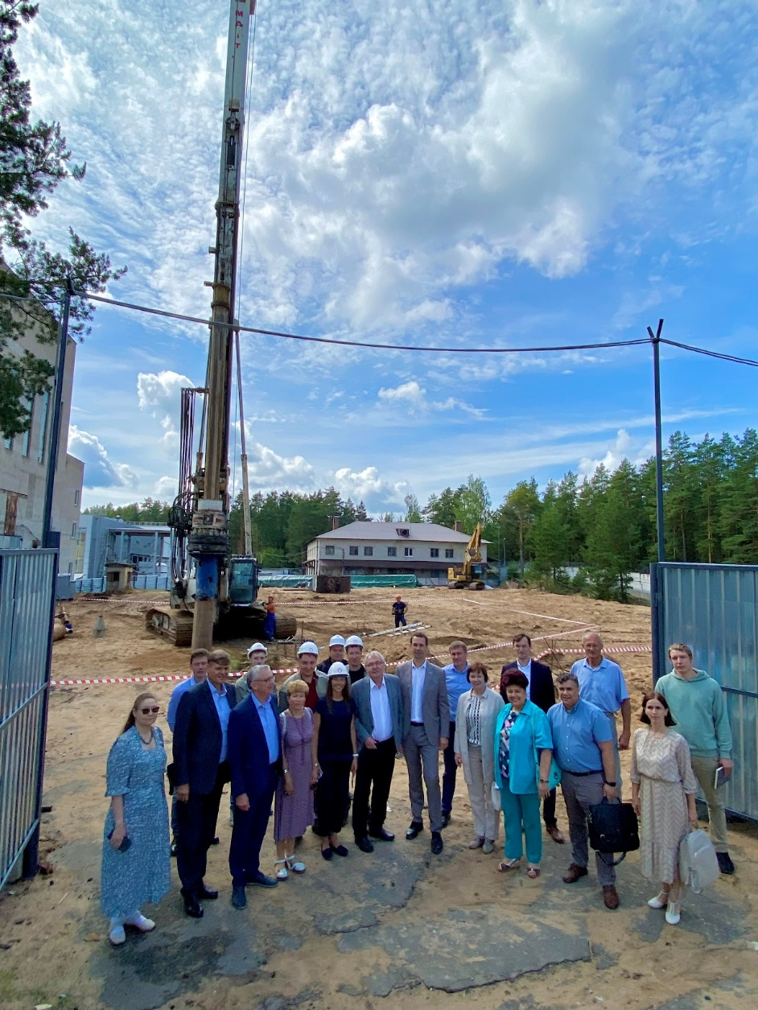
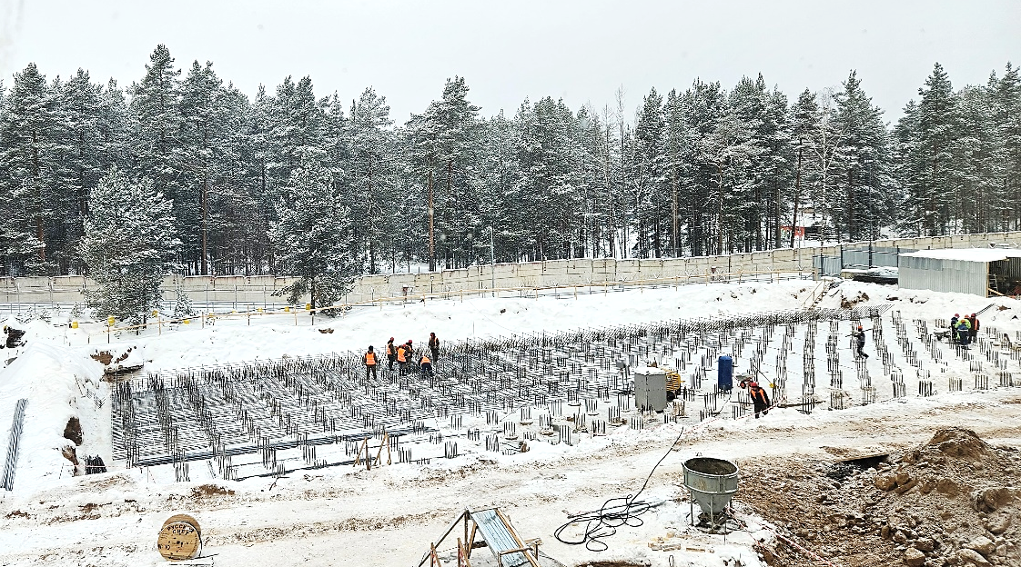
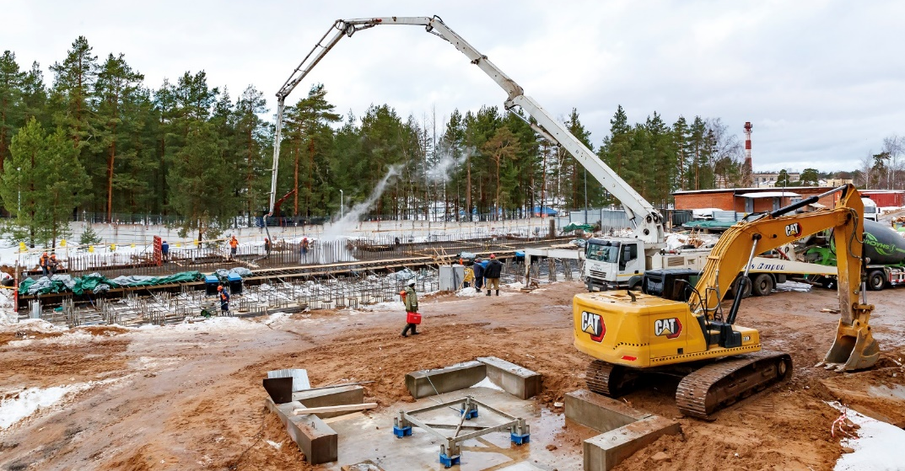
New experimental hall for U-400R
JSC “Electrocentromontazh”
Piles:
763 pcs Ø 0.6m x 18m
Concrete volume:
~4000 m3
Metal reinforcement:
~740 t.
Completion of the pile field 08.12.23
Grillage (rostverk): Concrete volume:
~2771 m3
Metal reinforcement:
~402 t.
First pile 27.07.23
Beginning of pouring the grillage (rostverk) 21.12.23

Slide 10
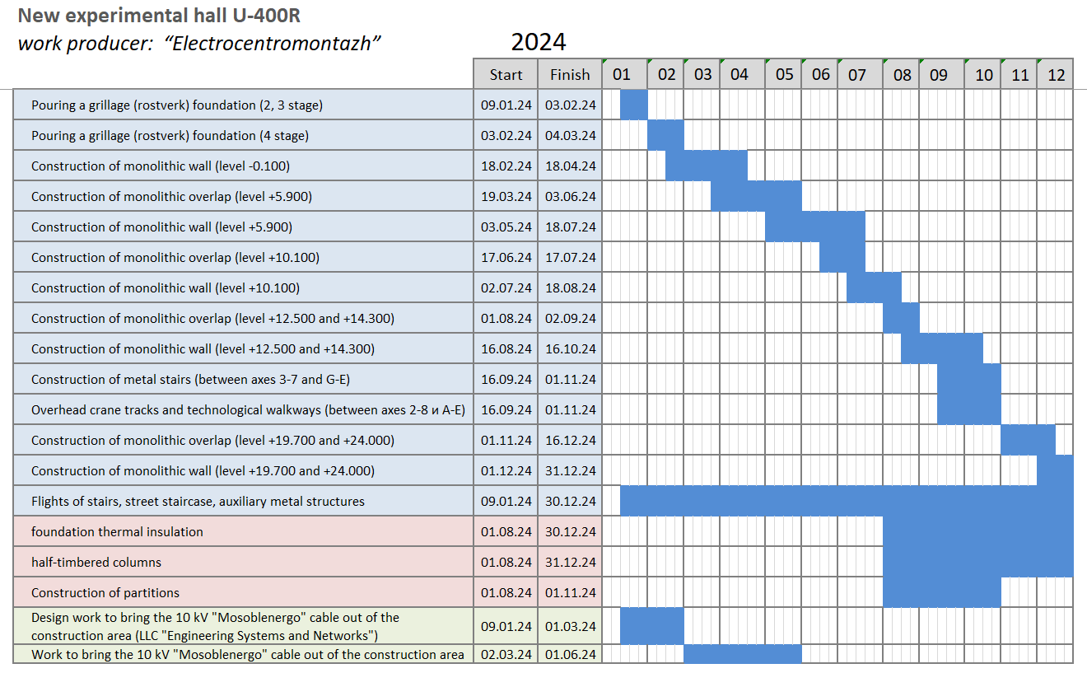
New experimental hall (U-400R)
plans of New experimental hall project realization 06.23 – 06.26
JSC “Electrocentromontazh”
03-5-1129-1-2024/2028

Slide 11
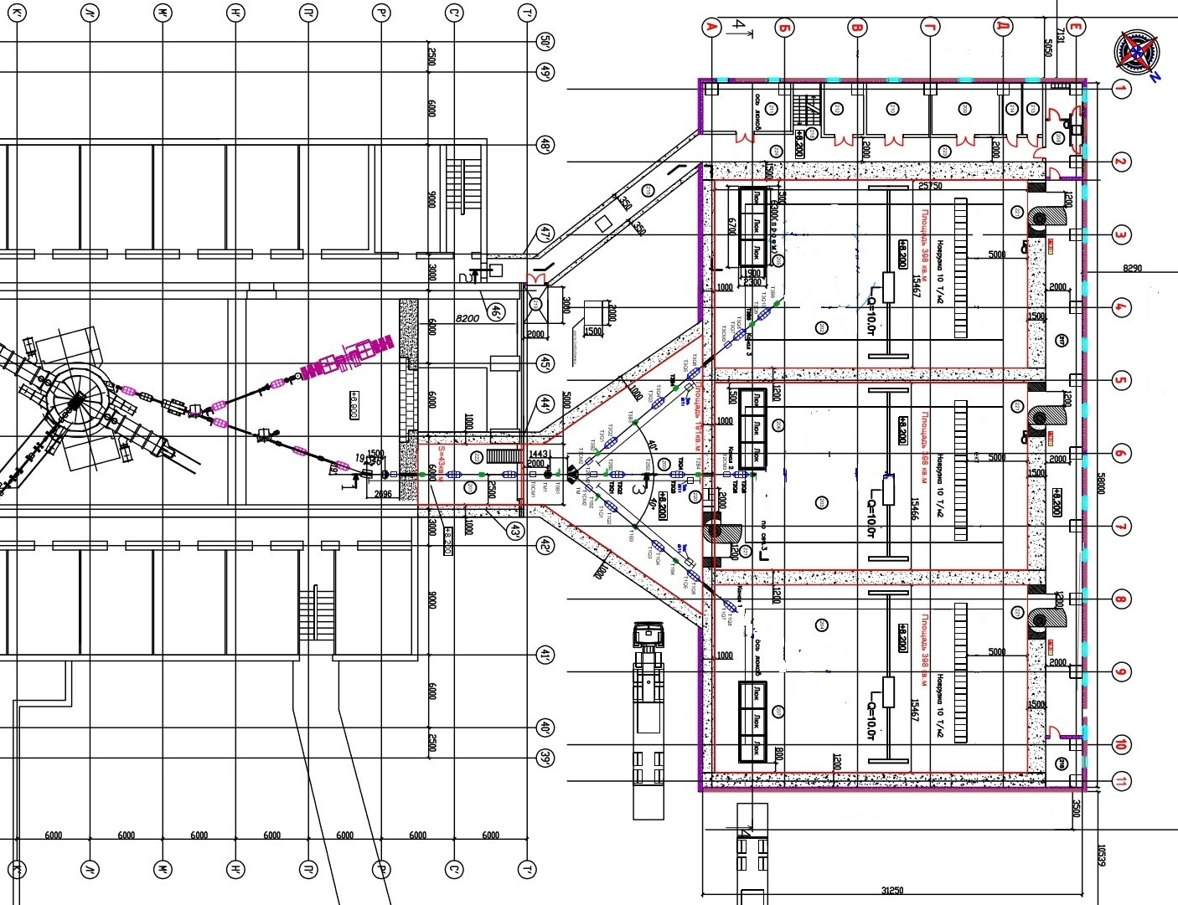
Planned U400R accelerator complex
Building 131
New experimental hall U-400R
Delivery of new cyclotron components and removal of old elements
JSC “Electrocentromontazh”
Construction
zone
Project intersections:
In the process of upgrading
U-400 to U-400R,
the delivery and export of large-sized cyclotron units and components is required
U-400R
Construction
zone
Modernization of U-400 into U-400R
in the second half of 2024.
03-5-1129-1-2024/2028

Slide 12
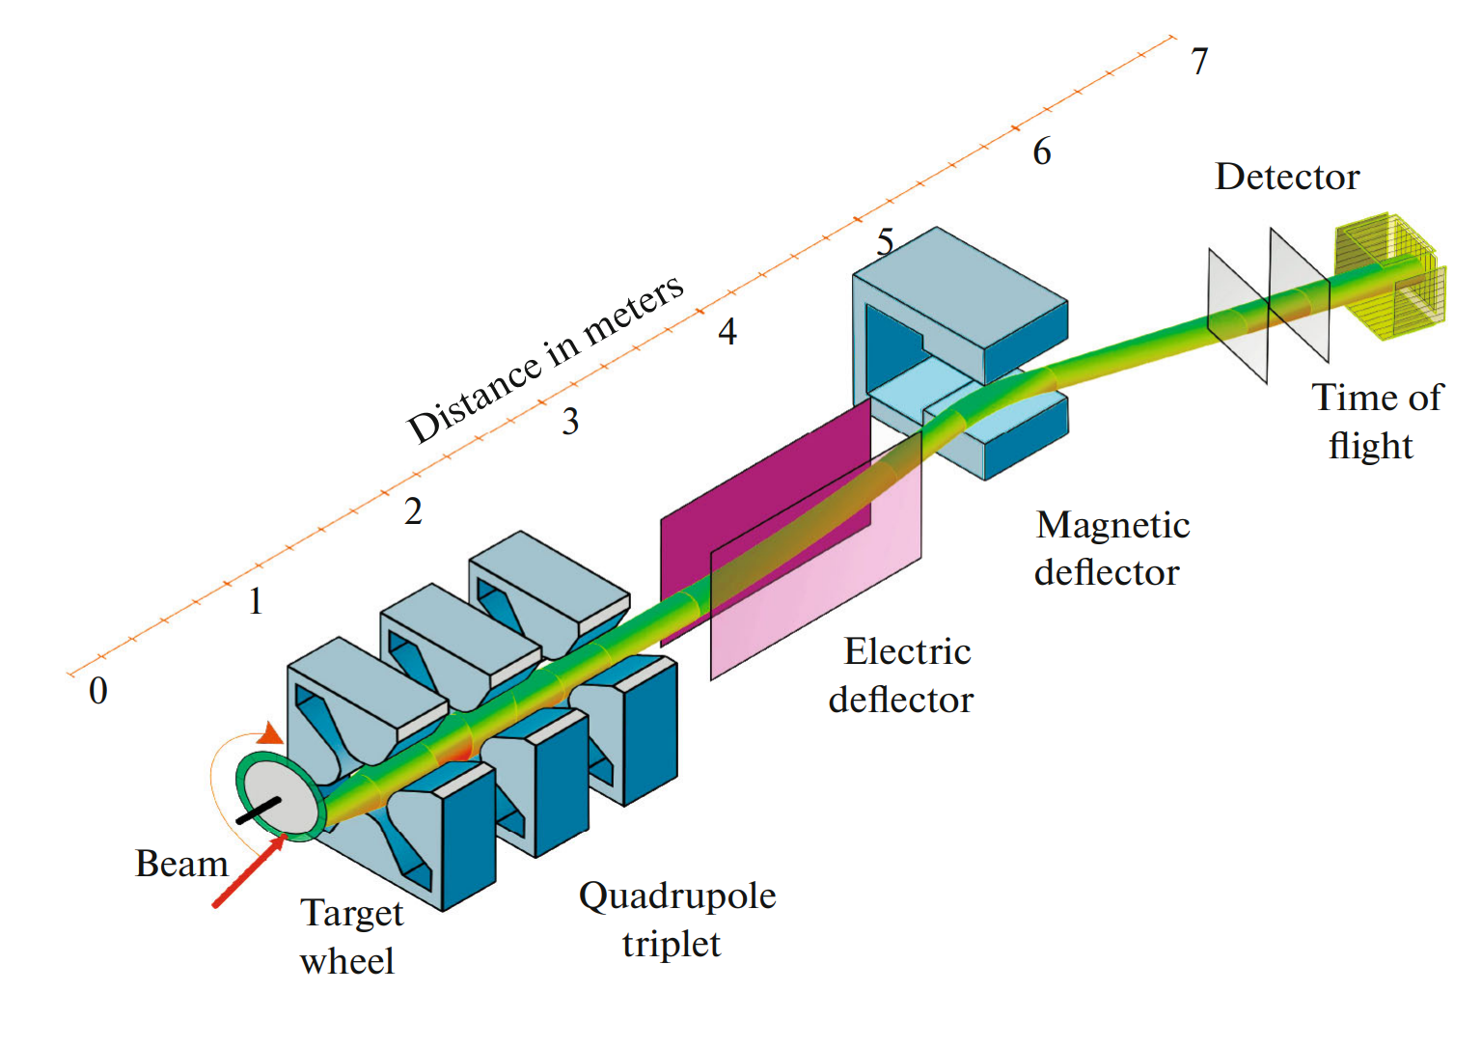
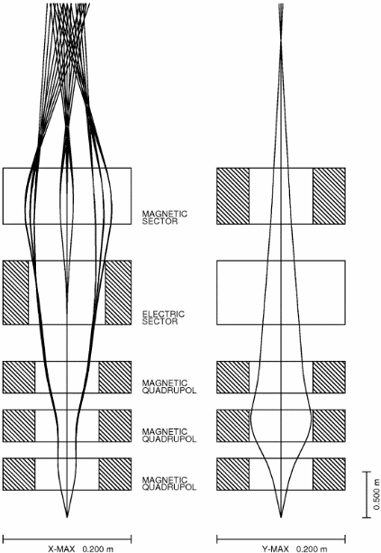
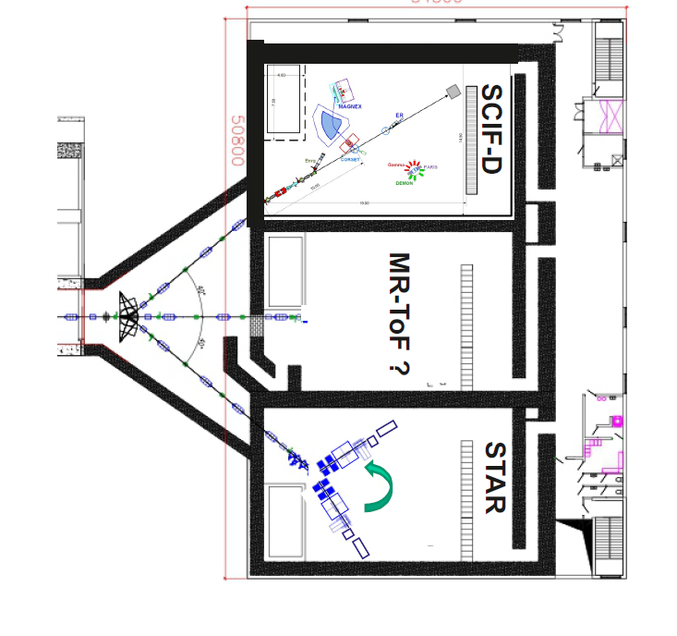
New experimental setups (U-400R)
studying the characteristics of MNT reactions and properties of radioactive decay of neutron-rich isotopes of heavy elements formed in MNT reactions
STAR
New experimental hall U-400R
Components of the spectrometer STAR
1. Rotating platform (angle from +10º to +60º)
2. Separator:
2.1. Quadrupole triplet;
2.2. Electric deflector;
2.3 Magnetic deflector (dipole magnet);
3. Clover detector system GABRIELA;
03-5-1129-1-2024/2028

Slide 13
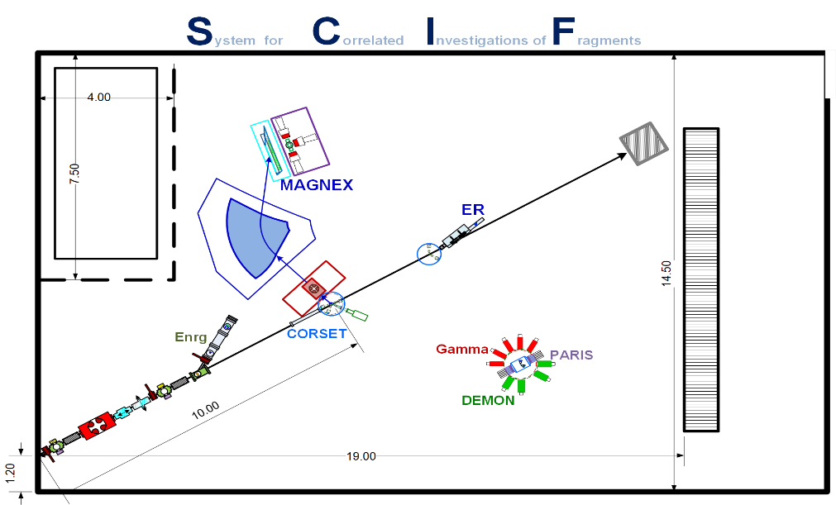
New experimental setups (U-400R)
to study MNT and quasi-fission reactions near the Coulomb barrier:
New experimental hall U-400R
Components of the spectrometer SCIF-D
CORSET time-of-flight spectrometer;
Bragg cameras;
Magnetic spectrometer;
Assembly of semiconductor detectors;
Neutron spectrometer;
Gamma spectrometer;
Spectrometer for measuring evaporation residues.
03-5-1129-1-2024/2028 ACTIVITY

Slide 14

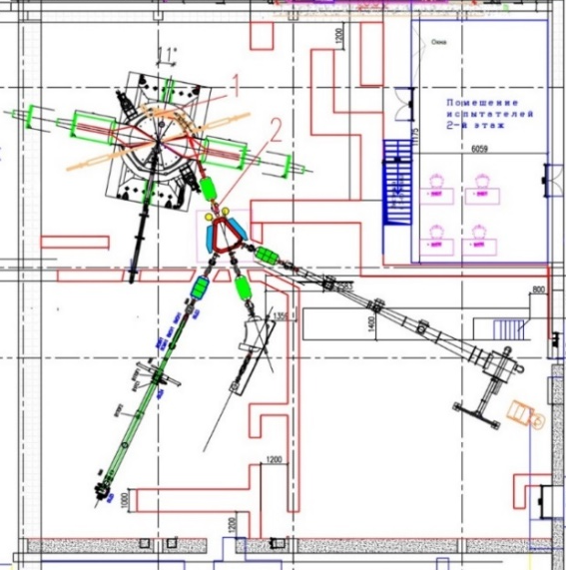
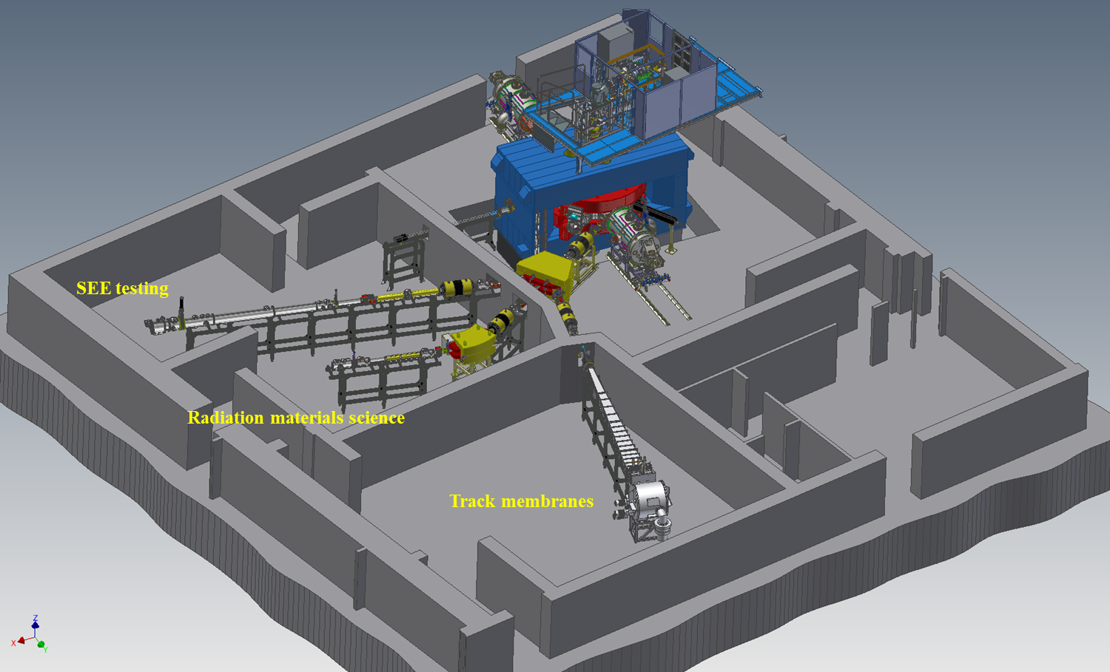
Complex for applied research based on the DC-140 cyclotron
General circuit of a cyclotron DC-140
Energy 4,8 MeV/nucleon |  |  |  | Energy 2,214 MeV/nucleon
Ion | A/Z | I, µA |  | Ion | A/Z | I, µA
²⁰⁹Bi³⁸⁺ | 5,5 | 20,67 |  | ²⁰⁹Bi²⁶⁺ | 8,038 | 0,416
¹⁹⁷Au³⁶⁺ | 5,472 | 19,58 |  | ¹⁹⁷Au²⁴⁺ | 8,208 | 3,84
¹³²Xe²⁵⁺ | 5,28 | 13,6 |  | ¹⁵⁸Gd²⁰⁺ | 7,9 | 3,2
⁸⁶Kr¹⁶⁺ | 5,375 | 8,7 |  | ¹⁴²Nd¹⁸⁺ | 7,889 | 2,88
⁵⁶Fe¹¹⁺ | 5,091 | 5,98 |  | ¹³²Xe¹⁶⁺ | 8,25 | 2,56
⁴⁰Ar⁸⁺ | 5 | 4,35 |  | ⁹⁸Mo¹²⁺ | 8,167 | 1,92
¹⁶O³⁺ | 5,333 | 1,63 |  | ⁹⁰Zr¹¹⁺ | 8,182 | 1,76
²²Ne⁴⁺ | 5,5 | 2,18 |  | ⁸⁶Kr¹¹⁺ | 7,818 | 1,76
²⁰Ne⁴⁺ | 5 | 2,18 |  | ¹⁶O²⁺ | 8 | 0,32
03-5-1129-1-2024/2028

Slide 15
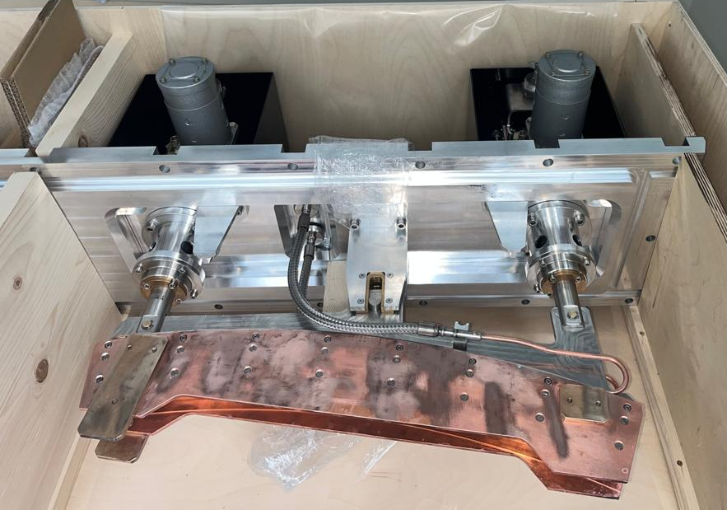
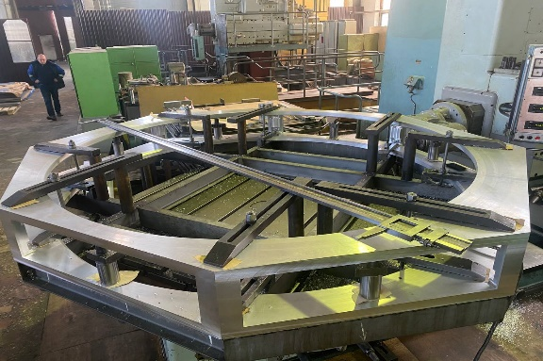
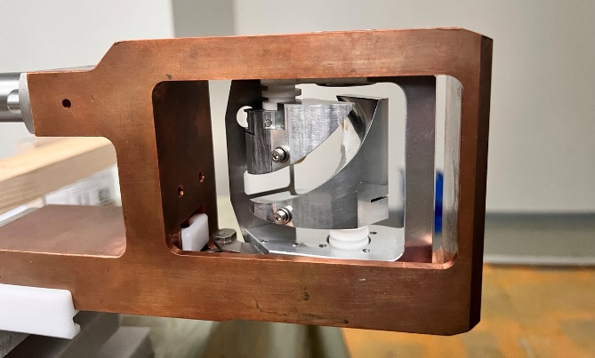
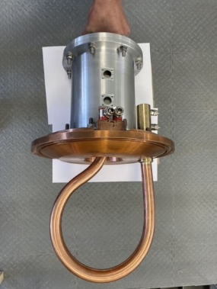
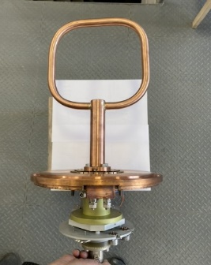
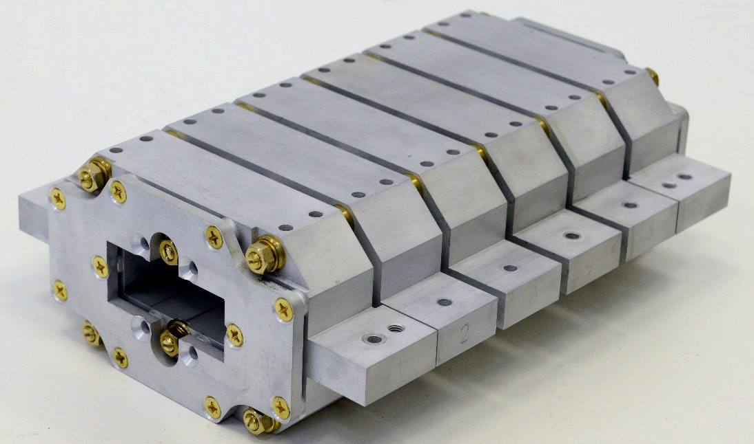
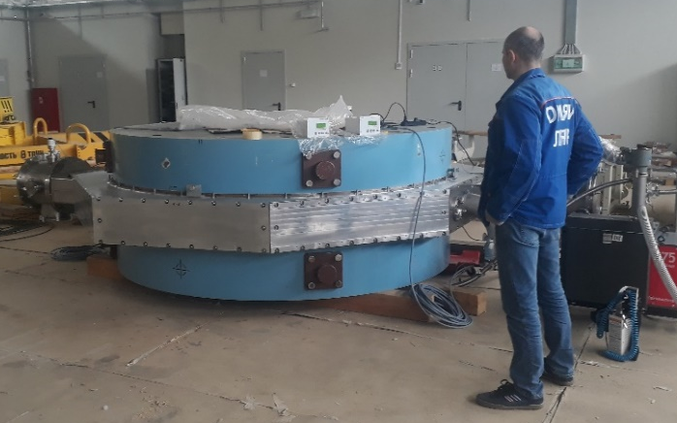
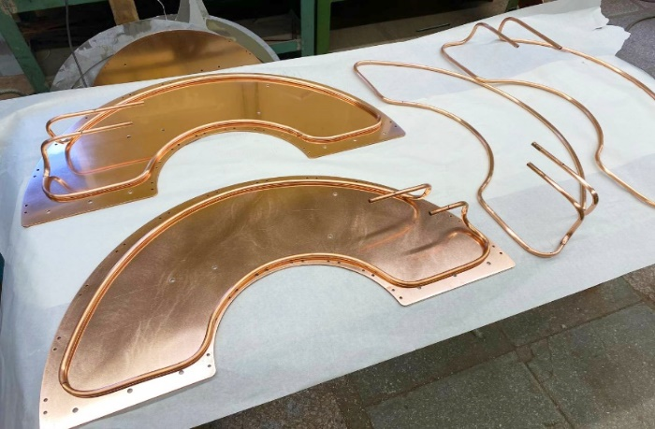
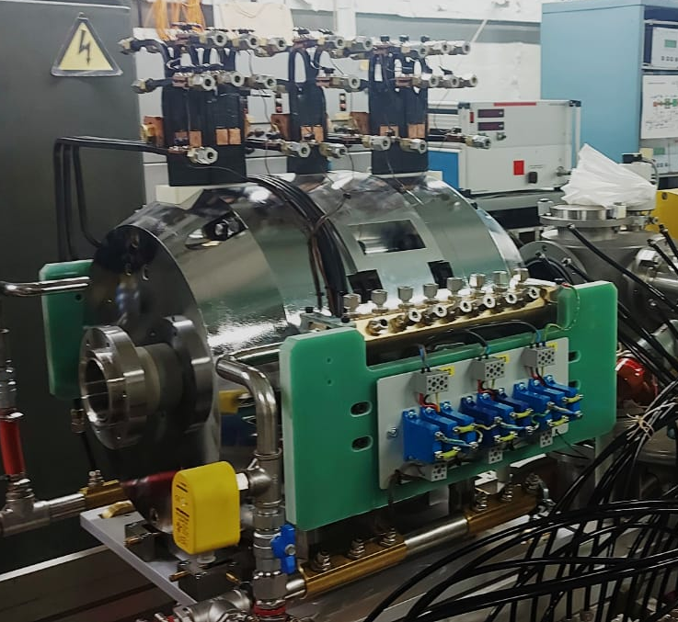
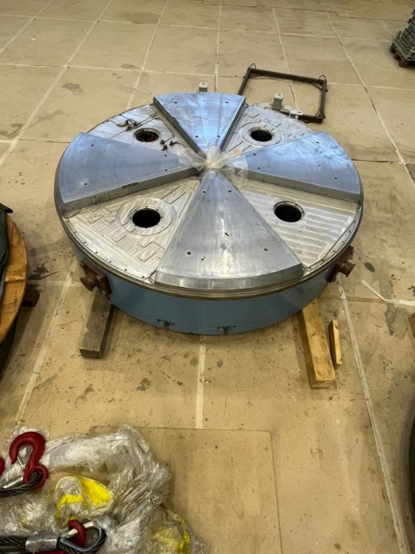
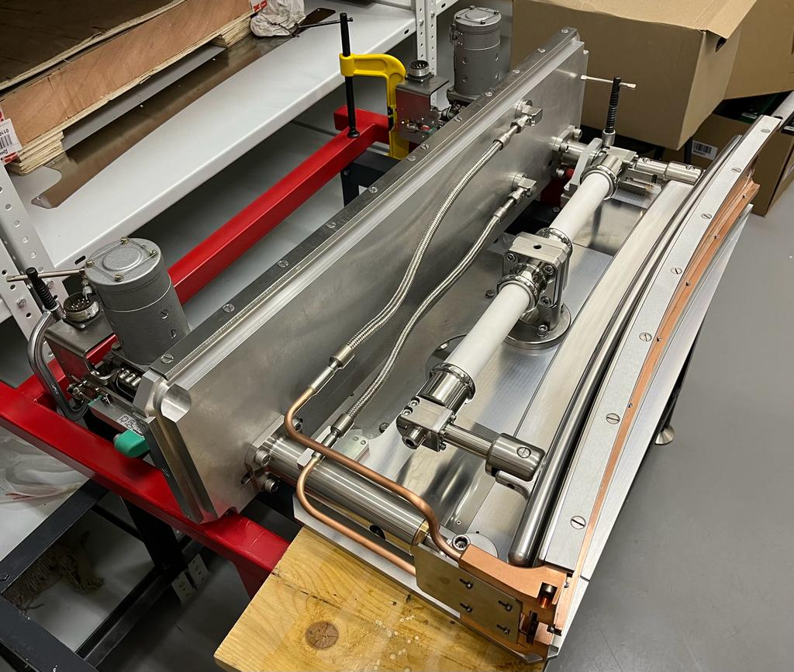
Cyclotron DC-140 elements
90% of the equipment has been manufactured and arrived at FLNR
Elements of RF system
Magnet channel
Cyclotron vacuum chamber
Connection loop
Trimmer of AFT
Inflector
PMQ
Cyclotron vacuum chamber vacuum test
Short-circuiting plates
Pole assembling
Deflector
DECRIS-5M on the test bench
15

Slide 16
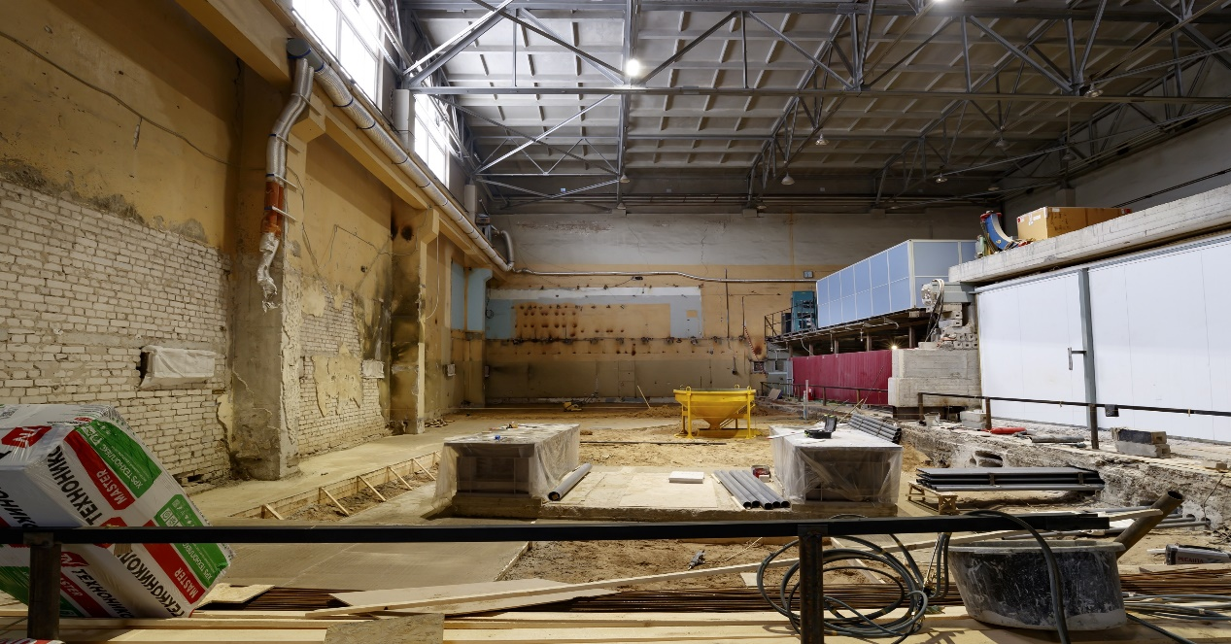
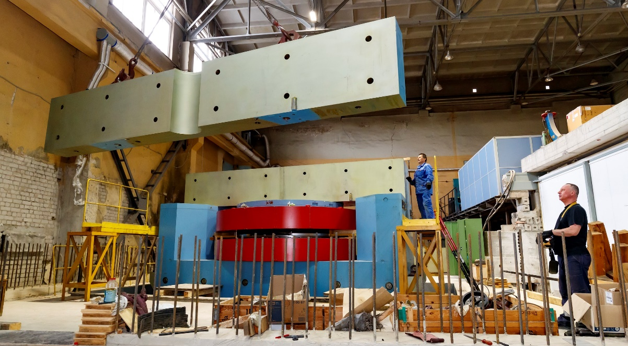
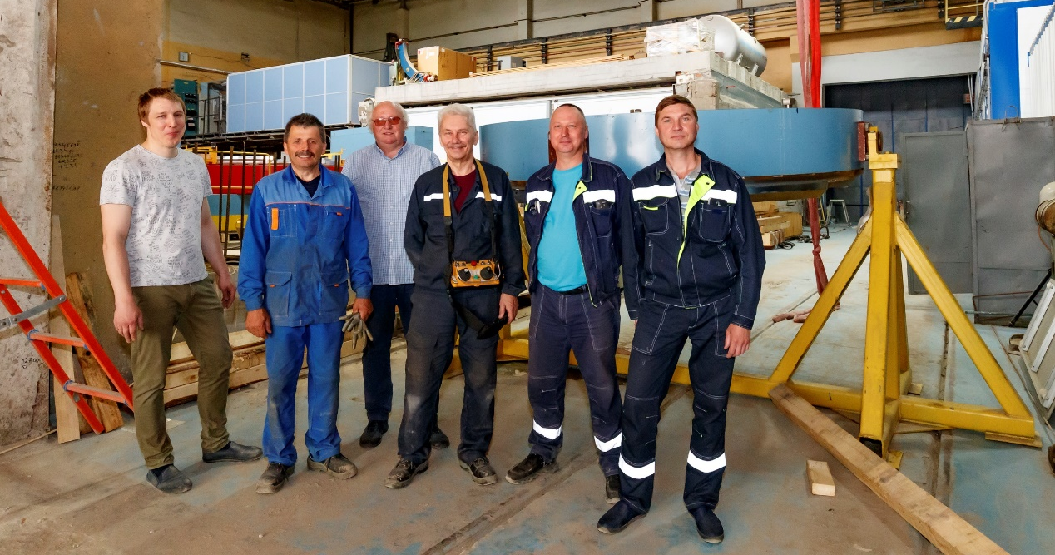
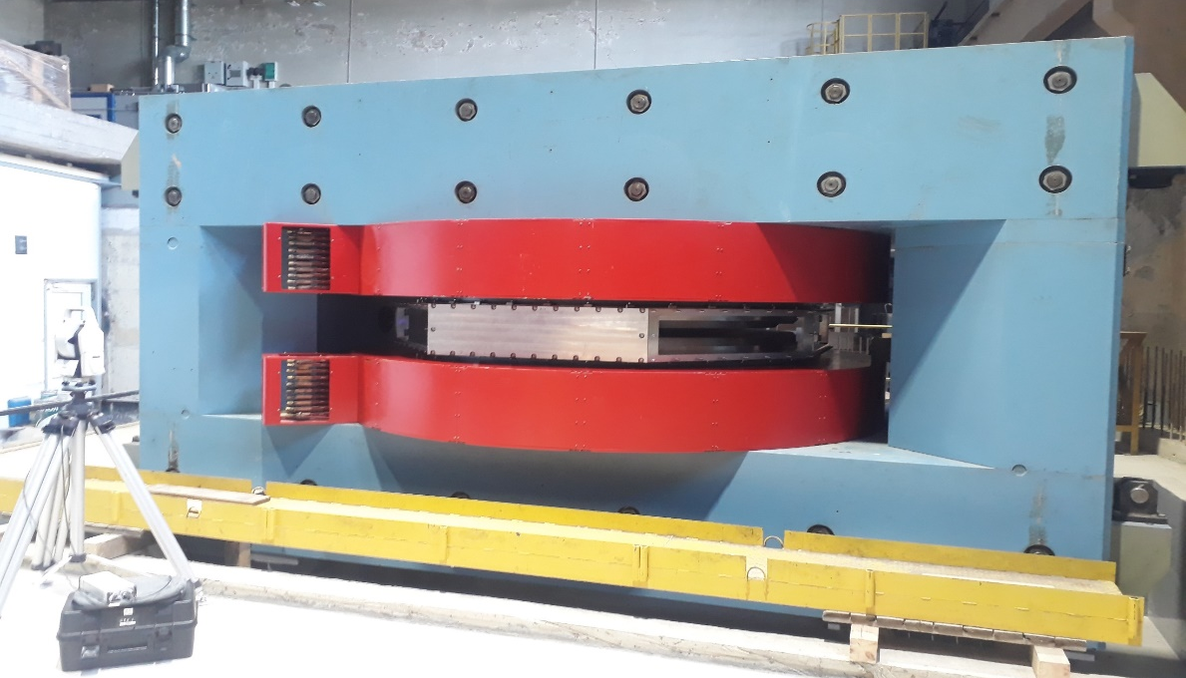
Cyclotron DC-140
30.01.23
Mounting of DC-140 main magnet
03-5-1129-1-2024/2028

Slide 17
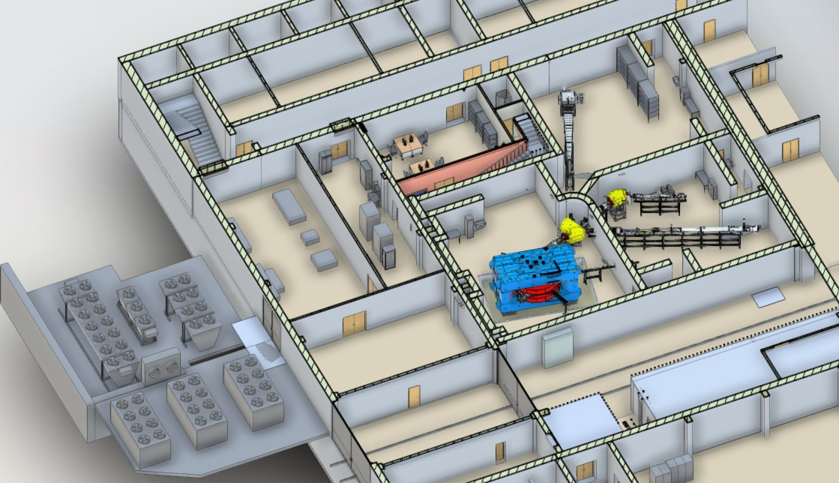
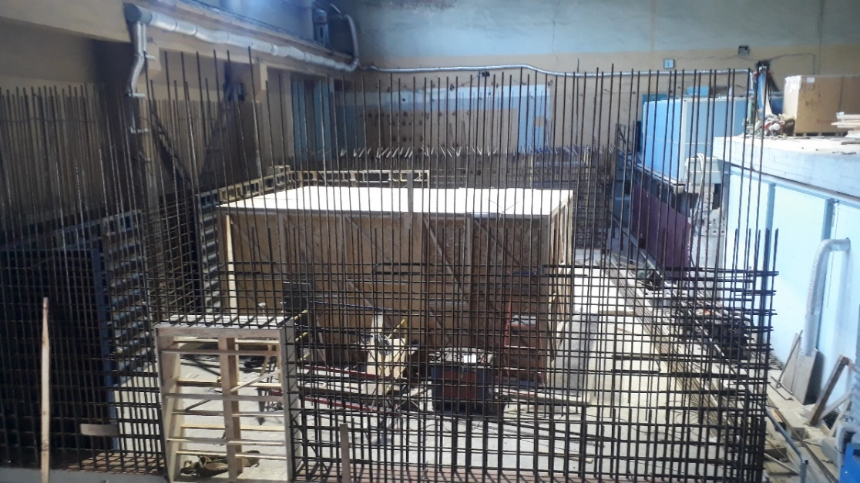
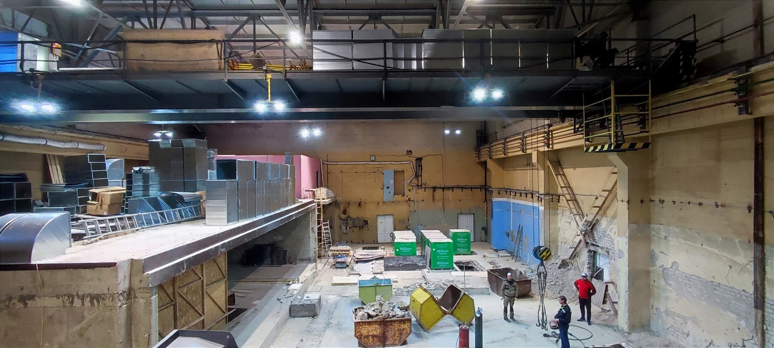
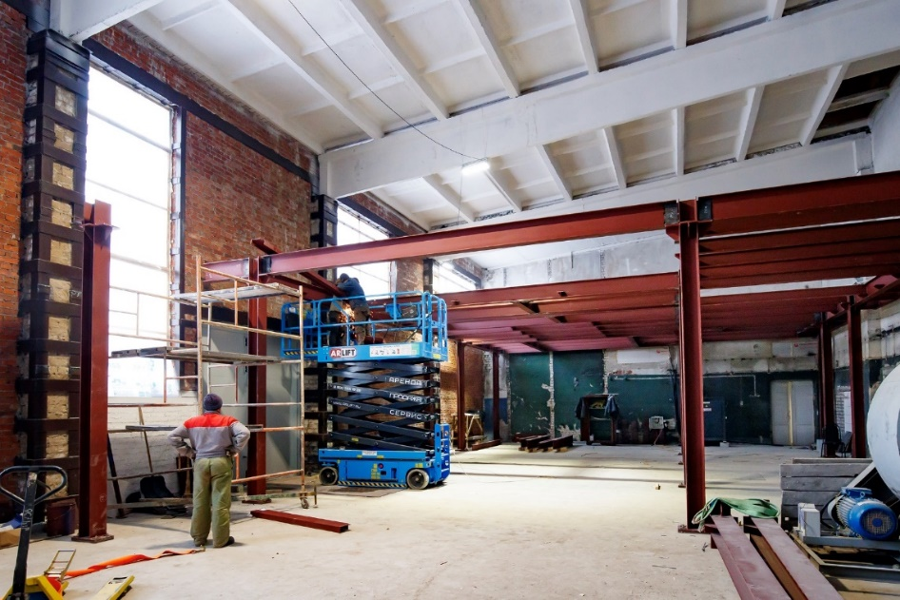
Placement of DC-140 in building 101
LLC "MASTERPROM"
Control room,
Accelerator hall,
Experimental channels halls
General layout of the DC140 facility
25.01.24
Engineering systems hall
03-5-1129-1-2024/2028

Slide 18
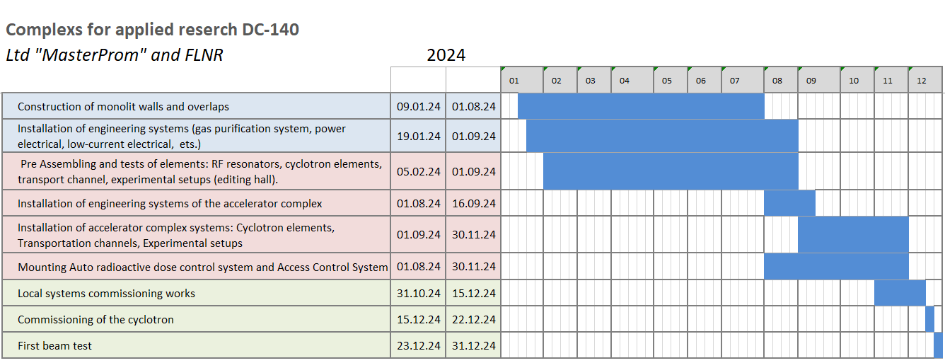
Cyclotron DC-140
LLC "MASTERPROM"
12.12.23
03-5-1129-1-2024/2028

Slide 19
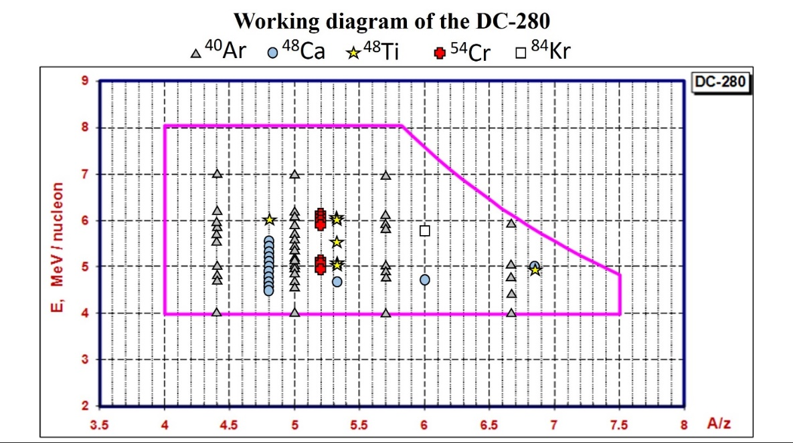
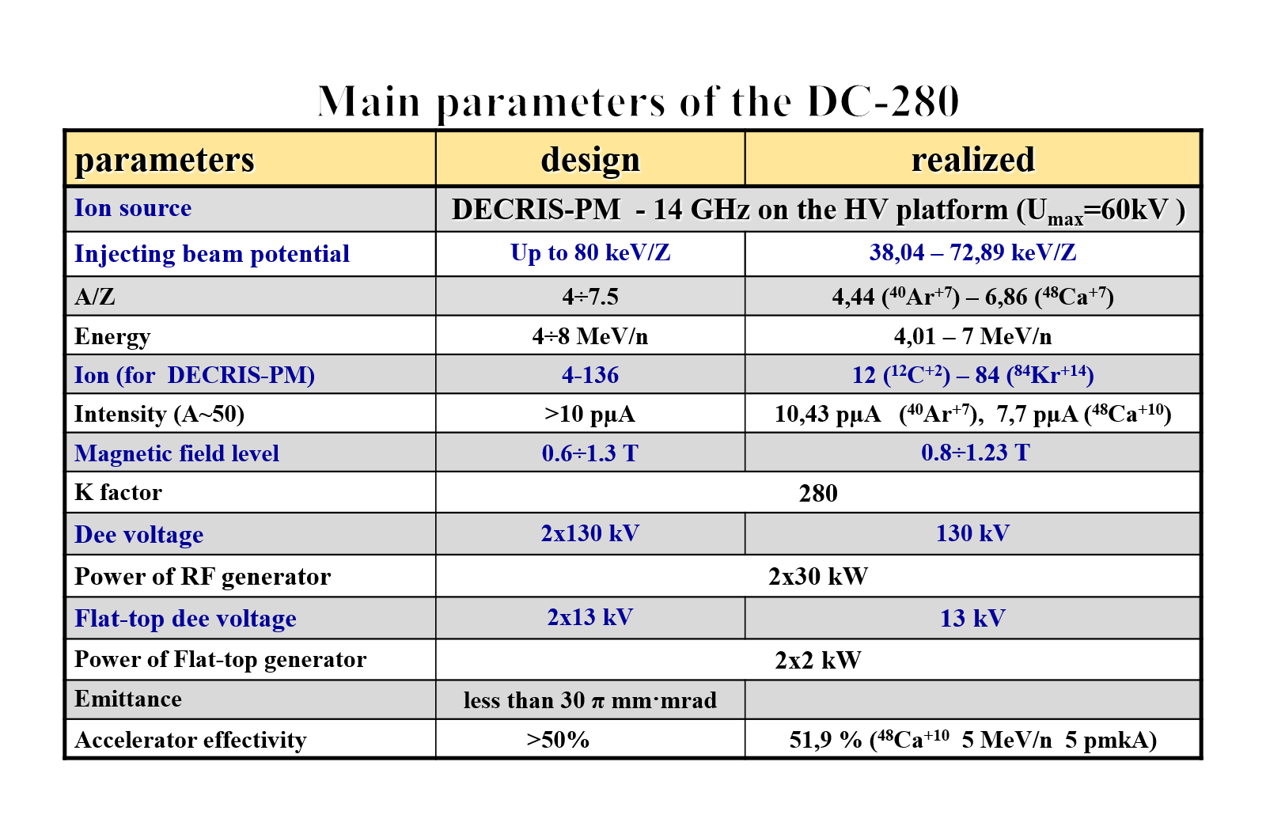
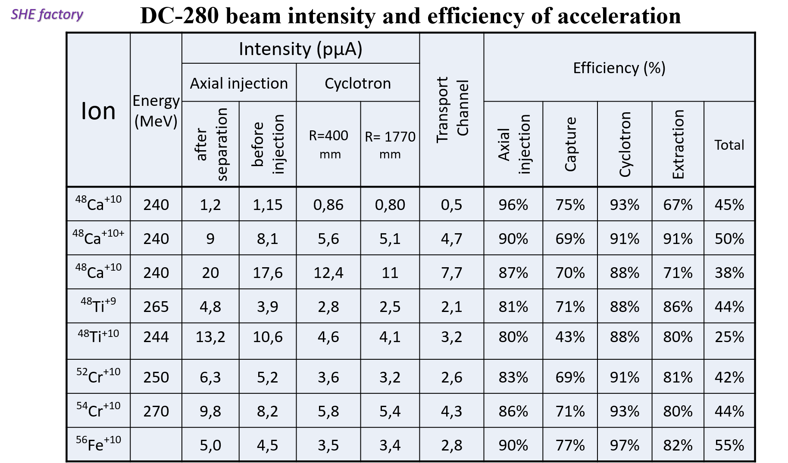
SHE factory
Cyclotron DC-280
Year | Total work time | Ions
2018 | First Beam | ⁸⁴Kr
2019 | 3377 | ¹²C, ⁴⁰Ar, ⁴⁸ Ca, ⁸⁴Kr
2020 | 3705 | ⁴⁰Ar, ⁴⁸ Ca, ⁴⁸Ti
2021 | 5357 | ⁴⁸ Ca, ⁴⁸Ti , ⁵²Cr
2022 | 6037 | ⁴⁰Ar, ⁴⁸Ca, ⁴⁸Ti , ^{52,54}Cr
2023 | 6182 | ²⁶Mg, ⁴⁰Ar, ⁴⁸Ca, ⁴⁸Ti , ^{52,54}Cr, ⁵⁶Fe
03-5-1129-2-2024/2028

Slide 20




SHE factory
Effectivity of acceleration on DC-280
Spectrum from DECRIS-PM in optimal regime
⁴⁸Са¹⁰⁺
⁴⁸Ti⁹⁺ from
(CH₃)₅C₅Ti(CH₃)₃
⁵²Сr¹⁰⁺ from
Cr(C₅H₅)₂
03-5-1129-2-2024/2028

Slide 21




SHE factory
GASSOL
GASSOL
SC solenoid-based spectrometer for the chemical studies of short-lived super-heavy nuclei is expected to be completed and delivered in Dubna by the end 2024.
transmission efficiency > 40%
Focus to spot < Ø1 cm
(T_{1/2}< 0.5 s)
Test coil (October 2023)
SC solenoid, cryogenic system, control equipment
Contract with XI'an Superconducting Magnet Technology Co., Ltd.
Delivery at the end of 2024.
Installation of ion transport channel in the experimental hall at the SHE factory, Preparation for equipment placement
During 2024
Schematic view of the GASSOL magnetic separator.
03-5-1129-2-2024/2028

Slide 22



SHE factory
MR ToF
MR TOF spectrometer
Main characteristics of the spectrometer.
The length of the time-of-flight base of the mass analyzer is 1000 mm.
The maximum number of revolutions in the analyzer is 500.
Required vacuum in the analyzer chamber < 10⁻⁸ Torr.
Range of measured masses А=12÷500.
Mass resolution М/ΔМ=1.5∙10⁶.
Accuracy of mass determination with event statistics >100 ∆M/M=10⁻⁷.
Minimum lifetime of analyzed nuclides τ>50 ms.
Sensitivity of statistically significant measurement ~10 ions;
Measurement frequency up to 400 Hz;
Transmission efficiency up to 95%;
Measurement dynamic range >10⁴.
Availability of the ability to analyze single
and doubly charged ions without loss of efficiency.
General view of cryogenic gas catcher:
1 - entrance window;
2 - external warm vacuum shell;
3 - internal cold chamber;
4 - cylindrical electrodes of constant electric field;
5 - radio-frequency multielectrode cone;
6 - head of cryo-refrigerator;
7 - supersonic nozzle;
8 - transport radio frequency quadrupole.
Block diagram of the mass spectrometer.
The ion source for the spectrometer is a gas-filled ion stopping cell
at the outlet of the gas filled recoil separator.
Diagram of a mass spectrometer:
1 - node of the multi-turn time-of-flight mass analyzer;
2 – node of quadrupole mass filters;
3 - node of the channel for introducing sample ions;
4 - node of the channel for introducing calibrant ions;
5 - node of detectors.
Accuracy of about 300 keV
relative accuracy of 10⁻⁶
for a mass of 300 a.m.u.
03-5-1129-2-2024/2028

Slide 23


SHE factory
MR TOF
MR TOF spectrometer
Cryogenic gas stopping cell (gas catcher)
1. Done:
Mechanical design,
Vacuum system,
Gas inlet,
Cryogenic,
Control system
2. Offline testing started
MRTOFMS
1. Ion-opting system calculation done
2. Draft mechanical design done
3. Development of design documentation was started
03-5-1129-2-2024/2028

Slide 24










Development of
refractory metals
ion production methods
Production of high-intensity ion beams ⁴⁸Ti⁺¹⁰ at the DC-280 cyclotron
Axial injection system |  | Cyclotron |  | Transport channel (T0FC2), pµA
After separation (IFC2), pµA | Before injection (IFC3), pµA | R=400 mm, pµA | R=1770 mm, pµA
13,2 | 10,6 | 4,6 | 4,1 | 3,26
80,0%
 | 43,5%
 |  | 88,4%
 |  |  | 79,7%
24,5%
iThe ⁴⁸Ti ion spectrum, optimized for ⁴⁸Ti¹⁰⁺
11 hours
*Production of multiply charged metallic ions by compact electron cyclotron
resonance ion source with SF₆ plasma Y. Saitoh et al.
REVIEW OF SCIENTIFIC INSTRUMENTS VOLUME 69, NUMBER 2 FEBRUARY 1998
Accelerated beam stability ⁴⁸Ti⁺¹⁰
*Recycling effect of germanium on ECR ion source P. Leherissier et al.
Nuclear Instruments and Methods in Physics Research B 211 (2003) 274–280
03-5-1129-2-2024/2028

Slide 25





Development of
refractory metals
ion production methods
INDUCTIVE OVEN
Adaptation to DECRIS-PM
Thermocouple1500⁰С
Test Ni wire
03-5-1129-2-2024/2028

Slide 26
SHE factory
DC-280 beam intensity and efficiency of acceleration
Ion | Energy (MeV) | Intensity (pµA) |  |  |  | Transport Channel | Efficiency (%)
 |  | Axial injection |  | Cyclotron
 |  | after separation | before injection | R=400 mm | R= 1770 mm |  | Axial injection | Capture | Cyclotron | Extraction | Total
⁴⁸Ca⁺¹⁰ | 240 | 1,2 | 1,15 | 0,86 | 0,80 | 0,5 | 96% | 75% | 93% | 67% | 45%
⁴⁸Ca⁺¹⁰⁺ | 240 | 9 | 8,1 | 5,6 | 5,1 | 4,7 | 90% | 69% | 91% | 91% | 50%
⁴⁸Ca⁺¹⁰ | 240 | 20 | 17,6 | 12,4 | 11 | 7,7 | 87% | 70% | 88% | 71% | 38%
⁴⁸Ti⁺⁹ | 265 | 4,8 | 3,9 | 2,8 | 2,5 | 2,1 | 81% | 71% | 88% | 86% | 44%
⁴⁸Ti⁺¹⁰ | 244 | 13,2 | 10,6 | 4,6 | 4,1 | 3,2 | 80% | 43% | 88% | 80% | 25%
⁵²Cr⁺¹⁰ | 250 | 6,3 | 5,2 | 3,6 | 3,2 | 2,6 | 83% | 69% | 91% | 81% | 42%
⁵⁴Cr⁺¹⁰ | 270 | 9,8 | 8,2 | 5,8 | 5,4 | 4,3 | 86% | 71% | 93% | 80% | 44%
⁵⁶Fe⁺¹⁰ |  | 5,0 | 4,5 | 3,5 | 3,4 | 2,8 | 90% | 77% | 97% | 82% | 55%
Thank you for your attention

Slide 27



Development of the infrastructure of the ACCULINNA-2 fragment separator in 2024
RF-kicker:
  Test of new measuring system
  Local radiation shield design
  Radiation safety control
Tritium target complex:
  Precommissioning of tritium supply equipment
  Mounting of system for storage and transport of pure gases

