Slide 1
About a Possible Test of T - Invariance in a Measurement of Neutron – Nuclear Total Cross Sections with a Usage of
"Polarization - Asymmetry" Theorem.
V.R. Skoy
Frank Laboratory of Neutron Physics
Joint Institute for Nuclear Research
/ЖЭТФ 164, 3, (2023) 380
JETP 137, 3, (2023) 328/

Slide 2
MOTIVATION
To date violation of T - invariance (TI) has been established for the decays and oscillations of neutral kaons, which is associated with the difference of the Kobayashi–Maskawa phase from zero (or π) in the Standard model.
For nucleon–nucleus interactions this phase is very small and has a large spread.
Therefore, the test of TI in nuclear processes means a search for other mechanisms for TI violation.
01

Slide 3
T – invariance means reversal of the entries physical events and replace their initial and final states:
Properties of the vector quantities under parity (P) and time (T) inversions:
 | r | k | s | E | H
P | -r | -k | s | -E | H
T | r | -k | -s | E | -H
Invariance under P – or T – inversions means equality of the probabilities of direct and reversal processes. If these probabilities are not equal, that means violation.
Thus to test T – invariance one needs to compare the probabilities of the mutually reversal processes.
In case of neutron-nuclear interaction it may be cross sections of a direct and reversal reactions.
02

Slide 4
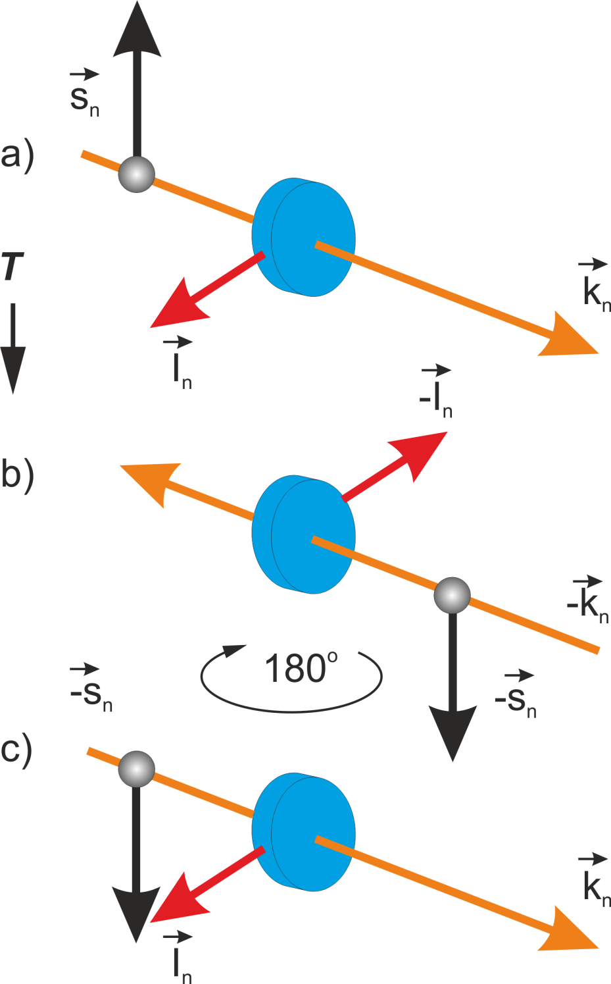
1. TEST OF T-INVARIANCE WITH POLARIZED NUCLEI
x
y
z
This way of test requires a complicate polarized nuclear target and has
build-in
strong source of the systematic errors
03

Slide 5
2. THE THEOREM "POLARIZATION - ASYMMETRY" (PА)
If T – invariance takes place, then for an unpolarized incident beam of particles with spin ½ the polarization P of scattered particles is equal to the asymmetry A in the scattering of a completely polarized beam.
P-A theorem for the neutron transmission with P – violation (P-odd)
Why transmission?
In transmission process the initial and final states of reaction coincide by definition, and match well the requirements of the time reversal, which replaces initial and final states.
A neutron transmission (total cross section) requires just one neutron detector and provides a highest counts rate in comparison with other types of experiments, which provides a potentially highest statistical accuracy as well.
Det
Target
04

Slide 6
The Hamiltonian of the interaction between a neutron moving along the Z axis and a nucleus :
m neutron mass
a amplitude of the strong interaction
b amplitude of the weak P-odd interaction
n_{t} number density of the target nuclei,
s₀ identity matrix
σ_{z} Pauli matrix.
Time evolution of the neutron spin density matrix while passing through the target :
strong
weak interaction
05

Slide 7
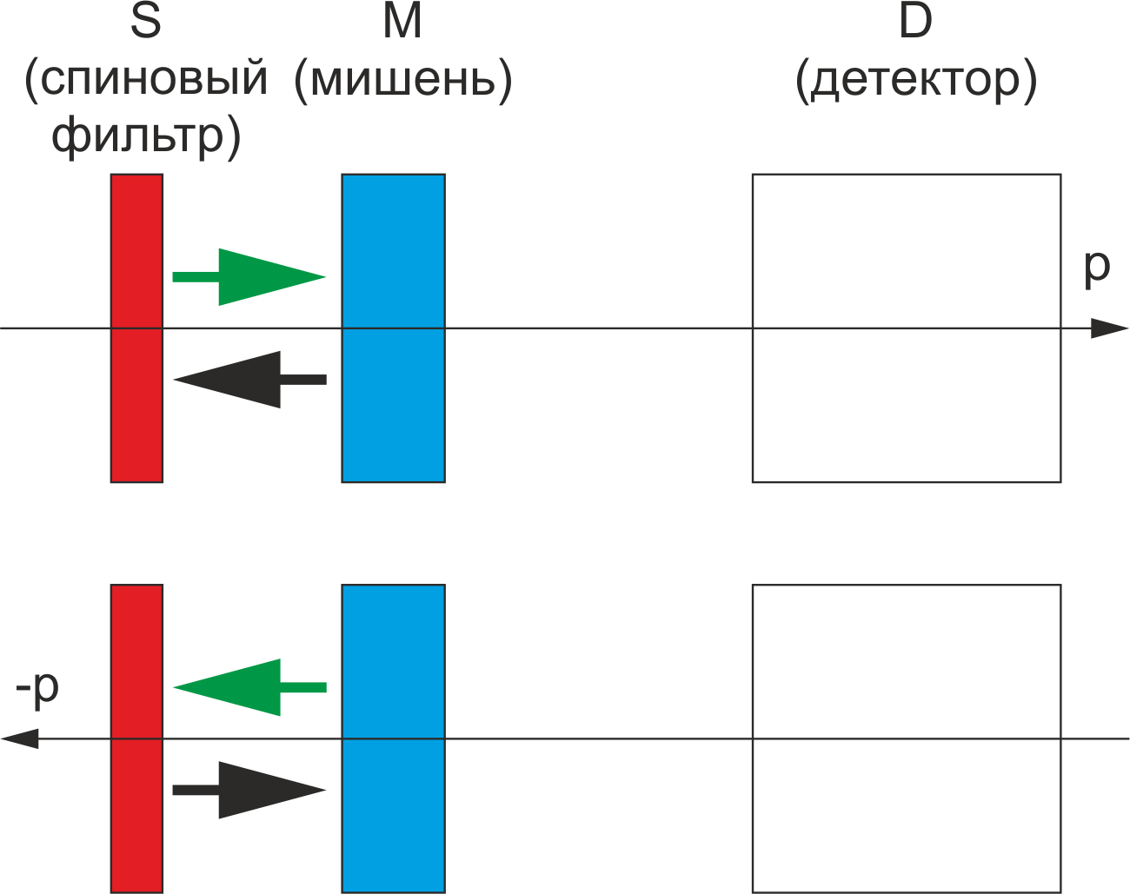
Test of T-invariance in neutron transmission thru unpolarized target with
"Polarization - Asymmetry" Theorem
spin
filter
target
detector
Transmission asymmetry
Time reversal
180^{о} rotation
Polarization in
a neutron beam
If T-invariance breaks: А ≠ Р
06

Slide 8
р
М
М
р
Z
Z
Target after spin filter
Target before spin filter
Neutron spin density matrix on a target input:
Transmission asymmetry for polarized beam
Polarization, arisen in unpolarized beam
07

Slide 9
Calculations give:
σ_{P} cross section of P – odd interaction.
d target thickness
Thus, PA theorem is satisfied in neutron transmission in the presence of the P-odd effect.
3. VIOLATION OF T - INVARIANCE
In S-matrix approach:
T ~ v_{P} is transition matrix, which depend on P-odd matrix element v_{P}
Under time reversal, T is transformed in the first order in v_{P} :
08

Slide 10
Since the measurements of А и Р are mutually reversal in time, then substitution for one of them b₊~ v_{P} + iv_{T} and for other b₋ → v_{P} - iv_{T} :
Thus, within PA theorem a model of T-violation for neutron transmission is built.
Just a form of PA theorem, and the common transformation properties of amplitudes under T-invariance were used.
No polarized nuclei were assumed.
4. S – MATRIX STRUCTURE OF AMPLITUDE b
S – matrix element for transmission:
l orbital momentum of neutron
j total angular momentum of neutron
09

Slide 11
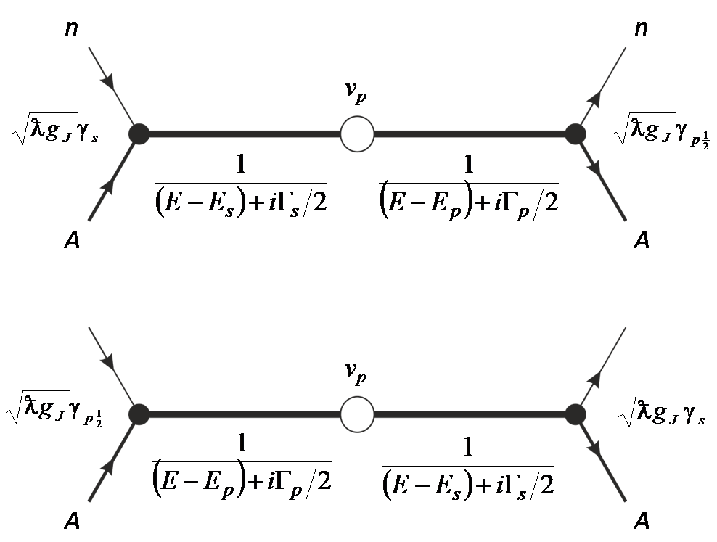
For s (l = 0) and p (l = 1) neutrons:
Obviously this diagrams are mutually reversal in time.
10

Slide 12
Weak interaction mix nuclear states with the same spin J and different parities (-1)^{l}
which cause P-violation
11

Slide 13
If one assume again
v_{P} + iv_{T}
v_{P} - iv_{T}
≠
S
P
P
S
12

Slide 14
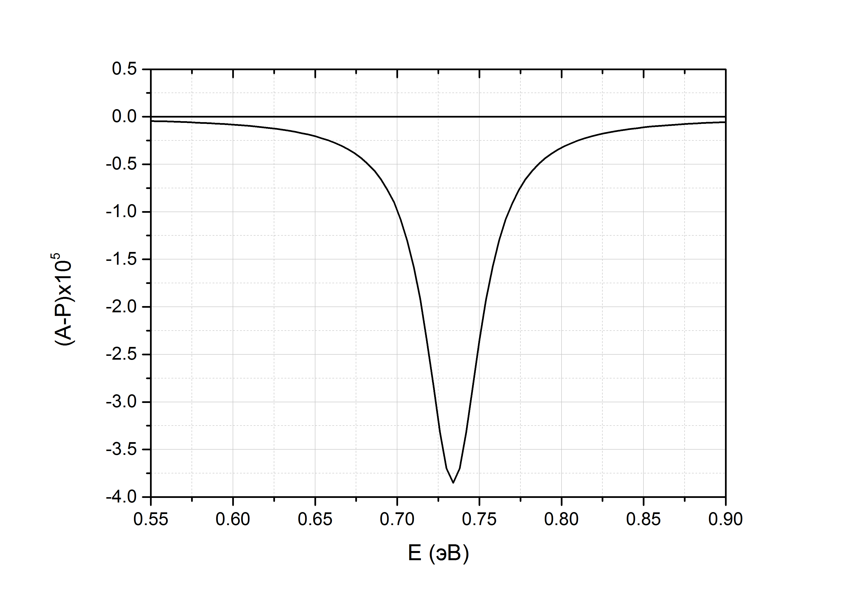
Calculated А - Р for LaAlO₃ 3 сm thick, near р – wave resonance 0.734 eV;
v_{P} = 4.2×10⁻³ eV, v_{T} = 10⁻³v_{P},.
Beam polarization 100%
13

Slide 15
Model | v_{Т} /v_{P}
Phenomenological milistrong | 10⁻²
Weinberg (charged Higgs bosons) Weinberg (neutral Higgs bosons) | 10⁻⁵ – 10⁻⁴ 10⁻³ – 10⁻¹
Neutron EDM (one π-loop mechanism) | < 10⁻³
θ-term in QCD Lagrangian | < 10⁻⁴
Модель великого объединения на основе группы SO(10) | < 10⁻⁷
Kobayashi – Maskawa phase in Standard Model | < 10⁻⁸
Horizontal symmetry | < 10⁻¹⁰
14

Slide 16
5. STSTISTICAL ACCURACY
Absolute error of A and P (N ~ N±) during t_{mes} :
Relative error of an effect ε = Р - А:
Intensity of an incident beam over total target area:
2×10⁵ 1/(s⋅eV) year
2×10⁶ 1/(s⋅eV) month
15

Slide 17
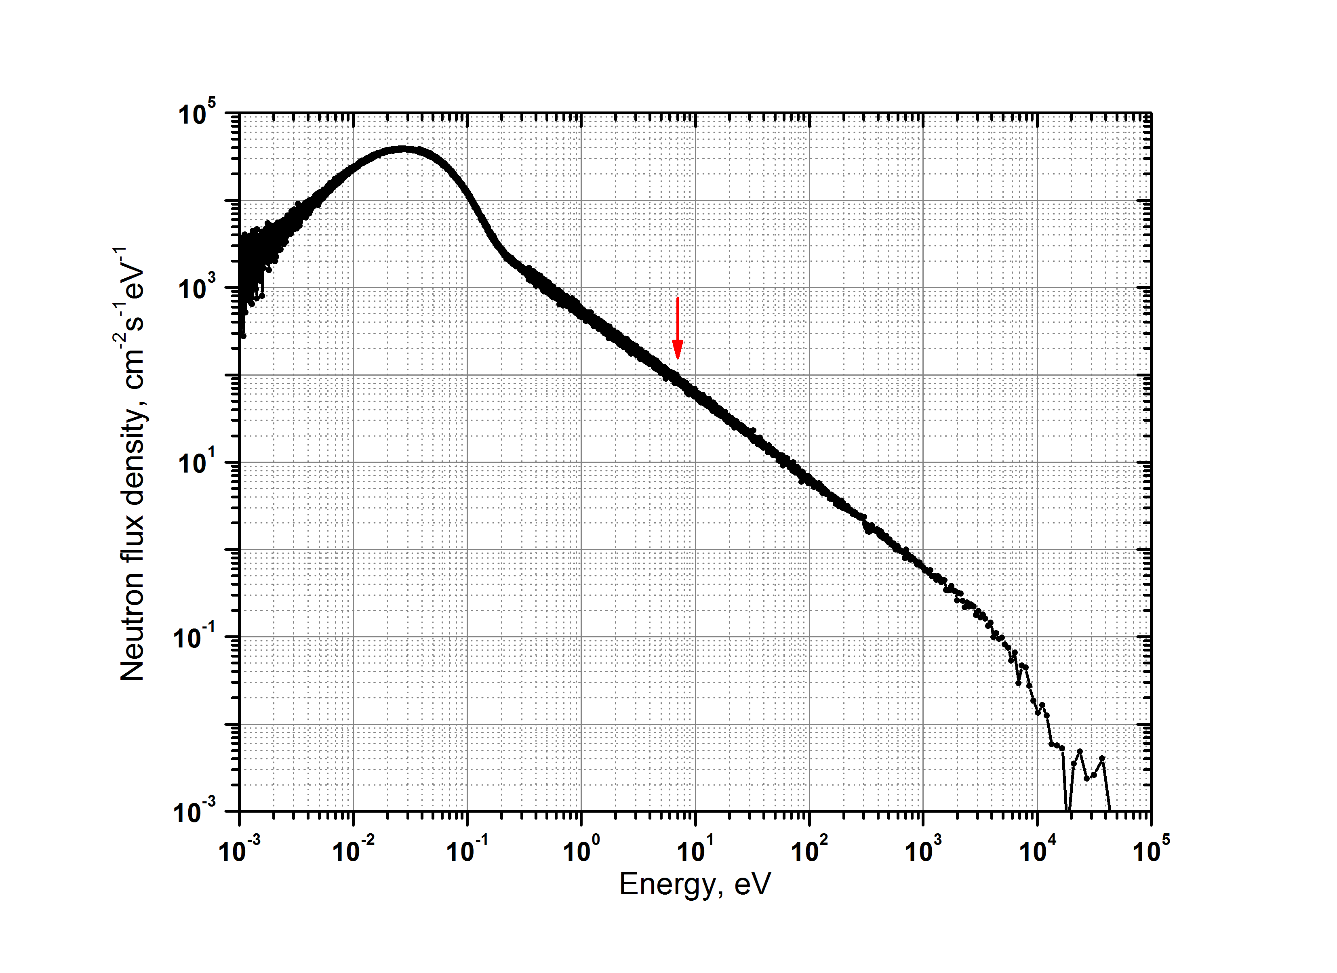
IREN
16

Slide 18
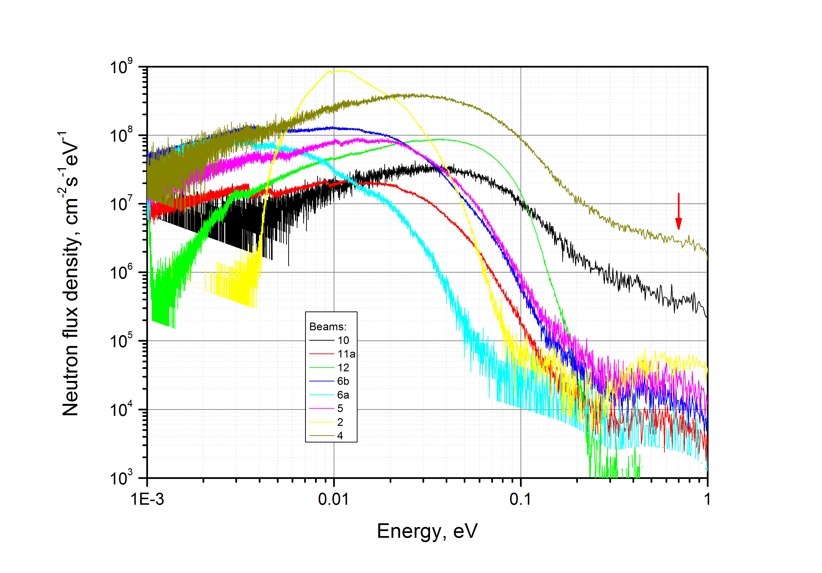
IBR-2M
17

Slide 19
6. SYSTEMATIC ERRORS
1. Difference in conditions on the neutron detector before and after the replacement or rotation a target around spin filter.
Perform a measurements out p-resonance, since there the effect is much smaller than at the resonance, while the influence of the detector environment is the same.
2. A magnetic transport channel (solenoid), the spin can be affected by the misalignment between the beam and the field in the solenoid.
The solution these problems requires, in addition to the purely technical aspects, the study of the measured quantities for a magnetic field with additional term in Hamiltonian:
SYSTEMATIC ERRORS CAN BE OVERCOME TO A MUCH EASILY THAN WITH POLARIZED AND ALIGNED TARGETS.
18

Slide 20
Thank You for Attention!

Slide 21
³HE POLARIZER
The most optimal for neutron energies ~ 1 eV
For 0.734 eV, a cell with pressure 3 atm:
P_{He} | Optimal length (cm) | T_{n} | P_{n}
0.5 | 23.7 | 0.23 | 0.73
0.7 | 24 | 0.30 | 0.87
0.8 | 25 | 0.35 | 0.92

Slide 22
MATRIX ELEMENT IS PURELY IMAGINARY WHEN b_{P} ~ v_{P} = 0
P-resonance is formed by neutrons with j = 3/2 and no mixing with the s-resonance.
A and P in transmission arise because an interaction that violates T - invariance but holds P-parity

Slide 23
If v_{Р} – pure real, then:
is common for А и Р and PA theorem is valid.
Let , then:
Then imaginary parts of a direct and reversal reactions are different:

