Slide 1
Investigations of the Atmospheric Deposition of Trace Elements in Georgia Based
on 2019-2023 Moss Survey
Chaligava O.^{1,2,3} Zinicovscaia I.¹, Peshkova A.^{1,2}, Yushin N.^{1,2}, Frontasyeva M.V.¹, Vergel K.^{1,2}, Grozdov D.¹, Cepoi L.²
¹Sector of Neutron Activation Analysis and Applied Research, Division of Nuclear Physics, FLNP, Joint Institute for Nuclear Research, Dubna, Russian Federation
²Doctoral School Biological, Geonomic, Chemical and Technological Science, Moldova State University, Chisinau, Republic of Moldova
³Faculty of Informatics and Control Systems, Georgian Technical University, Tbilisi, Georgia
*e-mail: chaligava@jinr.ru

Slide 2
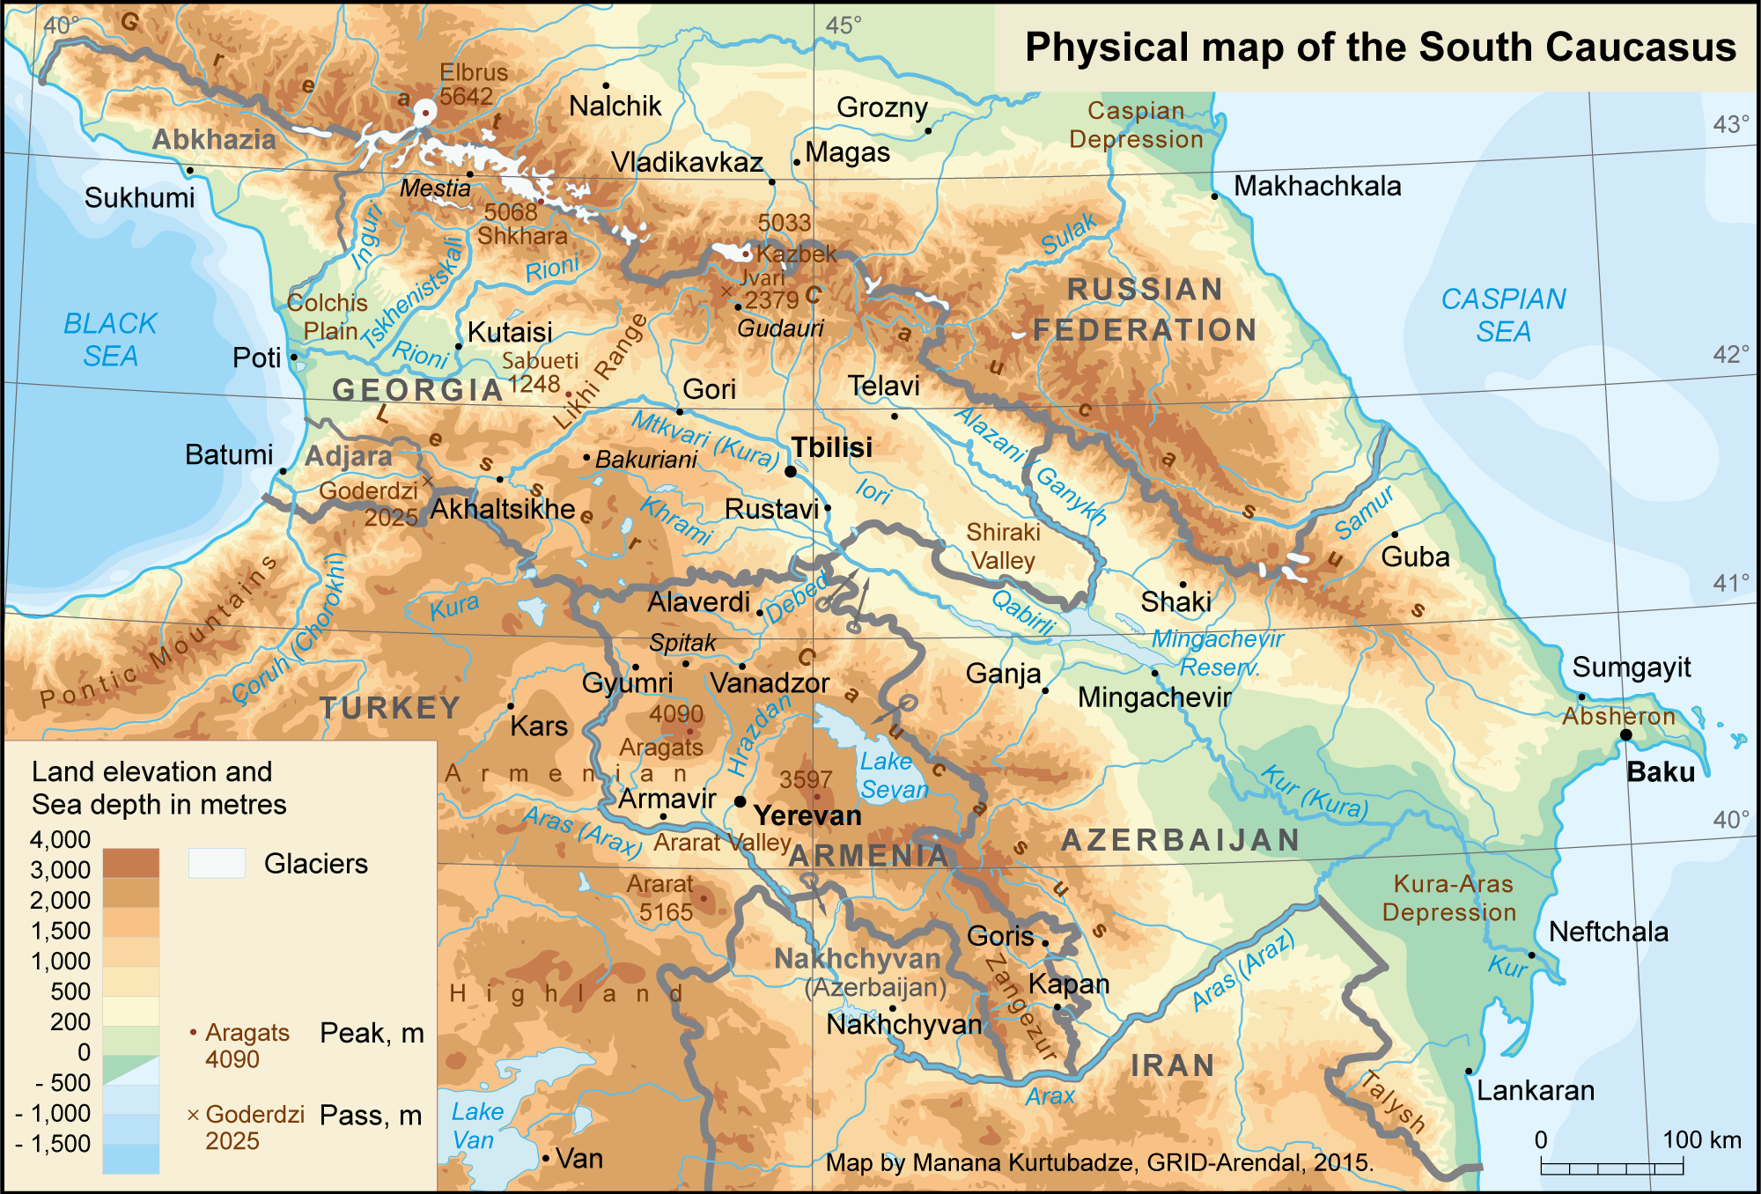
Areas under investigation
The landscape within the nation's boundaries is quite varied.
Western Georgia's landscape ranges from low-land marsh-forests, swamps, and temperate rainforests to eternal snow and glaciers, while the eastern part of the country even contains a small segment of semi-arid plains.

Slide 3
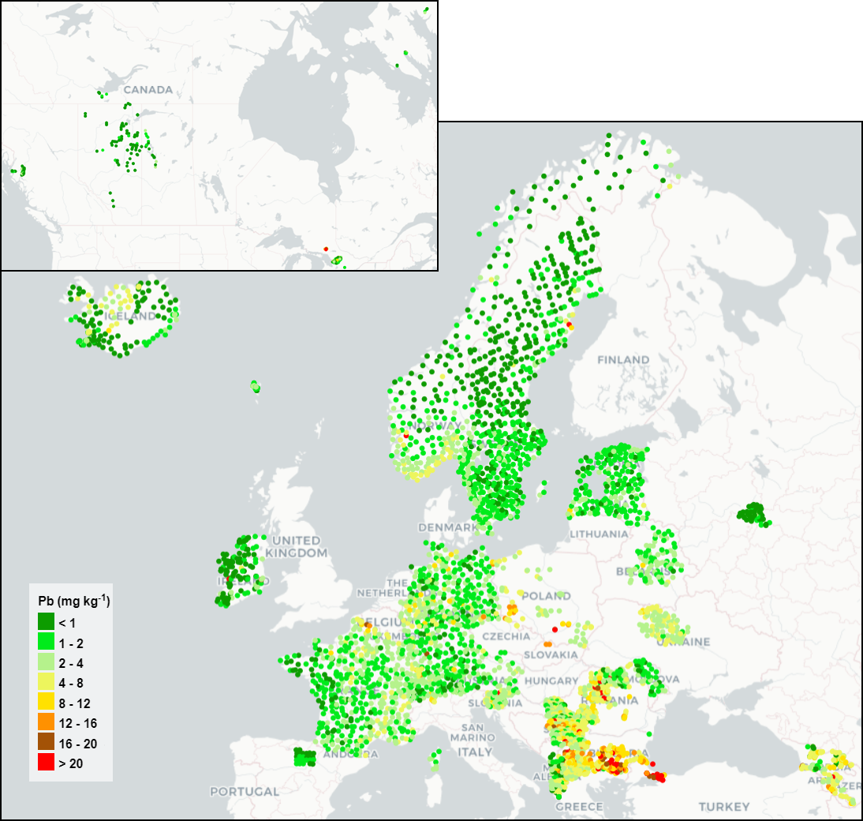
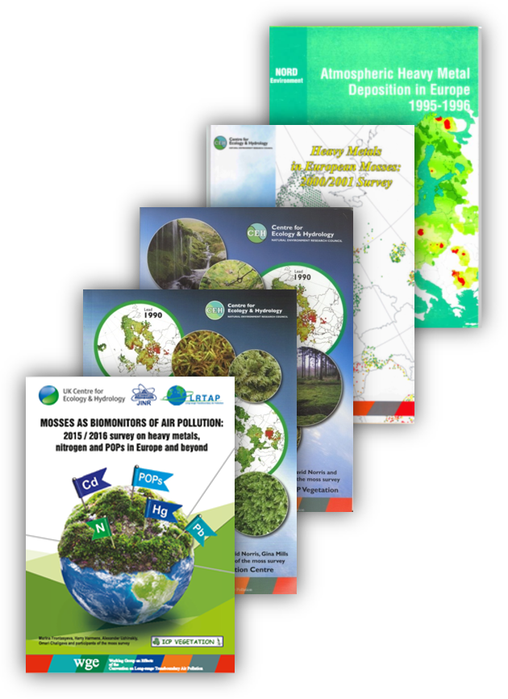
Moss Biomonitoring
Over the past few decades, biomonitoring studies using living organisms as environmental pollution monitors have become a useful addition to instrumental monitoring.
Since 2014 Georgia participates in the moss biomonitoring programme of the UNECE ICP Vegetation in the framework of the Convention on Long-Range Transboundary Air Pollution in Europe.

Slide 4
Sampling map 2019-2023
95 Samples
Altitude range from 3m to 2132m

Slide 5
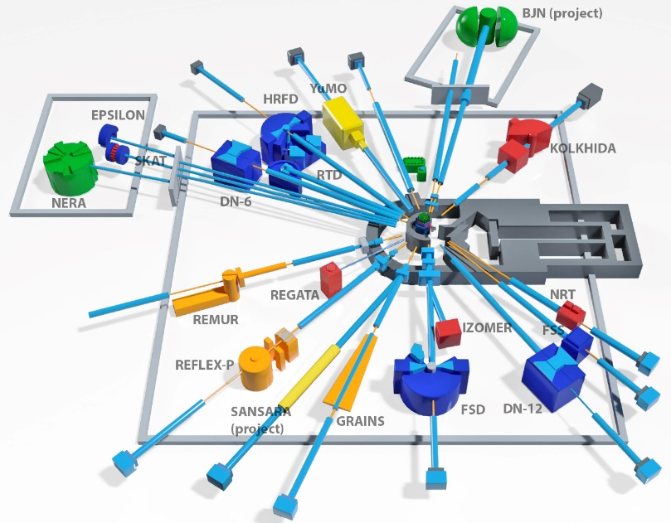
Analysis
Inductively Coupled Plasma Atomic Emission Spectroscopy (ICP-AES)
Sample Preparation: 0.5g of moss was placed in a Teflon vessel and digested with 5 mL of nitric acid (HNO3) and 2 mL of Hydrogen peroxide (H2O2) at a temperature of 180 °C in a microwave digestion system The solutions were quantitatively transferred into 50 ml calibrated flasks and made up to volume with bidistilled water.
The concentrations of 14 elements (Al, Ba, Cd, Co, Cr, Cu, Fe, Mn, Ni, Pb, S, Sr, V and Zn) in moss samples were determined.
Neutron Activation Analysis (NAA)
Sample Preparation: About 0.3 g of moss was pelletized in press-form and packed for short-term and long-term irradiation.
The concentrations of 39 (Na, Mg, Al, Cl, K, Ca, Sc, Ti, V, Cr, Mn, Fe, Co, Ni, Zn, As, Se, Br, Sr, Zr, Mo, Pb, Sb, I, Cs, Ba, La, Ce, Nd, Sm, Eu, Tb, Yb, Hf, Ta, W, Au, Th, U) elements in moss samples was determined using REGATA facility in the IBR-2 (JINR).

Slide 6
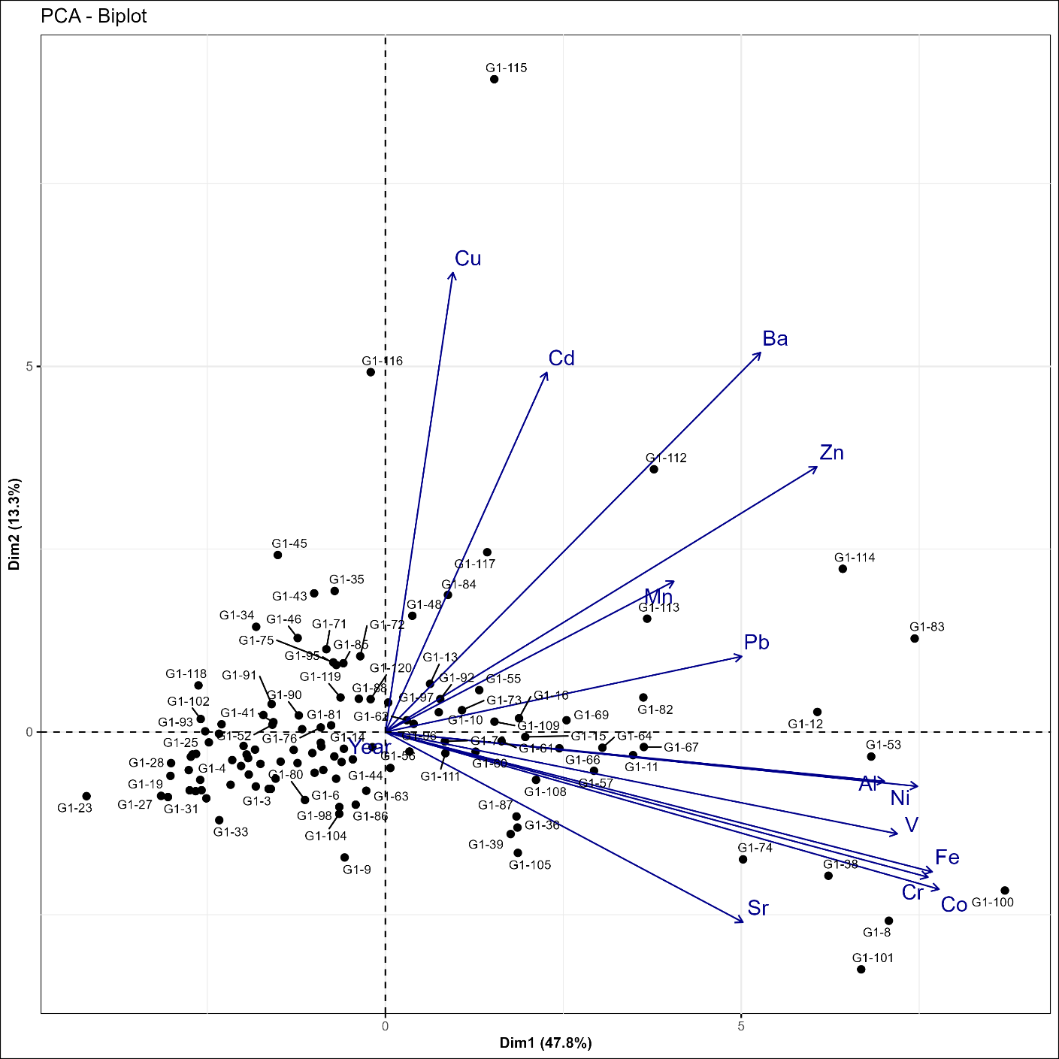
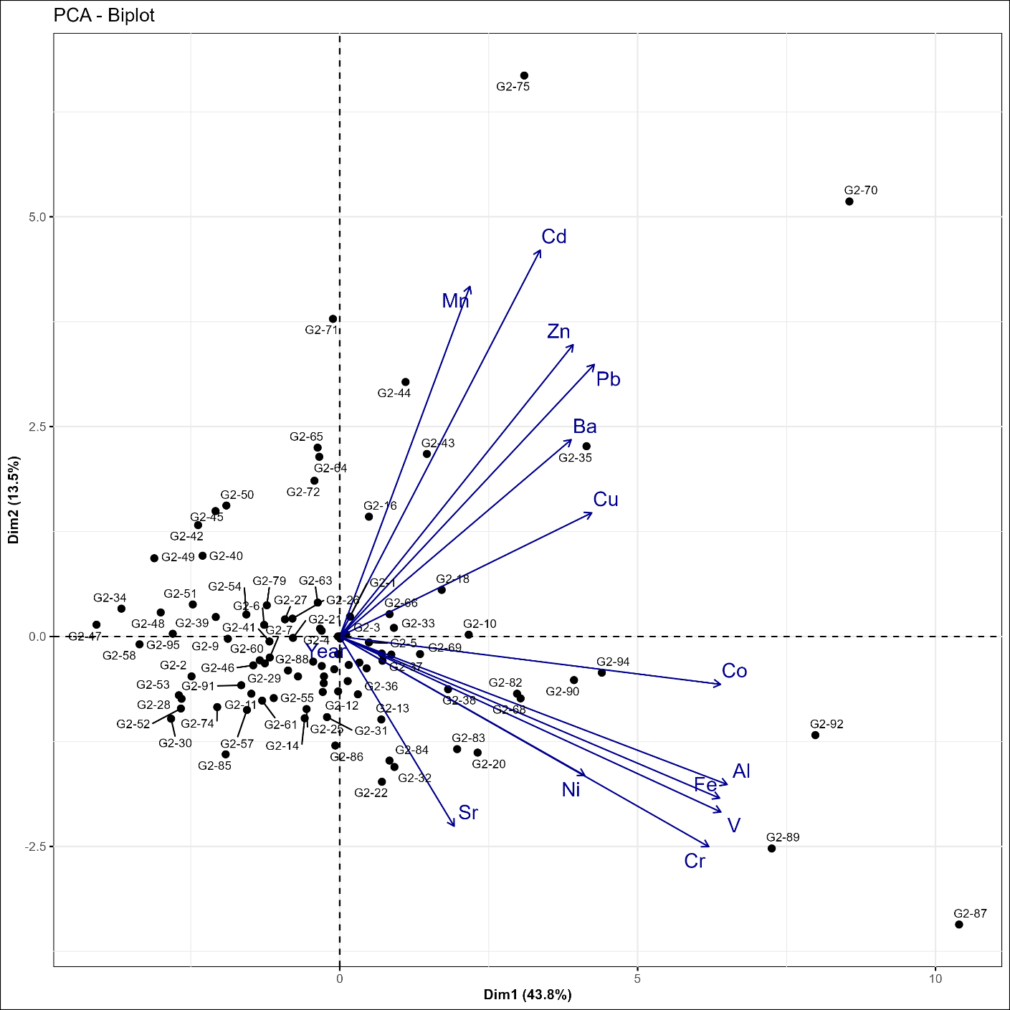
PCA
2015
PCA
2020

Slide 7
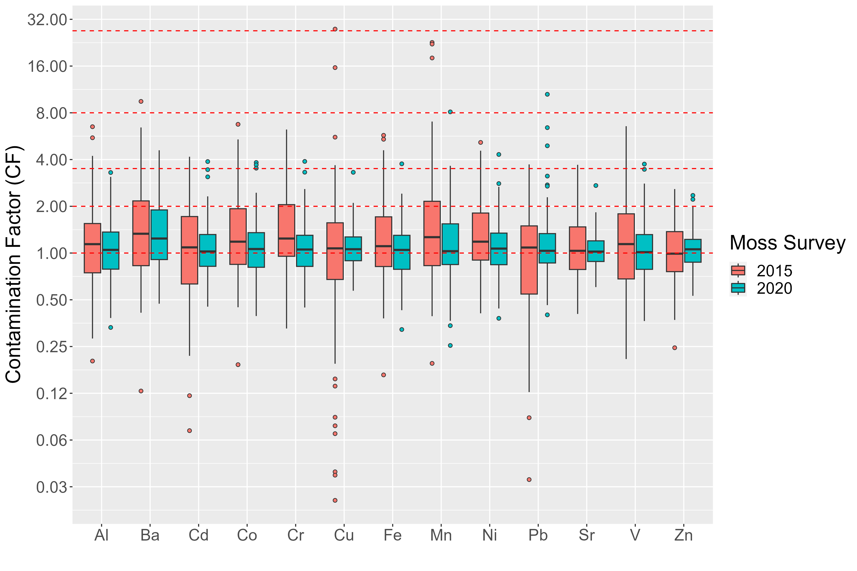
Extreme
Severe
Moderate
Slight

Slide 8
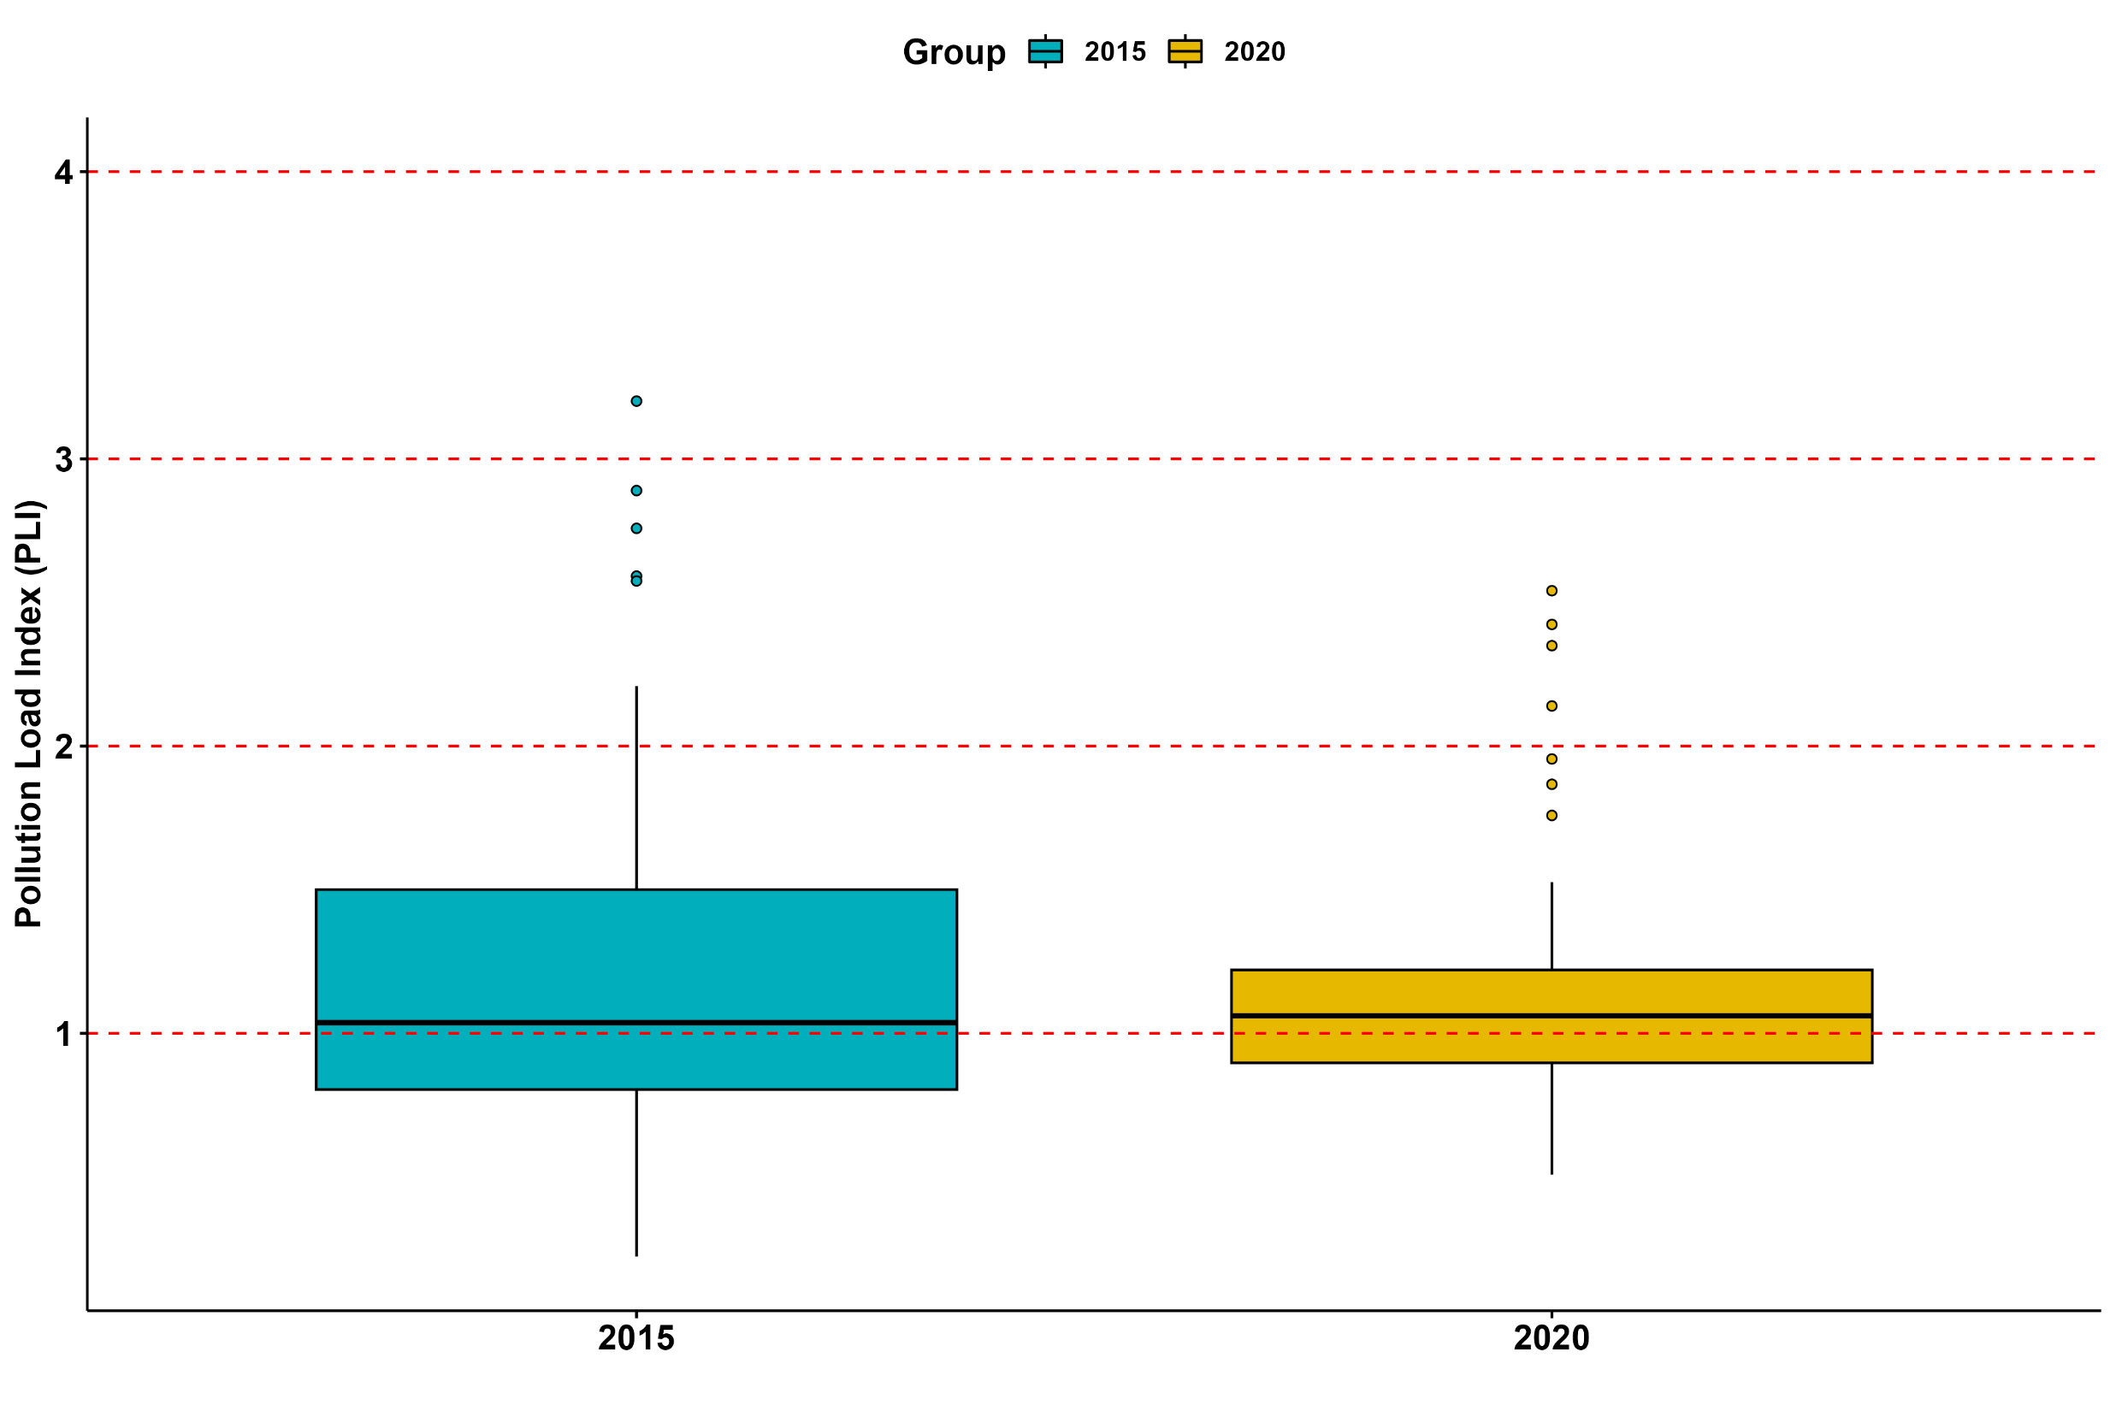
Moderately
to highly polluted
Severe
Moderate
Moderately
polluted
Slight
Unpolluted to moderately polluted
Unpolluted

Slide 10
Conclusions
The 2019-2023 moss survey effectively identified the main hotspots of atmospheric deposition of trace elements.
Anthropogenic impact was identified as key factor, primarily pollution comes from large cities and vehicle emissions, along with contributions from local industries like the Zestafoni Ferroalloy plant.
Geogenic and anthropogenic factors were especially noticeable in the agricultural region Kakheti. Human activities on agricultural lands likely contribute to the release of soil particles into the atmosphere, especially during dry seasons. Open areas further facilitate the dispersal of dust particles across extensive territories.
The survey also showed a general decrease in the concentrations of the majority of elements compared to the 2014-2017 moss survey, although not drastic.
Contamination factor (CF) is quite useful tool to assess the possible presence of contaminants in the sample.

Slide 11
Thank you for attention!

