Slide 1
New synchronizer of the IREN facility LUE-200 accelerator
Zhironkin I.S., Minashkin V.F., Sumbaev A.P., FLNP IREN

Slide 2
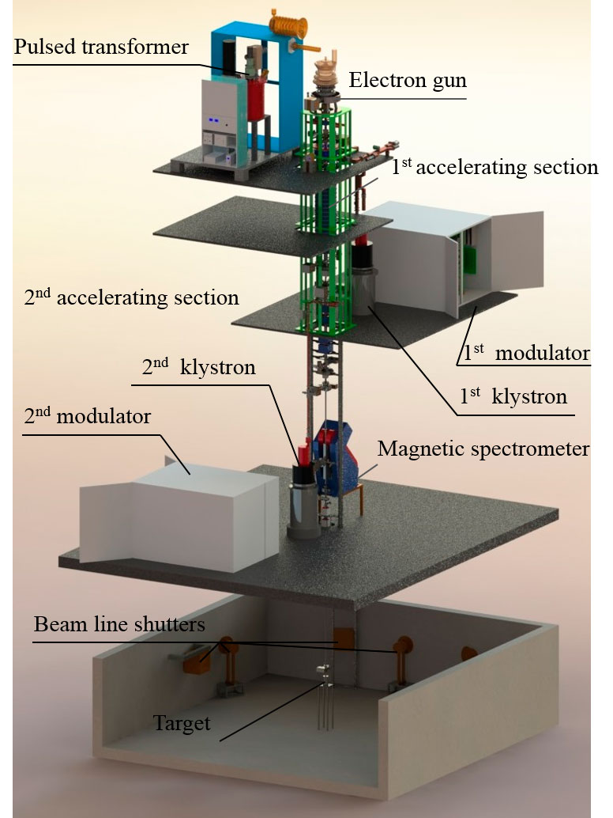
The main task of the synchronizer is to strictly implement equipment startup timings.

Slide 3
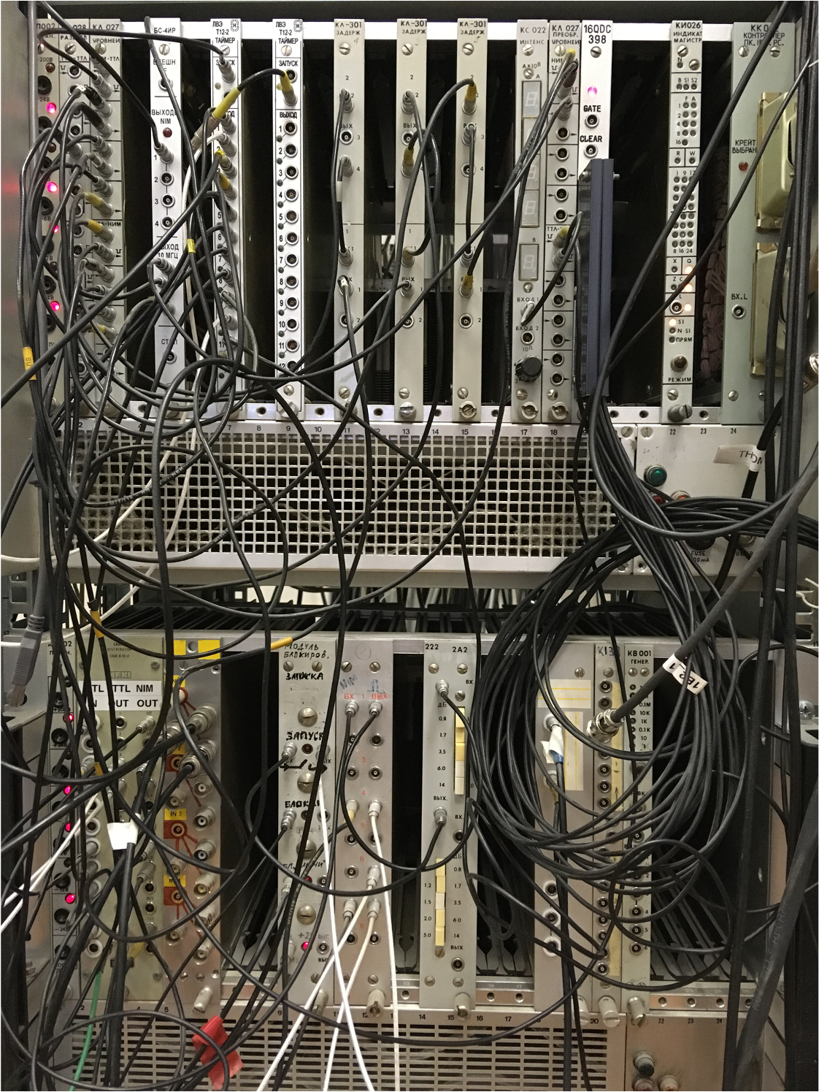
Disadvantages of the old system: 1. Impossibility of modernization/expansion 2. Lack of “hot” replacement 3. Inability to smoothly adjust frequency

Slide 4
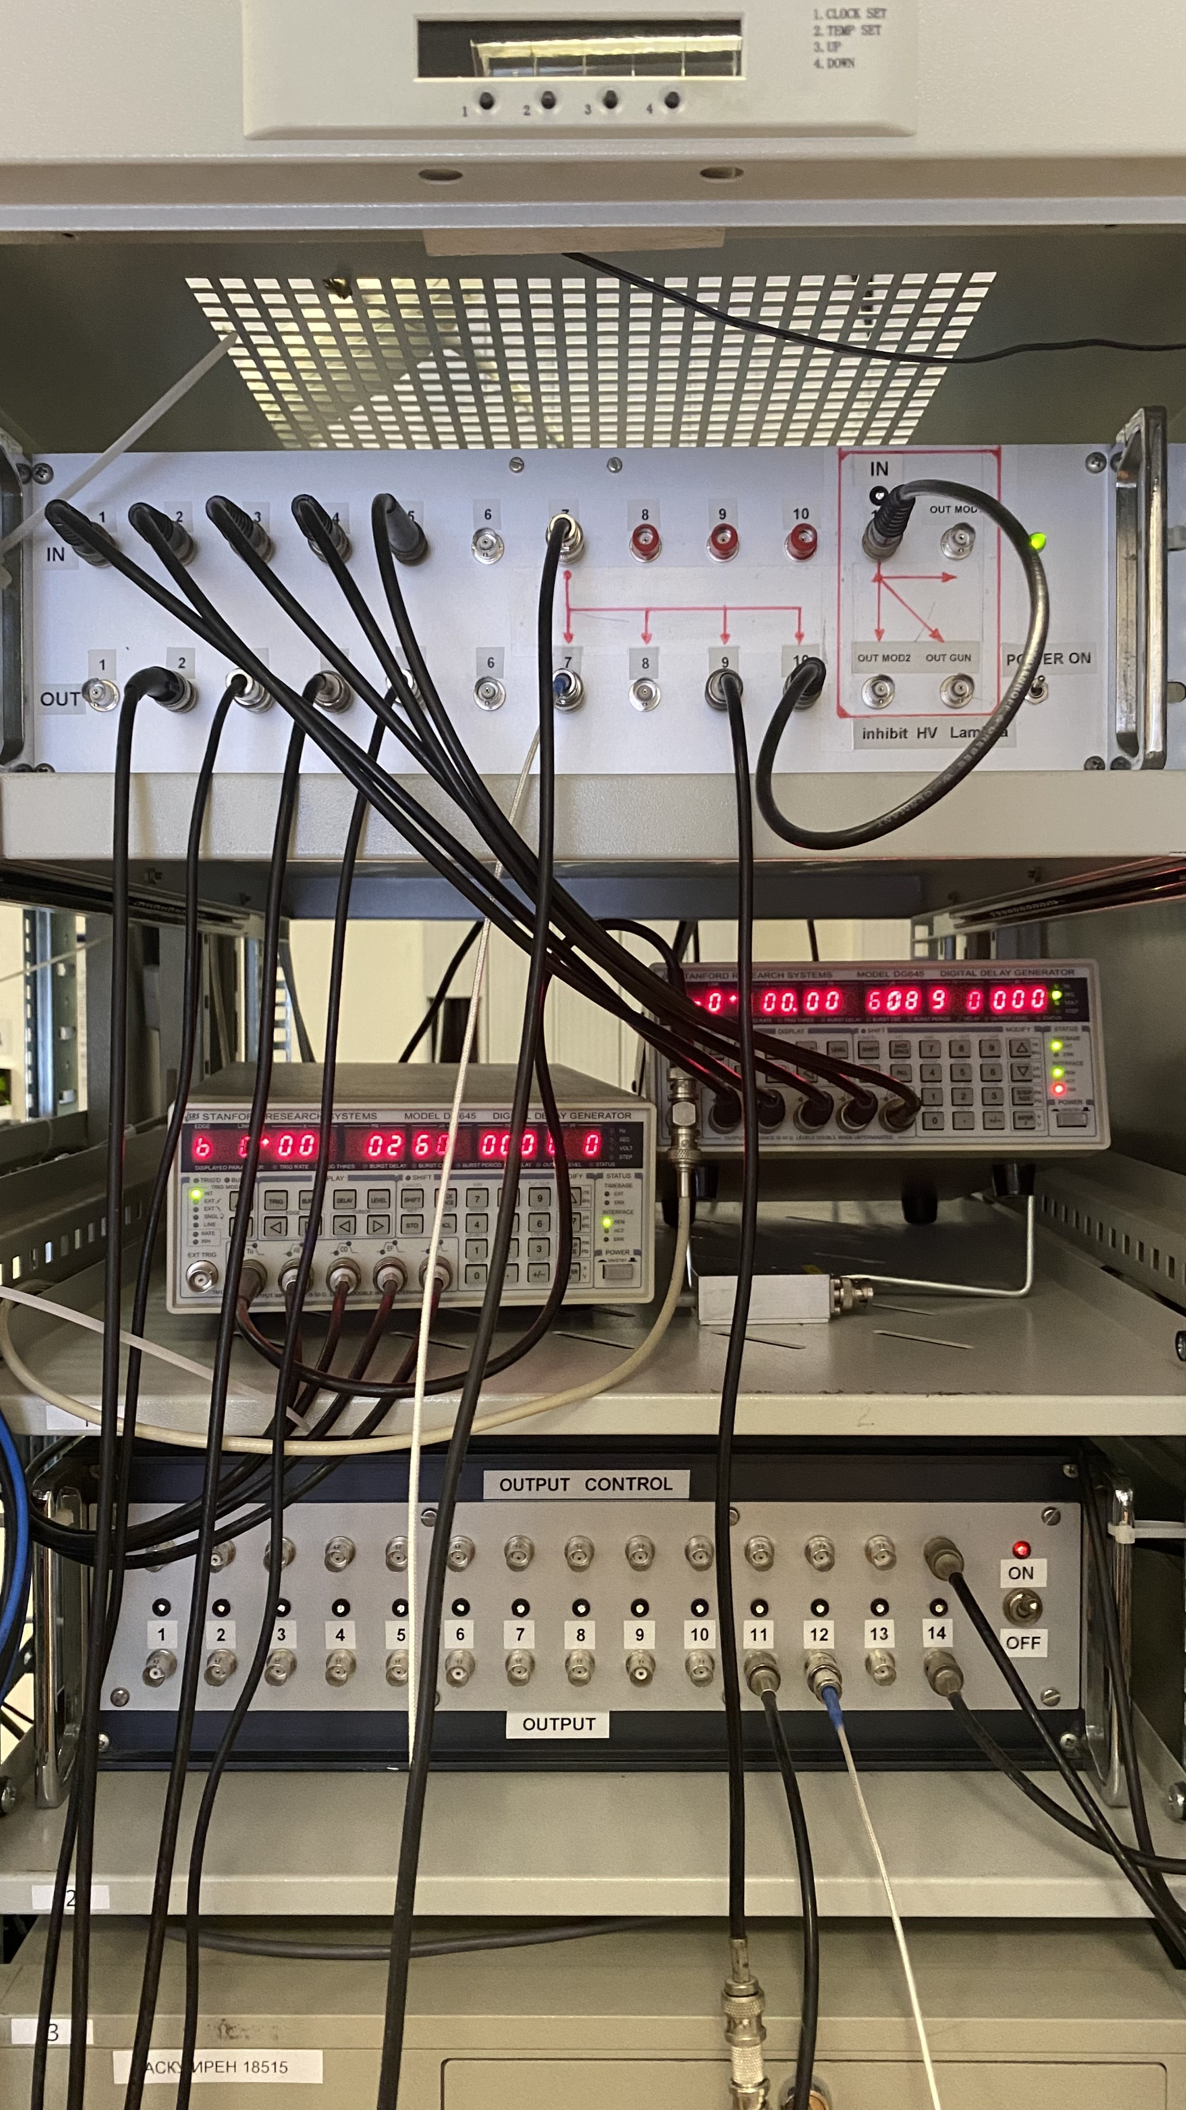
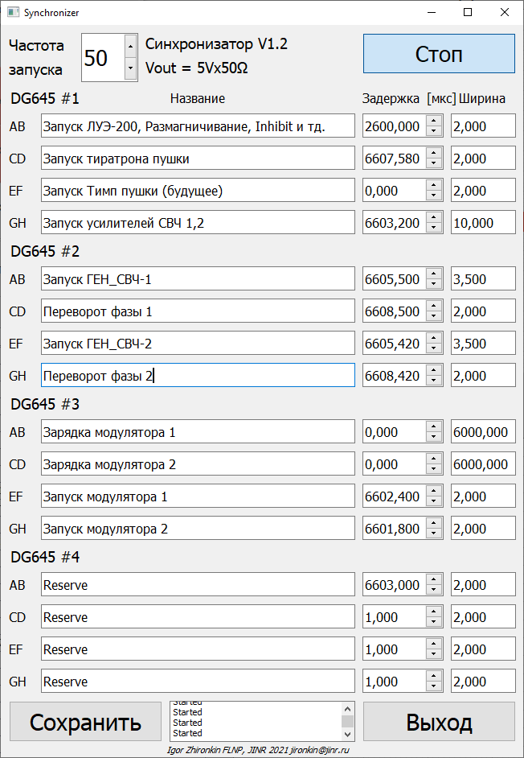
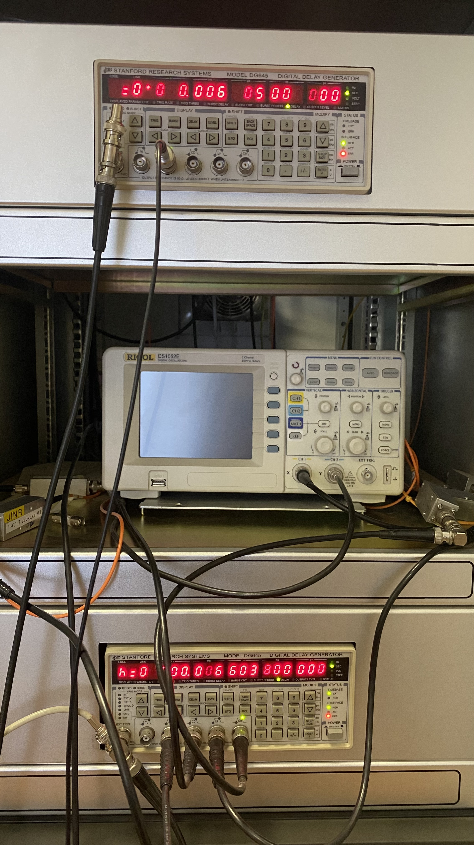
Current status:

Slide 5
Thank you for your attention!

