Slide 1
Chromium, nickel and zinc accumulation and translocation in root and leafy vegetables irrigated with industrial effluents – a laboratory study. Kravtsova A. V. ª, Zinicovscaia I. I. ^{a, b, c}, Peshkova A. A. ^{a, d}, Yushin N. S. ^{a, d}
ª Joint Institute for Nuclear Research, Dubna, Russia
^{b} The Laboratory of Quantum Chemistry, Chemical Cynetics and Magnetic Resonance, The Institute of Chemistry of the Academy of Sciences of Moldova, Chisinau, R. Moldova ^{c} Department of Nuclear Physics, Horia Hulubei National Institute for R&D in Physics and Nuclear Engineering, Magurele, Romania ^{d} Doctoral School Biological, Geonomic, Chemical and Technological Science, State University of Moldova, Chisinau, R. Moldova

Slide 2
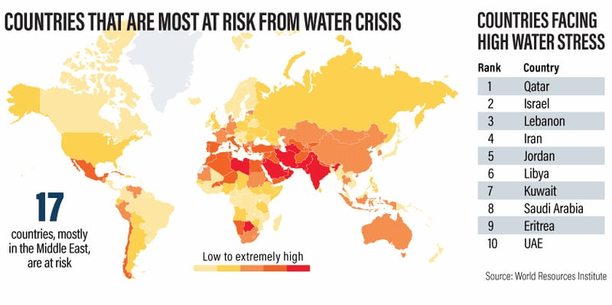
Practice of wastewater irrigation
About 8% of the total land area is irrigated by wastewater worldwide (2/3 belongs to Asia)
Advantages of wastewater irrigation
Reduced stress on freshwater
Nutrient recycling
Economical support and provision of livelihood for farmers
Increased agricultural production

Slide 3
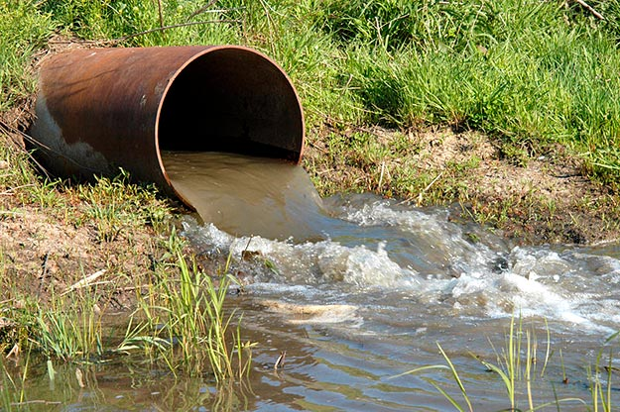
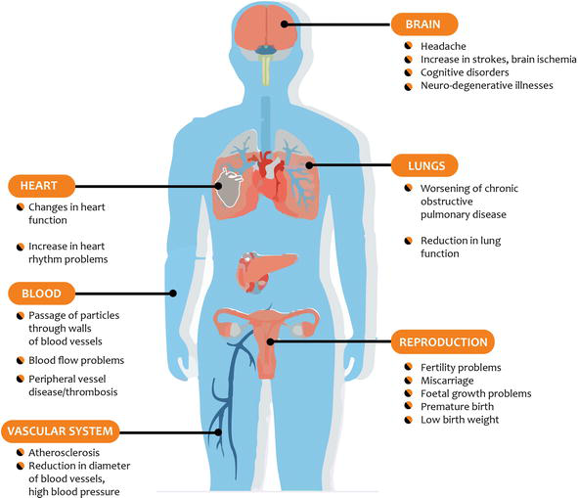
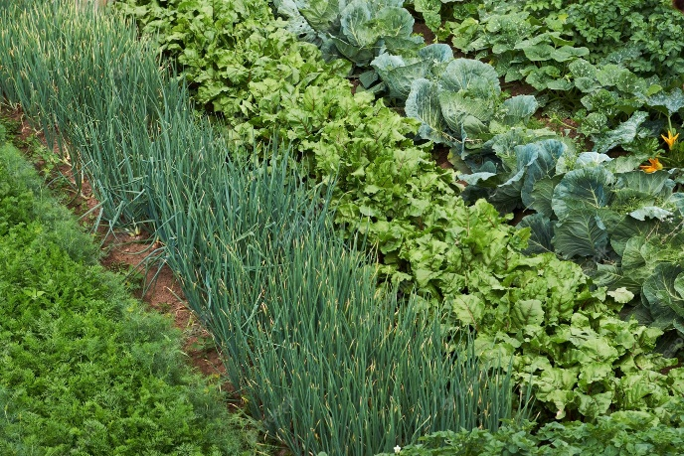
Harmful impacts of wastewater irrigation
Irrigation with wastewater
Discharge of both industrial and sewage wastewater without their proper treatment in developing countries
Human health risks
Soil and crop contamination
Wastewater usually contains Cr, Cd, Cu, Ni, Zn, Fe, Mn, Pb, Co etc., organic/chemical compounds, salts and microbial pathogens

Slide 4
Problems
Aims
Content of metals in irrigation wastewater?
Features of metals distribution in roots and edible parts of vegetables?
Influence on biochemical composition of plants?
Daily intake of leafy and root vegetables?
Maximum permissible concentration of metals in vegetables?
to assess the accumulation of Cr, Ni and Zn in soil and different parts of radish, lettuce and green onion grown on soils irrigated with industrial effluents
to measure the bioaccumulation capacity of vegetables
to estimate Cr, Ni and Zn translocation in different parts of vegetables
to calculate the estimated daily intake, target hazard quotient and hazard index of Cr, Ni and Zn through intake of wastewater-irrigated vegetables
to determine the biochemical parameters and antioxidant activity of vegetables, irrigated with industrial effluents.

Slide 5
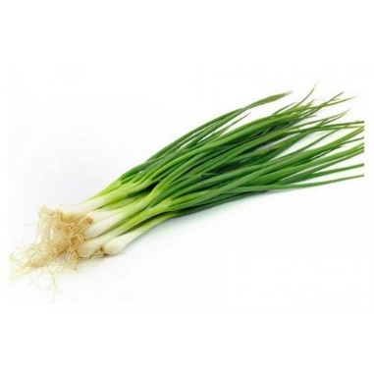
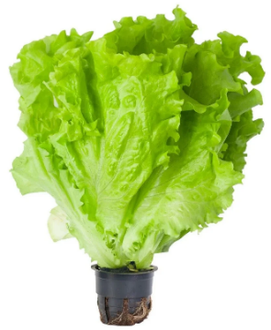
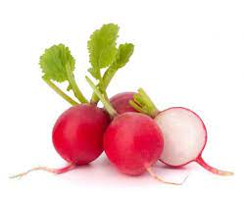
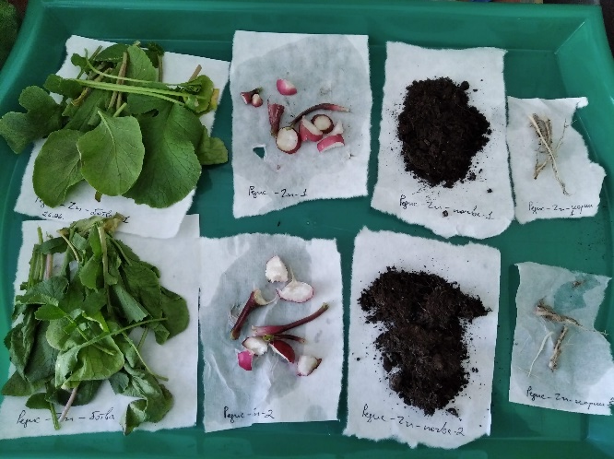
Laboratory experiment
3 Plants
4 industrial effluents
Zn
≈ MPC*
Zn
≈ 40 MPC
Cr + Zn
Cr (VI) ≈ 100 MPC Zn ≈ 3 MPC
Ni
≈ 20 MPC
*Maximum permissible concentration (MPC) of metal in irrigation water
Elemental accumulation in soils, leaves and roots of plants + biochemical parameters of plants
Bioconcentration factor (BCF)
Translocation factor (TF)
Estimated daily intake of metals (EDI)
Target hazard quotient (THQ)
Hazard index (HI)
Features of metal accumulation in plants
Human health risks

Slide 6
Cr and Zn translocation in radish, lettuce and onion
% of Cr and Zn in edible part of plants
 | Zn (Control) | Zn (Effluents) | Cr (Control) | Cr (Effluents)
Radish | 27 | 23-28 | 20 | 11
Lettuce | 51 | 32-43 | 18 | 3.5
Onion | 13 | 10-12 | 32 | 4
Bioconcentration factor C (edible part) / C (soil) | Bioconcentration factor (Zn)
 | Lettuce | Onion
Zn | 0.55 | 0.55
Cr | 0.04 | 0.08
Ni | 0.03 | 0.74

Slide 7
Estimated daily intake of Cr, Ni and Zn through consumption of contaminated vegetables (µg/kg bw/day)
$EDI=\frac{C_{metal conc} × C_{factor} × D_{food intake} }{B_{average weight} }$
$C_{metal conc}$ ˗ Cr and Zn concentration in edible part of vegetables (mg/kg dry weight);
$C_{factor}$ - the conversion factor of 0.085 was used;
Daily intake of radish/lettuce/onion – 0.04 kg/day;
The average body weight for an adult was considered as 70 kg
Intake | Plants | Cr | Ni | Zn
EDI | Radish | 0.7 | 0.5 | 4 - 20
 | Lettuce | 0.5 | 0.4 | 8 - 50
 | Onion | 0.4 | 0.7 | 4 - 30
Safe daily dietary intake | Food | 0.71 - 2.9* | 20* | 200 - 285**
THQ and HI < 1 for all metals in the vegetables subjected to different types of industrial effluents
* EPA, 1998 ** WHO, 1982

Slide 8
Conclusions
Zn: the highest concentrations - lettuce (up to 833 ± 131 mg/kg dry weight); minimum content - radish (up to 396 ± 38.5 mg/kg dry weight)
Cr: similar levels in the edible parts of vegetables (7.50 – 12.1 mg/kg dry weight)
Ni: similar levels in the edible parts of vegetables (7.28 – 10.9 mg/kg dry weight)
The values of bioaccumulation factor of Zn and Ni in radish and lettuce decreased with increasing of metal concentrations in the industrial effluents. Conversely, the bioaccumulation factors of Cr for all vegetables and Ni (for onion) were higher when irrigated with wastewater.
In general, the accumulation of Cr, Ni and Zn followed such patterns as:
soil ≥ roots > leaves for lettuce,
roots > soil ≥ leaves for green onion,
soil > non-edible roots ≥ leaves and edible roots for radish.
The significant decrease of total chlorophyll content as well as chlorophyll b and carotene content were observed in the lettuce and onion leaves irrigated with the effluents, containing high concentration of Zn (78.0 mg/L) and Ni (3.88 mg/L). When onion leaves were irrigated with the effluent containing high concentration of Zn, a significant decrease in antioxidant activity was also observed.
The obtained values of estimated daily intake of metals with vegetables were by an order (or two orders – for Ni) of magnitude lower than the reference doses established for Zn (0.3 mg/kg bw/day), Ni (0,02 mg/kg bw/day) and Cr (0.003 mg/kg bw/day).

Slide 9
Thank you for attention!

