Slide 1
OBTAINING OF INITIAL FORMS FOR SYNTHETIC SELECTION OF DROUGHT-RESISTANT RICE CROPS USING RADIATION MUTAGENESIS ON FAST NEUTRONS
58th meeting of the PAC for Nuclear Physics
A.I. Kruglyak¹ , Y. V. Aleksiayenak¹, K.B. Bakiruly², A.S. Doroshkevich¹
¹Joint Institute for Nuclear Research, Dubna, Russia
²Kazakh Research Institute of Rice named after I. Zhakhaev, Kyzylorda, Kazakhstan
Dubna, 2024

Slide 2
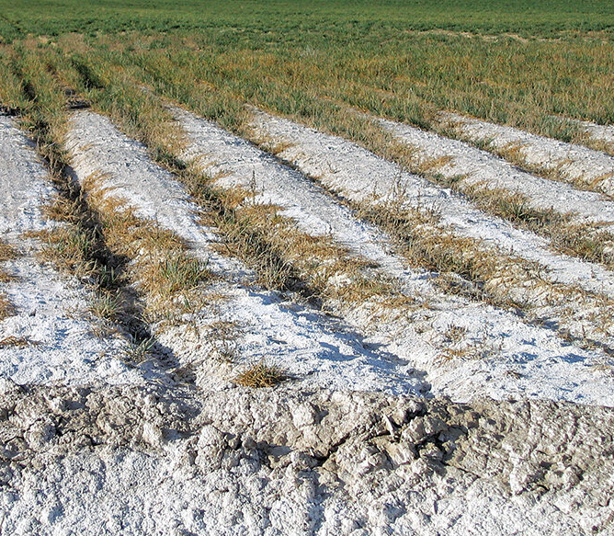
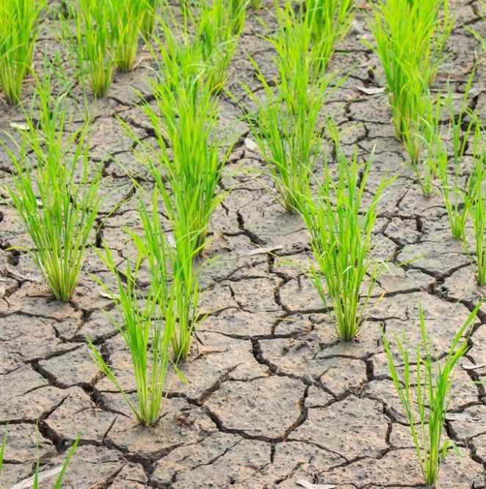
Induced mutation breeding
Ionizing radiation
Wing R.A. et. al. The rice genome revolution: from an ancient grain to Green Super Rice // Nat Rev Genet. 2018.

Slide 3
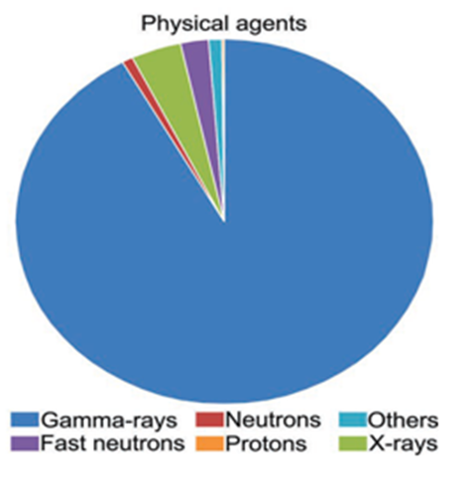
Fast neutrons as a type of radiation mutagenesis
higher energy compared to γ rays, especially in biological materials (H- high interaction cross-section with n)
neutron capture and elastic scattering with C, H, O, N nuclei
generation of direct and indirect ionizing radiations
Physical mutagens applied in rice
mutagenesis according to FAO/IAEA-MVD
Increase the frequency of chlorophyll mutations
Changes in amylose content not alter the amylopectin structure
Changes in the FRO1 gene tolerance to iron toxicity
Deletions, inversions, translocations, tandem duplications
NPR1 homologue immune responses against bacterial infection by Xanthomonas oryzae
V.E. Viana, C. Pegoraro, C. Busanello and A. Costa de Oliveira (2019). Mutagenesis in Rice: The Basis for Breeding a New Super Plant.
Front. Plant Sci. 10:1326. doi: 10.3389/fpls.2019.01326

Slide 4
Location of rice samples ready for neutron irradiation on channel 5 of the EG-5 accelerator
Method of experiment
Irradiation characteristics:
Seed samples
$D(d,n){}_{}^{3}{He}$
$E_{n}$ = 4.1 MeV
I$\sim 1,7−2μA$
$E_{D}$ = 2.5 MeV
neutron monitor of the PIXE-4 type
204 hours
35 - 40 million particles / hour
Neutron–producing gas target
Output of the accelerator ion conductor

Slide 5
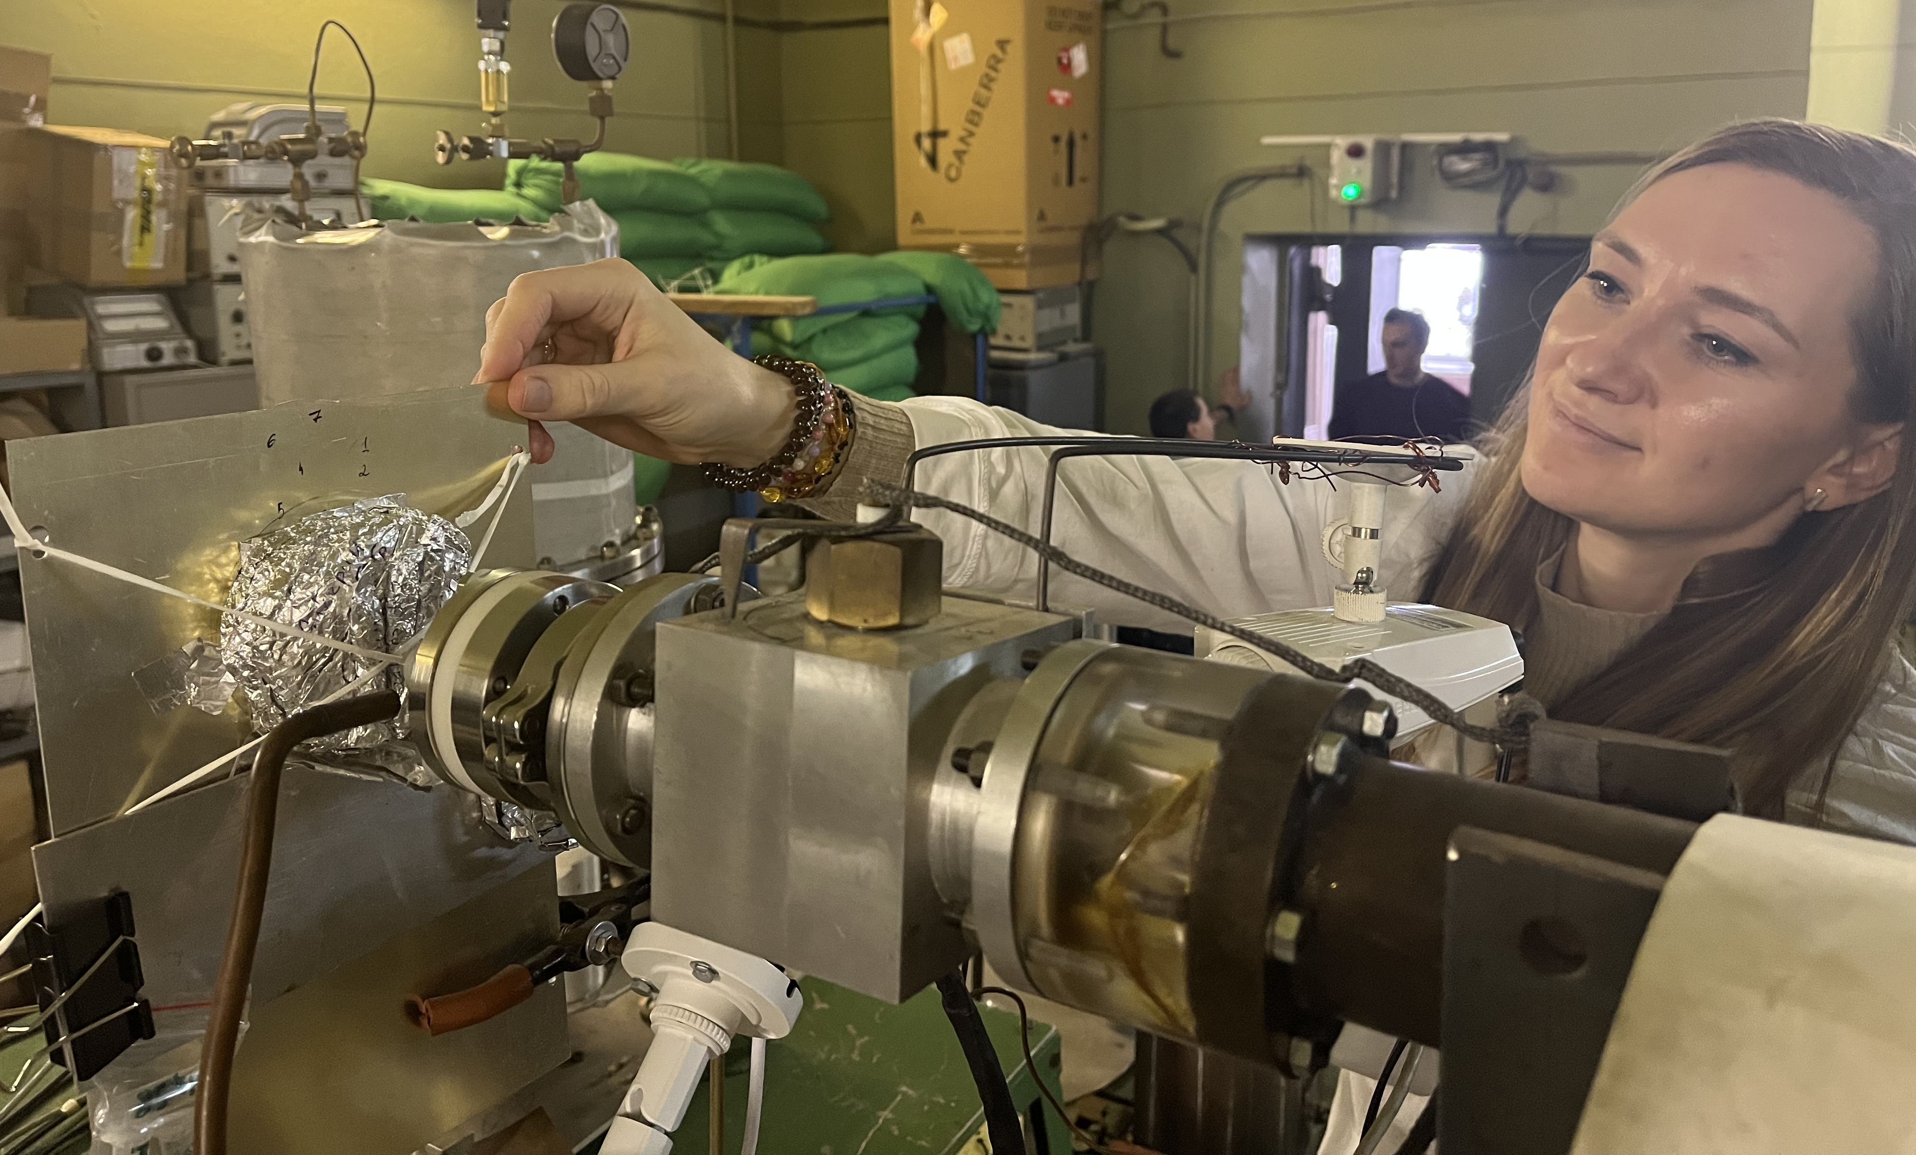
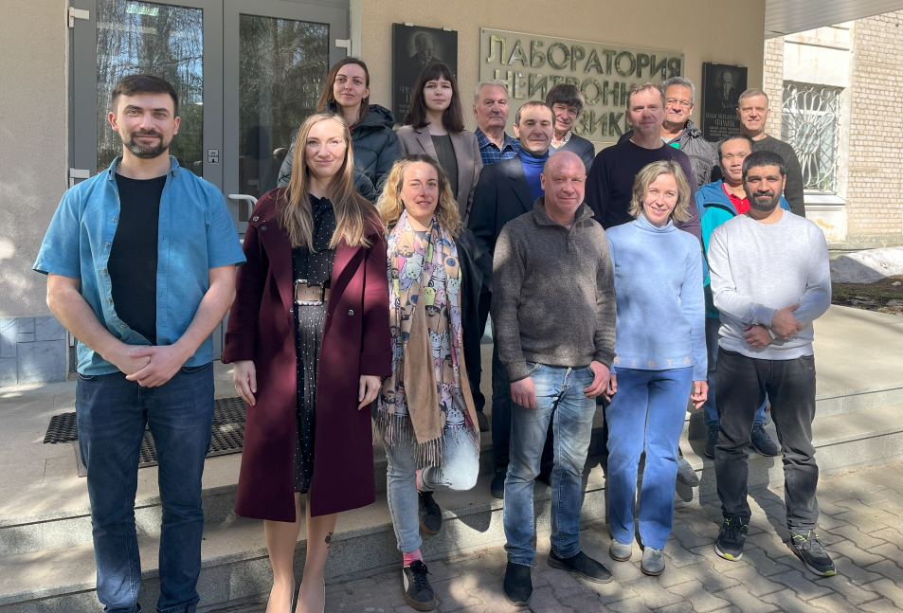
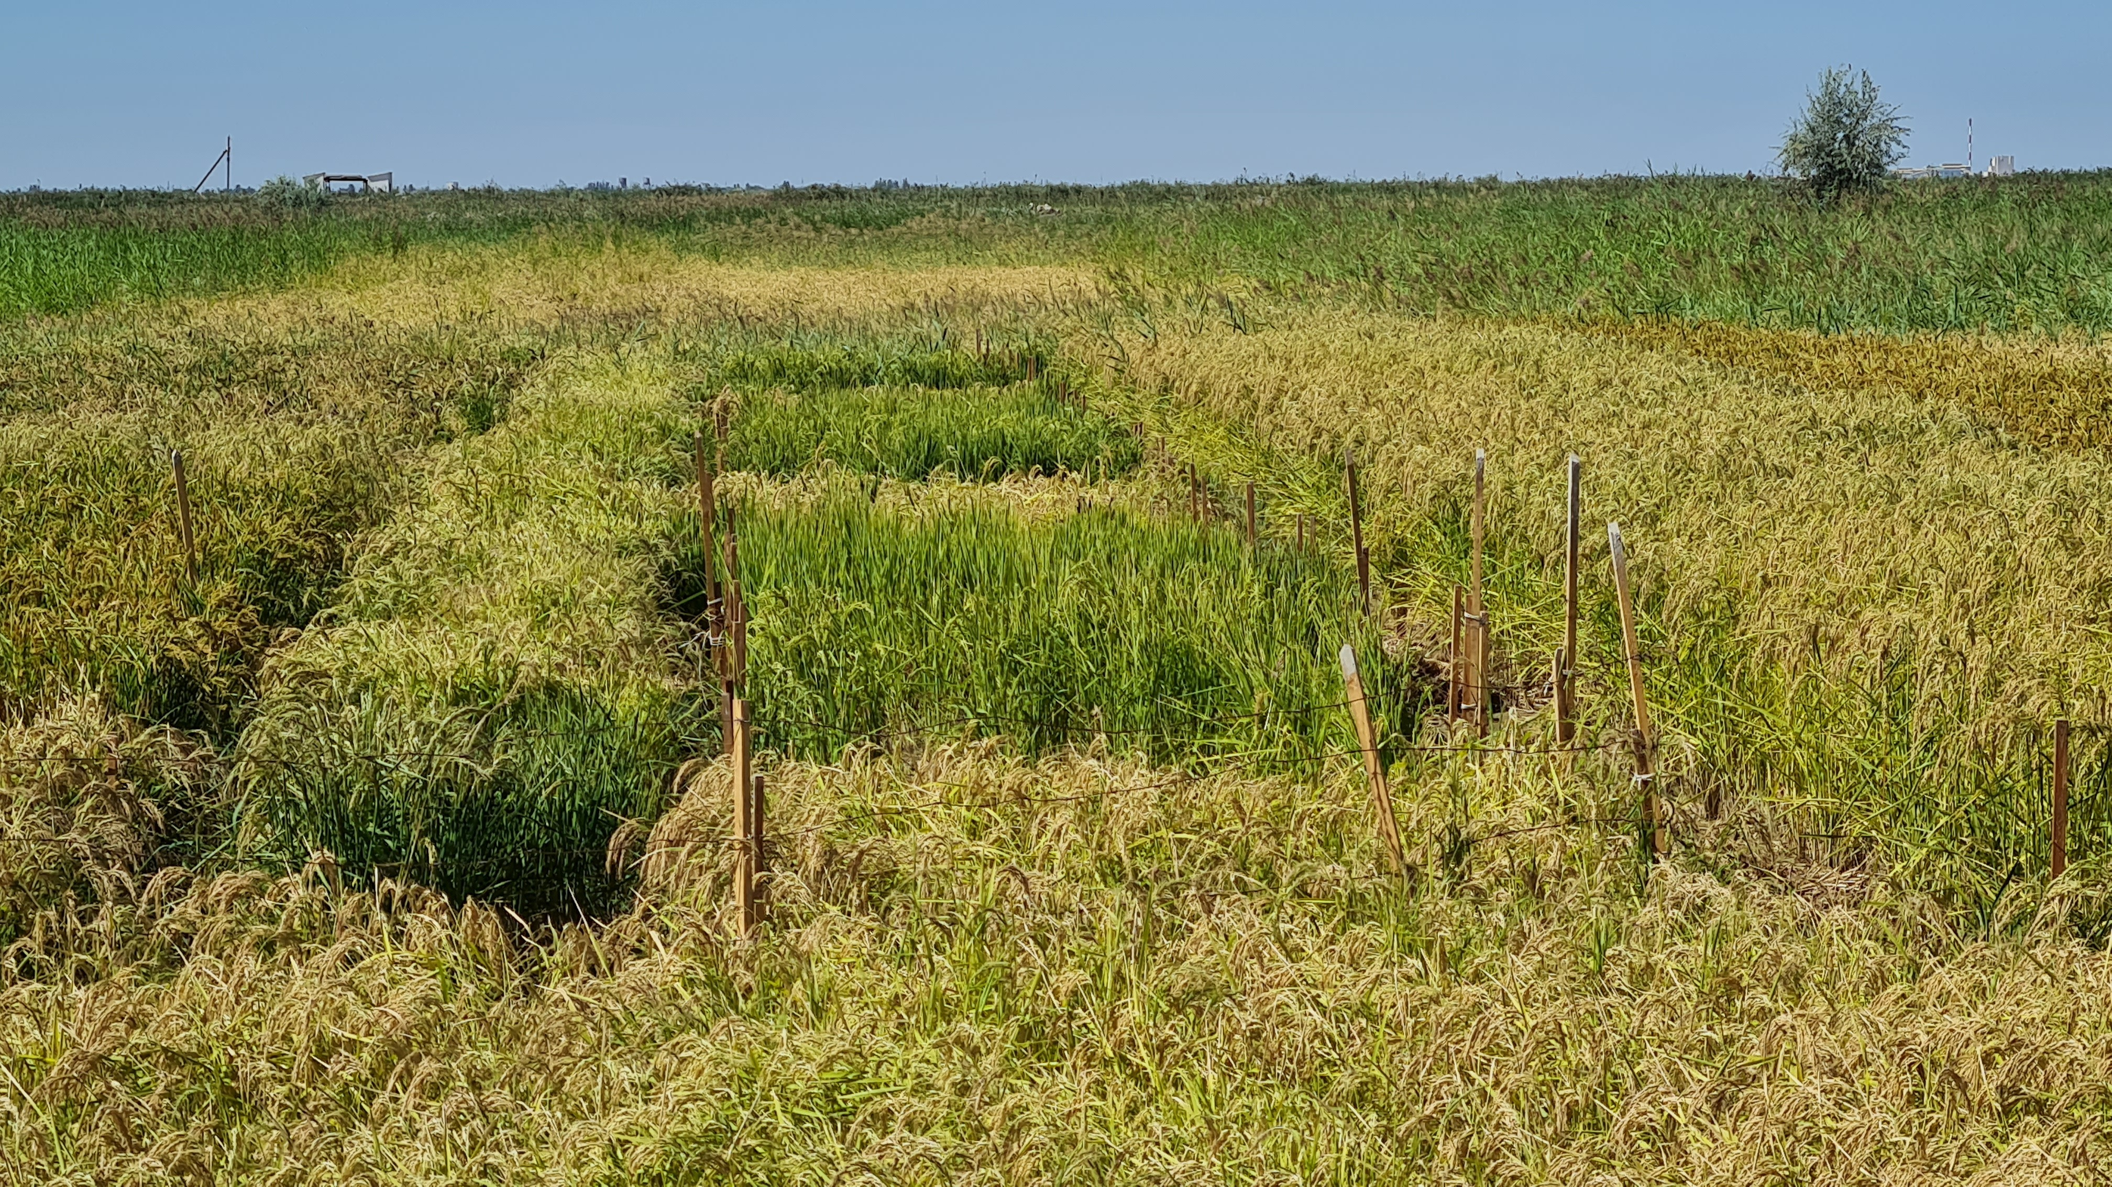
Fast neutron irradiation
Method of experiment
EG-5 group FLNP JINR
Corresponding member
of the Kazakh Academy
of Sciences
Prof. K.B. Bakiruly
Experimental site LLP "Kazakh Research Institute of Rice named after. I. Zhakhaev” in the Republic of Kazakhstan.

Slide 6
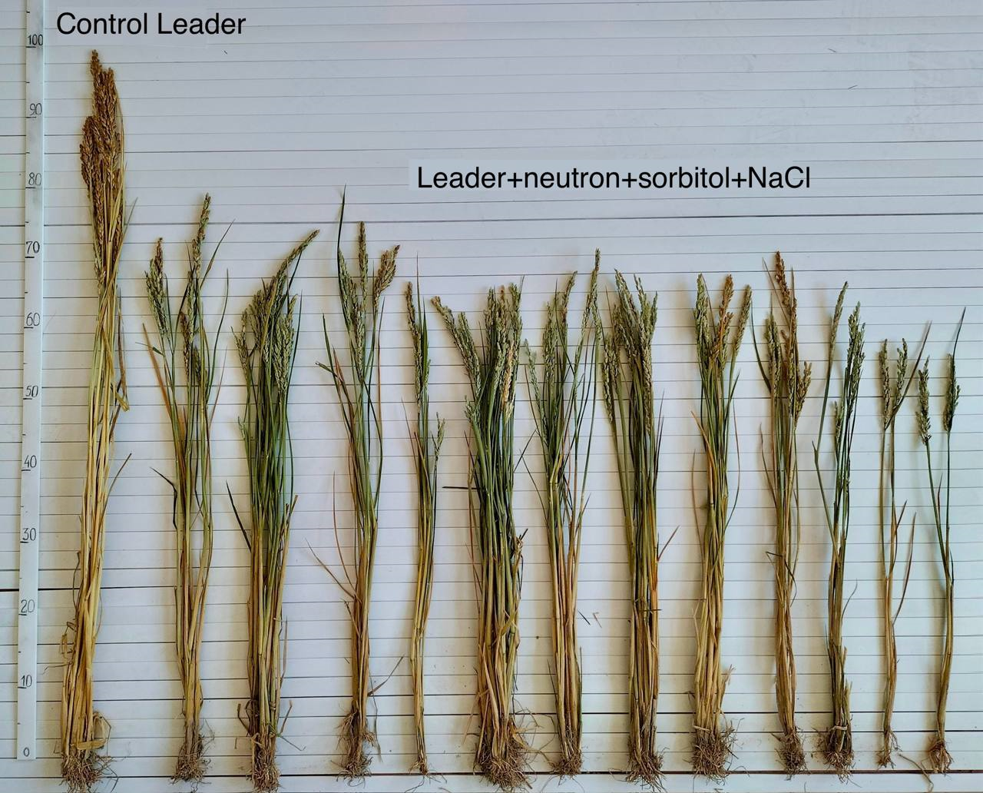
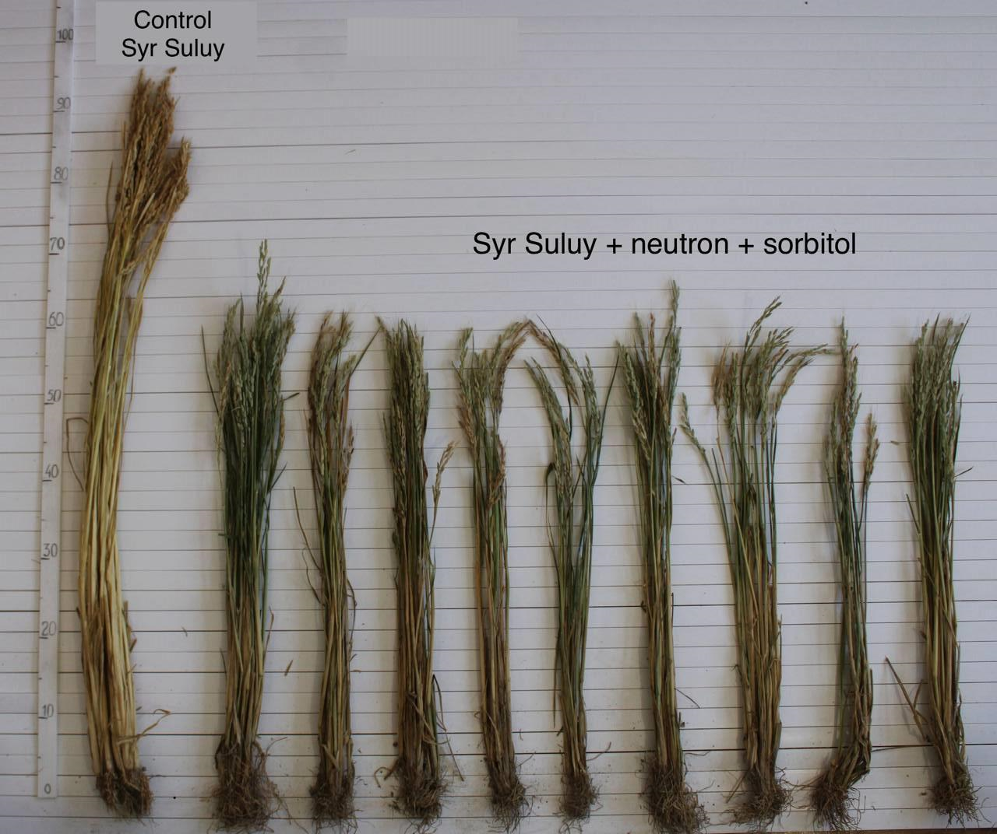
Results of fast neutron irradiation
received mutant forms resistant to salinity (NaCl) and drought factors (sorbitol). The largest number of mutant forms was obtained from variety Syr Suluy, followed by Leader and Aikerim varieties
M1 plants differ significantly from the original forms in morphological features : plant height, length, stunting and dwarfism (40-80 cm), and high empty-grain of panicles (up to 100%)
Photo of the control plants (on the left) and M1 plants distinguished by resistance to salinity and/or drought.

Slide 7
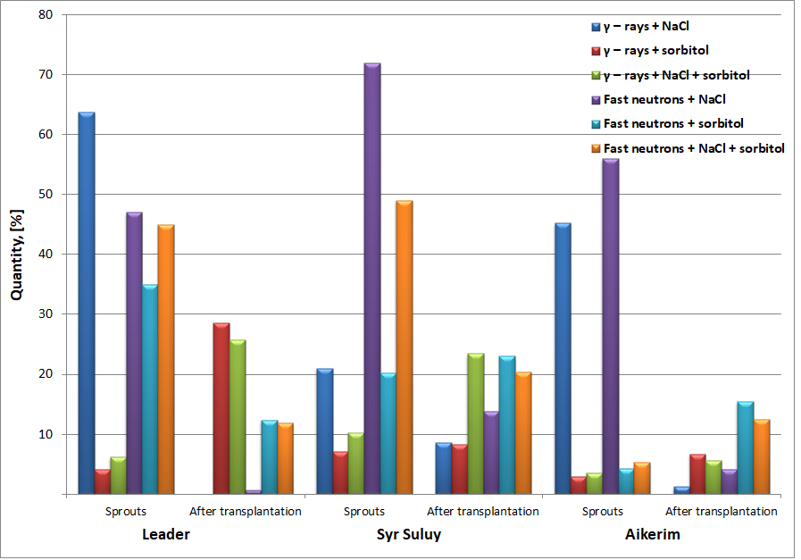
Results of fast neutron irradiation
Figure 1. Laboratory germination and survival of seeds treated with γ-rays, fast neutrons and salinity (NaCl) and drought factors (sorbitol)

Slide 8
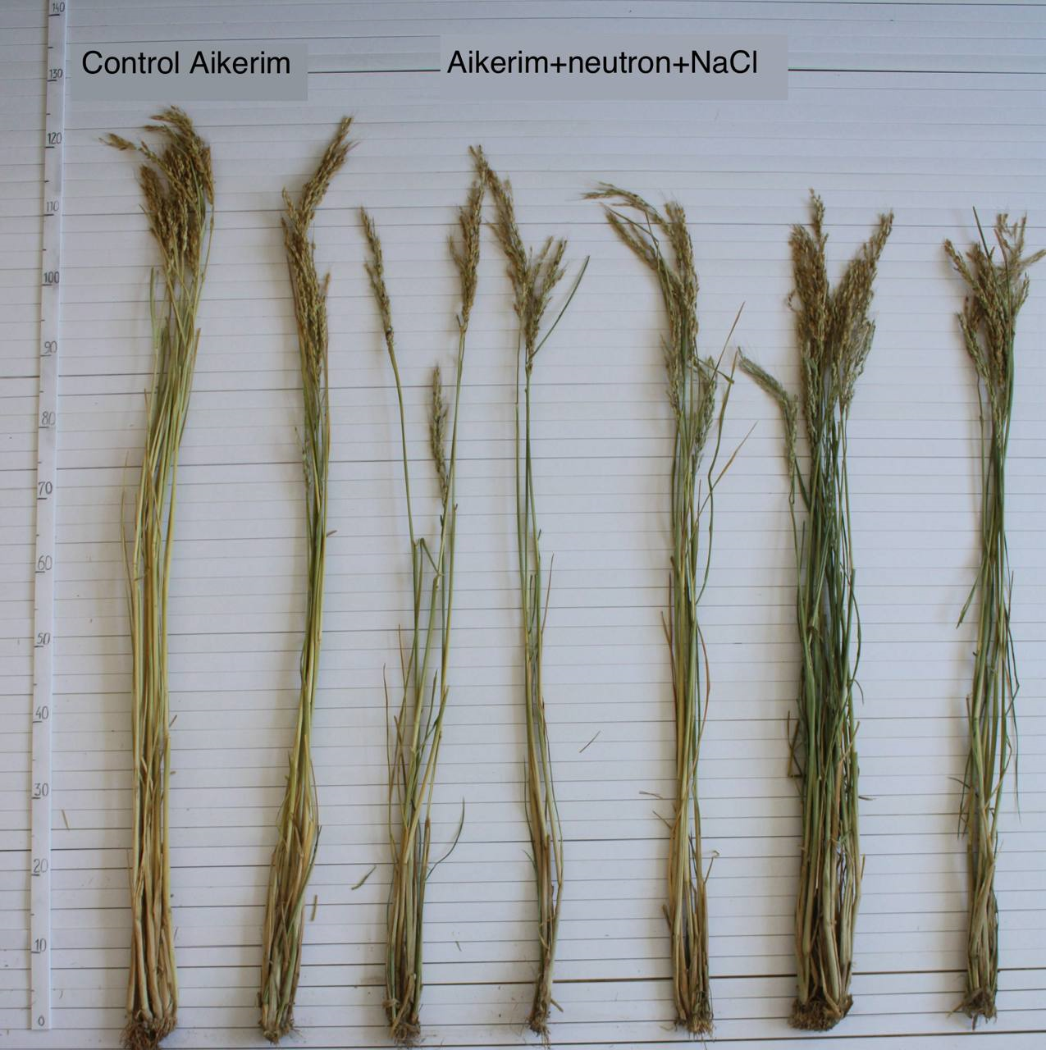
Variability plot of grain weight per plant
Figure 2. Grain weight per one plant from control and M1 plants of three rice varieties,
where FN – irradiation with fast neutrons.
Photo of the control Aikerim plants (on the left) and M1 plants distinguished by resistance to salinity and/or drought.
The main panicles of the altered Aikerim plants appeared to be 0.4-6.4 cm longer than the original form (19.6 cm). The shapes of the Leader and Syr Suluy varieties were respectively, shorter than the initials.

Slide 9
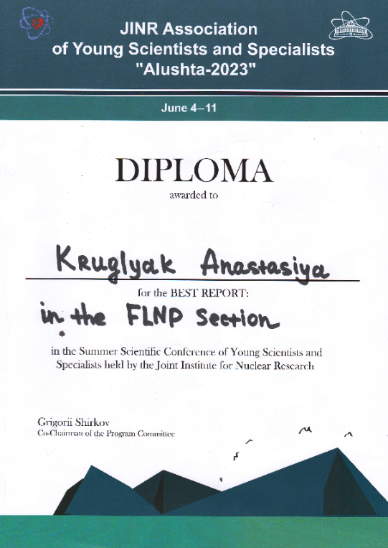
Conclusion
It was discovered that the median lethal dose (LD50) for fast neutrons – 50 Gy
Received mutant forms (max Syr Suluy), resistant to the stressful conditions of the Kazakhstan region of the Aral Sea (salinity, sorbitol)
Mutant forms are going to be used as initial forms in synthetic selection
The Aikerim variety seems to be very promising for further breeding work
The best report at JINR Summer Scientific Conference of Young Scientists and Specialists "Alushta-2023“.

Slide 10
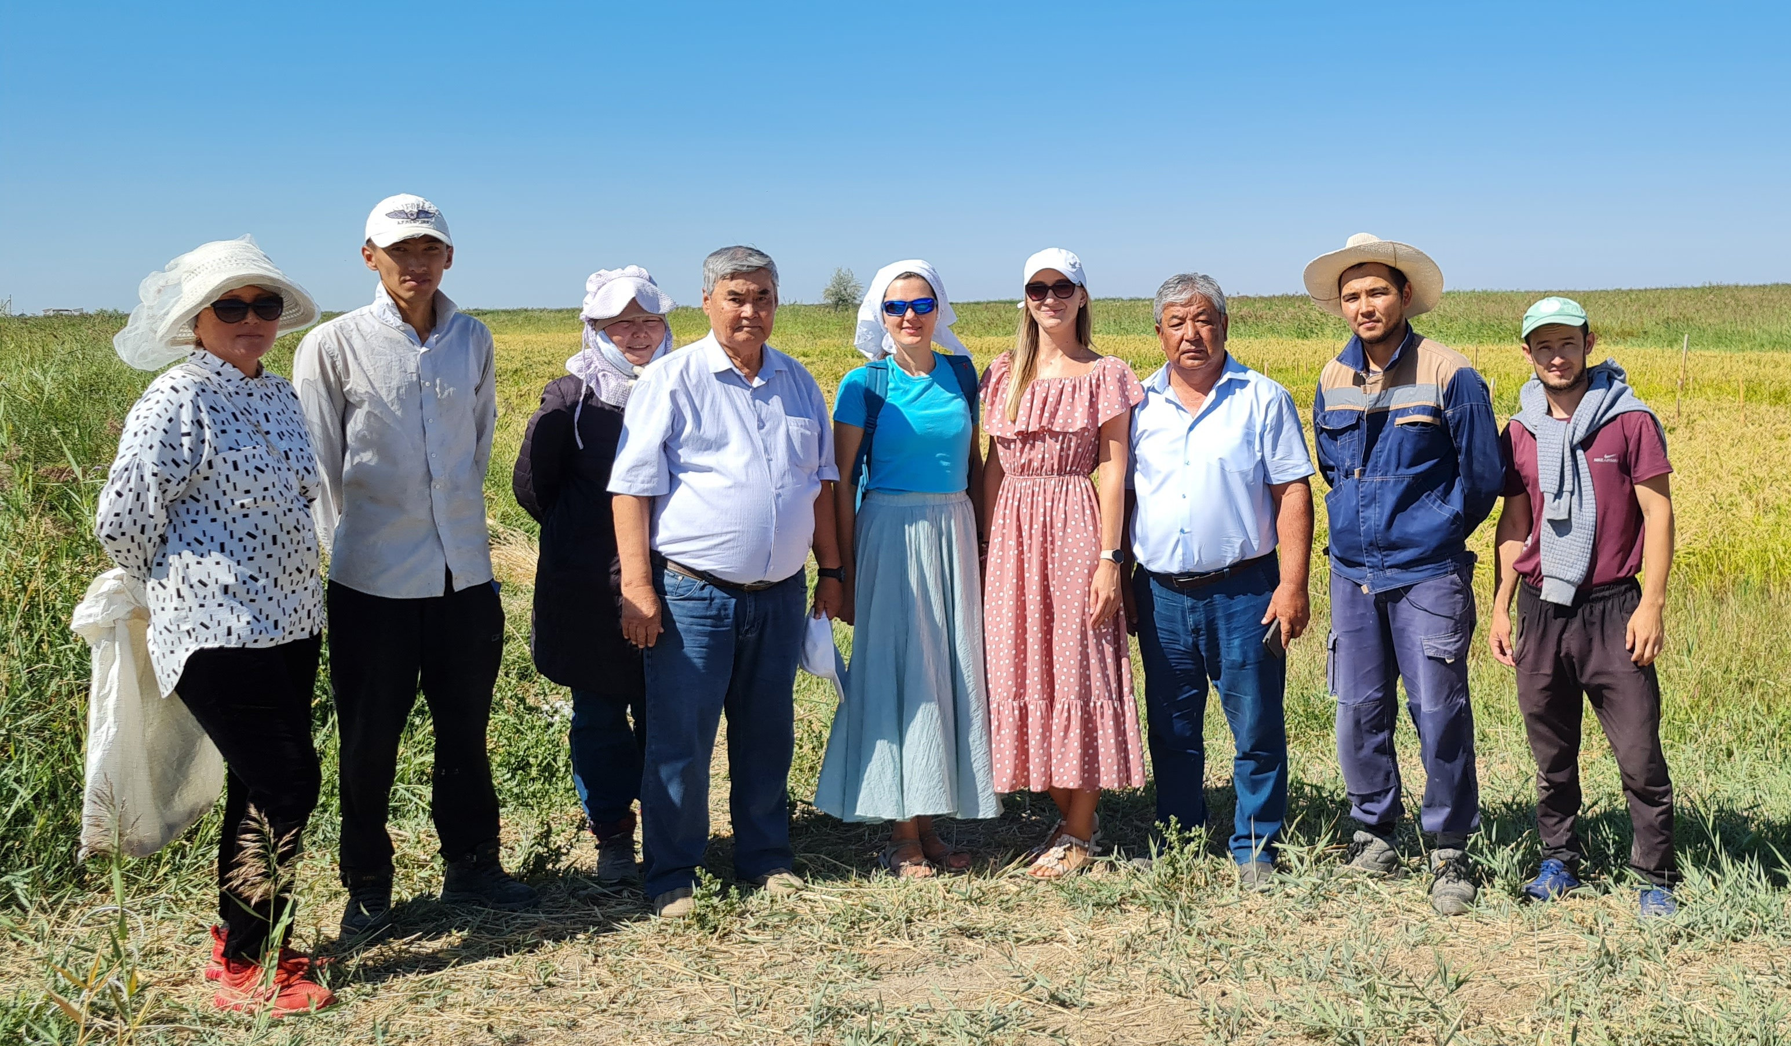
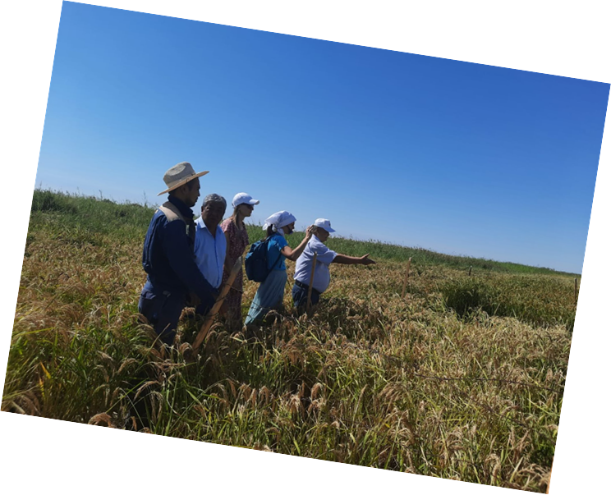
Thank you for attention!

