Slide 1
Pneumatic transport system REGATA-2 for automation of activation analysis at the IREN facility, FLNP JINR
Valerii Lobachev
Senior Engineer
Group of Neutron Activation Analysis (GNAA)
lobachev@jinr.ru
58th meeting of the PAC for Nuclear Physics, JINR, Dubna, 2024JI

Slide 2
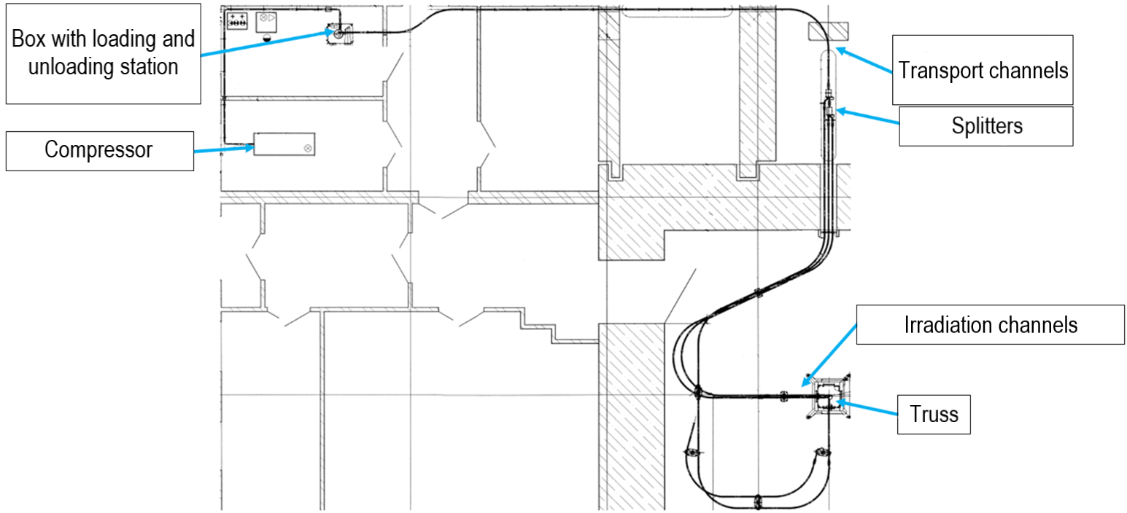
Pneumatic transport system REGATA-2 at the IREN facility
Notes:
The IREN facility is used for experiments to determine elemental composition of various samples by neutron activation analysis (NAA).
Pneumatic transport system (PTS) REGATA-2 was implemented to automate the delivery of containers with samples to the irradiation position and back.

Slide 3
Components of the REGATA-2 pneumatic transport system
Notes:
Let's consider the main components of the system.

Slide 4
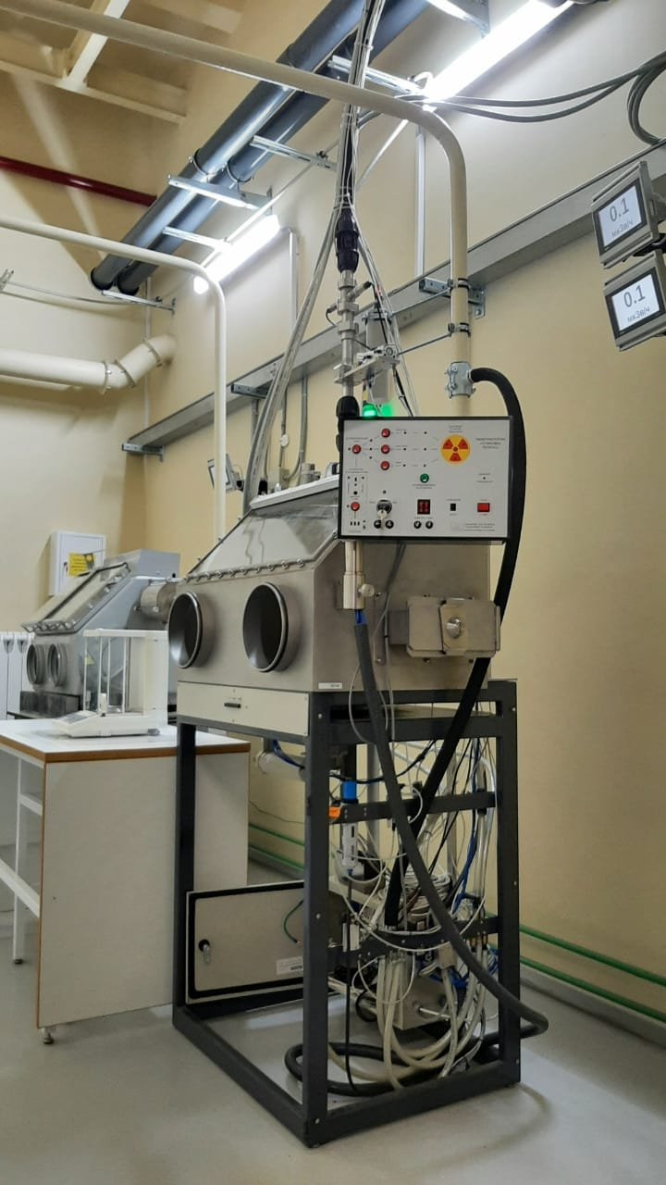
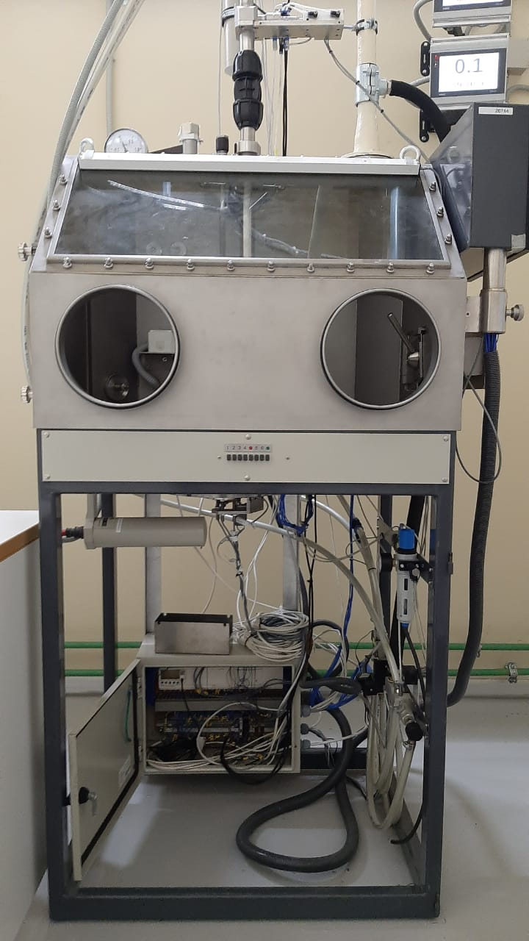
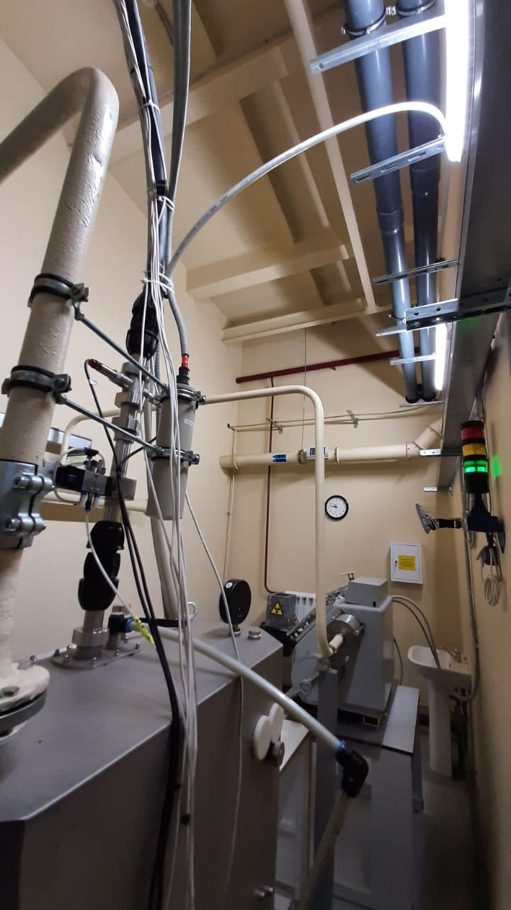
Box with loading and unloading station
Notes:
One of the PTS’s components is a box with a loading and unloading station. A polyethylene transport channel starts from the box.

Slide 5
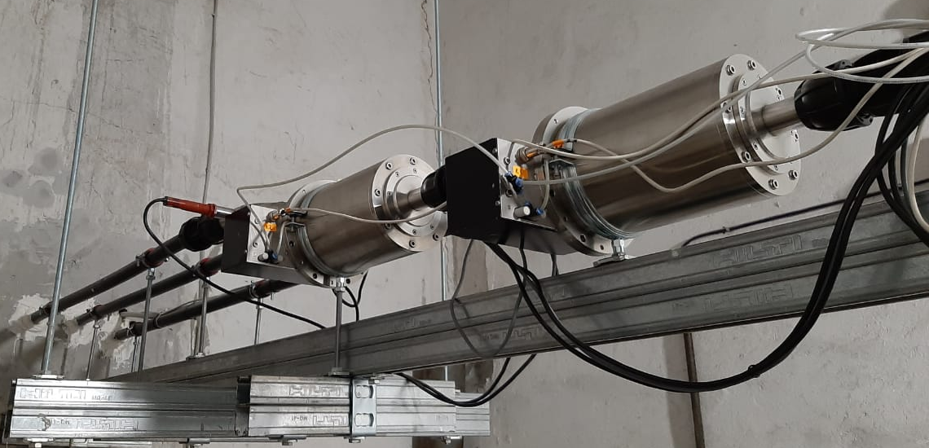
Splitters
Splitters
Reflective optical sensors
Notes:
The transport channel divides into three channels using splitters.

Slide 6
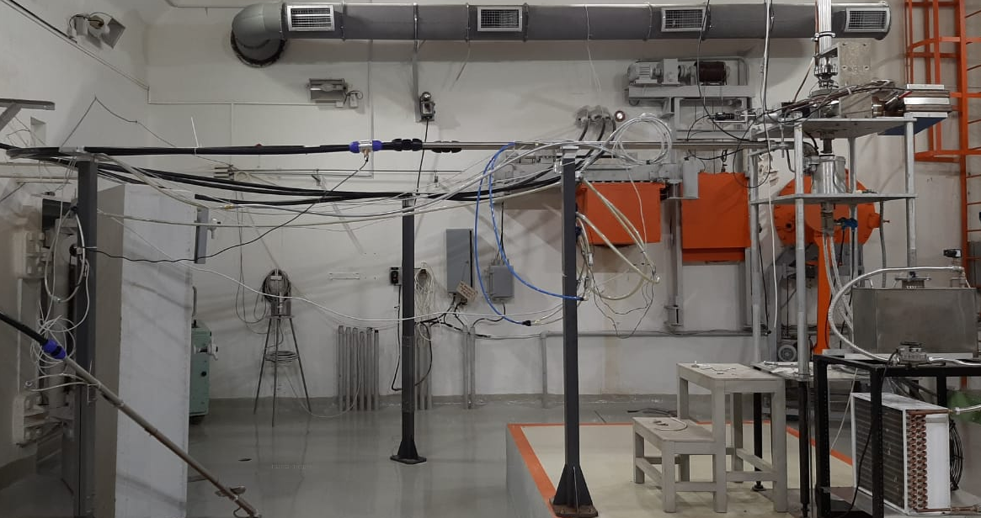
target hall
Transport channels
Irradiation channels made of stainless steel
Neutron moderator
Supporting columns
Notes:
In the target hall three transport channels are fixed on supporting columns. The transport channels end with irradiation channels made of stainless steel.

Slide 7
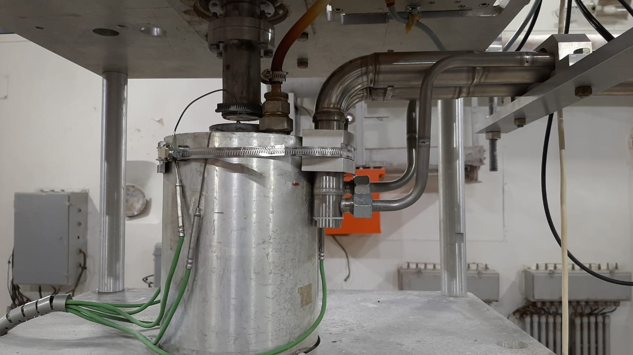
Irradiation channels
Channel N2
Channel N1
Notes:
The irradiation channels are fixed on an adjustable structure called a truss close to the neutron moderator.

Slide 8
The characteristics of the pneumatic transport system operation
Three irradiation channels: N1 and N2 for neutron activation analysis, G – for gamma activation analysis.
The average time for delivery of a container with samples to the radiation zone is 15 seconds, the same time it takes to return back.
The air in the pipeline is vented within 50 seconds after the container enters the radiation zone.
Notes:
On this slide, you can see characteristics of the PTS operation. These characteristics let to identify short-lived isotopes with a half-life of no less than one minute.

Slide 9
benefits after implementation Of
the pneumatic transport system
The capability to obtain short-lived isotopes.
The capability to carry out gamma activation analysis.
Protection of individuals from adverse impact due to the ionizing radiation.
Notes:
Let's talk about the benefits which we got after implementation the PTS. First, without PTS, we had to manually place samples on the moderator surface, which had a negative impact on the health of the staff in the Target hall. Now, the experimenter can deliver the sample while being at the safe distance from the neutron source. Second, PTS allowed us to obtain short-lived isotopes, which was impossible before its implementation. And third, we can establish a gamma-producing target for gamma activation analysis.

Slide 10
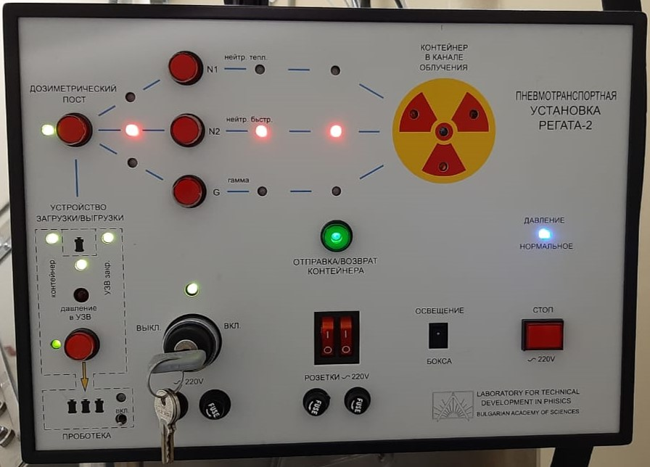
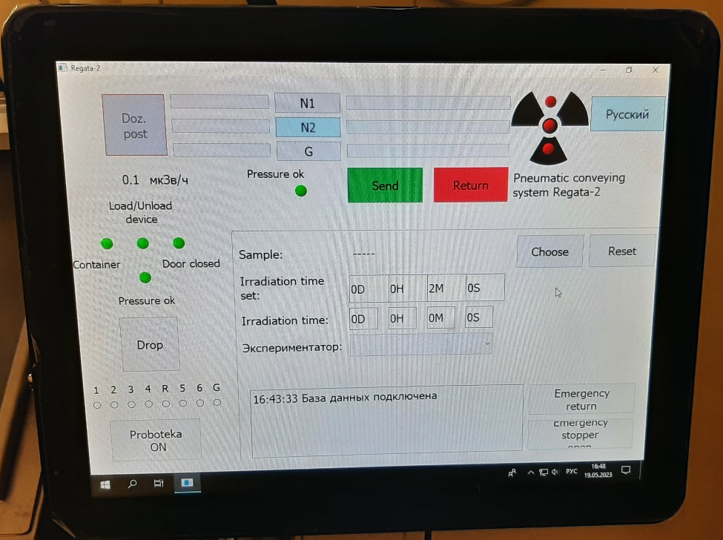
MODERNIZATION
Fix the issues that need more attention
Solving the problem with the container presence sensor at the irradiation position.
Solving the problem of overheating for the exhaust solenoid valve.
Modern touch control panel replaced the old electromechanical one.
Information exchange with the neutron activation analysis database.
Old control panel
New touchscreen
Notes:
Modernization of the TCP was carried out. The most notable innovation of which is replacement of the old electromechanical control panel with a modern touch control panel. It let to add information exchange with the NAA database.

Slide 11
Neutron activation analysis
Notes:
Let’s talk about neutron activation analysis(NAA). NAA is a method for elemental analysis.

Slide 12
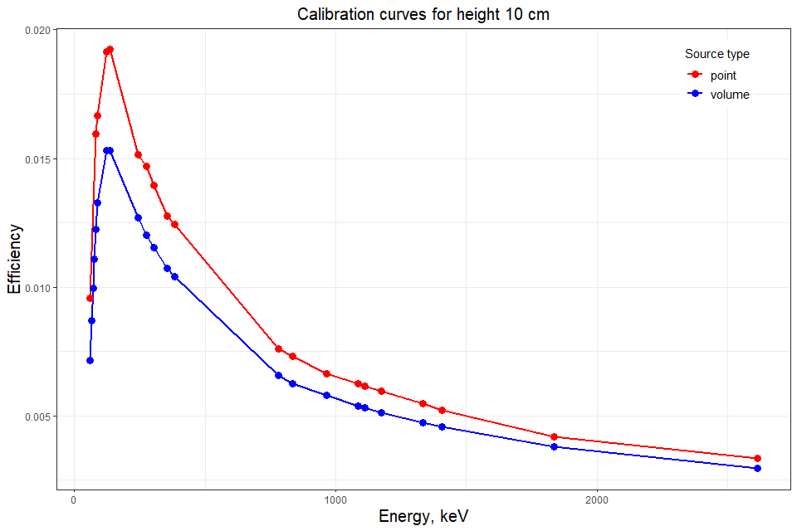
VOLUME CALIBRATION
The ANGLE software was used for efficiency calibration transfer from gamma rays point source to volumetric one.
Blue curve – the efficiency calibration for a point source, 10 cm height above the detector surface.
Red curve – the efficiency calibration for a volumetric source for the same height.
Notes:
I would like to focus your attention on volume calibration. The sample mass for irradiation on the IREN facility is 3 grams. Previously, we couldn't calculate mass fractions for volume samples. But now we use volume calibrations, which was created for our detector using the program ANGLE.

Slide 13
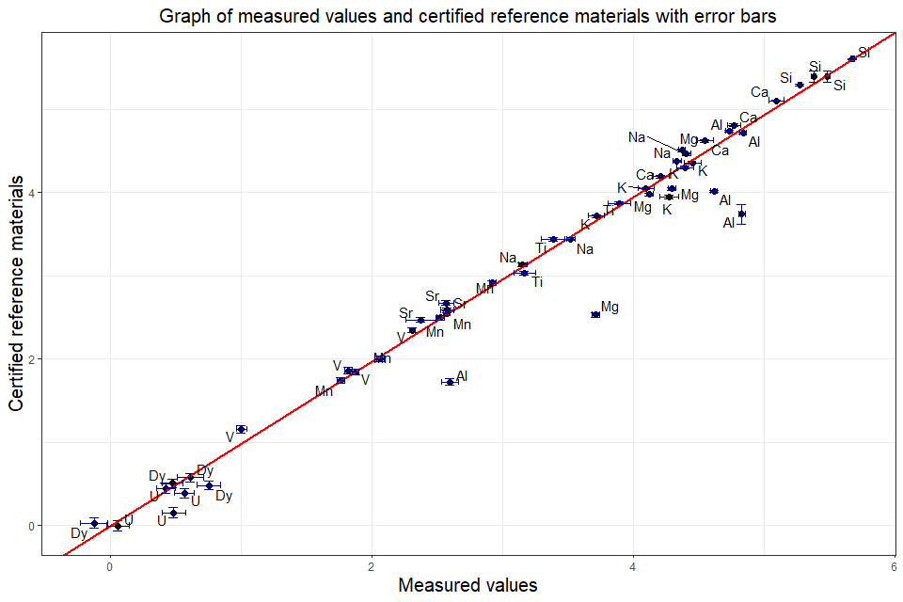
IAEA PROFICIENCY TEST SAMPLES
IAEA proficiency test samples were researched using NAA.
The obtained mass fractions showed good agreement with the certified reference materials.
Al and Mg are outliers. The causes of discrepancies are being explored.
Notes:
Also IAEA proficiency test samples were investigated using neutron activation analysis. The obtained mass fractions are in a good agreement.

Slide 14
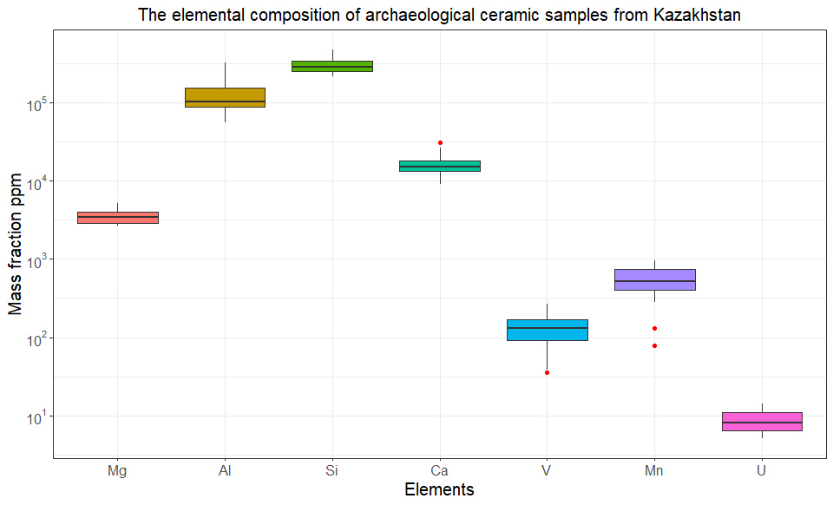
DETERMINATION OF THE ELEMENTAL COMPOSITION OF CERAMIC SAMPLES FROM KAZAKHSTAN
IREN
Short lived isotopes
7 mass fraction of elements
The important macroelements for ceramic analysis (Mg, Al, Si) were obtained using the PTS at the IREN facility.
Notes:
Investigations of ceramics samples found on the territory of Kazakhstan was carried out by short-lived isotopes. Mass fractions of 7 elements were found, including the main macroelements.

Slide 15
Gamma activation analysis
Notes:
Gamma activation analysis(GAA) is method for elemental analysis, which expands the list of determined elements compared to NAA. The first steps were taken to carry out GAA.

Slide 16
IRRADIATION OF A COPPER SAMPLE AND 50C NIST STANDARD
The goal of the experiment was a qualitative elemental analysis using gamma activation.
Cu: lines from ⁶¹Cu isotope were detected when analyzing the spectra.
Cu⁶³(γ - 2n) Cu⁶¹
50C NIST SRM (tungsten, chromium, and vanadium steel): peaks of several isotopes were detected; Ta¹⁸⁵, Cr⁴⁹ and Ni⁵⁷ – results of gamma reactions.
W¹⁸⁶ (γ - n, p) Ta¹⁸⁵
Cr⁵⁰ (γ - n) Cr⁴⁹
Ni⁵⁸(γ - n) Ni⁵⁷
Notes:
The goal of the experiment was a qualitative elemental analysis using gamma activation. We irradiated three samples whose elemental composition was known: copper, standard 50C

Slide 17
IRRADIATION OF A PLASTER SAMPLE
The fragment of plaster from the Savior Church on Nereditsa (12th century) was irradiated.
Peaks of several isotopes were detected; K⁴³, Fe⁵³, and Zr^{89m} isotopes – results of gamma reactions.
Ca⁴⁴ (γ - n, p) K⁴³
Fe⁵⁴ (γ - n) Fe⁵³
Zr⁹⁰ (γ - n) Zr^{89m}
Notes:
and the fragment of plaster from the Saviour Church on Nereditsa. In all three samples, we were able to determine isotopes using gamma activation analysis. This demonstrates that gamma activation analysis is possible at the IREN facility.

Slide 18
Article in the scientific journal Physics of Elementary Particles and Atomic Nuclei
Notes:
Detailed information about PTS and the research that I talked about is published in the article whose title page you can see on the slide.

Slide 19
CONCLUSIONS
REGATA-2 PTS was realized at the IREN facility.
Modernization of the PTS was carried out.
The implementation of PTS allowed to:
Obtain results of neutron activation analysis that are agreed with IAEA proficiency test.
Obtain macroelements (Mg, Al, Si) important for the analysis of ceramics from short-lived isotopes using PTS on the IREN facility.
Carry out qualitative elemental analysis using gamma activation.
Notes:
So, we have the following results: write on the slide:
The implementation of PTS allowed to:
Obtain results of neutron activation analysis that are agreed with IAEA proficiency test.
Obtain macroelements (Mg, Al, Si) important for the analysis of ceramics from short-lived isotopes using PTS on the IREN facility.
Carry out qualitative elemental analysis using gamma activation.

Slide 20
Thank you for your attention
Notes:
Also, the first steps to conduct gamma-activation analysis (GAA) have been made.

