Slide 1
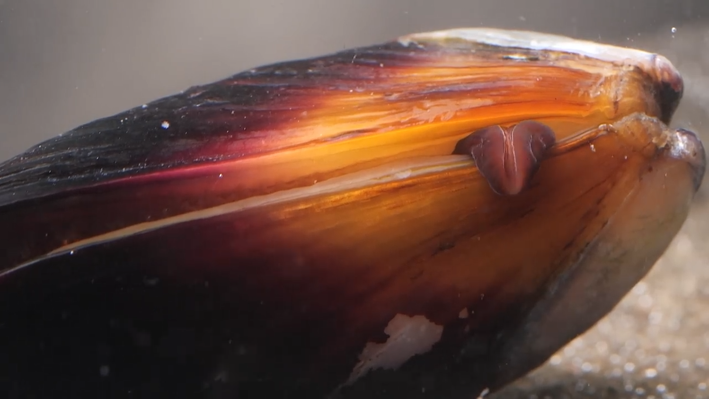


Local patterns and features of the accumulation of macro- and microelements in wild-growing and cultivated mussels under anthropogenic stress.
Pavel Nekhoroshkov, Jacques Bezuidenhout, Rikus le Roux,
Inga Zinicovscaia, Nikita Yushin, Marina Frontasyeva
Sector of Neutron activation analysis and Applied research
Frank Laboratory of Neutron Physics
p.nekhoroshkov@gmail.com

Slide 2
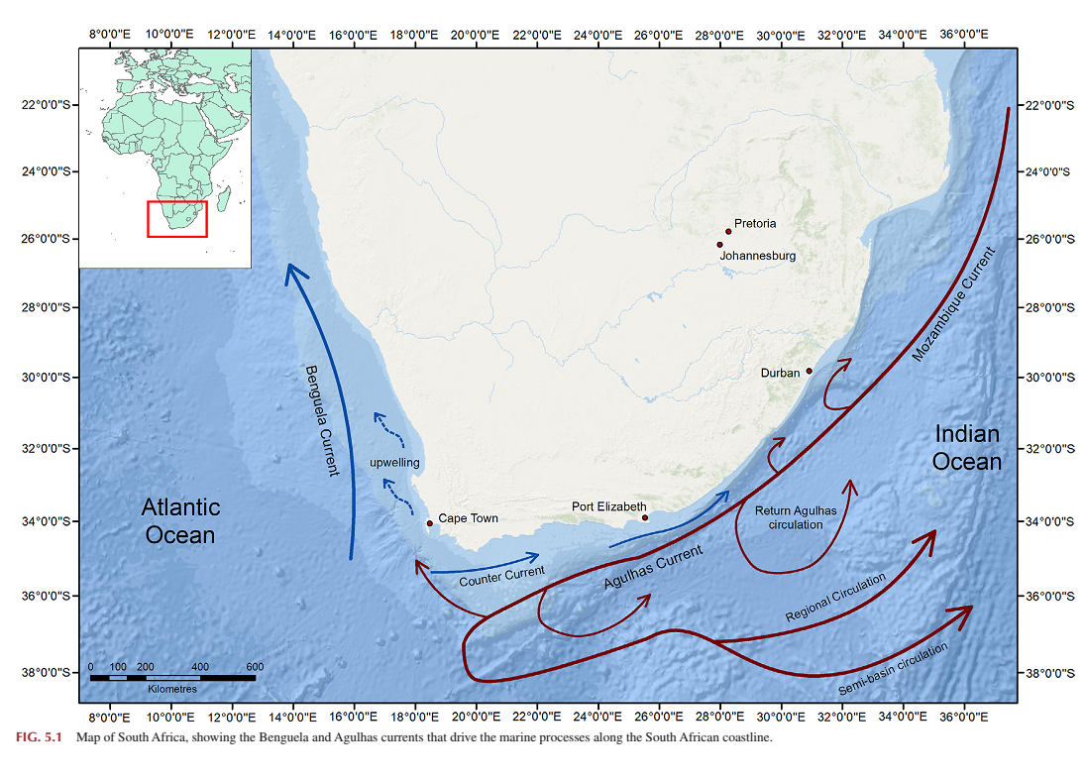
Sampling sites
(South coast of Africa)
– sampling sites
Wepener and Degger, 2019

Slide 3
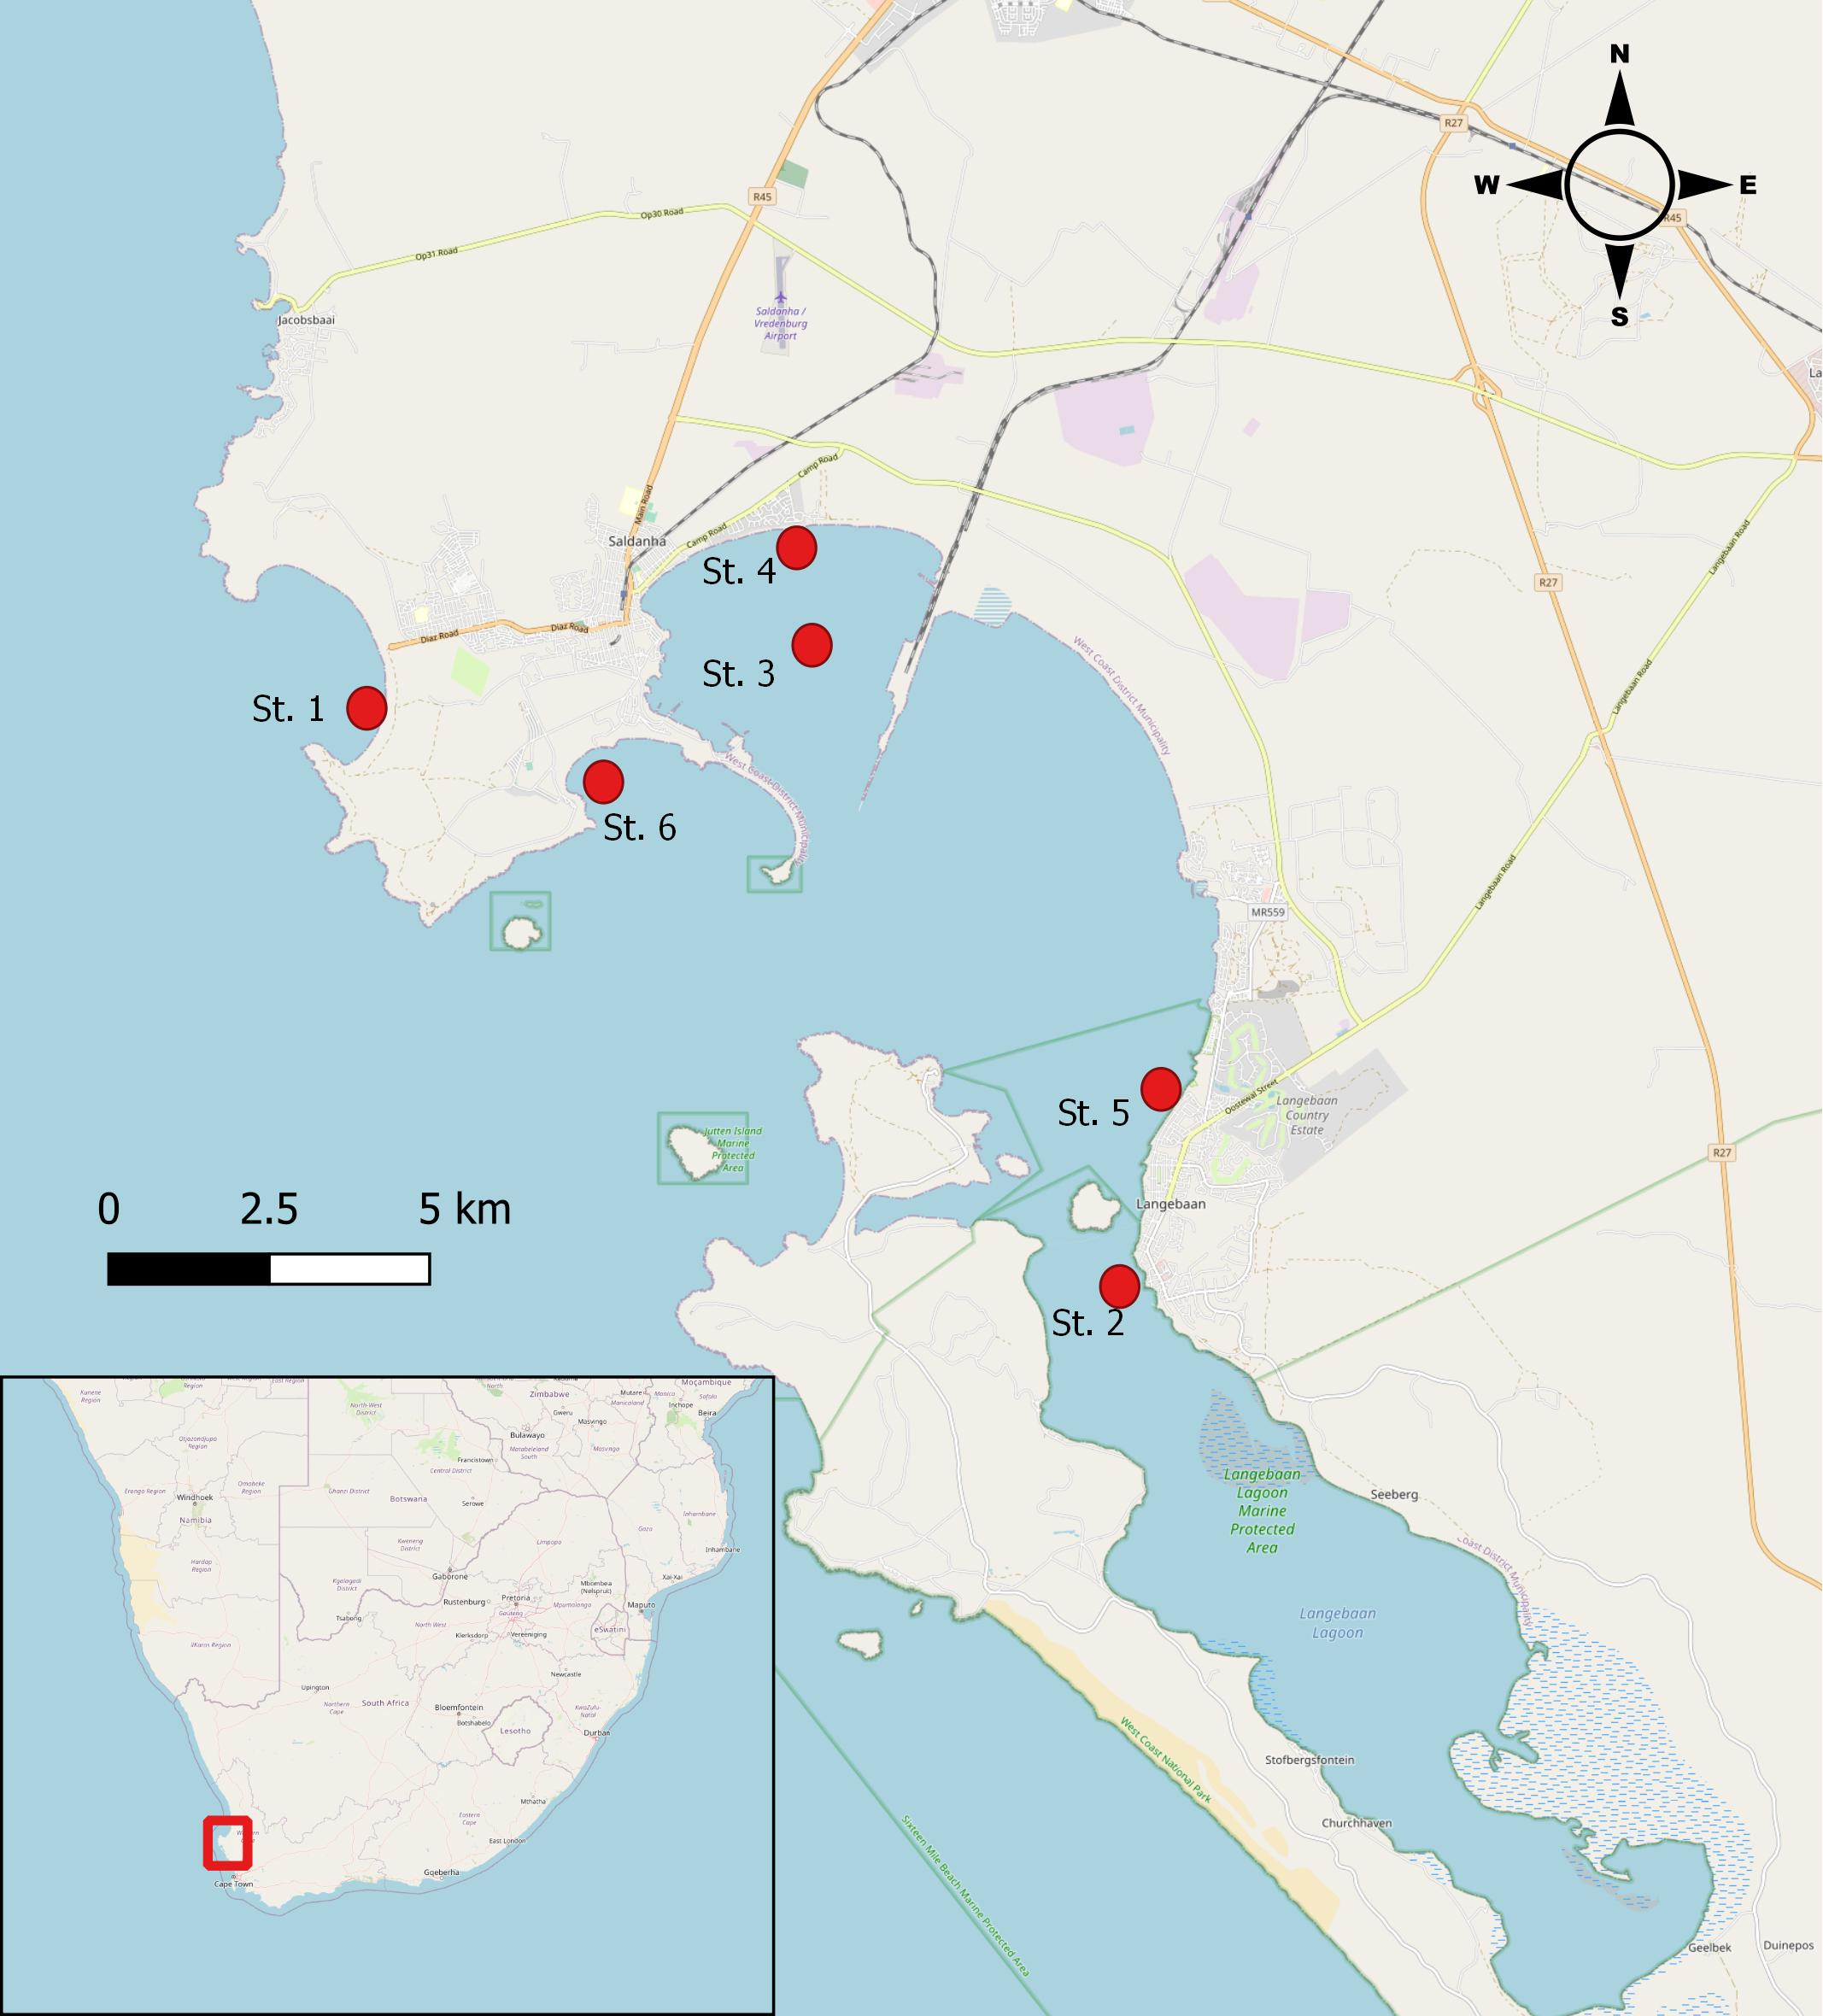
Sampling sites in the 2013-2019
Wild
St. 1
Pristine open ocean area with tidal activities
Mouth of protected area. Yacht club, prier
Wild
St. 2
Farmed
St. 3
Semi-closed area. Technological transport
Wild
St. 4
Semi-closed area.
Outlets of grey water (discharges)
Wild
St. 5
Mouth of protected area.
Outlets of grey water (discharges)
Wild
St. 6
Open ocean area with tidal activities. Marine transport

Slide 4
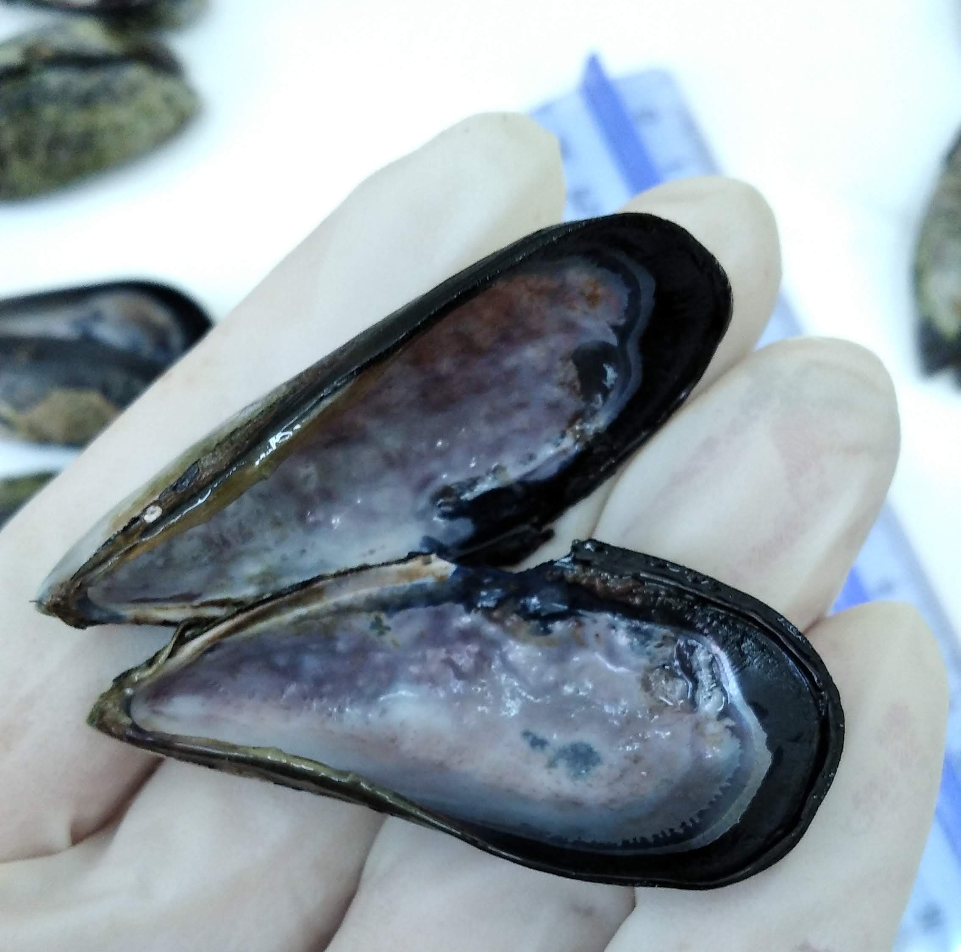
problems
Number of elements
Consumption rate
The most harmful trace elements such as Cu, Cd, Pb, Hg are well studied and controlled in food products.
However, other microelements are not well studied. Interaction, limits of accumulation, properties and function.
The levels of consumption should be regulated according to levels of toxic substances. It is hard to define real consumption
Background levels
For each coastal zone, the background levels should be established on the local studies.
Guideline limits
The regulation limits for the most elements are under consideration.
Environmental changes
Natural and anthropogenic factors affect the levels of elements and state of organisms

Slide 5
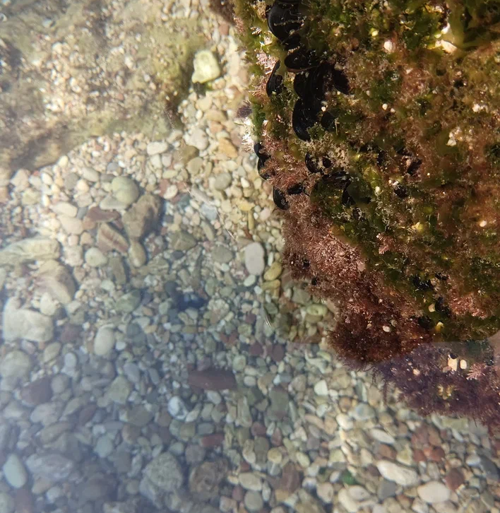
Why Mussels?
Bivalve molluscs-filtrators
Accumulate the dissolved and suspended elements with the food
Ecosystem engineers
Mytilus galloprovincialis – ubiquitous alien organisms, tolerable to anthropogenic and natural influence.
Reflect the state of ecosystem from days to years
Uncontrolled used in food – could cause harm for human population
29-Jan-24

Slide 6
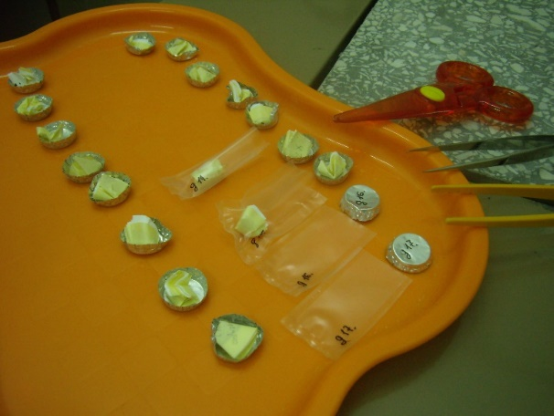
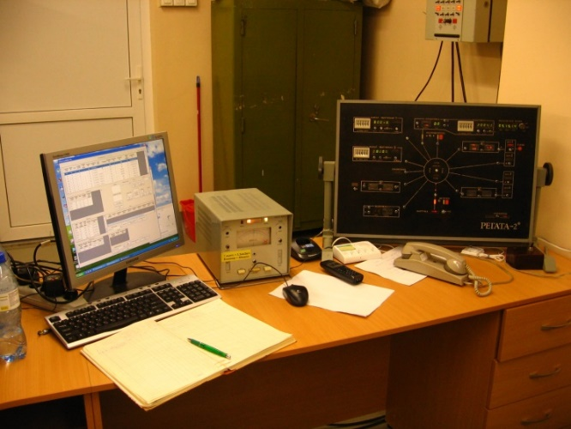
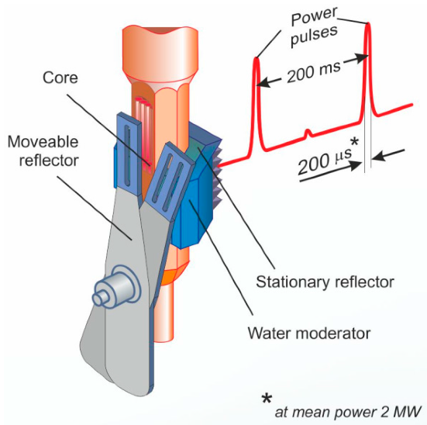
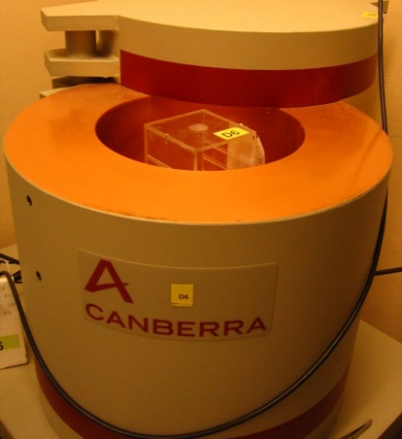
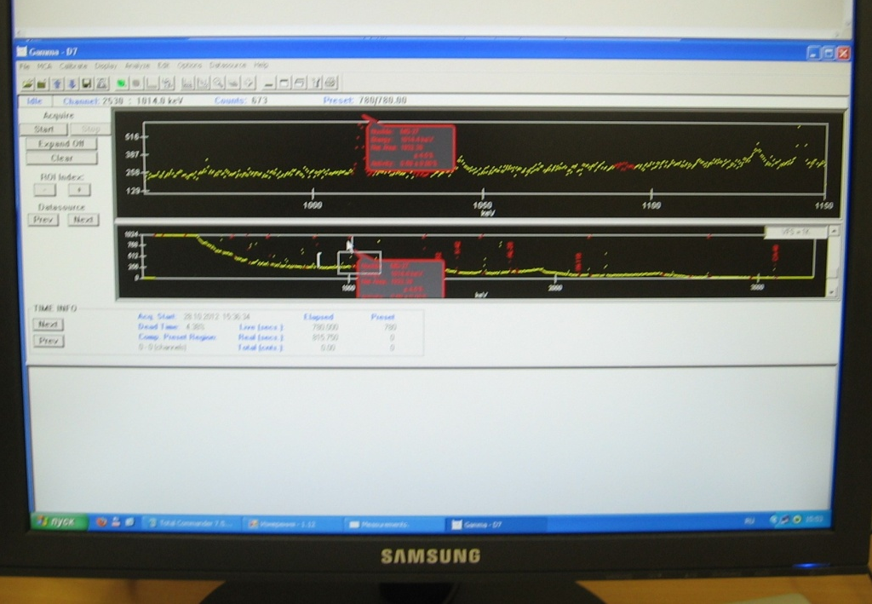




Neutron activation analysis at the REGATA facility of the reactor IBR-2
Irradiation
At the reactor
Measurements with detectors
Data processing
Sample preparation
Lyophilizing, Weighing. Milling, homogenization, packing into aluminum cups and plastic bags
REGATA facility. The transportation of the containers and control of time of irradiation and measurement
Measurements the induced gamma activities of isotopes in the samples
Search the peaks of isotopes and recalculation of activities in concentrations by using Genie2000 and CalcConc

Slide 7
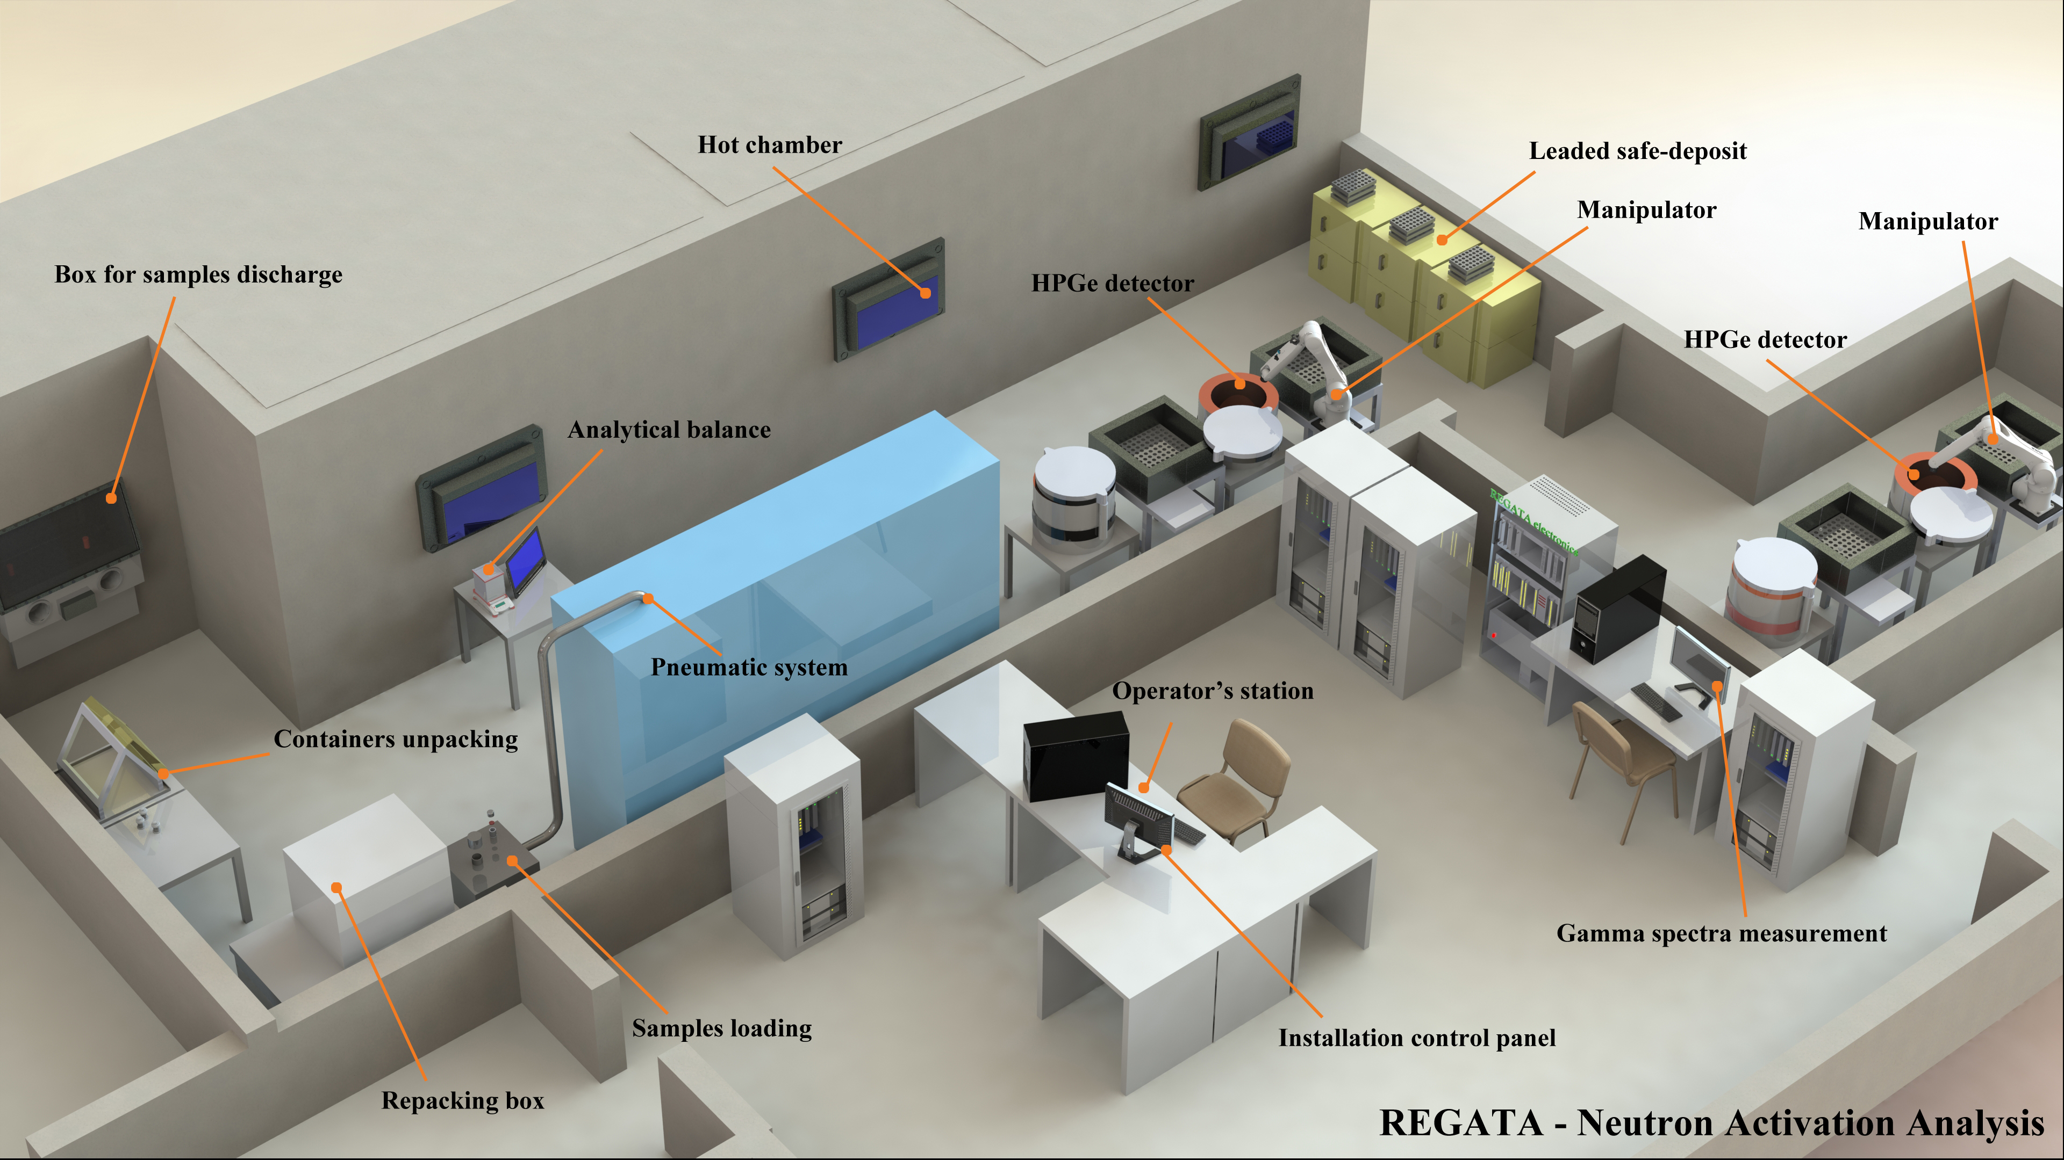

Slide 8
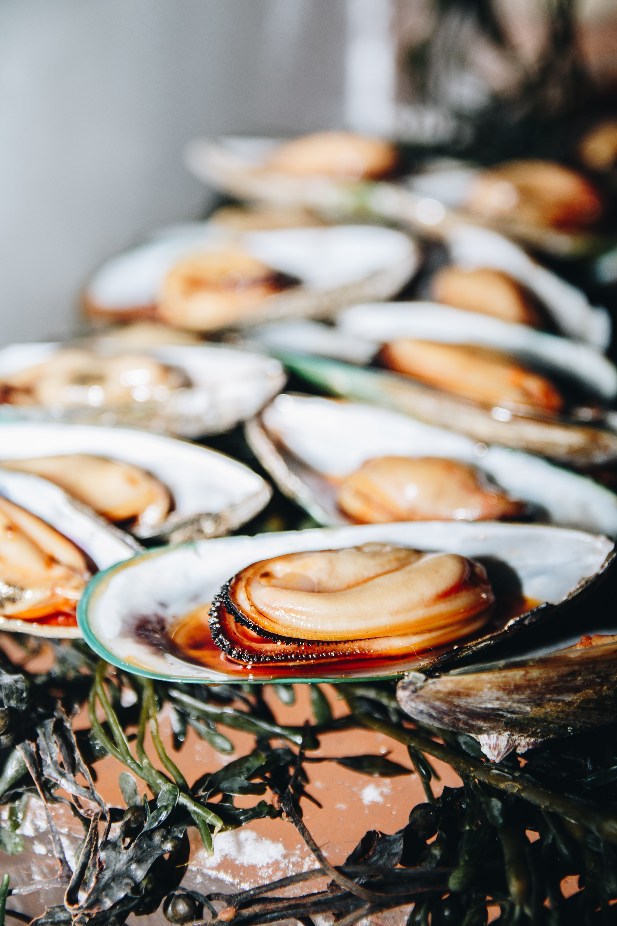
Analytical technique
Neutron activation analysis:
  Samples irradiated at 2 channels at the IBR-2 reactor (FLNP, Dubna) with the neutron flux of 3.31⋅10¹¹n cm⁻² s⁻¹,
  Technique of the group standard: 10 SRMs (NIST, IRMM, BCR) irradiated and measured together with the samples for quality assurance (including oyster tissue)
  Measurements by Canberra detectors with the resolution of 1.9 kev for 1332 kev of ⁶⁰co
  Obtaining mass fractions of > 20 macro and microelements in soft tissues and shells were analyzed in each sample
  The differences between certified and determined levels (recovery rates) were in the range 0-5 % for the majority of elements
  Statistics: nonparametric Kruskal-Wallis test

Slide 9
Elemental ratios along south coast of Africa
As/Sc indicated the anthropogenic coastal water discharges and influence of the bottom contribution of the groundwaters.
The low levels of As/Sc ratios could indicate the accumulation of a terrigenous suspended matter of river runoffs (In the cases of high levels of Sc)

Slide 10
 | F1 | F2 | F3 | F4 | F5
Station | -0.35 | 0.42 | -0.47 | -0.44 | -0.14
Season | 0.06 | 0.30 | 0.14 | -0.09 | -0.21
Length | -0.21 | -0.55 | -0.61 | -0.15 | -0.12
Na | -0.03 | 0.90 | -0.25 | 0.00 | 0.14
Mg | -0.05 | 0.91 | -0.18 | -0.14 | -0.03
Al | 0.77 | 0.10 | 0.19 | 0.11 | -0.01
Cl | -0.09 | 0.92 | -0.23 | 0.01 | 0.03
K | -0.14 | 0.09 | -0.72 | 0.34 | -0.08
Ca | 0.09 | 0.87 | 0.12 | 0.05 | -0.08
Sc | 0.93 | 0.06 | 0.04 | 0.01 | 0.08
V | 0.01 | 0.07 | 0.01 | 0.62 | 0.12
Cr | 0.29 | -0.05 | 0.55 | 0.09 | 0.61
Mn | 0.32 | 0.15 | -0.21 | 0.44 | -0.21
Fe | 0.76 | 0.08 | 0.32 | 0.21 | 0.36
Co | 0.12 | 0.14 | 0.01 | 0.14 | 0.87
Ni | 0.15 | 0.08 | 0.33 | 0.11 | 0.81
Zn | 0.03 | 0.36 | 0.25 | -0.08 | 0.24
As | -0.06 | -0.03 | 0.00 | 0.79 | 0.17
Se | 0.75 | -0.05 | -0.09 | -0.04 | 0.29
Br | -0.02 | 0.73 | 0.03 | 0.49 | 0.22
Rb | 0.29 | 0.17 | -0.76 | 0.34 | -0.02
Sr | 0.03 | 0.78 | 0.07 | 0.10 | 0.05
Sb | 0.25 | -0.07 | -0.10 | 0.45 | -0.04
I | 0.06 | -0.03 | 0.64 | 0.45 | 0.29
Cs | 0.82 | -0.07 | -0.05 | 0.27 | 0.05
Th | 0.89 | -0.02 | 0.02 | -0.08 | -0.06
U | 0.12 | 0.49 | 0.47 | 0.43 | 0.28
Expl.Var | 4.67 | 5.45 | 3.19 | 2.71 | 2.49
Prp.Totl | 0.17 | 0.20 | 0.12 | 0.10 | 0.09
Factor analysis
(whole set of data)
Al-Sc-Cs
K-Rb-I
Na-Mg-Cl-Ca-Sr
V-As
Cr-Co-Ni
Years, 2013
2019
Nekhoroshkov et al., (2023)

Slide 11
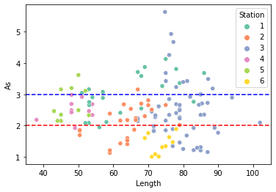
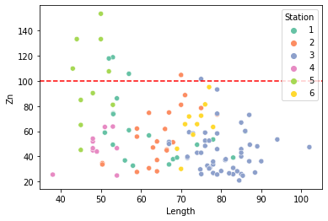
Concentrations of As and Zn and Maximum permissible levels (WHO)
Water discharges
Water discharges
Nekhoroshkov, P., Bezuidenhout, J., Zinicovscaia, I., Frontasyeva M. & Yushin N. Seasonal and interannual variability of heavy metals and other microelements in wild and farmed mussels Mytilus galloprovincialis in Saldanha Bay (South Africa). Regional Studies in Marine Science. (under review)

Slide 12
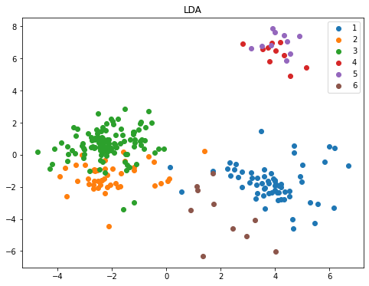
The assessment of levels
The mussels from the outlets’ sites were separated in one group
Wastewater discharges
Closed bays
Open waters

Slide 13
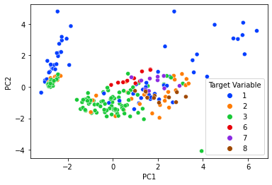
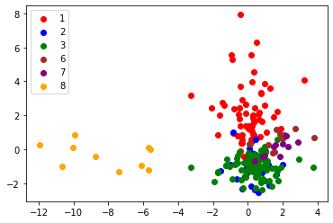
Risks for human consumption (Target hazard quotients)
Description of stations on mussels
Principal Component Analysis
Linear Discriminant Analysis
Open ocean
Open ocean
Open ocean
Closed bay
Closed bay

Slide 14
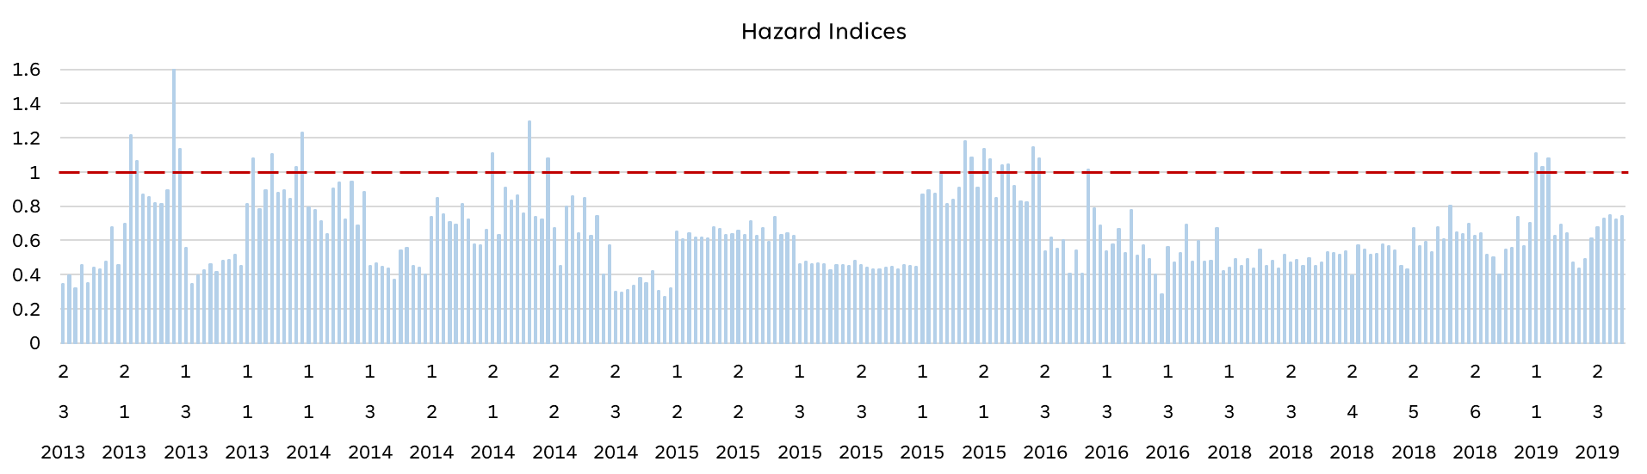
Hazard Indices for Saldanha
HI: Al, V, Cr, Mn, Fe, Co, Ni, Zn, As, Se, Sr, Sb, I, Cs, U
HI = ∑THQ_{i} = ∑(C_{i} * CR / RfD_{i} BW)
The mussels could pose the risks in seasonal increasing the appropriate elements
Nekhoroshkov, P., Bezuidenhout, J., Zinicovscaia, I., Frontasyeva M. & Yushin N. Temporal trends of risks in consumption of wild and farmed mussels in 2013-2019 in the Saldanha Bay area (South Africa). Journal of Food composition and analysis. (Under review)

Slide 15
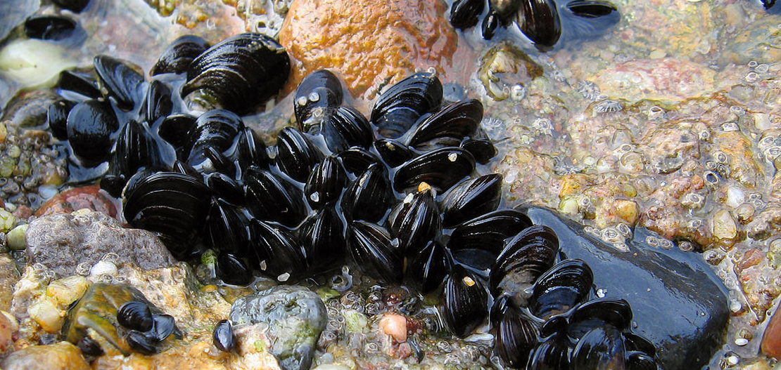
summary
The mussels could be used for temporal biomonitoring
The risks for human population are low, but with wide temporal range for specific elements
The low levels could be increased due to anthropogenic activities
The guideline limits should be tested on typical groups of food (mussels) and reassessed
Ratios El/Al, El/Sc, El/Th in soft tissue could be used as indicator of terrigenous matter (river runoff and storm resuspending of sediments)
The range of controlled elements should be expanded
Temporal studies on the local populations should be conducted

Slide 16
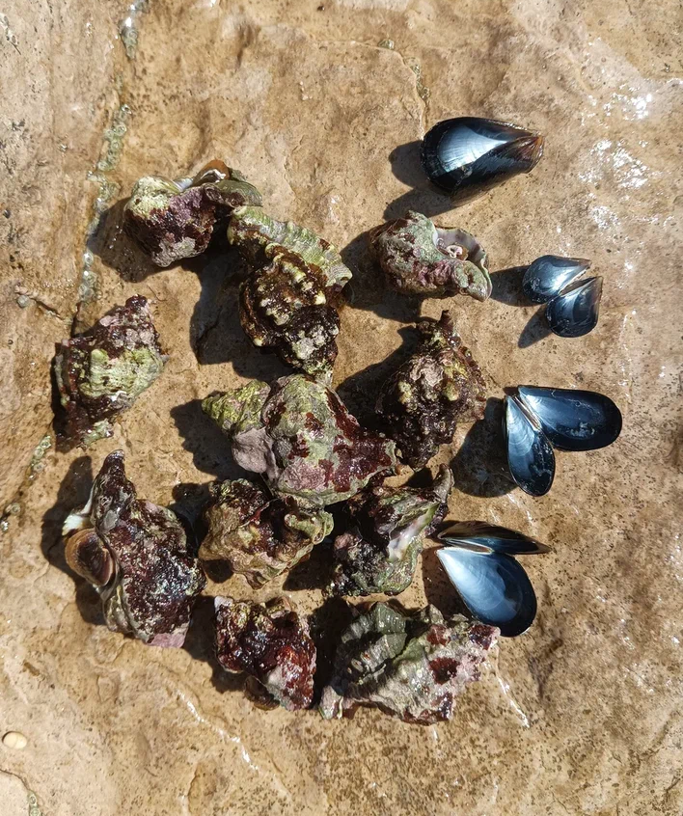
Thank you for attention!
Pavel Nekhoroshkov
Researcher in
Sector of Neutron activation analysis and Applied research
p.nekhoroshkov@gmail.com

