Slide 1

«Enhanced Directional Extraction of Very Cold Neutrons Using a Diamond Nanoparticle Powder Reflector»
Alexander Nezvanov,
Researcher at Frank Laboratory of Neutron Physics

Slide 2
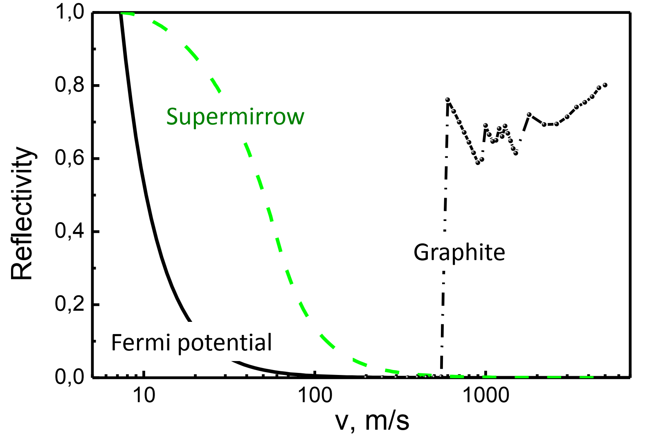
Very Cold Neutrons
Ultracold Neutrons
(4 m/s)
Cold Neutrons
(500 m/s)
Very cold neutrons (VCN):
the typical wavelengths are 2.5–60 nm;
the velocities are 20–160 m/s;
the energies are 0.25–130 μeV;
the temperatures are 3×10⁻³–1.55 K.
The reflection probability for isotropic neutrons with different velocities.

Slide 3
VCN Applications
The VCN advantages are:
• long time of observation;
• large angles of reflections from mirrors;
• larger phase shift and as result more sensitive to contrast variation;
• large coherent length;
• large capture cross-section and big contrast at transmission;
• structure analysis of large molecular complexes; etc.
The main disadvantage is a low flux intensity!
Neutron techniques:
SANS;
spin-echo;
TOF spectroscopy, in particular, high-resolution inelastic scattering;
reflectometry, diffraction, microscopy, holography, tomography, etc.
Fundamental Physics:
a search of extra-short-range interactions at neutron scattering;
experiments with neutrons in a whispering gallery;
beam experiment to measure of the neutron decay, etc.

Slide 4

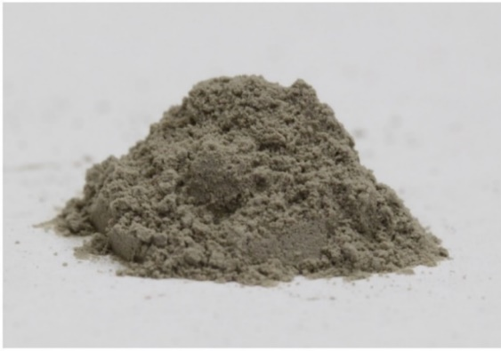
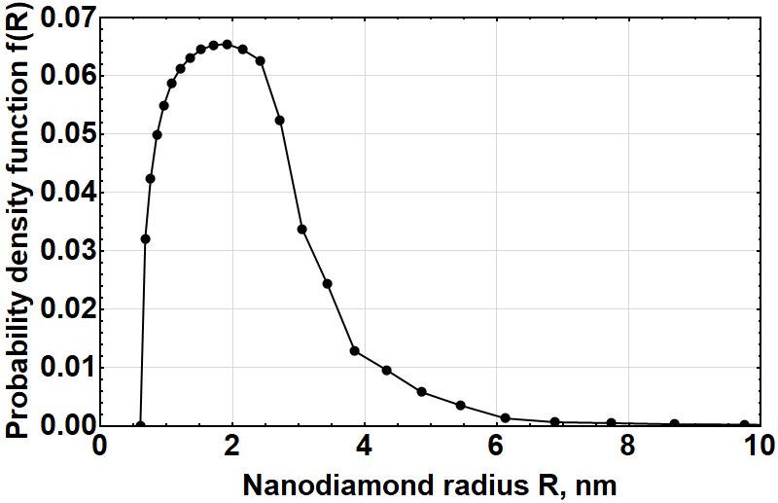
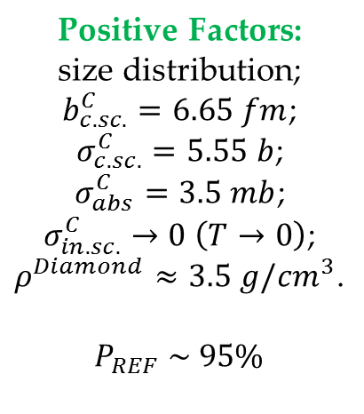

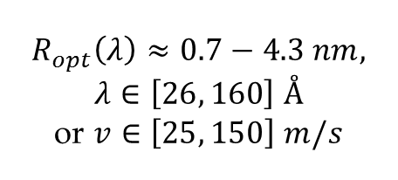

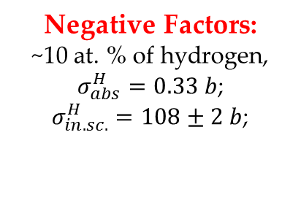
VCN Reflector
Criteria for the VCN reflector are minimum losses and maximum reflection.
Detonation nanodiamonds (DND) are the ideal candidate!
$$P_{REF}^{max}: R_{opt}≈0.27λ$$
$$R_{opt}\left(λ\right)≈0.7−4.3 nm,$$
$$λ∈\left[26, 160\right] Å$$
or $v∈\left[25, 150\right] m/s$
Positive Factors:
size distribution;
$b_{c.sc.}^{C}=6.65 fm$;
$σ_{c.sc.}^{C}=5.55 b$;
$σ_{abs}^{C}=3.5 mb$;
$σ_{in.sc.}^{C}→0 \left(T→0\right)$;
$ρ^{Diamond}≈3.5 g/{cm}^{3}$.
$$P_{REF} \sim 95\%$$
Negative Factors:
~10 at. % of hydrogen,
$σ_{abs}^{H}=0.33 b$;
$σ_{in.sc.}^{H}=108±2 b$;
Implemented solutions:
the fluorination of DND
$C/H=7.4±0.2$ (before)
$C/H=430±30$ (after)
The possible scheme of the VCN source.

Slide 5
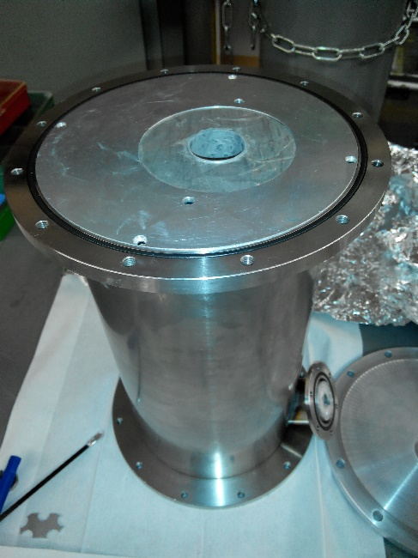
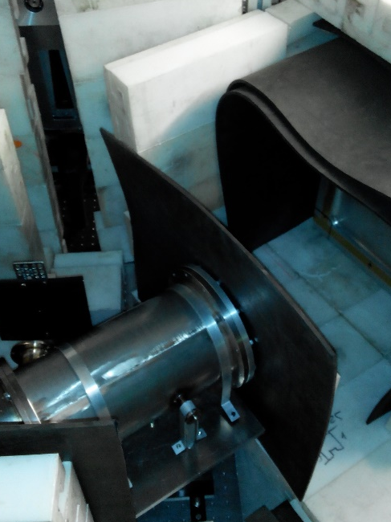
Experimental Extraction System for Very Cold Neutrons
Schematic layout of the experimental setup.
1 - a cylindrical tube made of reflector; 2 - a reflector in the disk shape;
2’ - the disk position when measuring the incident beam flux;
3 - a rotating velocity selector with screw slits;
4 - a position-sensitive detector (PSD) for measuring the flux of escaping neutrons; 4’ - the PSD position when measuring the incident beam flux;
4” - the PSD position when measuring the angular distribution of escaping neutrons; 5 - a Cd-diaphragm; 6 - an evacuated volume.
Photos of an evacuated volume of the reflector (on left) and the installation setup (on right).

Slide 6
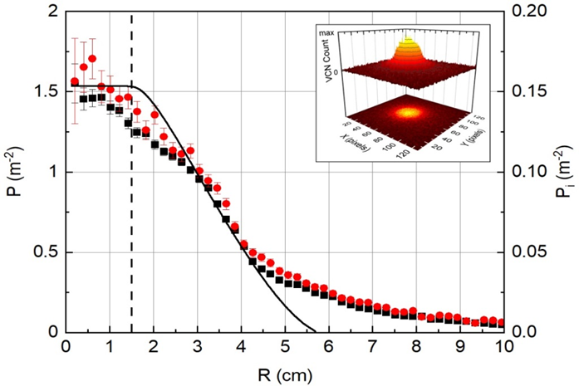
Experimental Results
26 cm
1
72 cm
3
3 cm
30.3 cm
The radial dependence of the specific probability of VCN detection.
Experiments: — 57 m/s, — 75 m/s.
Right axis and solid line indicate the specific probability of VCN detection calculated for the homogeneous isotropic source. Vertical dashed line stands for the reflector cavity and the Cd diaphragm radii. The insert shows a map of the PSD counts by pixels for ~75 m/s.
2
3 cm
Geometry for calculating an isotropic VCN source:
1 — a position-sensitive detector (PSD) ; 2 — the isotropic source of VCN; 3 — Cd-diaphragm.

Slide 7
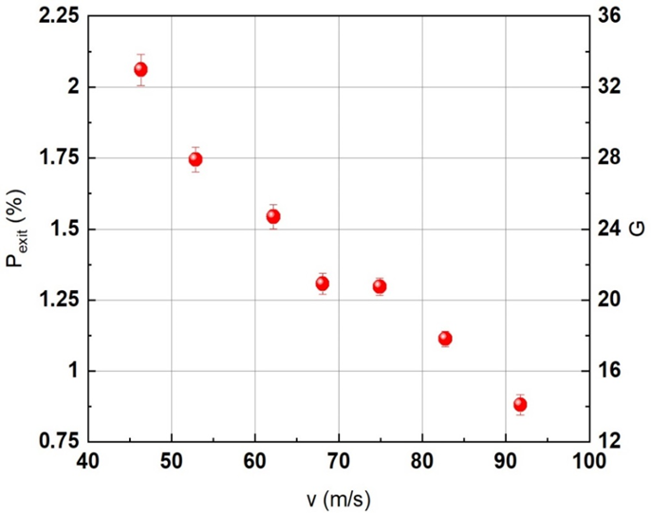
Experimental Results
26 cm
1
3
3 cm
34 cm
30.3 cm
2
3 cm
Left axis: the probability of VCN extraction from the reflector.
Right axis: the corresponding gain factor G.
Geometry for calculating an isotropic VCN source:
1 — a position-sensitive detector (PSD) ;
2 — the isotropic source of VCN;
3 — Cd-diaphragm.

Slide 8
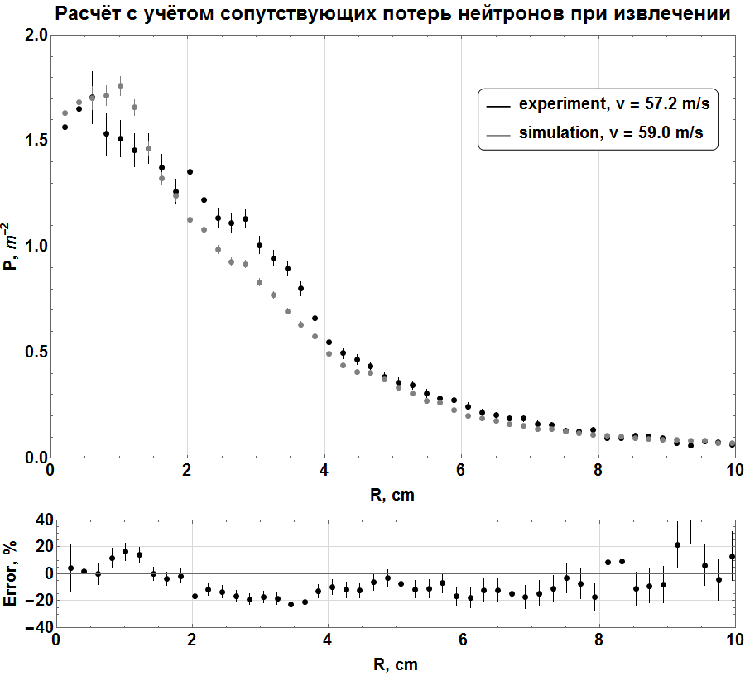
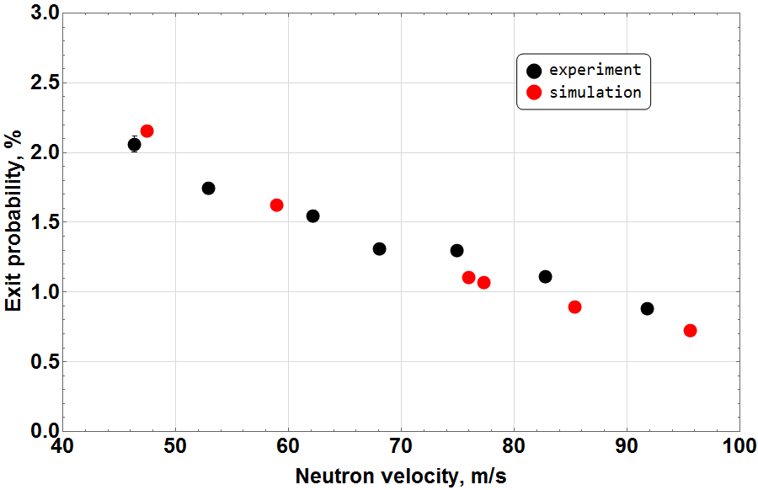
Simulation of the Experiment
The probability for neutron to escape the reflector through the open end.
The radial dependence of the specific probability of very cold neutron detection.
The model gives us the opportunity to calculate the reflection coefficient (albedo), as well as the efficiency of the full-scale reflector.
Average error for the point is 11.9 ± 1.4 %.

Slide 9
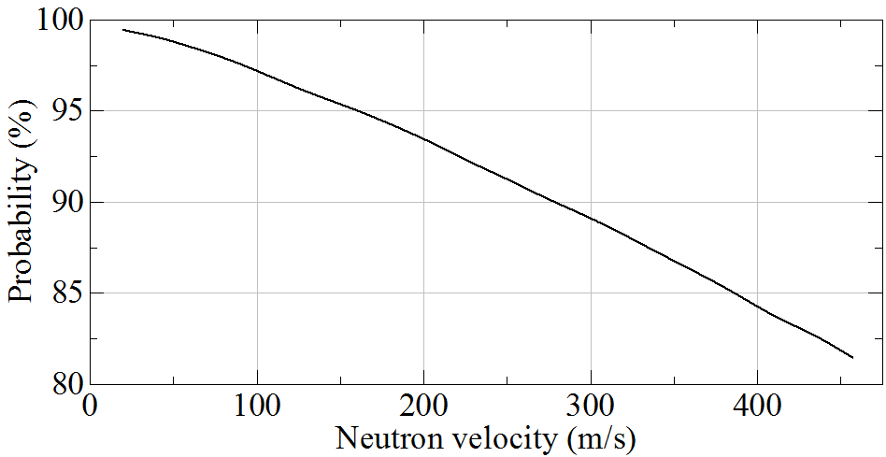
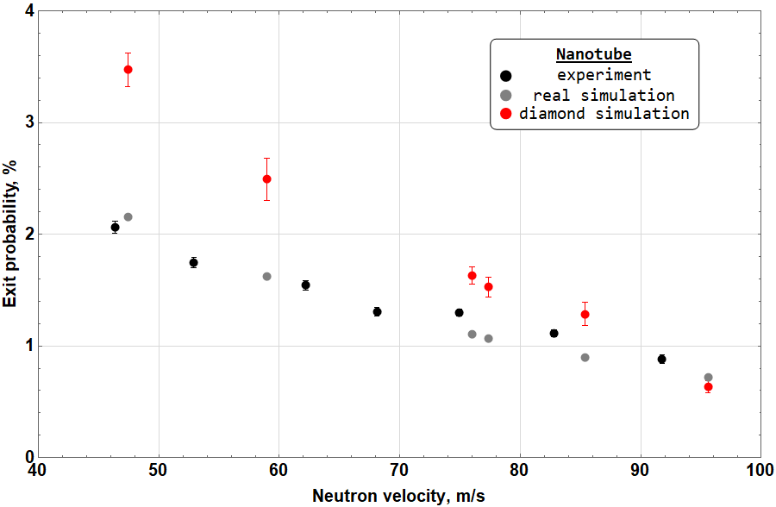
Using the Model for Calculation of Unknown Parameters
Neutron albedo for the semi-infinite flat layer of fluorinated nanodiamonds.
The exit probability for diamond walls instead of the Mg ones.

Slide 10
Conclusions
The first experiment demonstrating the possibility of directional extraction of very cold neutrons using a nanodiamond reflector was conducted.
The existing model was verified via the simulation of the experiment.
Simulation of the experiment expands the possibilities for the analysis and interpretation of experimental data.
The obtained results could be used for the development of the ultracold and very cold neutron source in Dubna.

Slide 11
Thank you all for your kind attention!
Alexander NEZVANOV, Ph.D.
nezvanov@jinr.ru
Frank Laboratory of Neutron Physics
Joint Institute for Nuclear Research, Dubna.

