Slide 1


Control Facilities in NICA Project
Full name
Youmna Ghoneim

Slide 2
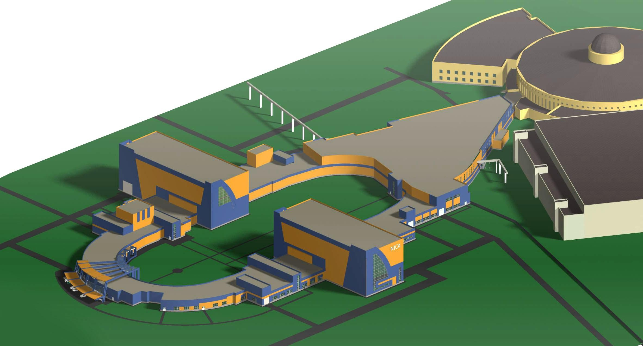
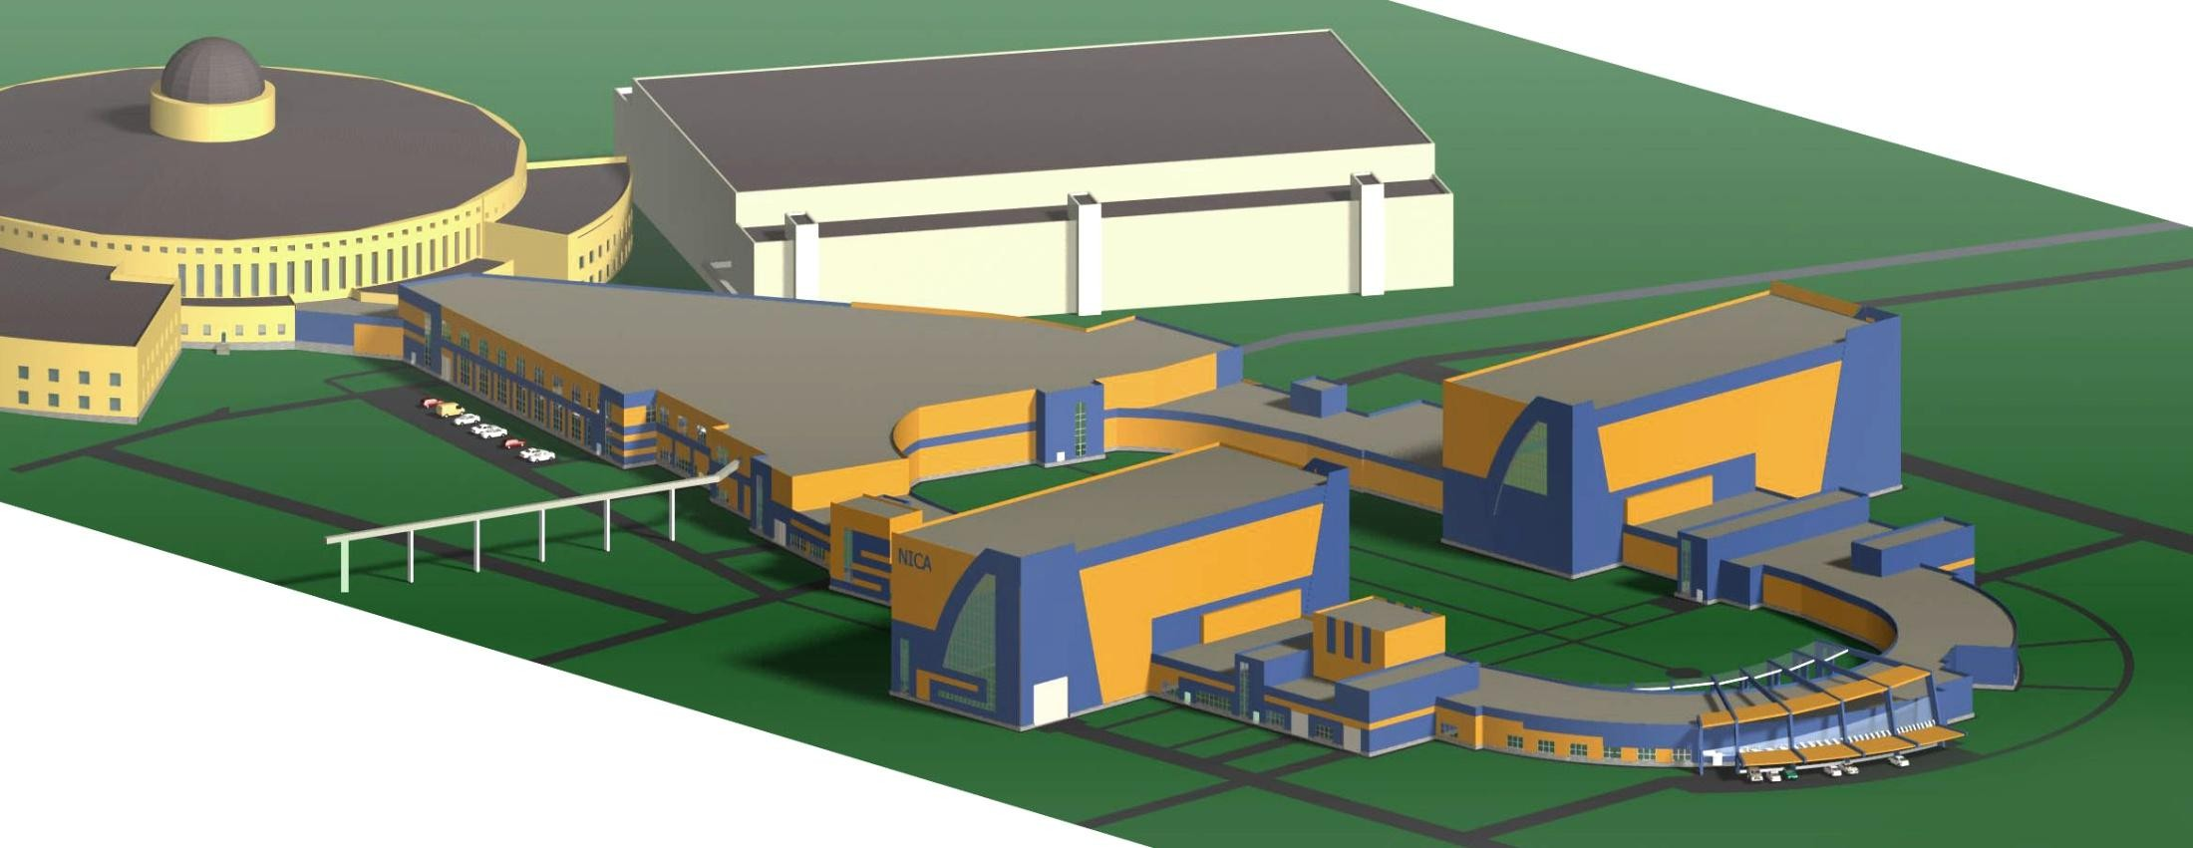

Nuclotron-based Ion Collider fAcility (NICA)
3

Slide 3
Control Facilities in NICA in Current Days
There is only one main control room, which can be classified as a control centre.
According to this definition, a combination of control rooms, control suites, and local control stations that are functionally related and all on the same site has access to control and monitor all the systems and subsystems for the NICA Project.
2. There is only one control suite in the facility.
According to this definition, a group of functionally related rooms, co-located with the control room and including it, that house the supporting functions of the control room, such as related offices, equipment rooms, rest areas, and training rooms.
3. There are only 6 control rooms

Slide 4
Control Facilities in NICA in Current Days
one main control room, which can be classified as a control centre.
only one control suite in the facility
There are only 6 control rooms

Slide 5
Control Rooms in NICA in Current Days
There is only one main control room, which can be classified as a control centre.
According to this definition, a combination of control rooms, control suites, and local control stations that are functionally related and all on the same site has access to control and monitor all the systems and subsystems for the NICA Project.
2. There is only one control suite in the facility.
According to this definition, a group of functionally related rooms, co-located with the control room and including it, that house the supporting functions of the control room, such as related offices, equipment rooms, rest areas, and training rooms.
3. There are only 6 control rooms

Slide 6
Current Control Suite
Management for control and monitoring through the Control Suite.
1.Radio biological Protection
2.Magnetic Vacuum subsystems
3.Ion Sources Linear Accelerator
4.Beam transfer channels from Linear accelerator to Cyclotron

Slide 7
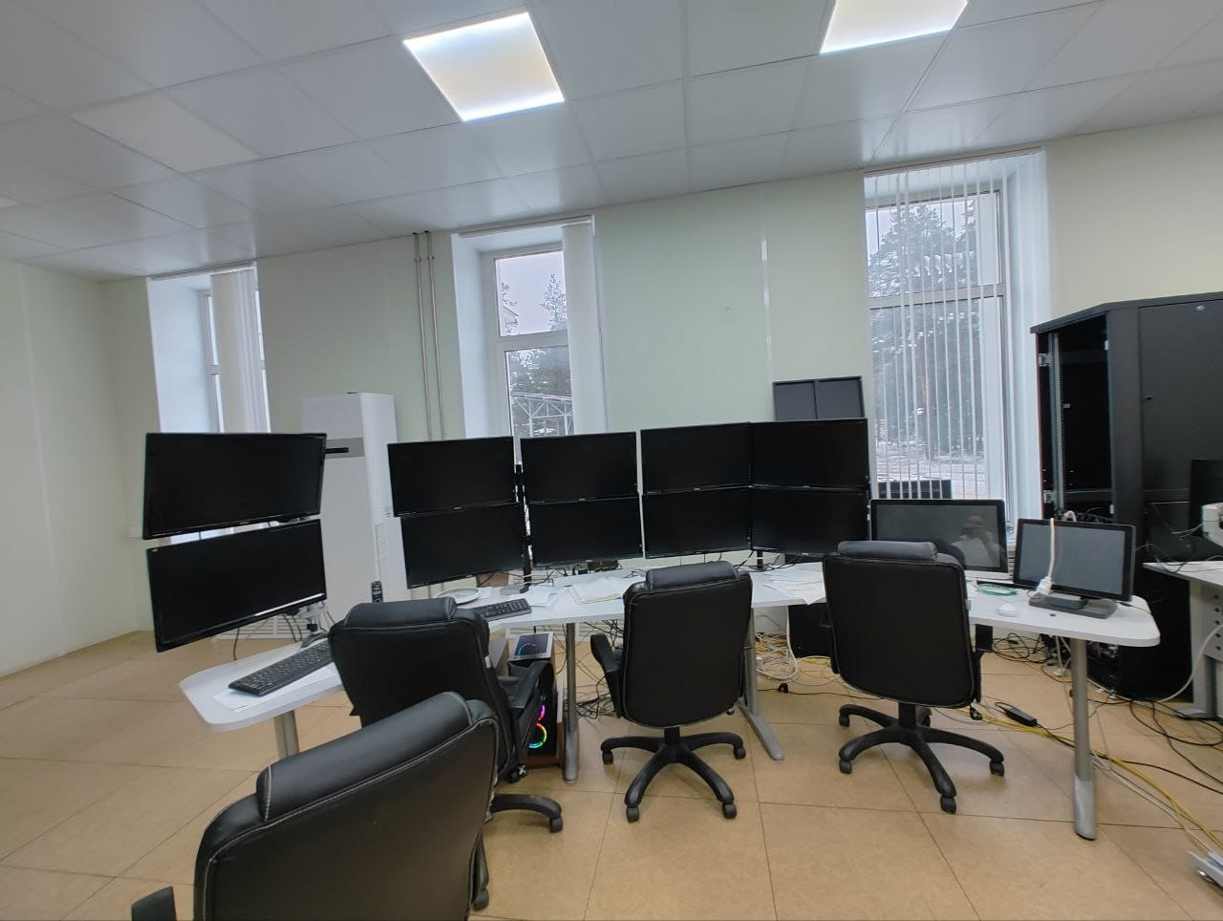
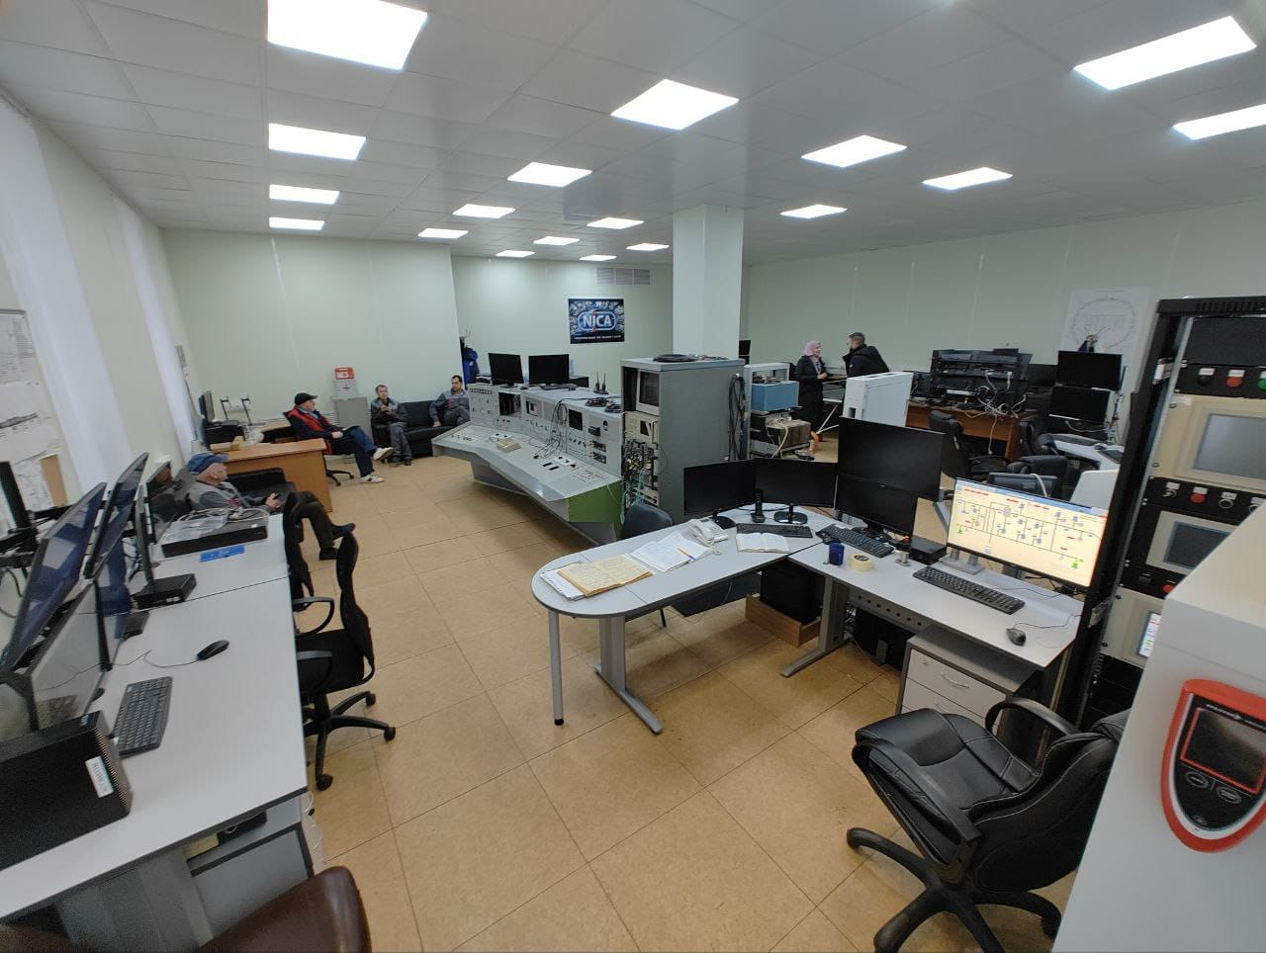
Current Control Suite

Slide 8
Current 6 Control Rooms
1. Manage power supplies.
2.quench protection
3. beam transfer channel from nuclotron to physical experiment
4.current leads
5. Two control rooms operate in remote mode for any emergent situation.

Slide 9
Control Rooms in NICA for 2025 Plan
There will be only one main control room, which can be classified as a control centre.
According to this definition, a combination of control rooms, control suites, and local control stations that are functionally related and all on the same site has access to control and monitor all the systems and subsystems for the NICA Project.
2. There will be only one control suite in the facility, as the current one.
According to this definition, a group of functionally related rooms, co-located with the control room and including it, that house the supporting functions of the control room, such as related offices, equipment rooms, rest areas, and training rooms.
There will be only 6 control rooms
4. The management will base its work to decrease the number of operators staff.

Slide 10
Control Facilities in NICA for 2025 Plan
one main control room, which can be classified as a control centre.
only one control suite in the facility
There will be decreasing in number of control rooms
The management will base its work to decrease the number of operators staff.

Slide 11
Control Suite for 2025 Plan
Management for control and monitoring through the Control Suite.
1.Radio biological Protection
2.Magnetic Vacuum subsystems

Slide 12
How do you train an operator from a junior to an experienced level?
1. Each operator has to learn through the training, both academic and technical, for the management and control procedures.
2. Learn the rules of the JINR organization, which aims to teach them the rules to manage and control a variety of systems and subsystems and the contact between each of them.
3. Exams of operators after each training
4. The junior operators don't have the excess to control work and have shifts before working under supervision for some time, and they confirmed that they can manage their work without errors.

Slide 13
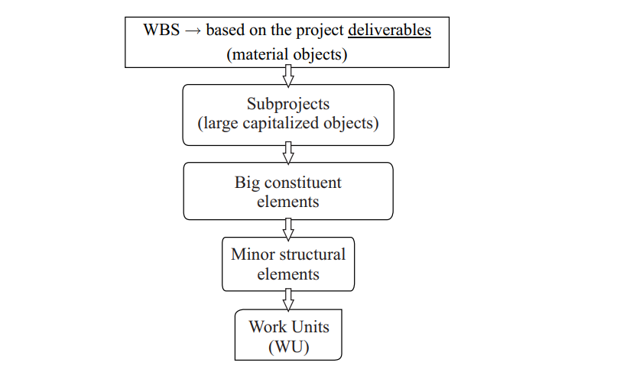
FIRST STAGE. PRELIMINARY ANALYSIS OF NICA PMIS
NICA PMIS is a program consisting of projects and subprojects, linked by a single goal. The structure of NICA project is based on the principles of the hierarchy and a multi-layered structure where the first level represents subprojects, , the second level- the major constituent elements, then smaller structural elements, equipment and activities, and the last level Å work units.
Fig: The NICA project structure

Slide 14
SECOND STAGE. OPERATING SYSTEM APT EVM AT JINR
In 2010, JINR and CERN signed a formal agreement on the exchange of experiences and transfer of functional modules of information system APT EVM at JINR for using this system in the management of the project NICA.
The APT EVM system was developed in the early 2000s as part of the complex AIS at CERN. In the first step it was decided to conduct a pilot project of PMIS.
The main goals of the NICA PMIS project are: Functional analysis of APT EVM; Identification of the possibilities of APT EVM. The second step was made to install a separate module APT EVM at CERN site and JINR staff organized access to it.

Slide 15
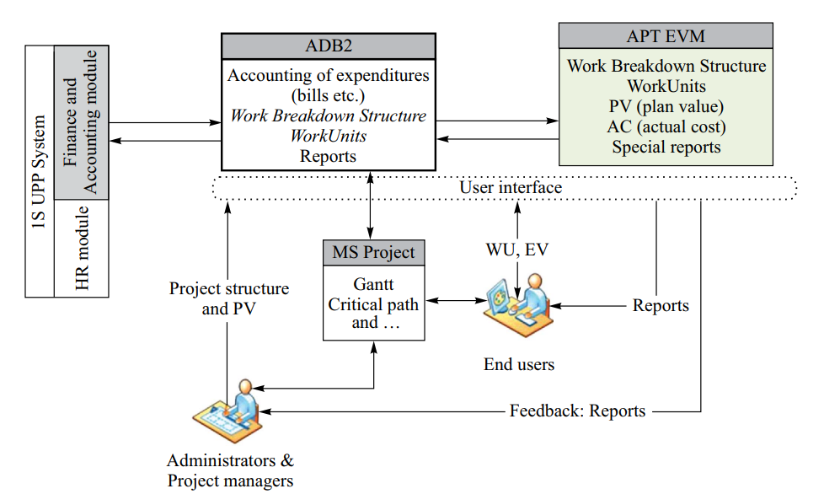
The resulting scheme of work in the PMIS

Slide 16
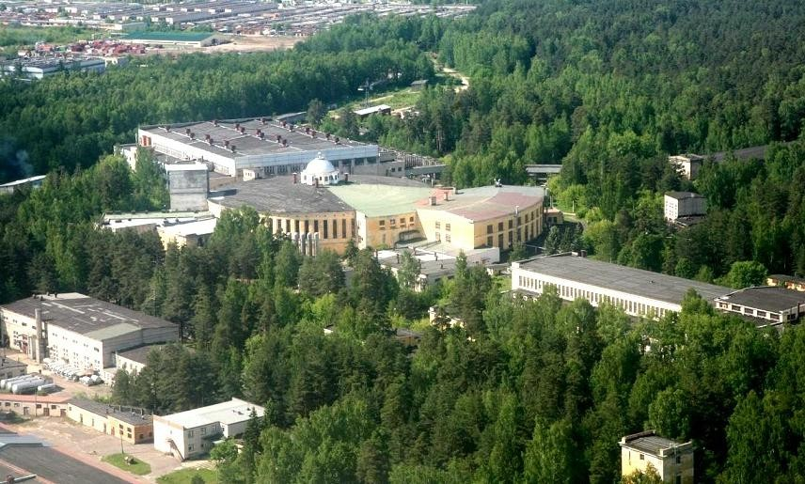








NICA
FT experiment area
bld. 205 (10⁴ m²)
Collider
New Linac
Nuclotron
Booster
Lu 20
4

Slide 17

Thanks for your Attention
Telegram Contact
Full Name
Youmna Ghoneim
Tel.: +7 (923) 40 80 895
E-mail: youmnasami24@gmail.com, Ghoneim@jinr.ru
04.12.2023

