Slide 1
the ALICE High Level Trigger at the LHC
By Alaa ElSadieque

Slide 2
General description
The HLT is a compute farm composed of 180 worker nodes and 8 infrastructure nodes.
It receives an exact copy of all the data from the detector links.
After processing the data, the HLT sends its reconstruction output to the Data Acquisition (DAQ) via dedicated optical output links.

Slide 3
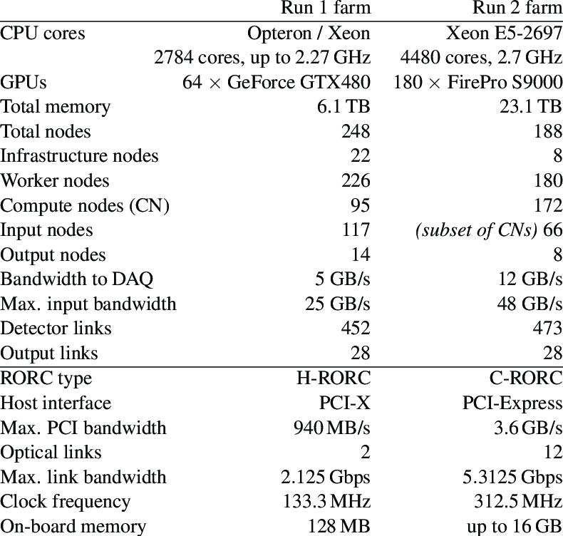
Overview of the HLT Run 1 and Run 2 production clusters.

Slide 4
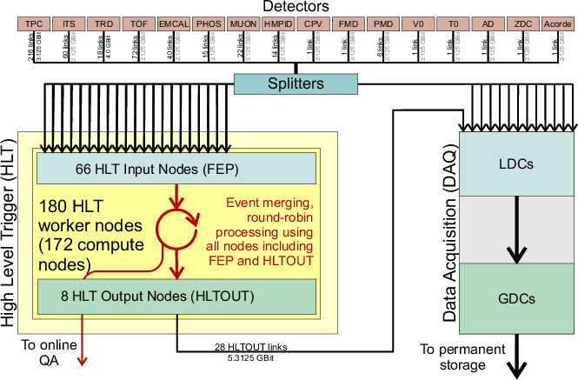
The ALICE HLT in the data readout scheme during Run 2. In the DAQ system the data flow through the local and the global data concentrators, LDC and GDC, respectively. In parallel, HLT ships QA and calibration data via dedicated interfaces.

Slide 5
The compute nodes use off-the-shelf components except for the Read Out Receiver Card (RORC), which is a custom FPGA-based card developed for Run 1 and Run 2. During LHC Run 1 the HLT farm consisted of 248 servers including 117 dedicated Front-End Processor (FEP) nodes equipped with RORCs for receiving data from the detectors and sending data to DAQ.
The servers consisted of standard compute nodes, each equipped with either AMD Magny-Cours twelve-core CPUs or Intel Nehalem Quad-core CPUs. Among them, 64 nodes had NVIDIA Fermi GPUs for hardware acceleration in track reconstruction. Additionally, there were about 20 infrastructure nodes for tasks like provisioning, storage, database services, and monitoring.
The cluster had two separate networks: a gigabit Ethernet network for management and a fast fat-tree InfiniBand QDR 40 GBit network for data processing. Remote management of compute nodes utilized a custom FPGA-based CHARM card and BMC (Board Management Controller) iKVM, which supports IPMI (Intelligent Platform Management Interface) standard in new compute nodes.

Slide 6
ALICE Control Coordination (ACC)
the functional unit mandated to co-ordinate the execution of the Detector Control System (DCS) project.

Slide 7
Technical competencies in ACC
Safety aspects (member of ACC is deputy GLIMOS)
System architecture
Control system developement (SCADA, devices)
IT administration (Windows, Linux platforms, network, security)
Database development (administration done by the IT deparment)
Hardware interfaces (OPCS, CAN interfaces)
PLCs

Slide 8
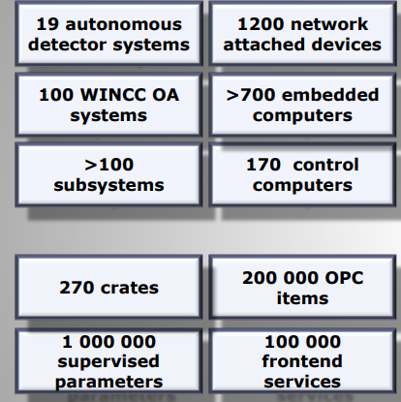
The DCS context and scale

Slide 9
