Slide 1



SOLCRYS
new laboratory for structural research
at the Polish synchrotron SOLARIS:
proposed concept
123rd session of the JINR Scientific Council
Dubna, 22-23 February 2018
Marek Stankiewicz
Notes:
PLAN:
Description of Solaris facility , parameters etc and its position in Poland and on the international level.
- Its current status – existing and constructed beamlines
- Development plans – planned beamlines
- Technical description of the SOLCRYS laboratory – the infrastructure and its parameters – research potential.
History of efforts
Pre-decision times
40MEUR allocated
Conceptual layout of the machine agreed - basic parameters decided
MAX-lab involvement
State of the art machine for small money
Decision
September 2009 application submitted
February 2009 – application granted
March 2010 – contract signed
Solaris basic parameters
Solaris schedule
Solaris current status
The team
The building
The purchasing
The machine
The beamlines
The collaboration

Slide 2

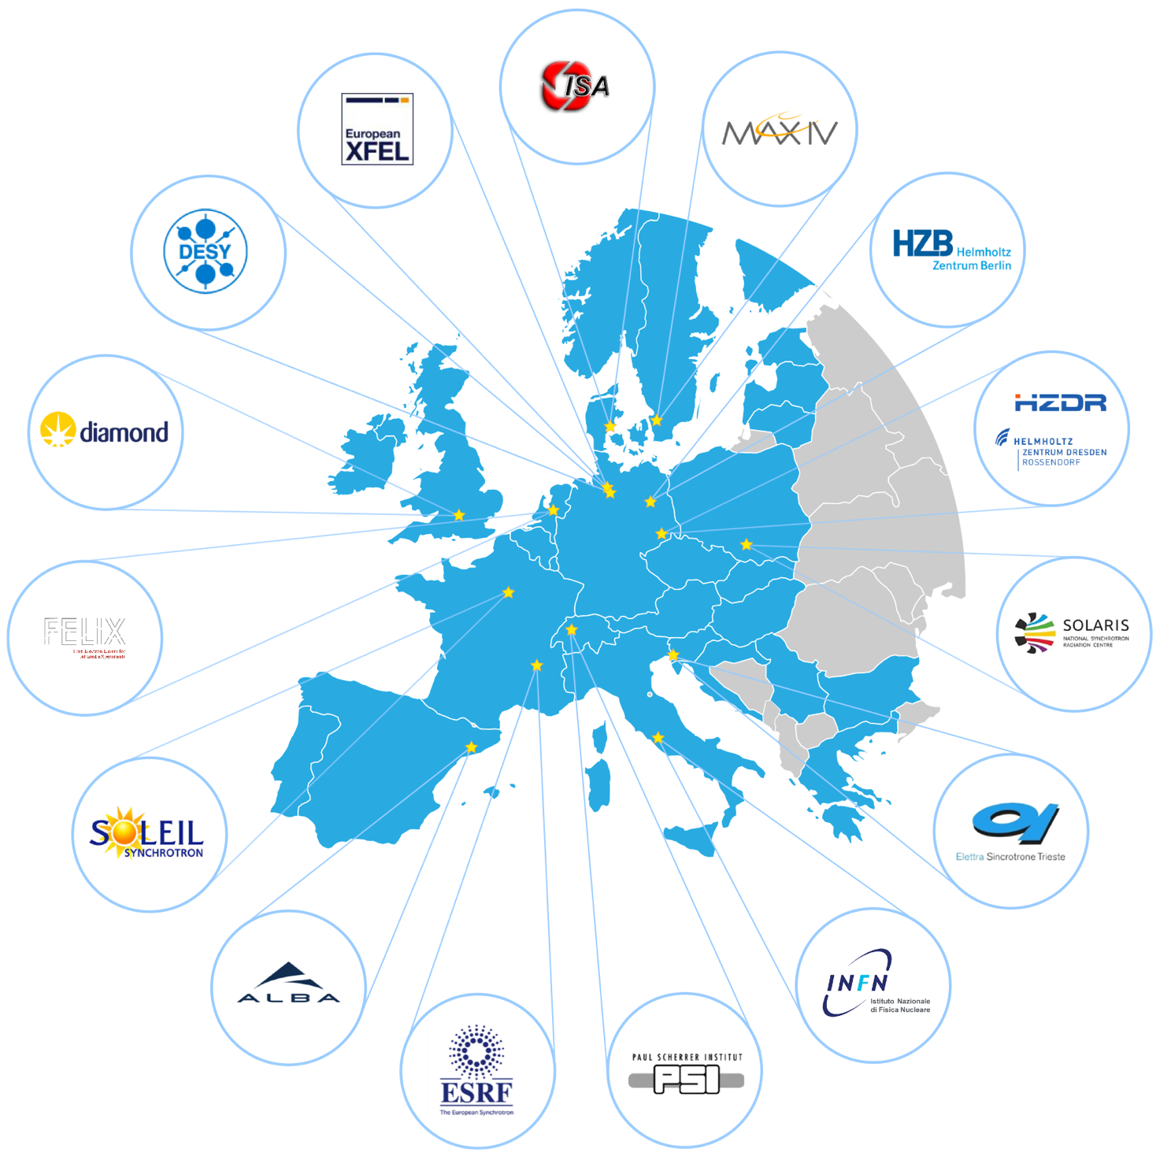
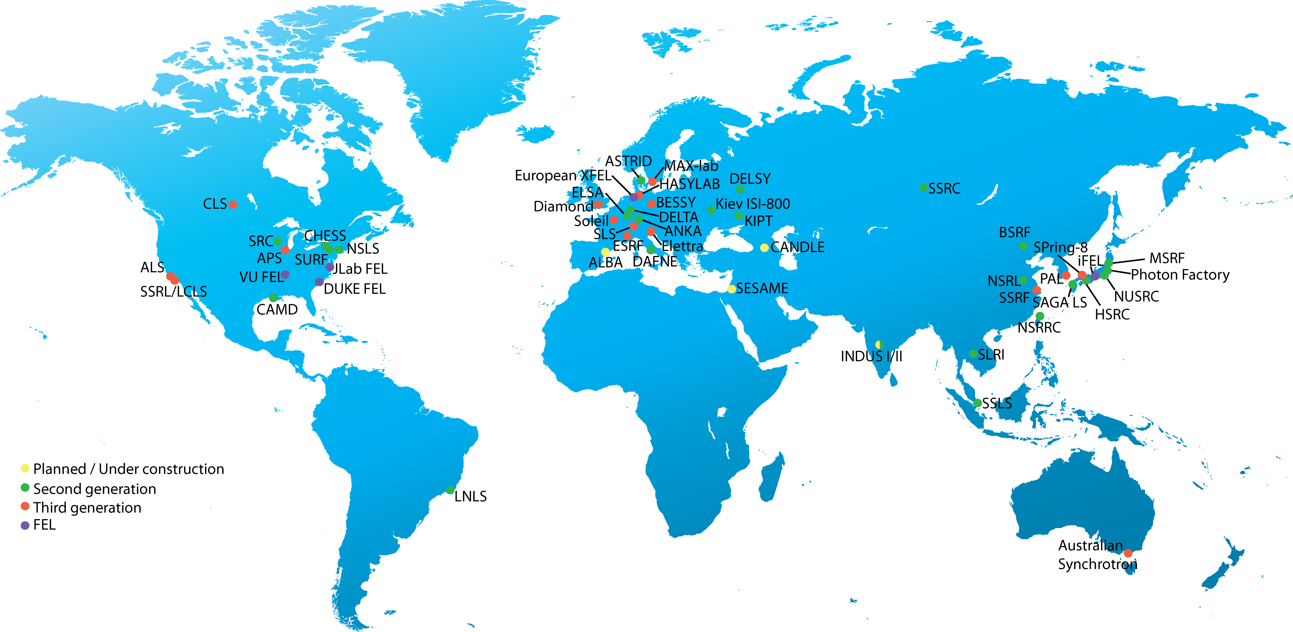
Synchrotrons of the world

Slide 3
What is a synchrotron light source?
Synchrotron Radiation (SR) sources:
purpose built synchrotrons – to generate electromagnetic radiation (EM)
There are many sources of radiation (light) from a single synchrotron
Synchrotrons are of unique designs – of different configurations and sizes – from very small (of few meter circumference) to very large (km)
They operate 24/7 mode
They are true multi user / multidisciplinary facilities
unique, man made sources of EM radiation
Mission:
to provide exceptional opportunities in many areas of research for many groups at the same time

Slide 4
Applications of synchrotron radiation (light) source
Synchrotrons open new research frontiers in
  fundamental research
    Physics
    Chemistry
    Cosmology
    Biology
    Geology
    …….
  applied research
    Material studies
    Environmental science
    Archeology and cultural heritage
    Medicine
    Semiconductor industry
    Pharmaceutical industry
    ……
Multidisciplinary, multiuser research facilities

Slide 5
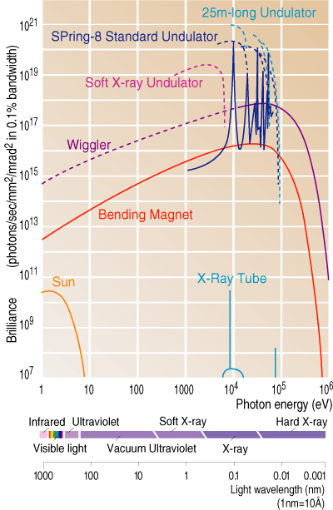
Unique properties of synchrotron light:
Broad spectral range: 10⁻¹ - 10⁵ eV (10⁵ – 10⁻¹ Ǻ)
Monochromaticity
Intensity – millions time stronger than any other
Collimation – pencil like photon beam
Small focus spot (nano meters)
Polarization
Adjustable (pulsed) time structure
torch,
manipulator
scalpel

Slide 6

SOLARIS - Project settings and boundary conditions
Motivation
  Polish synchrotron radiation users community - >300
  Polish Synchrotron Radiation Users Society (PTPS)
  Polish Synchrotron Consortium – 36 members
  Long lasting initiative to built a SR source in PL
  2009 – 40 M€ package assigned (later increased to 10 M€)
Brain Storm - Goal
  The best possible synchrotron radiation source for the money
  MAX-IV Correlation
Collaboration with MAX-lab in Lund
  New MAX-IV facility - 2 rings:
    MAX IV ring: 3 GeV, 528m circumference
    MAX II replacement: 1.5 GeV, 96m circumference ring
  SOLARIS - replica of the new 1.5 GeV MAX-lab ring
  New MAX-lab magnet technology - Integrated Double Bend Achromats

Slide 7
SOLARIS
Project settings and boundary conditions
National Project, executed by Jagiellonian University
Timetable
Conceptual design 2009
Project approved 2010
Project completed: December 2015
Budget
50 M€ - European Union Regional Development Fund,
Innovative Economy Operational Program
Deliverables
Building
Machine (linac + synchrotron)
2 experimental beamlines
TEAM

Slide 8
SOLARIS - Project settings and boundary conditions
Replica of MAX-IV 1.5 GeV ring – but:
  Different building
    Different storage ring tunnel
    Different building infrastructure
  Different injection – linac but not full energy
  Ramping
Uniqueness (first such facility in PL)
  There are no commercially available synchrotrons
  Tailored made design
  Tailored made equipment
Funds: 50 M€ - source:

Slide 9
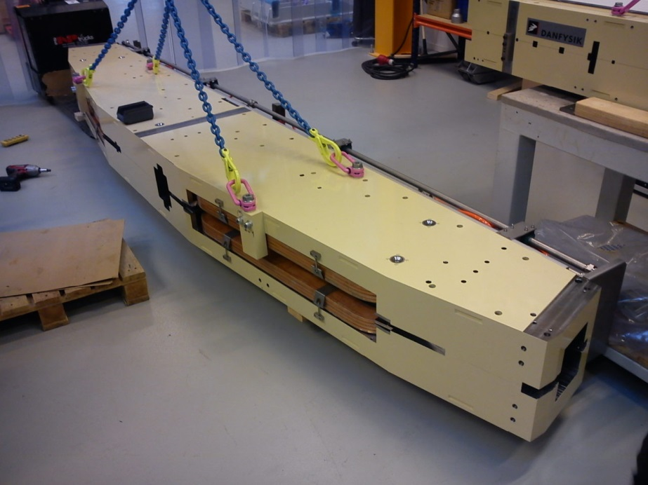
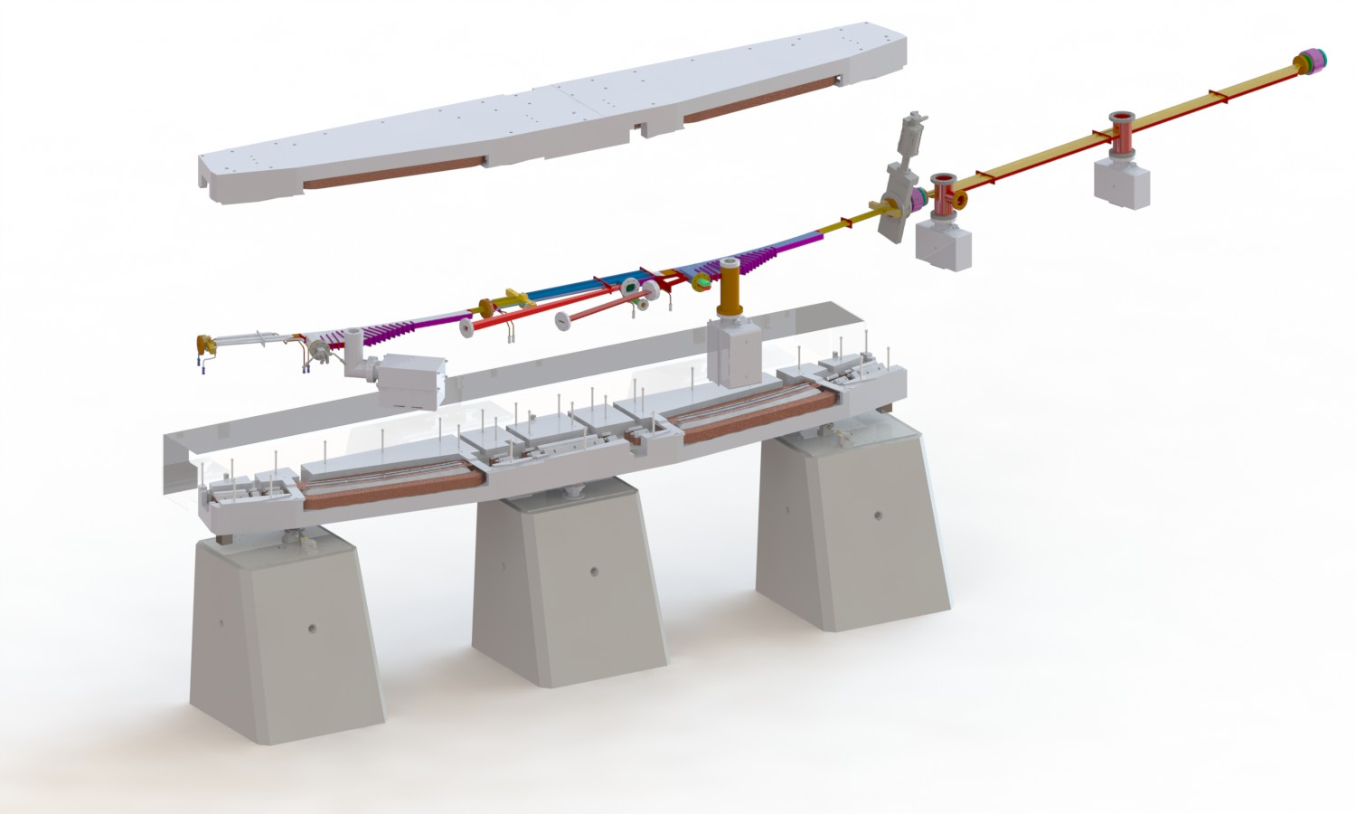
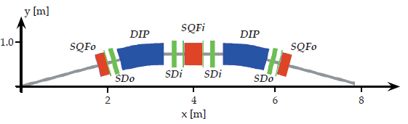
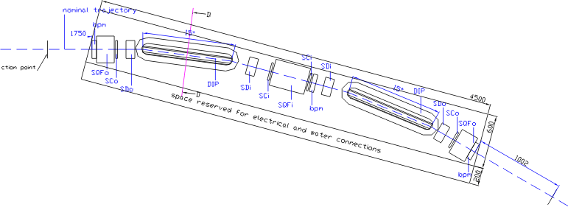

SOLARIS 1.5 GeV ring design - MAX-lab accelerator team - Mikael Eriksson
SOLARIS – unique design
of the storage ring
Ring circumference | 96 m
Electrons’ energy | 1.5 GeV
Injection energy | 0.4-0.7 GeV, upgrade to 1.5 GeV
Current | 500 mA
Bends | 12
Straight section length | 3.48 m
H beam size: 184 um
V beam size:13 um
Emmitance: 5.6 nm rad
Unique, revolutionary design:
single yoke magnetic cells (double bend achromats)

Slide 10
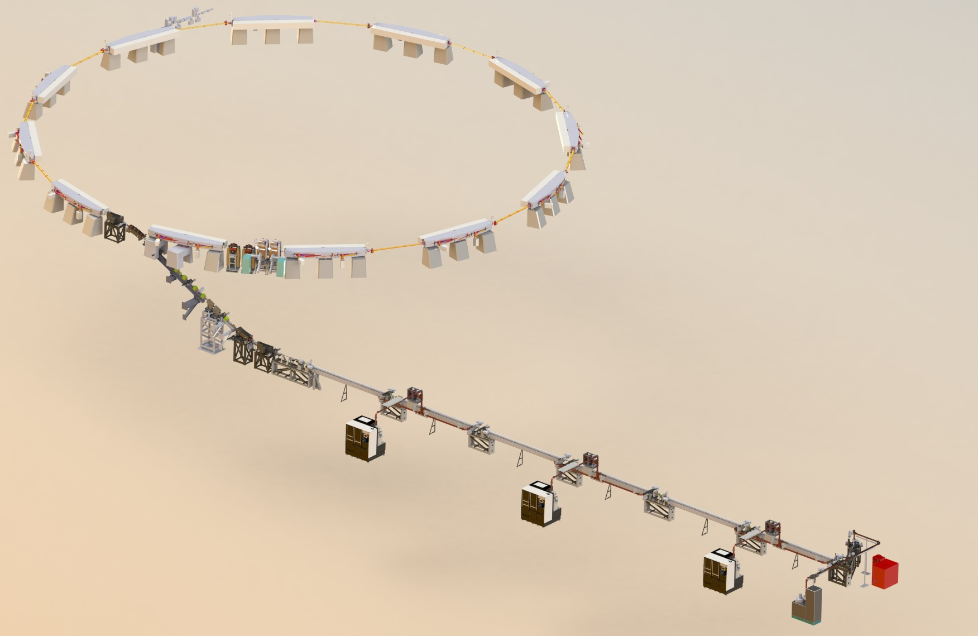
Machine
1.5GeV Storage ring
12 DBA Cells – 96 m circ.
Space for ID’s (10 sections) ~ 3.5 m
10 straight sections for Ids
100 MHz RF system
300 MHz Landau Cavities
Injection dipole kicker
Ramping
Current: 500mA
Emmitance (bare Lattice): 6nmrad
600 MeV Linac
RF Thermionic Gun
6 accelerating structures (in 3 units)
Accelerating gradient 20 MeV/m
S-band – 2998.5 MHz
3 RF Units :
- ScandiNova K2 modulators
Toshiba klystrons
SLED cavities

Slide 11
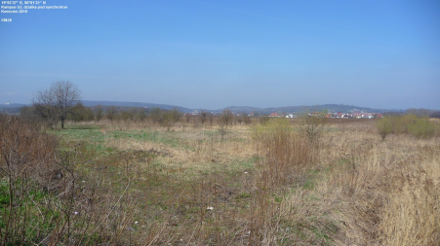
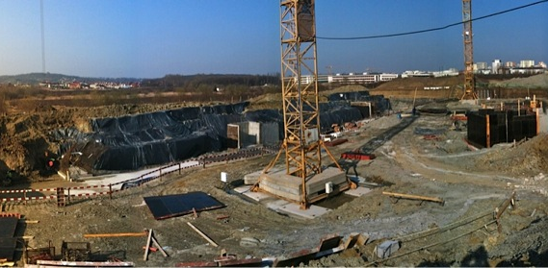
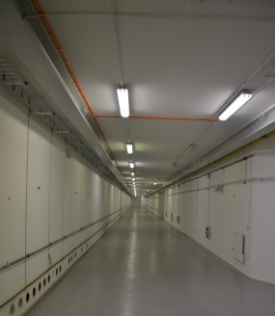
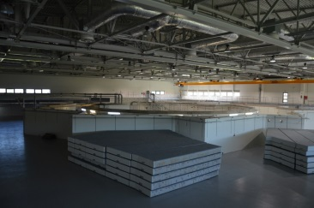
Time schedule
April 2010 – project start
January 2012 – start of the building construction
May 2014 – building handover
June 2014 machine installation

Slide 12
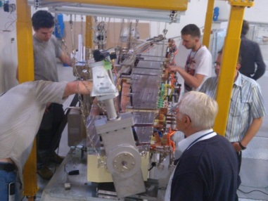
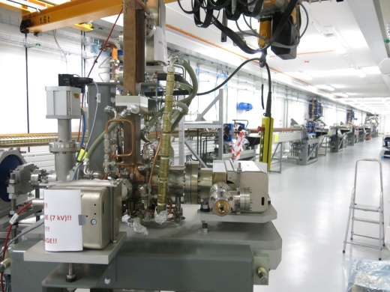
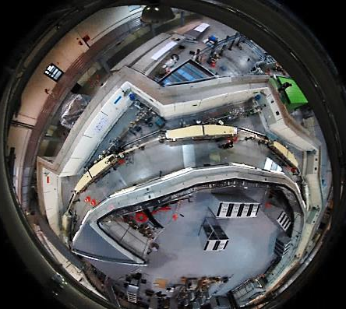
Time schedule
November 2014 linac conditioning start
April 2015 Storage ring installation done
May 2015 Solaris commissioning start
December 2015 end of the project

Slide 13
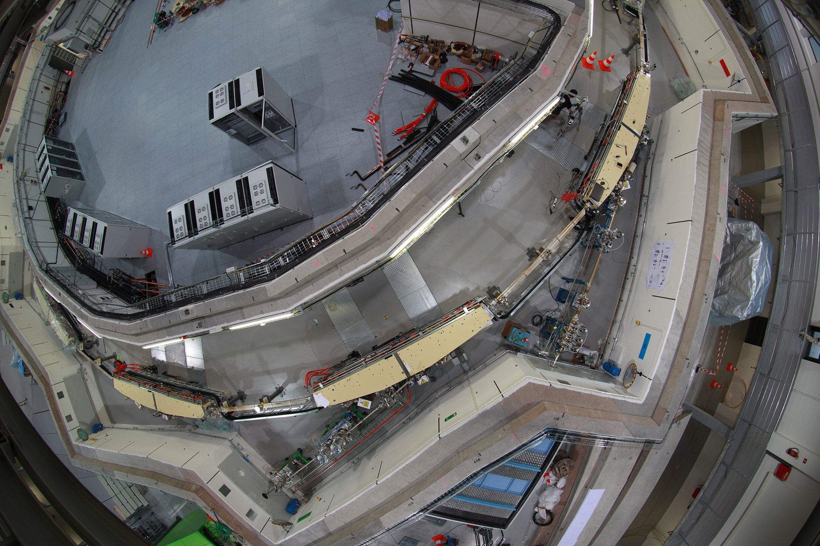

Slide 14
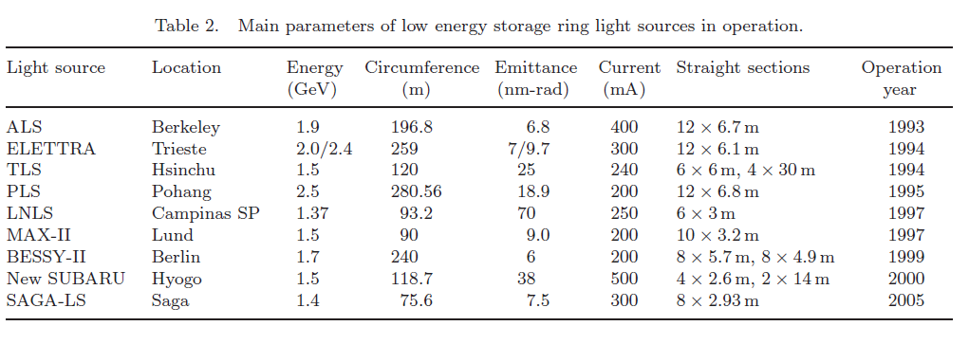
SOLARIS – comparison
SOLARIS Kraków 1.5 96 5.6 500 12 x 3.5 m 2015

Slide 15
In recent years, Polish scientists have also benefited from new facilities for research. Generous EU funding for research and innovation, €14 billion between 2007 and 2013, has led to the creation of 10 new international research centres since 2007, including the Solaris Synchrotron at Kraków’s Jagiellonian University, which began operation in 2015. AM
The selection of rising stars is based on the rate of increase in the countey’scontribution to 68 index journals, a metric known as a Weighted Fractional Count (WFC)

Slide 16
SOLARIS context
The Polish synchrotron is the first research infrastructure of such substantial size and potential constructed in this part of Europe
The synchrotron, being a large-scale, multi-user and multidisciplinary facility represents a very efficient investment in research infrastructure by providing state-of-the-art research opportunities for many research groups
The expected benefits are not limited only to the scientific community
The availability of such a technologically advanced facility also contributes to developments in many areas e.g. enhancing education and training, stimulating hi-tech companies and services, providing new options for the research oriented industry, creation of new jobs
The biggest research infrastructure in Poland
Polish Research Infrastructure Roadmap Facility

Slide 17















Collaboration/acknowlegements
Project success relied on exceptional transnational collaborations
FOREMOST - The freely given design of the MAX IV 1.5 GeV ring and its injector technology by MAX-lab
MAX IV – Solaris Collaboration:
  Training and exchange of personnel
  Exchange of ideas and requirements
  Collaboration in procurements and contract specifications: Procurements for Solaris were as options in MAX IV tenders
  Provision of state-of-the-art components: Gun System, Landau cavities, modifications to vacuum chambers and magnets
  Technical support with industrial follow-up and FATs
  Maximised return for cash by allowing industry to plan for double purchase orders

Slide 18
Collaboration/acknowlegements
Elettra-Sincrotrone Trieste - Expert advice, contracts for PSS, design of transfer line, vacuum chamber components, beamline and front-end, EPU insertion device
Swiss Light Source - Expert advice, trainingBake-out oven and control
Diamond - Expert advice
Soleil - Expert advice, commissioning software
ALBA - Expert advice, commissioing software, training
ESRF - Expert Advice, IcePAP motion controllers
Machine Advisory Committee – Expert advice of 5 world class experts from Diamond, Soleil, PSI
National Centre for Nuclear Research, Świerk - Vacuum system installation inclusive of linac, storage ring and RF cavities.
Polish Synchrotron Consortium (36 universities and institutes)
Polish Synchrotron Radiation Society
Polish Physical Society
PL-Grid
Institute of Catalysis and Surface Chemistry PAS – PEEM End Station
Cracow University of Technology

Slide 19

SOLARIS future – stage II
New beamlines
Linac extension - full energy injection (1.5 GeV)=> 24 hrs operation
Experimental hall extension – more beamlines

Slide 20
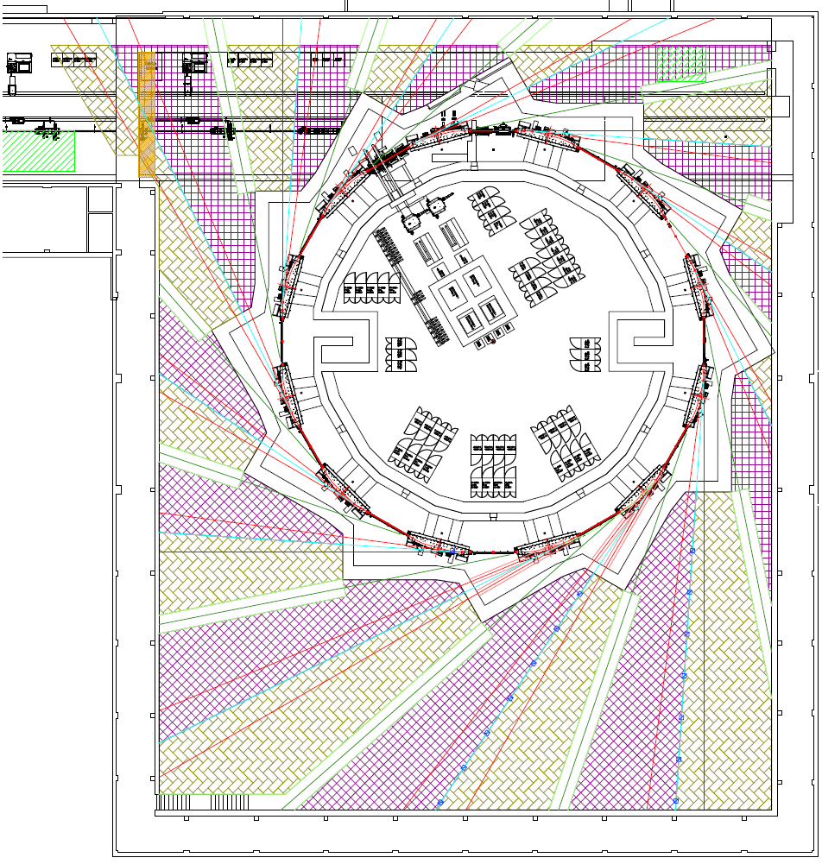
SOLARIS current status
and future development
10-20 m
Short ID
Future Beamlines:
8 straight sections available
for 2.6 m insertion devices
1 straight section available for short (1.5 m) ID
6 BM sources available
PHELIX
UARPES
PEEM/XAS
XMCD

Slide 21
Experimental beamlines @ SOLARIS current status and future development
Name | Techinques | source | energy range [eV]
 | INSTALLED
UARPES | Angle-Resolved Photoelectron Spectroscopy (ARPES) | EPU | 8 - 100
PEEM/XAS | Photoemission Electron Microscopy X-ray Absorption Spectroscopy | BM | 200 - 2000
 | UNDER CONSTRUCTION
PHELIX | angle integrated photoelectron spectroscopy x-ray absorption techniques in the TEY and TFY modes angle resolved photoemission spin resolved photoemission | EPU | 50 - 1500
XMCD | X-ray Magnetic Circular Dichroism XMCD | EPU | 100 - 2000
OPTIDIAG | Machine Diagnostics | BM | 1.6 - 3.4
 | APPLICATIONS SUBMITTED
SX MNISW funds | X-ray absorption spectroscopy XANES (X-ray Near Edge Absorption Spectroscopy) EXAFS (Extended X-ray Absorption Fine Structure Spectroscopy) XES (X-ray emission spectroscopy) | BM | 2.4 - 10000
FTIR CERIC or MNISW funds? | Absorption microspectroscopy Imaging | BM | 0.05 - 0.5
STXM (XMCD branch) CERIC funds | Scanning Trensmission X-ray Microscopy | EPU | 100 - 2000

Slide 22
Experimental beamlines @ SOLARIS current status and future development
 | PLANNED
MIDAMAX | X-ray absorption, micro imaging diffraction, magnetic dichroism | BM | 1000 - 15000
XAS/XES | Resonant X-ray Emission Spectroscopy (RXES) HR X-ray Absorption Spectroscopy (HR-XAS) High Energy Resolution Off-Resonanat Spectroscopy (HEROS) X-ray Emission Spectroscopy (XES) | IN VAC UND | 2000 - 10000
POLYX | X-ray microimaging, Microtomography X-ray fluorescsence, Fluorescsence tompography Diffraction/topography | BM | 5000 - 16000
NAPXPS (PHELIX branch) collaboration with Czech Republic | near ambient pressure X-ray photoelectron spectroscopy | EPU | 50 - 1500
XRF/XAS collaboration with Germany | XAS: transmission, fluorescence, electron yield | BM | 1300 - 12000
MX-BioSAXS-PD collaboration with JINR? | MX – Macromolecular Crystallography diffraction of single crystals (incl. protein crystallography) SAXS - Small Angle X-ray Scattering PD - Powder Diffraction X-ray absorption spectroscopy | SC Wiggler or in-vac undulator | 6000-25000

Slide 23
Line MX-BioSAXS-PD
Representing person | prof. Maciej Kozak (Department of Physics UAM)
POLISH research groups interested in cooperation on development and uses of the line | prof. Adam Patkowski ( Dep. of Physics UAM) prof. Mariusz Jaskólski (Dep. of Chemistry UAM, Institute of Bioorganic Chemistry Polish Academy of Sciences-IChB PAN) dr hab. Paweł Piszora (Dep. of Chemistry UAM) prof. Artur Jarmołowski (dep. of Biology UAM) prof. Wojciech Rypniewski (Institute of Bioorganic Chemistry Polish Academy of Sciences- IChB PAN) Institute of Bioorganic Chemistry Polish Academy of Sciences, Poznań University of Technology, Dr Sebastian Glatt -Małopolska Center of Biotechnology Prof. Marcin Nowotny-International Institute of Molecular and Cell Biology in Warsaw (IIMCB)
Energy range | 6 - 25 keV
The source of radiation: | Wiggler 3.5T or vacuum undulator
Research stands | 3 end stations enabling measurements in 4 modes of measurement - diffraction of single crystals (in particular protein crystallography), - X-ray small angle scattering, - powder diffraction, - X-ray absorption spectroscopy
construction TIME | 3-4 years

Slide 24
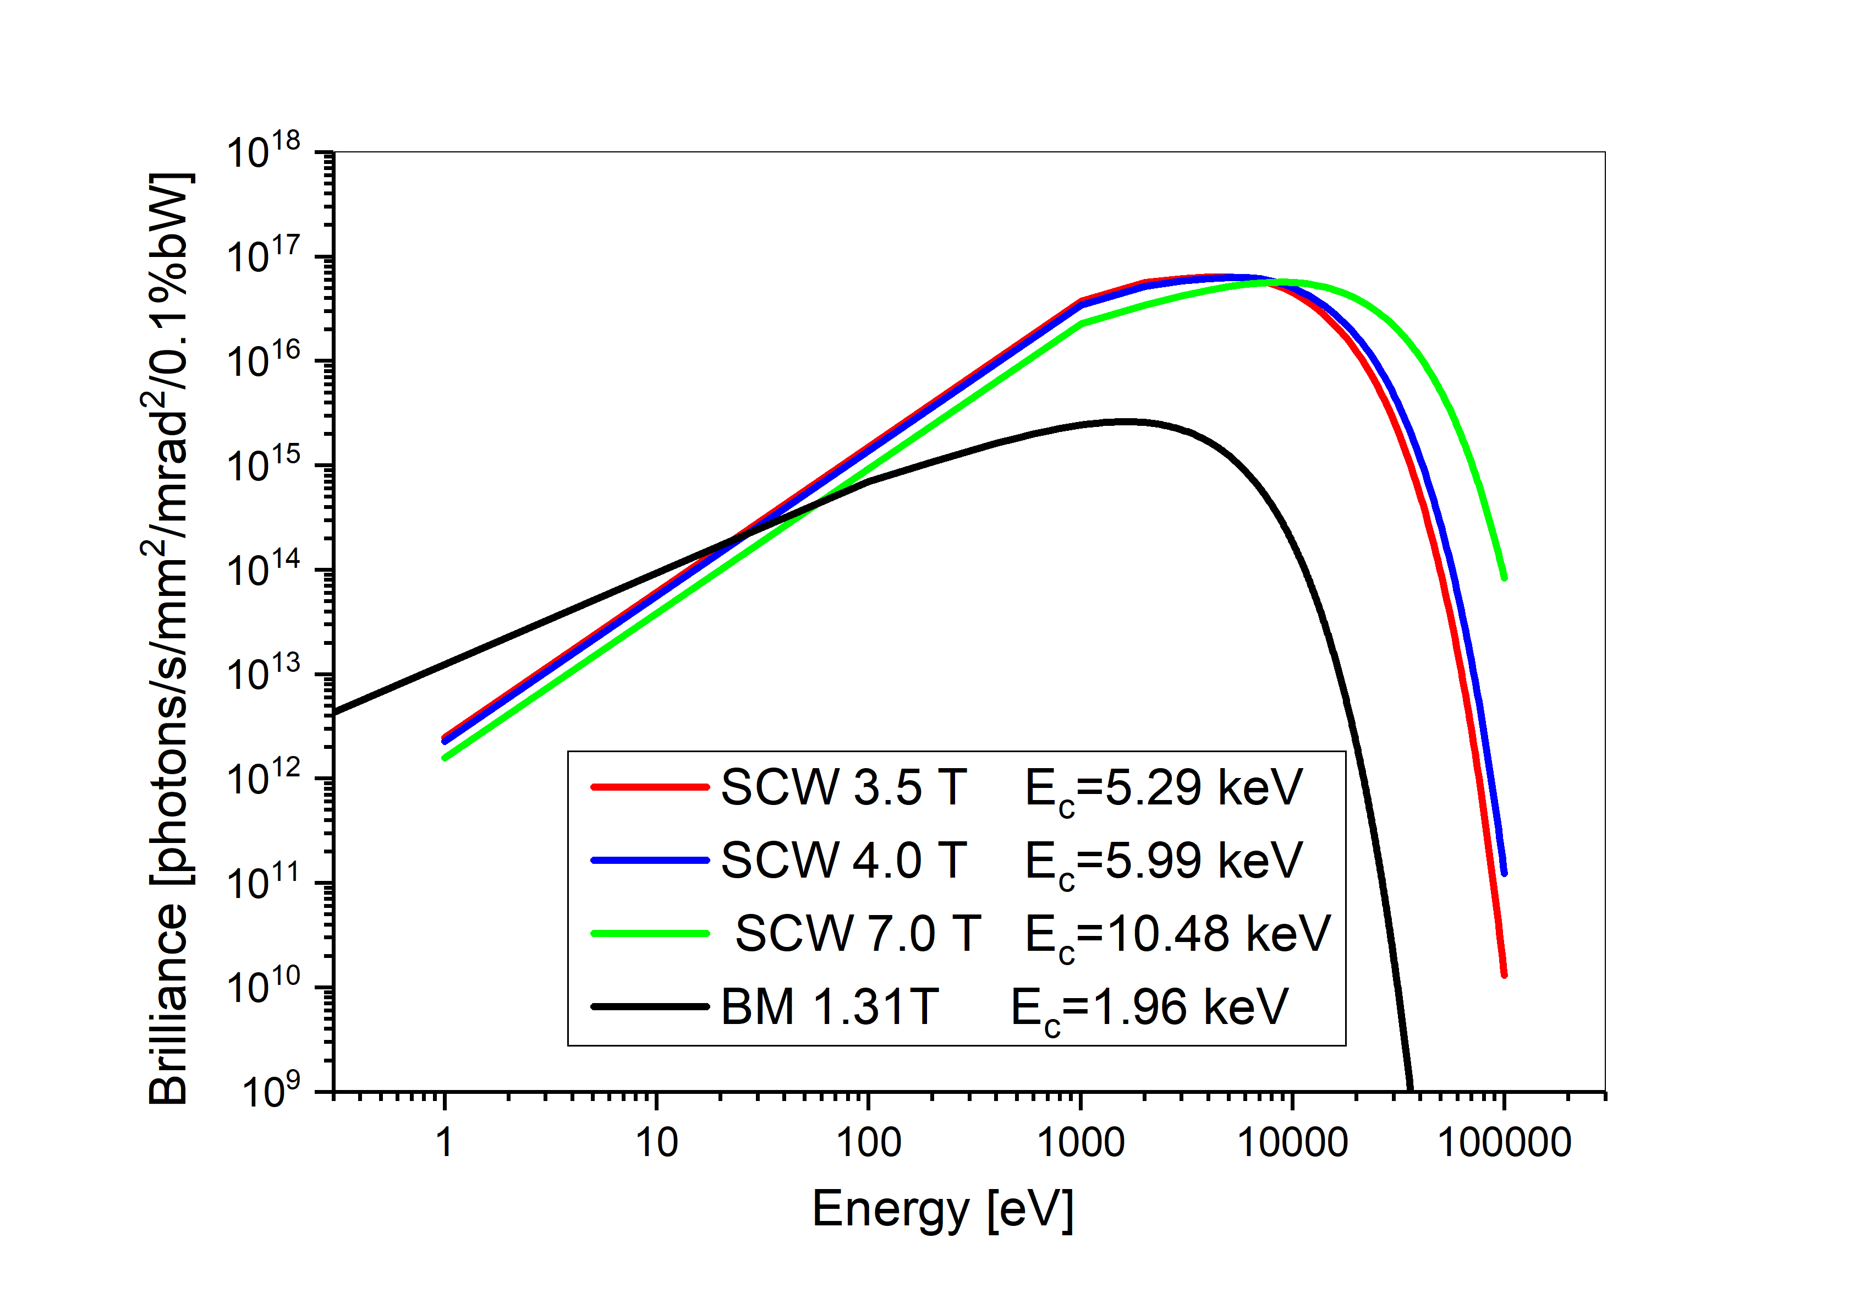
MX/BioSAXS/PD beamline
High-energy beamline MX/BioSAXS/PD will use the monochromatized synchrotron radiation from a superconducting (SC) wiggler.
The beamline configuration will allow measurements in 4 experimental modes:
single crystal diffraction – Macromolecular Crystallography (in particular protein crystallography - PX),
small angle X-ray scattering (SAXS),
powder diffraction (PD),
X-ray absorption spectroscopy (XAS).
30 keV

Slide 25
MX/SAXS BeamLine @ Solaris
The Small Angle X-ray Scattering sector
tunable beamline (for anomalous SAXS)
Wavelength range: 0.75 – 2.0 Å (16.5-6 keV);
Energy resolution ~ 1-2 ^{x} 10⁻⁴.
Main components
Toroidal Collimating Mirror (Si and Rh)
Water-cooled or Cryogenically-cooled (preferred) Double Cristal Monochromator (DCM) (~0.75 –2.0 Å <> 16.5-6 keV)
Endstation
Expected beam size ~100-150 μm

Slide 26
MX/SAXS BeamLine @ Solaris
The Macromolecular Crystallography sector
tunable beamline for Muliwavelength Anomalous Diffraction - MAD
Wavelength range: 0.6 – 3.0 Å (20 – 4 keV) ;
Energy resolution ~ 1 x 10-4.
Main components
Vertically Collimating Mirror (Si and Rh)
Cryogenically-cooled Double Cristal Monochromator
operating at 5-21 keV (~0.6 –3.0 Å)
Toroidal Focusing Mirror
Endstation
Expected spot size at the sample position ~ 50μm

Slide 27
MX/SAXS BeamLine @ Solaris
endstations
The Macromolecular Crystallography sector tunable beamline for MAD
Detectors – Pilatus 3X 6M or EigerX 9M (Dectris),
cryocooling system,
robotic autosampler for remote access,
High Pressure (HP) cell (mini HP cell).
The Small angle X-ray scattering sector - tunable beamline (for anomalous SAXS)
Detectors (for SAXS/WAXS) – Pilatus 3S 2M or EigerX 4M,
size exclusion chromatography system (SEC),
temperature attachments,
HP system (optional).

Slide 28
Scientific topics (examples) for MX end station
The MX endstation will be used for routine collection of diffraction data for macromolecular crystallography including:
  Multiwavelength Anomalous Diffraction experiments
  (using Se – selenomethionine substituted proteins, Br – brominated oligonucleotides, …),
  Cryocrystallography,
  Remote access, high pressure (option).
Objects:
  Protein and peptides (crystals),
  Protein complexes, viruses (crystals),
  Nucleic acids (crystals),
  Protein fibrils (fiber diffraction - eg. amyloids).

Slide 29
Scientific topics (examples) for SAXS end station
SAXS studies at this station will include wide range of research on:
biological objects,
new materials,
nanoparticles and nanocomposites (in solution or in solid state)
  nanocomposites
  polymers and copolymers,
  nanoparticles,
  semiconductors and new materials for nanoelectronics
  nanomaterials for energy storage applications
  amphiphilic molecules (surfactants, lipids etc),
  drug delivery systems,
  intrinsically disordered proteins,
  globular and membrane proteins,
  macromolecular complexes,
  viruses and virus-like particles,
  liposomes, biological membranes, nucleic acids and their complexes with proteins.

Slide 30
Applied science @
MX/SAXS BeamLine
XRD / powder diffraction (PD) - Pharmaceuticals (polymorphism of drugs), materials science (structure of crystalline materials)
SAXS / BioSAXS - pharmacy (drug carriers), cosmetic industry (structure of gels, lotions, creams, etc.), Light industry (polymer materials, fibers), chemical industry (catalysis, porous materials)
MX- research on protein structure with a potential importance in drug creation
XAS – materials studies (semiconductors, new electronic materials, alloys and nanocomposites), chemical industry (catalysis, porous materials).

Slide 31
SOLCRYS new laboratory for structural research at SOLARIS
Two main research infrastructures are foreseen to enable state of the art structural research
  “classical” beamline called MX/BioSAXS/PD equipped with three experimental endstations which will utilize the synchrotron radiation in the hard X ray region.
  Cryo TEM microscope - very much desired option.
Research methods available in the laboratory will be complementary enabling complex structural characterization of various materials including the biological samples (proteins, protein complexes, nucleic acids etc).

Slide 32
Cryo TEM
Single particle cryo-electron microscopy and cryo-tomography are currently the most advanced methods to determine intermediate and high resolution electron densities of large and dynamic macromolecular protein assemblies.
The field is expanding extremely fast and has recently been nominated the “Nature Method of the Year”.
In similarity to the fast development of crystallography due to the appearance of high energy synchrotron radiation in the early 90s of the last century, recent technical advancements in cryo-EM hardware and data analysis software have made the technique very attractive to many excellent research groups around the world. The broad availability to this new generation of microscopes today allow us to directly address and answer important biological questions, which have remained unresolved for decades.
Cryo-EM now progresses into the main structural biology method, as it allows to study large molecular complexes at atomic resolution without the need for growing crystals. The latest development of the so called “Volta phase plate” will allow to study complexes (<200 kDa), which are currently too small to be studied at high resolution. In addition, the improved contrast will facilitate the collection of higher resolution data also in cells directly using cryo-tomography and sub tomogram averaging techniques.

Slide 33
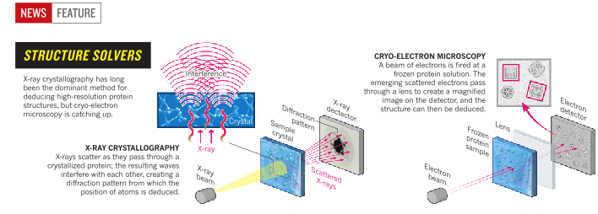
Cryo TEM

Slide 34
Exemples of research projects for Solaris PX/SAXS BL
X-ray diffraction studies of new materials: catalysts, polymers, etc.
  Dealumination process of Y Zeolite catalyst
  Microstructure of coral calcitic skeleton
Protein crystallography & drug design
  Structure of HIV protease, a target for drug design
SAXS for studies of new nanomaterials: nanoparticles, nanocomposites, polymers etc.
  SAXS – monitoring the synthesis of Au nanoparticles
Combination of protein crystallography & BioSAXS
  Structural analysis of mtEXO mitochondrial RNA degradosome reveals tight coupling of nuclease and helicase components

Slide 35
X-ray powder diffraction – studies of new materials dealumination process of Y Zeolite catalyst
X-Ray diffraction data: 300 K -> 873 K (heating) -> 300 K (cooling)
Models: 300 K -> 873 K (heating) -> 300 K (cooling)
XRPD Rietveld Refinement
G. Agostini et al. J. AM. CHEM. SOC. 2010, 132, 667–678

Slide 36
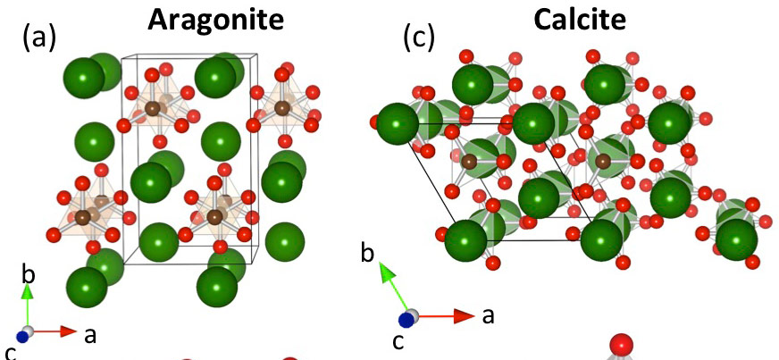
X-ray powder diffraction – Microstructure
of coral calcitic skeleton
Morphology of the modern aragonite Desmophyllum sp. and the Late Cretaceous calcitic Coelosmilia sp.
Calcium carbonate – CaCO₃
www.esrf.eu/home/news/spotlight/content-news/spotlight/spotlight263.html

Slide 37
Microstructure of coral calcitic skeleton
calcitic Coelosmilia sp. Desmophyllum sp.
SR-XRD

Slide 38
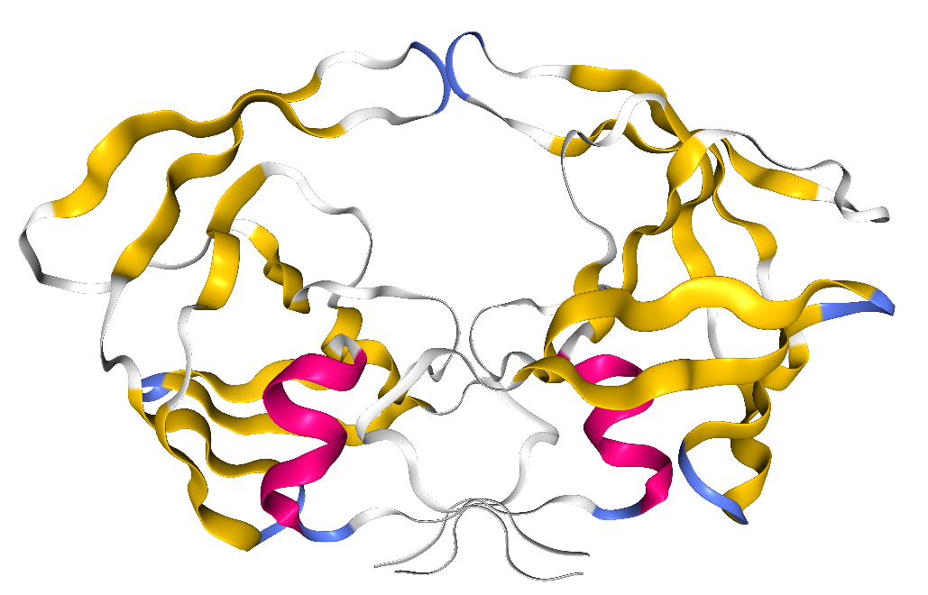
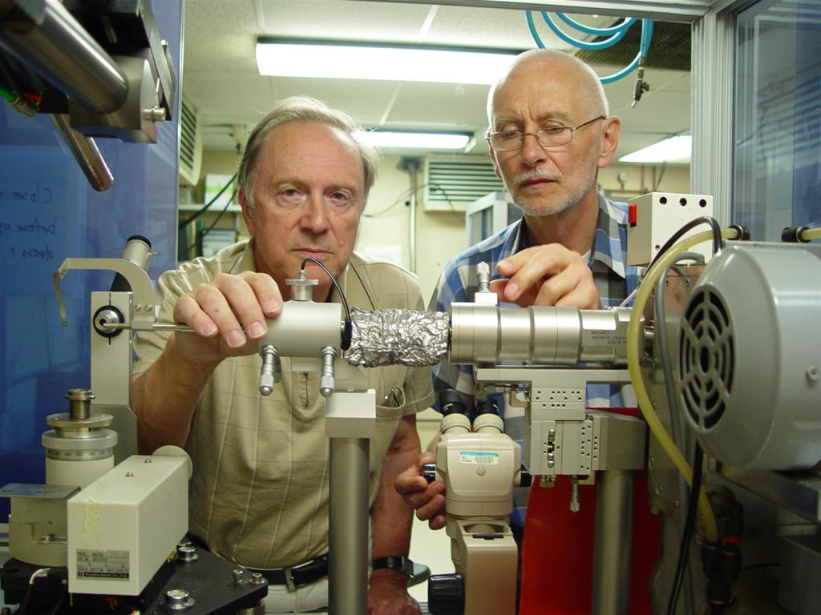
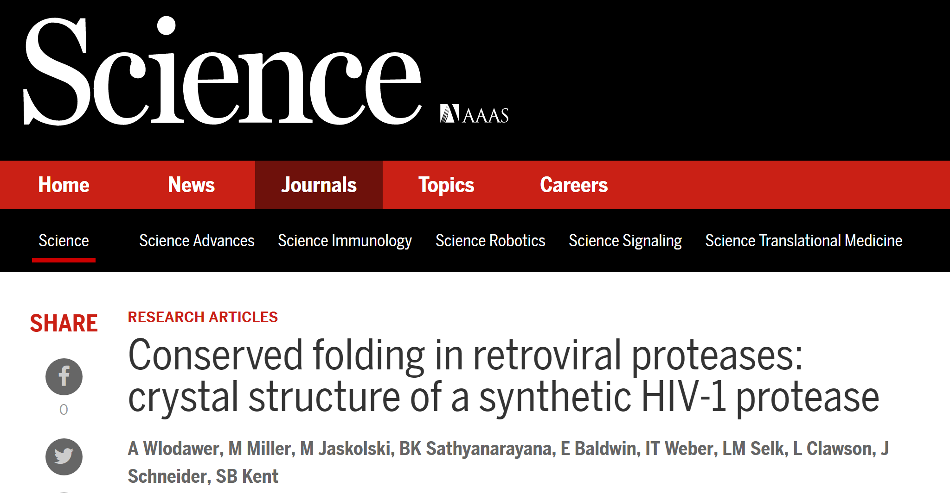
Protein crystallography & Drug desing –
Structure of HIV protease
Discovery of HIV protease structure - 1989
PDB code: 3HVP

Slide 39
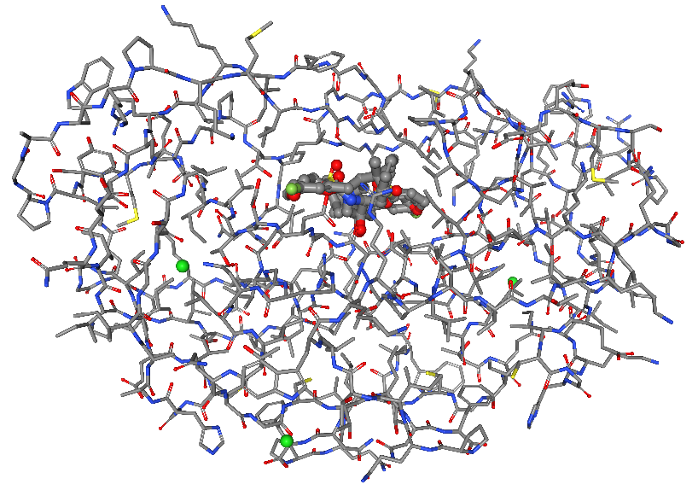
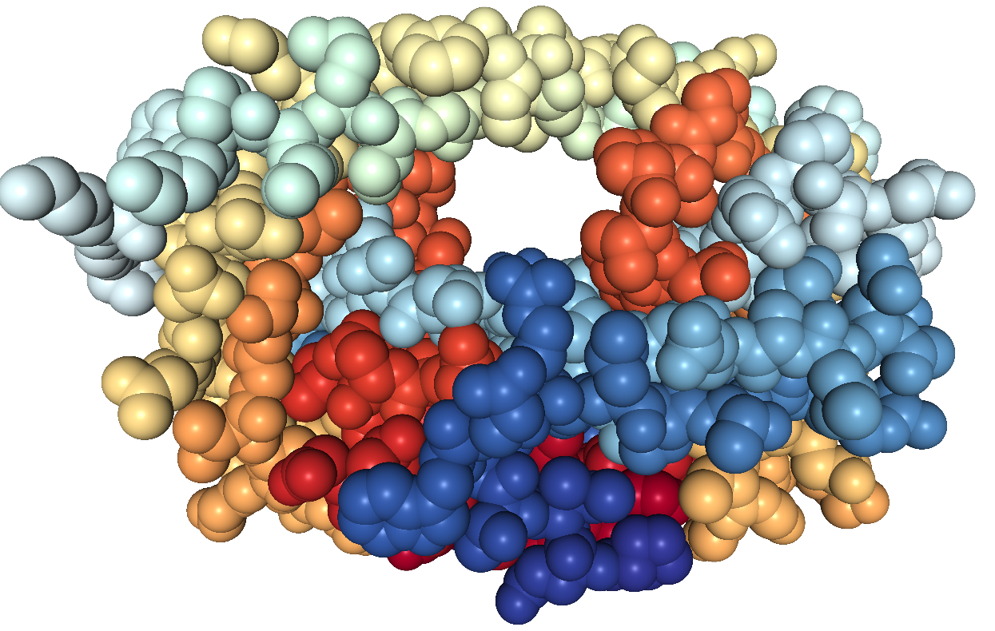
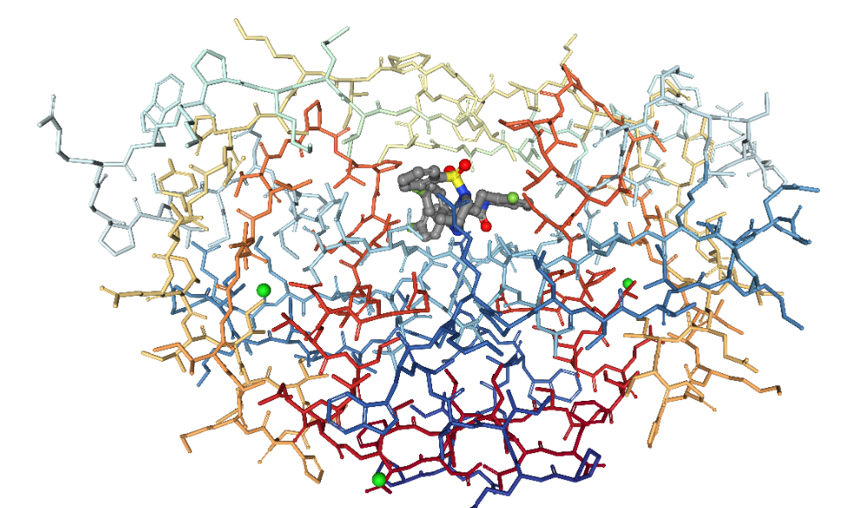
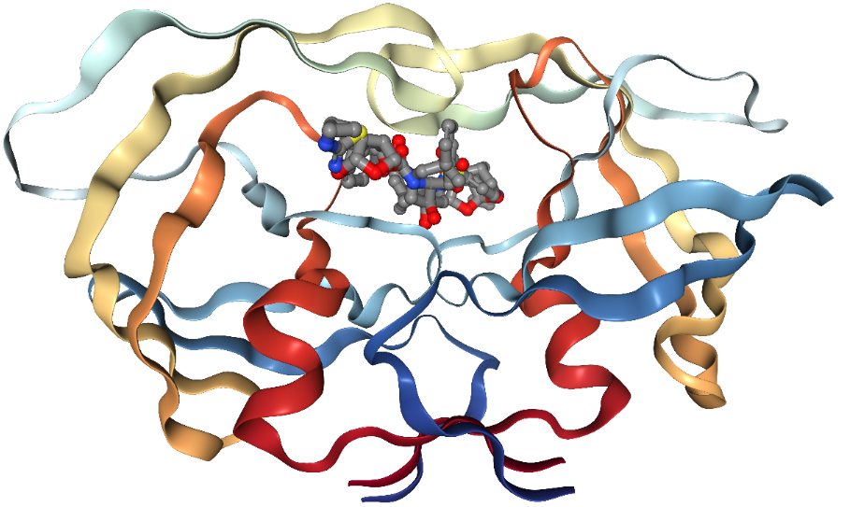
Structure of HIV protease – a taget for drug design
HIV protease complex with inhibitor SA526P
PDB: 4MC1; Ashit K. et al. Tetrahedron 70 (2014) 2894.
HIV protease - PDB code: 3HVP
Wlodawer A., et al. Science 245 (1989) 616
HIV protease with inhibitor GRL-121
PDB: 5TYR; Aoki, M. et al. eLife 6 (2017) e28020
HIV protease with inhibitor MK-8718
PDB: 6B36; Bungard, C.J et al. ACS Med Chem Lett 8 (2017) 1292

Slide 40
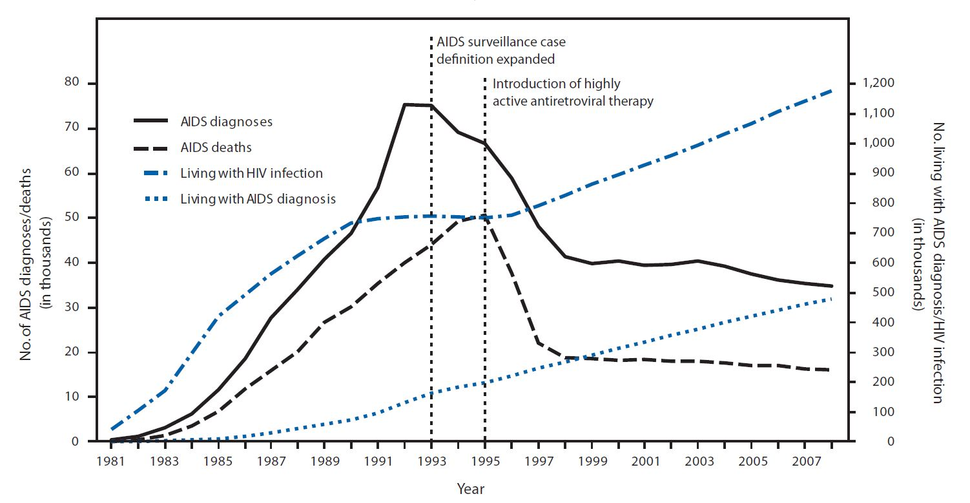
Protein crystallography –
HIV protease as a taget for drug design
en.wikipedia.org/wiki/Protease_inhibitor_(pharmacology)
Results of introduction of antiretroviral
inhibitors as drugs in HIV therapy

Slide 41
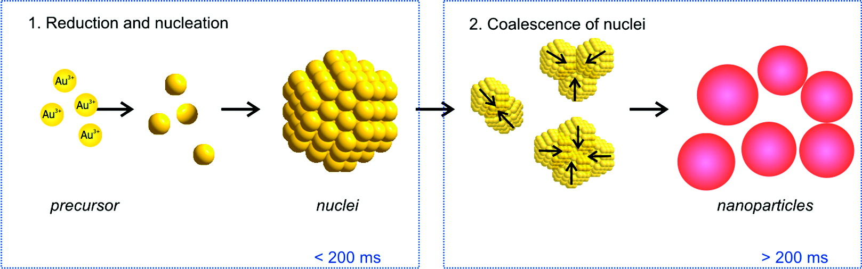

SAXS – synthesis of nanomaterials
- monitoring the formation of Au nanoparticles
(reduction of HAuCl₄ by NaBH₄)
.
Schematic illustration of the Au nanoparticle formation process
Jörg Polte et al., ACS Nano 2010, 4, 1076-1082.

Slide 42
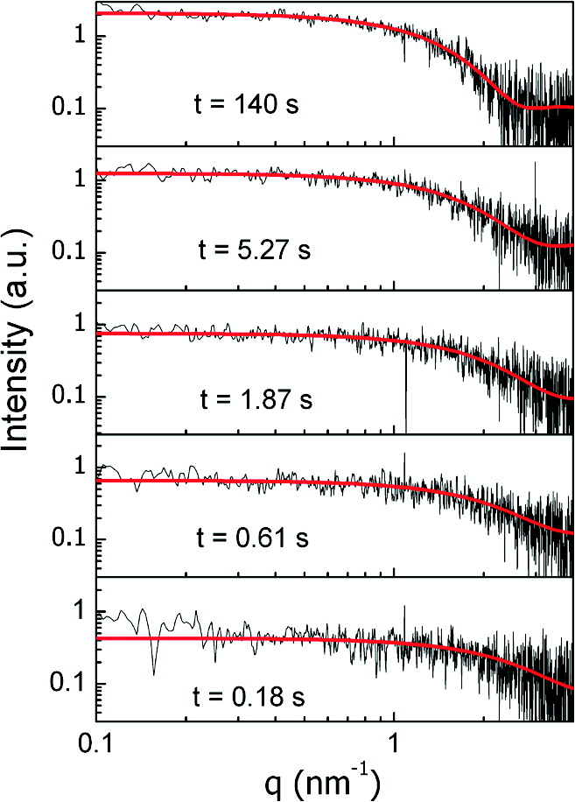
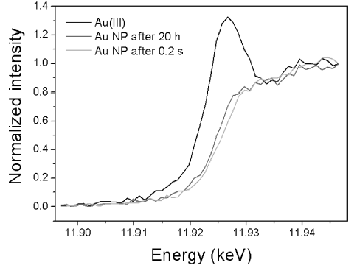
SAXS – synthesis of nanomaterials
- monitoring the formation of Au nanoparticles
SAXS in continuous-flow mode
at different reaction times.
XANES
Jörg Polte et al., ACS Nano 2010, 4, 1076-1082.

Slide 43
BioSAXS & protein crystallography
Structural analysis of mtEXO mitochondrial RNA degradosome reveals tight coupling of nuclease and helicase components
Razew, M. et al. Nature Communications 9 (2018) Art. Number 97
Understanding
the degradosome !

Slide 44
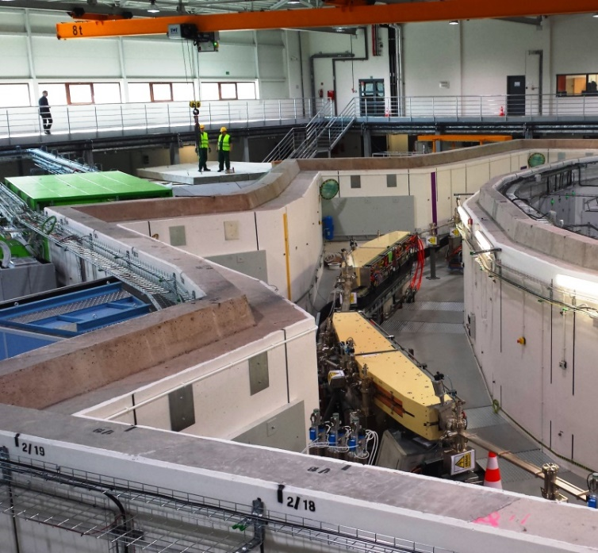
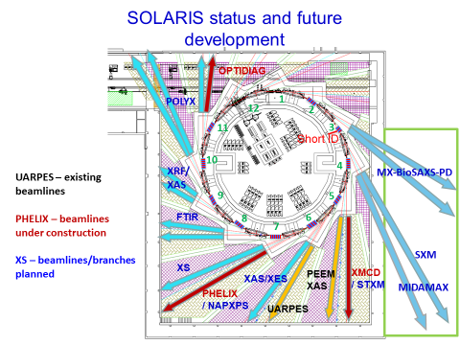
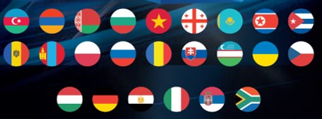
SOLARIS in 4-5 years
SOLCRYS

Slide 45
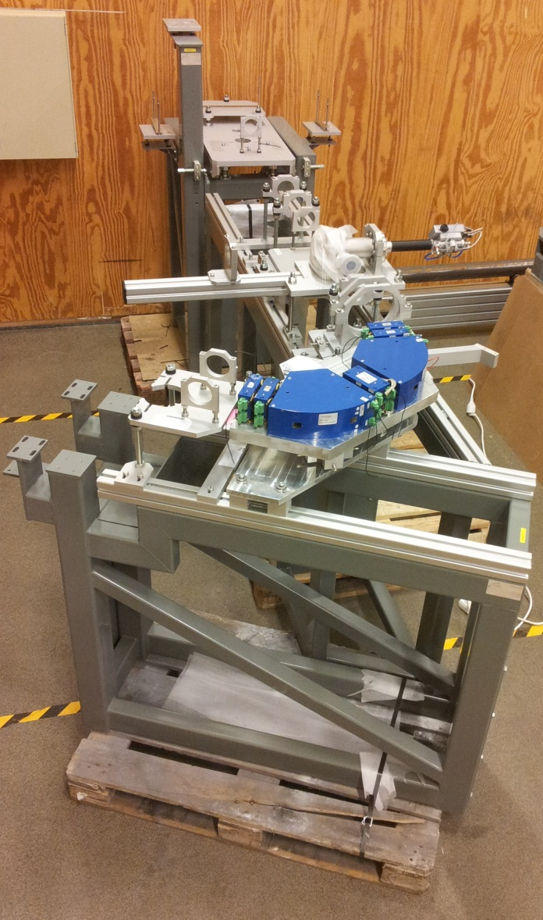
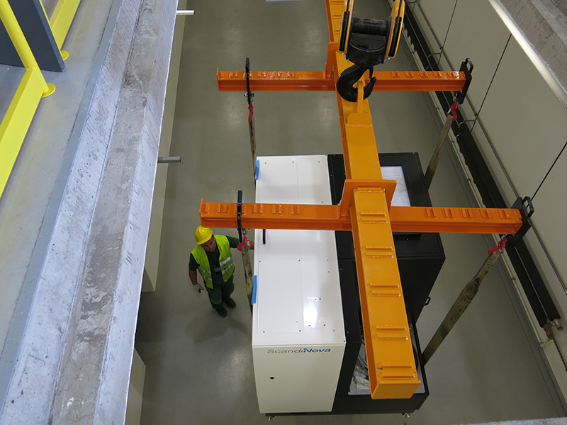
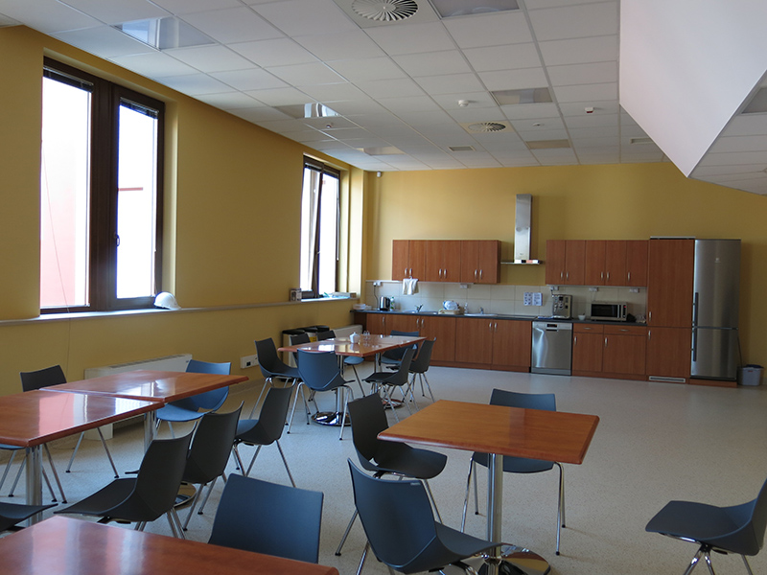
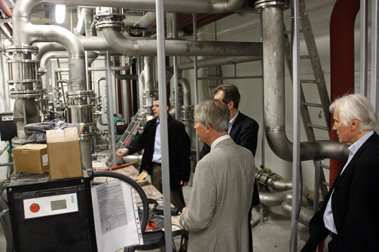
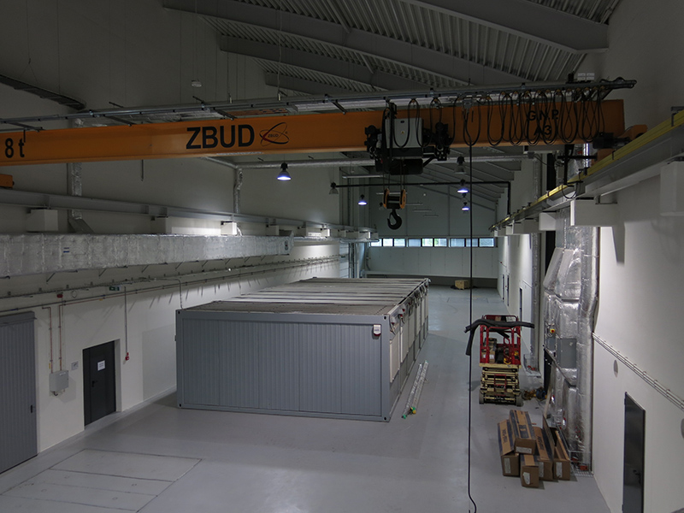
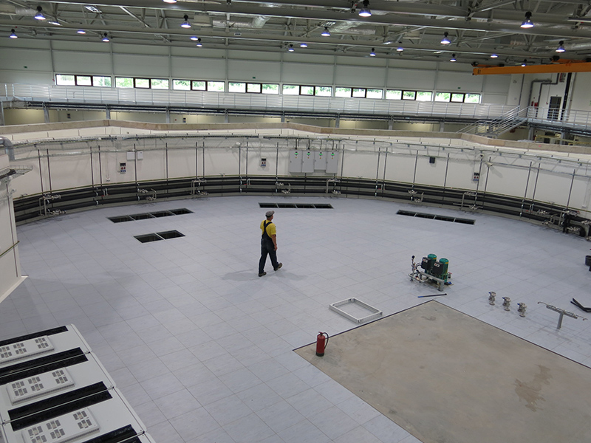
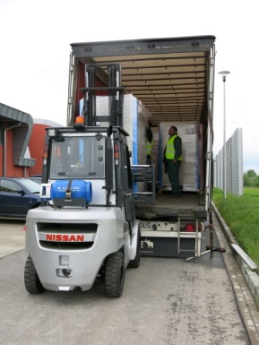
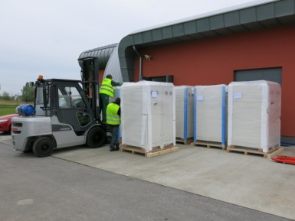
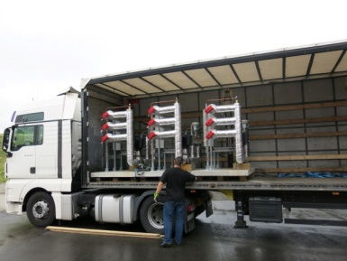
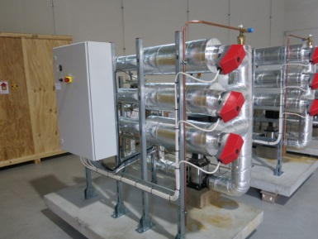
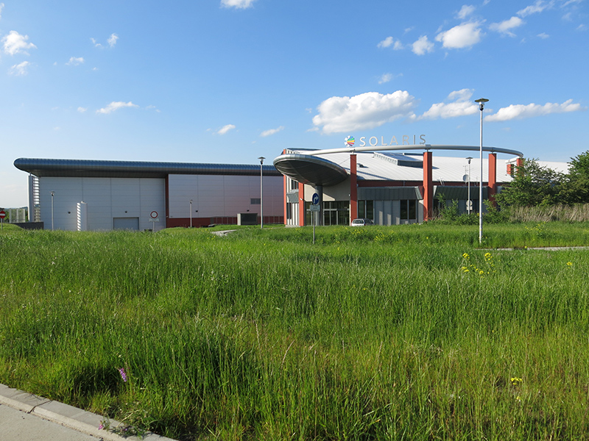
Thank you for your attention!
Спасибо за внимание!
  SOLARIS June 2014
http://www.synchrotron.uj.edu.pl/

Slide 46

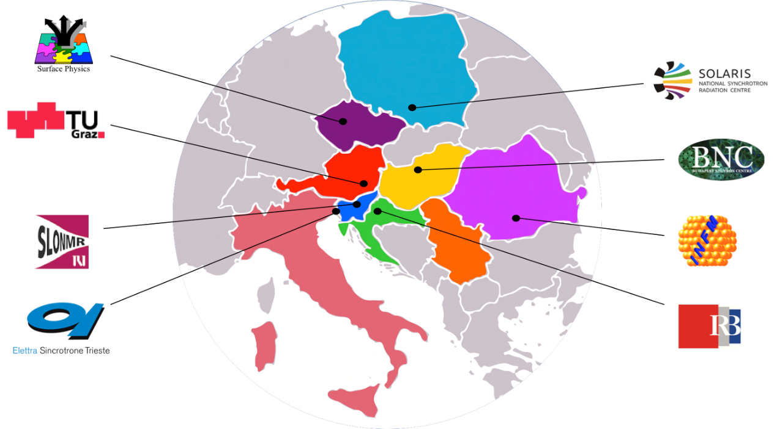
SOLARIS –as an international RI
CERIC-ERIC: a unique distributed research facility
Number of infrastructures (Partner Facilities), one from each member countries made available to member countries for free
no transfer of money, but transfer and share of values, IT funds the Seat
single entry point, offering over 40 available techniques;
peer evaluation system to select the best proposals;
free and open access by quality selection only;
STRUCTURE:
Participating Country (member)
Representing Entity
Partner Facilities

Slide 47
International context (CERIC)
External users / open access /CERIC users
SOLARIS will operate 5000h/year and 80% of the beamtime will be available for the external users.
SOLARIS will be open for external domestic and international applications – keeping the balance between those groups. Digital User Office under development by Solaris.
Open access - SOLARIS already participates in the Coordinated Access to Lightsources to promote Standards and Optimization (CALIPSO) initiative.
The number of access units dedicated to CERIC open calls will depend on the number of applications, with the assumption that for the beginning it will be about 10% of the total beamtime.
SOLARIS is open to international initiatives resulting in building international beamlines and end stations.

