Slide 1

Status and future development of the Laboratory of Information Technologies
Vladimir Korenkov
LIT Director
The 123rd Session of the JINR Scientific Council
22 – 23 February 2018

Slide 2
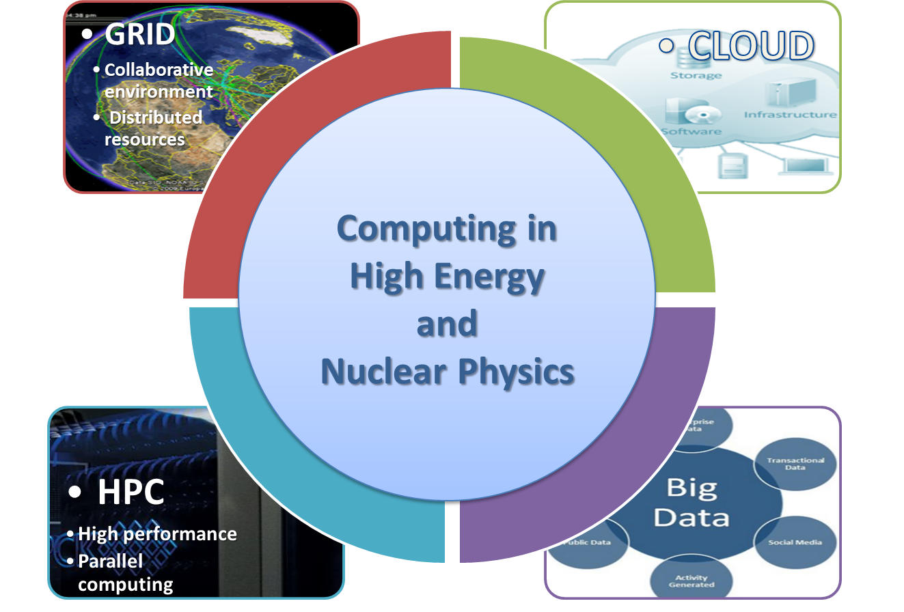
Computing in High Energy and Nuclear Physics
Big variety of
  architectures,
  platforms,
  operational systems,
  network protocols,
  software products.
The interface of the uniform environment should provide a way for organization of collective development, solution of problems of various complexity and subject matter, management and processing of data of various volumes and structures, training and organization of scientific and research processes.

Slide 3
The objectives of the 7-years plan
Development of the JINR Multifunctional Information and Computing Complex (MICC) of a global level for advanced information technologies.
Development of a territorially distributed research environment that provides use of the capacities of the Complex by the JINR-participating countries and other scientific organizations including joint international projects.
Creation of a software technological complex providing introduction of cloud technologies for organization of research by distributed user groups.
Development of new parallel applications, cross-platform and multi-algorithm software complexes in a heterogeneous computing environment that allow one to expand a spectrum of computationally intensive solved fundamental scientific problems.
Development of the JINR corporative information system.
Development of training of IT expetrs for JINR and Member States.

Slide 4
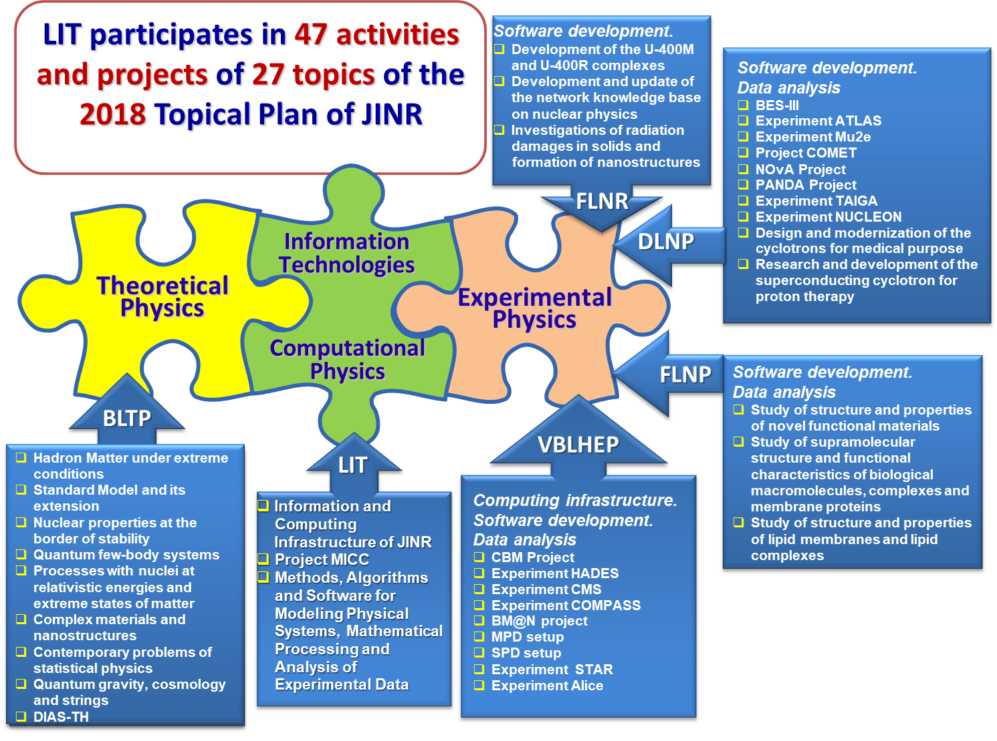

Slide 5
IT-services
Network
Telecommunication channels, JINR LAN, JINR IXP, JINR LAN Remote Access, Datacenter Network, Device registration, DHCP, DNS, IPDB, Network Registration & Connection, Network Monitoring, Technical Network, WIFI, WLCG Network
Primary
Account Management, JINR Certificate Authority, Computer Security Controls, Security Firewall, Single Sign On, SSH (Secure SHell), E-mail, Resources, Portal
Collaboration
Audio Conferencing, Eduroam, Indico, Video Conferencing, Webcast and Recording, Project Management, GIT, JINR Disk, JINR Document Server (Invenio)
Database
Services
Administration Database Service, ADB2, ISS, 1.C EPR, EDH “Dubna”, General Purpose Database Service
Computer Science &Physics Computing
Development
Research
НРС
BigData analytics
Сomputing
GRID Tier-1 Tier-2
CLOUD
Applied software
JINRLIB
Software support

Slide 6
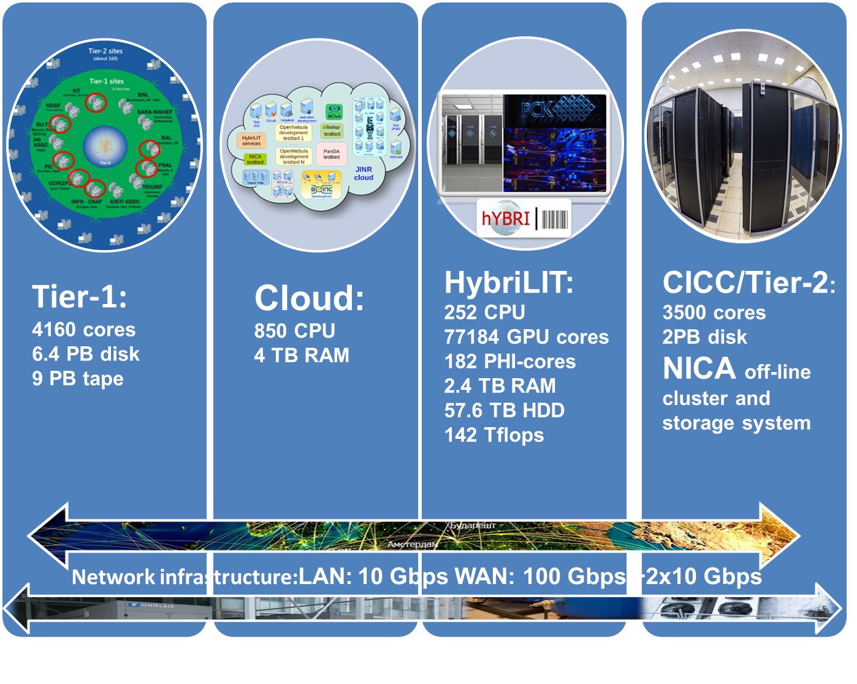

Multifunctional Information and Computing Complex
Main components
LIT IT-infrastructure is the one of JINR basic facilities

Slide 7

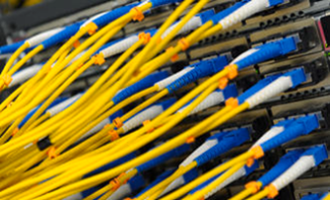
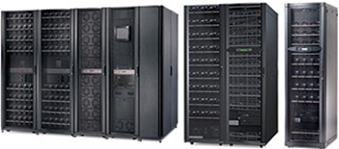
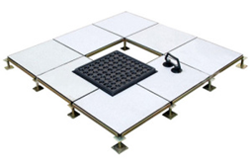
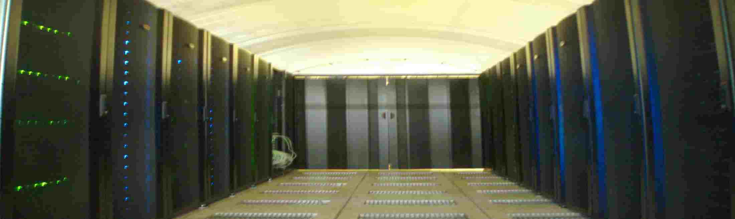
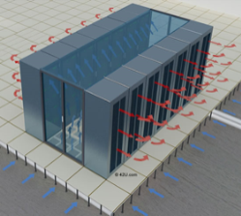
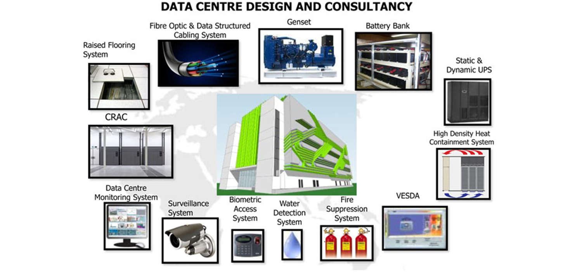
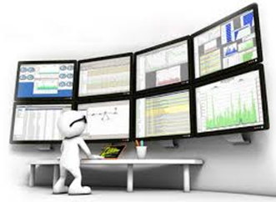


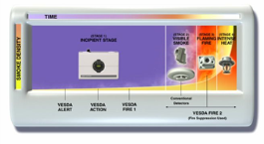

MICC engineering infrastructure
Fibre Optic & Data Structured Cabling System
Diesel generator set
Uninterruptible power supply
Raised Flooring System
High Density Heat Containment System
Computer Room Air Conditioner
Water Detection System
MICC Monitoring System
Biometric Access System
VESDA (Very Early Smoke Detection Apparatus)
Fire Suppression System
Surveillance System

Slide 8
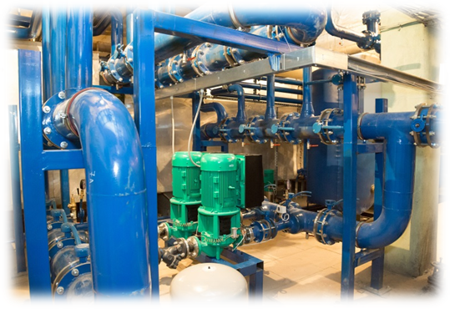
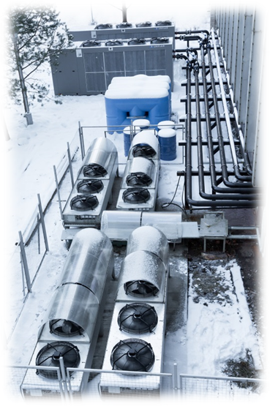
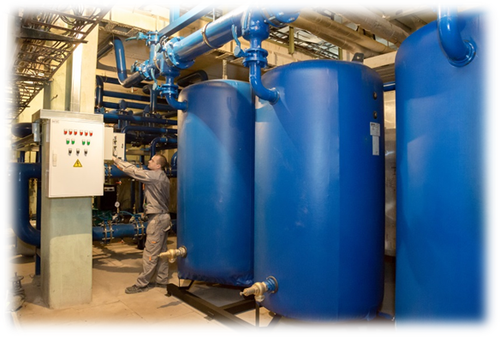
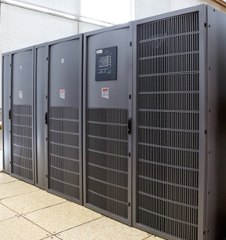
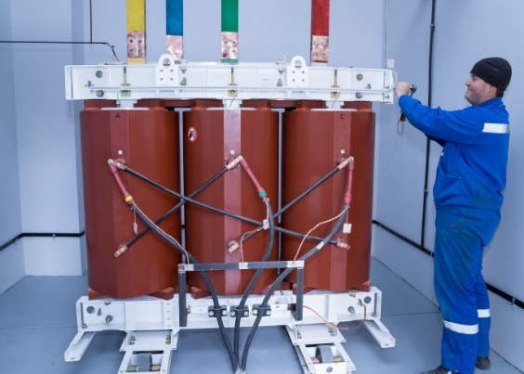
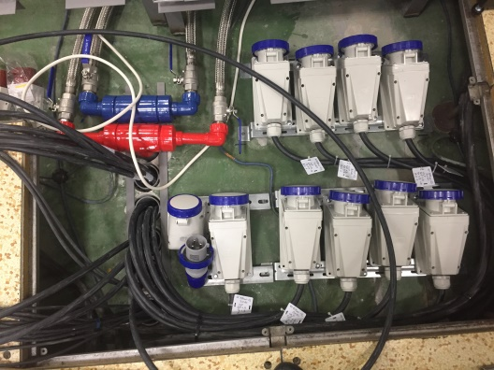
Engineering infrastructure
The main results of developing the engineering infrastructure:
Installation of two new transformers (2.5 MW)
New cooling system for Tier-1 complex
New water cooling system for supercomputer
Development of the project on guaranteed power supply using a diesel generator
8

Slide 9
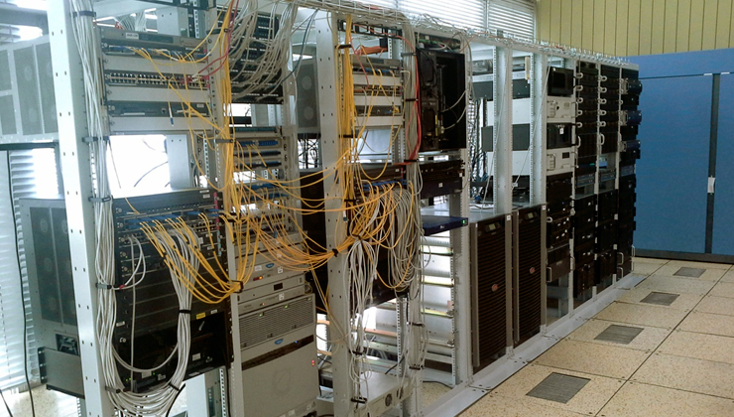
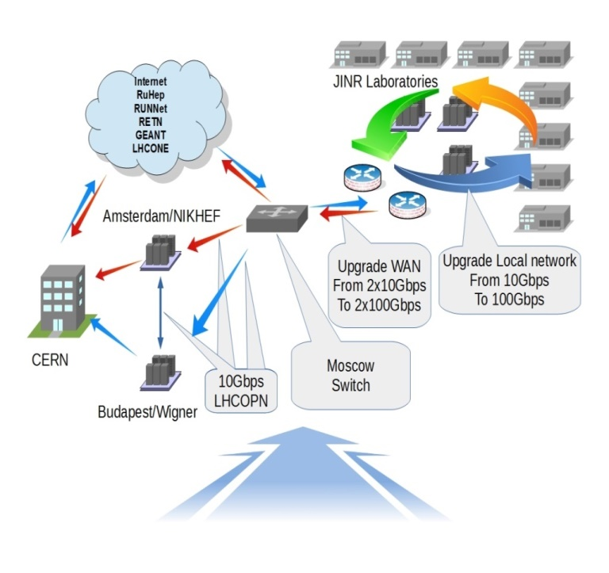
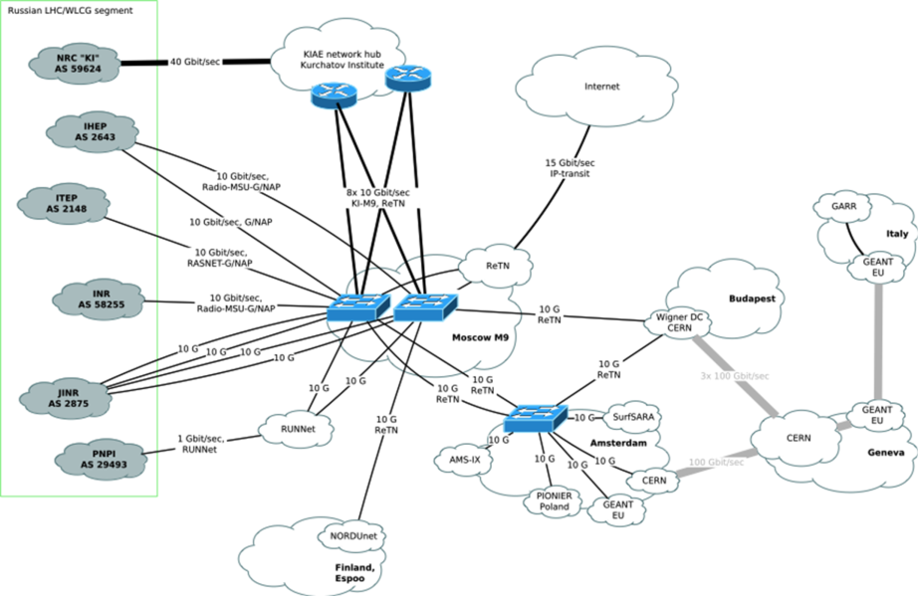
Network and telecommunication channels
One of the most important components of JINR and MICC providing access to resources and the possibility to work with the Big Data is a
network infrastructure.
JINR Local Area Network
Comprises 8010 computers & nodes
Users – 4489, IP – 14136
Remote VPN users – 397
E-library- 1596, mail.jinr.ru-2626
AFS -369, VOIP - 128
Local Area Network – 10Gbps
2018 - upgrade to 100Gbps
Wide Area Network – 2x10Gbps, 100Gbps
2018 - upgrade WAN to 2x100Gbps

Slide 10
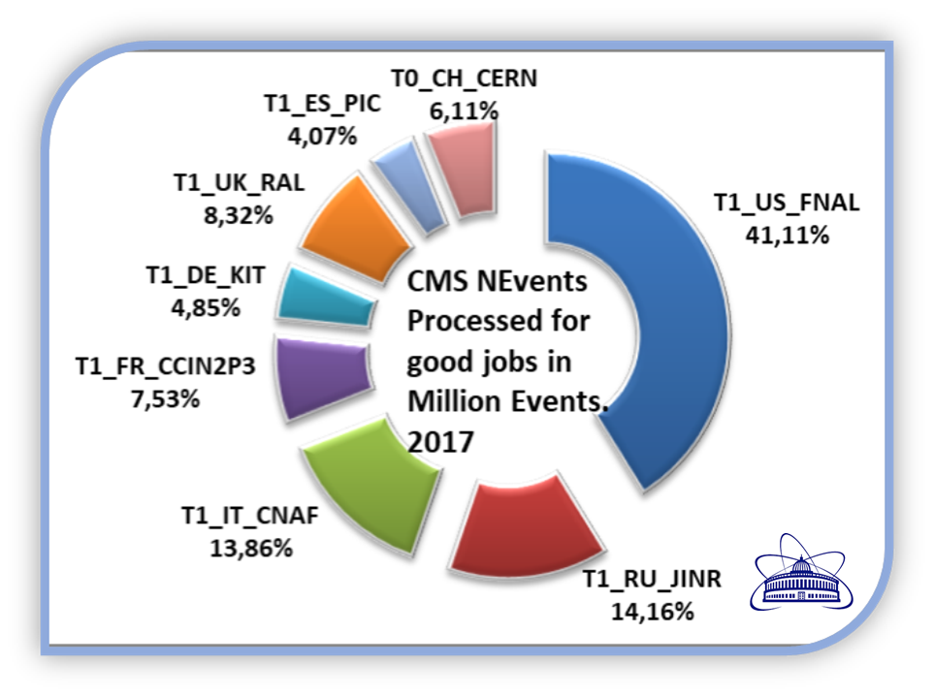
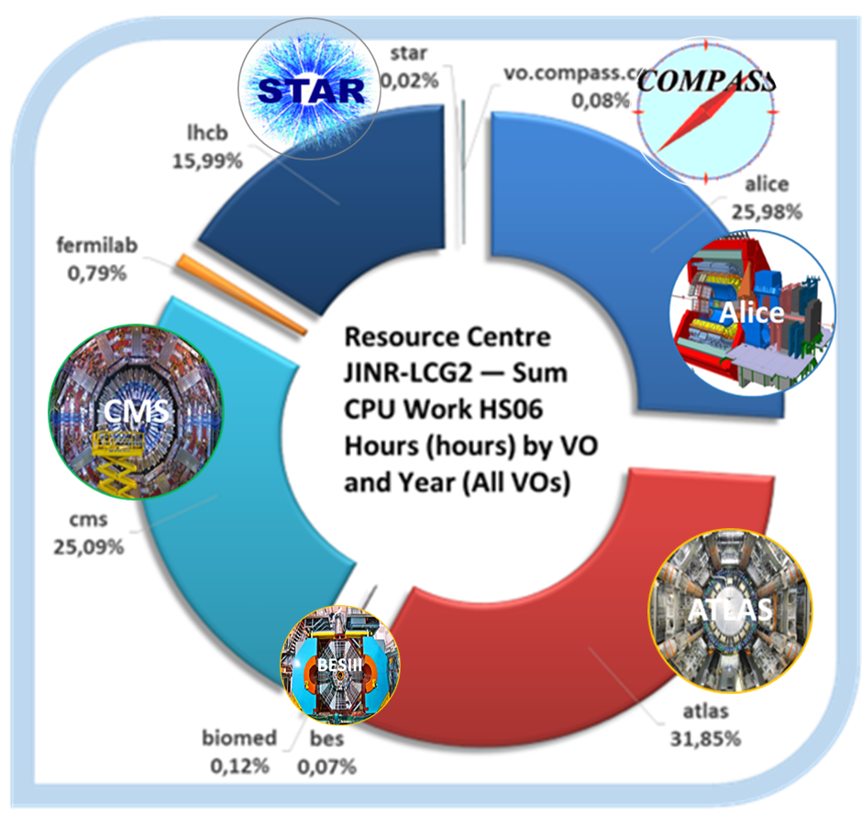
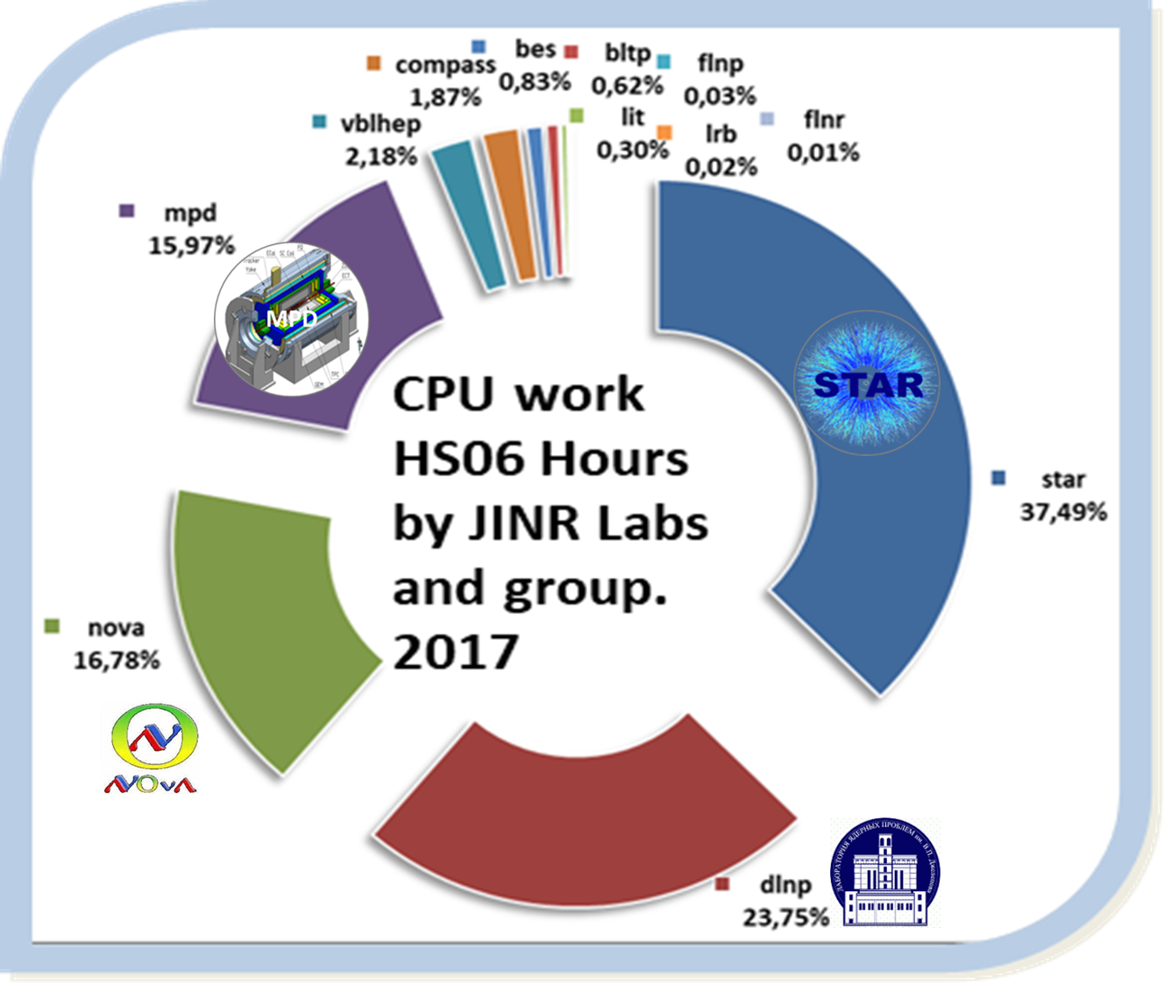
Multifunctional Information and Computing Complex
for experiments and JINR Laboratories
MICC provides Grid, Cloud and HPC resources needed for many projects MPD, BM@N, CMS, ALICE, ATLAS, LHCb, COMPASS, DIRAC, NOvA, BESIII, OPERA, PANDA, STAR, NEMO, NUCLON, HONE, FUSION, BIOMED for data processing, simulation and numerical calculations.

Slide 11

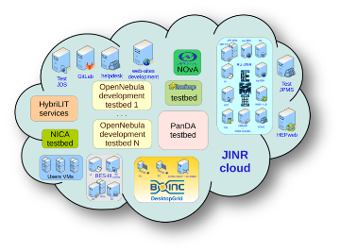
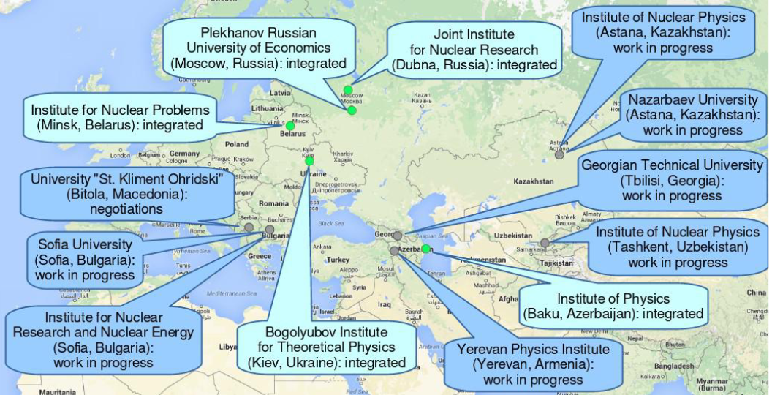
JINR Cloud
One of the ambitious trends in the cloud technologies is the development of a method of integration of various cloud infrastructures.
In order to join the cloud resources of partner organizations from JINR Member State for solving common tasks as well as to distribute a peak load across them, a cloud bursting driver has been designed by the JINR cloud team. It allows one to integrate the JINR cloud with the partner clouds either OpenNebula-based one or any other cloud platform which supports Open Cloud Computing Interface (OCCI).
Integration of the cloud infrastructure and optimizing the workload distribution in IaaS clouds allows one to join resources for solving common tasks as well as to distribute a peak load across resources of the partner organizations.

Slide 12



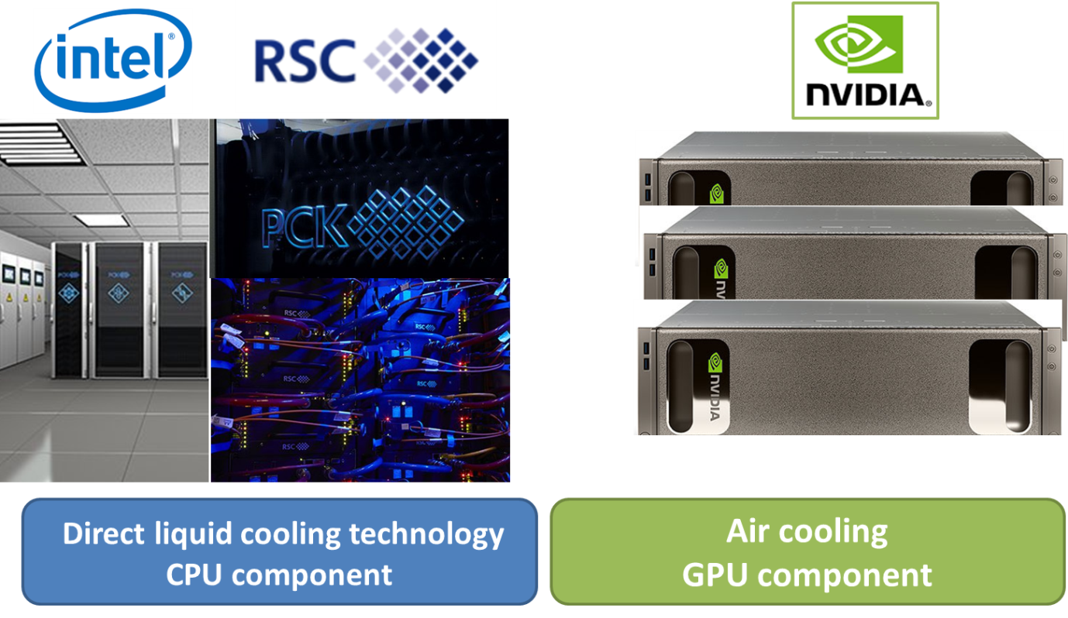
JINR supercomputer –
revolutionary ultra-high dense HPC solution
Goal:
multiple growth of the computational power for massive parallel calculations which is required for a major acceleration of complex theoretical research underway at BLTP within the phase "Hadronic matter under extreme conditions" of theme
01-3-1113 "Theory of
fundamental interactions“,
creation of a polygon to investigate the possibilities of using the newest computational platforms for the NICA computing..
Total performance::
1000 Tflops
Commissioning:
March 26, 2018

Slide 13
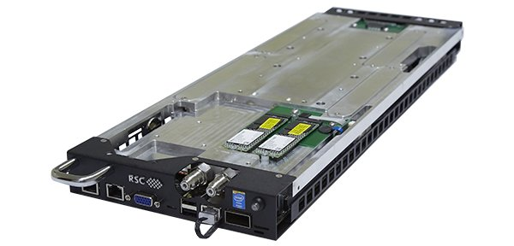
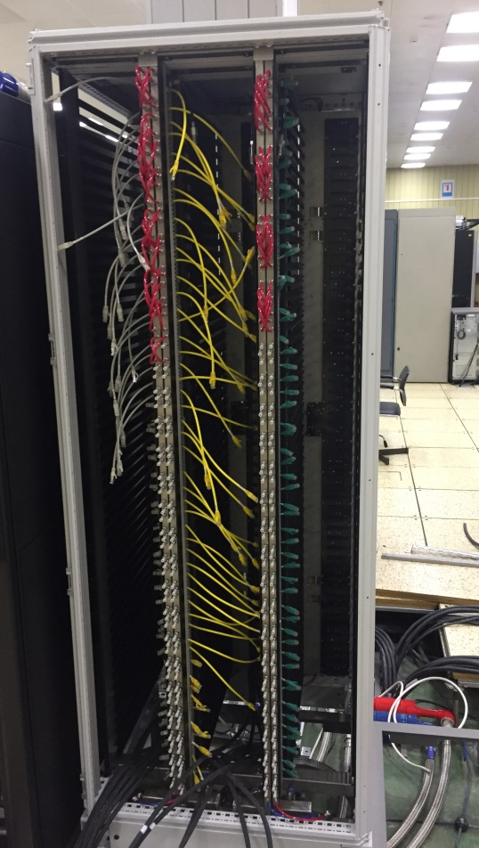
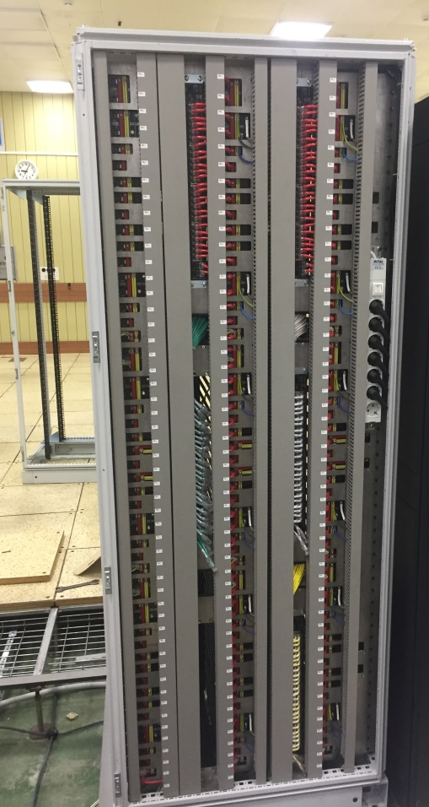

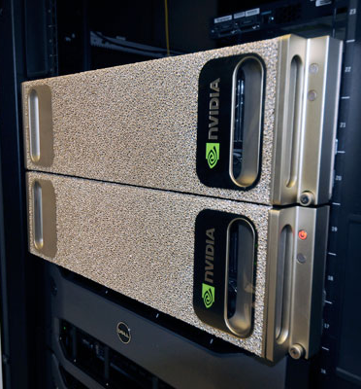



Heterogeneous computing in JINR: under construction
Start to run: March 26, 2018

Slide 14
Heterogeneous computing in JINR: Nearest plans
Supercomputer GOVORUN &
HybriLIT
CPU
component
Intel Skylake
Intel KNL
Clouds and cloud services
Multicore & multithreads computing
BigPanDA & GRID
Tracks reconstruction
Physical generators
Monte-Carlo simulations
GPU
component
NVIDIA Volta
Quantum chromodynamics
Deep learning
NVIDIA K40, K80
BigData analytics
Peak performance: 1 PFlops
Volta: 205 000 CUDA cores & 26 000 Tensor cores | K40, K80: 78 000 CUDA cores
Skylake: 1440 cores | KNL: 1512 cores

Slide 15
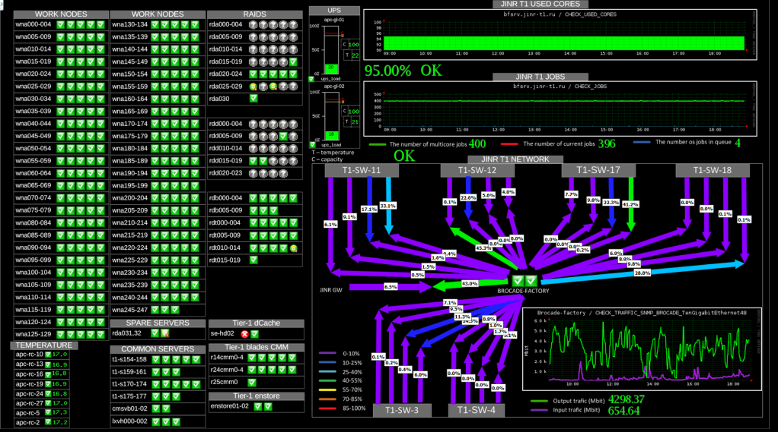
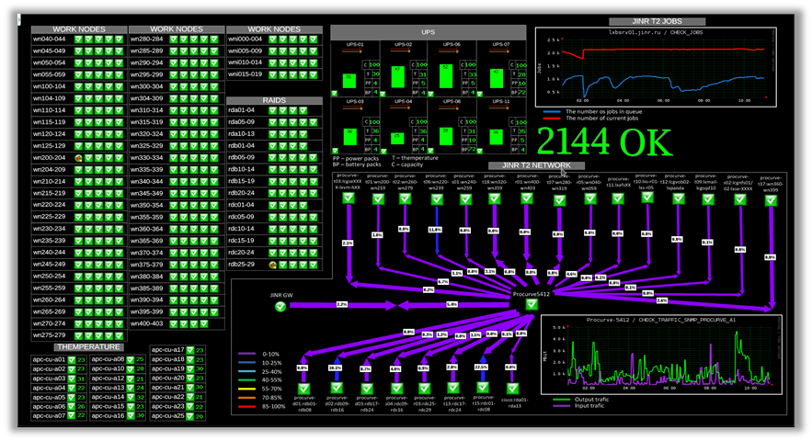
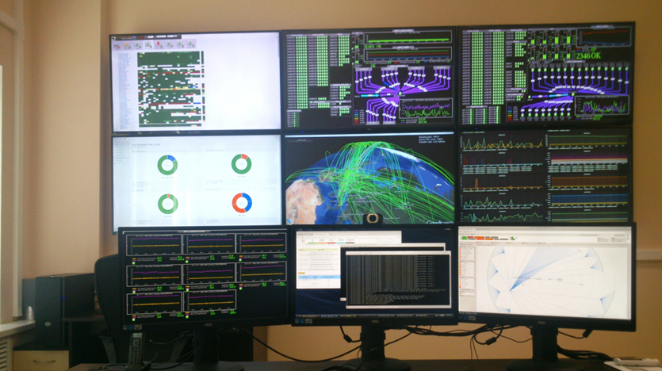
MICC Monitoring
For a robust performance of the complex it is necessary to monitor the state of all nodes and services - from the supply system to the robotized tape library.
The system allows one, in a real time mode, to observe the whole computing complex state and send the system alerts to users via e-mail, sms, etc. 690 elements are under observation 3497 checks in real time.

Slide 16
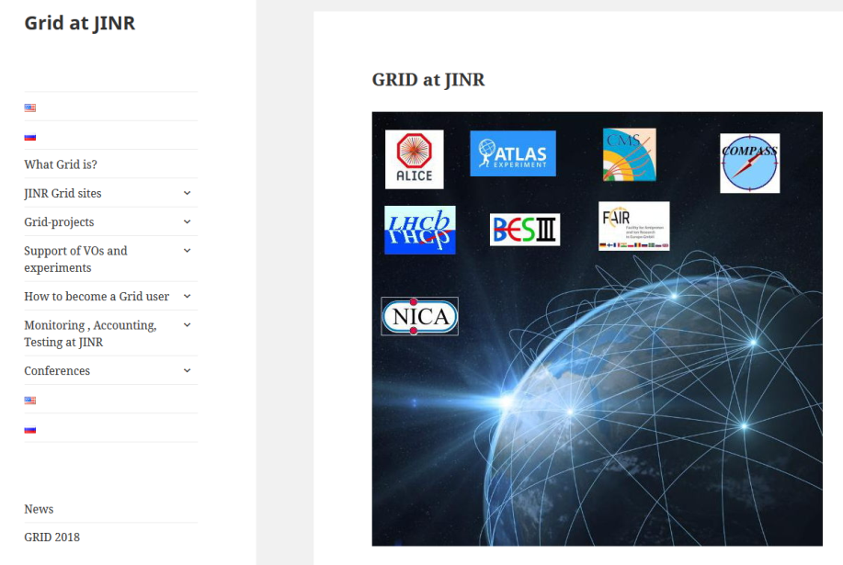
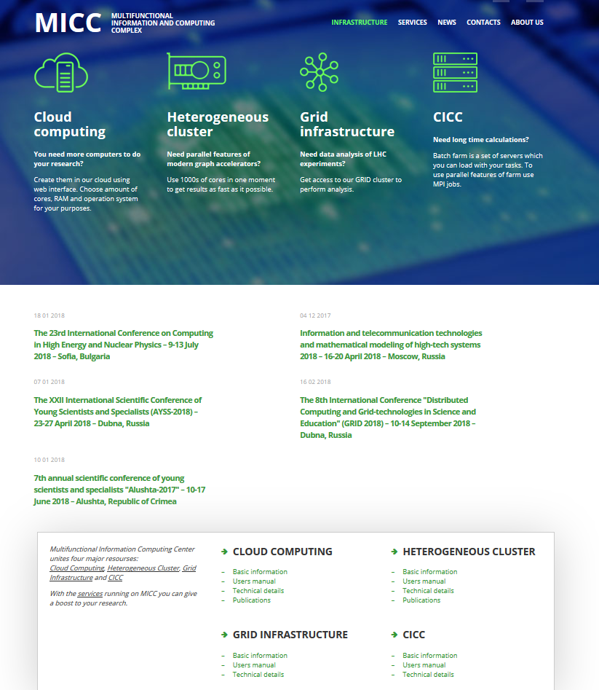
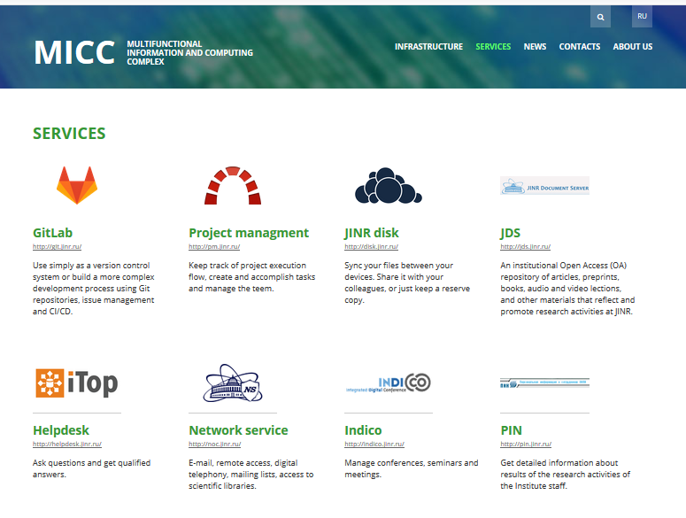
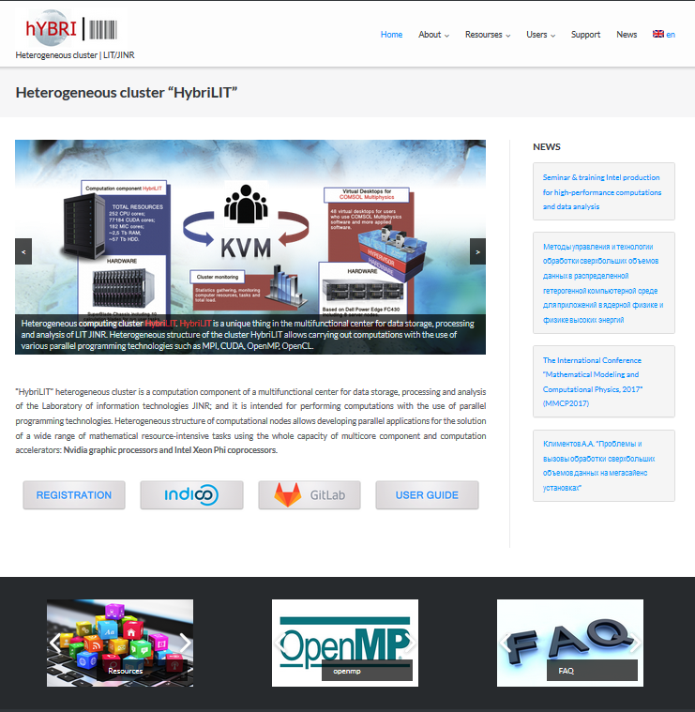
New WEB-portal MICC http://micc.jinr.ru/

Slide 17
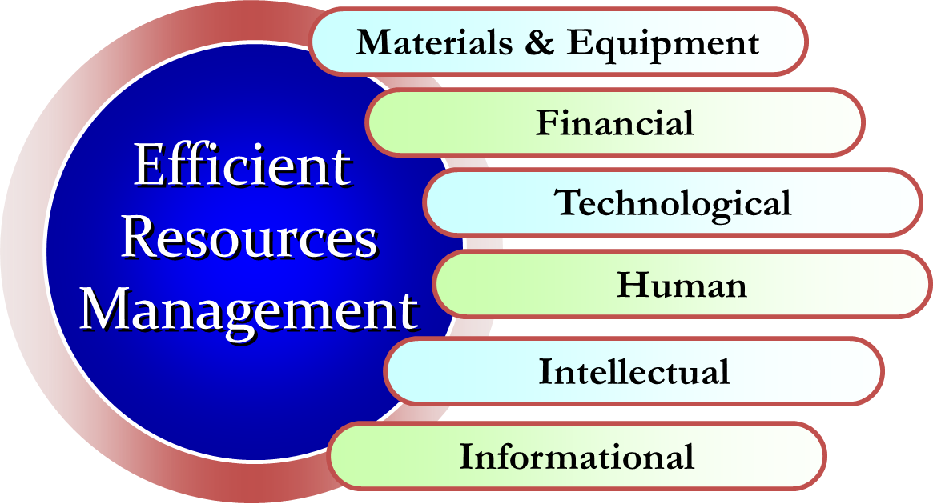
The JINR corporative information system
General 1C:Enterprise platform intended for automation of everyday tasks of economic and management activity,
APT EVM system (Activity Planning Tool Earned Value Management) for NICA and future projects management,
Electronic document handling system EDH «Dubna»,
Complex of information and analytical systems for financial and human management (ADB2, ISS,…),
JINR Document Server – electronic open archive-repository of scientific publications and documents,
JINR Member States access to e-library,
PIN – JINR staff personal information,
JINR video portal,
WEB-portals.

Slide 18
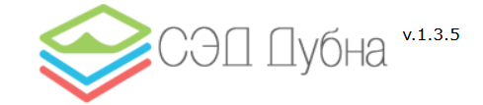
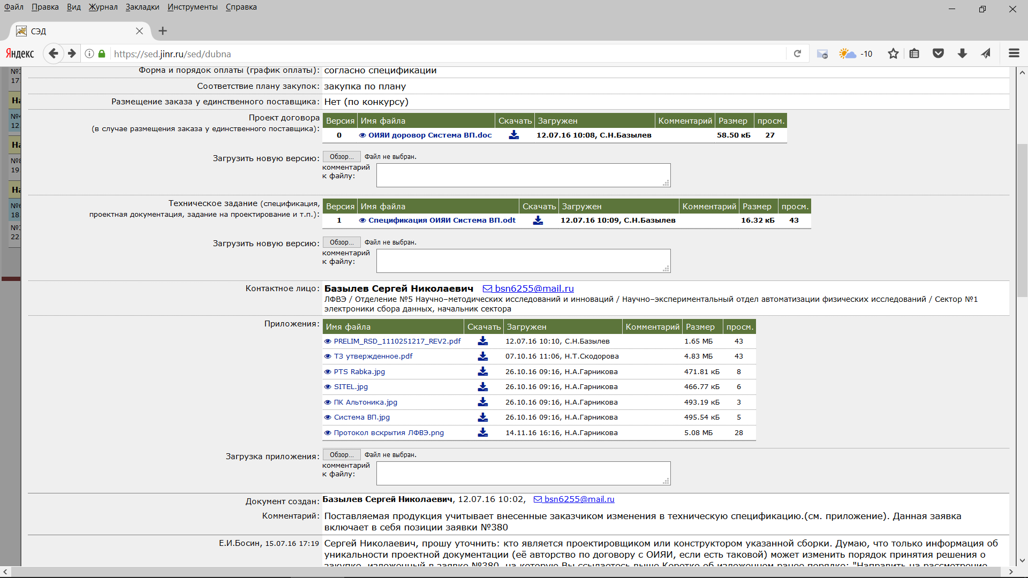
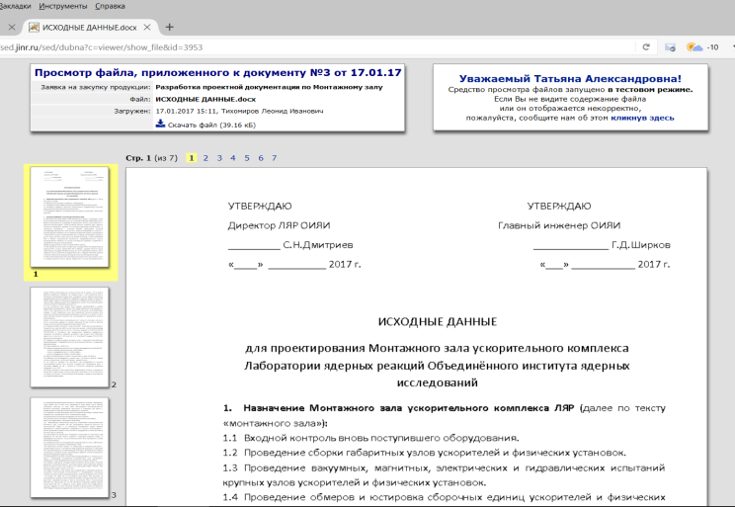
Electronic document handling system EDH «Dubna»
Development and maintenance of electronic document management system EDН "Dubna".
Processed more than 2000 documents.
Developed a variety of specialized reports.
Developed new documents: “Supply agreement", “The contract onerous rendering of services", "Contract execution of research works", “Supplementary agreement“, etc.
The principle of flexible development methodology ("agile software development") was applied.
Notes:
В 2016г. продолжалась эксплуатация системы электронного документооборота СЭД «Дубна», созданной ЛИТ в 2015г. За год в системе было обработано более 1000 документов. Система доказала свою работоспособность и эффективность. Одновременно с эксплуатацией система интенсивно развивалась и адаптировалась под специфические требования ОИЯИ. Разработан ряд специализированных отчетов, к запуску подготовлены документы «Договор поставки», «Договор возмездного оказания услуг», «Договор выполнения научно-исследовательских работ», а также «Дополнительное соглашение» к этим договорам. Добиться успешного развития системы с минимальными затратами людских и материальных ресурсов удалось благодаря применению принципов гибкой методологии разработки («agile software development»), а также благодаря использованию накопленного в ОИЯИ опыта разработки информационных систем. На 2017 год планируется существенное увеличение количества документов, обрабатываемых в СЭД «Дубна».
In 2016, the functioning of the system of electronic document management (EDM "Dubna") created in LIT in 2015, continued. During the year, more than 1000 documents were processed by the system. The system has proved its working capacity and efficiency. Simultaneously with the operation, the system was intensively developed and adapted to the specific requirements of JINR. Developed was a series of specialized reports, documents "Supply Agreement", "Paid Services Agreement", "Agreement on performance of research work" as well as "Supplementary Agreement" to these contracts have been prepared to run. To achieve the successful development of the system with minimal expenses of the human and material resources was possible due to applying the principles of a flexible development methodology ("agile software development") as well as due to the use of the experinece accumulated at JINR in the field of the development of information systems. It is planned to significantly increase the number of documents processed in the system EDM "Dubna" in 2017.

Slide 19

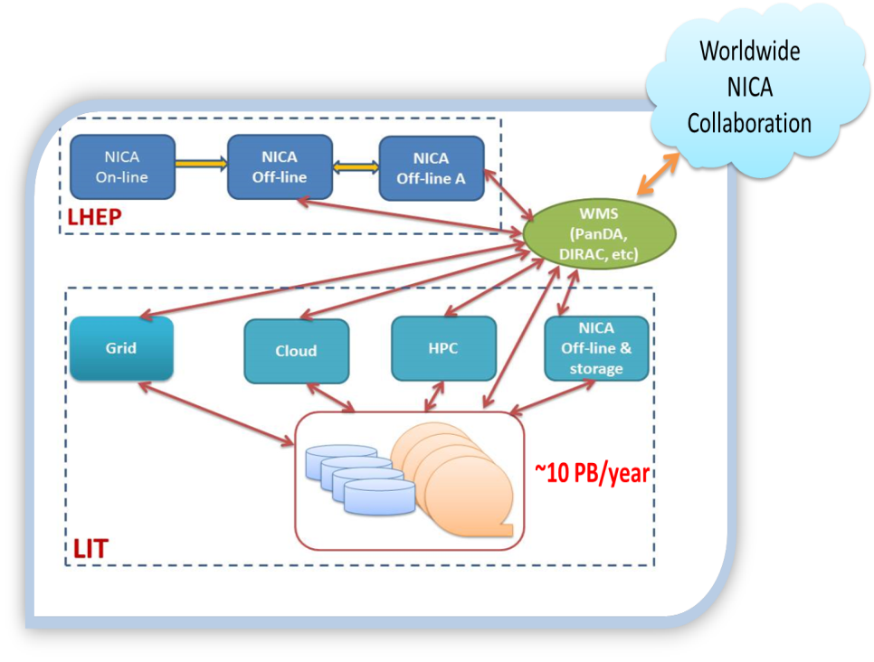
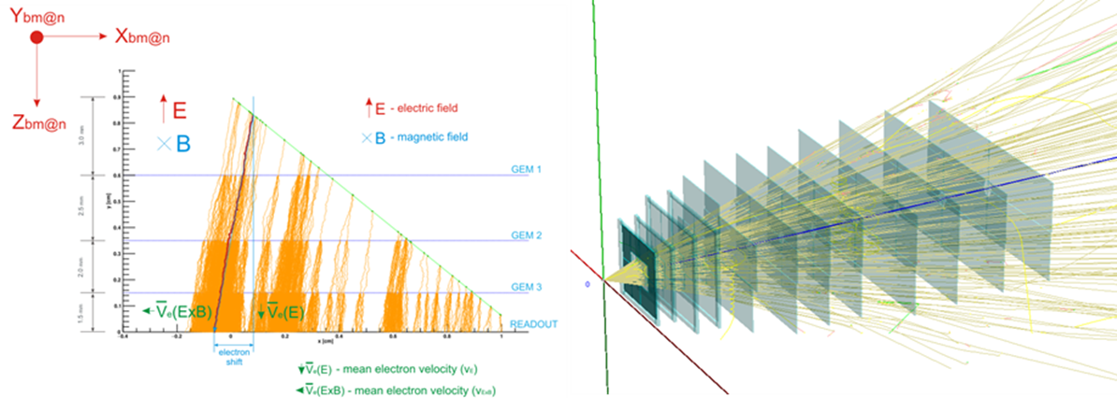
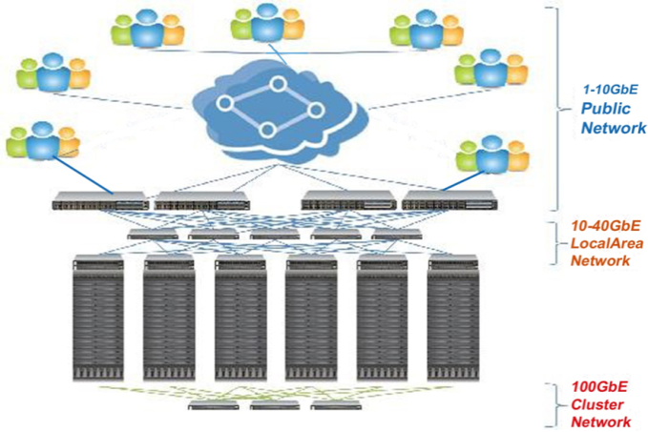
Computing for MPD-BM&N
GOAL:
integration of various computing resources from NICA VBLHEP and MICC LIT for the development of computer infrastructure of the NICA.
REQUIREMENTS:
reliability, scalability, interoperability, adaptability to new technical solutions, year-round operation in 24x7 mode
CURRENT DEVELOPMENT:
maintenance and development of a management system for
the NICA project
local network of the NICA project
optimization of Distributed Data Processing System using simulation
software for BM@N GEM (Gas Electron Multiplier) tracker based on deep learning methods
Nuclotron beam momentum estimation in BM@N experiment
HOT TOPICS:
Software for simulation and data processing
HPC for theoretical investigation of dense hadronic matter
Integrated computing resources for data processing
Data storage system – datalake concept based on EOS

Slide 20
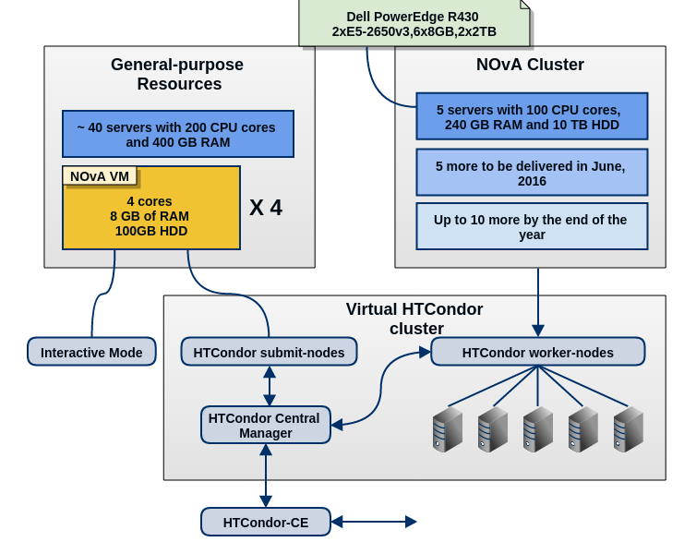
Computing Support for Neutrino Projects
NOvA (Fermilab, USA) is the first neutrino experiment actively using JINR Cloud:
Computing support team was formed including physicists and IT specialists.
In December 2017, DLNP bought 4 computer servers Dell equipped with Intel Xeon E5 processors. Servers are already assembled in the LIT cloud infrastructure and will be used for simulation and analysis of data obtained in the Daya Bay and JUNO experiments.
Notes:
This slide shows the JINR’s Computing Center Scheme of equipment.
Here you can see the JINR Tier 1 connectivity plan with Tier0.
20

Slide 21

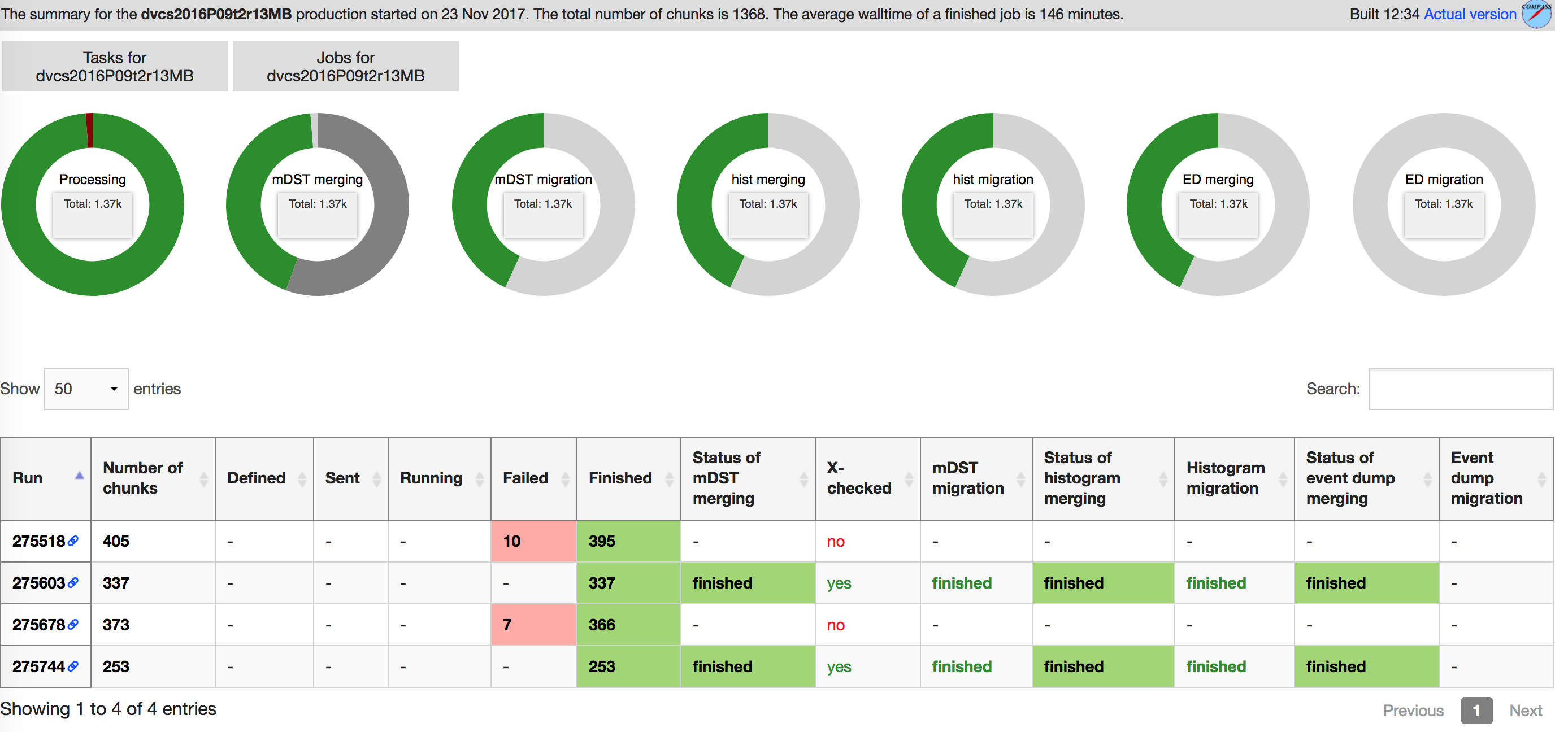
New COMPASS Production System
COMPASS Grid Production System was developed and provides automated task processing from definition till archiving
Key features:
Production management via Web UI, allows one to define a task, send, follow and manage it during lifecycle.
Via PanDA job execution layer jobs are being sent to any available type of computing resource: Condor, LSF, PBS, etc.
Computing sites: CERN Tier-1, JINR Tier-2
Storage: EOS and CASTOR at CERN
All management services deployed at
JINR Cloud Service
In production since August, statistics:
  ~1 000 000 chunks of raw data processed,
  ~30 billions of events,
  ~200 TB of data produced,
  ~3 000 000 jobs processed:
  reconstruction, ddd filtering,
  merging of mDST, histograms
  and event dumps.
Tasks requests layer: Web UI
Job definition layer: ProdSys
Job execution layer: PanDA
Task definition layer: ProdSys

Slide 22
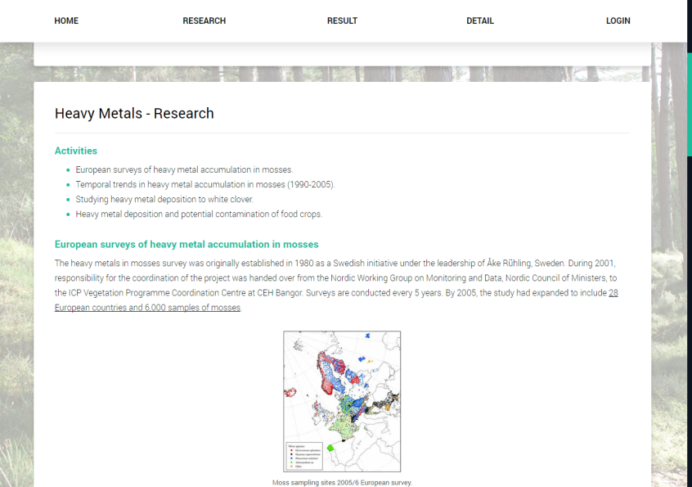
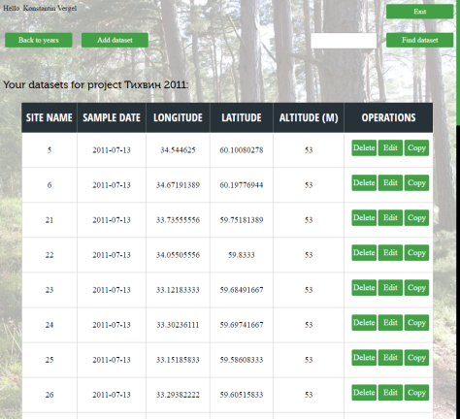
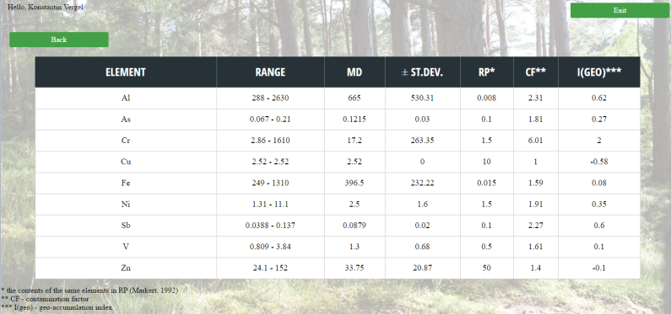
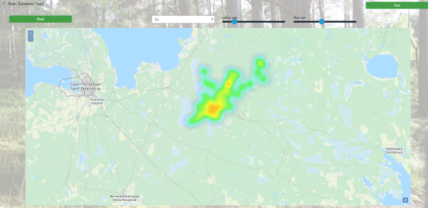

Data Management of the Environmental Monitoring Network: UNECE ICP Vegetation Case
Since 2014, the Frank Laboratory of Neutron Physics at JINR has been in charge of that part of the project which is related to the moss biomonitoring.
We propose a cloud platform for data management to facilitate IT-aspects of all biological monitoring stages:
Architectural principles and approaches to build the cloud platform for data management of global biological monitoring networks.
Methods for authentication and authorization of the cloud platform users.
Formats and mechanisms to transfer and storage environmental monitoring data.
Mechanisms for biological monitoring data import into a database of the cloud platform.
Mechanisms and interfaces of data manipulation and representation to
authorized participants of biological
monitoring networks.
The basic method for creating math-cartographic models on the basis of spatial analysis and neural networks.

Slide 23







Machine learning algorithms for particle physics
Two-step Deep learning algorithm for the tracking for experiment BM@N with GEM detectors
Machine-learning algorithms for identification and separation of the neutron and gamma-ray signals obtained from the DEMON detector
1) Directed K-d Tree Search
Two dimensional diagram of neutron and gamma-ray signals
2) Deep Recurrent Neural Network Classifier
Software for ML
used on HybriLIT
Results on simulated events:
True track recognition efficiency is on the level of 97.5%.
Result of ML classifier (AdaBoost1, 200 parameters) for pre-sorted dataset is 99.922%

Slide 24



QUANTUM COMPUTING AT LIT JINR:
NON-CLASSICALITY IN QUBITS ENSEMBLES
Studies of Quantum — Classical correspondence via the Wigner function;
Unitary non-equivalent Wigner functions for N-level quantum system has been constructed based on the Stratonovich–Weyl correspondence;
Non-classicality (negativity) of the Wigner functions has been studied for the random Hilbert-Schmidt ensembles of qubits.
Probability density of Wigner function negativity for Hilbert-Schmidt ensemble of qubits
Gradient plot of qubit Wigner function
Fundamental domain, Mobius triangle (3,3,2), of Wigner function kernel for quatrit
[1] A. Khvedelidze, A. Torosyan, The spectrum and separability of mixed two-qubit mixed X-states,
Journal of Mathematical Sciences, v.224, N2, 349-359 (2017)
[2] A.Khvedelidze and I.Rogojin, On the geometric probability of entangled mixed states,
Journal of Mathematical Sciences, v.209, N6, 988–1004 (2015)
Notes:
24

Slide 25



Efficient parallelization of complex numerical problems in computational physics
Determination of the Vesicular Systems Parameters: Parallel Implementation and Analysis of the PTNS Vesicle Structure.
Basic parameters of phospholipid vesicles are estimated within the separated form factors method (SFF) by means of the least square minimization procedure.
M. Bashashin, E. Zemlyanaya, E. Zhabitskaya, M. Kiselev, T. Sapozhnikova. European Physics Journal – Web of Conferences, Vol. 173 (2018) 05003
Reduction of computation time
by ~10 times
Reduction of computation time
by ~18 times
MPI calculation of microscopic nucleus-nucleus optical potential within the frame of the double-folding model.
The double folding microscopic nucleus-nucleus optical potential is constructed by means of numerical solution of nonlinear integral equation with help of respective iteration procedure.
E.Zemlyanaya, K.Lukyanov, M. Bashashin. System analysis in science and education, Num 3 (2016)
Reduction of computation time
by ~10 times
Numerical Simulation of the Formation of Hydrated Electron States.
The model is described by a system of nonlinear partial differential equations which are solved by means of implicit method with the use of partition algorithm.
A. Volokhova, E. Zemlyanaya, V. Lakhno, I. Amirkhanov, M. Bashashin, I. Puzynin, T. Puzynina. European Physics Journal – Web of Conferences, Vol. 173 (2018) 06013

Slide 26





HLIT-VDI – HybriLIT Virtual Desktop Infrastructure
HLIT-VDI is a new service that is aimed at providing users with possibility to work via virtual desktops and, thus, use software packages with GUI support. This will allow using heavy mathematical packages such as COMSOL Multiphysics, Matlab, Mathematica, Maple, and also Geant4, ROOT, et al.
24 virtual machines (VM)
Example using of HLIT-VDI service. Modelling and simulation of the magnetic field distribution for design and production of the superconducting magnet SC200 with COMSOL Multiphysics
Superconducting magnet SC200 designed for medical application
Magnetic field distribution at median plane of the magnet
Computational mesh

Slide 27




CHALLENGE: R&D of software to acquire, manage, process, and analyse the big amounts of data to be recorded
Data Analysis and Interpretation
Data Organisation, Management and Access
Data-Flow Processing Framework
Conditions Data
Visualisation
Software Development, Deployment, Validation and Verification
Data and Software Preservation
Physics Generators
Detector Simulation
Software Trigger and Event Reconstruction
Machine Learning
Facilities and Distributed Computing
Security
CMS estimation
CMS estimation

Slide 28


CHALLENGE: distributed data storage evolution: DATALAKES
GOAL:
to provide a computing infrastructure to the experiments and the community to store and analyze data,
to achieve storage consolidation where geographically distributed storage centers (potentially deploying diﬀerent storage technologies) are operated and accessed as a single entity.
EOS - a CERN open-source storage software solution to manage multi PB storage.
XRootD - core of the implementation framework providing a feature-rich remote access protocol.
Improvement of already existing production quality Data Management services.
Scalable technologies for federating storage resources and managing data in highly distributed computing environments.

Slide 29





Tier-1:
>15000 cores
>16 PB disk
>42 PB tape
Cloud:
>7500 CPU
>15 TB RAM
Storage
HybriLIT:
2018 ~ 1 Pflops
2023 plan 0,5 Pflops
Storage
СICC/Tier-2: >10000 cores
>6 PB disk
NICA off-line cluster and storage system
Network infrastructure: LAN >100 Gbps WAN: ?x100 Gbps
Engineering infrastructure

Slide 30

Strategy of Information Technologies and Scientific Computing in JINR
CONCEPT
of the development of
IT-technologies and scientific computing aimed at solving strategic tasks of JINR through the introduction and development of a whole range of advanced IT solutions, integrated into a unified computing environment – scientific IT ecosystem that combines a variety of technological solutions, concepts and methodologies.

Slide 31
Telecommunication technologies
networks with terabit data speeds
Computer systems
distributed software-configured platform that combines supercomputer (heterogeneous), grid and cloud technologies for the most efficient use of the latest computing architectures
exascale distributed data storage
Algorithms and software
distributed solution of certain classes of computational problems
Technologies of data processing and analysis
networks based on new principles of the organization, including cognitive, hybrid, adaptive, reconfigurable and heterogeneous (network-on-demand, network networking, software-configured networks, etc.)
network systems with guaranteed dynamic resource allocation
research systems of new generation allowing to transfer enormous data
network that allows performing a distributed processing of exabyte amounts of data
machine learning
formalization and extraction of information from bad structured and unstructured data
calculations based on quantum formalism
services for distributed and parallel computing (metacomputing) to improve the efficiency of scientific research via the use of supercomputers
development of scalable algorithms and programs for processing multi-parameter, multi-dimensional, hierarchical and serial data sets of exabyte volume
system analysts of the new generation based on efficient methods and algorithms of formalization and knowledge extraction and big data processing
predictive modeling, computer models of mega-experiments
Information security
protection of the computer infrastructure systems based on fundamentally new paradigms, including quantum cryptography and computing, neurocognitive principles
use of advanced tools and software systems for data protection based on new principles of organization of data and interaction of data objects, including the global integration of information systems, shared access to applications, new Internet protocols, virtualization, social networks, mobile device data and geolocation

Slide 32
















LIT traditional conferences
Distributed Computing and Grid-technologies
in Science and Education
LIT schools
Mathematics. Computing. Education

Slide 33
Conclusion
The project of the Multifunctional Information and Computing Complex is in constant development for scientific research underway at JINR and its Member States on the basis of advanced information technologies in accordance with the Seven-year plan for the development of JINR for 2017–2023.
Development of high-performance computing (HPC), new architectures and principles of the organization of computations leading to innovative changes in the research strategy.
Building up at JINR the scientific IT-ecosystem as a distributed software-configured HPC-platform which combines supercomputer (heterogeneous), grid- and cloud technologies which contributes to refining scientific research, accelerating the production of results and new scientific knowledge, increasing management efficiency, emerging new forms of education, improving communication and interaction between scientists, and ensuring access to a wider range of information.
Extension of new and upgrading of existing algorithms for experimental data processing based on the principles of advance machine learning.
The active participation in implementing the priority tasks of JINR and its Member States, in particular those related to the NICA megaproject.
Strengthening the work with students and PhD aimed at rejuvenation of personnel.

Slide 34

THANK YOU FOR YOUR ATTENTION !

