Slide 1
Proposal for awarding the title “Honorary Doctor of JINR”
G. Trubnikov
135th session of the JINR Scientific Council

Slide 2
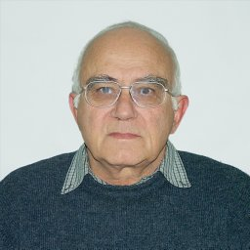
Professor Chavdar Stoyanov
Bulgarian scientist, Professor, Head of the Laboratory of Nuclear Spectroscopy, Institute for Nuclear Research and Nuclear Energy (INRNE), Bulgarian Academy of Sciences (BAS).
Scientific interests: theoretical and experimental nuclear physics. Made a major contribution to creating the quasiparticle-phonon model of the nucleus, which helped explaining the mechanism of formation of the widths of giant resonances and single-particle excitations of high energies.
Positions held: Leading Professor, INRNE BAS (since 1987); Corresponding Member, BAS (since 2004); Member, JINR Scientific Council (since 2010); Chair, Scientific Council, INRNE BAS (since 2011).
Awards: JINR prizes (1979, 2022), Prize in Physics named after Academician Georgiy Nadzhakov BAS (1989); Fellowship from DAAD, Germany (1998), Japan Society for the Promotion of Science (2003), and Fulbright, USA (2003–2004); Honorary badge of BAS “Marin Drinov” (2014).
Professor Chavdar Stoyanov is one of the organizers of the International School of Nuclear Physics in Varna, has the highest authority in the world's academic circles.
We are very grateful for his many years of participation as a member of the JINR Scientific Council and for his huge role in strengthening the cooperation of our Institute with the scientific community of Bulgaria.
By conferring the title “Honorary Doctor of JINR” we would like to recognize in one more way his outstanding achievements in physics research and personal contribution to the development of JINR.
NOMINEE
Notes:
2

Slide 3
The JINR Directorate asks the Scientific Council to approve this proposal

