Slide 1
PAC on Particle Physics
59th Meeting:
Report to Scientific Council
JINR, February 15-16, 2024
Itzhak Tserruya

Slide 2
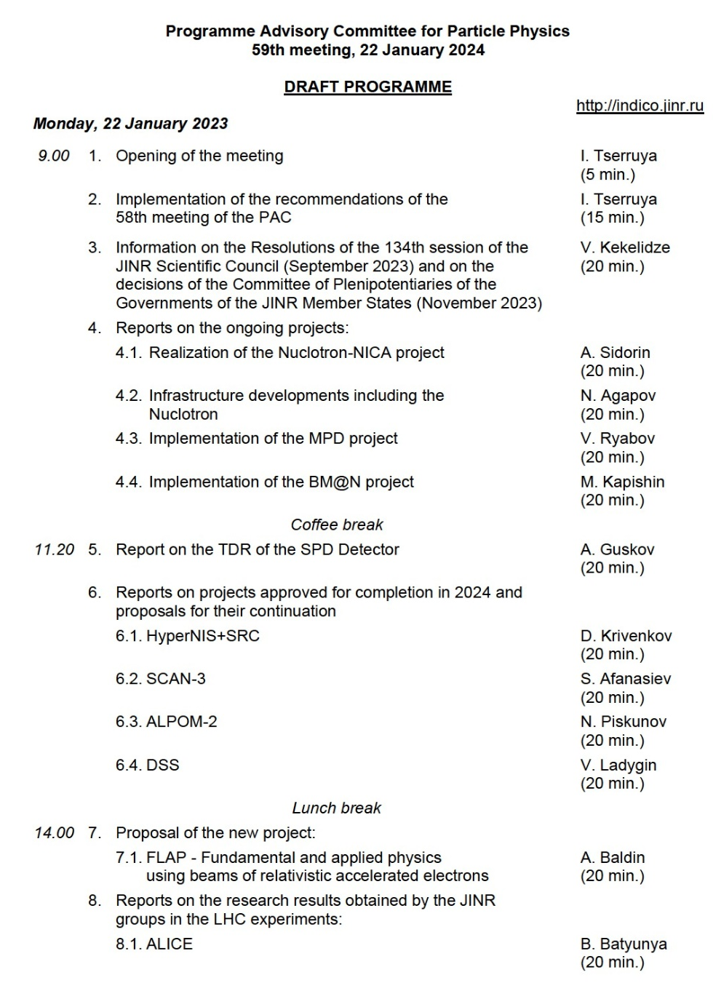
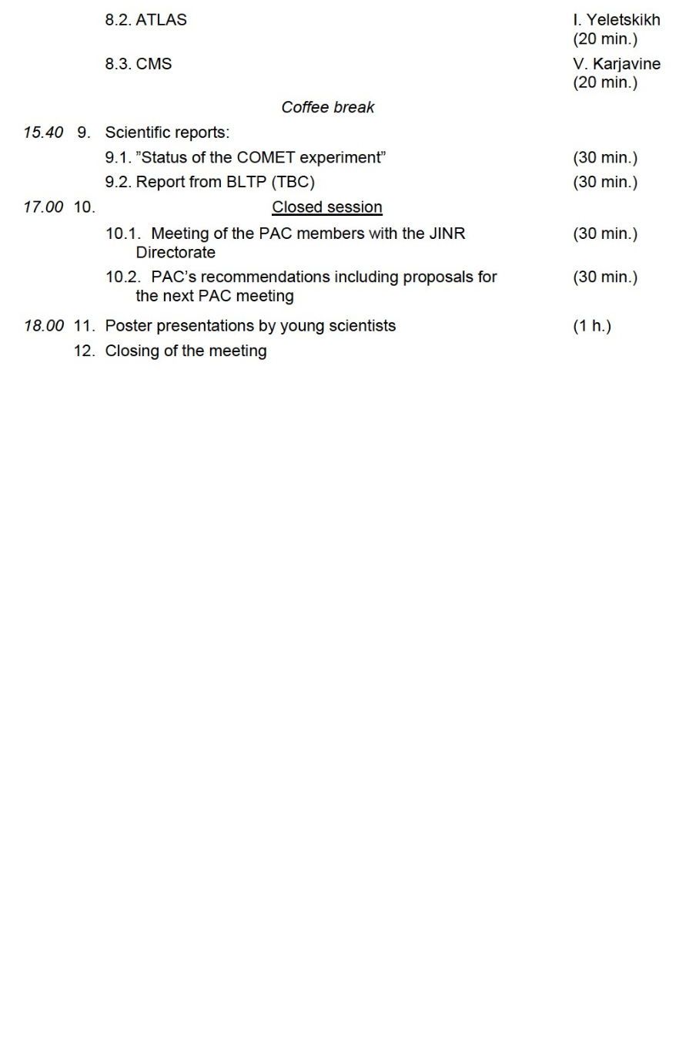
59th PAC-PP agenda January 22, 2024
Highlights of today's meeting:
JINR News
Update reports on NICA, MPD, BM@N and SPD
Extension of projects: SCAN-3, ALPOM-2, DSS, HyperNIS+SRC
New project: FLAP
Reports from the LHC experiments

Slide 3
JINR News
The PAC welcomes the adoption of the new Seven-year plan for the development of JINR and the plans of the Institute’s Directorate to concentrate efforts on the priority implementation of major projects, including the flagship mega-science project NICA.

Slide 4
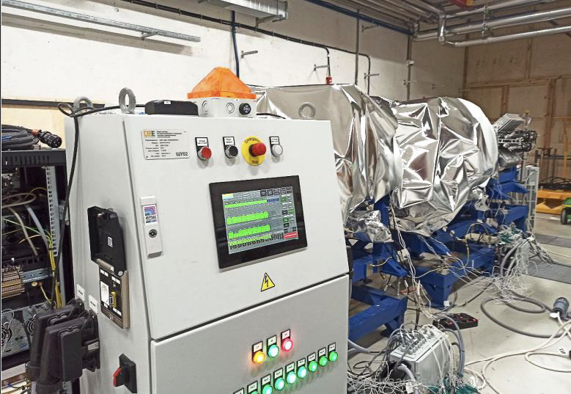
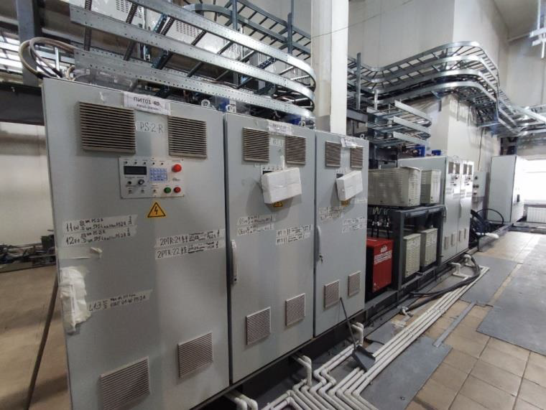
Report on the Nuclotron-NICA project
Anatoly Sidorin
The Committee appreciates the successful completion of the assembly of the ISCRA and SIMBO stations for applied research.
The installation of the NICA collider magnets continues in the tunnel as the building’s engineering infrastructure located in key areas is commissioned. In particular, the elements of the RF1 and RF2 systems were installed, vacuum annealing and vacuum tests were carried out.
The power supply system for structural elements of the collider is ready for commissioning.
The PAC is pleased to note the start of a personnel training programme in preparation for the collider’s commissioning in 2025.
Vacuum baking of RF1 and RF2
Power supply ready for commissioning

Slide 5
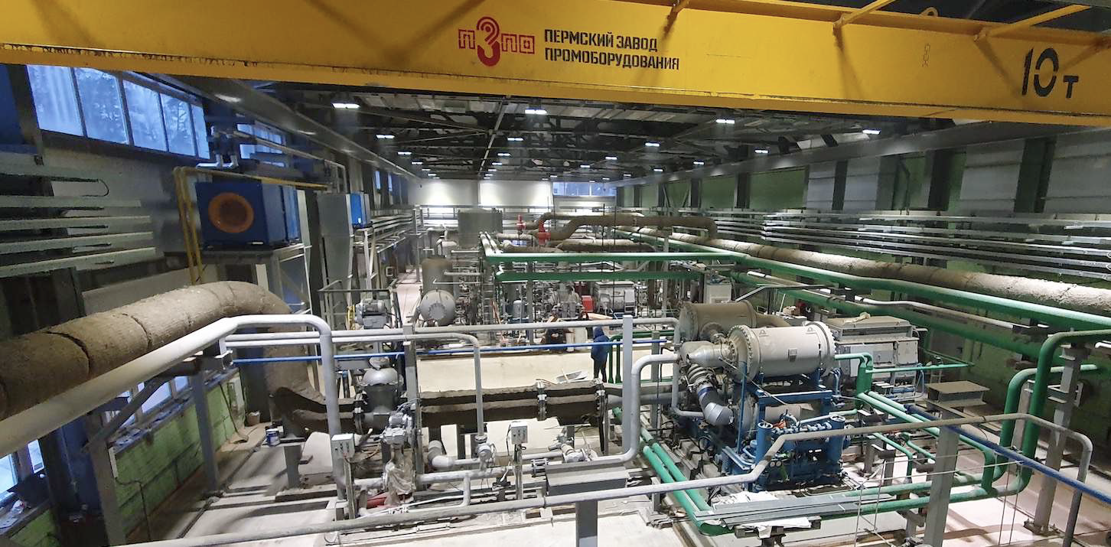
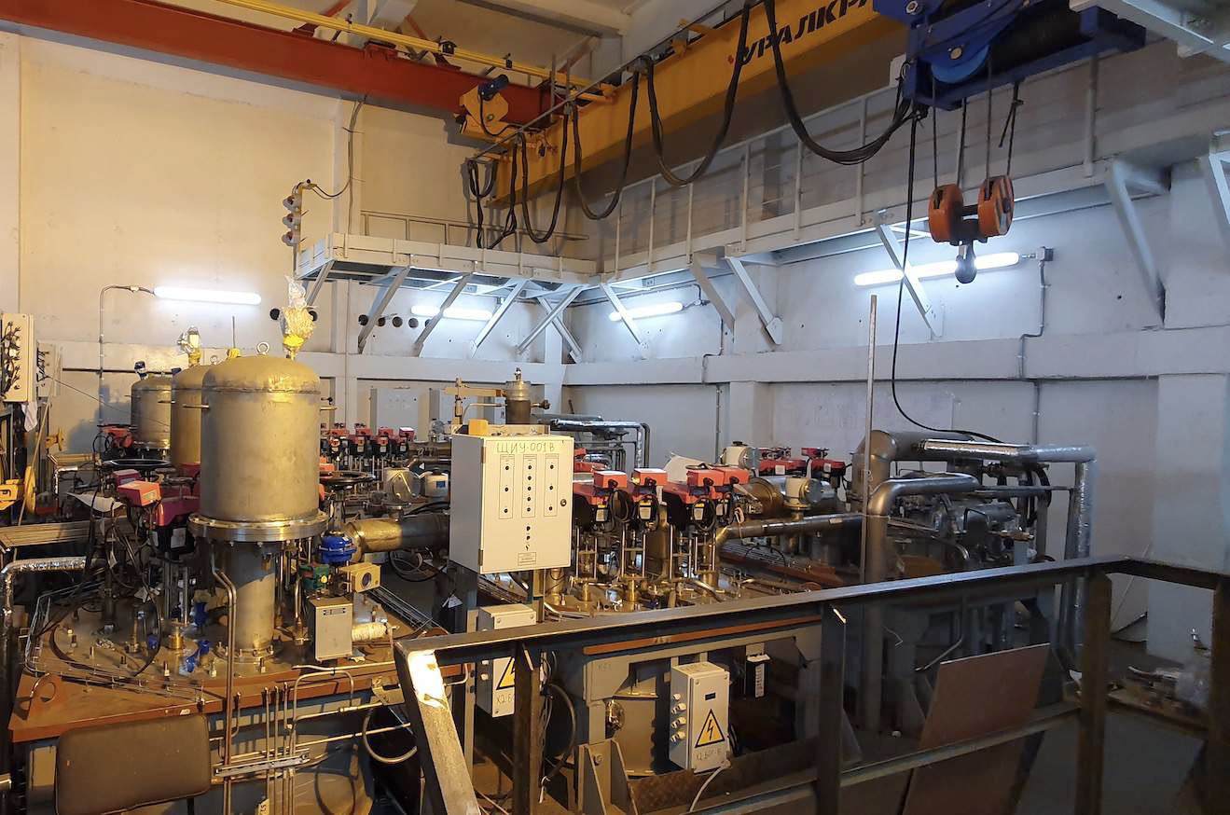
Infrastructure Developments
Nikolay Agapov
General construction work is being completed in the new buildings of the NICA complex – the collider building and the new compressor station.
The staff is carrying out installation and adjustment of equipment. Full completion of this work is expected during 2024.
Full completion of the commissioning of the NICA cryogenic complex is planned for August 2024.
The PAC notes that attention is paid to work on automation of processes of the engineering systems in connection with preparing for operation of the NICA complex in long-term sessions.
New Compressor Building
Cryogenic Plant

Slide 6
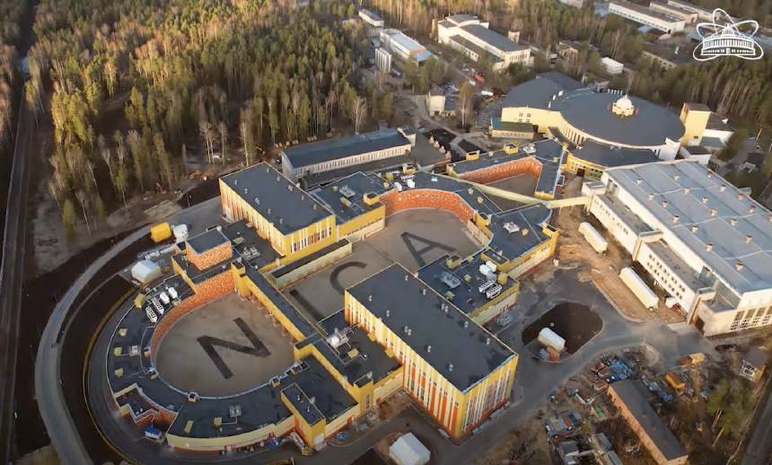
NICA Project
Exciting year
Completion of civil construction, completion of commissioning of services, completion of machine installation
Start commissioning and operations within one year!

Slide 7
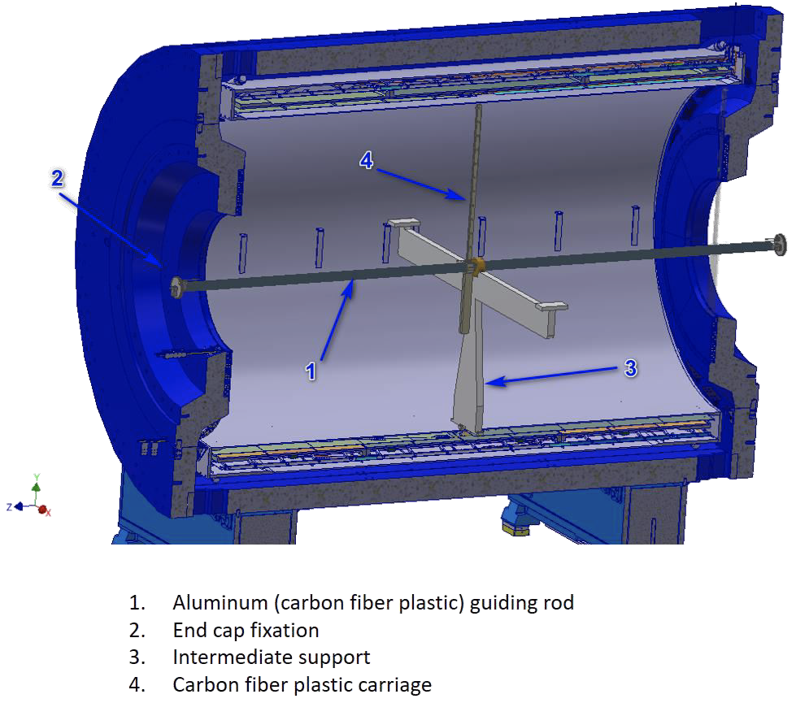
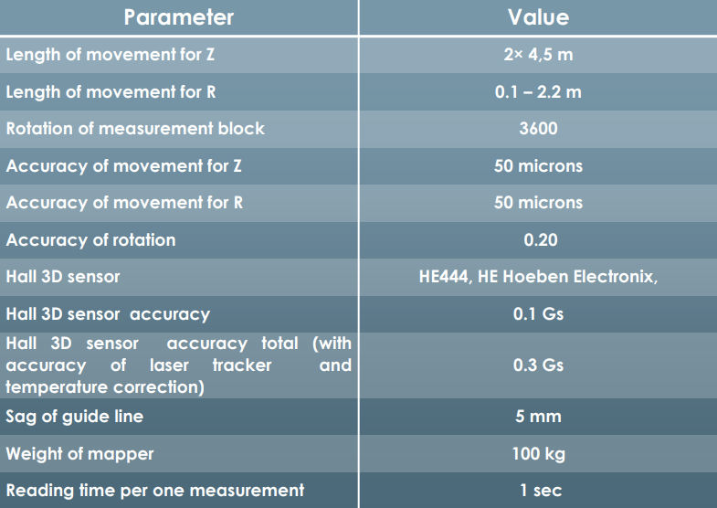
Report on MPD
Victor Riabov
The production of all components of the MPD first-stage detector is progressing with minimal delays.
The most critical task is still cooling and current supply of the large superconducting solenoid. Cooling to liquid nitrogen and liquid helium temperatures starts in January.
Magnetic field measurements will start in June 2024 and take three months for different field configurations using the mapper produced by Novosibirsk INP. Installation of the carbon fiber support frame and detector subsystems will follow starting in September.
The PAC congratulates the team on finding viable solutions for the critical issues arising from many aspects of the detector construction, assembly, and commissioning.
Novosibirsk INP mapper specifications

Slide 8
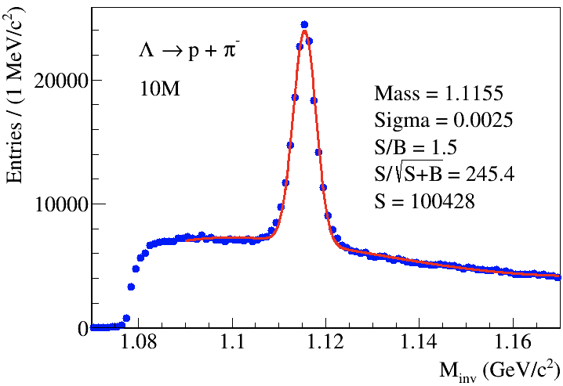
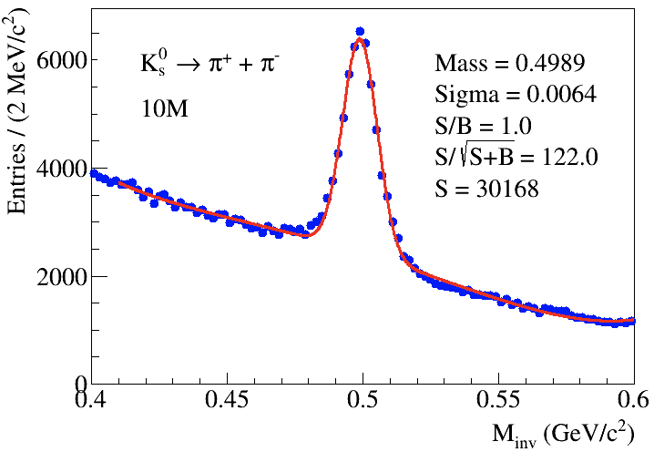
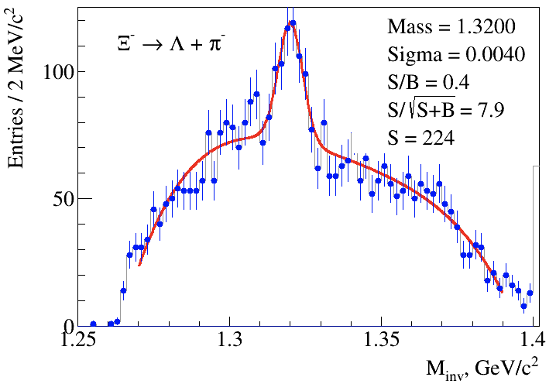
Report on BM@N
Mikhail Kapishin
The first processing of the reconstructed data recorded in 3.8 A GeV Xe-CsI collisions was performed using the DIRAC system at the MLIT Tier-1/Tier-2 computers.
Data analysis is ongoing on the production of protons, deuterons, and tritons in argon-nucleus interactions at 3.2 A GeV.
The next physics run of the BM@N experiment is planned with a Xe beam at a reduced energy of 2–3 A GeV.
The PAC emphasizes the lack of manpower for the ongoing analysis of recorded data.
Xe + CsI at 3.8 AGeV data: Λ ◊ pπ⁻, Kº_{S} ◊ π⁺ π⁻, Ξ⁻ ◊ Λπ⁻
In 500 M events, expect 4M Λ, 1.2 M Kº_{S}, and 8K Ξ⁻

Slide 9
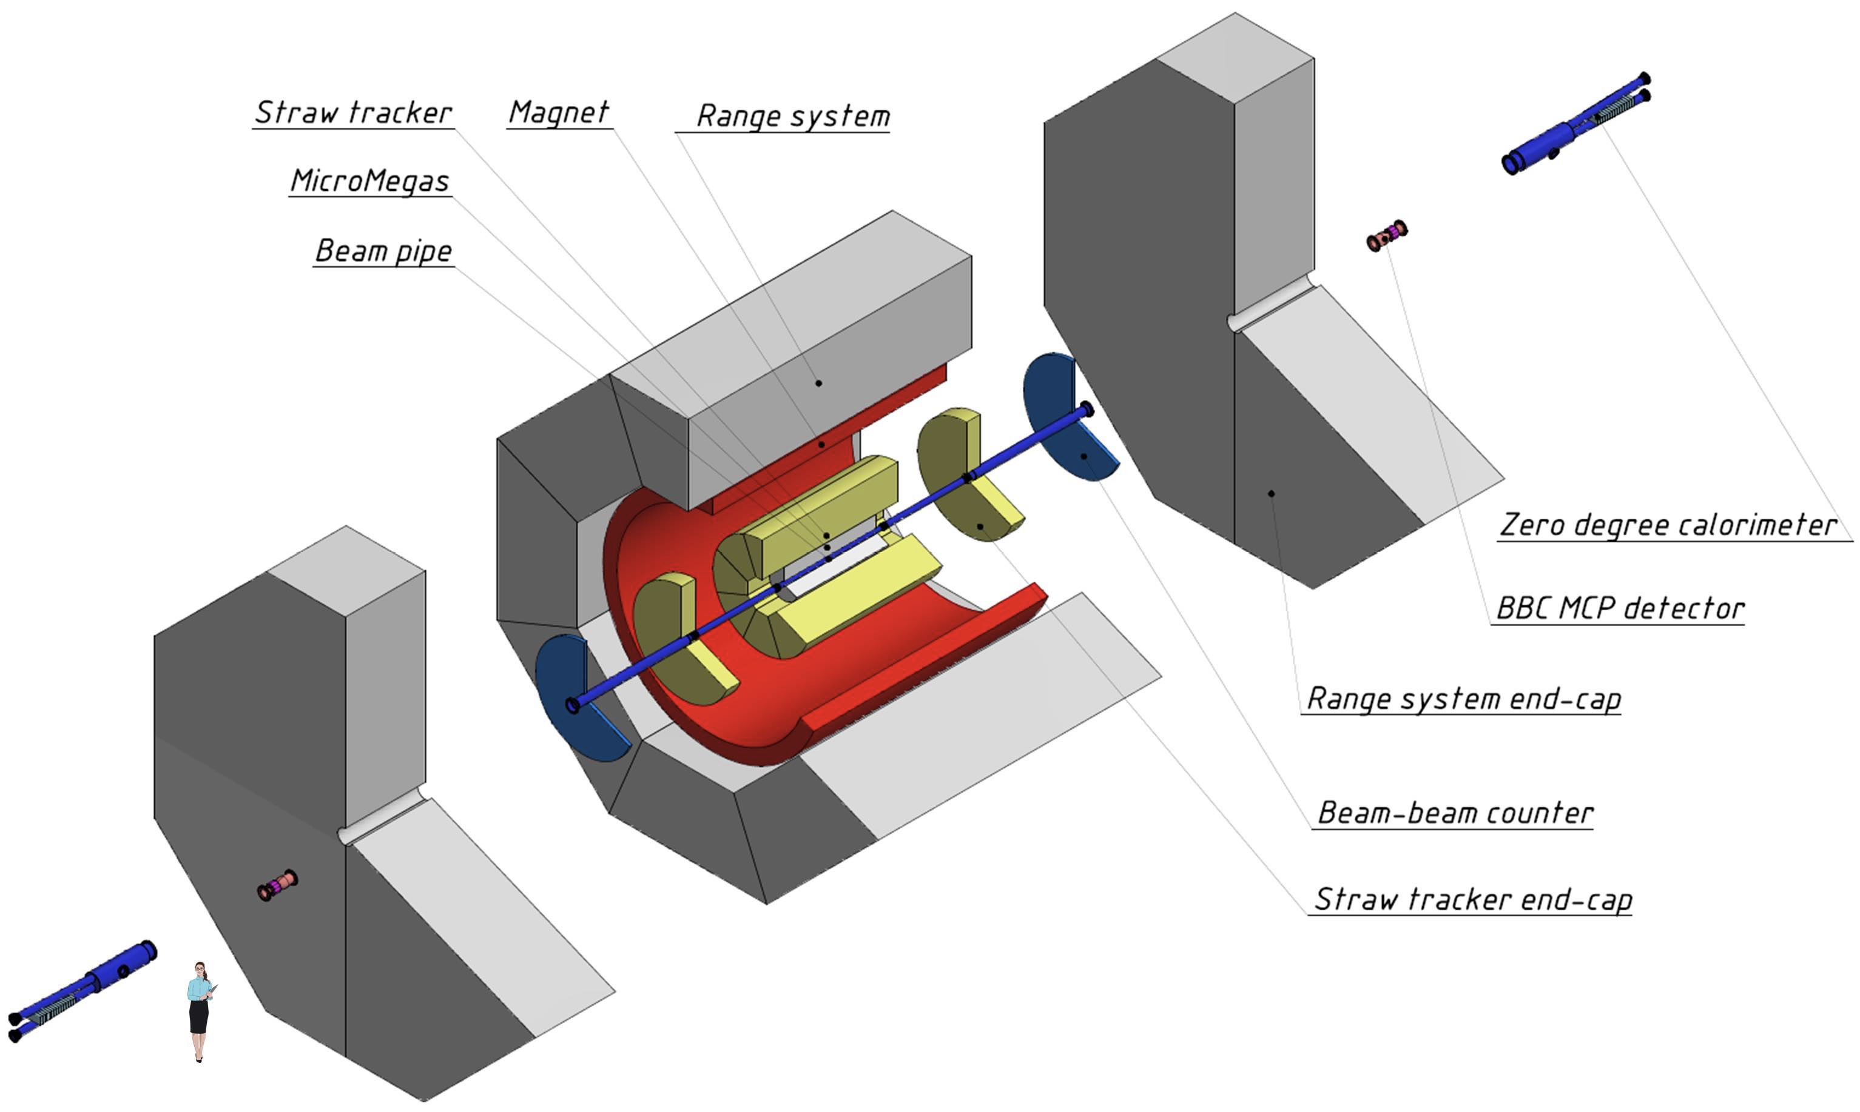
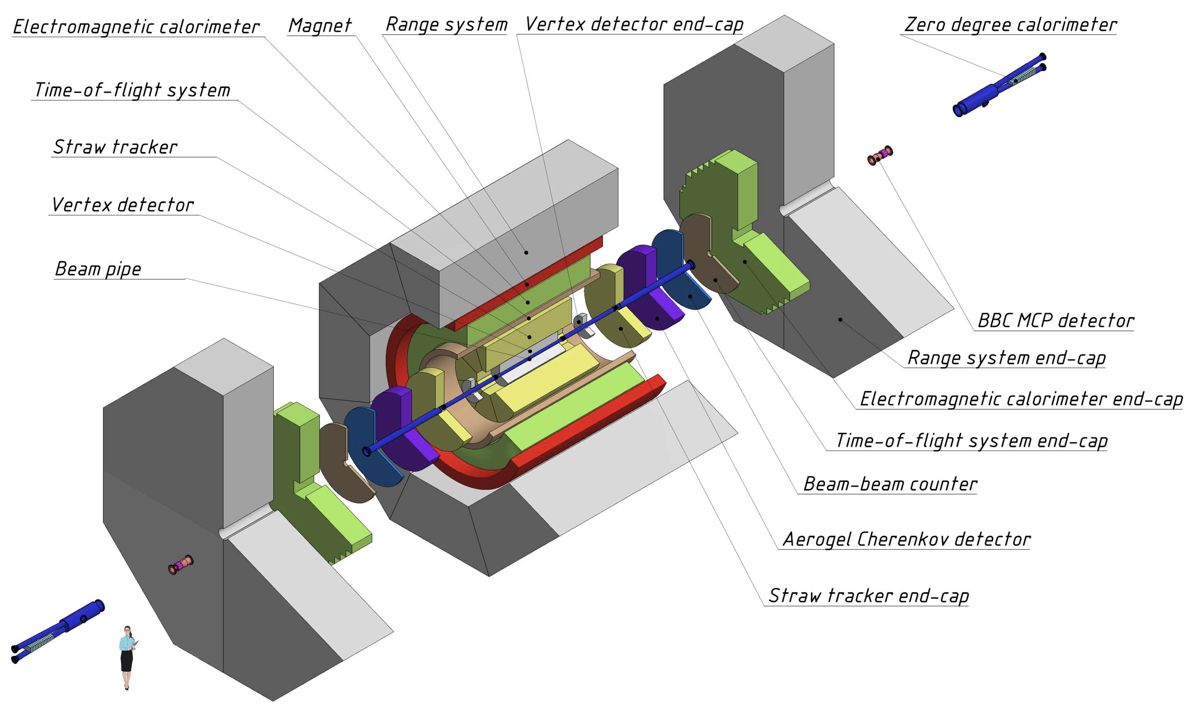
SPD Report – Towards TDR
Alexey Guskov
The detector size has been increased according to the revised allowed load on the floor of the experimental hall.
The design has been modified for the aerogel detector, micromegas-based central tracker, and beam-beam counter. Alternatives for the front-end electronics of the first-stage detectors have also been considered, and the DAQ and computing systems are adapted accordingly. The cost estimate has been updated taking into consideration current prices and availability of materials and equipment.
The Committee appreciates the appointment of the international SPD Detector Advisory Committee and the progress in forming the SPD collaboration. The PAC recommends that the new DAC conduct a thorough review of the updated TDR and present a report at the next PAC session.
SPD DAC:
Ivan Logashengo, BINP
Eduard Kistenev, BNL
Huang Xingtao,Shandong U.
Heng Yuekun, IHEP CAS
Start of NICA +4y +6y +8y

Slide 10
Ongoing projects seeking continuation (I)
SCAN-3 – Sergey Afanasiev
Study the highly excited nuclear matter formed in dA interactions by observing the decay of the excited nucleus into a pair of energetic particles emitted at an angle close to 180⁰. Such pairs will enable the study of the ηA interaction and to search for η−mesic nuclei
ALPOM–2 Nikolay Piskunov
Measure the analyzing power of polarized nucleons scattered on various targets at the highest momenta available at the Nuclotron – 7.5 GeV/c for p and 6.0 GeV/c for n.
DSS – Vladimir Ladygin
Study the spin structure of 2N and 3N short-range correlations using polarized d and p beams at the Nuclotron.
Recommendation:
The PAC recommends extending these 3 projects until the end of 2027 with ranking A.
The commissioning of the NICA facility in the next years, including the accelerator complex and the experiments, together with the high priority given to the NICA flagship experiments – BM@N, MPD, and SPD, makes it questionable whether or not beam time will be available for other experiments. This may affect the timely realization of the SCAN-3, ALPOM-2, and DSS projects. In view of that, the PAC recommends that the VBLHEP and NICA managements define an overall strategy for the availability of beam time for users for the next 2–3 years. Once this strategy is defined, the PAC will be ready to prioritize and quantify the beam time to be allocated to these experiments.

Slide 11
Ongoing projects seeking continuation (II)
HyperNIS + SRC – Alexander Averyanov
HyperNuclear Intrinsic Strangeness and Short-Range Correlations”. The initial stage of the experimental programme aims at studying the lightest neutron-rich hypernuclei, like ⁶_{Λ}Н, ⁴_{Λ}Н, ³_{Λ}Н. The search for such hypernuclei can be performed with a special setup, such as HyperNIS.
Adding the SRC apparatus dedicated to the study of short-range correlations will considerably expand the physics programme. The study of the possibility of locating the SRC experiment at the HyperNIS setup area is ongoing.
Recommendation:
The PAC supports the proposed experiment with hypernuclei at the Nuclotron, the plans to expand the setup for the SRC study, and recommends approval of this project until the end of 2029 with ranking A.

Slide 12
Reports on new projects (I)
FLAP – Anton Baldin
“Fundamental and applied physics using beams of relativistic accelerated electrons (FLAP)”. The FLAP collaboration is planning to carry out its research at the linear electron accelerator LINAC-200. The project is related to the fundamentals of electromagnetic interactions as well as new applications. The task list includes the study of controllable generation of electromagnetic radiation by relativistic electrons using functional materials, the investigation of the characteristics and controllable generation of Cherenkov, synchrotron, and transition radiation with a frequency of up to the GHz scale, the interaction of beams of relativistic electrons with surface and corrugated structures, the creation of secondary neutron beams for neutron radiography, and testing new detectors for non-destructive beam diagnostics with high spatial and time resolution.
Recommendation:
The PAC supports the proposal to develop these interlaboratory activities at JINR and recommends opening the new project FLAP for the period of 2025–2029 with ranking A.

Slide 13
Reports from the LHC experiments
Reports presented by:
ALICE – Elena Rogochaya
ATLAS – Evgeny Khramov
CMS – Vladimir Karjavin
The PAC heard detailed reports on the activities of the JINR groups involved in the three LHC experiments, ALICE, ATLAS and CMS with emphasis on their scientific and detector upgrade contributions.

Slide 14
Scientific Reports
The PAC takes note of the reports “Status of the COMET experiment” presented by David Chokheli and “Preparation of the SRC experiment” presented by Maria Patsyuk, and thanks the speakers for their interesting presentations.

Slide 15
Poster presentations by young scientists
The PAC reviewed 25 posters presented by young scientists from BLTP, DLNP, MLIT, and VBLHEP at the poster session.
The Committee selected the report: “Development of technology for the production of double-sided silicon microstrip modules for upgrading the NICA BM@N Silicon Tracking System” made by A. Sheremetiev to be presented at this session of the Scientific Council.

Slide 16
Next PAC-PP Meeting – June 17-18, 2024
The next meeting of the PAC-PP is scheduled for June 17-18, 2024.
The following items are proposed to be included in the agenda of the next meeting:
Status report on the Nuclotron-NICA project
Status report on infrastructure issues including the Nuclotron
Report from the Coordinator of the Nuclotron experimental programme
Status report on the MPD project
Status report on the BM@N project, including physics results from the Xe run
Report from the SPD DAC on the TDR
Progress reports on JINR’s participation in the LHC experiments
Consideration of new projects
Reports and recommendations on the projects to be completed in 2024
Posters from young physicists

Slide 17
Thank you!

