Slide 1
Programme Advisory Committee for Condensed Matter Physics
Follow-up after the 58th meeting, 25 January 2024
Dénes Lajos Nagy
135th session of the Scientific Council, 15-16 February 2024

Slide 2
Agenda of the PAC meeting
Thursday, 25 January 2024

Slide 3
On current activities at the IBR-2 facility
The PAC took note of the information on the status of obtaining a license to operate the IBR-2 facility and on the preparatory work to replace the air heat exchangers (HE) of the second cooling circuit of the reactor, presented by Egor Lychagin. At present, the plan of the FLNP Directorate is to restart the reactor operation in the autumn of this year.

Slide 4
The schedule of organizational and technical work for the resumption of regular operation of the reactor (optimistic scenario)

Slide 5
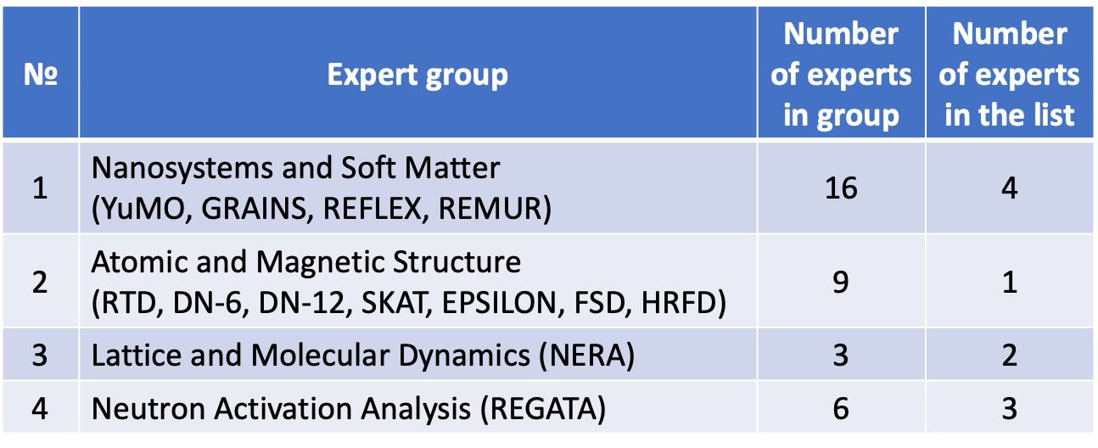
Preparing for the resumption of the user program
An update of the user program regulations is being prepared in connection with the inclusion of neutron activation analysis (NAA) in the program and changes in the political situation.
Expert groups need to be updated.
The FLNP asked PAC members to help with finding candidates for working in expert groups.
Schematic of the large-aperture backscattering detector.

Slide 6
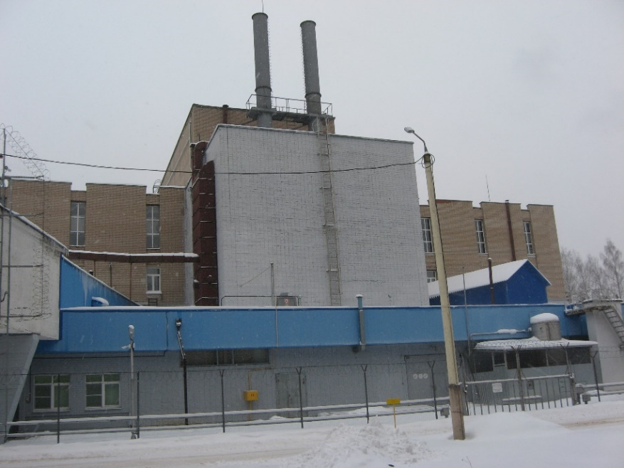
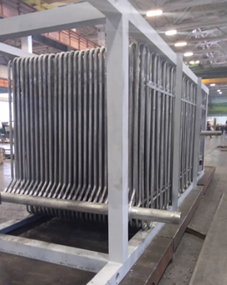
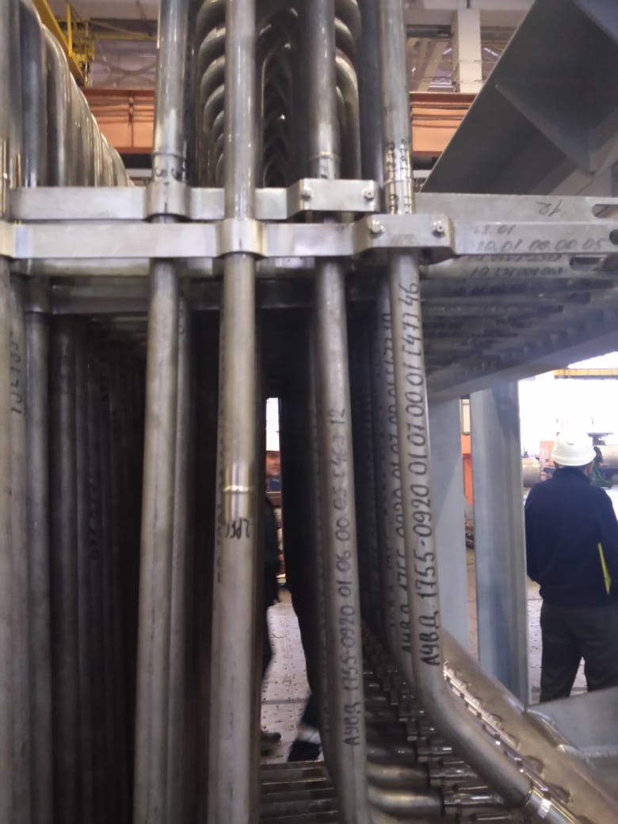
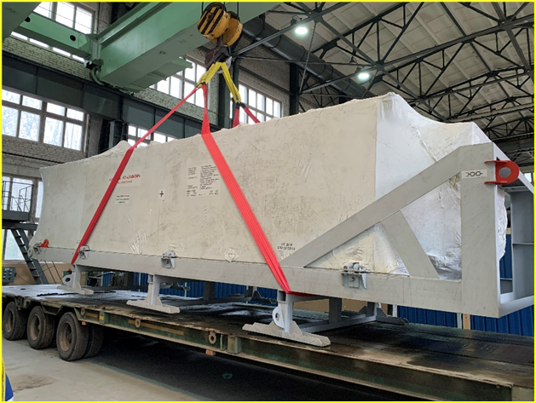
On current activities at the IBR-2 facility
Recommendation. The PAC appreciated and supported FLNP’s plans and efforts to restart the operation of the IBR-2 facility in 2024–2025.
New heat exchangers at the manufacturer’s site.
External view of the
HE transport container.
Temporary storage is organized in building No. 5, DLNP.

Slide 7
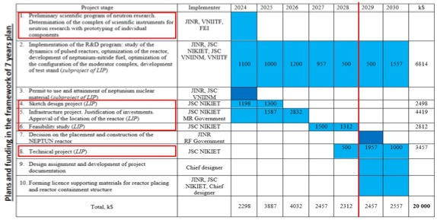
Development of the concept for a new neutron source at FLNP
The PAC took note of the report presented by Maksim Bulavin on the results of activities in 2023 and work plans for 2024 within the project “New advanced neutron source at JINR” and the subproject “Research and development for the justification of the draft design of the new advanced neutron source at JINR – NEPTUN pulsed fast reactor” being implemented within the Large Infrastructure Project (LRI) “Pulsed neutron source and the complex of spectrometers”.
Structure of the project
The PAC recommended continuing work on the project of a new neutron source –
the pulsed fast reactor NEPTUN, and supported the ongoing activities within this LRI.

Slide 8
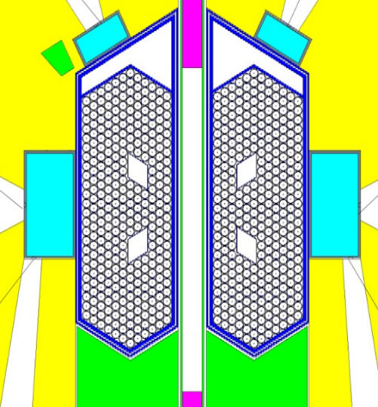
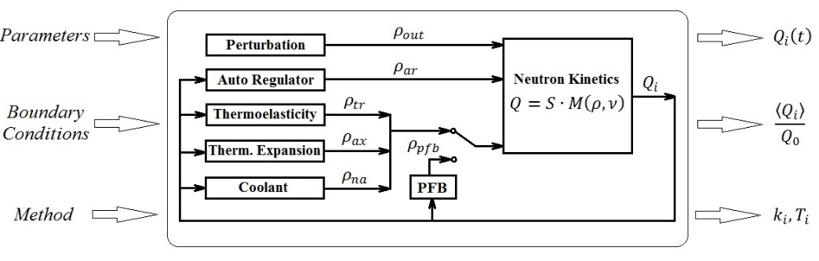
Development of the concept for a new neutron source at FLNP
In particular, the PAC recommended the continuation of activities on verifying the dynamics model of pulsed reactors, on selecting the optimal configuration of the active core and optimizing the design of the reactor vessel and reactivity modulator.
Selection of NEPTUN reactor’s active core configuration (a.c.c.)
What are the requirements for an optimal a.c.c.:
The parameters of the optimal a.c.c. must give the stable operation of the reactor and high neutron flux (small energy release gradient, small bending magnitude of fuel rods or fuel assemblies in a power pulses, depending on the temperature gradient and fixation of fuel rods). They are determined from the model of the dynamics of the reactor
The energy release for the optimal a.c.c. should not cause overheating for the construction of the RV and RM
The construction of a.c.c., RV and RM must be realizable and justified from the safety’s point of view of state rules
Optimal design of fuel rods and the composition of the NEPTUN reactor active core

Slide 9
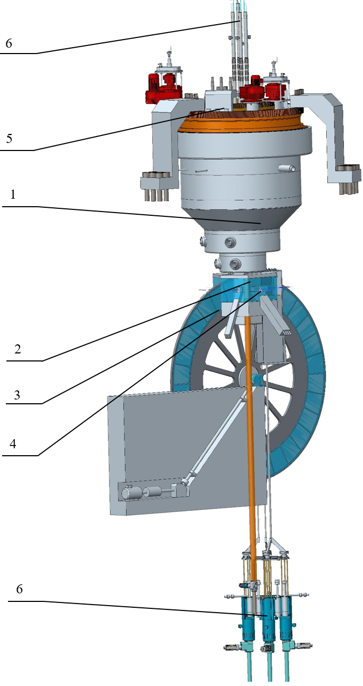
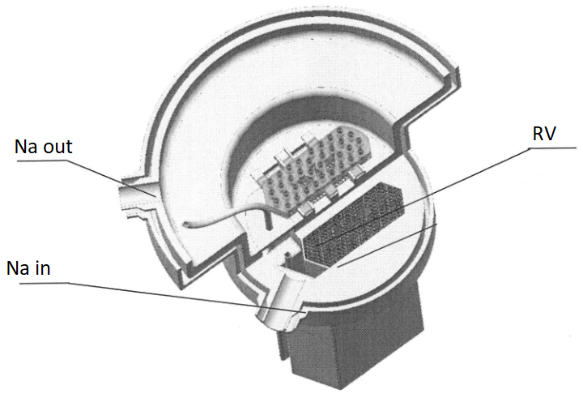
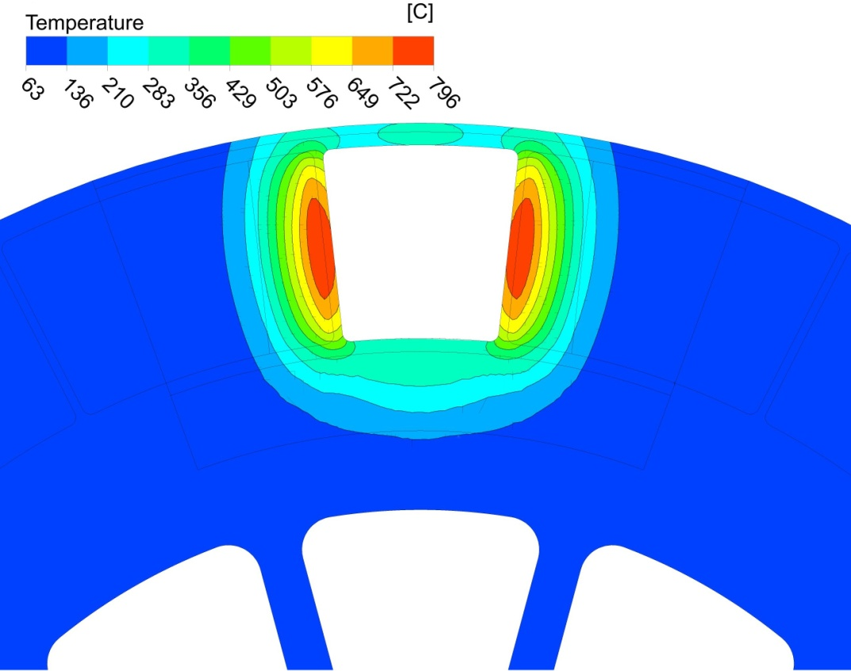
Development of the concept for a new neutron source at FLNP
The PAC also welcomed the ongoing development of a list of R&Ds to create a full-scale model of the reactor reactivity modulator and appreciated the continuation of developing the concept of a system for fast changing the working substance in the chamber of the cryogenic moderator of the reactor. The PAC also welcomed the development of the scientific programme of the NEPTUN reactor.
Optimization of the reactor construction: reactor vessel, reactivity modulator, a.c.c. (NIKIET)
1 – reactor;
2 – stationary reflector;
3 – reactivity modulator;
4 – moderators;
5 – rotary plugs;
6 – CPS actuators;
7 – RS of RSS
Power 10-15 МW
Fuel 500 kg
Average flux 10¹⁴ n/cm²/s
Flux in pulse 10¹⁶ n/cm²/s
Main task is
optimization of reactor vessel and
reactivity modulator for reduce thermal
capacity and deformation for the finding out of the safety factor (before starting Draft Design)!

Slide 10
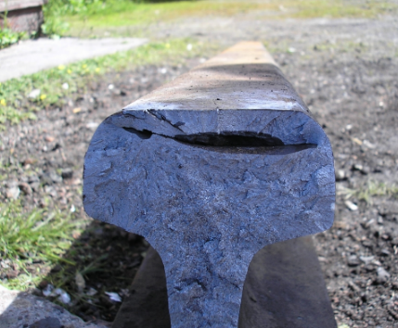
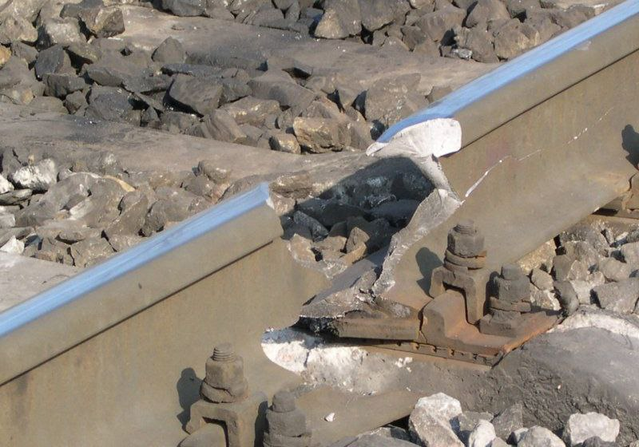
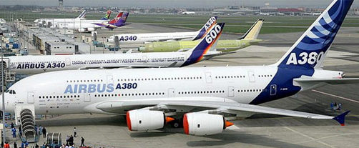
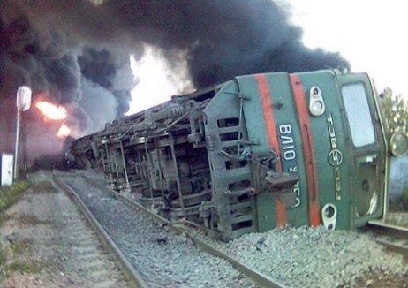
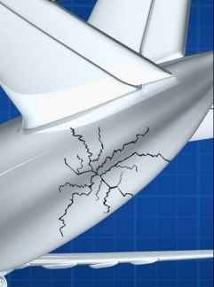
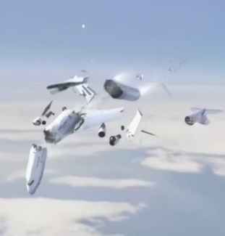
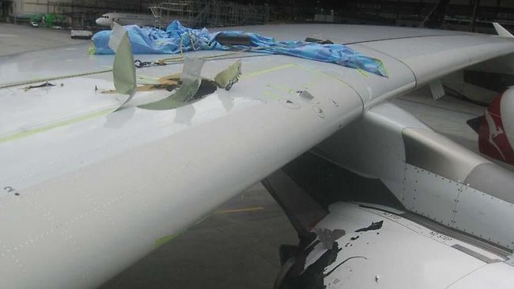
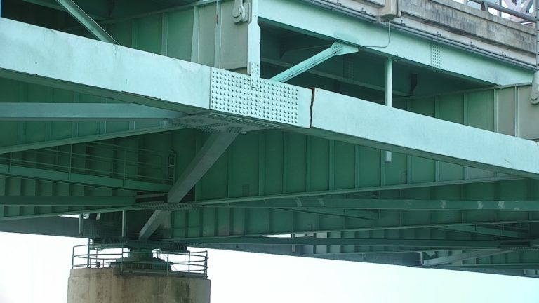
Status report on the Fourier stress diffractometer FSD
The PAC took note of the report by Gizo Bokuchava on the current state of the Fourier stress diffractometer FSD at beamline 11A of the IBR-2 reactor. The PAC believes that the achievements of FLNP in the development of the correlation diffractometry method will be very useful for creating instruments at new long-pulse neutron sources.
Sources of internal stresses in materials and products
Technological operations
Welding, rolling, peening,
bending, forming, hardening,
hydrogenation, …
Details and structures
Cyclic mechanical loads
Cyclic thermal loads
Static loads
Fatigue failure
Radiation swelling
Structural materials
Steels, alloys
Composites
Gradient materials/alloys
Materials with defects
Metal ceramics
Fatigue cracking in rails
Plane crash 25.05.2002: Boeing 747-209B of China Airlines suddenly broke apart and crashed into the water 25 min after takeoff.
Airbus A380 Wing-Spar Cracking
Cracked Mississippi River bridge (Memphis)

Slide 11

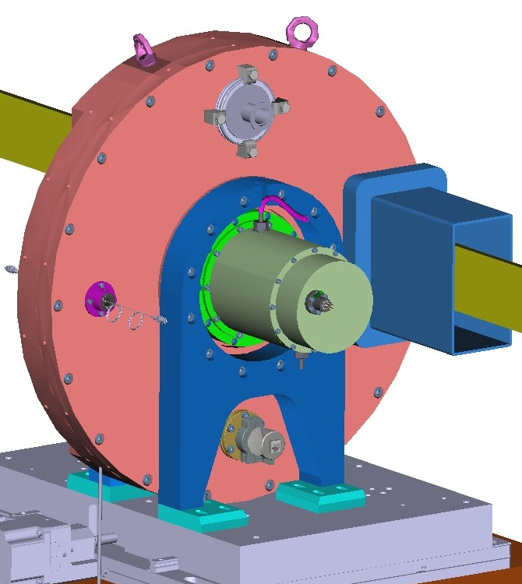
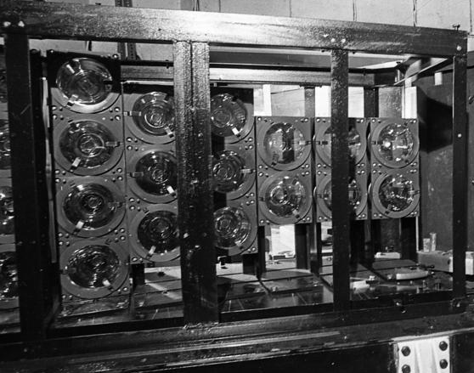
Status report on the Fourier stress diffractometer FSD
New F-chopper of the FSD diffractometer (2020)
Benefits of the new design: - Operation in vacuum: less vibration and higher dynamical stability - No absorption and scattering from chopper disc material - Combination of two pickup systems: 1) main - laser pickup system; 2) auxiliary - optical encoder with 1024 pulses - Direct measurement of transmission by neutrons and by laser beam - Low gamma background; improved PID regulation; water cooling - Moving platform (TOF/RTOF-modes) - Absence of pickup signal shift (phase error) - Significantly lower pickup fluctuations - Five different frequency windows
Manufacturing contract:
start - 2018
end - 2020
Funding:
theme 1121 (50%)
theme 1122 (50%)
FSD detector system
Recommendation.
The PAC supported the further development of high-resolution neutron correlation diffractometry at long-pulse neutron sources.
Strain measurement in bulk specimen with radial collimators
⁶Li glass backscattering (BS) detector, 16 PMTs, 2θ = 140°, resolution: Δd/d≈2×10⁻³

Slide 12
Scientific reports
The PAC heard with interest the scientific reports
“Mechanisms of membrane protein crystallization in "bicelles"”
(by Tatiana Murugova)
“Scientific and methodical programmes of research with the LINAC accelerator (JINR): FLAP collaboration” (by Pavel Karataev).
The PAC thanked the speaker for the excellent reports.

Slide 13
Discussion of the project assessment template at JINR
The PAC discussed the procedures applied to assess projects at JINR. The PAC took note of the new rules for the preparation of projects introduced at JINR in 2023 and analyzed the experience of the reviewing procedure, which was applied at the 57th meeting of the PAC for Condensed Matter Physics.
Recommendation. The PAC considered the current procedures for the assessment of projects at JINR to be appropriate and recommended their application in future meetings.

Slide 14
Virtual presentations by young scientists
The PAC reviewed 17 virtual presentations made by young scientists in the field of condensed matter physics and related fields. The virtual poster presentation “Origin of high-pressure phase transition in the Ln₂Ti₂O₇ (Ln = La, Nd, Pr) Carpy-Galy phases” made by Asif Asadov was selected as the best presentation of the session.
The PAC also noted two more virtual poster presentations of a high level: “DNA DSB formation kinetics in mature neurons of primary rat hippocampal cell culture after exposure to ionizing radiation with different physical characteristics” by Tatiana Hramco and “Structural features of the fragment of cast iron cauldrons of Medieval Golden Horde: neutron tomography data” by Veronika Smirnova. All three authors will be awarded diplomas of the PAC.
Recommendation. The PAC recommended the poster “Origin of high-pressure phase transition in the Ln₂Ti₂O₇ (Ln = La, Nd, Pr) Carpy-Galy phases” to be presented in the session of the JINR Scientific Council in February 2024.

Slide 15
Next meeting of the PAC
The next meeting of the PAC for Condensed Matter Physics is scheduled for 24–25 June 2024.
The preliminary agenda for the next meeting of the PAC includes:
report by the PAC Chair on the implementation of the recommendations above;
report by the JINR Directorate on the sessions of the Scientific Council in February 2024 and of the Committee of Plenipotentiaries in March 2024;
progress in the development of the concept for a new neutron source of JINR;
status reports on the upgrade of FLNP instruments;
information about scientific meetings;
scientific reports (not more than three);
poster (or virtual presentation) session.

Slide 16
Thank you for your attention

