Slide 1
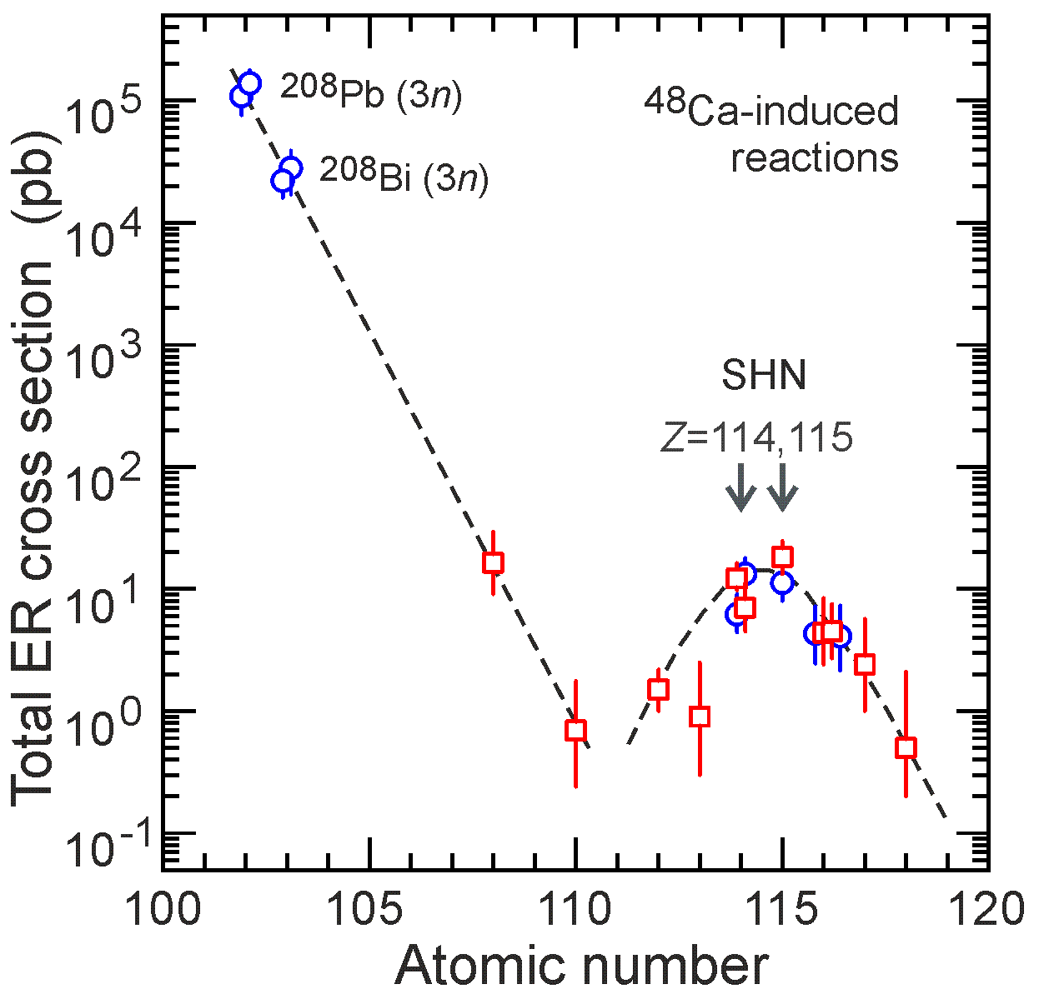
Nuclei at the minimum stability
²³²Th + ⁴⁸Ca → ²⁸⁰Ds* ²³⁸U + ⁴⁰Ar → ²⁷⁸Ds*
Production cross sections and decay properties of ^{273, 275, 276}Ds
?

Slide 2
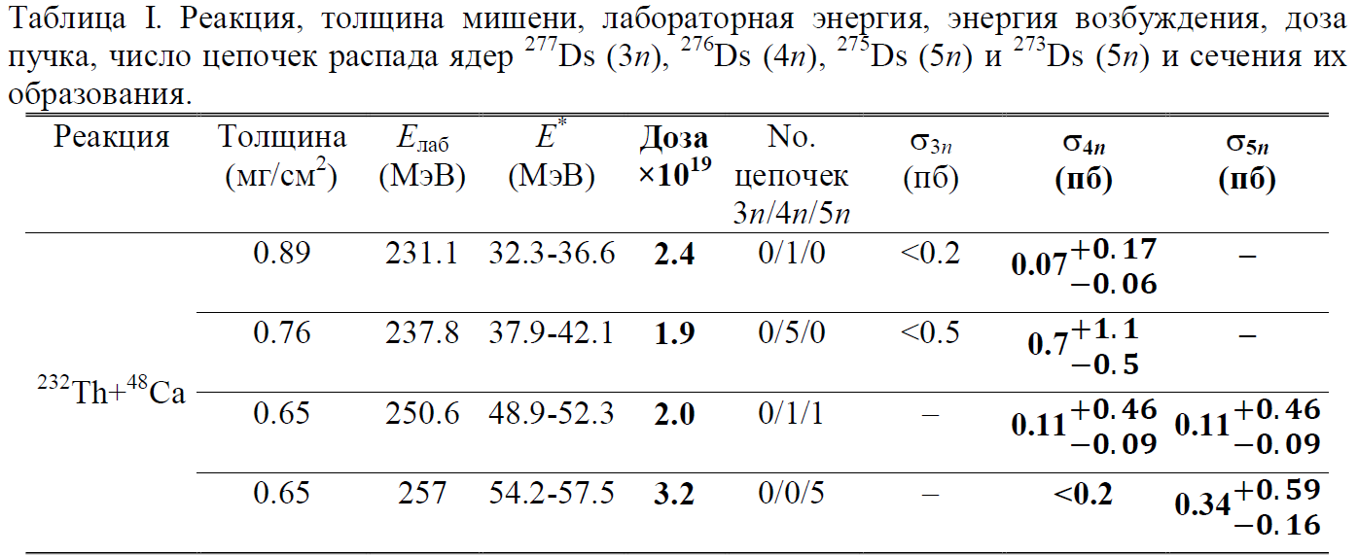
(2022)
(2023)

Slide 3
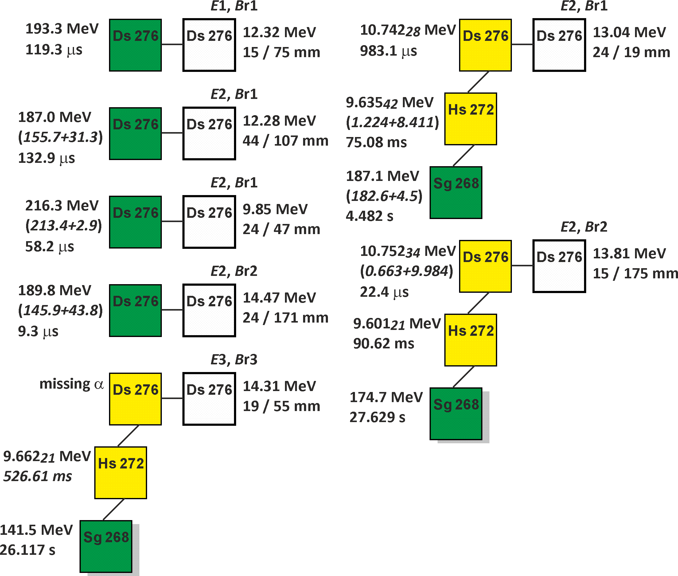
7 цепочек
²⁷⁶Ds – α и SF
²³²Th + ⁴⁸Ca → ²⁸⁰Ds*
E₁ = 231 MeV
(2022)
E₂ = 238 MeV
(2022)
E₃ = 251 MeV
(2023)

Slide 4
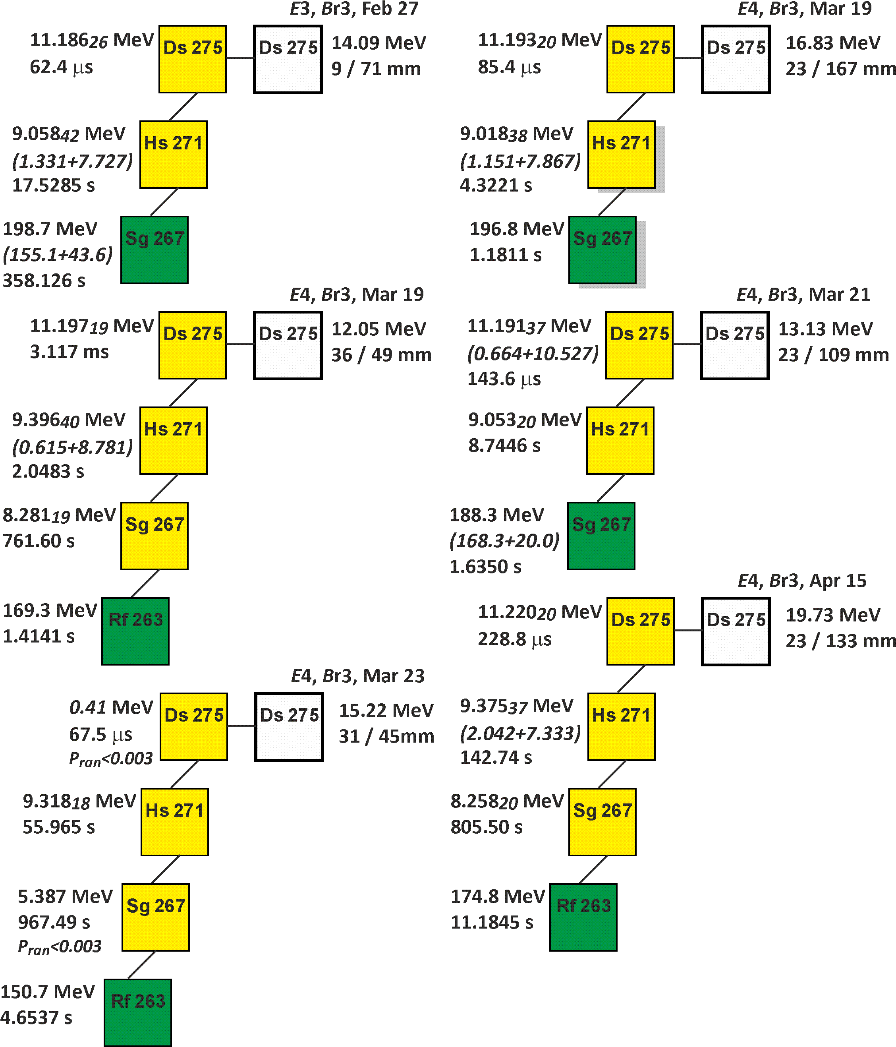
6 цепочек
²⁷⁵Ds
²⁶⁷Sg – α и SF
E₃ = 251 MeV
(2023)
E₄ = 257 MeV
(2023)
Впервые:
Распад ядра СТЭ в известные ядра ²⁷¹Hs, ²⁶⁷Sg, ²⁶³Rf
J. Dvorak et al.,
PRL (2006); (2008).

Slide 5
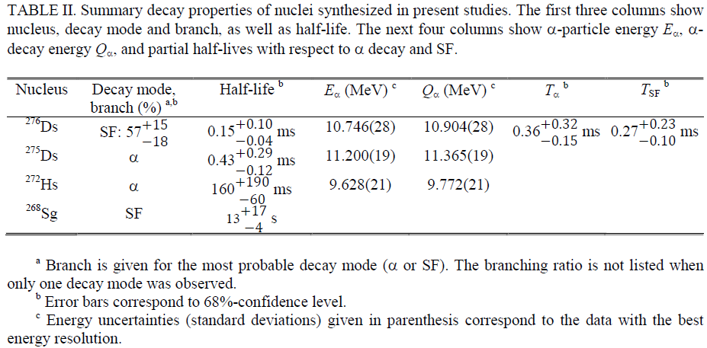
Decay properties of four isotopes are determined for the first time

Slide 6
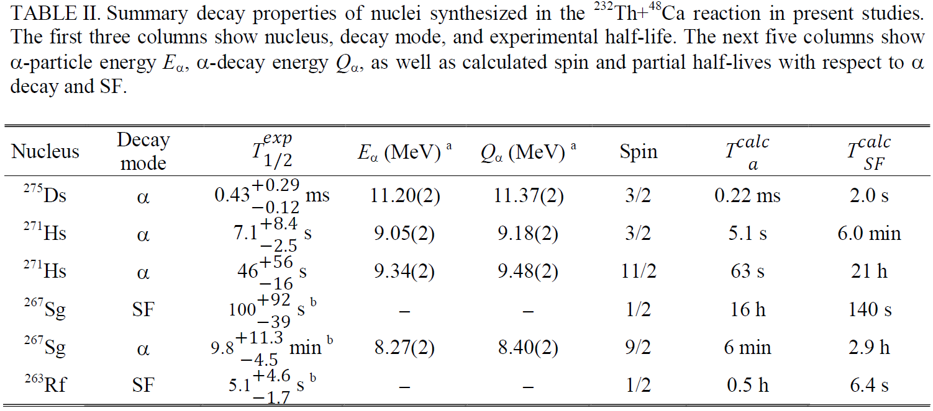
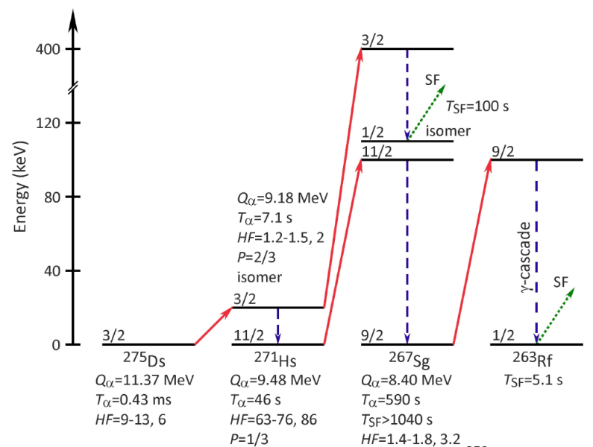
Level structure of odd-N nuclei

Slide 7
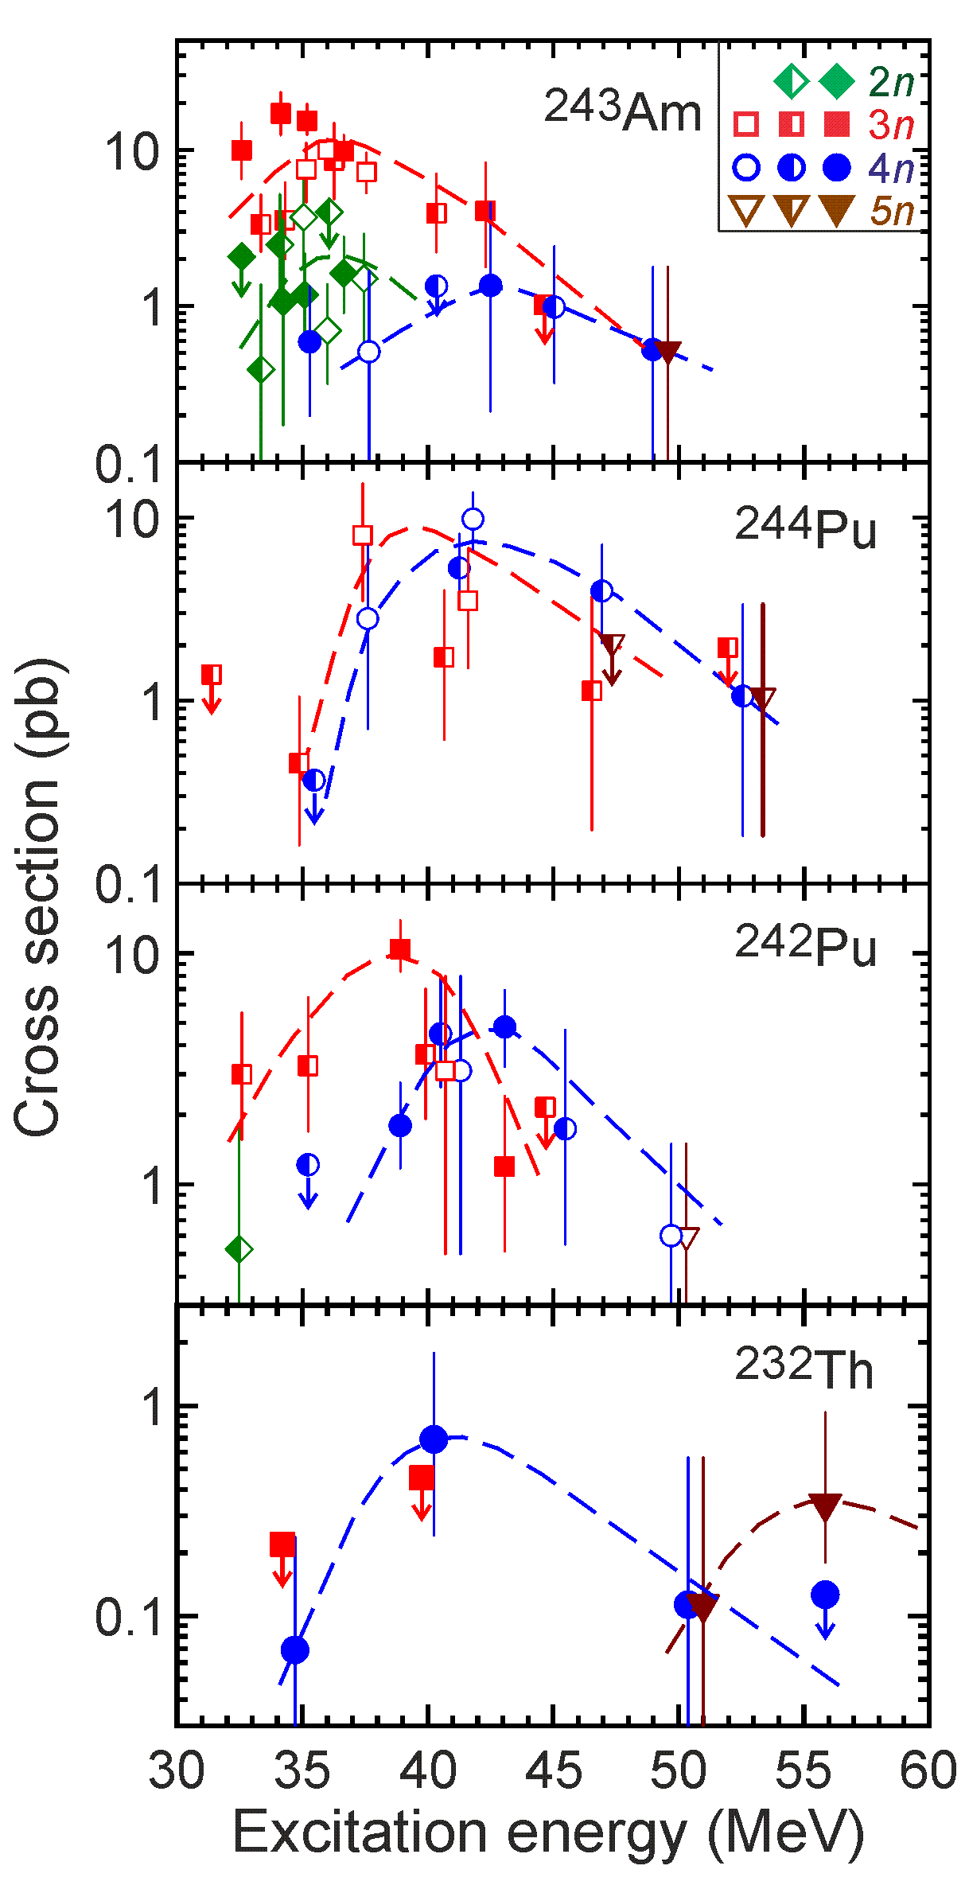
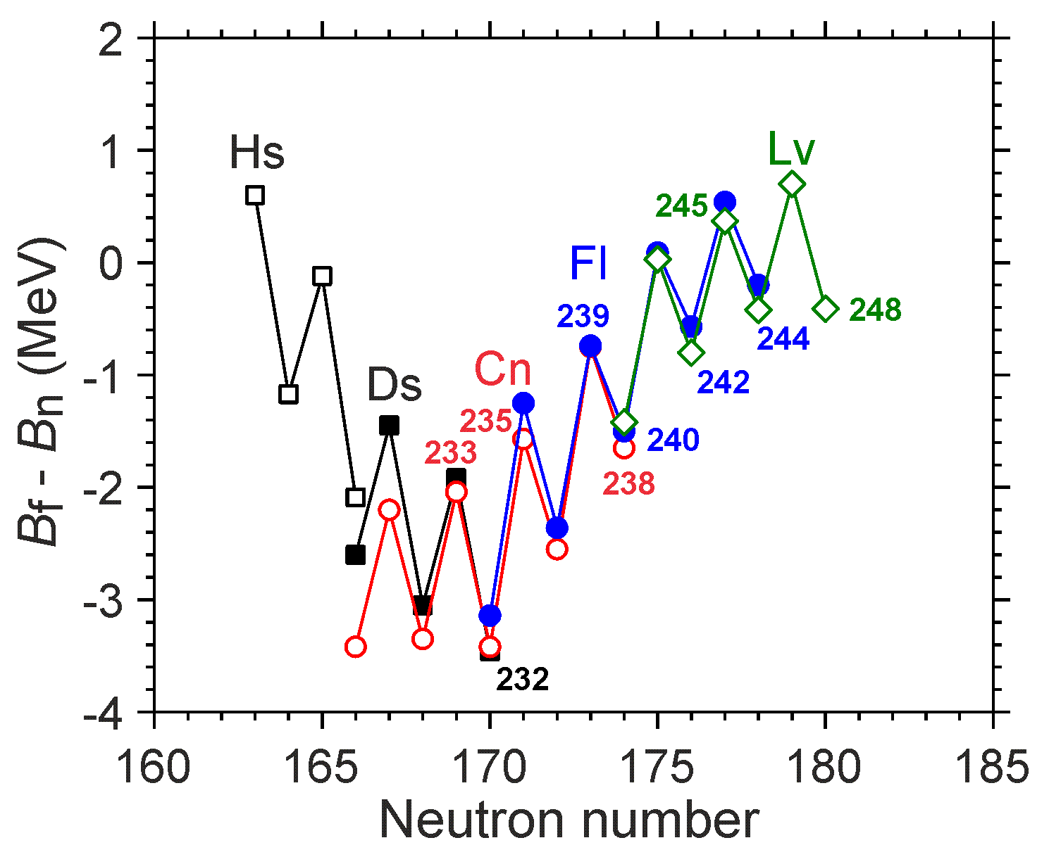
²³²Th(⁴⁸Ca,4-5n)^{275,276}Ds
Наблюдение 5n канала в 3 реакциях
Выживаемость ядер СТЭ с минимальным B_{f}-B_{n}

Slide 8
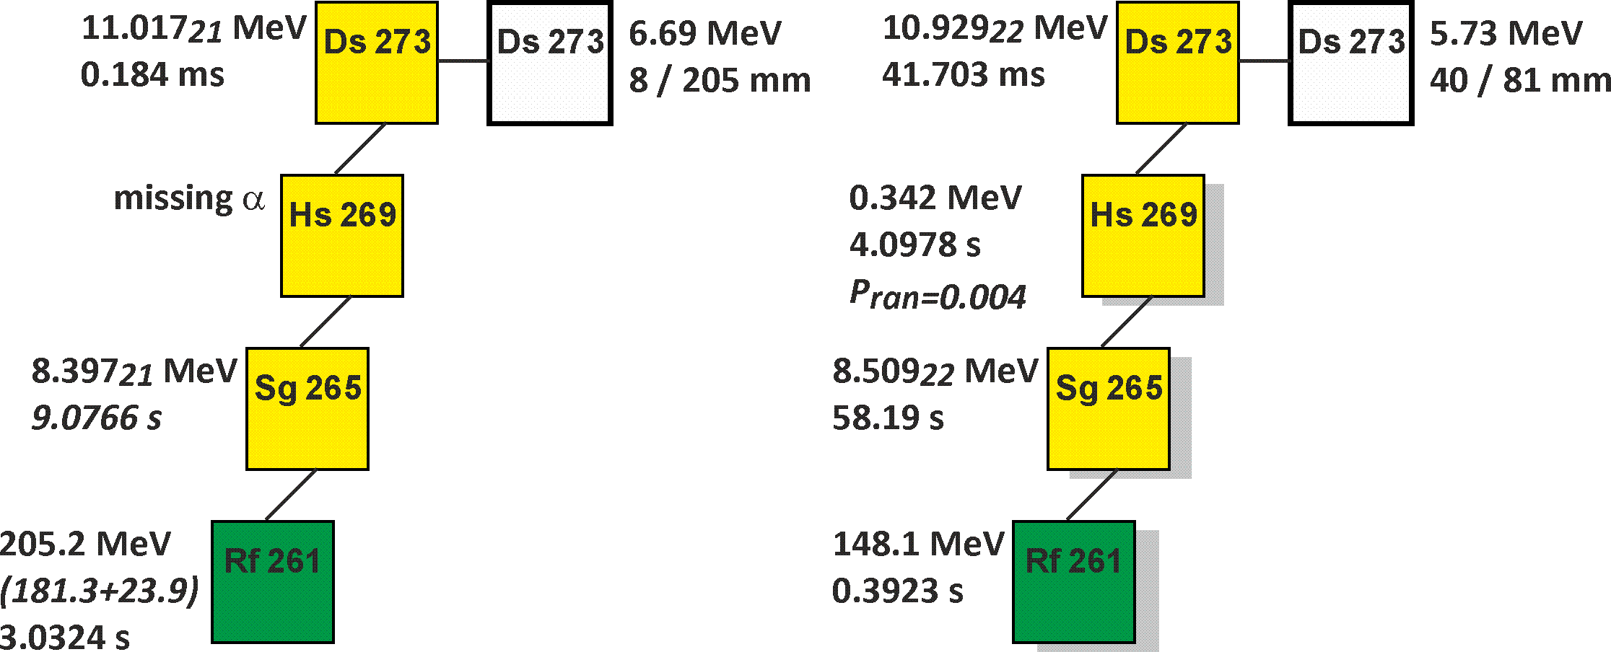
Nuclei at the minimum stability
²³⁸U + ⁴⁰Ar → ²⁷⁸Ds*
Production cross sections and decay properties of ²⁷³Ds

Slide 9
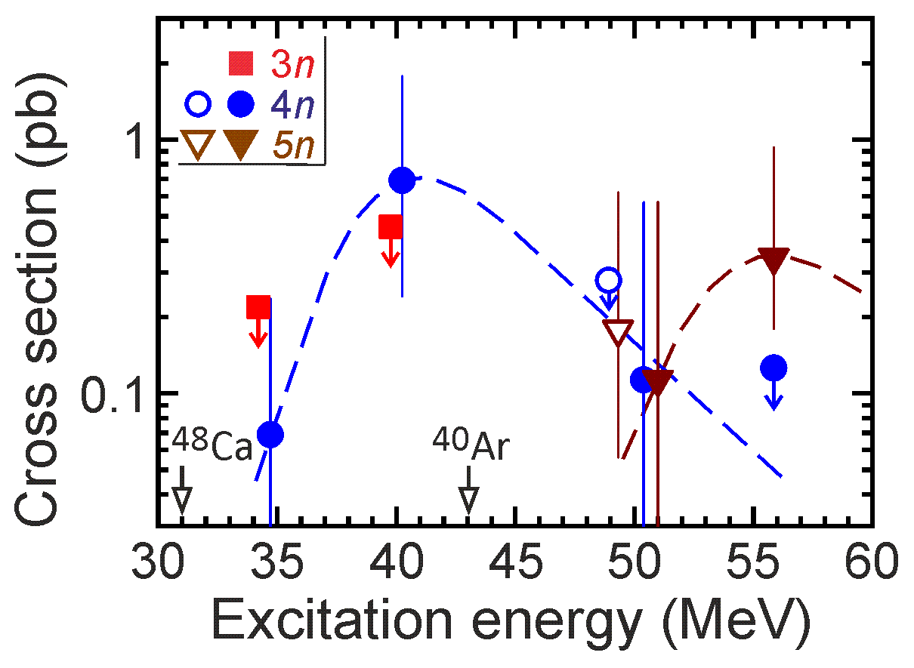
(2022)
(2023)
(2023)

Slide 10
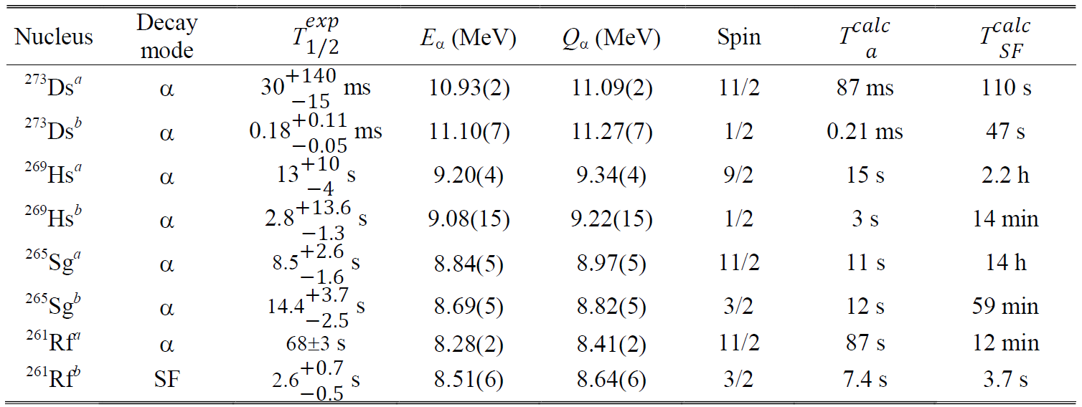
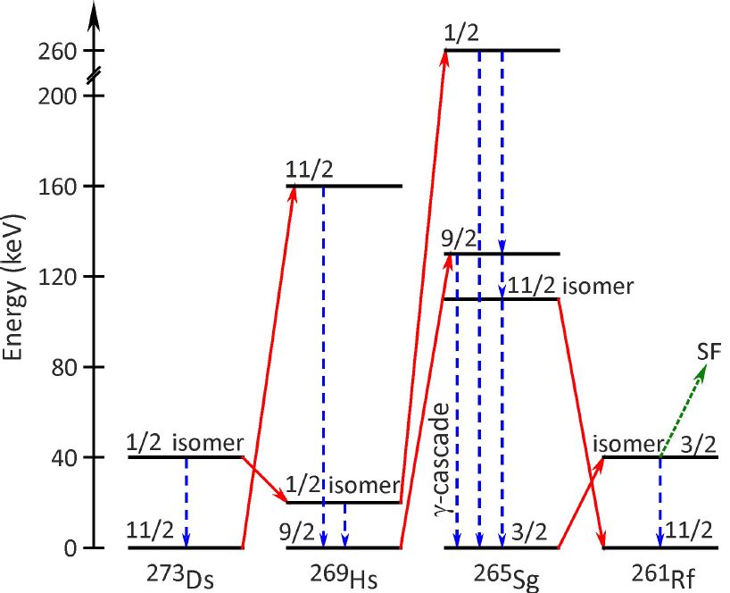
Level structure of odd-N nuclei

Slide 11
Experiment ²³⁸U + ⁵⁴Cr
Not TRP
escape at low angle
Target ²³⁸U: 0.72 mg/cm²
Beam dose: 3.9 x 10¹⁹
Excitation energy: 42 MeV
For the first time:
Actinide + ⁵⁴Cr
New isotope ²⁸⁸Lv
Confirmation of ²⁸⁴Fl
Cross section ~70 (20-150) fb
Notes:
For a more accurate estimation of the cross sections of reactions leading to the synthesis of new elements 119 and 120 in the fusion of 54Cr with Am and Cm isotopes, we performed a test experiment to obtain Lv nuclei in the 238U+54Cr reaction. The thickness of the target, the beam dose, the excitation energy and the distribution of the beam intensity over time are shown. The interval between the dates is one week. Two decay chains of 288Lv were registered, the alpha decay of which ended with spontaneous fission of the known isotope 284Fl. In the first chain, the energy and decay time of 288Lv corresponds well to the decay from the ground state to the ground state. In the second chain, the decay times in both cases are consistent with the times in the first chain. But the energy of the alpha particle is 1.45 MeV lower than in the first case. The data is preliminary. One of the reasons for the low energy may be incomplete registration of the particle, for example, the escape of alpha particle from the focal detector at a small angle to its surface or the nucleus got between the detector strips. Another reason may be the level structure of the nuclei. Data analysis continues.
Thus, for the first time in this experiment, a nucleus was obtained in the fusion reaction of a particle heavier than 48Ca with the nucleus of an actinide element, a new isotope was synthesized, and the decay properties of 284Fl were confirmed.
The reaction cross-section was 0.1 pb.

Slide 12
DGFRS-2: Результаты экспериментов 2023 г. (впервые)
²³²Th+⁴⁸Ca
Синтез 4 новых изотопов ²⁶⁸Sg, ²⁷²Hs, ²⁷⁵Ds, ²⁷⁶Ds
Структура уровней ядер в цепочке распада ²⁷⁵Ds
Сечение образования изотопов Ds (мин. стабильность)
Распад SHN ²⁷⁵Ds в известные ядра
²³⁸U+⁴⁰Ar
Структура уровней ядер в цепочке распада ²⁷³Ds
Сечение образования изотопов Ds (мин. стабильность)
²³⁸U+⁵⁴Cr
Сечение реакции актинид + ⁵⁴Cr
Синтез нового изотопа ²⁸⁸Lv
Подтверждение свойств ²⁸⁴Fl

Slide 13
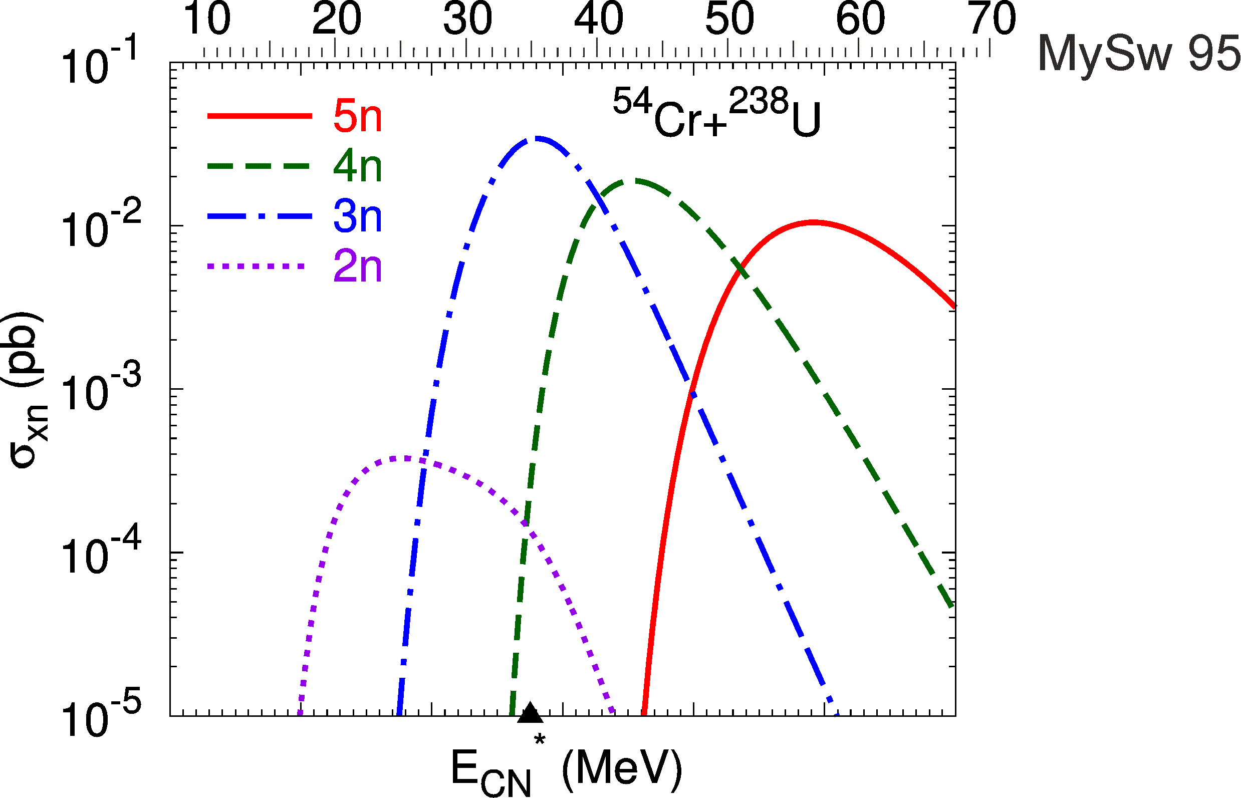
Experiment ²³⁸U + ⁵⁴Cr
1. Положение максимума
функции возбуждения
Е*=35 МэВ?
2. Сечение – фактор падения
при переходе к ⁵⁴Cr
30 – 200?
Г.Г. Адамян
(частное сообщение)
3. Заряд?

Slide 14
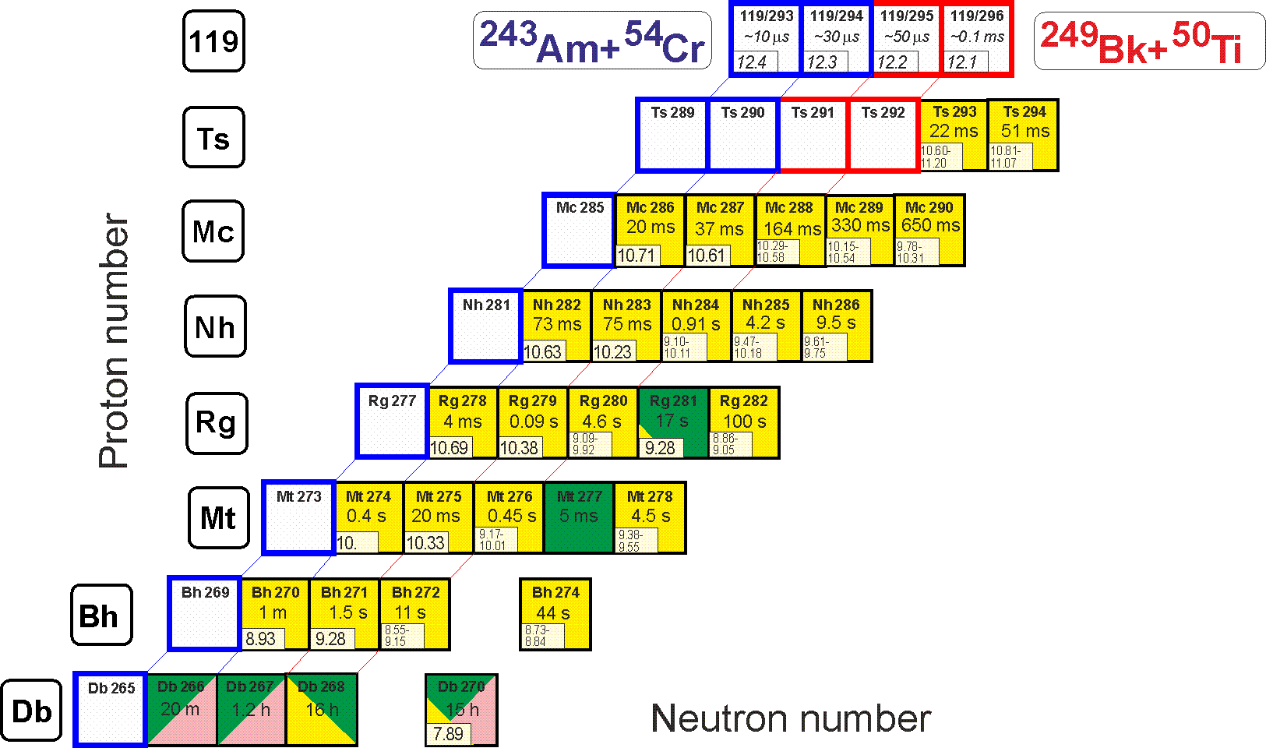
Perspectives
Synthesis of new element 119
²⁴³Am(⁵⁴Cr,3-4n)^{293,294}119 ²⁴⁹Bk(⁵⁰Ti,3-4n)^{295,296}119
Test reaction:
²³⁷Np(⁴⁸Ca,3-4n)^{281,282}Nh

Slide 15
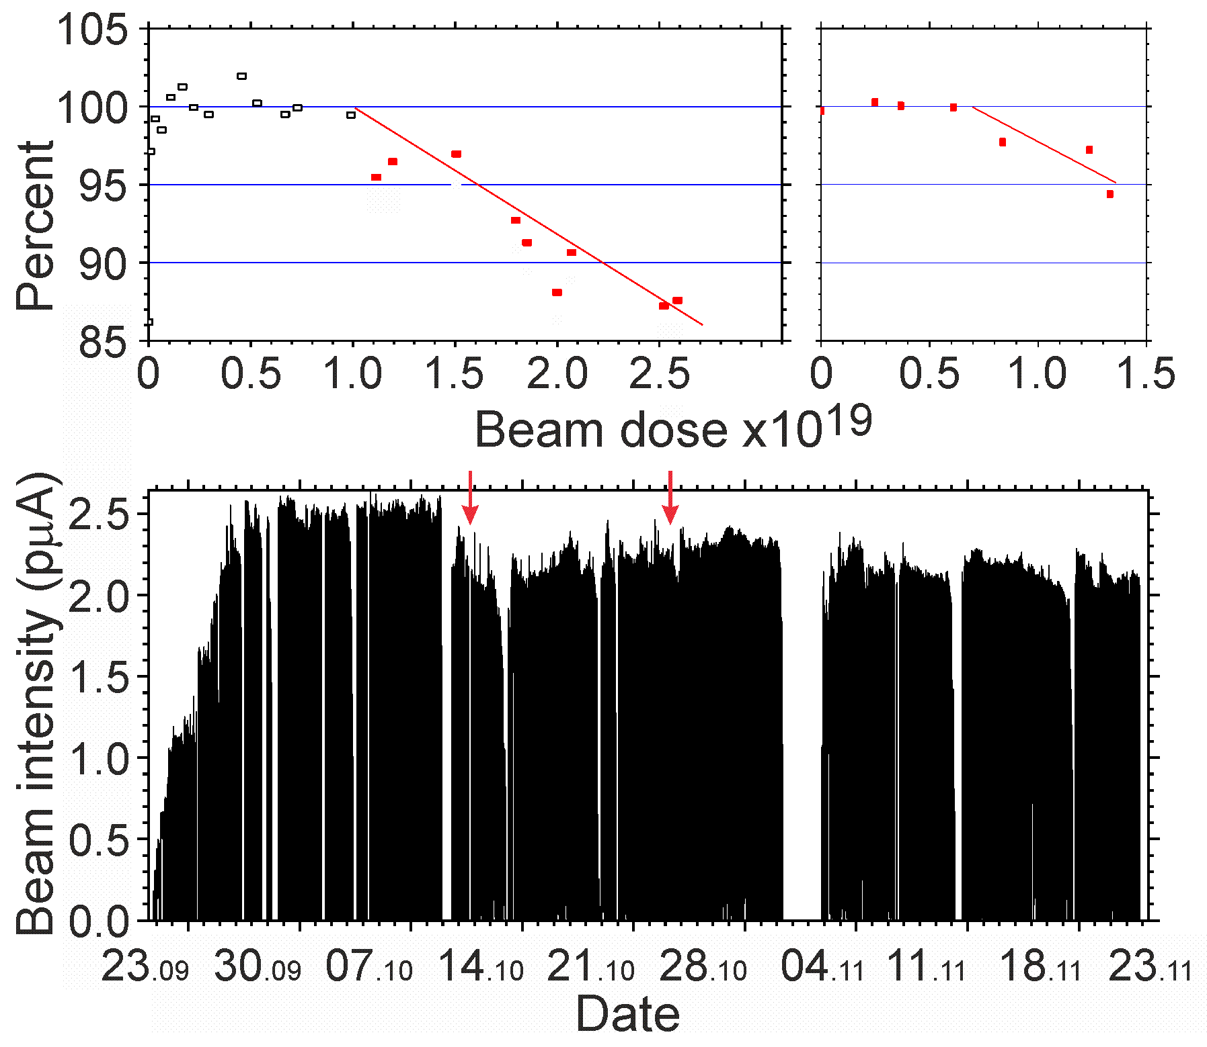
Perspectives
Synthesis of new element 120
Experiment ²³⁸U + ⁵⁴Cr
Target stability
Beam dose
2.2 x 10¹⁹ / month
at 2 pμA

Slide 16
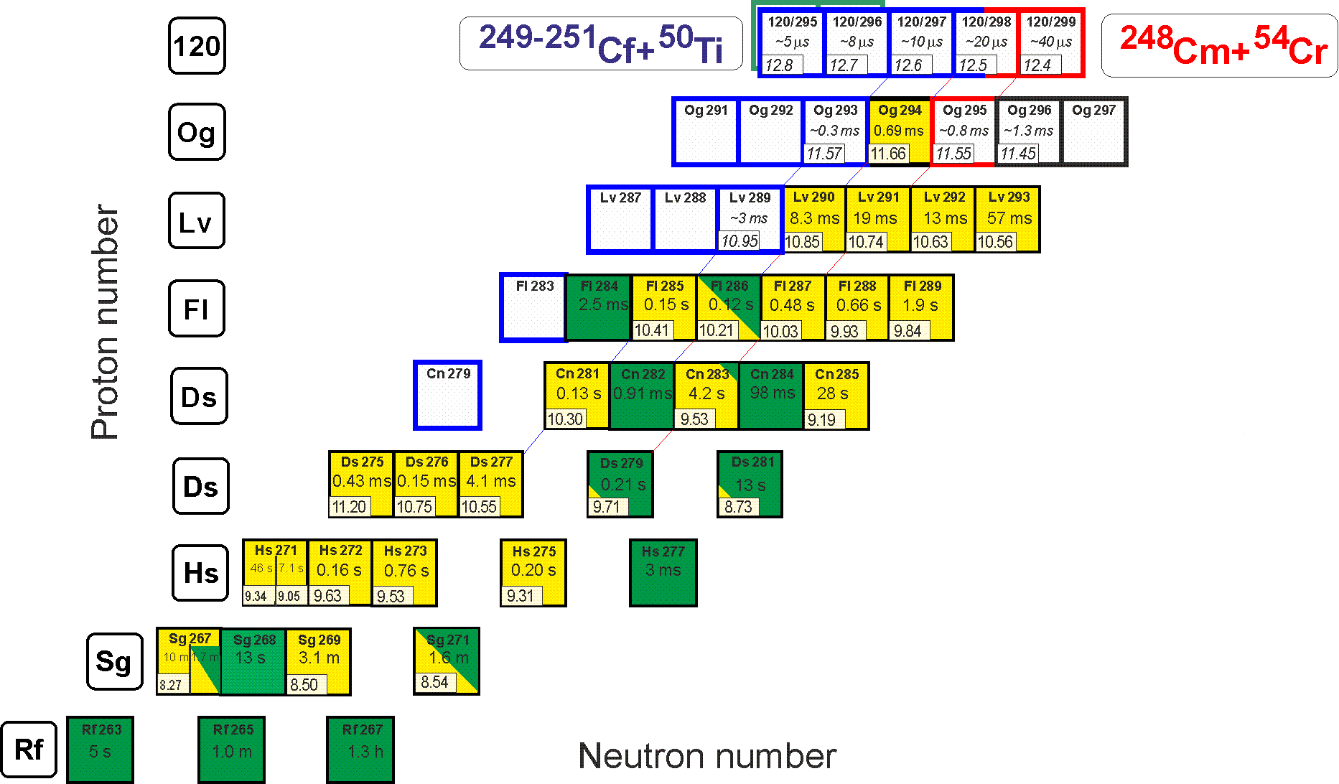
Perspectives
Synthesis of new element 120
²⁴⁹⁻²⁵¹Cf(⁵⁰Ti,3-4n)²⁹⁵⁻²⁹⁸120 ²⁴⁸Cm(⁵⁴Cr,3-4n)^{298,299}120
²⁴⁵Cm(⁵⁴Cr,3-4n)^{295,296}120
Known decay properties

Slide 17
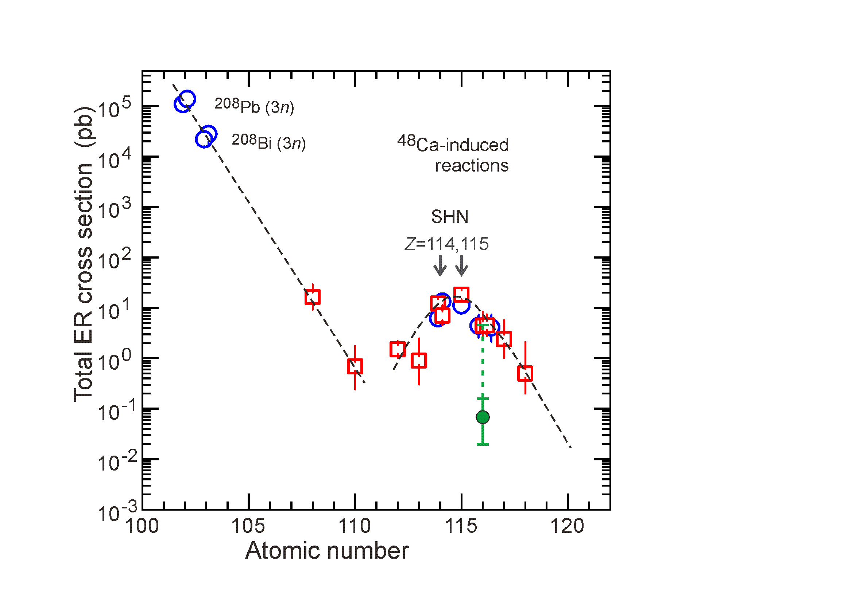
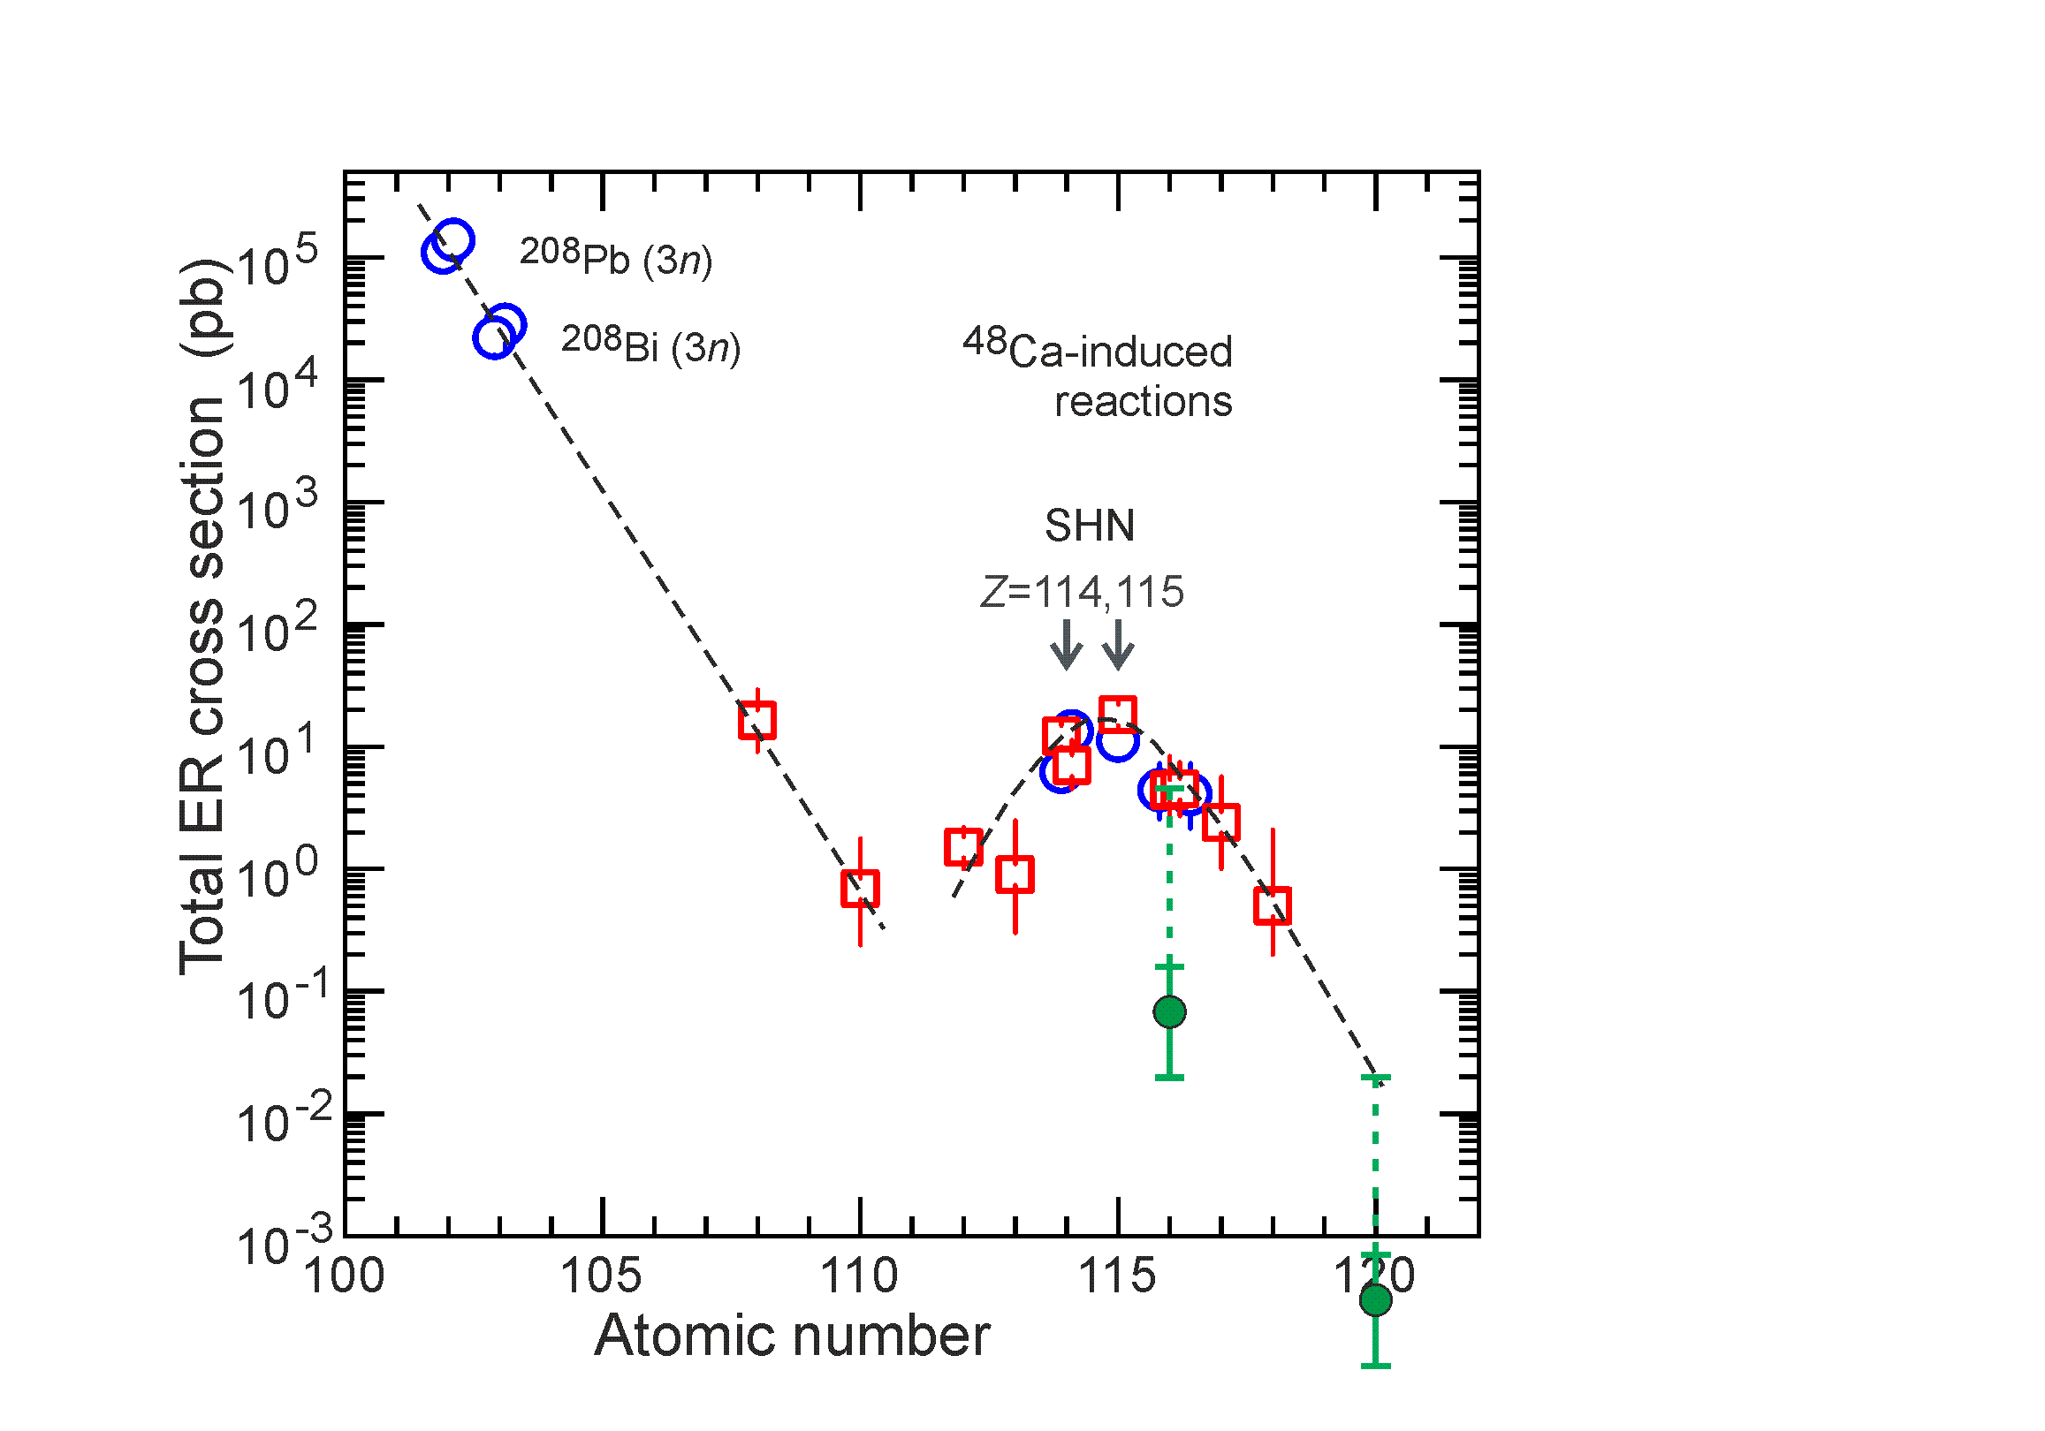
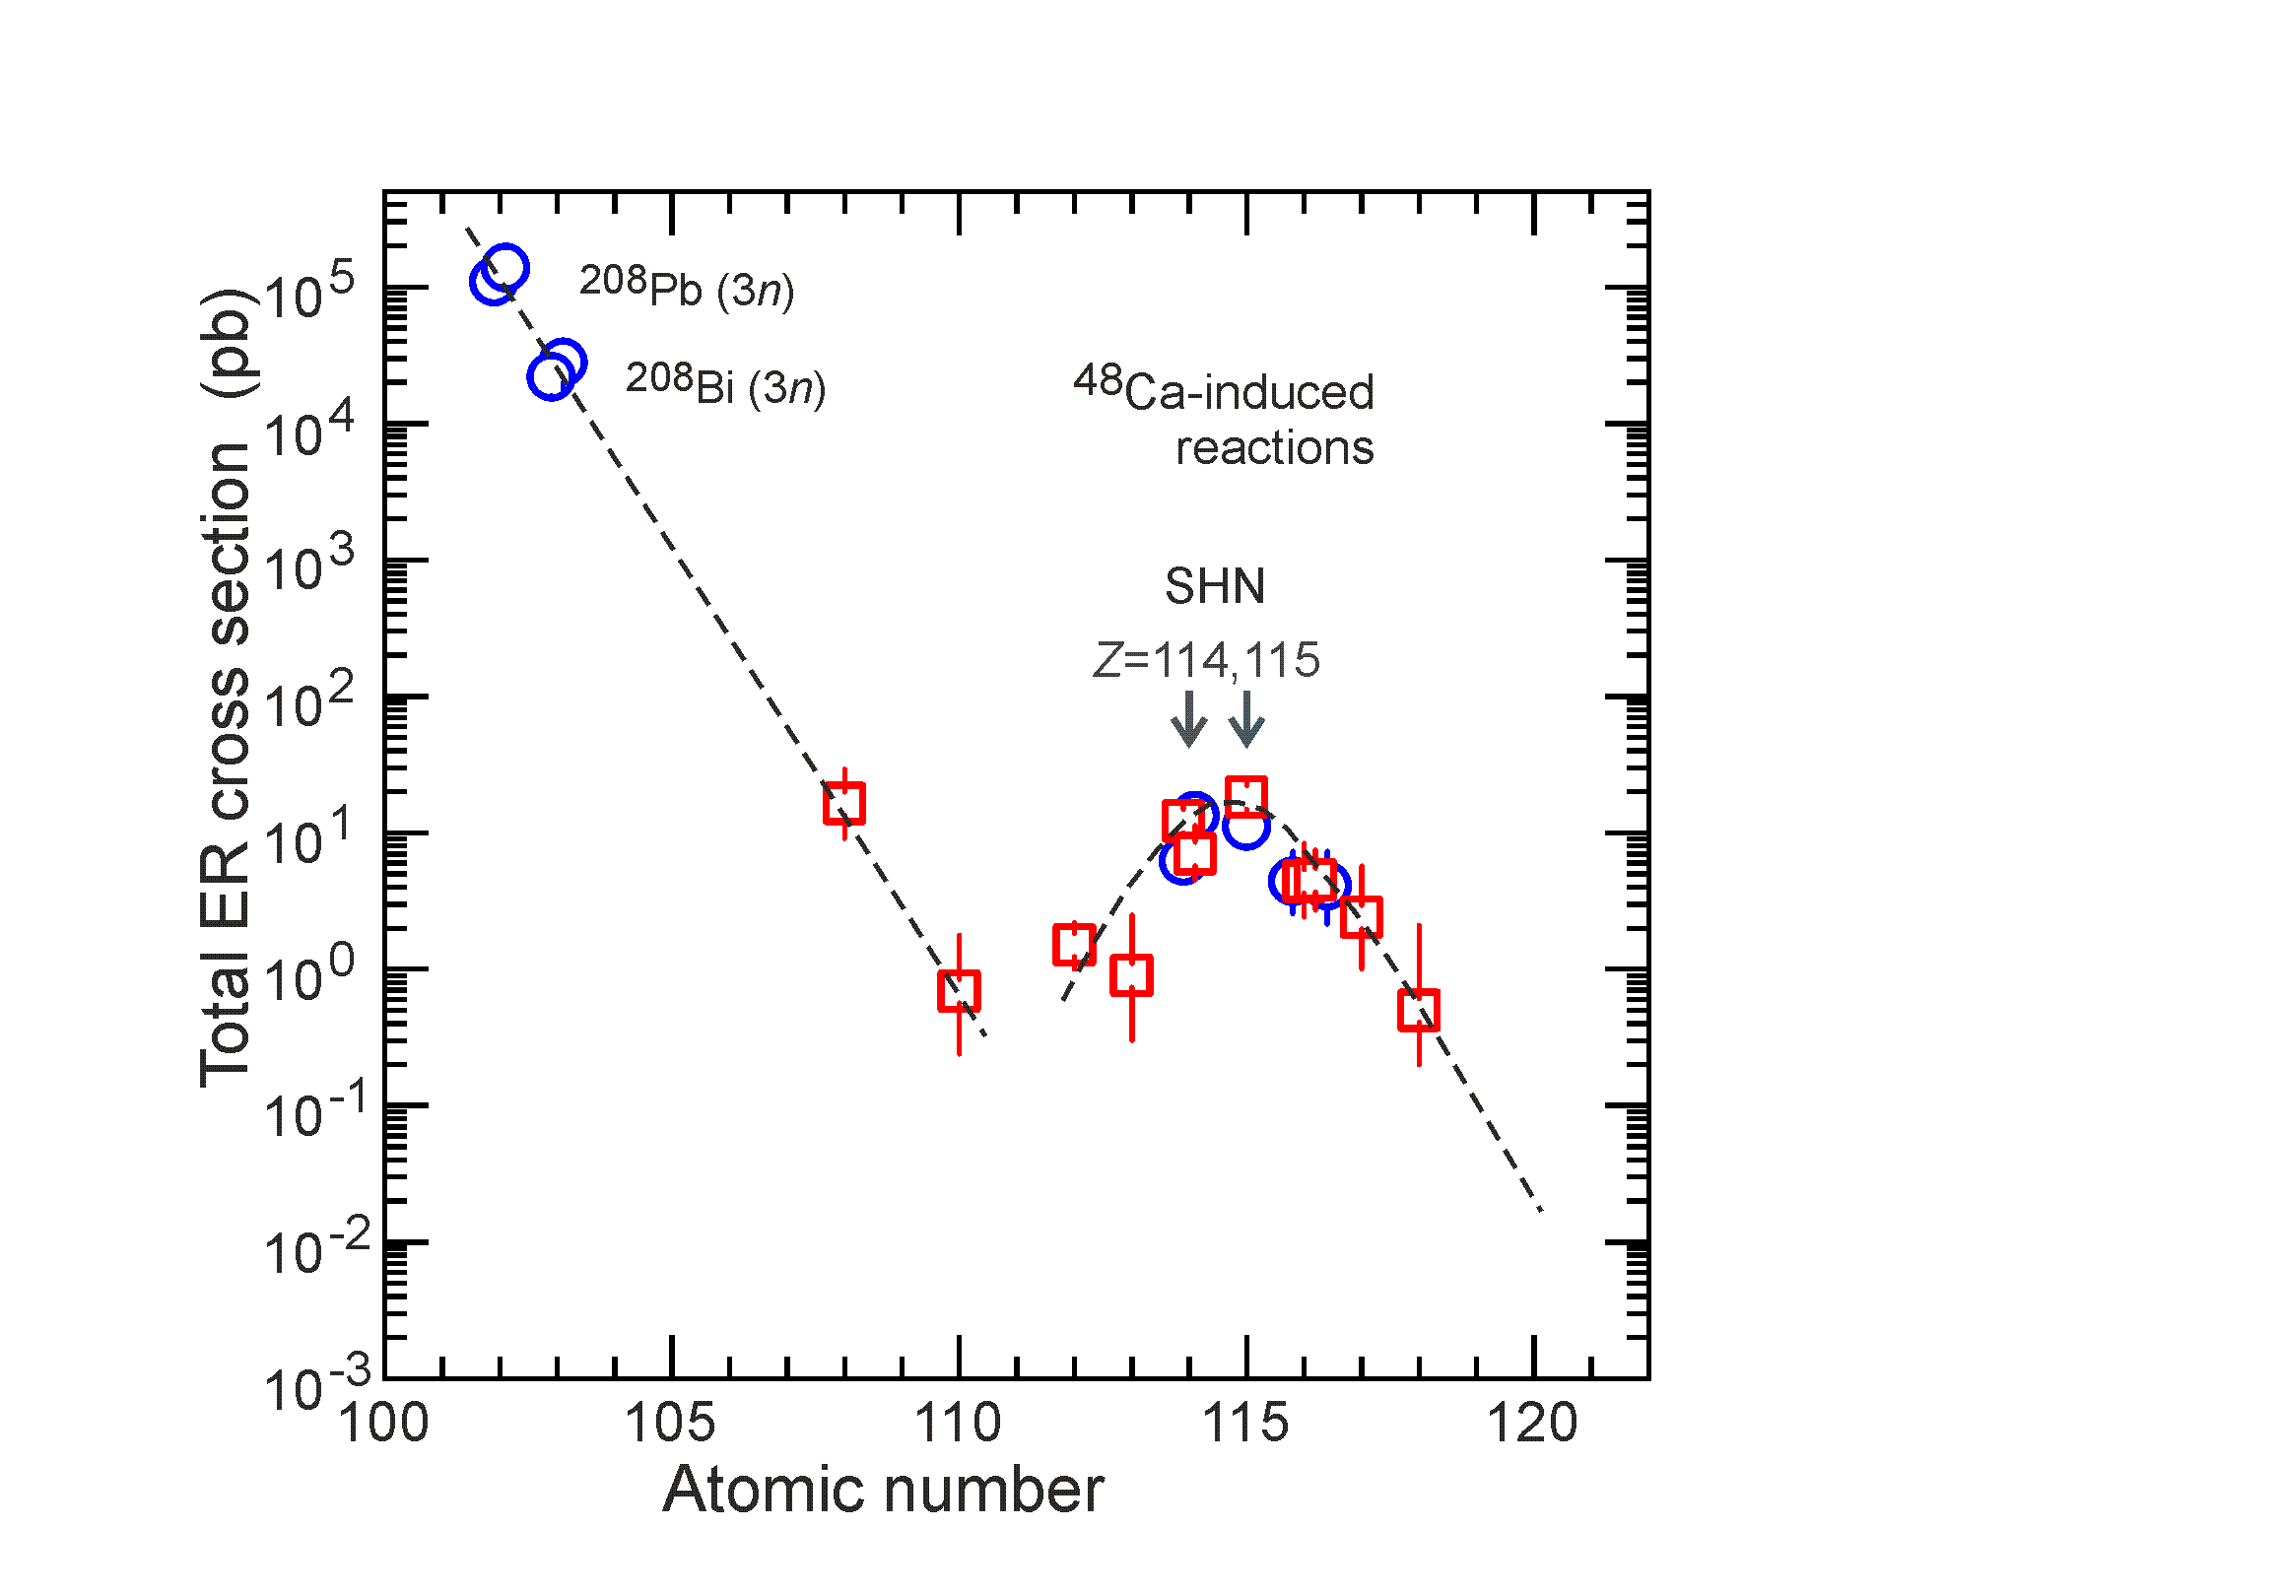
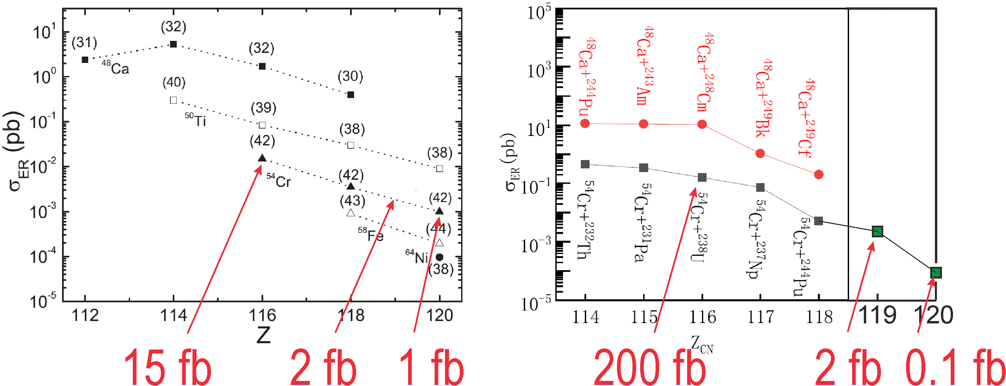
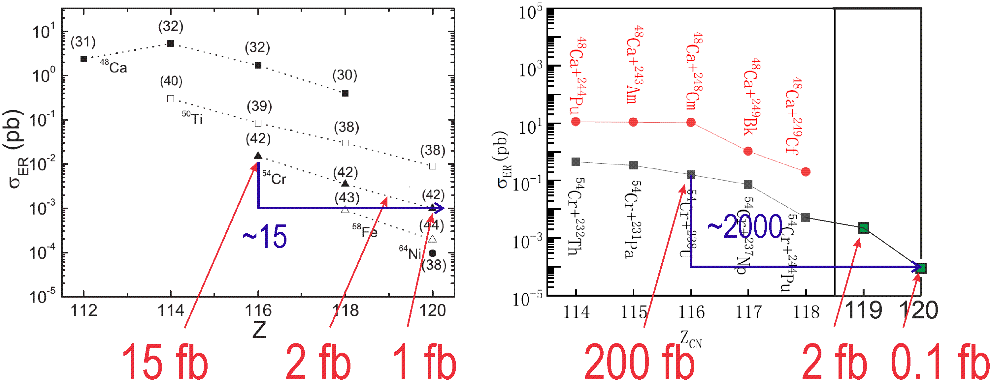
Perspectives
Synthesis of new element 120
σ=70 fb, h_{t}=0.7 mg/cm², I_{beam}=2 pμA → ≈1 / month
σ=1 fb, h_{t}=0.7 mg/cm², I_{beam}=4 pμA → ≈1 / 3 year
Accuracy of estimations?
Z_{mag} = 120 – 126?
0.1 – 0.7 fb
G.G. Adamian et al., PRC 101, 034301 (2020)
J.X. Li et al., PRC 108, 044604 (2023)

Slide 19
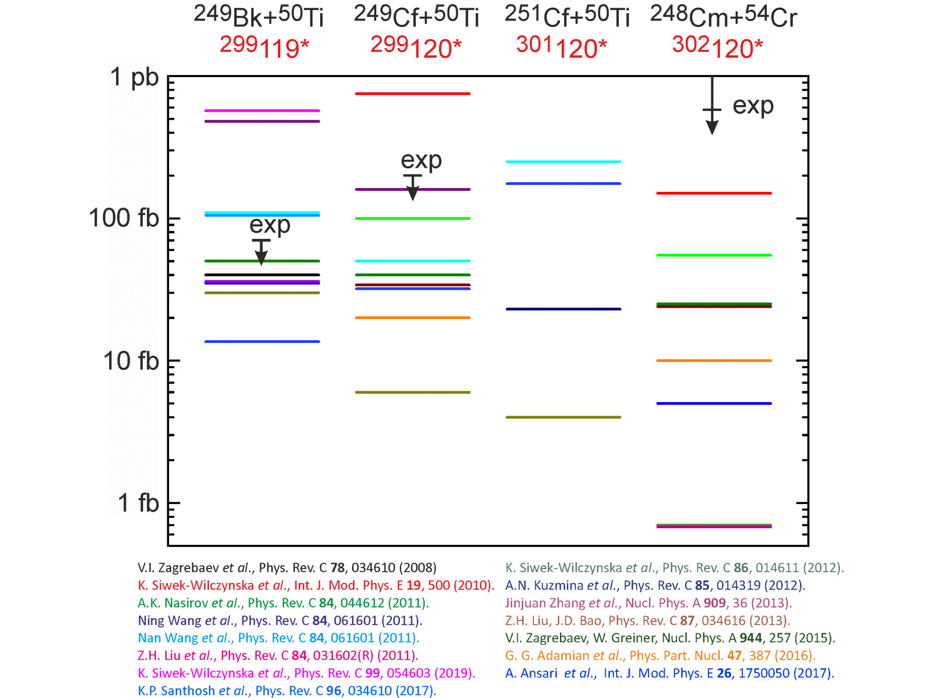
Predicted cross sections for production of isotopes of elements 119 and 120
in the ²⁴⁹Bk+⁵⁰Ti, ²⁴⁹⁻²⁵¹Cf+⁵⁰Ti , ²⁴⁸Cm+⁵⁴Cr reactions
differ by 2-3 orders of magnitude

