Slide 1
Helices fitting with straws @ SPD
flash algorithm

Slide 2
How to
Why good ?
- for pattern recogn.
- segment ∼ C⁸_{N}
- trk ∼ (N/8)!
- N = 30 hits in ROI
- segment ∼ 6⋅10⁶
- trk ∼ 24
<< 30! ∼ 10³¹
- allows xyz reco

Slide 3
HLX = circle ⊕ line
Helix
Line
clock param.
Circle

Slide 4
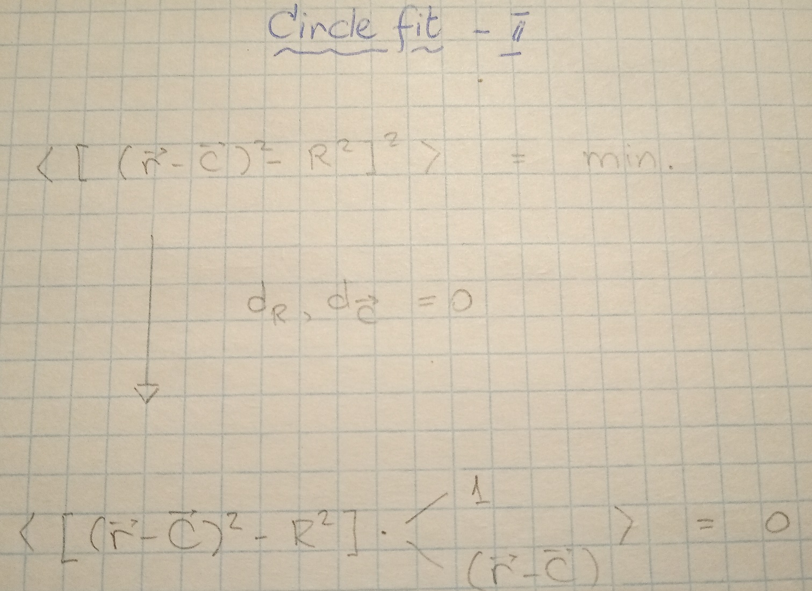
Circle-II fit
100% analytical !

Slide 5
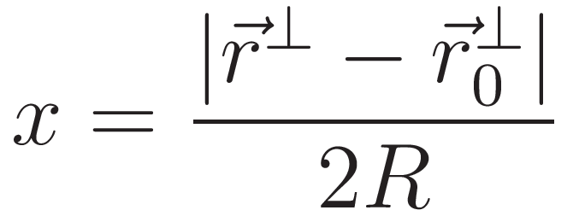
HLX = circle ⊕ line
Helix – Line correlation
17 op’s
8 op’s

Slide 6
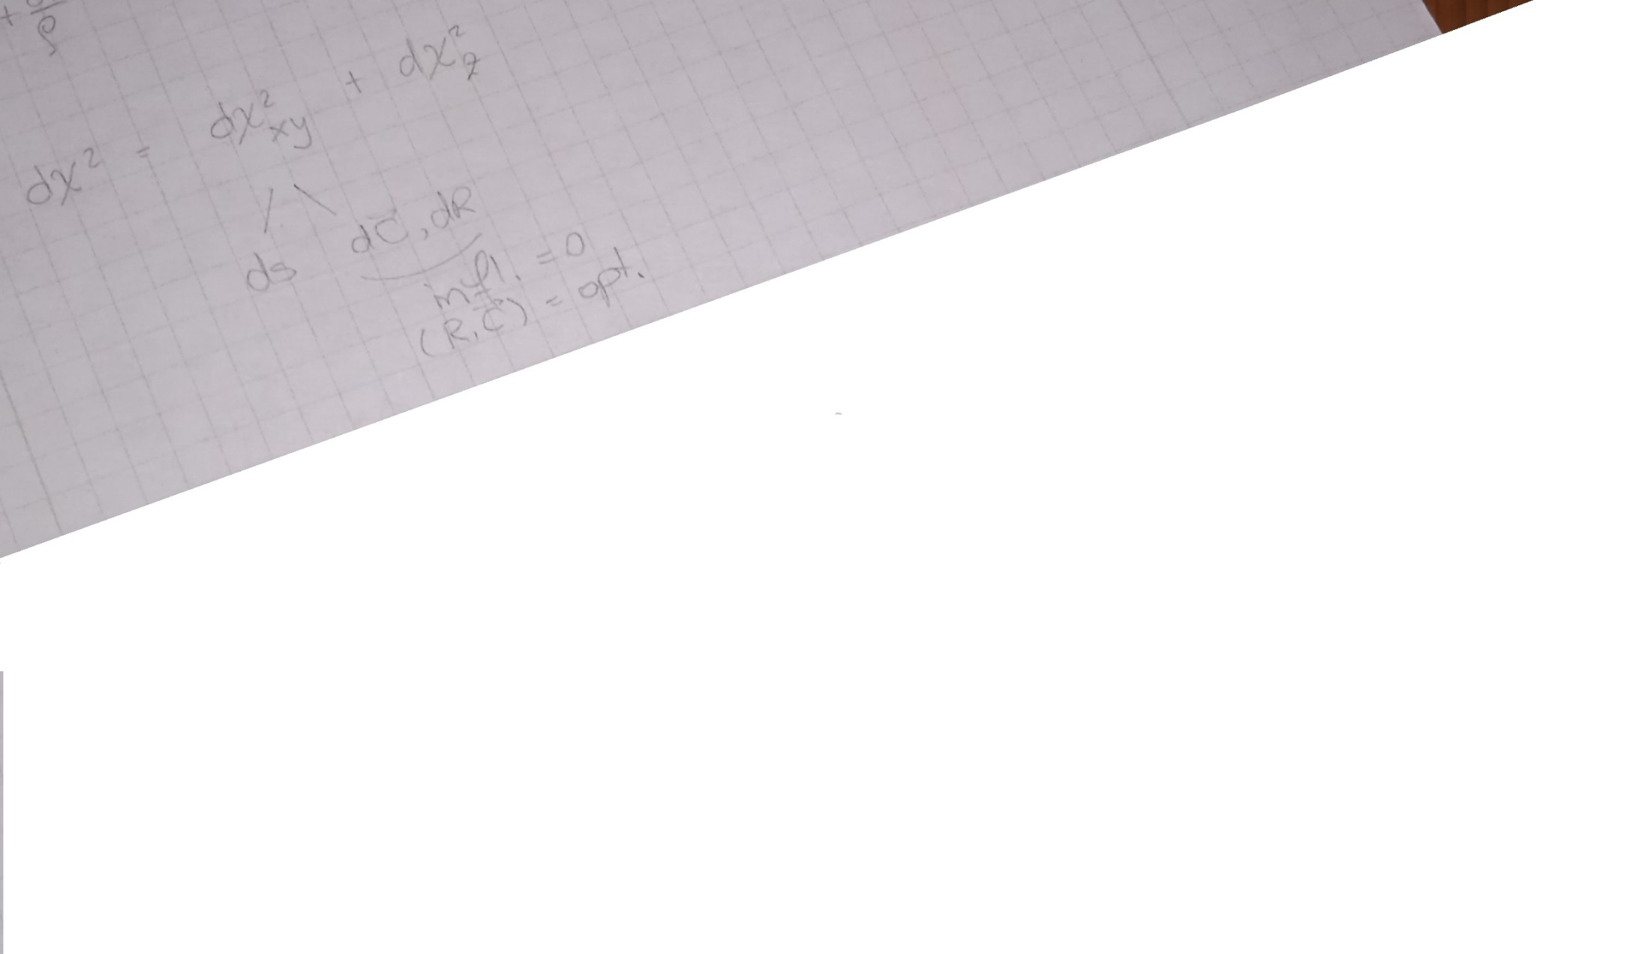
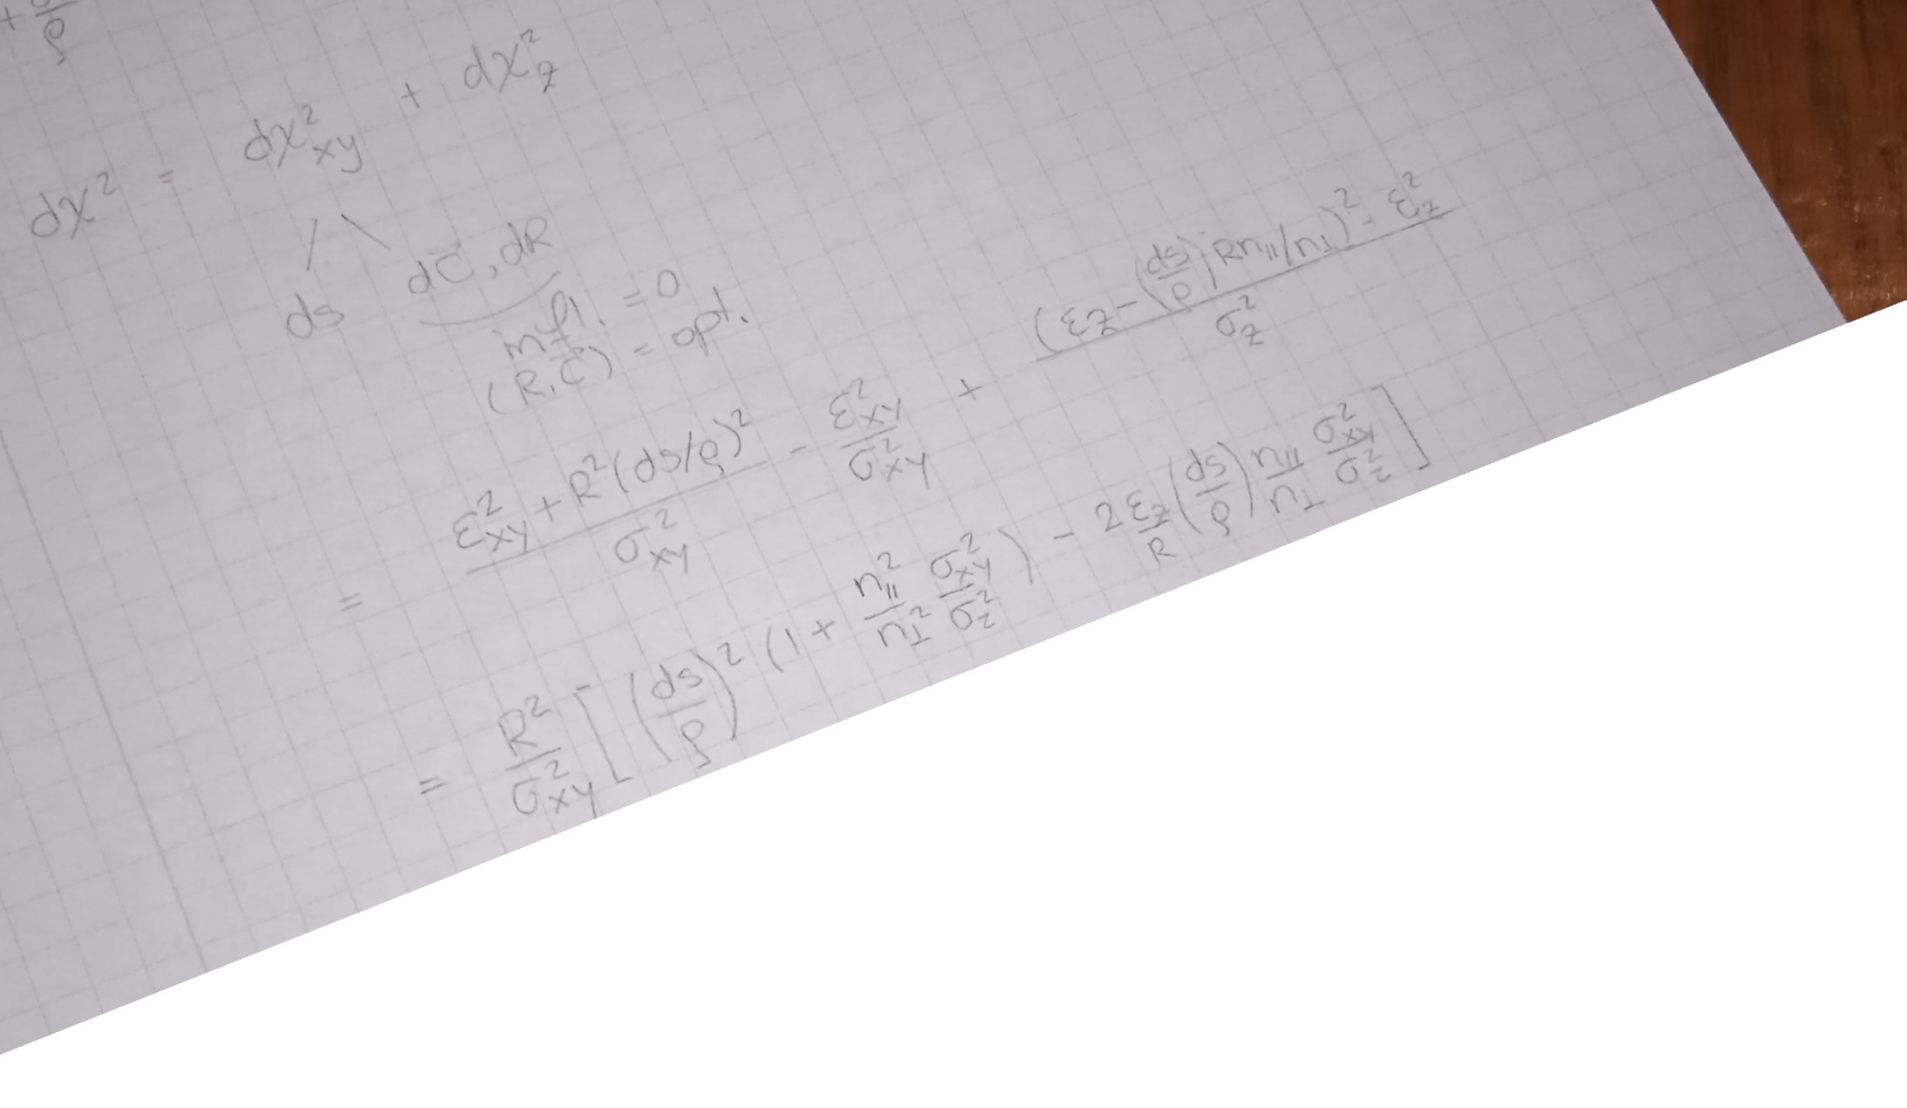
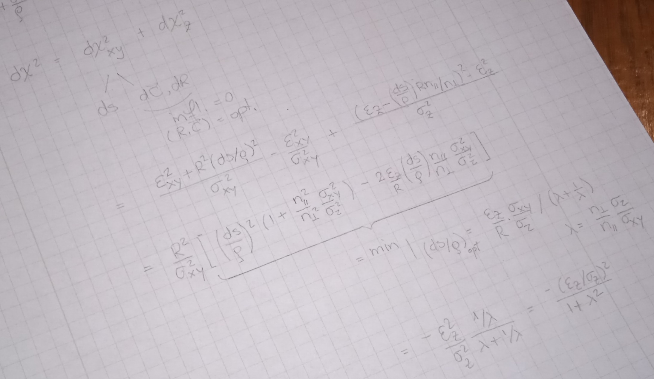
χ² balancing

Slide 7
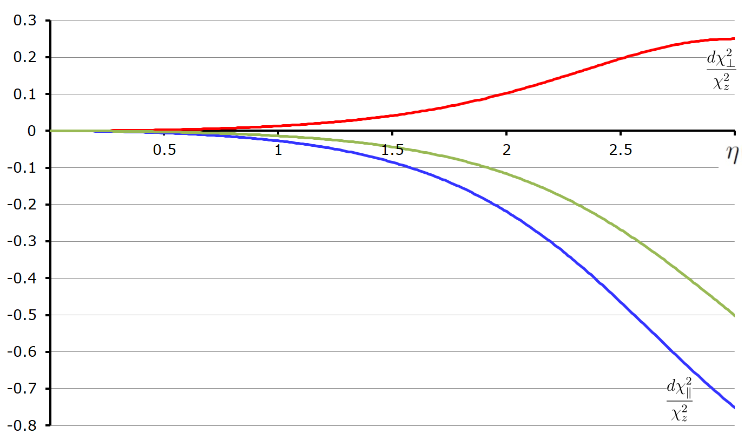
χ² balancing
6-7%

Slide 8
Conclusions
Importance
- flash-algo =>
online,
non-neuro
- remember: do not want skew between
- longit. / transv. trk‘s
- lo / hi momentum trk’s
Speed
- now implementing χ² balancing: expecting to reach cca. 450 ns / point
- currently 380 ns / point (N = 7) for:
- circle-II fit
- longit. fit
- χ² for circle-II
Спасибо !

