Slide 2
Distributed computing with DIRAC Interware
Igor Pelevanyuk, MLIT
14 November 2022

Slide 3
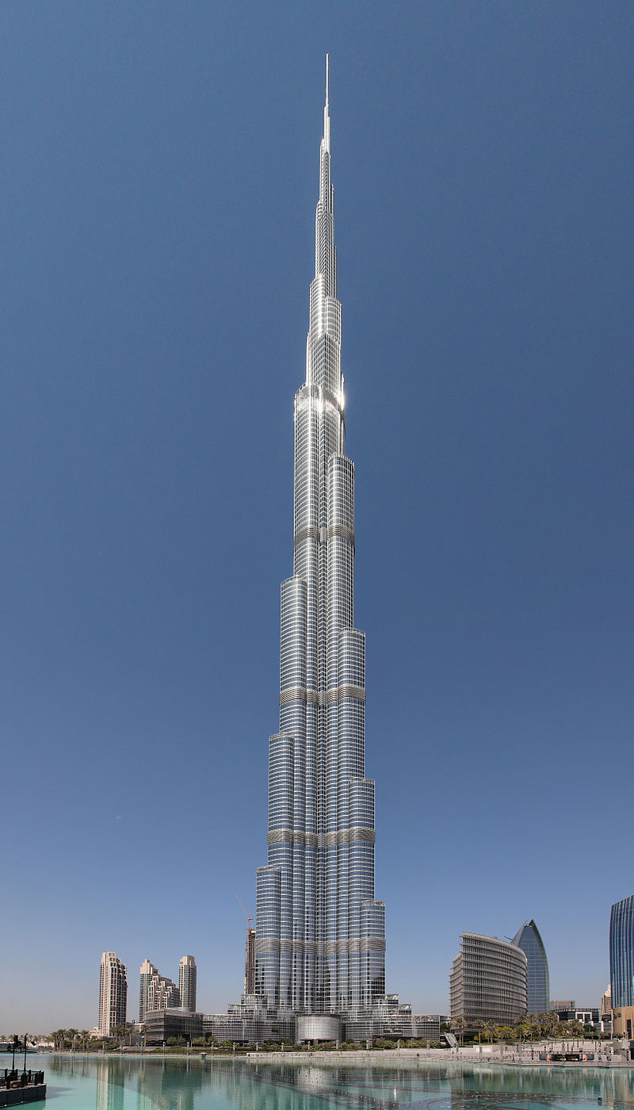
Throughput vs Performance

Slide 4
High Throughput - Many independent processes that can run in 1 or few cores on the same computer Example of jobs: Monte-Carlo generation, Data reconstruction
Throughput vs Performance
High Performance - Sharing the workload of interdependent processes over multiple cores
Focus of this talk

Slide 5
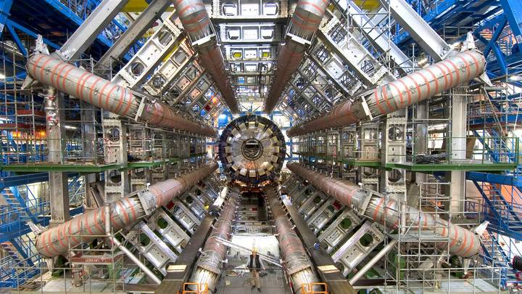
Experiment

Slide 6
Raw data
CH0:0.001;
CH2:0.14;
CH4:0.34;
…
CH98039232:0.08;

Slide 7
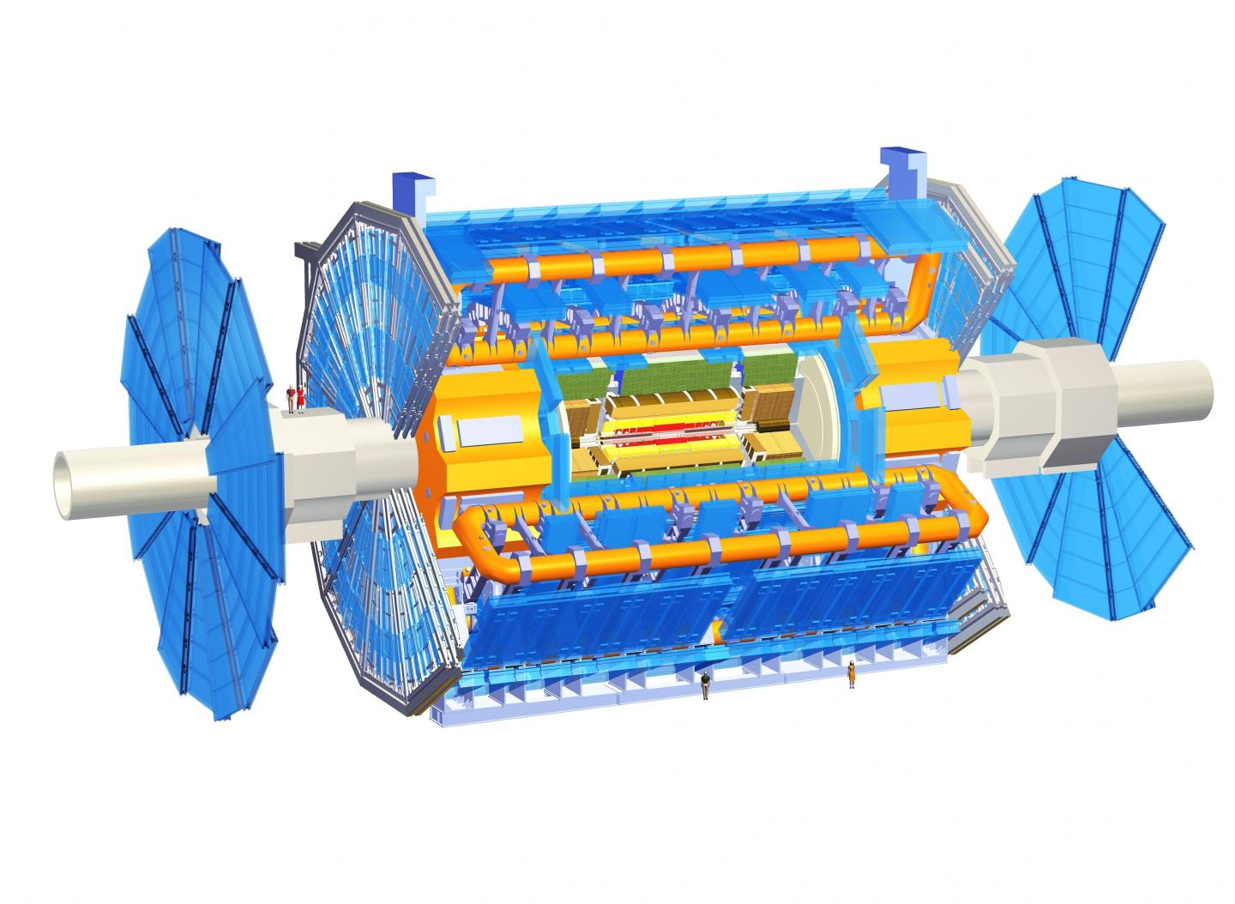
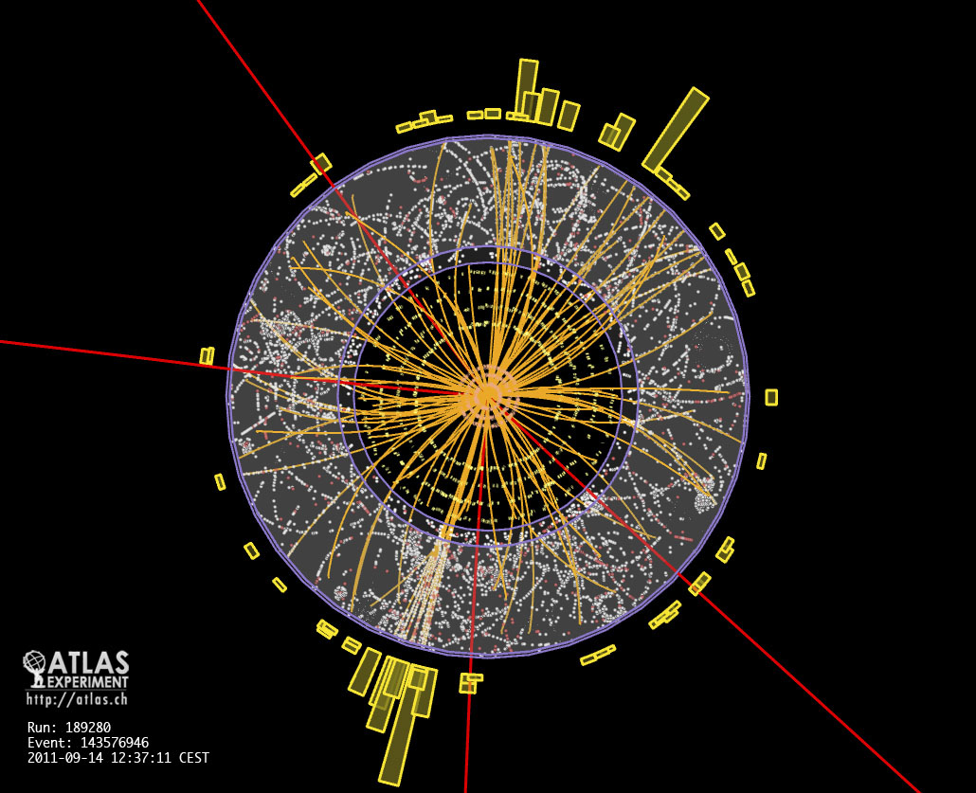
Reconstruction
CH0:0.001;
CH2:0.14;
CH4:0.34;
…
CH98039232:0.08;
Reconstruction algorithm
+
+
=

Slide 8
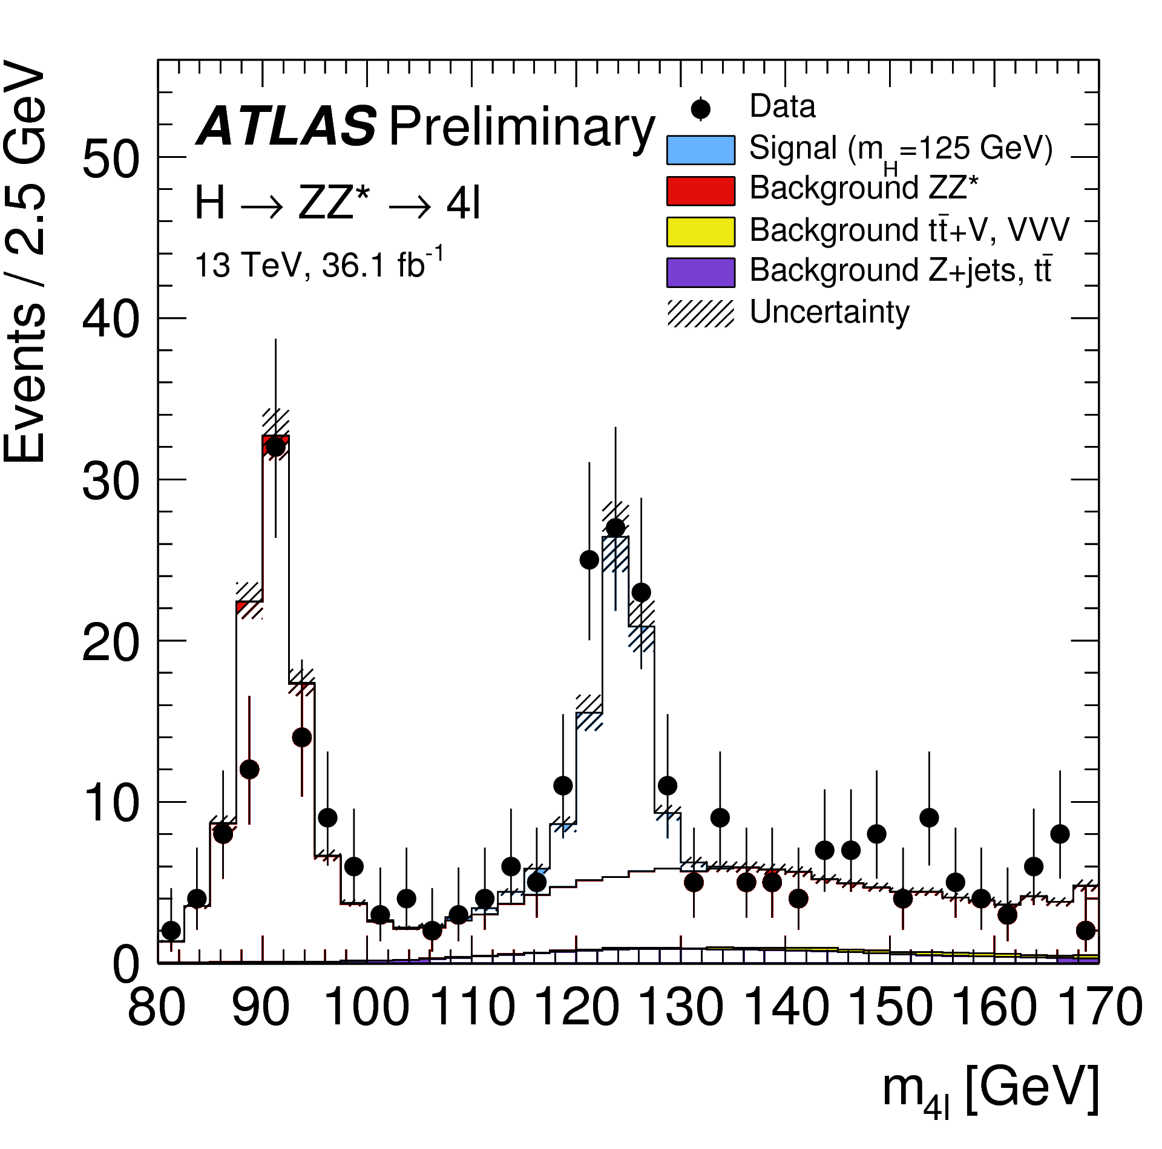
But that is not enough

Slide 9
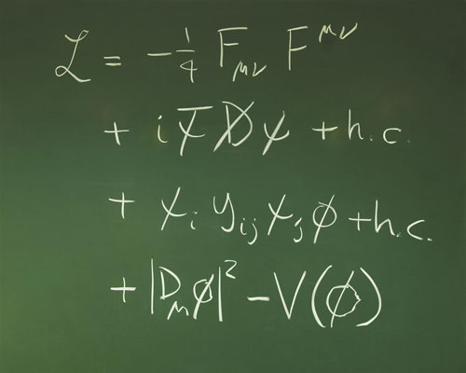
Model

Slide 10
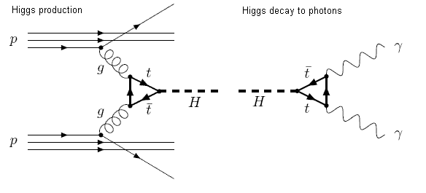
Event

Slide 11
Simulation
+

Slide 12
Simulation
+
CH0:0.001;
CH2:0.14;
CH4:0.34;
…
CH98039232:0.08;

Slide 13
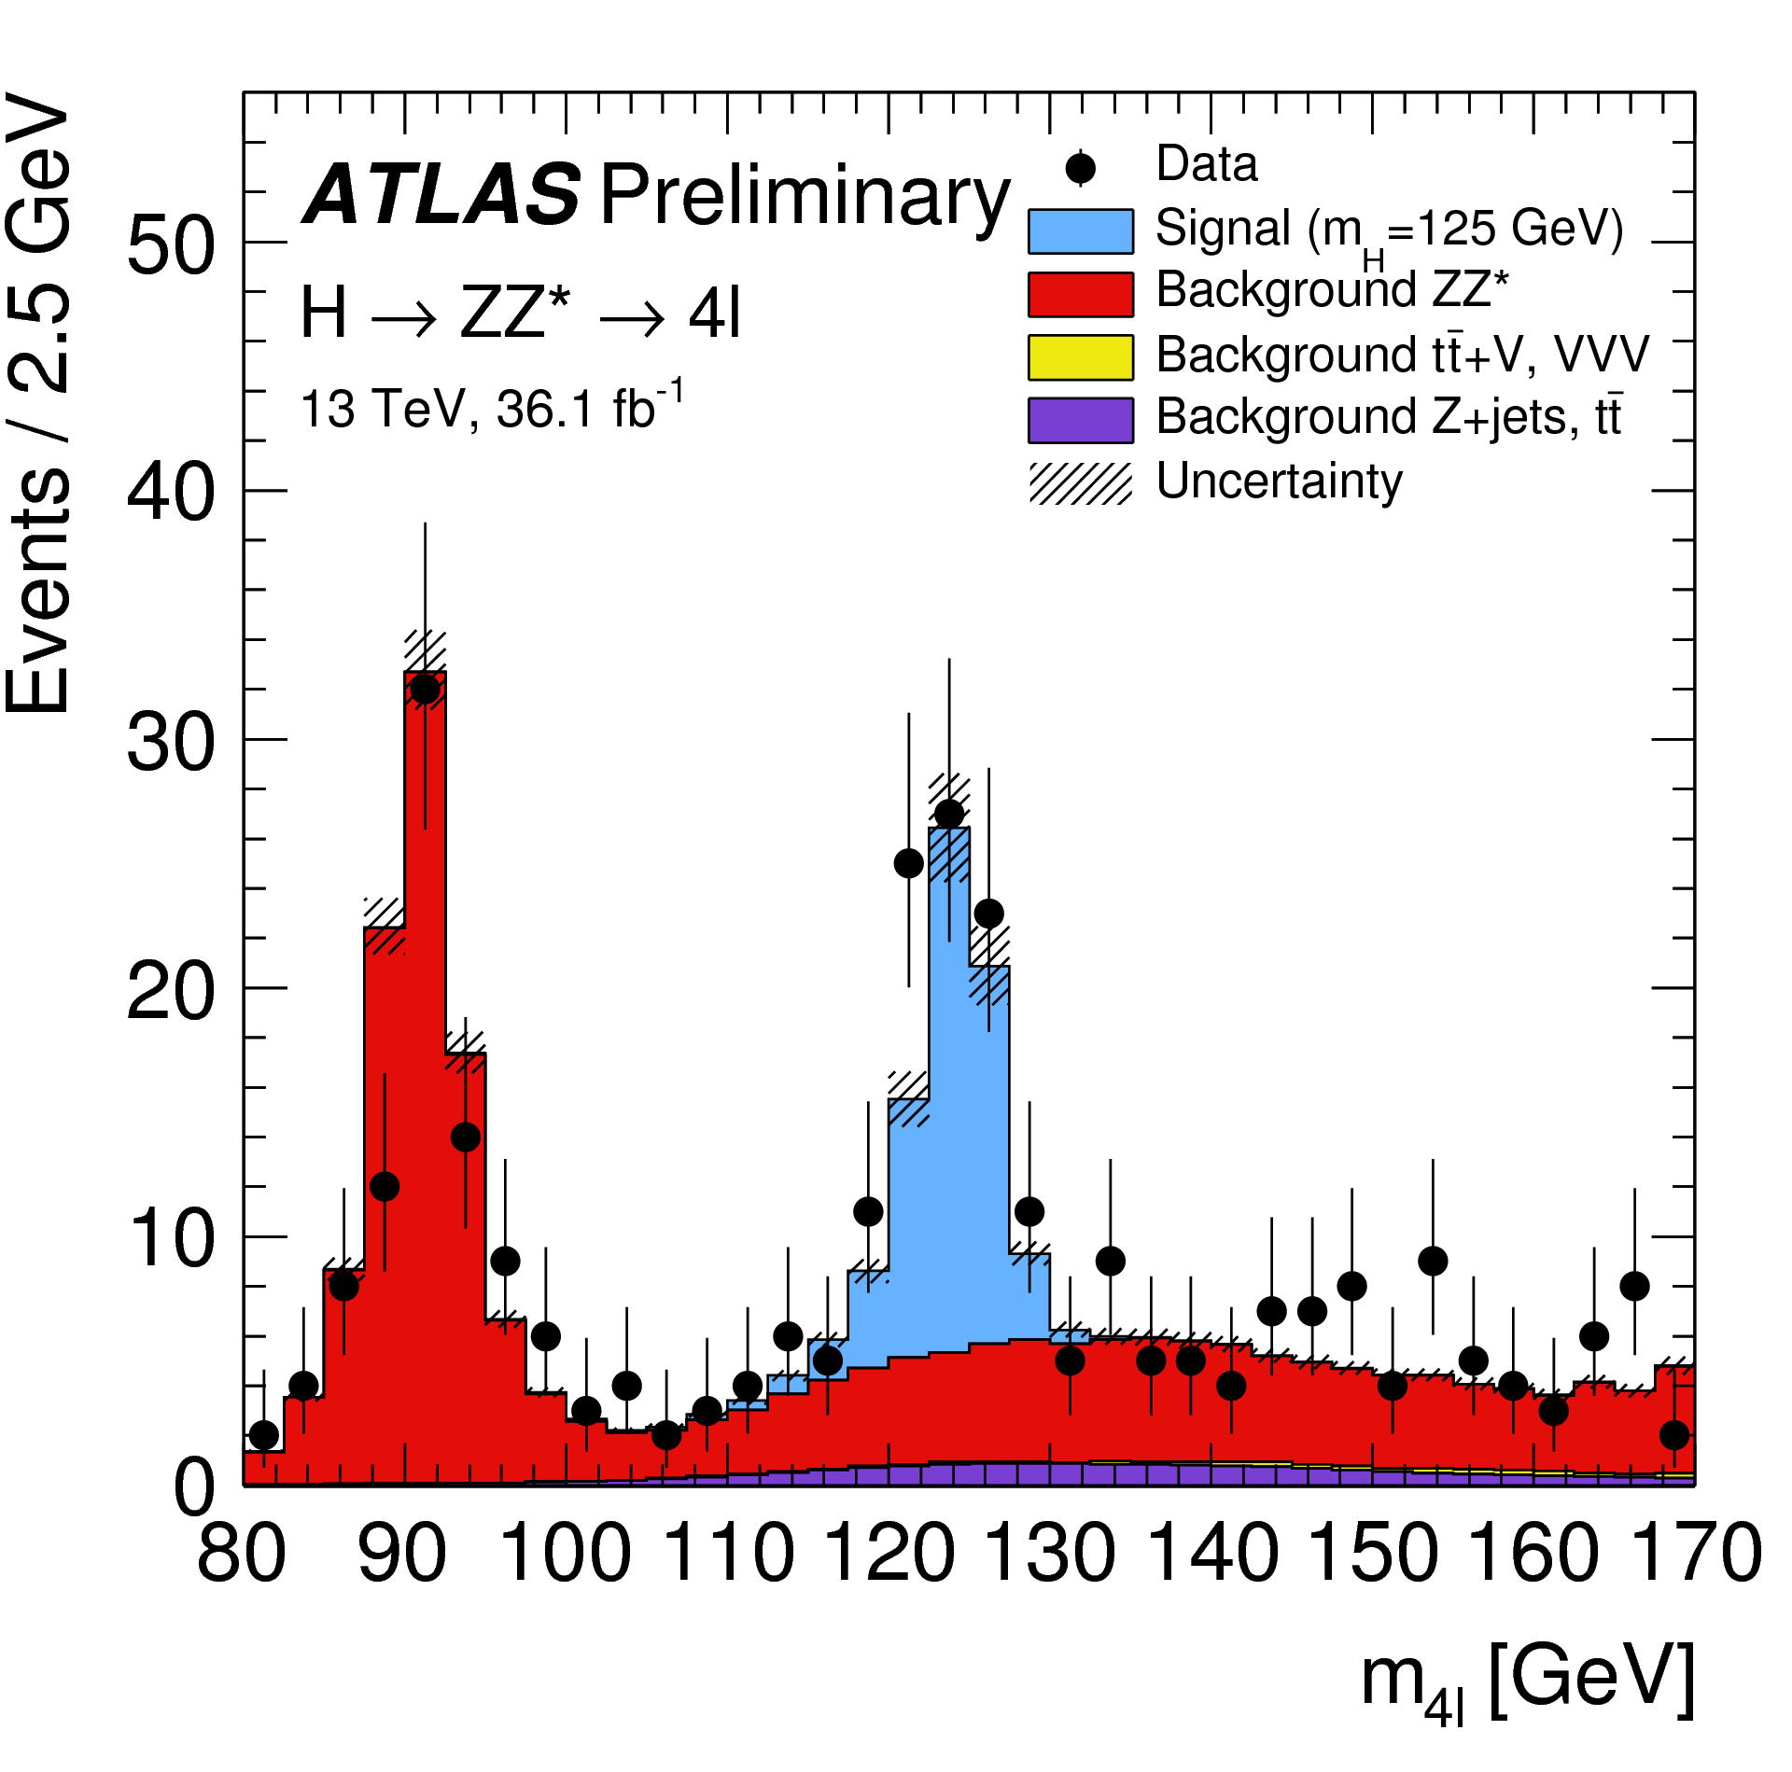
Full workflow
CH0:0.001;
CH2:0.14;
CH4:0.34;
…
CH98039232:0.08;
CH0:0.001;
CH2:0.14;
CH4:0.34;
…
CH98039232:0.08;

Slide 14
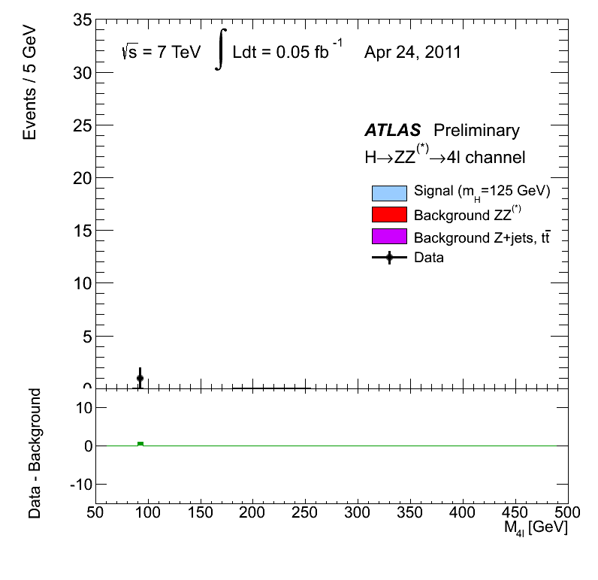
Result

Slide 15
Birth of DIRAC
LHC experiments, all developed their own middleware
PanDA, AliEn, glideIn WMS, PhEDEx, …
DIRAC is developed originally for the LHCb experiment
The experience collected with a production grid system of a large HEP experiment is very valuable
Several new experiments expressed interest in using this software relying on its proven in practice utility
In 2009 the core DIRAC development team decided to generalize the software to make it suitable for any user community.
The results of this work allow to offer DIRAC as a general purpose distributed computing framework
15

Slide 16
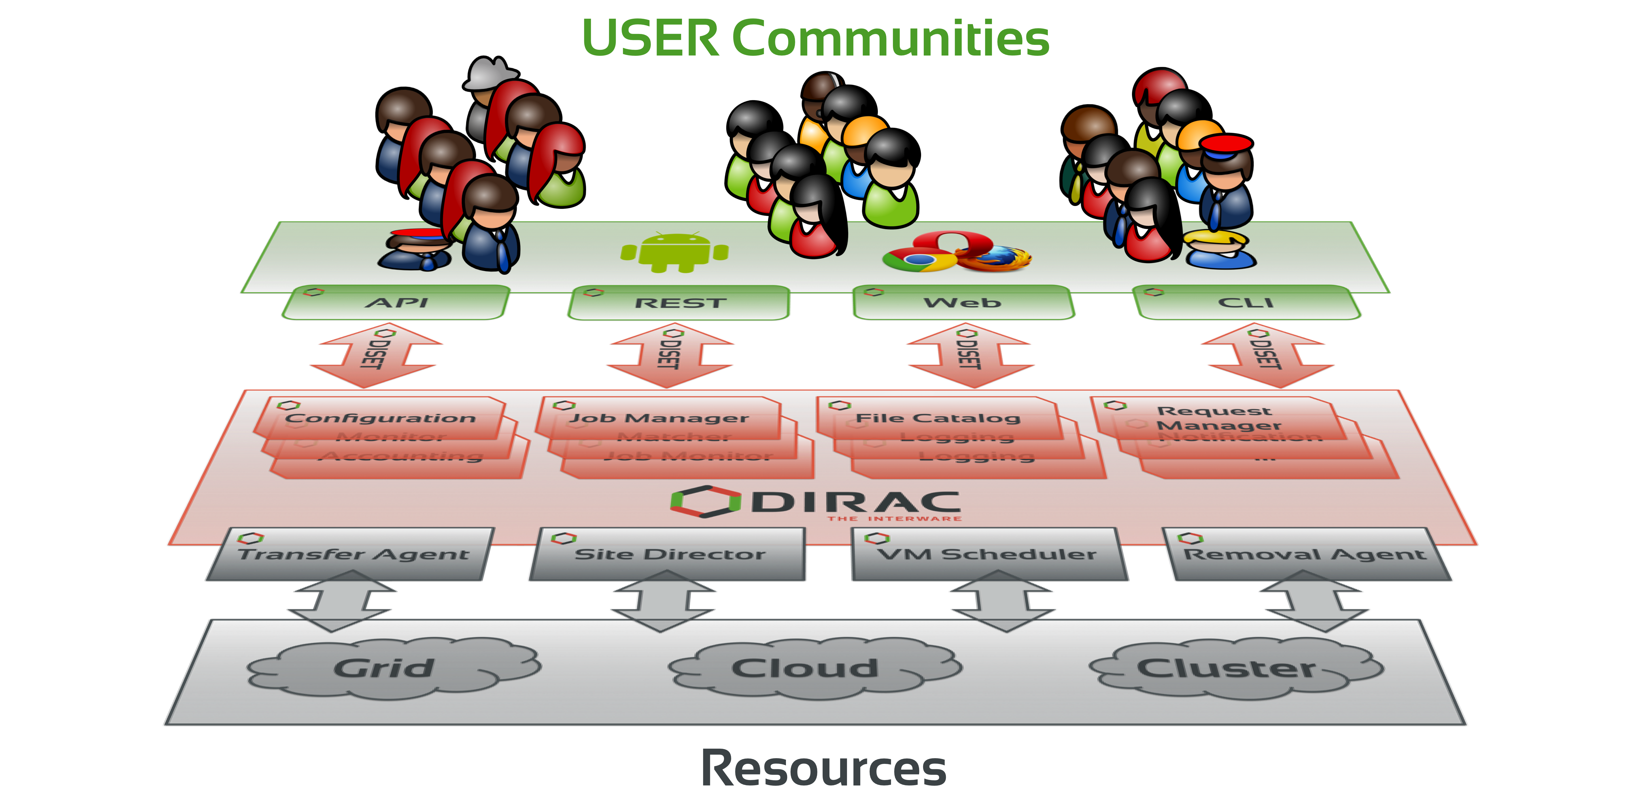
What is DIRAC?
DIRAC provides all the necessary components to build ad-hoc grid infrastructures interconnecting computing resources of different types, allowing interoperability and simplifying interfaces. This allows to speak about the DIRAC interware.
Web
CLI
API
REST

Slide 17
Why DIRAC?
1. Single system for all aspects of computing
User Interface
API
Central configuration
Workload management
Data management
Integration tools
File Catalog
Workflow management
Metadata management
Accounting
Management

Slide 18
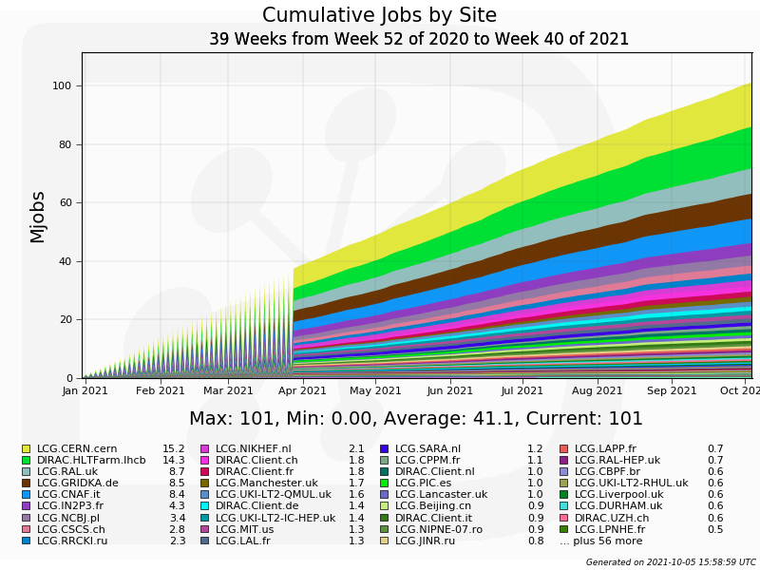
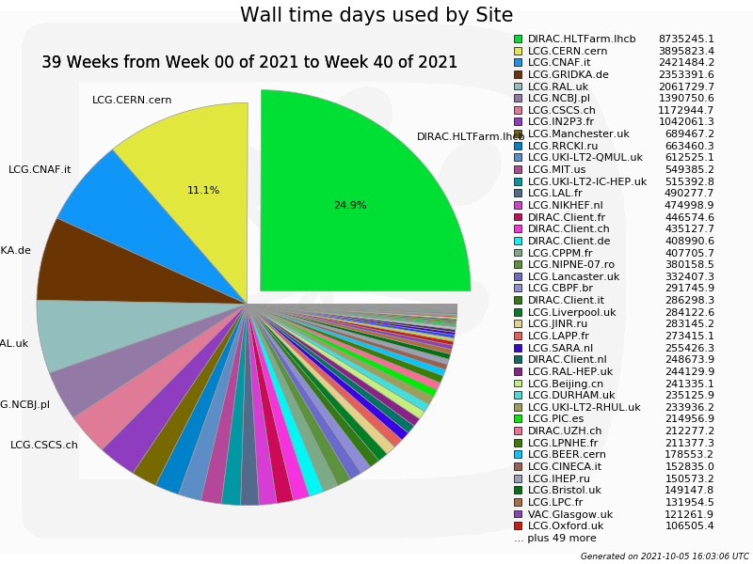
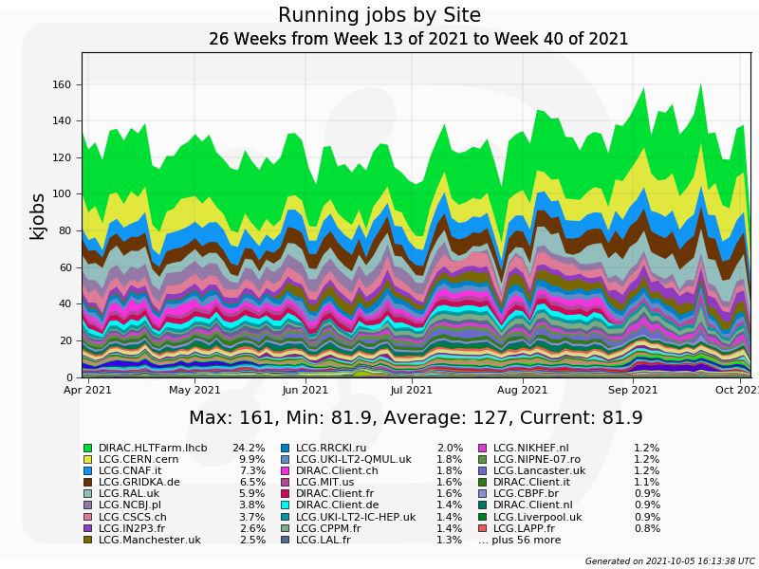
Why DIRAC?
2. Good performance

Slide 19
Why DIRAC?
3. Active users and developers community

Slide 20
What is DIRAC?
DIRAC is a multi-agent system written in Python.
DIRAC implements Service Oriented Architecture.
Whole system is built with the following bricks:
Services
Clients
DBs
Agents
Scripts
Repository: https://github.com/DIRACGrid

Slide 21
What is DIRAC?
Client
https
Service
SQL
DB
import
import
Agent
Script

Slide 22
DIRAC standard job workflow
1. Initial configuration
2. Input data download
3. Processing
4. Output data upload
5.Finalization

Slide 23
Job example
dirac-configure config.cfg
dirac-dms-get-file /bmn/raw/AuAu/data1002.raw
root –l –q –b reco.MC(“data1002.raw”)
#or
root –l –q –b reco.MC(/eos/nica/bmn/AuAu/data1002.raw)
dirac-dms-put-file /bmn/reco/AuAu/data1002.root \\ data1002.root \\
JINR-EOS-BMN
rm –f data1002.raw data1002.root

Slide 24
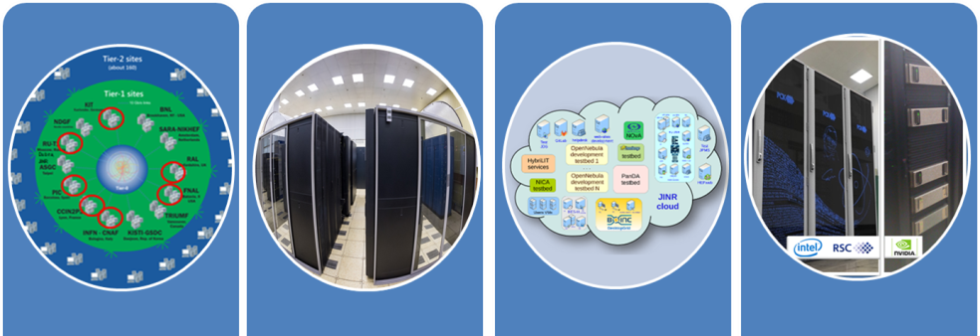
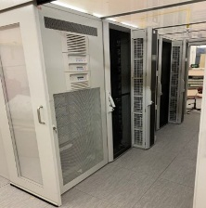
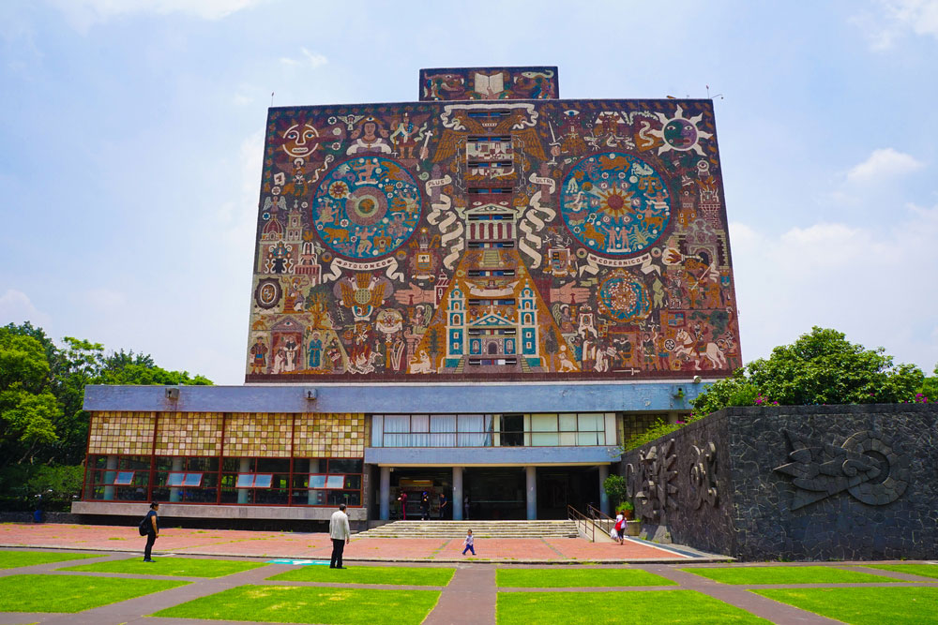
Workload management
Submit thousand of jobs to DIRAC Job Queue
Tier-1
CICC/Tier-2
Clouds
Govorun
NICA Cluster
UNAM

Slide 25
Workload management
Submit thousand of jobs to DIRAC Job Queue
User Job
User Job
User Job
User Job
User Job
User Job
User Job
User Job
User Job
Tier-1
CICC/Tier-2
Clouds
Govorun
NICA Cluster
UNAM

Slide 26
Workload management
Submit thousand of jobs to DIRAC Job Queue
User Job
User Job
User Job
User Job
User Job
User Job
User Job
User Job
User Job
Pilot job
Pilot job
Pilot job
Pilot job
Pilot job
Pilot job
Tier-1
CICC/Tier-2
Clouds
Govorun
NICA Cluster
UNAM

Slide 27
Workload management
Submit thousand of jobs to DIRAC Job Queue
User Job
User Job
User Job
User Job
User Job
User Job
Pilot job
Pilot job
Pilot job
Pilot job
Pilot job
Pilot job
User Job
User Job
User Job
User Job
User Job
User Job
Tier-1
CICC/Tier-2
Clouds
Govorun
NICA Cluster
UNAM

Slide 28
How to achieve that?
script
service
DB
SubmitJob
JobManager
JobQueue
agent
service
SiteDirector
Matcher
script
Pilot

Slide 29
Computing resources
Computing Elements
Clouds
Computing clusters (not included in any grid infrastructure)
Resources available at Universities and scientific laboratories
High Performance Computing (HPC) Centers, or Supercomputers
Volunteer Computing
Mostly based on BOINC technology
SETI@Home, LHC@Home, etc

Slide 30
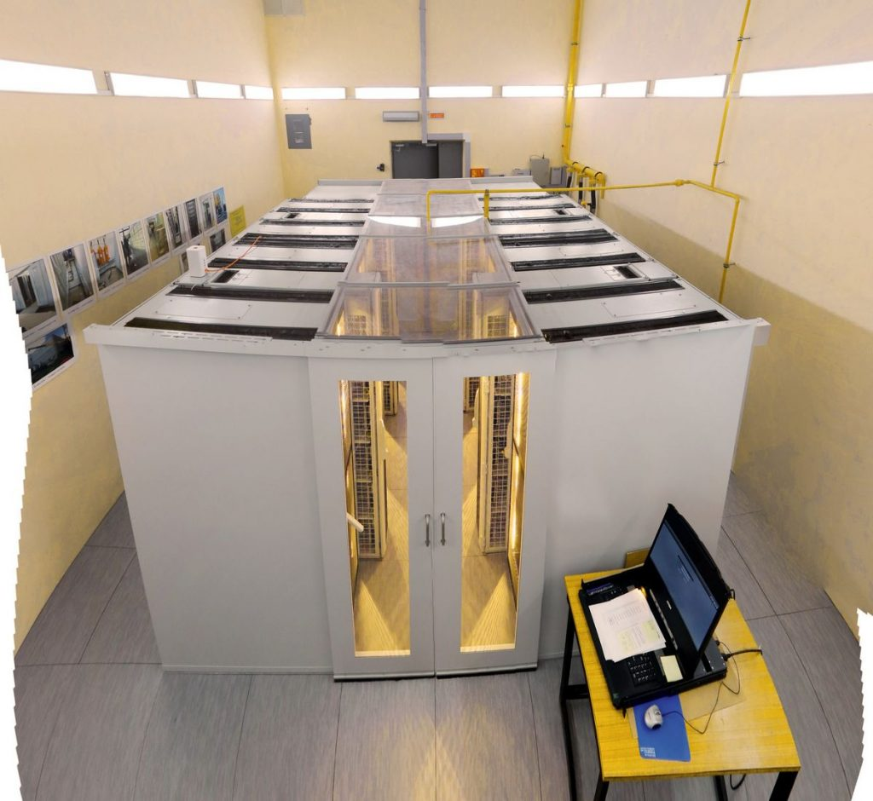
JINR Main Resources
EOS LIT
EOS HybriLIT
EOS LHEP
Tapes
Disks
EOS
EOS
EOS
root – transfer protocol
X509 – authentication
VOMS - authorization
Any
PC*
* Any computer with xrdcp, your certificate, or proxy of your certificate**
**How to pass credentials to processes to write? Proxy is the answer!

Slide 31
Symmetric-key algorithm
Hello
Da!1z0
Hello
Encryption
Decryption
256bit
Gues key is hard

Slide 32
Asymmetric-key algorithm
Hello
F10f%1
Hello
Encryption
Decryption
2048bit
Gues key is hard

Slide 33
Asymmetric-key algorithm
Encryption with public key
Hello
F10f%1
Hello
Encryption
Decryption
Encryption with private key
Hello
F10f%1
Hello
Encryption
Decryption

Slide 34
Making a certificate
Request to CA
Hash
Public
Certification
Authority(CA)
User/Server Info
CA Private
Encrypted Hash
Encryption
CA Public
CA Info
Duration

Slide 35
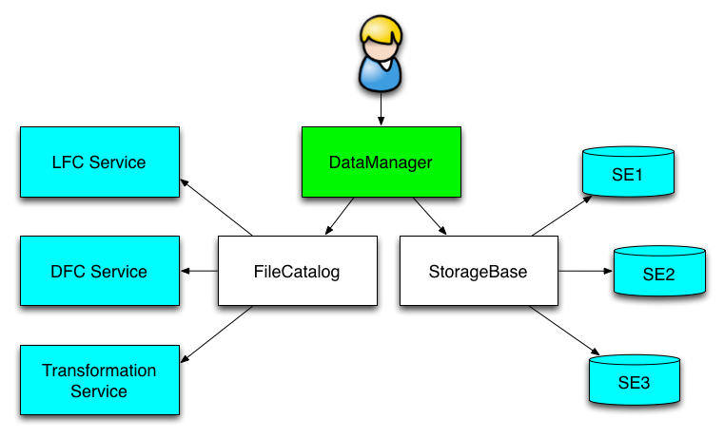
Data Management
DIRAC File Catalog(DFC) is maintaining a single global logical name space
A user sees it as a single catalog with additional features
DataManager is a single client interface for logical data operations
Upload file(example):
dirac-dms-add-file /mpd/vo/model/DQGSM/data.root ./data.roor EOS-MPD
Download file(example):
dirac-dms-get-file /mpd/vo/model/DQGSM/data.root

Slide 36
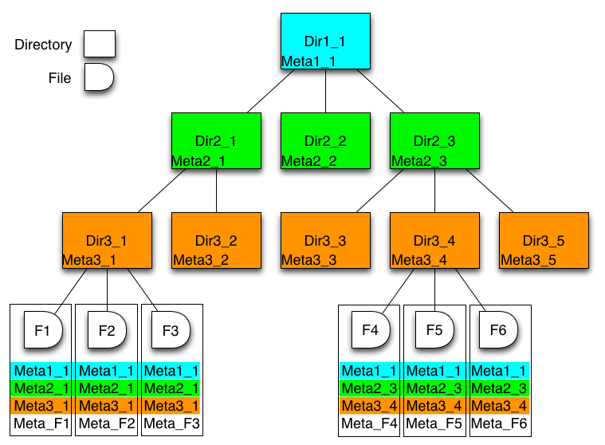
Meta Data
DFC also may host Metadata
User defined metadata
The same hierarchy for metadata as for the logical name space
Metadata associated with files and directories
Allow for efficient searches
Efficient Storage Usage reports
find /experiment/model LastAccess<01-10-2020 GaussVersion=v1,v2 SE=EOS-MPD Name=*.raw

Slide 37
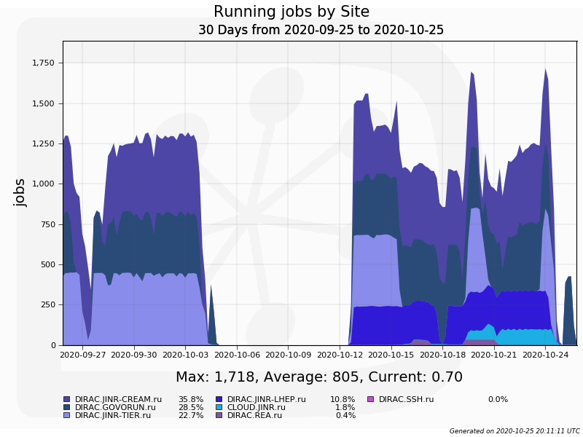
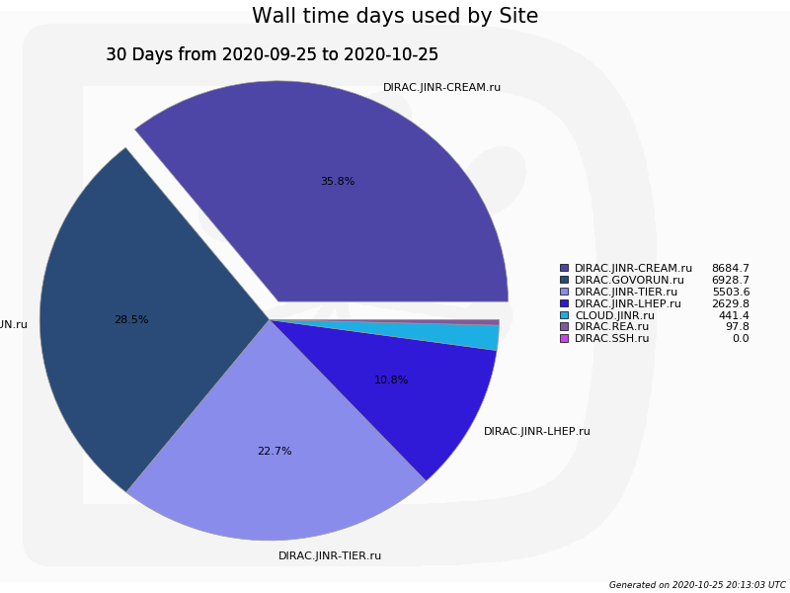
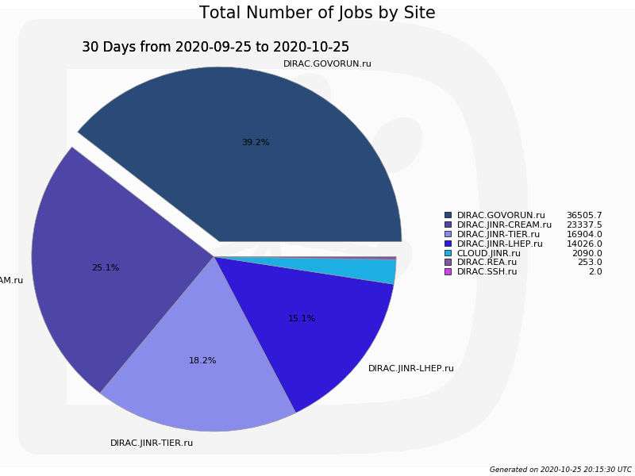
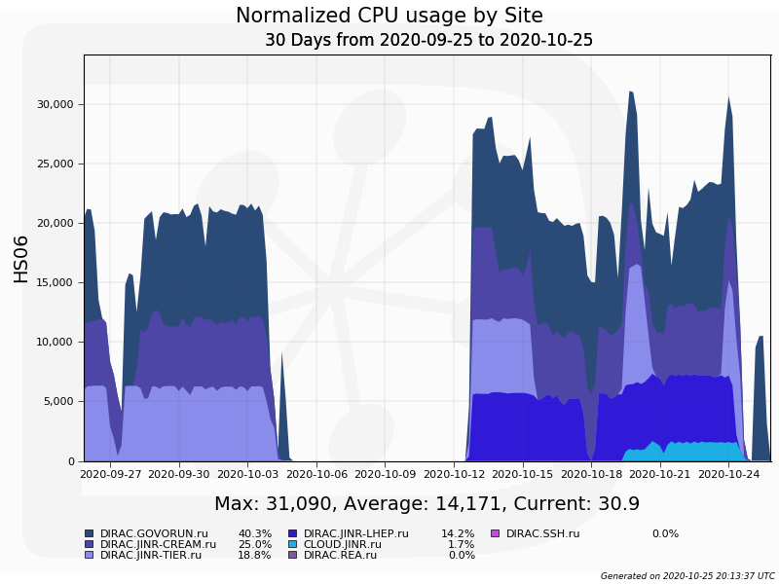
Accounting

Slide 38
MultiVO support
Installing, configuring and supporting DIRAC requires a lot of efforts.
CEPC* and JUNO** have joined to BES-III computing infrastructure.
*Circular Electron Positron Collider
**Jiangmen Underground Neutrino Observatory
MPD
SPD
Baikal
BM@N
Resource utilization
Support needs
Feature development

Slide 39
What was done
EOS
Tier-1
CICC/Tier-2
Clouds
Govorun
NICA Cluster
UNAM
Running
Running
Running
Running
Running
Running
The computing resources of the JINR Multifunctional Information and Computing Complex, clouds in JINR Member-States, cluster from Mexico University were combined using the DIRAC Interware.

Slide 40
History of DIRAC at JINR
2013 – Development of monitoring system for BES-III installation. First tries to setup and configure DIRAC infrastructure.
2017 – DIRAC Interware installed; basic configuration done. Used for educational purposes. dCache storage integrated, Tier2 integrated.
2018 – HybriLIT integrated. JINR cloud integrated using OCCI protocol. Tests of full cycle of Monte-Carlo for BM@N were performed.
2019 – Clouds of JINR Member-States integrated by module developed in JINR. MPD starts using DIRAC for massive Monte-Carlo production. Tier1, Govorun and EOS integrated in DIRAC.
2020 – Folding@Home jobs submitted to clouds via DIRAC. Baikal-GVD jobs submitted to JINR and PRUE clouds.
2021 – First tests for SPD Monte-Carlo successfully done. First million jobs done!
2022– Total walltime exceeds 1000 years. DIRAC in JINR updated to use Python 3.

Slide 41
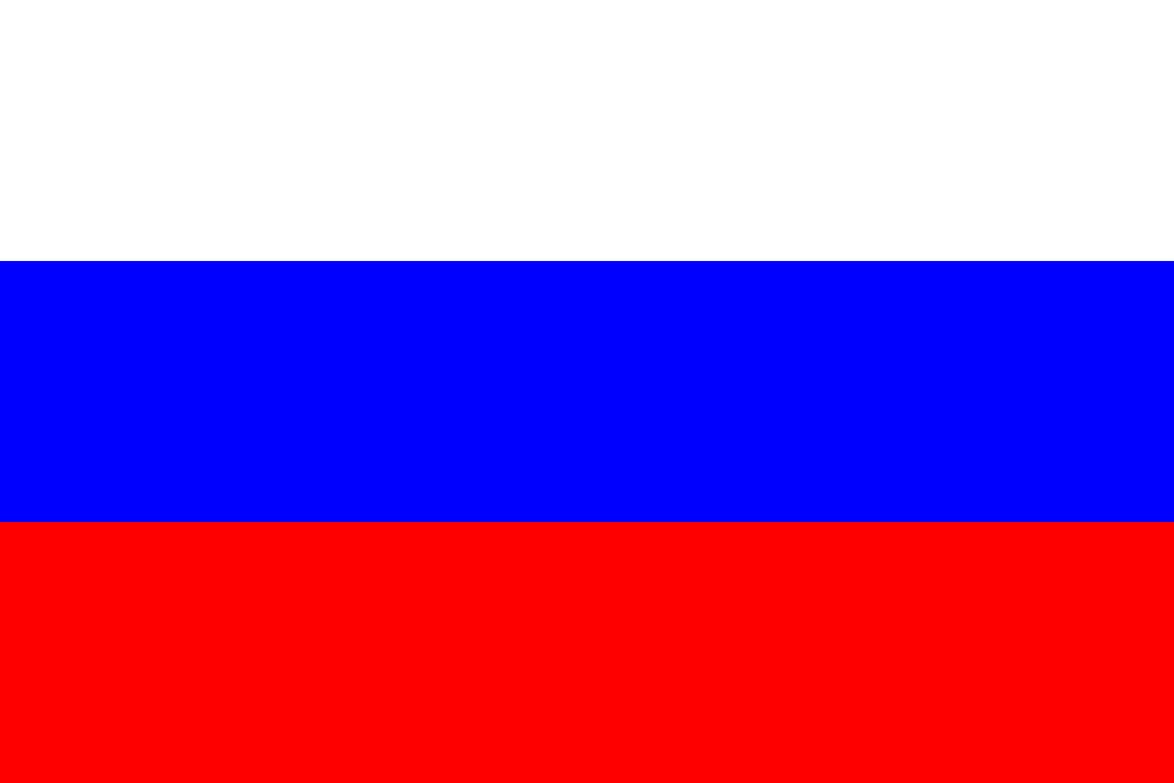
Computing Resources
MPD collaboration
JINR
Tier-1
920 slots
CICC/Tier-2
1000 slots
Cloud
80 slots
Govorun
184-870 slots
NICA Cluster
250 slots
UNAM
100 slots
Clouds
IPANAS
16 slots
INP
132 slots
SU
48 slots
INRNE
20 slots
INP
50 slots
REA Plehanova
132 slots
NOSU
84 slots
STI-SCI
98 slots
Total amount of cores exceeds 3000

Slide 42
Steps
1. DIRAC setup, configuration, development and tuning
2. Integration of computing and storage resources
3. Elaboration of approaches for effective use of resources

Slide 43
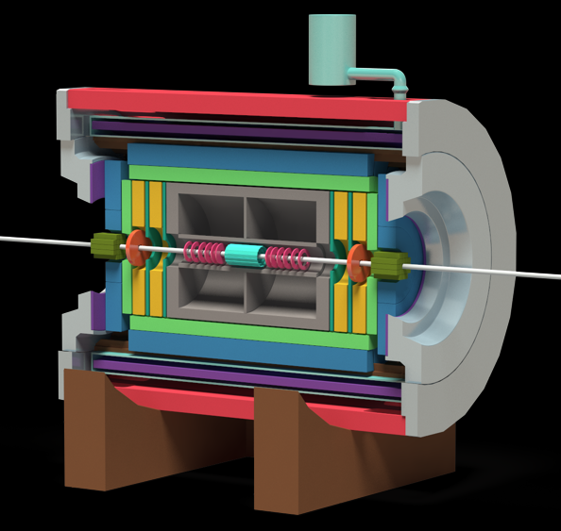
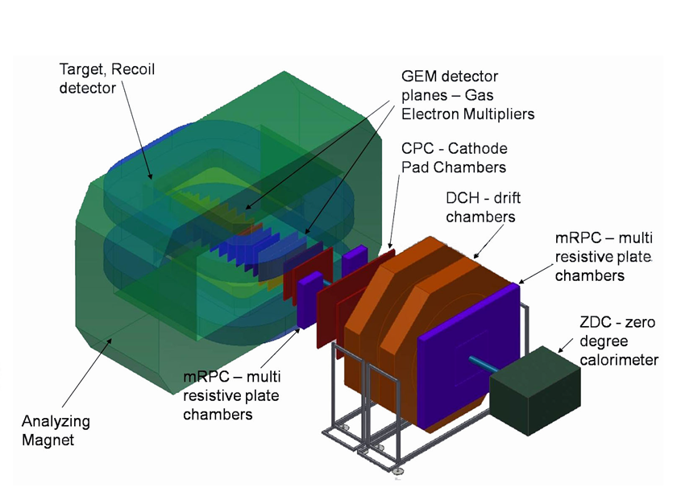
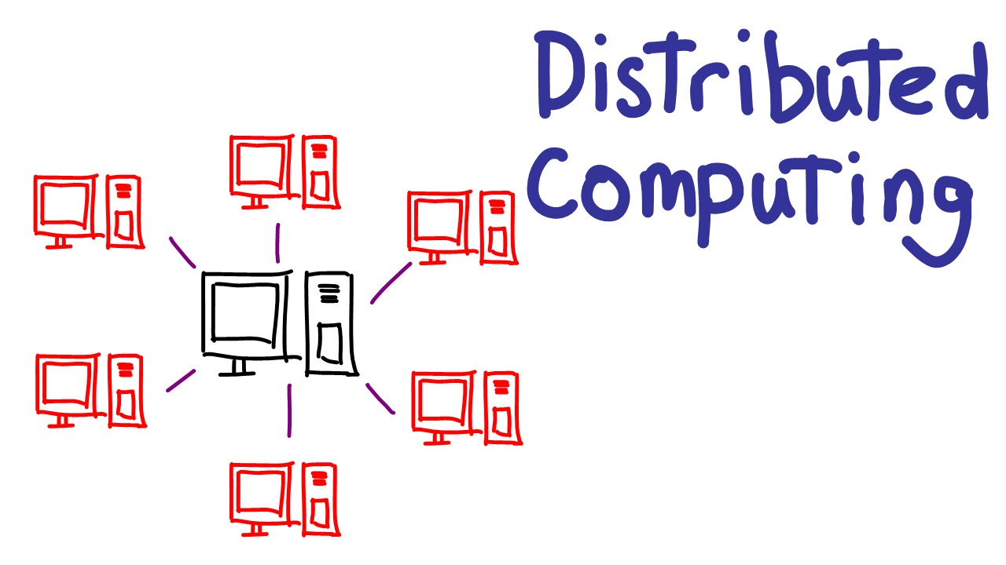
What do we use DIRAC for?
MPD@NICA
Baikal-GVD
BM@N
Monte-Carlo – Real
Analysis – Maybe
Monte-Carlo – Real
Monte-Carlo – Real
Reconstruction – Tests
SPD@NICA
Monte-Carlo – Real
Folding@HOME
Teaching

Slide 44
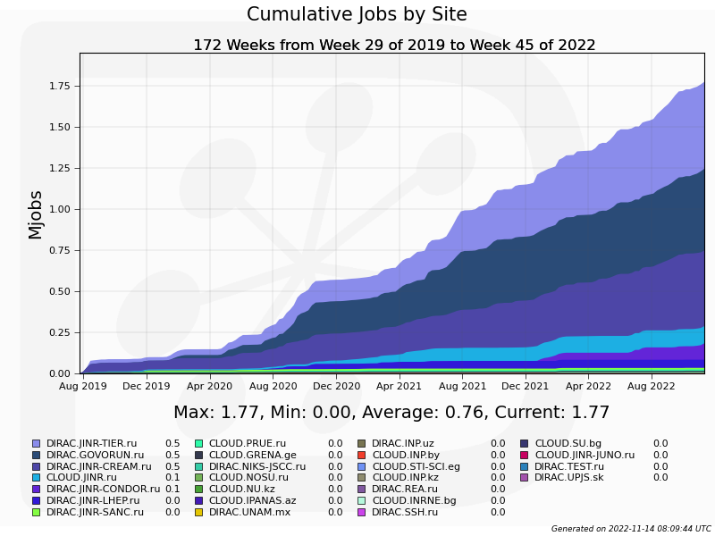
Statistics: jobs done
1 Million jobs

Slide 45
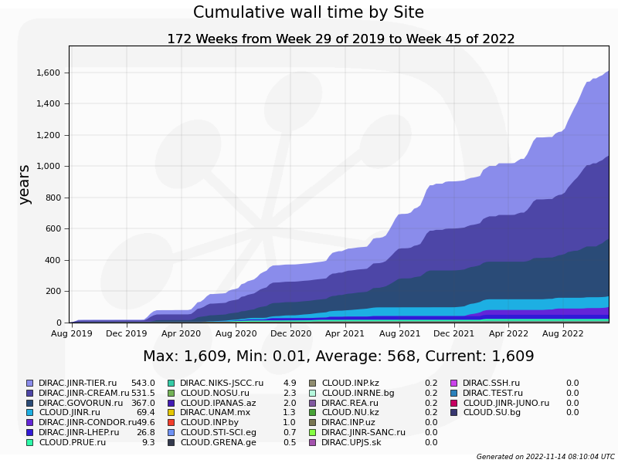
Statistics: walltime
1600 years
of computation on one core

Slide 46
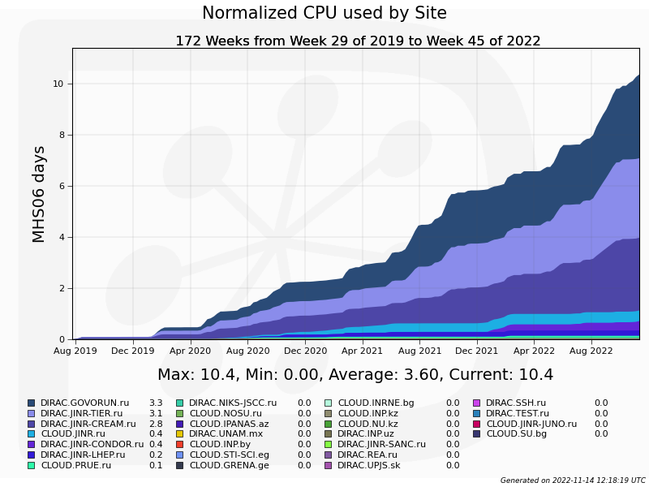
Statistics: normalized time

Slide 47
Ratio: between experiments

Slide 48
Individual CPU core performance study
Centralized job management gives possibility for centralized and unified performance study of different computing resources.
Before running user jobs DIRAC Pilots execute benchmark for CPU core they are running on.
Benchmark is DiracBenchmark2012 or DB12. It evaluate just CPU core performance. Disk I/O, RAM speed, Network, CPU caches and other highly important aspects of performance are neglected by DB12.

Slide 49
DB12 benchmark study
Piece of road from point A to B
A Monte-Carlo task
Speed of the car
Performance of the computer
Time to complete
Time to complete
$$Time= \frac{Amount of work}{Speed of computer}$$
DB12 gives results like: 10(old slow core), 17 (standard server core), 27 (high performance core)
What if we build a plot, where X is DB12 result, Y is time in seconds. Then, every point on the plot represent one job.
It would be mostly useless if all jobs were unique and different. But, in the real life there are usually many similar jobs.

Slide 50
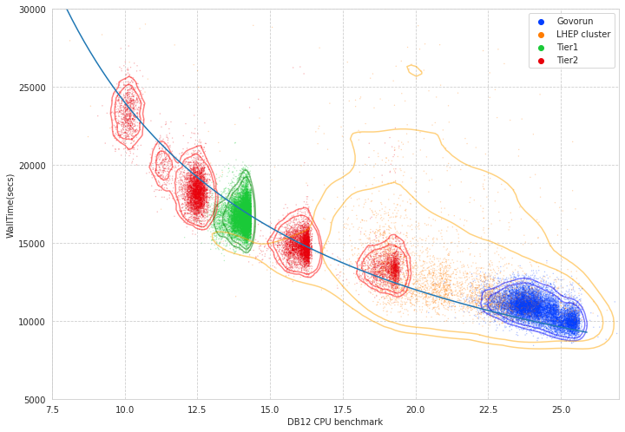
Performance analysis

Slide 51
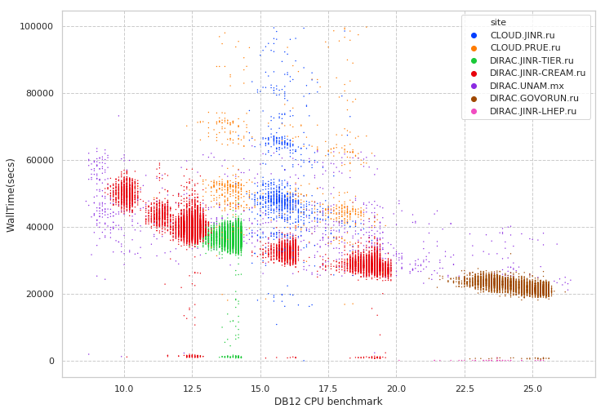
Performance analysis
Folding@Home
MPD MC
Immediate errors or short jobs
Errors during execution

Slide 52
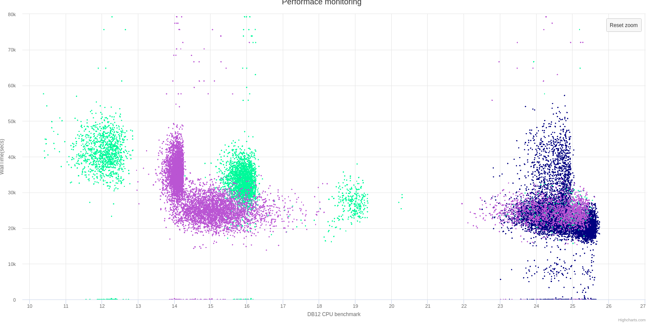
Discoveries
Wrong AMD processors estimation
Occasional speed loss on high ram Govorun nodes
Walltime
DB12 benchmark

Slide 53
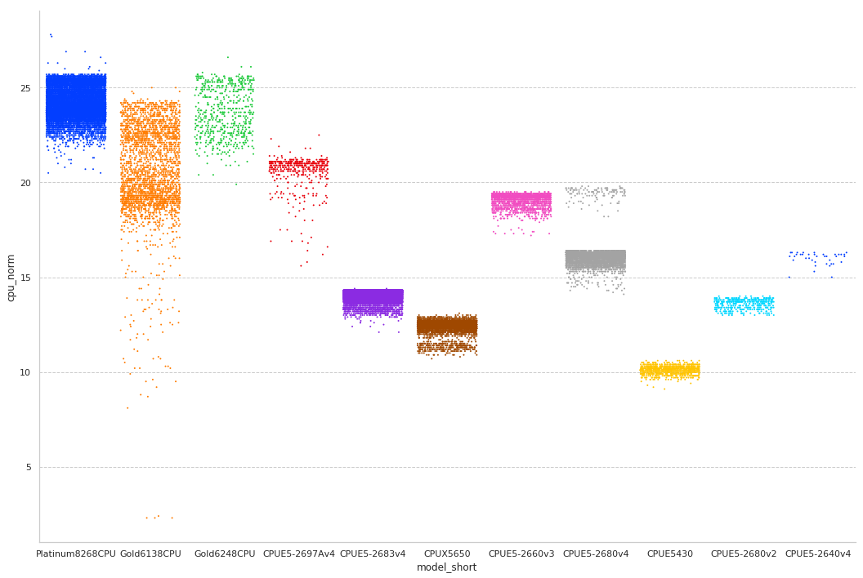
CPU core performance

Slide 54
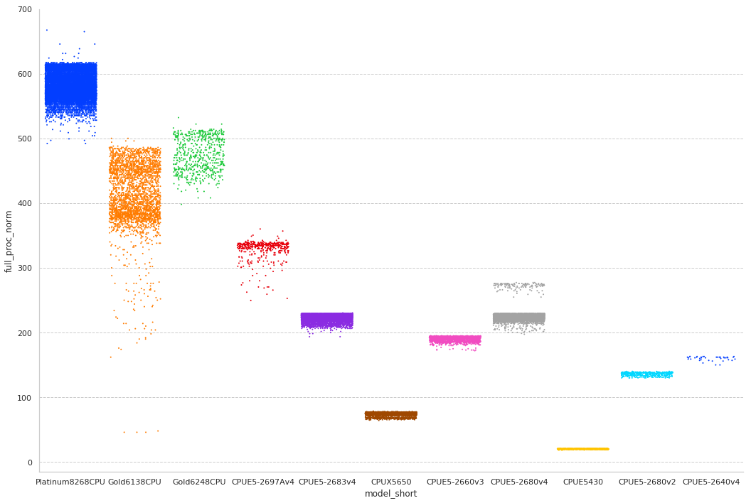
Total CPU performance

Slide 55
Questions that we ask
Are we efficient in our job execution?
We have no access to monitoring information on a remote computing resources
Even if we have monitoring, it may be spoiled by other jobs
Can we utilize more computing resources if we would have them in our disposal?
It is not so difficult to submit jobs on another thousand of cores, but will network handle them efficiently?

Slide 56
Parameters example
If we have 20 computing worknodes, 40 cores available on each worknode.
If 100 MB/s maximum disk writing speed on each worknode.
If new 40 GB RAW file appears every 90 seconds. 105000 events in each RAW file.
If each event processing time is 0.5 sec – one file processing will last for 14.5 hours.

Slide 57
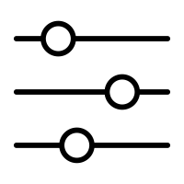
Simulation is a solution
Parameters
Simulation system
Results

Slide 58
Simulation system
JobQueue
Monitoring
Written in python to predict CPU, RAM, network and disk load
Uses data about performance of resources integrated in DIRAC
It is used to check the behavior of DIRAC jobs in real infrastructure.
Simulation is done every second, but period may be increased for speeding up simulation.
InfluxDB is used for results storage and visualization
Controller
Storage
Cluster
Worknode
Job
Task

Slide 59
Most important part
transfer simulation
Bandwidth
Rquest 1
Rquest 2
Rquest 3
Rquest 4
Rquest 5

Slide 60
Simple approach
Bandwidth
Rquest 1
10 / 5 = 2
Rquest 2
Rquest 3
Rquest 4
Rquest 5

Slide 61
Used approach
Bandwidth
Request 1
Request 2
10 / 5 = 2
Request 3
Request 4
Request 5

Slide 62
Try to apply share
Bandwidth
Request 1
Request 2
10 / 5 = 2
Request 3
Request 4
Request 5

Slide 63
Recalculate share
Bandwidth
Request 1
Request 2
7 / 3 = 2+1/3
Request 3
Request 4
Request 5

Slide 64
Apply share
Bandwidth
Request 1
}
Request 2
7 / 3 = 2+1/3
Request 3
These are left for the next simulation period
Request 4
Request 5

Slide 65
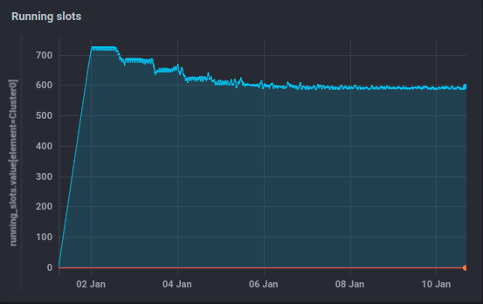
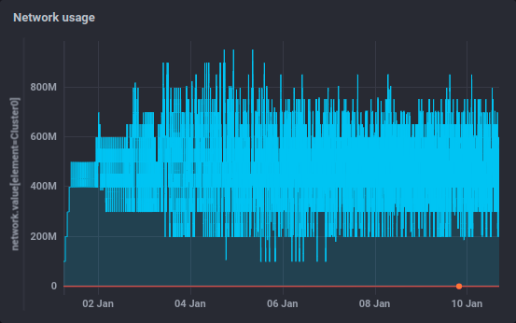
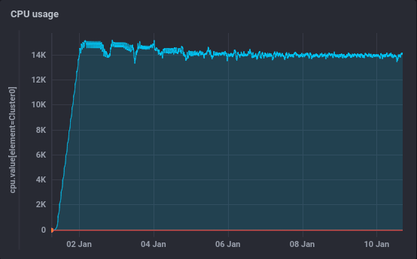
Simulation results

Slide 66
User job monitoring
$ root macro.c(input)
$ job_monitoring root macro.c(input)
User job (root)
job_monitoring
User job (root)
Monitoring DB (InfluxDB)

Slide 67
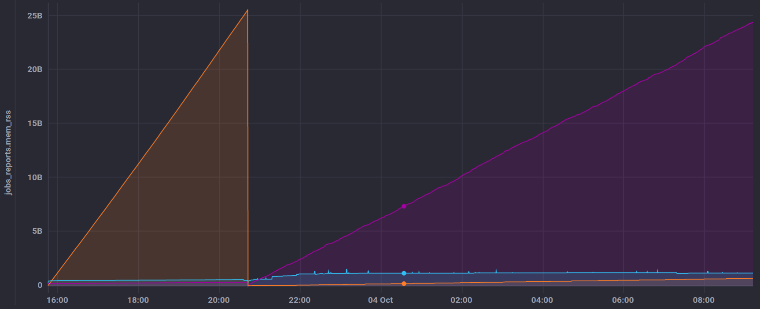
User job monitoring
GenToDst job on Govorun
Disk out
Disk in
RAM usage

Slide 68
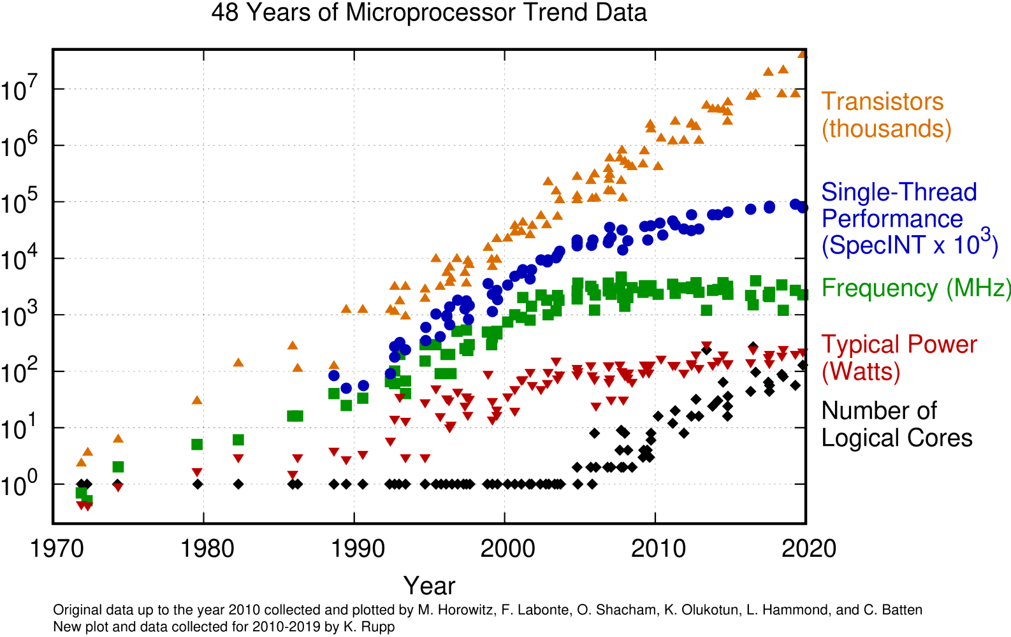
Why do we do all that?

Slide 69
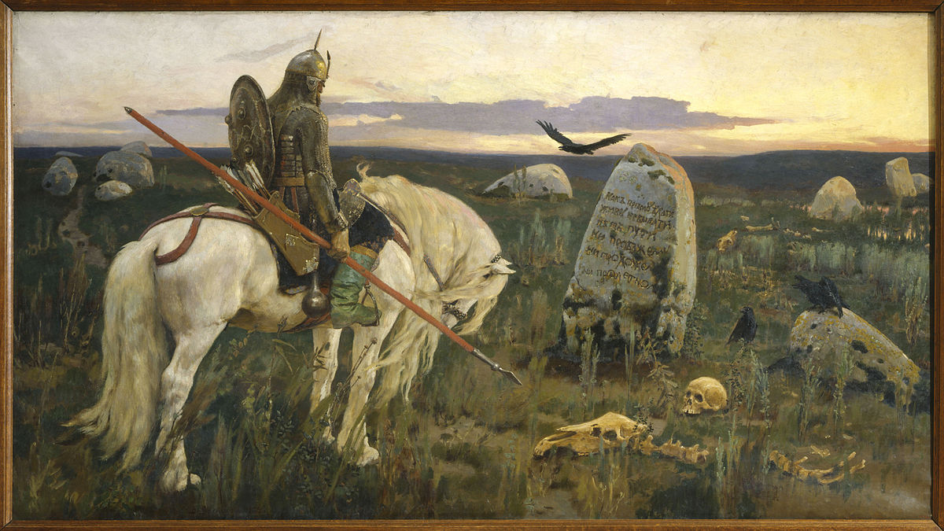
What to do with that
Go Parallel
Go Distributed
Go Effective
HPC, Supercomputers
Grid,
clusters
New algorithms,
machine learning

Slide 70
DIRAC: Igor Pelevanyk, Andrey Tsaregorodtzev Baikal-GVD: Dmitry Zaborov BM@N: Konstantin Gertsenberger, Dmitry Tsvetkov MPD: Oleg Rogachevskiy, Andrey Moshkin SPD: Alexey Zhemchugov, Katherin Shtejer Responsible for resources: Govorun: Dmitry Podgainy, Dmitry Belyakov, Maxim Zuev LHEP cluster: Boris Schinov Tier-1,Tier-2, EOS: Valery Mitsyn Cloud: Nikolay Kutovskiy, Nikita Balashov dCache: Vladimir Trofimov
List of participants

Slide 71
Detailed articles
1. Gergel, V., V. Korenkov, I. Pelevanyuk, M. Sapunov, A. Tsaregorodtsev, and P. Zrelov. 2017. Hybrid Distributed Computing Service Based on the DIRAC Interware.
2. Korenkov, V., Pelevanyuk, I. & Tsaregorodtsev, A. 2019, "Dirac system as a mediator between hybrid resources and data intensive domains", CEUR Workshop Proceedings, pp. 73.
3. Balashov, N.A., Kuchumov, R.I., Kutovskiy, N.A., Pelevanyuk, I.S., Petrunin, V.N. & Tsaregorodtsev, A.Y. 2019, "Cloud integration within the DIRAC Interware", CEUR Workshop Proceedings, pp. 256.
4. Korenkov, V., Pelevanyuk, I. & Tsaregorodtsev, A. 2020, Integration of the JINR hybrid computing resources with the DIRAC interware for data intensive applications.
5. Kutovskiy, N., Mitsyn, V., Moshkin, A., Pelevanyuk, I., Podgayny, D., Rogachevsky, O., Shchinov, B., Trofimov, V. & Tsaregorodtsev, A. 2021, "Integration of Distributed Heterogeneous Computing Resources for the MPD Experiment with DIRAC Interware", Physics of Particles and Nuclei, vol. 52, no. 4, pp. 835-841.
6. Pelevanyuk, I., "Performance evaluation of computing resources with DIRAC interware", AIP Conference Proceedings 2377, 040006 (2021)

