Slide 1



Machine Learning for Neutron stars
Hovik Grigorian:
JINR , AANL, YSU
in cooperation with A. Ayriyan
project

Slide 2
Content
Motivation from Neutron Star Physics
Neutron Star Structures
EoS & NS Configurations
Thermal Evolution of NS
Gravitational Wave Signal
Comparison with observational data
Machine Learning methods
Conclusions

Slide 3
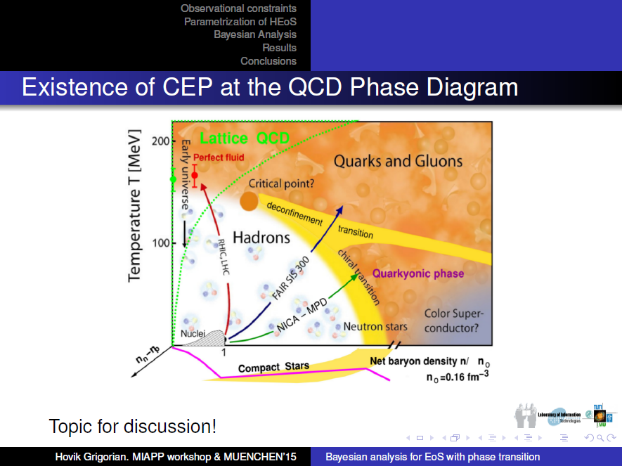
Phase Diagramm & Neutron Stars

Slide 4
MPD Experiment. Physics
√s_{NN} = 3-11 GeV

Slide 5
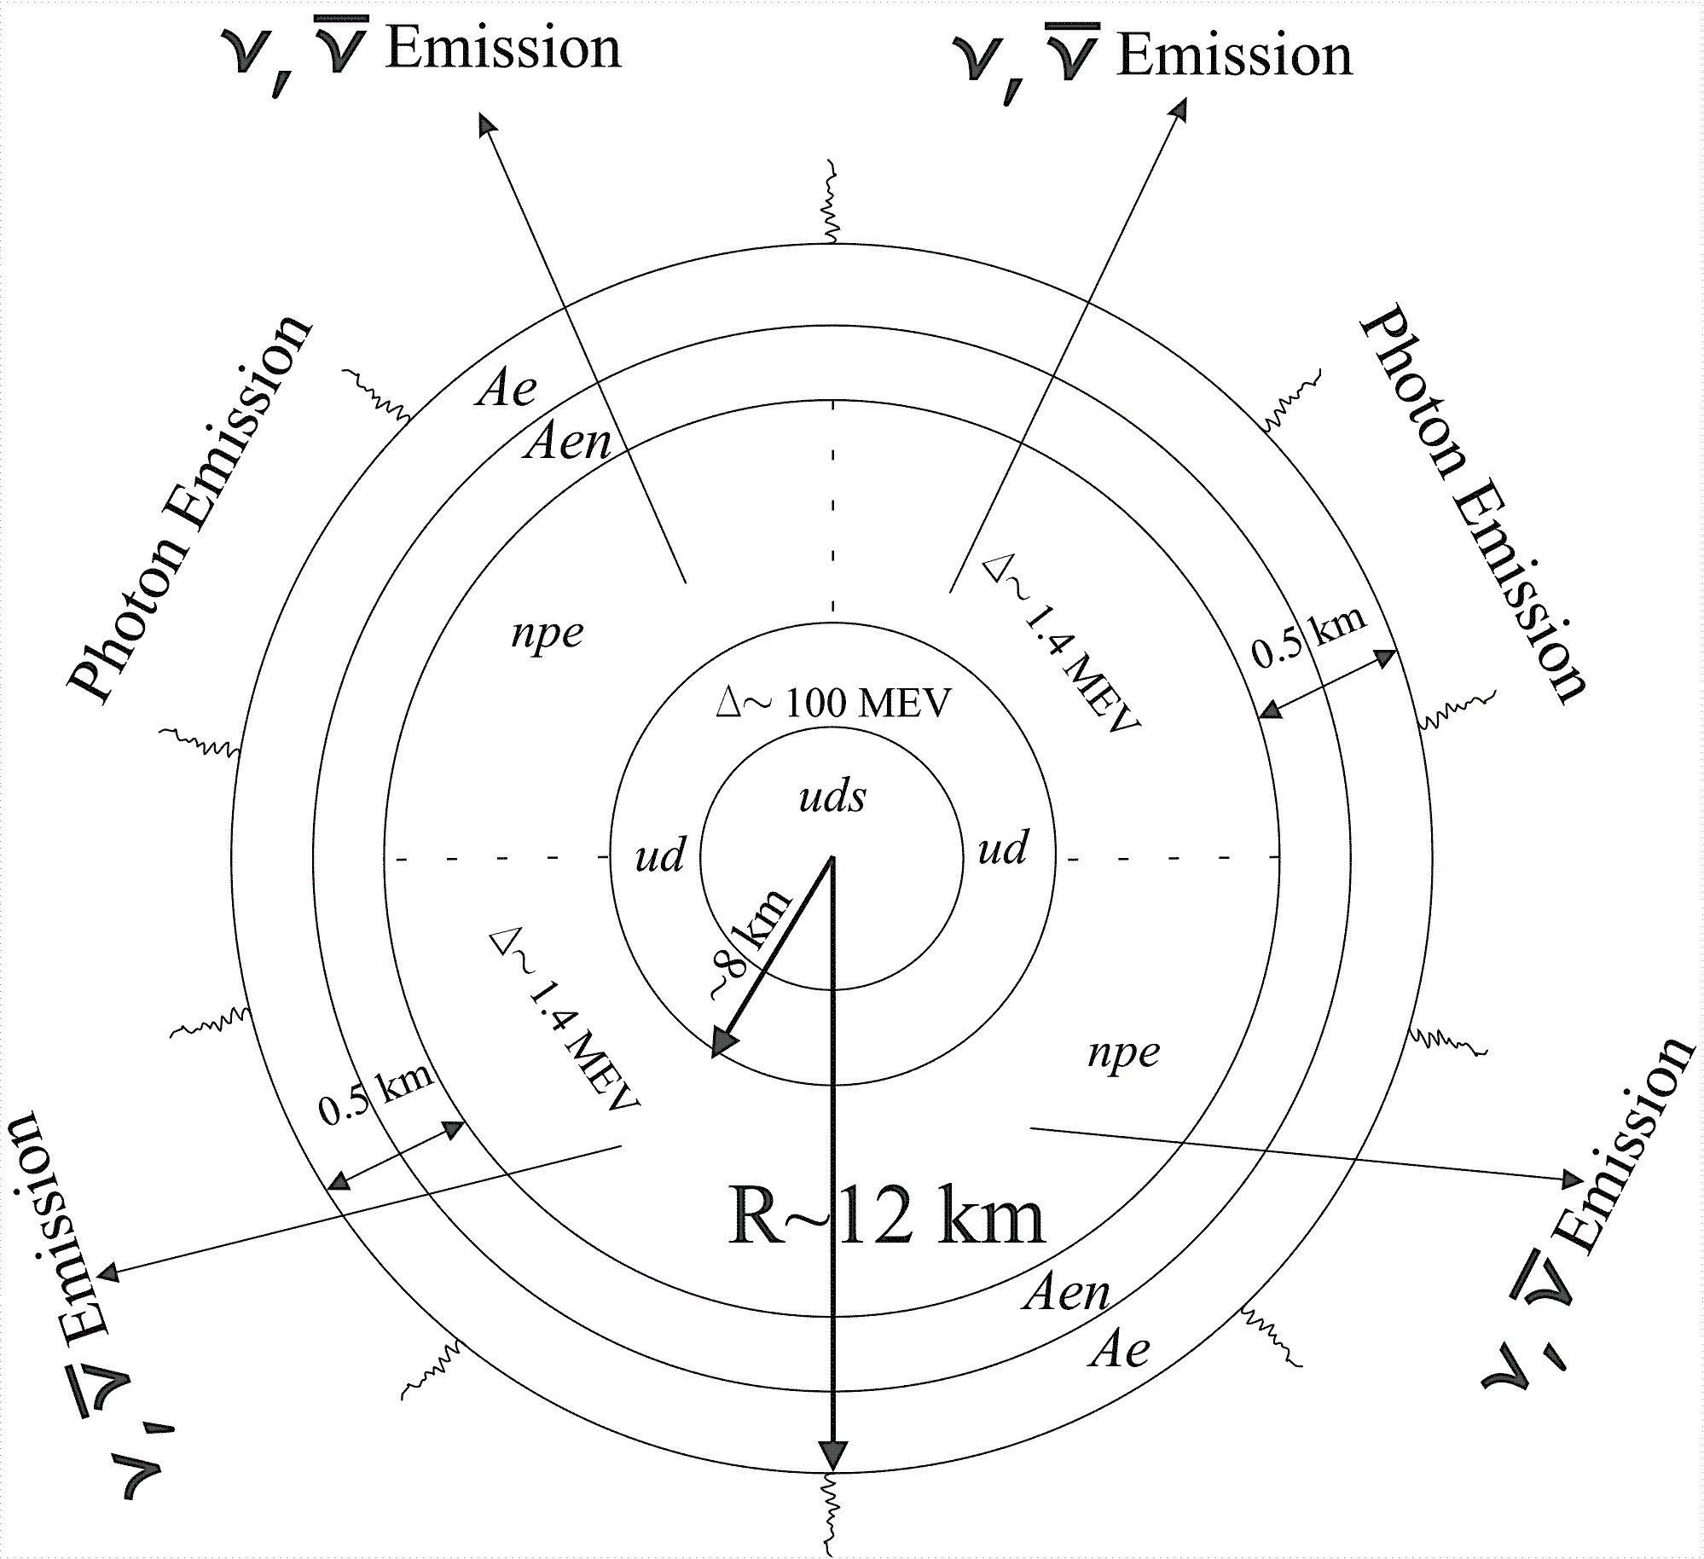
Structure Of Hybrid Star

Slide 6
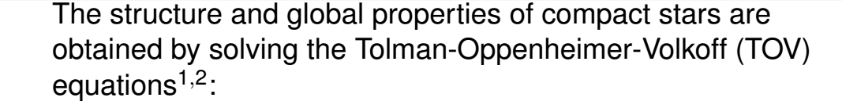
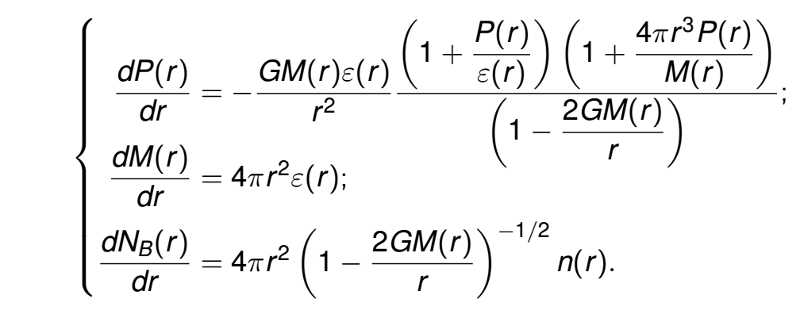

Static Neutron Star Mass and Radius

Slide 7
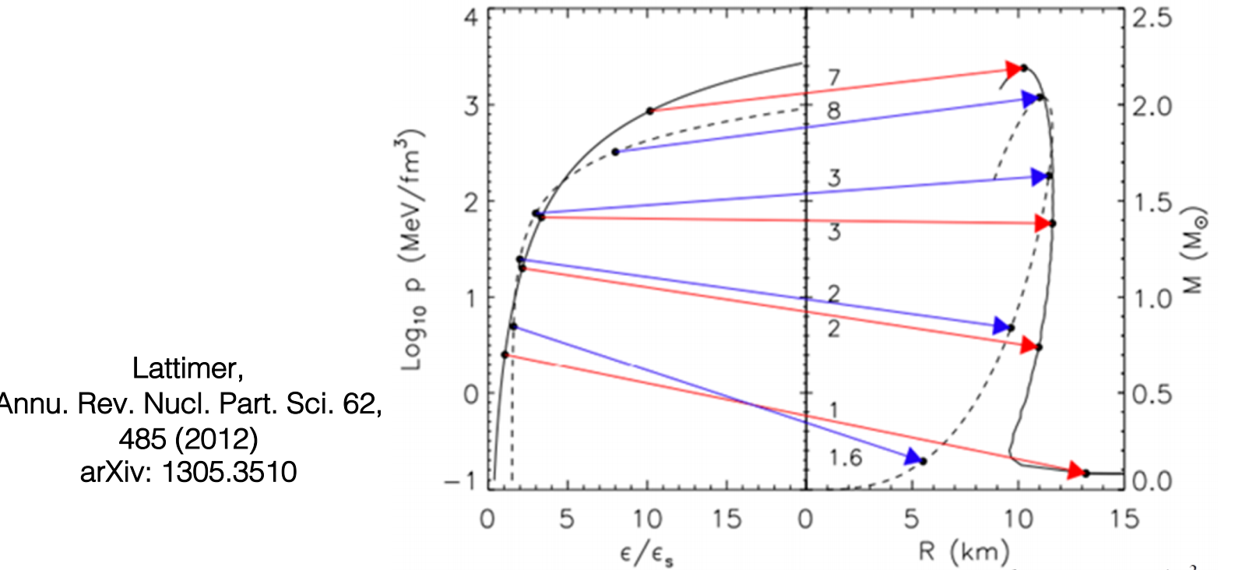
EoS vs. Mass Radious of NS

Slide 8
Stability of stars
HDD, DD2 & DDvex-NJL EoS models

Slide 9
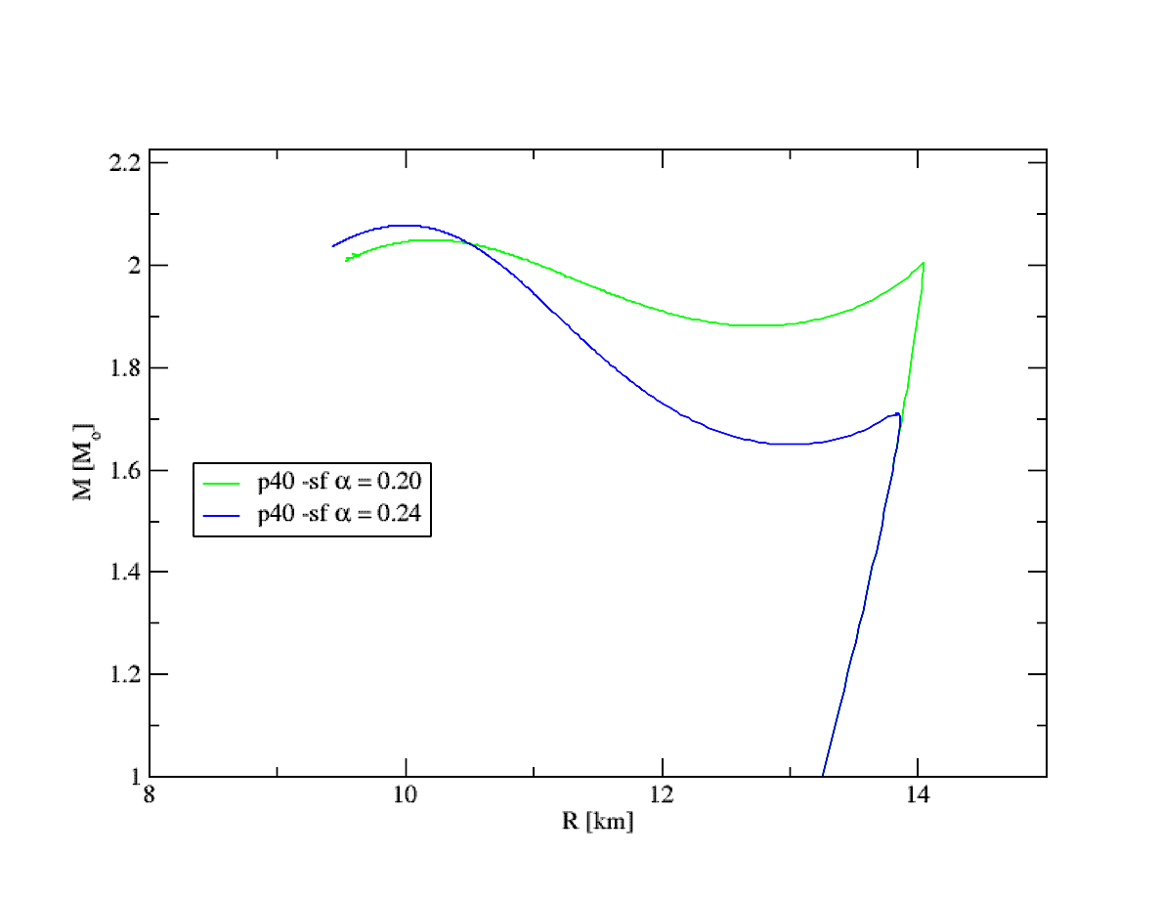
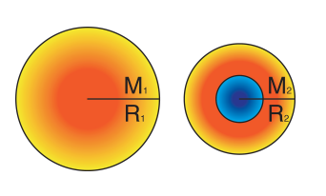
High Mass Twin CS

Slide 10
High Mass Twin CS

Slide 11
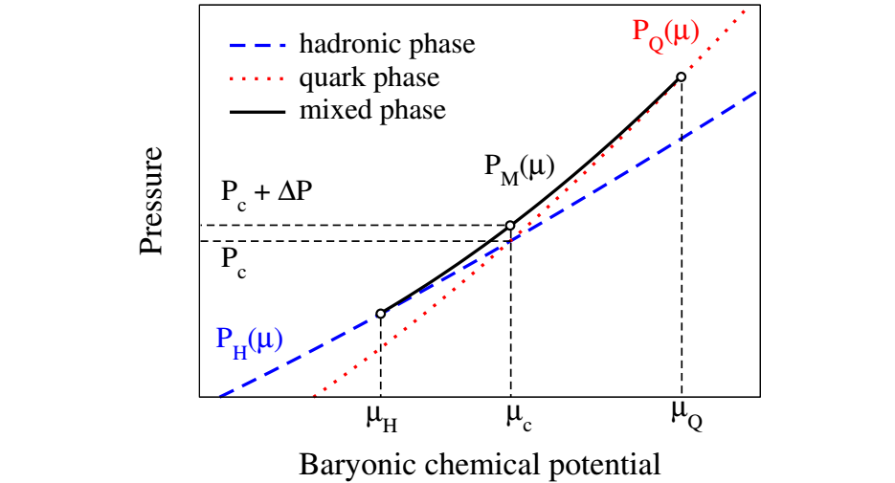
Mixed Phase in Quark-Hadron
Phase Transition

Slide 12
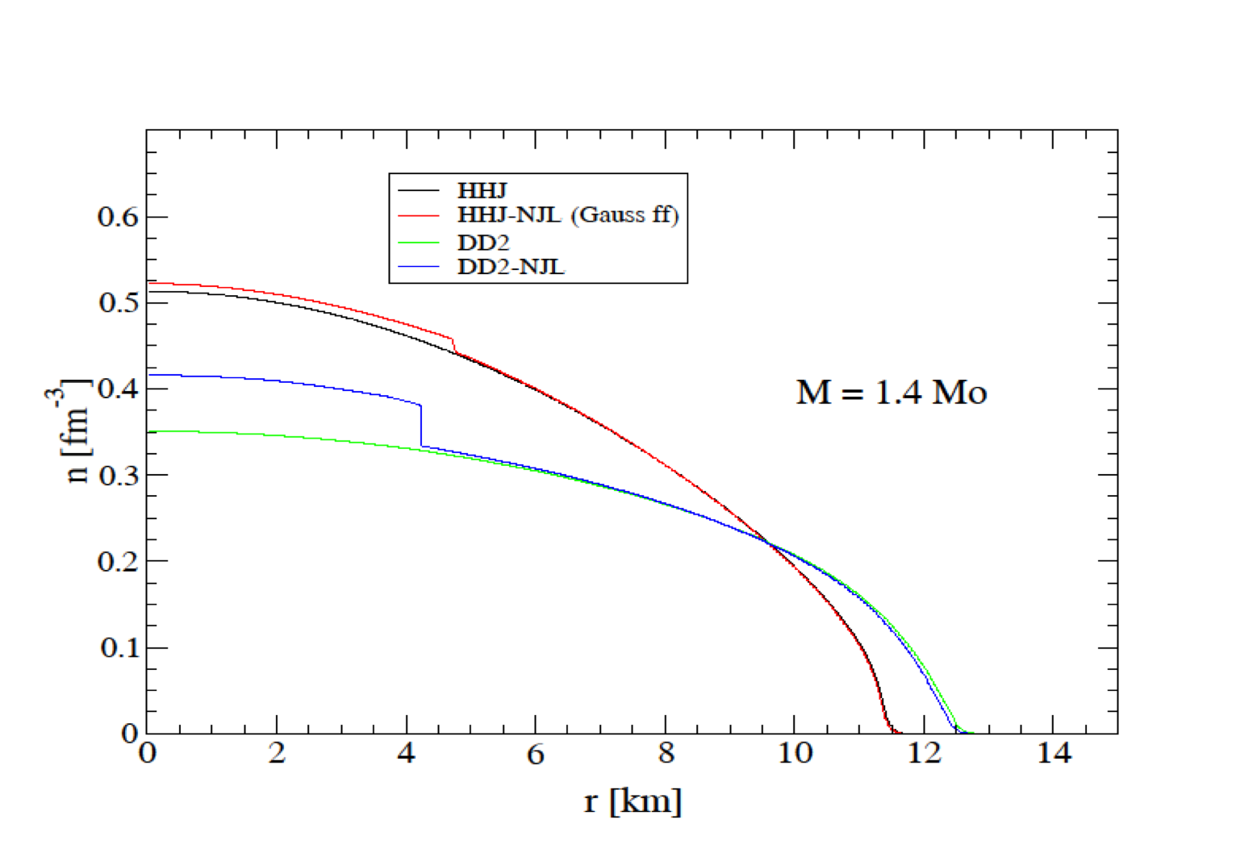
Different Configurations
with the same NS mass

Slide 13
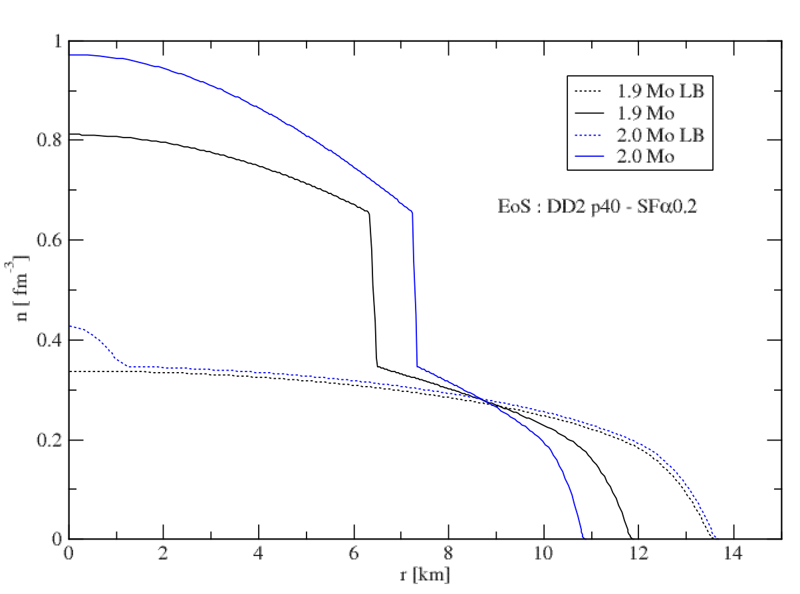
Different Configurations
with the same NS mass

Slide 14
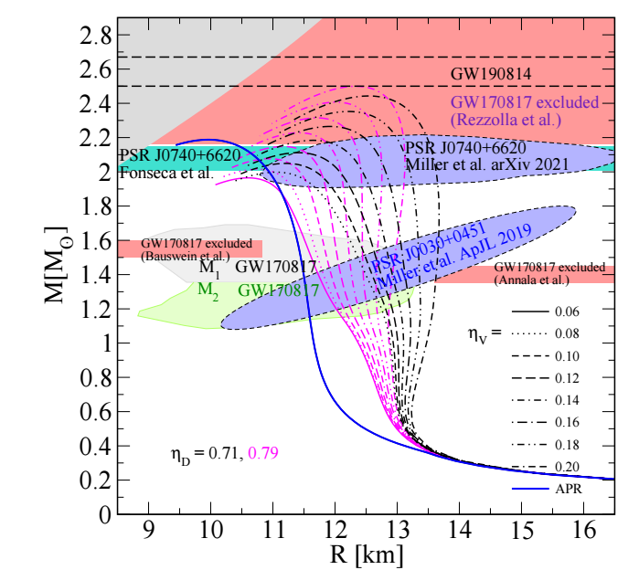
Modern MR Data and Models

Slide 15

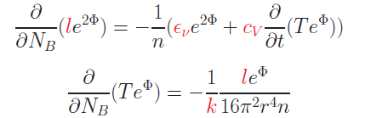

Thermal Evolution
The energy flux per unit time l(r) through a spherical slice at distance r from the center is:
The equations for energy balance and thermal energy transport are:
where n = n(r) is the baryon number density, NB = NB(r) is the total baryon number in the sphere with radius r
F.Weber: Pulsars as Astro Labs. (1999);
D. Blaschke Grigorian, Voskresensky, A& A 368 (2001)561.
Notes:
15

Slide 16
Equations for Cooling Evolution
Notes:
16

Slide 17
Finite difference scheme
Z_i next step
Time direction
Z_i+1
Z_i initial
Z_i-1

Slide 18
Finite difference scheme

Slide 19
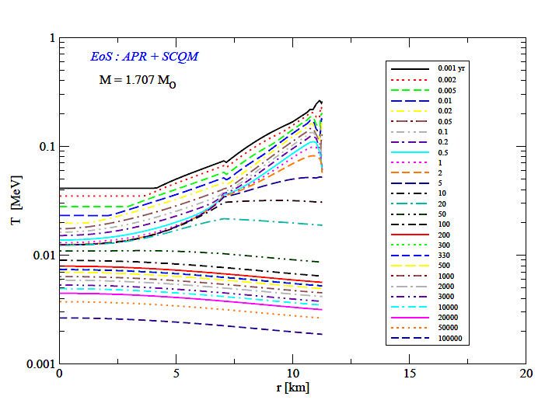
Temperature in the Hybrid Star Interior
Notes:
19

Slide 20
Cas A as an Hadronic Star

Slide 21
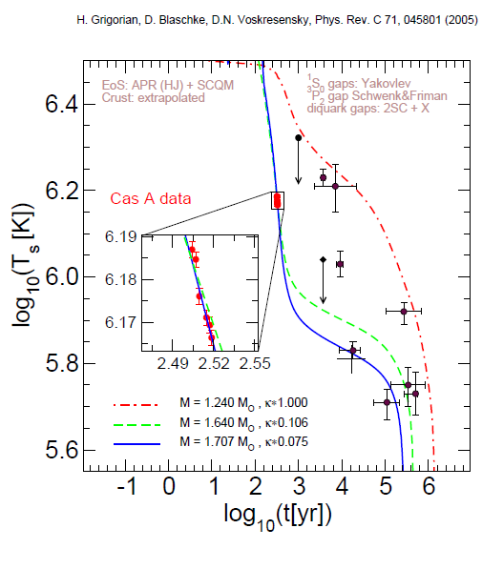
Cas A as an Hybrid Star

Slide 22
Possible internal structure of CasA

Slide 23
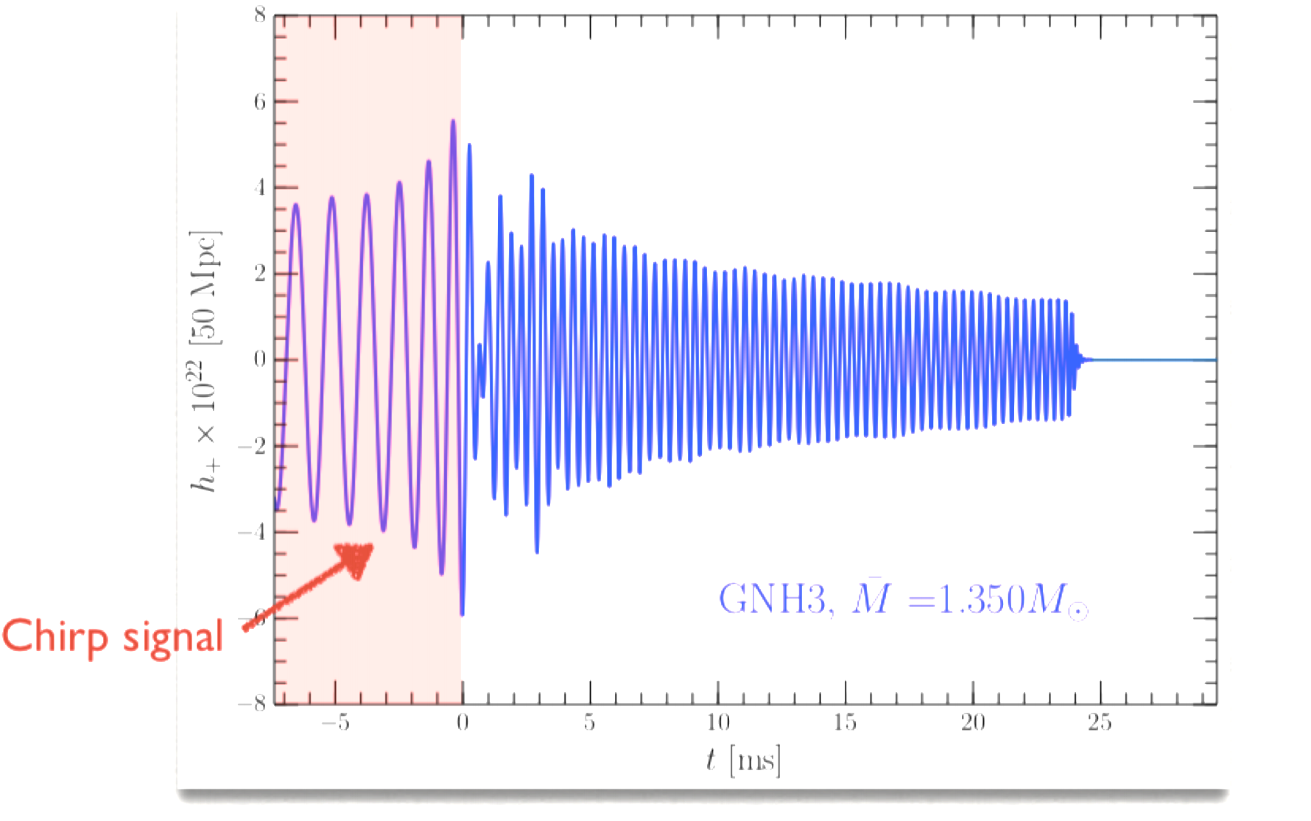
Anatomy of the GW signal

Slide 24
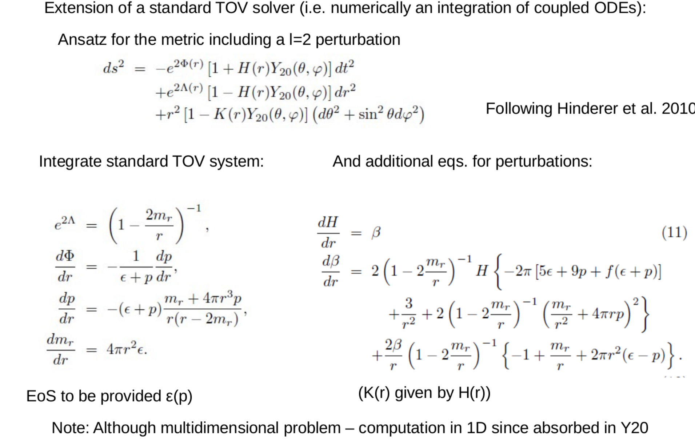
Computing the love number
and tidal deformability

Slide 25
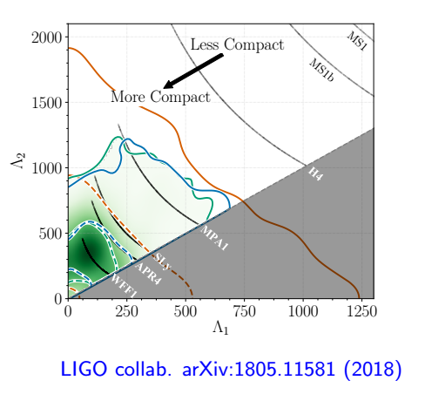
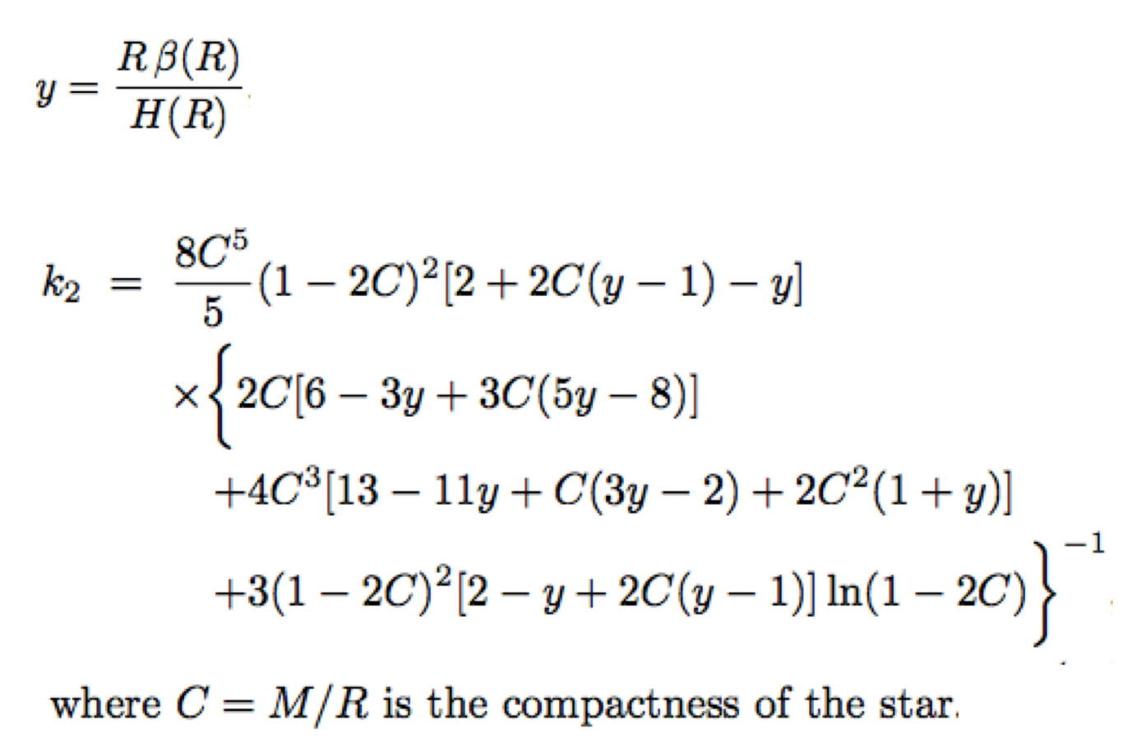
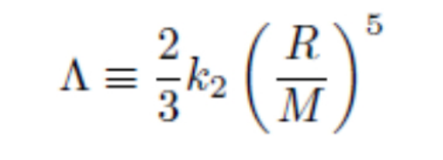
Tidal Deformability

Slide 26
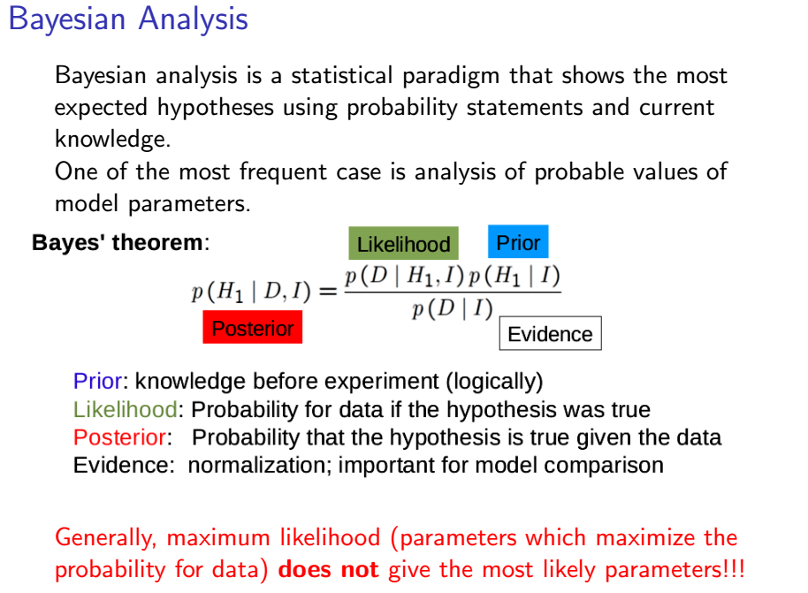
Bayesian Inference

Slide 27
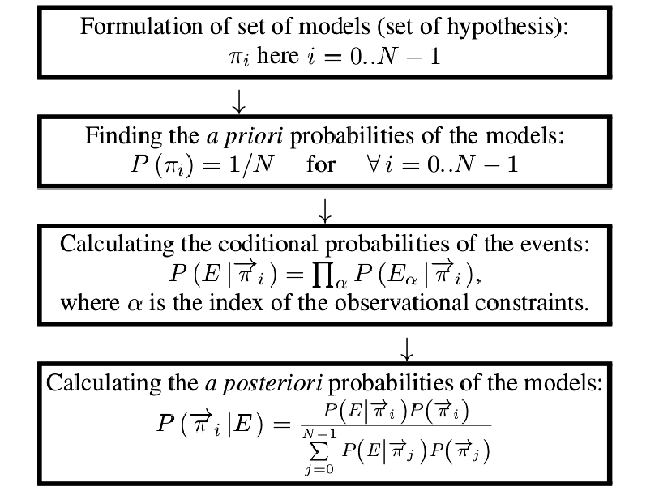
Bayesian Inference for NS

Slide 28
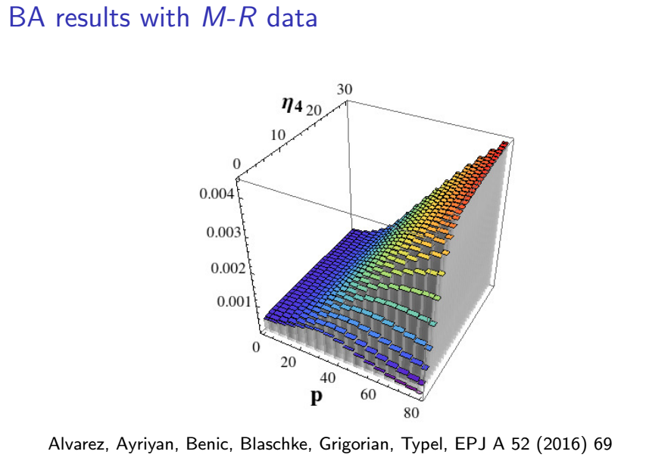
Example of Bayesian Inference Result

Slide 29
Possible Implementation
of Machine Learning
Relation of Description of the stellar matter with Mechanical characteristics of NS
Integration of multidimensional integrals in modeling of EoS of super-dense matter
Comparison with observational data (Bayesian inference )

Slide 30
EoS – MR relation
Image to Image neural Network:
GAN?
U-net?
Another one?

Slide 31
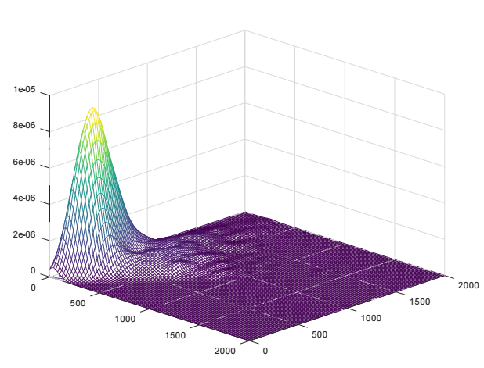

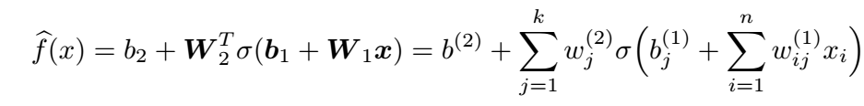
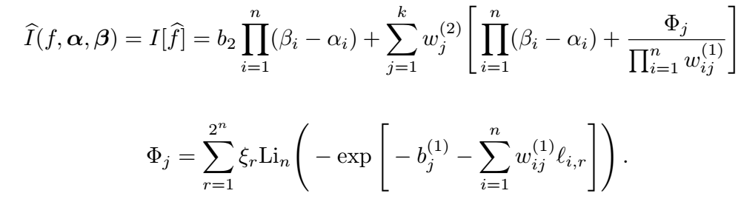
Multidimensional Integration

Slide 32
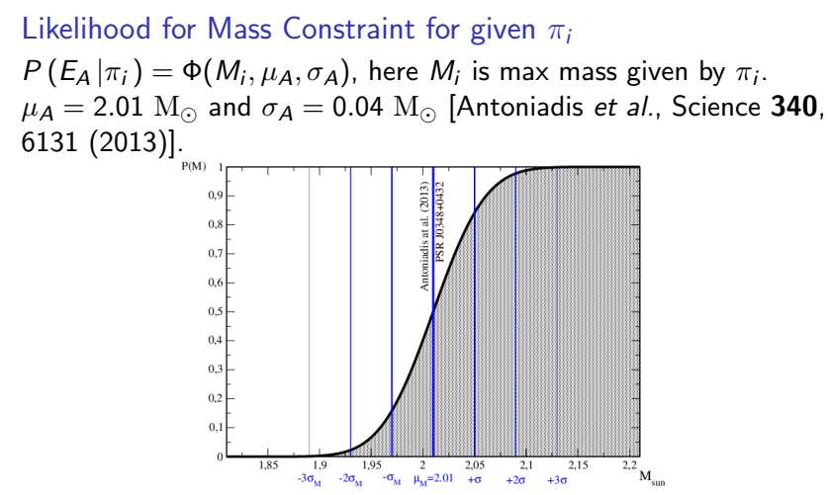
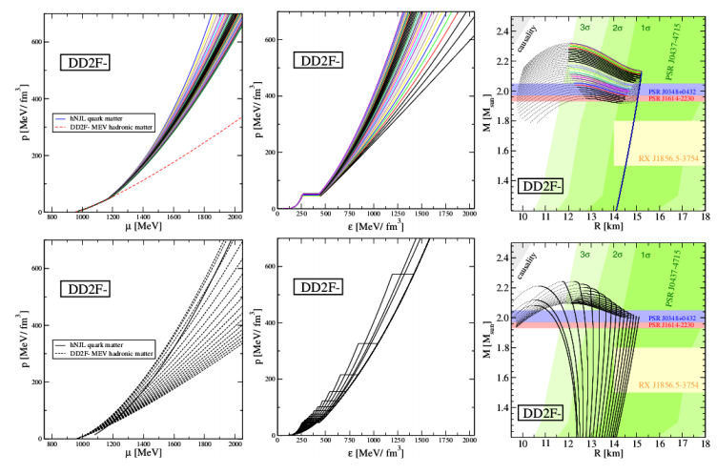
Comparison with Observational Data

Slide 33
