Slide 1
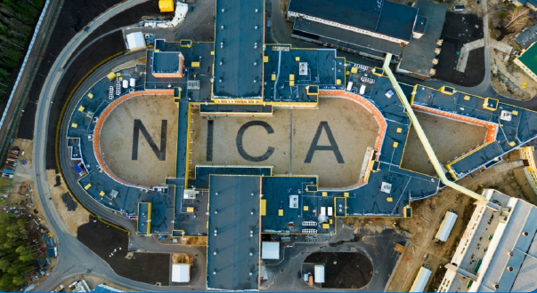
Изучение коллективных потоков и корреляций частиц в экспериментах MPD и BM@N
Аркадий Тараненко (ЛФВЭ ОИЯИ, НИЯУ МИФИ)
Михаил Мамаев , Петр Парфенов (НИЯУ МИФИ)
Осенняя школа по информационным технологиям ОИЯИ,
ЛИТ ОИЯИ, 16-20 Октября 2023
Notes:
1
1
1
1
1
1
1

Slide 2
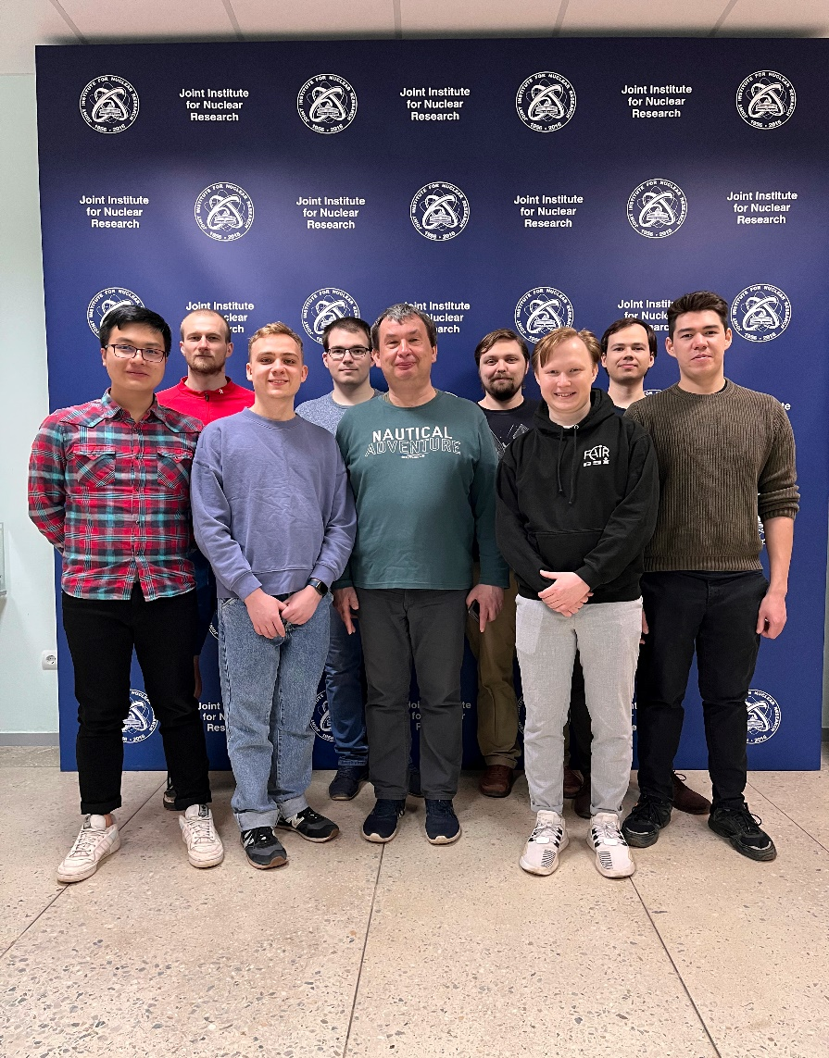
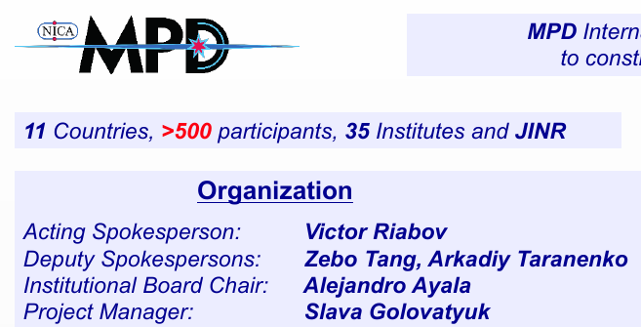
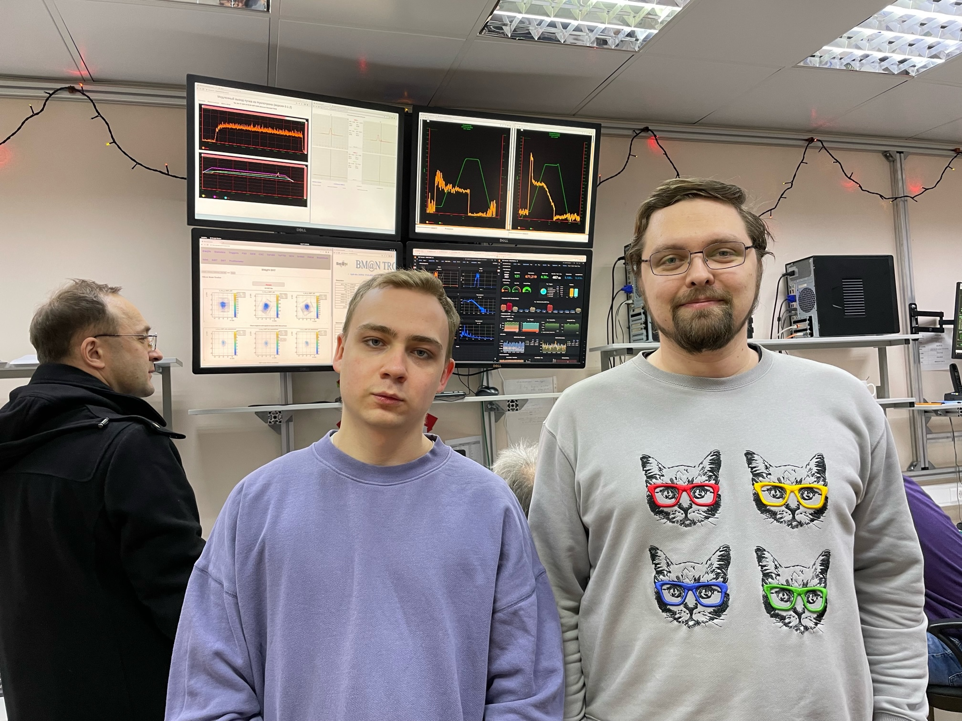
НИЯУ МИФИ в экспериментах MPD и BM@N (2015-…)
Михаил Мамаев Петр Парфенов
Notes:
2
2
2
2
2
2
2

Slide 3
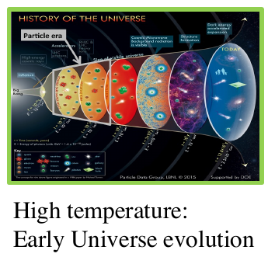
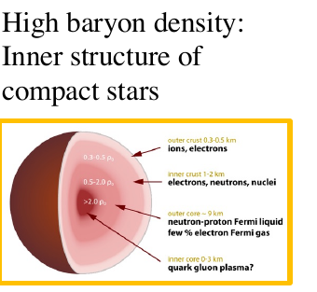
Relativistic Heavy-Ion Collisions and Quark Gluon Plasma (QGP)
It is the primordial form of QCD matter at high temperature or baryon density.
It was present during the first few microseconds of the Big Bang.
It provides an example of phase transitions which may occur at a variety of higher temperature scales in the early universe.
It can provide important insights on the origin of mass for matter, and how quarks are confined into hadrons.
M. Gyulassy, Nucl. Phys. A750, 30-63, 2005

Slide 4
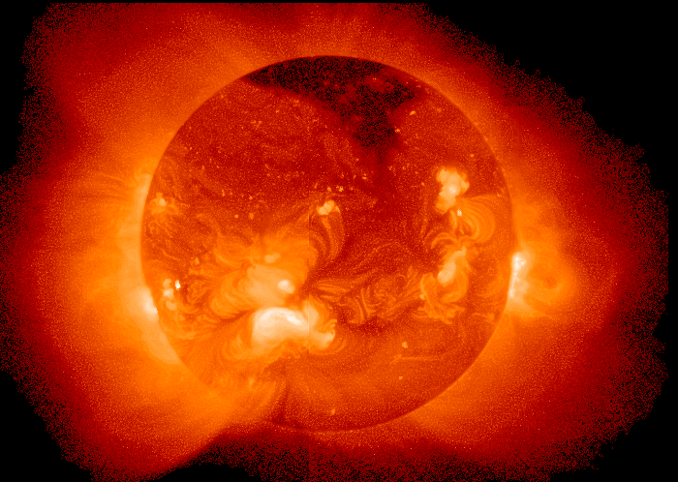
Temperature at the centre of the Sun ~ 15 000 000 K
A medium of 150-170 MeV is more than 100 000 times hotter !!!

Slide 5
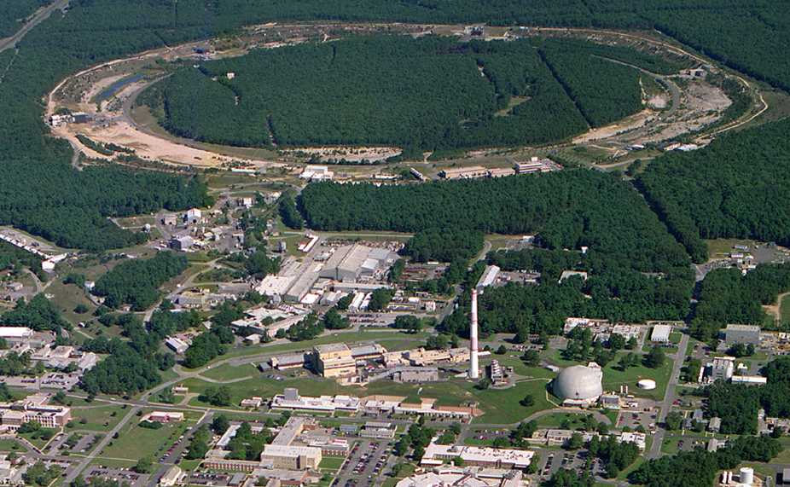
2005: Quark-Gluon Plasma is a “perfect liquid” Relativistic Heavy-Ion Collider (BNL), Upton, NY (USA)
PHOBOS
BRAHMS
RHIC
PHENIX
STAR
v = 0.99995⋅c = 186,000 miles/sec
Au + Au at 200 GeV
AGS
TANDEMS

Slide 6
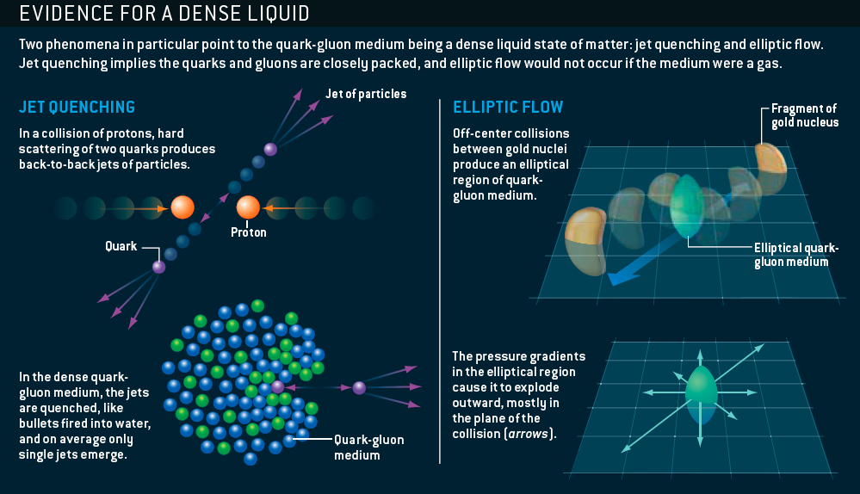
The sQGP Discovered at RHIC: 2005
M. Roirdan and W. Zajc, Scientific American, May 2006

Slide 7
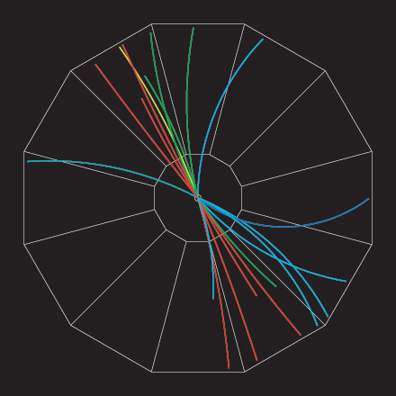
Эффект гашения струй (Jet quenching)
p+p jet event (струя адронов)
Analyze by measuring (azimuthal) angle between pairs of particles
Number of pairs
0º
180º
Угол между двумя частицами
В ядро-ядерных столкновениях мы видим только одну струю адронов
Jet quenching! Эффект гашения струй
q
q

Slide 8
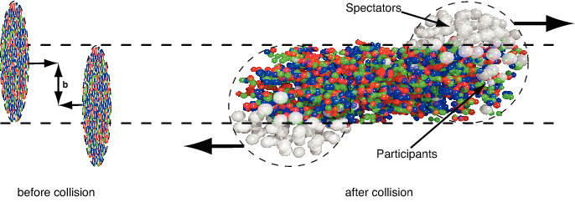
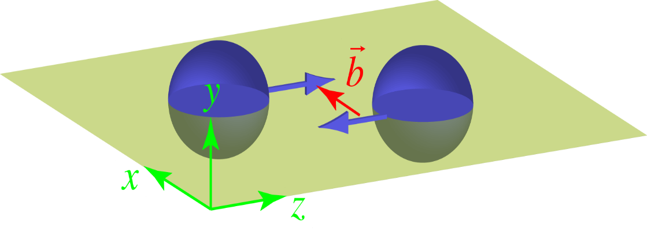
Геометрия ядро-ядерных столкновений
y
φ=Φ-Ψ_{R}
ψ_{R}
x
Reaction plane (плоскость реакции)

Slide 9
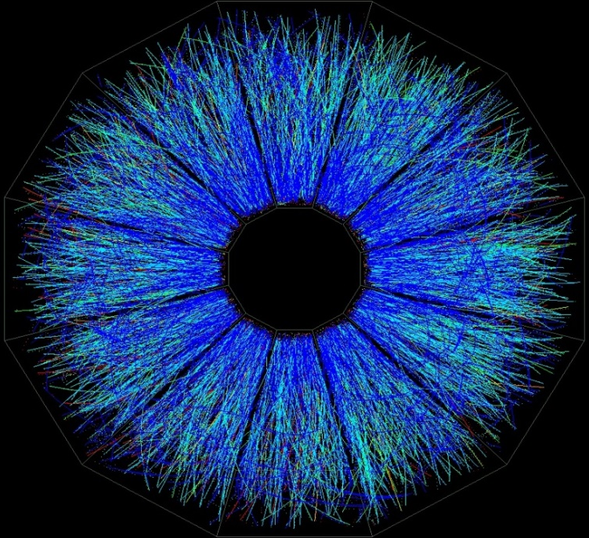
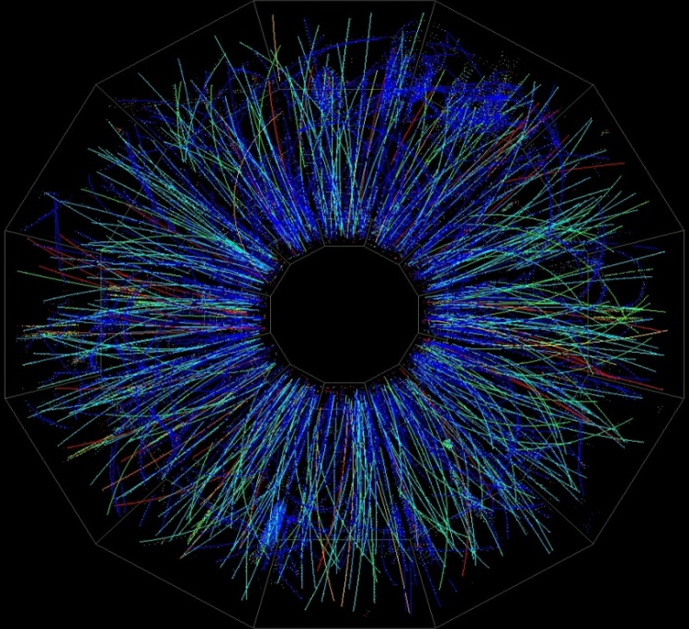
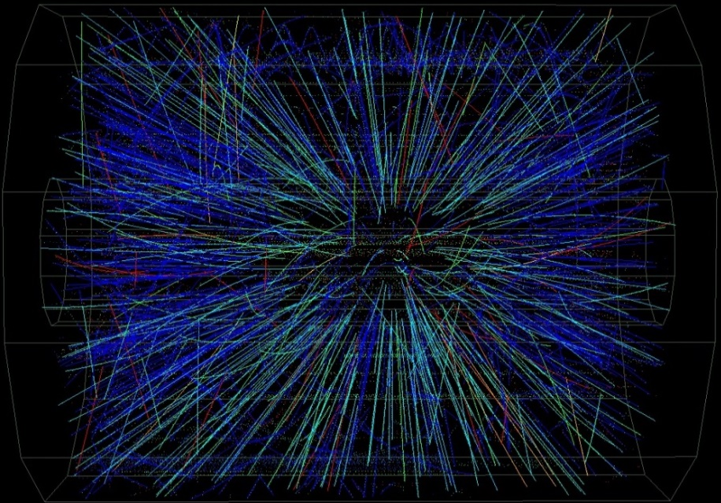
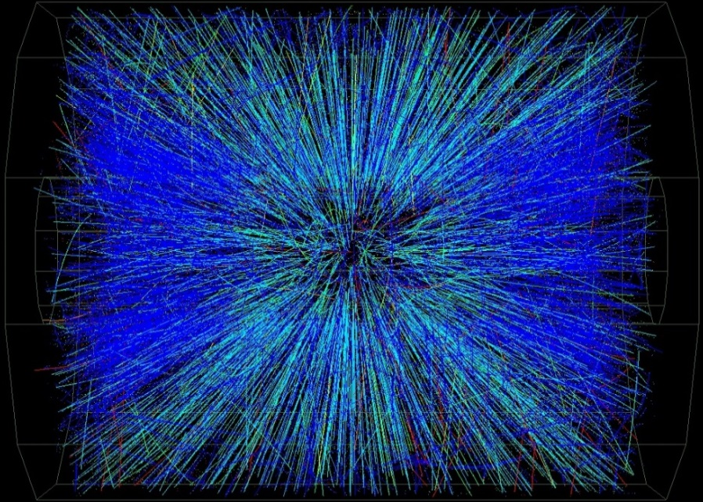
Impact parameter ( Прицельный параметр)
b = 0 → “central collision”
many particles produced
“peripheral collision”
fewer particles produced
Notes:
Before discussing dynamics of RHI, need to introduce nontrivial geometric concept **special to RHI** (not in particle physics, usually)
When WE see high multiplicity, we think of large **geometric** overlap; Glauber models: it overwhelms multiplicity fluctuations in pp from hard/soft

Slide 10
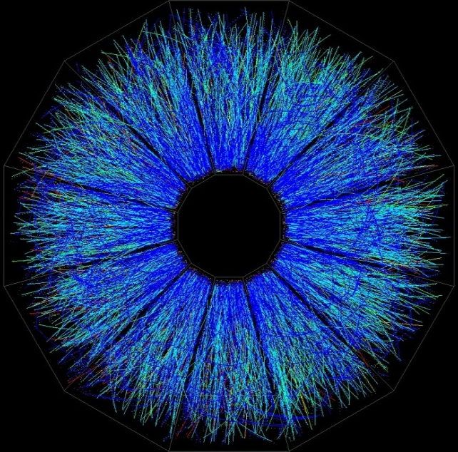
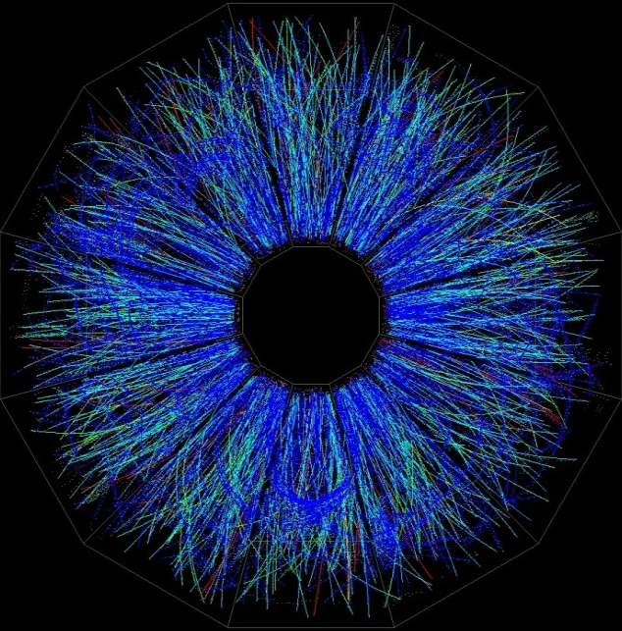
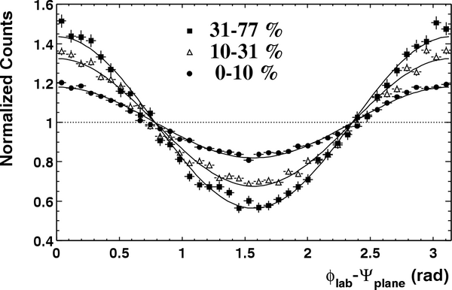
Azimuthal distributions at RHIC
b ≈ 6.5 fm
b ≈ 4 fm
“central” collisions
STAR, PRL90 032301 (2003)
midcentral collisions

Slide 11
Azimuthal distributions at RHIC
b ≈ 10 fm
b ≈ 6.5 fm
b ≈ 4 fm
peripheral collisions

Slide 12
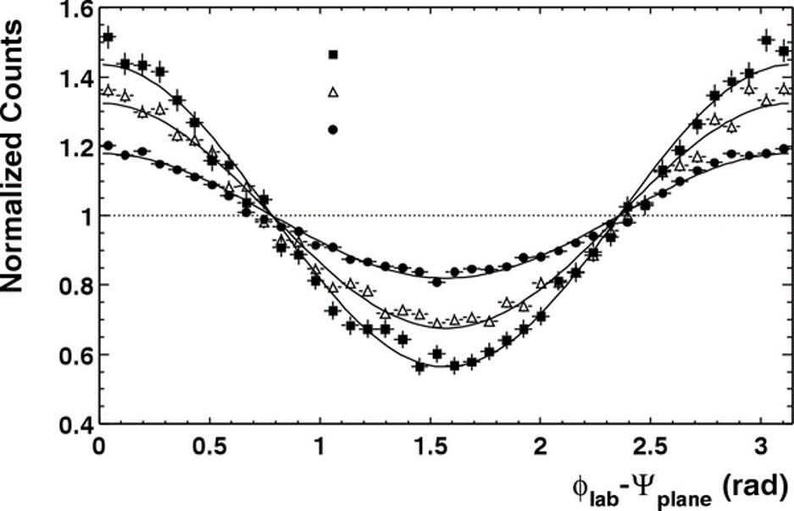
Azimuthal anisotropy of particles at HIC
y
Ф=φ-Ψ_{RP}
STAR, PRL90 032301 (2003)
b ≈ 10 fm
ψ_{RP}
b ≈ 6.5 fm
b ≈ 4 fm
x
4*v₂
b
Sergei Voloshin, Y. Zhang, Z. Phys. C70,(1996), 665
The sinus terms are skipped by symmetry arguments
From the properties of Fourier’s series one has
Fourier coefficients V_{n} quantify anisotropic flow:
v₁ is directed flow, v₂ is elliptic flow, v₃ is triangular flow, etc.
Term “flow” does not mean necessarily “hydro” flow – used only to emphasize the collective behavior of particles in event or multiparticle azimuthal correlation

Slide 13
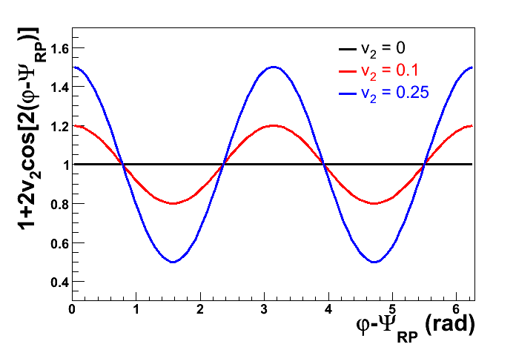
Elliptic Flow V₂
v₂ ≠ 0 - difference between the (||)[N(0⁰) + N(180⁰)] and
(⊥) [N(90⁰) + N(270⁰)] to
the impact parameter (b)
V₂= 0.25 → R_{in/out} = 3 ( 3 times more particles emitted in-plane than
out-of- the plane )
the impact
parameter
IN PLANE
v₂ > 0 → in-plane flow,
v₂ < 0 out-of-plane flow
OUT OF PLANE

Slide 14
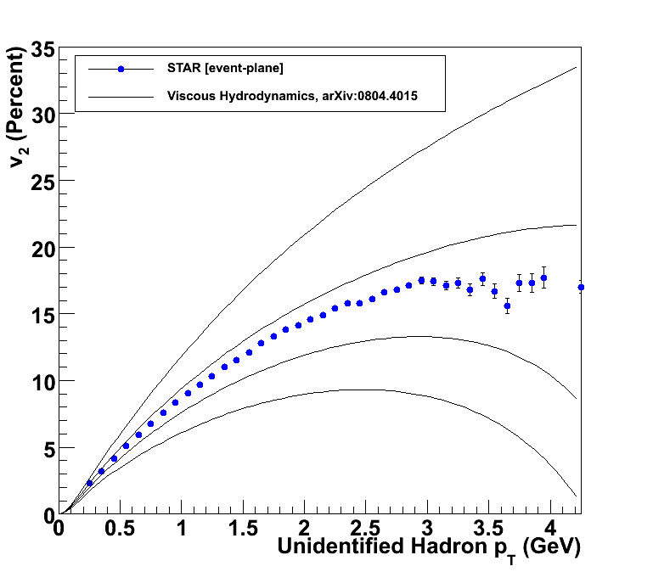
Relativistic viscous hydrodynamics compared to data
Luzum, Romatschke, Phys. Rev. C78, 034915 (2008)
η/s ~ 0
Lower Viscosity
↓
Less Dissipation
↓
More Flow
↓
Larger v₂
η/s = 1/4π
η/s = 2 x 1/4π
η/s = 3 x 1/4π

Slide 15
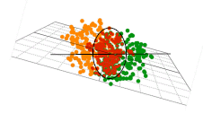
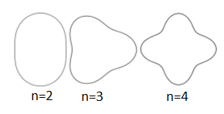
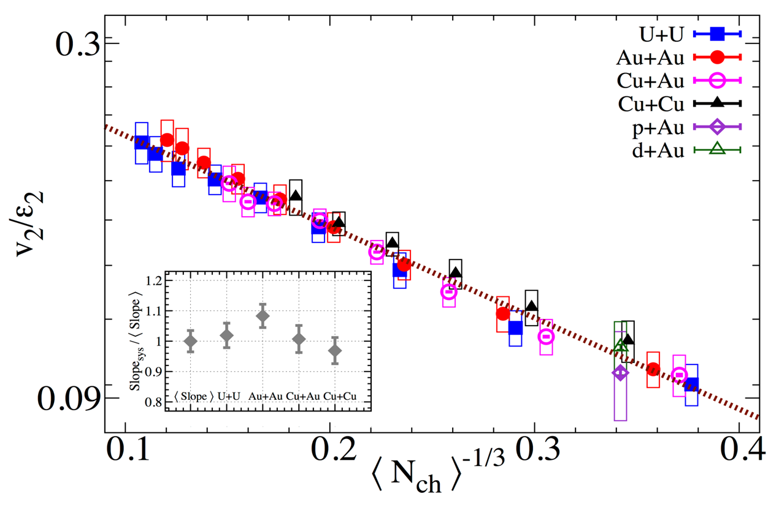
Anisotropic Flow at RHIC-LHC
Gale, Jeon, et al., Phys. Rev. Lett. 110, 012302
Phys. Rev. Lett. 122 (2019) 172301

Slide 16
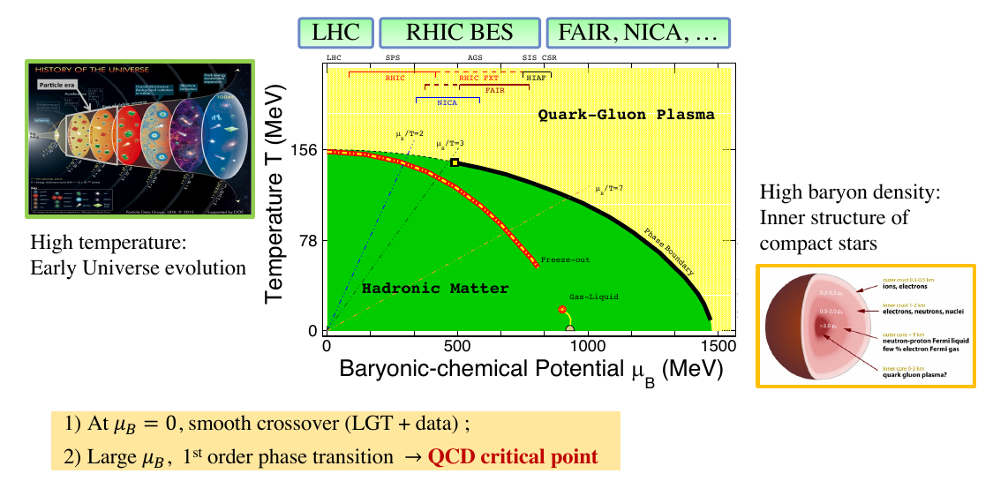
Relativistic Heavy-Ion Collisions and QCD Phase Diagram

Slide 17
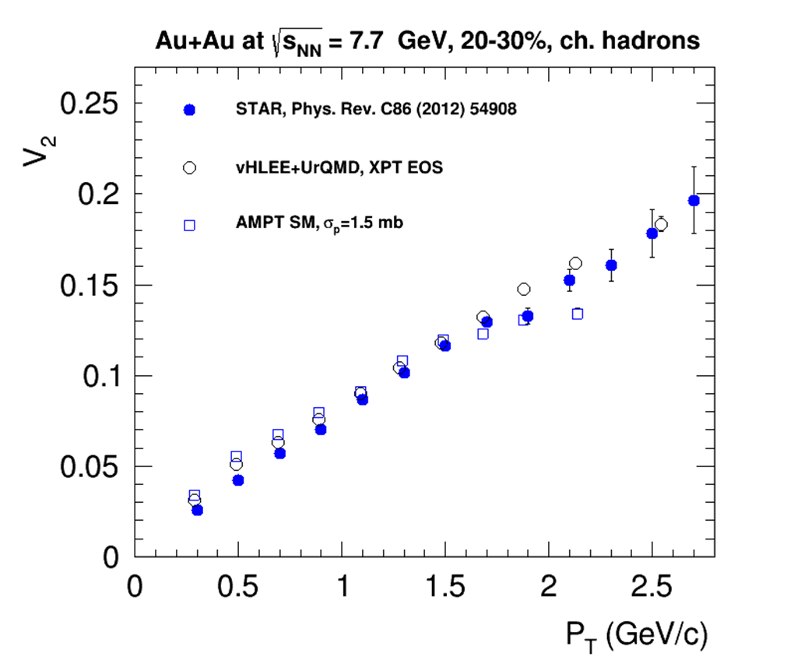
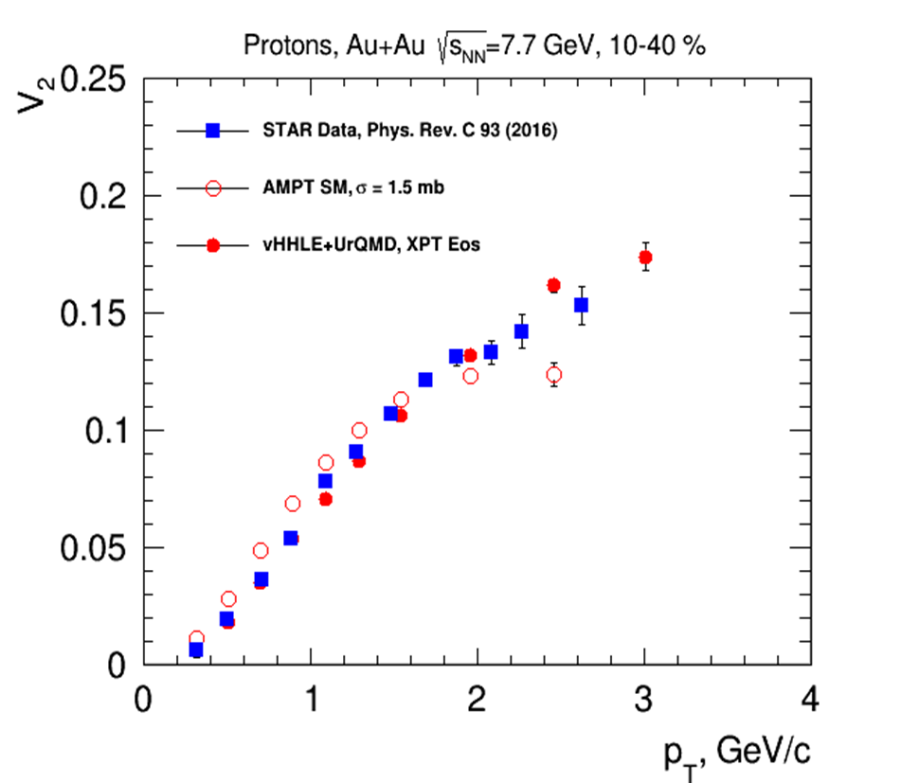
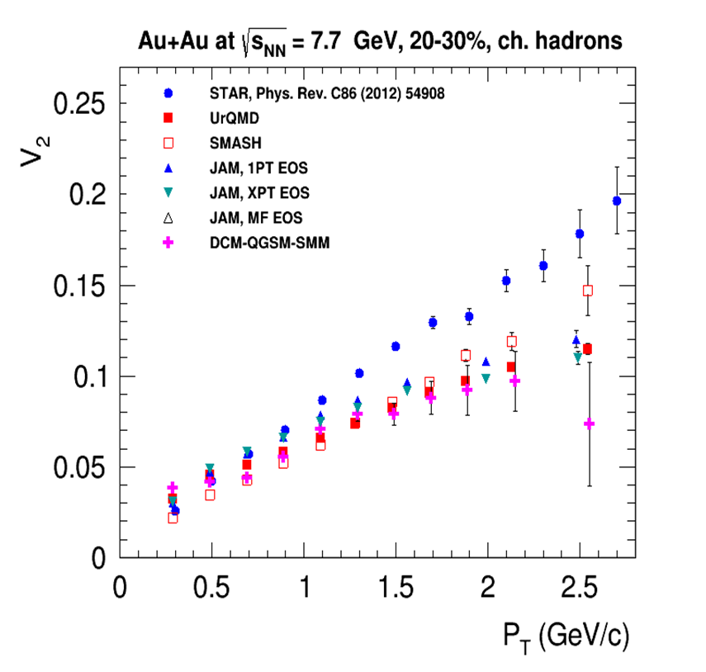
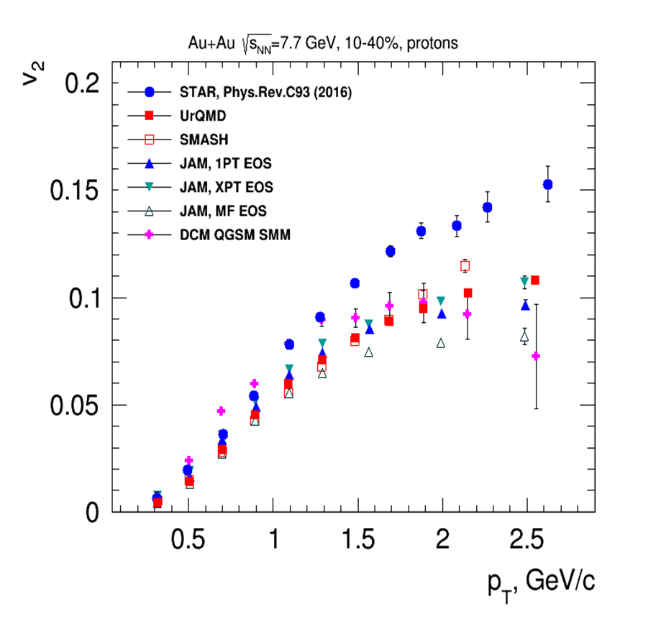
Elliptic Flow (v₂) at NICA energies: Models vs Data
at √s_{NN} ≥ 7.7 GeV pure string/hadronic cascade models underestimate v₂ – need hybrid models with QGP phase (vHLLE+UrQMD, AMPT with string melting,…)

Slide 18
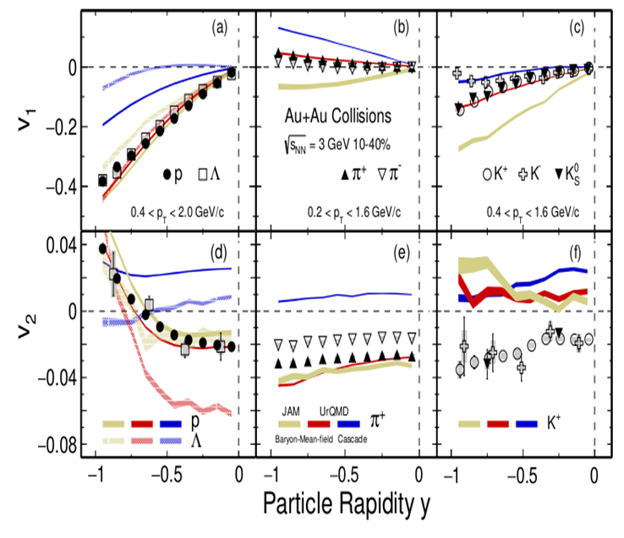
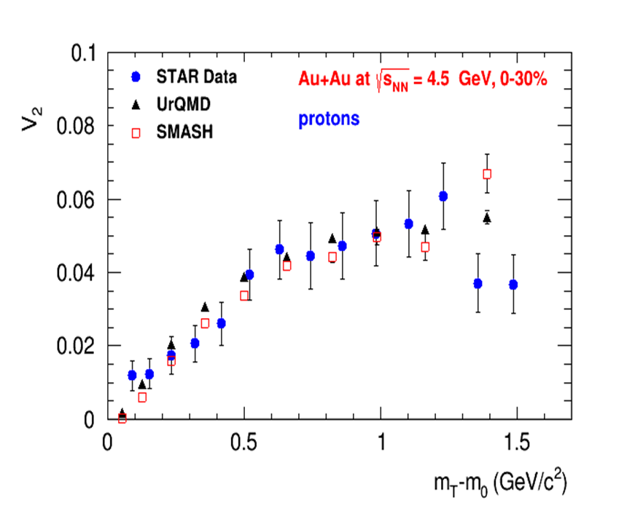
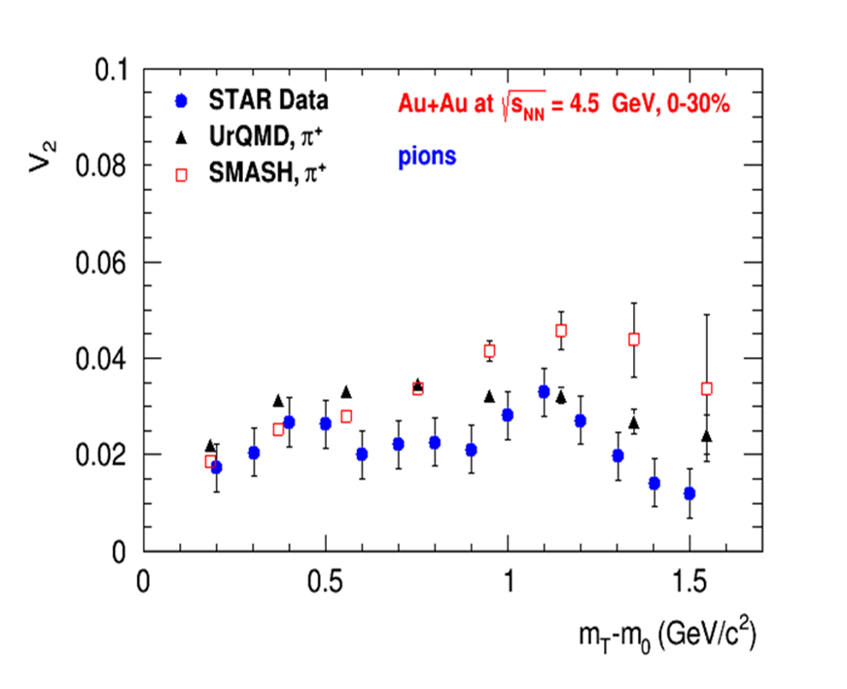
Anisotropic Flow at Nuclotron/NICA energies: Models vs Data
Phys.Rev.C 103 (2021) 3, 034908
at √s_{NN} ≥ 3-4.5 GeV pure hadronic models give similar v₂ signal compared to STAR data

Slide 19
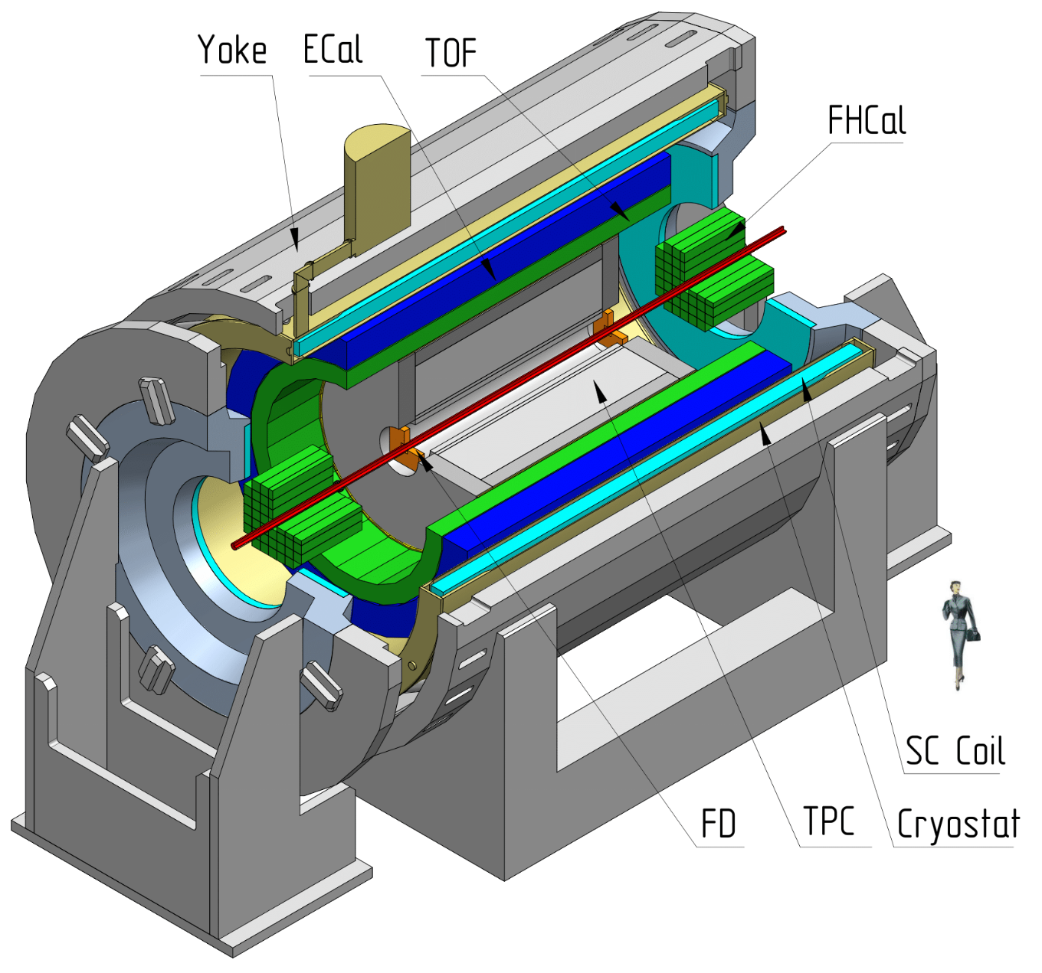
MPD Experiment at NICA
Bi+Bi: 50M at √s_{NN} = 9.2 GeV (prod. 25)
Centrality determination: Bayesian inversion method and MC-Glauber
Event plane determination: TPC, FHCal
Track selection:
Primary tracks
N_{TPC hits} ≥ 16
0.2 < p_{T} < 3.0 GeV/c
|η| < 1.5
PID – ToF + dE/dx
Multi-Purpose Detector (MPD) Stage 1
See Peter Parfenov presentation at MPD Collaboration meeting

Slide 20
Performance of v_{1,2} of identified hadrons in MPD
UrQMD, Bi+Bi, $\sqrt{s_{NN}}$=9.2, 10-40%, reconstructed (GEANT4) – production 25
Reconstructed and generated $v_{1,2}$ of identified hadrons have a good agreement for all methods

Slide 22
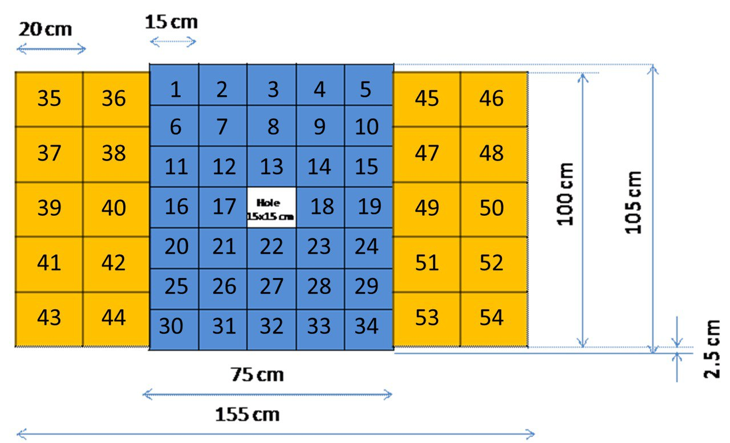
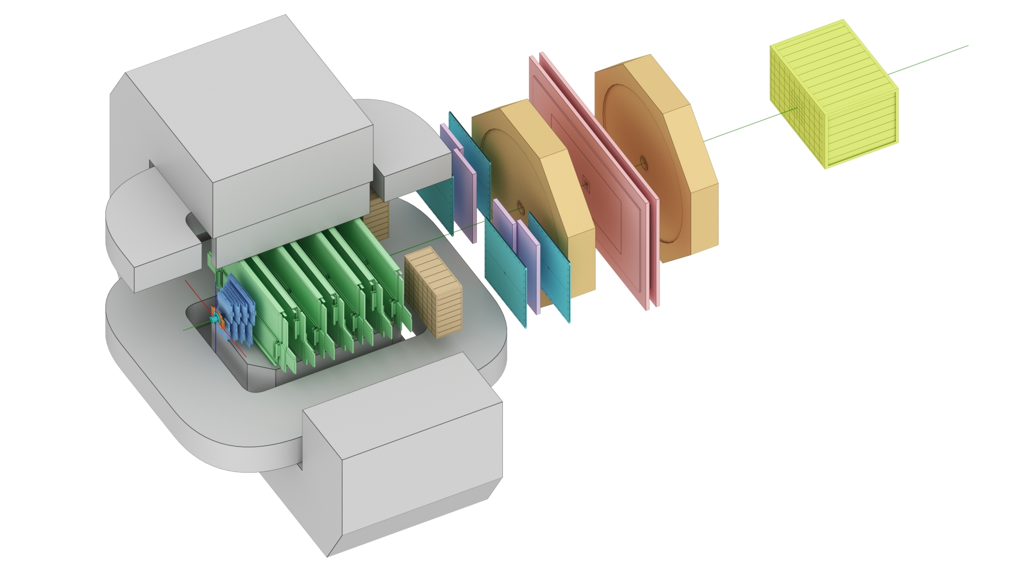
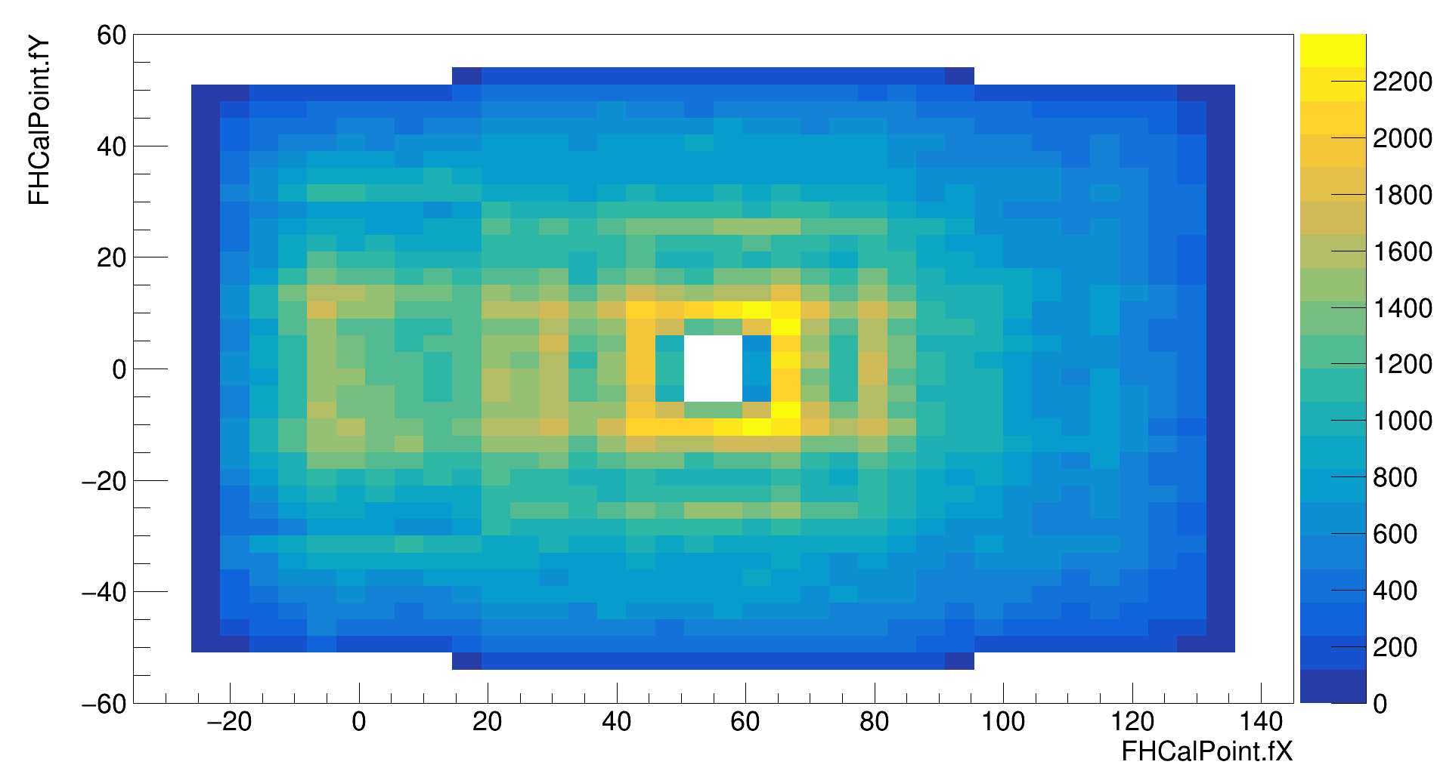
The BM@N experiment
Xe+CsI at E_{kin}=3.8A GeV
First physical run
FHCal
Silicon + GEM
TOF-700
neutron
x=0
ion
proton
TOF-400
Symmetry plane estimation with the azimuthal asymmetry of projectile spector energy
Tracking system within the magnetic field
Notes:
Схема эксперимента хадес на слайде.
Траектории рожденных частиц регистристрируются трекинговой системой, состоящей из …
Импульс восстанавливается по отклонению частиц в магнитном поле
Идентификация производится при помощи детекторов времени пролета … которые регистрируют время пролета. Зная длину траектории можно вычислить массу частицы.
Спектаторы регистрируются детектором FW. Поскольку они отклоняются в плоскости реакции материей в области перекрытия, спектаторы используются для оценки угла плоскости реакции.
Всего столько статистики ...

Slide 23
Flow vectors
y
u
For each particle:
х
Q
where φ is the azimuthal angle
Symmetry-plane vector Q_{n}
u
u
F3
Q{F2}
Q{F3}
F2
F1
Q{F1}
Ψ_{n}^{EP} is the event plane angle
Notes:
Let’s introduce flow vectors. Every particle in event represent as un vector in transverse plane, where phi is azimuthal angle of particle’s momentum. Summation over this un-vectors results with Qn vector, which is directed to symmetry plane of the event. This plane is called Event plane, and the transverse angle of this plane is called event plane angle relatively.

Slide 24
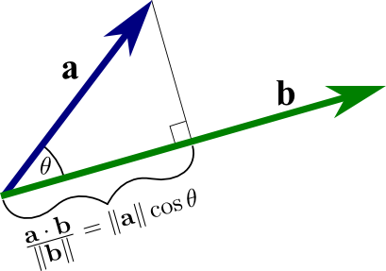
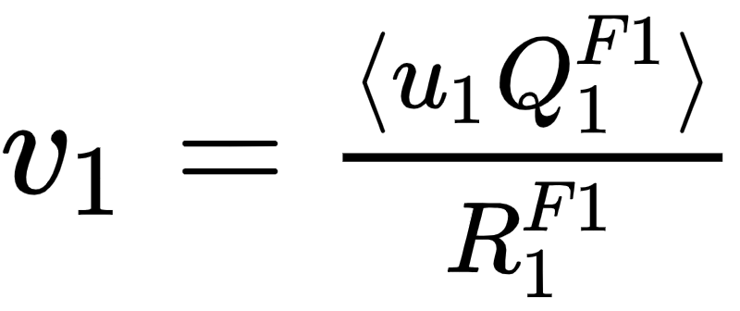
Analysis procedure
40 millions of Xe+Cs(I) collisions
u
Q
Event selection procedure
Estimating the particle vectors
Estimating the symmetry plane of the event
v₁{ev}
Correcting the detector anisotropy
Correcting the detector anisotropy
Estimating the correlation
Physical observable
v₁ is average scalar product of u and Q-vectors

Slide 25
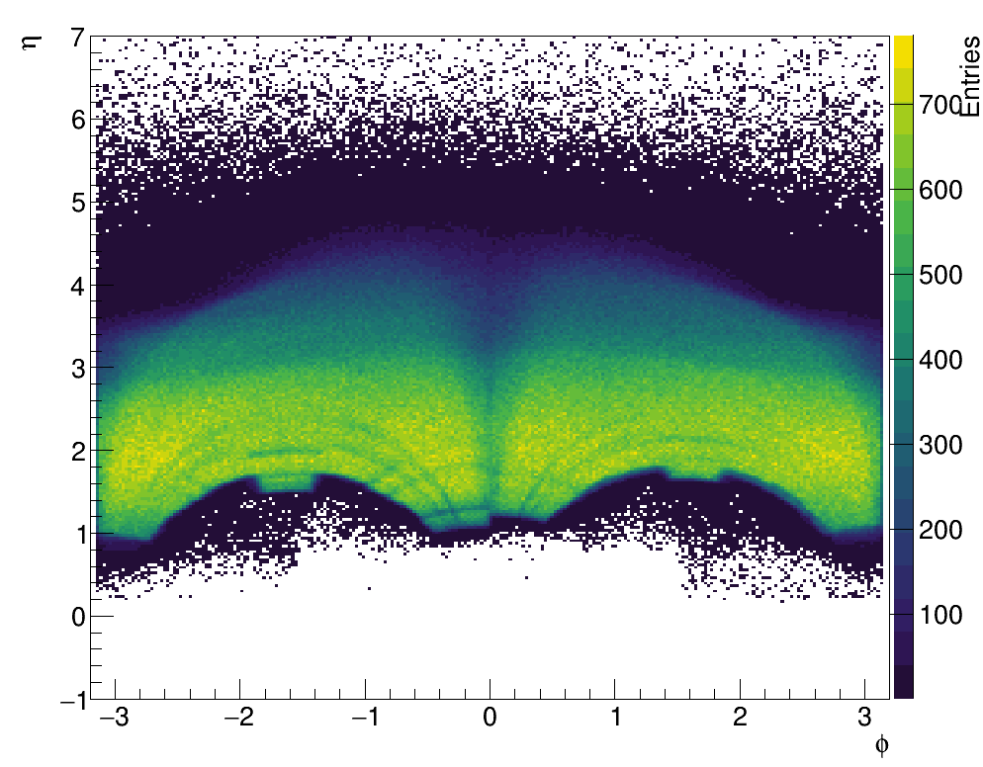
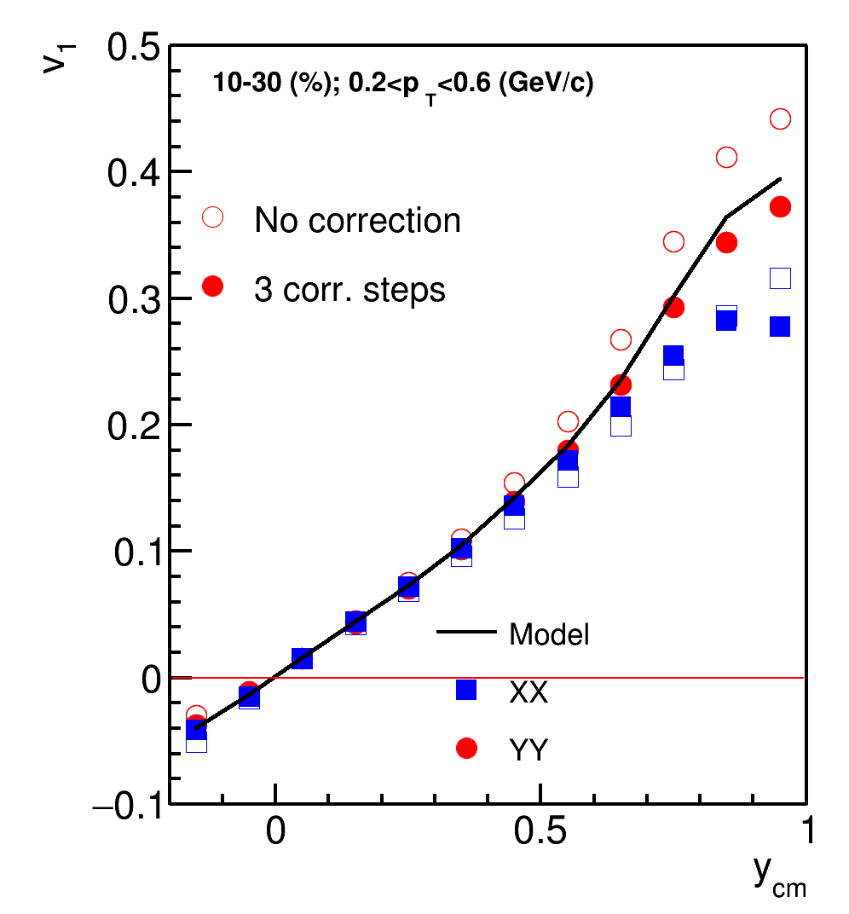
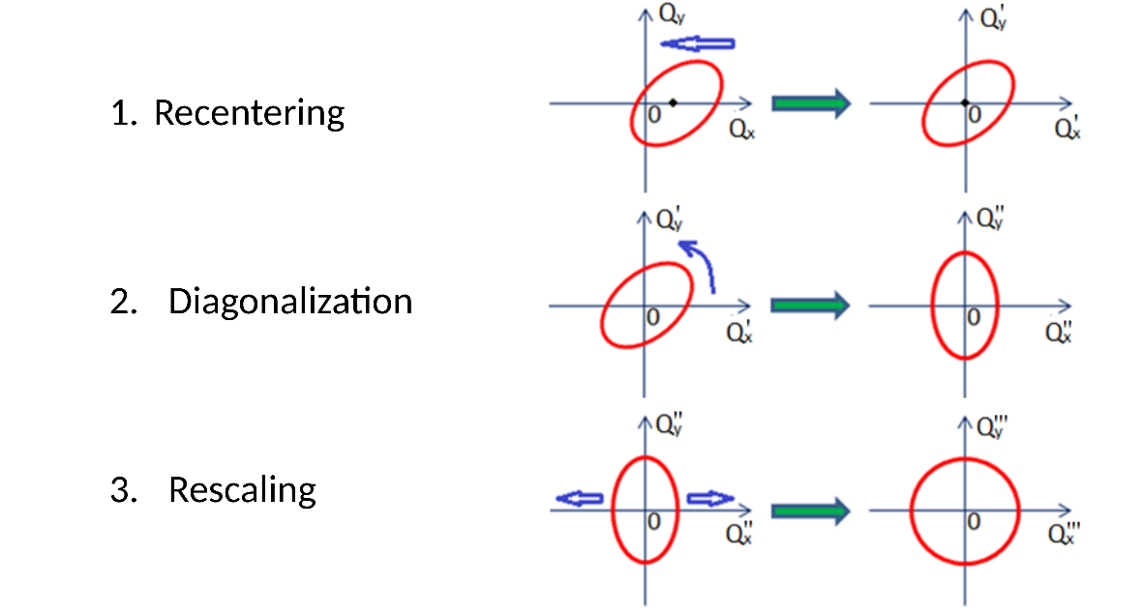
Azimuthal asymmetry of the BM@N acceptance
φ-η yield of protons
Corrections are based on method in: I. Selyuzhenkov and S. Voloshin PRC77, 034904 (2008)
Required corrections to reduce effects of non-uniform azimuthal acceptance
2. Twist
Particles, 2023, 6(2), pp. 622–637
Better agreement after applying corrections
Notes:
The phi-rapidity distribution of protons is represented on the left of the slide. As you can notice, distribution along phi is not flat due to sector-based construction of tracking system. That is why, corrections on azimuthal non-uniformity is required. The effects of non-uniform distributions and corrections of the effects are described in the work of Ilya Selyuzhenkov and Sergey Voloshin. The corrections are recentring, twist and rescaling. They are schematically represented on the slide

Slide 26
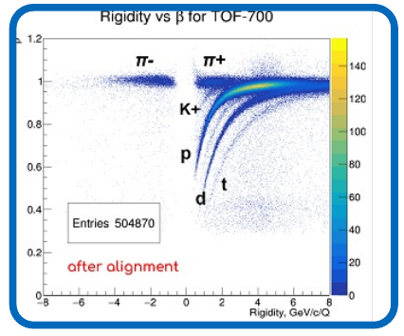
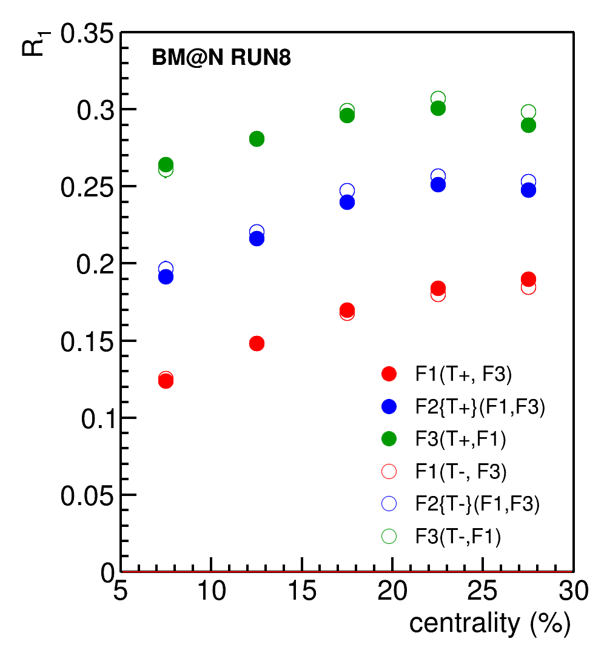
BM@N (Baryonic Matter @ Nuclotron)
December 2022 – February 2023: first physics run with Xe+Cs(I) (3.0 AGeV (50 M events) и 3.8 AGeV (500 M events))

Slide 27
Проекты
Изучение возможности измерения потоков легких адронов в эксперименте BM@N
Изучение возможности измерения потоков лёгких ядер в эксперименте BM@N
Изучение эффективности детектирующих способностей установки MPD в режиме работы с фиксированной мишенью для измерения анизотропных потоков заряженных адронов.
Requirements:
Your personal interest in the research field
C++ and ROOT
Git
LINUX

Slide 28
Backup slides
28
Notes:
28
28
28
28
28
28
28
28

Slide 29
Collective Flow in Heavy-Ion Collisions: Summary
Anisotropic Collective Flow is an important experimental observable to study the evolution of heavy-ion collision and properties of the strongly interacting matter.
It provides access to:
Equation of State of the produced matter
Transport properties: shear/bulk viscosity, speed of sound
Initial conditions in heavy-ion collisions
Mechanism of hadronization
Origin of the correlations between produced particles
Feasibility study: MPD/MPD FXT/BM@N: will provide the detailed differential measurements of anisotropic collective flow with high efﬁciency.
29
Notes:
29
29
29
29
29
29
29
29

Slide 30
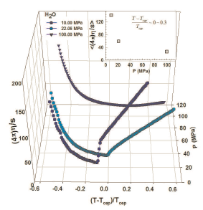
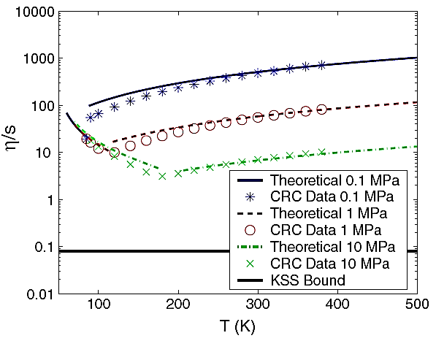
Possible signals for the CEP
Lacey et. al,
Phys. Rev.Lett. 98 (2007) 092301
arXiv:0708.3512 (2008)
Csernai et. al,
Phys.Rev.Lett. 97 (2006) 152303
A. Dobado et. al,
Phys. Rev. D 79, 014002 (2009)
H₂O
Argon
At the CEP or close to it, anomalies in the dynamic properties of the medium can drive abrupt changes in transport coeﬃcients
Anisotropic flow (v_{n}) measurements are an invaluable probe

Slide 31
0.04
(a)
STAR Preliminary
Au+Au
0-40%
v₂/2
(b)
n = 3
0.3
v₃ v₄
STAR Preliminary
0.03
_{β}′ ′
0.2
v_{n}
0.02
0.01
0
0.1
10
100
10 100
√s_{NN}[GeV]
√s_{NN}[GeV]
V_{n} shows a monotonic increase with beam energy. The viscous coefficient, which encodes the transport coefficient (𝜼/𝒔), indicates a non-monotonic behavior as a function of beam energy.

