Slide 1
58th meeting of the PAC for Condensed Matter Physics
January 25-26th 2024
M.V. Bulavin
Status of the new advanced neutron source’s project at JINR
Project is realized within the framework of the
LIP 04-4-1149-2024/2028 Pulsed Neutron Source and Complex of Spectrometers (Leader – E.V. Lychagin);
Project of the LIP – «NEW ADVANCED NEUTRON SOURCE IN JINR»;
Subproject of the LIP - R&D for the justification of the development of a draft design project of a new advanced neutron source at JINR - the NEPTUN fast pulse reactor
Project leaders: E.V. Lychagin, V.N. Shvetsov, M.V. Bulavin

Slide 2
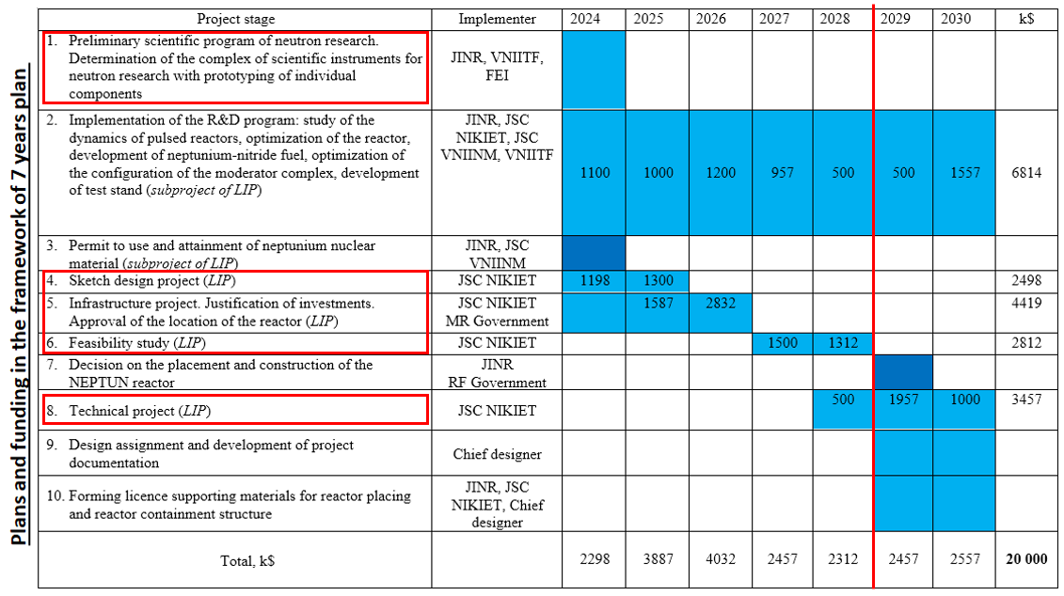
Structure of the project
LARGE INFRASTRUCTURE PROJECT 04-4-1149-2024/2028 Pulsed Neutron Source and Complex of Spectrometers
(Leader – E.V. Lychagin)
Project of the LARGE INFRASTRUCTURE PROJECT
New Advanced Neutron Source in JINR
(Leaders –E.V. Lychagin, V.N. Shvetsov, M.V. Bulavin)
Main goal is development of a new high intensity advanced neutron source – fast pulse reactor, that will replace IBR-2
Subproject of the LARGE INFRASTRUCTURE PROJECT
R&D for the justification of the development of a draft design project of a new advanced neutron source at JINR - the NEPTUN fast pulse reactor
(Leaders –E.V. Lychagin, V.N. Shvetsov, M.V. Bulavin)
Main goal is R&D work to justification of the development of a draft design project of the NEPTUNE fast pulse reactor (12-15 MW)
Notes:
Прямо сейчас мы не можем начать дизайн проект поскольку есть перечень работ НИОКР, которые мы должны выполнить перед началом дизайн проекта

Slide 3
The sequence and content of work on the preparation of a decision on the placement and construction of a research nuclear power plant (resolution of the Government of the Russian Federation №306)
DRAFT DESIGN
(NIKIET)
INFRASTRUCTURE DESIGN
(NIKIET)
Technical Project
(NIKIET)
Justification of Investments
(NIKIET)
Approval of Justification of Investments
MR government, Rosatom, ministries (expertise and conclusions)
Feasibility Study (NIKIET
Approval of Feasibility Study
(RF Government)
Petition of Intent to Create
(JINR)
Approval of Petition of Intent (MR government, Rosatom)
Deciding on the creation
JINR Directorate
Federal Target Program
Or
Order of the RF Government
License for placement and creation
Notes:
Базовым документом проекта реактора НЕПТУН на данном этапе является ЭП. На основе ЭП+ОП разрабатывается ОБИН. На основании этих трех документов, которые содержат информацию о целях, источниках и возможностях инвестирования, вариантах местоположения, сроках строительства и ввода объекта в эксплуатацию, технико-экономических показателях, радиационной и экологической безопасности объекта, Дирекция ОИЯИ принимает решение о сооружении реактора в Дубне, готовит Ходатайство о намерениях и отправляет его в Росатом и правительство МО.
При положительном рассмотрении ходатайства ОИЯИ направляет разработанный ОБИН, с приложениями необходимых материалов согласований и решением о предварительном месте размещения объекта, соответствующих коммуникаций, а также при необходимости его санитарной (охранной) зоны в: Правительство Московской области для оформления и утверждения акта выбора земельного участка в соответствии с законодательством Российской Федерации, в ГК «Росатом, Министерство науки и высшего образования, Минприроды, МЧС, ФМБА для проведения экспертиз и подготовки соответствующих заключений. После утверждения ОБИН (Главгосэкспертиза?) приступаем к разработке ТЭО – основной проектный документ на сооружение объекта. Технико-экономическое обоснование по объектам федерального значения проходит необходимые согласования, государственные экспертизы, включая экологическую, осуществляемую в соответствии с Федеральным законом "Об экологической экспертизе", и утверждается соответствующим федеральным органом исполнительной власти (правительство РФ).

Slide 4
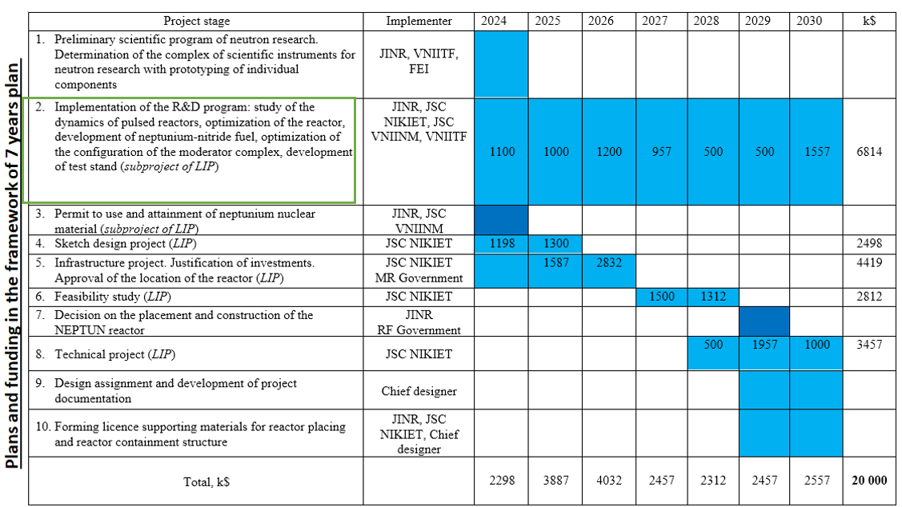
Structure of the subproject
LARGE INFRASTRUCTURE PROJECT 04-4-1149-2024/2028 Pulsed Neutron Source and Complex of Spectrometers
(Leader – E.V. Lychagin)
Project of the LARGE INFRASTRUCTURE PROJECT
New Advanced Neutron Source in JINR
(Leaders –E.V. Lychagin, V.N. Shvetsov, M.V. Bulavin)
Main goal is development of a new advanced neutron source – fast pulse NEPTUN reactor, that will replace IBR-2
Subproject of the LARGE INFRASTRUCTURE PROJECT
R&D for the justification of the development of a draft design project of a new advanced neutron source at JINR - the NEPTUN fast pulse reactor
(Leaders –E.V. Lychagin, V.N. Shvetsov, M.V. Bulavin)
Main goal is R&D work to justification of the development of a draft design project of the NEPTUNE fast pulse reactor
Notes:
Прямо сейчас мы не можем начать дизайн проект поскольку есть перечень работ НИОКР, которые мы должны выполнить перед началом дизайн проекта

Slide 5
Goal and tasks of subproject: R&D for starting Draft Design of the NEPTUN reactor
Tasks of subproject of LIP: implement R&D to start the development of draft and infrastructure design of the new NEPTUN reactor
Permit to use neptunium nuclear material. Development of methods for measuring fuel characteristics
1. Development of neptunium-nitride fuel and neptunium-nitride-based fuel rods. Stage I
Stage 2. Fuel rods
Stage 3. Irradiation
4. R&D program to justification of NEPTUN reactor safety: experimental stands, models, prototypes (CM prototype)
Contract JINR-VNIINM (Rosatom)
Manufacture a pellet from NpN. Pre-reactor tests.
Technical task for fuel rod draft design
Draft Design
(NIKIET)
Infrastructure Design
(NIKIET)
5. Scientific program and the concept of the suite of instruments
3.NEPTUN reactor dynamics. Oscillating stability
2. Selection of a.c.c. and optimization of design RV and RM of the NEPTUN reactor
(GC NIKIET)

Slide 6
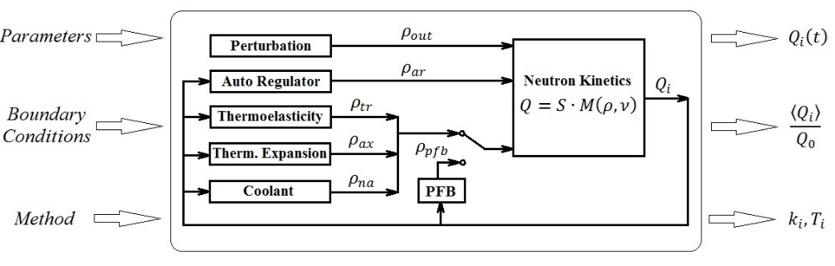
Selection of NEPTUN reactor’s active core configuration (a.c.c.)
What are the requirements for an optimal a.c.c.:
The parameters of the optimal a.c.c. must give the stable operation of the reactor and high neutron flux (small energy release gradient, small bending magnitude of fuel rods or fuel assemblies in a power pulses, depending on the temperature gradient and fixation of fuel rods). They are determined from the model of the dynamics of the reactor
The energy release for the optimal a.c.c. should not cause overheating for the construction of the RV and RM
The construction of a.c.c., RV and RM must be realizable and justified from the safety’s point of view of state rules

Slide 7
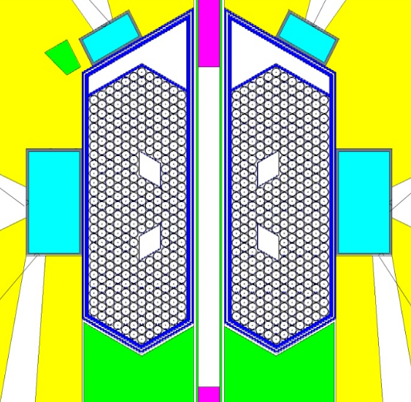
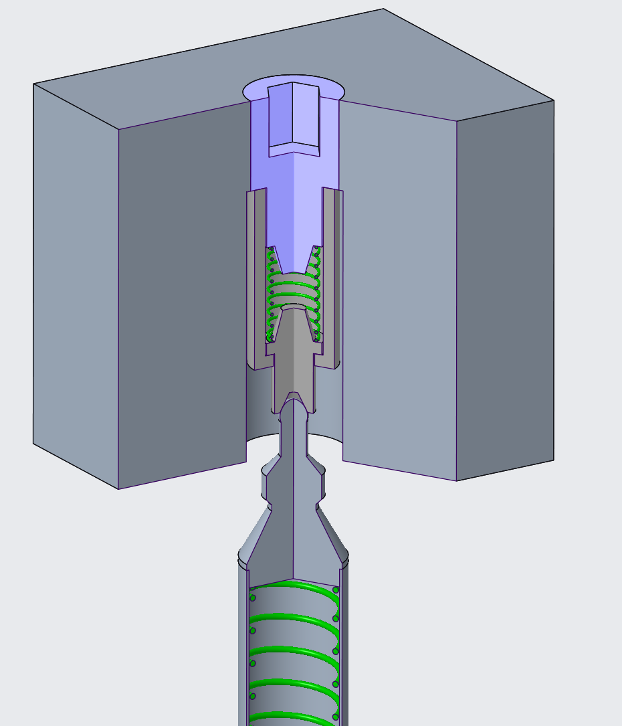
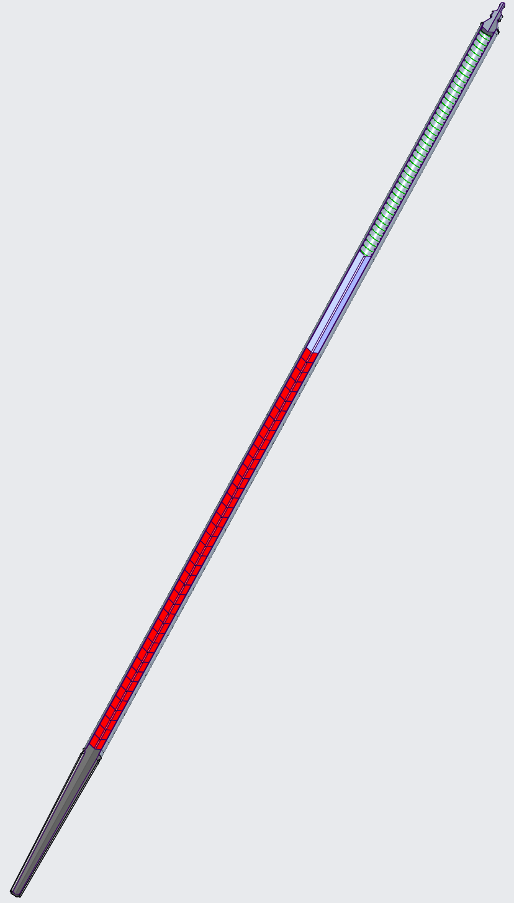
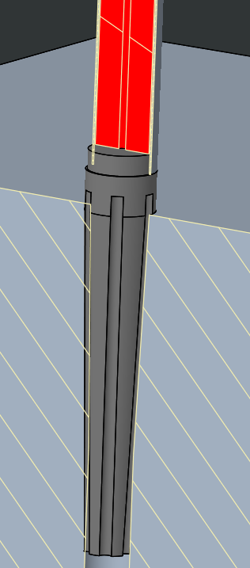
Selection of NEPTUN reactor’s active core configuration (a.c.c.)
specific fixation
Limited small radial displacement
Advantages
- maximum neutron flux
- maximum energy release (compact a.c.)
- minimal temperature gradient
- minimal bending of the fuel rod
- can be described by the dynamics model
- stability operation of the reactor
Disadvantage
- difficult to build and operate
(GC)
Optimal design of fuel rods and the composition of the NEPTUN reactor active core
Rigid fixation of the bottom end

Slide 8
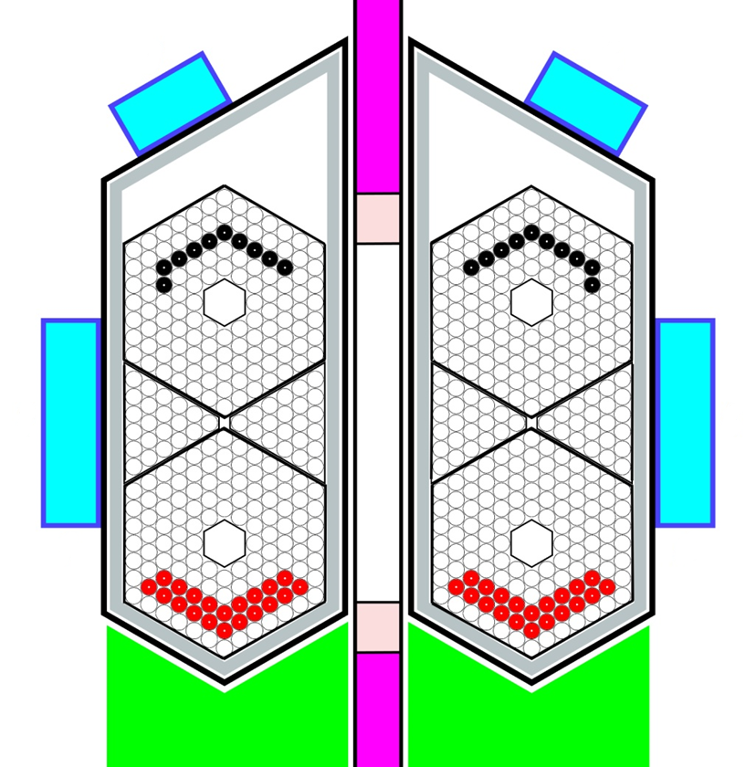
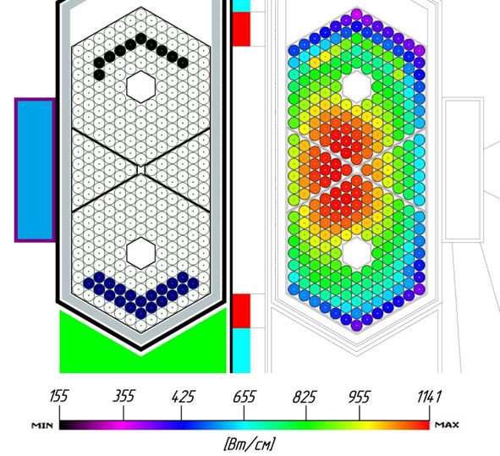
Example of fuel rod assemblies a.c.c. from GC TP
NEPTUN reactor’s active core configuration
1) Effect of influence of the bending of the fuel rod assembly on the stability of the reactor is even stronger (compared with single neptunium fuel rods), due to the greater magnitude of the temperature gradient on the fuel assembly wall
It is necessary to profile the coolant flow through the fuel assembly to equalize the gradient and, accordingly, minimize the amount of bending
Also, we need to use plutonium on the periphery of the a.c. for this goal
2) Calculations of the stability of a pulsed reactor in such configuration will require serious complication of the model of the dynamics of the pulse reactor and its verification in future
Currently, selection the optimal a.c. configuration of the NEPTUNE reactor continues together with GC within the framework on R&D work

Slide 9
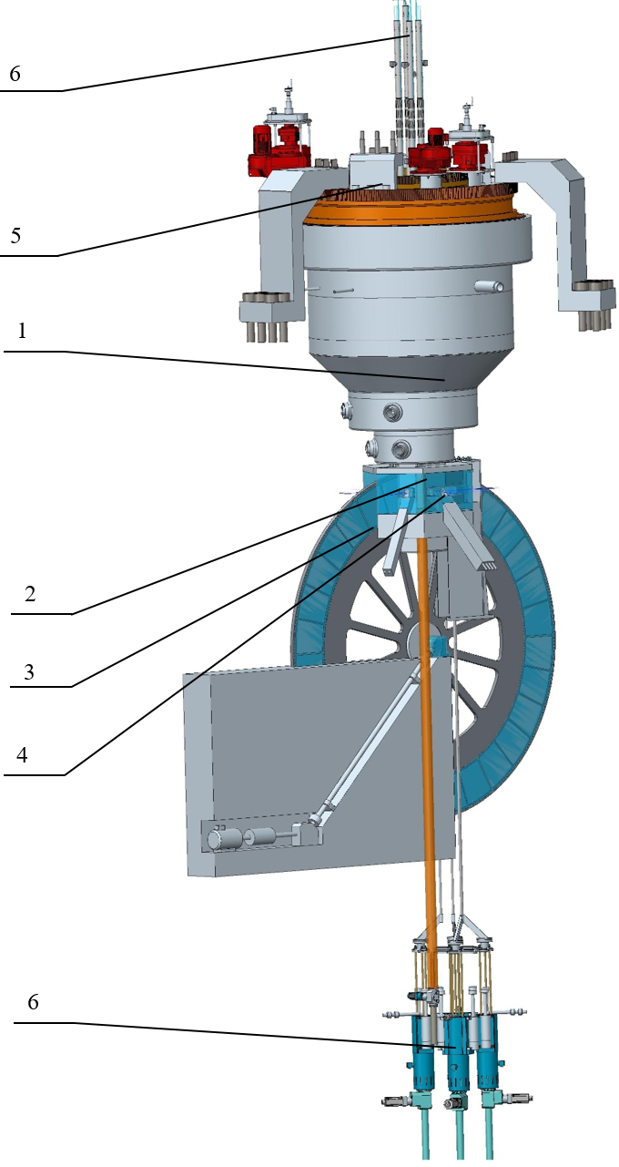
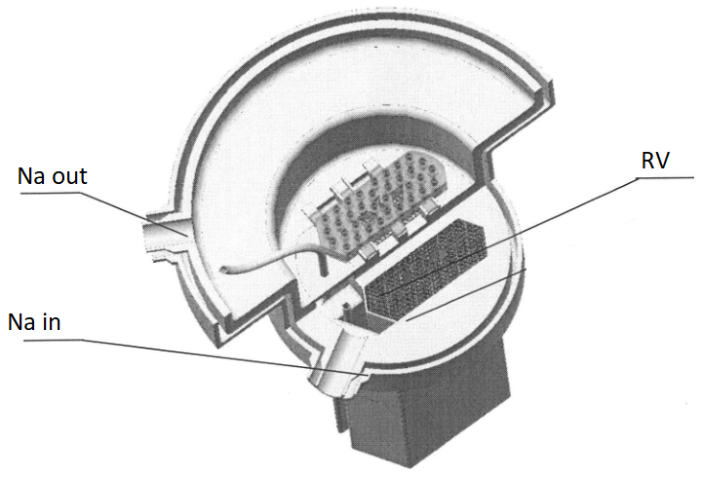
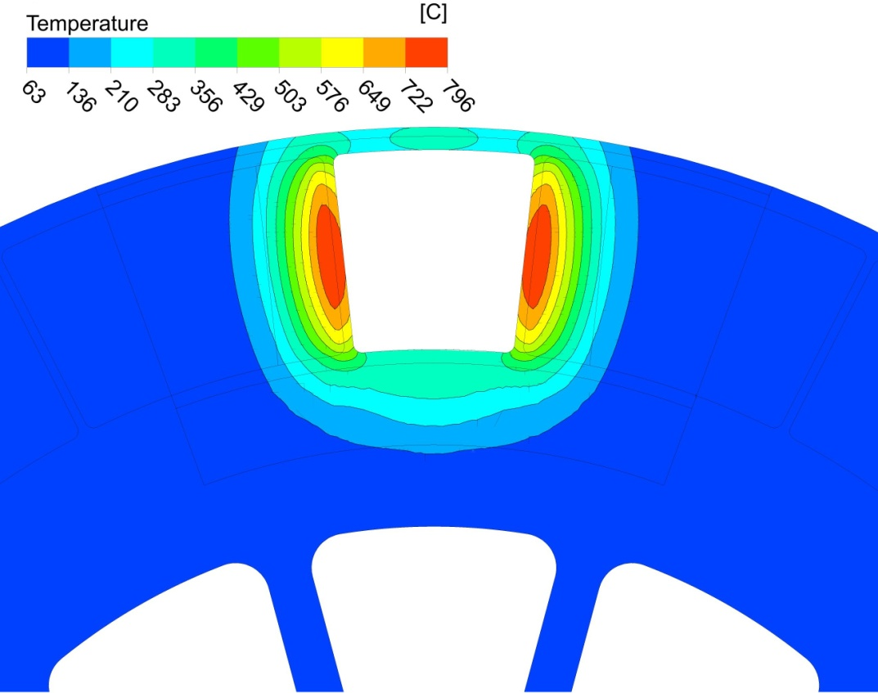
Optimization of the reactor construction: reactor vessel, reactivity modulator, a.c.c. (NIKIET)
1 – reactor;
2 – stationary reflector;
3 – reactivity modulator;
4 – moderators;
5 – rotary plugs;
6 – CPS actuators;
7 – RS of RSS
Power 10-15 МW
Fuel 500 kg
Average flux 10¹⁴ n/cm²/s
Flux in pulse 10¹⁶ n/cm²/s
Main task is
optimization of reactor vessel and
reactivity modulator for reduce thermal
capacity and deformation for the finding out of the safety factor (before starting Draft Design)!

Slide 10
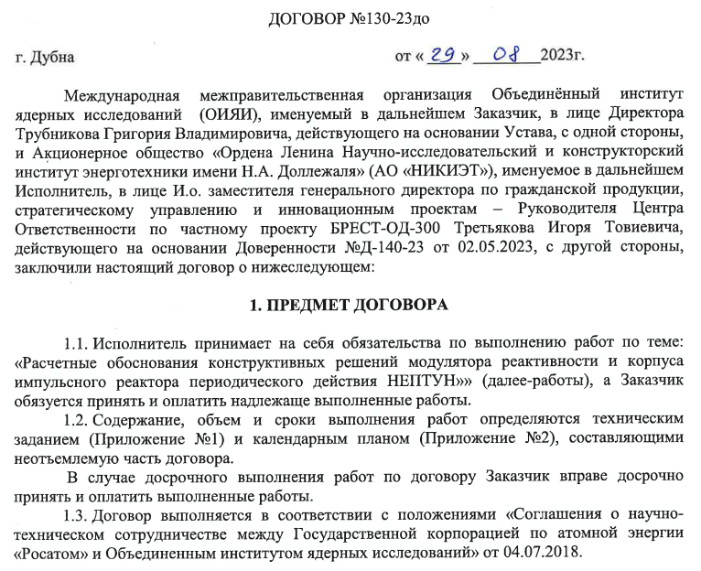
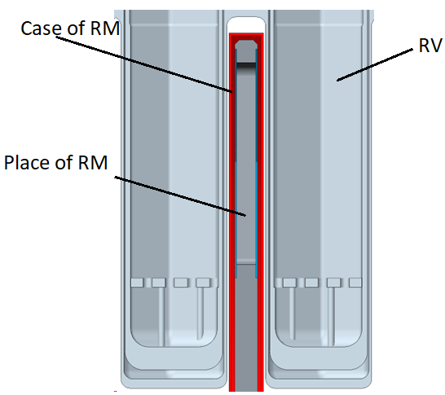
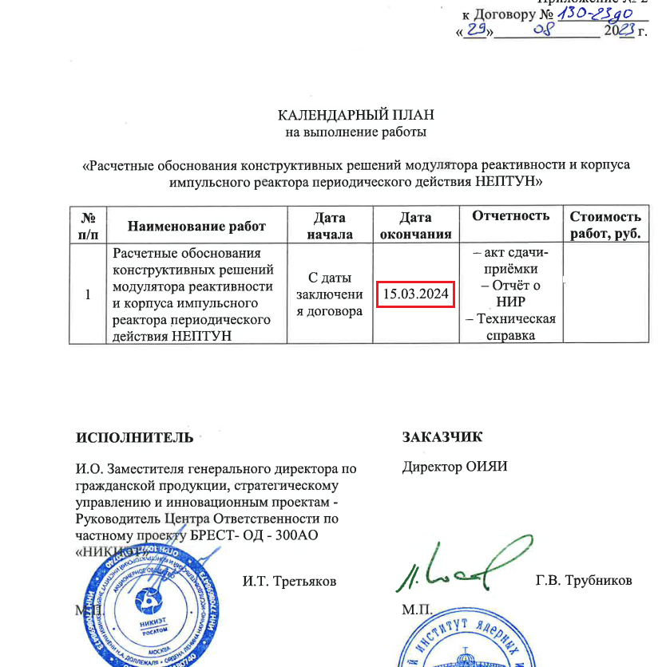
Optimization of the reactor construction by NIKIET (Rosatom): reactor vessel, reactivity modulator, a.c.c.
Propose to use Ni
Dehydration temperature is about 350⁰C!

Slide 11
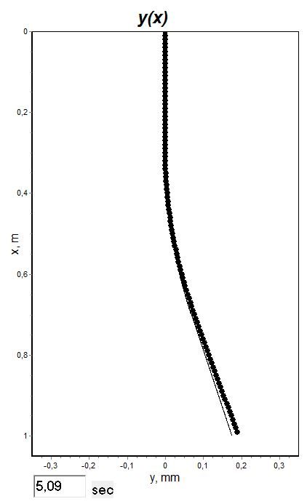
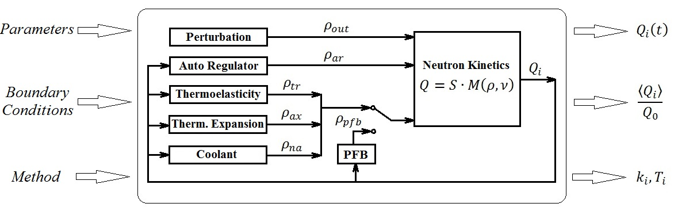
1.The dynamics model describing and studying the reasons of pulse reactor instability, determination of the parameters of stable reactor operation (including optimal a.c.c. and fuel rod fixation - thermoelasticity block), verification of theoretical methods to the study of dynamics of the pulse reactor
2. Development of a certified and attested dynamics computer model to justify the safety of the reactor in governmental agency (Rostechnadzor etc.) in future. For certification, it is necessary to do a verification each program blocks using attested digital calculation codes and if you don’t have them, you need setting up experiments
Model of dynamics of fast pulsed NEPTUN reactor

Slide 12
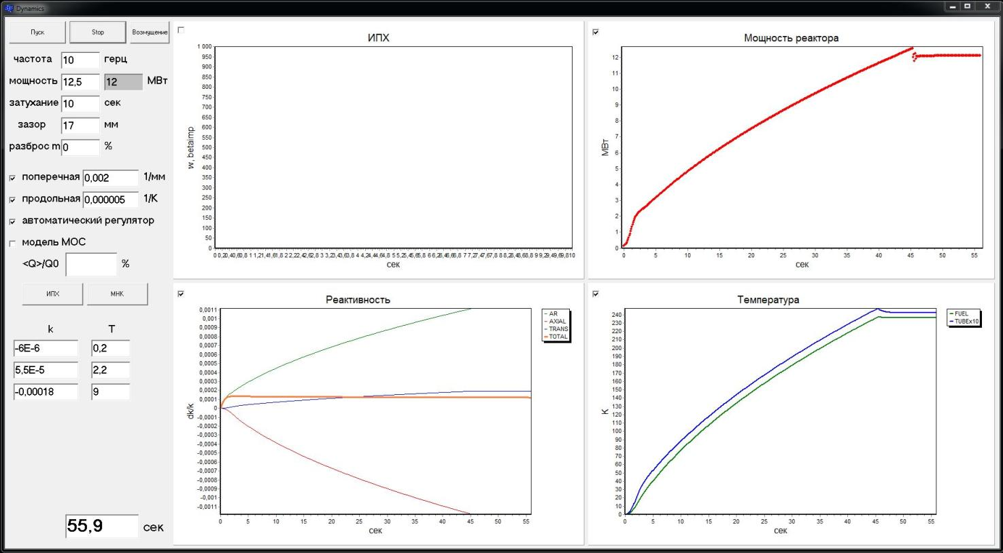
Model of dynamics of fast pulse NEPTUN reactor: first calculations
The program has simple interface. Graphs of main parameters (reactivity, temperature and reactor power) are plotting in the process of calculation. Calculations are quite fast - computer time equals reactor time.

Slide 13
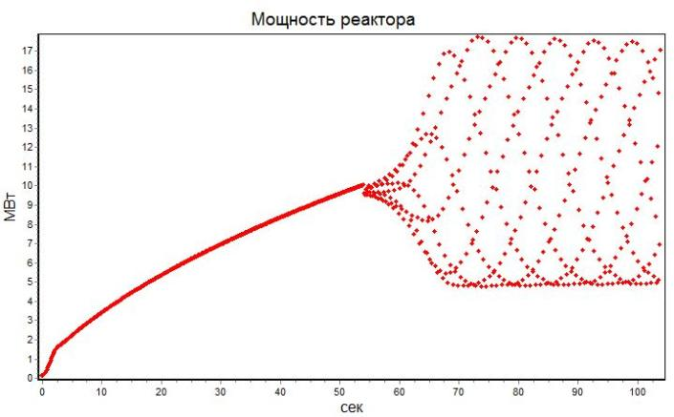
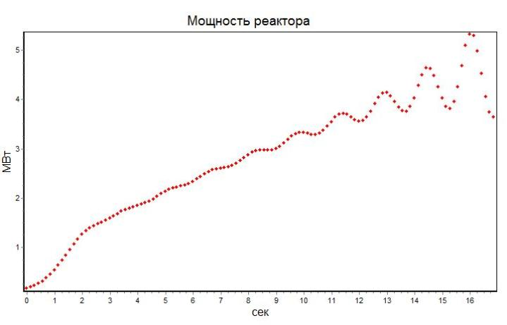
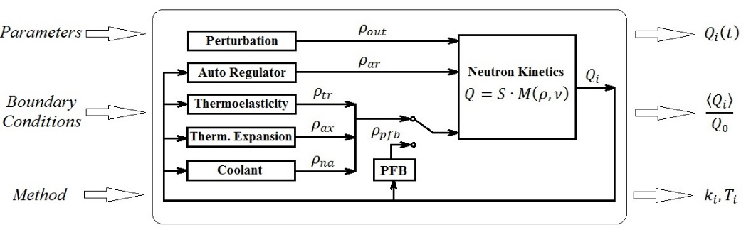
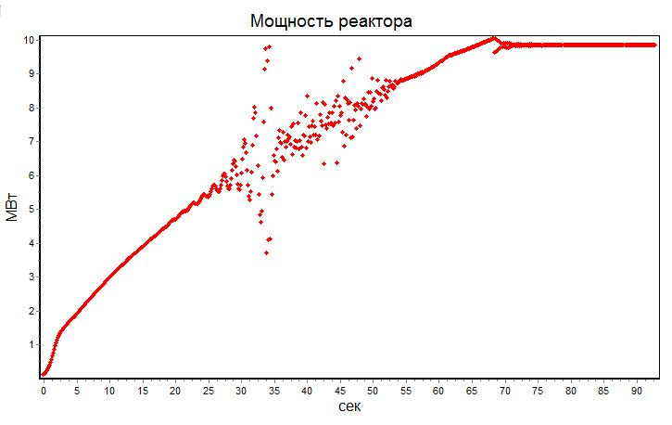
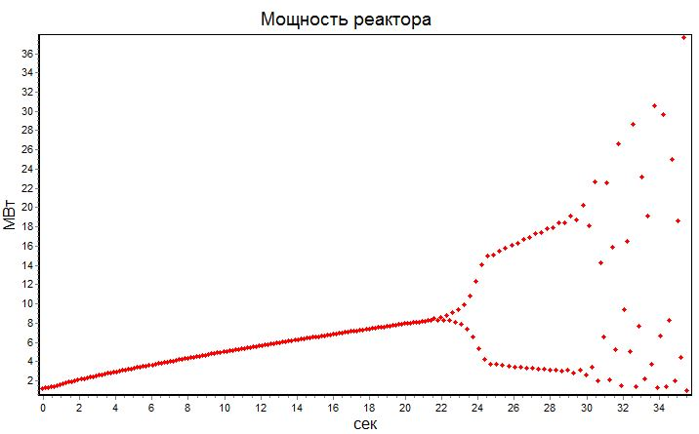
Model of dynamics of fast pulse NEPTUN reactor: first calculations
Results shows strong negative influence of fuel rod dynamic bending during the pulses of the power of the reactor on stability of the reactor’s operation. It means that we have to choose pulse reactor parameters (a.c.c.) very precisely and need to do an experimental verification of the dynamics model

Slide 14
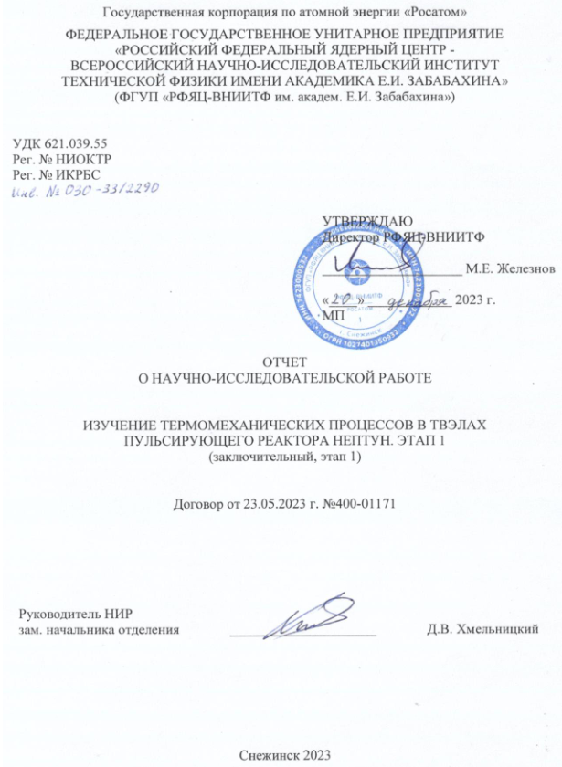
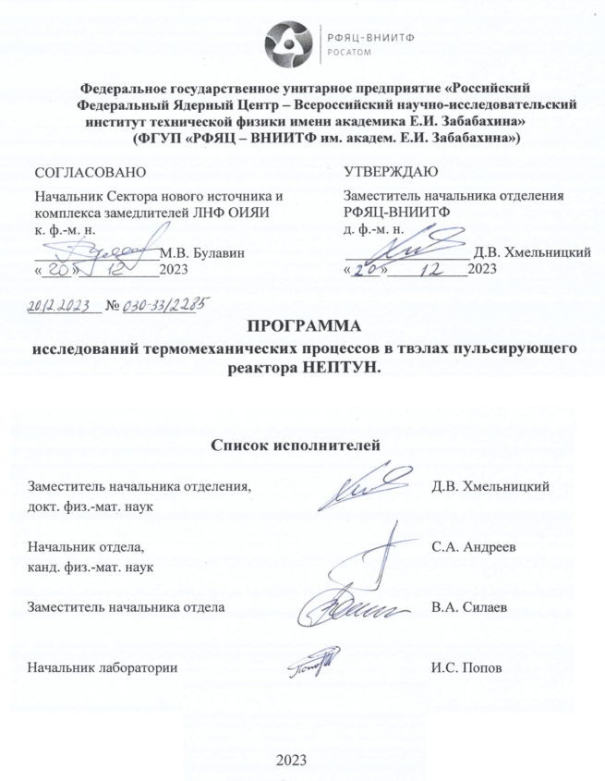
Computational and theoretical justification of the experiment on verification of the model of dynamics – thermoelasticity block (with VNIITF Rosatom, stage 1)
Main goal – justification of the setting up experiments at the BARS-5M pulse reactor (determination of magnitude of the fuel rod bending in the pulse of the power in the real conditions) for the verification and refinement of the dynamics model of the NEPTUN reactor (VNIITF)
Results:
Results of calculations which is used in model of the dynamic of the fast pulsed NEPTUN reactor (FLNP JINR) and thermomechanical calculations of VNIITF are in good agreement to each other!
The design of the model fuel rod has been selected and justified taking into account the characteristics and operating conditions of fuel rods in the pulse NEPTUNE reactor
Parameters of the energy release of the BARS-5M reactor and the location of the model fuel rod relative to the a.c. have been determined, providing the possibility of reliable registration of displacements of the fuel rod shell resulting from its thermomechanical bending
Measured values (bending, deformations, frequencies etc), type of sensors for monitoring loading parameters and registration are selected, the installation locations of the sensors are determined
The errors of the measurement results will plan at the level 1-3%
At the 1st stage VNIITF selected the experimental conditions at the BARS-5M reactor (as at the NEPTUN reactor real conditions) and parameters of the model fuel rod (close to neptunium nitride fuel rod)

Slide 15
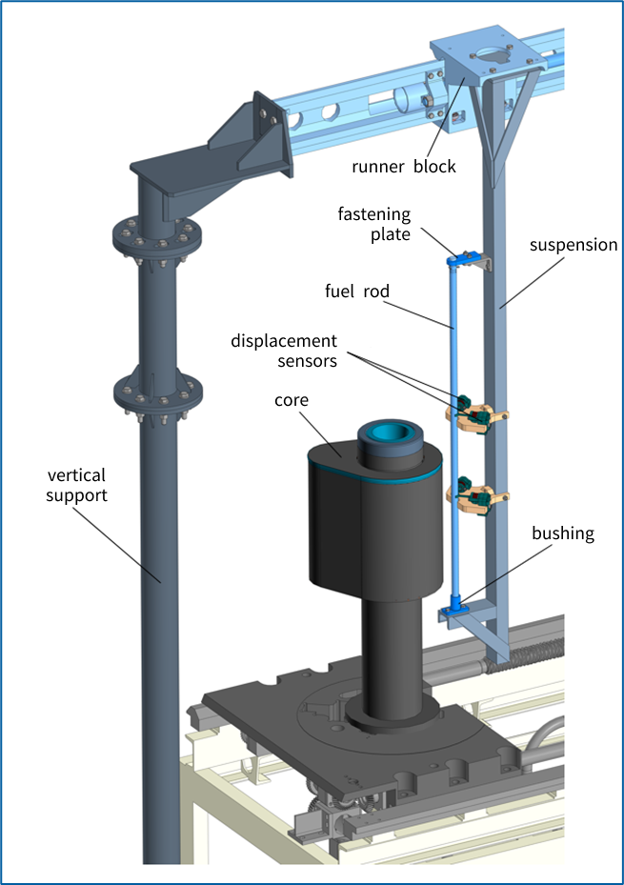
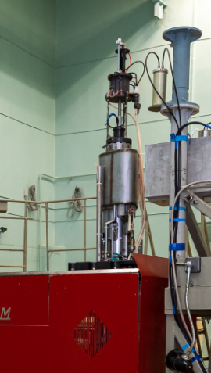
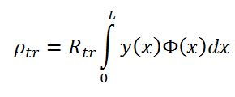
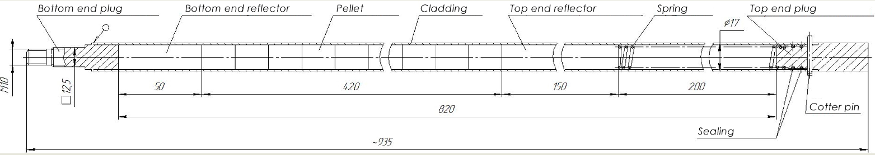
Experiment on verification of the model of dynamics (with VNIITF Rosatom, stage 2)
At the stage 2 VNIITF will plan to setting up experiments at the BARS-5M reactor
We need to make sure that the model gives a correct and exact results and describes of instability very exactly!
Distance from a.c. to fuel rod is 5 cm
Energy release in pulse of the power is 2•10¹⁷ fissions, more than in NEPTUN reactor (the predicted bending value of fuel rod for the BARS-5M reactor is 5 mm, in NEPTUN is 0,13 mm)

Slide 16
Characteristics of the model fuel rod (VNIITF)
Selection Criteria
Manufacturability
Utilization of available materials with known properties
Utilization of fissile materials from existing stock
Characteristics of the model fuel rods (part 1) BARS-5 NEPTUN
Characteristics of the model fuel rods (part 2)
Fuel rod length, mm | ≈ 935 | 900-1100
Bottom end reflector height, mm | 50 | 50
Fuel pellet outer diameter, mm | 15,6 | 15,7
Gap b/w the cladding and the fuel pellet, mm | 0,2 | 0,2
Fuel column height, mm | 420 | 420
Top end reflector height, mm | 150 | 150
Fuel rod cladding thickness , mm | 0,5 | 0,45
Gas cavity height, mm | 200 | 300
Top end plug height, mm | ≈ 50 | -
Pellet | Uranium-molybdenum alloy
Reflector | EK61-ID or an alloy close in density
Gap | Gallium
Cladding | Steel 12Cr18Ni10Ti
End plugs | Steel 12Cr18Ni10Ti
Material selection of model fuel rod: uranium-molybdenum fuel is available (VNIITF), shell material – steel (criteria: Young's modulus and thermal conductivity), reflector material – steel (criterion: density), gap filling material – gallium (criterion: high thermal conductivity coefficient)
Fuel rod | Density, g/cm3 | Heat capacity, J/(g·K) | Thermal conductivity, W/(m·K)
Uranium-molybdenum (model) | 17,1 | 0,134 | 23
Neptunium nitride | 13,3 | 0,275 | 14,4
Mode | Itself frequency, Hz
 | 1 |  | 2
 | NEPTUN f.r. | BARS-5M m.f.r. | NEPTUN f.r. | BARS-5M m.f.r.
1 | 8,0 | 7,6 | 28,7 | 26,1
2 | 42,8 | 40,1 | 87,5 | 81,3
3 | 107,4 | 100,4 | 182,8 | 171,2
An approximation of the attached mass was used

Slide 17
Conditions of the experiments and justification of the materials of the model fuel rod for the second stage of the R&D contract with VNIITF (2024-2025)
The itself frequencies of the model fuel rod correspond to their values for fuel rods in the NEPTUNE reactor
It is possible to increase the effect of bending of model fuel rod due to greater energy release at the BARS-5M reactor for reliable and correct recording by available measuring sensors (the predicted bending value for the BARS-5M reactor is 5 mm, in NEPTUN is 0,13 mm)
The difference in the conditions of the experiment on BARS-5M, associated with the placement of the model fuel element in the air, and not in the flow of liquid sodium, as in NEPTUN reactor, does not change the heating time of the fuel rod’s shell, and the degradation of heat exchange at the external boundary gives only to an increase in the amplitude of its cross oscillations (similar conditions)
Material selection of model fuel rod: uranium-molybdenum fuel is available (VNIITF), shell material – steel (criteria: Young's modulus and thermal conductivity), reflector material – steel (criterion: density), gap filling material – gallium (criterion: high thermal conductivity coefficient)
Preparations to the experiments and their setting up will plan at 2024-2025

Slide 18
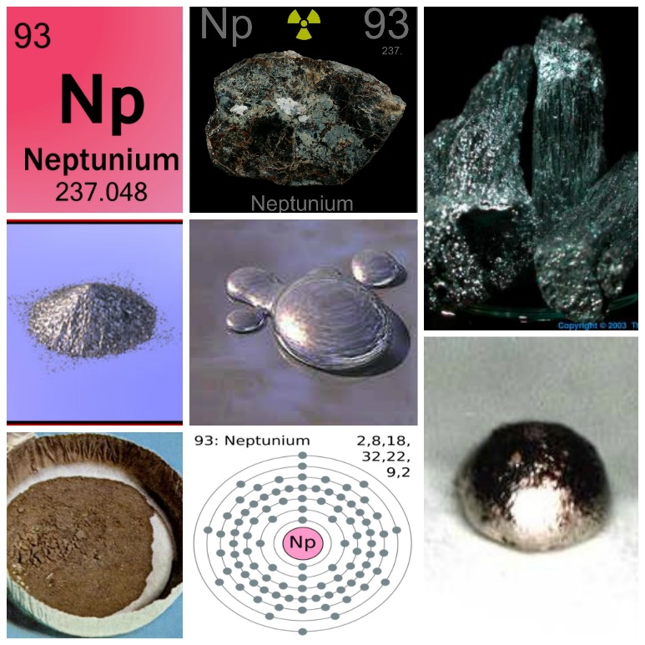
Development of neptunium-nitride fuel and neptunium-nitride-based fuel rods. Stage I
Advantages of neptunium for using as fuel for NEPTUN fast pulse reactor
The advantages of 237Np are the threshold character of the fission cross section (the effective fission threshold is about 0.4 MeV), which ensures the creation of a critical mass with a sufficient density of neptunium nuclei
High intensity of neutron flux 10^14 n/cm^2/s (10^16 n/cm^2/s) (not achievable when using other types of fuel in PR)
Short lifetime of fast neutron generation 3-10 ns – shorter flash (pulse duration)
Low effective fraction of delayed neutrons µ (1,2−1,3)· 10^-3 – small background (2-3%)
The possibility of using hydrogen-containing materials for RM (hydrogen withdrawal from the core = input of a fissile substance, high effectivity of RM)
A good reactivity reserve (the reactivity coefficient does not decrease from the burning of neptunium)

Slide 19
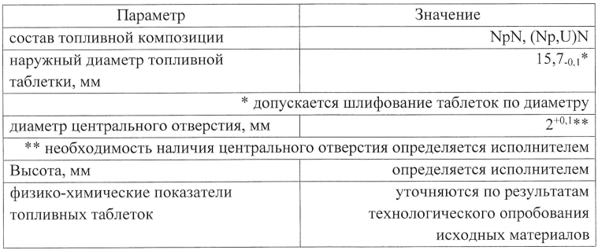
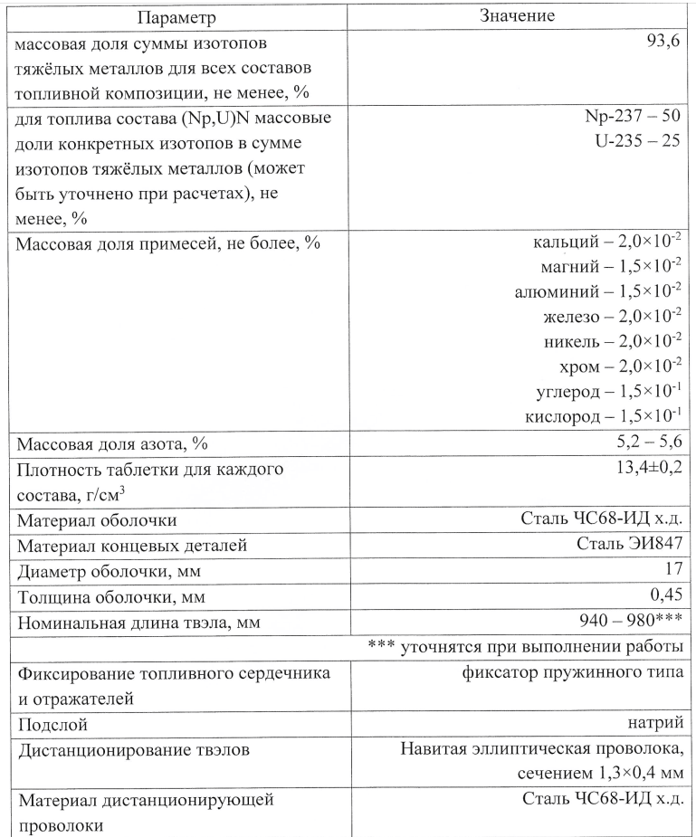
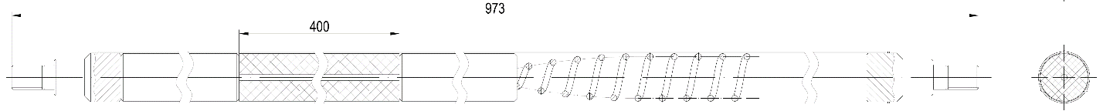
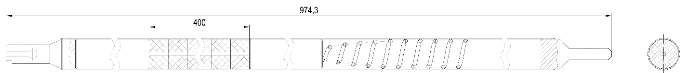
Development of neptunium-nitride fuel and neptunium-nitride-based fuel rods. Stage I
Preliminary technical requirements for fuel rods of NEPTUN reactor
Main problems of first stage of R&D:
Development of preliminary design specifications for neptunium nitride fuel
Development a complex of fuel characteristics’ measurement methods
Development a technology of fuel fabrication for experimental fuel rods
Carry out of fuel pellet researches before reactor irradiation
Main result will be a technical specification for development draft design of the fuel rod (with VNIINM, Rosatom)
Stage 2. Fuel rods
Stage 3. Irradiation
! We are currently preparing a technical specification for the development of documentation for the R&D of neptunium nitride fuel, but we need to start this R&D at the same time with a.c.c. selection together with General Constructor (NIKIET ROSATOM)

Slide 20
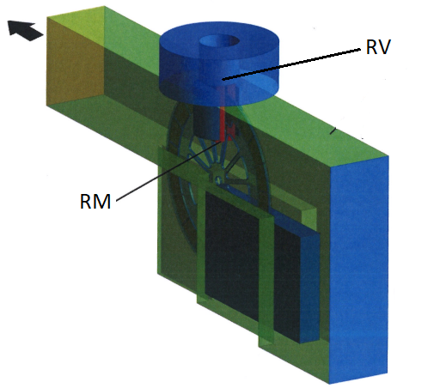
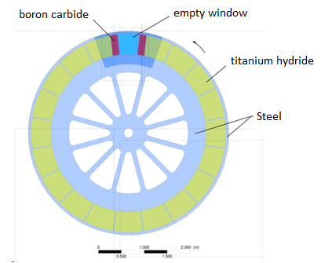
R&D of Reactivity Modulator: conditions of operation
Conditions of operation:
High linear speed (⁓ 100 m/s)
High temperature fields (hundred degrees)
High radiation doses (10²⁰ n/cm2)
Potential problems during operation:
Vibrations due to deformations
Degradation of hydrogen (RM effectivity)
3) Service life
R&D

Slide 21
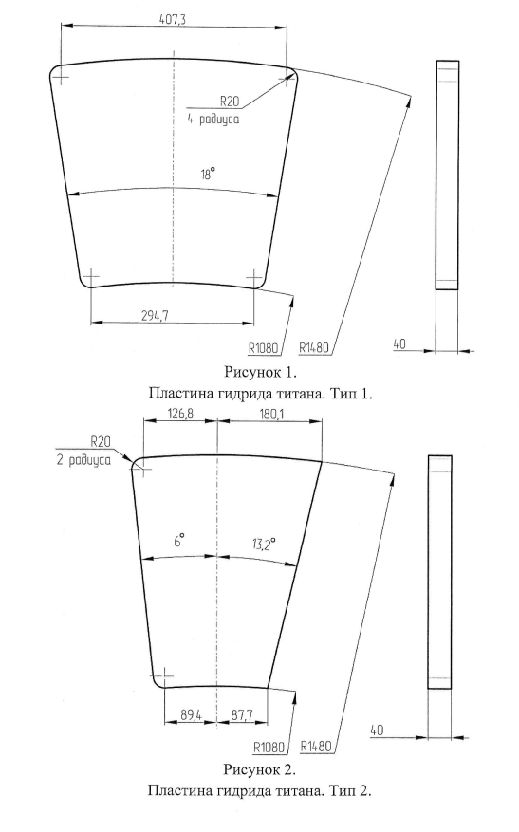
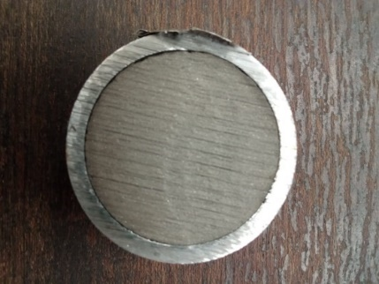
List of R&D of Reactivity Modulator (preliminary version)
Calculations of the RM design (development of a physical and mathematical model of the RM for numerical calculations)
In Progress
Development of an industrial design
In Progress
Development of a prototype
Investigation of the internal structure of samples (distribution of hydrogen – RD, ND), measurement of hydrogen concentration, irradiation, thermal dehydration, improvement of the prototype
In Progress
Production of prototypes from titanium hydride by various methods (for example, sintering at different temperatures under pressure)
Numerical calculations of the scale model of the RM, the choice of scale based on the theory of similarity
Optimization of the RM design and configuration
RM
Large-scale model of the RM as mechanical stand
Development list of R&D with GC (NIKIET) inside of the Draft Design

Slide 22
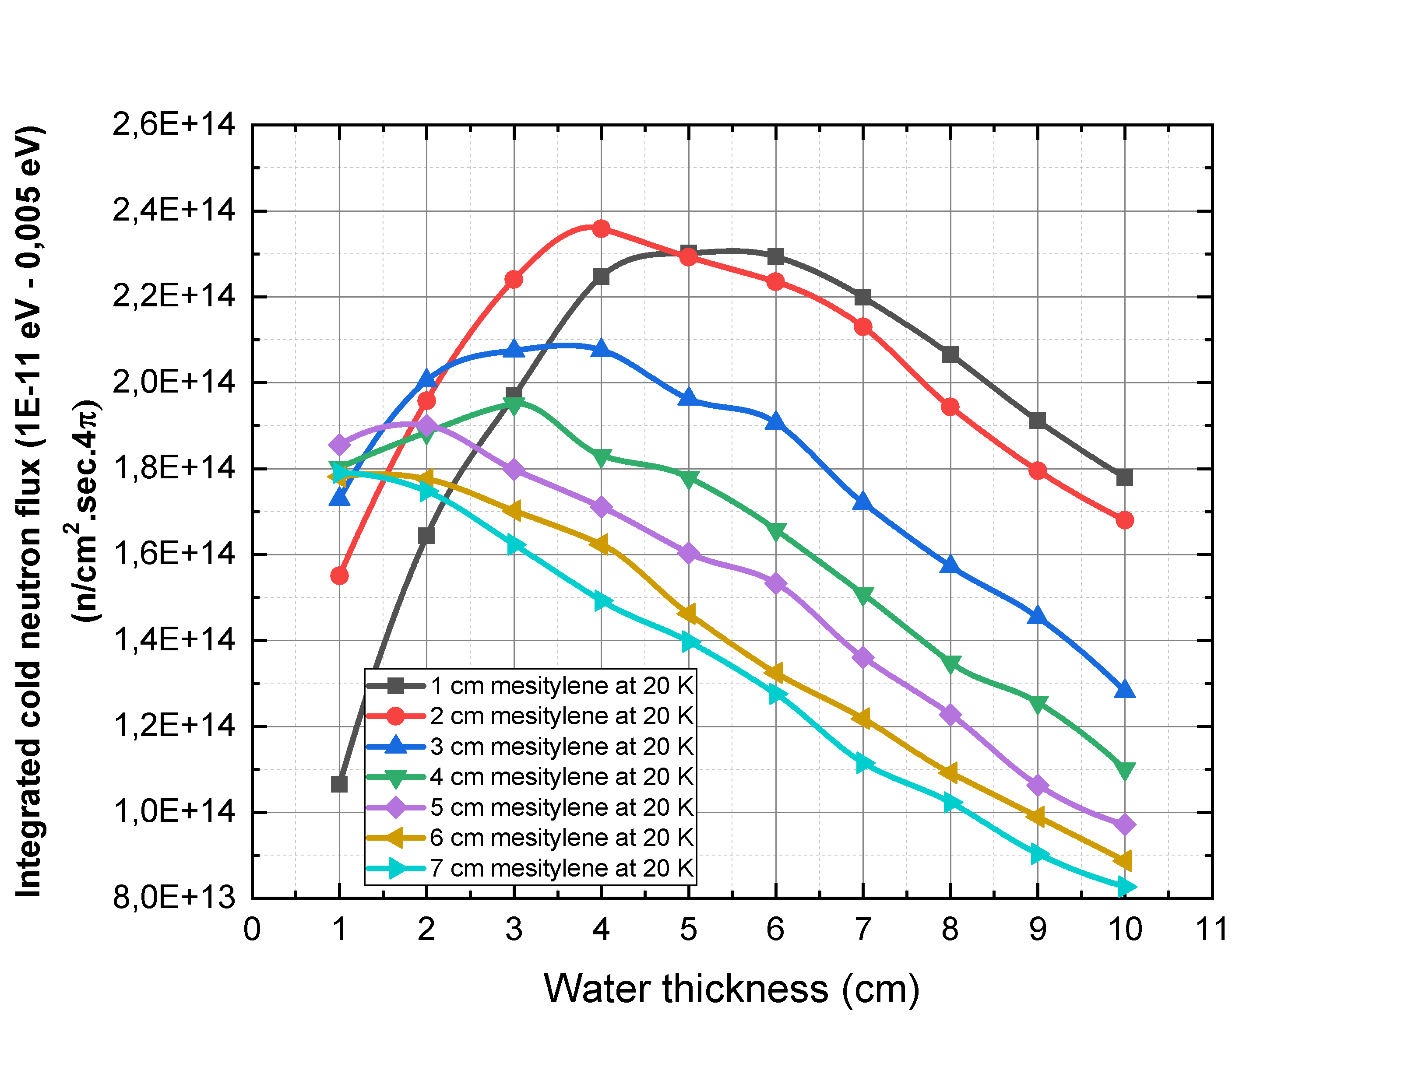
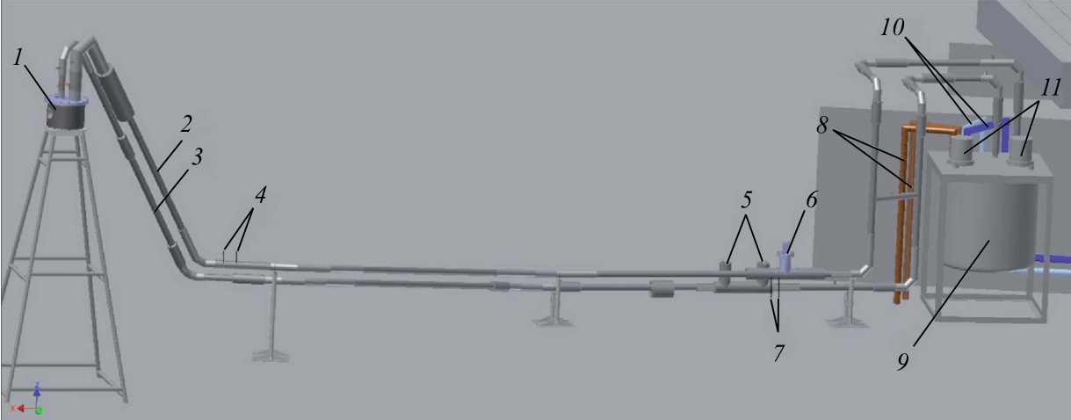
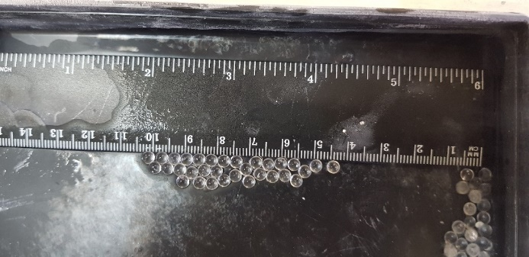
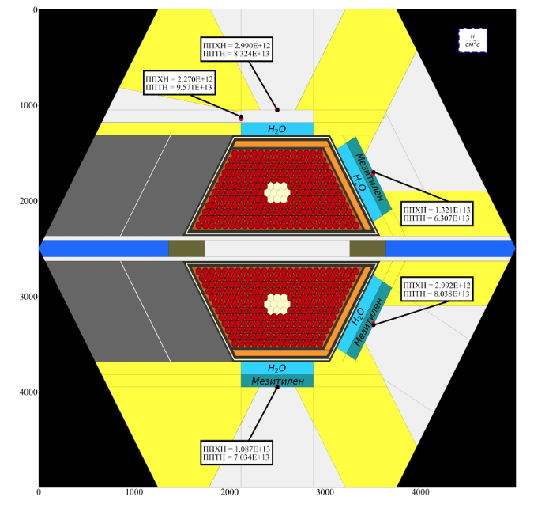
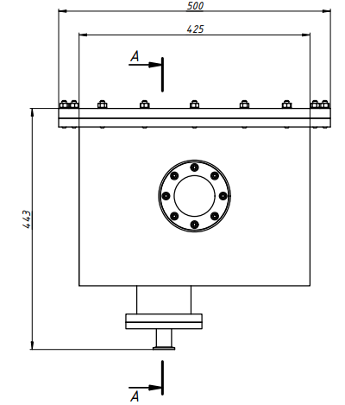
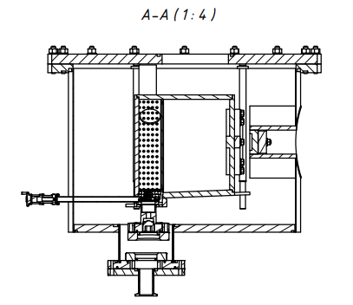
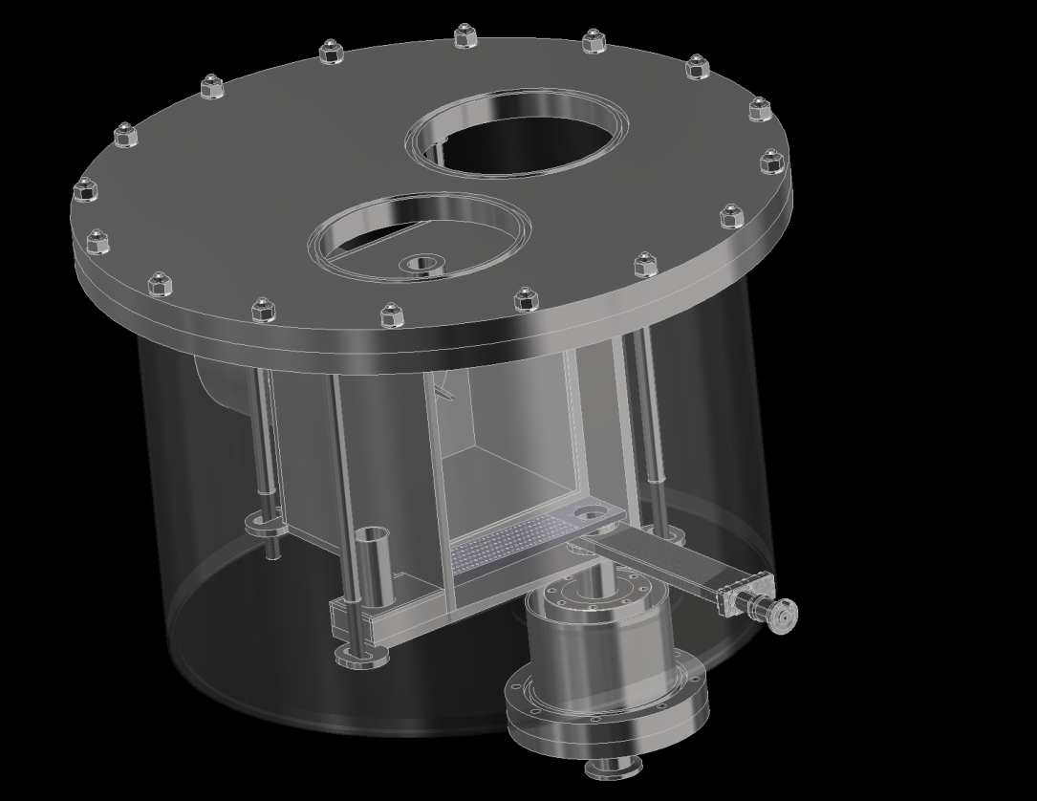
R&D of a cold moderators of the NEPTUN reactor
Stage 1
Stage 2
Optimal configuration
Also, we will plan to calculate an optimal configuration of the chamber of the luquid hydrogen

Slide 23
Conclusions
1. The draft design, the infrastructure design and the justification of investments are key documents in the development of the NEPTUNE research pulsed reactor at first stage. The justification of investments is developed on the basis of draft and infrastructure projects.
2. To start the development of the draft design it is necessary to perform follow R&D:
selection a.c.c. of the NEPTUN reactor using model dynamics of the pulsed reactor and GC calculations
optimization the construction of the reactor vessel and reactivity modulator (to reduce thermal loads, deformation and vibrations to acceptable loads, results will be in the spring of 2024)
obtain nuclear material neptunium, make a tablet based on neptunium nitride, to determine its technological, physical and chemical properties. First step of this R&D allows to develop technical specification of fuel rod (with VNIINM, Rosatom) draft design of the NEPTUNE as part of draft design
3. The following works have already begun, and they need to be continued until the stage of development of the technical project and beyond
development a list of R&D with GC, including R&D of RM and CM
continue work on optimizing the complex of moderators, including liquid hydrogen moderator; R&D of fast charging/discharging of the chamber;
experimental verification of the mathematical model of the dynamics of the fast pulse NEPTUNE reactor together with VNIITF (Rosatom);
4. To develop an infrastructure project, it is necessary to determine the infrastructure of the spectrometer complex of a new source. The infrastructure of the complex is determined by the scientific program of the new NEPTUNE reactor

Slide 24
Thank you for your attention!

