Slide 1

Current state of the
FSD Fourier diffractometer
for residual stress measurement
G.D. Bokuchava
58th meeting of the PAC for Condensed Matter Physics, 25 January 2024

Slide 2
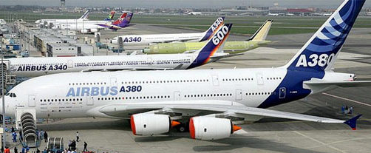
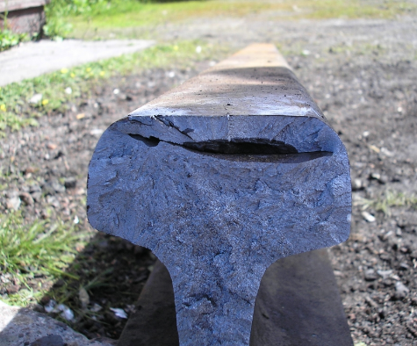
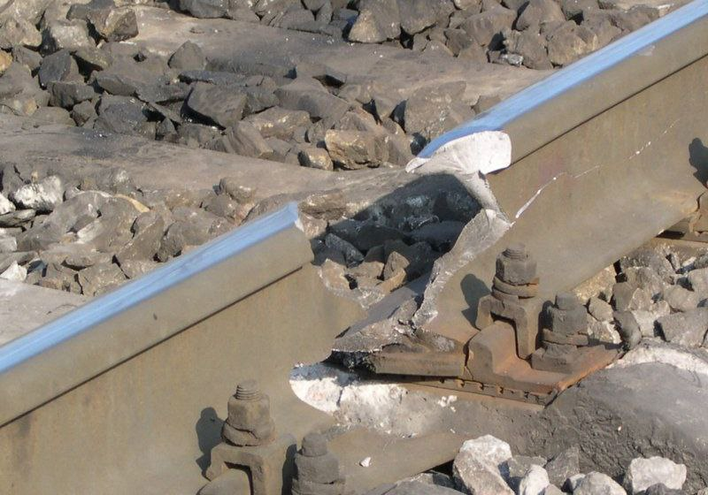
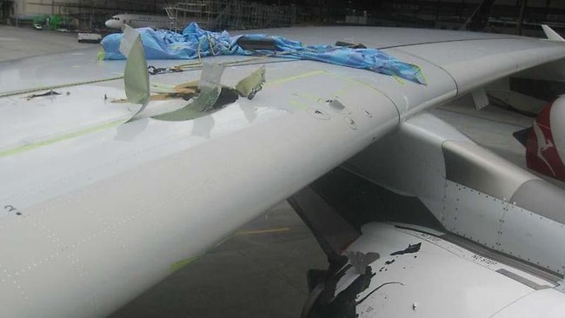
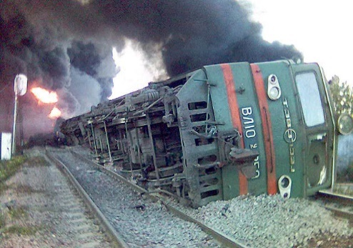
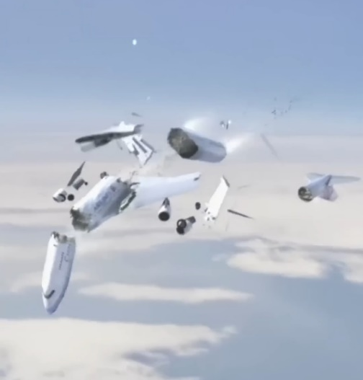
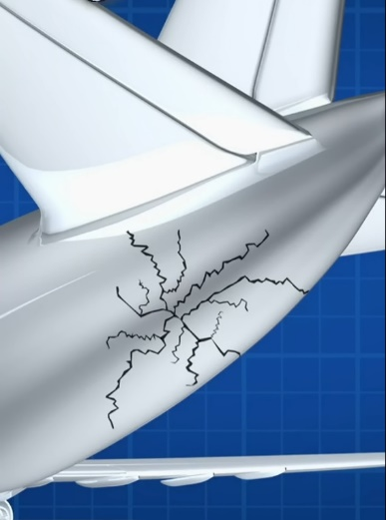
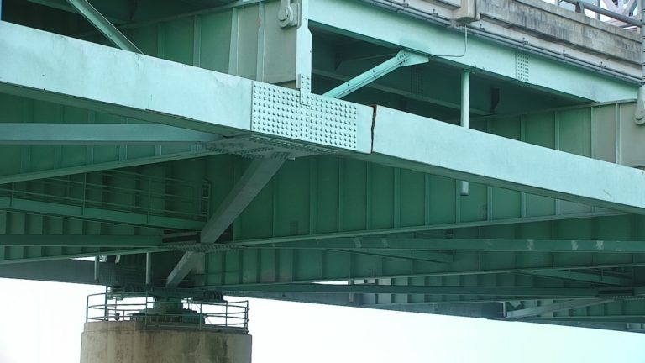
Sources of internal stresses in materials and products
Technological operations
Welding, rolling, peening,
bending, forming, hardening,
hydrogenation, …
Details and structures
Cyclic mechanical loads
Cyclic thermal loads
Static loads
Fatigue failure
Radiation swelling
Airbus A380 Wing-Spar Cracking
Fatigue cracking in rails
Structural materials
Steels, alloys
Composites
Gradient materials/alloys
Materials with defects
Metal ceramics
Plane crash 25.05.2002: Boeing 747-209B of China Airlines suddenly broke apart and crashed into the water 25 min after takeoff.
Cracked Mississippi River bridge (Memphis)

Slide 3
FSD – Fourier Stress Diffractometer
at the IBR-2 pulsed reactor (JINR, Dubna)
beamline 11-A

Slide 4
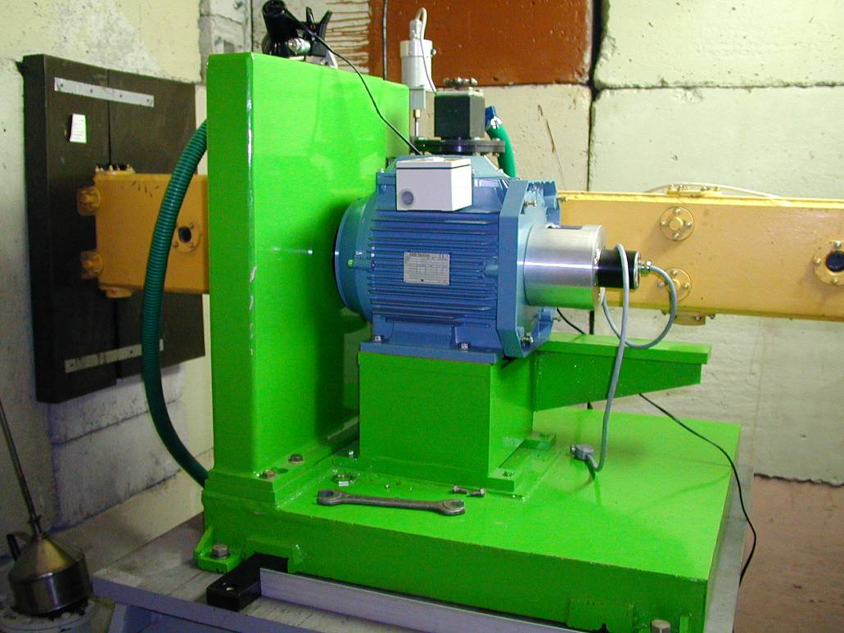
High-resolution Fourier diffractometry at long pulse neutron source
IBR-2 is a long-pulse neutron source:
Δt≈340 μs, R ∼ 0.01 = 1 % (L=25 m, d=2 Å)
Objective: R ∼ 0.001 = 0.1 % (L=25 m, d=2 Å)
Fast Fourier chopper (FC)
F-chopper parameters (FSD):
Number of slits N = 1024
Max. rotation speed: Ω_{max} = 6000 rpm
Max. beam modulation frequency:
ω_{max} = NΩ_{max} = 102.4 kHz
Eff. neutron pulse width: Δt₀ ≈ 1/ω_{max} ≈ 10 μs
Flight path (FC-detector): L = 6.5 m
Resolution: Δt/t ≈ 2.5·10⁻³ (d = 1 Å, 2θ = 90°)
Effective neutron pulse width as a function of 1/Ω_{max}
FC of the FSD in normal position in the gap of the mirror neutron guide
P. Hiismäki, H. Pöyry, A.Tiitta. Exploitation of the Fourier chopper in neutron diffractometry at pulsed sources. J. Appl. Cryst. 1988, 21, 349-354

Slide 5
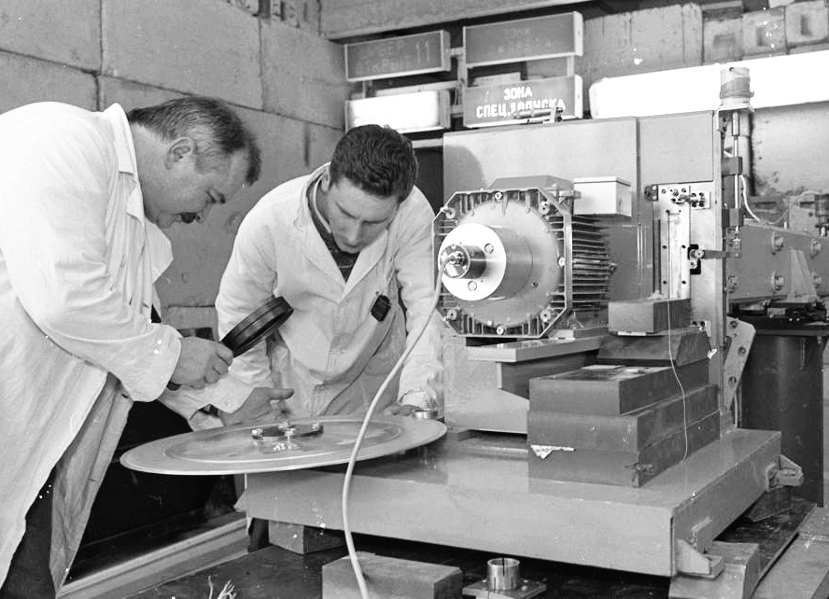
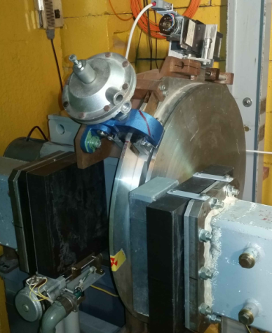
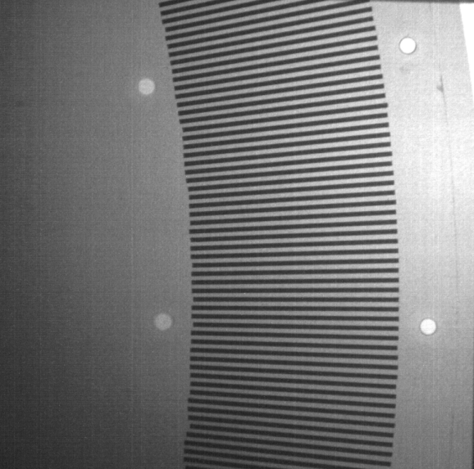
Slit width 0.7 mm
Fourier choppers (FC) – before 2020
Rotor
Stator
Transmission function
Old FC of the FSD in its normal position in the gap of the mirror neutron guide
Old FC of the FSD (Ω_{max} = 6000 rpm) with the rotor disk removed. Operation in open air (without vacuum).
Binary signals
Scheme of a fast FC consisting from a rotating disk (rotor) and a stationary stator.
Top: triangular FC transmission function.
Bottom: The corresponding sequence of binary pickup signals from the encoder.
Neutron image of part of the FSS FC disk. Dark stripes are layers of metallic Gd ~0.7 mm wide
Old FC of the FSS (Ω_{max} = 2000 rpm)

Slide 6

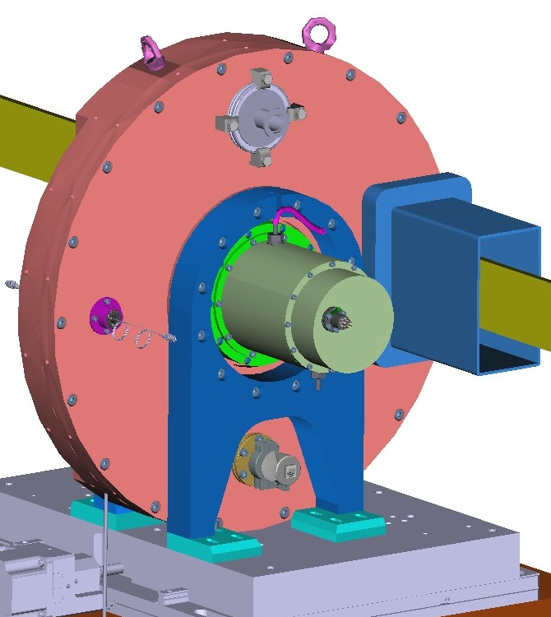
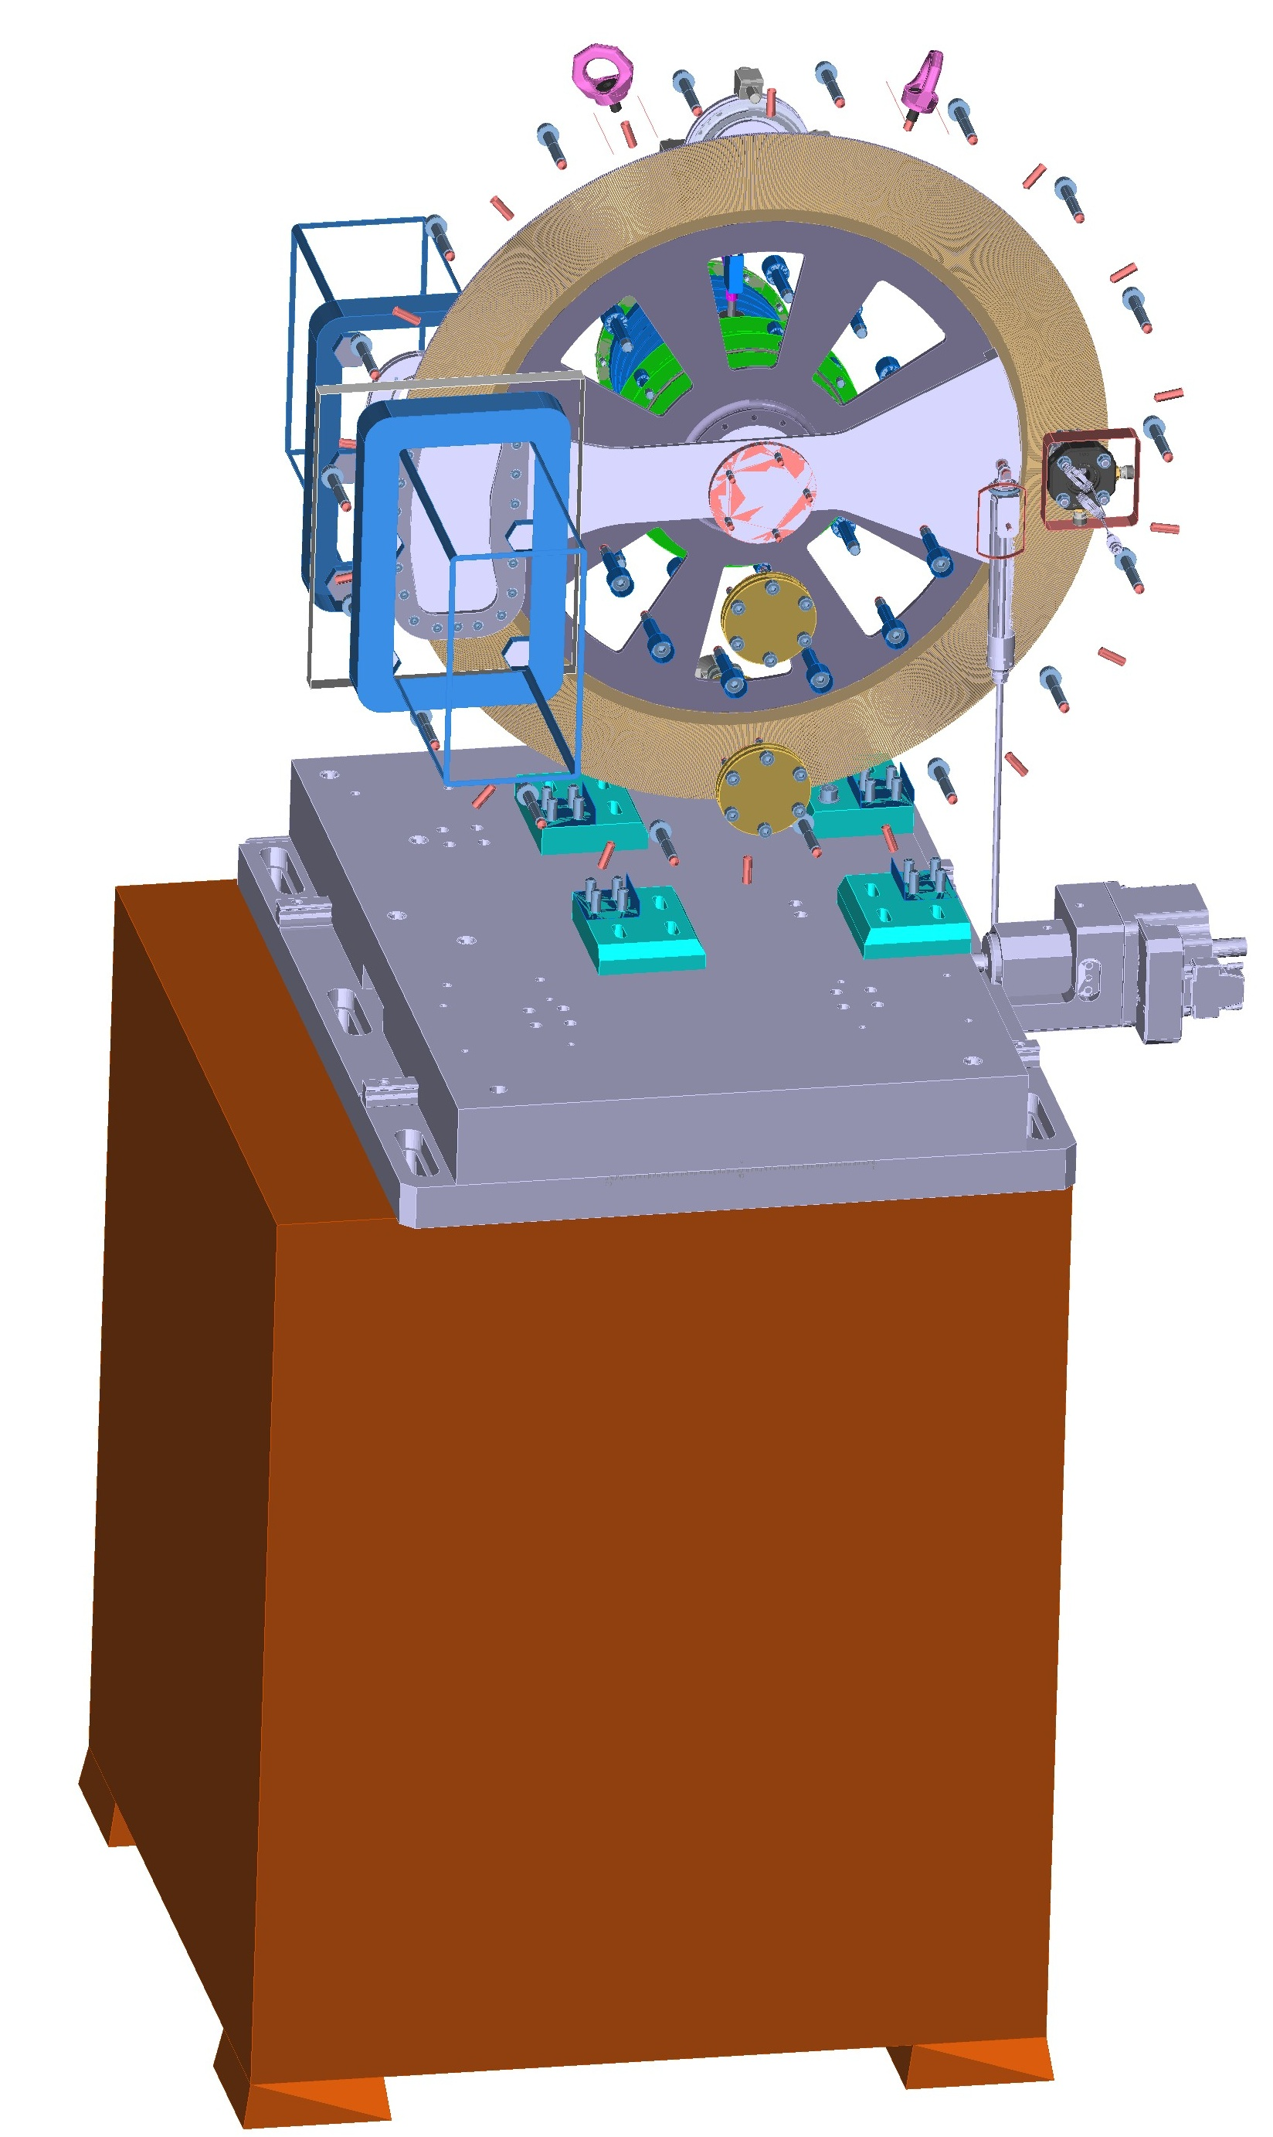
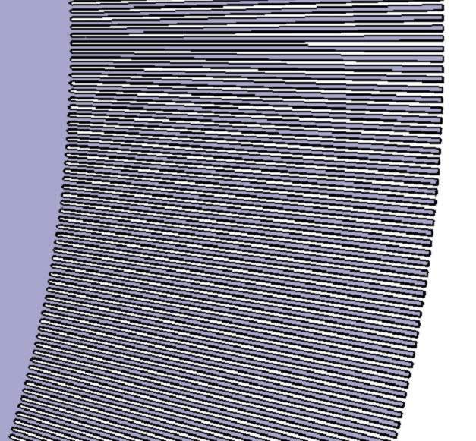
New F-chopper of the FSD diffractometer (2020)
Benefits of the new design: - Operation in vacuum: less vibration and higher dynamical stability - No absorption and scattering from chopper disc material - Combination of two pickup systems: 1) main - laser pickup system; 2) auxiliary - optical encoder with 1024 pulses - Direct measurement of transmission by neutrons and by laser beam - Low gamma background; improved PID regulation; water cooling - Moving platform (TOF/RTOF-modes) - Absence of pickup signal shift (phase error) - Significantly lower pickup fluctuations - Five different frequency windows
Manufacturing contract:
start - 2018
end - 2020
Funding:
theme 1121 (50%)
theme 1122 (50%)
Main parameters:
- Max. rotation speed | 6000 rpm
- Rotor/stator material | high strength Al-alloy
- Rotor/stator thickness | 4.3 mm in the slits area
- Rotor (disk) diameter | 540 mm
- Rotor-stator distance | 1 mm
- Slit type | real cut-away radial slits
- Number of slits | 1024
- Slit length, mm | 60 mm
- Slit width | 0.736 mm in middle part
- Absorbing layer material | ¹⁰B₄C
- Absorbing layer thickness | 0.8 mm
- Extended (x300) acceleration range | 0.1 ÷ 300 rpm/s

Slide 7
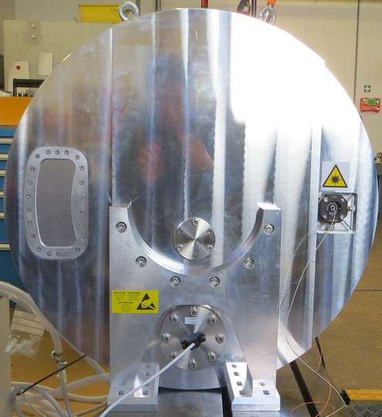
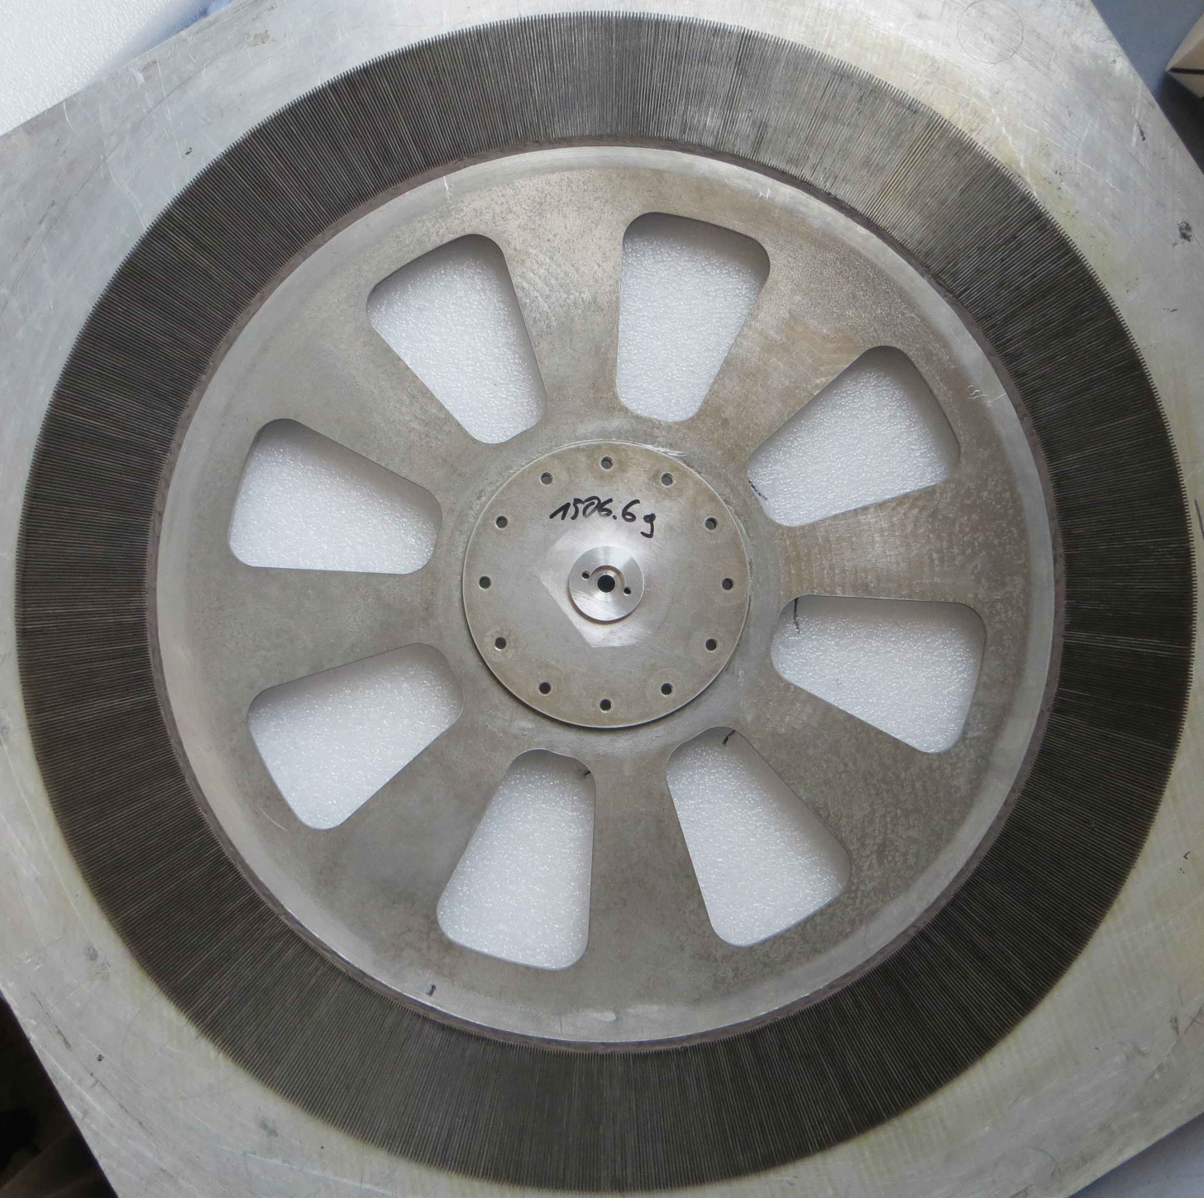
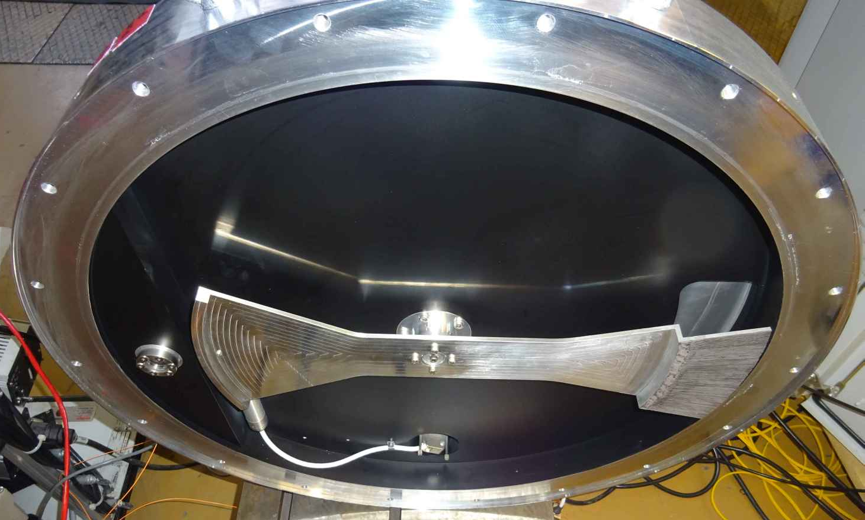
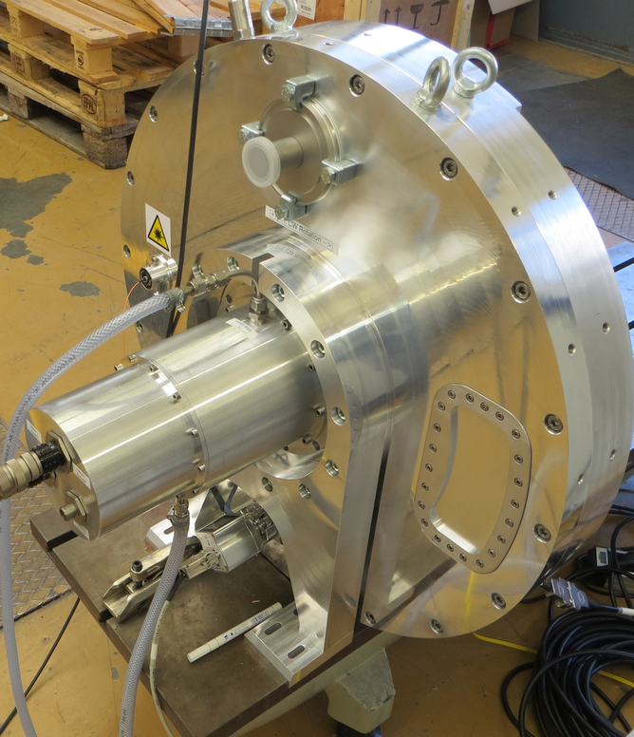
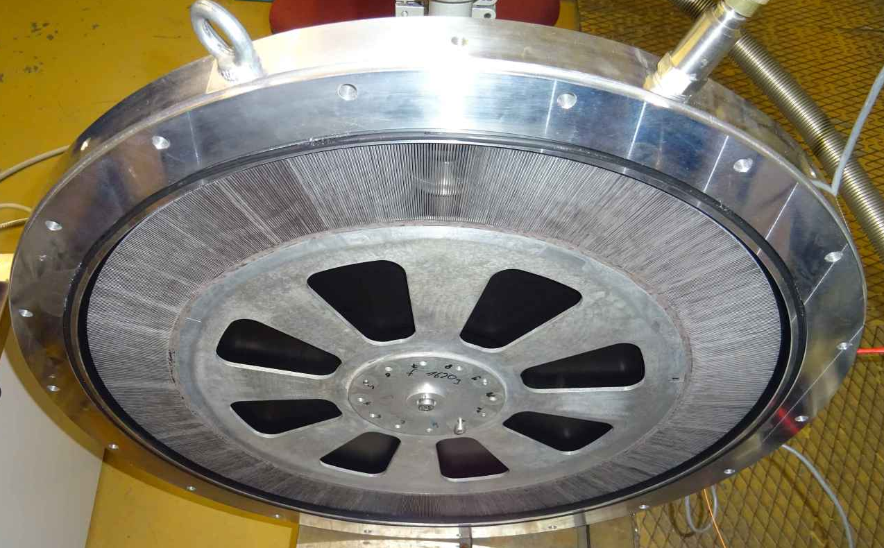
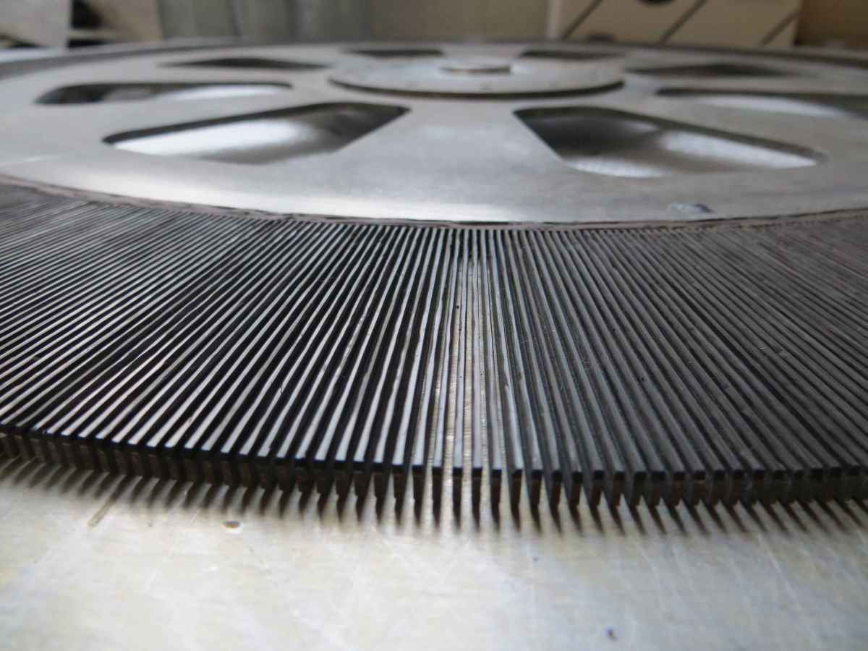
Front view
New F-chopper: installed on FSD at the end of 2020
Precise actuator
Back view
Part of the FC with stator
Rotor disc of the FC
Mating part of the FC with disk and drive
Radial slits in the rotor disc

Slide 8
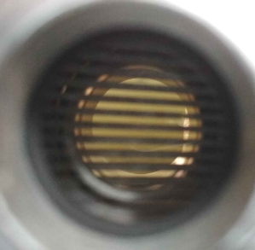
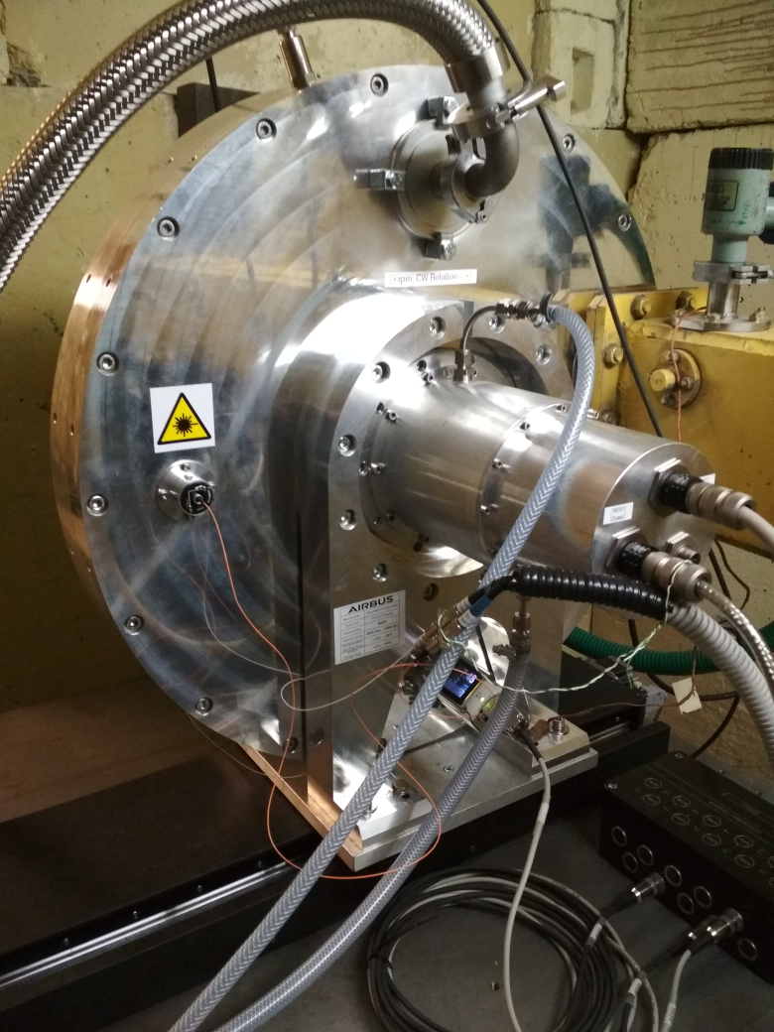
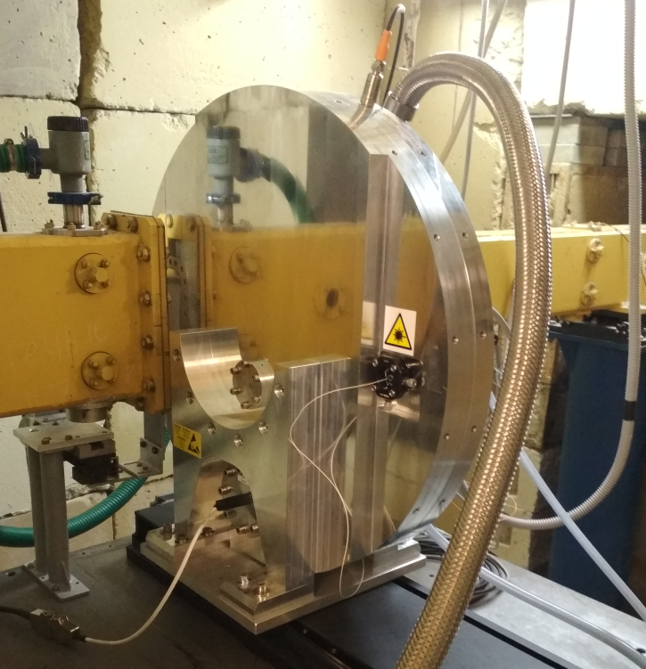
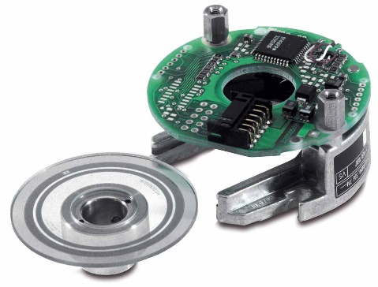
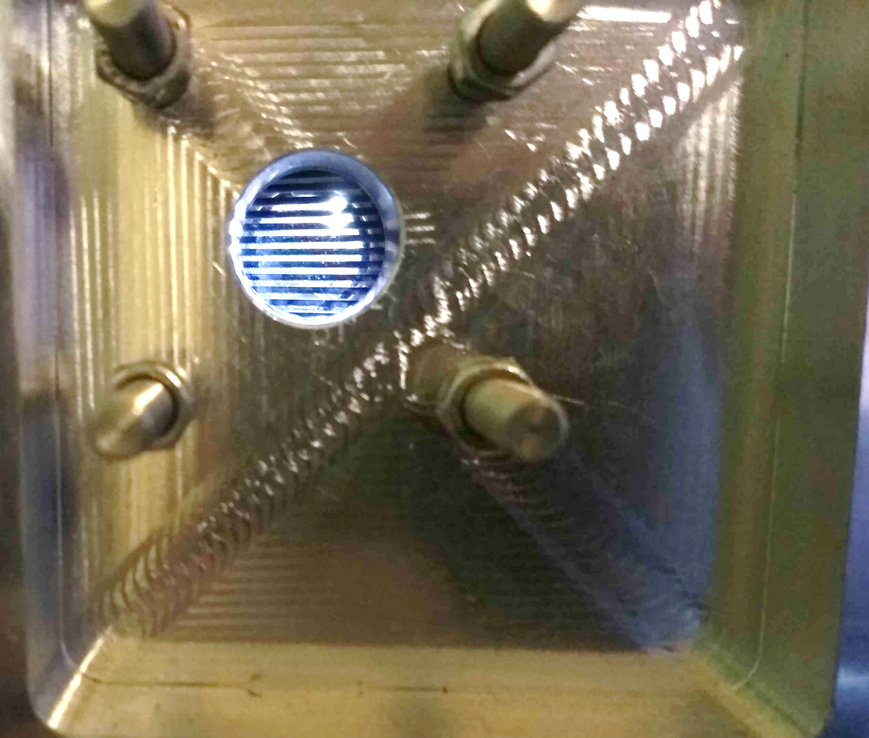
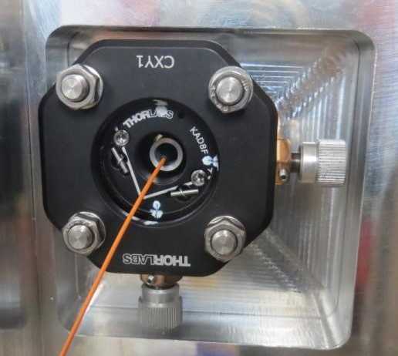
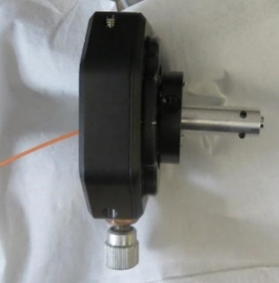
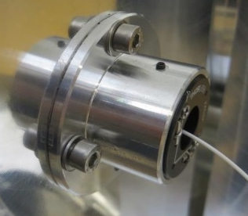
Laser
Internal structure of the FC drive
Incremental optical encoder HEIDENHAIN ERO 1225
Optical window in the FC housing
Collimator based on GRIN lens with optical fiber
Infrared laser with 1550 nm wavelength
Design of the LPS laser pickup system

Slide 9
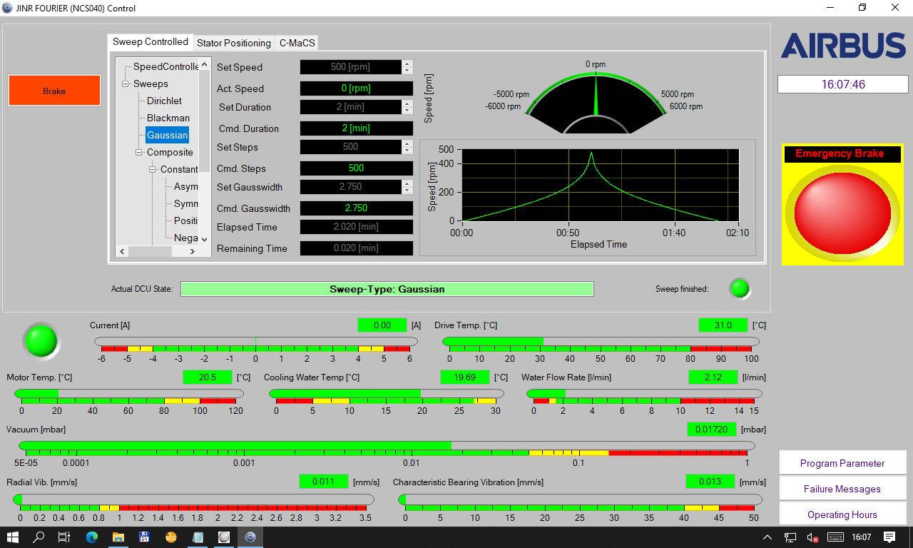
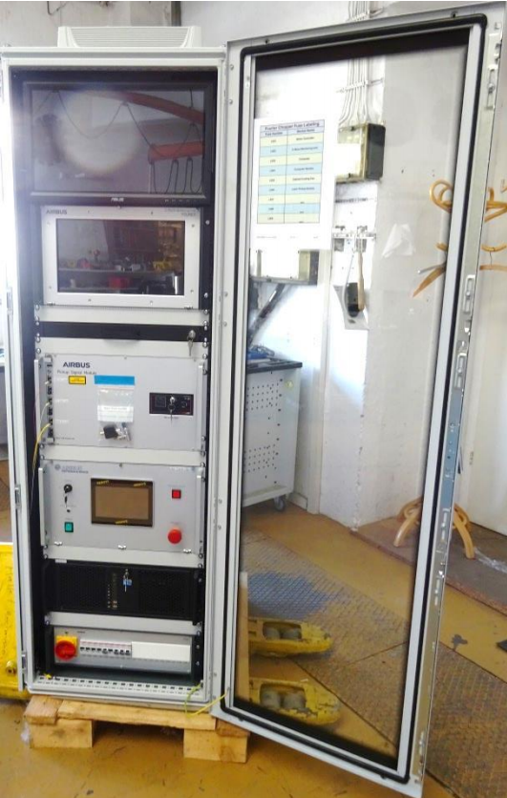
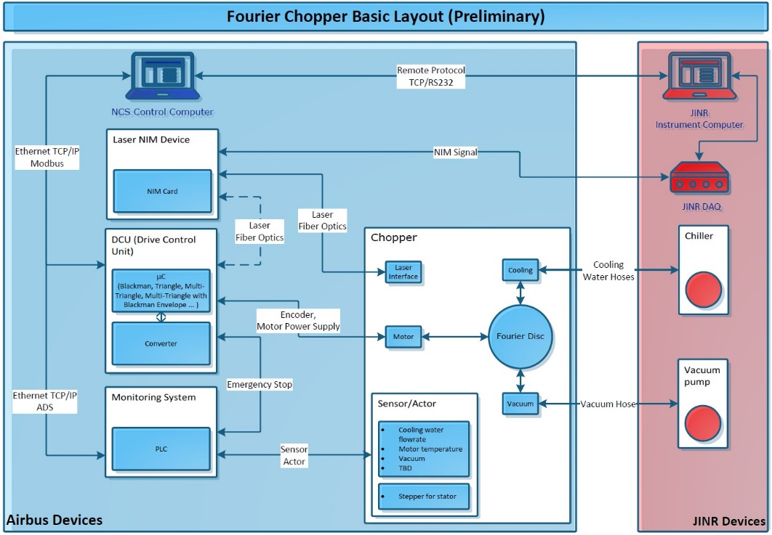
Graphical interface of the control software
Block diagram of the FC control
The chopper is equipped with vacuum, vibration, temperature, water flow sensors, as well as a locking and emergency stop system.
FP control rack (top to bottom):
LCD monitor, C-MaCS monitoring module, drive controller, LPS laser pickup control module, control PC

Slide 10
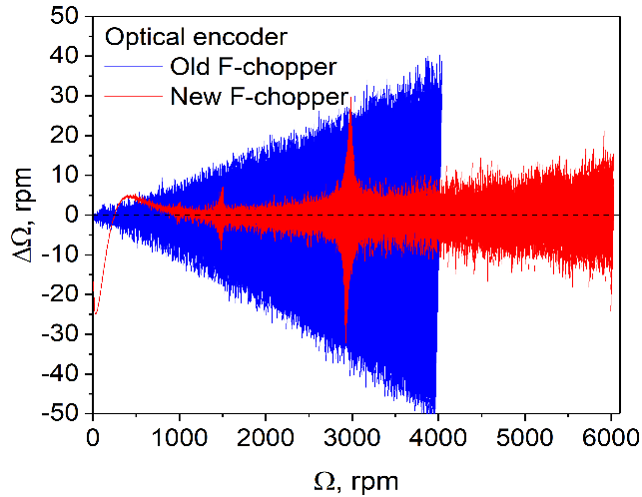
Frequency windows: Const, Dirichlet, Blackman, Gauss, CompBD-C, CompBD-V
Absolute deviations of speed ΔΩ from linear dependence for old and new FC
Sweep functions reconstructed from raw list-mode data for Dirichlet, CompBD-C, Gauss, Blackman sweeps
Transmission function: dependence of the diffraction peak intensity on the stator position Ψ

Slide 11
Constant speed mode (Const)
Individual Fourier harmonics for the diffraction RTOF spectrum from the α-Fe standard sample, measured at various constant F-chopper speeds in RTOF mode
Individual Fourier harmonics for the α-Fe(211) peak measured at various constant FC speeds. Experimental data are approximated by an oscillating function:
A typical RTOF diffraction spectrum with symmetrical Gaussian peak profiles consists of the sum of Fourier harmonics measured according to a specified frequency window g(ω) in the modulation frequency range from 0 to ωmax.

Slide 12
Results of the first diffraction experiments
High-resolution RTOF diffraction spectra measured with a new F-chopper on a standard α-Fe sample using ASTRA (2θ = ±90°) and BS (2θ = 140°) detectors. Sweep Gauss, σ = 3.286, Ωmax = 6000 rpm.
Pickup signal from an optical encoder.

Slide 13
Results of the first diffraction experiments
Encoder
Laser
Comparison of high-resolution RTOF spectra measured with an encoder (left) and an LPS laser pickup system (right)
FSD resolution function measured at max. speed Ωmax = 6000 rpm of the new F-chopper for the BS detector (2θ = 140°) and two ASTRA detectors (2θ = ±90°)

Slide 14
New Fourier chopper - Conclusions
The design of the new Fourier chopper of the FSD diffractometer and the organization of the control system provide significantly better PID control and stability of operation over a wide range of speeds, which makes it possible to achieve more accurate execution of the specified frequency windows g(ω).
The range of acceleration limits expanded by 300 times (0.1 ÷ 300 rpm/sec) allows one to create sweeps in a wide range of operating parameters (maximum speed, duration and number of steps).
The stator control system (precision actuator) ensures high phase stability of the pickup signal, which allows obtaining symmetrical diffraction peaks over the entire range of d_{hkl}.
Using a movable platform allows one to quickly switch between TOF (high intensity) and RTOF (high resolution) operating modes.
The principal possibility of generating pickup signals using a laser beam (LPS) passing through slits in the rotor and stator is shown, which provides a direct measurement of the chopper transmission function, identical to the neutron signal.
The location of the LPS system outside the zone affected by the neutron beam allows one to avoid radiation damage of the pickup generation system units.
There are potential opportunities that can be very useful for the further development of the RTOF method.

Slide 15
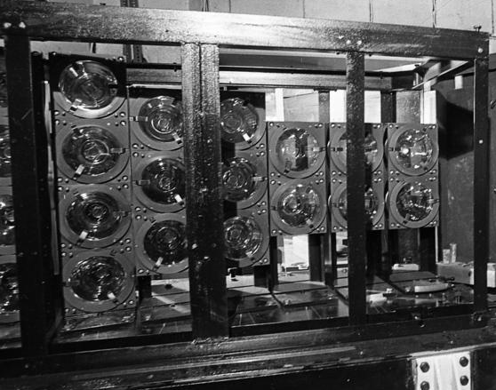
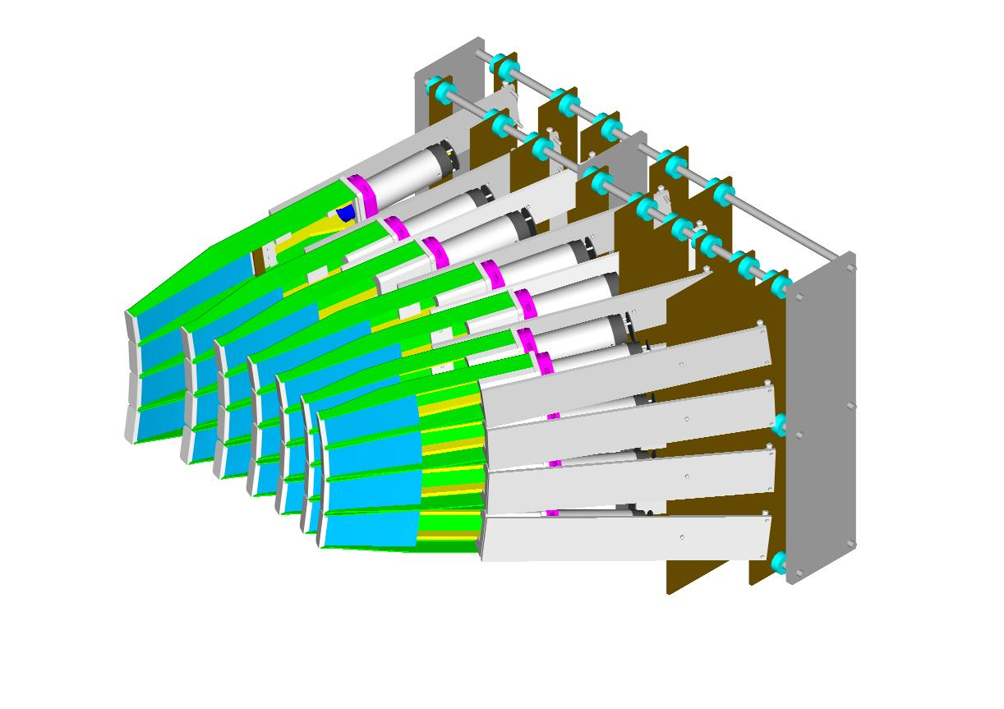
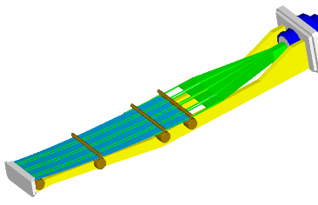
FSD detector system
⁶Li glass backscattering (BS) detector, 16 PMTs, 2θ = 140°, resolution: Δd/d≈2×10⁻³
Strain measurement in bulk specimen with radial collimators
Each bank of ASTRA 90º-detector consists of 7 ZnS(Ag) based modules.
Scattering angle range: Δ(2θ) = 40°
Vertical angle range: Δφ = 24°
Total solid angle: ΔΩ = 179 mstr
Resolution: Δd/d≈4×10⁻³
Interior arrangement of the single module: ZnS(Ag) scintillator with WLS-fibers
3D model of the 90º-detector bank

Slide 16
Electronic focusing of detector modules
Initial diffraction spectra from individual modules of the ASTRA detector reconstructed with the same channel width
3D model of 90° ASTRA detector made of 7 elements with individual TOF-scales (geometric time focusing)
Arrangement of sensitive ZnS(Ag) layers of the ASTRA 90°-detector in the horizontal scattering plane
TOF-scale coefficients:
L_{i}, L₀ are the flight paths, θ_{i}, θ₀ are the scattering angles, and τ_{i}, τ₀ are RTOF channel widths for the i-th and basic detectors, respectively
k_{i} = L_{i}⋅sin(θ_{i}) / L₀⋅sin(θ₀) τ_{i} = k_{i} τ₀
After E-focusing: the same diffraction spectra reduced to the unified TOF scale (E-focusing) and the final total spectrum

Slide 17
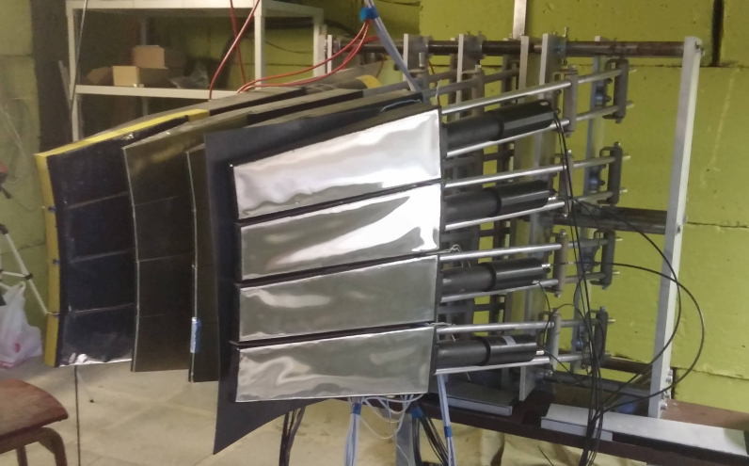
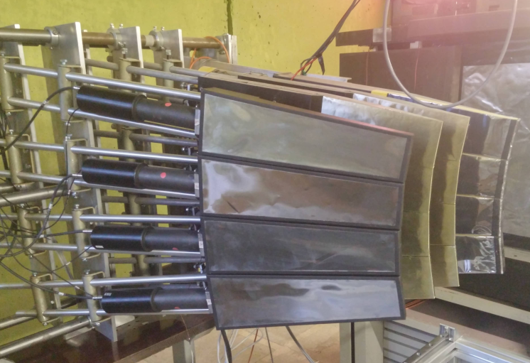
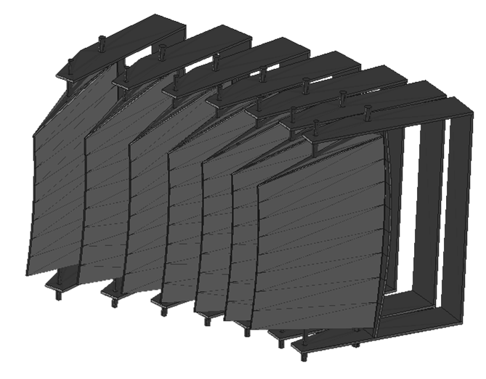
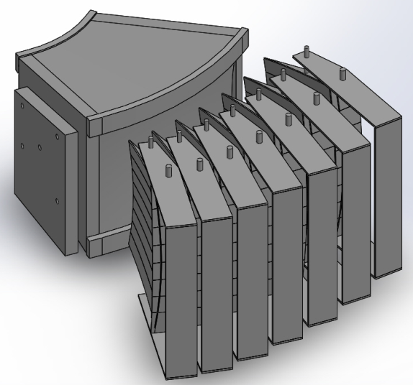
±90° ASTRA detectors: situation until 2022
AstraLeft: 4 elements
AstraRight: 4 elements
Upgrade plan: installation of 7 elements for each detector bank (Astra-Left and Astra-Right) in accordance with the developed detector design

Slide 18
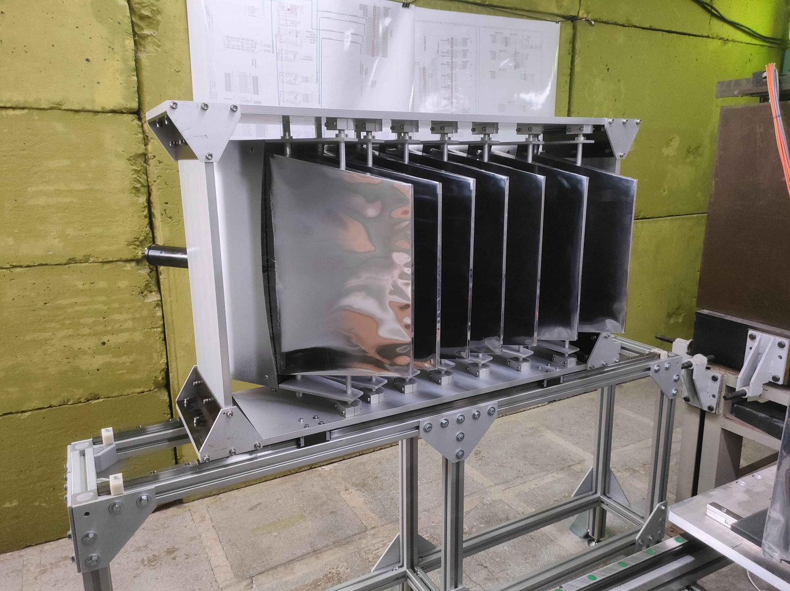
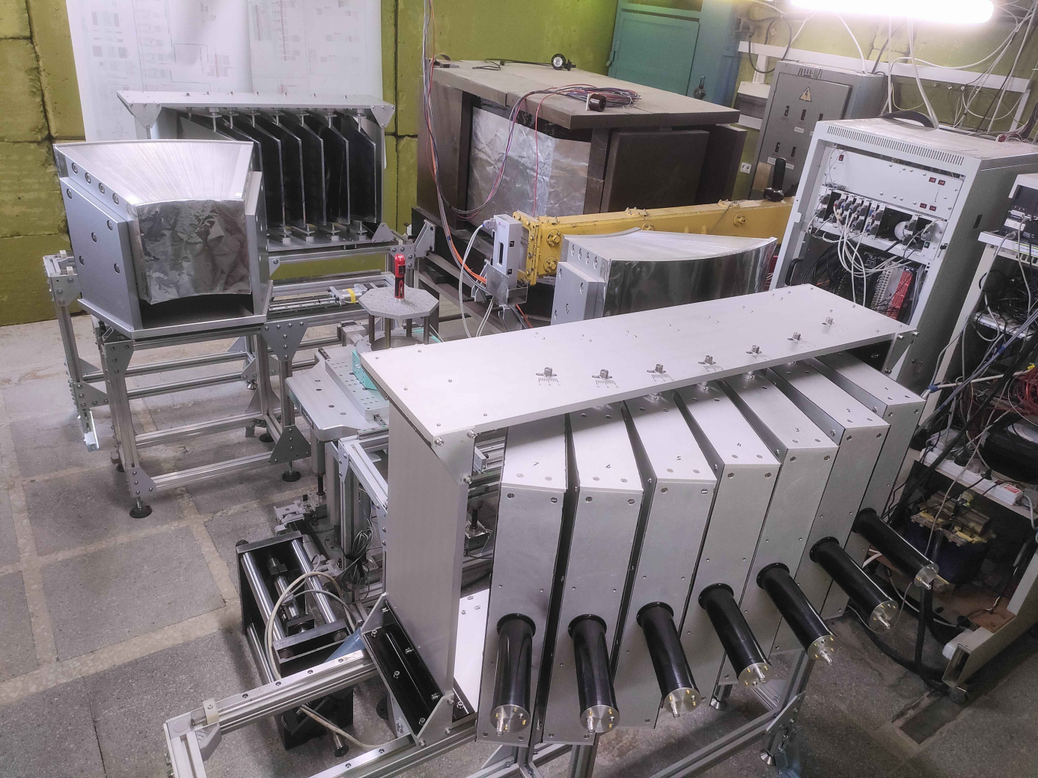
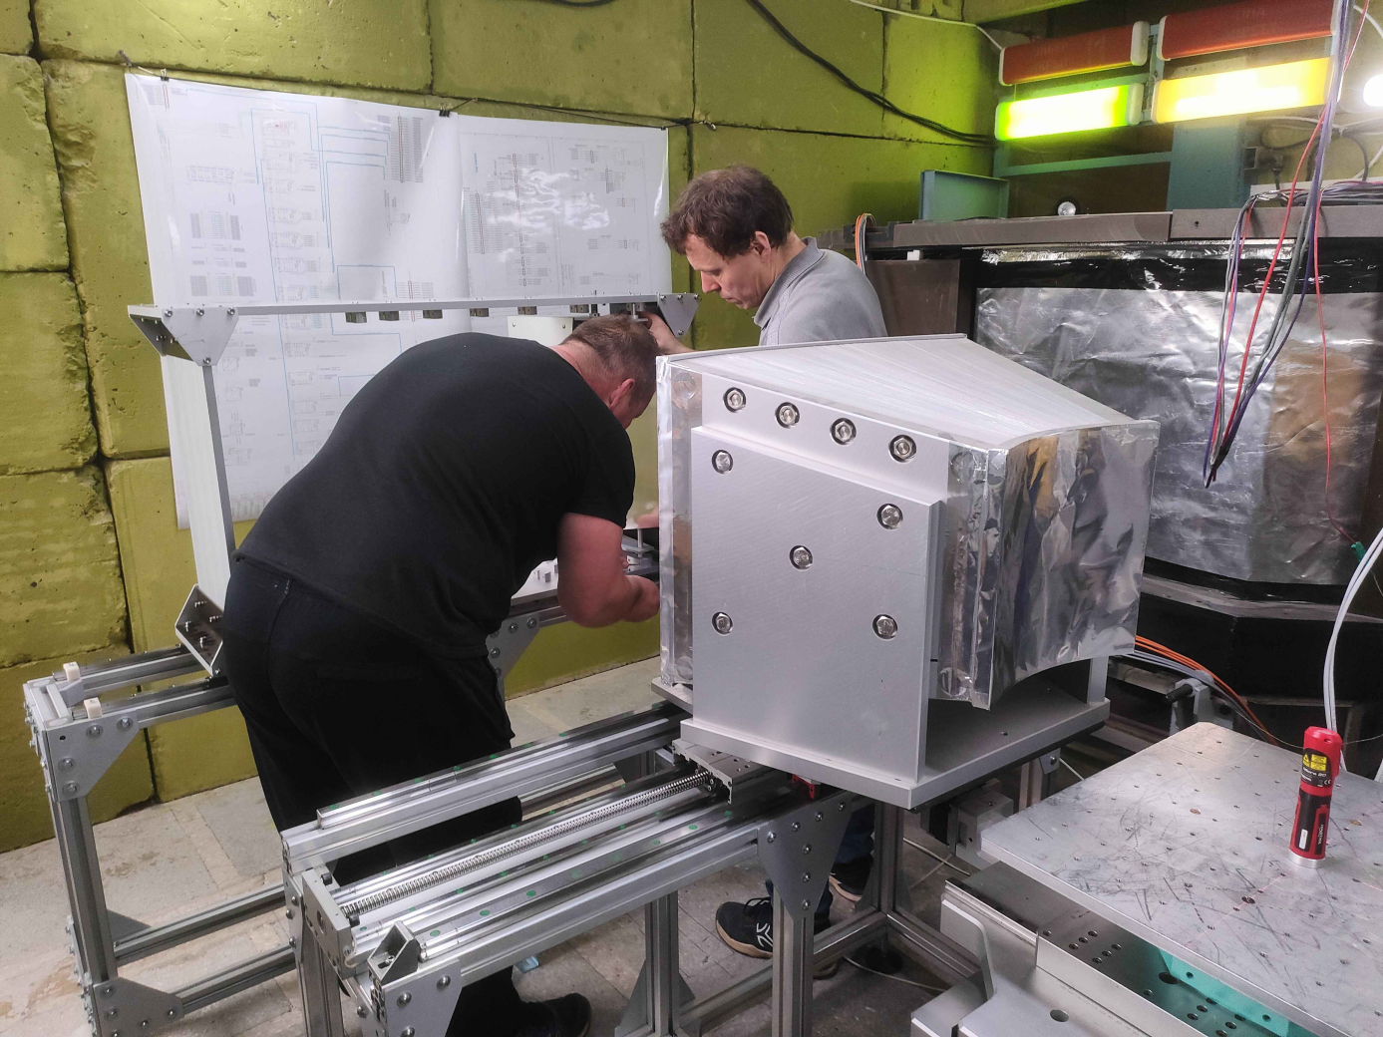
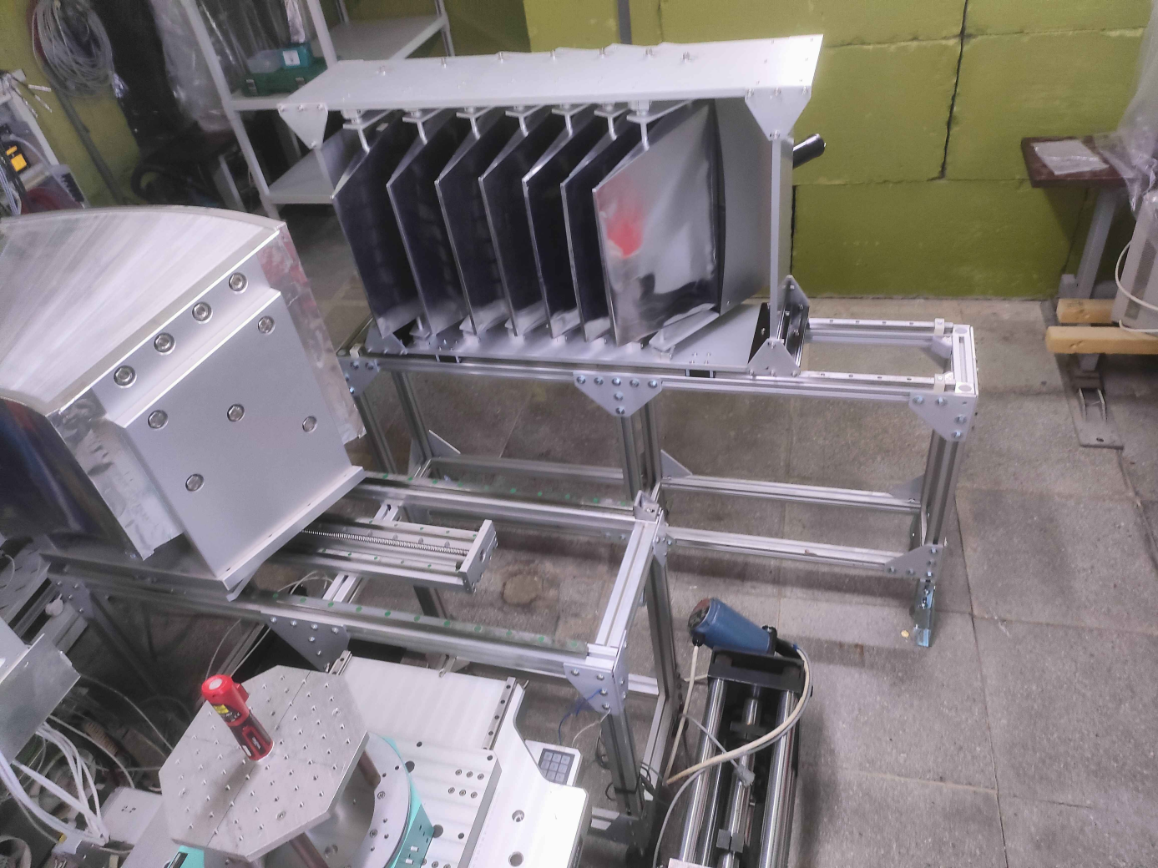
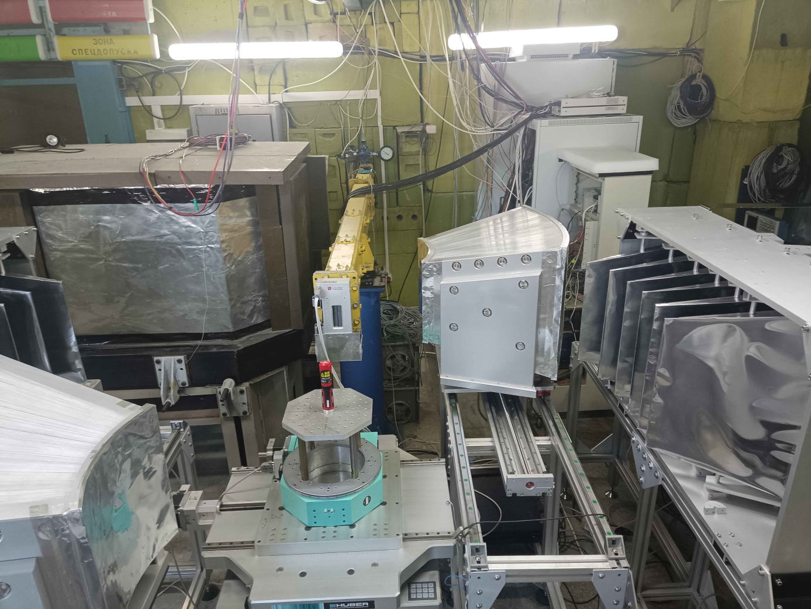
2022: new 90° ASTRA detectors
Total upgrade
AstraRight: 7 elements
Manufactured by the Spectrometer Complex Department
AstraLeft: 7 elements
In 2022, 14 new modules of ASTRA detectors were installed on the FSD diffractometer. The detector electronics have also been replaced. Thus, the detector system at scattering angles 2θ = ±90° is fully equipped, which will increase the luminosity by ~1.5 times. Adjustment works will be carried out after the launch of the IBR-2 reactor.

Slide 19
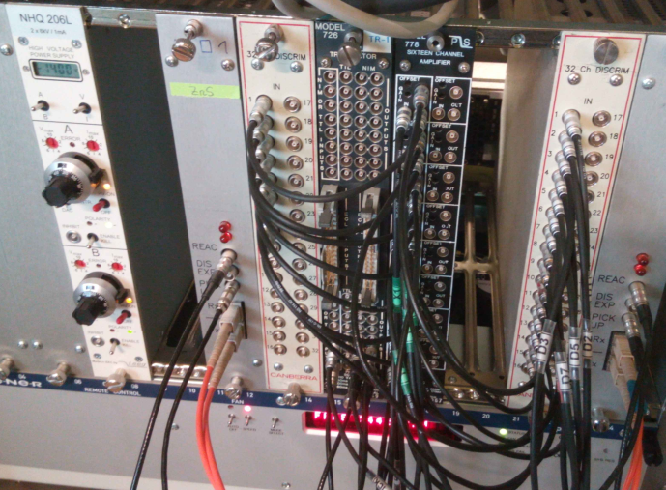
2022: extension of the list-mode DAQ system
Current DAQ setup:
RTOF analyzer 1 – Backscattering (BS) detector (2θ = 140°)
RTOF analyzer 2 – ASTRA detectors (2θ = ±90°)
Main advantages of the list-mode DAQ system:
high performance and scalability of LM DAQ system;
offline spectra reconstruction is possible without repeated measurements;
flexibly configurable TOF-scale parameters;
possibility to analyze: real frequency window, F-chopper pickup signals, reactor starts, detector events;
phase error correction; detector events filtering;
precise electronic focusing for multi-element detectors.
A second RTOF analyzer (MPD-32 unit) is installed for independent recording of raw data in list-mode from the new ASTRA detectors
Correlation RTOF diffractometry at long-pulse neutron source: data analysis methods
[1] G. Bokuchava, Correlation RTOF diffractometry at long-pulse neutron source: I. Data acquisition in list-mode,
Nucl. Instrum. Methods Phys. Res. A, 2020, Vol. 964, 163770. DOI: 10.1016/j.nima.2020.163770
[2] G. Bokuchava, Correlation RTOF diffractometry at long-pulse neutron source: II. Analysis of frequency windows and diffraction peak profiles, Nucl. Instrum. Methods Phys. Res. A, 2020, Vol. 983, 164612. DOI: 10.1016/j.nima.2020.164612
[3] G. Bokuchava, On the diffraction peak amplitude measured by neutron reverse time-of-flight (RTOF) diffractometry,
Nucl. Instrum. Methods Phys. Res. A, 2022, Vol. 1037, 166917. DOI: 10.1016/j.nima.2022.166917

Slide 20
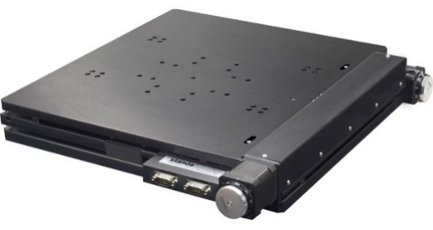
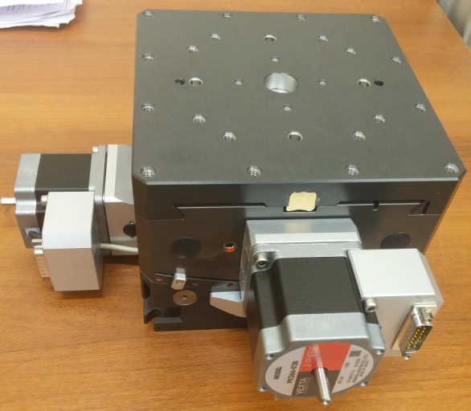
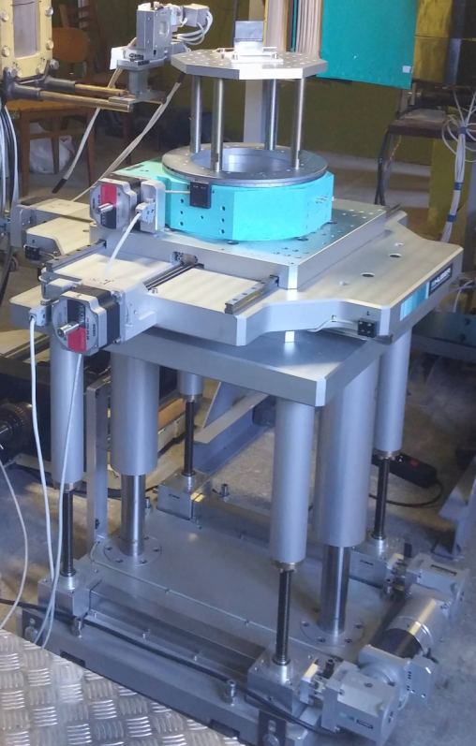
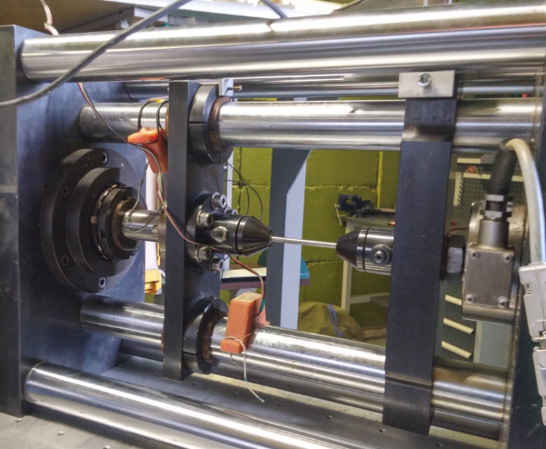



Sample environment
Running task: software upgrade for Stress rig LM-29
Fmax = 29 kN, Tmax = 800°C
New auxiliary
XY-platform (2021)
±100 mm
2-Circle Segment ±15°
HUBER goniometer:
Linear: X, Y: ± 150 mm
Linear: Z: 0 ÷ 300 mm
Rotation: Ω: 0 ÷ 360°
Max. load: 300 kg
Mirror furnace
Tmax=1000° C

Slide 21




Estimation of residual microstresses in Al alloy samples using Genetic Programming (GP)
Collaboration:
- FLNP JINR (Dubna, Russia)
- CENIM (Madrid, Spain)
- BAM (Berlin, Germany)
- Research Centre Řež (Řež, Czech Rep.)
- Uni. of Applied Sciences Upper Austria
(Hagenberg, Austria)
FSD@IBR-2 reactor
A tree-like solution found by GP for the first model
Measured EBSD map
Extruded cylindrical sample: 5083 Al alloy (quenched)
Measured macrostress
Solution found by GP algorithm
Profiles of axial residual macro- (blue) and microstresses (red)
Neutron diffraction pattern
Overview of the GP learning process
Lattice spacing and residual microstress values for some ⟨111⟩ grains calculated with the expression found by GP using HeuristicLab
[1] L. Millán, G. Bokuchava, R. Fernández et al., J. of Alloys and Compounds, 2021.
[2] L. Millán, G. Bokuchava, R. Fernández, G. González-Doncel et al., J. of Mater. Res. and Techn., 2023.
[3] G. Kronberger, L. Millán, R. Fernández, G. Bokuchava, G. González-Doncel et al., Applic. in Eng. Science, 2023.

Slide 22
Thank you for your attention!

