Slide 1
On current activities
at the IBR-2 facility
Egor Lychagin

Slide 2
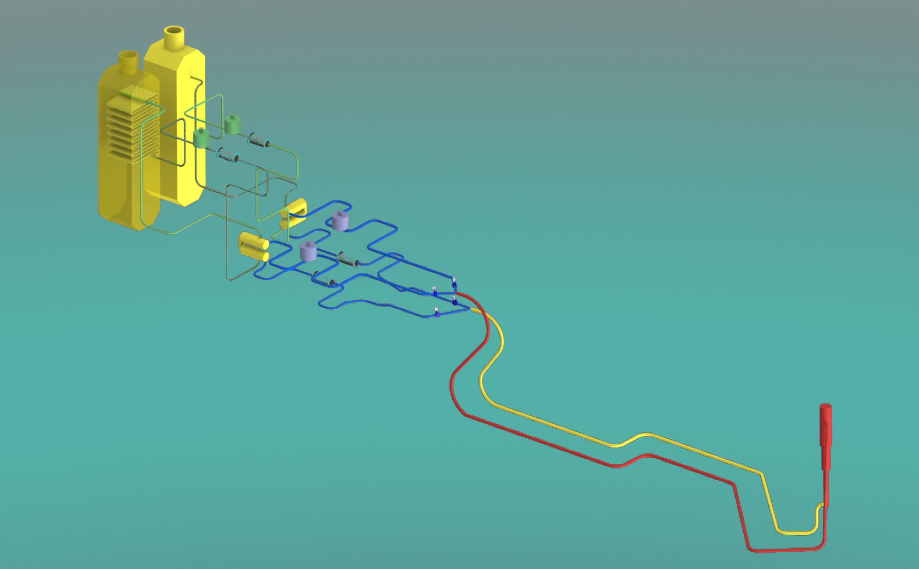
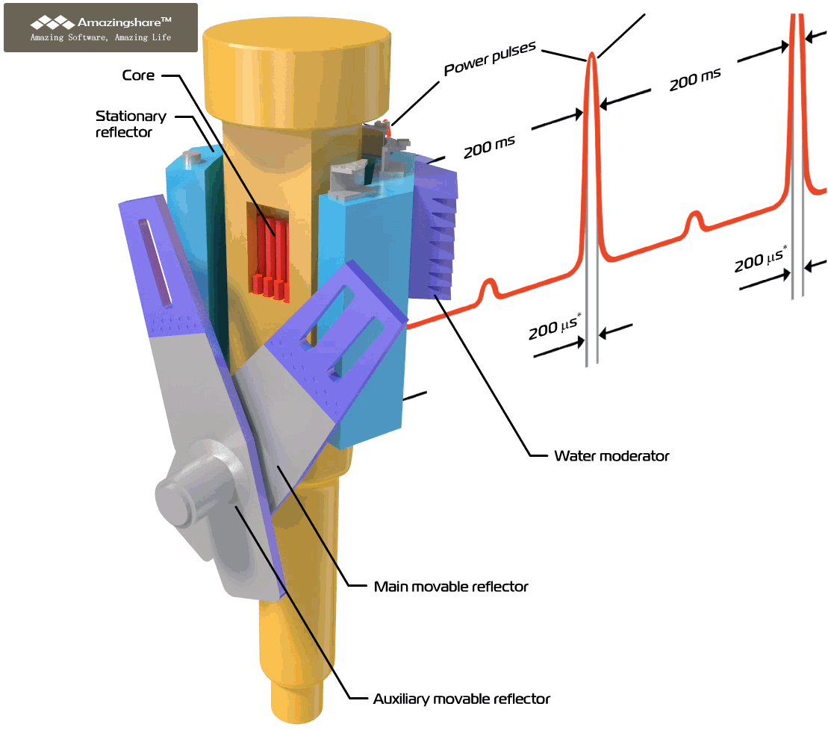
October 16, 2021, reactor shutdown due to leakage in the secondary cooling circuit air heat exchanger (HE).
Repair of the affected HE (due to the safety regulations we need 2 operated HE) – has been done in April 2022.
On September 30, 2022, the license for the reactor exploitations was expired.
The package of the documentation for licensing was sent to regulator in October 2022.
New leakage at HE in June 2023 during the reactor shutdown.
HE was repaired in September 2023.
The examination of documents by an independent organization would to be completed by the end of November 2023, but the end of examination was postponed to January 2024.
Primary circuit
Core
Secondary circuit
Notes:
Пояснения на русском и английском языках.

Slide 3
today
Validity of the license
Reactor operation/shutdown
HE leakage/repairing
HE replacement project (work was started 04/12/2019)
HE manufacturing
HE replacement contract
Documents for new license sent to the Regulator
Examination of documents by independent experts
Notes:
Пояснения на русском и английском языках.

Slide 4
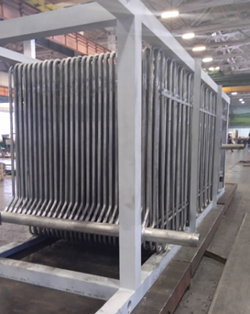
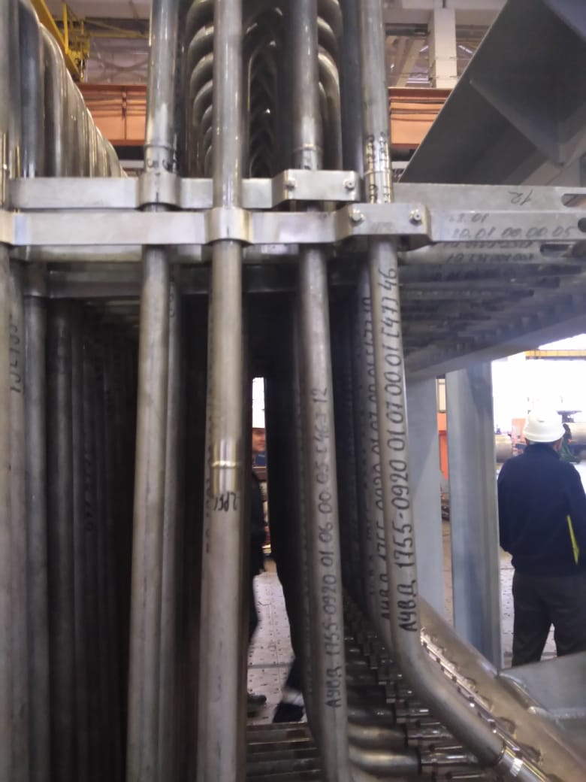
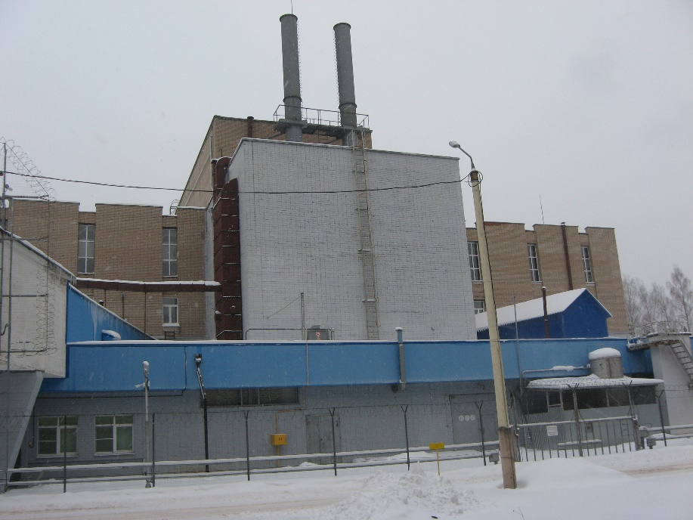
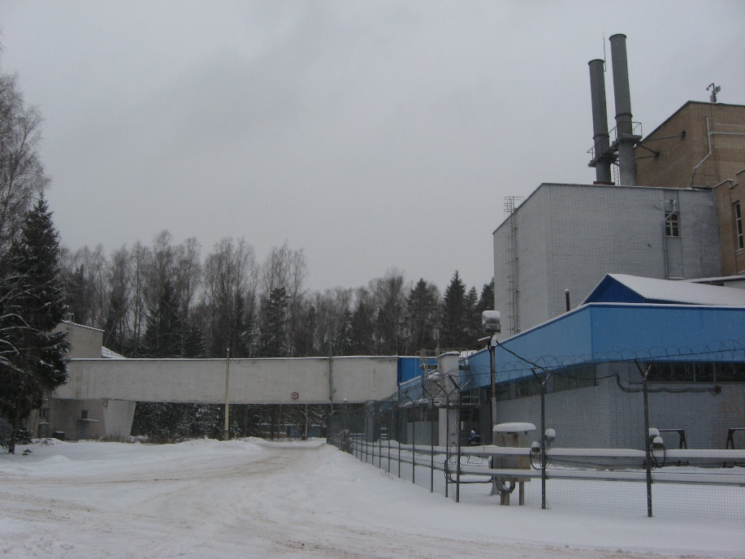
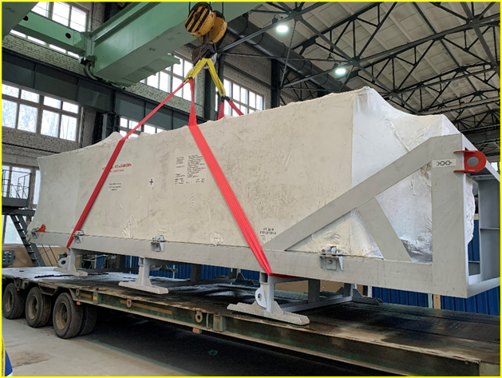
New heat exchangers at manufacturer site.
External view of the HE transport container.
Temporary storage is organized in building No. 5 DLNP.
View of the room 223 building 117.
Notes:
Пояснения на русском и английском языках.

Slide 5
The schedule of organizational and technical work for the resumption of regular operation of
the reactor (optimistic scenario).
2023|2024
 | Nov | Dec | Jan | Feb | Mar | Apr | May | Jun | Jul | Aug | Sep | Oct | Nov | Dec
Examination of documents Was extended twice: up to end of December 2023 up to end of January 2024
2. Regulator’s (Rostechnadzor) decision to issue a license
3. Issuing a license
4. Change of the air heat exchanger
5. Making changes to the current license
6. Star-up of the reactor
!
P. 1 was started in Oct 2022. It included several iterations in papers preparation. There is no time regulation.
P. 2 can be started only after P. 1. There is time regulation for this point: 20 working days for decision.
P. 3 can be started only after P. 2. There is time regulation for this point : 20 working days for license issue.
P. 4 can be started only after obtaining the license. All preparation works has been done.
P. 5 contains stages as P. 2 and P. 3 with similar time regulation and the stage of examination of documents, which has no time regulations.
Start of the proposal collection for April-May 2025
Notes:
Пояснения на русском и английском языках.

Slide 6
Preparing for the resumption of the user program
An update of the user program regulations is being prepared in connection with the inclusion of NAA in the program and changes in the political situation.
Expert groups need to be updated
№ | Expert group | Number of experts in group | Number of experts in the list
1 | Nanosystems and Soft Matter (YuMO, GRAINS, REFLEX, REMUR) | 16 | 4
2 | Atomic and Magnetic Structure (RTD, DN-6, DN-12, SKAT, EPSILON, FSD, HRFD) | 9 | 1
3 | Lattice and Molecular Dynamics (NERA) | 3 | 2
4 | Neutron Activation Analysis (REGATA) | 6 | 3
We ask PAC members to help us find candidates for working at expert groups.
Notes:
Пояснения на русском и английском языках.

Slide 7
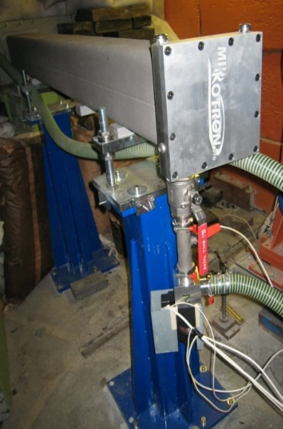
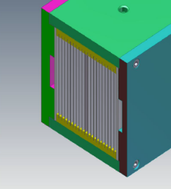
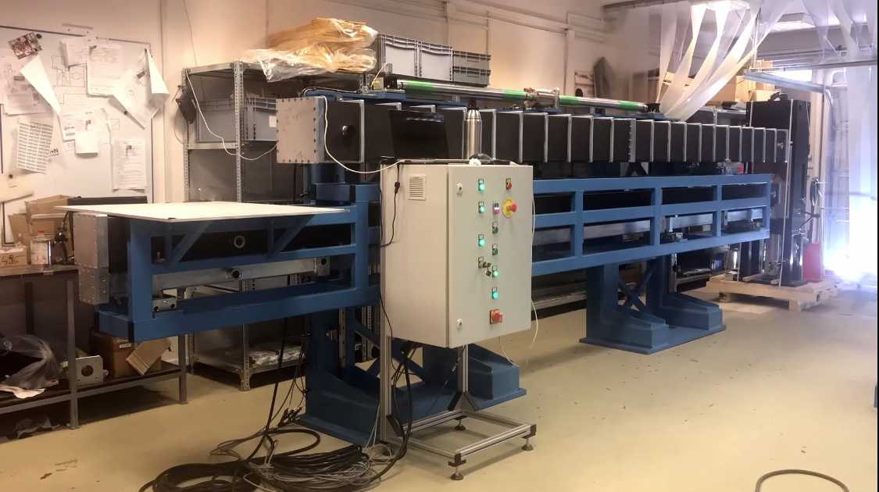
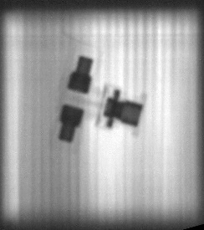
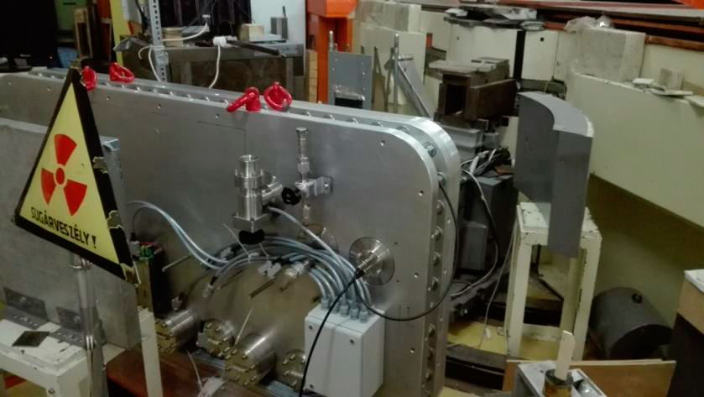
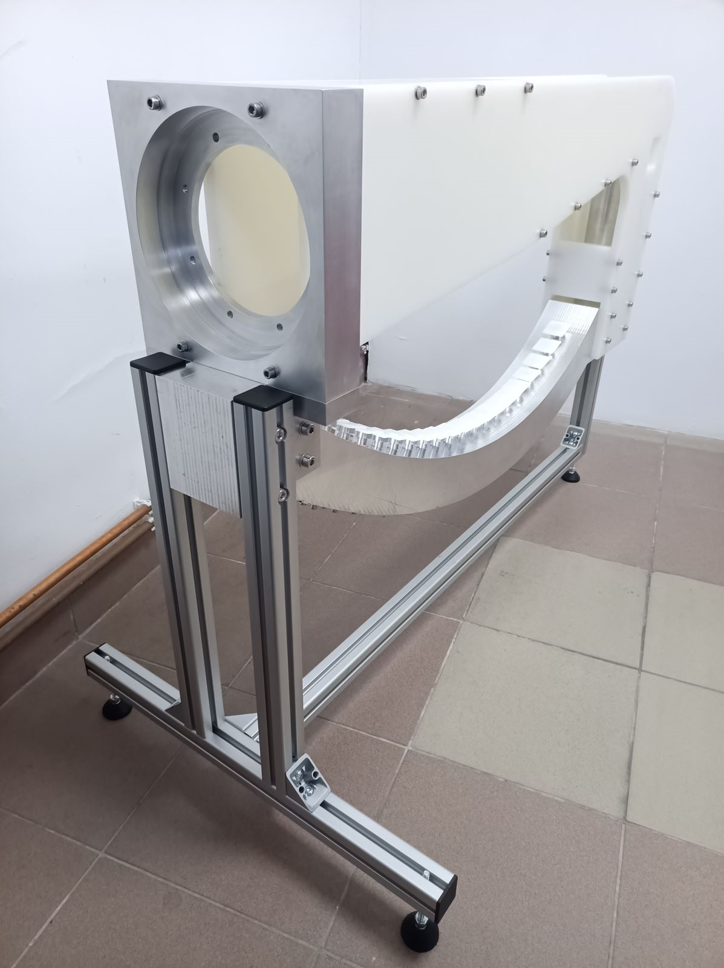
Spectrometers development
Project of BJN spectrometer
SANSARA – Small-Angle Neutron Scattering/
Neutron Tomography
BJN (Bajorek-Janik-Natkaniec)
Main tasks for 2023
Bender
Changeable beam forming system
Development of a draft design of the spectrometer elements - preparation of technical drawings of the spectrometer elements, which include: - HOPG crystal fastening systems | √
- detector mounting systems | √
- boron carbide block attachment systems to suppress forward scatter from the sample into the detector | √
- a vacuum container containing all the elements of the secondary spectrometer | x
Purchase of HOPG crystal* | √ / x
Purchase of Beryl | √
Development and manufacture of prototype | √
L = 2 m, R = 14 .3 m, N = 20 (m = 2)
L = 6 m
Produced and installed at IBR-2 by MIRROTRON (2018)
Produced and delivered to JINR by MIRROTRON (2020)
Vacuum tank for PSD
PSD
* 400 pcs was produced. 60 pcs selected after testing of 108 pcs on the spectrometer STOIK at IR8 reactor.
D = 1.6 m, L = 12 m
PSD case during tests by MIRROTRON (2021).
Delivery is planned in 2024
Produced and delivered to JINR by MIRROTRON (2023)
Notes:
Пояснения на русском и английском языках.

Slide 8
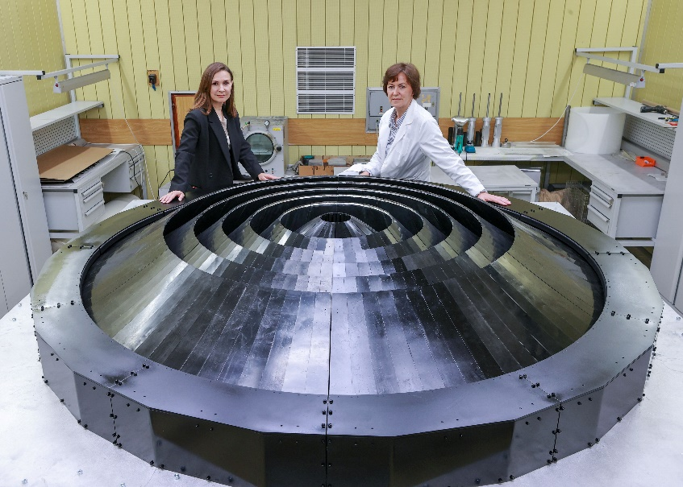
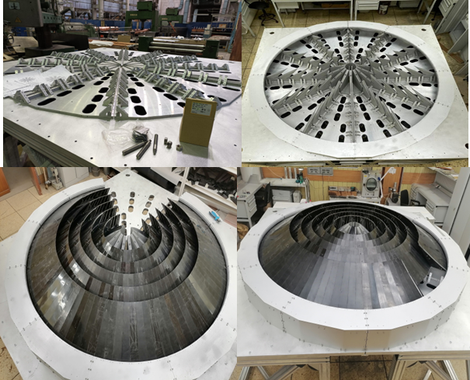
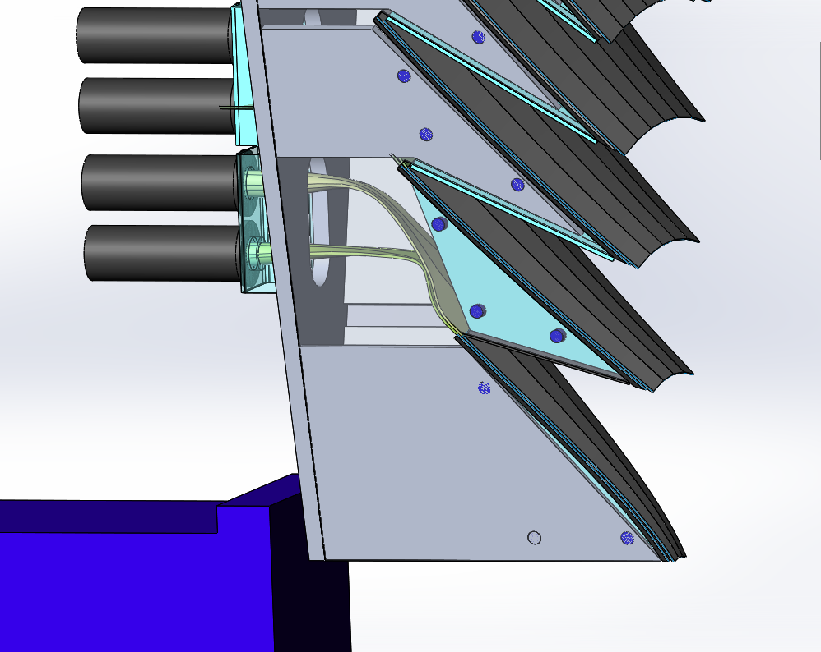
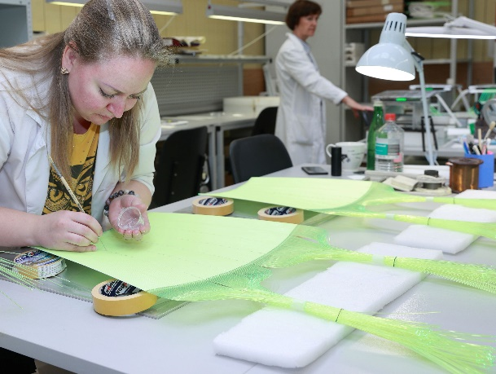
Back Scattering Detector (BSD)
Photomultipliers : 216
The surface of scintillator S > ${\text{10} m}^{2}$
The approximate length of fibers L=36000 m
High voltage (CAEN)
2 NIM creates
Pre-amplifiers and 216 independent detectors of the Data Acquisition and Accumulation System. The system is designed in the NIM standard. In its full configuration, it consists of 8 units of amplifiers-discriminators with 32 inputs.
Scintillation detectors based on ND screens ZnS(Ag)/6LiF
An element of the scintillation screen (white plate) together with the optical wavelength shifting fibers glued to it on both sides.
Notes:
Пояснения на русском и английском языках.

Slide 9
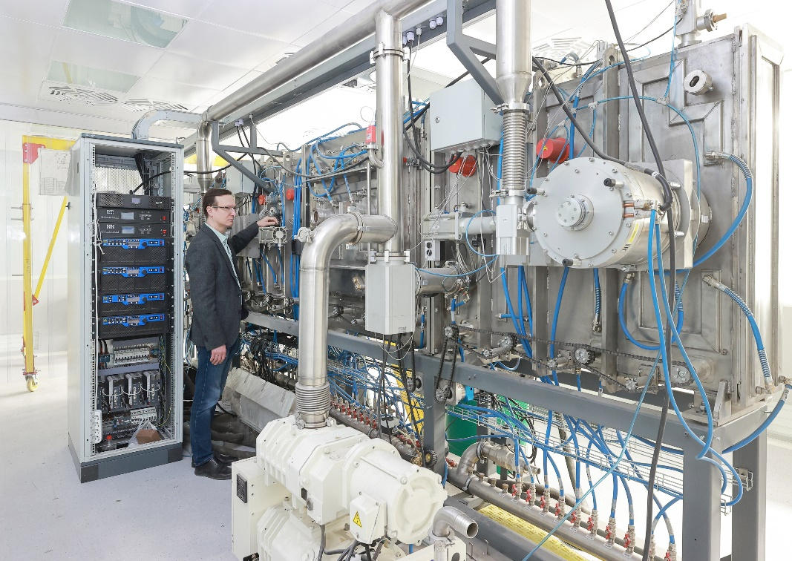
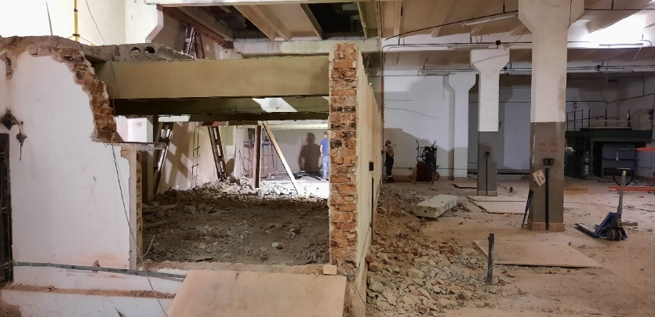
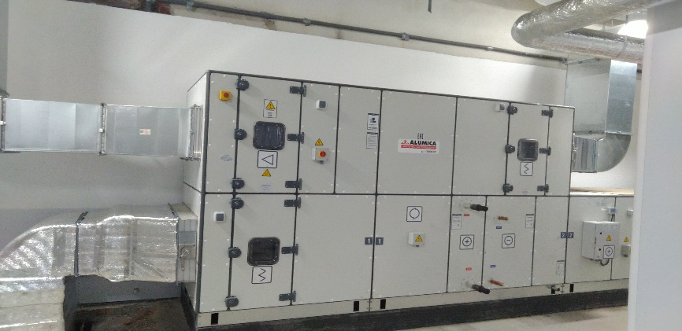
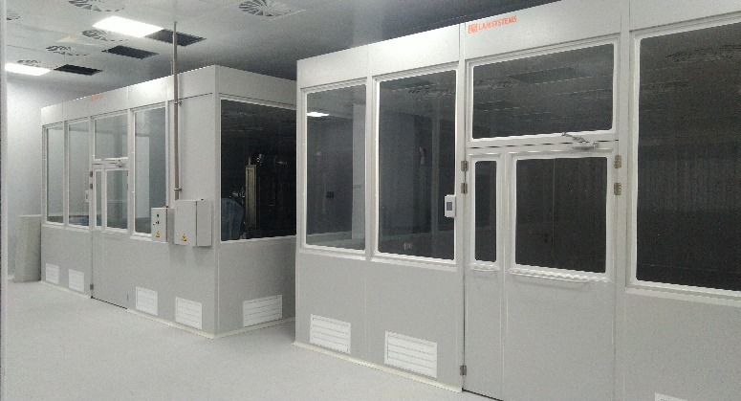
Building of experimental site for detector production
Initial stage of building
Today: modern equipment and engineer systems

Slide 10
Thank you for your attention.

