Slide 1
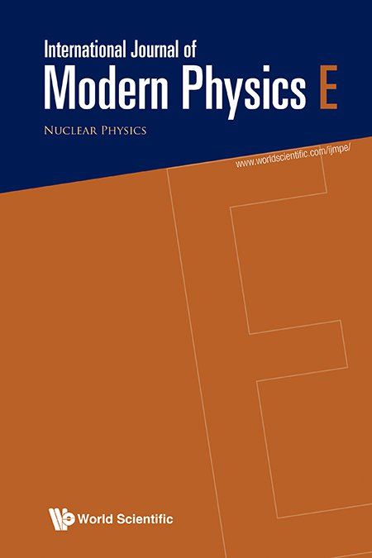
International Journal of Modern Physics E (IJMPE)
An international peer-reviewed journal focused on nuclear physics and its intersections with astronomical and particle physics.
IJMPE and LXXIV International Conference Nucleus-2024 cover similar ground with topics like experimental and theoretical studies of nuclear properties, reactions, and applications in science and technology.
Indexed in major databases, such as SCIE, Scopus, INIS/IAEA, ADS/NASA, IJMPE is a trusted publication of quality research that advances the field.
We welcome manuscript submissions from the Conference speakers and participants.
Managing Editors:
Dmitri E Kharzeev (Stony Brook University & Brookhaven National Lab)
Jie Meng (Peking University)
Xin-Nian Wang (Central China Normal University & Lawrence Berkeley National Lab)
Learn more about submitting your work to IJMPE:
Submit your work
to IJMPE:

