Slide 1

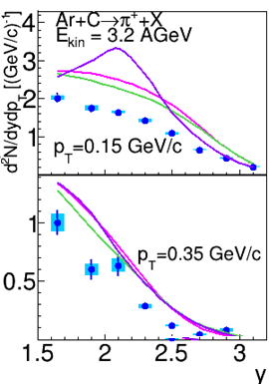
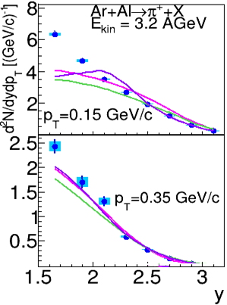
Is there diffraction dissociation of nuclear nucleons in nucleus-nucleus interactions?
V. Uzhinsky, A. Galoyan, A. Ribon, 3 July 2024
1 BMN results for Ar + A inter. at 3.2 A GeV
It was interesting for us, how does Geant4 FTF model describe the data?
Some details of the Geant4 FTF
will be given and considered.
Production of Pi+ and K+ mesons
in argon-nucleus interactions at 3.2 AGeV
JHEP 07 (2023) 174
2 NA61/SHINE results for Ar + Sc inter.
at 13, 19, 30, 40, 75 and 150 A GeV/c
3 NA61/SHINE results for Be-7 + Be-9
inter. at 19, 30, 40, 75 and 150 A GeV/c
Ongoing BMN publication
Production of protons, deuterons, tritons in argon-nucleus interactions at 3.2 AGeV BM@N Collaboration
It was presented by V.Plotnikov
at the RAS session, 1 – 5 April 2024.
JINR, Dubna
1

Slide 2
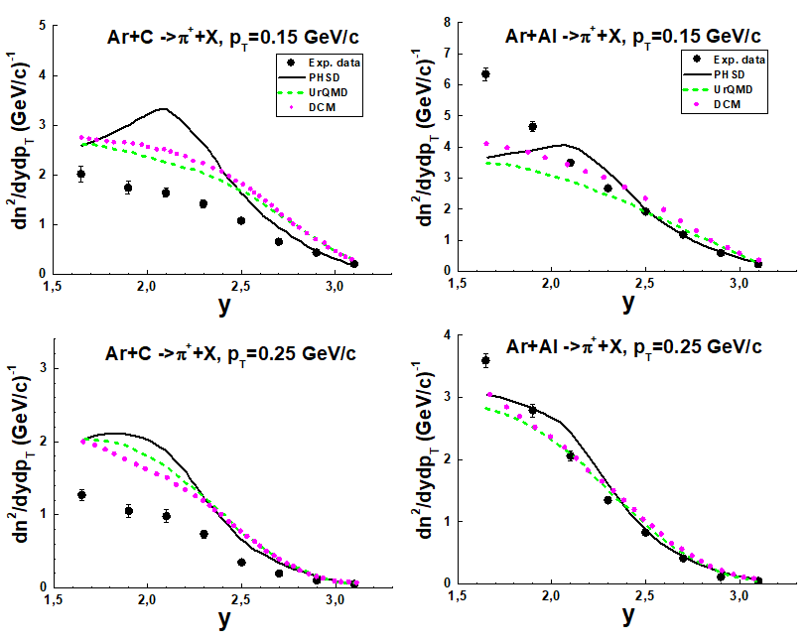
BMN results for Ar + C and Ar + Al
DCM/AGT model: local simulations of NN channel cross sections
like P+P -> N Pi+ P. No Deltas! (P+P -> P + Δ+ -> P + N + Pi+)
UrQMD local simulations of NN inter. Using matrix elements.
No Delta formation time and size!
PHSD based on Fritiof 7.0 at high energies and UrQMD at low energies.
2

Slide 3
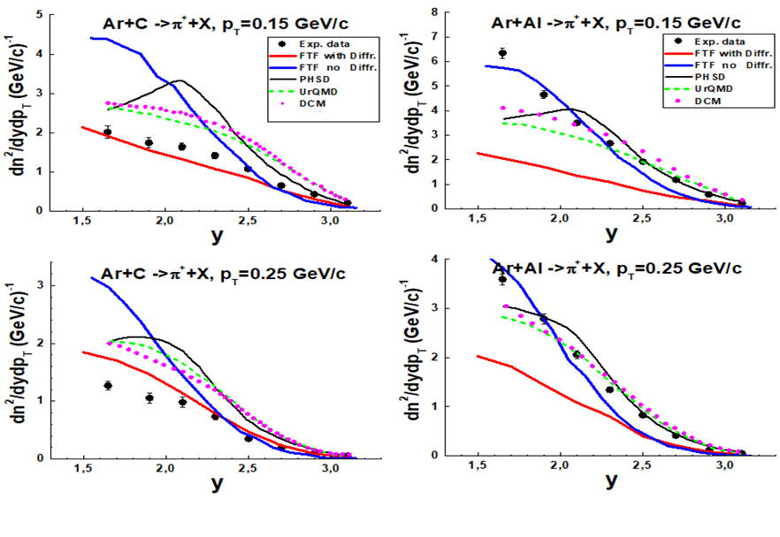
BMN results for Ar + C and Ar + Al
Red lines – default FTF model, blue ones – new FTF
C – target, OK, Al – not OK. What is the matter?
Blue lines (suppressed DD) – OK for Al and heavy A!
3

Slide 4
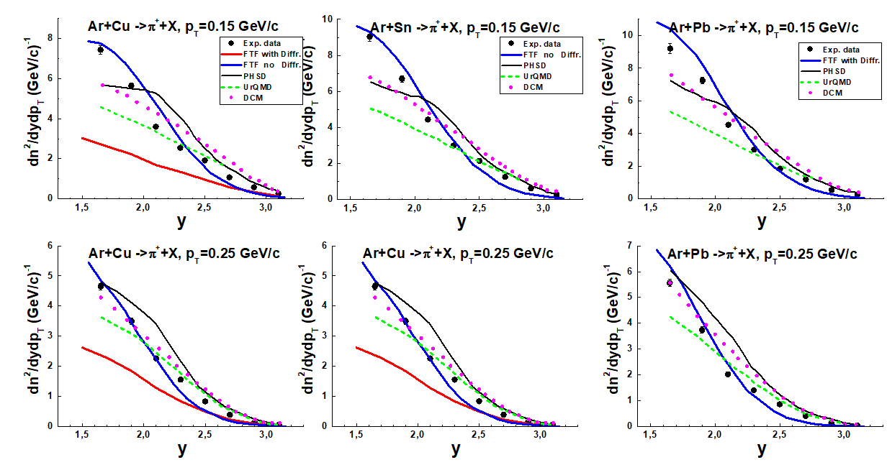
BMN results for Ar + Cu, Sn and Pb
Red lines – default FTF model, blue ones – new FTF
New FTF works better than other models.
4

Slide 5
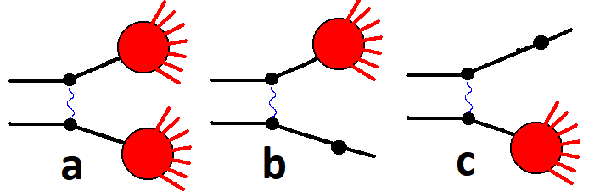
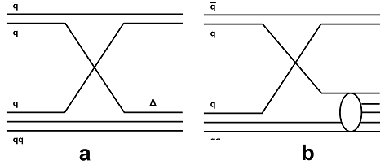
Geant4 FTF model : basic assumptions
B.Andersson et al. Nucl. Phys. B281 289 (1987)
B.Nilsson-Almquist, E.Stenlund, Comp. Phys. Comm. 43 387 (1987).
Fig. 1: Processes of string's creations considered in the FTF model.
Str.
Str.
GS
GS
Str.
Str.
Fig. 2 Additional quark exchange processes in the FTF model.
String mass distribution
5

Slide 6
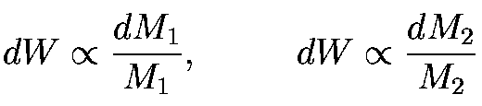
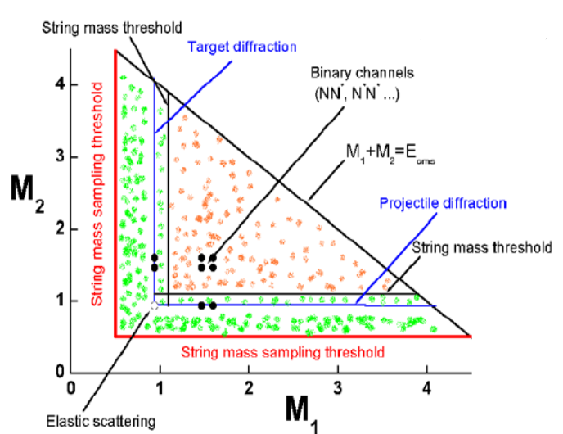
Simulation of inelastic nucleon-nucleon interactions
Fritiof model
UrQMD Md=1.46
Fritiof 1.6 Md=1.2
Fritiof 7.0 Md=1.2
Hijing Md~2;
FTF – 1.16
6
Notes:
6

Slide 7
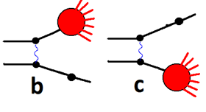
Diffraction processes in PP interactions
Diffractive Production Mechanisms A.B. Kaidalov, Phys. Rept. 50 (1979) 157, cited 289!
This is the triumph of the Pomeron theory
K. Goulianos and J. Montanha, Factorization and scaling in hadronic diffraction,
Phys. Rev., D 59 (1999) 114017
CDF data, Solid lines -- calculations
7

Slide 8
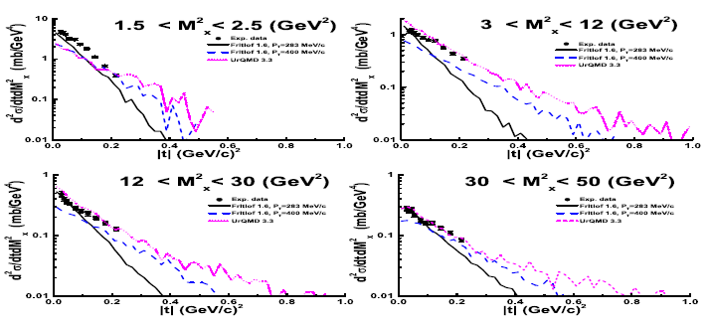
Дифракция с малыми передачами не воспроизводится в UrQMD!
Дифракция в большие массы воспроизводится в UrQMD!
8

Slide 9
Diffraction processes in PP interactions
Diffractive processes (~ 40 %)
and quark exchange ones are
very important at low energies
(NICA)!
Single diffraction dissociation cross section in 𝑝𝑝-interactions. Points are data gathered by
K. Goulianos and J. Montanha [GM99]. Lines are FTF model calculations.
(Physics Reference Manual, Release 11.1 Geant4 Collaboration Rev7.0: December 9th, 2022
https://geant4-userdoc.web.cern.ch/UsersGuides/PhysicsReferenceManual/html/index.html)
9

Slide 10

What has to be done in nucleus-nucleus interactions?
States of hadrons in FTF
Secondary
Interactions?
Quark exchange (GS + GS, QE)
Quark exchange with excitation (GS + TrD or PrD + GS, QE)
Projectile diffractive excited (PrD)
Target diffractive excited (TrD)
Non-diffractive interactions (Str. + Std., ND)
Target/ Project. | GS | PrD | Str.
GS | Qe PrD TrD ND | PrD TrD ND | ND
TrD | PrD TrD ND | PrD TrD ND | ND
Str.. | ND | ND | ND
New algorithm of DD accounting
10

Slide 11
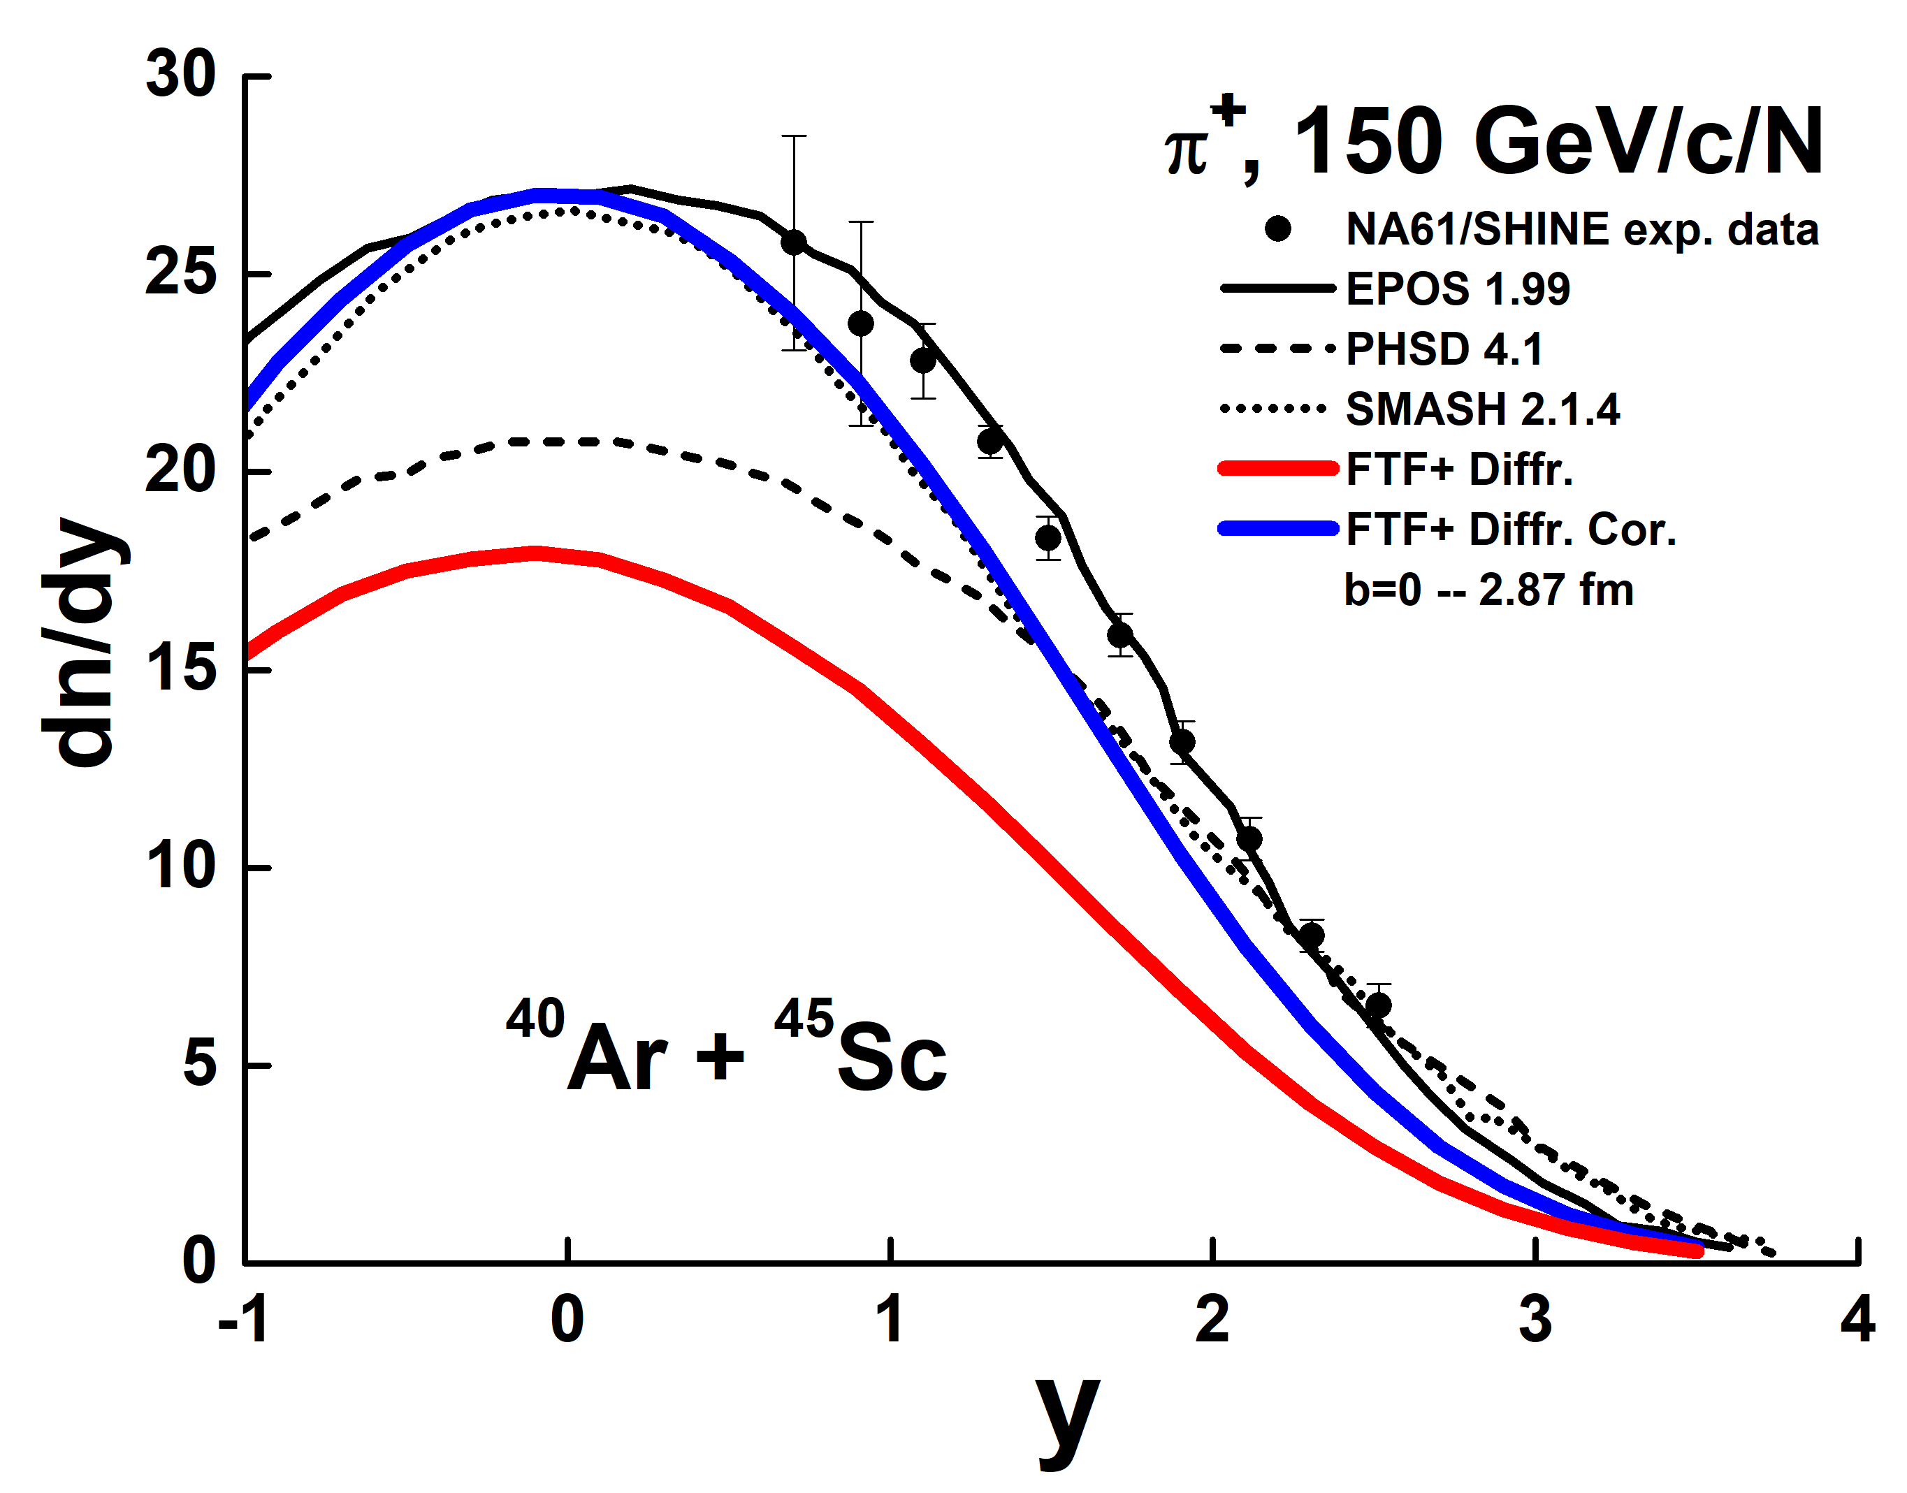
NA61/SHINE data on Ar-40 + Sc-45 and FTF model
10 % centrality. Bmax = 2.87 fm
Measurements of 𝜋±, 𝐾±, p and anti-𝑝 spectra in ⁴⁰Ar+⁴⁵Sc collisions at 13A to 150A GeV/c
NA61/SHINE Collaboration (H. Adhikary et al.)l Eur. Phys. J.C 84 (2024) 416
These first results
encouraged us!
Now we can reproduce (~) results of other model in Geant4 FTF one! It is very good!
11

Slide 12
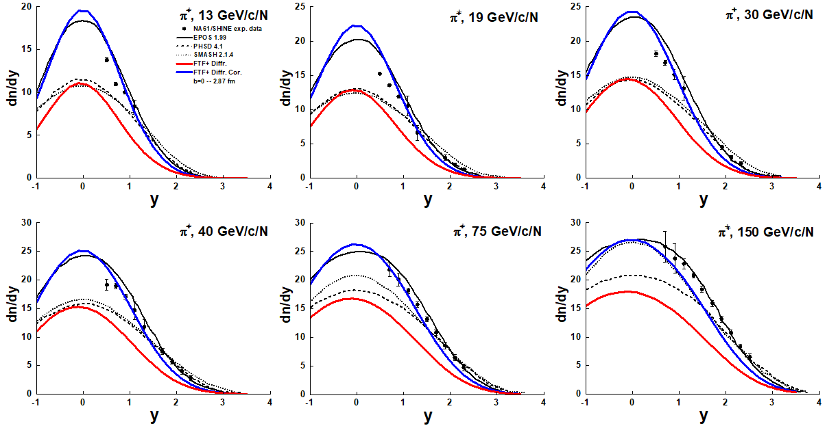
NA61/SHINE data on Ar-40 + Sc-45 and FTF model
10 % centrality. Bmax = 2.87 fm, Pi+
Now we can reproduce (~) results of other model in Geant4 FTF one! It is very good!
Of course, it is not good that the data do not cover the central region.
12

Slide 13
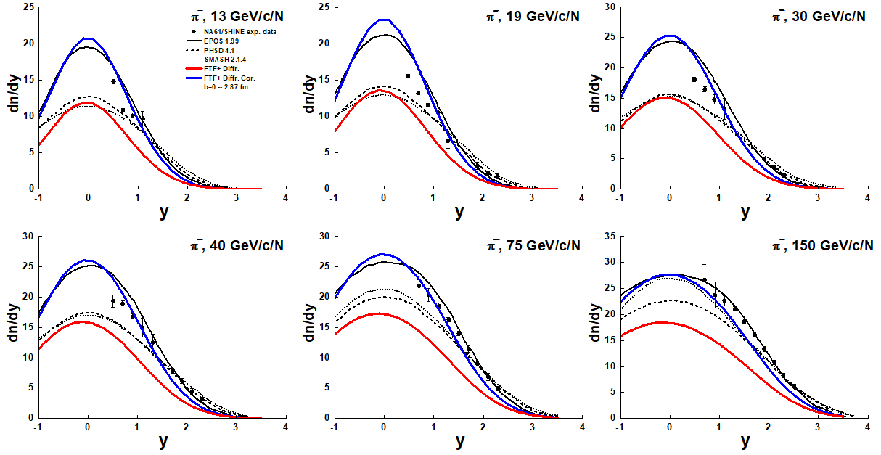
NA61/SHINE data on Ar-40 + Sc-45 and FTF model
10 % centrality. Bmax = 2.87 fm, Pi-
Now we can reproduce (~) results of other model in Geant4 FTF one! It is very good!
13

Slide 14
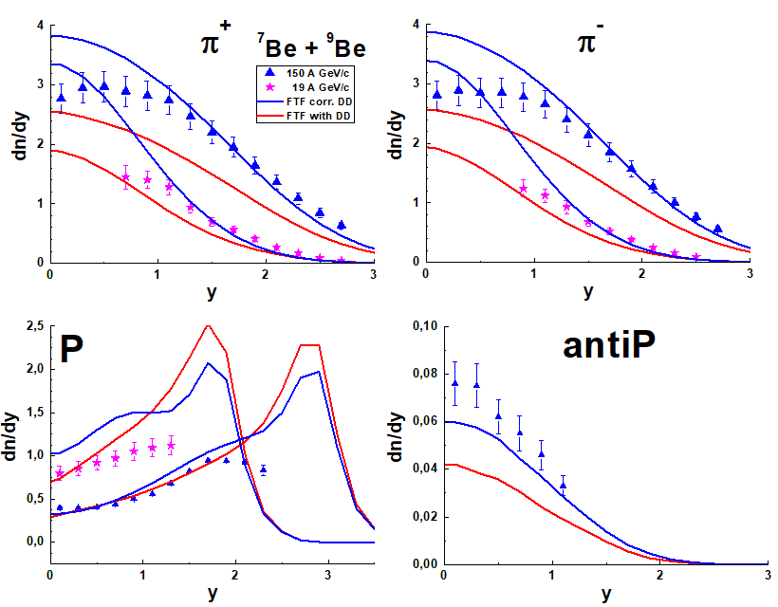
NA61/SHINE data on Be-7 + Be-9 and FTF model
20 % centrality. Bmax = 1.92 fm, Pi, Protons
There is a space for improvement of the Geant4 FTF model.
14

Slide 15
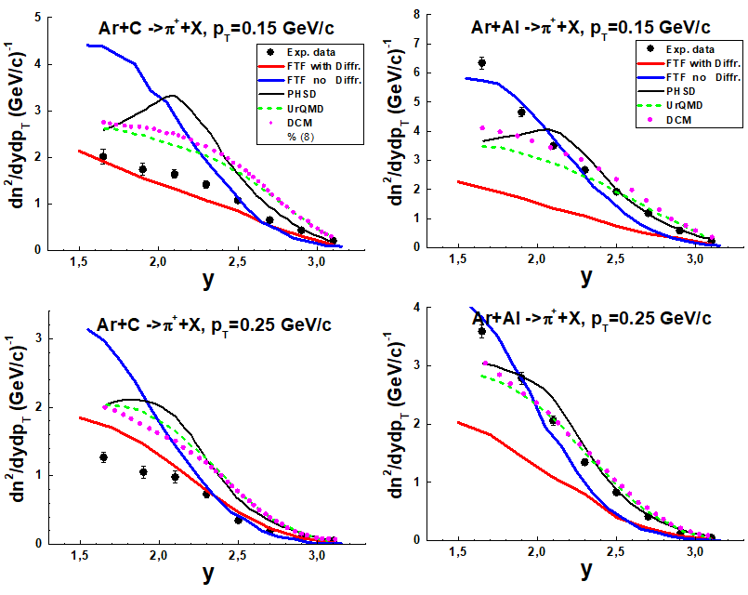
Summary
The new algorithm of accounting of the nuclear nucleon diffraction dissociation in nucleus-nucleus interactions has been proposed. It allows to improve FTF results.
Good results have been obtained for heavy nuclei.
There is a problem of description of interactions with light nuclei.
It is almost unclear, how to reach a description of K-meson production in Ar-40 + Sc-45 interactions?
15

Slide 16
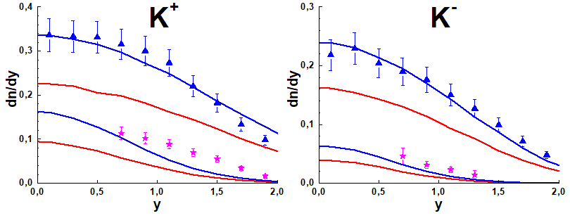
NA61/SHINE data on Be-7 + Be-9 and FTF model
20 % centrality. Bmax = 1.92 fm, Pi, Protons
We hope a small tuning will be need for
a description of the data!
16

Slide 17
Questions to think about
Model predictions for Ar + C?
Exp. points at y = 1.65?
Large scattering of model predictions for K mesons in Ar + A interactions? What about Pi- and K- (Propan)?
Strong leading particle effect in FTF for proton production?
Pauli blocking in QGSM and FTF?
DD and Pauli blocking in models?
K meson production in Ar + Sc?
Condensed baryonic matter?
17

