Slide 1
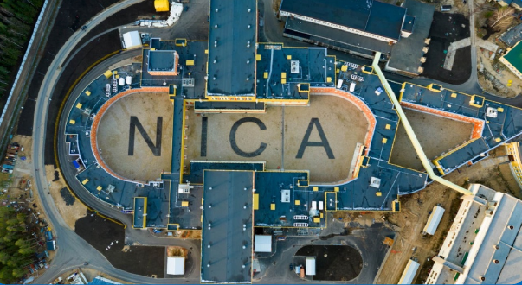


Anisotropic Collective Flow at High Baryon Density
Arkadiy Taranenko
(NRNU MEPhI, JINR)
LXXIV International Conference Nucleus-2024: Fundemental Problems and Applications
1-5 July 2024, JINR Dubna
The work has been supported by the Ministry of Science and Higher Education of the Russian Federation, Project "Fundamental and applied research at the NICA megascience experimental complex" № FSWU-2024-0024

Slide 2
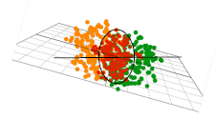
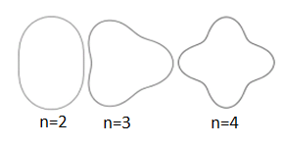


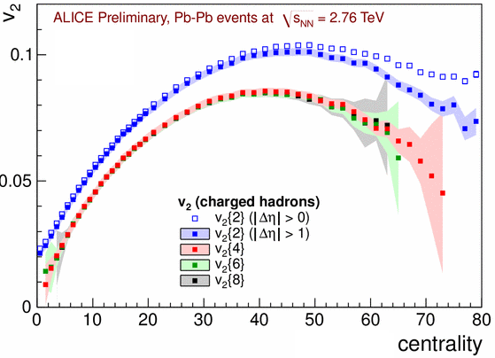
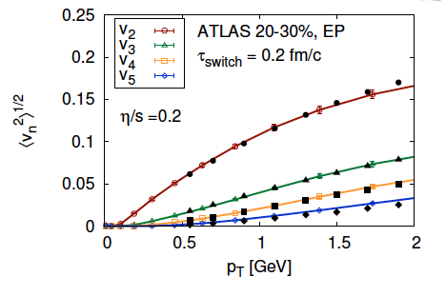
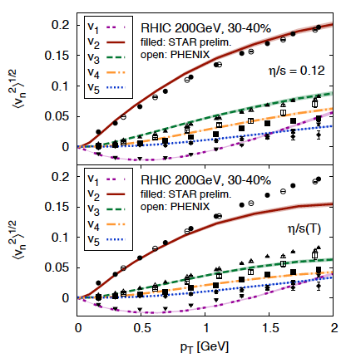
Anisotropic Flow at RHIC-LHC
Gale, Jeon, et al., Phys. Rev. Lett. 110, 012302
<number>
Flow and non-Flow, Fluctuations

Slide 3
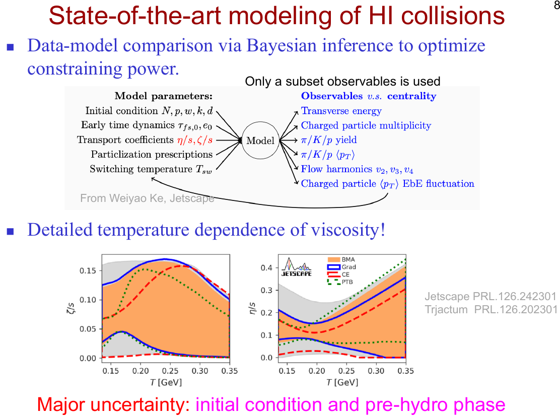
<number>

Slide 4
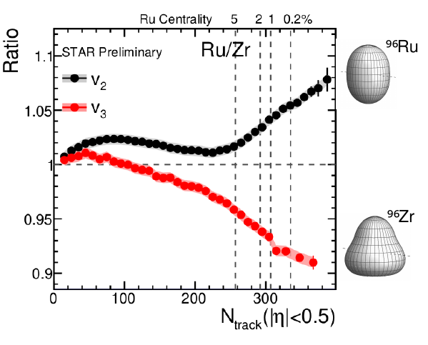
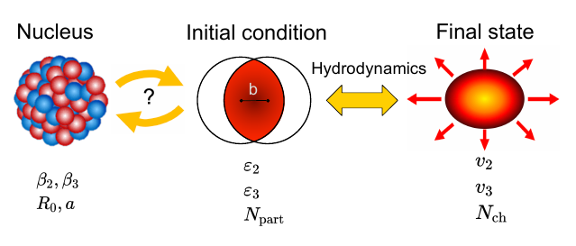
2011-2020
Nucleon substructure matters
2020-2024
<number>

Slide 5
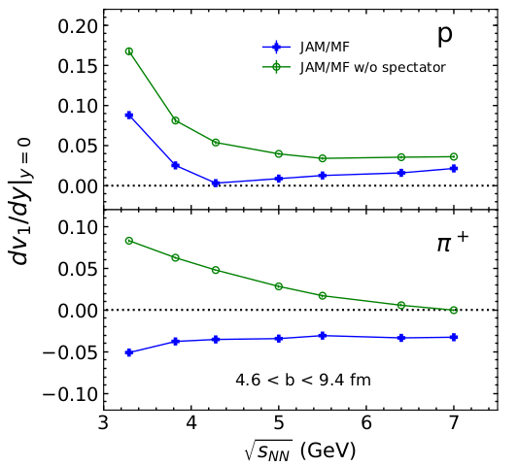
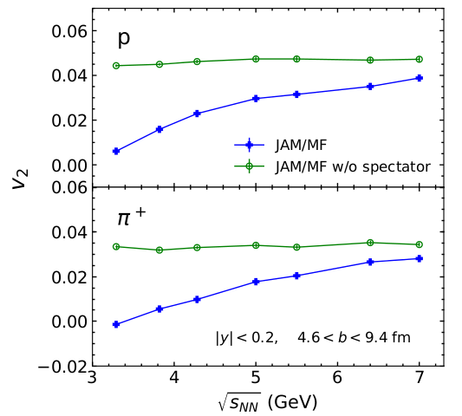
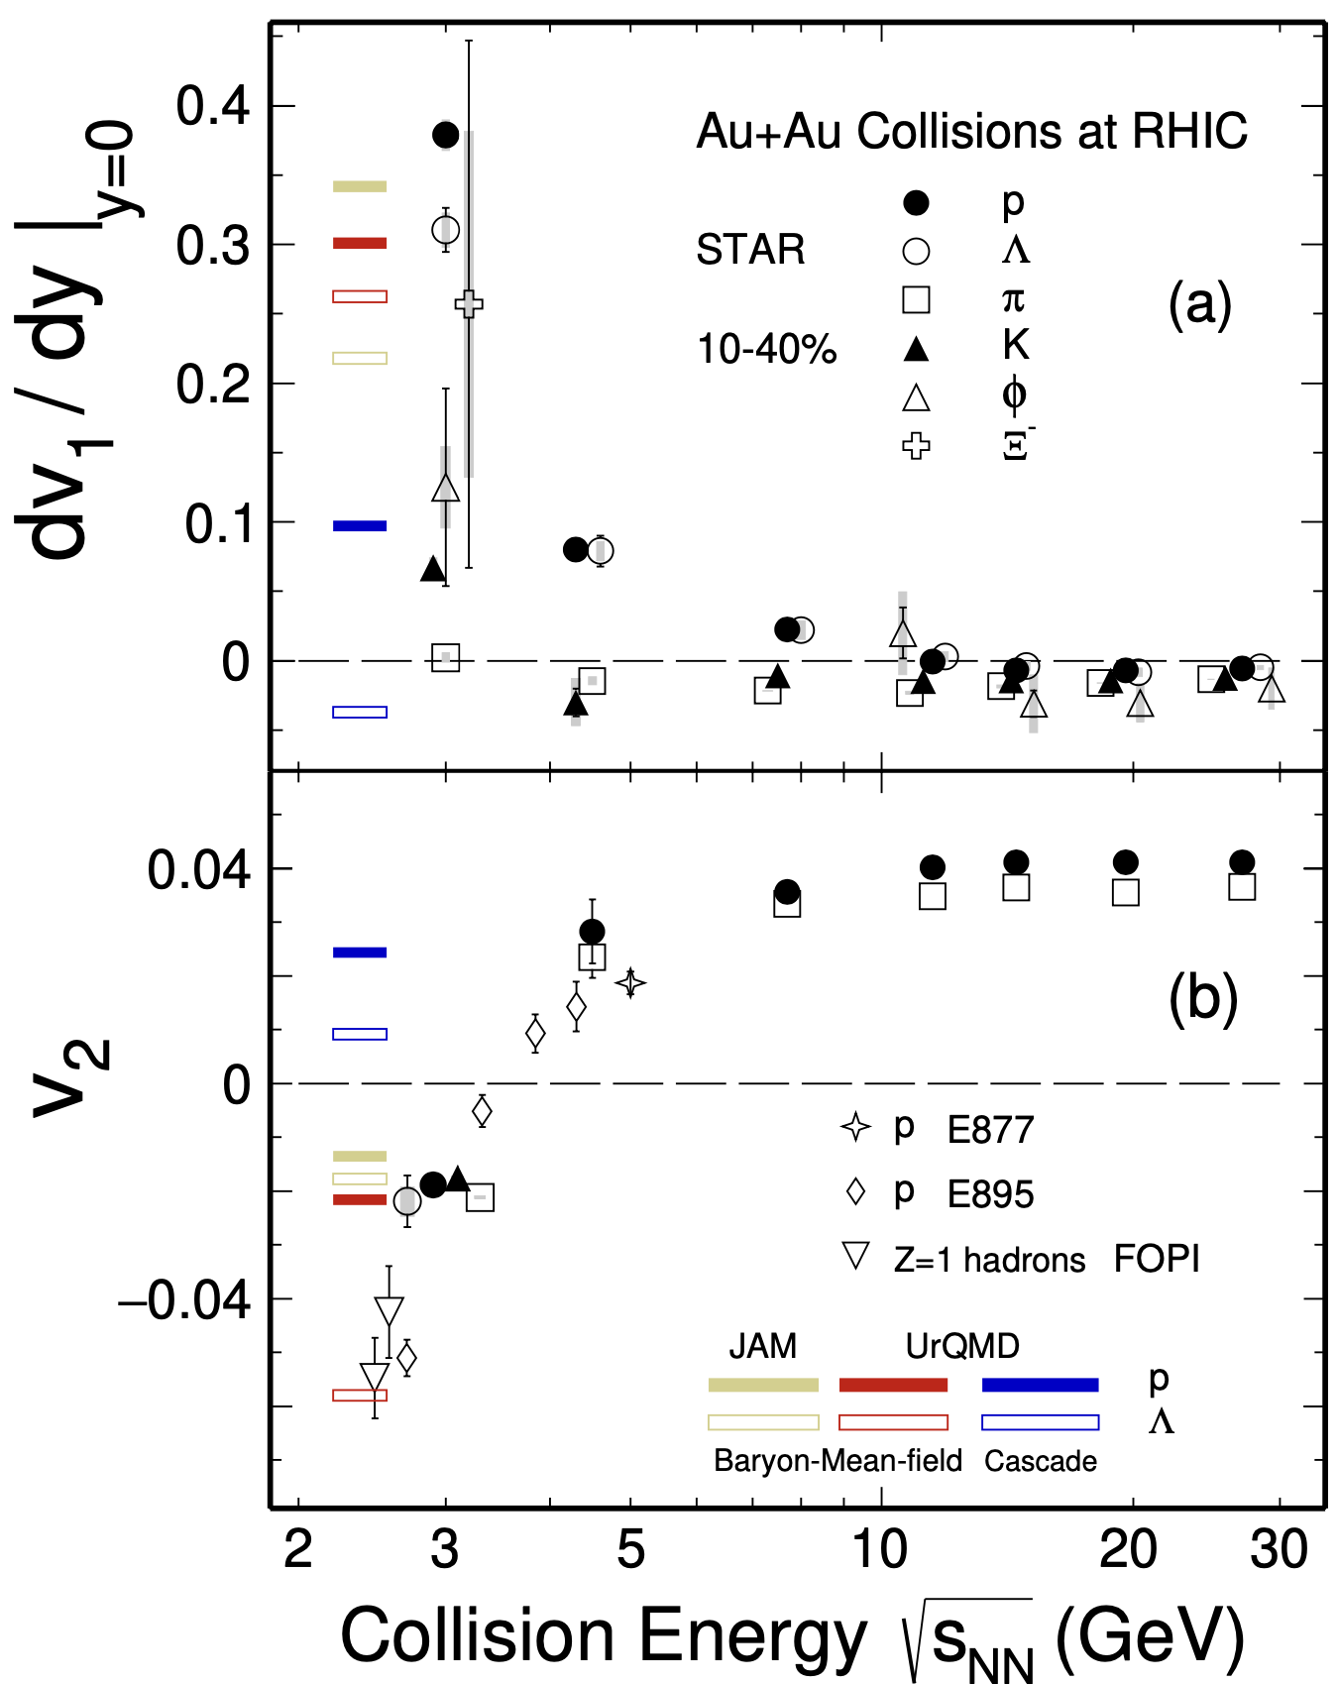

Anisotropic flow in heavy-ion collisions at high baryon density
M. Abdallah et al. STAR, Phys. Lett. B 827, 137003 (2022)
n]
BM@N
CBM
MPD
Anisotropic flow at FAIR/NICA energies is a delicate balance between:
The ability of pressure developed early in the reaction zone () and
The passage time for removal of the shadowing by spectators ()

Slide 6
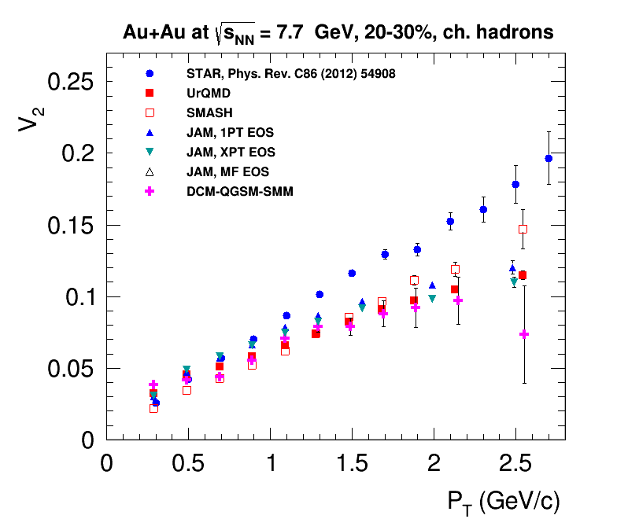
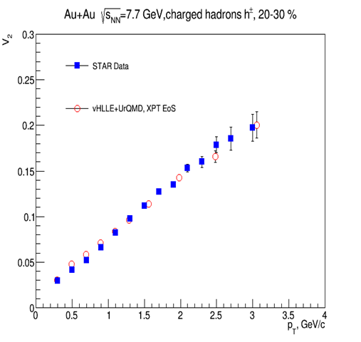
Elliptic flow at NICA energies: Models vs Data comparison
Pure String/Hadronic Cascade models give smaller v₂ signal compared to STAR data for Au+Au √s_{NN}=7.7 GeV and above
<number>
<number>

Slide 7
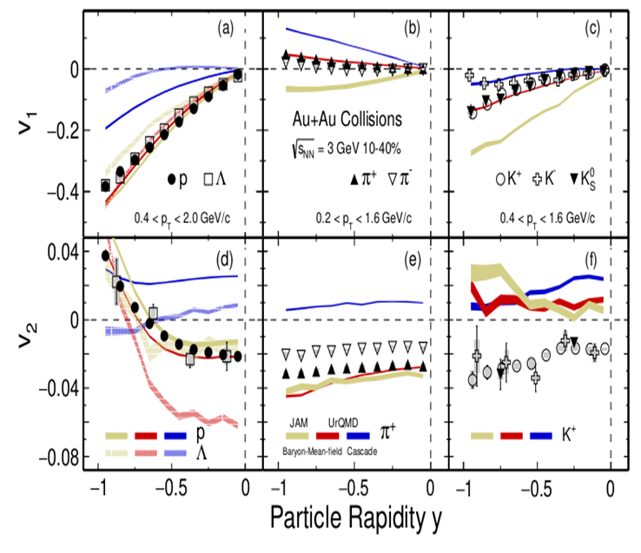
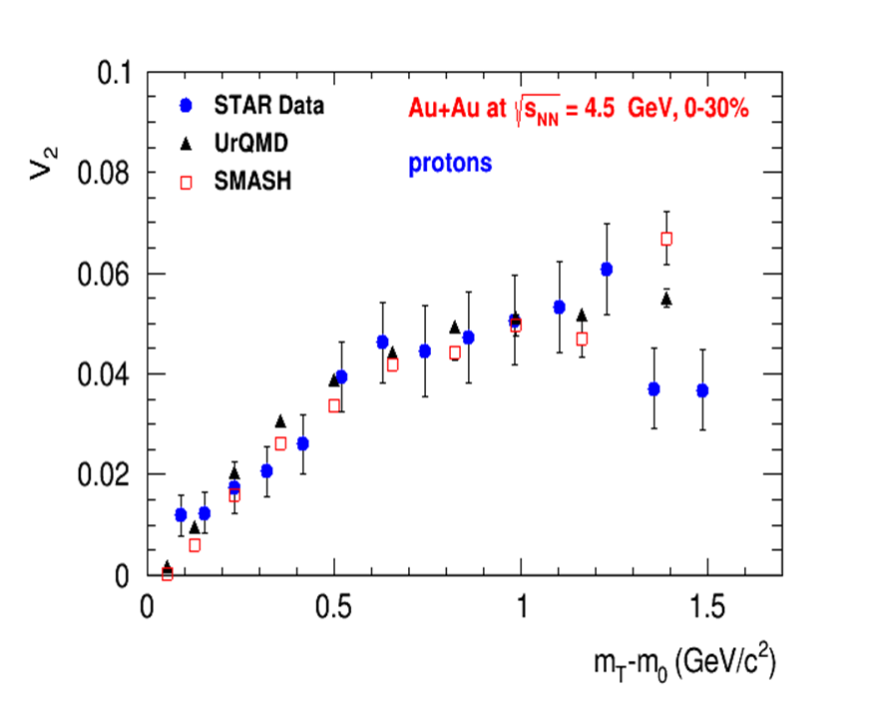
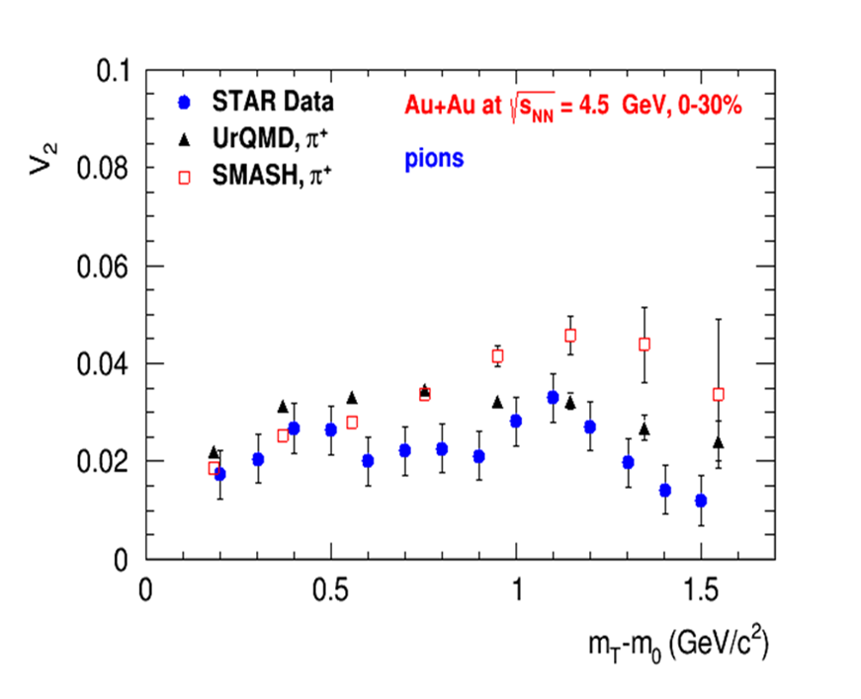
Anisotropic Flow at Nuclotron energies: Models vs Data
Phys.Rev.C 103 (2021) 3, 034908
at √s_{NN} ~ 3-4.5 GeV pure hadronic models give similar v₂ signal compared to STAR data

Slide 8
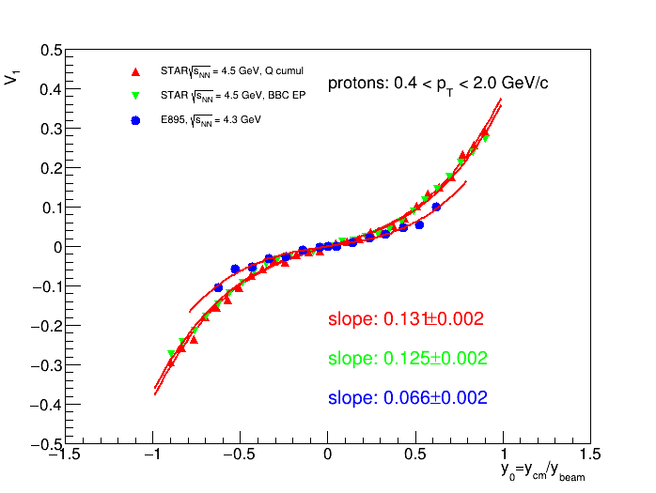
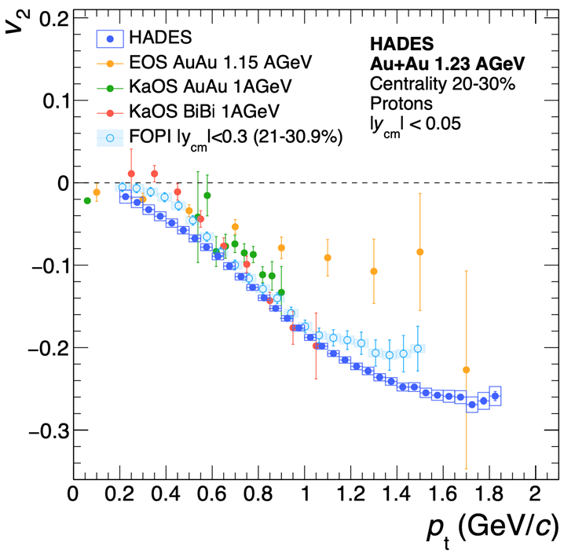
The main source of existing systematic errors in measurements
The main source of existing systematic errors in measurements is the difference between results from different experiments (for example, FOPI and HADES, E895 and STAR)

Slide 9
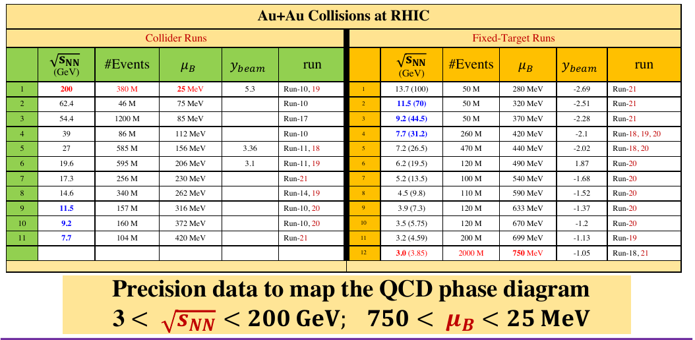
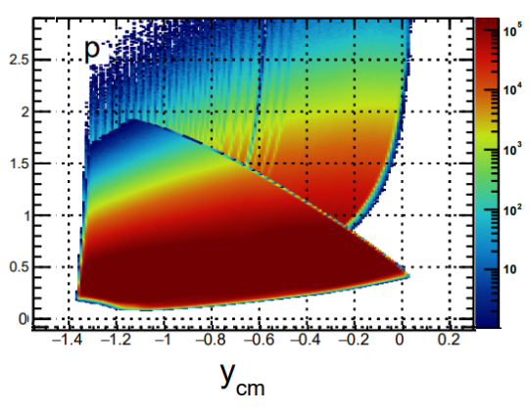
RHIC BES programs
Data taking by STAR at RHIC: 3 < < 200 GeV (750 < μ_{B} < 25 MeV)
Au+Au @ 3.9 GeV
A very impressive and successful program with many collected datasets, already available and expected results
Limitations:
  Au+Au collisions only
  Among the fixed-target runs, only the 3 GeV data have full mid-rapidity coverage for protons (|y| < 0.5),

Slide 10
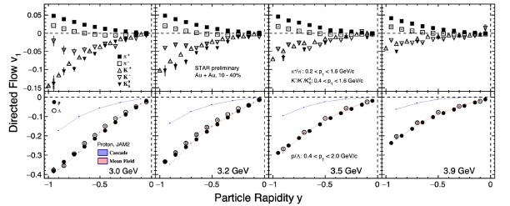
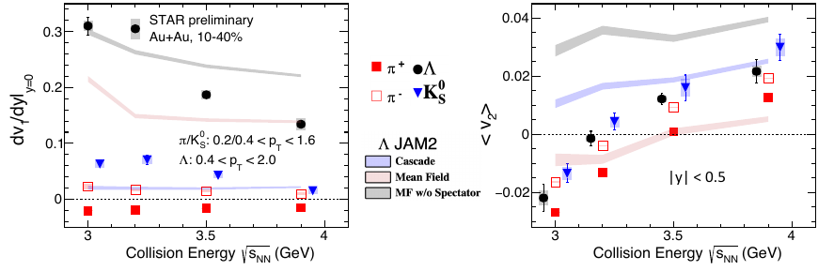
STAR preliminary results from BES – II program

Slide 11
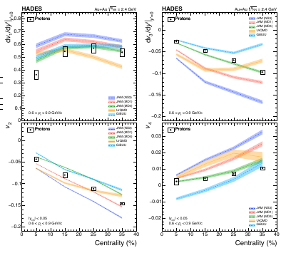
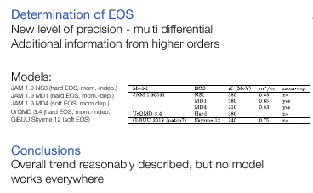
Vn of protons in Au+Au collisions at 2.4 GeV - HADES

Slide 12
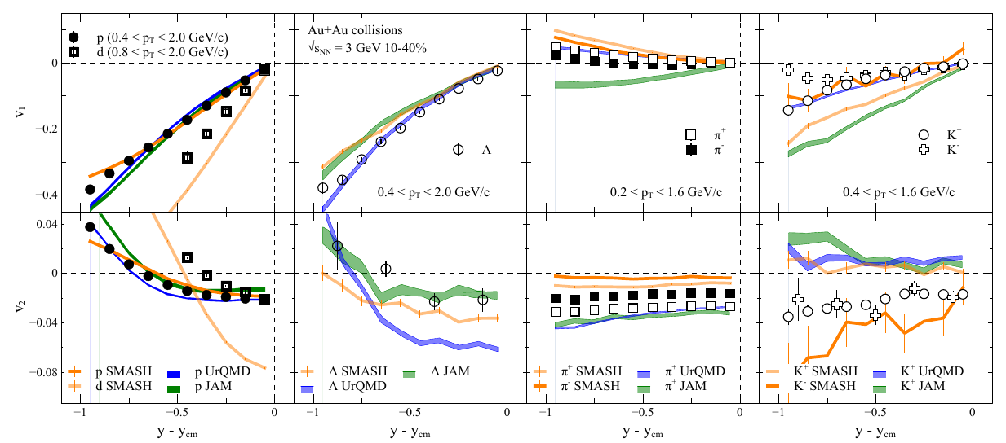
Describing proton flow is not enough
Prog.Part.Nucl.Phys. 134 (2024) 104080
Strange baryons are not well described
— the results may depend on:
• nucleon-hyperon and hyperon-hyperon
interactions
• in-medium modifications of interactions
Pions and kaons NOT described!
Not very surprising: UrQMD, JAM, and SMASH
don’t have mean-fields for mesons

Slide 13
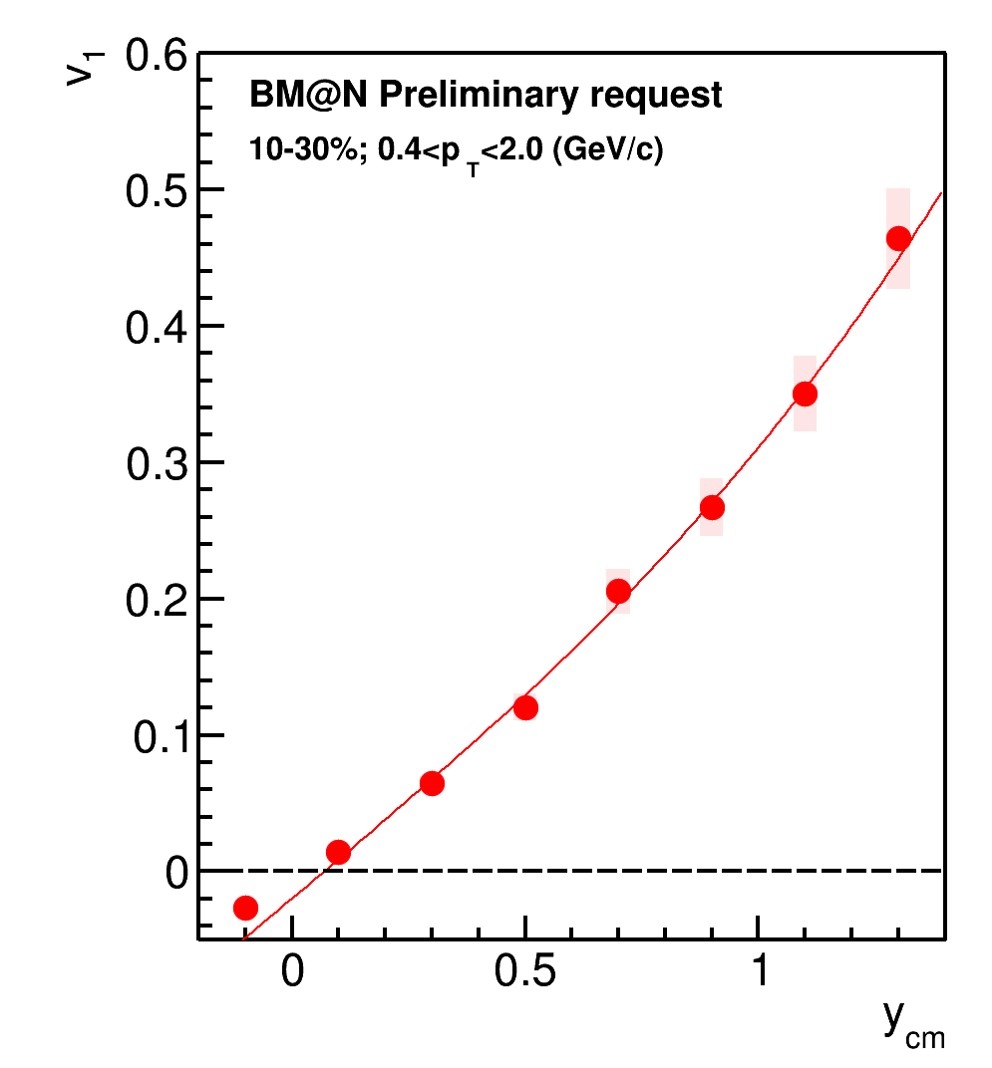
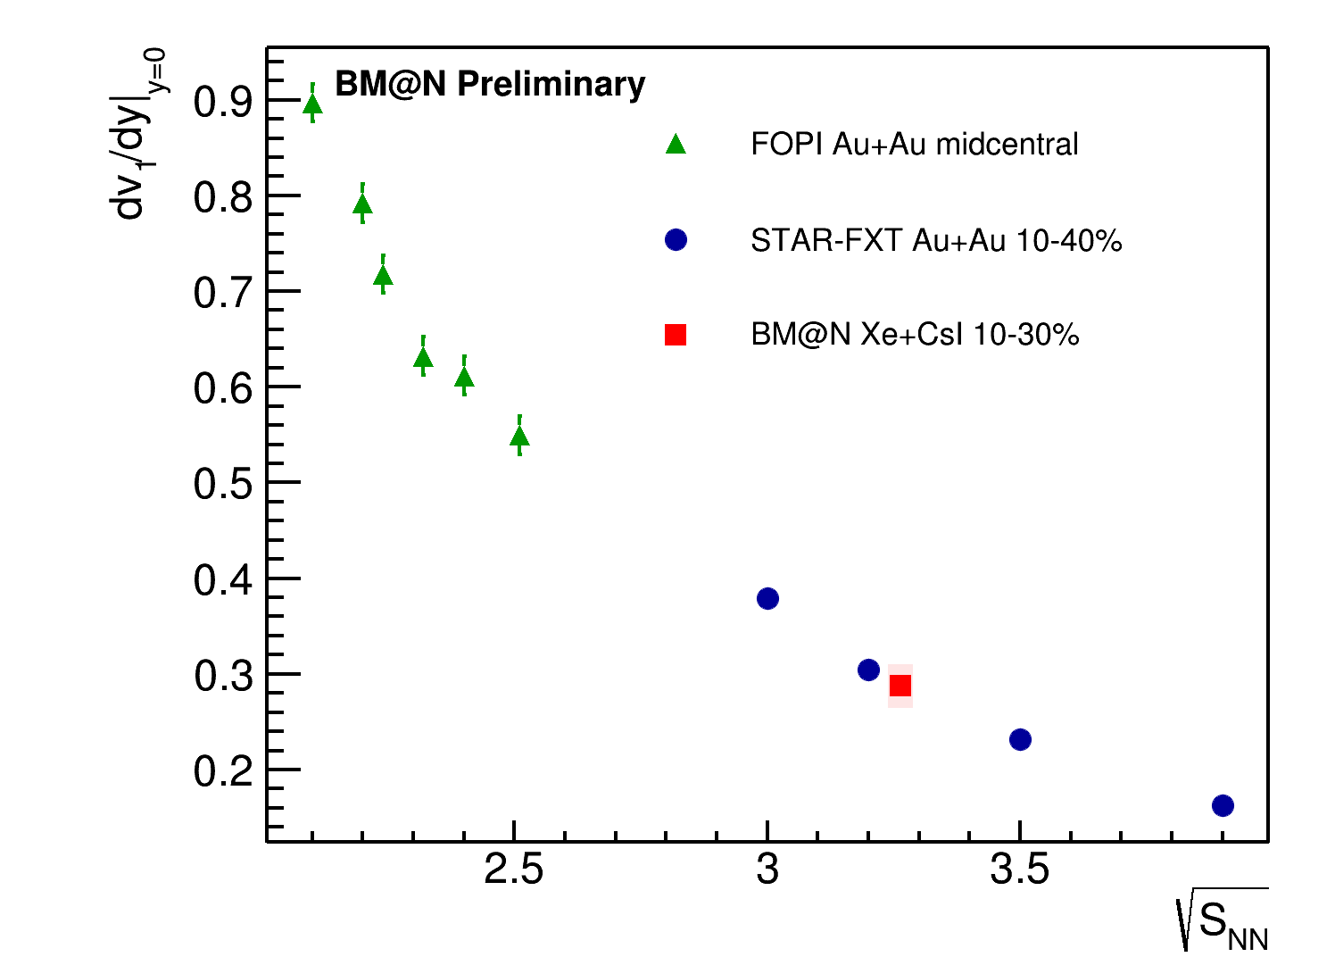
Collision energy dependence of directed flow dv₁/dy|_{y=0}
Please see Mikhail Mamaev talk at Nucleus-2024 – 03/07//2024

Slide 14
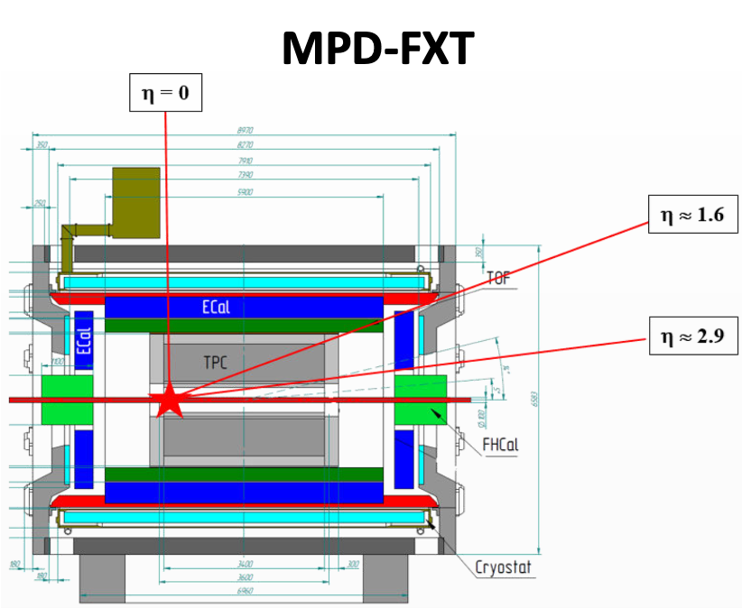
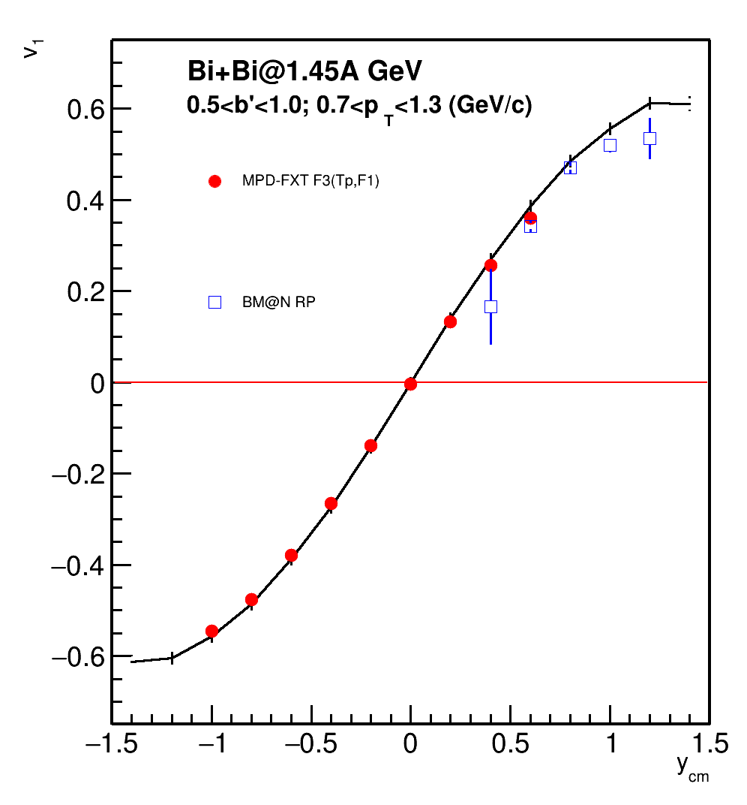
MPD in Fixed-Target Mode (FXT) vs BM@N
Please see Pater Parfenov talk at Nucleus-2024 – 02/07//2024

Slide 15
Summary and outlook
Measurements of anisotropic flow, flow fluctuations, correlations between flow of different harmonics are sensitive to many details of the initial conditions and the system evolution. It may provides access to the transport properties of the medium: EOS, sound speed (cs ), viscosity, etc.
v_{n} at NICA energies shows strong energy dependence:
  At √s_{NN}=4.5 GeV v₂ from UrQMD, SMASH, JAM are in a good agreement with the experimental data
  At √s_{NN}≥7.7 GeV UrQMD, SMASH underestimate v₂ – need hybrid models with QGP phase
Feasibility study for anisotropic flow in MPD/MPD FXT/BM@N:
Programs for flow analysis are available for MPD/BM@N collaboration – first flow results from BM@N will come very soon
<number>
Notes:
<number>
<number>
<number>
<number>
<number>
<number>
<number>
<number>

Slide 16
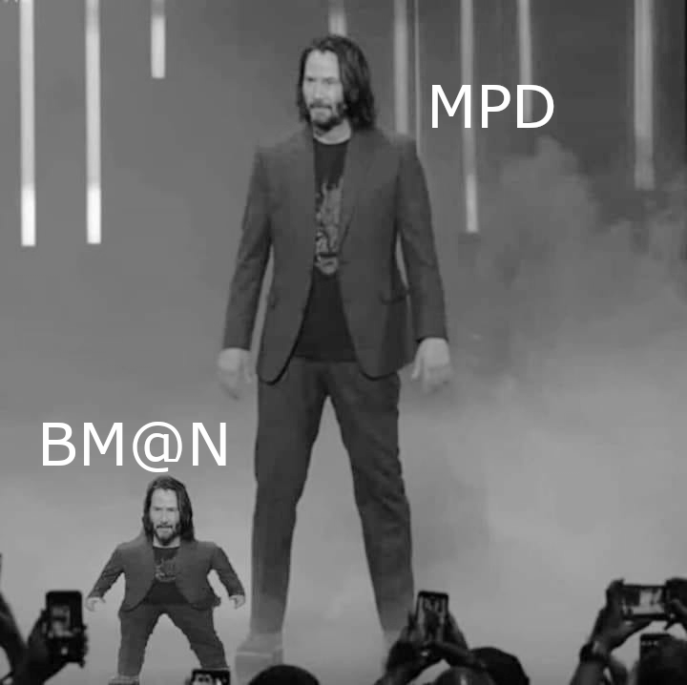
Backup

