Slide 1
Low energy incomplete fusion: A systematic study of entrance channel parameters
Anuj Kumar Jashwal
Research Scholar
Bareilly College Bareilly
India
Notes:
Good evening to all, My self Anuj Kumar jashwal Research bareilly college bareilly. My title of presentation Low energy incomplete fusion: A systematic study of entrance channel parameters.

Slide 2
Profile of presentation
Introduction
Scope of the work
Issues of ICF dynamics
Experimental Details
Results
Summary and conclusion
Notes:
Here is the profile of presentation, First I will be discussion introduction in the introduction section will be discussed about complete fusion and incomplete fusion, next scope…. Next issue….. Next ….. Experimental…..next result….in last I will discussed summary and conclusion.

Slide 3
Complete fusion
Projectile completely fuses with the target
66_{Ga}
ϒ-radiations
111_{Sn}
n
_{9F}19
_{41Nb}93
112_{Sn}*
p
¹¹¹_{In}
Projectile
Target
α
Compound
nucleus system
108_{Cd}
Notes:
Complete fusion is the process in which the entire projectile fuses with the target nuclei leading to the formation of excited composite system, which may decay after attaining equilibrium by particle and gamma emission …… The emission of nuclear particles or γ –rays depend upon
the available excitation energy. so in such type of reaction processes the entire charge and mass is involve …… the full linear momentum transfer occurs ….

Slide 4
incomplete fusion
Due to
projectile,
fractional
the
fusion of
Compound
nucleus (CN) is formed with relatively less mass and charge as that of CF.
¹⁰⁷_{Cd}
n
¹⁰⁵_{Cd}
3n
p
¹⁰⁷_{Ag}
spectator
¹⁹_{F}
⁹³_{Nb}
¹⁰⁸_{Cd}*
¹⁵_{N}
α
α
Projectile
Target
Compound nucleus system
α
¹⁰⁴_{Pd}
Notes:
Now the another important reaction mechanism is the incomplete fusion at these energies in Heavy-ion interaction … in such a reaction process the projectile breaks up into its fragments and one of the fragment fuses with the target nuclei however another flows in the forward direction with out any interaction with target nuclei … so we called it as spectator …….. So in such a case fusion incompleteness occurs means the CN forms with less mass and charge as that of CF. Thus, the total fusion of the projectile can be expressed as sum of a complete fusion and incomplete fusion of the projectile.

Slide 5
Some of important issues associated with Icf dynamics
What is the effect of entrance channel parameters on ICF probability?
How does the input-angular momentum affect the reaction dynamics?
Is there any interplay between mass-asymmetry of interacting partners and projectile structure?
What is the effect of break up on fusion cross-section?
Notes:
Lot of theoretical and experimental effort has been made to understand the incomplete fusion dynamics but still some issue associated with ICF dynamics such as role of entrance channel parameter? How does input angular momenta effect the reaction dynamics? Is there any interplay between mass asymmetry of interacting partners and projectile structure? What is the breakup on fusion cross section?

Slide 6
Experimental details
Target Preparation
ACTIVATION TECHNIQUE
Notes:
same

Slide 7
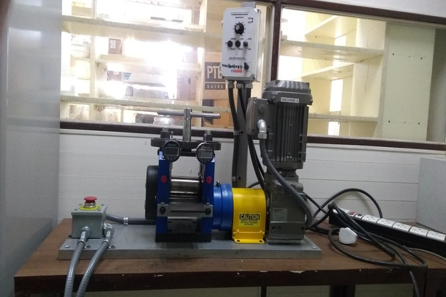
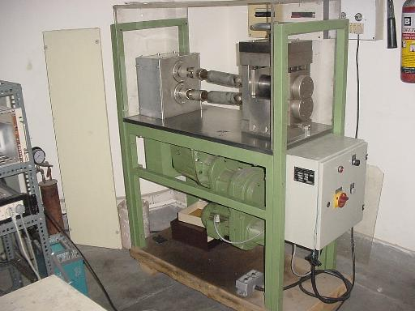
Target preparation
In the present work rolling technique was used to obtain self- supporting target foils of Niobium (⁹³Nb) and Al-catcher foils at Target Lab of IUAC, New Delhi.
Rolling Machine 1
Rolling Machine 2
Notes:
In the present work rolling method was used to obtain self supporting target foils of Niobium and Al catcher foils at target lab of IUAC New Delhi.
These machines are used to prepare thin foils by cold rolling method.
The thickness of the foil can be achieved of order 1 mg/cm2 by this method.
Very efficient method, no loss of expensive materials.
The thickness of the foil was verified by the alpha transmission method as well as via micro balance.

Slide 8
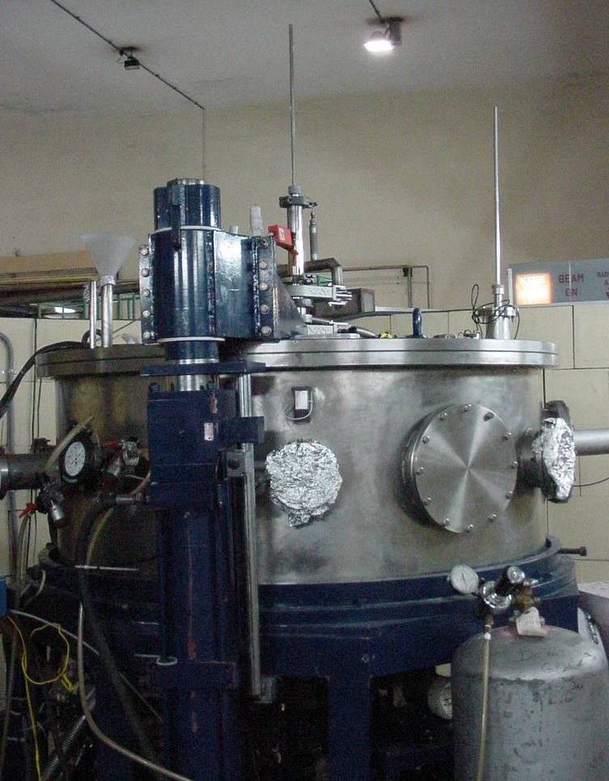
Irradiations
In-vacuum transfer facility (ITF)
Beam line
Scattering chamber
All the irradiations have been performed at General Purpose Scattering Chamber.
Notes:
The experiment was performed by using GPSC facility at IUAC New delhi. The GPSC has a well-known in-vacuum transfer facility to minimize the time lapse between the stop of irradiation and the start of the counting without disturbing the vacuum of the chamber. It is an important technique to identify the residues that have short half-lives.

Slide 9
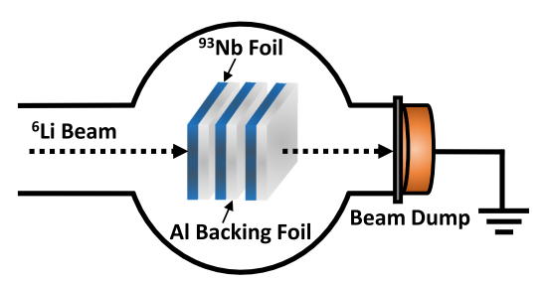
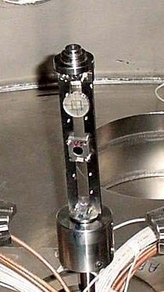
Activation Technique
Target Ladder
¹⁹F Beam
A typical stack arrangement of target-catcher foils for the measurement of EFs
Notes:
To obtain the EFs measurements for wide energy range, the activation technique have been used. In this method after each target foil, an Al-catcher foil is placed, this arrangement hereafter called the target-catcher foil assembly. Here, the Al-catcher foil fulfill two objectives; stopping the heavy recoils populated during the bombardments in their respective target-catcher foil assembly, and also lowering the incident-beam energy for the next target-catcher foil assembly. In the present experiment,three stacks have been prepared, each stack having five target-catcher foil assemblies. These stacks have been irradiated at three different bombarding energies viz., ≈108, 110, 112 MeV around 8-10 hour. Monte carlo simulation based srim code was used to compute the energy degradation through each target and catcher foil. The final energy points were obtained by averaging the energies at the entrance and exit of the foils.

Slide 10
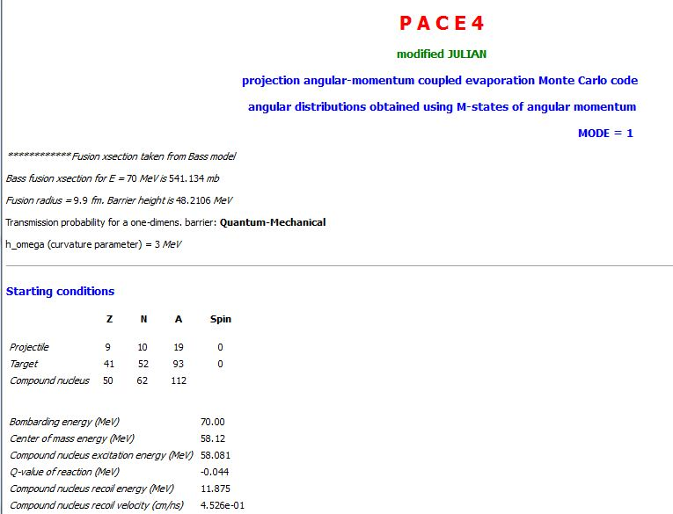
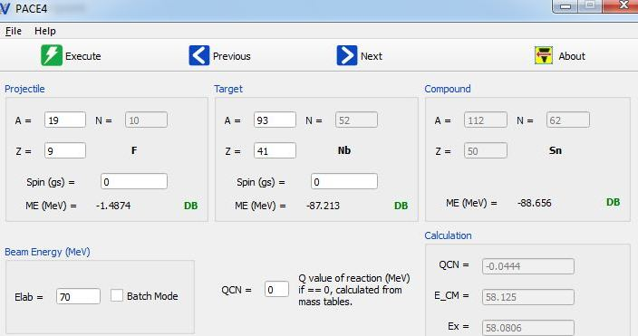
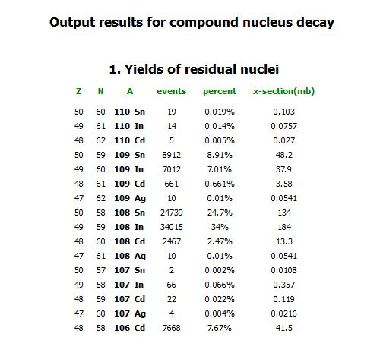
Theoretical Calculation
PACE-4 code has been used for the theoretical calculations.
Notes:
in order to understand the production mechanism and course of cross-section for the identified reaction products, the experimentally measured EFs have been reviewed within the framework of one of the widely used statistical model code PACE4. Here is the input and output file of the code. This code does not include breakup and equilibrium process.

Slide 11
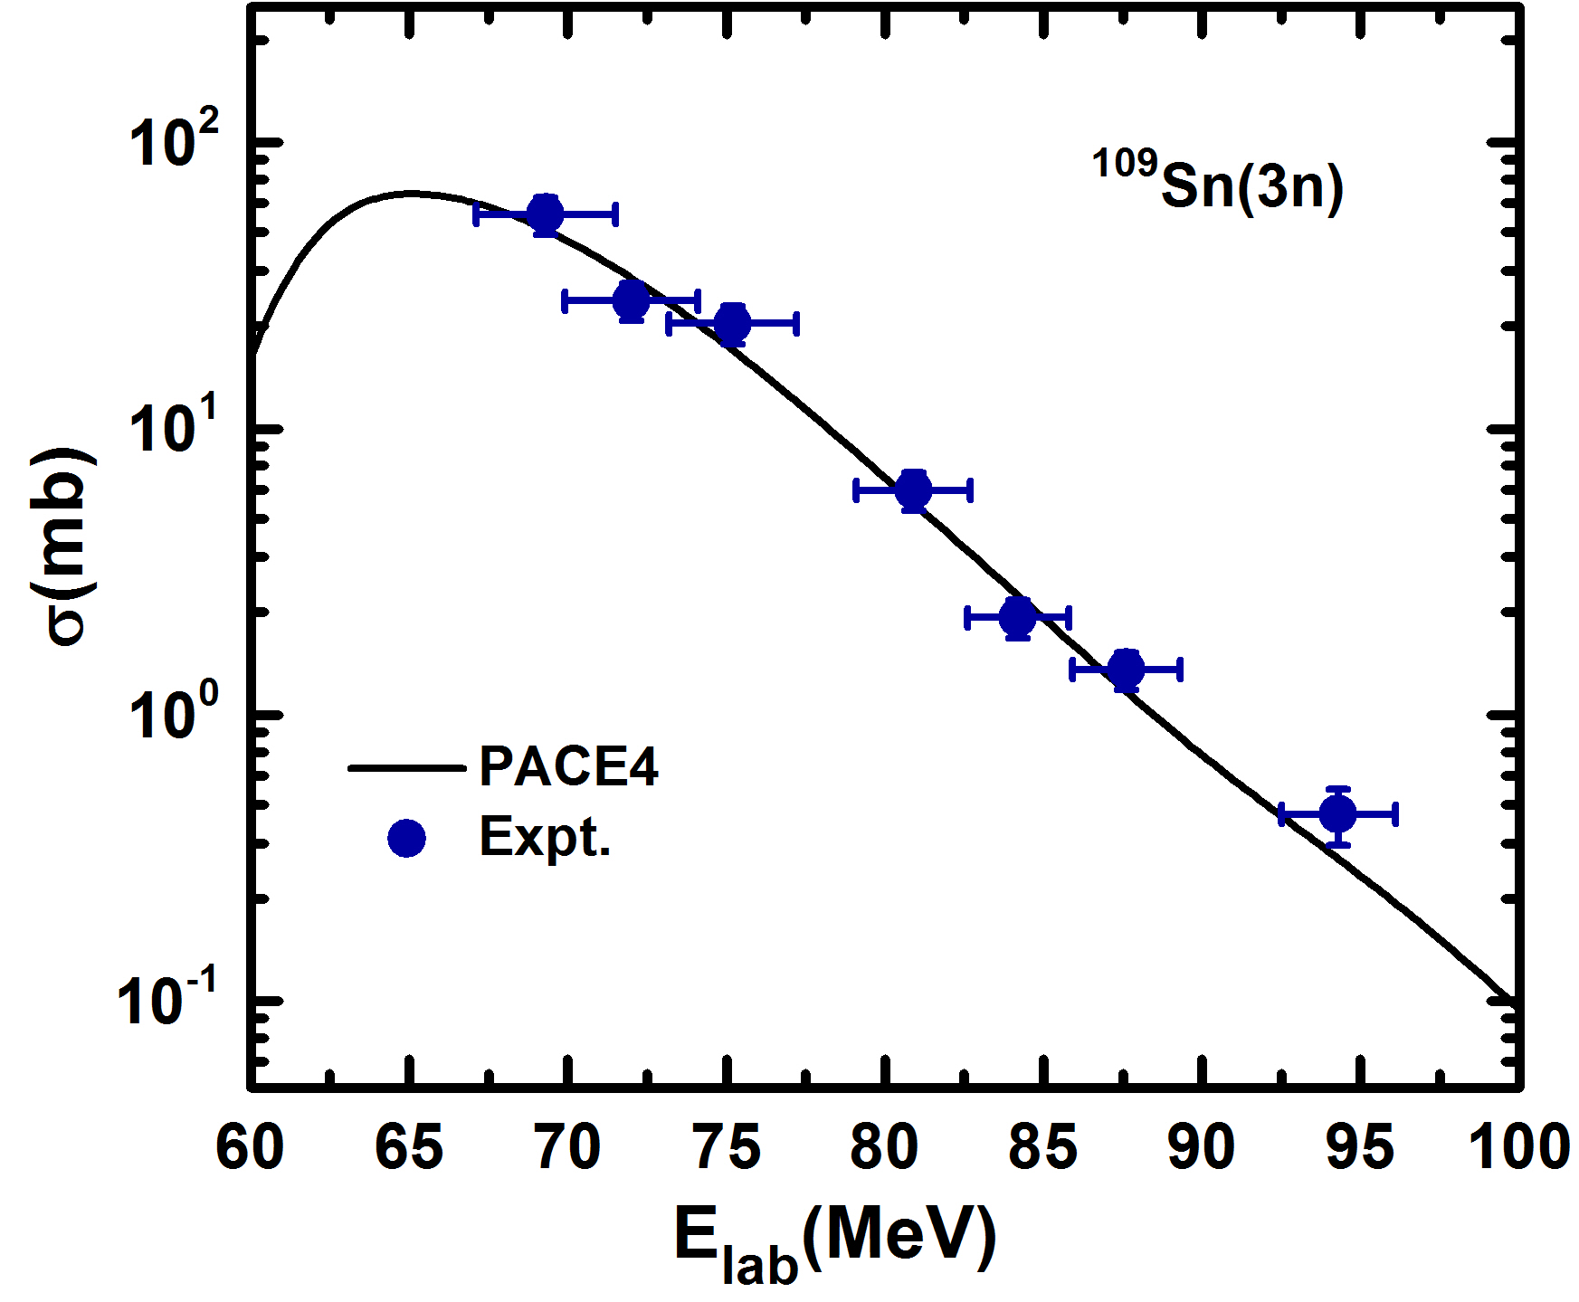
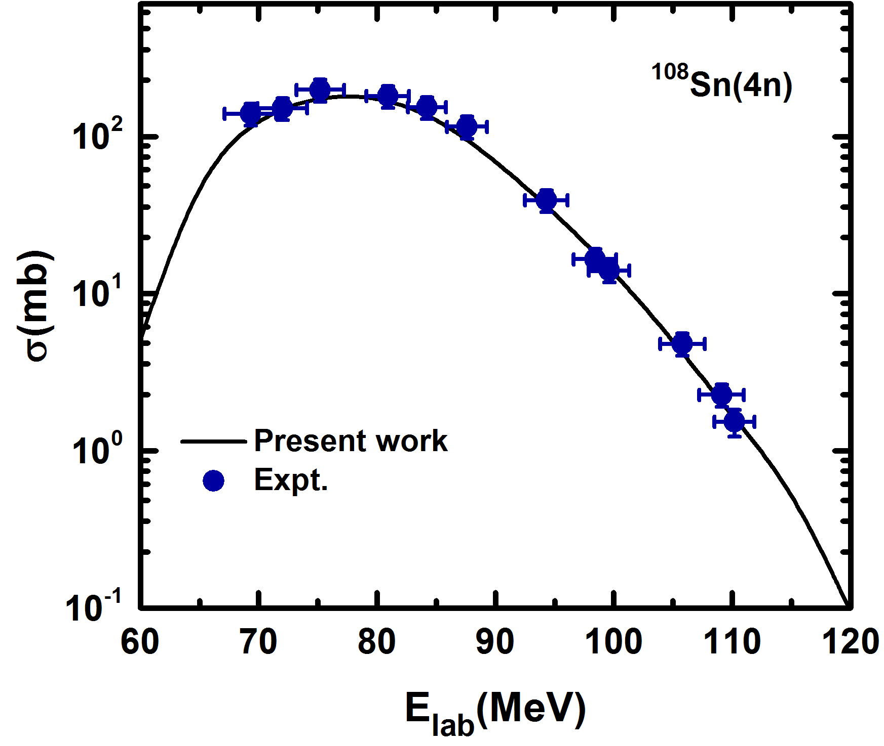
Results and analysis
Analysis of experimental excitation functions for ¹⁹F+⁹³Nb system with PACE-4.
Notes:
Here is the cross section versus energy graph for the 3n and 4n channels. It can be seen from theses figures that experimental EFs of these xn channels are in good agreement, throughout the studied energy range, with the calculations done through the statistical model PACE4. This satisfactory agreement between the experimental and theoretical EFs leads to the conclusions: first is that the origin of these residues (xn channels) are through the deexcitation of the fully equilibrated compound nucleus (112Sn∗) formed via complete fusion of 19F with 93Nb target nuclei, and second, this reproduction also validates the choice of the parameters used for the analysis. Thus, this allows us to use the same set of parameters, uniformly, for further analysis.

Slide 12
Results and discussion
Precursor Contribution
4n
¹⁰⁸_{Sn}
_{9F}19
_{41Nb}93
112_{Sn}*
p3n
β⁺/EC
Direct and the precursor decay contribution in the population of 108In.
108_{In}
Notes:
In heavy-ion induced reactions, generally, a large number of residues are populated through different reaction channels. In some cases the same residue is populated via two different modes viz., (i) directly from a given reaction and (ii) via β and/or electron capture decay of a nuclide (precursor). Separation of the two is required for a better understanding of reaction dynamics. Here in this figure shown tha case of p3n channel half life 58 min may have precursor 108 Sn 4n channel half life 10.30 min and needs to be separated out.

Slide 13
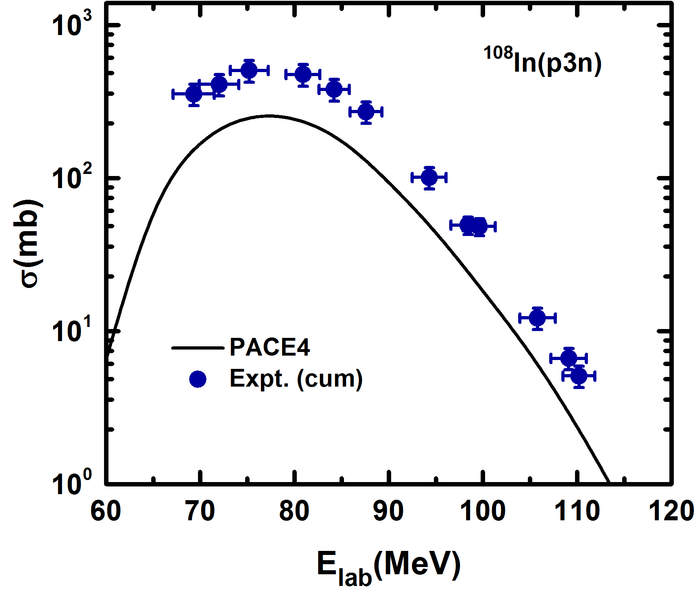
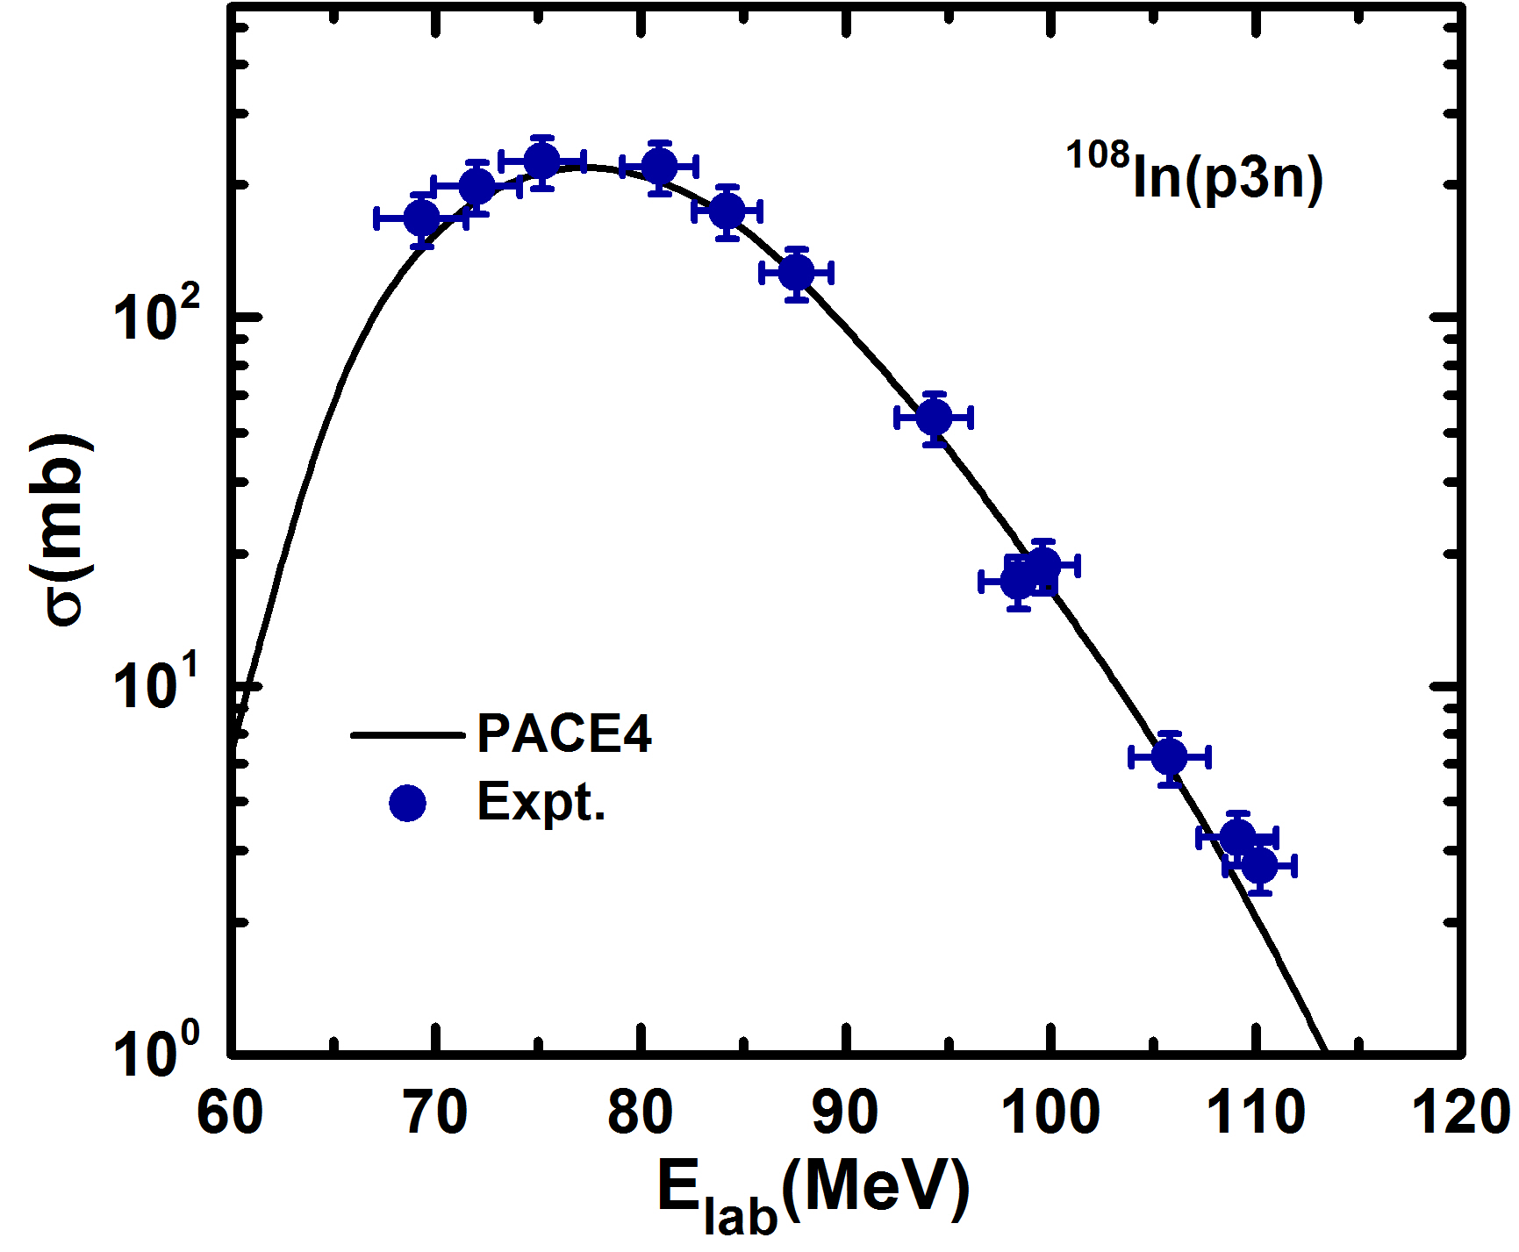
Results and discussion
During the decay curve analysis, the cross section of reaction residues ¹⁰⁸In(p3n) having a half-life of 58 min was found to be strongly fed from its higher charge isobar precursor ¹⁰⁸Sn(4n) having a half-life of 10.30 min, through β+/EC decay.
Cavinato et al. formulation
Phys. Rev. C 52, 2577 (1995).
Notes:
Here figure 1st shown the cross section of cumulative production of p3n channel. Cavinato et al proposed the formulation shown here we have used to separate out the independent cross section. The independent cross section of p3n channel are in good agreement with theoretical calculations.

Slide 14
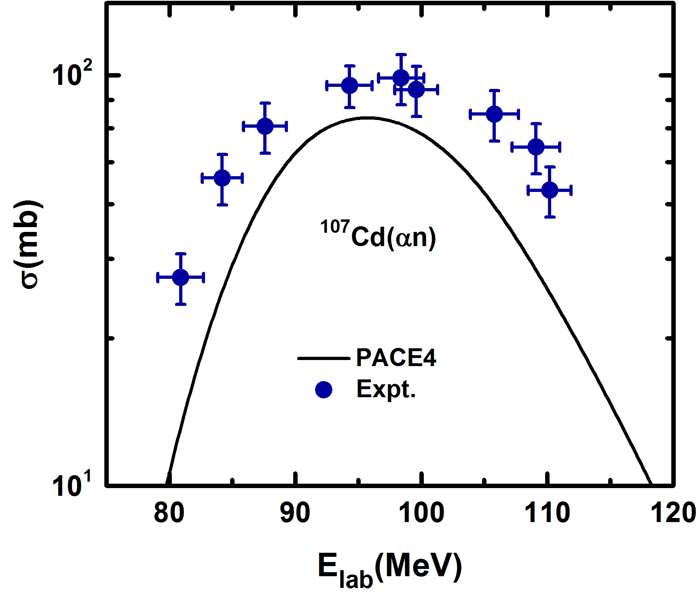
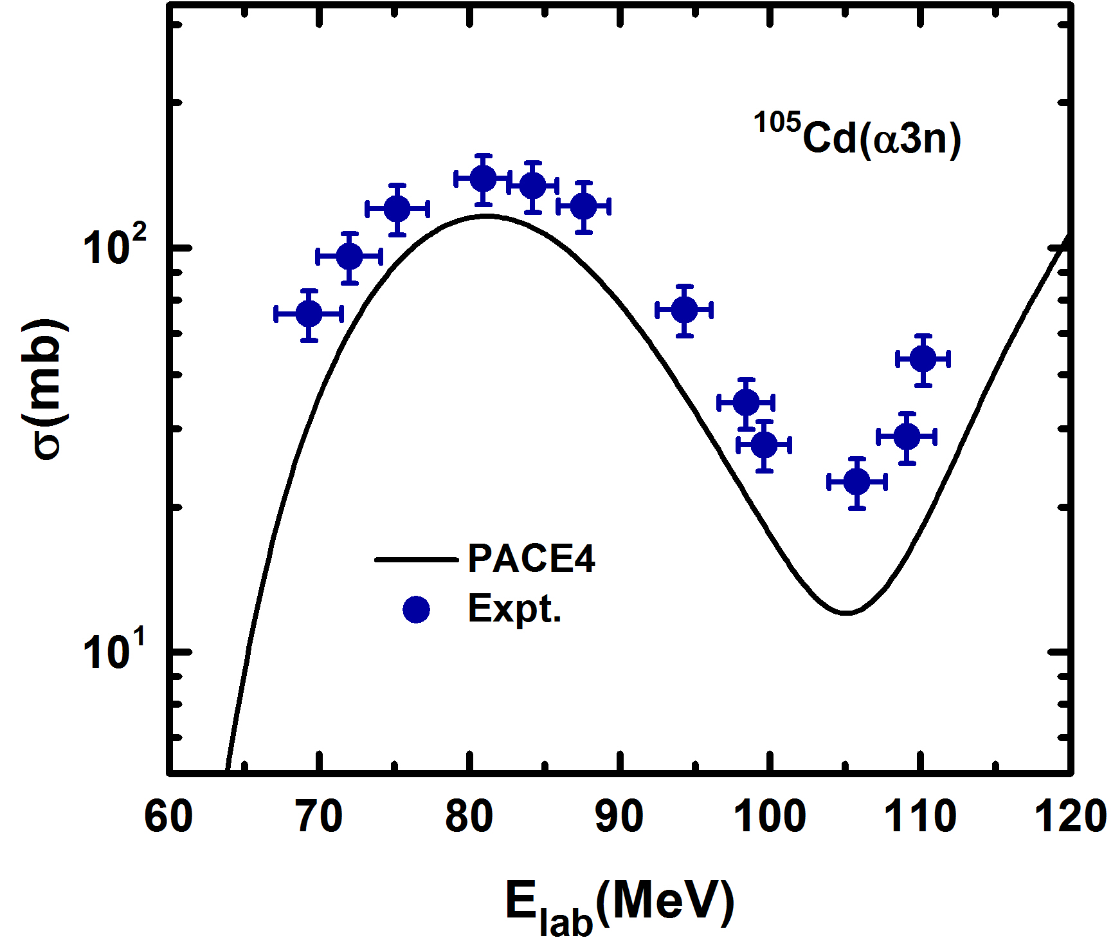
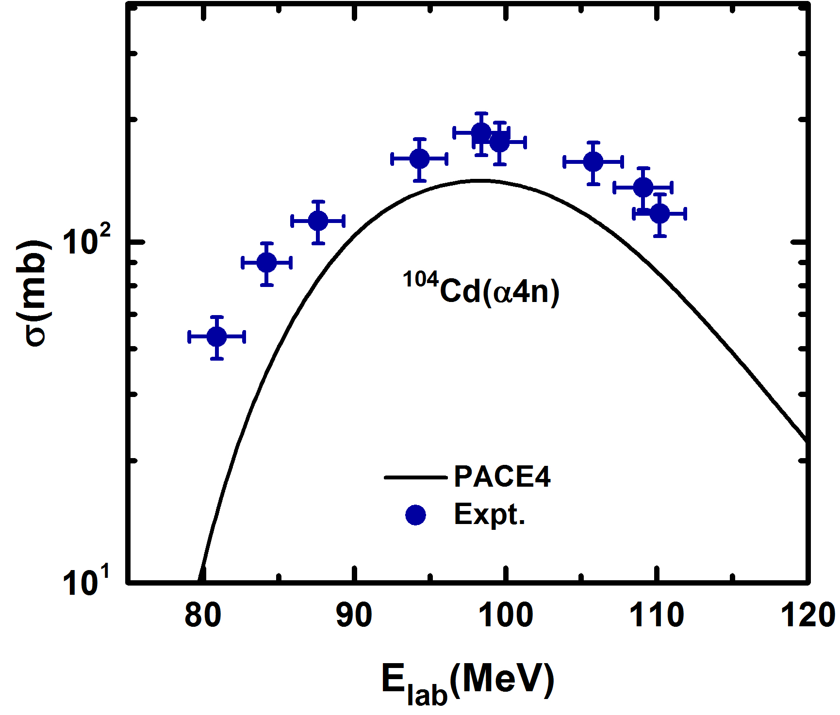
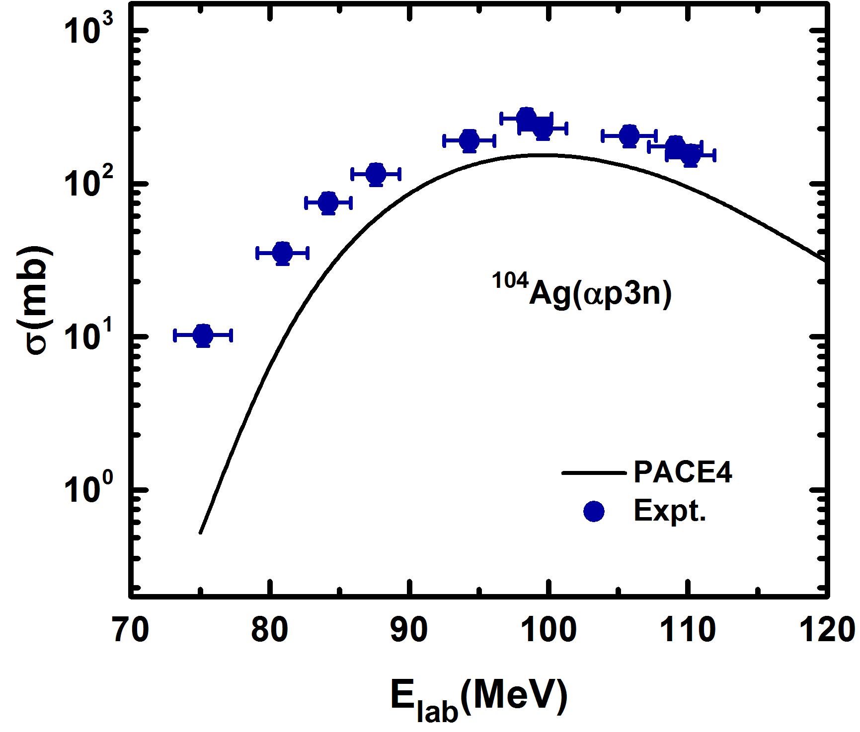
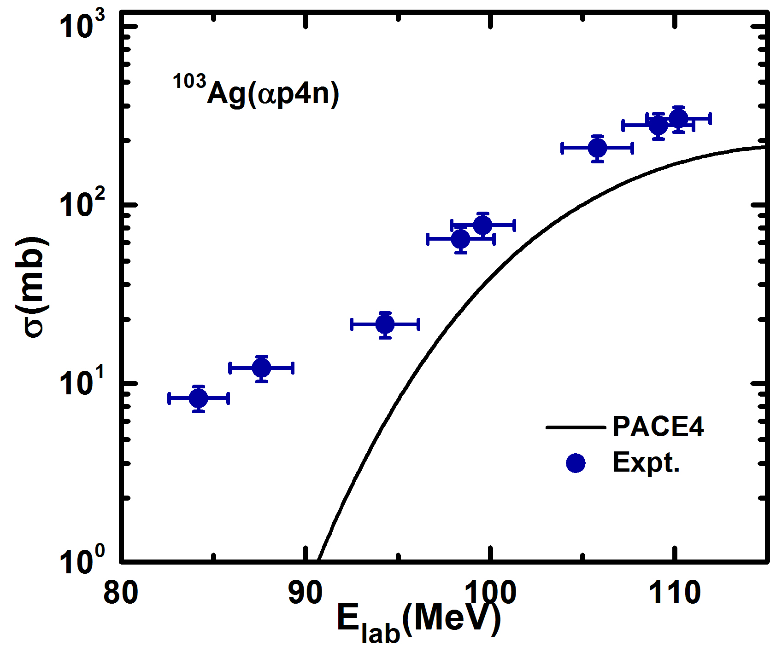
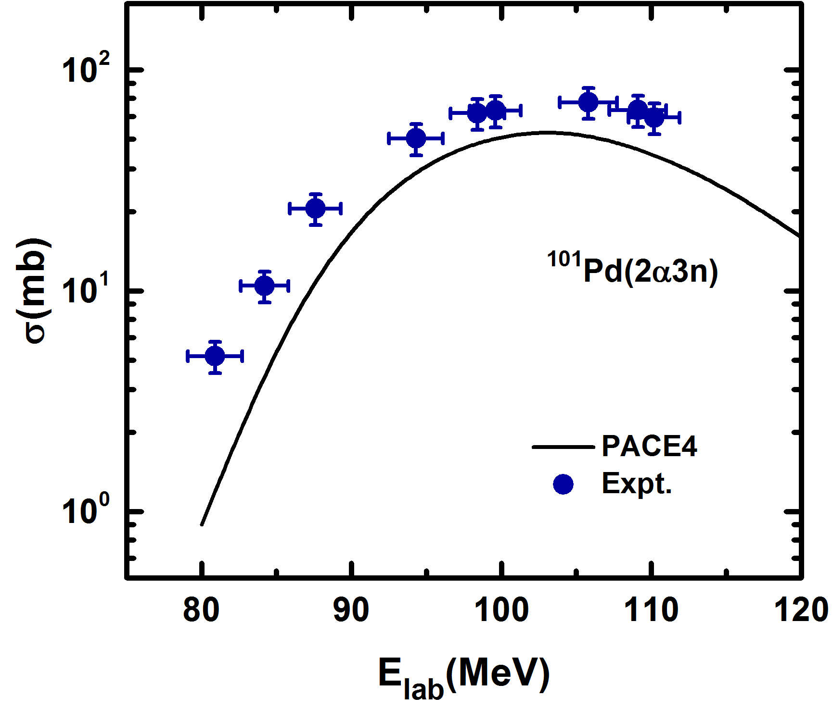
Results and analysis
Analysis of the α-emitting channels
Notes:
Here these figures shown the excitation function of alpha emitting channels with the theoretical calculations of PACE4 code. PACE4 calculations were performed with the same set of parameters as used to understand the EFs of the xn channels. A significant enhancement have been shown in alpha emitting channels with PACE4 code. How ever code PACE4 does not include breakup reactions. It may be pointed that these residues may have contribution both CF as well as ICF reactions.

Slide 15
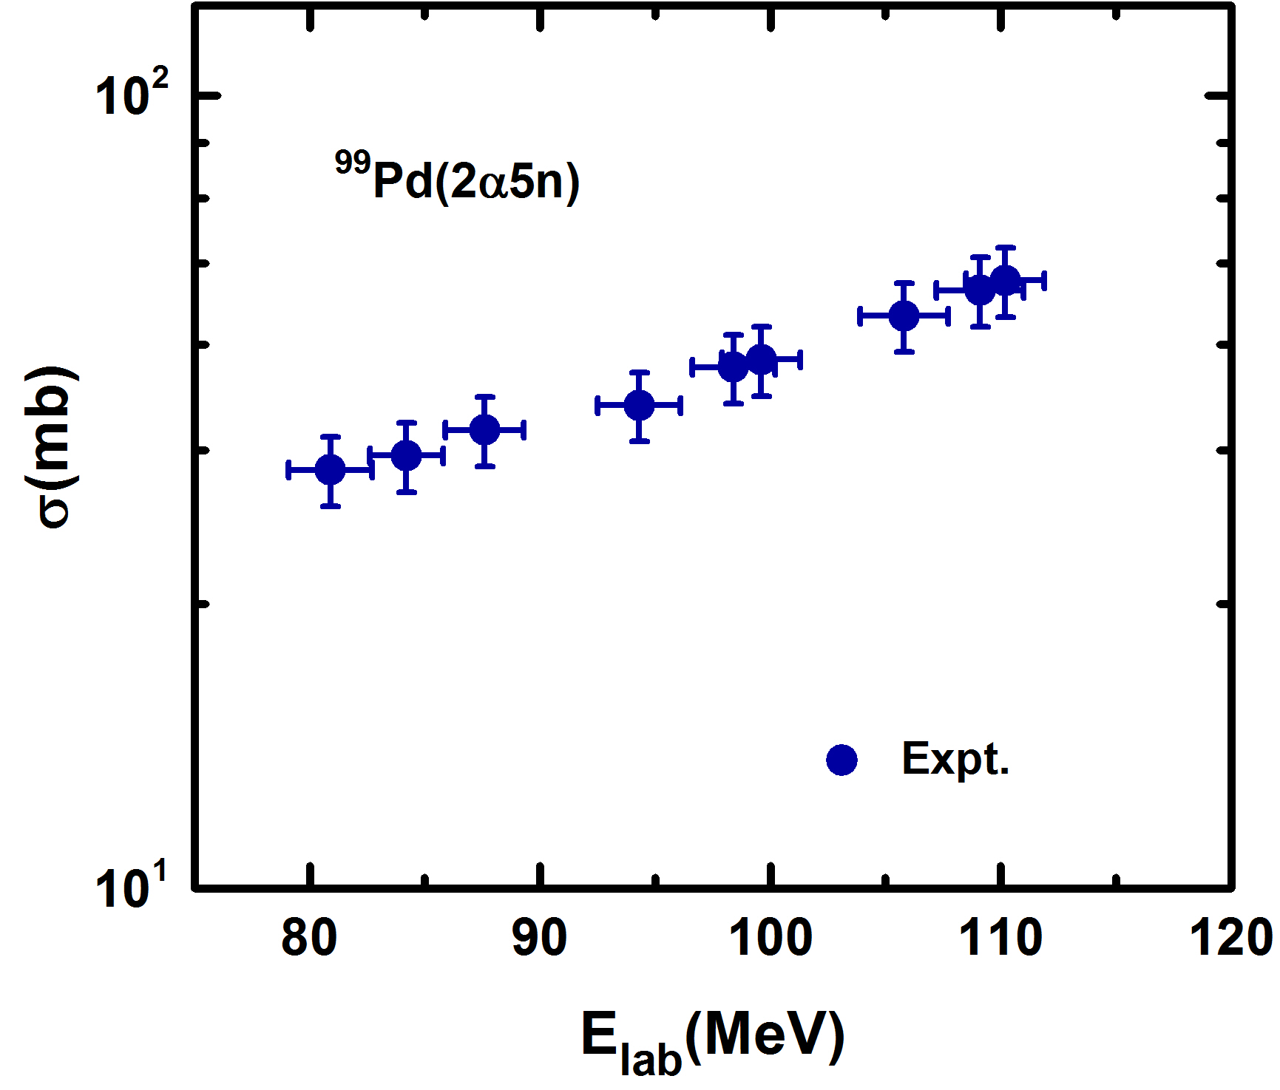
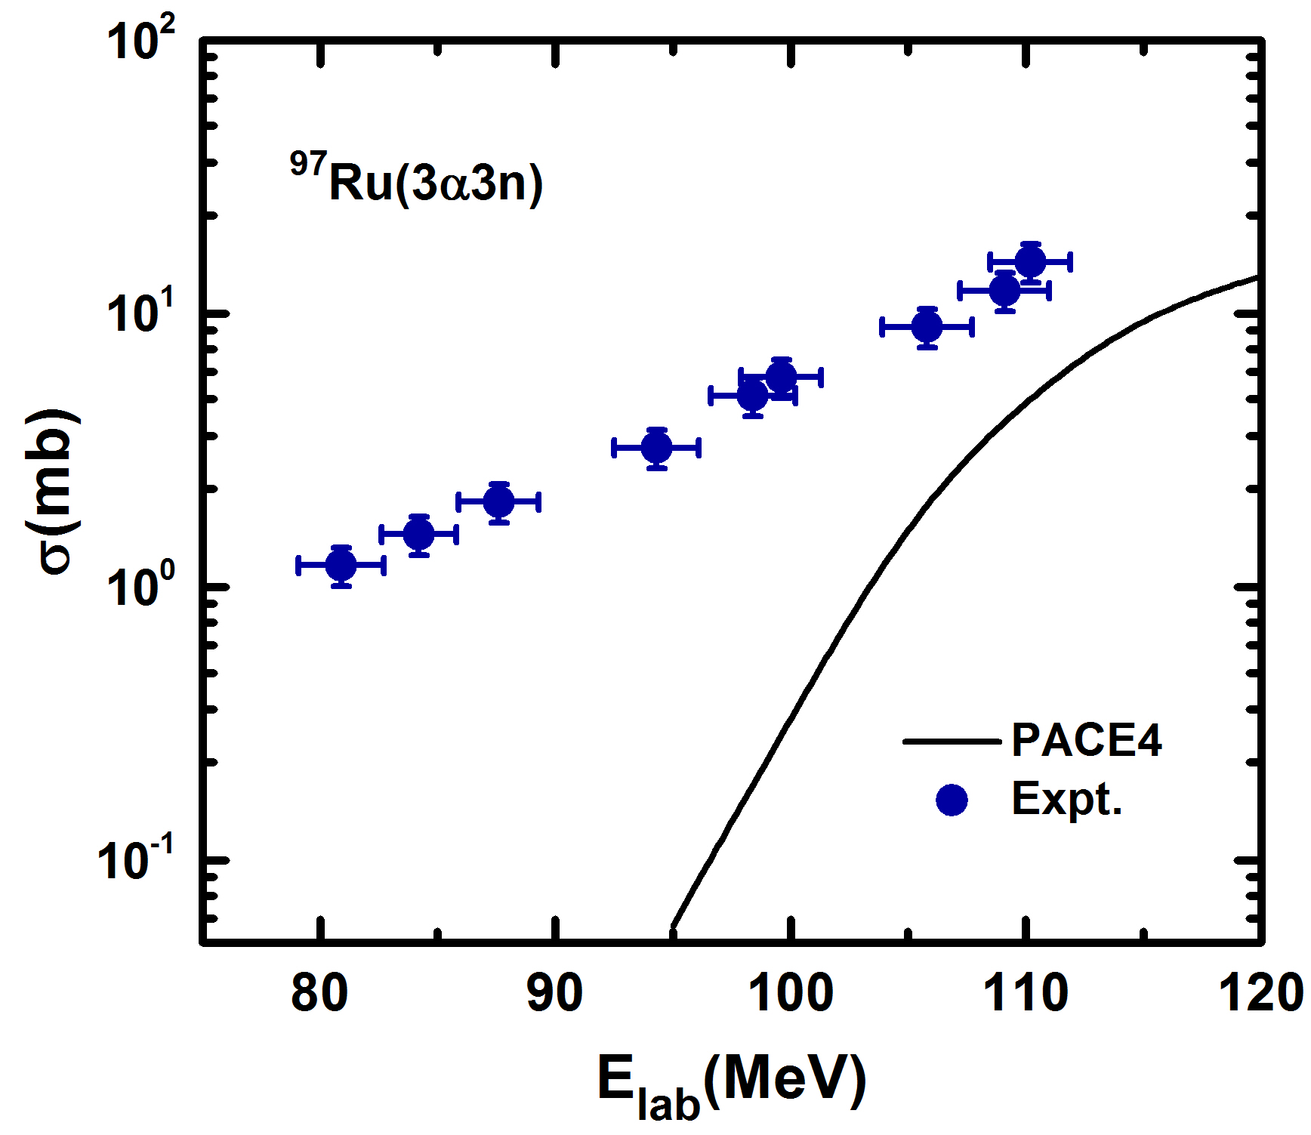
Results and analysis
Analysis of the α-emitting channels
Notes:
Here the graph for 2a5n and 3a3n channels are shown. In case of 2a5n channel negligible theoretical cross section values have been found and not shown here. As a result the cross section of this residues are purely populated by ICF.

Slide 16
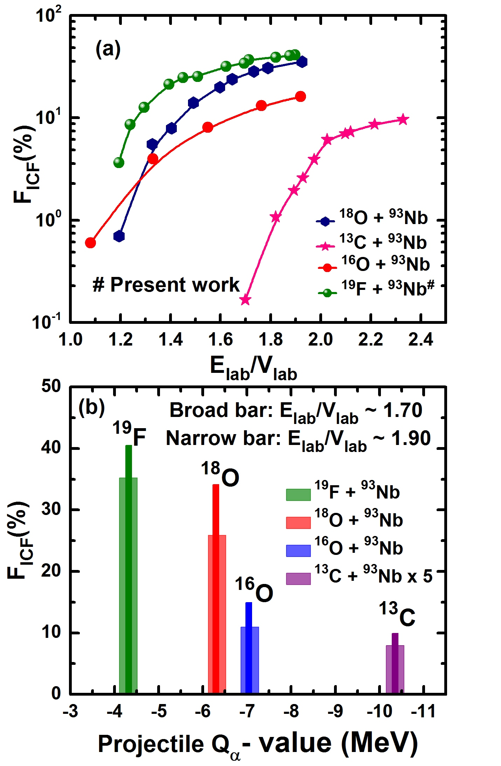
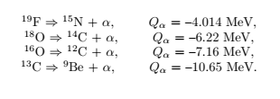
Results and analysis
Entrance channel parameters effect on incomplete fusion probability.
An entrance channel parameter, the projectile’s α-Q value (Qα), which is expressed as the minimum energy needed to eject an α particle from the projectile, have been considered to understand these observations regarding the strong projectile-type effect on ICF reactions.
Notes:
Further to understand the role of ICF probability on the entrance channel parameter. The ICF fraction has been calculated and plotted against normalized energy with other available systems. Here the target is same so target structure effect normalized it self. It may be pointed out from this figure (i) the value of FICF increases with the incident-beam energy for all the systems, (ii) the rate of change of FICF values are different for the different projectile target combinations. Since the target nuclei is same for these systems, thus it can be inferred that the FICF values are sensitive to the projectile type (iii) the threshold energy, the onset energy for the ICF, is also different for each system.

Slide 17
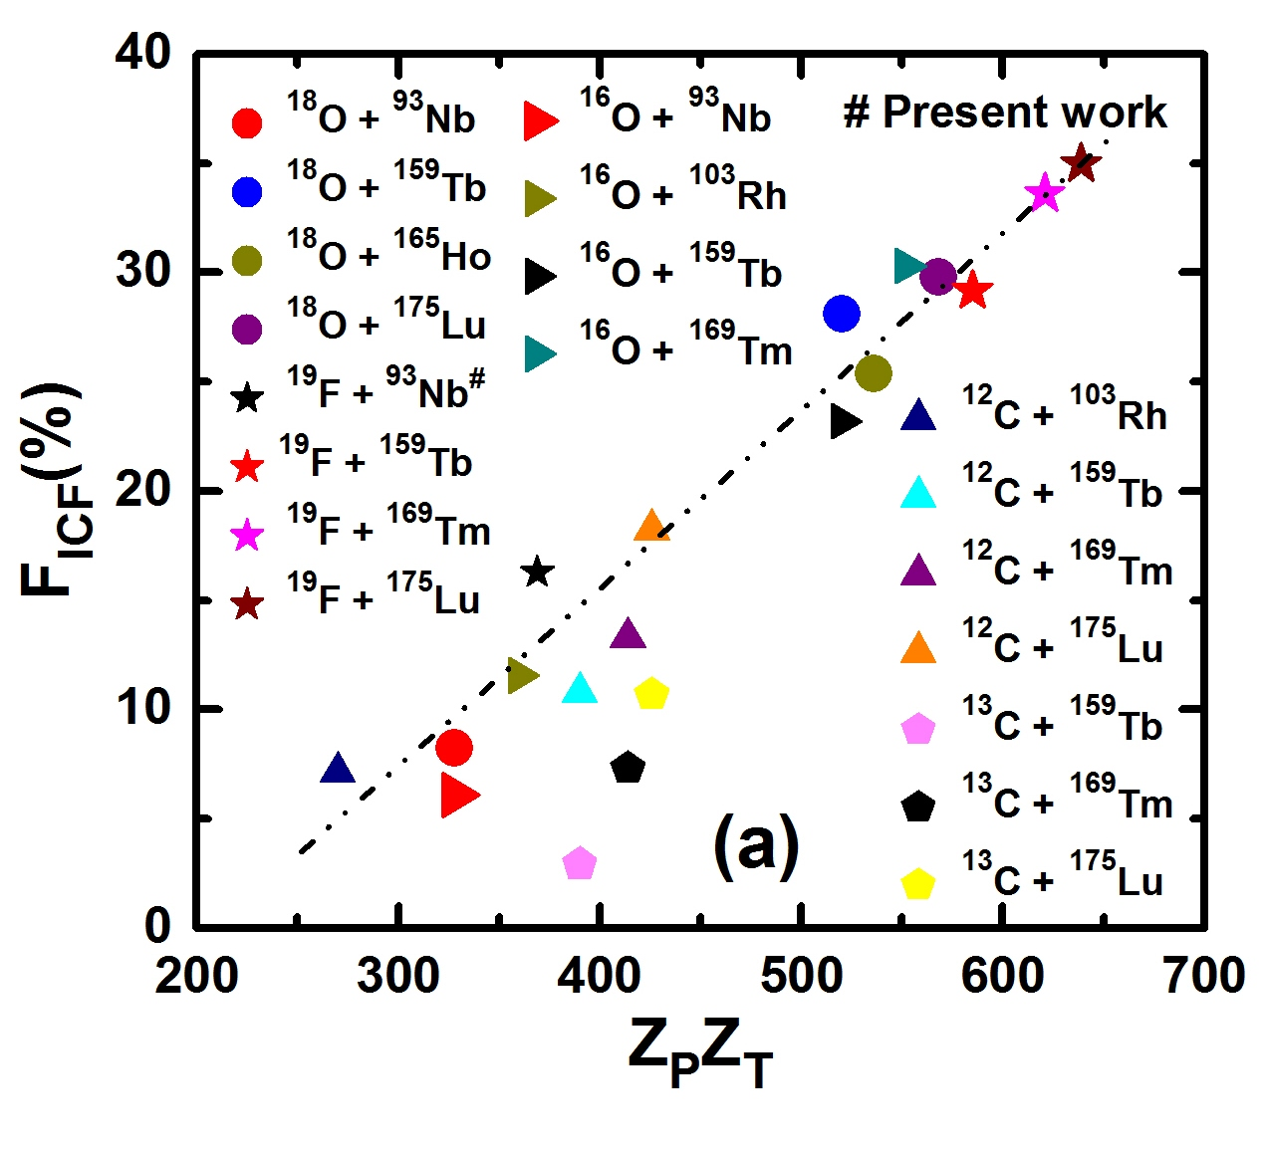
Results and analysis
Entrance channel parameters effect on incomplete fusion probability.
The strength of the Coulomb interaction between the interacting partners, with the projectile of charge ZP and the target of charge ZT , is proportional to the ZPZT , hence, it will be interesting to investigate the role of the ZPZT , called the Coulomb factor, on the ICF reactions.

Slide 18
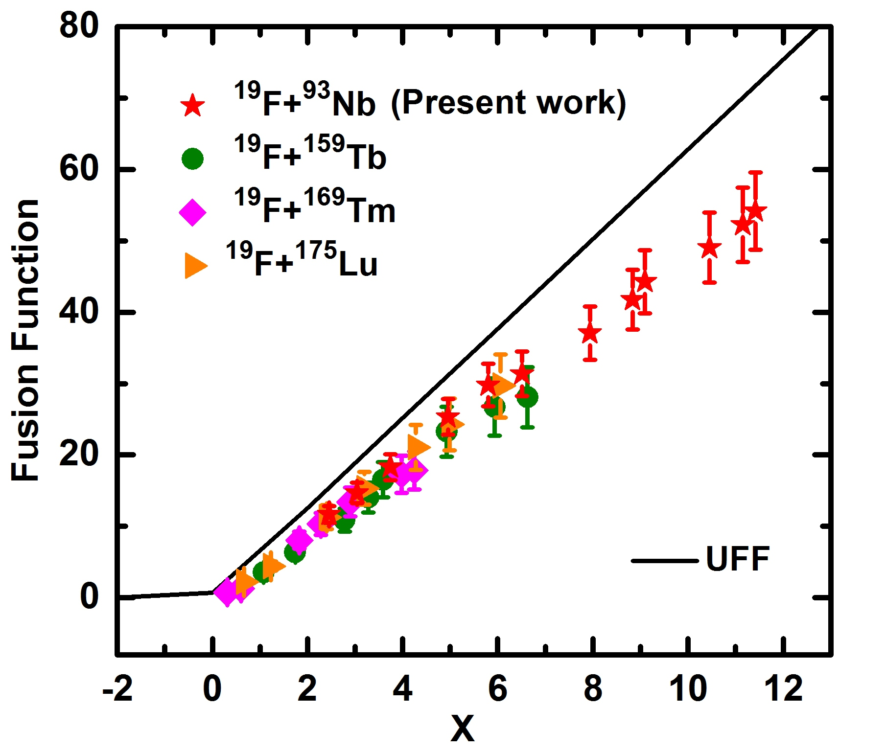
Results and analysis
Entrance channel parameters effect on incomplete fusion probability.
Universal fusion function
Notes:
UFF is a reduction method to understand the breakup effect. We have calculated the UFF for the 19F projectiles reactions and found the fusion function is suppressed that may be due to breakup of the projectile.

Slide 19
Summary and Conclusion
The measured EFs for all xn/pxn channels are in agreement with the theoretical predictions of PACE4. The theoretical values for K=10 reproduces the
experimental EFs for all CF channels.
The enhancement has been observed for α-emitting channels with theoretical
predictions support the ICF of projectile with the target.
The value of FICF (%) is found to increase with the increase in projectile
energy.
The value of FICF (%) is found to increase with increasing Q_{α} value.
The value of FICF (%) is also affected by the Coulomb factor (ZPZT).
Suppression in fusion cross section represents the observed effect of the breakup of 19F on the CF for all systems.

Slide 20
Thanks
for your attention…!

