Slide 1
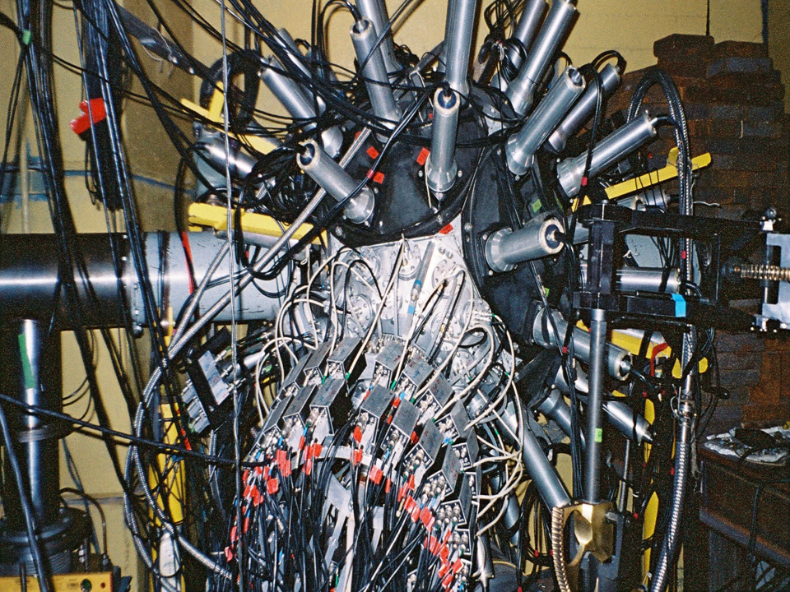

VARIATION OF THE SOURCE VELOCITY
IN COLLISIONS OF 2.1 GeV PROTONS WITH GOLD TARGET
S.P. Avdeyev^{1,2}, W. Karcz¹, V.V. Kirakosyan¹,
P.A. Rukoyatkin¹, V.I. Stegaylov¹, A.S. Botvina³,
Z. Igamkulov¹, S.G. Busin¹, M.G. Buryakov¹, G.D. Milnov^{1,2}.
¹Joint Institute for Nuclear Research, Dubna, Russia,
²Dubna State University, Dubna, Russia,
³FIAS, Frankfurt am Main, Germany.

Slide 2
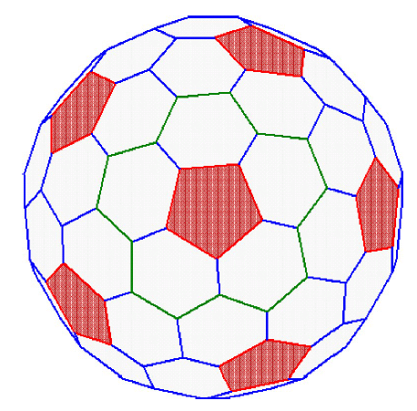
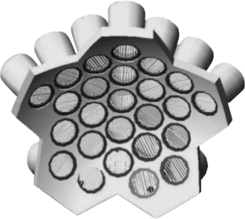
58 CsI(Tl) detectors
5 telescope-spectrometers
25 telescope-spectrometers
Notes:
заметка 3

Slide 4
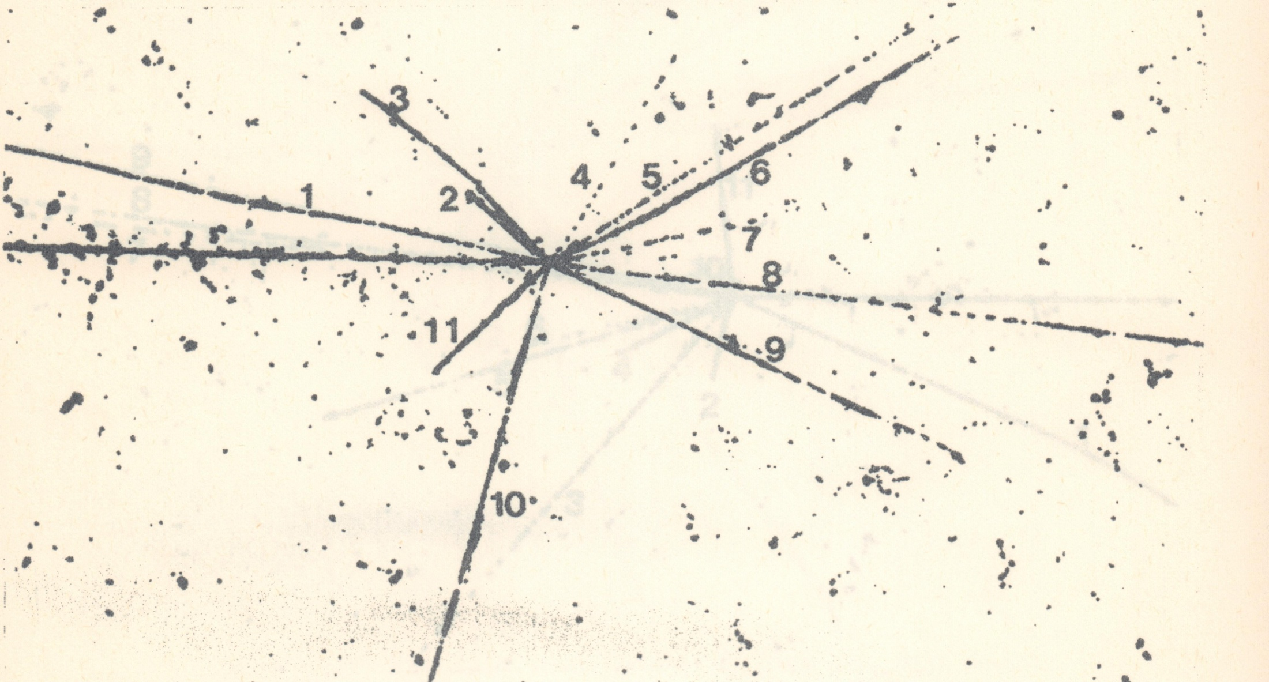
Bo Jacobsson, et al., Z. Phys. A 307, 293 (1982)
Photo-emulsions irradiated with a carbon beam (250 MeV/nucleus)
at the Bevalac Berkeley accelerator

Slide 5
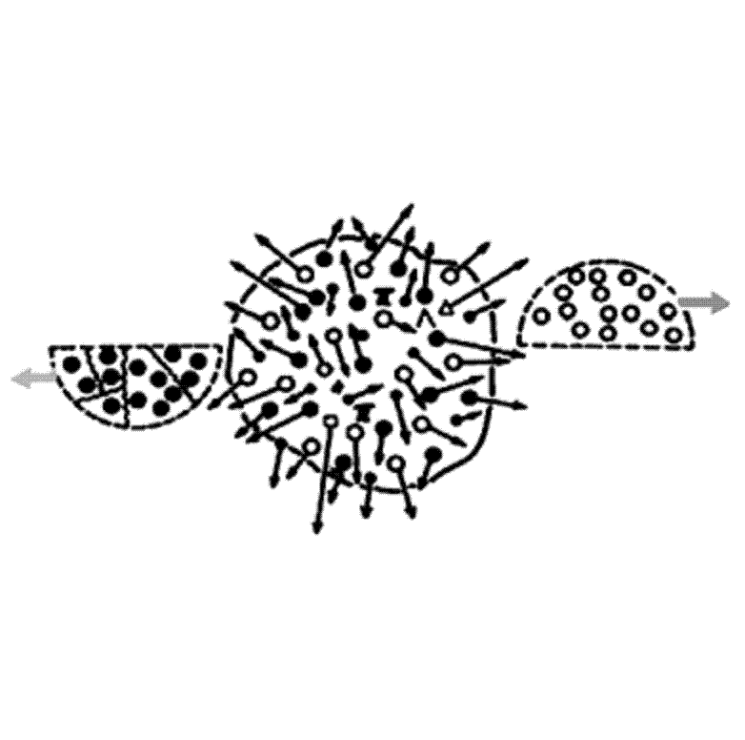
Spectator
Spectator
Hot and
compressed
region
Participants

Slide 6
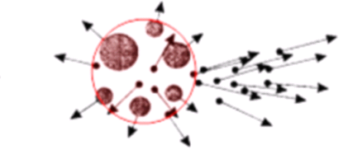
multi-fragmentation of heavy target
by the light relativistic projectiles
excitation energy comparable with the total binding energy
IMF-intermediate mass fragments: IMF=2<Z<20
E* = Eth > 400 MeV (T = 5 –7 MeV )
Model: INC*+SMM+ multybody Coulomb trajectory
(Heavy ion collisions: E* =Eth + Ecompr + Erot )

Slide 7
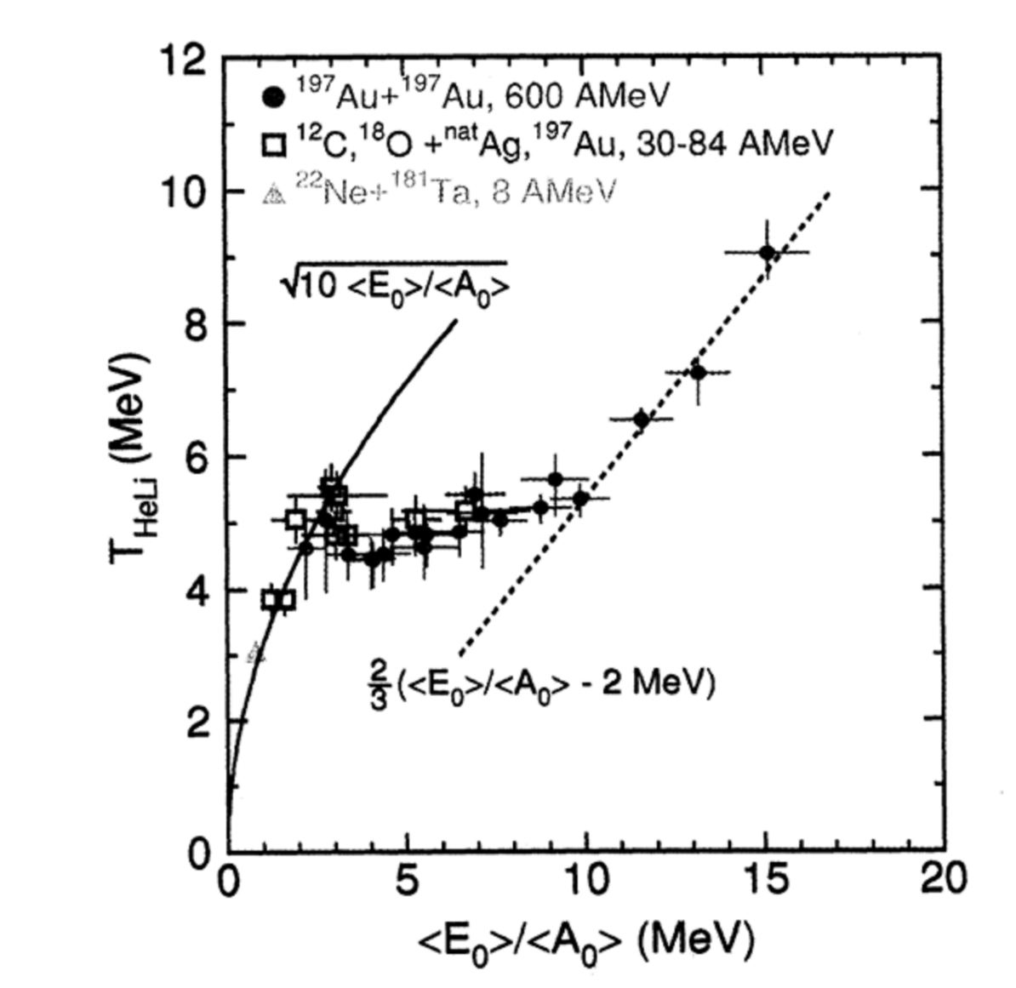
gas of classical
elementary particles
evaporation regime
Caloric curve of nuclei determined by the dependence
of the isotope temperature T_{HeLi} on the excitation energy per nucleon.
J. Pochodzalla et al., Phys. Rev. Lett. 75, 1040 (1995).

Slide 8
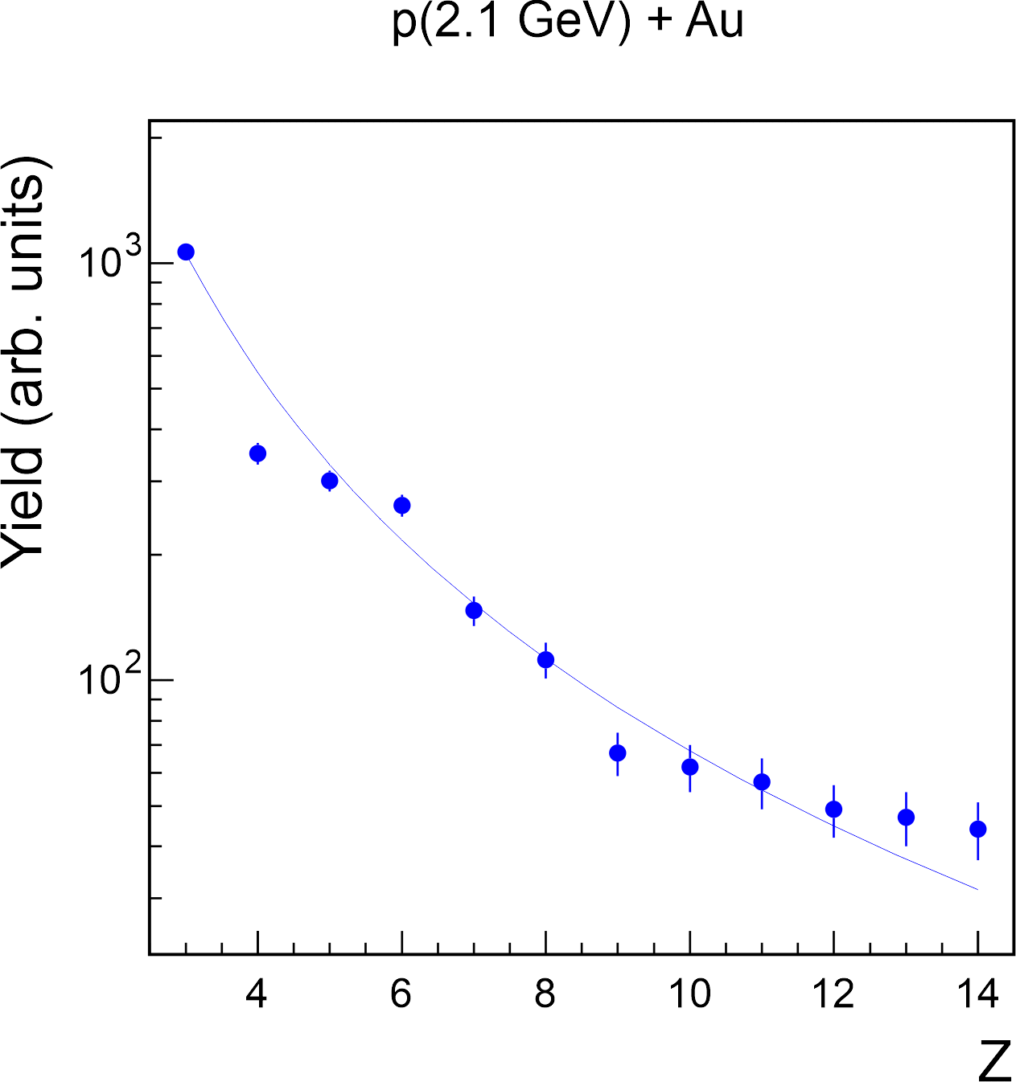
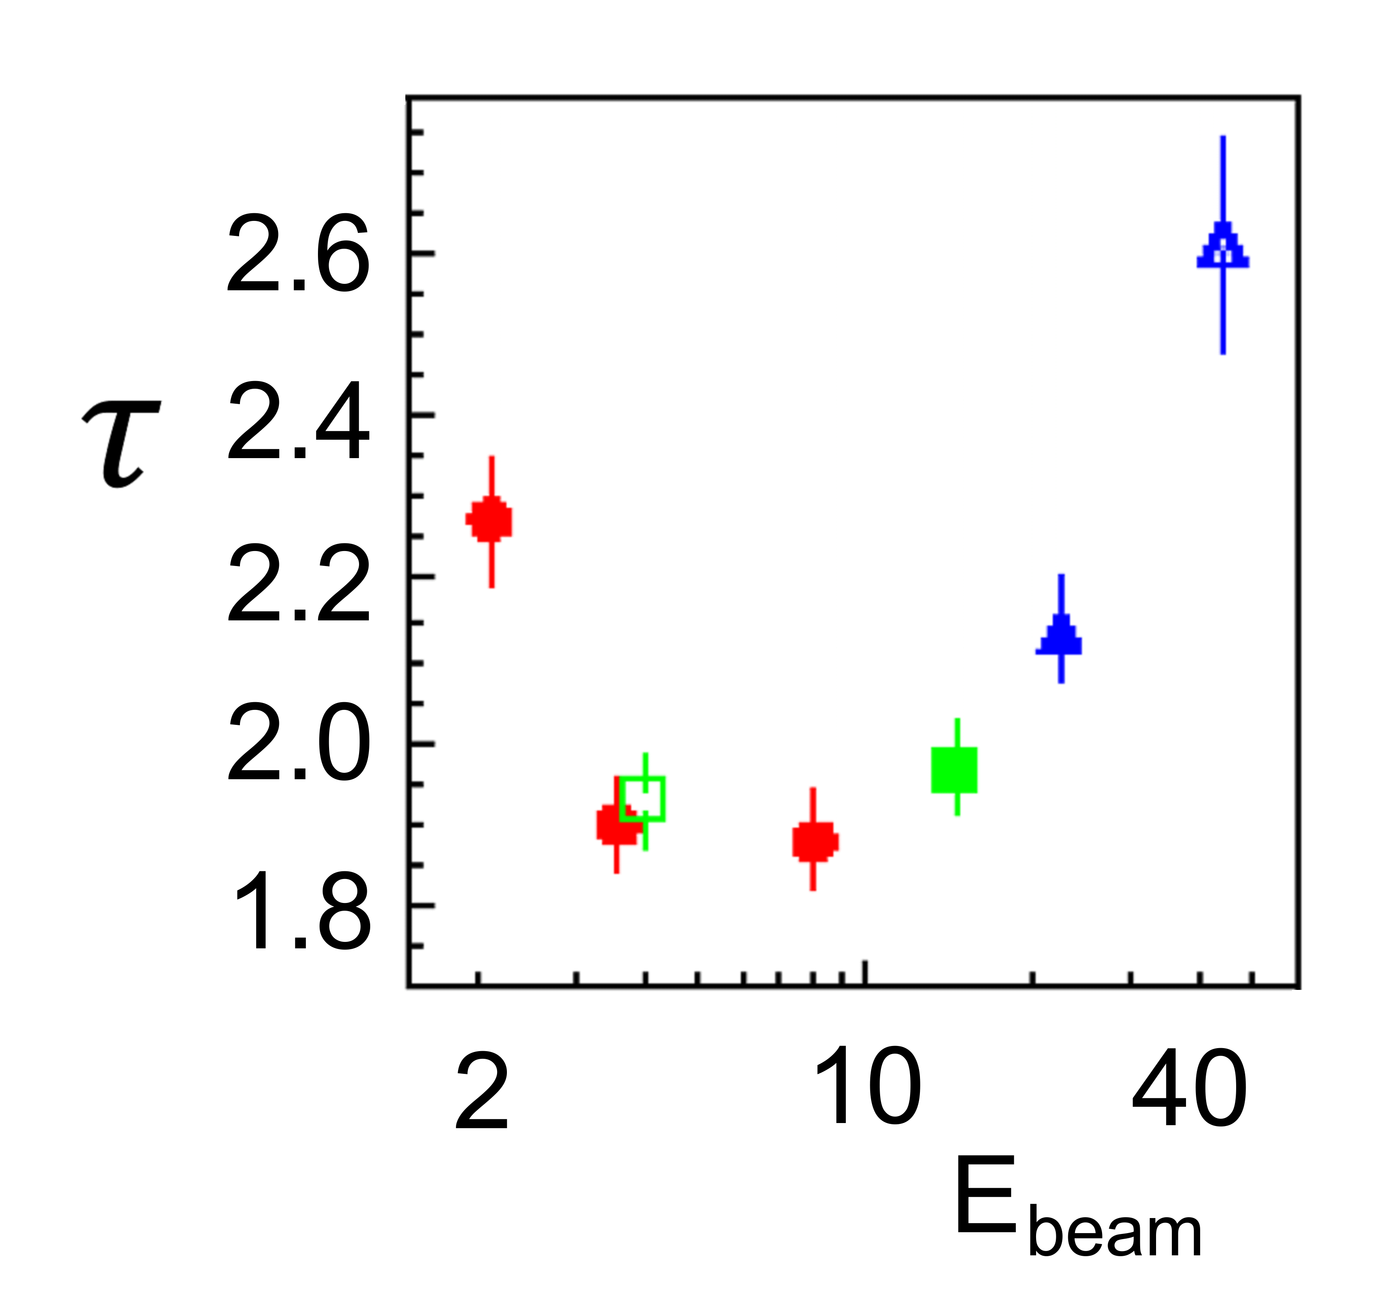

Slide 9
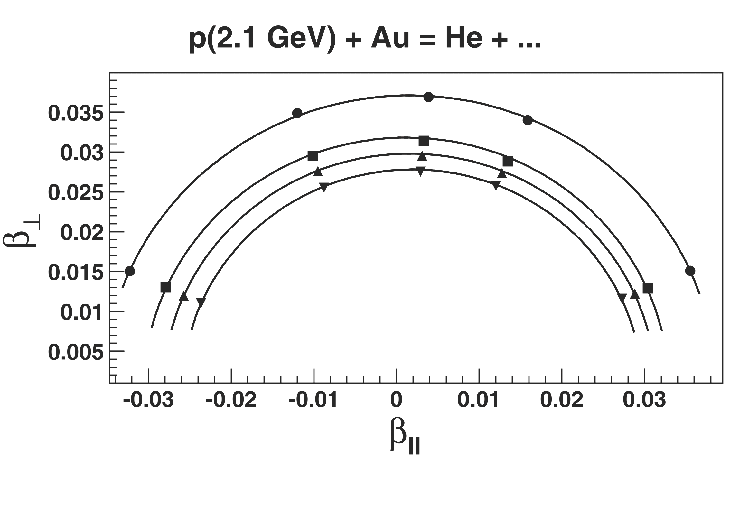

Slide 10
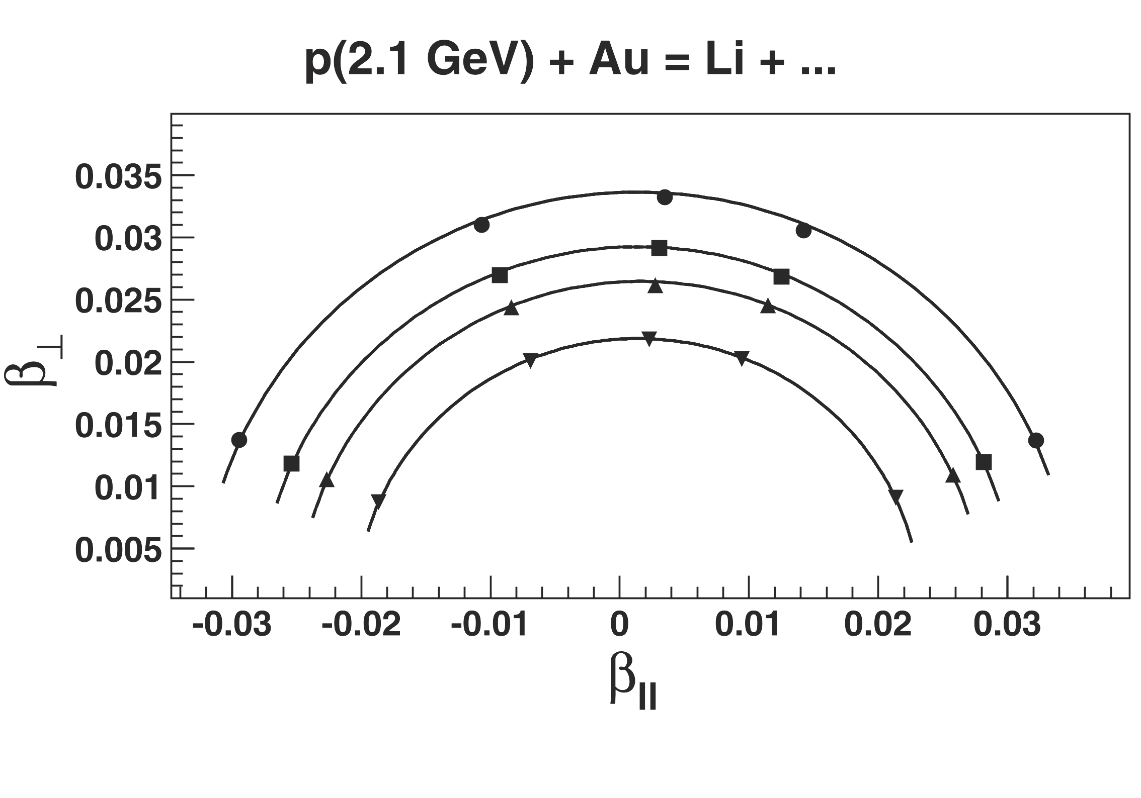

Slide 11
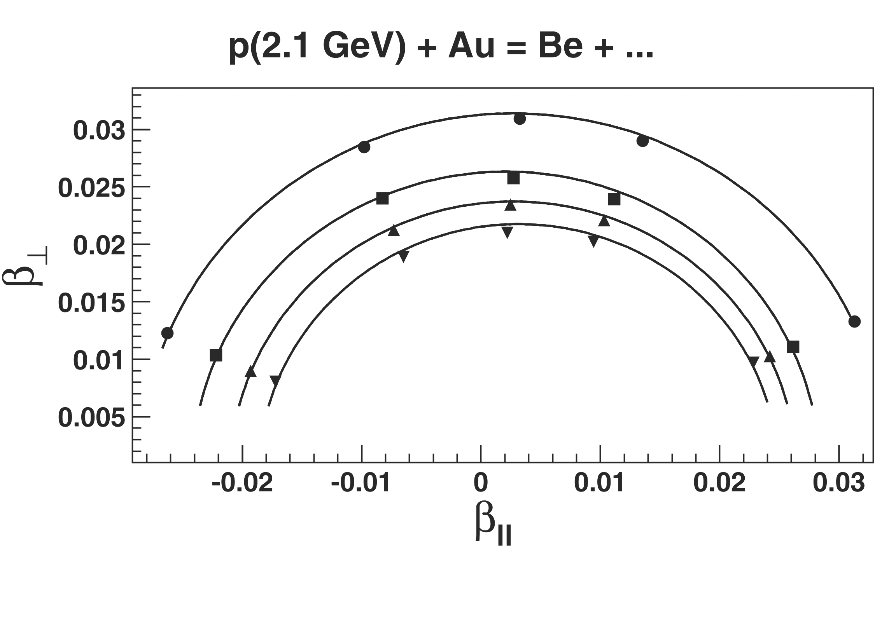

Slide 12
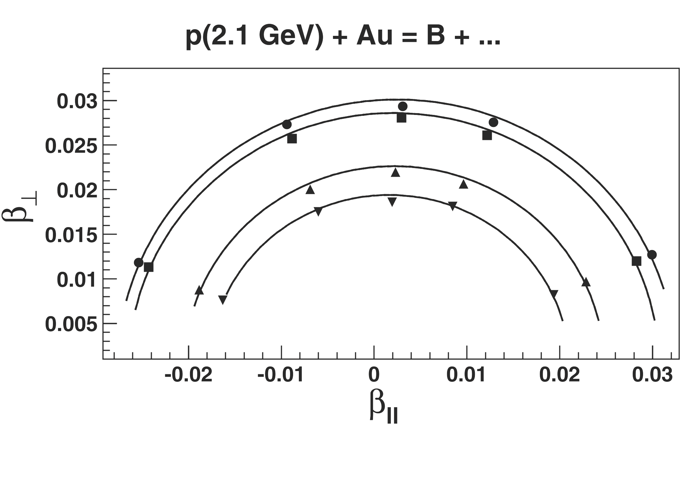

Slide 13
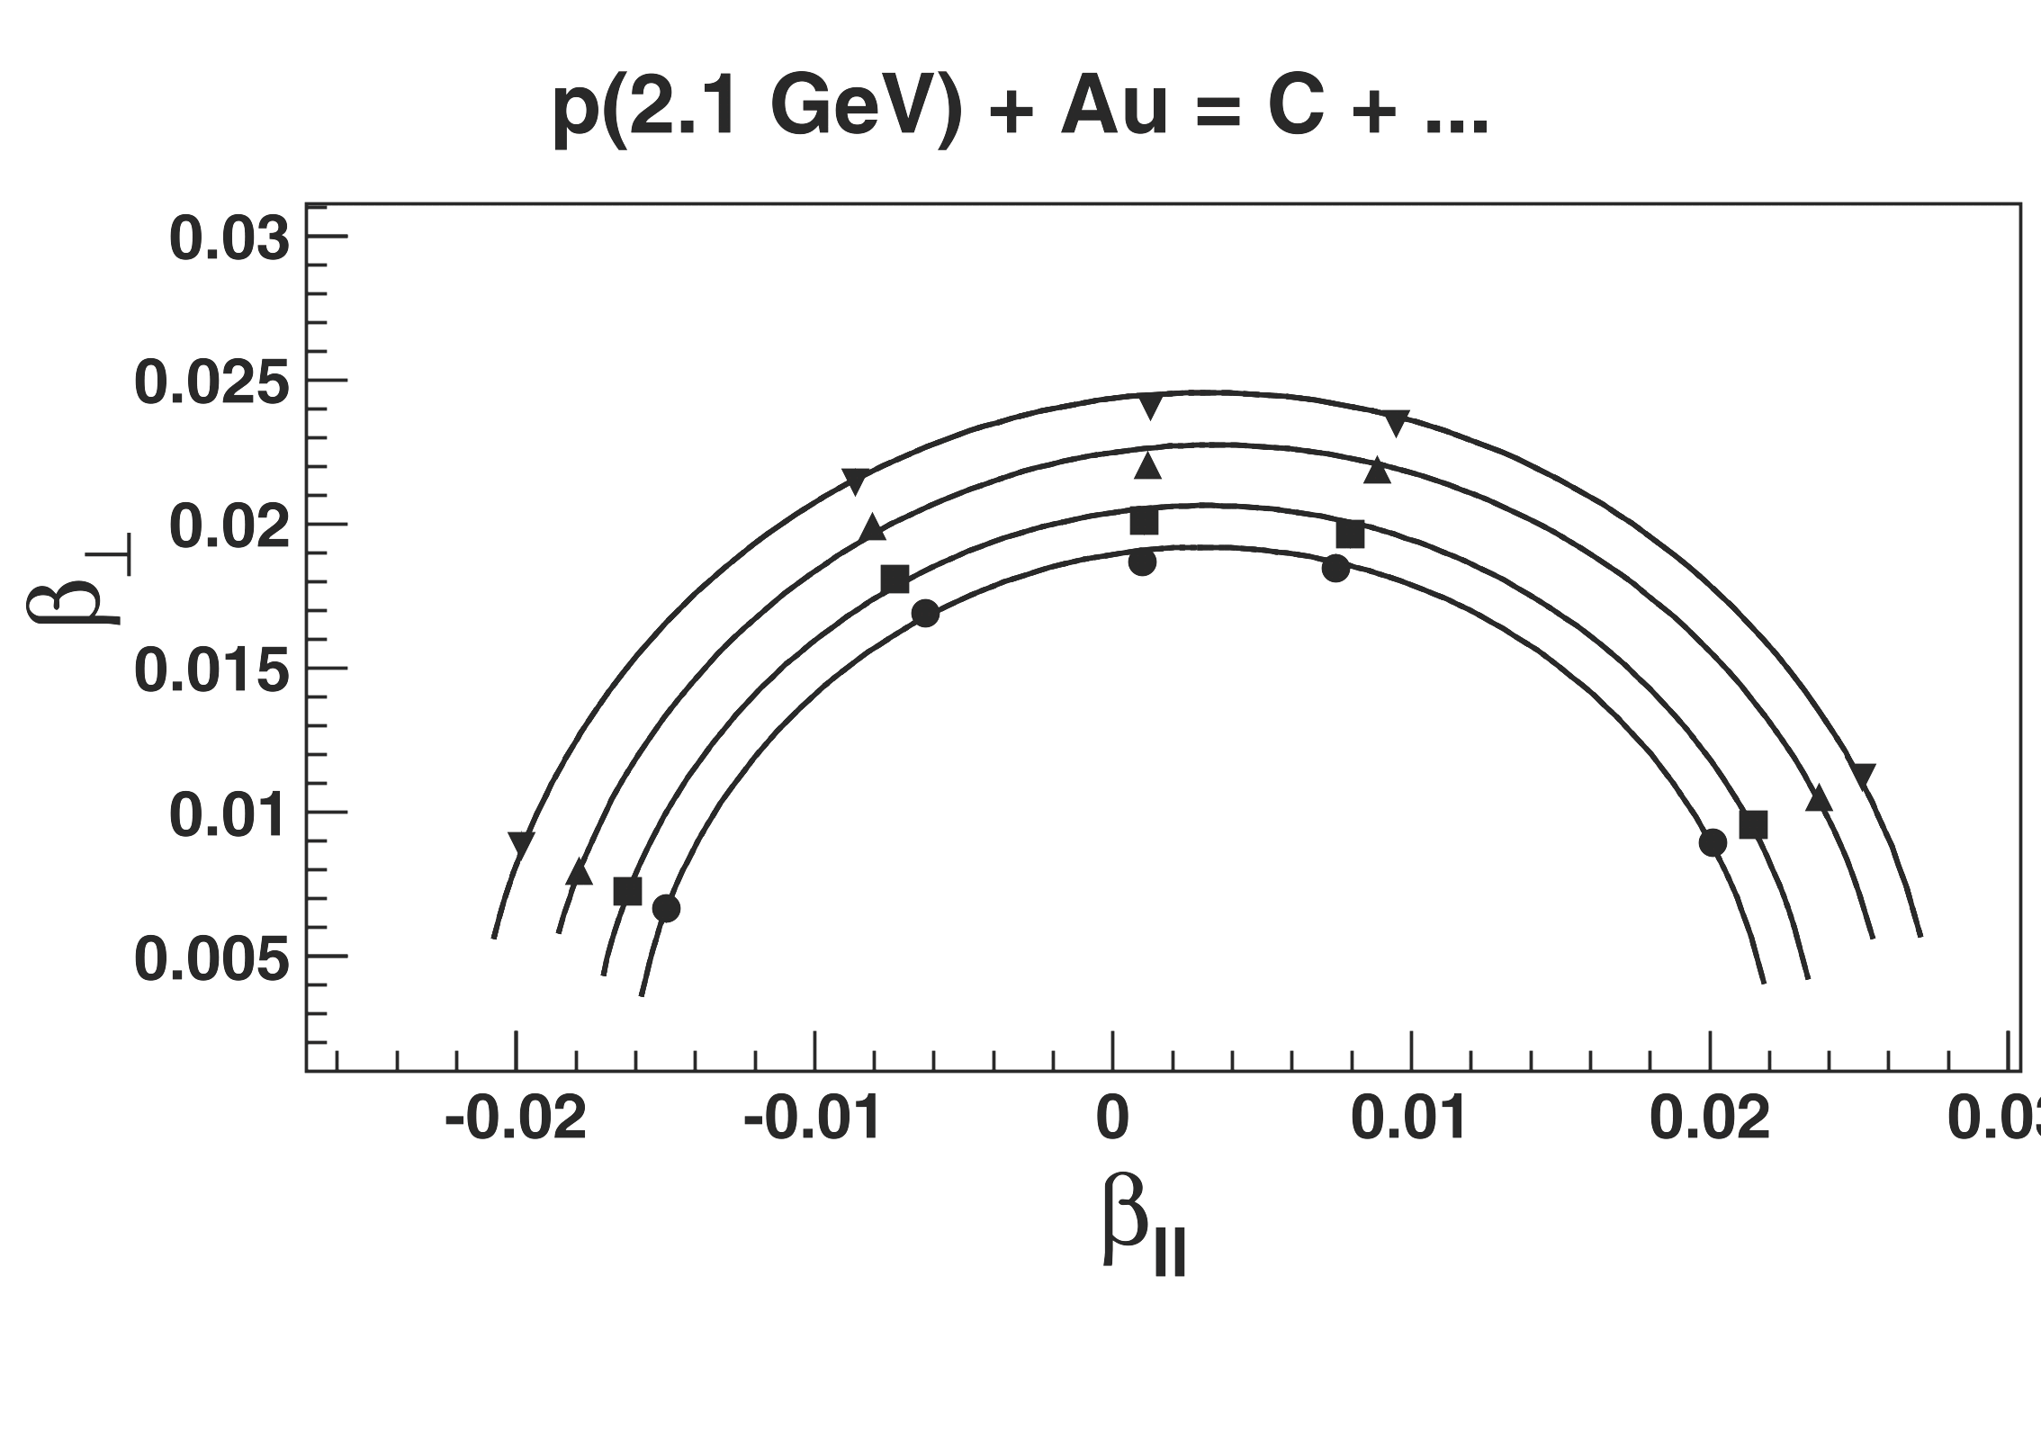

Slide 14
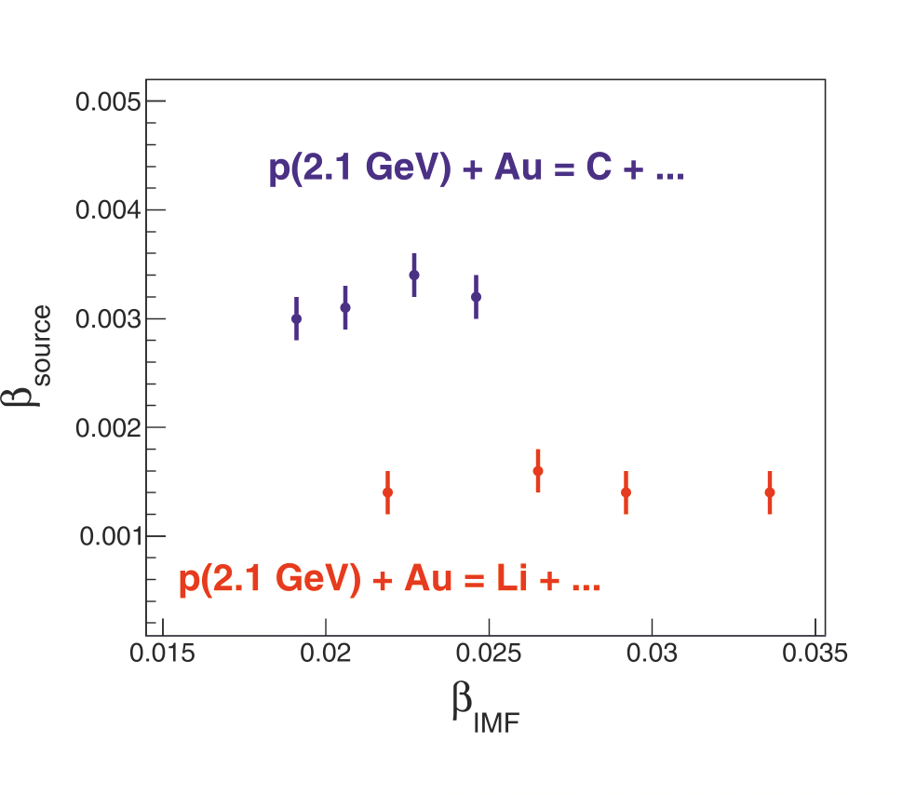

Slide 15
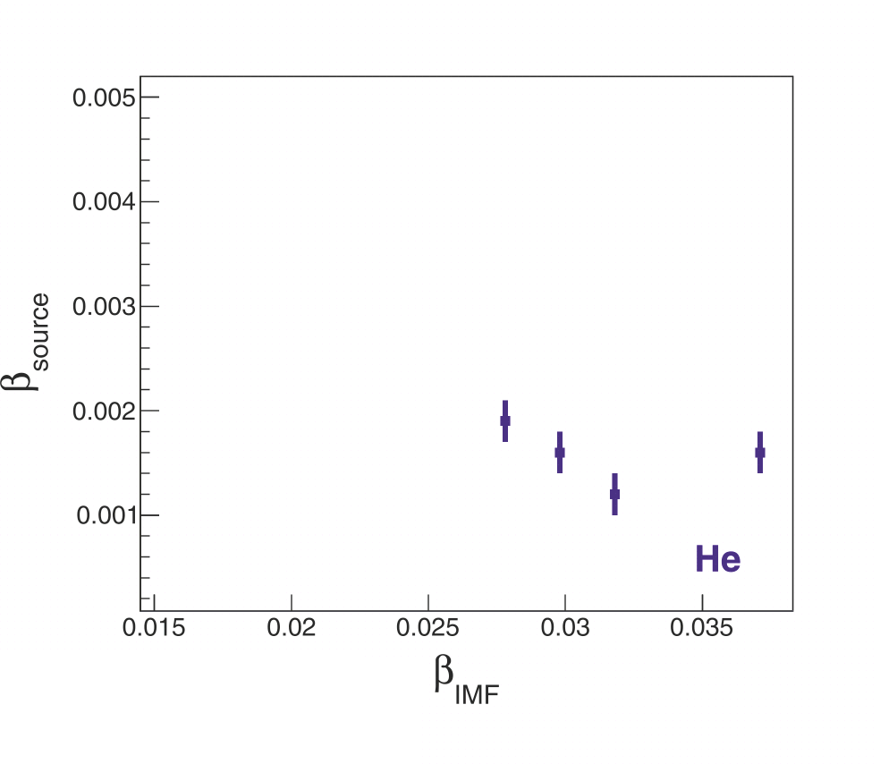
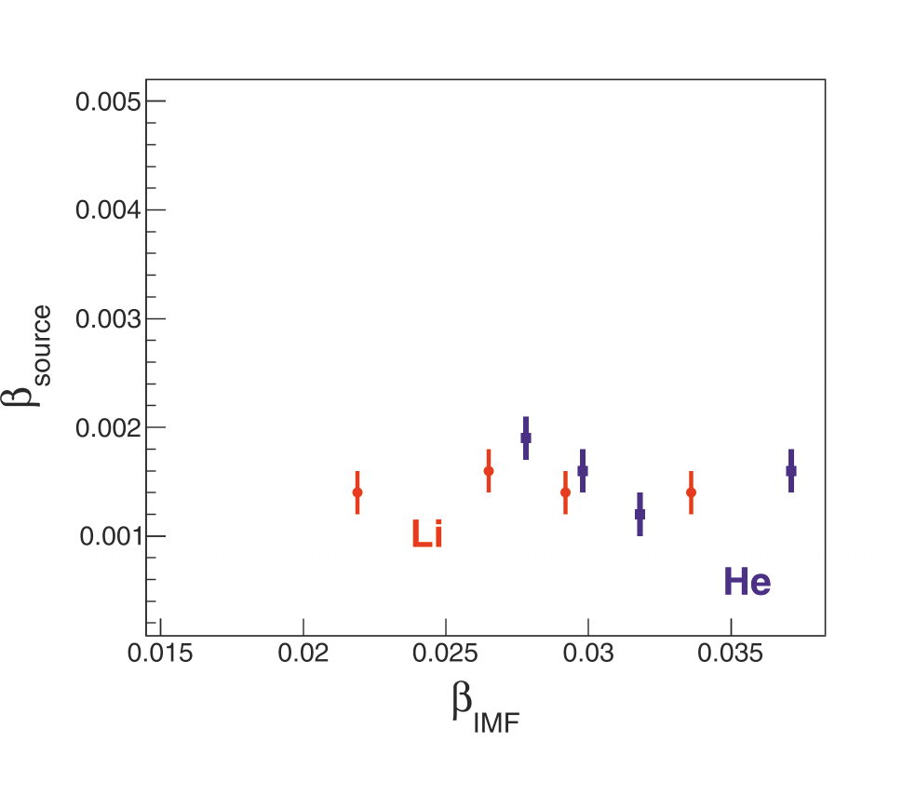
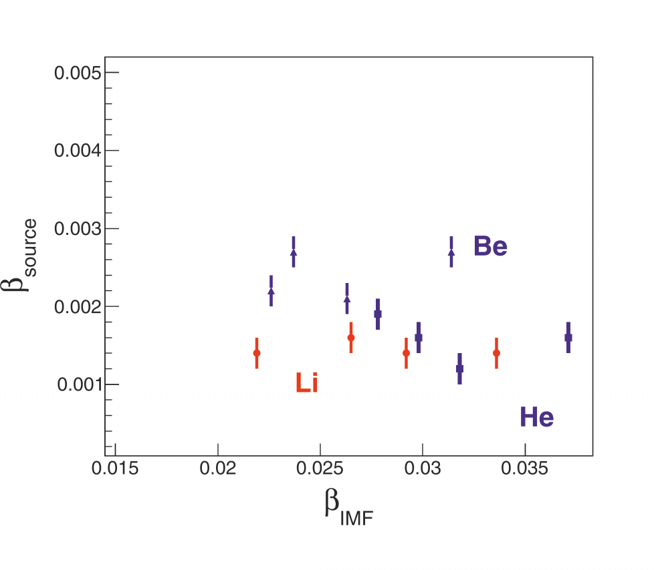
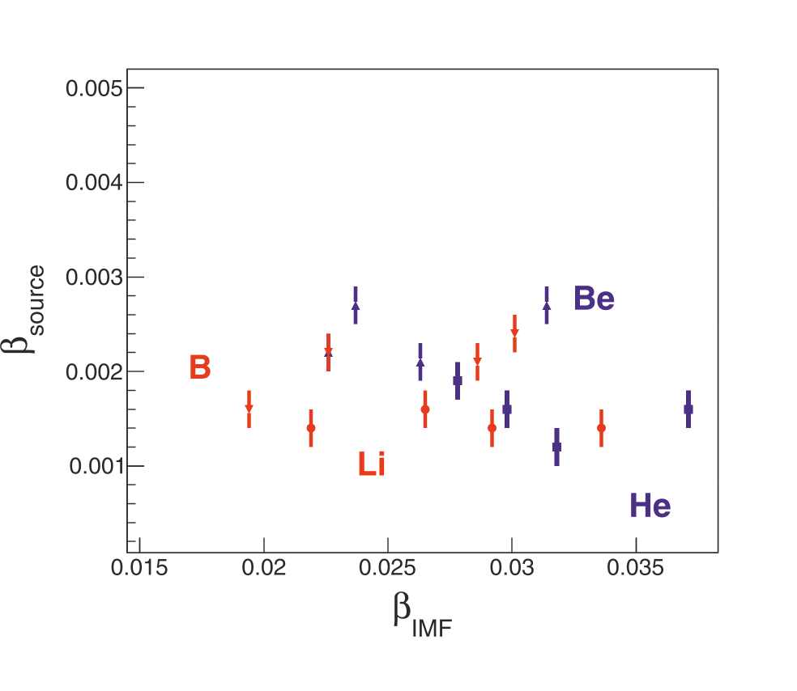
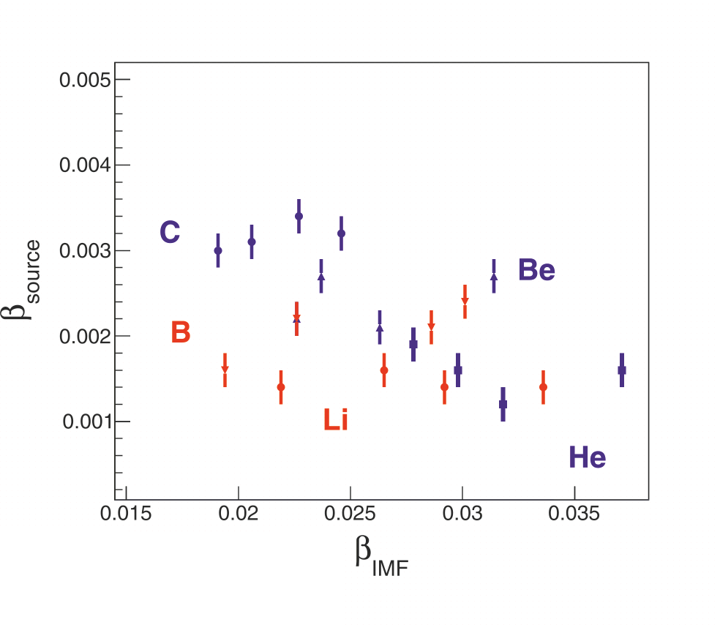

Slide 16
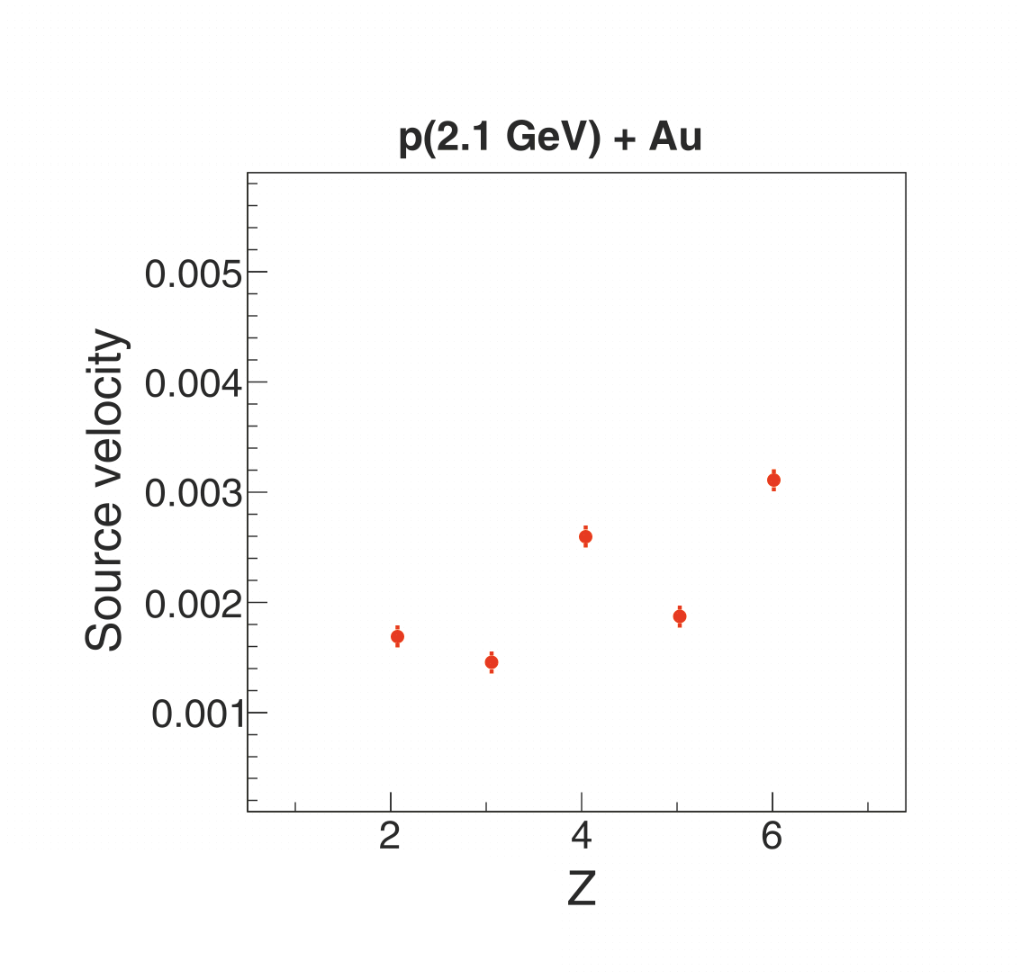

Slide 17
“Kinetic equilibrium” of the system is achieved before fragmentation.
It was found decreasing of source velocities as the charge of fragment is decreasing.
The research was supported by the Russian Science Foundation, Grant No. 23-22-00160.
Notes:
17
заметка 3

