Slide 1
Precise measurements of low energy ion stopping power by Doppler broadening estimation.
Alexey Grachkov
Dukhov All-Russian Scientific Research Institute of Automation

Slide 2
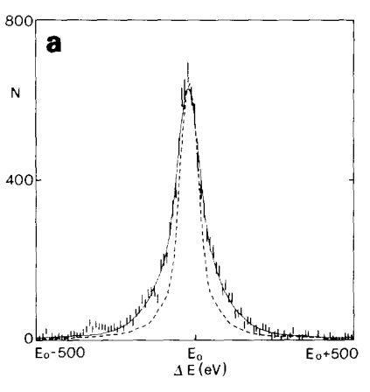
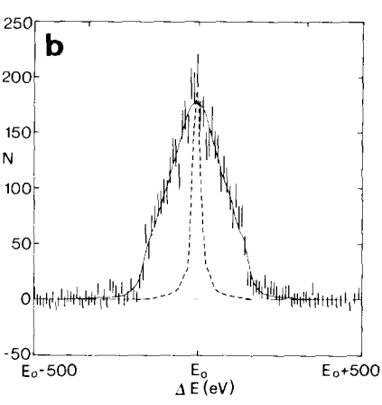
Reaction
E₀ =1.793 MeV
E₀ =1.498 MeV
H. Borner, J. Jolie, F. Hoyler, S. Robinson, M. S. Dewey, and G. Greene, Phys. Lett. B 215, 45 (1988).
60 eV
200 eV
1.793 MeV
1.498 MeV
8.142 MeV
3.175 MeV(-1/2)
3.26 MeV(-3/2)
1.382 MeV(-3/2)
1.762 MeV(-5/2)

Slide 3
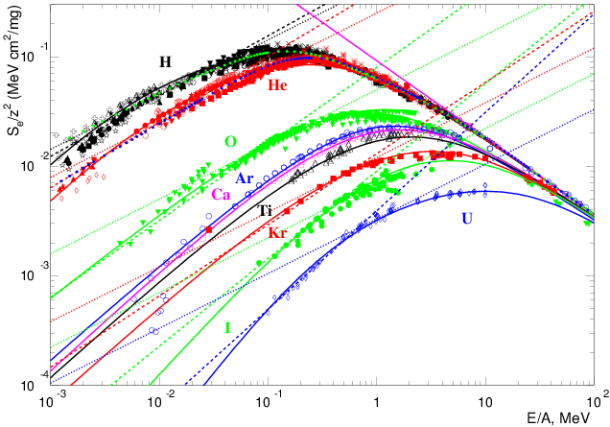
The ТРТ fit of the experimental dE/dx values (IAEA) for different ions in gold
The dotted lines – LSS model
The solid lines – ТРТ
Bethe-Bloch for nuclei
The light ions can be fitted by the LSS power α=1, but the heavy ions definitely have α>1. At high energies the common Bethe-Bloch law is a power law too.

Slide 4
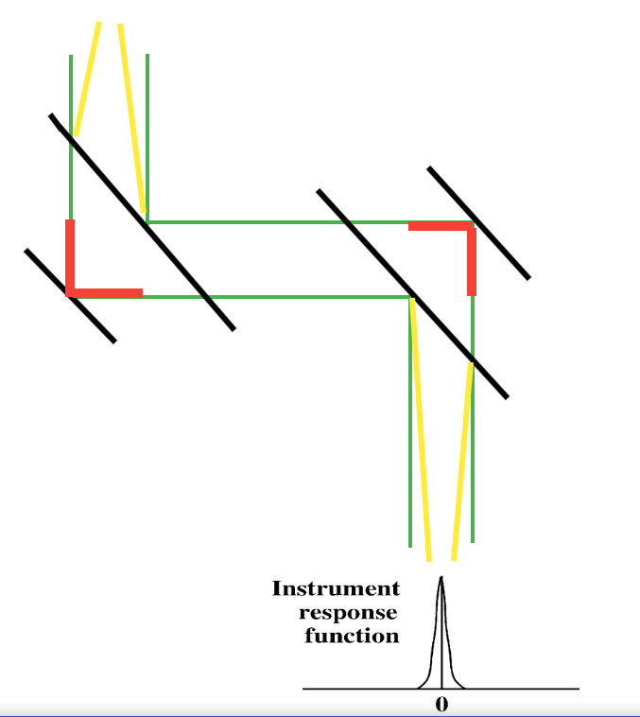
Response function estimation
Gamma beam (1e-4 rad) hits first Si crystal, rotated at bragg angle, then, after diffracted picture hits second Si crystal (parallel to first Si crystal), beam convolutes.

Slide 5
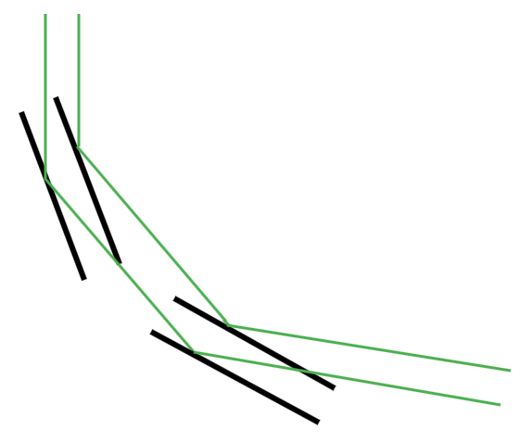
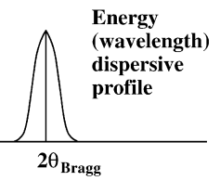
Dispersive profile estimation

Slide 6
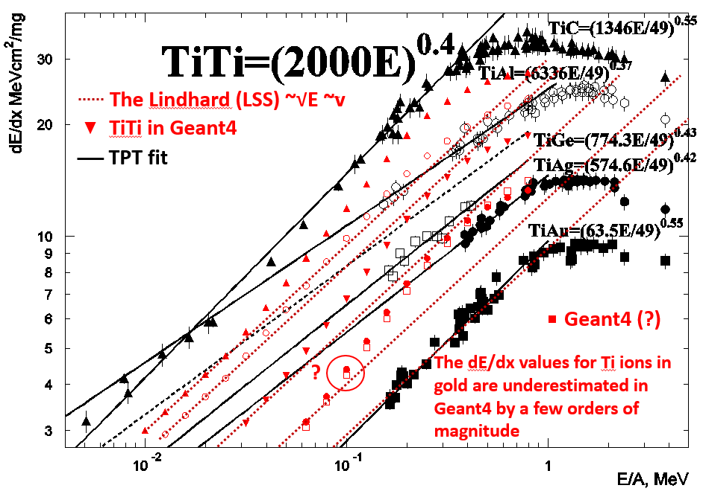
Stopping power estimation
Geant4 α=1/2 (red dots), TPT α – free parameter (black lines). Black dots – experimental data

Slide 7
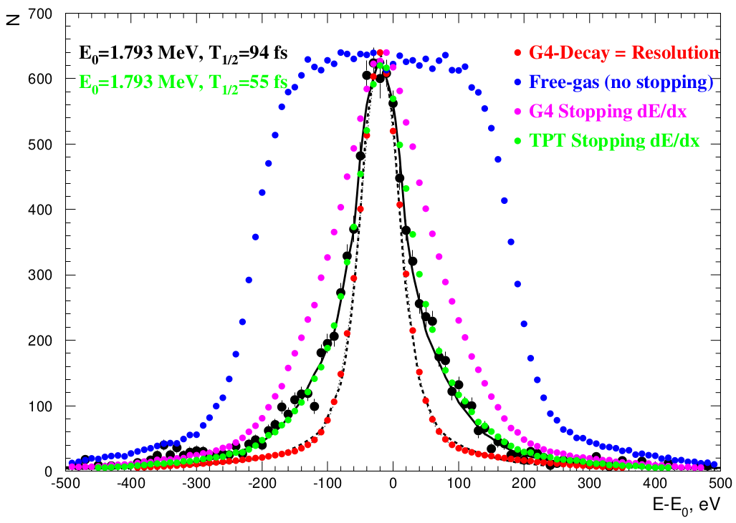
Result 1
Red – instrumental response function
Blue – without slowing down
Pink – Geant4 slowing down
Green –TPT slowing down

Slide 8
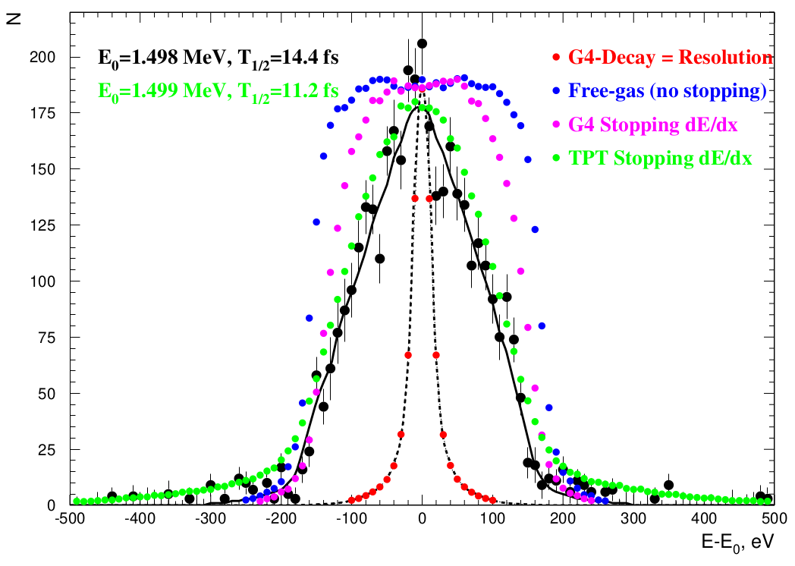
Result 2
Red – instrumental response function
Blue – without slowing down
Pink – Geant4 slowing down
Green –TPT slowing down

Slide 9
Conclusions
Method for calculate stopping power of low energy ions.
More valid for heavy ions.
Ions fly in their own media or ions compounds.
Could be additional failures with cascade relaxation.
Lifetime necessary.

Slide 10
Thank you for attention

