Slide 1
TUNED ELECTRON-NUCLEUS RESONANCE AS A TOOL OF PRODUCING THE 229Th ISOMER
F.F. Karpeshiin
Saint-Petersburg Institute for Metrology VNIIM
A method for enhancing the optical pumping of a nuclear isomer is substantiated using the resonant properties of the electron shell.

Slide 2
The required error is not worse
Achieved error in atomic clocks:
~5x10⁻¹⁸ – PTB
10⁻¹⁹
Evaluated error in nuclear clocks: 10⁻¹⁹ – in ions of ²²⁹Th⁺⁺⁺
Notes:
2
Ядру безразличны внешние условия: температура, давление и т.п.

Slide 3
Applications of the nuclear clocks
Test of the constancy of the fundamental constants
Search for the dark matter

Slide 4
2024 – YEAR OF NUCLEAR CLOCK under sign of ²²⁹Th
Two independent laser excitations of the isomer:
ћω = 8.355740(3) eV [1] – J. Tiedau et al.
Phys. Rev. Lett. 132, 182501 (2024)
𝜈_{Th} /𝜈_{Sr}=4.707 072 615 078(5)
𝜈_{Sr87} = 429 228 004 229 873.00 (0.07) Hz
Chuankun Zhang et al.
http://arxiv.org/abs/2406.18719
ћω
3/2+[631]
0
5/2⁺[633]
The splendor and misery of western technology

Slide 5
Properties of the isomeric line
Isomer decay wavelength: 148.71(42) nm (8.338(24) eV).
Width: 10⁻⁵ Hz (10⁻¹⁹ eV).
Proper lifetime: 2 h 10 min.
Lifetime in neutral atoms: 10 μs.
Width in neutral atoms: 10⁻¹⁰ eV.

Slide 6
Lifetimes in ions of ²²⁹Th
 | ThI | ThII | ThIII | ThIV
experiment | 10⁻⁵ s | <10 ms | > 2 min
theory | 3.5 mcs with R=300 | 10 ms – with the probability of 40% | 40 min | 2 h
Experiment: Benedict Seiferle, Lars von der Wense, and
Peter G. Thirolf, Phys. Rev. Lett. 118, 042501 (2017).
Theory: F. F. Karpeshin and M. B. Trzhaskovskaya,
Nucl. Phys. A 969, 173 (2018); A 1010, 122173 (2021).

Slide 7
Resonance photoexcitation
,
S = 1/ Δ_{las}
Δ_{las} ≈ Γ
Δ_{las} < Γ
Δ_{las} > Γ
σ ≈ ${(\frac{π}{ω} )}^{2}\frac{Γ}{Δ_{las}}$
σ ≈ ${(\frac{π}{ω} )}^{2}$
Δ_{las}

Slide 8
Lars von der Wense and Chuankun Zhang, Eur. Phys. J. Ser. D. 2020. V. 74.
Схема экспериментальной установки, предложенной для прямого ядерного лазерного возбуждения на основе частотной гребенки ^{229m}Th.

Slide 9
Эскиз предлагаемой экспериментальной концепции с параметрами

Slide 10
SCANNING TIME ESTIMATION
Isomer decay wavelength: 148.71(42) nm (8.338(24) eV).
Width: 10⁻⁵ Hz (10⁻¹⁹ eV).
Proper lifetime: 2 h 10 m.
Lifetime in neutral atoms: 10 μs.
Width in neutral atoms: 10⁻¹⁰ eV.

Slide 11
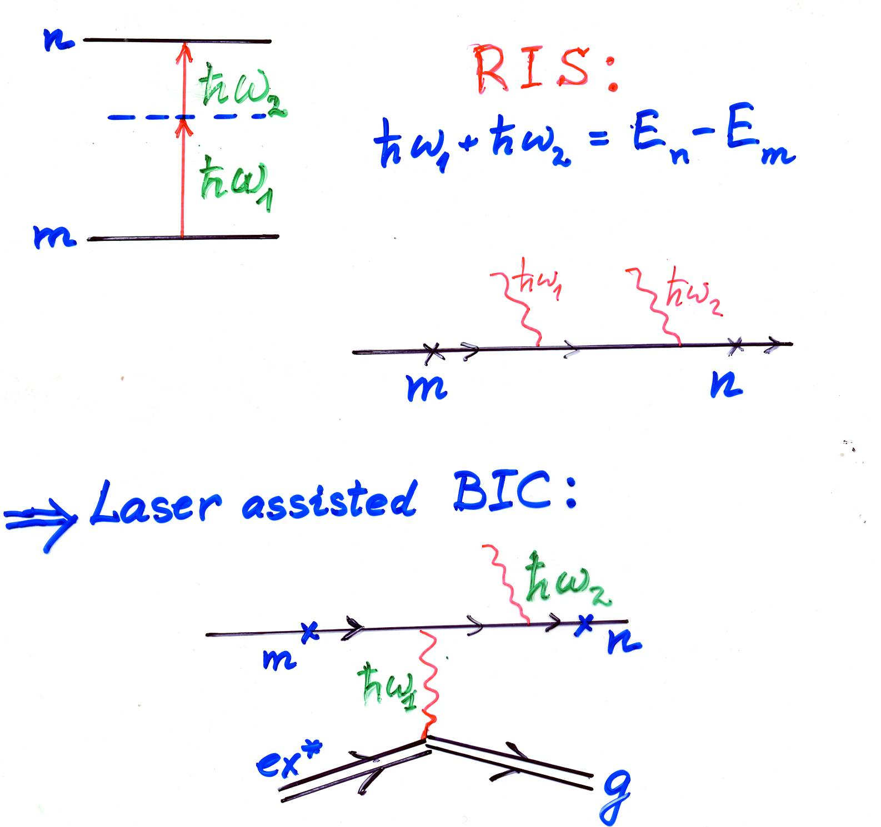
LASER ASSISTANCE OF THE NUCLEAR ISOMER TRASITIONS

Slide 12
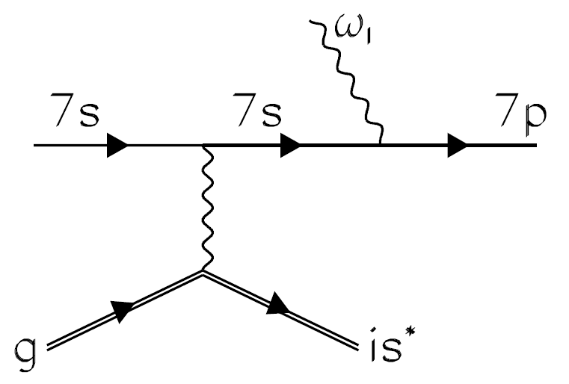
Electron shell as a resonator
Важно!!! 7p – возбужденное состояние!!!

Slide 13
ADVANTAGES:
On one hand, one has a nuclear resonance with the width Γ_{n} ≈ 10⁻¹⁹ eV.
On the other hand, one can make use of an atomic width of the 2p – 1s transition Γ_{a} ≈ 10⁻⁷ eV ≈ 10¹² Γ_{n}

Slide 14
DISADVANTAGES:
Probability of the virtual nuclear excitation ~ 10⁻¹² n enters the atomic mechanism (Warsaw effect). one hand, on has a nuclear resonance with the width Γ_{n} ≈ 10⁻¹⁹ eV. Strict calculation shows that the gain ~200 remains.
The atomic method requires ~2 eV harder photon beam.
Excitation of the shell
Nuclear Isomer
laser
laser

Slide 15
Thank you!

Slide 16
ADVANTAGES

