Slide 1
Creation of the theoretical data base for the rare nuclear reactions, calculated by the quark-level model of nuclear reactions CHIPS
Mikhail KOSOV, Aleksey GRACHKOV
Dukhov Automatics Research Institute «VNIIA»

Slide 2
Perspectives of the new theoretical data base for cross-sections of the nA reactions
Prediction of the cross-sections of many rare nA reactions, which are not measured and can't be assessed by any empirical model with free parameters:
the neutron-nuclear exclusive reaction cross-sections for rare isotope targets;
the exclusive cross-sections of reactions with production of heavy nuclear fragments, which can significantly reduce radiation strength of nuclear materials;
the anisotropy of differential multiplicities of the generated nuclear fragments.
More accurate fit for the stopping power of the nuclear isotopes at low energy:
generation of the speed distribution of the γ-radioactive nuclear fragments for more accurate simulation of the Doppler broadening of γ-lines in the measured γ-spectra;
the bend gap factor in the stopping power of the low energy ions in insulators;
the electron screening factor in the elastic ion-ion scattering cross-section.
The theoretical data base for the unmeasured lifetimes of nuclear γ-transitions.
the empirical fit for the measured Е1, М1, Е2, and М2 γ-transitions in nuclei;
CHIPS modelling of the γ-radiation during the quark exchange between the excited nuclear cluster (Quasmon) and the cold nuclear clusters in nuclear reactions;
quark-level calculation of the nuclear excited states and γ-transitions between them.

Slide 3
The quark-level CHIPS algorithm for nuclear reactions in flight and at rest
_
_
qq
qq
Nonperturbative physical vacuum
The Chiral Invariant Phase Space (CHIPS) model considers a nucleon as a ensemble of 3 massless quarks, surrounded by the physical vacuum with the boiling temperature Т_{с}.
The physical vacuum separates clusters, which exchange quarks of the same color through it.
The quark exchange through the vacuum barrier shifts exchanging N nucleons from their mass shells and bound them in clusters.
The N-clusters can accumulate the external energy (Quasmon) by increasing a number of quarks n(Т_{с}):М_{Q}≈(2n-1)T_{c}, n≈(М_{Q}/T_{c}+1)/2.
The nQuasmon (nQ) exchanges a quark of the energy k with the N-cluster quark ξ, knocking out the corresponding nuclear fragment with mass M_{N}, energy T_{kin}, and momentum p, then
q
q
T_{c}= 220.5 MeV
_
q
_
qq
qq
q
q
q
q
q
q
Quark exchange
q
q
q
q
q
q
q
3N-cluster
q
q
q
_
5Q-Quasmon М≈11·Тс≈2.4 GeV
q
q
q
q
{
Q
M_{N}
E+ξ=M_{N}+k
q
_
ξ
p-ξ=k
q
q
q
q
q
q
k
q
(E,p)
T_{kin}=E-M_{N}
hard hadronization:
k=(T_{kin}+p)/2
k=(T_{kin}+p)/2

Slide 4
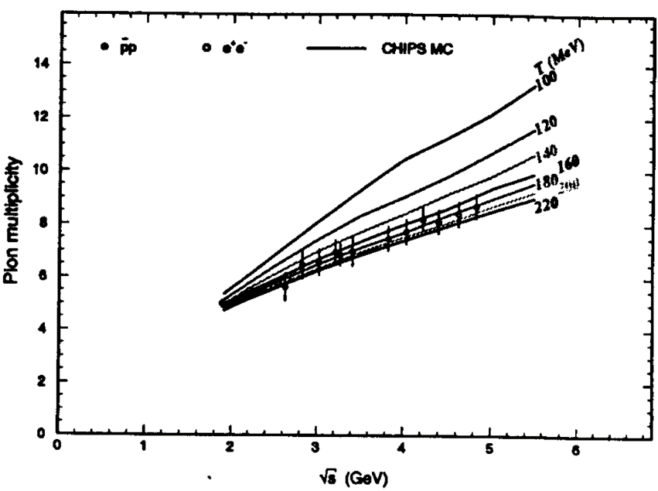
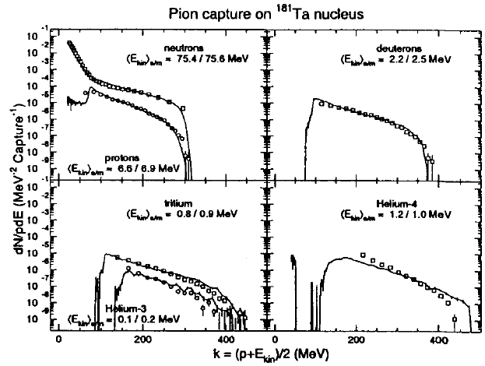
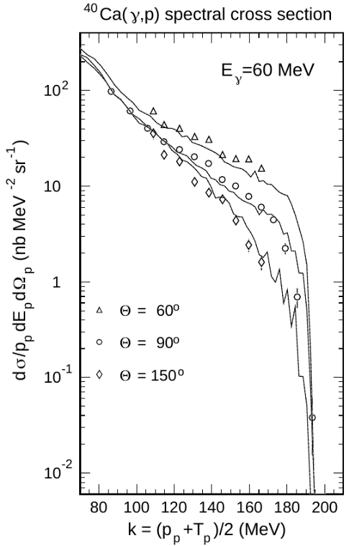
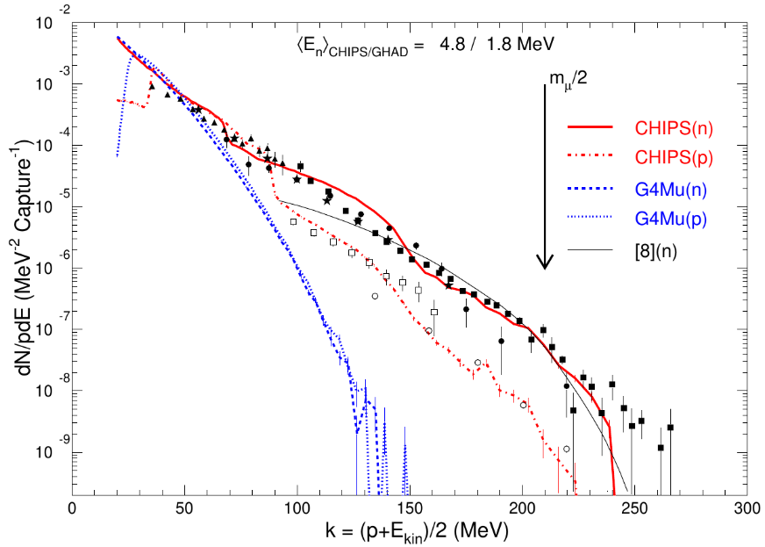
The most emphatic quark-level effects in nuclear reactions
Pion multiplicity in the proton-antiproton and electron-positron annihilation
Neutron spectra in pion capture at rest
Anisotropy of the proton spectra in low energy photonuclear reactions at 60 MeV
Neutron spectra in muon capture at rest
Vacuum temperature Т_{с} and 1s hadron masses
Annihilation
"Thermometer"
Т_{с}= 220.5 MeV
Pion multiplicity increase with annihilation energy increasing
evaporation
n
Pion capture
p
d
60⁰
Muon capture
Deep inelastic process
π¹⁸¹Ta
10
150⁰
Geant4
t
data
⁴He
μ⁻+p=n+ν E_{n}=5 MeV
³He
n
p
⁴⁰Са(γ,р)X 60 MeV
The deep inelastic (quark-level) processes + the neutron evaporation. Production of heavy nuclear fragments.
The additional quark-level CHIPS processes: μ⁻+u→d+ν (m_{μ}/2) и μ⁻→d+u+ν (m_{μ})

Slide 5
Vacuum temperature in annihilation
"Annihilation Thermometer"
The pion multiplicity increases with the annihilation energy increasing
Т_{с}= 220.5 MeV
2m_{N}≈T_{c}(2n_{q}-1)
_
ξ
k
the smaller T_{c} the more n_{q} & n_{π} are.
q
q
π
(E,p)
E=k+ξ p=k-ξ →
k=½(E+p)
P. V. Degtyarenko, M. V. Kossov, H.-P. Wellisch, "CHIPS event generator I: Nucleon-antinucleon annihilation at rest", Eur. Phys. J. A 8, 217 (2000)

Slide 6
Pion capture fragmentation spectra
Evaporation nonrelativistic PS
π¹⁸¹Ta pion capture
n
p
d
Deep q-inelastic ultra-relativistic PS
lnW
Blokhintsev clusterization
quasi-free
P. V. Degtyarenko, M. V. Kossov, H.-P. Wellisch, "CHIPS II :π-capture & γA", EPJ A9,411, 2000
N_{N}
1
2
3
4
the kinematic limit
decay
t
⁴He
³He
CHIPS

Slide 7
Photonuclear reactions below Δ(3,3)
P. V. Degtyarenko, M. V. Kossov, H.-P. Wellisch, "CHIPS event generator III: Photo-nuclear reactions below Δ", Eur. Phys. J. A 9, 421 (2000)
⁴⁰Са(γ,р)X 60 MeV
The unpublished paper of P.D.Harty was cited in PRC 49, 2704 (1994). Nobody could believe that 100 MeV gamma can accelerate the carbon nucleus so much (the boost of massless quarks). Even the nucleon-quasmon can't move so fast. The absorption of γ by the nucleon quark solves the problem.
60⁰
150⁰
90⁰
10
Quark absorption of γ
γ
q₁
q₂
Quarks are massless
CHIPS
P. D. Harty

Slide 8
Muon capture fragmentation spectra
μ⁻+p=n+ν →E_{n}=5 MeV
The T.E.O. Ericson's idea (e. a.,PRL, 69, 161, 1977): μ→νπ*
n
The additional quark-level CHIPS processes: μ⁻+u→d+ν (m_{μ}/2) и μ⁻→d+u+ν (m_{μ})
fit
p
CHIPS
Data beyond the kinematic limit (?)
M.V.Kossov,"CHIPS event generator: Nuclear muon capture at rest", Eur. Phys. J. A 33, 7 (2007)
Geant4
background
There are fragments too

Slide 9
CHIPS simulation of ion-ion interaction
nucleus
NA
nucleon
quasmon
1 GeV/fm
Q
quark
rapidity
QGS
A Niedermaier string is split in nuclear and vacuum parts
In the ion-ion interactions the Niedermaier string is split in the two nuclear parts and the vacuum part in-between.
There can be a few quasmon-pairs creation in the collision.
The multi-quasmon fragmentation algorithm is verified.
AA
Q
Q
The CHIPS ion-ion algorithm is a decay-algorithm. It is much faster than the cascade-algorithms of the other models (DPMJET, UrQMD, FRITIOF, VENUS).

Slide 10
Vacuum temperature T_{c} =220.5 MeV for calculation of 1s hadron masses
The T_{c} dependence of the mass of n partons: M=2T_{c}√n(n-1)
Mesons spin products <s₁,s₂>=½S(S+1)-½(½+1)=^{+¼}_{-¾}
Mesons: M₂=2T_{c}√2=624 MeV, (3m_{ω}+m_{π})/4=621 MeV
Baryons spin products 2<s₁,s₂>=⅓S(S+1)-½(½+1)=^{+½}_{-½}
Baryons: M₃=2T_{c}√6=1080 MeV, (m_{N}+m_{Δ})/2=1074 MeV
ω
+¼
M₂
-¾
π
Δ
+½
M₃
-½
N
M.V.Kossov, EPJ, A14, 265 (2002)
The light quark hadron masses are published
All 92 1s-hadron masses (be published)
Masses of glueballs (f-mesons) without the color-magnetic shifts are close to M₂, M₃, M₄=1528 MeV, M₅=1972 MeV
The T_{c} could be a third fundamental constant: ΔE=T_{c}ΔI (I=-S)

Slide 11
The TPT algorithm for exclusive and inclusive cross-sections of reactions with production of nuclear fragments
To normalize the differential multiplicity the inelastic cross-section σ_{in} is used
The CHIPS algorithm generates the final states of nuclear reactions, which can be sorted and collected for different exclusive channels of the nuclear reaction in a form of the 3N-histograms, where N is a number of the final state fragments with [p_{x},p_{y},p_{z}];
Below the separation energies of the secondary fragments only the γ-excited residual nucleus can exist, so the "closest" γ-excitation level is selected, and the last decay in the fragment is recalculated with the corresponding fixed residual nucleus A* mass;
To calculate the inclusive spectra of the identical fragments "i" all these fragments are collected to the common differential multiplicity histogram ρ_{i}(p)=dn_{i}/E/dp (n_{i}=N_{i}/M_{n}), which can be converted to the invariant inclusive cross-section f_{i}(p)=σ_{in}·ρ_{i}(p).
The γ-decays of the excited nuclei are simulated by the γ-cascade tables RIPL
The "closest" level choice for the CHIPS simulated nuclear excitations can be done, taking into account the width and the strength of the surrounding γ-excitation levels;
The TPT models for the probabilities of the Е1, М1, Е2 и М2 γ-transitions are under development in the TPT software package to assess the unknown γ-transitions.
The TPT stopping power solutions for simulation of the Doppler line broadening.
For simulation of the γ-lines Doppler broadening the lifetime of the excited γ-levels and the stopping power of ions are necessary. The data provide knowledge of them.
If the stopping power is known at low energies, one can find the lifetime? And if the lifetime is known, one can find the stopping power from the Doppler broadening form.

Slide 12
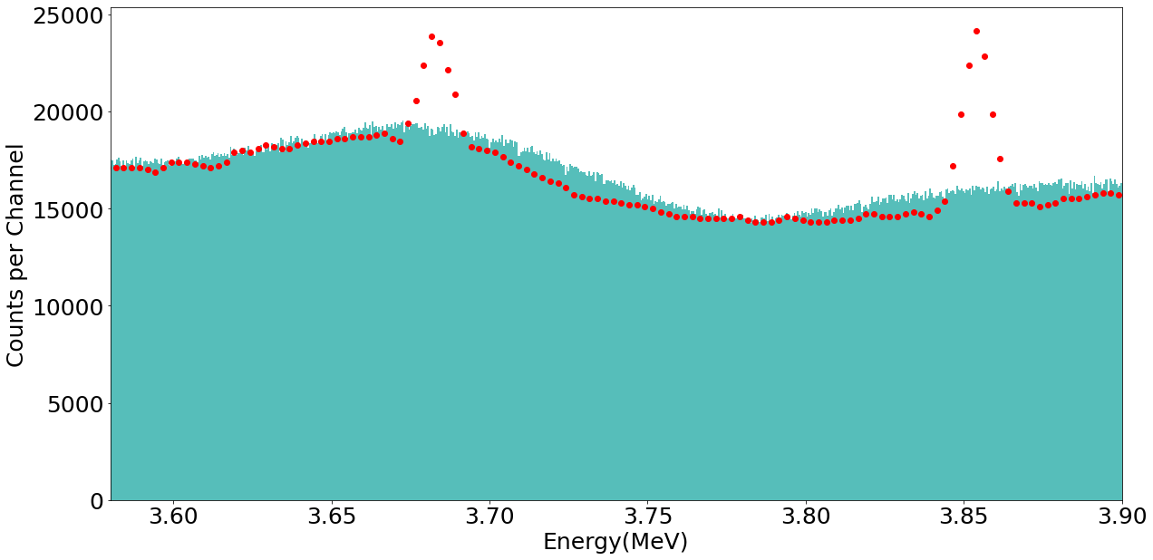
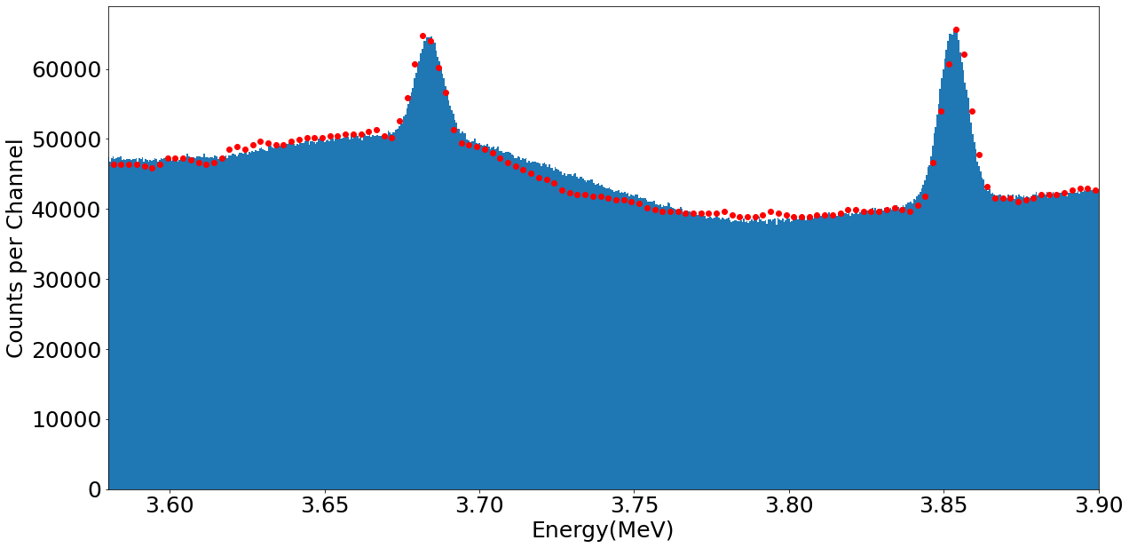
The TPT simulation of the γ-line Doppler broadening in the ¹⁶O(n,α)¹³C reaction
To slow down an ion only small steps can be used in the simulation, as the energy loss drops down significantly with energy decreasing. The first ion transport ТРТ algorithm was realized in the gas approximation without any slowing down, but now the one step slowing down algorithm is used:
The TPT algorithm, taking into account the ion slowing down in the dt→αn reaction, was implemented in 2022.
The TPT low energy neutron elastic scattering algorithm for the logging simulation was implemented in 2023.
The 1-step slowing down algorithm for the γ-cascade was implemented in 2024
The experimental data
the resolution
The CHIPS cross-section for the ¹⁶O(n,α)¹³C* reaction, but in the gas approximation (wide)
The CHIPS cross-section for the ¹⁶O(n,α)¹³C* reaction with the new 1-step ¹³C slowing down
The adequate to the experimental data ¹⁶O(n,α)¹³C* reaction cross-section is absent in Geant4 NewtronHP and in the open data bases. For the TPT software package it was generated by the CHIPS model. The Doppler broadening of the γ-line depends on the lifetime (RIPL) and the stopping power dE/dx for the excited ¹³C isotope in the BeO media (Geant4). The demonstrated experimental γ-spectrum (red dots) shows, that the line 3.686 MeV has two widths: the first one for the direct excitation (wide), and the second one is the result of the 167 keV γ-decay of the long lived 3.853 MeV level (narrow). The data are perfectly reproduced by the TPT simulation.

Slide 13
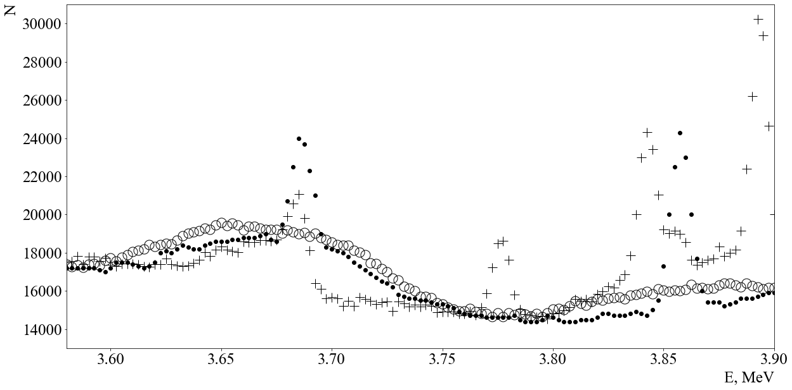
For comparison the Geant4 simulated γ-spectrum is shown
The experimental data
?
The Geant4 simulation results
The ТРТ simulation (gas approximation)
?
All the Geant4 spikes are narrow, so they correspond to the ¹³C decay at rest without any Doppler broadening. To the left of the 3.686 MeV line there is a dense set of lines, but this is not a Doppler effect, as to the right of the line there is no events.
Geant4 generates a lot of the strong spikes, which are not seen in the experiment, while they are much stronger than the lines, which are seen in the experiment.

Slide 14
Conclusion
The theoretical CHIPS data base can fill a gap in our knowledge of the neutron-nuclear reactions with production of heavy nuclear fragments.
The heavy fragments production, especially the α-particle production (the helium pores), is very important for simulation of the radiation hardness of materials of nuclear setups and atomic power plants.
The energetic ions as a result of the material irradiated can be products of elastic and inelastic neutron-nuclear scattering and the induced ion cascade.
For ions knocked out of the crystal lattice and for ions produced in inelastic neutron-nuclear reactions the dE/dx function should be improved for the robust simulation of the ion cascades, especially for the low energy ions.
For the simulation improvement it is necessary to fit all IAEA experimental dE/dx data and measure the dE/dx functions at lowest energies.
The CHIPS model is validated at high energies, where the kinematic limits are not important, but at relatively low energies the new validation should be done, which can prove applicability of the quark level model al low energies.
We are looking forward to extend the CHIPS model beyond the projectile neutrons to the projectile γ-rays and other projectile nuclear fragments.

Slide 15
Thank you for your attention

Slide 16
The perspectives of the improvement of the dE/dx function from Geant4 to ТРТ
The black dotes are the IAEA data for the dE/dx function of Ti in different media. The data for Ti in Ti are absent. The TPT estimation is shown by the dashed line.
The red markers of the same shape as the data correspond to Geant4. They are proportional to the ion speed (the LSS law). For the low energy ions the Geant4 fit is too far from the existing experimental data. One should vary the speed dependence.
The Lindhard (LSS) ~√E ~v
TiTi in Geant4
TPT fit
Geant4 (?)
?
The dE/dx values for Ti ions in gold are underestimated in Geant4 by a few orders of magnitude
In our simulation we used the Geant4 fit of the dE/dx function, because as a result of the α-decay the ¹³C* nucleus acquires relatively high speed, for which the Geant4 fit is close to the data. For the linear dE/dx it's much easier to calculate the step length to the ¹³C* decay.

Slide 17
Calculations of the step length to the nuclear decay and the nuclear speed
If dE/dx=С·v, then m·dv=C·dx. If х is the distance to the stopping poin (х=0 и v=0): m·v=C·x. If the decay time t_{d} is known, one can calculate the distance to the decay х_{d}, which is passed during t_{d}. Substituting v=dx/dt, we get m·dlnx=C·dt relation, and it means that the slowing-down time (х=0, v=0) is infinite. If the radioactive ion was born at x=m·v/C and decay after t_{d} in the point x_{d}, then m·ln(x/x_{d})=C·t_{d} and x_{d}=x·exp(-C·t_{d}/m). The step is L=x·[1- exp(-C·t_{d}/m)]. As x_{d}=m·v_{d}/C, wher v_{d} is the speed at the decay point, m·ln(v/v_{d})=C·t_{d}, and v_{d}=v·exp(-C·t_{d}/m).
If the stopping power is proportional to another power speed, then dE/dx=C·v^{α}, where α=1 is the LSS model. Then, substituting dx=v·dt, we get m·dv=C·v^{α}·dt or m·dv^{1-α}=(1-α)C·dt, that is m·v^{1-α}=(1-α)C·(t-t₀). For α<1 the slowing-down time (х=0, v=0, t₀=0) is finite t=m·v^{1-α}/(1-α)/C. If t_{d}>t the nucleus manages to stop, but if t_{d}<t, it still has v_{d}=[(t-t_{d})(1-α)C/m]^{1/(1-α)}, that is (without t) v_{d}=[v^{1-α} -t_{d}(1-α)C/m]^{1/(1-α)}. For α>1, the same as for α=1 (LSS), the slowing-down time is infinite and for any t_{d}: v_{d}=[v^{1-α} +t_{d}(α-1)C/m]^{1/(1-α)}. To get the step length L=x-x_{d}, the speed should be integrated L=∫v(t)dt from 0 to t_{d}: L={[v^{1-α} +t_{d}(α-1)C/m]^{(2-α)/(1-α)}-v^{2-α}}·m/C/(α-2). This formula is valid for any α, except for the α=1, but if α<1 for t_{d}>t the step is restricted by the stopping point L=v^{2-α}·m/C/(2-α). At this point the radioactive nuckeus is at rest, ad the γ-decay does not have any Doppler effect. One can see, that if α≠1 the calculations are a bit more complicated, but the calculations of the step length to the nuclear decay and the nuclear speed at the decay point are still durable.

Slide 18
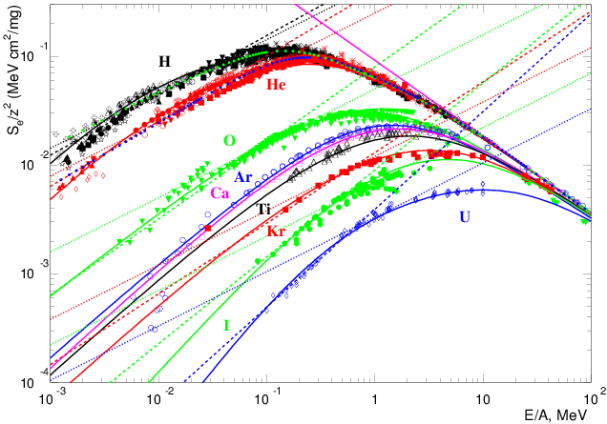
The ТРТ fit of the experimental dE/dx values (IAEA) for different ions in gold
The dotted lines – LSS model
The solid lines – ТРТ
Бете-Блох для полностью ионизированных ядер
The light ions can be fitted by the LSS power α=1, but the heavy ions definitely have α>1. At high energies the common Bethe-Bloch law is a power law too.

