Slide 1


Stochastic cooling system @ NICA state of affairs, May 2024
template author(JINR LHEP)
e-mail:shpakov@jinr.ru
on behalf of JINR LHEP collaboration
template

Slide 2


Introduction
This is a brief summary about the development progress of the Stochastic Cooling System (SCS) for the NICA collider. The main intention of the summary is to provide all involved parties with general overview of the SCS state as of May 2024.

Slide 3
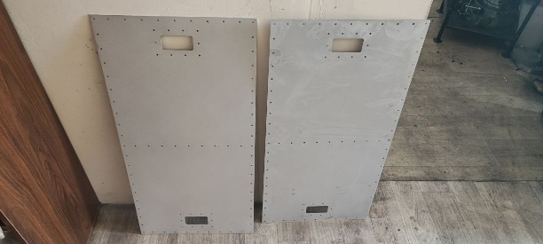
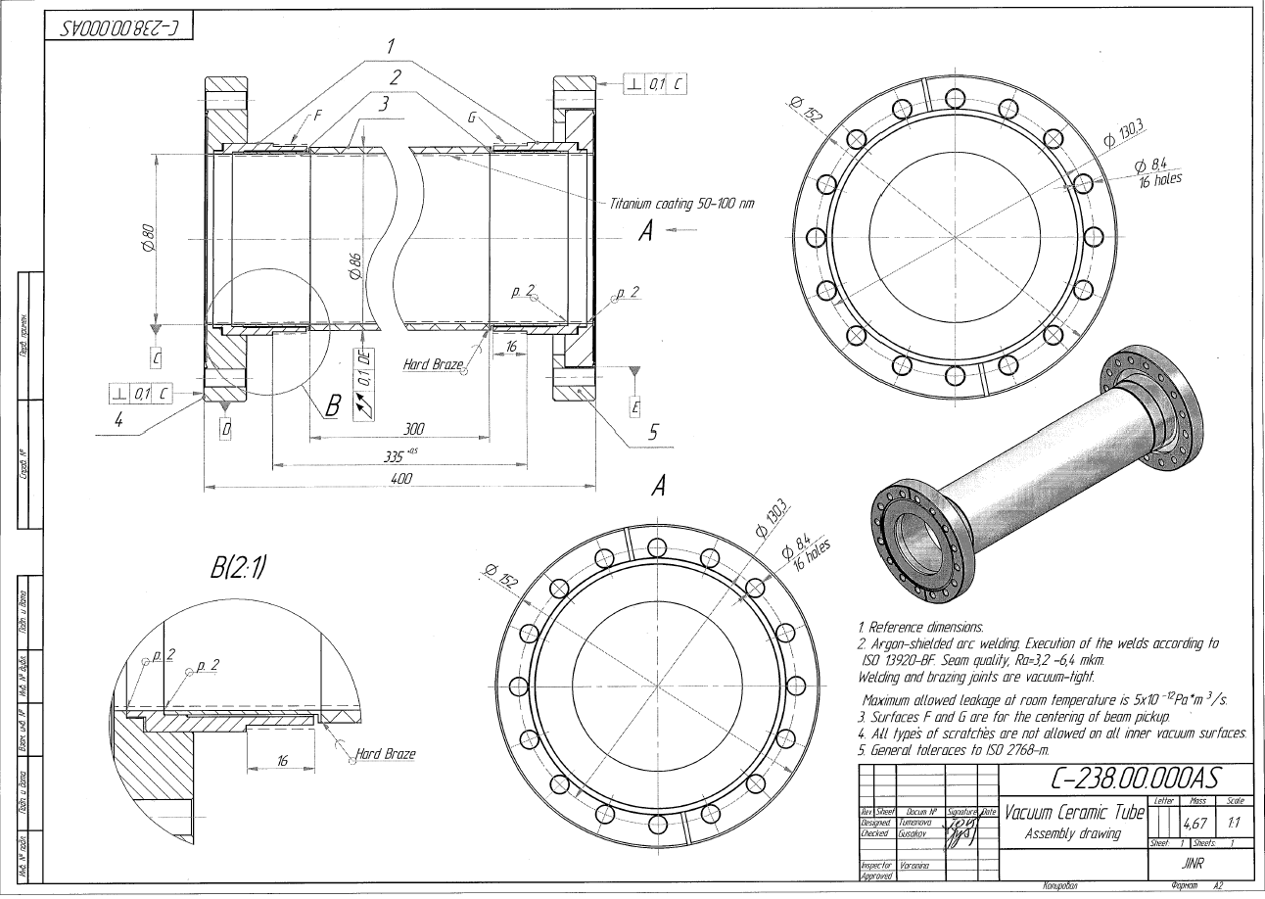
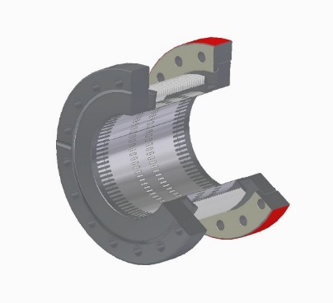
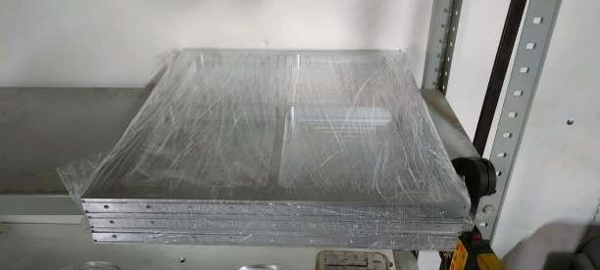
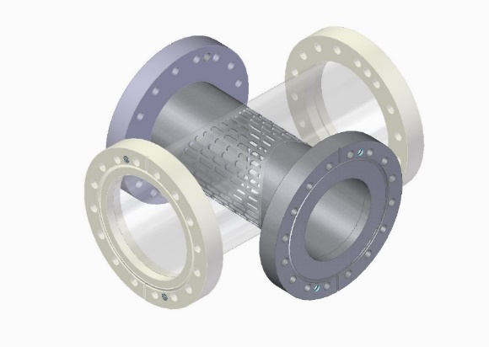
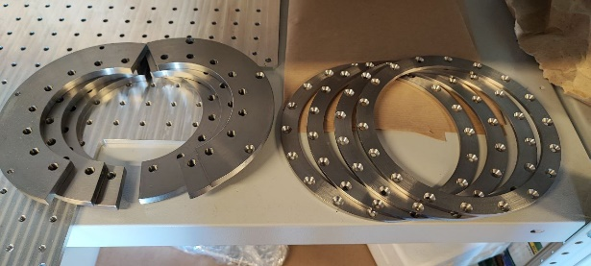
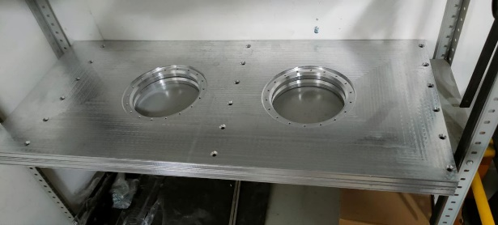
Mechanical / Vacuum block
Supports for the ceramic tubes
Ceramic tube
Vacuum components
the prototype is in production, final stages
we plan to begin the acquisition procedure for 30 units next week, after receiving the confirmation from the producer that our design at least can be assembled
the supplier have resolved the issues with the payment
the tubes are in production as we speak. The production end is expected at 15th September
the delivery time is unclear as of now
all the designs were finalized
the order has not been placed yet
there is a real possibility that we will have to replace the ceramic cameras with the metallic ones across the board

Slide 4
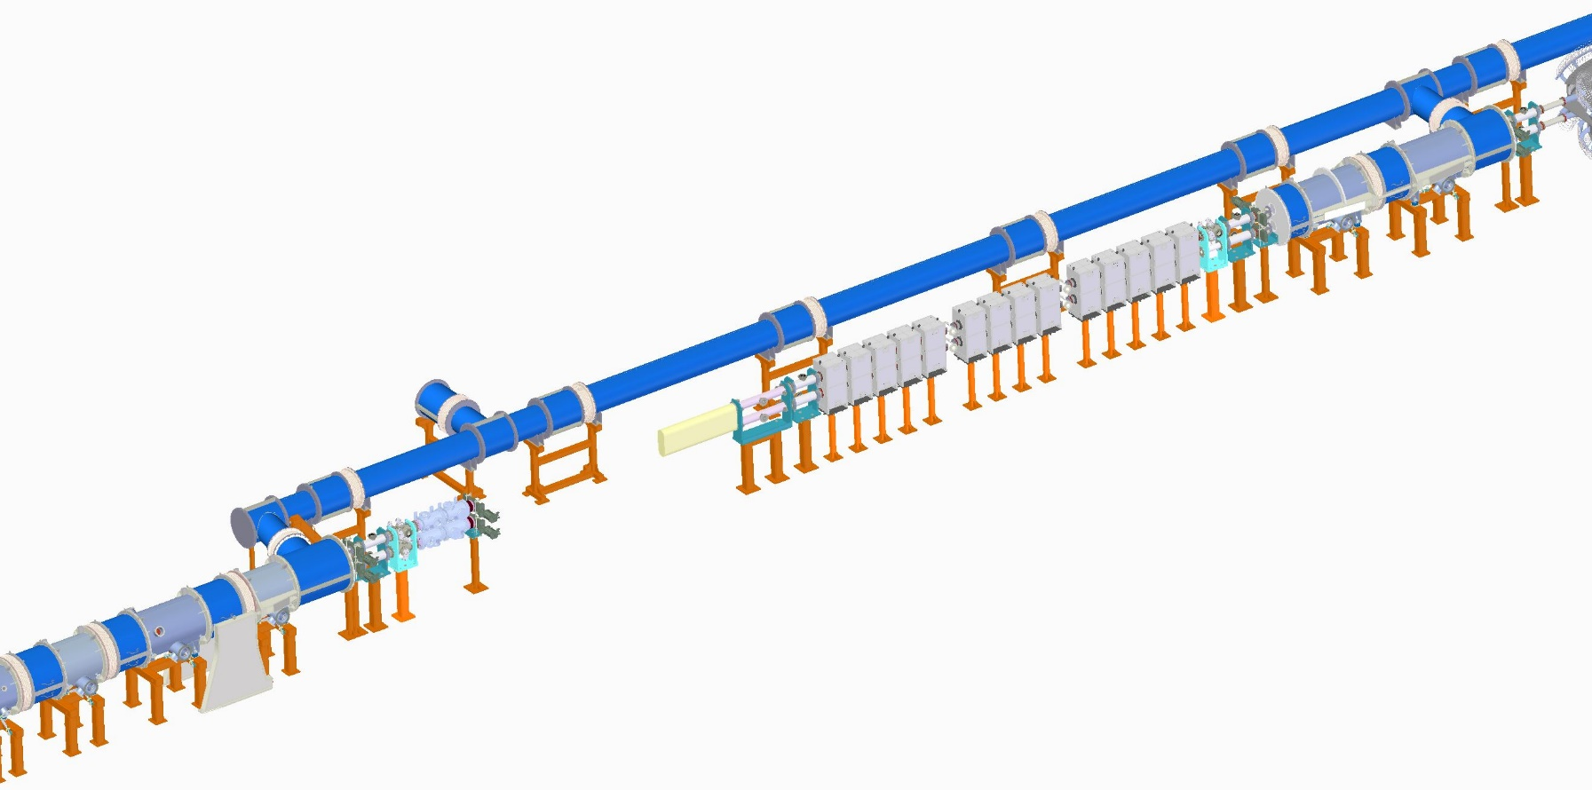
Mechanical / Vacuum block
We have begun placing the s-Cooling system components into the collider general layout.
A couple of important points:
under no circumstances the s-Cooling system will be moved from this moment onward
the integration follows a simple logic: if we have to connect to already finalized elements, then the connector elements are our problem. Otherwise we leave our flange open, and connecting elements are not our problem.
we plan to finish preparations for the supports inside the building №17 by the end of the summer (August 2024)

Slide 5
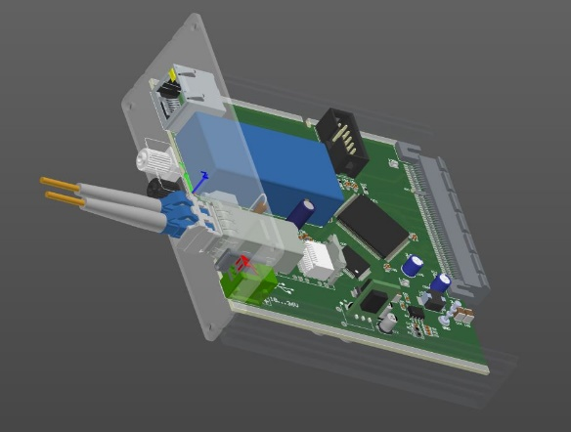
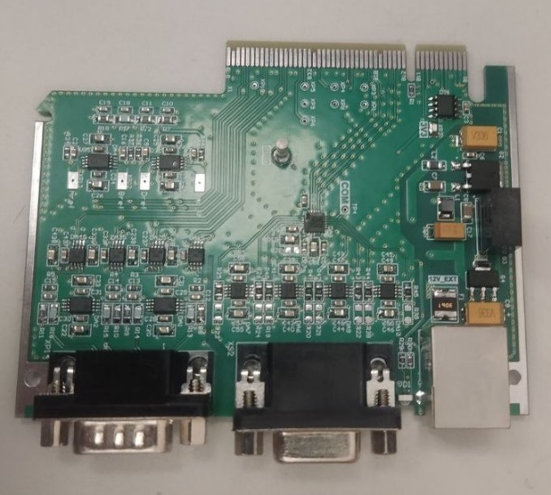
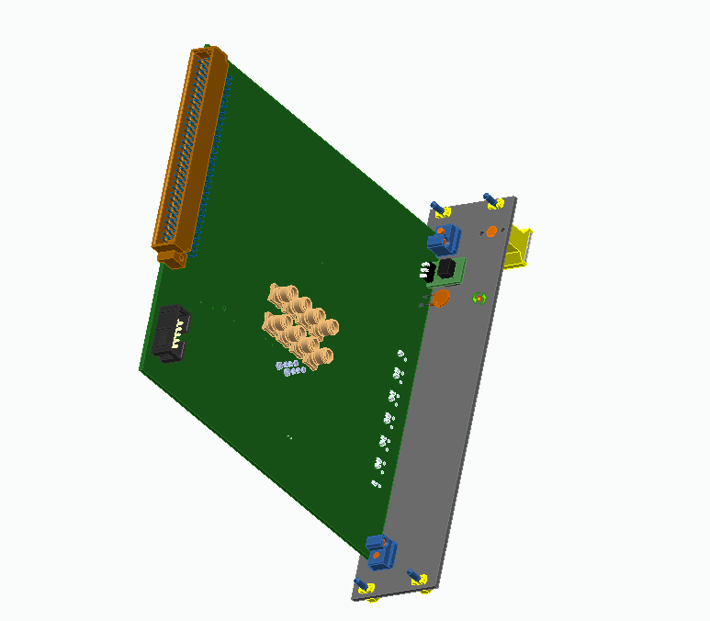
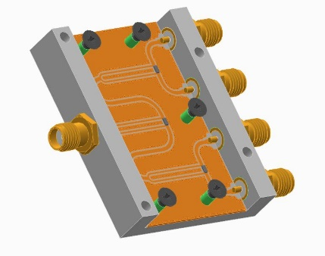
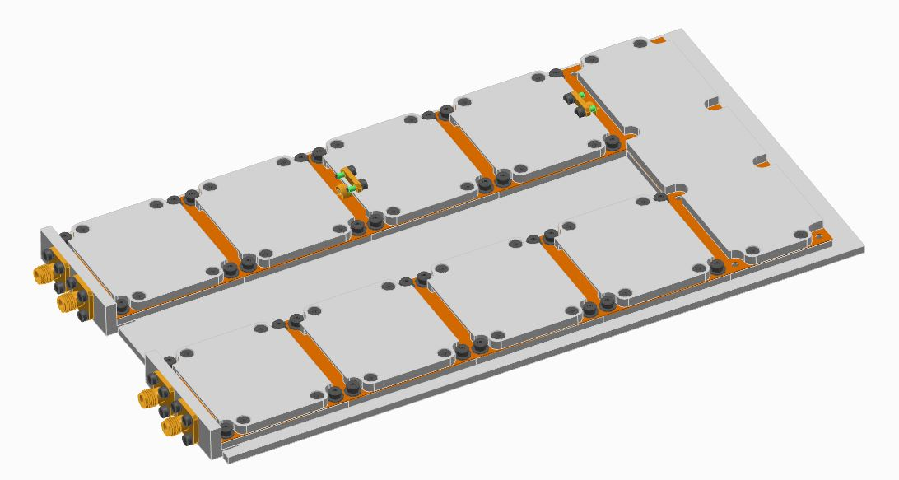
Electronics production and development
Booster Schottky monitor pickup electronics
Prototype for the rack mounted module
Single RF block (1-4 divider)
we have managed to get our first electronics component to a final (assembled) state. Although, we have not tested it yet.
main goal here is to streamline our electronics development process, which seems more or less OK on each step, except for the last one – the assembly
next step – the RF components
Full RF block assembly concept

Slide 6
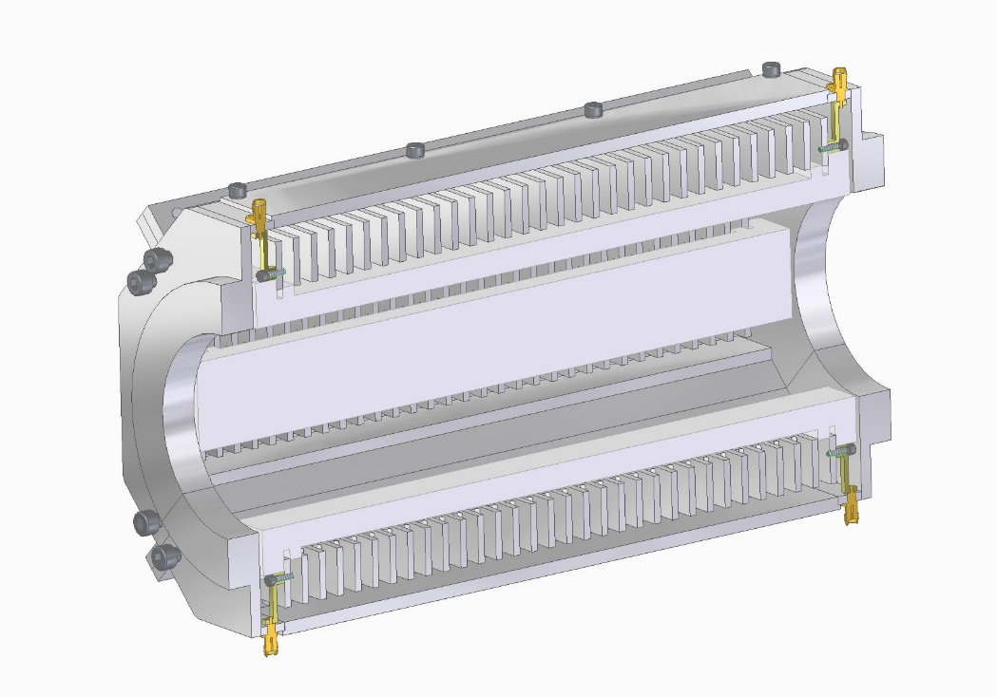
PickUps/Kickers & Software
Software issue
the new PickUp design
United rack client
TD3
TD5
TD1
TD4
TD6
TD2
TD7
given the experience with the PickUp installed at Nuclotron the design was updated specifically to minimize the number of separate components
we plan to send the new pickup design into production next week at the latest
so far we have a little overload with components that should be controlled one way or another
we are looking into the options to streamline that process as well

Slide 7
The end
Thank You!

