Slide 1



Exotic quarkonium in e⁺e⁻ collisions
Galina Pakhlova
The XXIV International Baldin Seminar on High Energy Physics Problems
"Relativistic Nuclear Physics and Quantum Chromodynamics"
September 17 - 22, 2018, Dubna

Slide 2
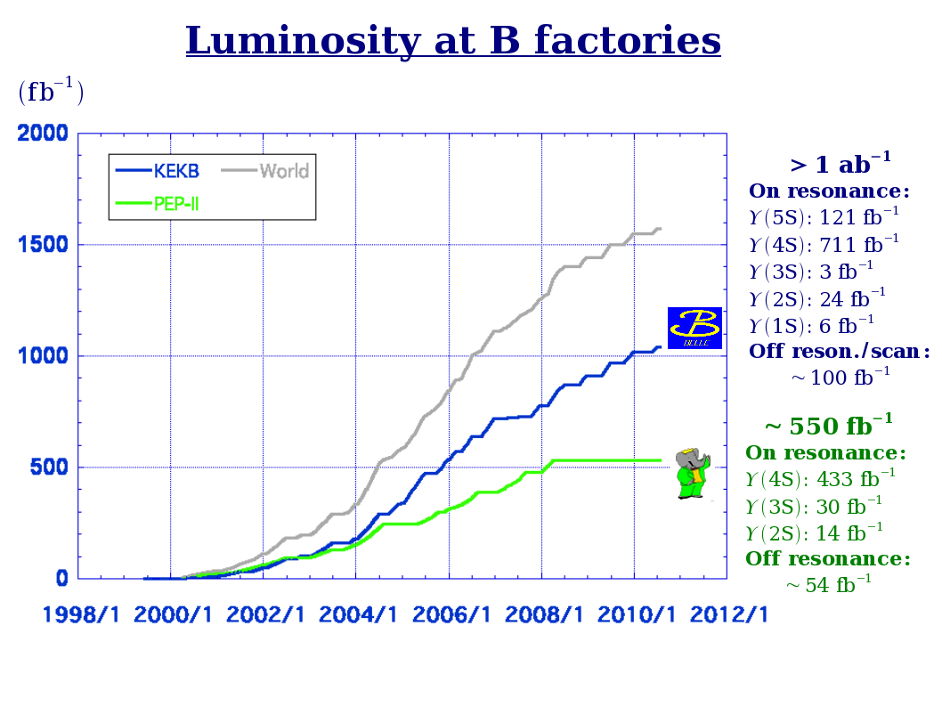
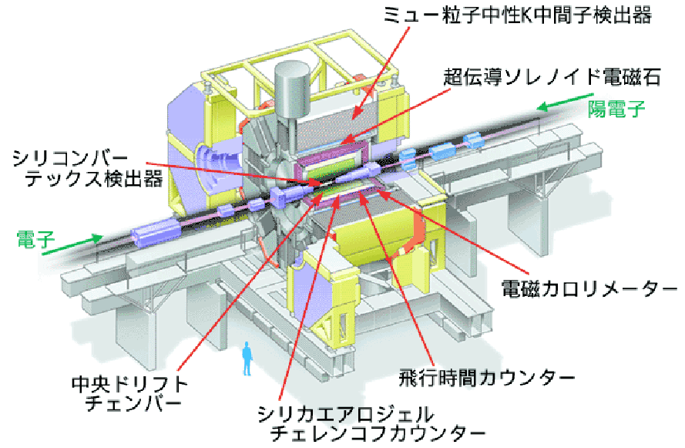

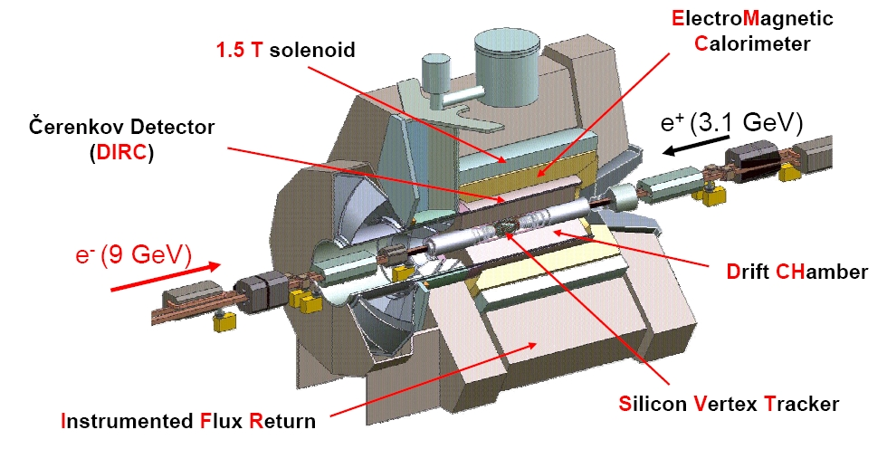
e⁺e⁻ collisions at B factories
8 GeV (e–) × 3.5 GeV (e⁺)
designed luminosity: 10.0×10³³cm^{–2}s^{–1}
achieved 21.2×10³³cm^{–2}s^{–1}
>2 times larger!
Belle
completed data taking on June, 2010
to start SuрerKEKB/Belle II upgrade
Notes:
2

Slide 3
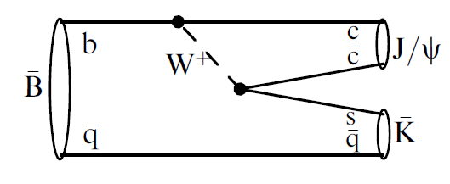
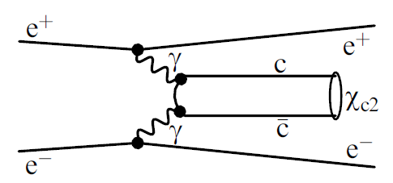
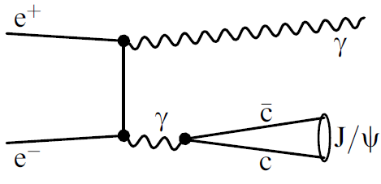
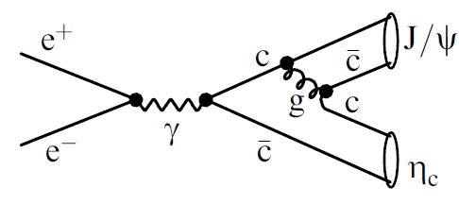
Charmonium (+like) production at B factories
B decays
γγ fusion
Any quantum numbers are possible, can be measured in angular analysis
J^{PC} = 0^{±+} , 2 ^{±+}
e⁺e⁻ annihilation with ISR
double charmonium production
J^{PC} = 1– –
Study of charmonium(+like) final states from threshold in wide energy region
in association with J/ψ
only J^{PC} = 0^{±+} seen

Slide 4

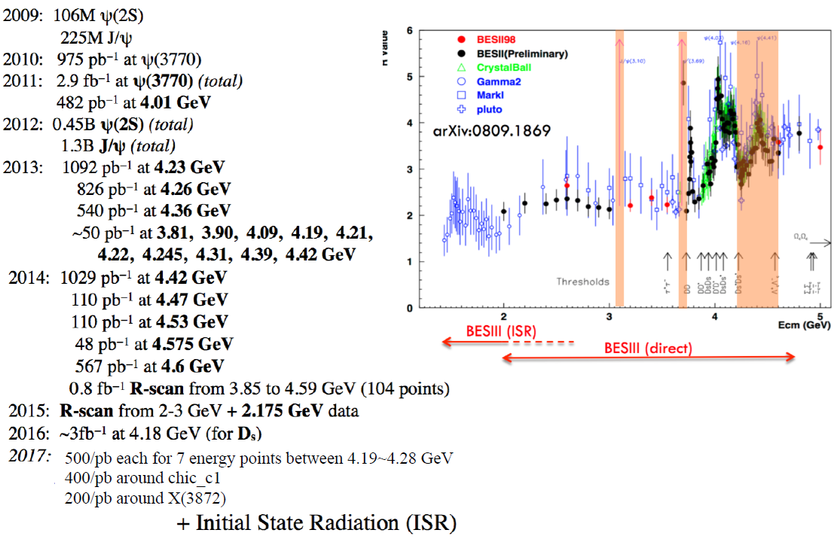
e⁺e⁻ collisions at Charm factory BESIII
BESIII symmetric e⁺e– collider
scan 2.0 - 4.6 GeV; L ~ 10³³/cm²/s
e⁺e– →J/ψ, ψ(2S), ψ(3770), etc…

Slide 5
Belle citesummary 2018
Top 10

Slide 6

Charmonium in the standard
quark model
c
c

Slide 7
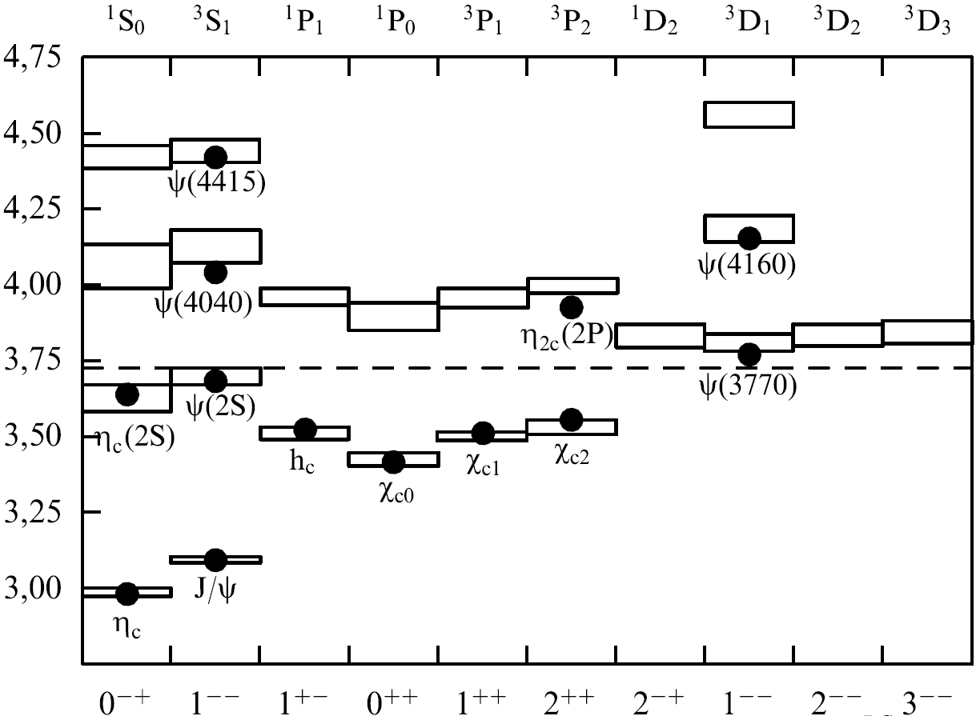

Charmonium in the standard quark model
c
c
X(4160)
(n+1)^{(2S+1)}L_{J}
n radial quantum number
S total spin of quark-antiquark
L relative orbital ang. mom.
  L = 0, 1, 2 ... corresponds to S, P, D...
J = S + L
P = (–1)^{L+1} parity
C = (–1)^{L+S} charge conj.
ψ₂(3823)
X(3940)
_
open charm threshold
DD
Below open charm threshold
all states are measured
S=0
S=1
S=0
S=1
J^{PC}
1974-1980 Discovery of 10 standard charmonium states
1980-2002 … nothing
2002-2013 Discovery of 6 new states that can fit into charmonium table
Below open charm threshold a good agreement between theory and experiment

Slide 8
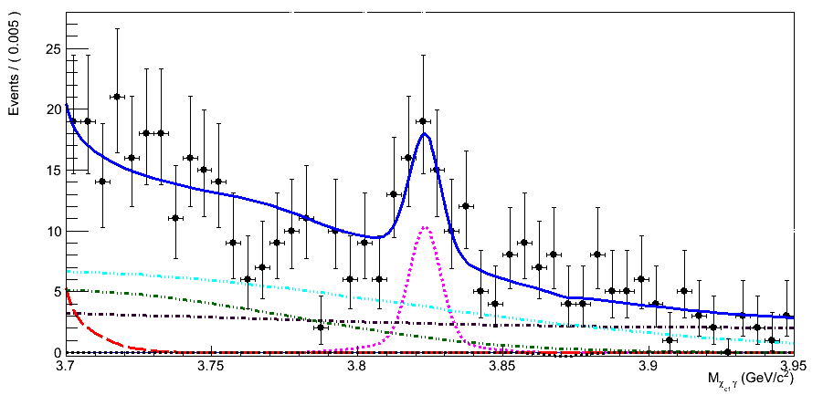

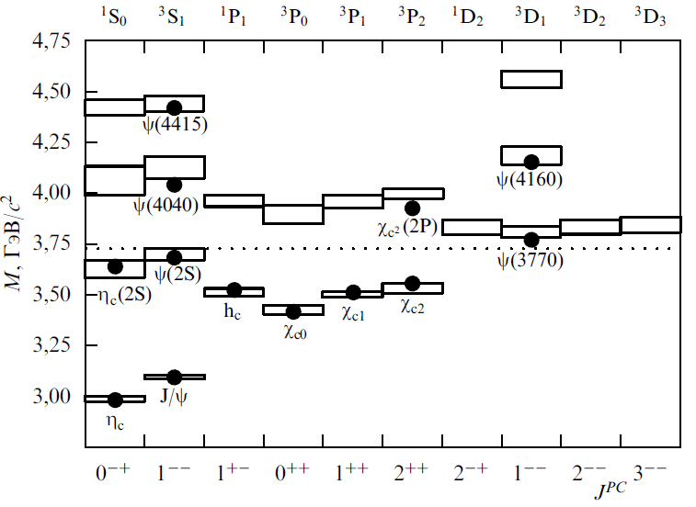
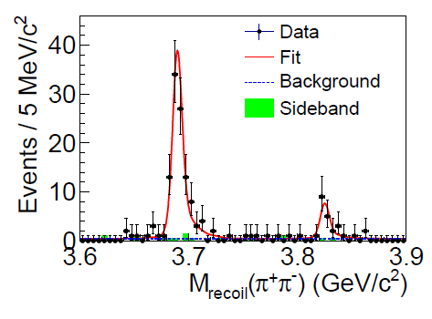
PRL 111, 032001 (2013)
X(3823) = ψ₂(1³D₂) PDG2018
B⁺ →χ_{c1} γ K⁺
X(3823)
X(3823)→χ_{c1}γ C = −
1⁻ ⁻ 1⁺ ⁻ 2⁻ ⁻ 3⁻ ⁻
Ψ(3770) h_{c}(2P) ψ₂ ψ₃ → DD
4.2σ
711 fb⁻¹
decay to DD is forbidden due to unnatural spin-parity → small Γ
decay to χ_{c1}γ should be prominent (E1)
Γ(χ_{c1} γ ) ~ O(10KeV) is typical for charmonium
M (χ_{c1} γ), GeV
M = 3823.5 ± 2.8 MeV
Γ < 14 MeV @ 90%CL
e⁺e⁻ →π⁺π⁻X(3823)→π⁺π⁻γχ_{c1}
PRL115, 011803 (2015)
M = 3821.7 ± 1.3±0.7 MeV
Γ < 16 MeV @ 90%CL
ψ₂
X(3823)
γ
6.2σ
Notes:
8

Slide 9
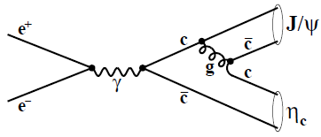
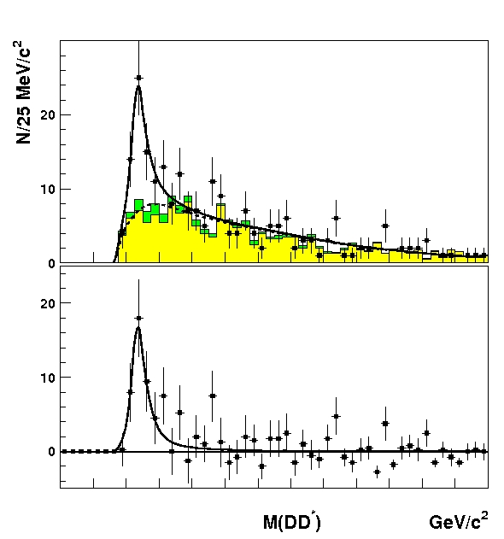
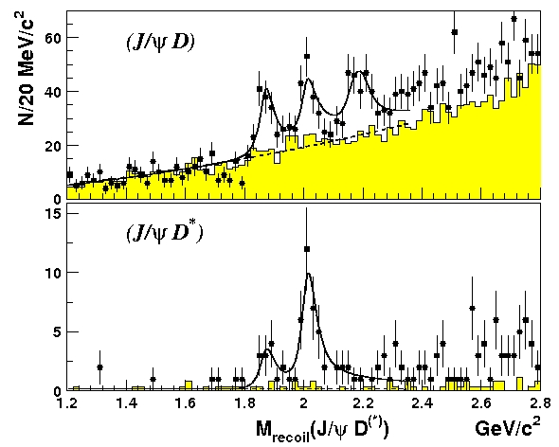

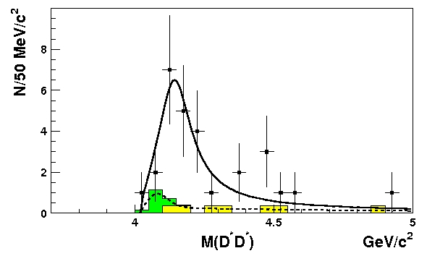
X(3940)&X(4160) in e⁺e⁻ → J/ψ D^{(*)}D^{(*)}
PRL 100, 202001(2008)
M = 3942 ±6 MeV
Γ_{tot} =37 ±12 MeV
+7
-6
+26
- 15
D*
D
D*π
X(3940) → DD*
+25
−20
M= 4156 ±15 MeV
Γ_{tot}= 139 ±21 MeV
+111
−61
D*
X(4160) → D*D*
D
Both observed states decay in open charm final states like standard charmonium
Possible assignments are η_{c}(3S) and η_{c}(4S) , but X(3940)&X(4160) PDG2018
The masses predicted by the potential models are ~100-250 MeV higher than observed
Theory probably needs more elaborated model to take into account charmonium coupling to charmed meson pairs

Slide 10
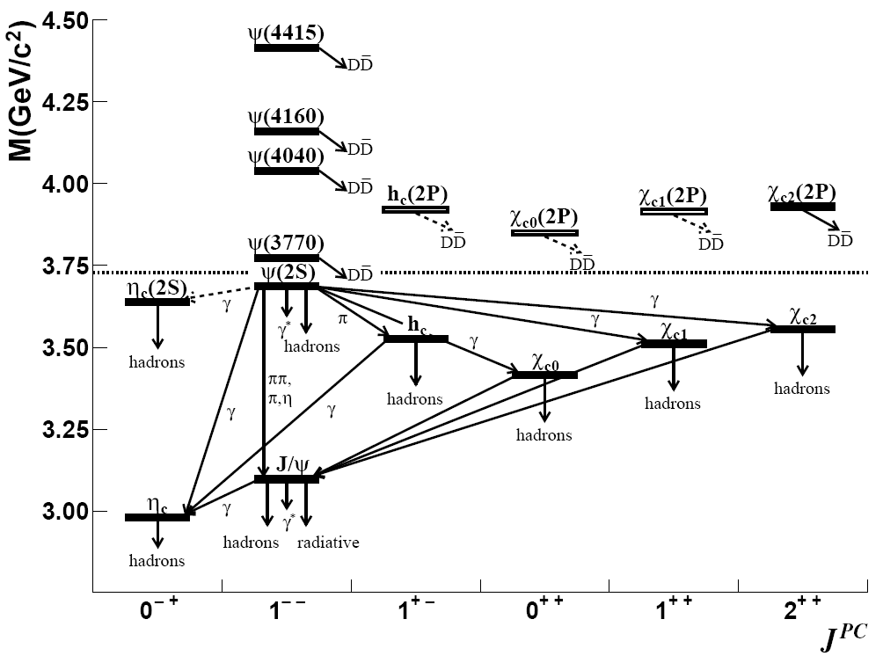
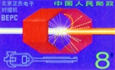
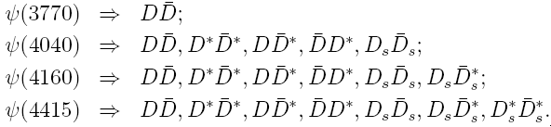
Vector charmonium states
Direct measurements at charm factories
ψ states: J^{PC} = 1– –
PLB 660,315(2008)
R_{res}=R_{BW}+R_{int}
Resonance shapes
Interference term
σ(e⁺e–→hadrons/(e⁺e–→μ⁺μ– )
Crystal Ball 1986
BESII 2005
CLEO 2009
Model dependent results
The interference is large & the total contribution differs from the simple sum of the Breit -Wigner resonances

Slide 11
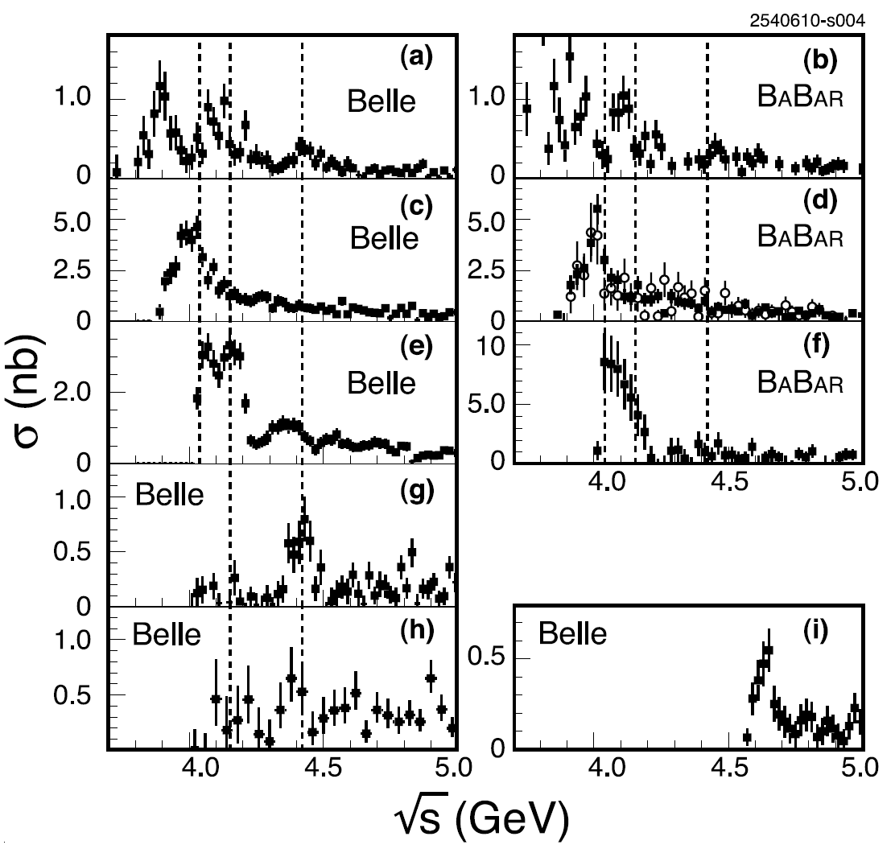
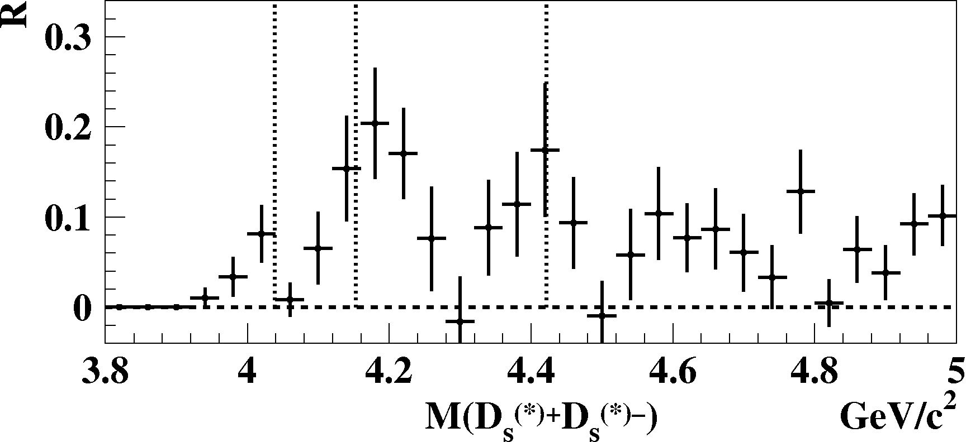
DD
DD
e⁺e–→ open charm
ISR measurements at B factories
Fixed quantum numbers
of final state J^{PC} = 1– –
ψ(4040)
DD*
DD*
D*D*
D*D*
ψ(4040) is seen in DD*, D*D*, D_{s}⁺D_{s}–
ψ(4160) is seen in D*D*, D_{s}⁺D_{s}*–
ψ(4415) is seen in DDπ , D_{s}⁺D_{s}*– e⁺e⁻→DD peak at 3.9 GeV
Y(4260) is seen as a dip
ψ(4160)
ψ(4415)
DDπ
DD*π
Λ_{c}Λ_{c}
ψ(4160)
ψ(4415)
D_{s}D_{s} +D_{s}D_{s}* +D_{s}*D_{s}*
ψ(4040)
Sum of e⁺e– → D_{s}^{(*)+}D_{s}^{(*)–}

Slide 12
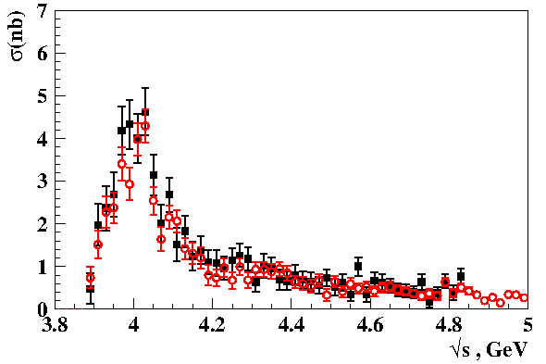
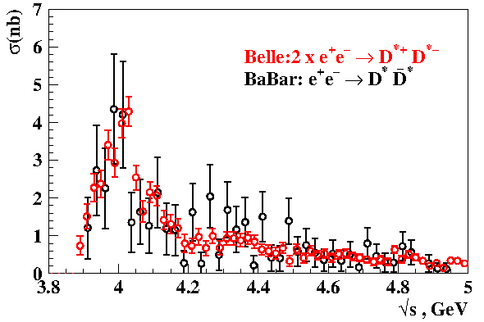
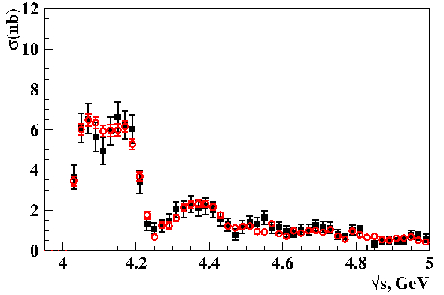
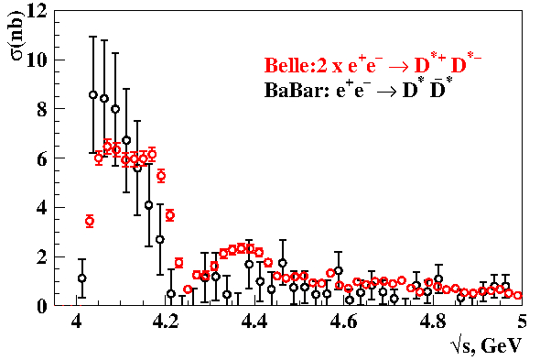
New measurements of σ(e⁺e⁻→D^{(*)+}D^{*−}) via ISR
PRD 97, 012002 (2018)
D⁺D^{*−}
Belle 2007
Belle 2017
DD* BaBar
2∙D⁺D^{*−} Belle 2017
951fb⁻¹
Ideal agreement with previous Belle and BaBar measurements
The accuracy is increased by a factor of two over the first Belle study
PRD 97, 012002 (2018)
D^{*+}D^{*−}
Belle 2007
Belle 2017
D*D* BaBar
2∙D⁺D^{*−} Belle 2017
951fb⁻¹

Slide 13
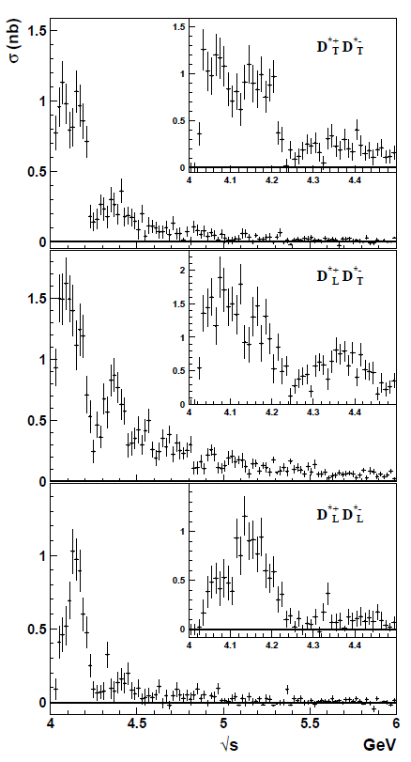
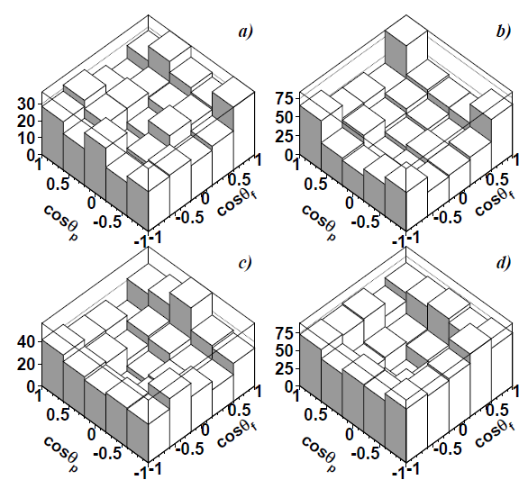
The first angular analysis of the e⁺e⁻→D^{*+}D^{*−} process
D^{*+}_{T}D^{*−}_{T}
Study of the D∗± helicity angle distribution in each bin of M(D^{∗+}D^{∗−})
Decomposition of the exclusive cross section into three components :
D^{*+}_{T}D^{*−}_{T} , D^{*+}_{L}D^{*−}_{T} and D^{*+}_{L}D^{*−}_{L}
  D*_{T} transversely polarized D* meson
  D*_{L} longitudinally polarized D* meson
D^{*+}_{L}D^{*−}_{T}
cos_{f} vs. cos_{p}
M(D^{∗+}D^{∗−}) :
a) 4.0-4.1GeV/c²
b) 4.1-4.25GeV/c²
c) 4.25-4.6GeV/c²
d) > 4.6GeV/c²
D^{*+}_{L}D^{*−}_{L}
Obtained components should allow to describe all the measured exclusive cross-sections simultaneously in the framework of the coupled channel model
JETP L 105, 3 (2017) Exclusive open-charm near-threshold cross sections in a coupled-channel approach

Slide 14
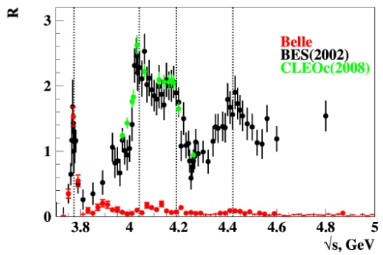
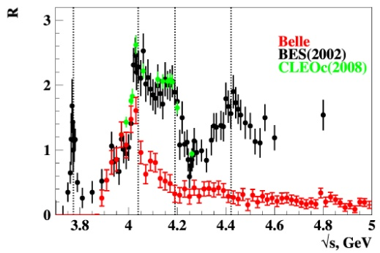
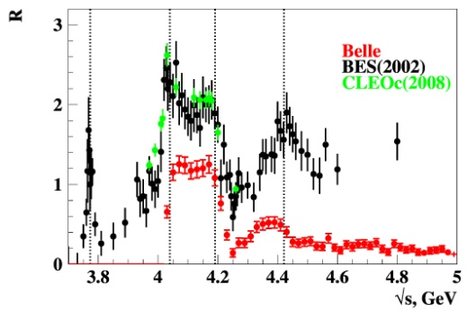
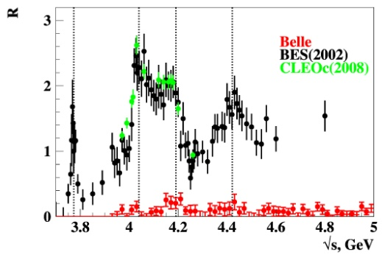
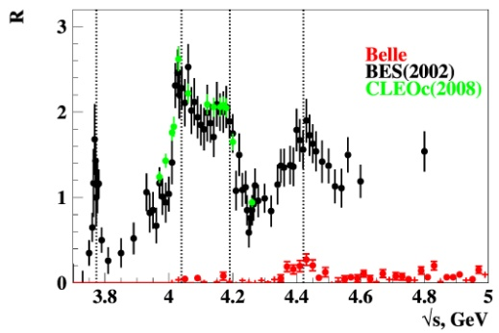
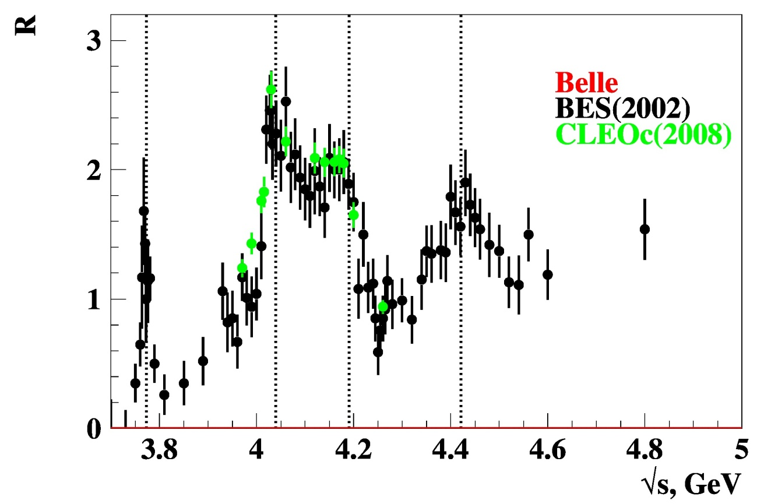

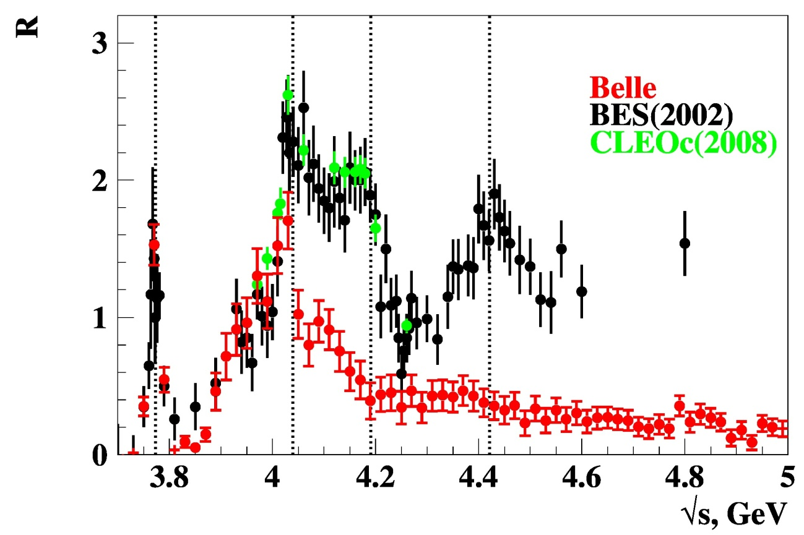
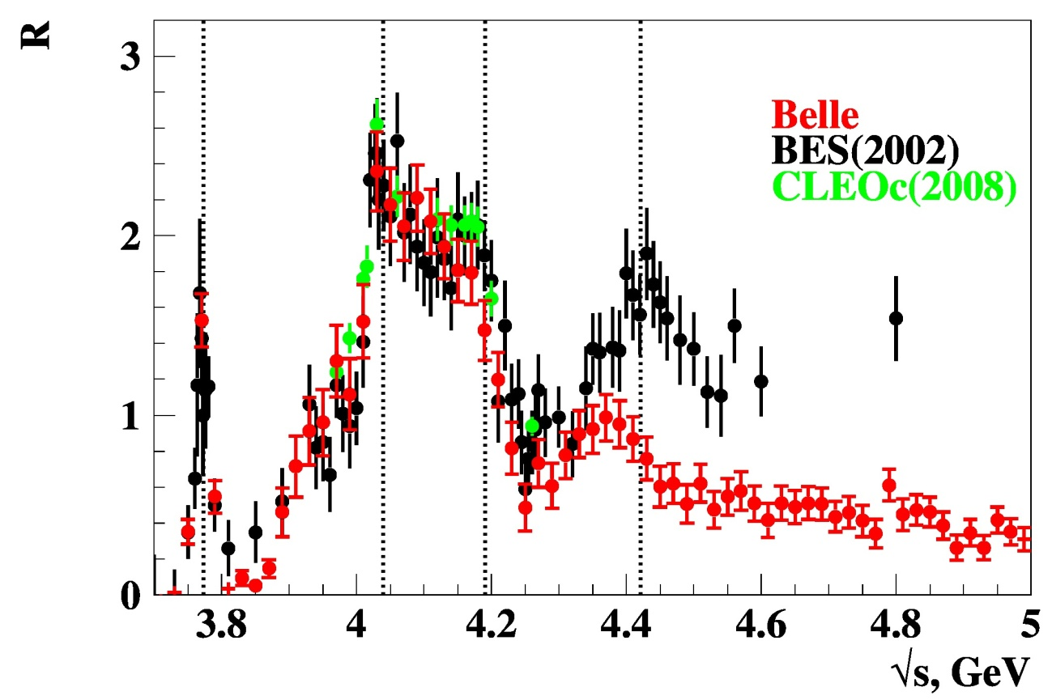
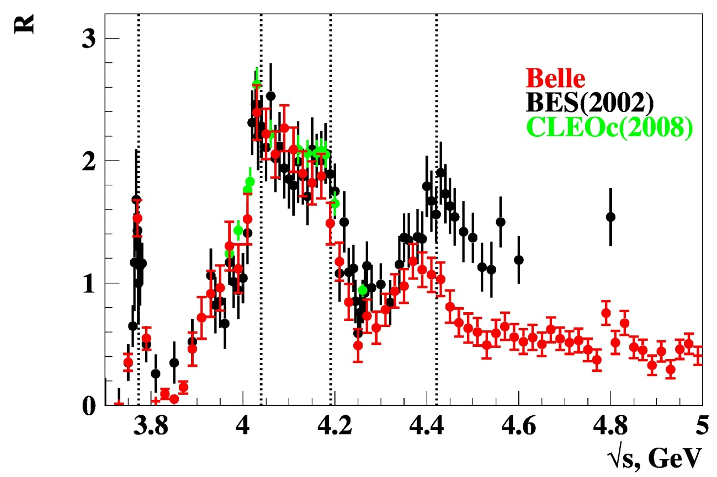
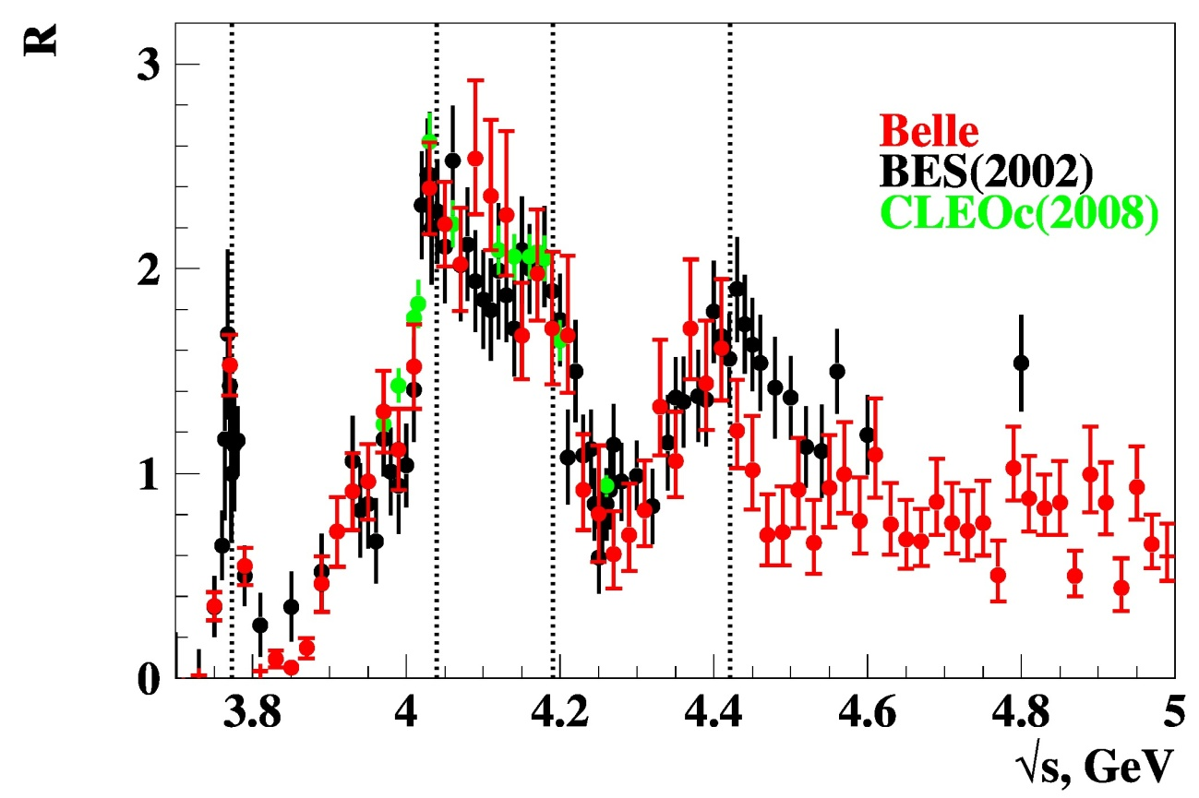
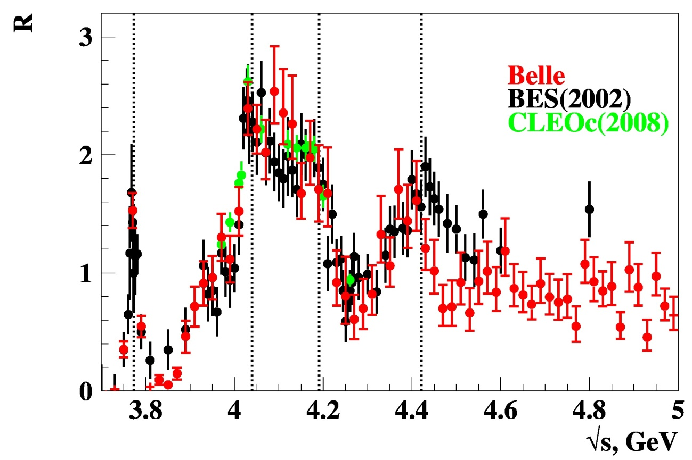
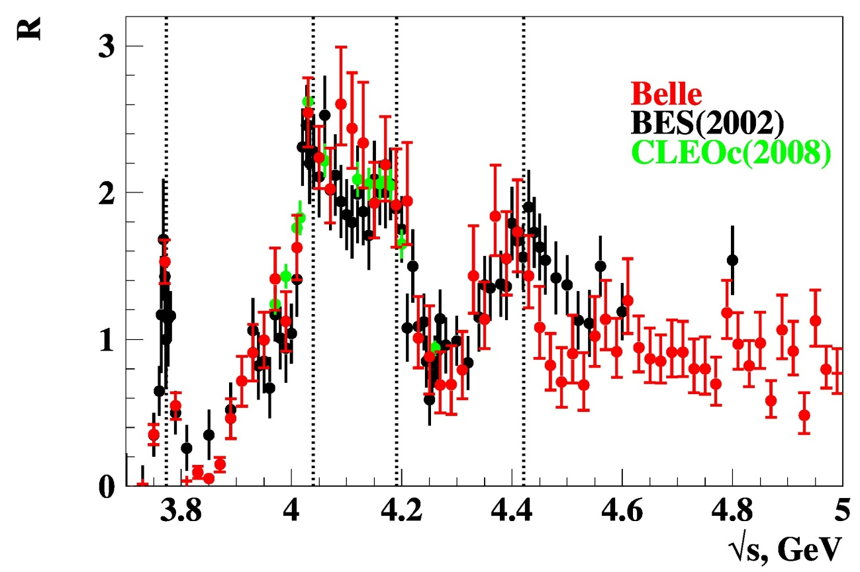
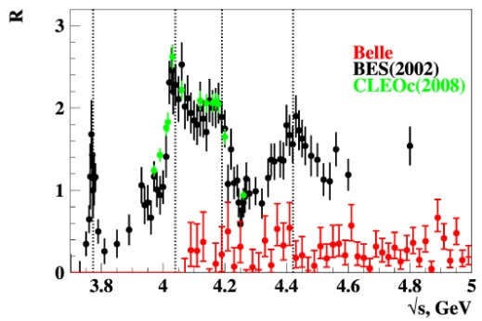
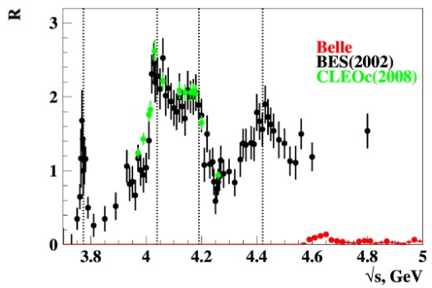
DD
DD*
D*D*
D_{s}^{(*)+}D_{s}^{(*)–}
Sum of all measured exclusive cross-sections to open charm
DDπ
DD*π
Λ⁺_{c} Λ⁻_{c}
Contributions of D⁺D*–, D^{*+}D*–, D⁰D–π⁺ and D⁰D*–π⁺ are scaled following isospin symmetry

Slide 15
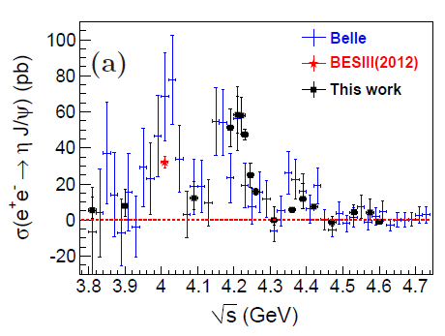

PRD87,051101R(2013)
e⁺e⁻ → J/ψη
ψ(4040)
ψ(4160)
BESIII scan
Peaks of ψ(4040) and ψ(4160)
No sign of any Y state
Γ (ψ(4040,4160) → J/ψη) ∼ 1 MeV
  Anomalous transitions: common feature of all 1– – states above threshold ?
980 fb⁻¹
PRD91,112005(2015)
BESIII scan is in agreement with Belle ψ(4160) → J/ψη structure
Do we understand conventional charmonium above DD threshold, in particular ψ states?
In fact, we even have not measured their parameters reliably…
η
η

Slide 16

Charmoniumlike states

Slide 17
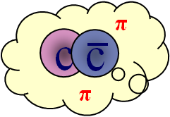
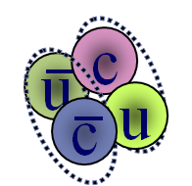
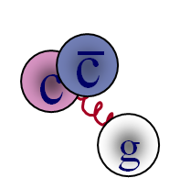
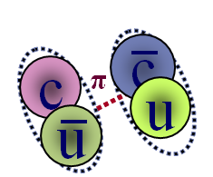
Charmoniumlike states (before PDG2018 naming scheme)
X(4700)
Y(4660)
&
something
X(4500)
Х(4630)
Z(4430)⁺
Y(4390)
Y(4360)
Z(4250)⁺
X(4160)
X(4274)
Y(4260)
Z(4240)⁺
c
X(4140)
Y(4230)
c
X(3915)
X(3872)
Z(4050)⁺
ψ₂(3823)
Z_{c}(4020)⁺
X(3940)
_
Z_{c}(3900)⁺
X(3860)
DD
2002-2016 Discovery of two dozens exotic charmonium states
All of them above open charm threshold
S=0
S=1
S=0
S=1
J^{PC}
Multiquark states
Tetraquark
tightly bound four-quark state
Molecular state
two loosely bound charm mesons
Charmonium hybrids
States with excited gluonic
degrees of freedom
Hadrocharmonium
Specific charmonium state “coated”
by excited light-hadron matter
Threshold effects
Virtual states at thresholds
Charmonium states with masses shifted by nearby D_{(s)}^{(*)}D_{(s)}^{(*)} thresholds
Rescattering
Two D-mesons, produced closely, exchange quarks

Slide 18

Exotic vector states

Slide 19
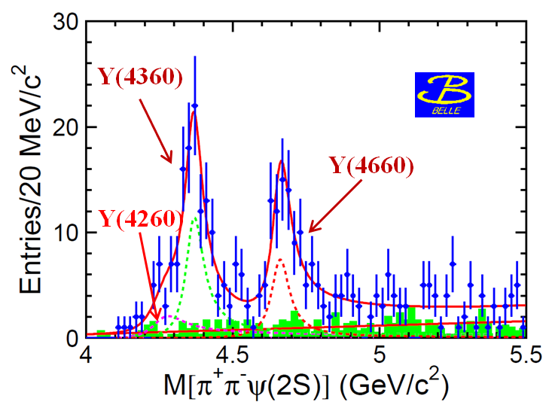
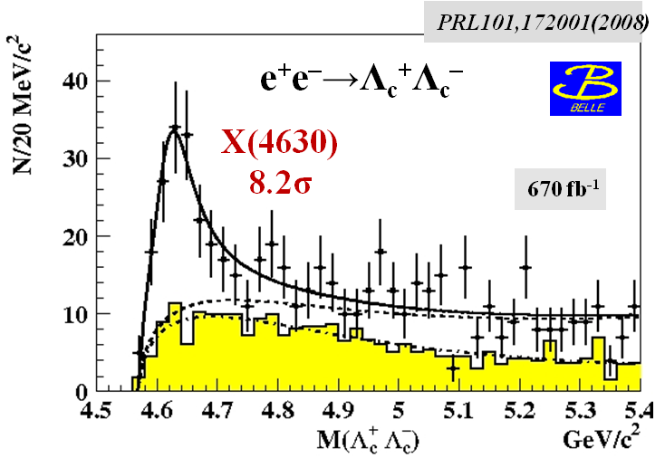
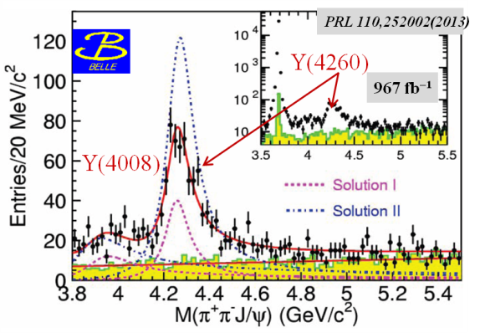
e⁺e⁻ →π⁺π⁻ψ(2S)
e⁺e⁻ →π⁺π⁻J/ψ
Y states at B factories via ISR
 | M(MeV) | Γ(MeV) | decay mode | experiment
Y(4260) | 4263⁺⁸₋₉ | 95±14 | J/ψππ | BaBar, Belle
Y(4360) | 4361±13 | 74±18 | ψ(2S)ππ | BaBar, Belle
X(4630) | 4634⁺⁹₋₁₁ | 92⁺⁴¹₋₃₂ | Λ_{с}⁺Λ_{с}⁻ | Belle
Y(4660) | 4664±12 | 48±15 | ψ(2S)ππ | BaBar, Belle
Y(4660)
X(4630)
π⁺π⁻
Y(4360)
Unlike conventional charmonium
No room for Y states among 1– – charmonium
3³S₁ = ψ(4040); 2³D₁ = ψ(4160) ; 4³S₁ = ψ(4415); masses of predicted 3³D₁ (4520); 5³S₁ (4760); 4³D₁(4810) are higher (lower)
Absence of open charm production
Anomalous large partial width
Γ(Y → J/ψππ) > 1 MeV
Only one decay channel per one Y state:
light charmonium + ππ
π⁺π⁻
Y(4260)
π⁺π⁻
π⁺π⁻
π
c
–
c
π

Slide 20
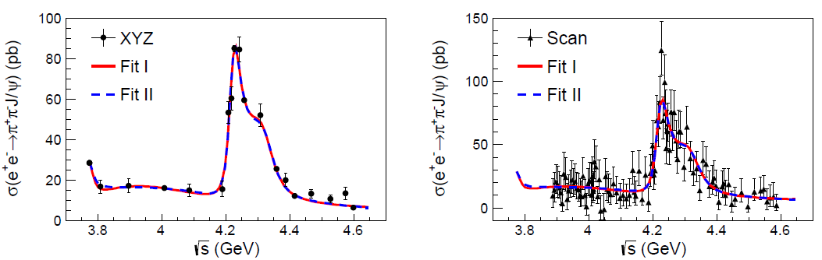
New precise measurements of e⁺e⁻ →π⁺π⁻ J/ψ
PRL118 092001 (2017)
e⁺e⁻ →π⁺π⁻ J/ψ cross section is inconsistent with a single pick of Y(4260)
Two peaks are favored over one peak by 7.6 σ
 | M, GeV/c² | Γ, MeV | Decay mode
X(4260), PDG | 4230±8 | 55±19 | π⁺π⁻ J/ψ
Y(4220), BESIII | 4222.0±3.1±1.4 | 44.1±4.3±2.0 | π⁺π⁻ J/ψ
X(4360), PDG | 4341±8 | 102±9 | π⁺π⁻ ψ(2S)
Y(4360), BESIII | 4320.0±10.4±7.0 | 101.4^{+25.3}_{−19.7}±10.2 | π⁺π⁻ J/ψ

Slide 21


New precise measurements of e⁺e⁻ →π⁺π⁻ ψ(2S), π⁺π⁻ h_{c}
PRD96 032004 (2017)
PRL118 092002 (2017)
π⁺π⁻ h_{c}
π⁺π⁻ ψ(2S)
BESIII confirms lineshape in e⁺e⁻→π⁺π⁻ψ(2S)
 | M, GeV/c2 | Γ, MeV | Decay mode
Y(4220) | 4209.5±7.4±1.4 | 80.1±24.6±2.9 | π⁺π⁻ ψ(2S)
Y(4220) | 4218.4^{+5.5}_{−4.5}±0.9 | 66.0^{+12.3}_{−8.3}±0.4 | π⁺π⁻ h_{c}
Y(4390) | 4383.8±4.2±0.8 | 84.2±12.5±2.1 | π⁺π⁻ ψ(2S)
Y(4390) | 4391.5^{+6.3}_{−6.8}±0.9 | 139.5^{+16.2}_{−20.6}±0.6 | π⁺π⁻ h_{c}
X(4360), PDG | 4341±8 | 102±9 | π⁺π⁻ ψ(2S)

Slide 22


e⁺e⁻ →π⁰π⁰ψ(2S)
e⁺e⁻ → χ_{cJ}ω
PRD 97, 052001 (2018)
PRD93 011102 (2016)
χ_{c0}ω
Y(4220)
χ_{c1}ω
Y(4360)?
e⁺e⁻→π⁰π⁰ψ(2S) consistent with the charged mode
from isospin symmetry (scan five points)
χ_{c2}ω
 | M, GeV/c2 | Γ, MeV | Decay mode
Y(4220) | 4209.5±7.4±1.4 | 80.1±24.6±2.9 | π⁺π⁻ ψ(2S)
Y(4220) | 4218.4^{+5.5}_{−4.5}±0.9 | 66.0^{+12.3}_{−8.3}±0.4 | π⁺π⁻ h_{c}
Y(4220) | 4230±8±6 | 38±12±2 | χ_{c0}ω
ψ(4415)
PRL 114 092003 (2015)
First measurements of ψ(4415)→ χ_{cJ}ω
mass, width, Γ_{ee} for ψ(4415) are fixed to PDG parameters

Slide 23



BESIII: e⁺e⁻→ D⁰D*–π⁺
Belle: e⁺e⁻→ D⁰D*–π⁺
PRD 80, 091101 (2009)
ψ(4415)
UL
Y(4220)
Y(4390) or ψ(4415)?
Y(4390)
ψ(4415)→ D⁰D₂(2460)⁰ → D⁰D*–π⁺
Belle: e⁺e⁻→ D⁰D–π⁺
Y(4220)
PRL100 062001(2008)
ψ(4415)
DD₂(2460)
Y(4390)
~10σ
DDπ non-DD₂(2460)
M = 4411 ± 7 МэВ
Γ_{tot} = 77 ± 20 МэВ
670 fb⁻¹
ψ(4415)→ D⁰D₂(2460)⁰ → D⁰D–π⁺
ψ(4415)→ D⁰D₂(2460)⁰ → D⁰D*–π⁺
UL due to limited statistics

Slide 24

Vector states summary 2018
 | Open charm | J/ψπ⁺π⁻ | ψ(2S) π⁺π⁻ | h_{c}π⁺π⁻ | J/ψη | χ_{c0}ω | χ_{c2}ω
ψ(3770) | ok
ψ(4040) | ok |  |  |  | ok
ψ(4160) | ok |  |  |  | ok
Y(4220) = ψ(4230) PDG 2018 Y(4260) = ψ(4260) PDG 2018 | DD*π none | ok ok |  | ok |  | ok |  | Same state?
Y(4390) = ψ(4390) PDG 2018 Y(4360) = ψ(4360) PDG 2018 | none | ok | ok ok | ok |  |  |  | Same state?
Y(4390) | DD*π |  |  |  |  |  |  | ψ(4415)?
ψ(4415) | DDπ |  |  |  |  |  | ok
Y(4630) = ψ(4660) PDG 2018 | Λ_{c}⁺Λ_{c}⁻ |  |  |  |  |  |  | Same state ψ(4660)?
Y(4660) = ψ(4660) PDG 2018 | none | ok | ok
Two newborns in Y family: Y(4220), Y(4390)
Only one Few decay channels per one Y state
  hadrocharmonium is excluded!
Nature of Y states?
PDG revolution 2018
  Y states with J^{PC} = 1– – turn into ψ states
PDG

Slide 25

X(3872)
as
χ_{c1}(3872) in PDG2018

Slide 26










PRL91, 262001 (2003)
First observed by Belle
in B→K J/ψπ⁺π–
Belle top cited
1500+
PRD73, 011101 (2006)
10σ
PRL93, 162002 (2004)
M(J/ψππ)
EPJ C72 1972 (2012)
J^{PC} = 1⁺⁺
finally
established
PRL93, 072001 (2004)
Hadronic collisions:
produced mostly promptly; only
0.263±0.023±0.016
from B-decays (CMS)
JHEP 04, 154 (2013)
M_{X} close to D⁰D^{*0} threshold M = 3871.69± 0.17 MeV
not clear below or above: Δm = – 0.01 ± 0.18 MeV
Surprisingly narrow: Γ_{tot}< 1.2 MeV at 90% CL

Slide 27
ψ(2S)γ
X(3872) interpretation
J/ψω
J/ψγ
J/ψρ
D⁰D^{*0} molecular state: (the most popular)
M_{X} ~ M_{D0} + M_{D*0} is not accidental
J^{PC}=1⁺⁺ (D⁰D^{*0} in S-wave)
DD* decay
Small rate for decay into J/ψγ is expected
too large X(3872) → ψ(2S)γ
too small binding energy: D⁰ and D^{*0} too far in space to be produced in high energy pp collisions
X(3872)
D⁰D^{*0}
Mixture of P-wave charmonium χ_{c1}(2P) and S-wave DD^{*0} molecule
Search for X(3872) partners decays Molecules with J^{PC} = 0⁺⁺, 1^{+–}, 2⁺⁺…
χ_{c1} γ χ_{c2} γ | Forbidden by C-parity conservation C-odd partners: tetraquark, molecule UL : < 1/4 from J/ψ π⁺π–
J/ψ η | C-odd partners: tetraquark UL : < 1/2 from J/ψ π⁺π–
η_{c} η η_{c} π⁰ η_{c} π⁺π– η_{c} ω | Search for other X-like molecular states UL : ~ J/ψ π⁺π
χ_{c1}(3872) PDG2018
X(4160)
X(3872)
ψ₂(3830)
X(3940)
_
DD
Notes:
27

Slide 28

Z_{c}⁺
Charged charmoniumlike states

Slide 29



Charged Z_{c}⁺ states in B decays
PRL 100, 142001 (2008)
PRL 112, 222002(2014)
Z(4430)⁺→ψ(2S) π⁺
6.5 σ
LHCb: Parameters (including quantum numbers) are consistent with the Belle results
Another peak at 4240 MeV with significance ~5 σ
548 fb⁻¹
~5 σ
>14 σ
M(π⁺ψ(2S))
c
–
Belle: Z(4430)⁺ three different analysis, J^{P} = 1⁺
Discovery: fit to M(ψ(2S)π⁺) with K*(890)&K*(1430) veto
Dalitz analysis
Full amplitude analysis to obtain spin-parity
Mass values are the same, width depends on method
u
d
–
c
Z_{c}⁺ cannot be conventional charmonium
Four Z_{c}⁺ states found by Belle
 | PDG2018 | M(MeV) | Γ(MeV) | J^{PC} | decay mode | production mode | experiment
Z⁺(4050) | X(4050) | 4051⁺²⁴₋₄₀ | 82⁺⁵⁰₋₂₈ | ? | χ_{c1}π | B→KZ⁺ | Belle
Z⁺(4250) | X(4250) | 4248⁺¹⁹⁰₋₅₀ | 177⁺³²⁰₋₇₀ | ? | χ_{c1}π | B→KZ⁺ | Belle
Z⁺(4200) | Z_{c}⁺(4200) | 4196⁺³¹₋₂₉⁺¹⁷₋₁₃ | 370⁺¹⁰⁰₋₁₅₀ | 1⁺ | J/ψπ | B→KZ⁺ | Belle/LHCb
Z⁺(4430) | Z_{c}⁺(4430) | 4478⁺¹⁵₋₁₈ | 181±31 | 1⁺ | ψ(2S)π, J/ψπ | B→KZ⁺ | Belle/LHCb

Slide 30



Z_{c} family in e⁺e⁻ annihilation
PRL 110, 252001 (2013)
PRL 115, 112003 (2015)
PRL 111, 242002 (2013)
PRL 113, 212002 (2014)
307±48
8σ
8.9σ
PRL 110, 252001 (2013)
PRL 115, 222002 (2015)
PRL 113, 132002 (2014)
PRL 115, 182002 (2015)
PRL 110, 252002 (2013)
PRD91, 112007(2015)
New signal in
Y(4360)→ π‒ Z(4050)⁺
M = 4054±3±1 MeV/c²
Γ = 45±11±6 MeV
BESIII
Z_{c}(4030)⁺
M = 4032.1±2.4 MeV/c²
Γ = 26.1±5.3 MeV
Z_{c}(3900)⁺
Z_{c}(4050)⁺?
5.2σ
3.5 σ
PRD96,032004(2017)
159±49

Slide 31

Z_{c} summary
Same states with different final states
Two isospin triplets: Z_{c}(3900)^{±/0} and Z_{c}(4200^{)±/0}
Amplitude analysis on Z_{c}(3900) : J^{P}=1⁺
Interpretation? Molecular states? Z_{c}(4050)⁺ = Z_{c}(4030)⁺?

Slide 32

Standard
or/and
Exotic

Slide 33

PRL 94, 182002 (2005)
X (3915) ≡ Y(3940)
Y→ ωJ/ψ
B→YK
Particle Data Group 2016
Y(3940) ≡ X(3915) ≡ χ_{c0}(3915)
Y→J/ψω
Y(3940)
8.1σ
Y→ ωJ/ψ
253fb⁻¹
X(4160)
χ_{c0}(2P)
ψ₂(3830)
The same decay mode
Similar masses and widths
Different production mechanisms
Found by Belle & confirmed by BaBar
X(3940)
BaBar prefers J^{P}=0⁺
PRL 104, 092001 (2010)
Y(3915)
J^{PC}
γγ → X(3915) → ωJ/ψ
Theory
χ_{c0}(2P) production in two body B decays is suppressed
χ_{c0}(2P) → DD should be dominant
7.7 σ
J = 0, 2 only
M(ωJ/ψ)

Slide 34


Better χ_{c0}(2P) candidate in e⁺e⁻→J/ψDD
New ideas:
BaBar angular analysis based on non strict exclusion of J^{P}=2⁺
New better candidate for χ_{c0}(2P) is seen in X*(3860)→ DD
PRL 100, 202001 (2008)
e⁺e–→J/ψX(3880) →J/ψDD
X(3880)
J^{PC}=0^{±+}
3.8σ
NEW
PRD95, 112003 (2017)
M(DD)
X*(3860)→ DD
6.5σ
X*(3860)
M=3862⁺²⁶₋₃₂⁺⁴⁰₋₁₃ MeV/c²
Γ= 201⁺¹⁵⁴₋₆₇⁺⁸⁸₋₈₂ MeV
χ_{c0}(3860)
PDG2018
X(4160)
980 fb⁻¹
ψ₂(3830)
X(3940)
Full amplitude analysis
J^{PC}=0⁺⁺ is favored over the 2⁺⁺ at 2.5σ level
J^{PC}
Nature of X(3915) is the open question… again

Slide 35

Bottomonium

Slide 36

Bottomonium in standard quark model
b
b
n^{(2S+1)}L_{J}
n radial quantum number
S total spin of q-antiq
L relative orbital ang. mom.
L = 0, 1, 2 ... correspond to S, P, D
J = S + L
P = (–1)^{L+1} parity
C = (–1)^{L+S} charge conj.
2M_{B}
open bottom threshold
States below open bottom
threshold are narrow
The heaviest quarkonium provide a unique non-relativistic system
for QCD testing
Notes:
psi(2D) in Y(3S)→γpsi by Cleo

Slide 37





Vector bottomonium states
PRL54,381(1985)
Direct measurements at e⁺e– colliders from CUSB&ARGUS&CLEO to Belle & BaBar
ϒ(10860)
ϒ(1S)
J^{PC} = 1– –
The most accurate measurements of masses and widths of ϒ(nS) states
ϒ(2S)
ϒ(3S)
ϒ(4S)
ϒ(11020)
PDG:
ϒ(1S), ϒ(2S), ϒ(3S), ϒ(4S), but...ϒ(10860) and ϒ(11020) [Common names ϒ(5S), ϒ(6S)]
Study bottomonium states using transitions of ϒ(nS) states
ϒ(4S)→BB (B = B⁰ or B⁺)
“B physics” at B-factories
ϒ(nS)→γbb , n =2,3
ϒ(10860) →B^{(*)}B^{(*)}, B^{(*)}B^{(*)}π, BBππ, B_{s}^{(*)}B_{s}^{(*)}, ϒ(nS) ππ, ϒ(nS)X... etc
PRL102, 012001 (2009)
R_{b} = σ(e⁺e– →bb)/(e⁺e–→μ⁺μ– )
open bottom threshold
ϒ(11020)
ϒ(10860)

Slide 38

χ_{bJ}(1P) χ_{bJ}(2P)
PRL94,032001(2005)
5.9 × 10⁶ ϒ(3S)
9.3 × 10⁶ ϒ(2S)
ϒ(2S) → γ χ_{b}(1P)
ϒ(3S) → γ χ_{b}(2P)
The inclusive photon spectrum
The inclusive photon spectrum
χ₁(1P)
χ₁(2P)
χ₂(1P)
χ₀(1P)
χ₁(2P)
χ₀(2P)
2M_{B}
open bottom threshold
γ
γ

Slide 39



η_{b} (1S) the ground state of bottomonium
ϒ(3S)→γη_{b}
γ_{ISR}
η_{b}
Measured η_{b} properties
χ_{bJ}(2P)
10σ
non-peaking background subtracted
109M ϒ(3S)
PRL 101, 071801(2008)
The inclusive photon spectrum
ϒ(2S)→γη_{b}
γ_{ISR}
η_{b}
χ_{bJ}(1P)
2M_{B}
open bottom threshold
non-peaking background subtracted
92M ϒ(2S)
PRL103,161801 (2009)
Good agreement between BaBar & CLEO
Hyperfine splitting predictions
  Lattice: ~ 50-60 MeV/c²
  NRQCD: ~ 40 MeV/c²
The inclusive photon spectrum
γ
ϒ(3S)→γη_{b}
γ_{ISR}
η_{b}
γ
PRD81, 031104 (2010)

Slide 40
Search for ϒ(1D)_{J}
PRD82:111102,2010
ϒ(1³D₂)
5.8σ
ϒ(1³D₁)
1.8σ
ϒ(1³D₃)
1.6σ
2M_{B}
open bottom threshold
M_{ϒ(1D2)} = 10164.5 ± 0.8 ± 0.6 MeV/c²
γ
γ
γ
γ
The first observation of ϒ(1D) PRD70,032001 (2004)
M_{ϒ(1D)} = 10161.1 ±0.6 ±1.6 MeV/c²
e⁺e–
μ⁺μ–

Slide 41




Observation of h_{b}(1P,2P)
PRL108,032001(2012)
ϒ(2S)
e⁺e⁻→ ϒ(5S) →X π⁺π–
h_{b}(2P)
ΔM_{HF}(1P) = 0.8 ± 1.1 MeV
ΔM_{HF}(2P) = 0.5 ± 1.2 MeV
consistent with zero, as expected
h_{b}(1P)
M_{miss}(π⁺π⁻)
π⁺π⁻
ϒ(5S) → h_{b}(nP) π⁺π–
ϒ(5S) → ϒ(2S) π⁺π–
2M_{B}
Due to spin flip to be suppressed as ~(Λ_{QCD}/m_{b} )²
π⁺π⁻
h_{b}(1P)
=
h_{b}(2P)
Large h_{b}(1P,2P) production rates! Unknown intermediate state?
CLEO
large e⁺e⁻→Y(4260)→h_{c}π⁺π–

Slide 42


Observation of h_{b}(1P,2P)→η_{b}(1S) γ
Kniehl et al, PRL92,242001(2004)
ϒ(3S)
Meinel, PRD82,114502(2010)
h_{b}(1P)
PRL 109 (2012) 232002
ϒ(2S)
Belle : 57.9 ± 2.3 MeV
PDG’12 : 69.3 ± 2.8 MeV
η_{b}(1S)
ϒ(3S)
LQCD
pNRQCD
h_{b}(2P)
ΔM_{HF}(1S)
π⁺π⁻
η_{b}(1S)
2M_{B}
Belle result decreases tension with theory
γ
π⁺π⁻
γ
γ
M_{miss} (π⁺π⁻γ)
^{(n)}
γ
e⁺e⁻→ϒ(5S)→h_{b}(nP) π⁺π–
h_{b}(nP)→ η_{b}(1S) γ

Slide 43


First evidence for η_{b}(2S)
PRL 109 (2012) 232002
η_{b}(2S)
pNRQCD
LQCD
ΔM_{HF}(2S) = 24.3 ^{+4.0}_{−4.5} MeV
4.2σ w/ syst
M_{miss} (π⁺π⁻γ)
⁽²⁾
π⁺π⁻
e⁺e⁻→ϒ(5S)→h_{b}(2P) π⁺π–
h_{b}(2P)→ η_{b}(2S) γ
2M_{B}
γ
Br(h_{b}(1P) → η_{b}(1S) γ) = 49.2±5.7^{+5.6} _{−3.3}%
Br(h_{b}(2P) → η_{b}(1S) γ) = 22.3±3.8^{+3.1}_{− 3.3}%
Br(h_{b}(2P) → η_{b}(2S) γ) = 47.5±10.5^{+6.8} _{−7.7} %
41%
13%
19%
BESIII Br(h_{c}(1P) → η_{c}(1S) γ) = 54.3±8.5 %
39%
Godfrey Rosner PRD66,014012(2002)
Γ(2S) = 4 ± 8 MeV, < 24MeV @ 90% C.L.
expect ∼4MeV
In agreement with theory

Slide 44

Charged bottomoniumlike states

Slide 45


Observation of large e⁺e–→ϒ(nS) π⁺ π– near ϒ(10860)
ϒ(2S)
Partial widths for ϒ(10860)→ϒ(nS) π⁺ π– more than two orders of magnitude larger than corresponding partial widths for ϒ(4S), ϒ(3S) or ϒ(2S) decays
M(μ⁺μ–π⁺π–) = √s
ϒ(3S)
ϒ(2S)
Γ(ϒ(nS) π⁺ π– )
ϒ(1S)
PRL100,112001(2008)
ϒ(1S)
Possible explanations
ϒ(10860) has exotic properties
Reactions in fact proceed via Y_{b} states similar to exotic vector charmonium
To be done
  Study of resonant structure of ϒ(5S)→(bb)π⁺π–
  Measure energy dependence of e⁺e–→ϒ(nS) π⁺ π–

Slide 46


Resonant structure of ϒ(5S)→(bb)π⁺π–
ϒ(5S) →h_{b}(1P)π⁺π⁻
ϒ(5S) →h_{b}(2P)π⁺π⁻
no non-res.
contribution
phsp
phsp
Large h_{b}(1P,2P) production rates!
M(h_{b}(1P) π± )
PRD88, 052016 (2013)
M(h_{b}(2P) π± )
π⁻
Dalitz plot analysis
Two peaks are observed in all modes
2M_{B}
π⁻
Z_{b}(10650)⁺
Z_{b}(10610)⁺
π⁺π⁻
π⁺
The first exotic bottomoniumlike Z_{b}(10610)⁺ and Z_{b}(10650)⁺
states were discovered in h_{b}(1P)π⁺, h_{b}(2P)π⁺ final states
Z_{b}⁺ are multiquark states
spin flip
suppressed
π⁺
b
–
–
b
d
u

Slide 47



ϒ(5S)→ϒ(1S)π⁺π⁻
ϒ(5S) →ϒ(2S)π⁺π⁻
ϒ(5S) →ϒ(3S)π⁺π⁻
note different scales
PRL108, 232001 (2012)
Resonant structure of ϒ(5S)→(bb)π⁺π–
π⁻
2M_{B}
π⁻
Z_{b}(10650)⁺
Z_{b}(10610)⁺
π⁺
Dalitz plot analysis
Two peaks are observed in all modes
π⁺
π⁺
The first exotic bottomoniumlike Z_{b}(10610)⁺ & Z_{b}(10650)⁺ states were discovered in ϒ(1S)π⁺, ϒ(2S)π⁺, ϒ(3S)π⁺ final states
Z_{b}⁺ are multiquark states
b
–
–
b
d
u

Slide 48


Summary of Z_{b} parameters
Average over 5 channels
M₁ ⟩ = 10607.2±2.0 MeV
Γ₁ ⟩ = 18.4±2.4 MeV
M₂ ⟩ = 10652.2±1.5 MeV
⟨ Γ₂ ⟩ = 11.5 ± 2.2 MeV
J^{P} = 1⁺
PRD91,072003(2015)
6D amplitude analysis
h_{b} production mechanism:
ϒ(5S) → h_{b}(1,2P) π⁺π– are not suppressed due to Z_{b} intermediate states!
Notes:
48

Slide 49


Resonant structure of ϒ(5S)→BB^{(*)}π
B^{(*)}
b
–
π
d
–
b
B
u
Phase space of Y(5S)→B^{(*)}B* is tiny
Relative motion B^{(*)}B* is small
Z_{b}(10610) → BB* dominantly
Z_{b}(10650) → B*B* dominantly
PRL108,122001(2012)
M_{Zb(10610)} – (M_{B}+M_{B*}) = +2.6 ± 2.1 MeV
M_{Zb(10650)} – 2M_{B*} = +1.8 ± 1.7 MeV
PRL116,212001(2016)
PRL117,142001(2016)
Favorable to the formation of
the molecular states
Select event in each peak
Z_{b}(10610)
J^{P} = 1⁺ :
B^{(*)}B* in S-wave
B
Z_{b}(10610) = | BB*⟩
Z_{b}(10650)
B^{(*)}
Z_{b}(10650) = | B*B*⟩
_

Slide 50
Energy scans: search for Y_{b} states
σ(e⁺e– →ϒ(nS)ππ)/(e⁺e–→μ⁺μ– )
max R_{b}
PRD82 091106 (2010)
PRL102, 012001 (2009)
ϒ(11020)
ϒ(10860)
3.9fb⁻¹
R_{b} = σ(e⁺e– →bb)/(e⁺e–→μ⁺μ– )
PRD82 091106 (2010)
ϒ(11020)
No evidence for new Y_{b} state
ϒ(10860)
8.4fb⁻¹
Belle & BaBar are in a good agreement

Slide 51



Bottomonium cross sections
e⁺e‒→Υ(nS)π⁺π‒
e⁺e‒→h_{b}(nP)π⁺π‒
Υ(5S)
n=1
n=1
Υ(6S)
Υ(5S)
Υ(6S)
n=2
Υ(5S)
n=2
Υ(6S)
Υ(6S)
Υ(5S)
PRL,142001(2016)
n=3
Υ(5S)
Υ(6S)
e⁺e‒→χ_{bJ}π⁺π‒ π⁰
Υ(6S)
PRD93,011101(2016)
Υ(5S)
Cross sections of e⁺e‒→Υ(nS)π⁺π‒ (n=1,2,3), e⁺e‒→h_{b}(nP)π⁺π‒ (n=1,2) & e⁺e‒→χ_{bJ}π⁺π‒ π⁰ :
Y(5S) and Y(6S) peaks only
arXiv:1806.06203
No evidence for new Y_{b} states yet

Slide 52

Future
Super-
B & c-τ
Factories

Slide 53




Mt. Tsukuba
KEKB upgrade SuperKEKB(nano-beam)
SuperKEKB
Belle II
7×4 GeV
~1 km in diameter
SuperKEKB built in of KEKB tunnel is almost entirely new machine
×20 smaller beam focus at interaction region
twice higher beam current
×40 higher Luminosity
First beam in 2016 , first collision in April 2018

Slide 54

Time of propagation & aerogel RICH detectors
K/π separation
ε ~ 90% @ 5% fake rate
EM Calorimeter
σE/E~ 2% @ E =1 GeV
The Belle II detector
Belle II is an upgrade of the Belle detector:
capable to work at much higher background environment
Highlights:
Vertex: 2 layers of pixels, 4 layers of DS Si strips with extended coverage
Drift chamber: smaller cell size + longer lever arm
PID: new TOP + ARICH
Better tracking
Better vertexing
Better particle identification
Better calorimeter resolution

Slide 55

Super Charm Tau Factory at BINP in Novosibirsk
Two rings, 800 m each
Crab waist
Collision energy from 2 GeV to 5 (6) GeV
Luminosity: 5·10³⁴ cm⁻²s⁻¹ at 2 GeV
and 10³⁵ cm⁻² s⁻¹ at 4 GeV
Longitudinally polarized electron beam at IP
The concept of the new collider is based on a new method to increase the luminosity, which was proposed by physicists from INFN (Italy) and developed by INFN and BINP experts
Detailed physics program is developed
Preliminary CDR was issued (in 2011) and updated in 2018
R&D for accelerator and detector is in progress, prototypes and key elements were designed and produced
Preliminary civil engineering and infrastructure design is completed
IT requirements are identified
Talk of P.V.Logachev, Director BINP at "Super c-tau factory workshop“, May 26-27 2018, Novosibirsk

Slide 56
To be done at Super-B & Super c-τ Factories
Huge luminosity and significantly improved detector parameters (better tracking, vertexing, particle identification, resolution) should allow to perform a lot of new measurements and studies inaccessible to previous experiments because of lack of statistics
Detailed physics programs are developed. They include:
Search for and precise measurements of all predicted quarkonium states above open charm (bottom) threshold
Energy scan in 3.7-5.0 GeV energy region at Super c-τ Factory. Precise measurements of σ( e⁺e⁻ →hadrons), including exclusive cross-sections to open charm final states
Search for new and precise study of known quarkoiniumlike states including angular & Dalitz & amplitude analyses

Slide 57

In conclusion

Slide 58
Dozens of quarkonium states and quarkoniumlike states named as XYZ states were discovered since 2002 by Belle & BaBar & BES experiments and this list continues to grow
  Particle Data Group 2018: instead of XYZ states new naming scheme of hadrons M. Tanabashi et al. (Particle Data Group), Phys. Rev. D 98, 030001 (2018).
Charmonium & Bottomonium tables below open charm & bottom thresholds are (almost) completed. Good agreement between theory and experiment!
Above open charm &bottom thresholds quarkonium physics is in deep crises! Observed states remain puzzling and can not be explained for many years!
BUT….
The mysterious behavior of exotic states motivates us to create new experiments and theoretical models
Super-B and Super-charm-tau factories have to shed light on unknown nature of quarkoniumlike states

