Slide 1
28th International Scientific Conference of Young Scientists and Specialists (AYSS-2024)
Development of Information Systems' Infrastructure for BM@N Data Processing
Alexander Chebotov
Konstantin Gertsenberger
Ilya Romanov
JINR, LHEP
29/10/2024

Slide 2
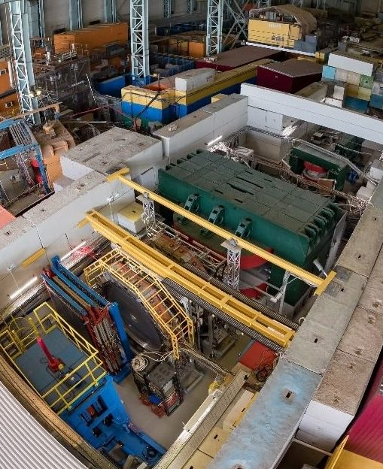
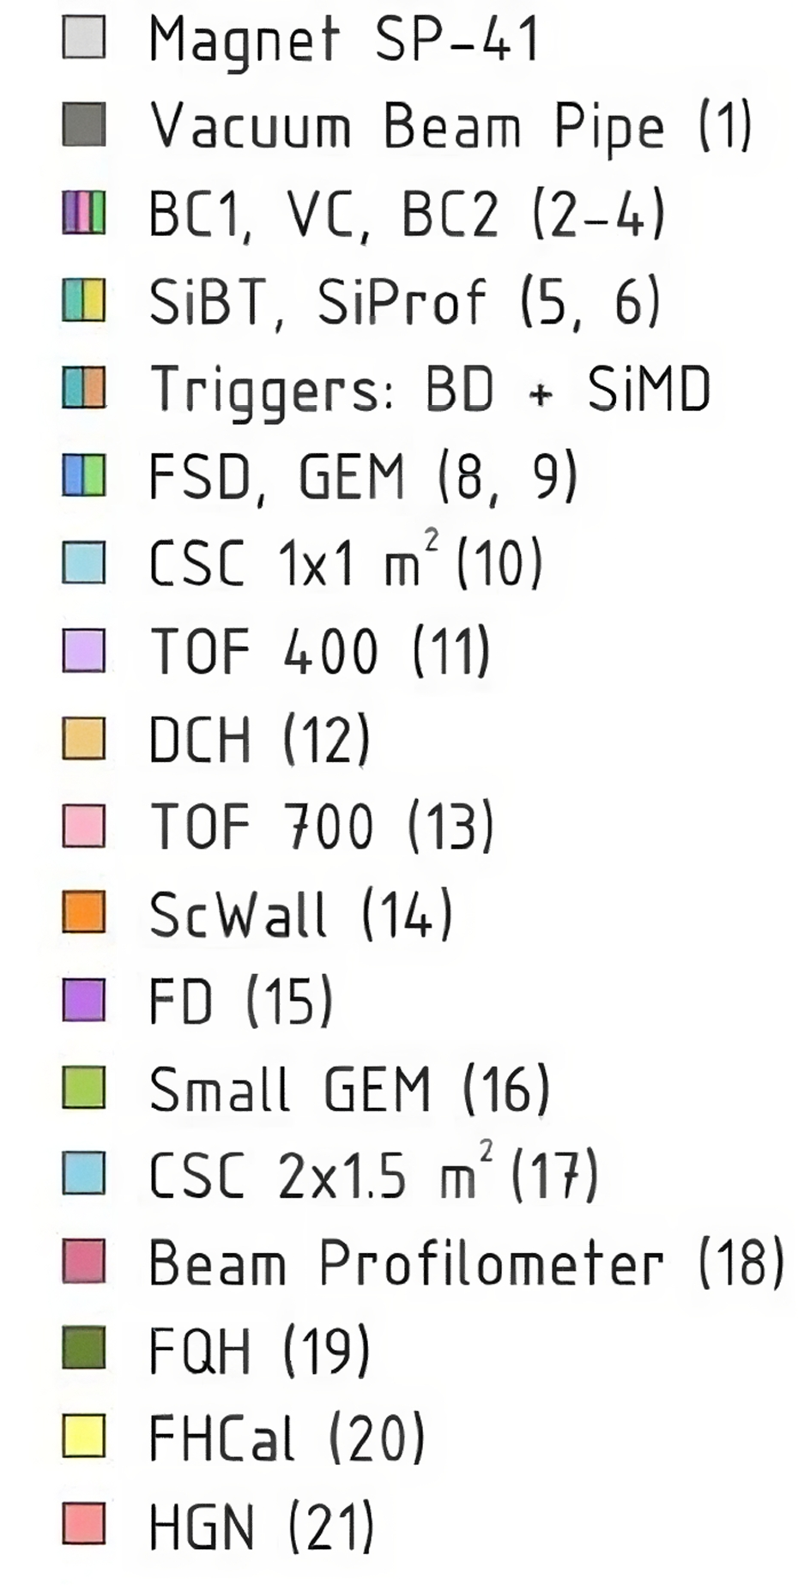
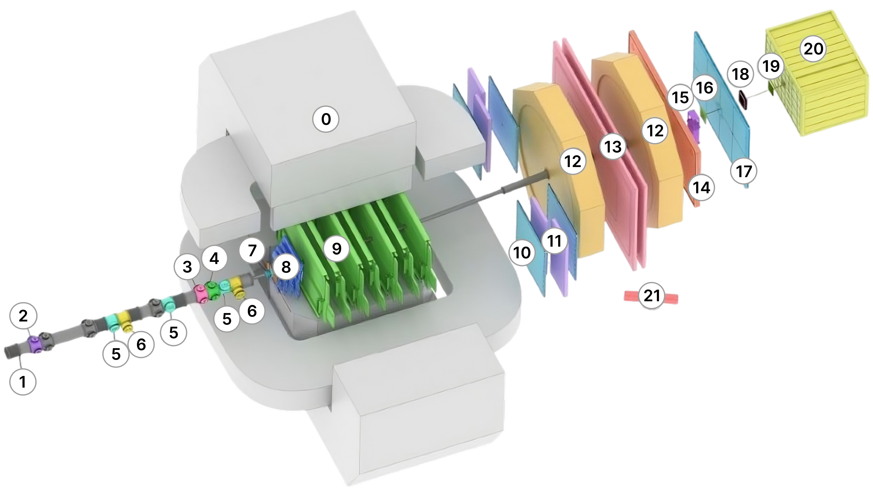
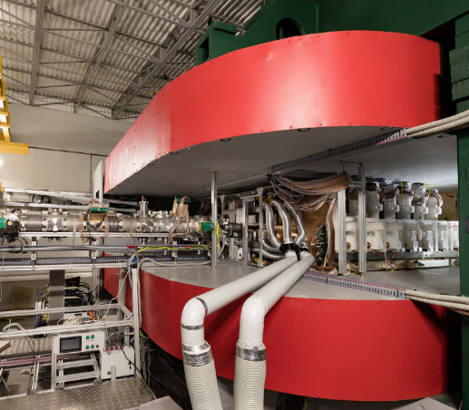
Baryonic Matter @ Nuclotron (BM@N)
The BM@N spectrometer at
the NICA accelerator complex
Nuclear Instruments
and Methods in Physics
BM@N Runs (2015 – 2023)
Session №51 (d,C)
Feb. 22 – Mar. 15, 2015
Session №55 (C,Ar,Kr)
Mar. 3 – Apr. 05, 2018
Session №52 (d)
June 29 – June 30, 2016
Session №56 (C) (SRC)
Mar. 7 – Mar. 28, 2022
Session №53 (d, $d^{↑}$)
Dec. 9 – Dec. 23, 2016
Session №57 (Xe)
Dec. 12 – Feb. 02, 2023
Session №54 (C)
Mar. 7 – Mar. 18, 2017

Slide 3
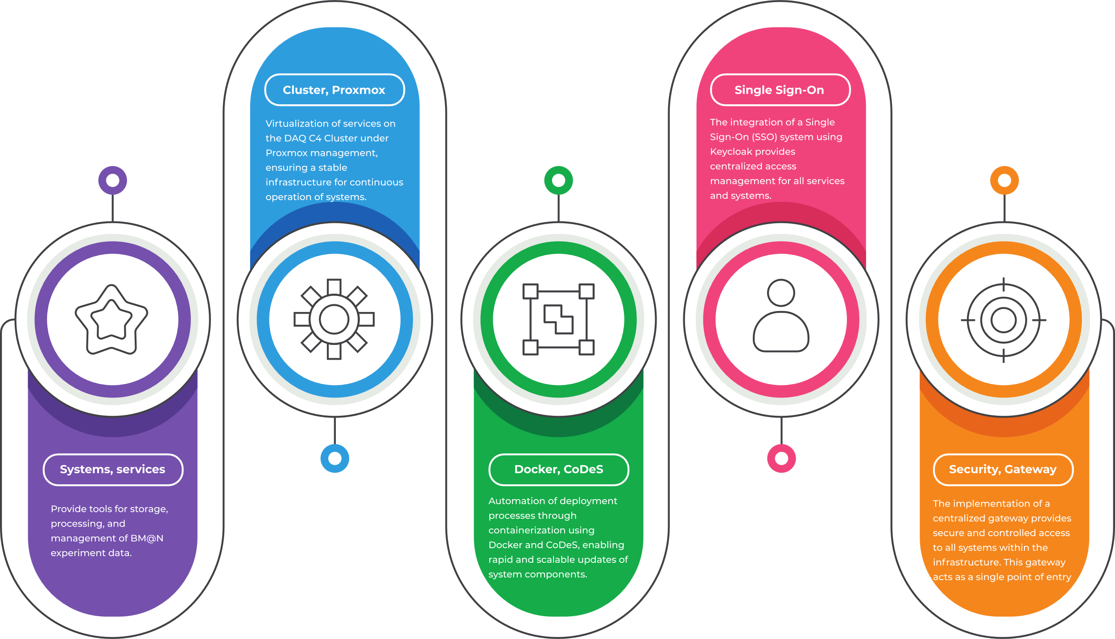
OUTLINE

Slide 4
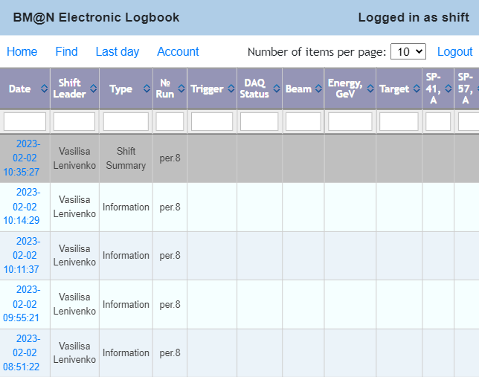
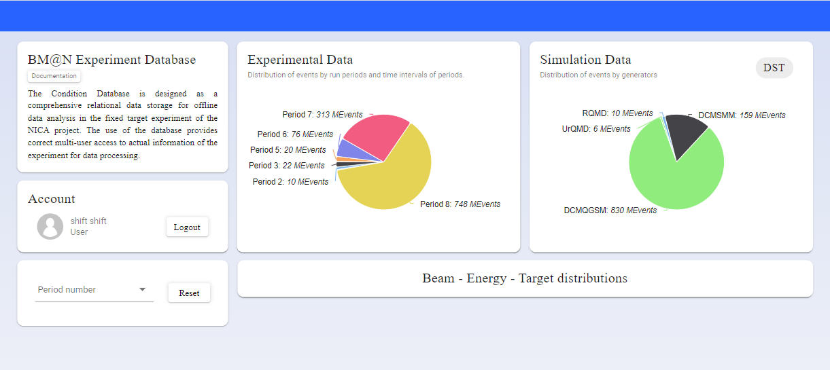
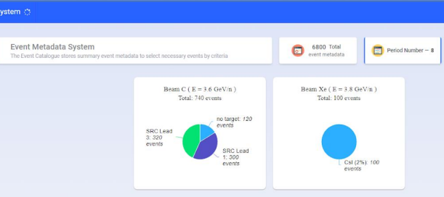
Electronic Logbook (e-Log platform)
The Electronic Logbook allows collaboration members to record information on events, system states, and detector operation during experiment runs, such as particle types, energies, magnetic field, and triggers. The data is crucial for the further processing and analyzing of BM@N collision events.
Condition Database (UniConDa)
The Condition Database is designed for storing and managing parametric information related to the experiment systems to be further used in simulation, reconstruction and physics analyses.
Event Metadata System (Event Catalogue)
The Event Metadata System is based on the Event Catalogue, which contains summary information on recorded particle collision events and allows for the quick selection of only those events needed for a particular physics analysis.

Slide 5
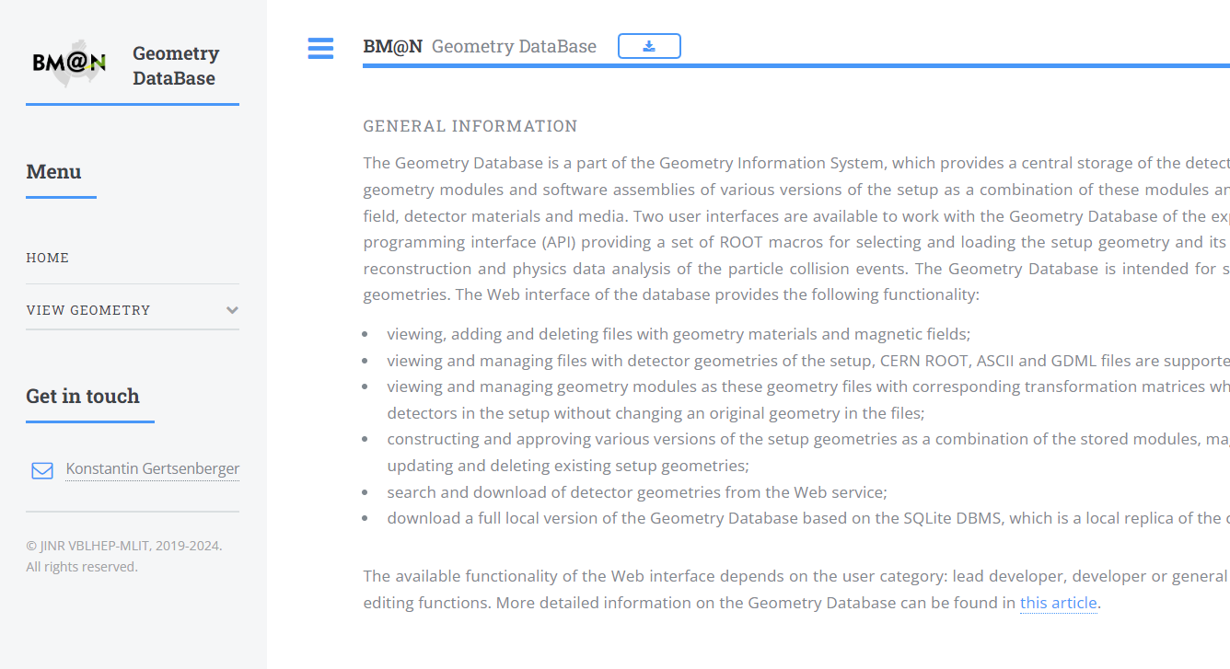
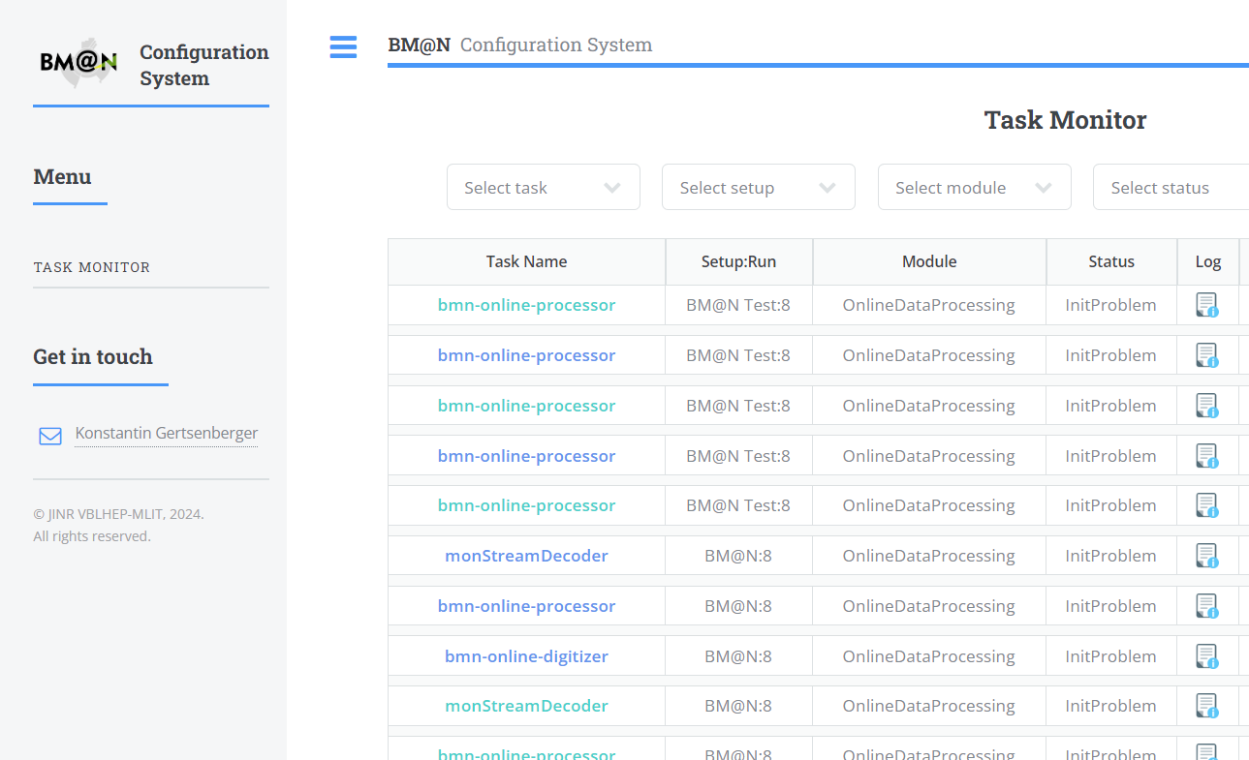
Geometry Database
The Geometry Information System is based on the Geometry Database, which is intended to store and manage data on geometric models of detectors, and to provide a centralized repository for detector geometries.
Online Configuration Platform
The Configuration Information System is used to store and provide data on the configuration of hardware and software systems of the experiment during online data acquisition from the detectors.

Slide 6
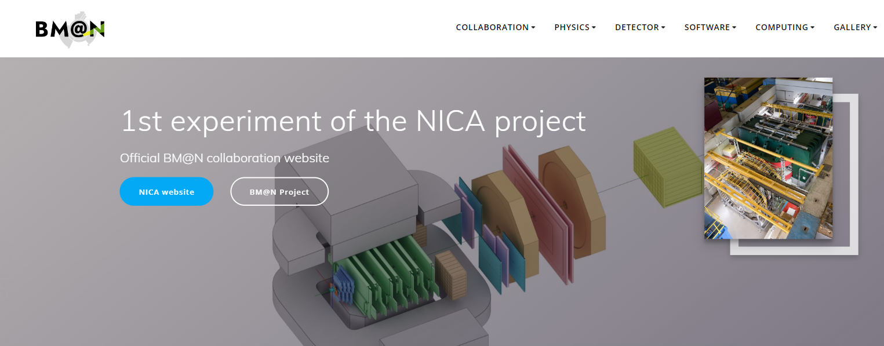
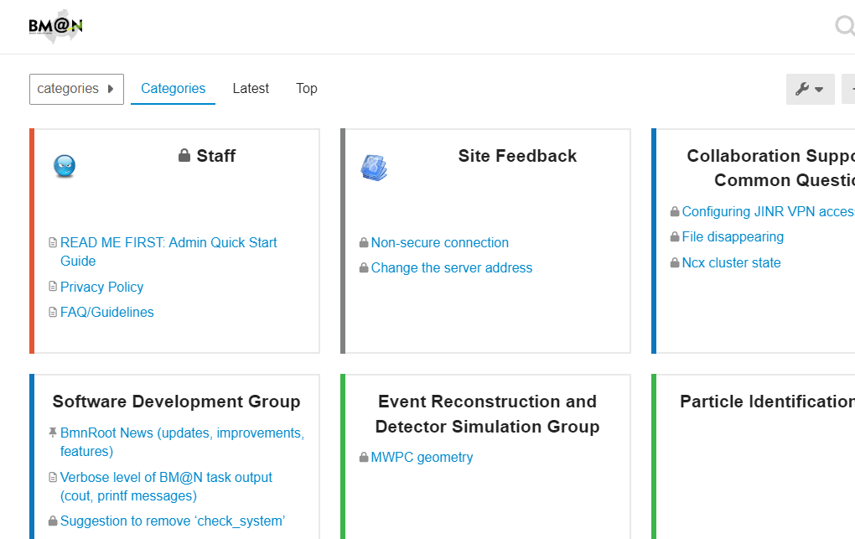
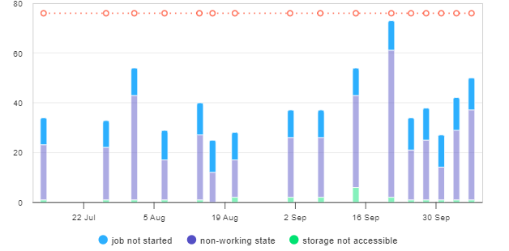
Official BM@N Website
The official website of the BM@N experiment serves as a important source of information on the experiment, participants, results, and project-related news.
BM@N Forum
BM@N forum has been developed to provide the collaboration members with discussion platform, exchanging ideas and experience, and collectively addressing important questions.
NICA-Scheduler Interface
NICA-Scheduler is a package that simplifies task running on clusters using existing batch processing systems (SLURM, SGE, Torque) without knowledge of these systems.
Tango Parameter Viewer
Tango Viewer is a viewer for hardware parameters of the Slow Control System.
Cluster Inspector File Inspector
…………………………………..

Slide 7
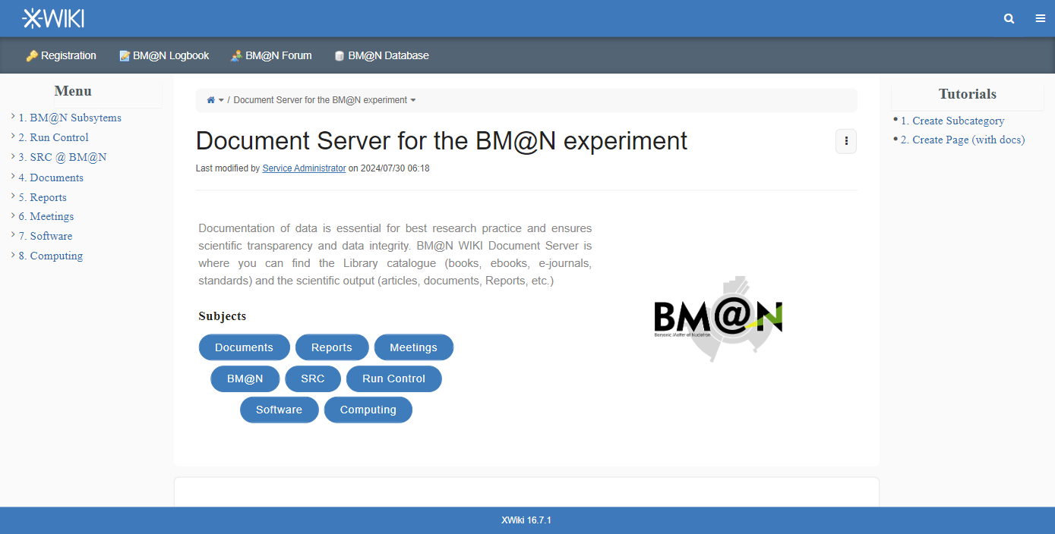
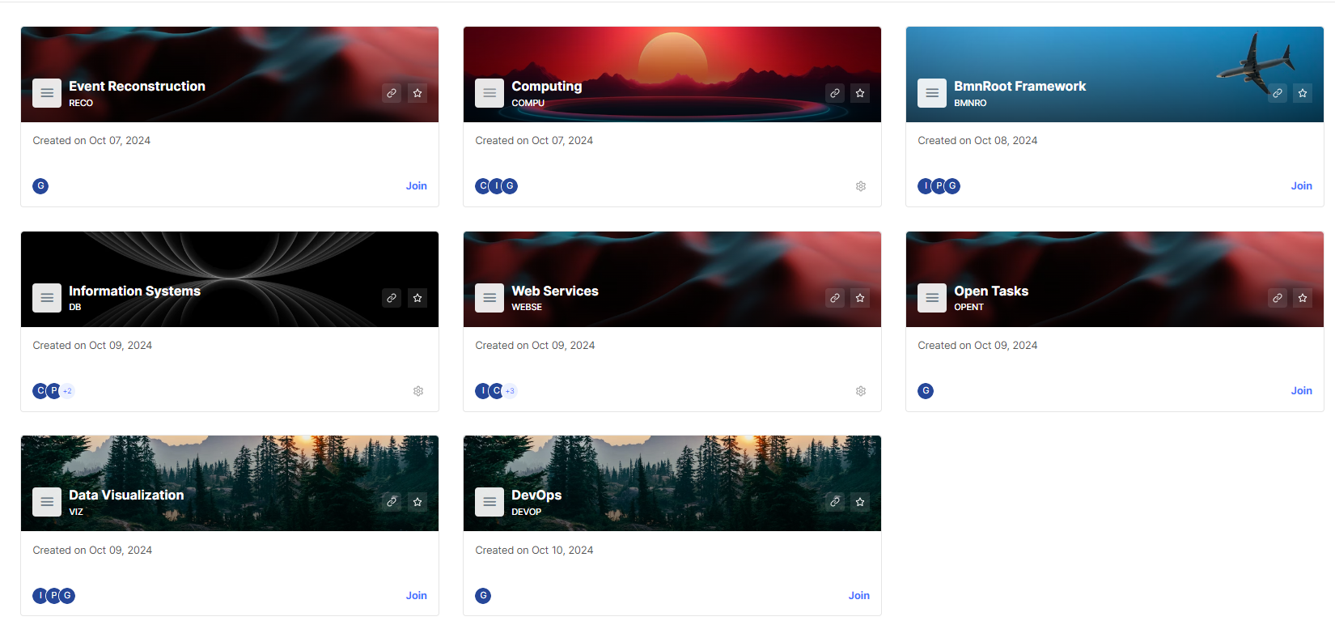
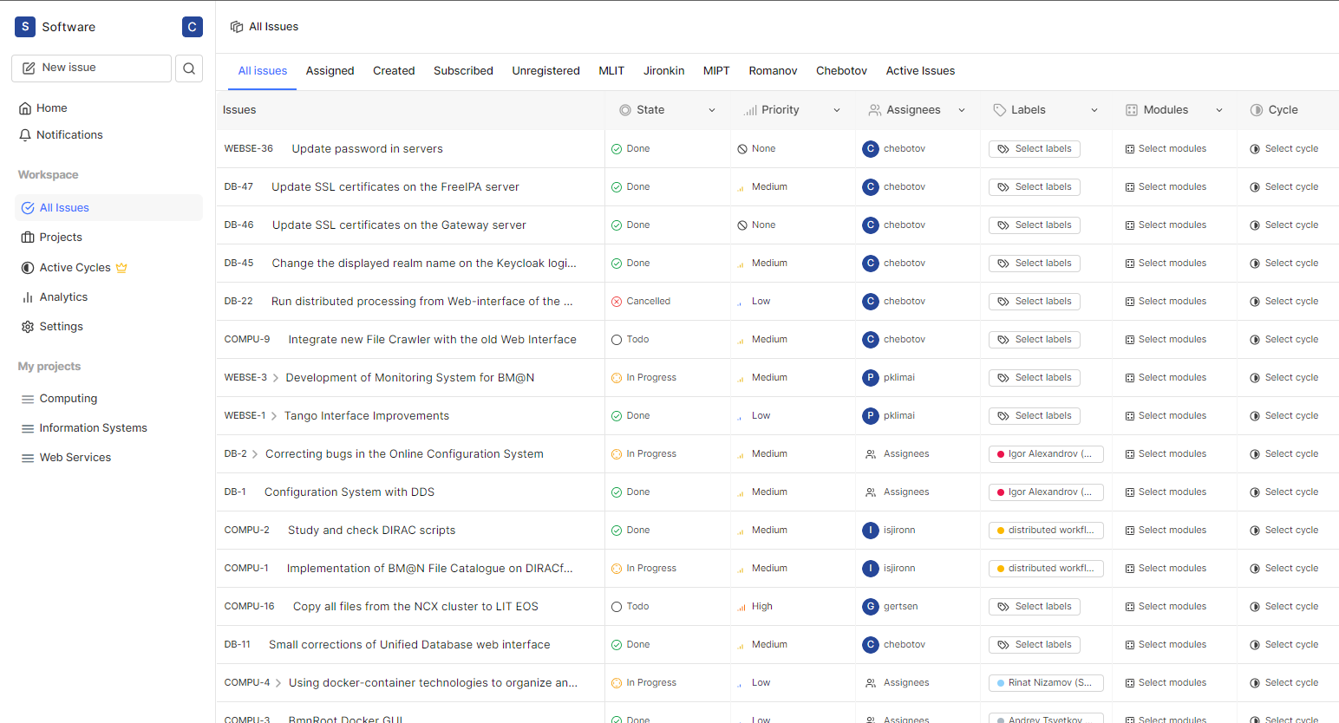
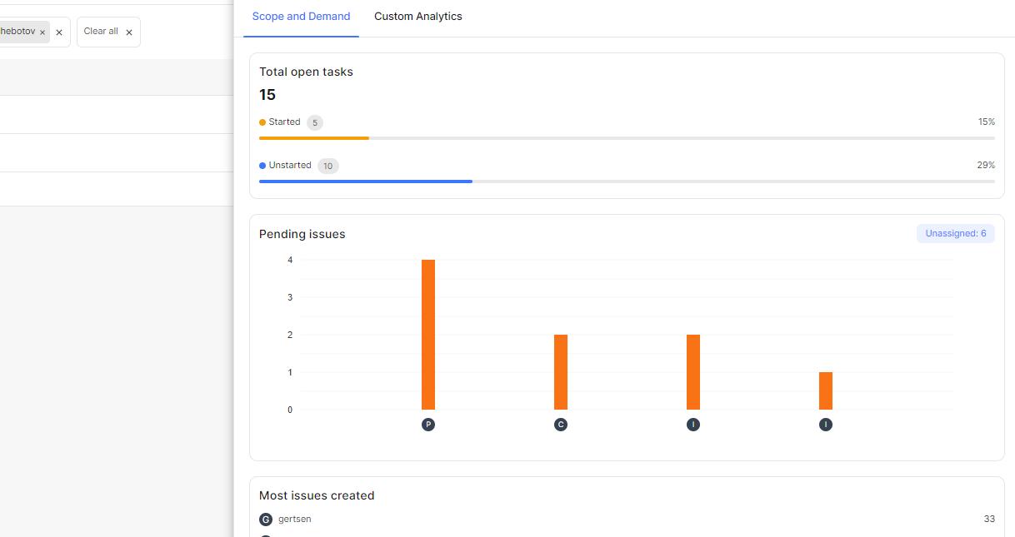
BM@N WIKI
The BM@N Wiki System ensures a document server for the experiment, which provides centralized storage and access to a variety of materials and documentation.
BM@N Project Management System
BM@N Project Management System is a tool that enables efficient task coordination and tracking the software progress.
Intuitive Interface
Progress Tracking
Real-time task updates
SSO-enabled
Kanban boards
Lists
Timelines

Slide 8
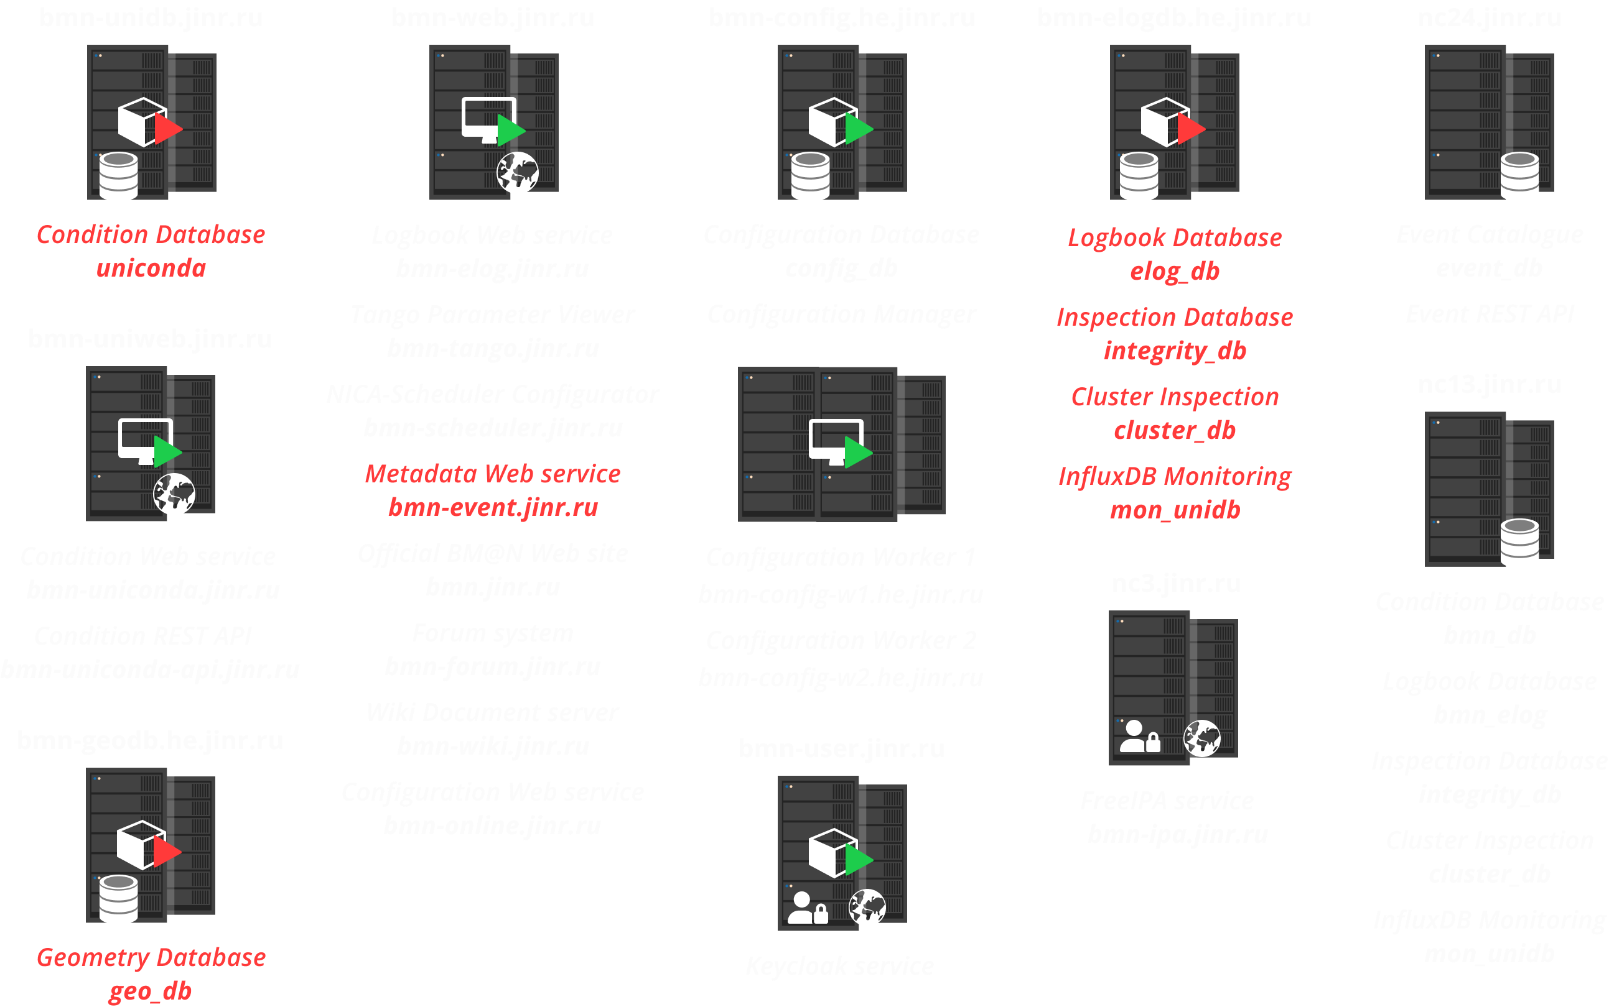
Old Infrastructure
Security vulnerability
Difficult to control
Limited scalability and conflicts
Lack of modern technologies

Slide 9
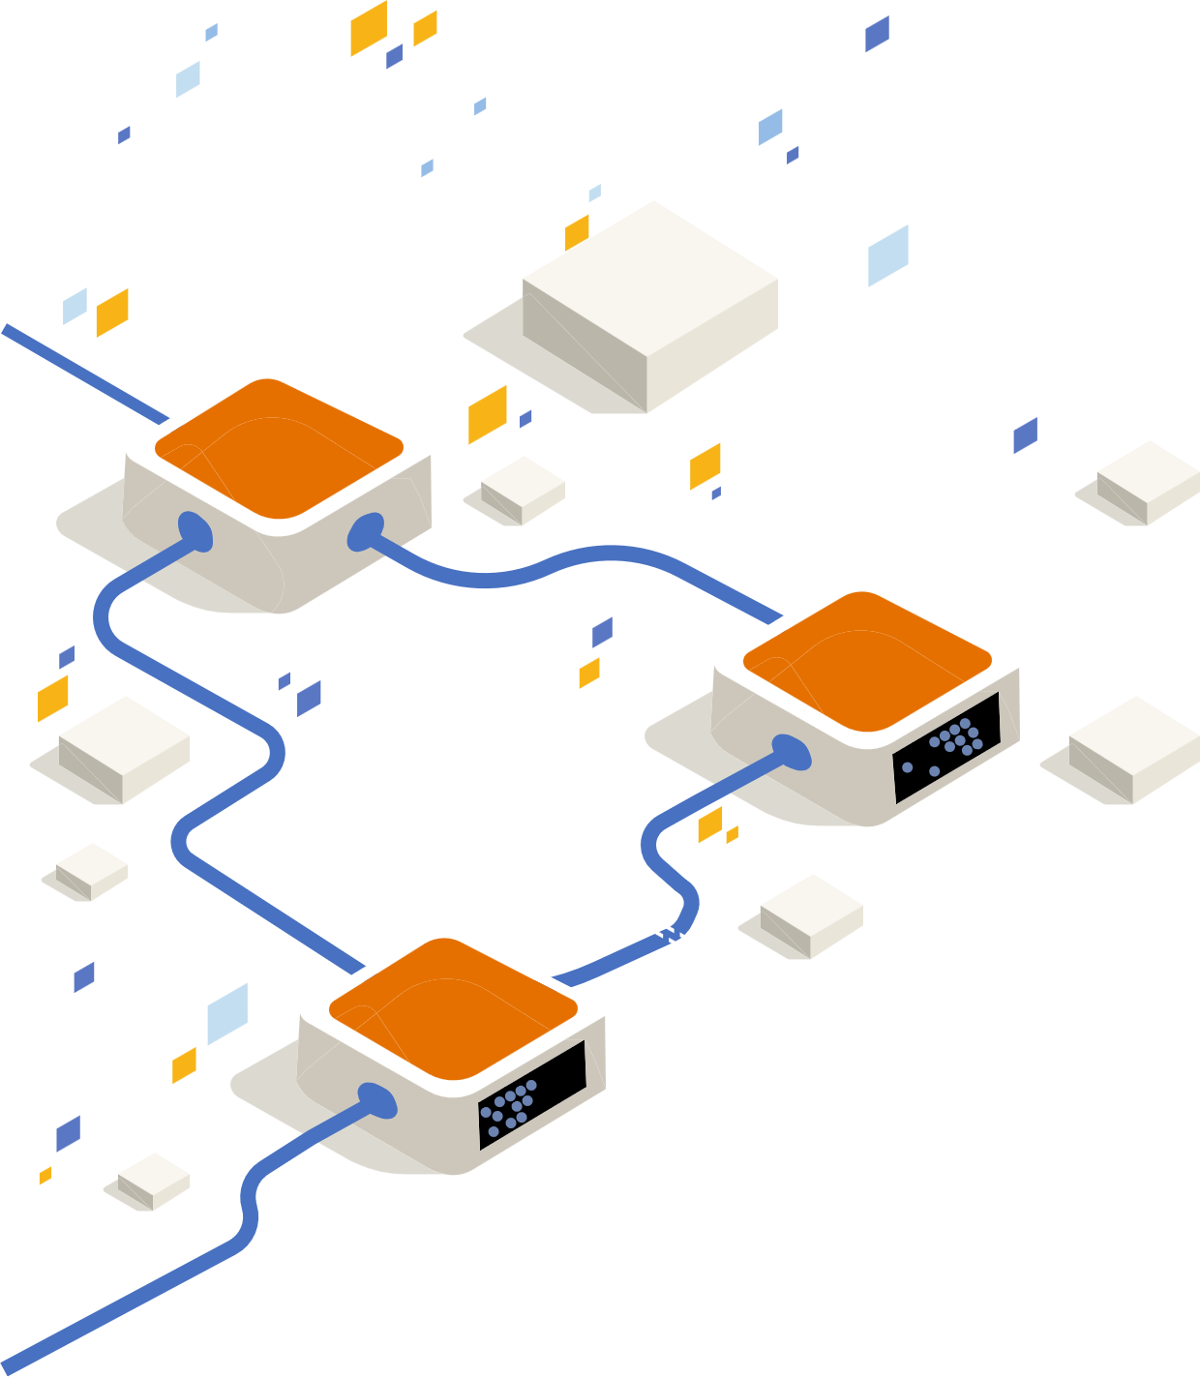
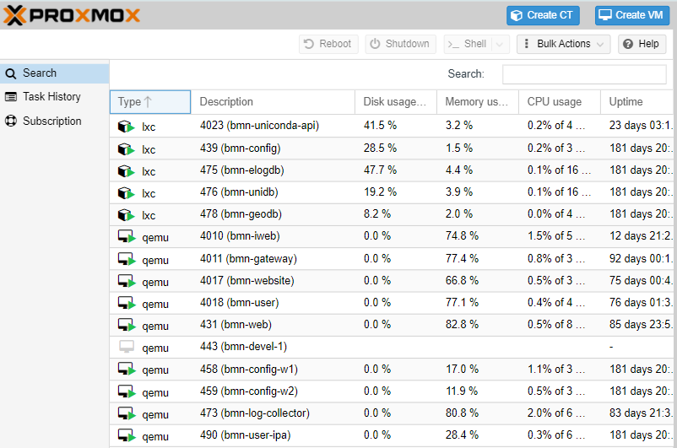
DAQ C4 Cluster
Proxmox is a virtualization and resource management platform that allows one to create VMs and containers using virtualization technologies such as KVM for VMs and LXC (Linux Containers) for containers.
Versatility: Support for virtual machines and containers.
High-Performance Storage: Utilizing Fast SSD Storage.
Convenient Interface: Web interface for managing all aspects of virtualization.
Backups and Recovery: Integrated tools for creating backups.
Performance: Good performance for virtual machines with KVM.
Free Software: Software based on open-source code.

Slide 10
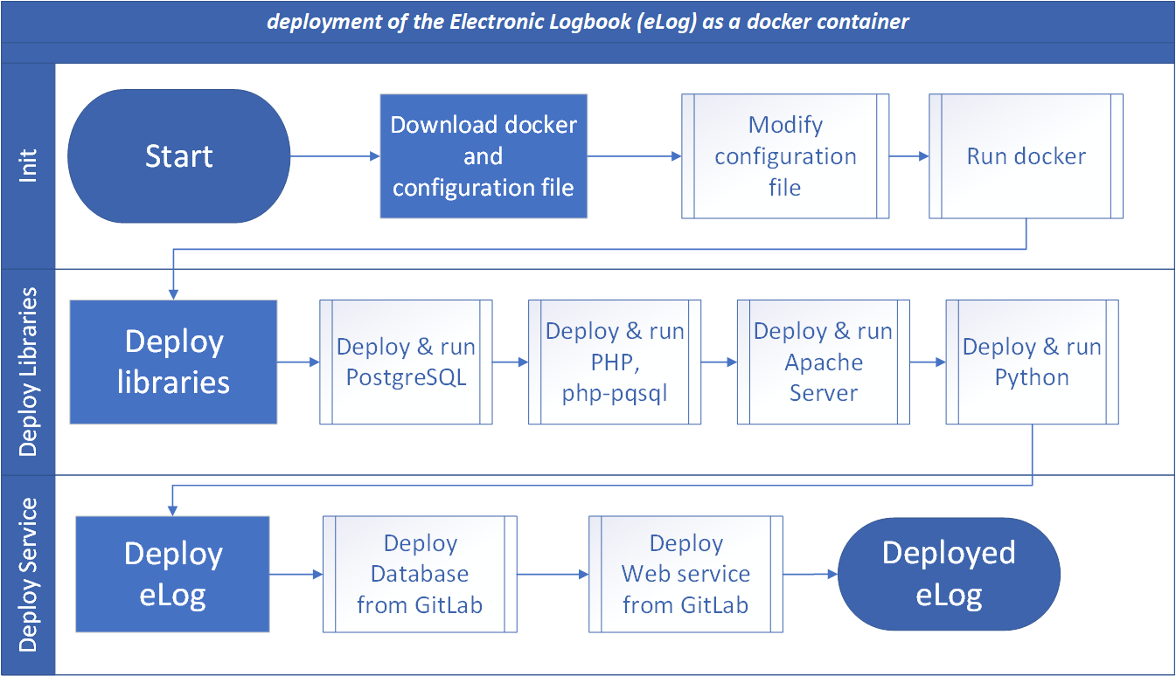
Deployment and Service Management with Docker and CoDeS
We use Docker containerization and the CoDeS system for efficient deployment of BM@N software systems
Isolated environment
Image portability
Resource efficiency (lightweight)
Base server (Web)
Run deploy script
Centralized configuration management
Updates and scaling
Uniformity
Tracking updates
The Common Deployment System is based on Docker containers and python scripts

Slide 11
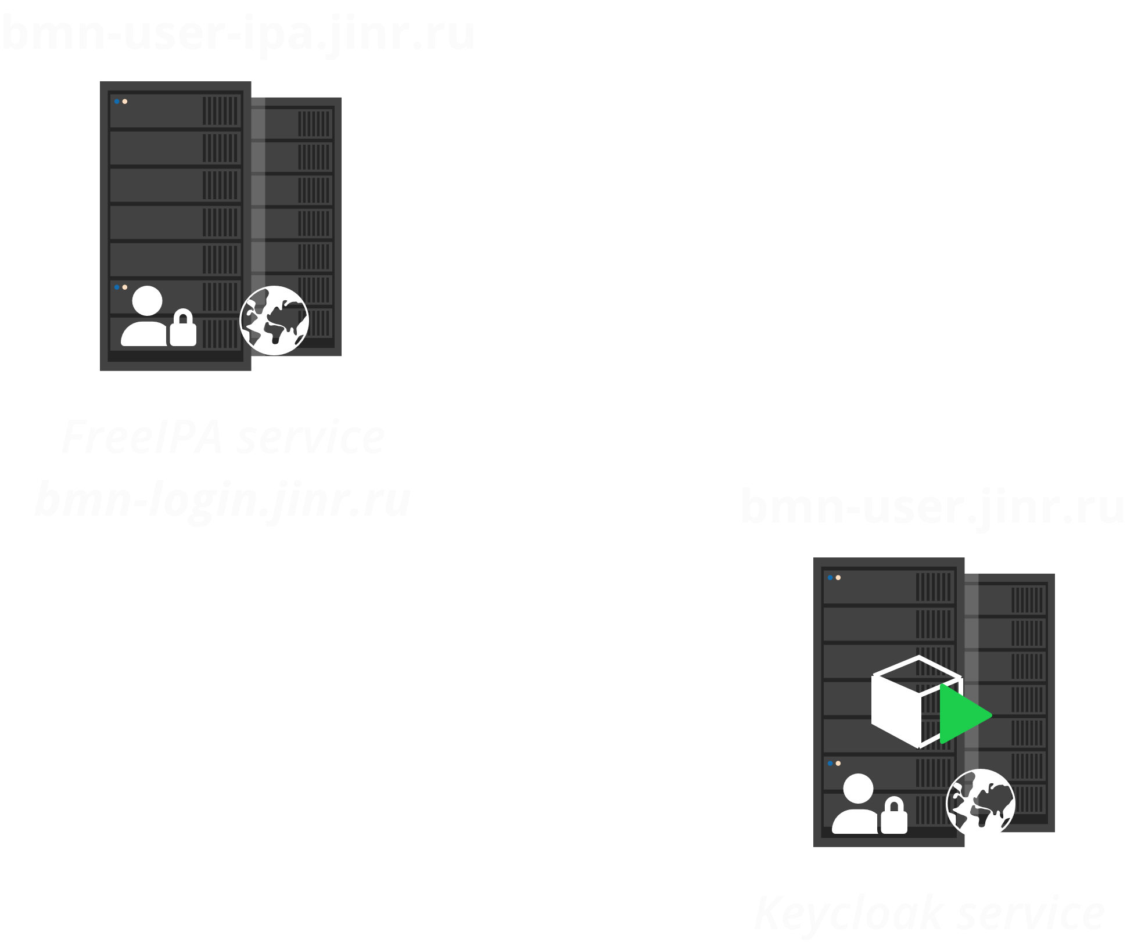
Implementation of a Single Sign-On (SSO)
The Keycloak system — a modern and reliable solution for identity and access management.
Migrating to Keycloak for implementing Single Sign-On offers numerous benefits, including centralized management, user convenience, and enhanced security.
User Federations
User Convenience
Enhanced Security
Centralized User Management
Keycloak ensures two protocols such as OpenID Connect and OAuth 2.0

Slide 13
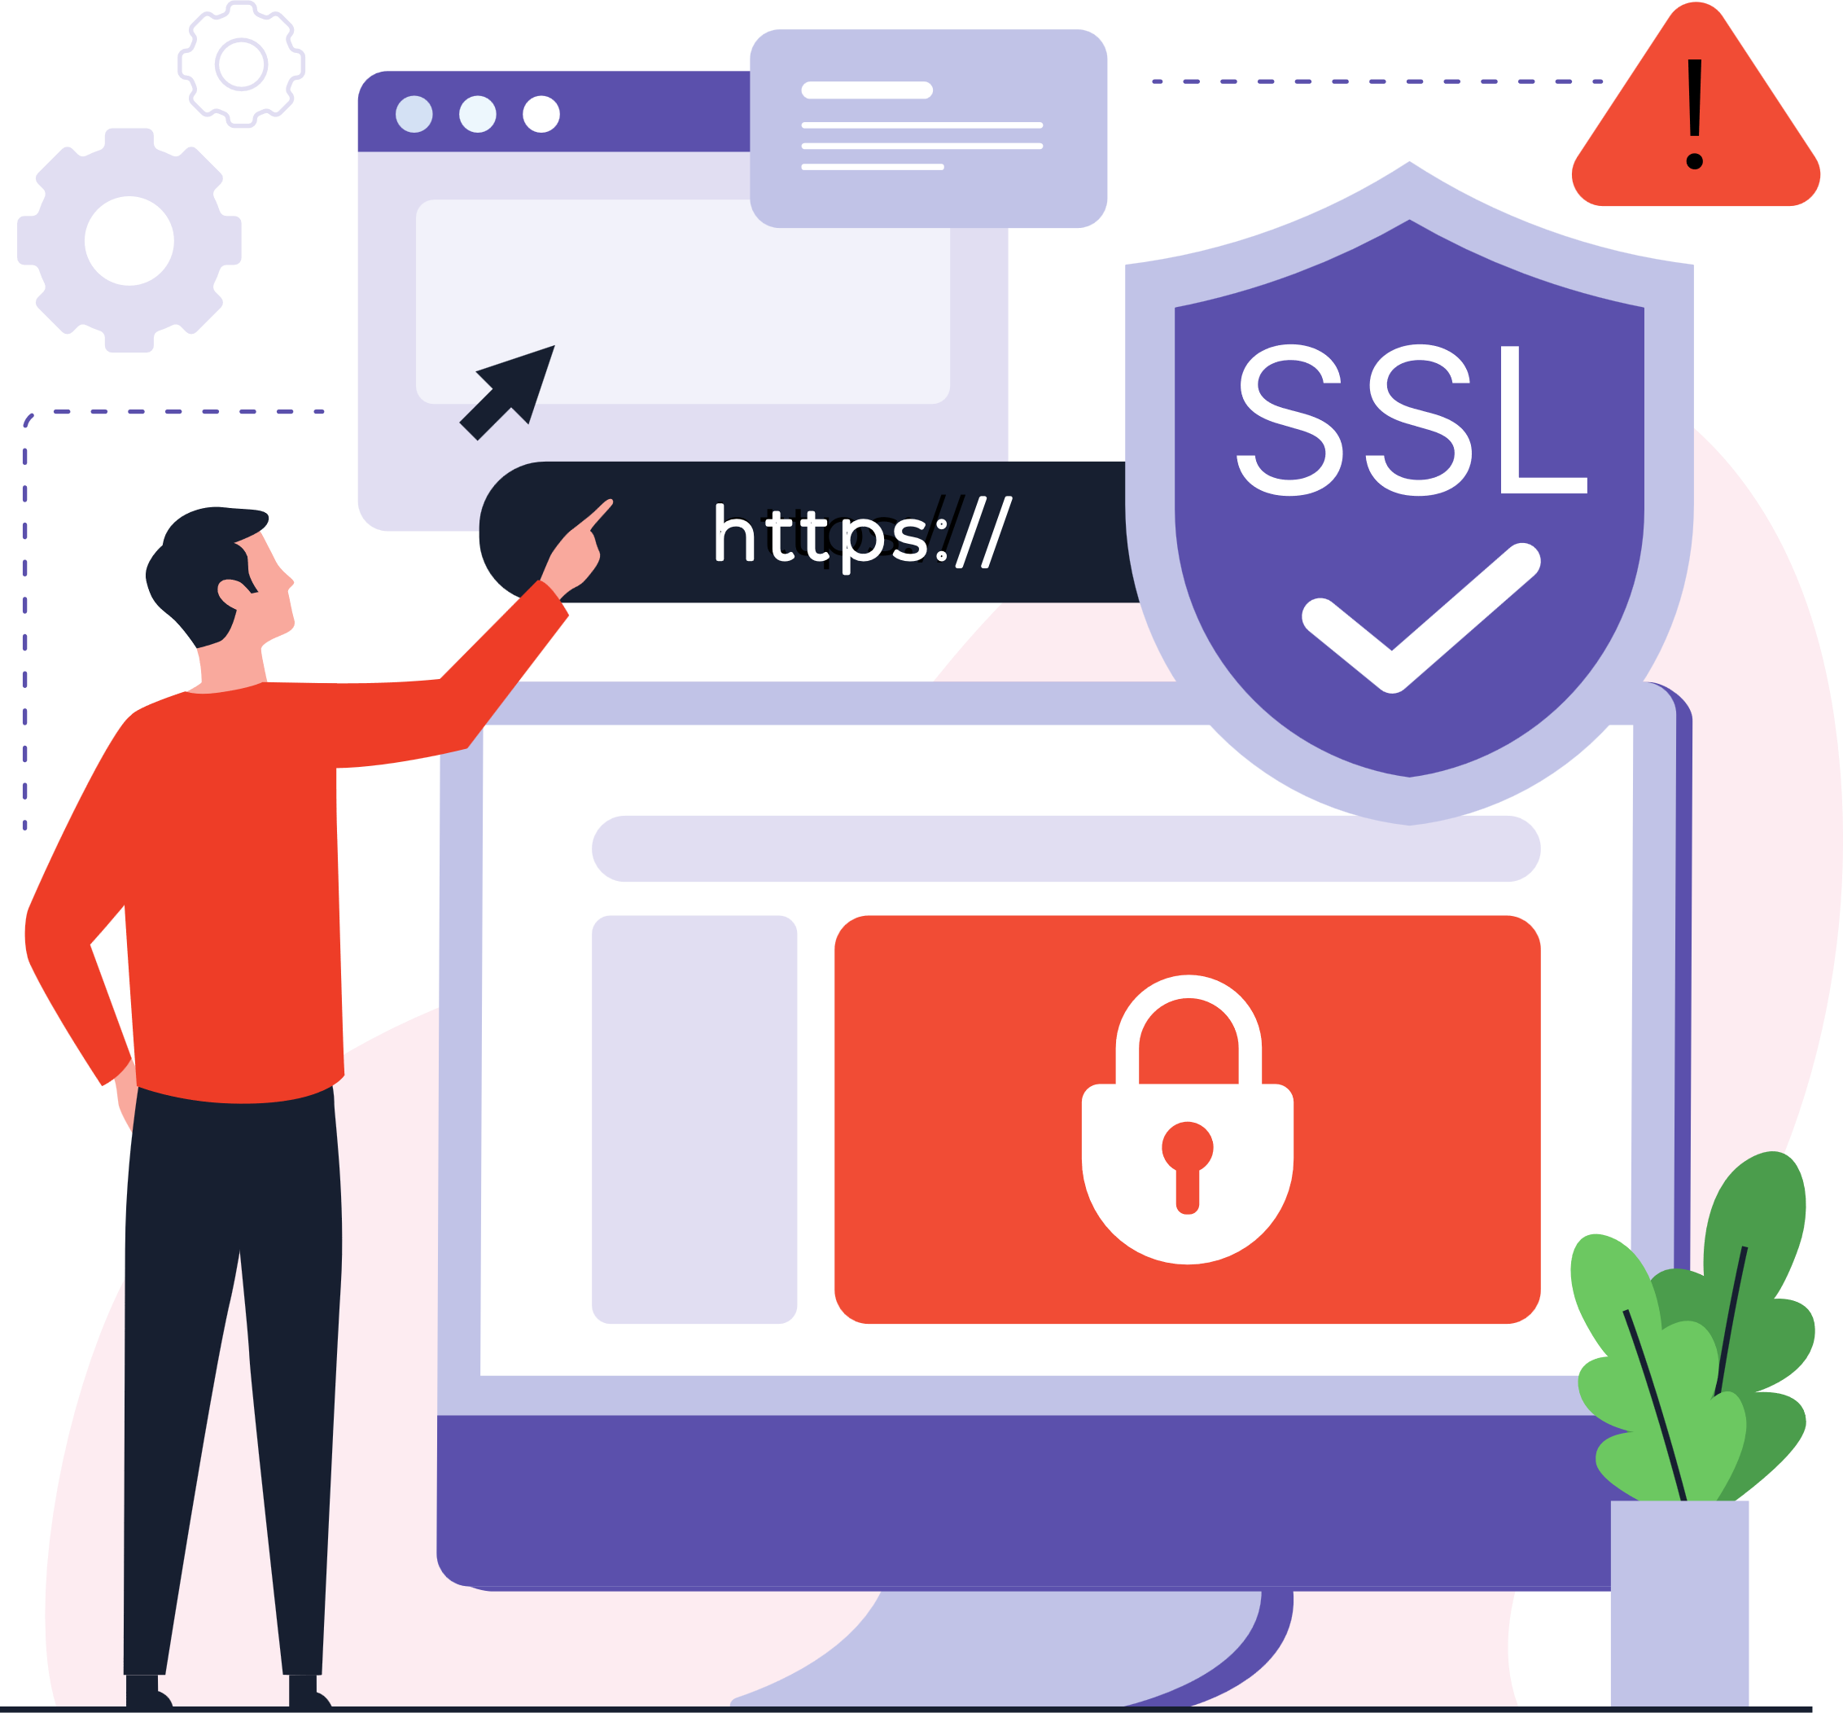
Details of implementation
SSL Termination
Reverse Proxying
Traffic Protection and Filtering
Performance Optimization(GZIP)
Centralized Logging
NGINX is a high-performance web server and reverse proxy that plays an important role in managing traffic and ensuring security within BM@N infrastructure.
NGINX not only helps manage traffic but also protects the infrastructure, ensuring flexibility, security, and scalability.
Reverse Proxy

Slide 14
Details of implementation
IPTABLES: Traffic filtering at the Linux kernel level.
Fail2Ban: Automated IP blocking on suspicious activity.
Regular Updates: Keeping systems and packages up to date to patch vulnerabilities.
Logging and Analysis: Monitoring and analyzing all events to prevent threats.
Rate Limiting
Authentication Protection
Malicious Bot Detection
Sensitive File Protection
Traffic Filtering
Optimized performance.
Simplified system management.
Ilya Romanov
Development of Contemporary Log Management Solution for the Information Infrastructure of the BM@N Experiment

Slide 15
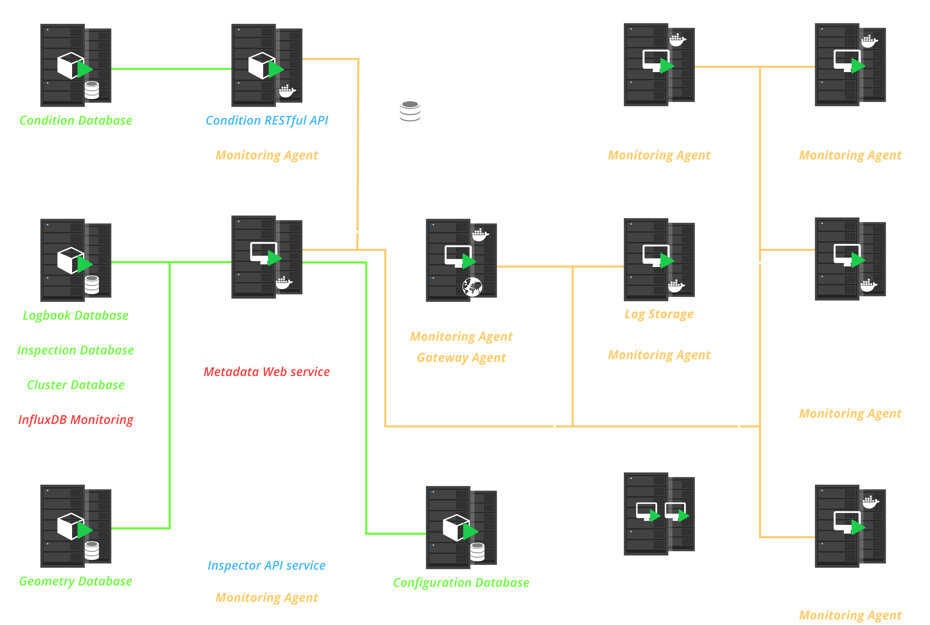
Current Infrastructure

Slide 16
Conclusions
Significant progress has been made in deploying new services, systems, and databases, as well as in smooth transition to the new software infrastructure.
The integration of these services with Keycloak authentication and authorization provides a high level of security.
The performance of the new BM@N software infrastructure has been optimized, which ensures seamless operation for the BM@N experiment.

Slide 17
Thank you
for your attention!

